Slide 1
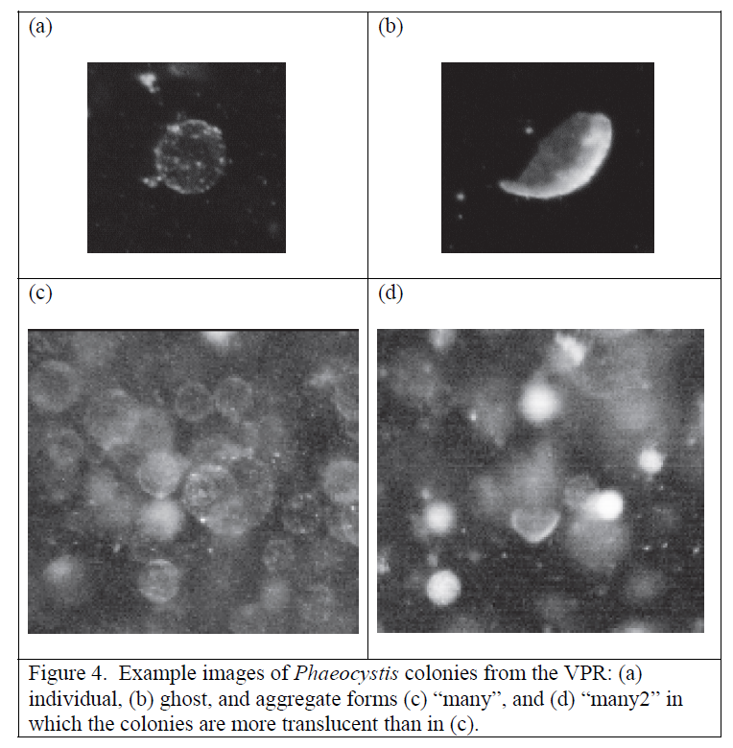
Phaeocystis Ghost Colonies:
Distribution and Abundance in the Ross Sea
Walker O. Smith, Jr.
Dennis J. McGillicuddy, Jr.
Elise B. Olson
Others

Slide 2
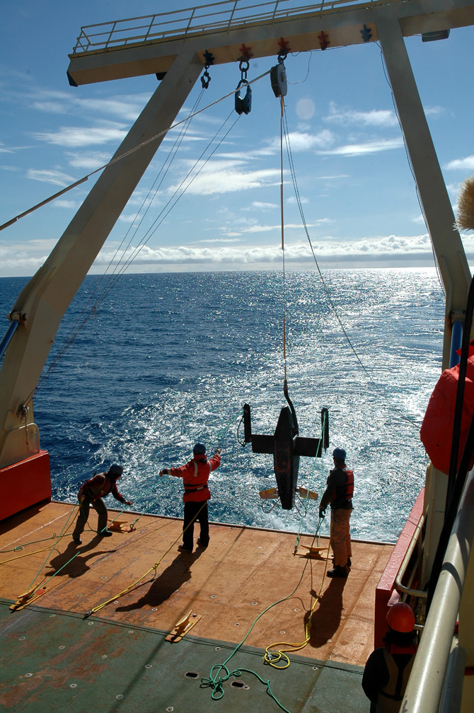
Movie

Slide 3
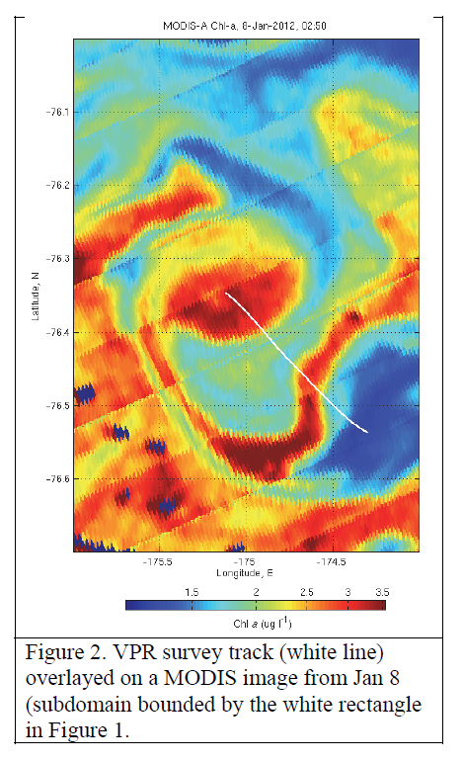

Slide 4
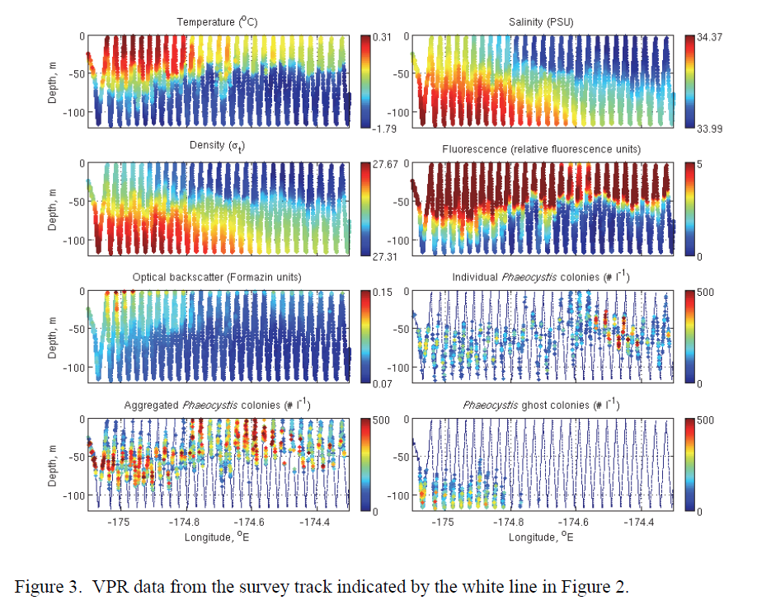

Slide 5
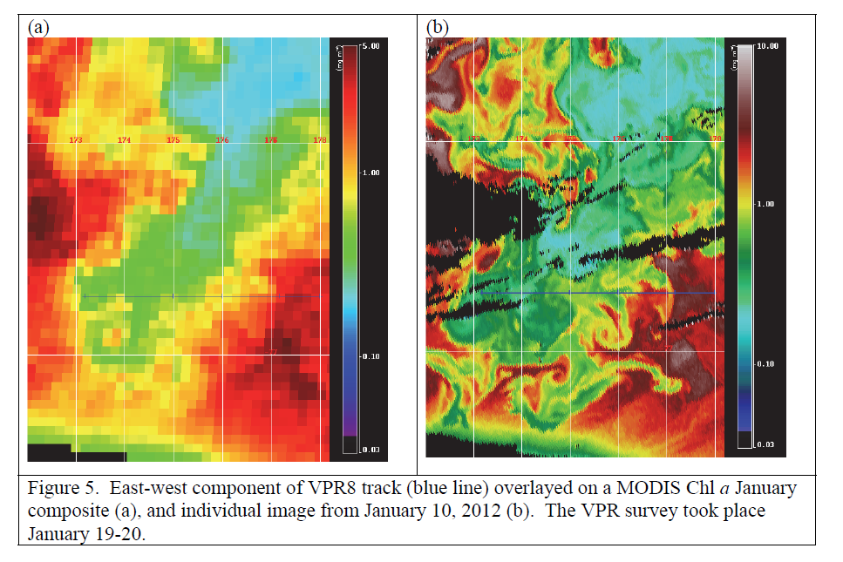

Slide 6
