Slide 1
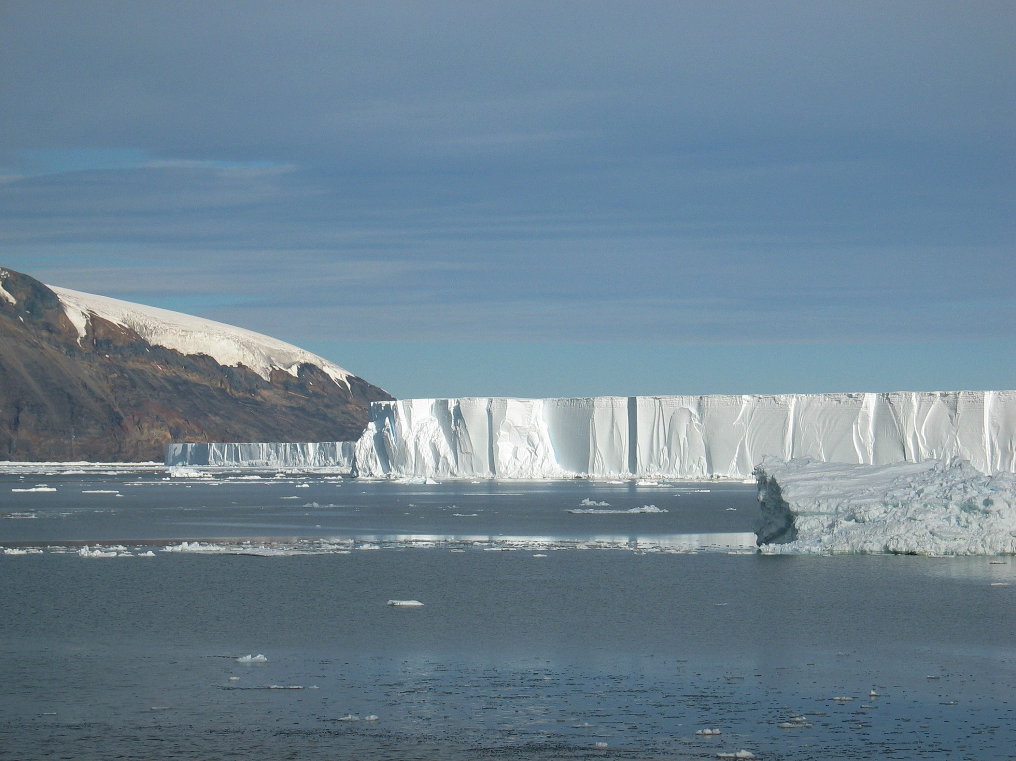

Ross Sea model updates
(including a first cut at looking at CDW/MCDW intrusion time scales)
Mike Dinniman
Center for Coastal Physical Oceanography
Old Dominion University
July 23-24, 2015

Slide 2
Outline
Updates
  Downscaling simulations of the Ross Sea
  Model run for SEAFARERS
Model variability near the shelf break (MCDW)
1.5 km model performance near Ross Bank

Slide 3
Downscaling Simulations of the Ross Sea
Strengthening of the cold southerly winds over the Ross Sea is thought to be one cause for the observed increases in ice extent in the area
Could this be affecting other aspects of the ocean circulation (Modified Circumpolar Deep Water transport, ice shelf basal melt, bottom water formation) and how might this change in the future?
Not going into details on this (showed it last time), but the manuscript should finally get submitted to Journal of Climate in the next week
Notes:
Mention both types of simulations.

Slide 4
Work with SEAFARERS project
They are interested in differences in residence times over Mawson vs. Pennell Banks
  Re-ran the base PRISM simulation (5 km, tides) with drifters released in the model over both locations at different times
They are also interested in examining the role of MCDW in fueling productivity over Pennell Bank
  Adam Kustka used drifter trajectories and CDW/MCDW dye values (as recorded by the drifters) to examine possible pathways of MCDW supplied dFe to SEAFARERS stations over Pennell Bank (Kustka et al., in review) in order to help conclude that MCDW was not a significant source of dFe to the region

Slide 5
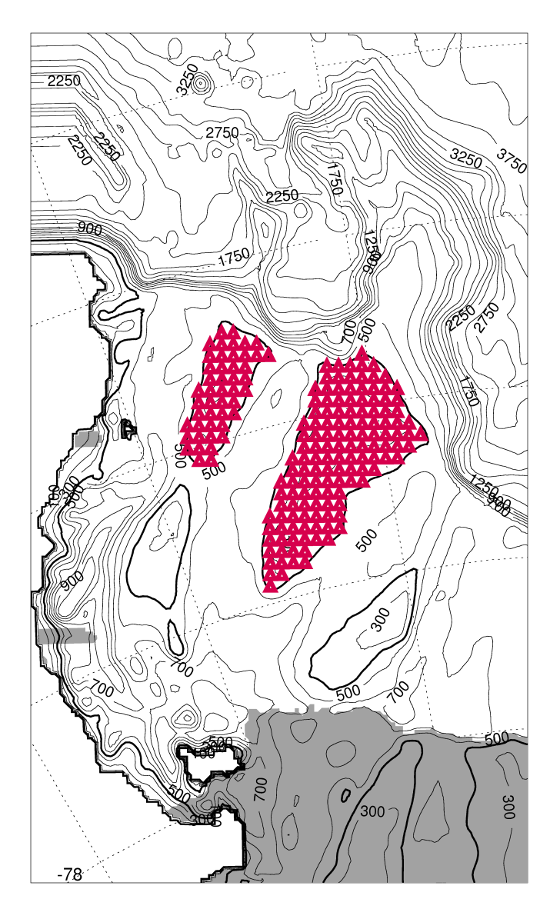
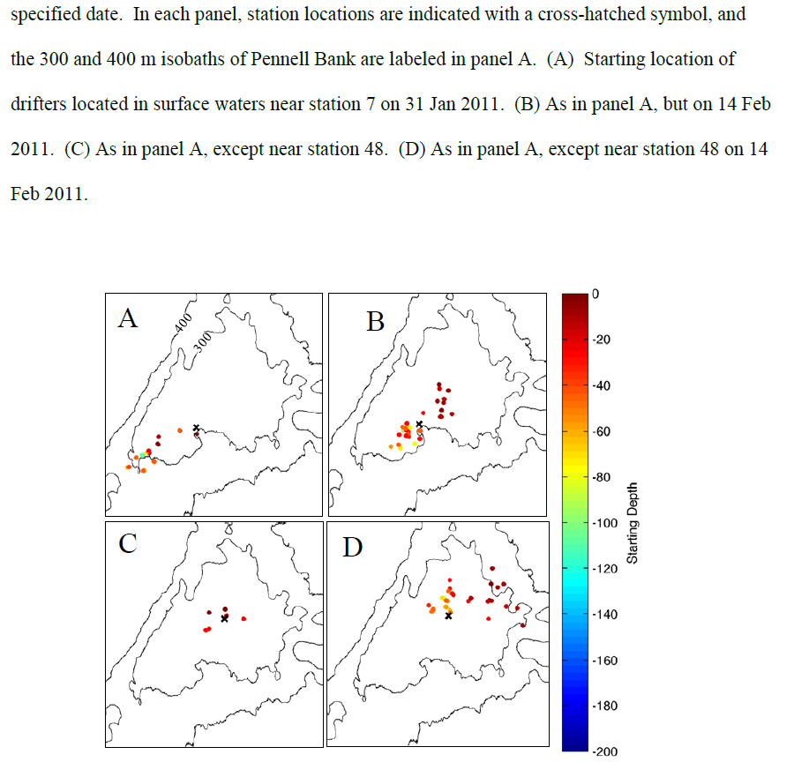
Same horizontal release pattern every 20m of depth (5 – 385m) on Jan 13, 2011 and every 5 days until Feb 17, 2011 29,280 total drifters
Starting points of drifters that went by two different stations at two different days
(Kustka et al., in review)

Slide 6
Model Variability near the Shelf Break
Start by comparing temperature to an Italian mooring in Drygalski Trough ~50 km from the shelf break

Slide 7
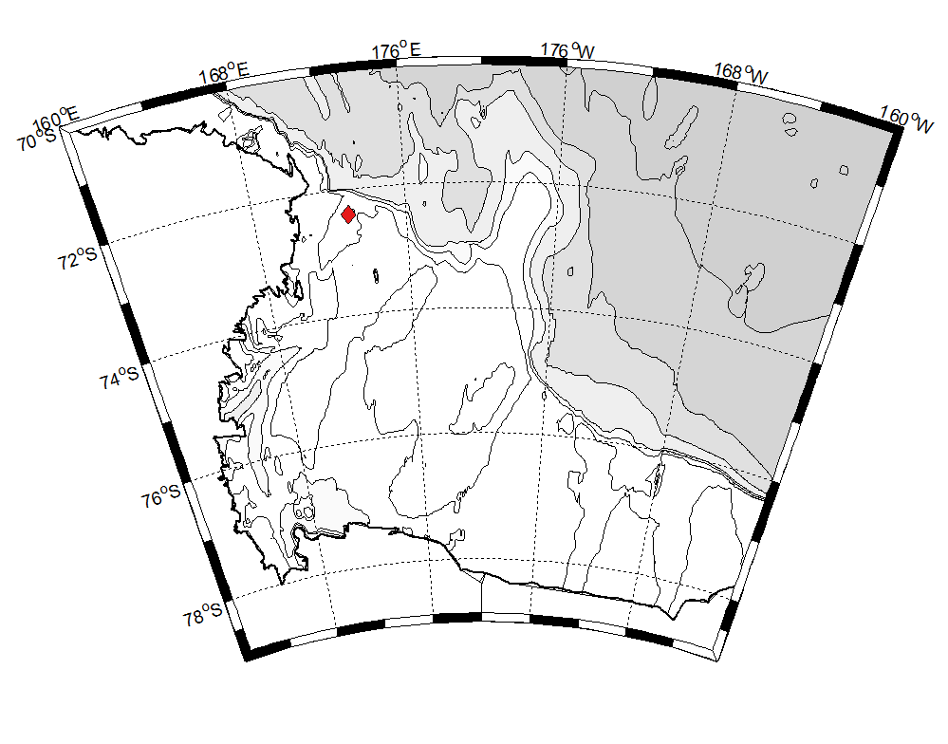
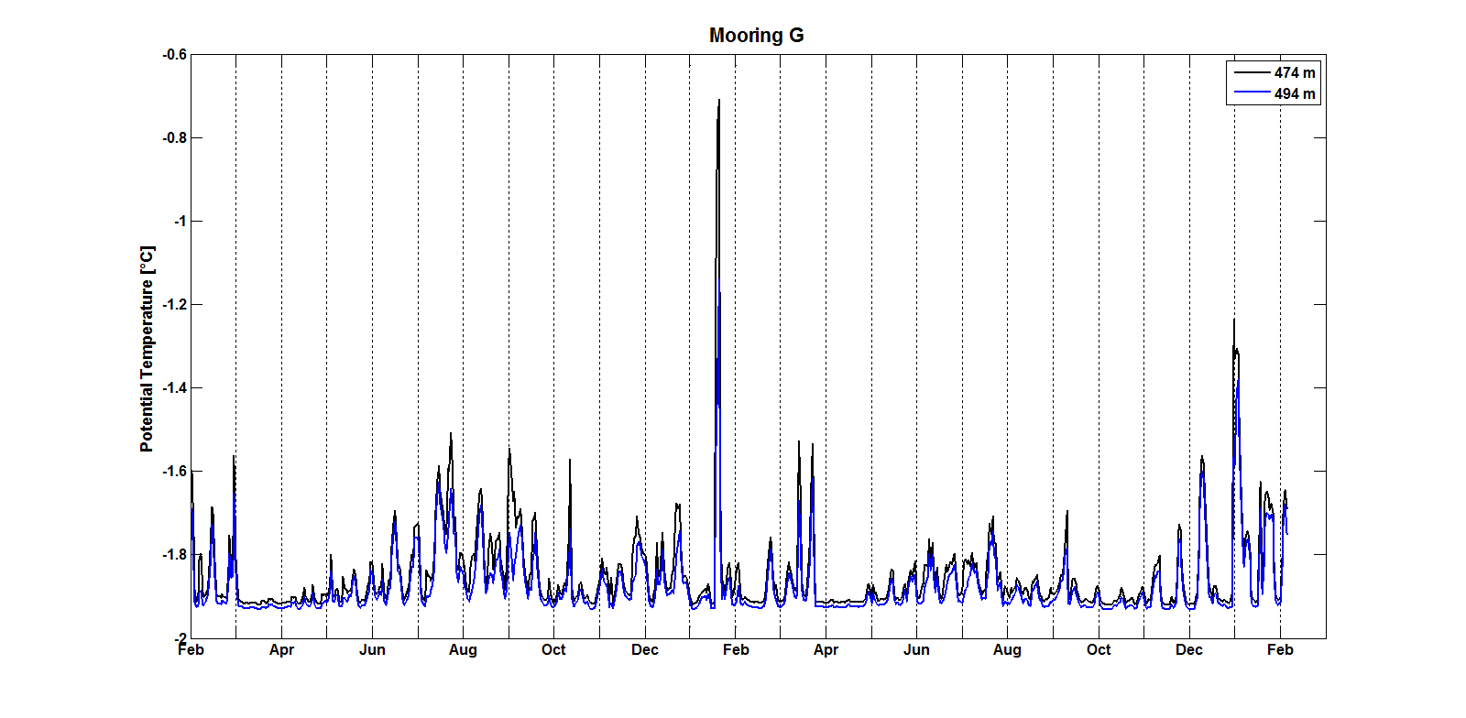
Mooring in center of Drygalski Trough (~50 km from shelf break)
Temperature at: 28 and 48 MAB
Seasonally variable CDW inflow and HSSW outflow year round, but note that CDW inflow is much less evident in March/April
Courtesy: Giorgio Budillon
Notes:
Time series here is from daily averages

Slide 8
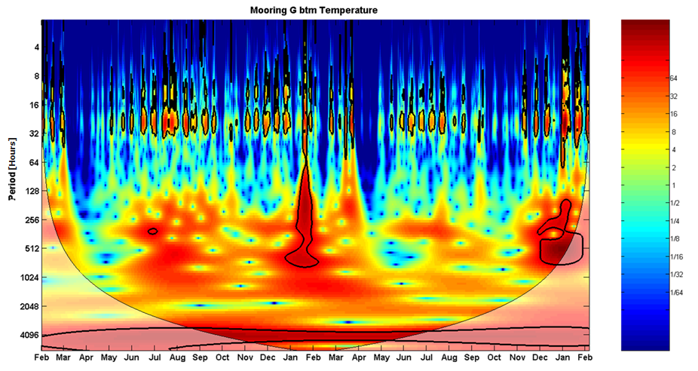
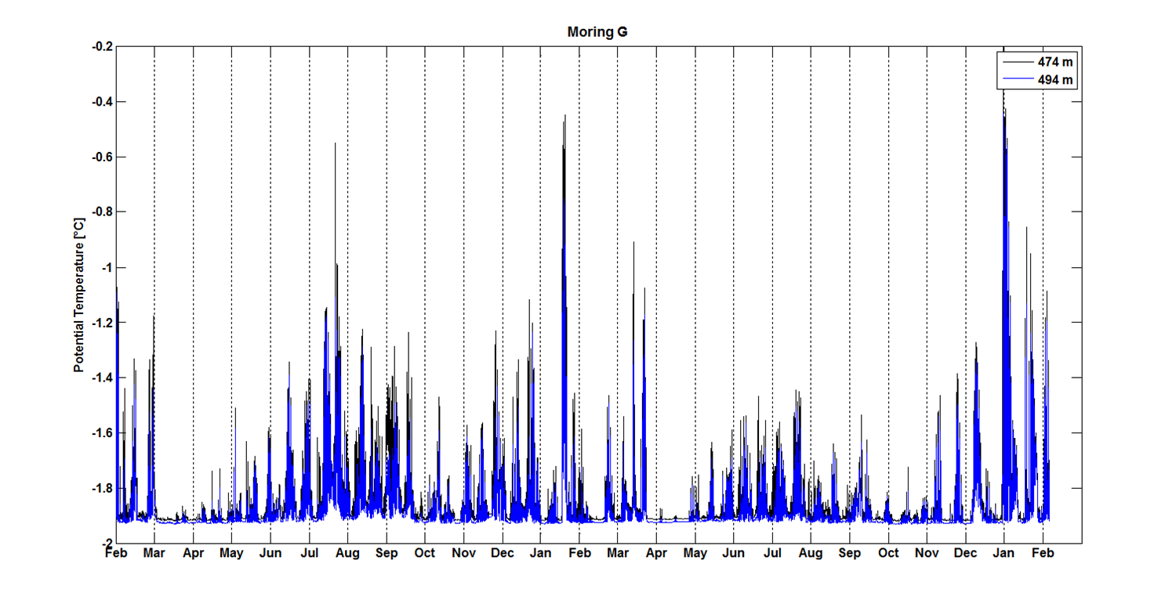
Wavelet analysis of bottom temperature:
Note the strong signal in January w/ a period of ~ 7-30d
Also, the absence of CDW inflow in March/April correlates with the absence of diurnal tides
2010 2011 2012
Courtesy: Giorgio Budillon
Notes:
Black lines are 95% confidence levels? Time series here is hourly (previous is daily). Don’t know if this is normalized or total power.

Slide 9
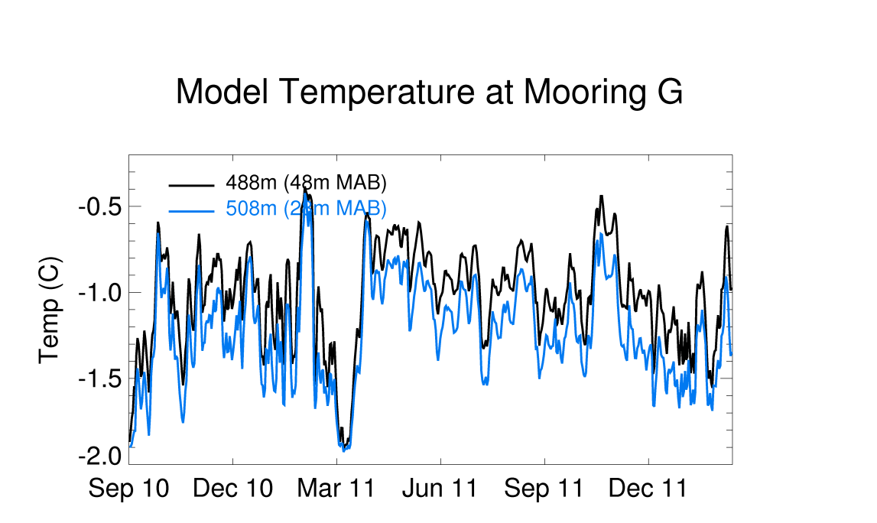
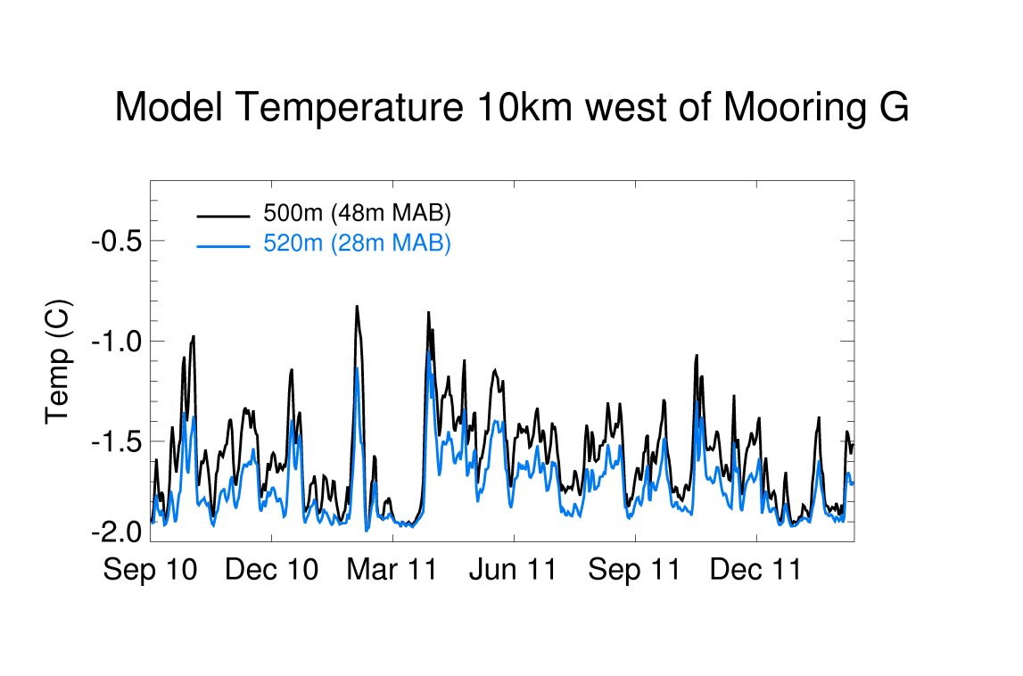
5 km model daily averages are too warm at Mooring G
Perhaps CDW inflow is too far west in model, so also looked at flow 10 km to west
(N.B. depths are different but distance to bottom is same)
2010 2011 2012
Notes:
Mooring plot here is daily averages

Slide 10
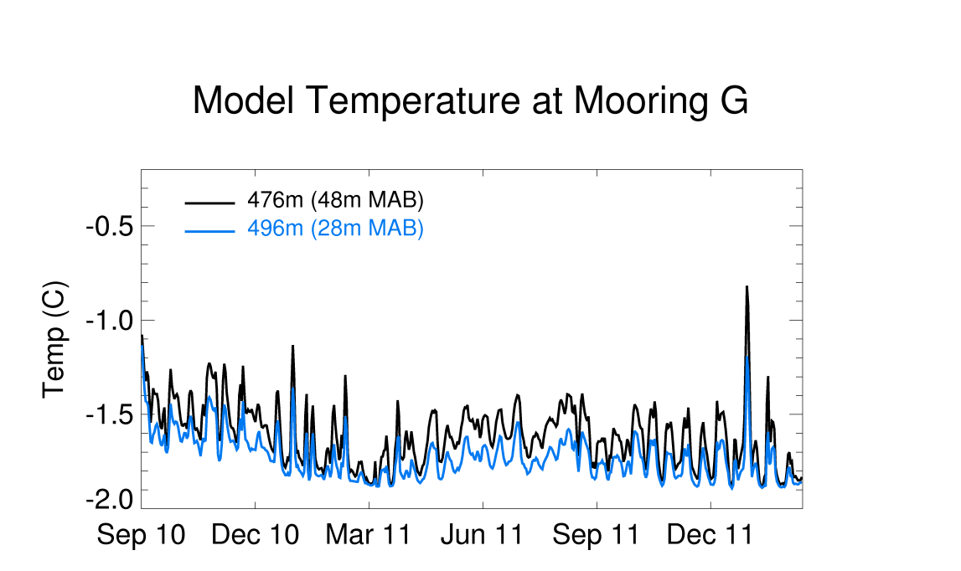
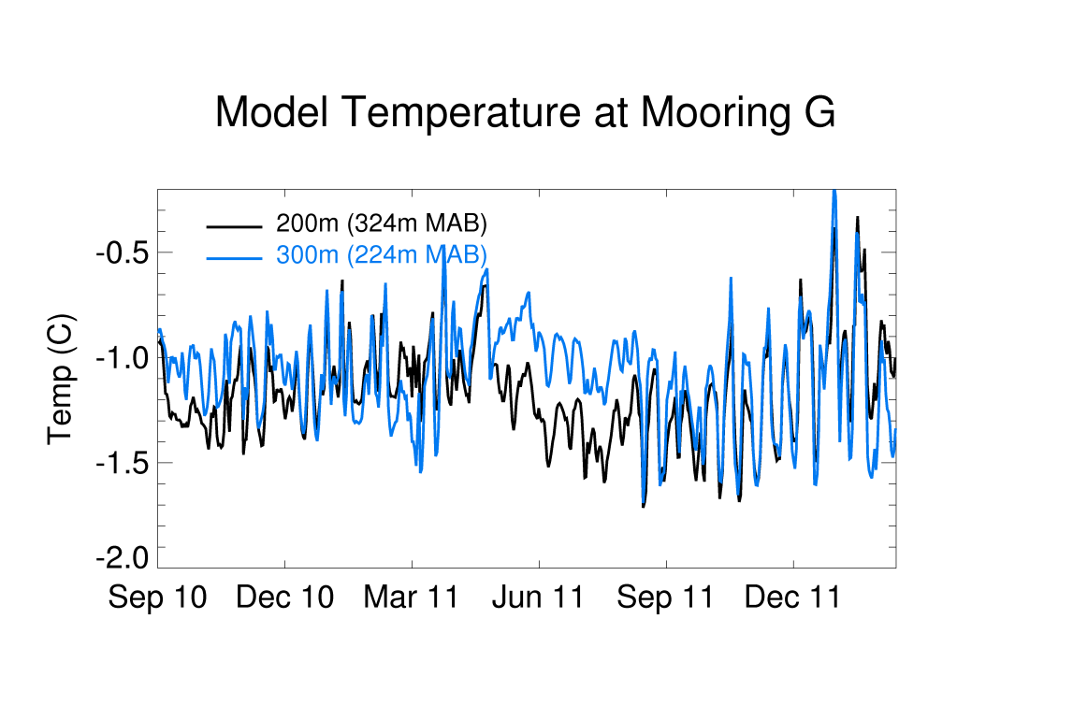
1.5 km model daily average temperature looks better at Mooring G than 5 km
Warmer MCDW higher in water column
(N.B. water depth is also much closer to observations)
2010 2011 2012

Slide 11
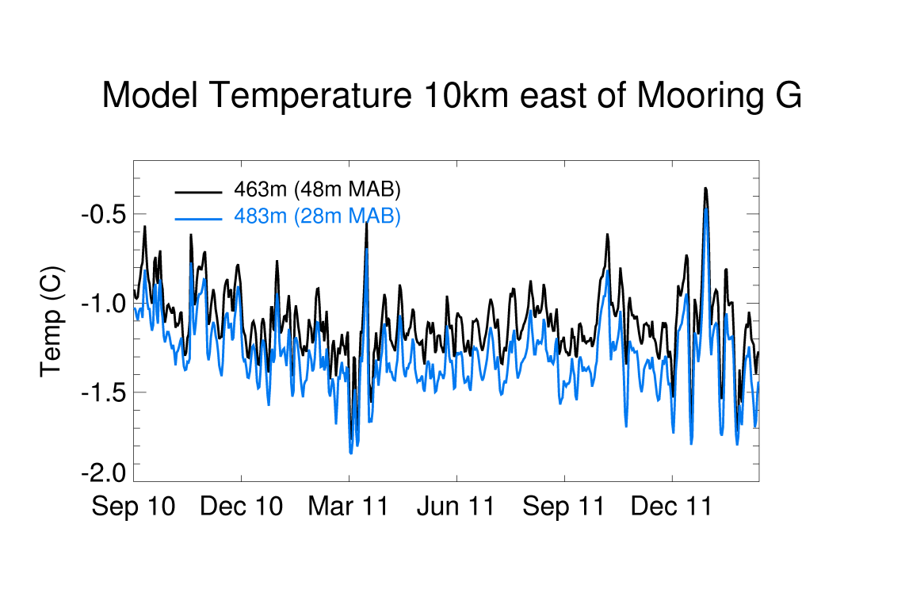
2010 2011 2012
1.5 km model
Warmer temperatures to the east (more in the CDW intrusion core)

Slide 12
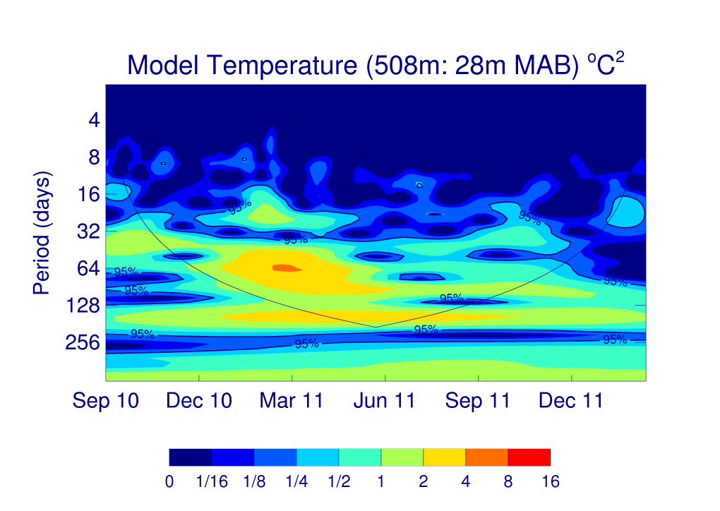
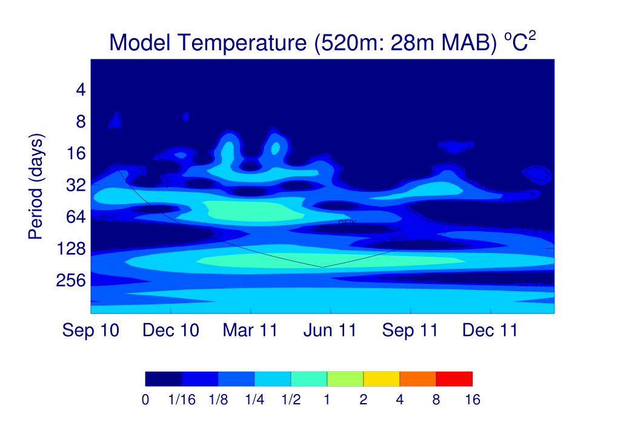
5 km model:
Wavelet analysis of both mooring G position (left) and 10 km west (right) shows a significant signal at a period of ~ 20d in February… is it meaningful?
Notes:
1 day averages for model data, so can’t see diurnal variability. Can’t really tell about 4d period shutdown. Note higher power to the east (more CDW). Explain 95% line in my plot.

Slide 13
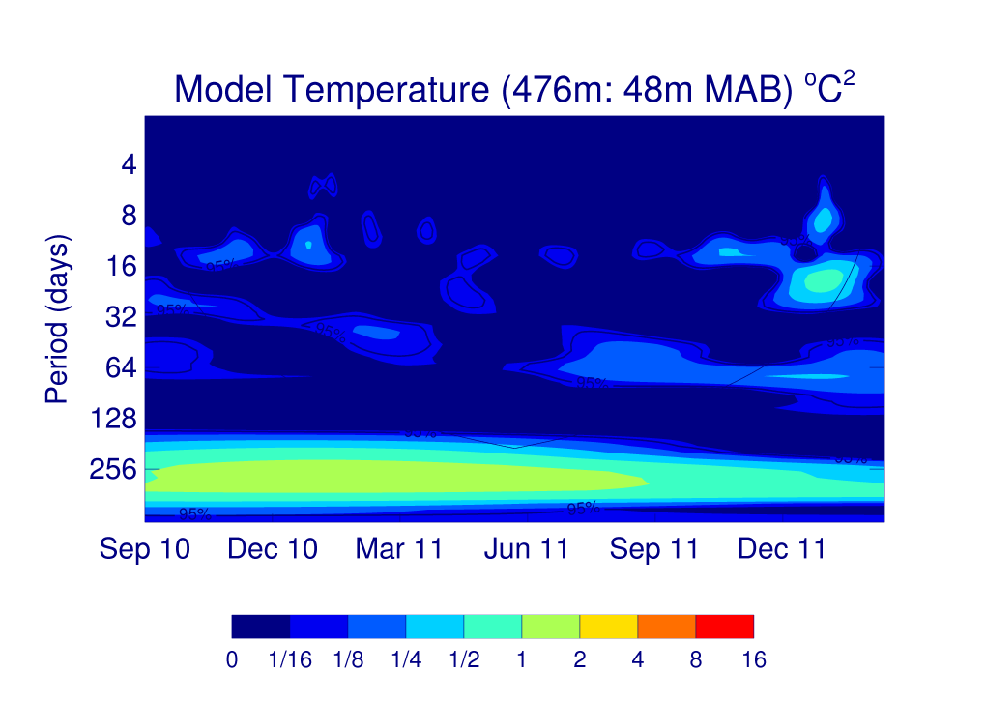
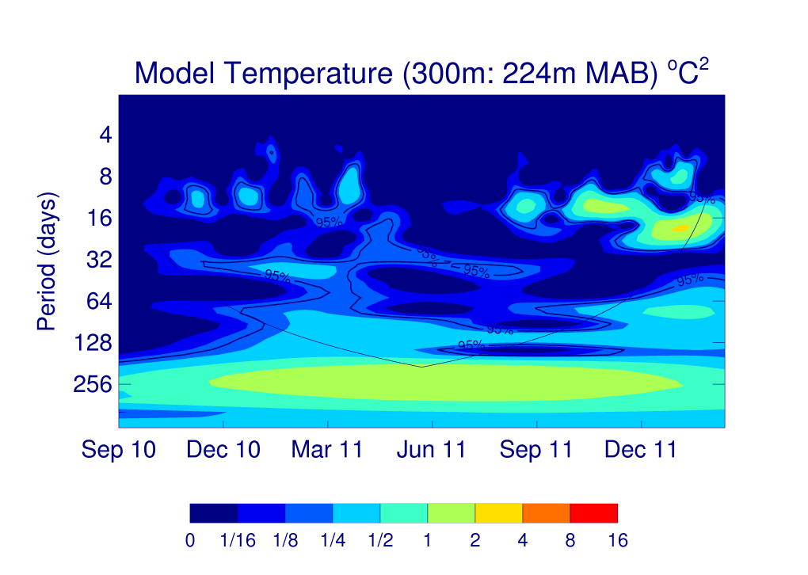
1.5 km model:
Maybe something at ~13d period in January? ~20d in 2nd January?
Higher in the water column shows some signal at ~13d at different times
Notes:
Note 95% confidence line. 13-14d is O1-K1 spring/neap cycle, which is strong along the NW shelf break. 20d signal in 2nd January is close to the cone of influence limit. Can make a case for January 2011 power in obs at 13 and 20d. Should probably look at normalized power for model.

Slide 14
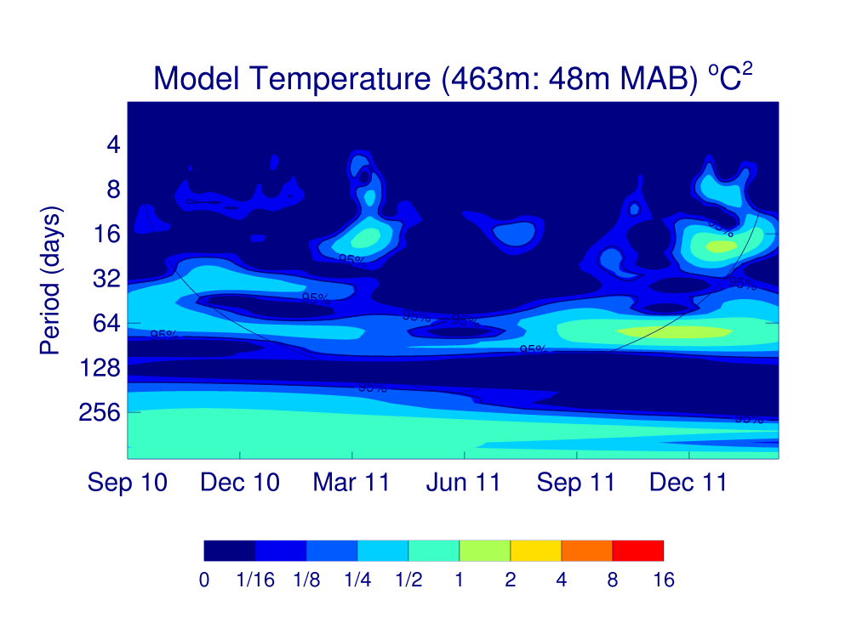
1.5 km model:
10 km east (closer to CDW onflow core) has something at ~20d in March

Slide 15
Future Time Series Anaylsis Plans
Examine other locations near shelf break after checking exactly where the model creates CDW/MCDW inflows and HSSW outflow
Only have daily data right now, need better time resolution
  Stefanie already has stations (with 15 minute data) at every PRISM mooring location
  Next time Stefanie runs model, will add more stations near the shelf break in different locations
Examine salinity (especially wrt HSSW outflow)
Co-ordinate with Giorgio about other comparisons (will send details when further along with analysis)
Notes:
Note: Haven’t shown any of this to Giorgio yet.

Slide 16
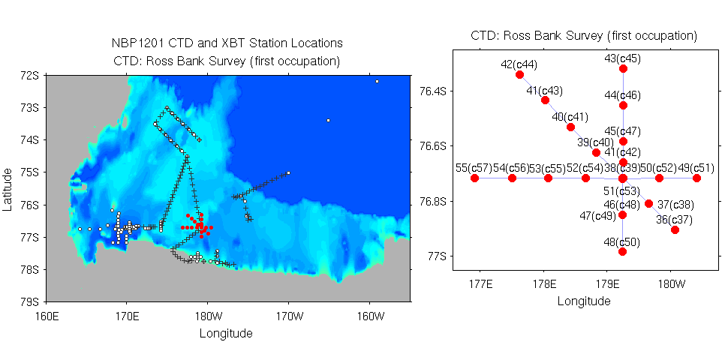
Ross Bank Survey
1st NW/SE Section: Jan 20/21, 2012
NS Section: Jan 21, 2012
EW Section: Jan 22, 2012
SeaHorse Deployment: Jan 20-26, 2012
2nd NW/SE Section: Jan 26, 2012

Slide 17
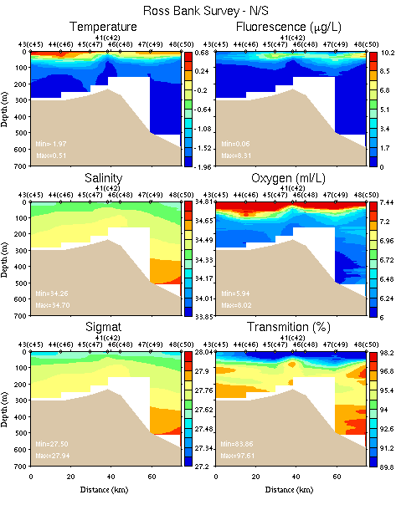
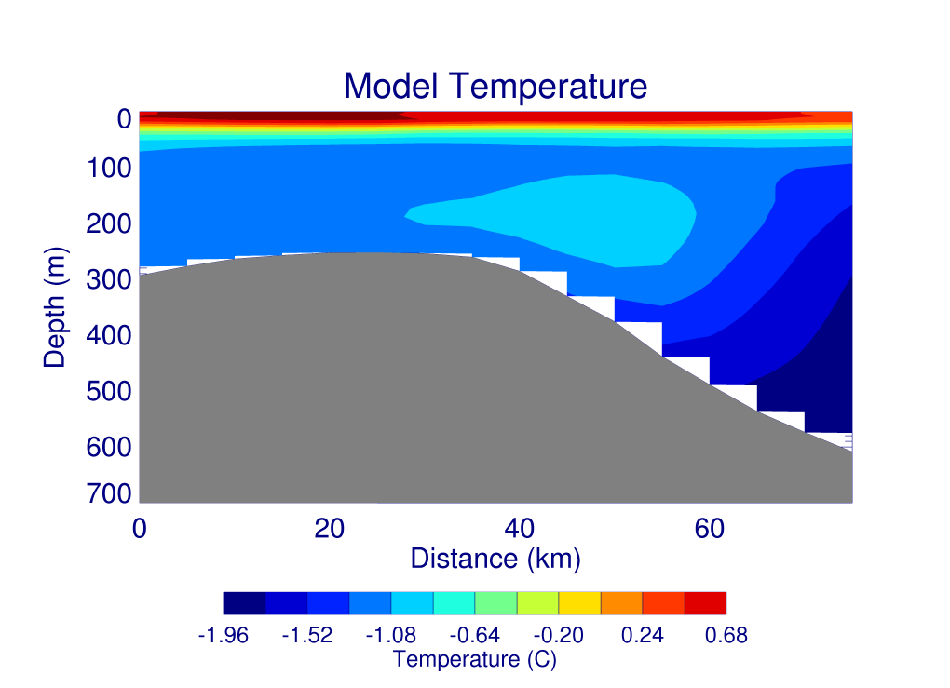
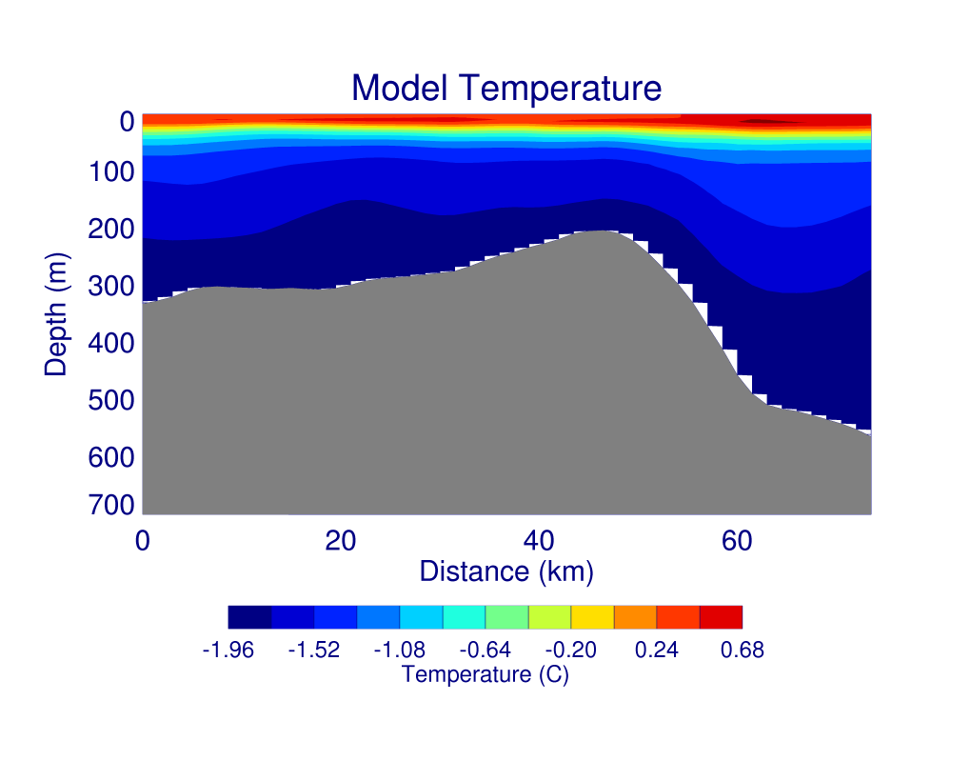
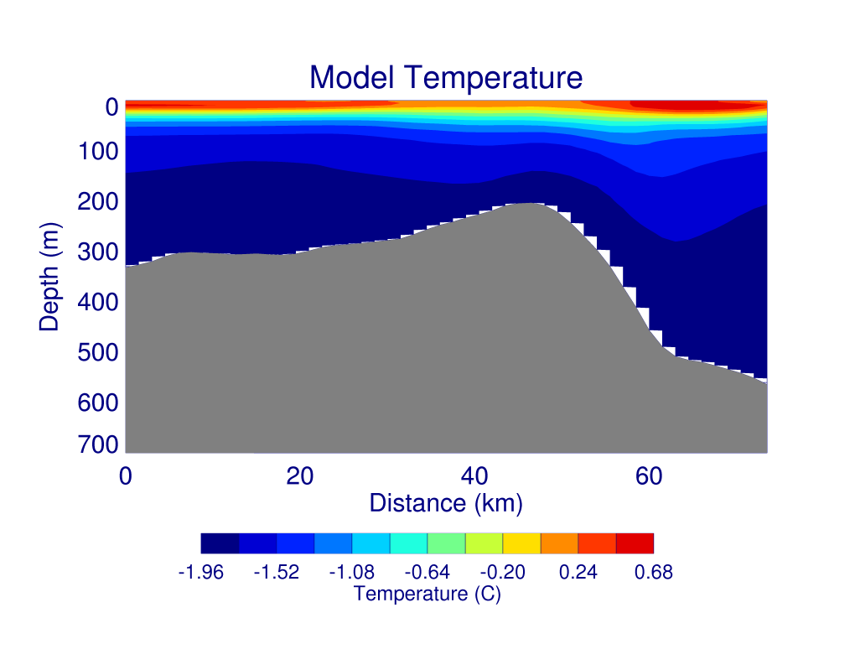
N/S Section
5 km
“bad”
tides
1.5 km, no tides
1.5 km, “good” tides
Notes:
North on left. Too warm before, now a little too cold, but temperature stratification looks good. Tides don’t seem to do a lot (in a daily average) except right at surface.

Slide 18
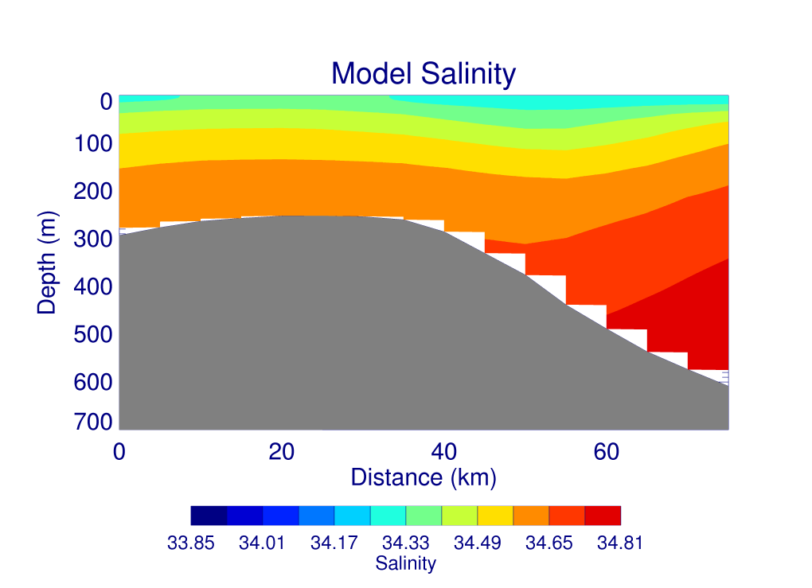
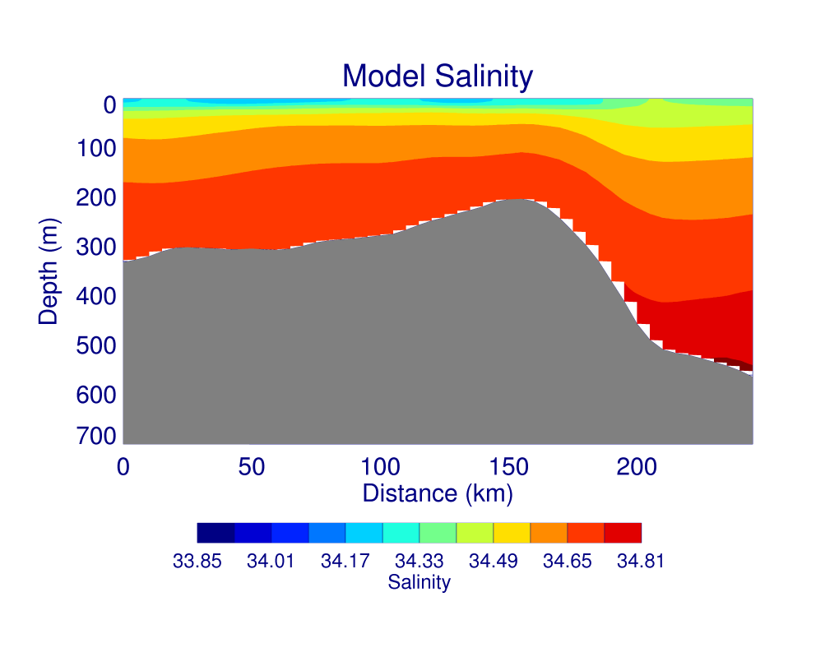
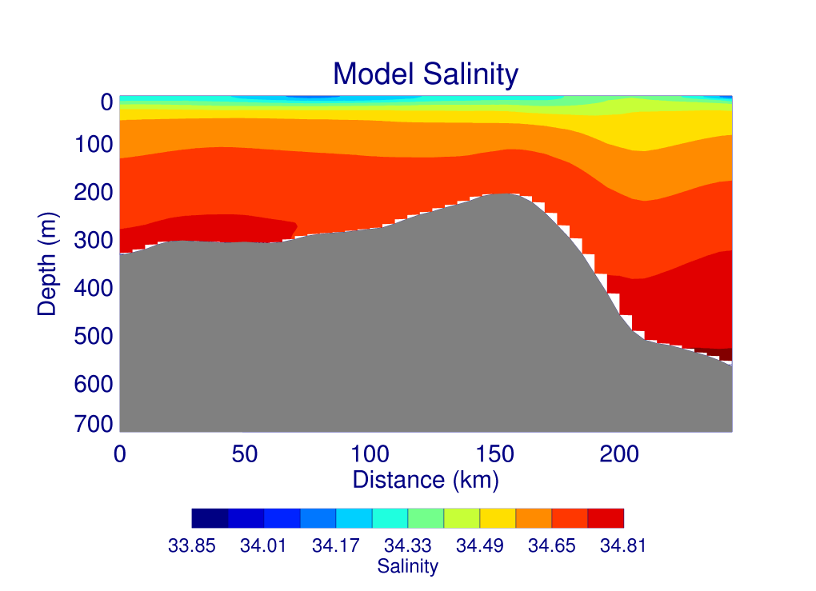
N/S Section
5 km
“bad”
tides
1.5 km, no tides
1.5 km, “good” tides
Notes:
North on left. 1.5km model seems to have made it even more salty.

Slide 19
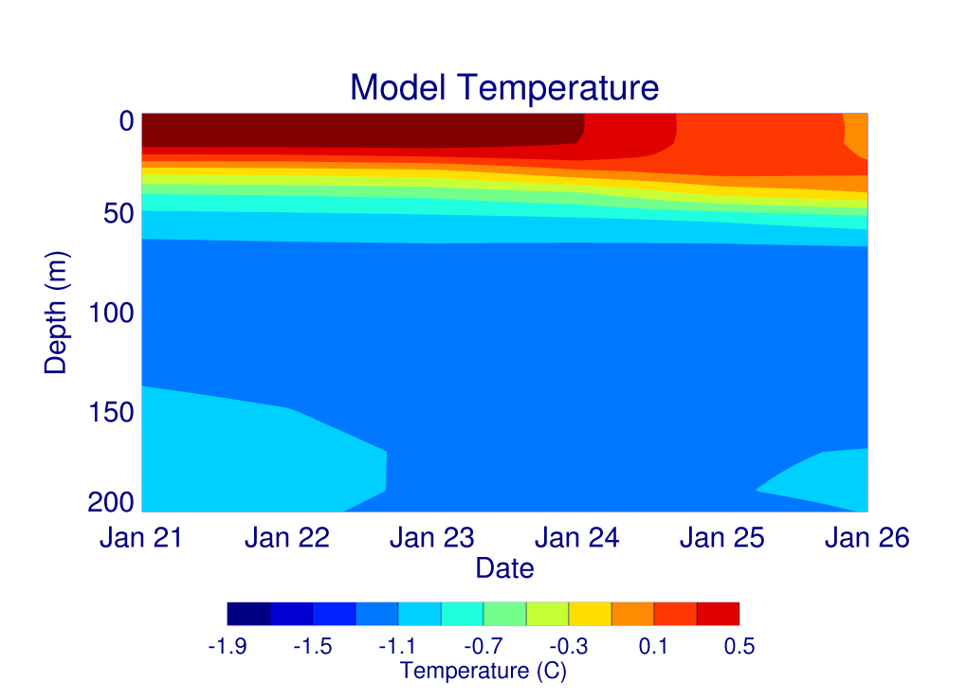
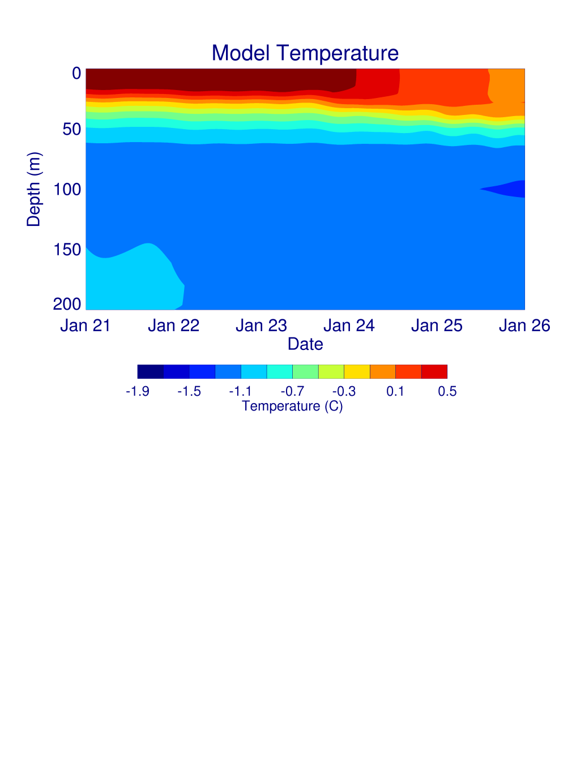
Time Series over Ross Bank
daily
average
40 min
output
Notes:
Both plots show the cooling and deepening of the ML. N.B. wind and temp forcing is 6 hourly

Slide 20
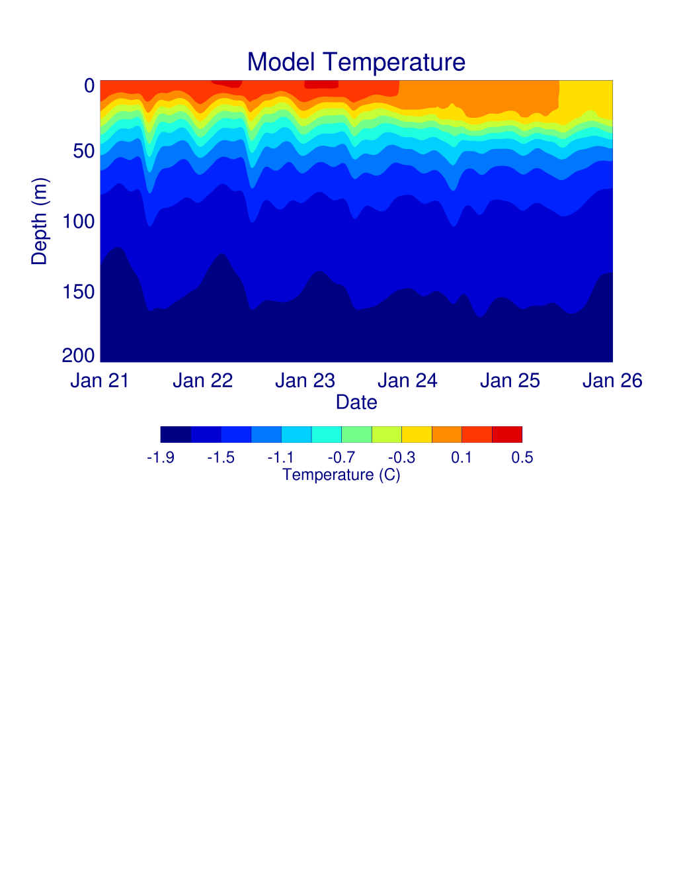
Time Series over Ross Bank
5 km w/
“bad”
tides
1.5 km w/
“good”
tides
Notes:
Both plots show the cooling and deepening of the ML. Station data for 1.5 km model is 15 minutes. Mention Stefanie’s stations at all PRISM stations now. Looks better (cooling of surface, temperature stratification, temporal variability)

Slide 21
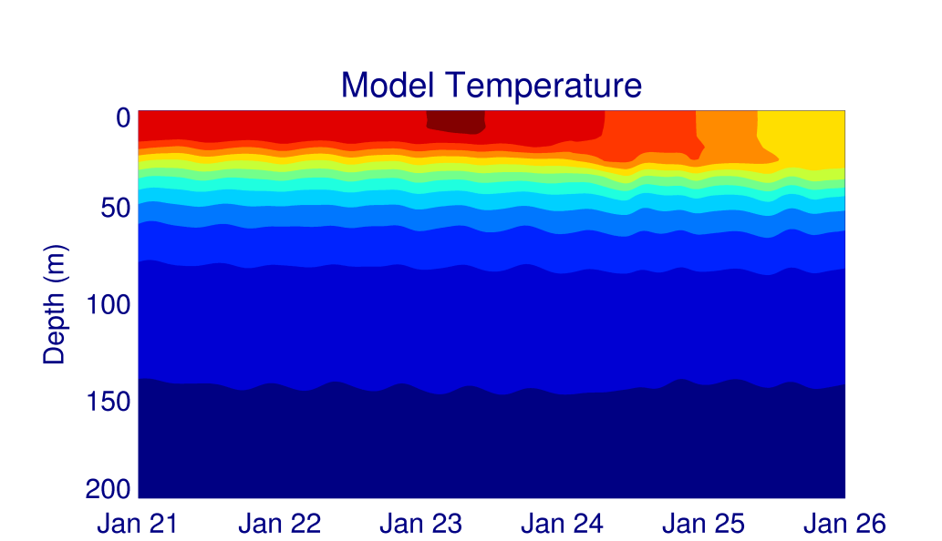
Time Series over Ross Bank
1.5 km w/
no tides
1.5 km w/
“good”
tides
Notes:
Effect of tides on the 1.5km model. Shows that much of the improvement is due to 1.5km resolution (instead of tides).

Slide 22
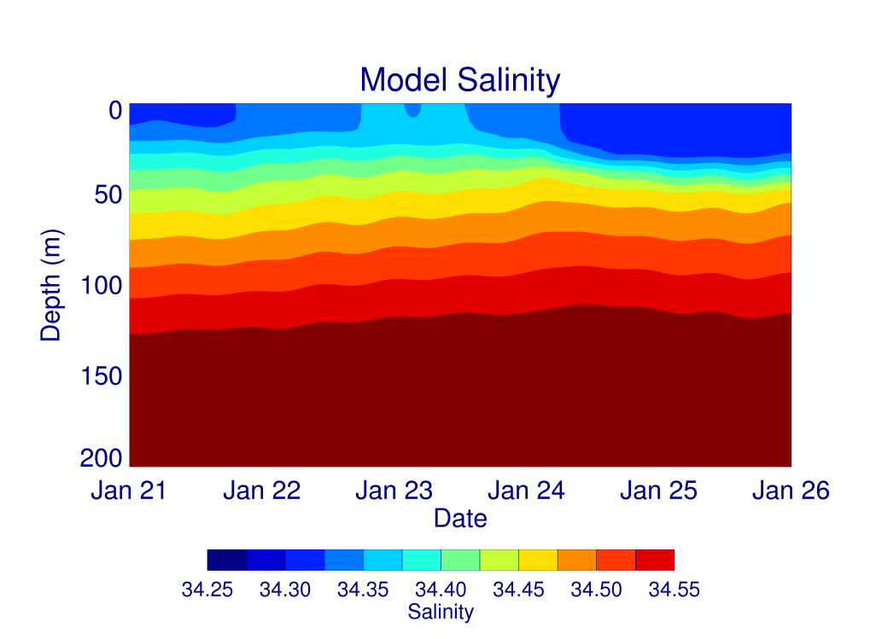
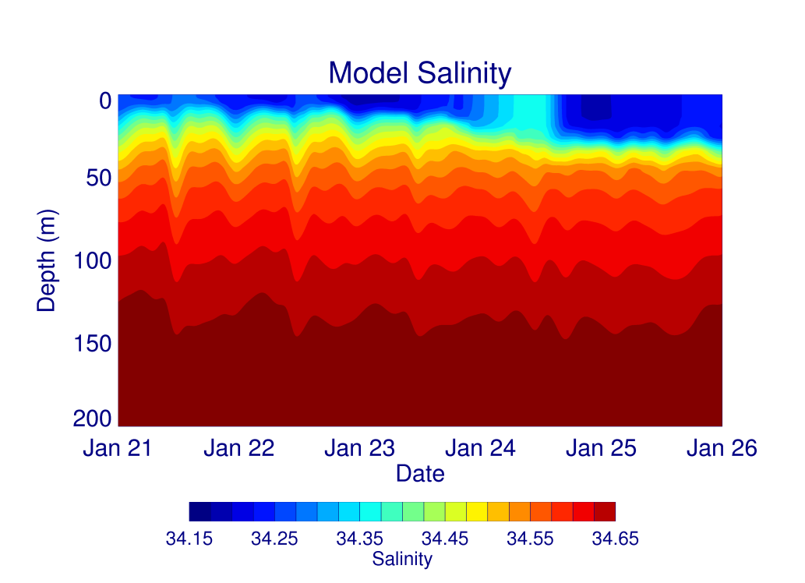
Time Series over Ross Bank
5 km w/
“bad”
tides
1.5 km w/
“good”
tides
(note
different
scale)
Notes:
Both plots have deepening and mixed layer getting saltier then fresher. Deep water over bank is too salty (too much HSSW…too salty and cold?). Surface response looks good.

Slide 23
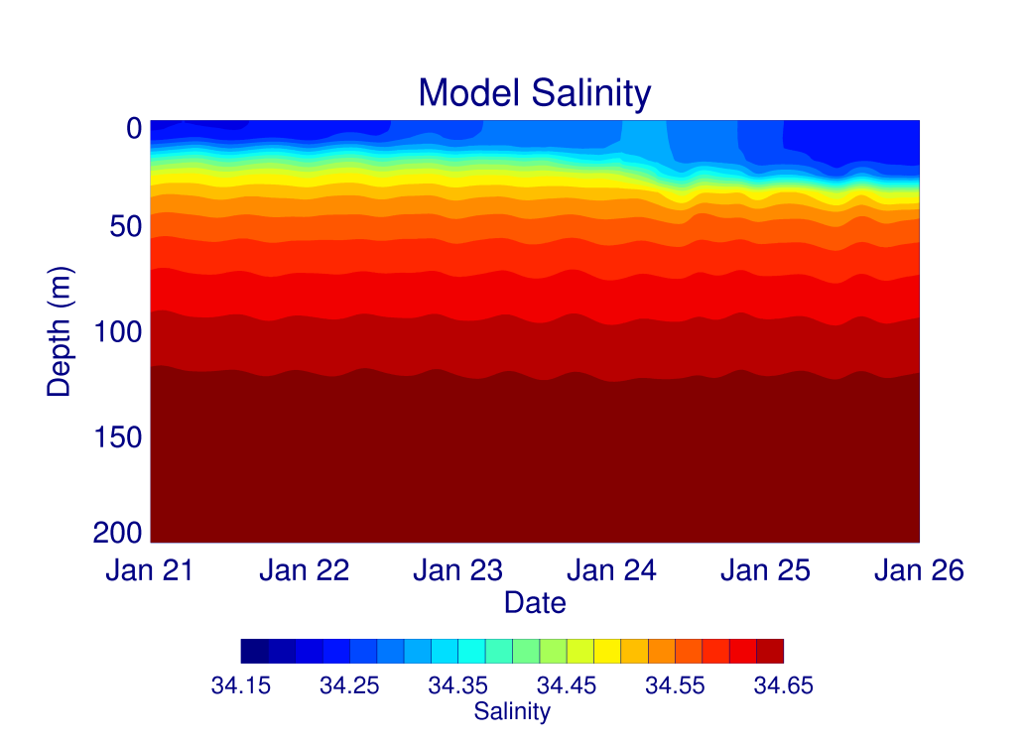
Time Series over Ross Bank
1.5 km w/
no tides
1.5 km w/
“good”
tides
Notes:
Both plots have deepening and mixed layer getting saltier then fresher. Effect of tides…definitely leads to more mixing (esp. near the surface).

Slide 24
Summary
Will submit paper titled “Effects of projected changes in wind, atmospheric temperature and freshwater inflow on the Ross Sea” next week (let me know if you want a pre-print)
Work continues with SEAFARERS group
Just starting to look at time variability of on/off shelf flows
Suggest switching to Stefanie’s 1.5 km model for the Ross Bank work
  More work to do on this (including adding a bottom dye of some kind in model re-run…see Stefanie’s plans)

Slide 25
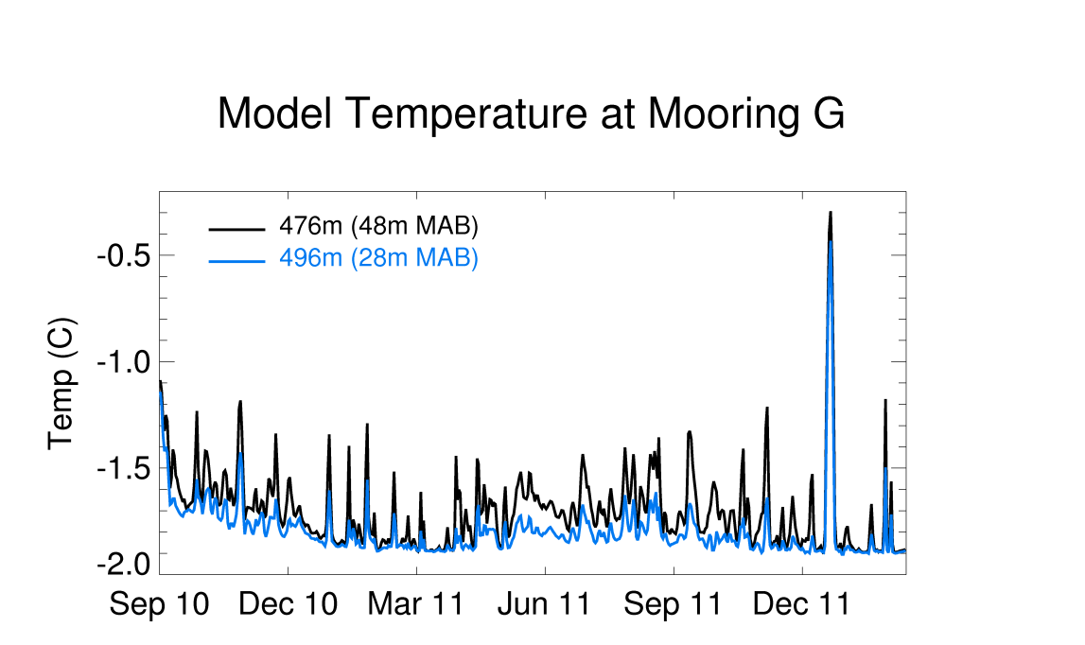
2010 2011 2012
1.5 km model daily averages look better at Mooring G
Shutting off tides (right) makes some difference, but hard to tell what

Slide 26
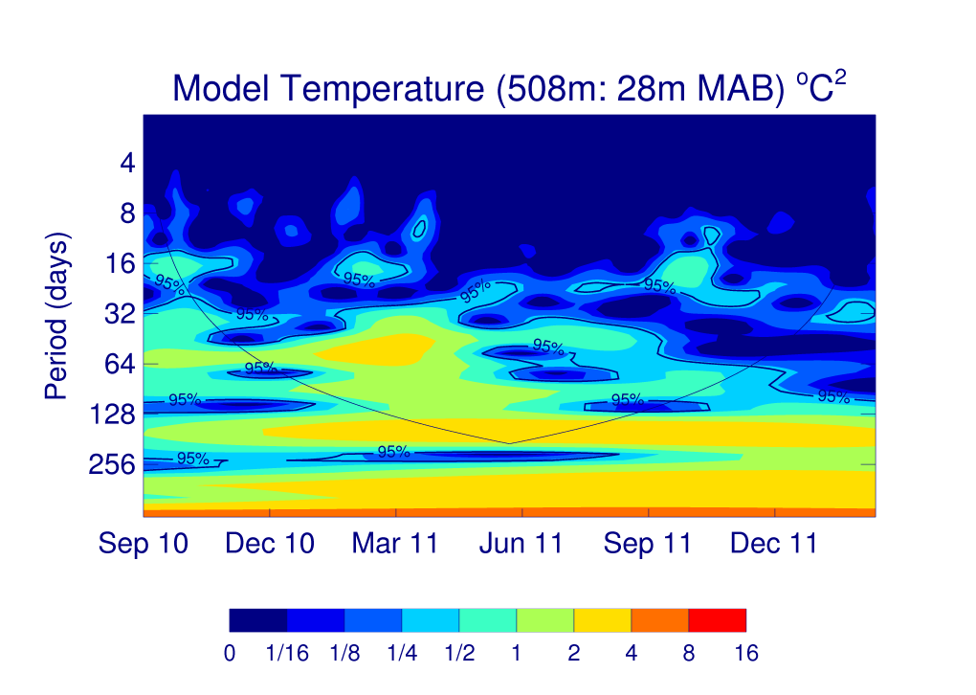
Turning off tides
(right) doesn’t seem to do much to the time series in the 5 km model

Slide 27
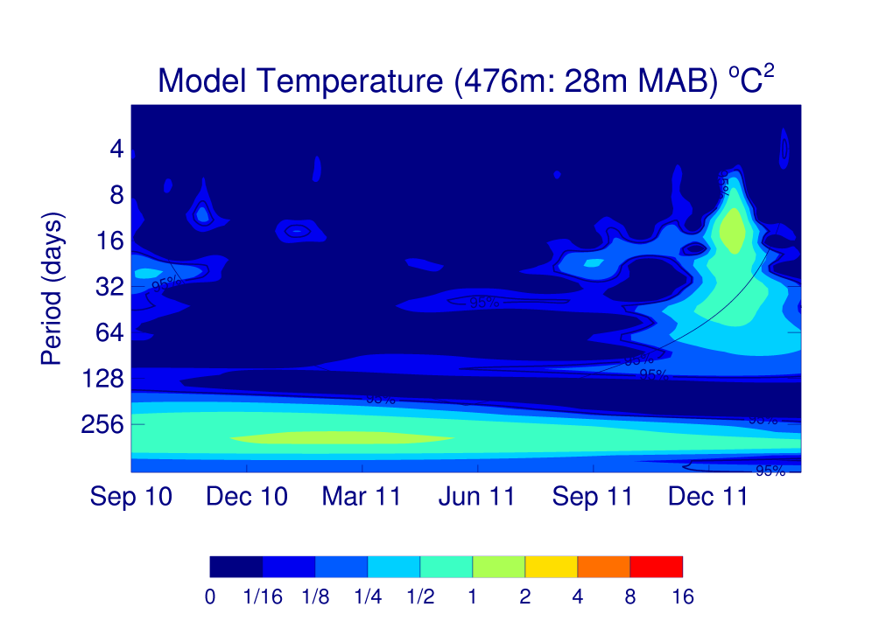
Maybe something in January ~10d?
Effect of no tides (right) in frequency space?
Notes:
Some of the 13d variability does disappear if tides turned off…

Slide 28
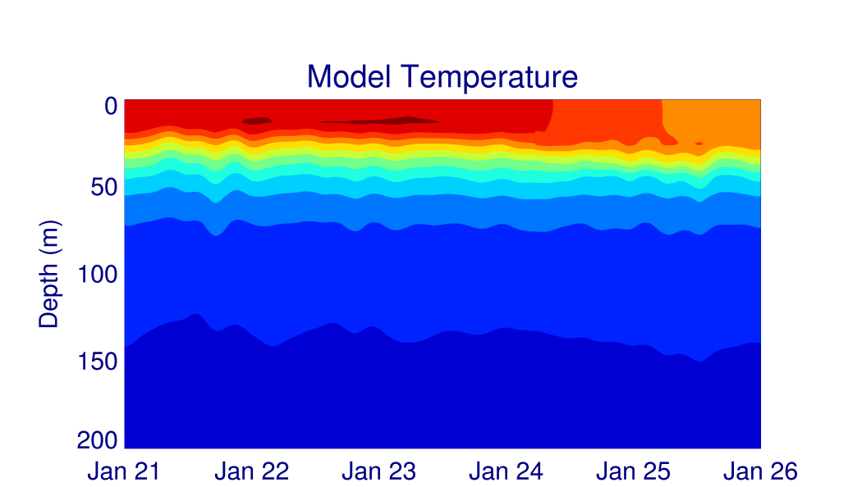
Time Series over Ross Bank
1.5 km w/
“bad”
tides
1.5 km w/
“good”
tides

Slide 29
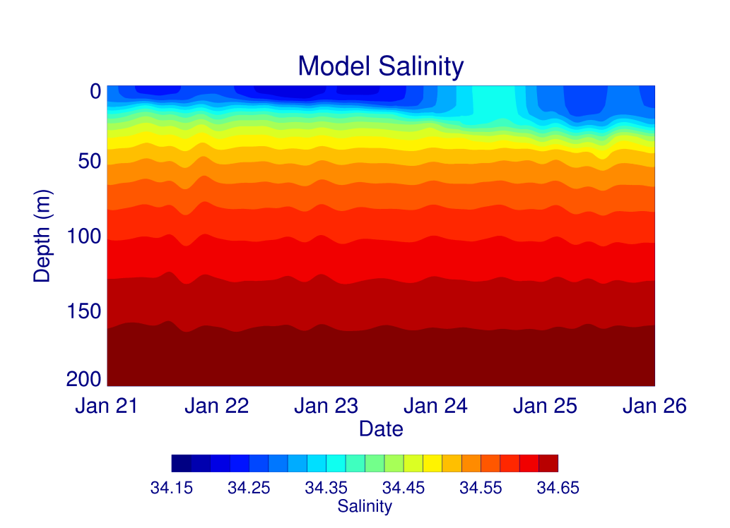
Time Series over Ross Bank
1.5 km w/
“bad”
tides
1.5 km w/
“good”
tides

Slide 30
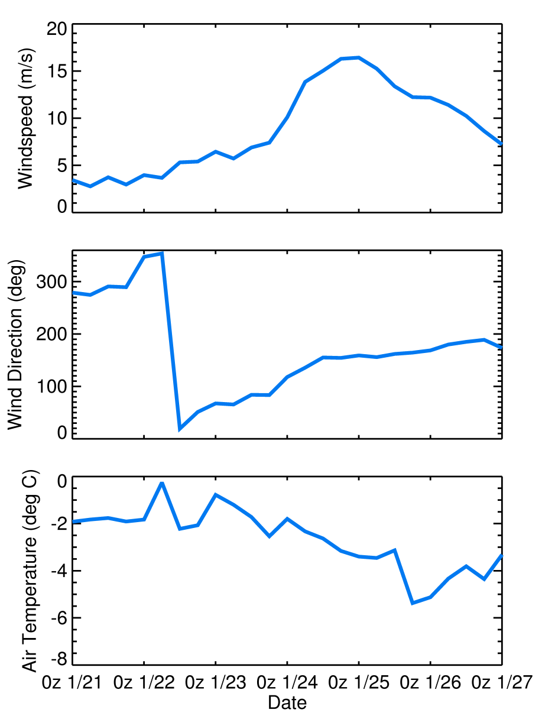
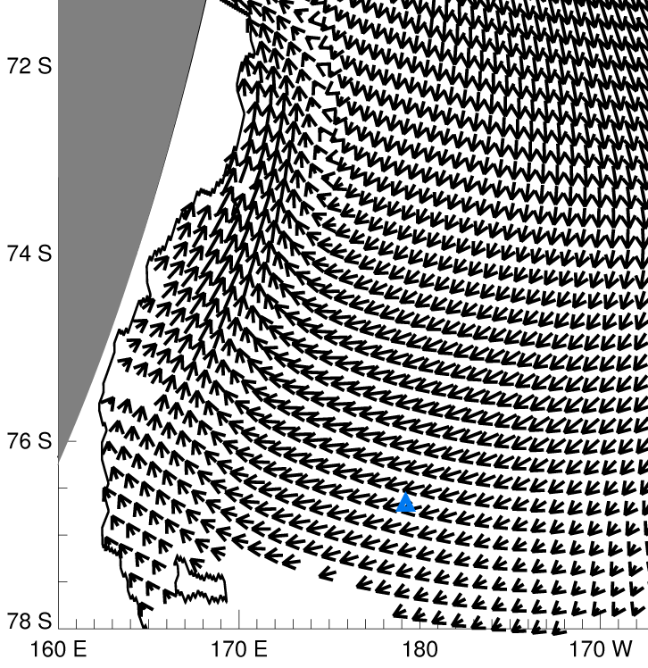
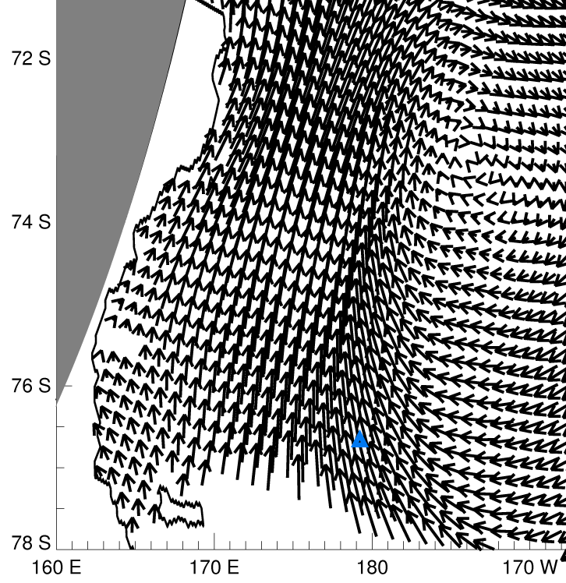
ERA-Interim wind:
1/23/2012 0Z
ERA-Interim wind:
1/25/2012 0Z
ERA-Interim weather at SeaHorse mooring

Slide 31
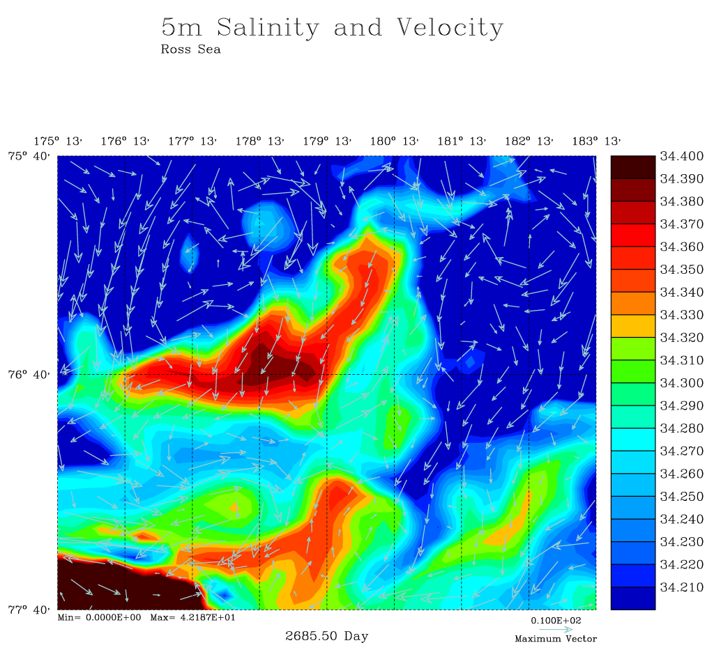
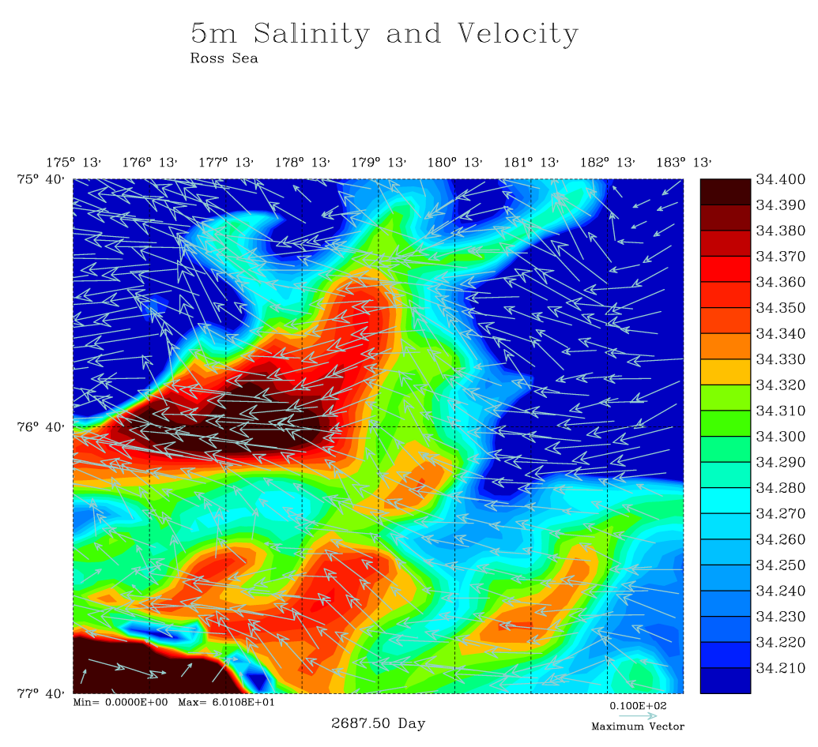
Model 5m Salinity and Velocity (Tides)
Jan 23, 2012
Jan 25, 2012
Notes:
Surface salinity is, in general, greater by 1/25 (vertical mixing), but a gradient has been advected westward by the strong, wind induced, surface currents.

Slide 32
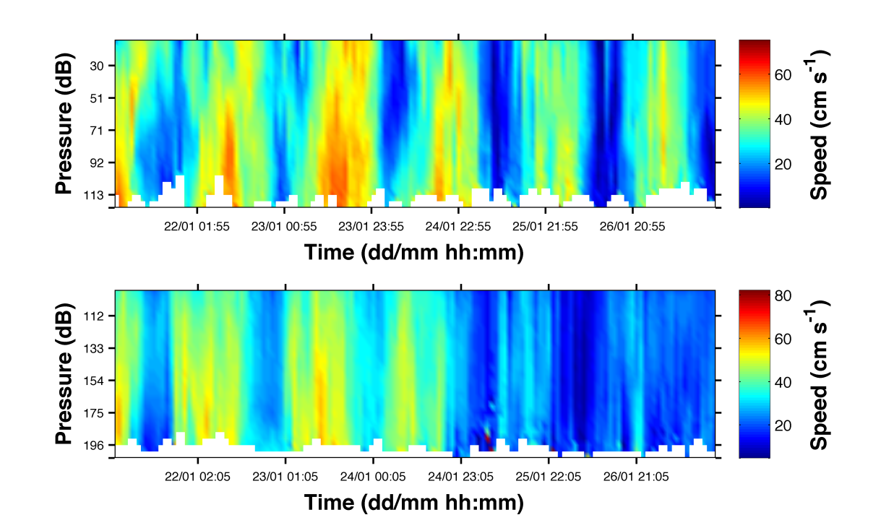
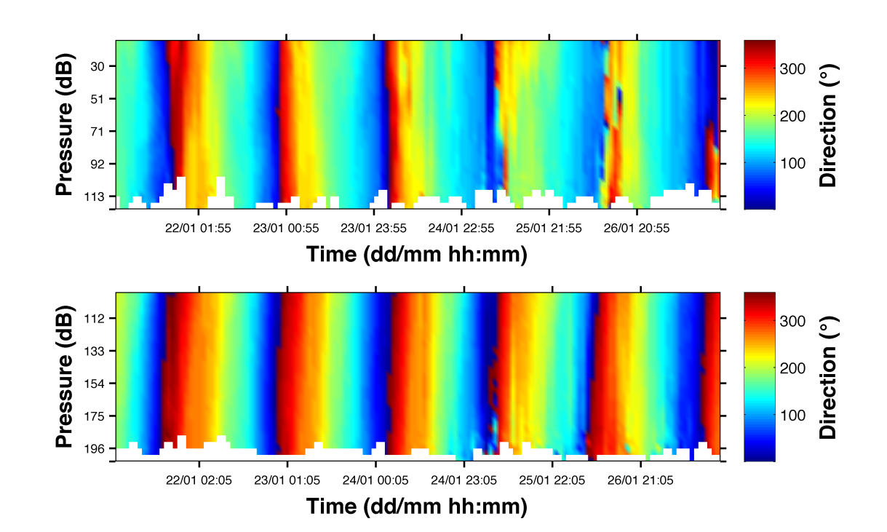
SeaHorse ADCP velocities (from Blair’s presentation two meetings ago)
Don’t know if this supports idea of strong westward surface currents during the later part of the SeaHorse deployment, but something happened around 0Z 1/25/2012
(If direction is magnetic north and given magnetic declination is 120E here
Decrease in the amount of “red” velocities (~320° magnetic = ~80° true) would indicate more westward flow)

