Slide 1
Ross Bank
Blair Greenan
Bedford Institute of Oceanography
PRISM-RS PIs Meeting
WHOI
23-24 July 2015

Slide 2
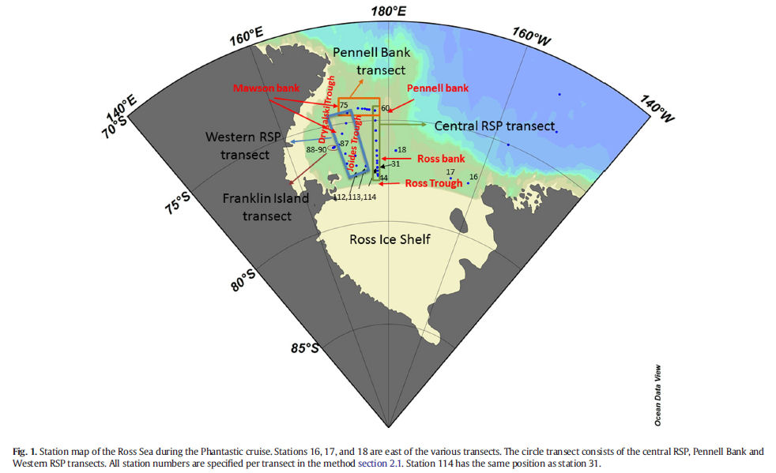
Gerringa et al. 2015

Slide 3
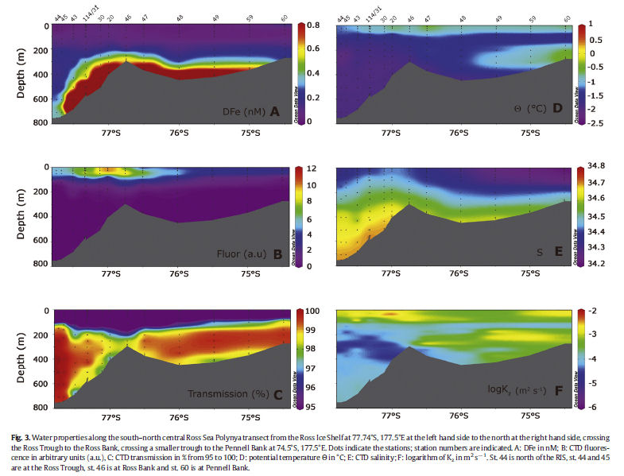
Gerringa et al. 2015

Slide 4
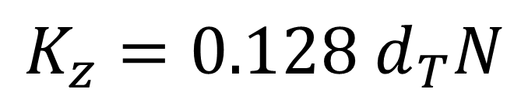

Gerringa et al. 2015
$K_{z}$ - vertical diffusivity
$d_{T}$ is the RMS of the Thorpe displacements
N is the buoyancy frequency
$$K_{z}=0.128 d_{T}N$$

Slide 5
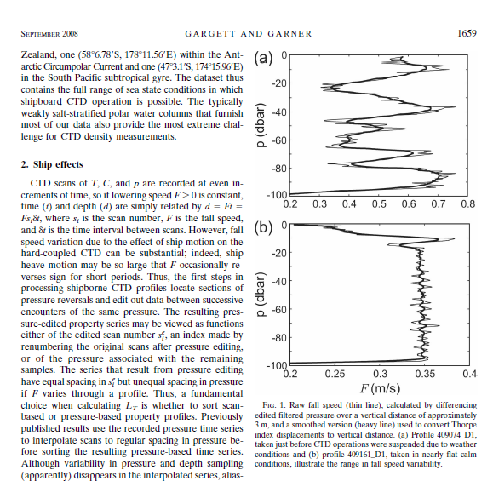

Slide 6
SeaHorse Examples – Deployment 2

Slide 7
SeaHorse Examples – Ross Bank

Slide 8
SeaHorse Examples – Deployment 4

Slide 9
Previous SeaHorse Estimates from EDDIES (Greenan 2008)

Slide 10
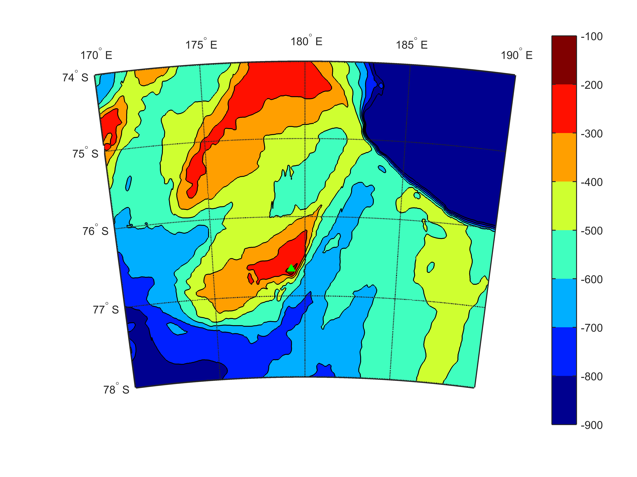
SeaHorse Deployment Location - Ross Bank

Slide 11
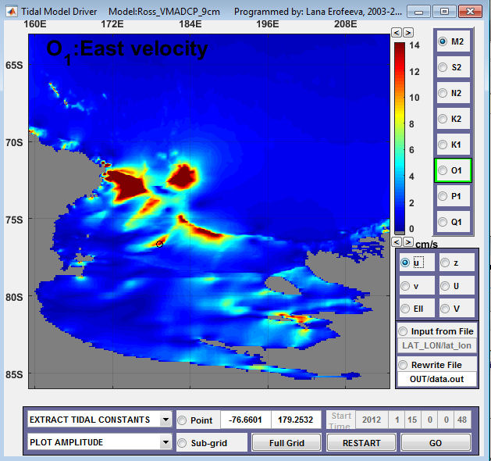
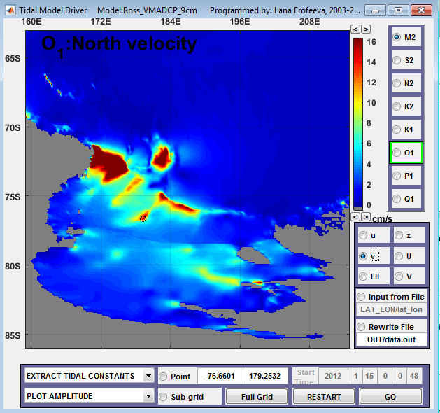
Tidal velocity amplitude (OSU/ESR model)

Slide 12
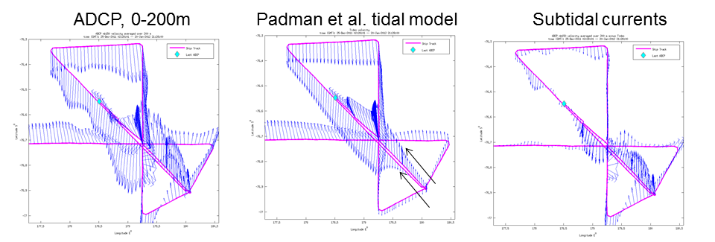
VM-ADCP

Slide 13
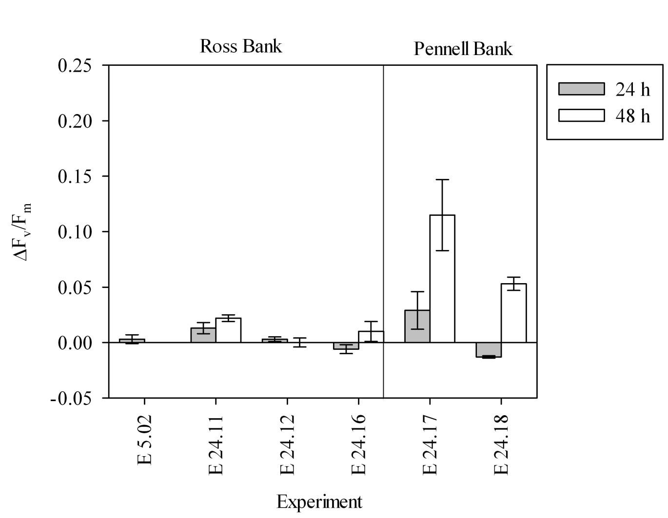
The relative degree of iron stress (deltaFv/Fm) (see Ryan-Keogh et al 2013) measured at 4 stations on the Ross Bank and two station on The Pennell bank. DeltaFv/Fm is constantly low over the Ross Bank (indicating the phytoplankton community there does not respond physiologically to added Fe after 24 or 48hrs). Stations at the Ross Bank span >1 occupation, over different stats of tide. The inference is that the phytoplankton are not physiologically limited by the in situ Fe availability.

Slide 14
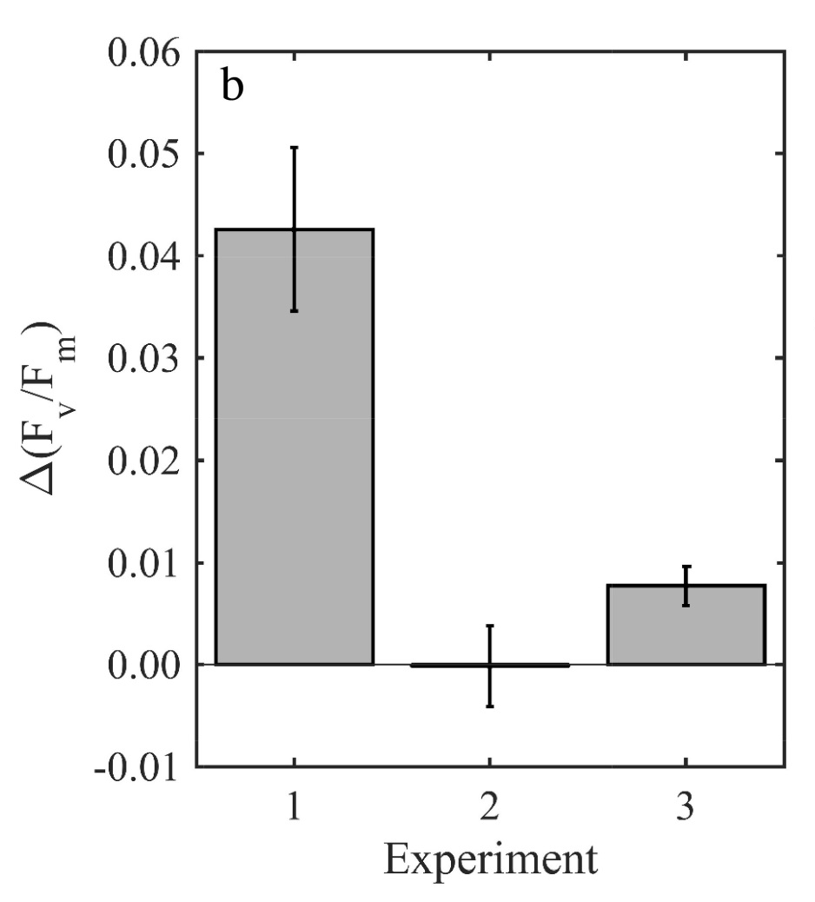
Variable response to iron addition to the extant phytoplankton communities. Change in deltaFv/Fm on addition of Fe. Experiment 1, established near the Ross Ice Shelf, and experiment 3, established in the middle of an anti-cyclonic eddy, provided evidence that the in situ phytoplankton communities were potentially iron limited. Experiment 2 set up over the Ross Bank did not show any significant differences (ANOVA, p>0.05).
This is data from the only 3 long-term incubation experiments we did in the Ross Sea so we have nutrient data, growth rates etc etc.

