Slide 1


Italian contribution to the special issue on
Mesoscale and high-frequency variability in the Ross Sea (Antarctica)
G. Budillon, P.Falco, G.Fusco, G.Auricino, P.Castagno, Y.Cotroneo, E. San Siviero ….
University of Naples "Parthenope" (Italy)
------------------------------------
Programma Nazionale di Ricerche in Antartide

Slide 2
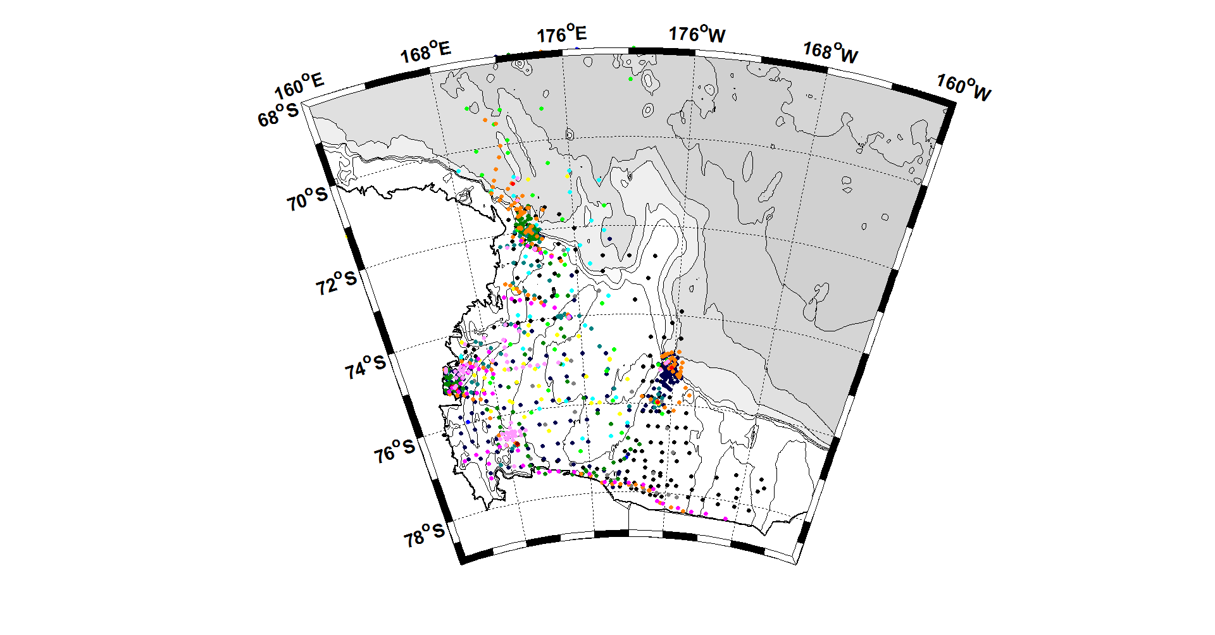
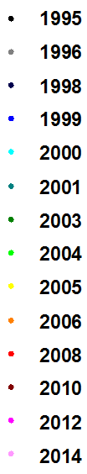
CTD casts
SeaBird SBE 911 + system:
pressure
Temperature
conductivity (salinity)
fluorescence
dissolved oxygen.
Lowered ADCP (2006, 2012 and 2014)
current speed
current direction.
Notes:
Mettere rettangolo per CTD prossima campagna se progetto approvato?

Slide 3
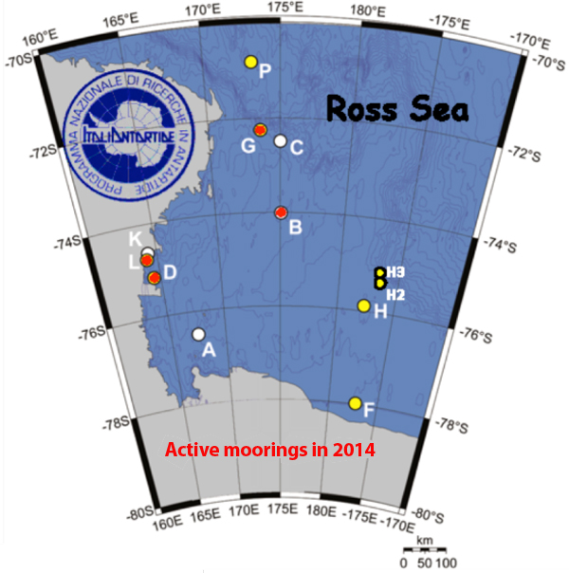
Moorings
http://morsea.uniparthenope.it/
http://www.soos.aq/news/current-news/202-italian-moorings

Slide 4
Antarctic Circumpolar Current
Falco and Zambianchi, 2011, JGR
Trani, Falco and Zambianchi 2011, Pol.Res
Trani, Falco, Zambianchi and Salleè, 2014, Progr. in Ocean.
ACCUA progect (2014-2016) Dynamic of Cricumpolar Current from data and modelling

Slide 5

Background
During summer, an observed abundance of macronutrients and scarcity of dissolved iron are consistent with iron limitation of phytoplankton growth in the Ross Sea (polynya).
Field observations and model simulations indicate four potential sources of dissolved iron to surface waters of the Ross sea:
circumpolar deep water intruding from the shelf edge;
sediments on shallow banks and nearshore areas;
melting sea ice around the perimeter of the polynya;
and glacial meltwater from the Ross Ice Shelf.
These potential iron sources are isolated, either laterally or vertically, from the surface waters of the Ross Sea for much of the growing season.

Slide 6
Ross Sea Mesoscale Experiment
Project aims: first, investigate how the surface layer mesoscale dynamics in the Ross Sea (one of the most productive area of the Southern Ocean), can contribute to regulate the primary productivity especially trough iron supply that acts as limiting factor. Second and more general, to evalutate the efficiency of the biological pump.
To address these aims, a complex system of observation based on the use of satellite data (sst and clorofille), in situ data (physical, chemical, biological ) and eventually numerical simulation were setup
Project last 24 months with the oceanographic cruise carried out during the austral summer 2013/2014; the remaing period is/will be dedeicated to data analysis.
The expected results in a short/medium term perspective will help to achieve a better understanding of the mesoscale structures in the Ross Sea, their role in supplying iron, of the primary productivit and of the biogeochemical cycle in the polar region. In a long term perspective the results could provide important information on how these processes can change in a changing system and if they can contibute through feedback mechanisms
Notes:
A project biologically oriented where the physics needs to support the sampling and then the analysis of the sample collected but whereas the new observations are fundamental to go on with the monitoring of the Ross Sea.

Slide 7
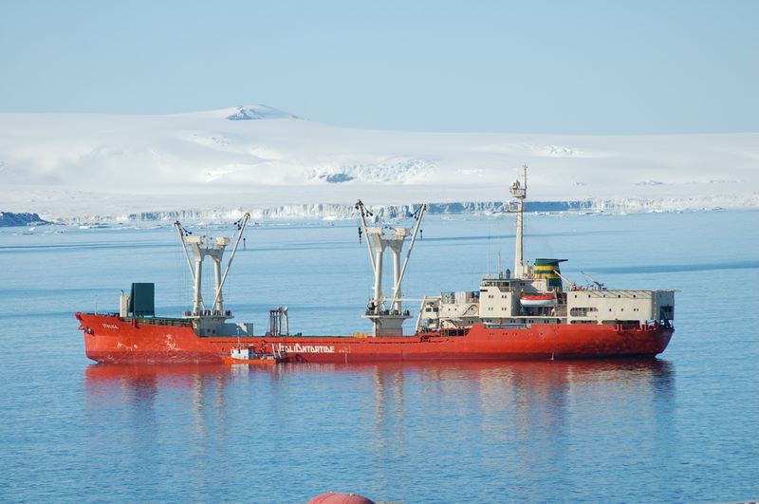
XXIX A.I.Exp, Austral Summer 2013-14
Vertical profile and discrete observation along the water column of the most important physical, chemical, biological parameters
Continous surface collection of SST, SSS, lidar and fluorescence
Acoustic survey for krill detection
Measurement of atmospheric CO₂
Three areas:
RoME1- offshore, northern part of Ross Sea polynya, frontal zone with meltwater influence
RoME2 - coastward, Terra Nova Bay polynya, HSSW signals
RoME3 - offshore, southern area, complex hydrodynamic features

Slide 8
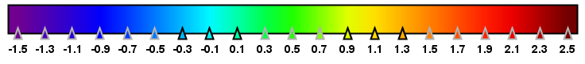
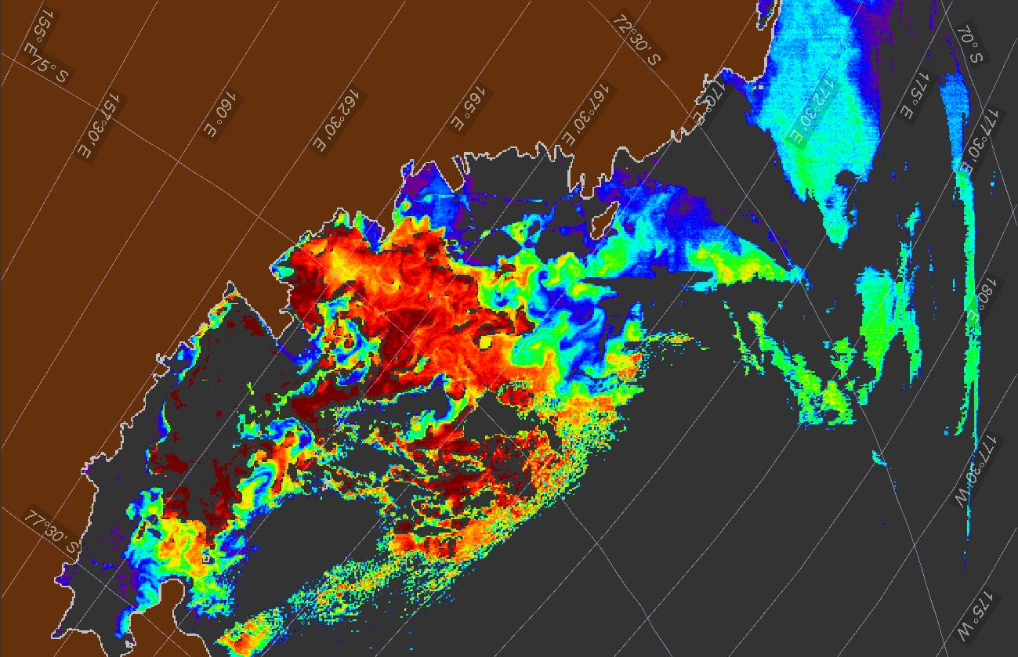
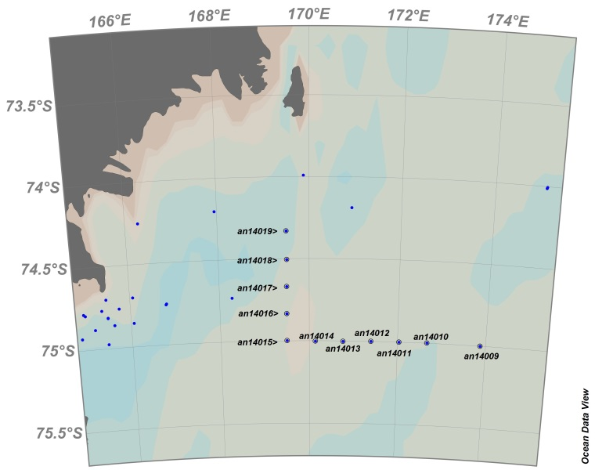
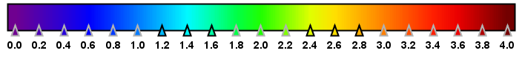
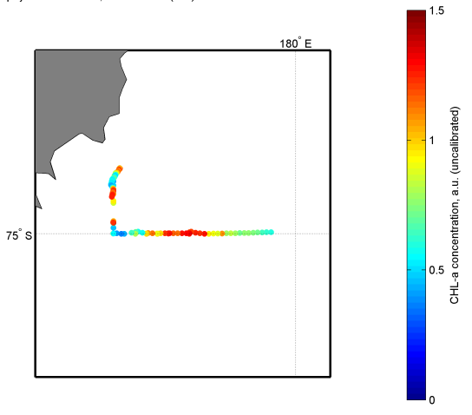
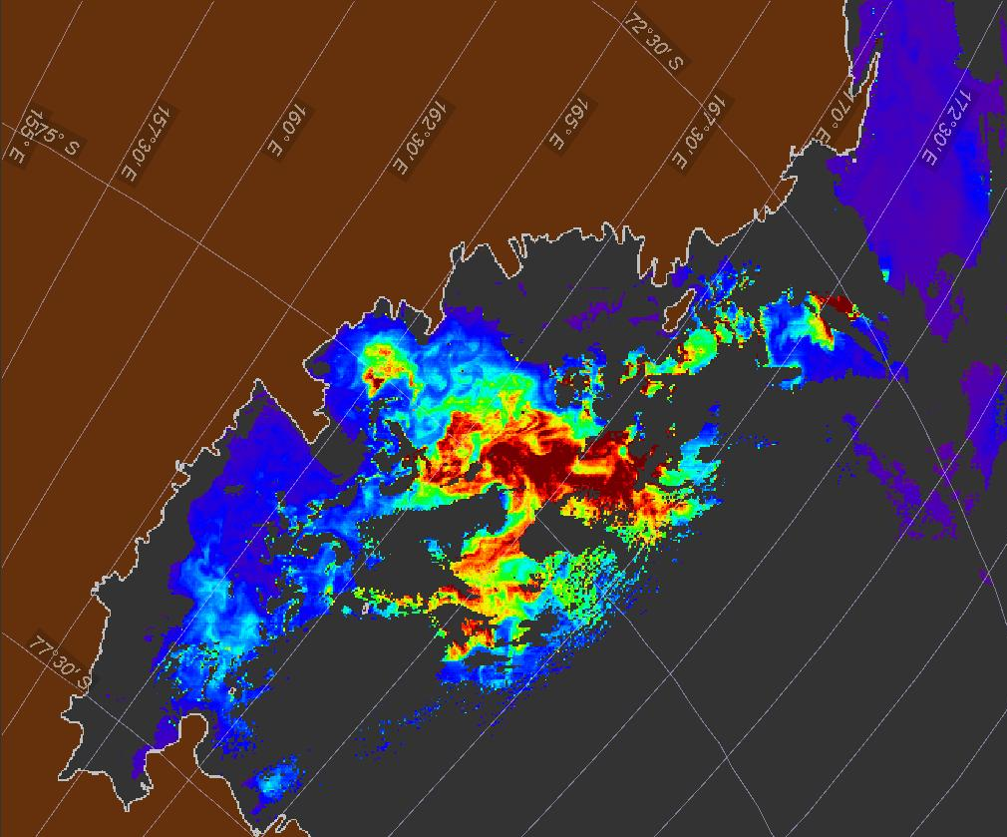
16 January 2014
ROME 1 16-17/01/2014
SST
Chlor_a
C

Slide 9
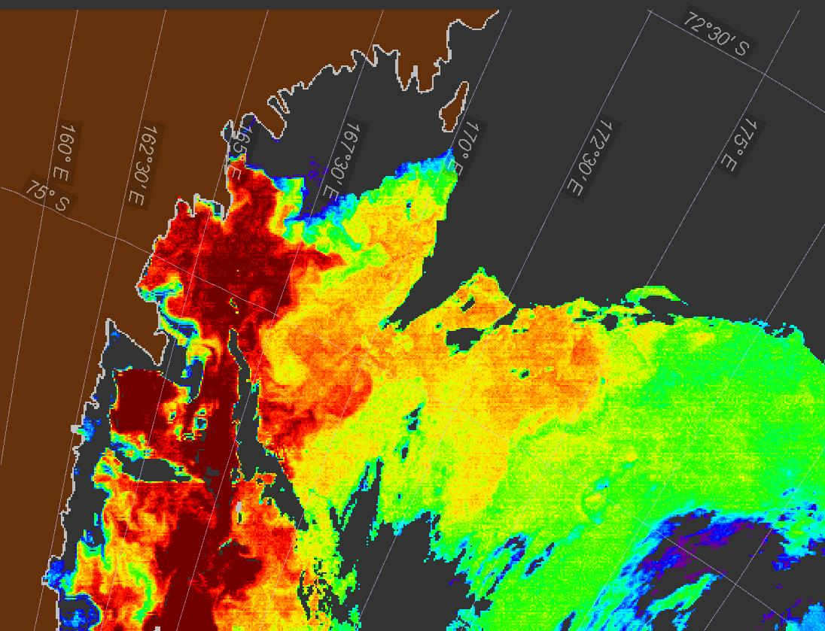
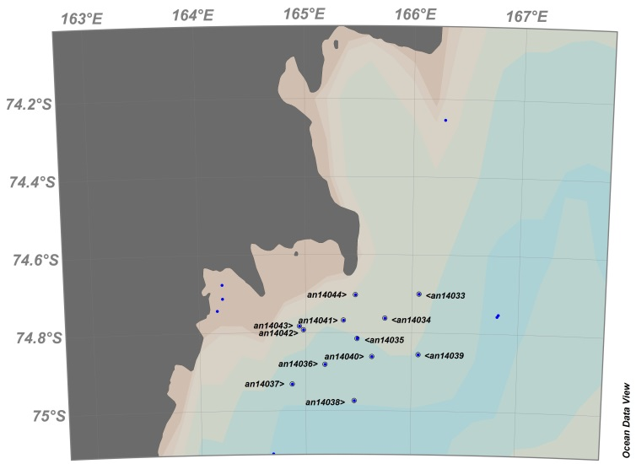
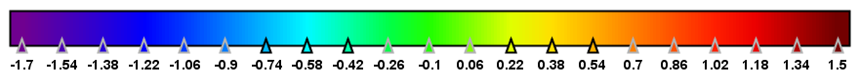
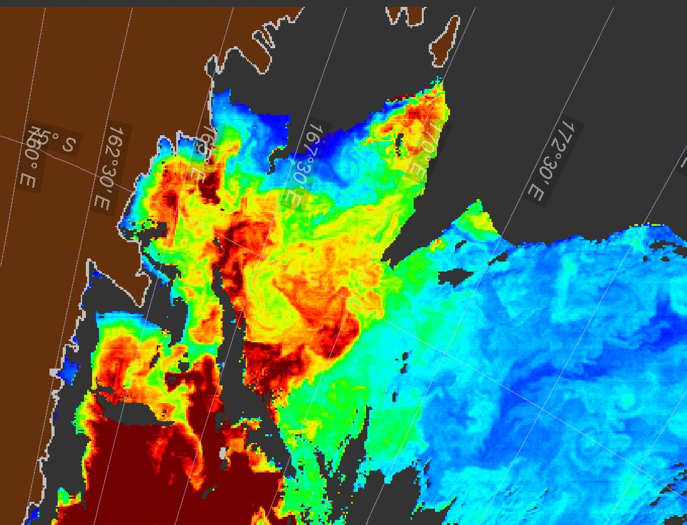
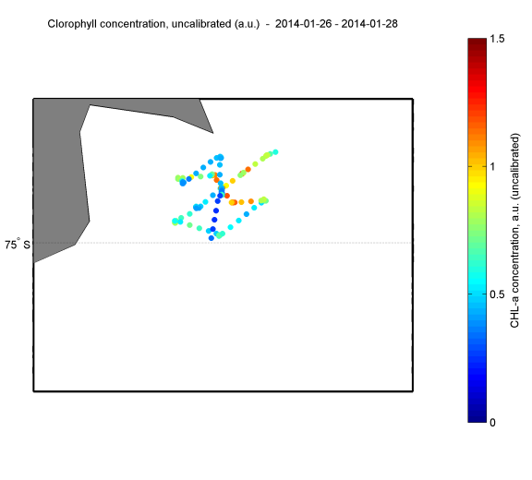
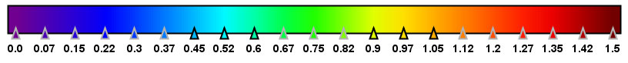
SST
28 January 2014
Chlor_a
ROME 2 26-28/01/2014

Slide 10
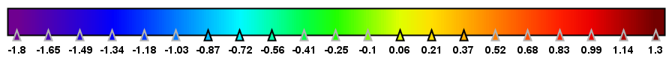
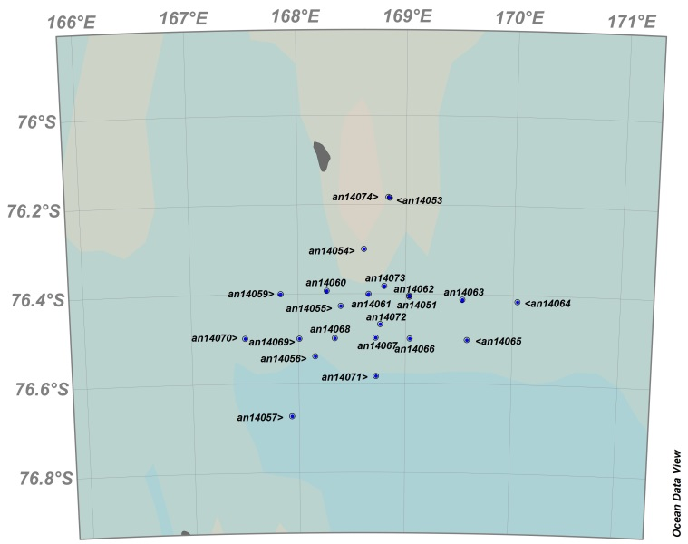
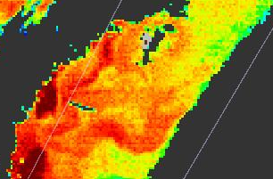
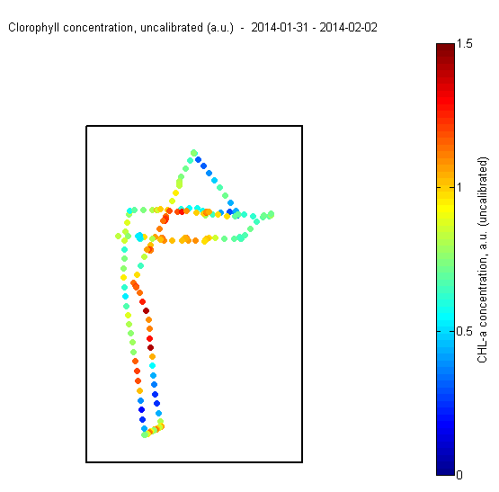
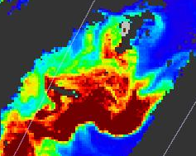
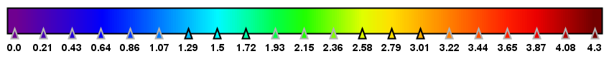
31 January 2014
SST
Chlor_a
ROME 3: 31/01-03/02/2014

Slide 11
Physical and biological forcing on the mesoscale variability of the carbonate system in the Ross Sea (Antarctica) during the summer season 2014.(first paper submitted)
Paola Rivaro^{1*}, Carmela Ianni¹, Leonardo Langone², Carlo Ori², Giuseppe Aulicino³, Yuri Cotroneo³, Maria Saggiomo⁴, Olga Mangoni⁵
¹ Department of Chemistry and Industrial Chemistry, University of Genoa, via Dodecaneso 31, 16146 Genova, Italy.
² National Research Council of Italy, Institute of Marine Sciences, Via Gobetti, 101, 40129 Bologna, Italy.
³ Department of Environmental Sciences, Parthenope University, Centro Direzionale, Isola C4 IT-80143 Napoli, Italy.
⁴ Stazione Zoologica Anton Dohrn, Villa Comunale 1, 80121 Napoli, Italy.
⁵ Department of Biology, University of Napoli Federico II, via Mezzocannone, 8, 80134 Napoli, Italy.

Slide 12
AIM:
Evaluating the physical and biological forcing on the carbonate system variability at amesoscale level
METHODS:
Total alkalinity, pH, dissolved oxygen, phytoplankton pigments and taxonomic composition were investigated in combination with measurements of temperature, salinity and current speed (LADCP)
The total inorganic carbon, the sea water CO2 partial pressure, the saturation grade for calcite and aragonite were calculated from the measured total alkalinity and pH.
Continuous measurements of atmospheric CO2 concentration was carried out during all duration of the sampling.
Results are obtained from the analysis of the ROME2 experimente (more coastal)

Slide 13
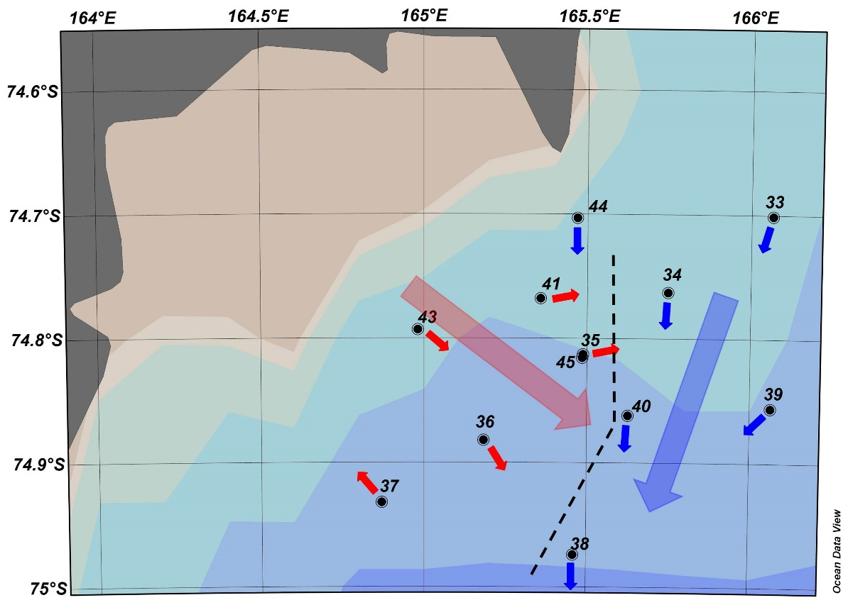
RESULTS:
LADCP measurements revealed the presence of a significant change in current speed and direction in correspondence of a well demarked frontal line. The frontal zone was characterized by intense gradients in both temperature and salinity.
The distribution of the carbonate system in surface waters was controlled largely throughout the phytoplankton activity more than the physical forcing
The dominance of diatoms vs haptophyceae is found to have particular implications for the ratios of nutrient drawdown and carbon export
Should phytoplankton communities shift from Phaeocystis Antarctica to diatom dominance in response to enhanced upper ocean stratification (Sarmiento et al., 1998), then our data indicate that the CO2 drawdown estimated from the C/P ratio, would be reduced in these areas by about 50%.

Slide 14
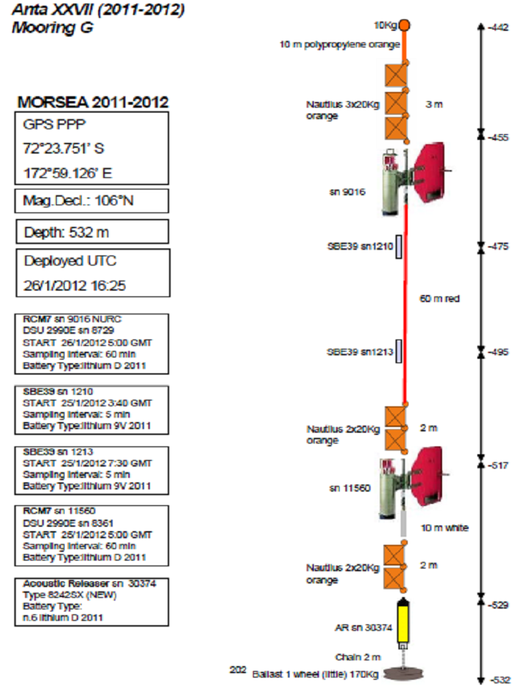
Spatial and temporal variability of the Circumpolar Deep Water inflow onto the Ross Sea continental shelf
P.Castagno, P. Falco, G.Budillon ….
CA
DT
MB
Notes:
Red line : CTD transect
Blue diamond: mooring G

Slide 15

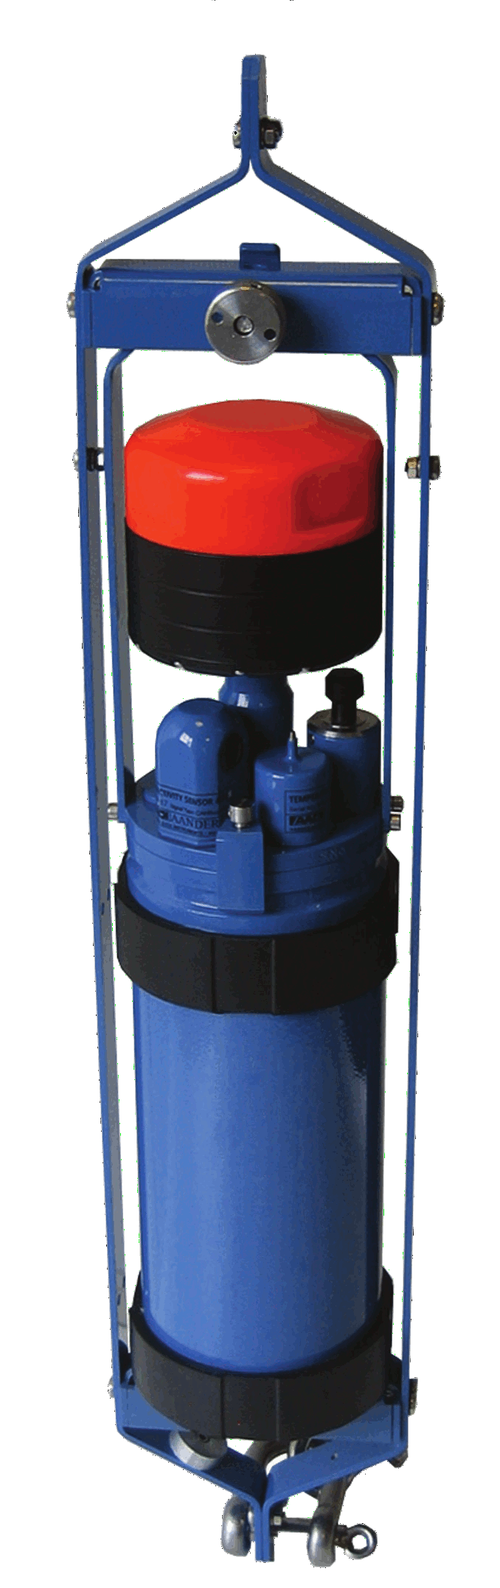


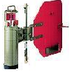
Anta XXIX (2013-2014) Mooring G
10Kg
-423
10 m polypropylene orange
MORSEA 2013-2014
Nautilus 3x20Kg orange
3 m
GPS PPP
72°23.516’ S
172°59.135’ E
1 m
Mag.Decl.: 107°N
sn 11560
-437
Depth: 515 m
10 m yellow
Deployed UTC
25/1/2014 19:43
Quick link
SBE39 sn1210
1 black mark
-457
RCM7 sn 11560
DSU 2990E sn 8361
START 23/1/2014 23:00 GMT
Sampling Interval: 60 min
Battery Type:2xlithium D 2013
60 m red
SBE39 sn1213
2 black mark
-477
SBE39 sn 1210
START 25/1/2012 10:40 GMT
Sampling Interval: 5 min
Battery Type:lithium 9V 2013
SBE39 sn 1213
START 25/1/2012 9:40 GMT
Sampling Interval: 5 min
Battery Type:lithium 9V 2013
Nautilus 2x20Kg orange
2 m
RCMDW sn 585
sea guard AAdii
START 25/1/2012 6:00 GMT
Sampling Interval: 30 min
Battery Type:
2xn.6 lithium D 2013
sn 585
-499
10 m white
Acoustic Releaser sn 30374
Type 8242SX (NEW)
Battery Type:
n.6 lithium D 2013
Nautilus 2x20Kg orange
2 m
-511
AR sn 30374
Chain 3 m
Ballast 1 wheel (little) 180Kg
-515

Slide 16
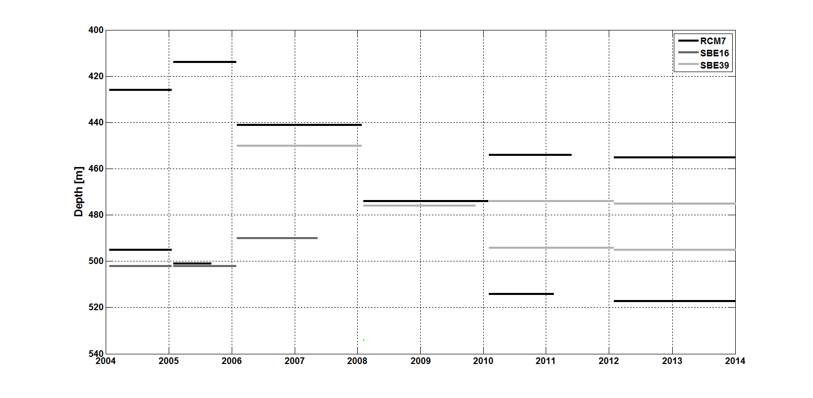
Data set: Mooring G
Sea-bird SBE 16:
Temperature
Conductivity
Sea-bird SBE 39:
Temperature
Aanderaa RCM 7
Current speed
Current direction
Temperature
Notes:
Mooring operational periods

Slide 17
1) In the CTD section and in the CTD casts made at the mooring position during different summer cruises we have never found a signal of the MCDW at the bottom of DT. While, the time-series of salinity and temperature registered by the different sensors on the mooring at about 10 meters above the bottom, show periodically the presence of the MCDW: in which way the MCDW arrives at bottom? is only related to the tide ore else (eddies)? and in which way?
2) In the mooring time series a strong seasonal variability of the CDW intrusion is clear, it appears that a strong inflow of CDW occurs each austral summer around the end of December beginning of January: why we see this seasonality? is this variability related to the CDW inflow itself or because in some period of the year the MCDW can't reache the bottom? may be related to the water stratification?

Slide 18
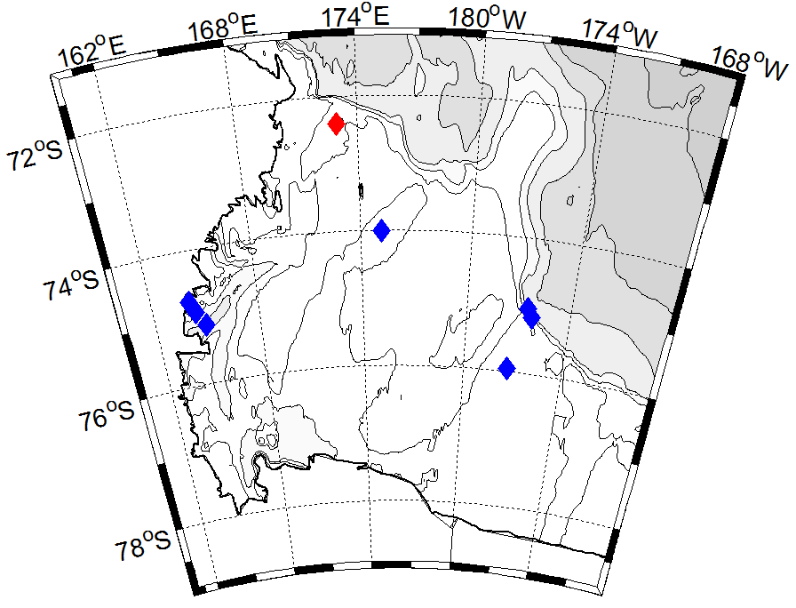

Drygalski Trough
CDW intrusion
2 pathways of CDW intrusion (θ maximum and 28 <γ^{n}< 28.27) onto the Ross Sea shelf are identified in the Drygalsky Trough at about 300 m
θ [°C]
2006
γ^{n}[Kg m⁻³]
2006
θ [°C]
2012
γ^{n}[Kg m⁻³]
2012
Notes:
Recent studies based on both model (wang et al. 2013) and observations (Kouht et al. 2013) suggested only one pathway of the CDW intrusion in the Ross Sea along the troughs. This patway is on the western slopes of the banks. Here for two differente years is evident that in the Drygalsky Trough are present two pathways of CDW.One path on the western slope of the Mawson Bank and in the middle of the Drygalsky Trough. These CDW intrusions are identified at about 300 m with a maxim in temperature and a neutral density betwwen 28 and 28.27 (next slide).
The black triangle shows the mooring G location

Slide 19
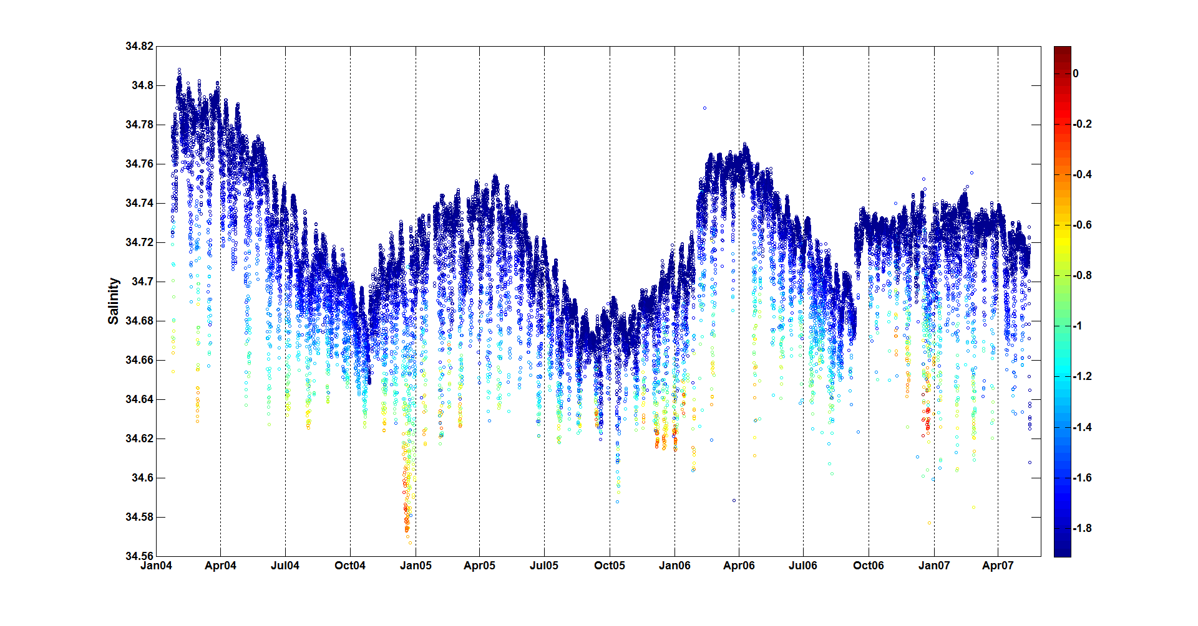
Drygalski Trough
Mooring G
CDW Seasonal variability
The CDW inflow (higher Temperature) is strictly related to the diurnal and spring/neap tidal cycles
A strong inflow of CDW occurs each austral summer around the end of December beginning of January
Notes:
The time-series registered at the bottom of the Drygalski Trough at about 50 Km from the shelf break show that the CDW intrusion at the bottom of the trough is strictly related to the diurnal and spring/neap tidal cycles, but It is clear a strong seasonal variability of the CDW. It appears that a strong inflow of CDW occurs each austral summer around the end of December, just after few months of the minimum of salinity (around October) that indicate the lowest presence of the HSSW. While almost no presence of CDW is found around April, at the maximum of salinity ,indicating the maximum of HSSW
This seasonal intrusion is evident too in the next slide looking at the neutral density (density lower than 28.27).

Slide 20
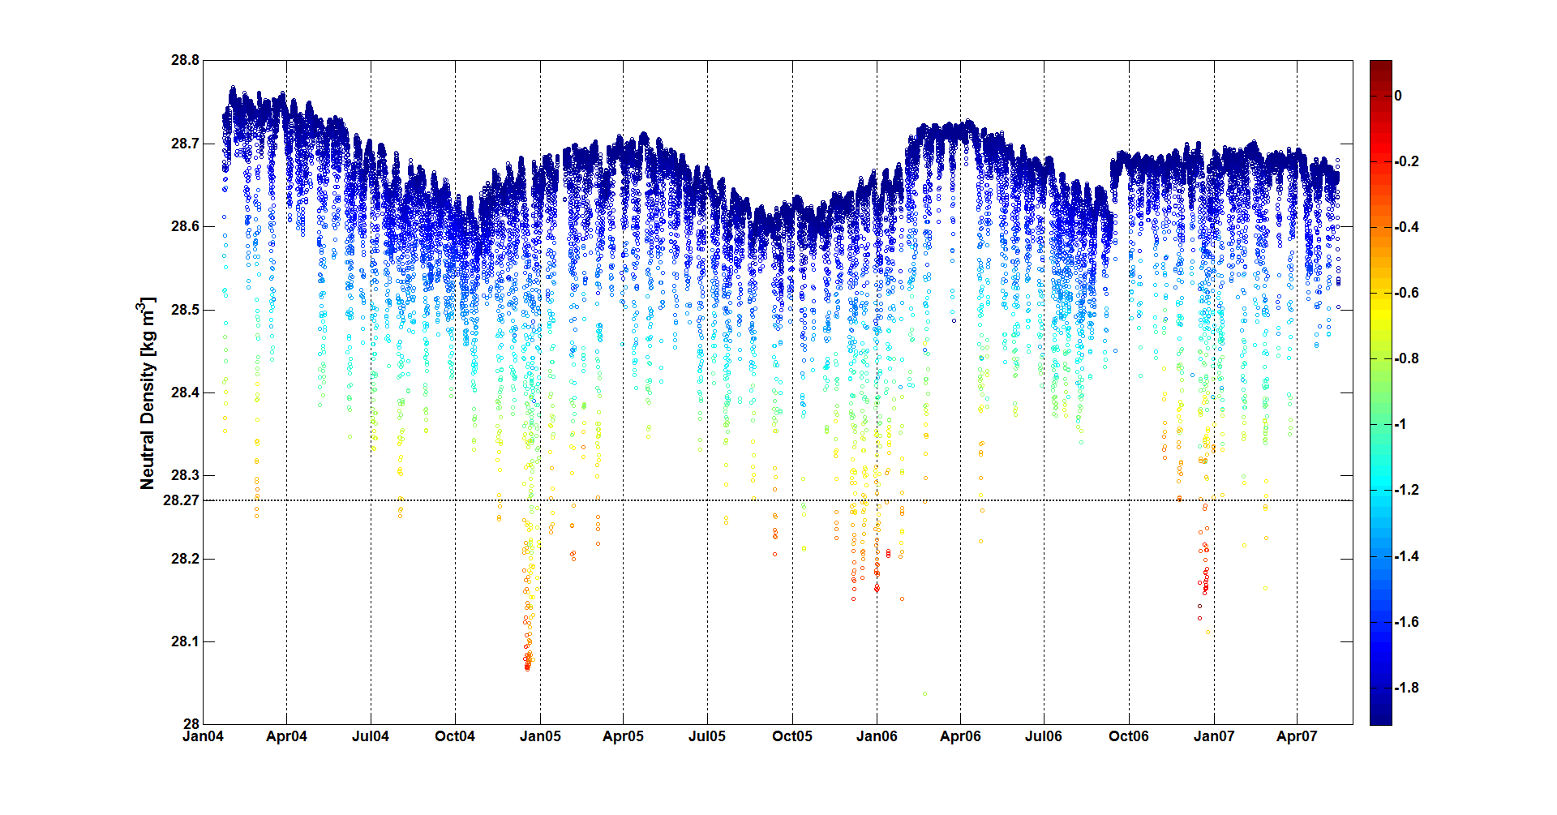
Drygalski Trough
Mooring G
CDW Seasonal variability
Neutral density lower than 28.27 indicate the presence of the CDW.
Notes:
Neutral density lower than 28.27 indicate the presence of the CDW.

Slide 21
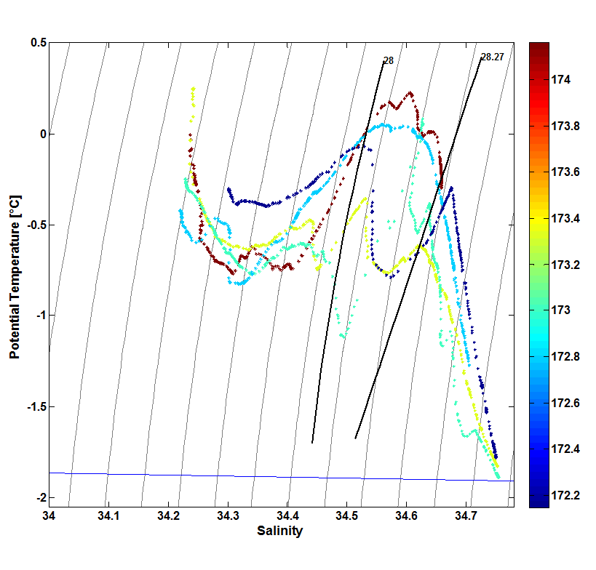
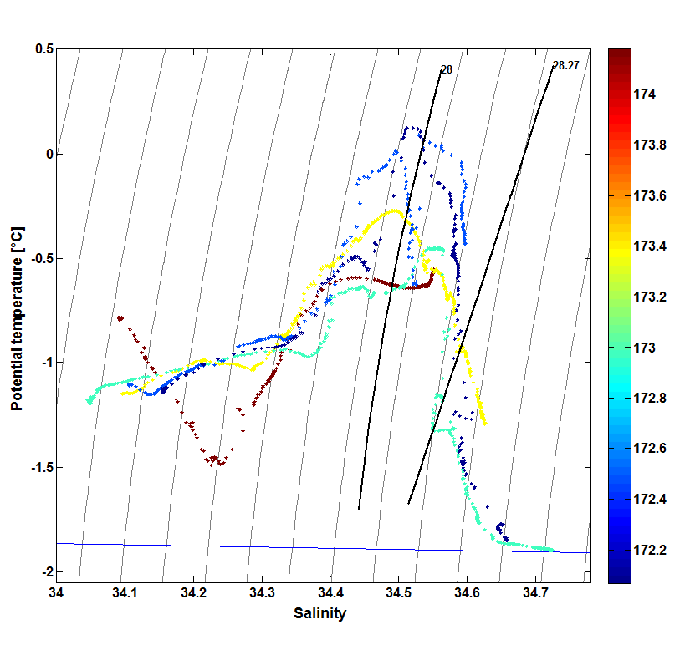
2006
2012
The salinity of the mCDW shifts of about 0.5, becoming much fresher and most important becoming lighter at the point that may change the definition itself of mCDW using the neutral density
… caution in evaluating these results. The mechanism determining such a decrease must be understood
Is the CDW arriving at the shelf changed ? Or is the freshening of the Antarctic Slope Current to reduce the CDW salinty ?
Notes:
It is very interesting to note how the mCDW misured on the Ross Sea shelf at just 50 Km from the shelfbreak from 2006 to 2012 undegoes to a substantial change. The salinity of the mCDW shifts of about 0.5, becoming much fresher and most important becoming lighter at the point that may change the definition itself of mCDW using the neutral density (Orsi et al. 2009)
Pier qui dici che è una cosa che comunque va presa con cautela in quanto dobbiamo analizzare tutti i CTD dell’area dentro e fuori la piattaforma per capire cosa veramente succede. Potrebbe essere che e la CDW che arriva in prossimità della scarpata ad essere cambiata, ma molto più probabilmente è legata al freshening delle antarctic slope current con la quale la cdw si mescola prima di arrivare sulla piataforma e quindi fa si che la mCDW è molto meno salata.

Slide 22
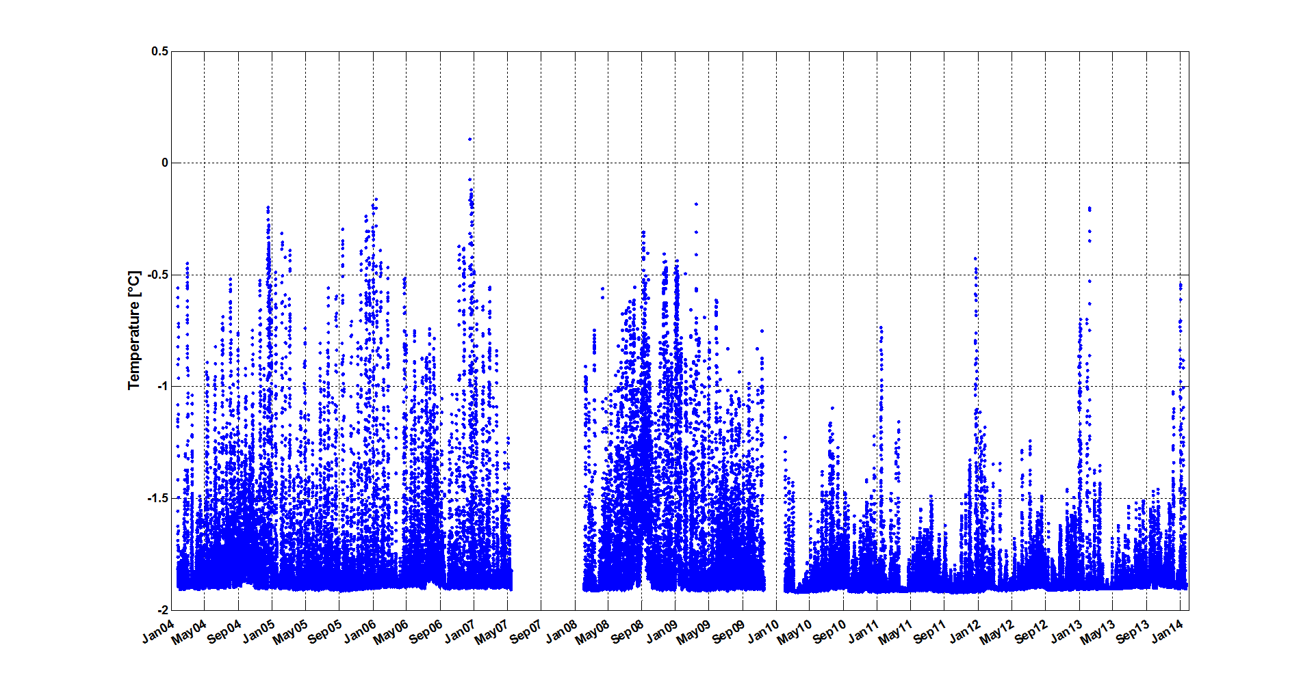
Drygalski Trough
Mooring G
CDW Seasonal variability
Notes:
This seasonal intrusion of CDW (in this figure represented by the higher temperature signal occur every year of the registered time series from 2004 to 2014.

Slide 23


Surface heat fluxes and thermohaline variability in Terra Nova Bay Polynya
Giannetta Fusco, Giuseppe Aulicino, Giorgio Budillon, Francesca Giordano, Manuela Sansiviero
The aim of this study is to investigate the processes that occur in the TNB coastal polynya and the role of the air-sea interactions in the determination of its opening and activity and consequently the HSSW production that can ventilate the abyssal ocean circulation.
First, the role of the katabatic winds using meteorological data acquired by the Automatic Weather Station (AWS) Eneide and Rita, from 1994 to 2012, located near the Italian base Mario Zucchelli, is analyzed.
In the second step the open water fractions from 2005 and 2012, detected by the Ice Surface Temperature (IST) imagery derived from the MODIS data, were used to estimate the opening and the activity of the polynya during the winter season. The analysis of the MODIS IST imagery (for day) show eight extreme events where the polynya extended several tenths of kilometers beyond the tip of the Drygalski Ice Tongue with an area comprised between 800 and 8800 km².
Then, the surface heat budget via empirical formulae were estimated in the investigated period. The surface heat fluxes estimations show that in the TNB polynya, the yearly heat loss, using Eneide data, ranges between -250 and -295 Wm⁻². The surface heat flux lost estimations by Rita data show its maximum in 2009 (-500 Wm⁻²) and its minimum (-401 Wm⁻²) in 2006.
During the freezing season, assuming that ice production rate in polynyas depends on the net heat flux and on the polynya extension, it is possible to calculate the total production of salt released during sea ice formation and HSSW volume. The HSSW production results switched from the lowest values during the first years of the investigated period to the highest values for the last period.
Finally, in order to compare and validate these estimation the measured thermohaline changes in the water column using hydrological casts collected in the framework of Italian National Programme for Antarctic Research (PNRA) projects were analyzed . The thermohaline characteristics of the water column in TNB show a general decrease in salinity with a superimposed variability.

Slide 24
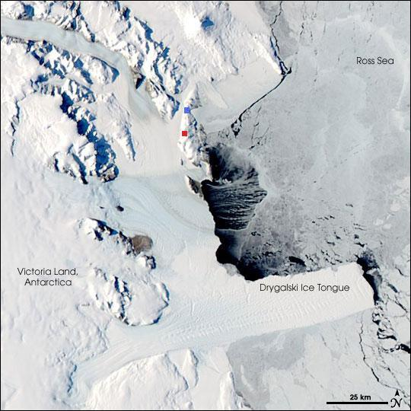
W m ̄²
Reevers Glacier
Priestley Glacier
AWS Eneide
W m ̄²
AWS Rita
Pack ice drift
Larsen Glacier
Pack ice drift
David Glacier
Northword drift of ice is blocked
Time [years]
Fig. 1. TNBP by the MODIS data on October 16, 2007 and AWS locations.\
Fig. 11 AWS Eneide data from 1994 to 2009: Annual means.
Surface heat budget estimated with a “constant” turbulent exchange coefficients value Ch = Ce of 1.75*10̄³.
Surface heat budget estimated with a “variable” turbulent exchange coefficients value Ch = Ce, calculated according wind speed (ms ̄¹) and air temperature (°C).
HSSW production [10¹³m³]
Time [years]
W m ̄²
Time [years]
Fig.12 AWS Rita data from 1994 to 2009: Annual means.
Surface heat budget estimated with a “constant” turbulent exchange coefficients value Ch = Ce of 1.75*10̄³.
Surface heat budget estimated with a “variable” turbulent exchange coefficients value Ch = Ce, calculated according wind speed (ms ̄¹) and air temperature (°C).
The HSSW production during the sea-ice season ranges between 0.5*10¹³m³ (2006) and 1*10¹³m³ (2007) with mean value of 0.7 ± 0.2*10¹³m³.

Slide 25
Sea ice mass balance in the
Terra Nova Bay polynya
Sansiviero M., Morales Maqueda M. Á., Fusco G., Aulicino G., Flocco D. and Budillon G.

Slide 26
OBJECTIVES:
Investigate sea ice cover seasonal variability in TNB in response to external forcing
Estimate sea ice production and polynya extent
COUPLED SEA ICE – OCEAN MODEL
developed in partnership with Dr M. Á. Morales Maqueda (National Oceanography Centre – NOC, Liverpool, UK)
in order to simulate the seasonal cycle of sea ice formation in, and export off, the polynya
The model is forced by a combination of ECMWF reanalysis (six-hourly parameters with a 0.5 × 0.5 degree horizontal resolution) and in-situ data from two automatic weather stations (Rita and Manuela), and also by idealized profiles of oceanic data.
Notes:
DOMAIN: 488 km x 154 km region of Ross Sea Latitude ∼ 74° - 78°S Longitude ∼ 162° - 168°E
HORIZONTAL RESOLUTION: 1km x 1km
SEA ICE DYNAMICS: Elastic-Viscous-Plastic (EVP) rheology from [1] to simulate the ice-ice interactions within the ice pack
SEA ICE THERMODYNAMICS: zero-layer thermodynamic model of [2] with no internal heat storage in either ice or brine pockets.
OCEAN: one reduced gravity layer model
[1] Hunke, E. C. and J. K. Dukowicz, 1997: An elastic-viscous-plastic model for sea ice dynamics, J. Phys. Oceanogr., 27, 1849-1868.
[2] Semtner, A. J., 1976: A model for the thermodynamic growth of sea ice in numerical investigations of climate, J. Phys. Oceanogr., 6, 379-389

Slide 27
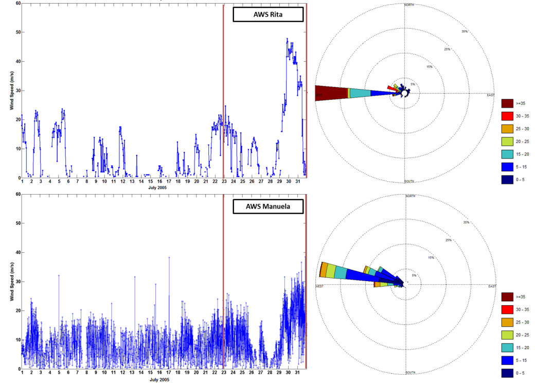
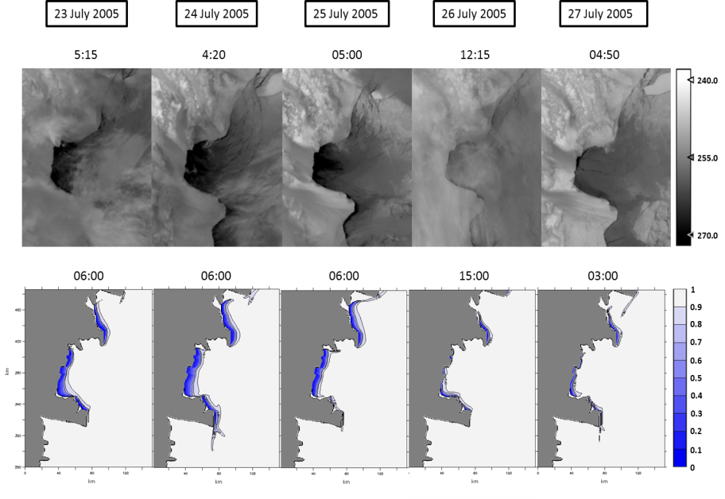
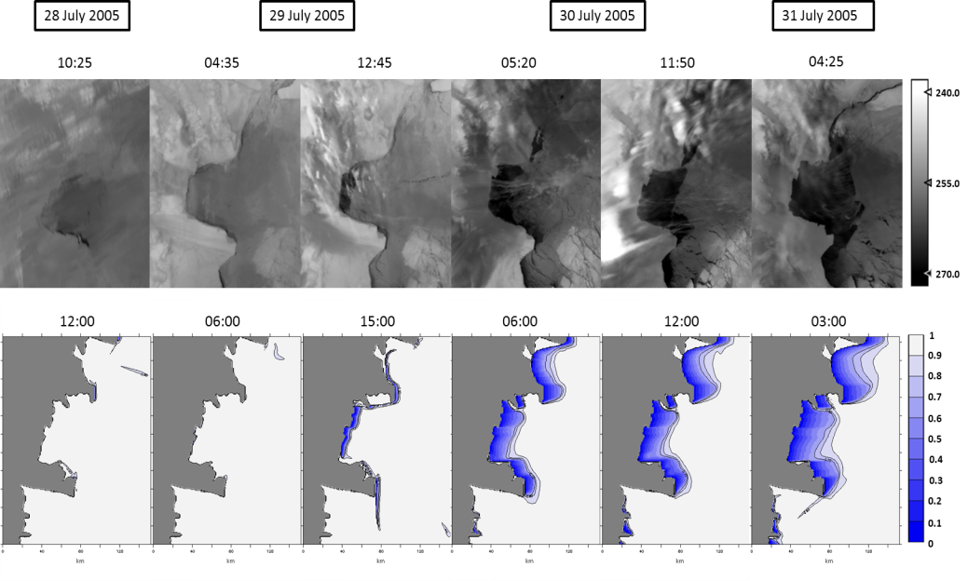
Model validation
The largest opening of 2005
IST MODIS scenes
Modelled sea ice concentration maps
Notes:
IST sta per Ice Surface Temperature calcolate dai prodotti di radianza MODIS
A few significant periods in the wintertime of 2005 characterized by stronger katabatic events resulting in opening/closing cycles of the polynya have been identified
CONCLUSIONS
The model well reproduces the sensitivity of the polynya to the atmospheric forcing.
The model resolves accurately sea ice drift in TNB and sea ice production rates leading to accurate polynya extent estimates.
The TNB polynya area is reproduced reasonably well by the model in terms of shape and distribution of sea ice.

Slide 28
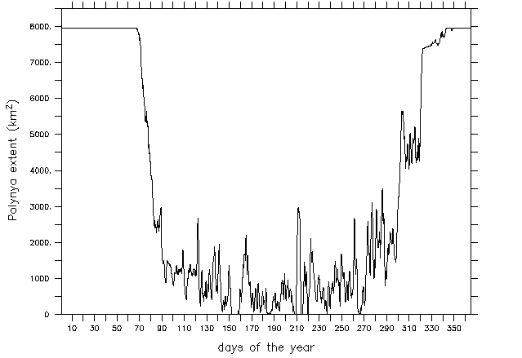
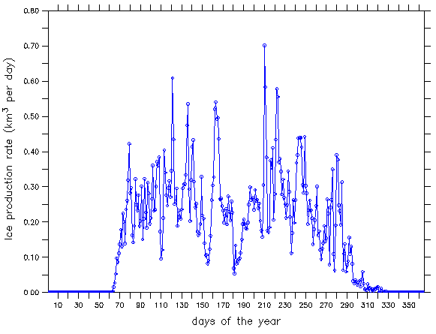
Results
Monthly maximum and mean polynya extent of the TNB polynya
Model-derived polynya extent in 2005
Winter months | Monthly maximum polynya extent (km²) | Monthly mean polynya extent (km²)
March | 7946 | 5574
April | 1806 | 1174
May | 2688 | 871.2
June | 2205 | 557.2
July | 2962 | 532.5
August | 2868 | 766.9
September | 2674 | 875.6
October | 5637 | 2304
Spatially cumulated daily rate of sea ice production in 2005
Winter month | Maximum daily rates of sea ice production (km³/day) | Mean daily rates of sea ice production (km³/day) | Monthly cumulative sea ice (km³)
March | 0.42 | 0.16 | 4.99
April | 0.40 | 0.26 | 7.86
May | 0.61 | 0.30 | 9.25
June | 0.54 | 0.25 | 7.52
July | 0.70 | 0.22 | 6.98
August | 0.58 | 0.30 | 9.39
September | 0.44 | 0.24 | 7.34
October | 0.39 | 0.14 | 4.29
CUMULATIVE ICE PRODUCTION
57.91 km³
Notes:
A simulation of the whole year 2005 has been carried out
A sea ice concentration threshold = 0.7 is used to estimate TNB polynya extent

Slide 29
Particulate organic matter distribution and trophic features in relation to phytoplanktonic characteristics and mesoscale physical structures in the Ross Sea
Misic¹, Mangoni², Budillon³ et al….
¹University of Genoa
²Stazione Zoologica, Naples
³University of Naples Parthenope
Trophic value of POM:
The POM is involved in:
production processes (phytoplankton, for instance), that supply the trophic web
recycling processes (bacteria),
vertical fluxes of C to the depth (biological pump), that regulate global climate processes
Two water layers:
UML - Upper mixed layer (from 10 to 100 m, on average 30 m)
DL - Deeper layer (down to 200 m)
Questions:
What are the POM trophic features during Austral summer? Are there differences between
the three areas?
What are the environmental features that regulate POM production and recycling during a virtually
ice-free season?
What is the POM role in the biological pump processes?

Slide 30
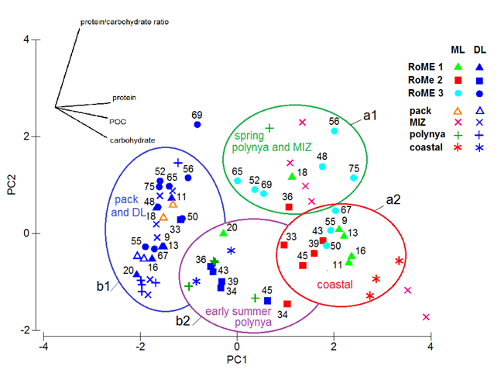
Question 1: POM characterisation
(we compared our results with other studies previously carried out in the same areas)
statistically significant differences between UML (a1-green and a2-red ellipses)
and DL (b1-blue and b2-purple ellipses)
POM accumulation in the UML
(explained 24 %)
(explained 71 %)

Slide 31
Question 1 and 2: POM characterisation and environmental features
(we compared our results with other studies previously carried out in the same areas)
6 to 9 stations of RoME3 showed MIZ features (but no ice coverage), due to the peculiar mesoscale
hydrodynamic regime that favoured primary biomass accumulation and POM heterotrophic
reworking, with high particulate protein concentrations (high trophic value)
RoME2 stations showed POM accumulation either at UML and DL, but lower trophic value

Slide 32
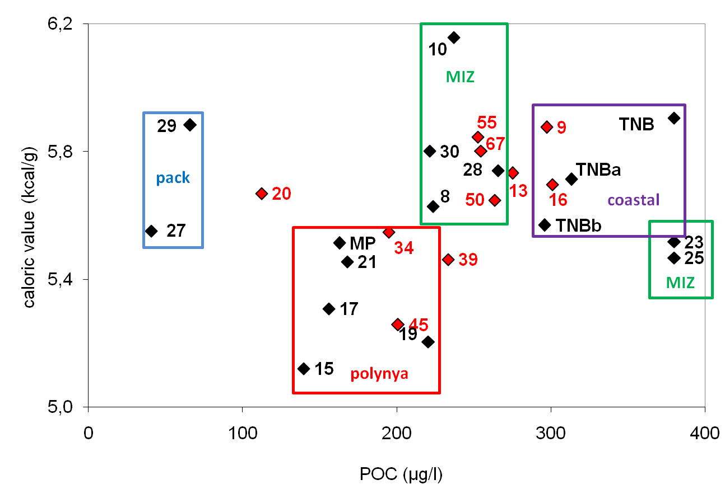
Question 3 : POM role in the biological pump
RoME 2 stations showed the lowest caloric values and the lowest trophic values: lower role in the
trophic web and lower consumption and respiration by heterotrophs
(C preservation in particulate form).
RoME 2 stations showed rather high POM concentrations also in the DL,
where HSSW signals were observed.
In the RoME 2 area, POM could enter the deeper circulation, joining the bottom water paths,
contributing to the C-sink properties of the Ross Sea
RoME 2 stations

Slide 33
Short-term variations in POC and DOC production and utilization by planktonic microorganisms in Terra Nova Bay Polynya (Ross Sea, Antarctica)
Del Negro et al.
OGS (Istituto Nazionale di Oceanografia e Geofisica Sperimentale)
Objective: to evaluate short term changes of DOC and POC as a consequence of the effect of the early summer phytoplankton bloom. This will affect bacterial abundance, biomass and activity (production and exoenzymatic activity) as well as nano-microzooplankton activity.
Study area and sampling stations (January 18th to 26th 2003)

Slide 34
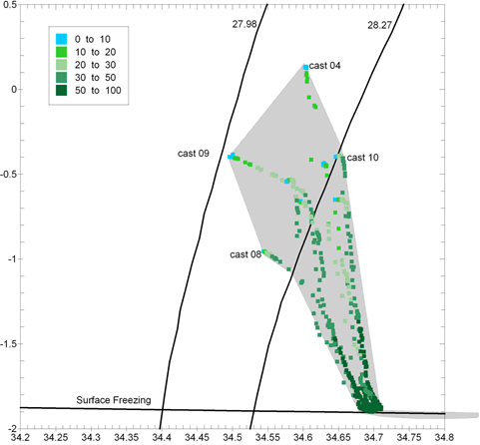
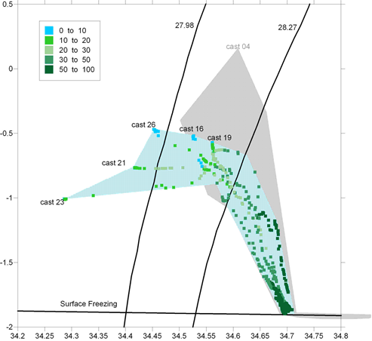
2 sampling periods:
First period (from 18 to 21 January 2003) – Phytoplankton bloom (8 stations sampled)
Second period (from 25 to 27 January 2003) – After bloom (6 stations sampled)
a
b
Water column physical characteristics of the TNB polynya in the first (a) and second (b) period.

Slide 35
Differences between the two sampling periods
Chla concentrations
Phaeo/Chla ratio
DOC concentrations
POC concentrations
Bacterial abundances
Bacterial carbon production
Heterotrophic nanoplancton abundances
Microzooplankton abundances

Slide 36
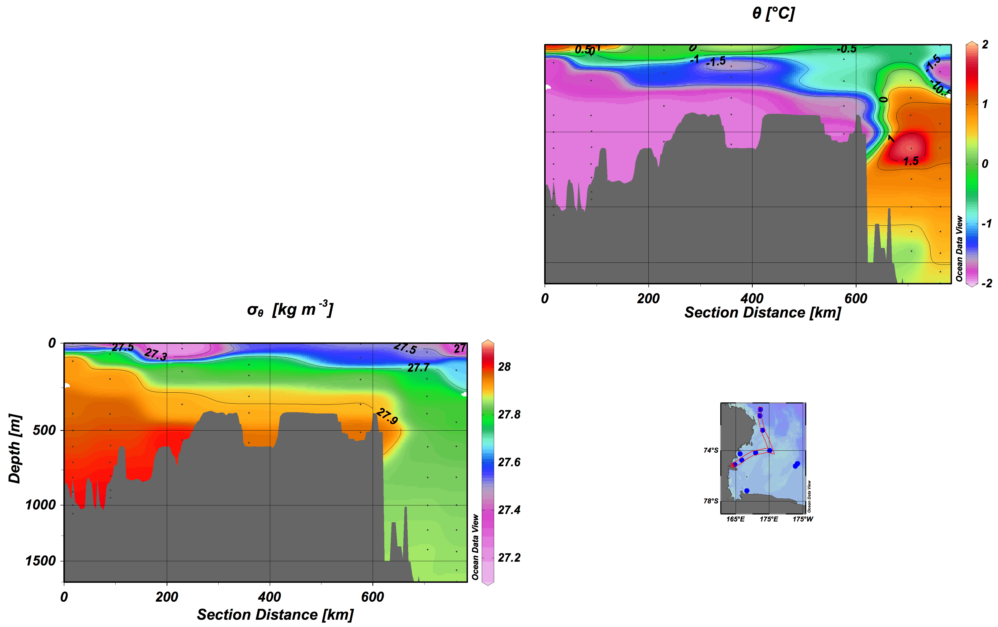
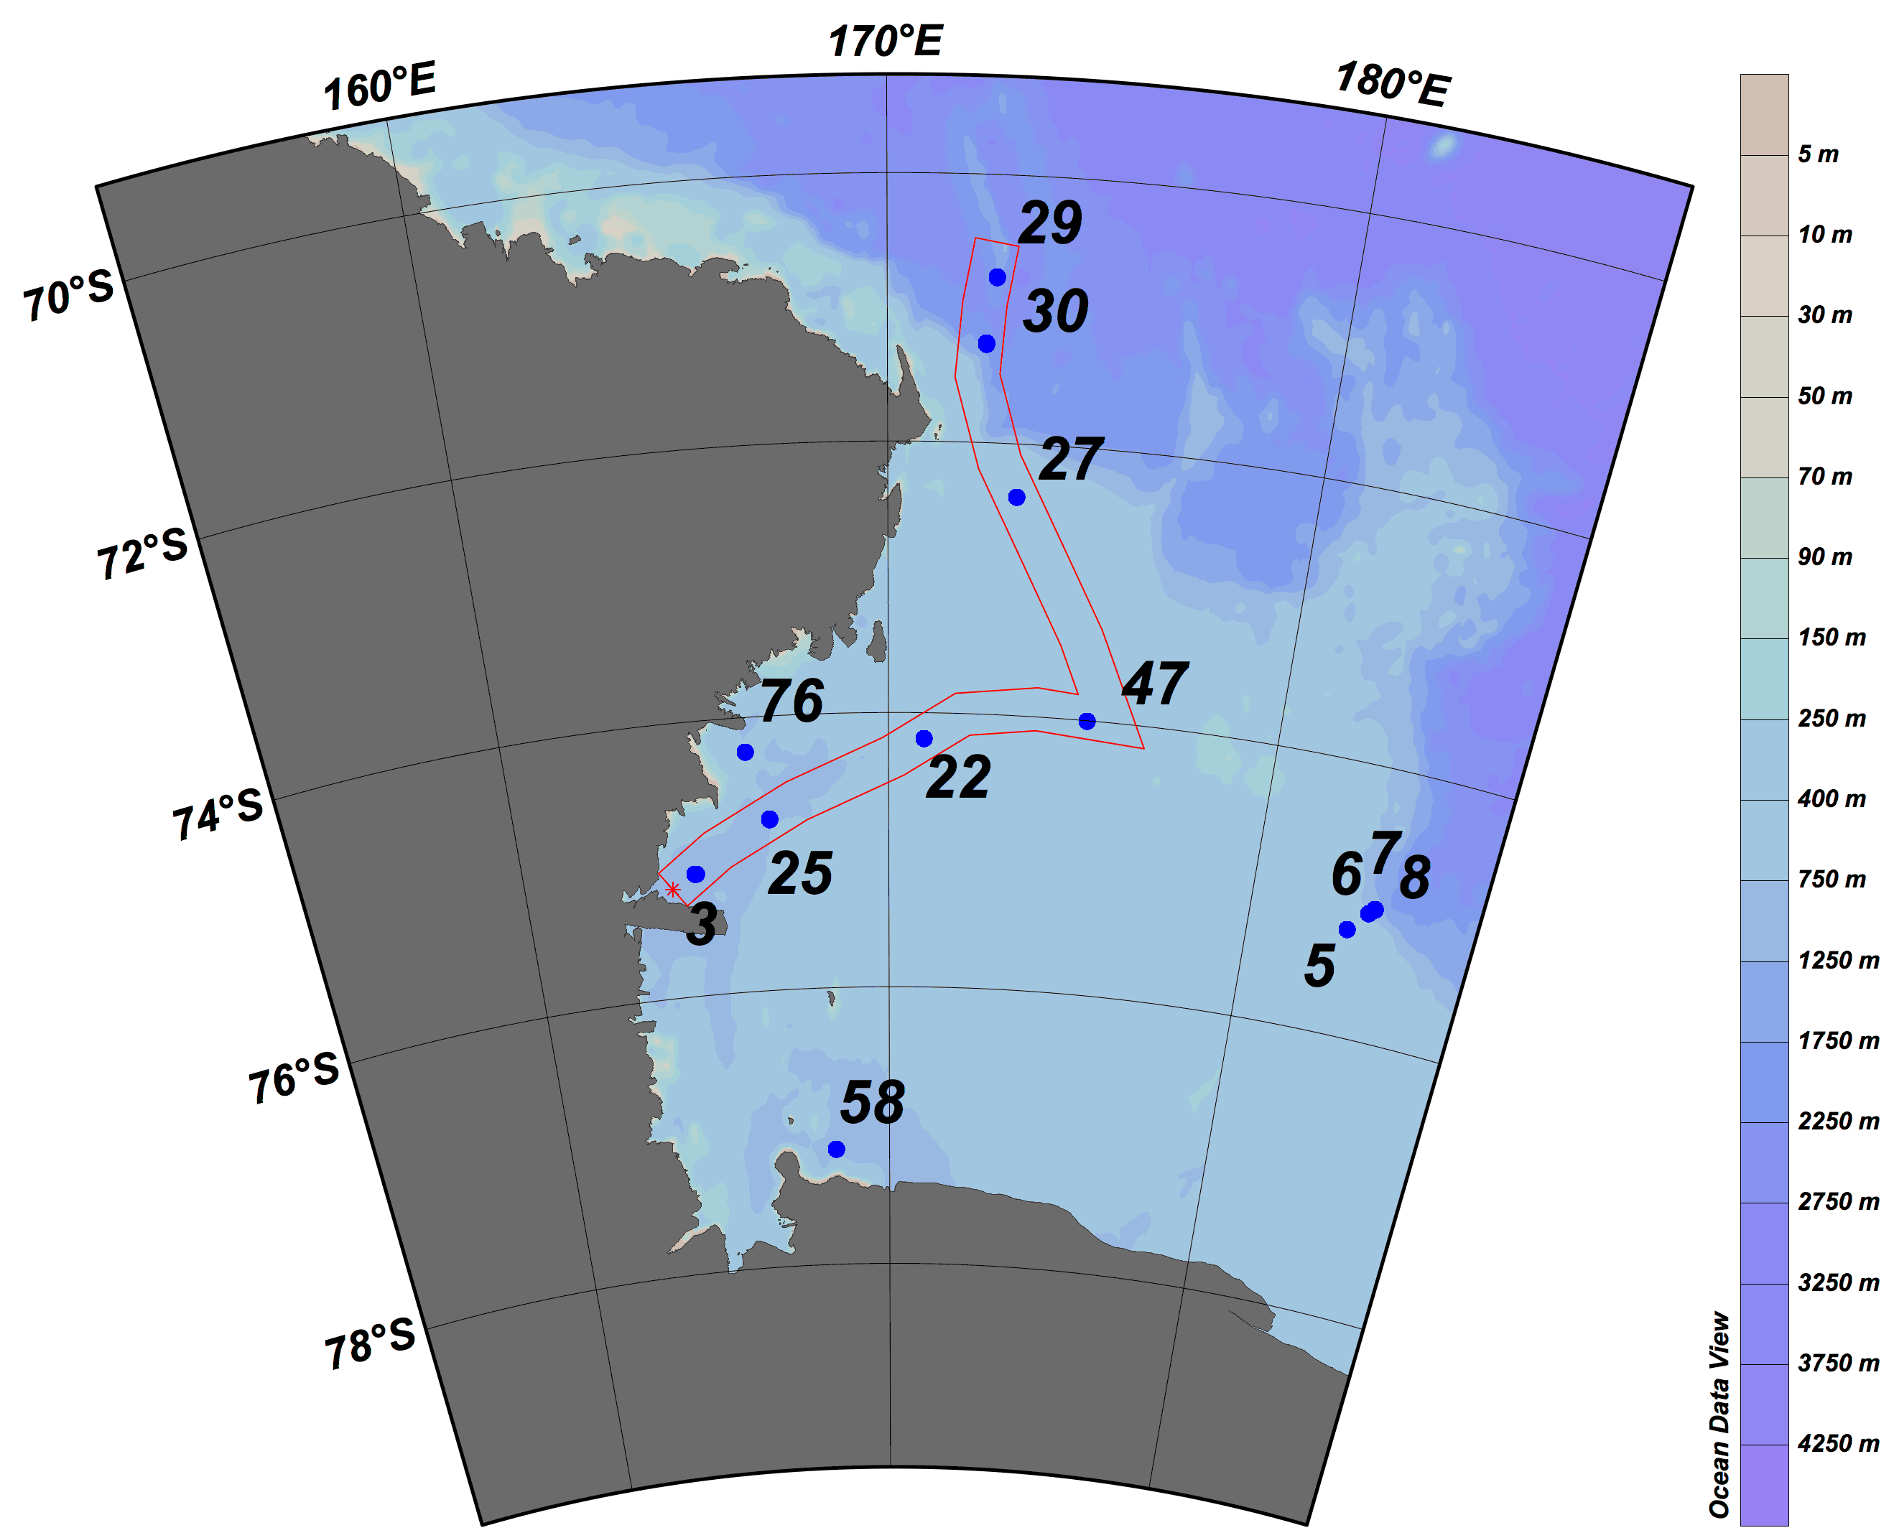
Carbonate chemistry features in the Ross Sea
during austral summer 2013-14
Gianmarco Ingrosso, Mauro Celussi, Giorgio Budillon, Luca Zoccarato,
Serena Fonda Umani, Paola Del Negro, Michele Giani
Objectives
characterization of the marine carbonate system in the different water masses
effects of physical and biological processes on the CO₂ equilibrium
contribution of microbial processes to the overall balance of total carbon

Slide 37
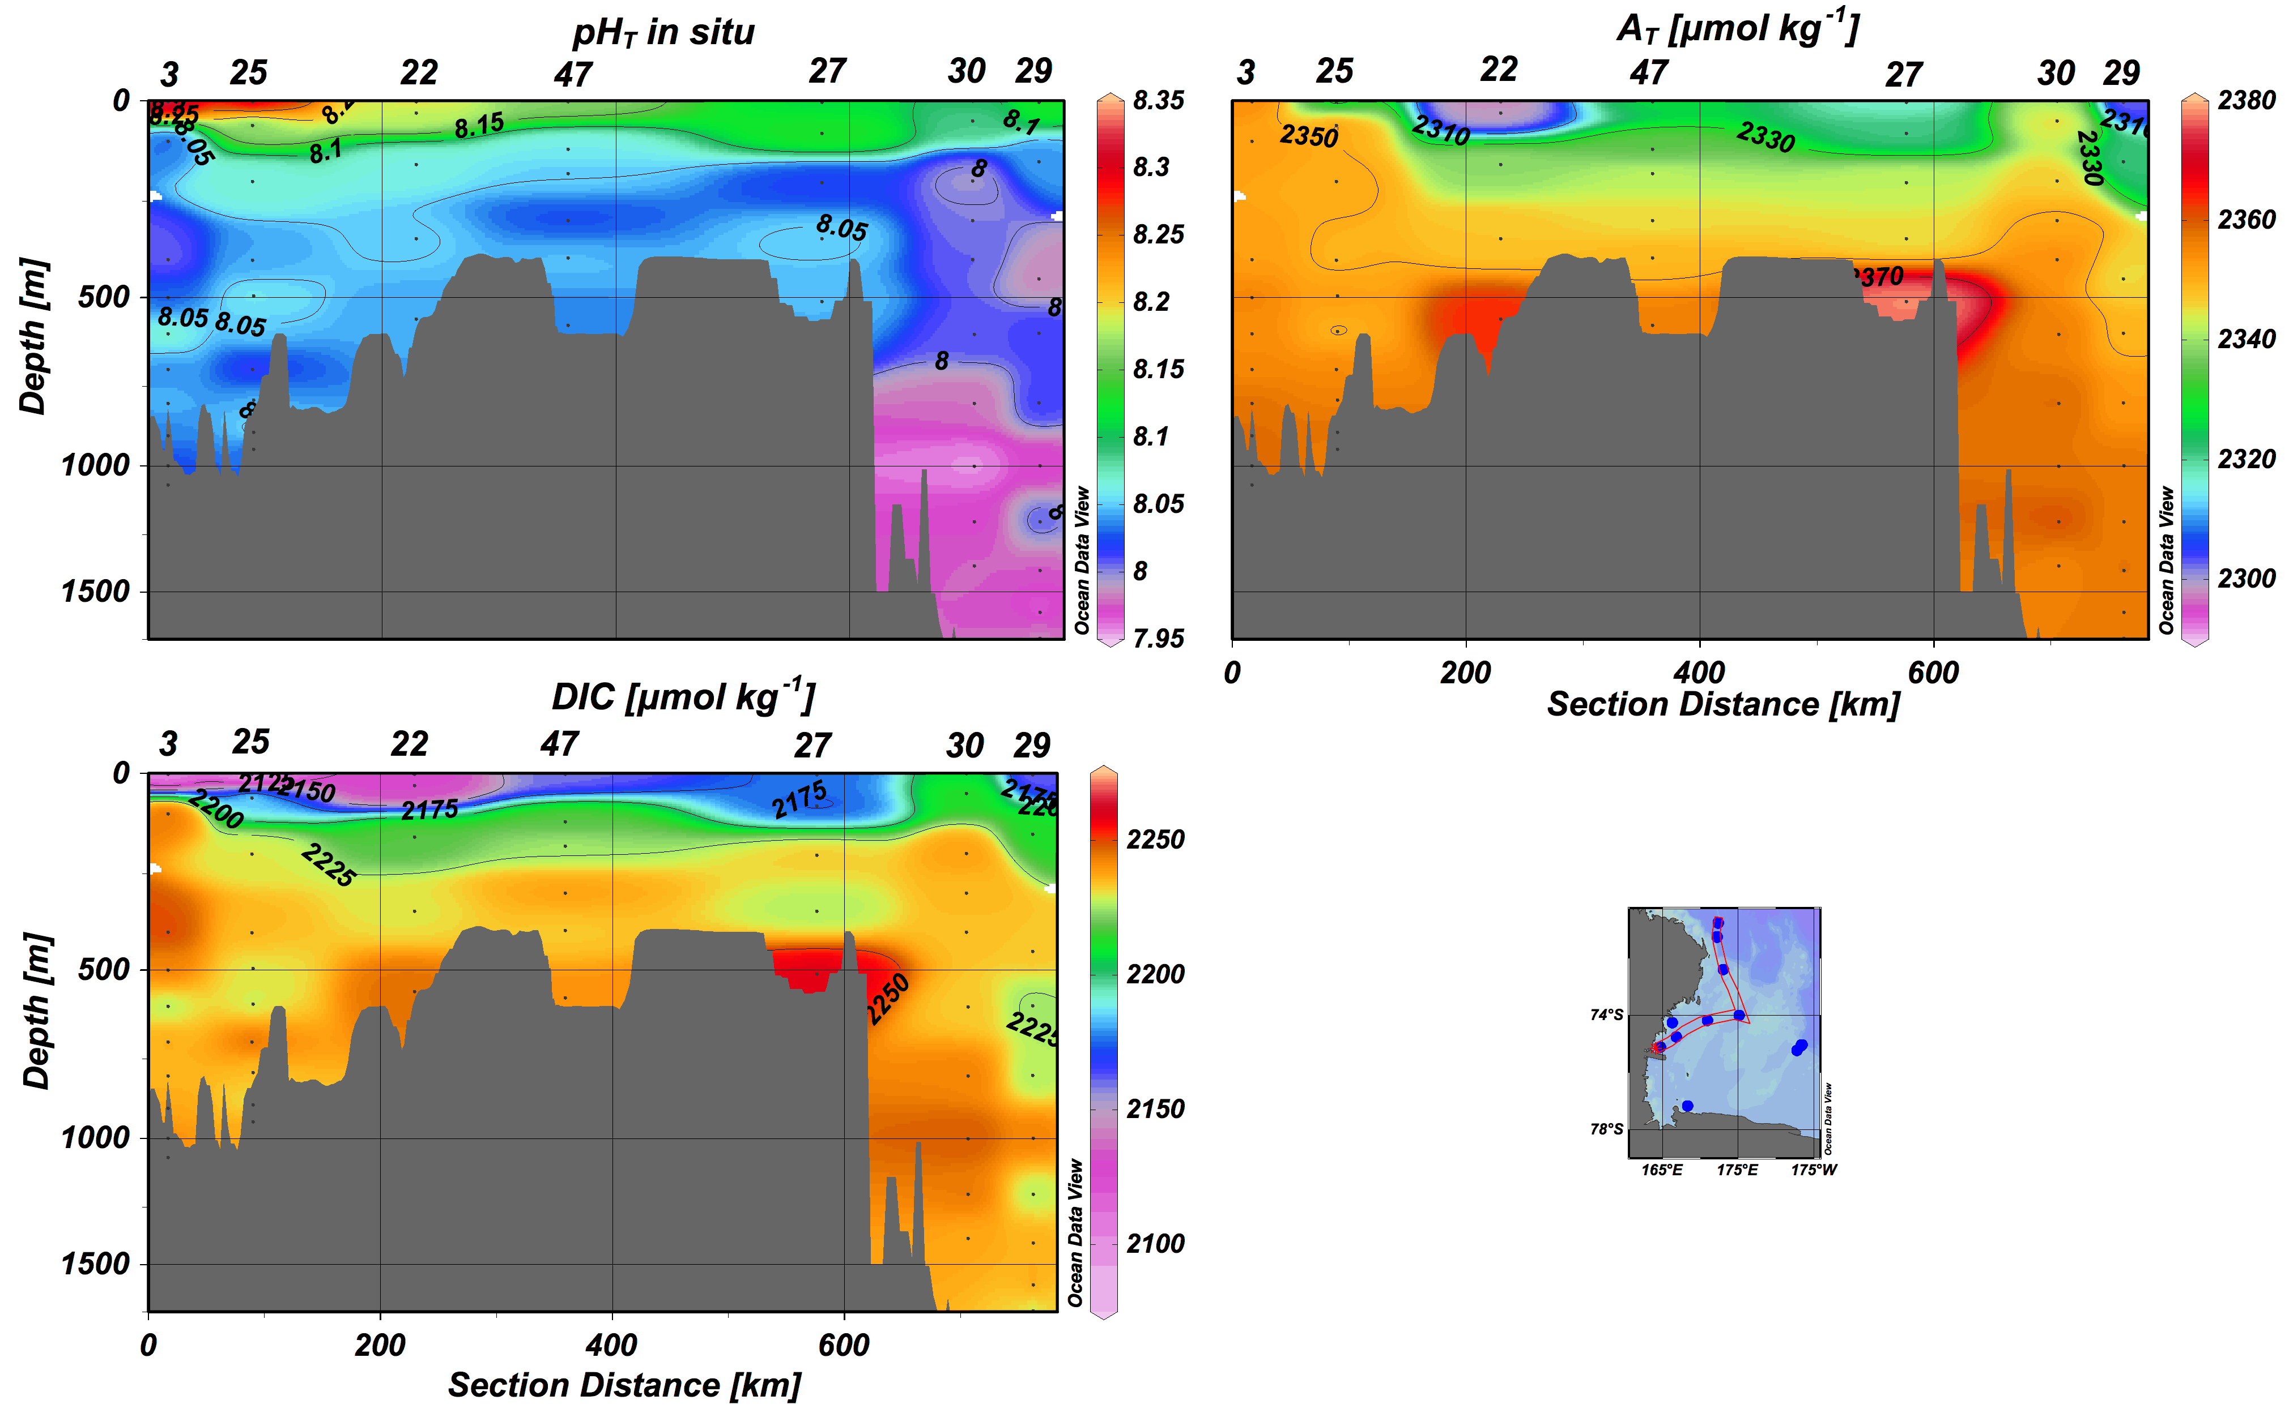
Carbonate chemistry features in the Ross Sea
during austral summer 2013-14
Gianmarco Ingrosso, Mauro Celussi, Giorgio Budillon, Luca Zoccarato,
Serena Fonda Umani, Paola Del Negro, Michele Giani

Slide 38
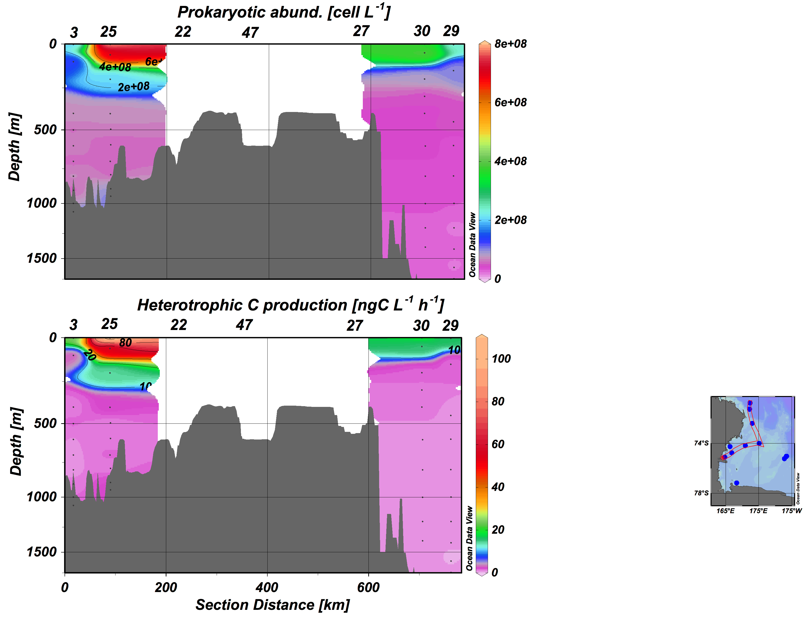
Carbonate chemistry features in the Ross Sea
during austral summer 2013-14
Gianmarco Ingrosso, Mauro Celussi, Giorgio Budillon, Luca Zoccarato,
Serena Fonda Umani, Paola Del Negro, Michele Giani
carbonate chemistry parameters did not reveal pronounced differences between HSSW and CDW
the recently ventilated HSSW carries a higher amount of CO₂ of both atmospheric and biological origins as a consequence of the faster microbial metabolism measured in this latter water mass

Slide 39
Leonori I. De Felice A., Canduci G., Biagiotti I., Costantini I., Budillon G.
Krill distribution in relation to environmental parameters at a mesoscale structures in the Ross Sea

Slide 40
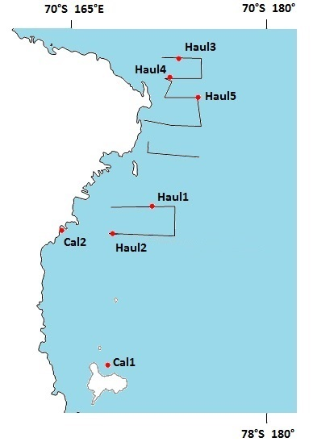
An acoustic survey targeting Antarctic krill (Euphausia superba) and ice krill (Euphausia crystallorophias) was conducted in western Ross Sea in January 2014 during the XXIX Italian Expedition
The acoustic survey was divided in two parts: the northern one was done at the bulk of Antarctic krill’s population (border between Ross Sea and Southern Ocean) and the southern one at the bulk of ice krill’s population (the area in front of MZS)
Information derived from acoustic data together with outcomes from 5 pelagic trawls confirmed the presence of the two species where expected
Information from CTD have been collected in order to asses the hydrology (water masses) of the studied area.

Slide 41
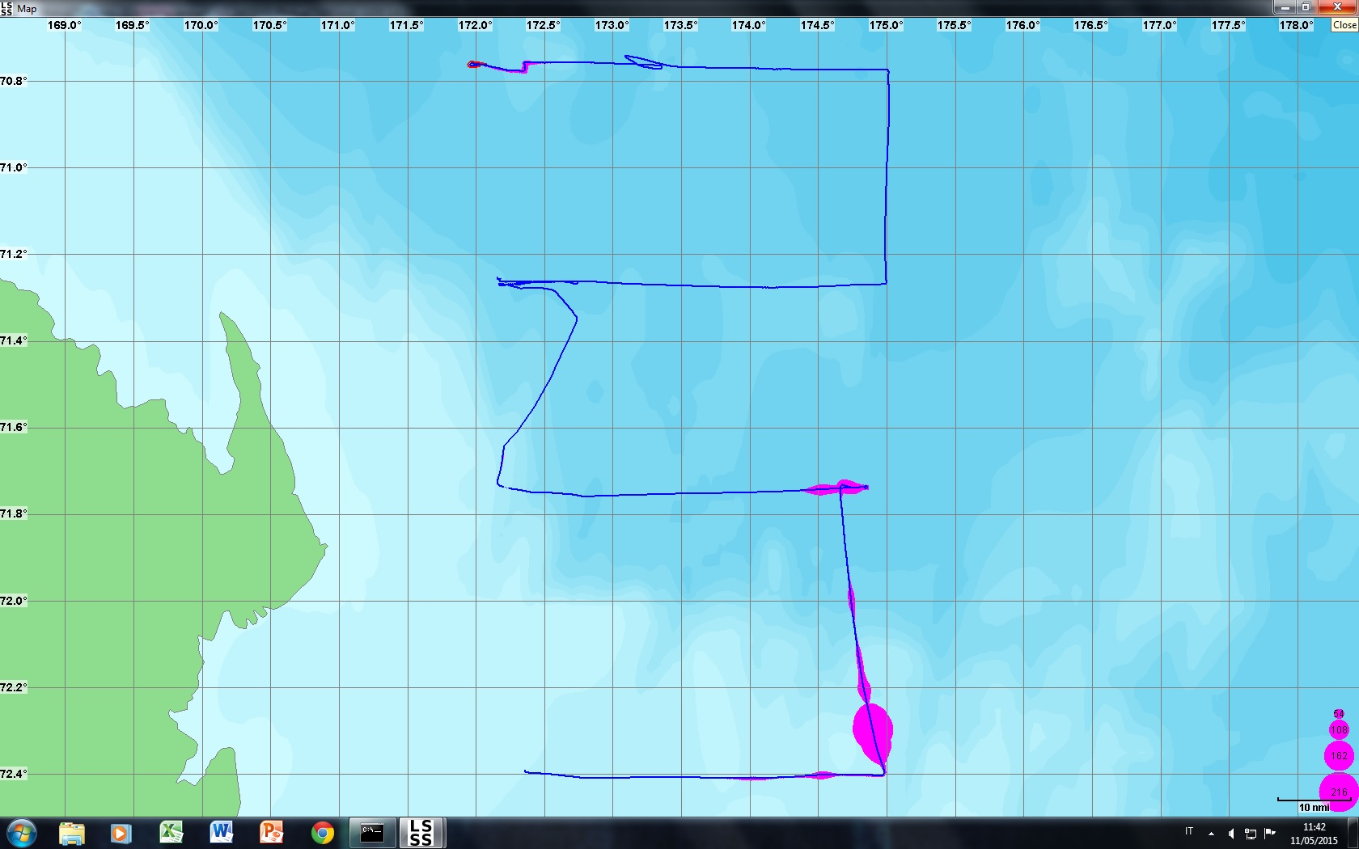
Antarctic krill density (Acoustic backscattering density expressed as NASCs: nautical area scattering coefficients in m² /nautical mile²) in north-western Ross Sea

Slide 42
Next…. Cruise 2015/2016….
Recovery and redeployment of the moorings:
D - Terra Nova Bay
L - Terra Nova Bay
G – Dryglski Trough
B - Joides Trough
Redeployment of the mooring H1 – Glomar Challenger Trough
Oceanographic Cruise to the Ross Sea in the austral summers 2016, 2017 and 2019:
Ctd casts in the eastern Ross Sea (red box):
T, S, O2, fluorescence, transmittance.
lowered ADCP (current velocity)
samples and data collection of T, S, O2, fluorescence, transmittance, total alkalinity, pH, nutrients, particulate organic C and N, total biomass, specific composition, pigments spectra and photosynthetic parameters of phytoplankton communities.
Eventually, a mooring will be deployed in an optimal location to monitor the westward CDW flow in the Eastern Ross Sea (red box).

Slide 43
The ocean a one-and-a-half layer reduced gravity ocean model
The oceanic dynamics satisfy the hydrostatic equilibrium and the Boussinesq
approximation.
The active layer (mixed layer) moves above a lower stagnant
(motionless) layer of infinite depth.
The base of the active layer is regarded as the main thermocline
The stratification is simplified as a two-layer fluid, where the upper layer has a density given by ρ (can be horizontally non-homogeneous); the lower layer is characterized by a
density equal to ρ + Δρ, where Δρ > 0 but can also vary in the horizontal.
The horizontal pressure gradient in the lower ocean layer is assumed to be zero, in
agreement with the assumption that the layer is motionless
DOMAIN: 488 km x 154 km region of Ross Sea
Latitude ∼ 74° - 78°S Longitude ∼ 162° - 168°E
HORIZONTAL RESOLUTION: 1km x 1km

