Slide 1
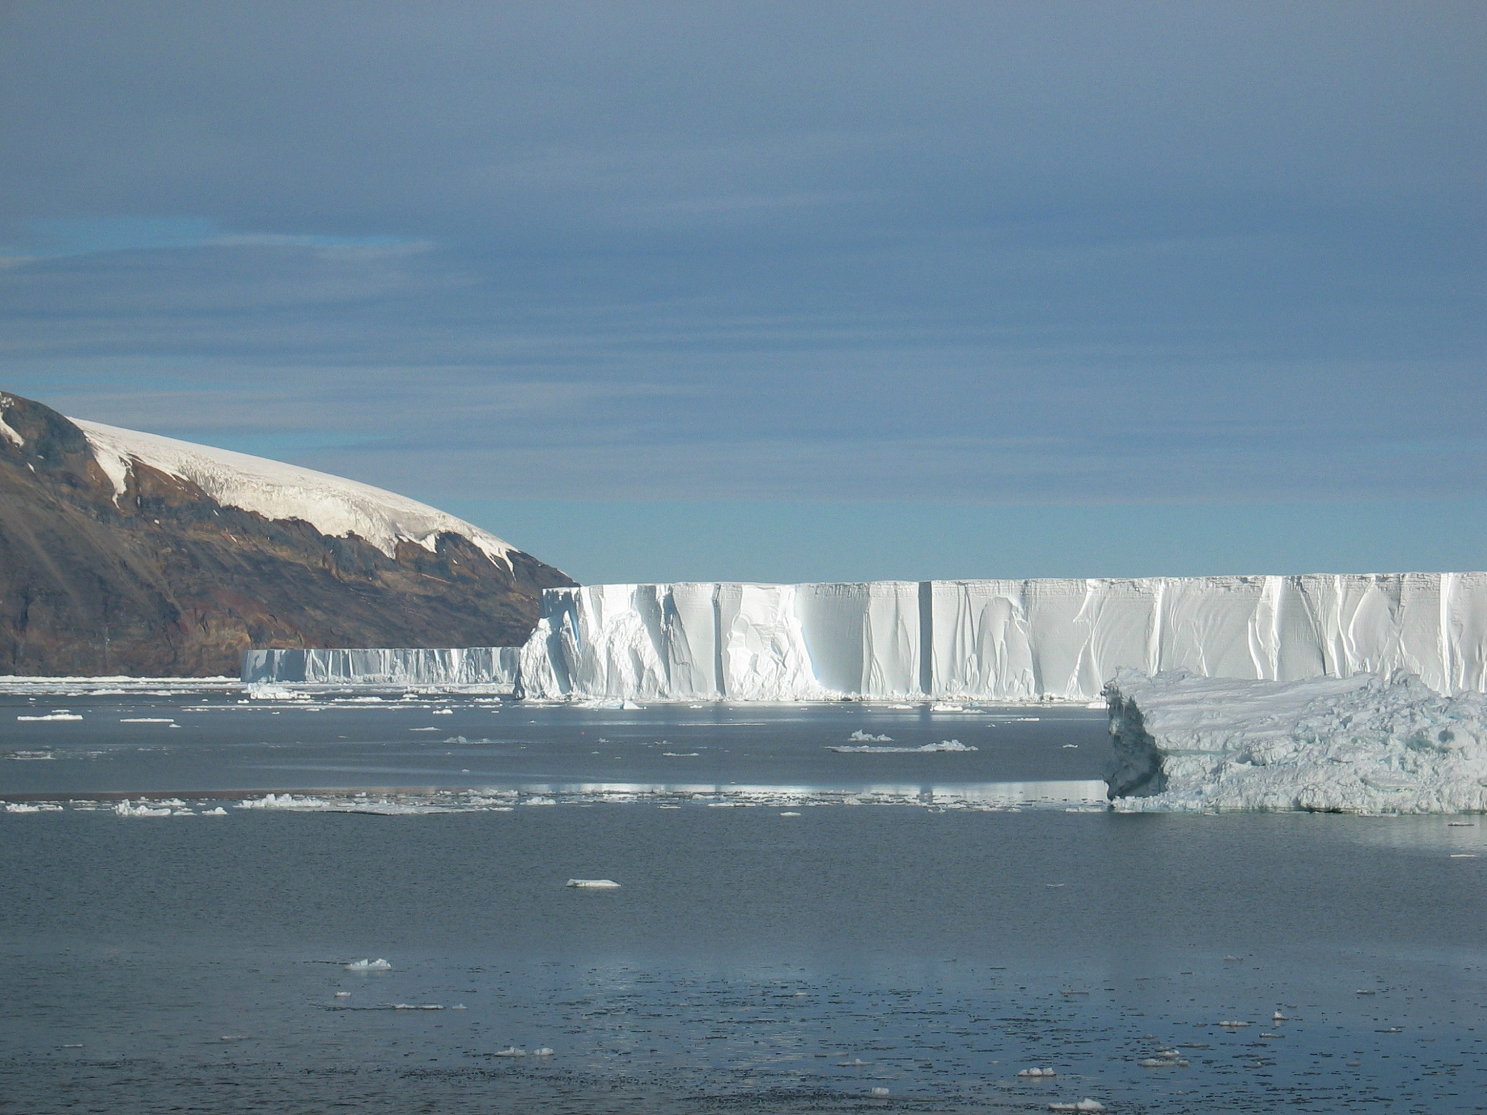

Sensitivity of water masses in the Ross Sea to changes in the winds, atmospheric temperatures and fresh water inflow
+
Other Ross Sea model updates
Mike Dinniman
Center for Coastal Physical Oceanography
Old Dominion University
October 7-8, 2014

Slide 2
Outline
Downscaling simulations of the Ross Sea
  Sensitivity of CDW transport, HSSW formation and ice shelf basal melt to idealized forcing changes
  AR4 simulation forcing (same simulations as Smith et al., 2014, GRL)
Ross Sea sector of circum-Antarctic model
Possible work with SEAFARERS
Update on future modeling plans and other tidbits

Slide 3
Downscaling Simulations of the Ross Sea
Strengthening of the cold southerly winds over the Ross Sea is thought to be one cause for the observed increases in ice extent in the area
Could this be affecting other aspects of the ocean circulation (Modified Circumpolar Deep Water transport, ice shelf basal melt, bottom water formation) and how might this change in the future?

Slide 4
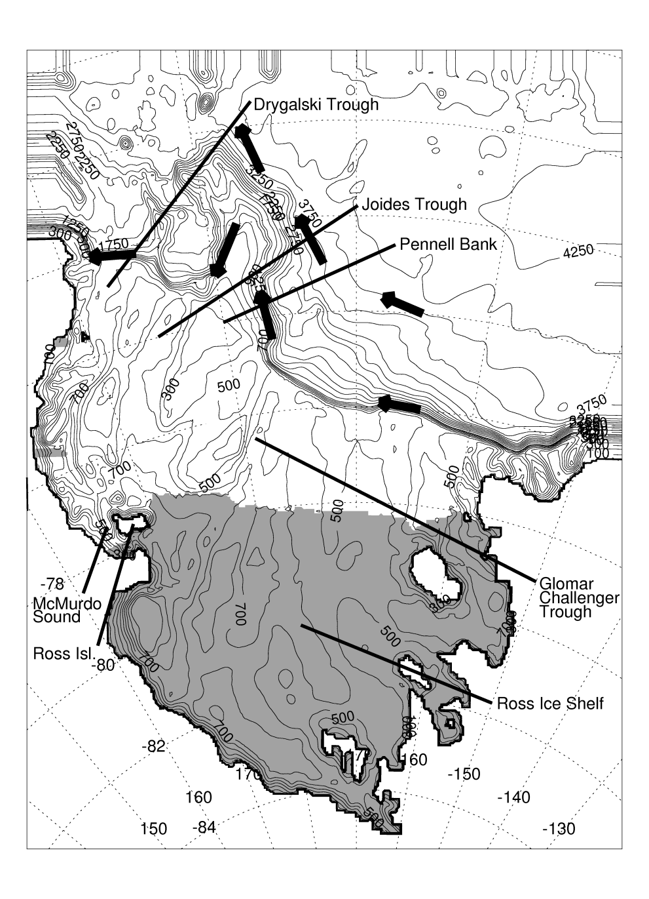
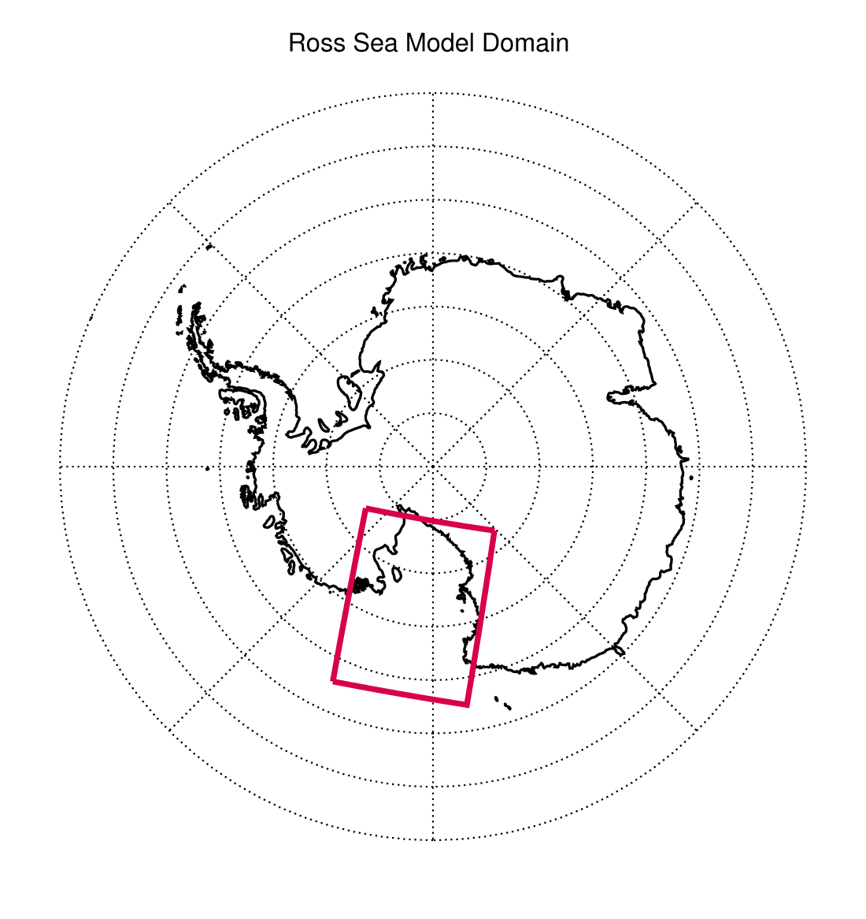
Notes:
Mention that we don’t have the full Ross gyre in our domain.

Slide 5
Idealized Forcing Simulations
Reference case: Daily AMPS winds and air temperatures for Sept. 2003 – Sept. 2005
Winds sped up or slowed down by simply multiplying both wind components by a constant factor
Atmospheric temperatures changed by a constant offset everywhere
Simulation | Wind Strength | Atmospheric Temperature
Base | Current | Current
Wind*0.8 | Current*0.8 | Current
Wind*1.2 | Current*1.2 | Current
T-1.0C | Current | Current – 1.0 °C
T-1.0C+ | Current*1.2 | Current – 1.0 °C

Slide 6
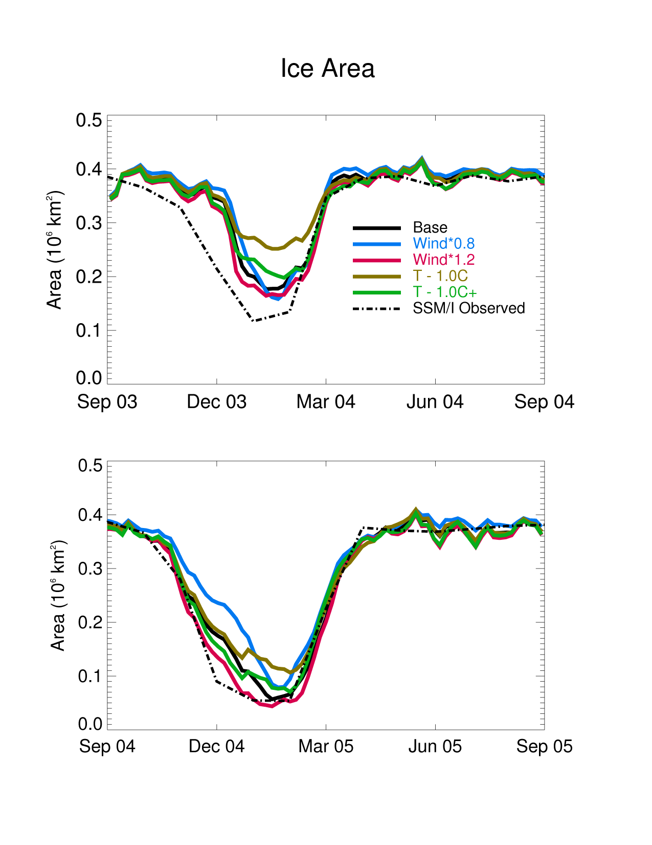
Increases in just the wind speed reduced the summer sea-ice extent and increased the polynya duration (opposite of what has been observed)
However, increases in the wind speed combined with decreases in the atmospheric temperature led to an increase in the summer sea-ice extent
Notes:
This is simulated ice-area over just the continental shelf.

Slide 7
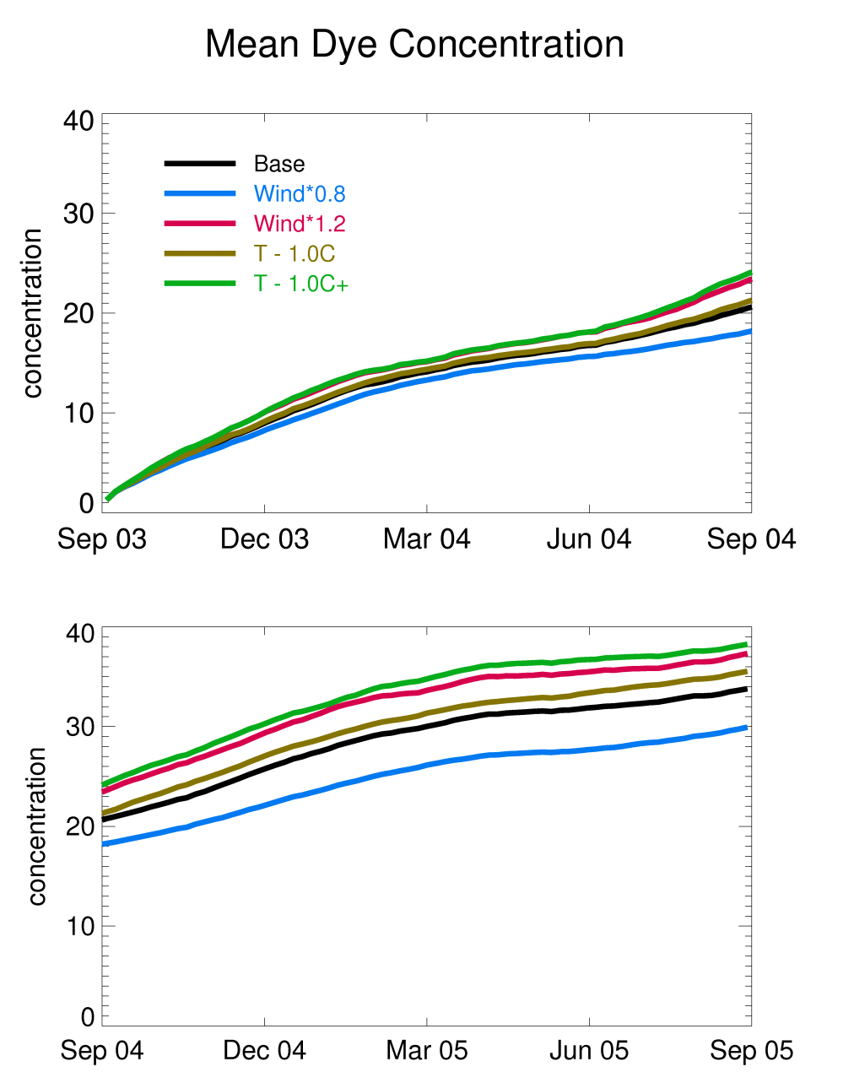
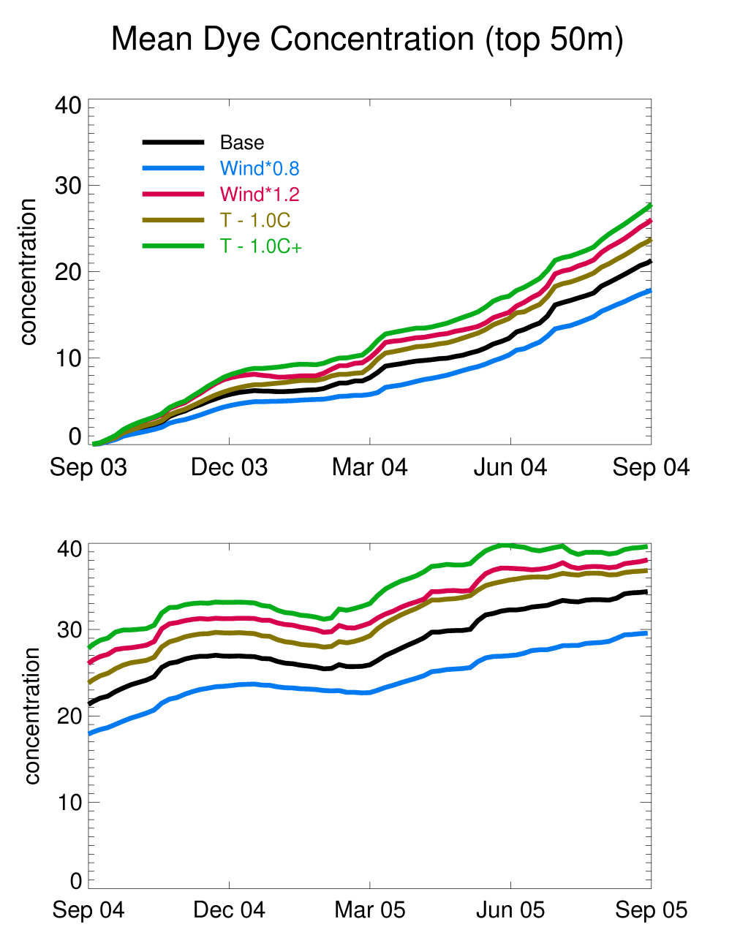
Stronger winds and cooler air temperatures both led to increased MCDW transport onto the continental shelf and increased vertical mixing of MCDW into the upper water column

Slide 8
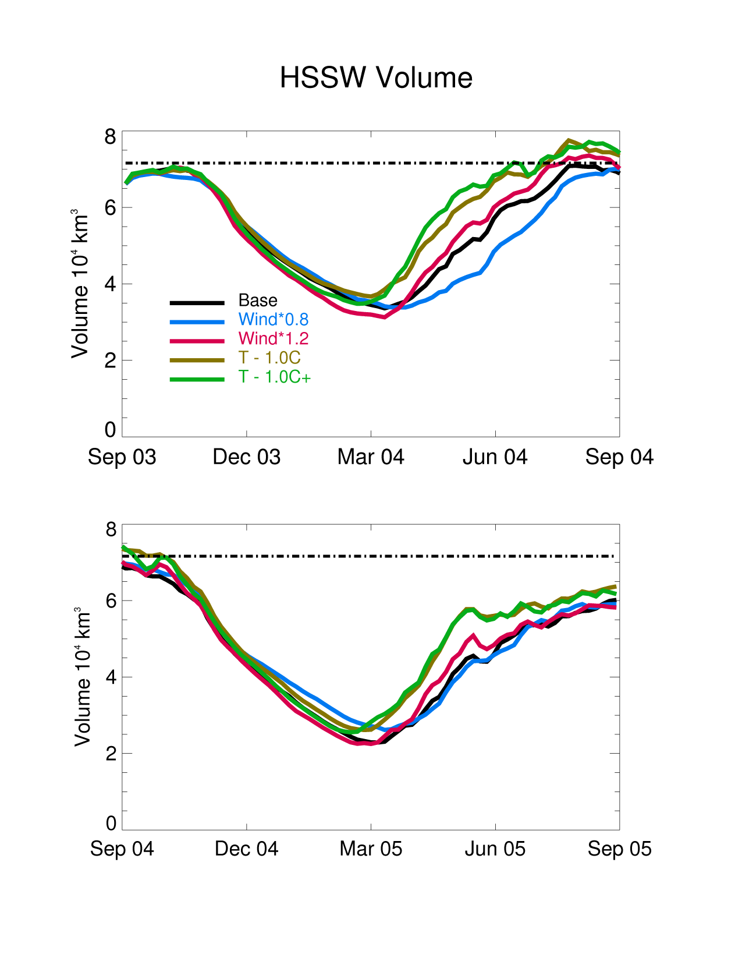
Increasing/decreasing the winds changes the timing of the annual cycle of HSSW formation, but makes little difference in the maximum volume at the end of winter
Decreasing the temperature does increase the total volume of HSSW created
Notes:
Dashed-dot line is Orsi and Wiederwohl estimate of Ross Sea HSSW.

Slide 9
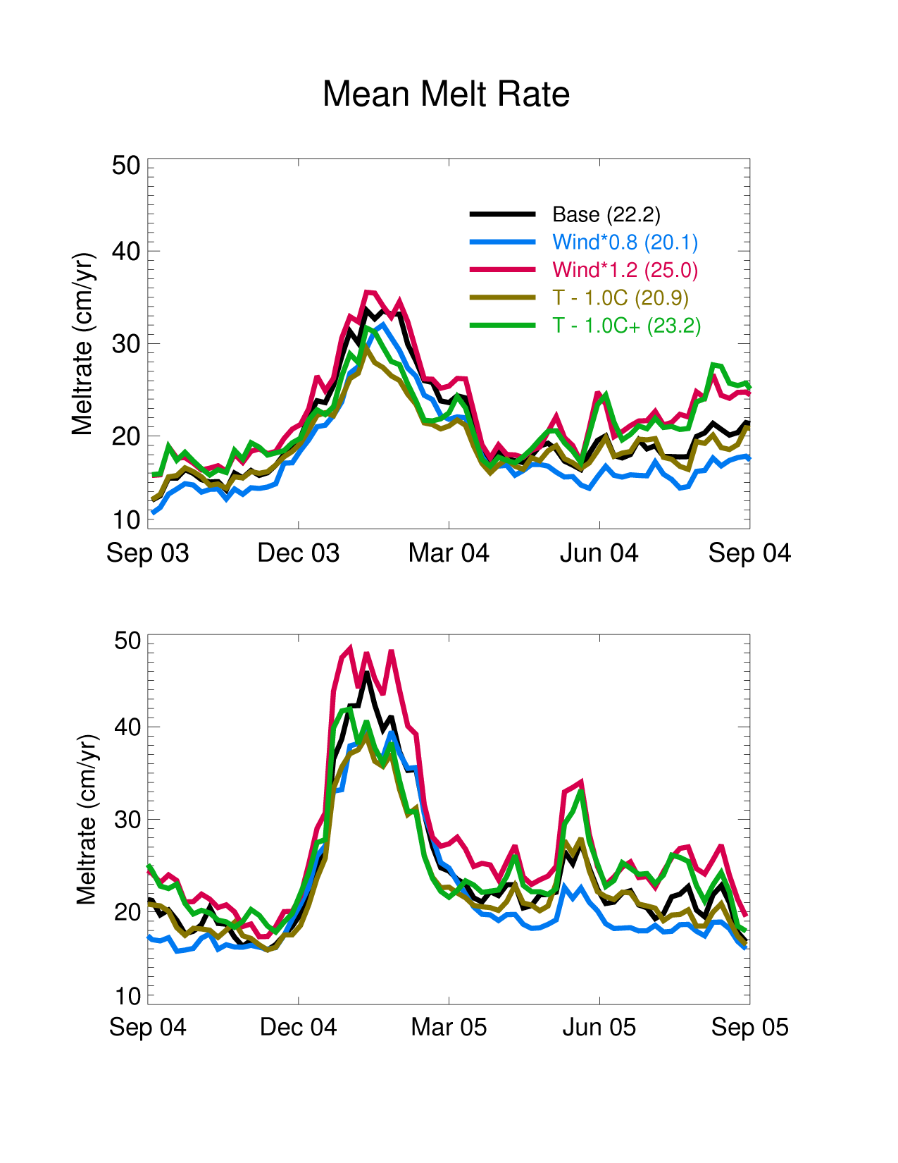
Basal melt rate underneath RIS increased with increased winds, decreased with lower temperatures and increased slightly with combined stronger winds and lower temperatures
Note that the stronger wind effect is year round while the reduced temperature effect is primarily only in the summer
Notes:
Note that stronger winds increase in the melt rate was year round, while the decreased temperature effect is mostly only in the summer => more year round heating from increased MCDW transport vs. less summer spike from the warm surface water in the RSP.

Slide 10
AR4 Forcing Simulations
Used 20th Century and AR4 SRES A1B Scenario (midrange) simulations from the MPI ECHAM5 model
  Daily winds for 1996-2000, 2046-2050, 2096-2100
  20th Century temperatures were too cold so used ERA-Interim climatology for 1996-2000 and added ECHAM5 A1B anomalies for 2046-2050 (+1.7 ± 2.6) and 2096-2100 (+2.5 ± 2.3)
  Two additional simulations with fresher
  (-0.12) boundary salinity to mimic possible continued freshening of the Ross Sea
Notes:
ECHAM5 temperatures were way too cold (esp. near the coast).

Slide 11
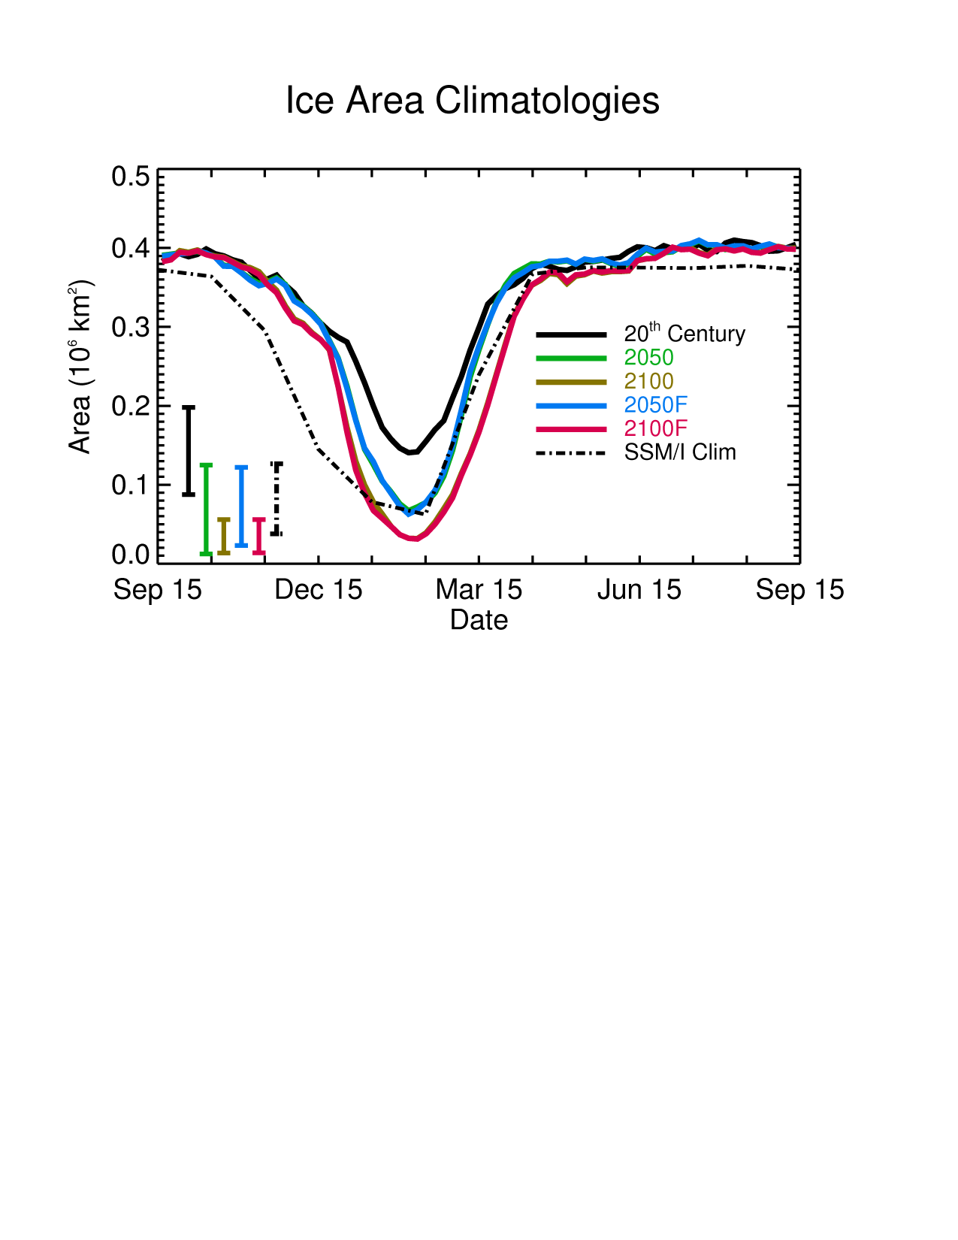
Difference between simulations varies from year to year, but the Ross Sea Polynya generally opens up more in 2050 and even more so in 2100
Little difference due to fresher boundary conditions
Entire continental shelf is covered with ice most of the year in all simulations
(see Smith et al., 2014)
Notes:
This is simulated ice-area over just the continental shelf.

Slide 12
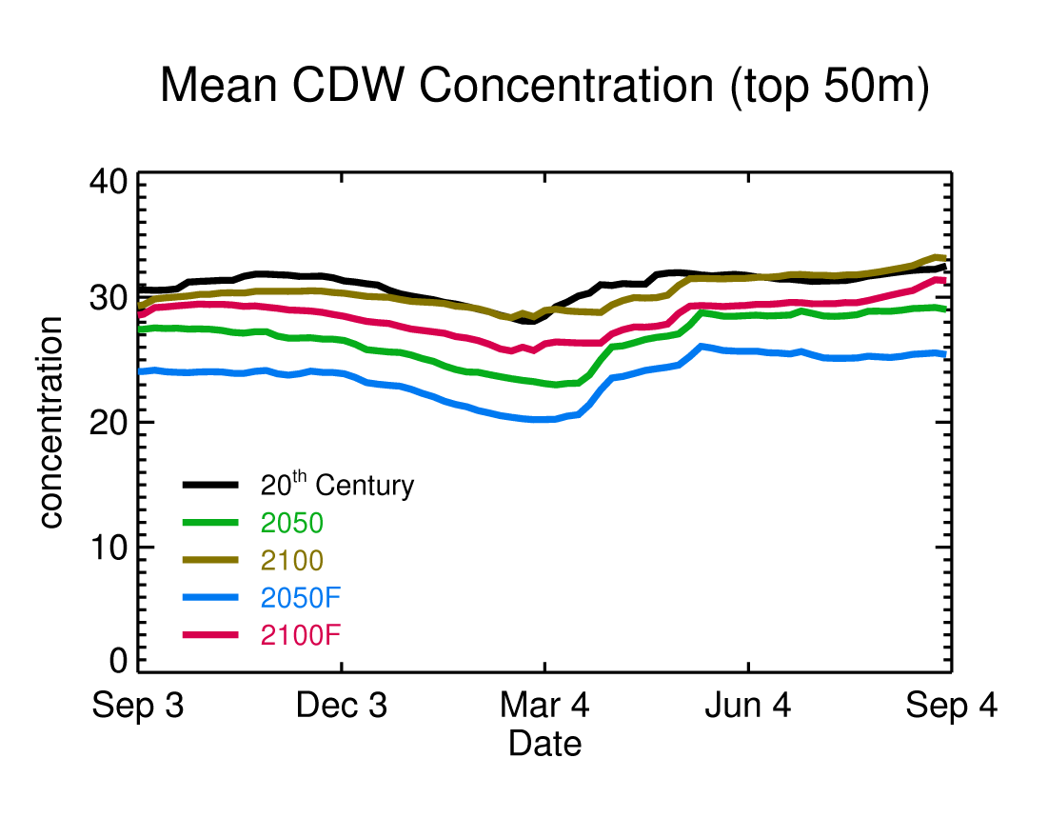
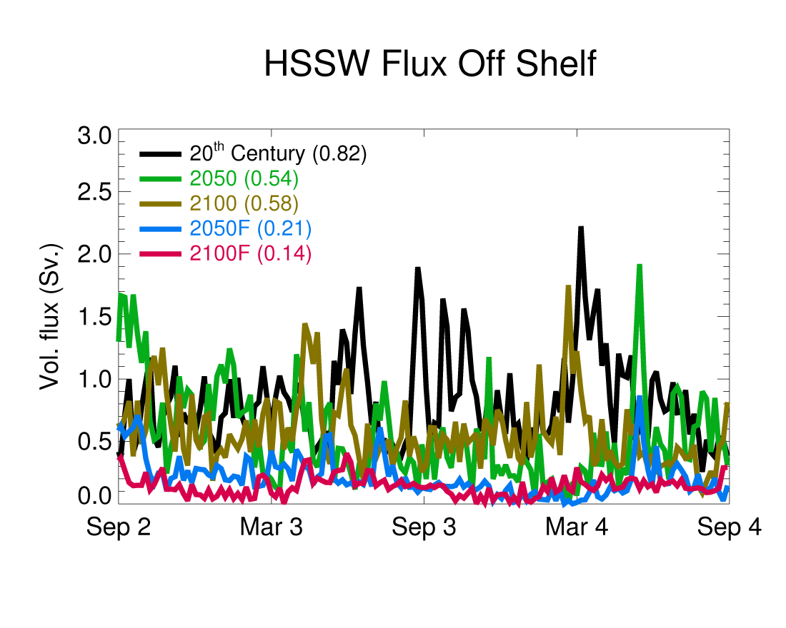
Warmer air temperatures (2050 and idealized cases) reduce the MCDW that gets to the shelf and upper shelf waters, but these are balanced out by changes in the winds by 2100
Fresher waters slightly lower MCDW transport but have a bigger reduction on vertical mixing of MCDW into the upper water column
Fresher waters also significantly reduce the creation and export of dense water from the shelf

Slide 13
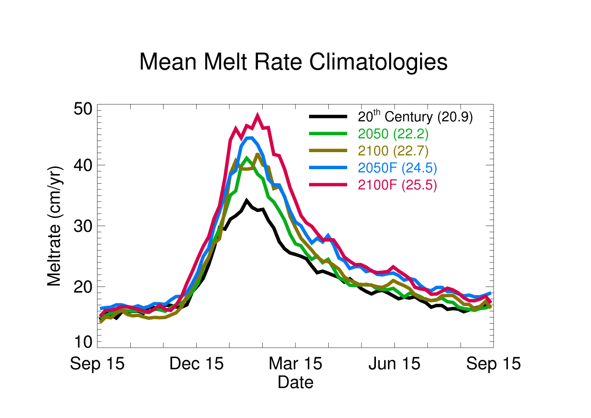
Basal melt rate underneath RIS increased slightly for both 2050 (6%) and 2100 (9%) and most of the increase was in summer
Difference due to warmer surface summer waters
Stronger basal melt rate increase (17% for 2050, 22% for 2100) with fresher boundary conditions and more of the difference is in fall/winter
Due to less mixing of heat out of CDW
Notes:
Note observed estimates are 12-22 cm/yr.

Slide 14

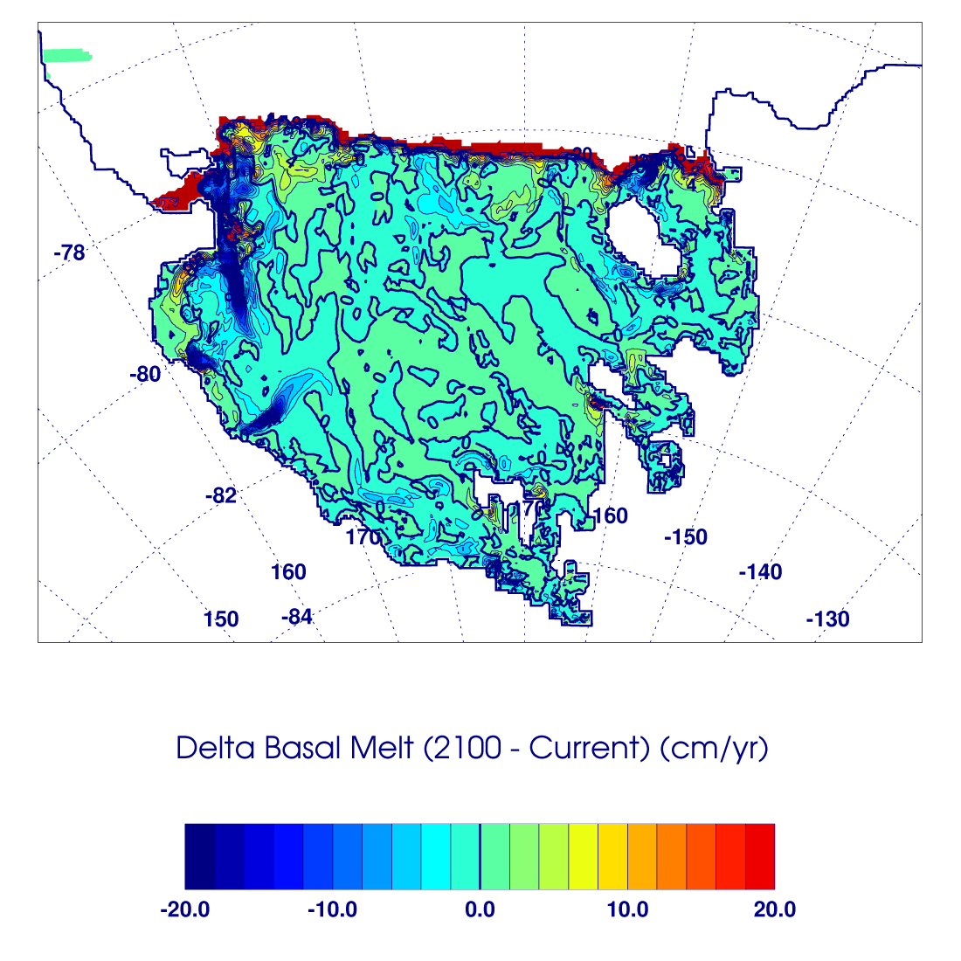
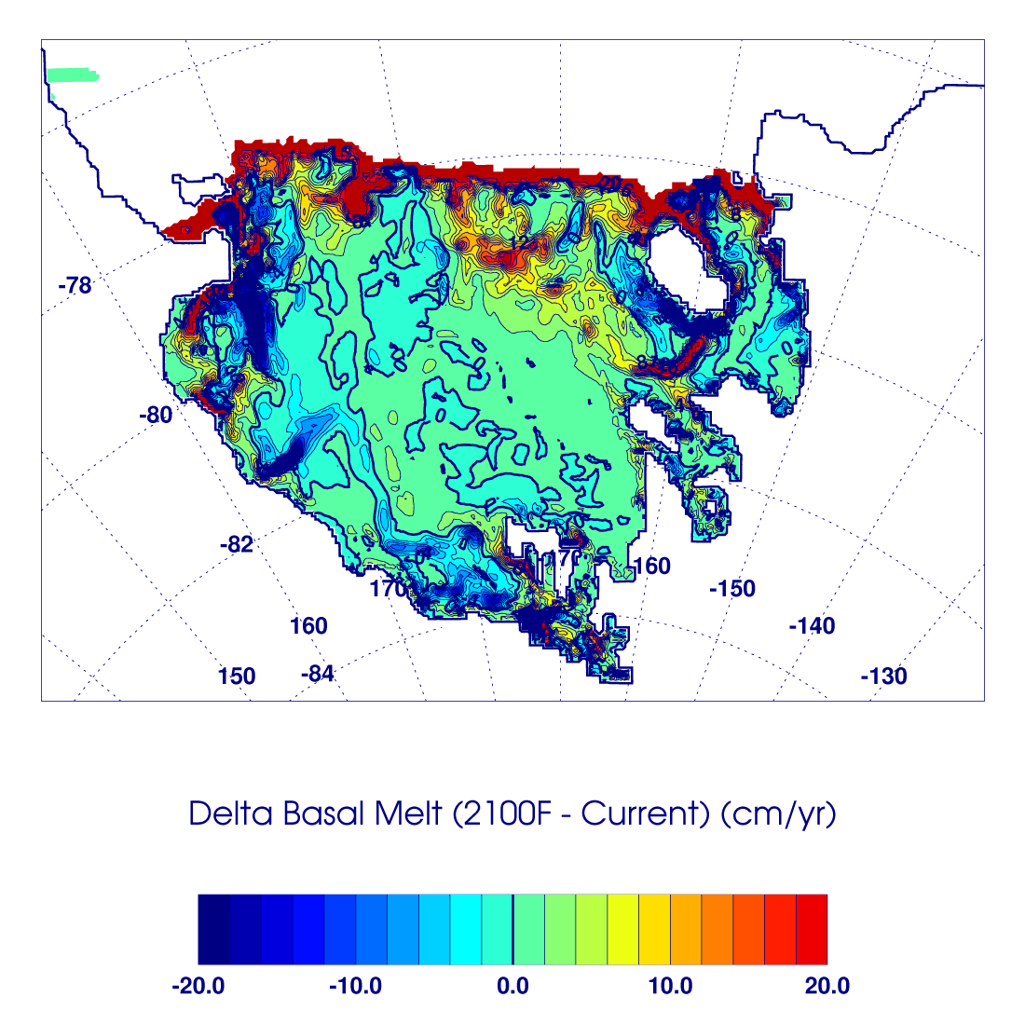
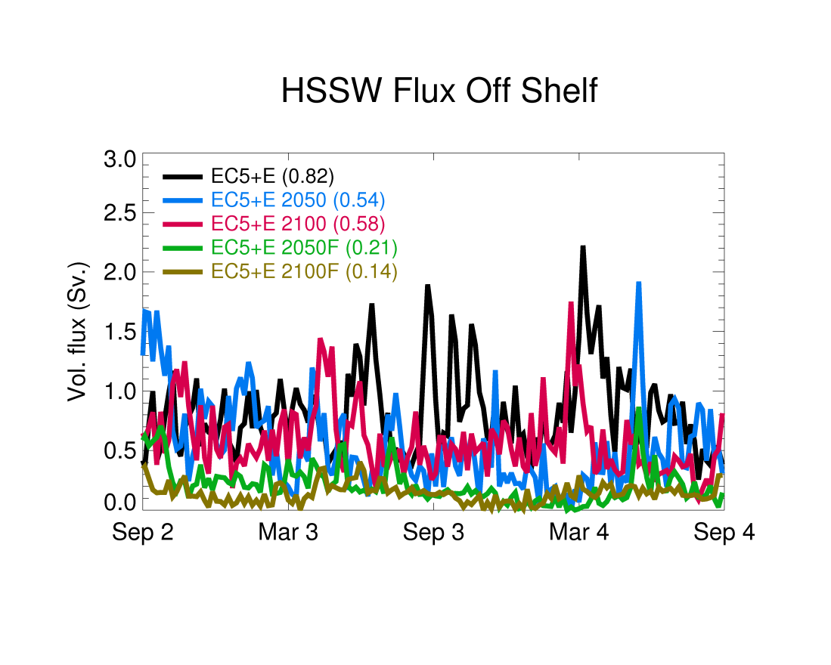
Difference in basal melt rate between 2100 simulations (standard boundaries and fresh) and current case
Smethie and
Jacobs (2005)

Slide 15
Conclusions
Increased southerly wind strength works against cooler air temperatures in changing the RIS basal melt and it is unclear which effect is currently more significant
Warmer future air temperatures could reduce MCDW transport and vertical mixing, but this may be balanced by changes in the winds (mentioned in Smith et al., 2014)
Continued freshening of the Ross Sea could reduce the creation and export of dense shelf water
The basal melt rate of the RIS only increases slightly by 2050 (6%) or 2100 (9%) unless a freshening of the Ross Sea is added (increased to 17% for 2050 and 22% for 2100)

Slide 16
Ross Sea Sector of Southern Ocean Model
As part of a separate project, we have an existing 10km resolution circum-Antarctic model with dynamic sea-ice and ice shelves (Dinniman et al., submitted)
Due to a recent upgrade in ODU computing capability, we are now experimenting with a 5km version (1 year of simulation takes ~2.5 days on 512 cores)
Current focus of model is ice shelf basal melt
However, we are starting to look into other uses for the model
  Advective pathways for Antarctic toothfish in the Ross Sea
  Using dye tracers (as done in Ross model) to look at heterogeneity in dFe sources around the continental shelves
Notes:
Haven’t done anything with the tracers in the 10km model yet.

Slide 17
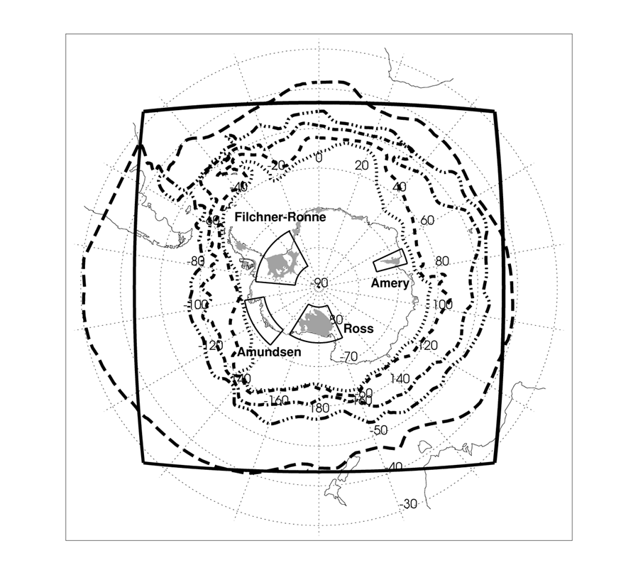
10 km resolution circum-Antarctic ROMS model with ice shelves
Model Drake Passage transport (ERA-Int case):
143 ± 10 Sv.
Observations:
134 ± 11 Sv. (Cunningham et al., 2003)
141 ± 13 Sv. (Koenig et al., 2014)

Slide 18
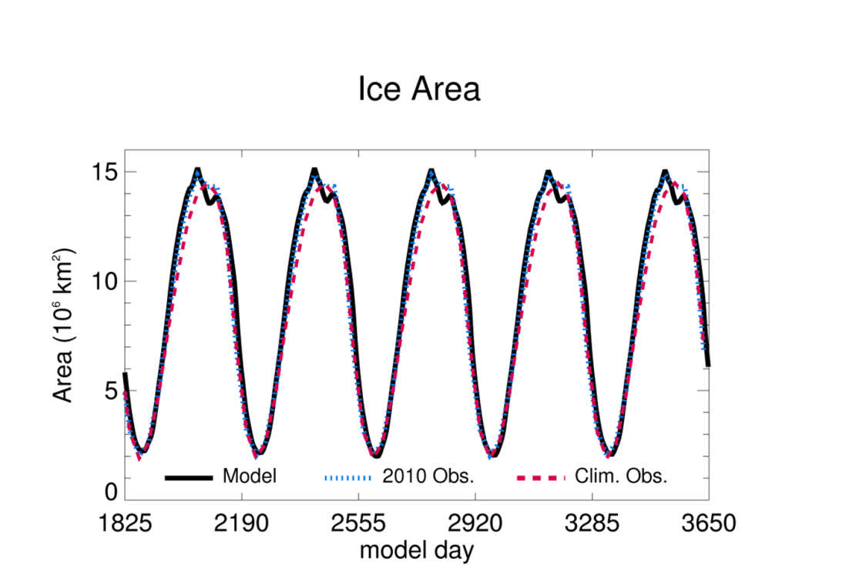
Model accurately simulates sea ice extent
(top row: Feb. and Sep. model
bottom row: Feb. and Sep. obs.)

Slide 19
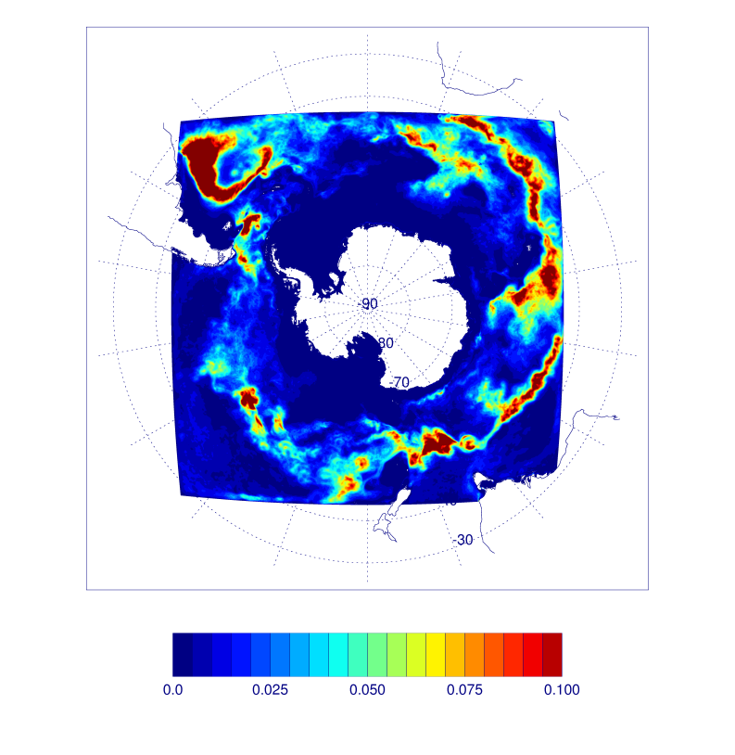

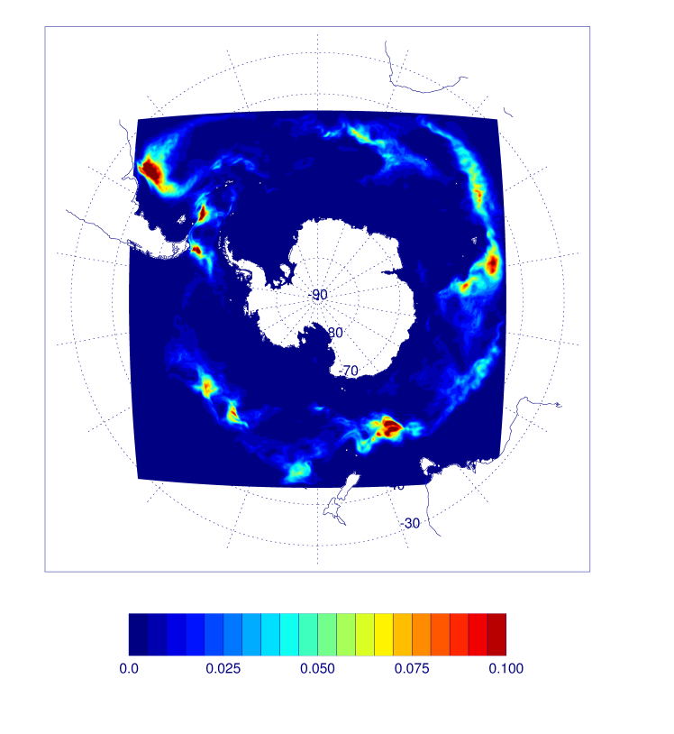
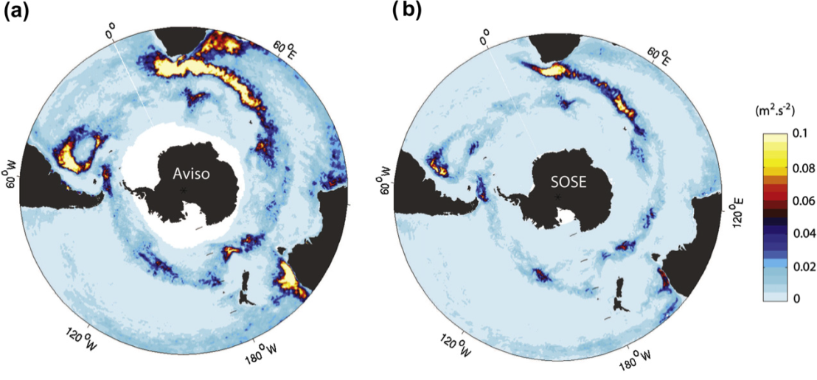
EKE: 5km grid
(mean: 0.0218 m²/s²)
EKE: 10km grid
(mean: 0.0180 m²/s²)
EKE: 20km grid
(mean: 0.0074 m²/s²)
(Sallée and Rintoul, 2011)

Slide 20
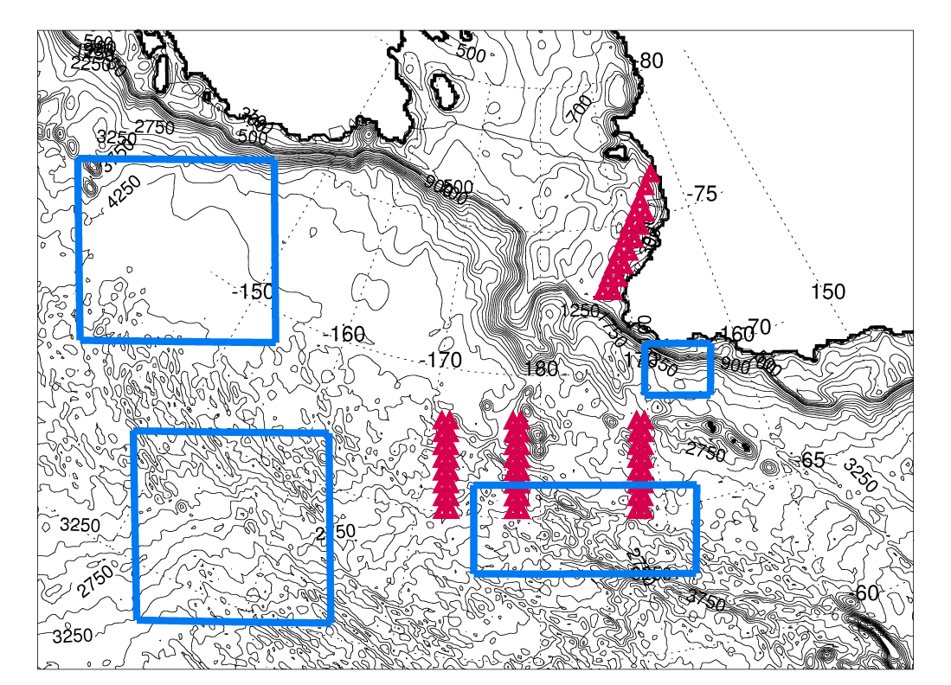
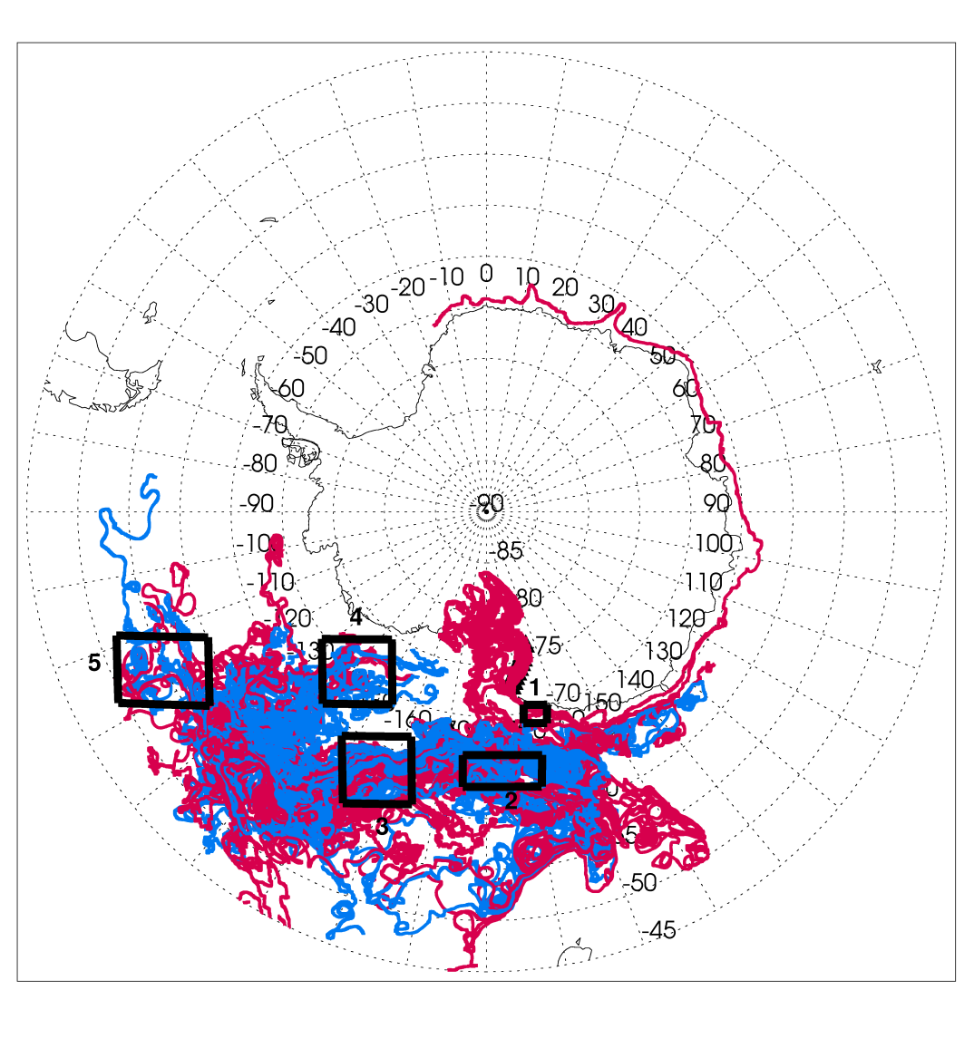
Initial positions for drifter release and locations for statistics
Path of drifters 4 years after release in June (10km model)
Notes:
Mention suspected spawning locations near the Pacific-Antarctic Ridge and Ross Gyre and statistics of going back onto the Ross shelf vs. going out in the ACC.

Slide 21
Work with SEAFARERS project
They are interested in differences in residence times over Mawson vs. Pennell Banks
  We plan to rerun the base PRISM simulation with drifters placed in the model over both locations at different times to look into this (easy to do…anybody here want drifters placed anywhere as well?)
They are also interested in examining the role of MCDW in fueling productivity over Pennell Bank
  Will give them model output from the existing base PRISM simulation to look at CDW/MCDW dye behavior
  Possibly add a tracer to look at the spread of near bottom waters over the shelf (already want to do something like this over Ross Bank)
Notes:
Josh and Adam will mention these in more detail later.

Slide 22
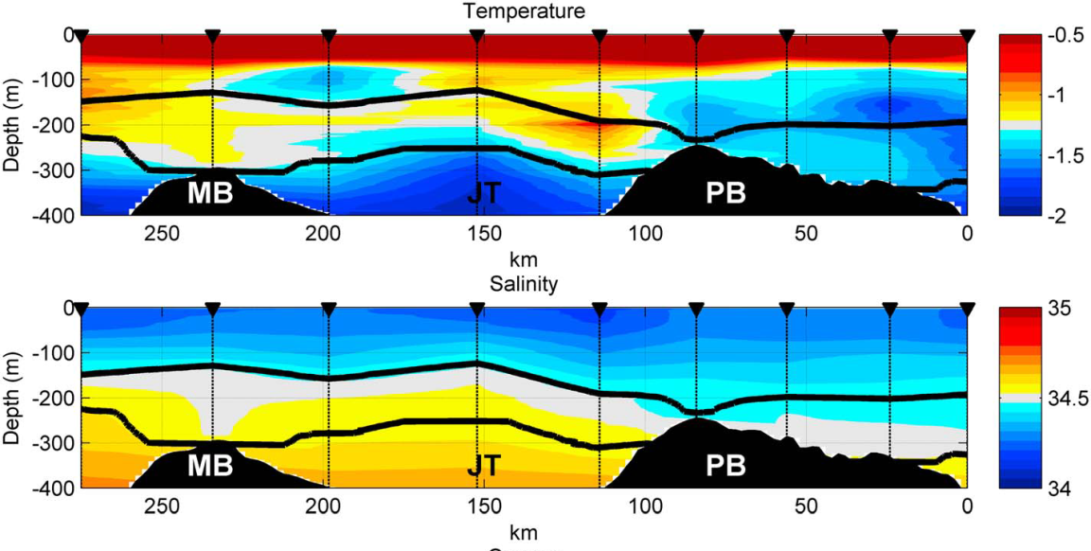
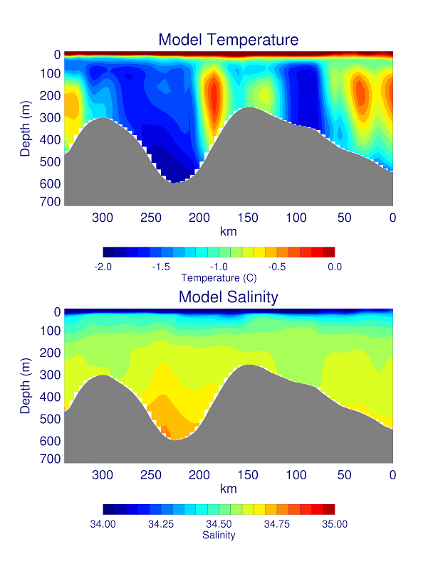
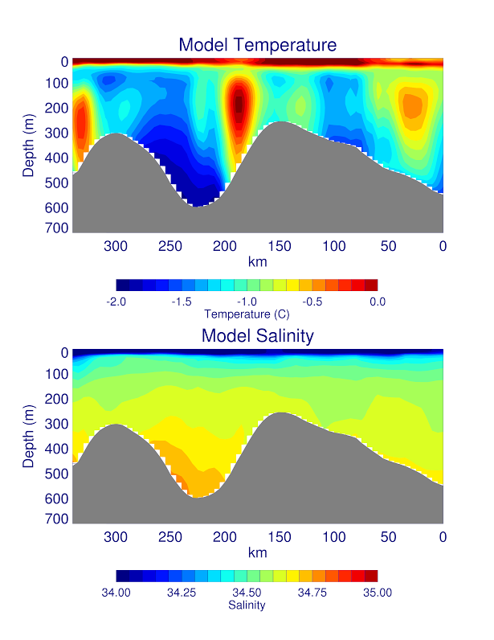
Average cross section over Jan 22 – Feb 12, 2011
(Kohut et al., 2013)
Model cross section (slightly longer and deeper than obs) averaged over 1 day (Jan 23 (left) and Feb 12 (right) 2011)
Notes:
Point out right limit of model plot wrt obs. Gross details are correct: MCDW is in the right place as well as the cold dense shelf water going out on the west side of Joides Trough. Cold feature above eastern Mawson ~100m is variable, but there in model.

Slide 23
Future Modeling Plans
Items already covered by Stefanie
Disk recovery re-runs have included virtual moorings at several locations (including SeaHorse deployment over Ross Bank) and future runs will have this data from all PRISM CTD cast locations
Elodie’s BGC model in an idealized 3D domain (work w/ Stuart Corney at ACE-CRC)
  Plan to run the idealized shelf/slope/ice shelf domain at different resolutions (down to 1km) to examine the effects of meso-circulation features on modeled phytoplankton
Figure out what model data to get to BCO-DMO

Slide 24
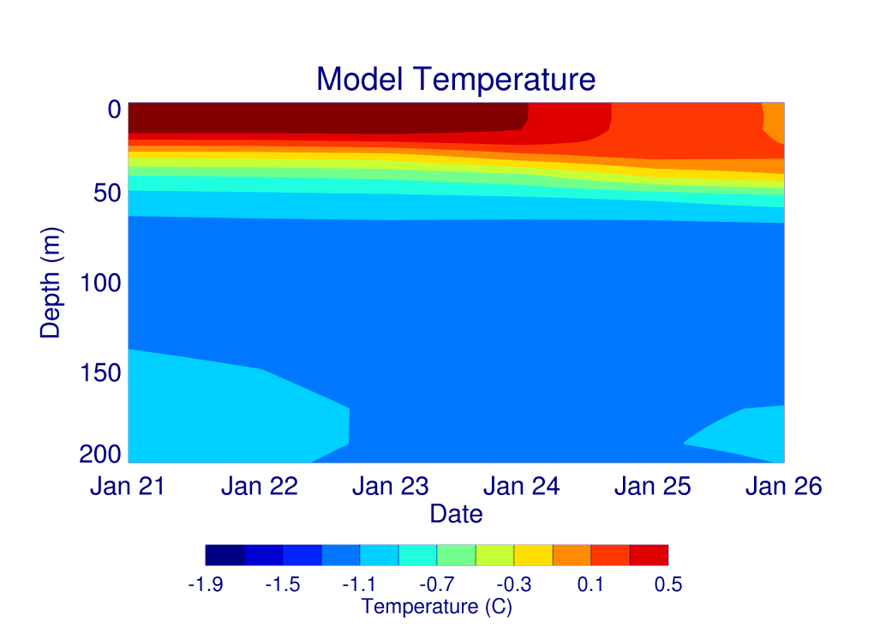
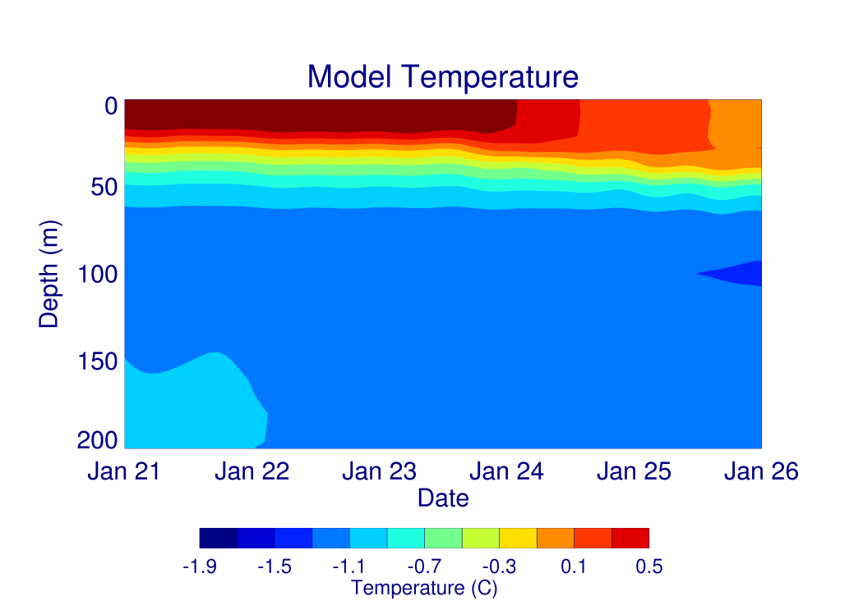
Time Series over Ross Bank
daily
average
40 min
output
Notes:
Both plots show the cooling and deepening of the ML. N.B. wind and temp forcing is 6 hourly

Slide 25
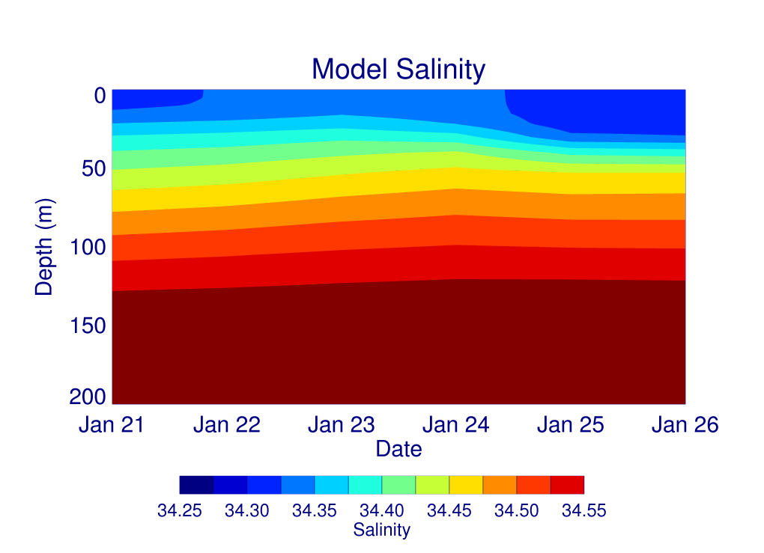
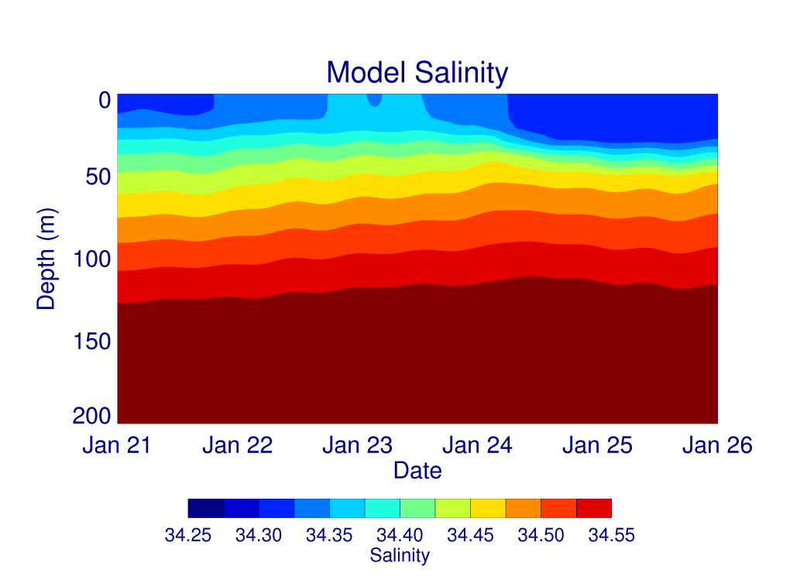
Time Series over Ross Bank
daily
average
40 min
output
Notes:
Both plots have deepening and mixed layer getting saltier then fresher. Don’t forget to go back to Future Plans.

Slide 26
Summary
Hope to soon submit paper titled “Sensitivity of water masses in the Ross Sea to changes in the winds, atmospheric temperatures and fresh water inflow”
ROMS circum-Antarctic model appears to reasonably simulate Southern Ocean Any thoughts on what can be done for PRISM with this new tool?
Getting closer to being able to model effects of mesoscale circulation features on shelf productivity
Need to get working again on Ross Bank output for Blair (including adding a bottom dye of some kind in model re-run)

