Slide 1
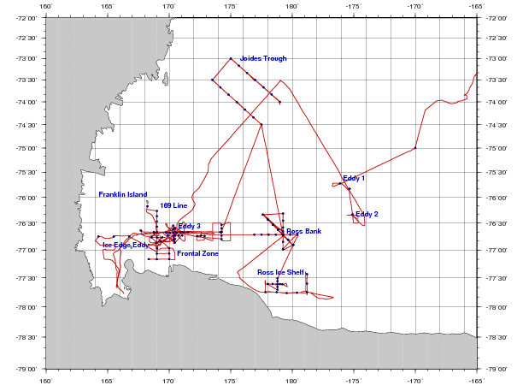
PRISM cruise track
H₁: CDW
H₂: Sediment: banks/coastal
H₃: Sea ice
H₄: Glacial melt
ACC Sea Ice
H₅: ISW
H₆: Dry Valleys
H₇: Vents
I. ACC Sea Ice
II. Eastern Ross Sea Eddies
III. Western Ross Sea
IV. Ross Bank
V. Ross Ice Shelf
VI. Joides Trough
VII. Western Ross Sea II

Slide 2
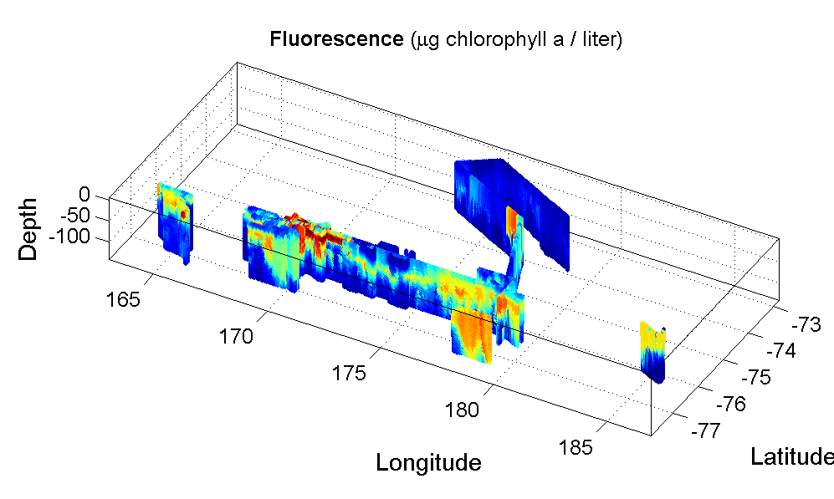
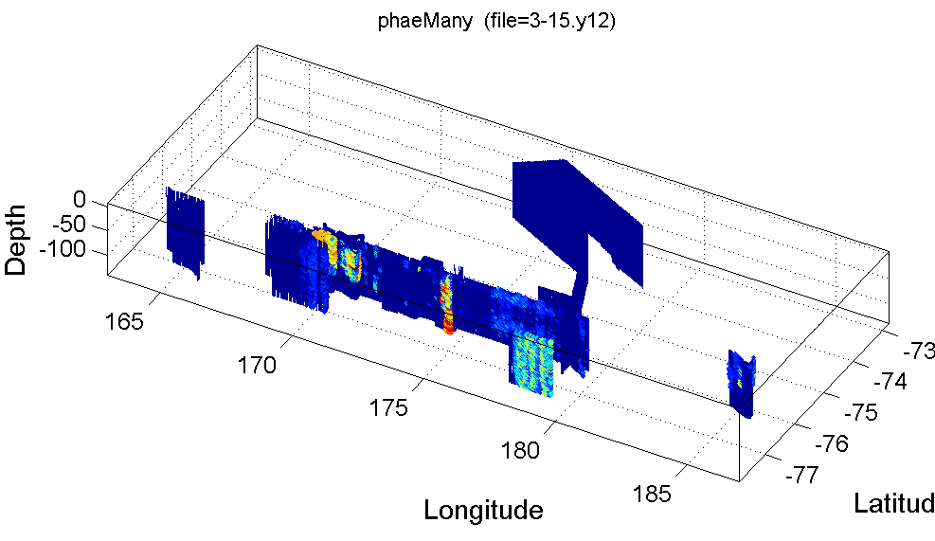
A river of Phaeocystis along the Ross Ice Shelf
Fluorescence
Phaeocystis colonies

Slide 3
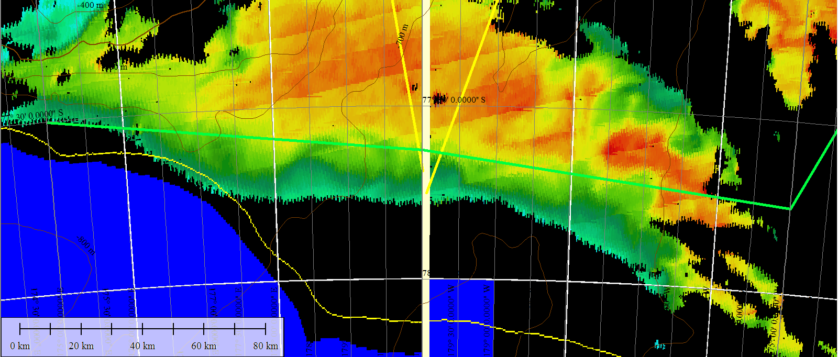
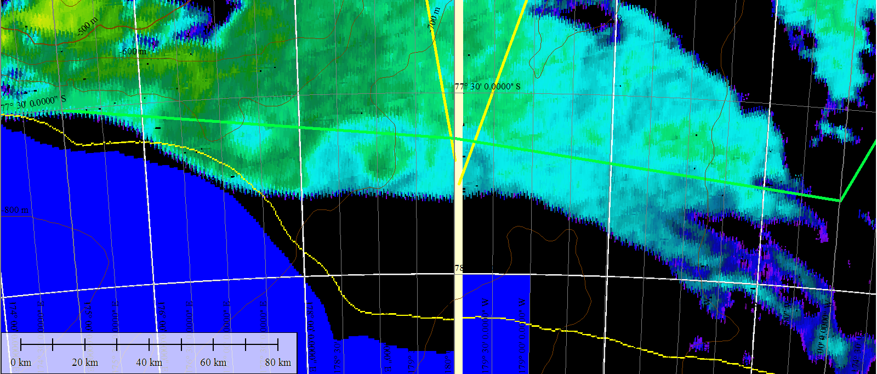
Ross Ice Shelf satellite imagery – Jan 22
Chl
SST

Slide 4
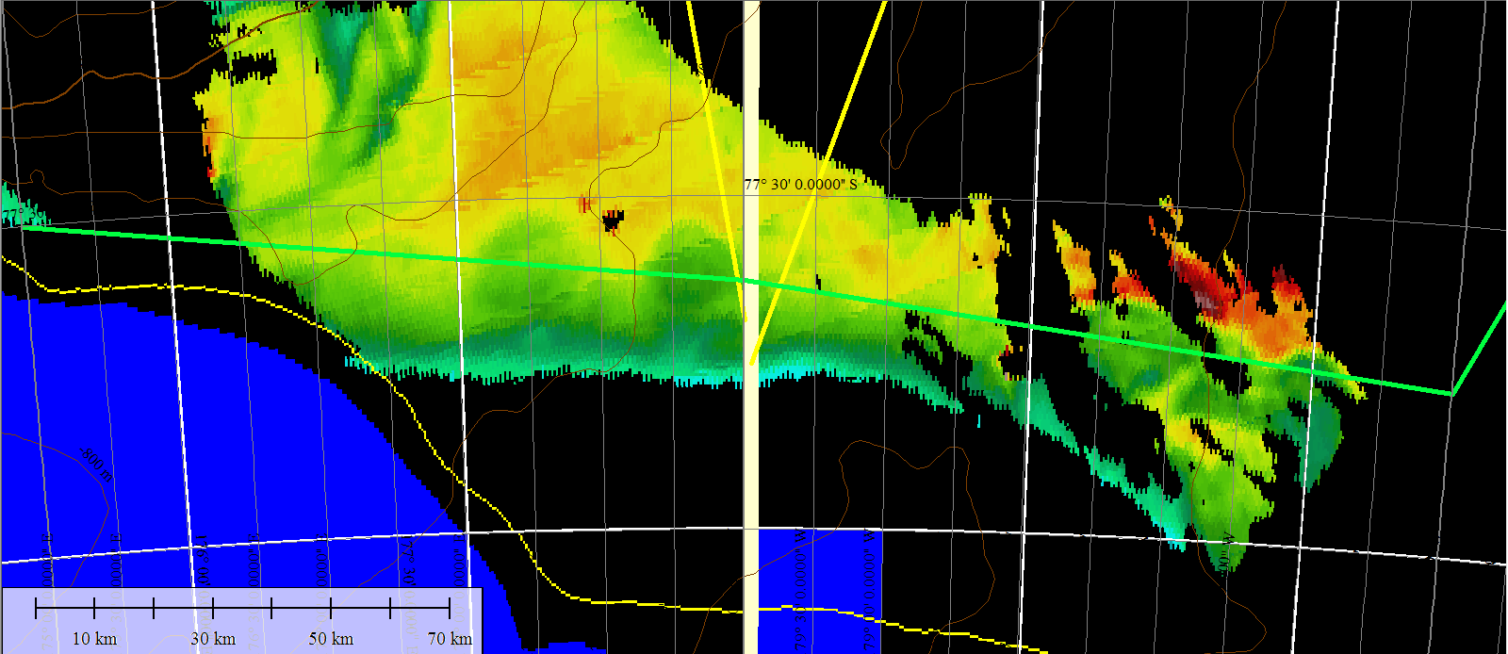
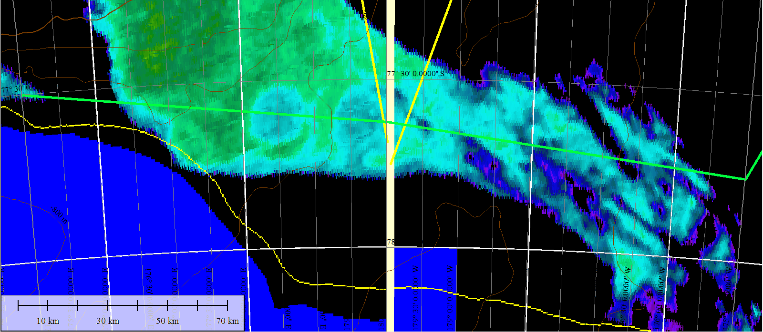
Ross Ice Shelf satellite imagery – Jan 25
Chl
SST

Slide 5
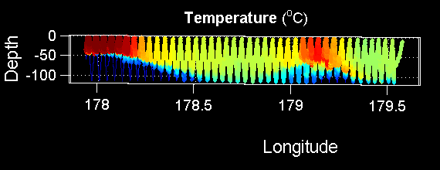
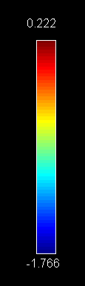
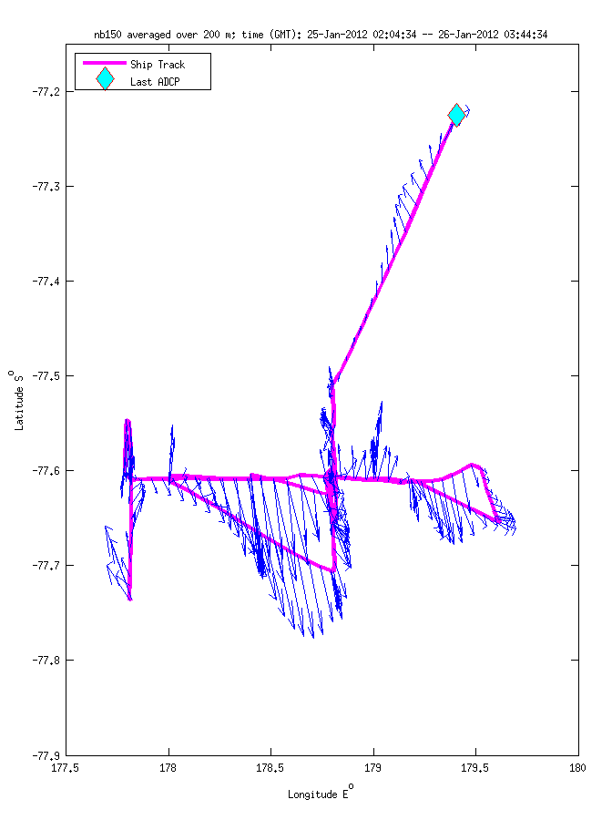
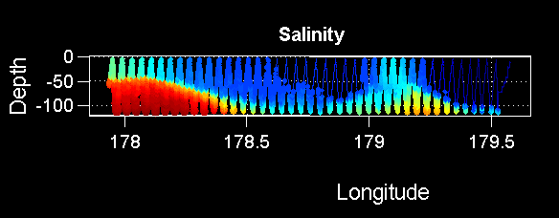
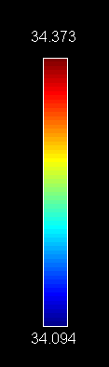
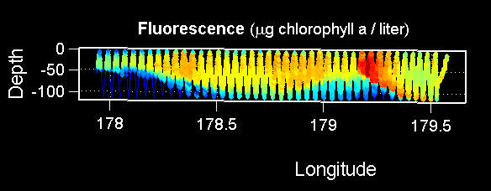
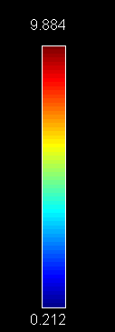
Ross Ice Shelf Eddy (VPR9, 1/26)
Temperature
Salinity
Fluorescence

Slide 6
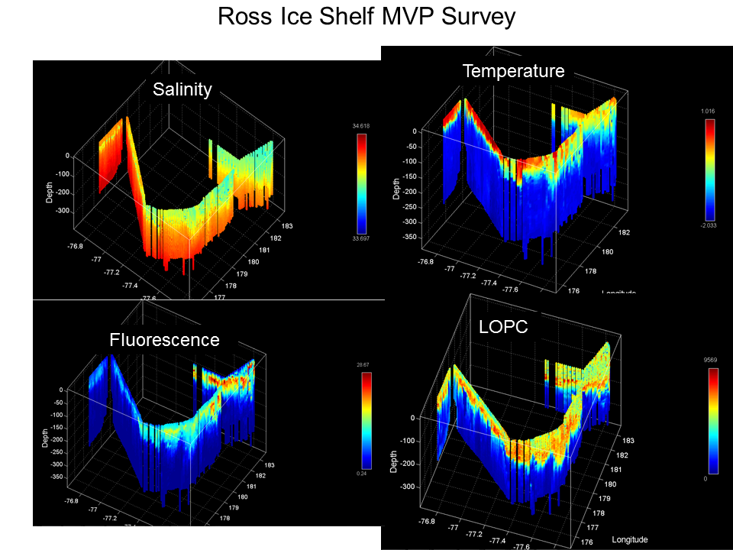
MVP Survey
Near-surface waters adjacent to the RIS were cold, fresh, and relatively enhanced in iron (ca. 0.2 nM) apparently due to glacial meltwater
Upper-ocean anticyclonic eddies can transport (previously) iron-rich waters northward, producing substantial blooms of Phaeocystis

Slide 7
Hypothesis: wind-driven upwelling and downwelling reduces stratification along the edge of the RIS.
Sea Surface
Upwelling
Ice Shelf
ρ
Downwelling

Slide 8
Work plan
Interrogate present model to see if the hypothesized process is active
(animation of x-z density slice normal to the RIS
Develop simple 2-D process-oriented simulation to illustrate the process and parameter dependence
- background stratification
- wind forcing

Slide 9
Misc. action items
ADCP
Is the plume detected in surface currents near the shelf?
Enhanced shear near the shelf?
Eddies export the effect into the interior; incubator (edge-driven mixing) is turned off.
Is there an Fv/Fm signal in the eddies?
MODIS retrospective: are eddies present on a regular basis?
MSD to contact Paul Holland about ice shelf simulations.
Pierre to consider new ice shelf runs.
WOS looking into historical data, including Italian database (Giorgio).
Connection with stations further W?
PNS will contact Giorgio about mooring F and sediment trap data.

Slide 10
Ross Ice Shelf Circulation
Smethie and Jacobs, 2005

Slide 11
Hypothesis: wind-driven upwelling and downwelling reduces stratification along the edge of the RIS.
Sea Surface
Upwelling
Ice Shelf
ρ
Downwelling

Slide 12
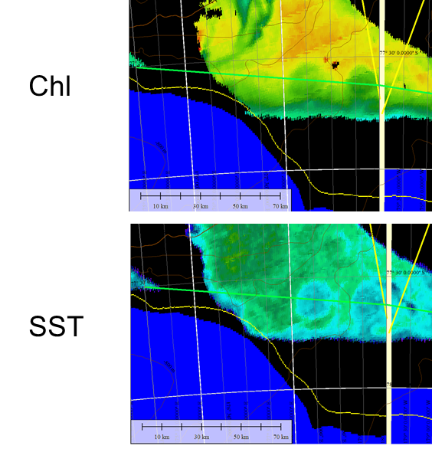
Ross Ice Shelf
First ever iron measurements in Ice Shelf Water; concentrations similar to the MCDW end-member at 0.3-0.5 nM
Near-surface waters adjacent to the RIS were cold, fresh, and relatively enhanced in iron (ca. 0.2 nM) apparently due to glacial meltwater
Upper-ocean anticyclonic eddies can transport (previously) iron-rich waters northward, producing substantial blooms of Phaeocystis

Slide 13
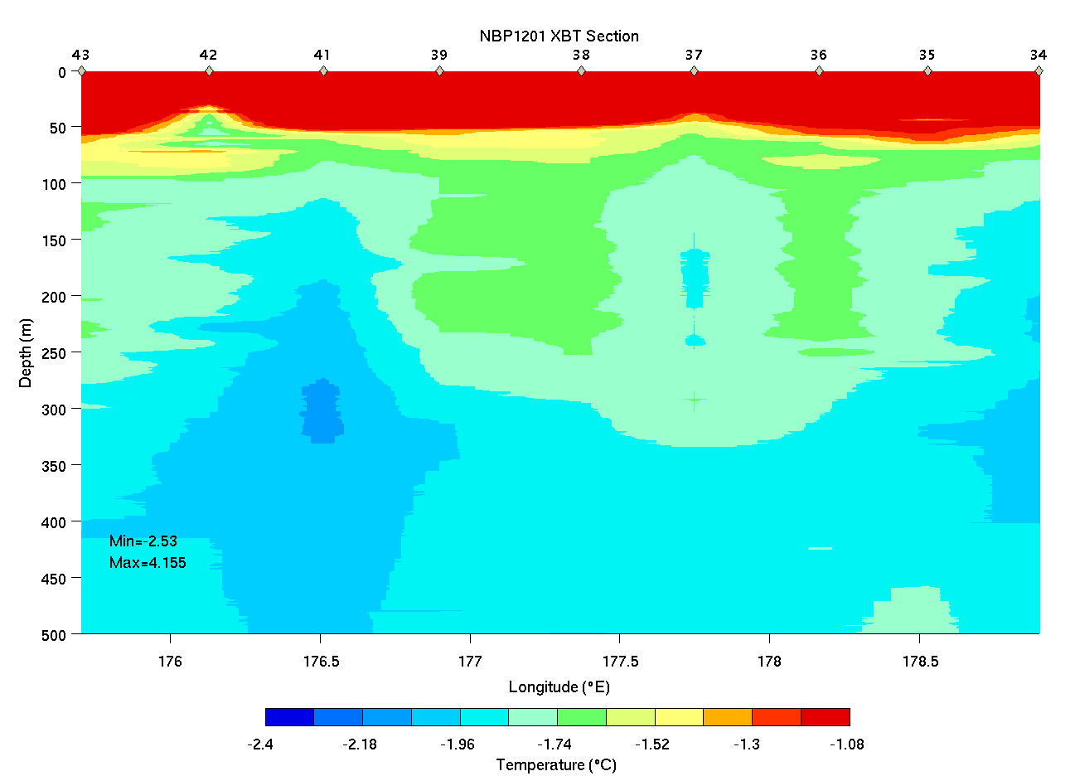
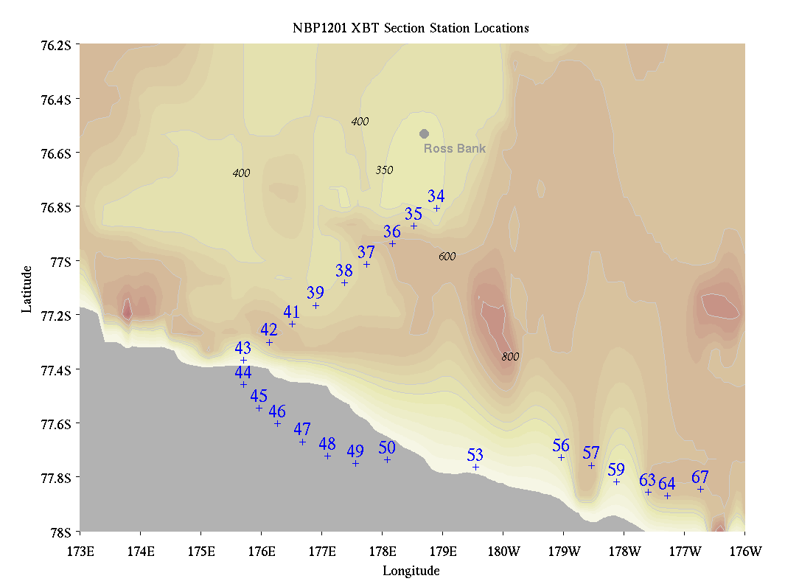
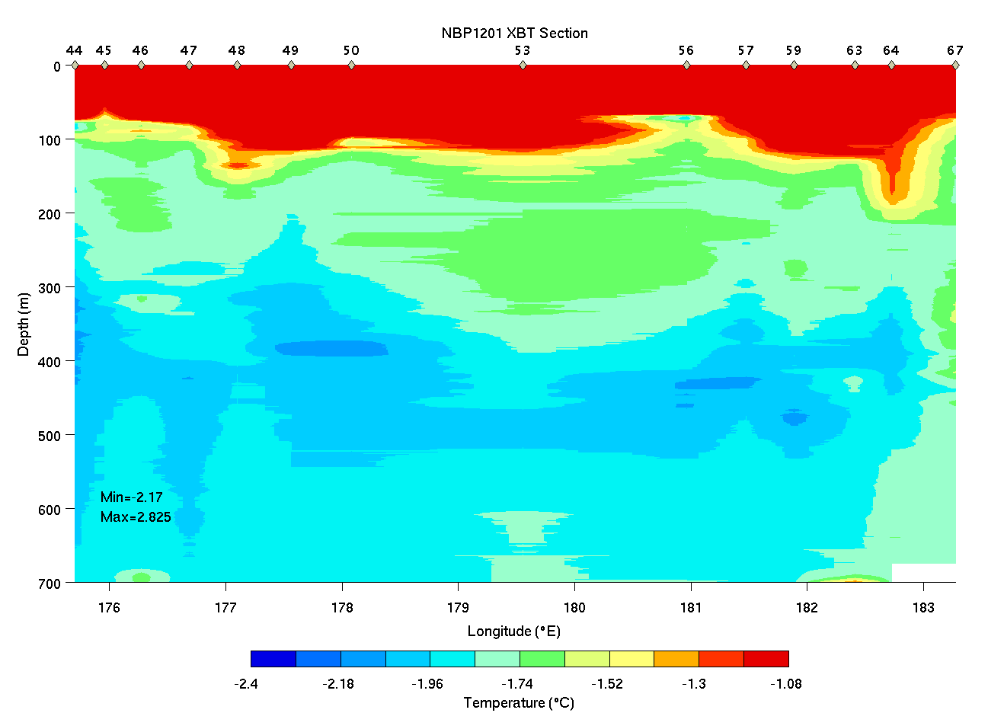
Ross Bank to Ice Shelf XBT Survey

Slide 14
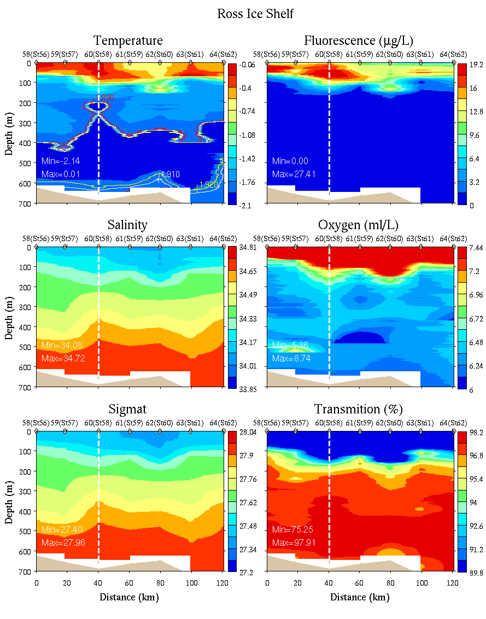
Ice Shelf CTD Survey
0-700m

