Slide 1
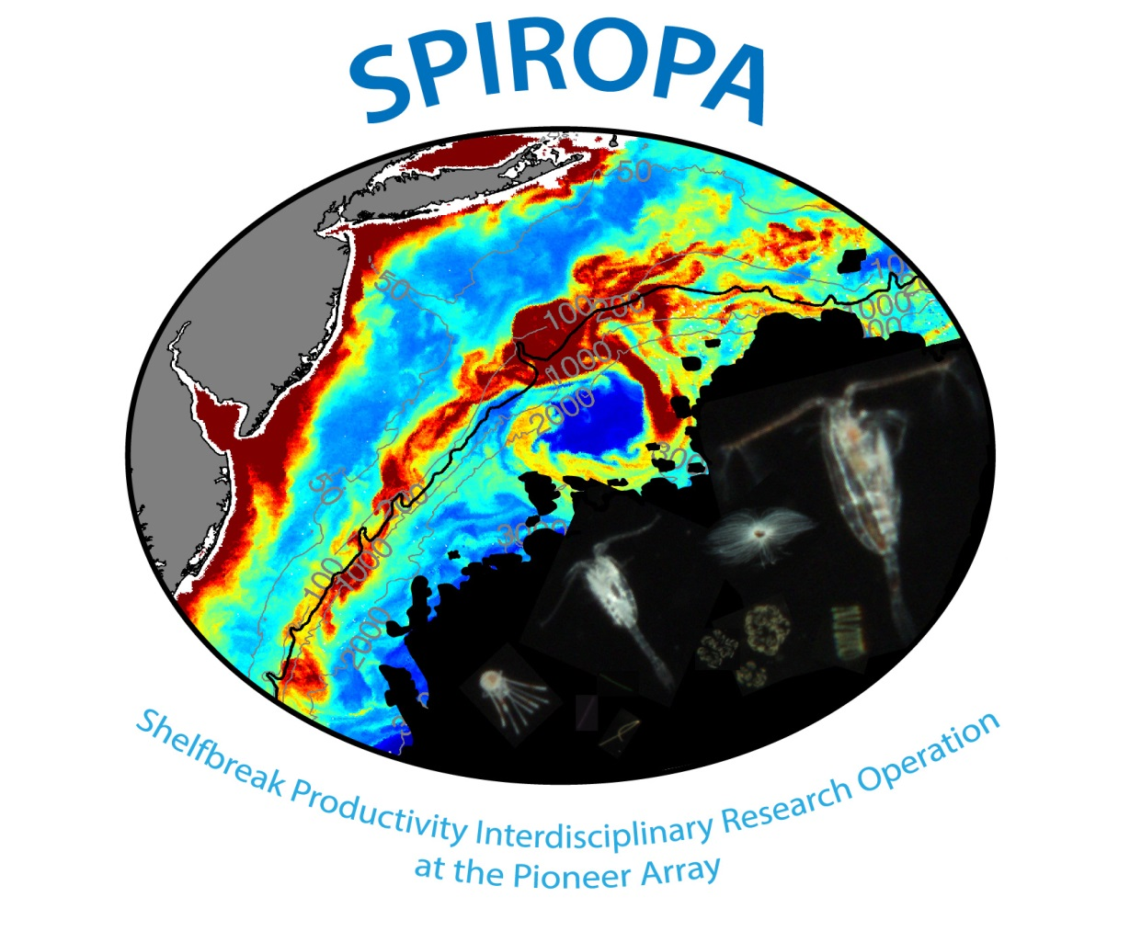
Ammonium Dynamics in the mid-Atlantic front zone
*Email: yzhu003@odu.edu
Yifan Zhu^{1, *}, Margaret R. Mulholland¹, Dennis J. Mcgillicuddy²,
Corday R. Selden³, P. Dreux Chappell¹, Weifeng Gordon Zhang², Sophie Clayton¹
¹ Department of Ocean and Earth Sciences, Old Dominion University
² Department of Applied Ocean Physics & Engineering, Woods Hole Oceanographic Institution
³Department of Marine and Coastal Sciences, Rutgers University

Slide 2
Outline
Introduction to the scientific question
Water masses in the MAB shelf-break front (shelf, front, slope)
N distribution (e.g., NH₄⁺, NO₃⁻ , PON)
Nitrifiers genes abundance (nitrification)
Conclusion, future work & Acknowledgement

Slide 3
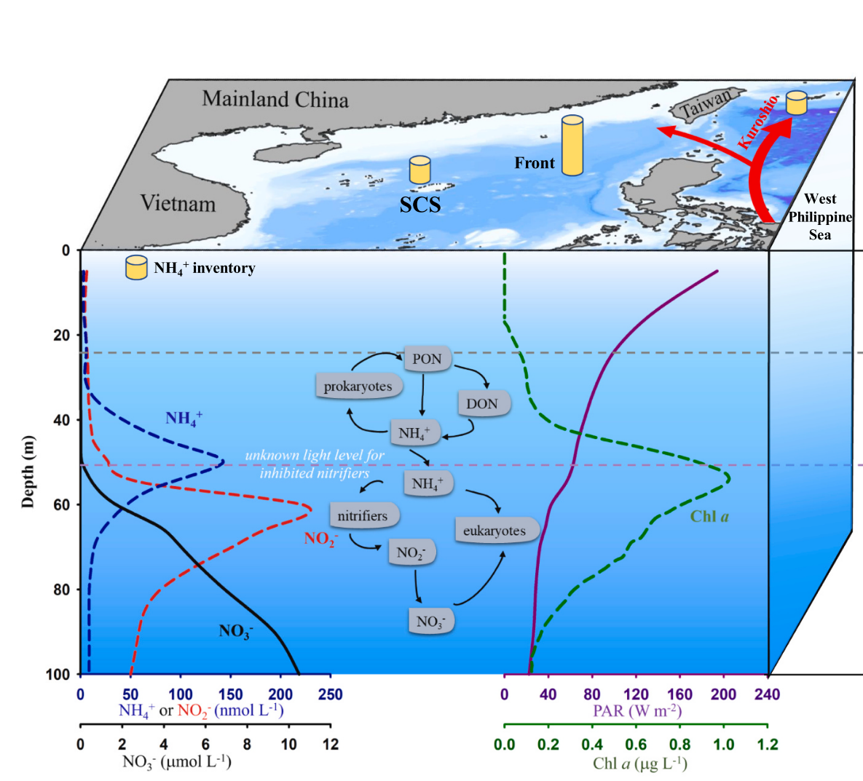
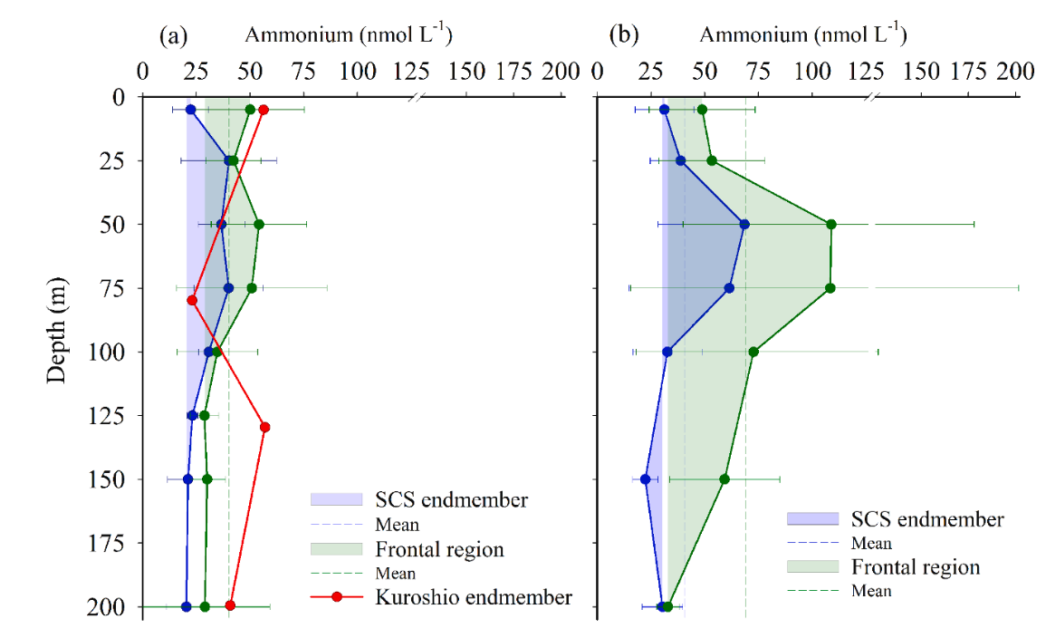
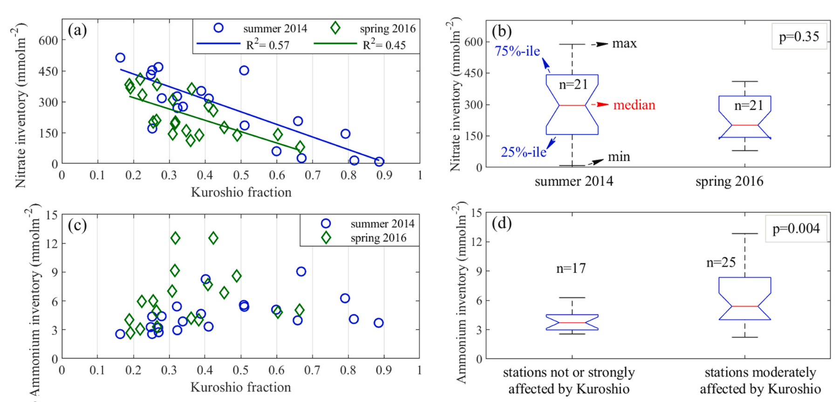
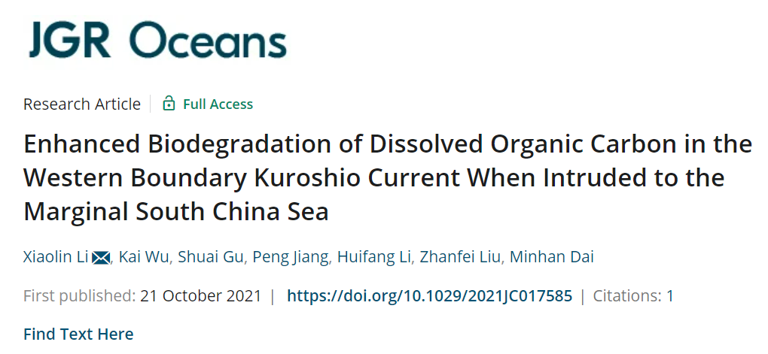
Scientific question
Is ammonium cycling enhanced at the mid-Atlantic shelf-break front, as South China Sea-Kuroshio front?
Zhu et al., 2021, Marine Chemistry

Slide 4
Study Area
A5-A18 transect, ranging 80−2300 m, 7 km apart,
8 repeating investigation
Two horizontal transects: SSF1−SSF6 and S1−S8
8-day mean SST from MODIS during July 4−11, 2019
Cruise time: July 5−July 18, 2019

Slide 5
MODIS SST before, during, and after the cruise
Streamer

Slide 6
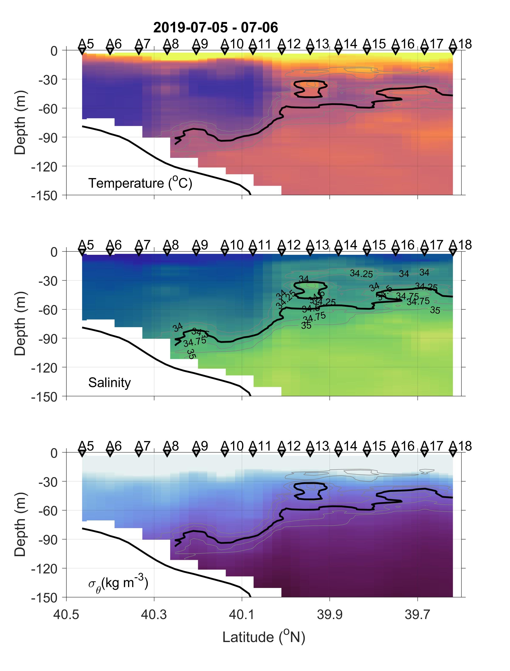
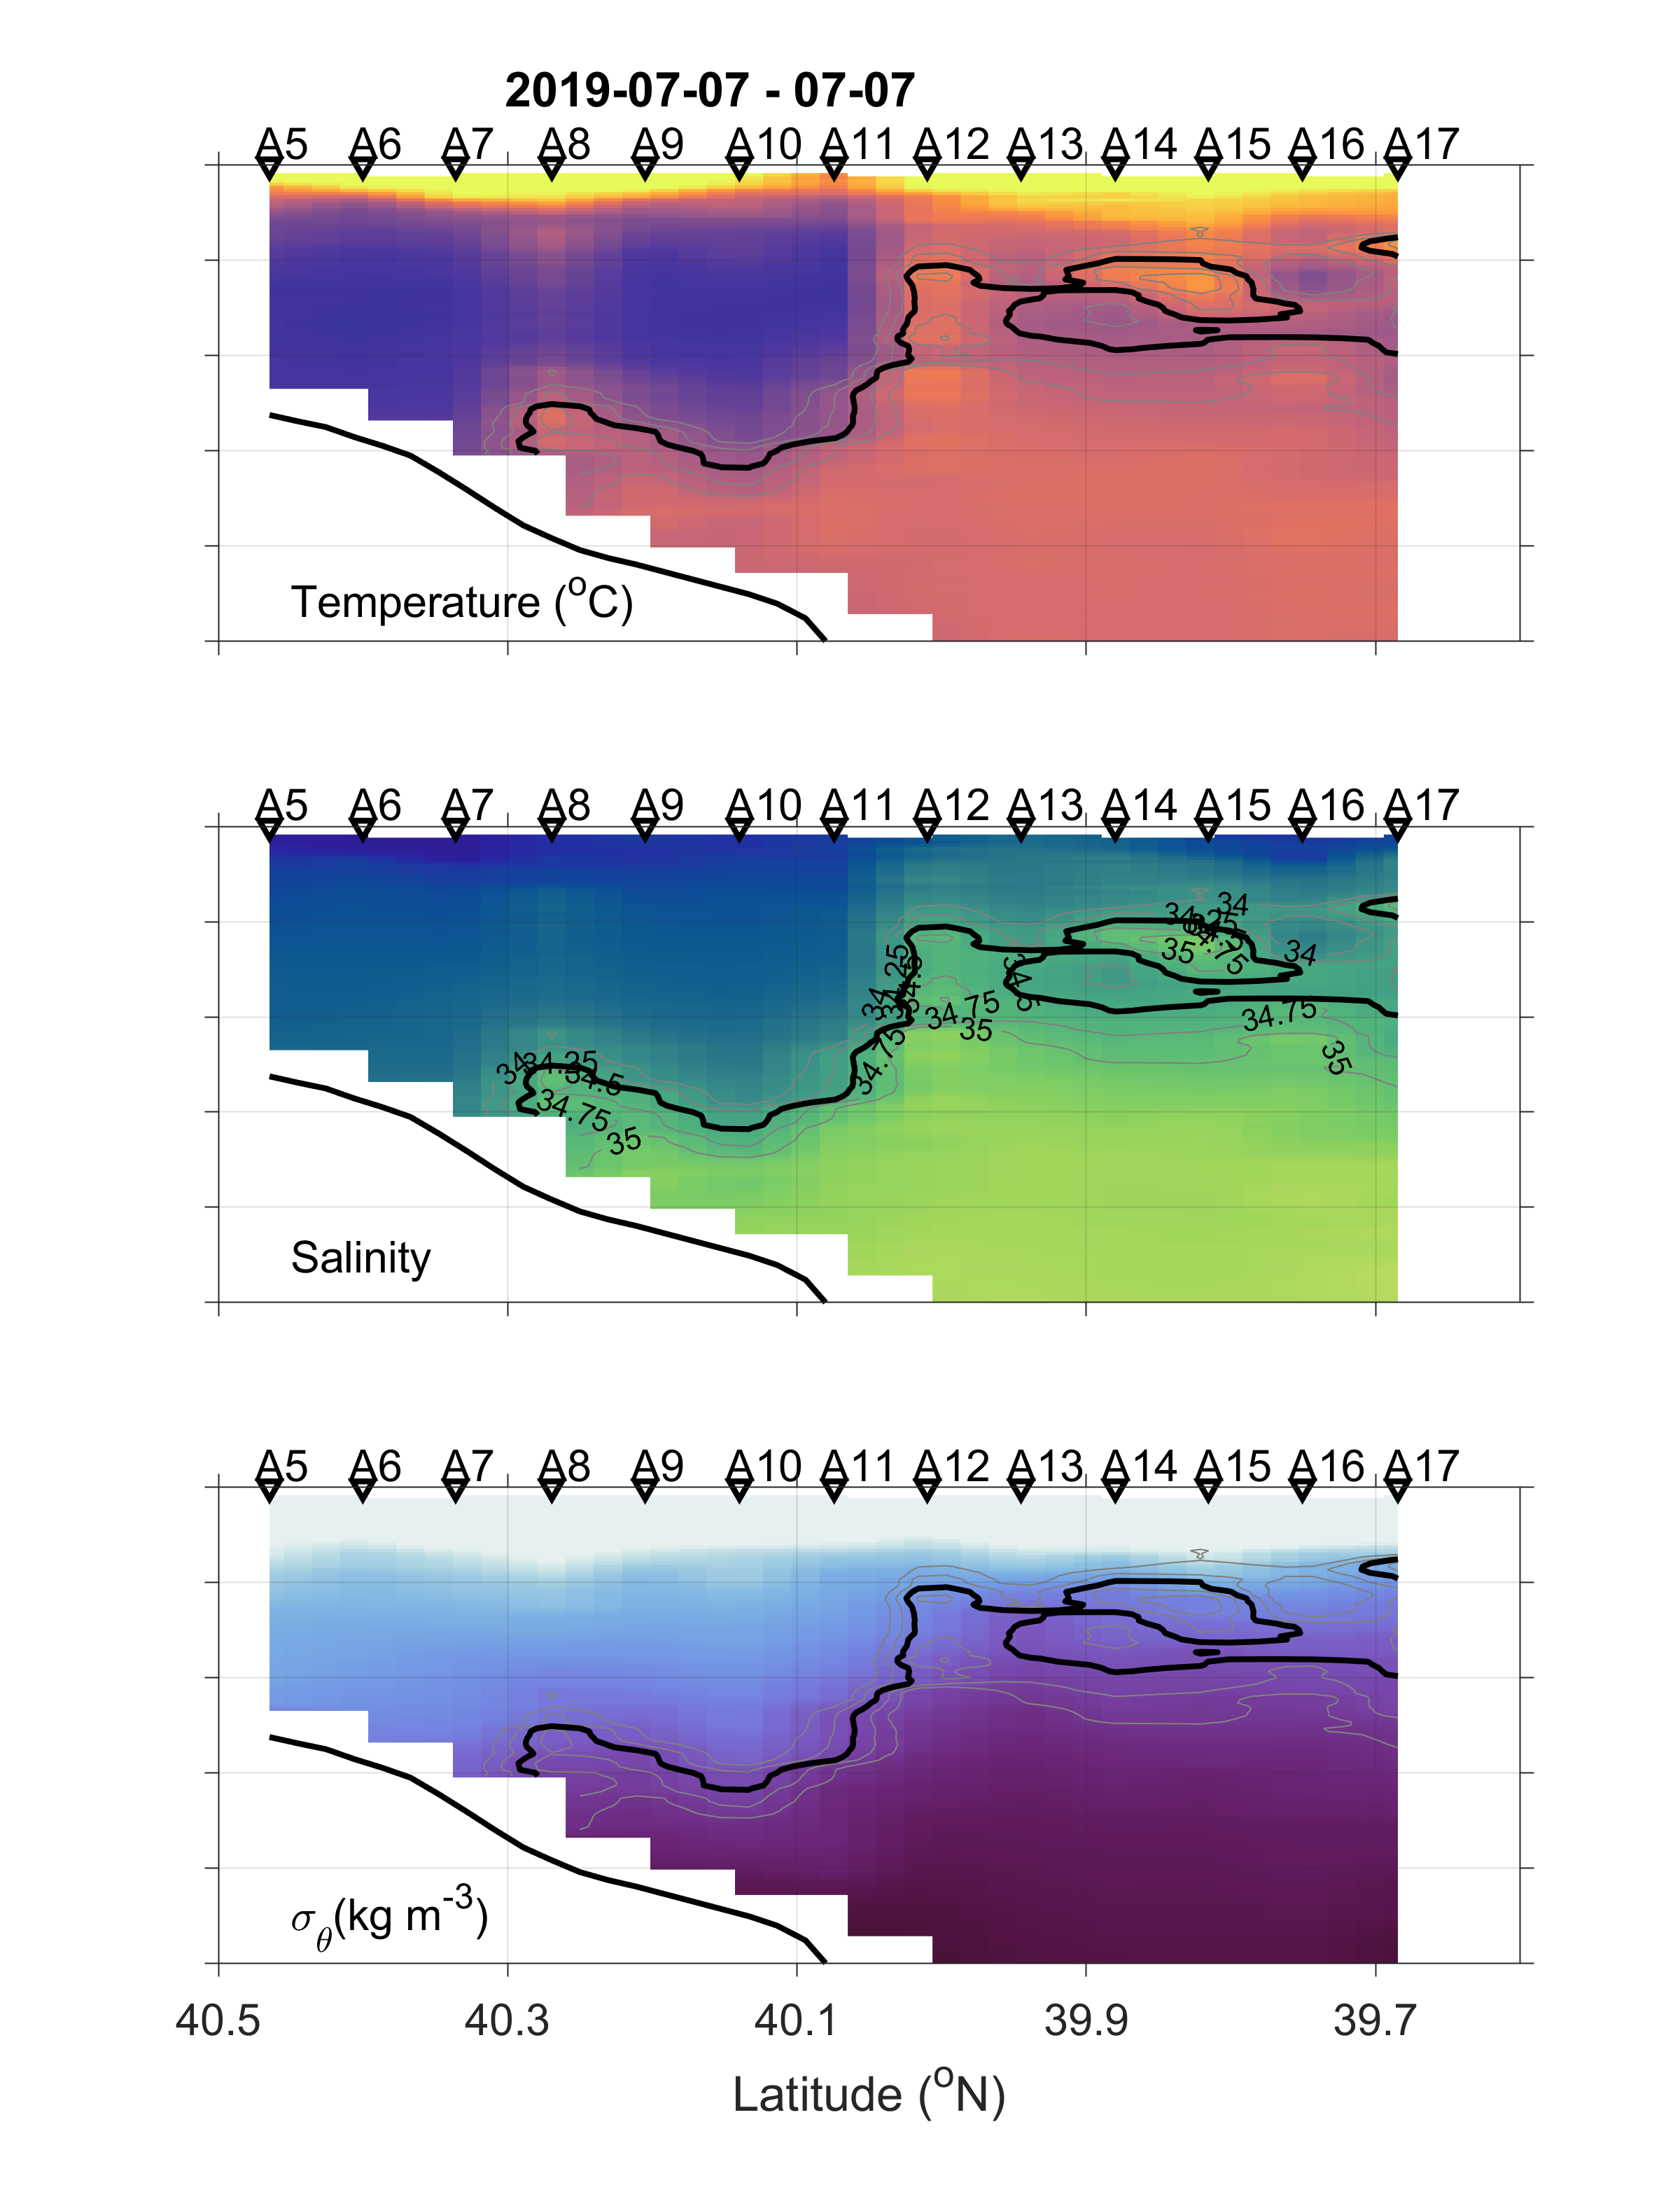
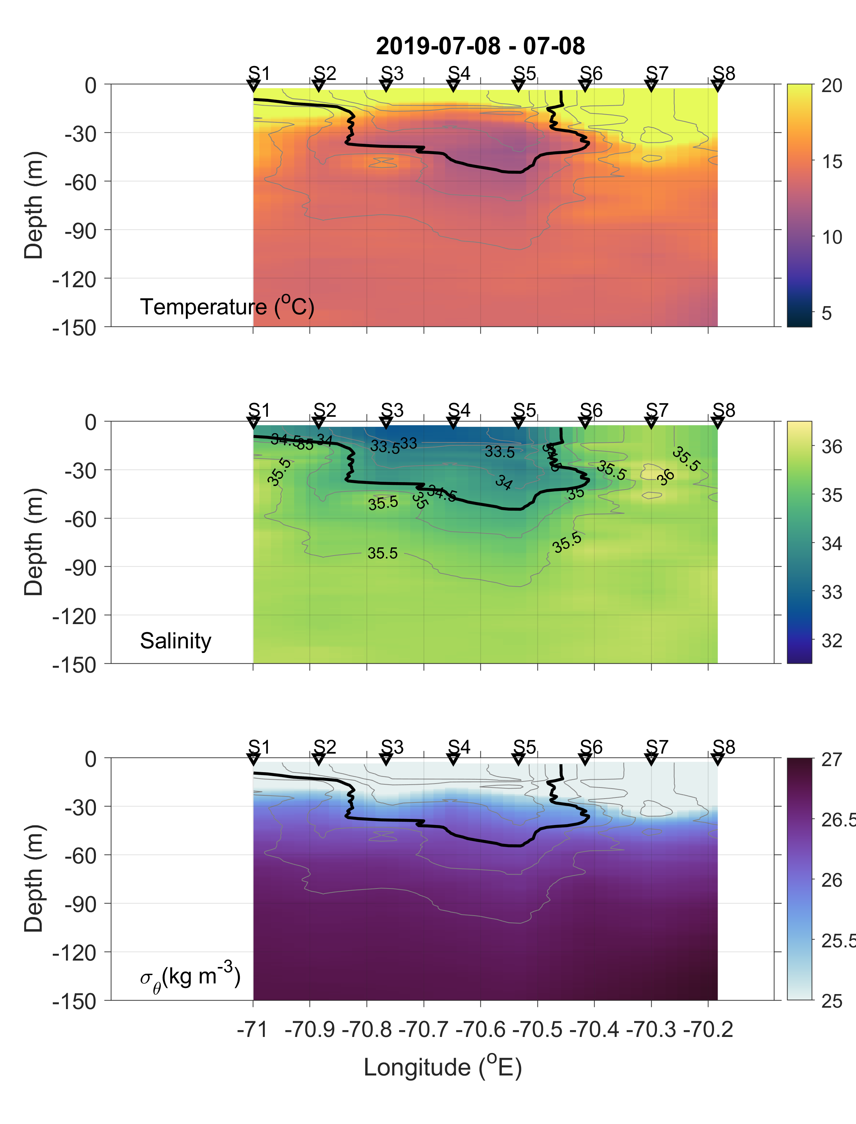
T−S structures reveal the changing nature of the front due to streamer
Black line shows isohaline of 34.5
Cross-shelf transect
Transect S in the slope sea

Slide 7
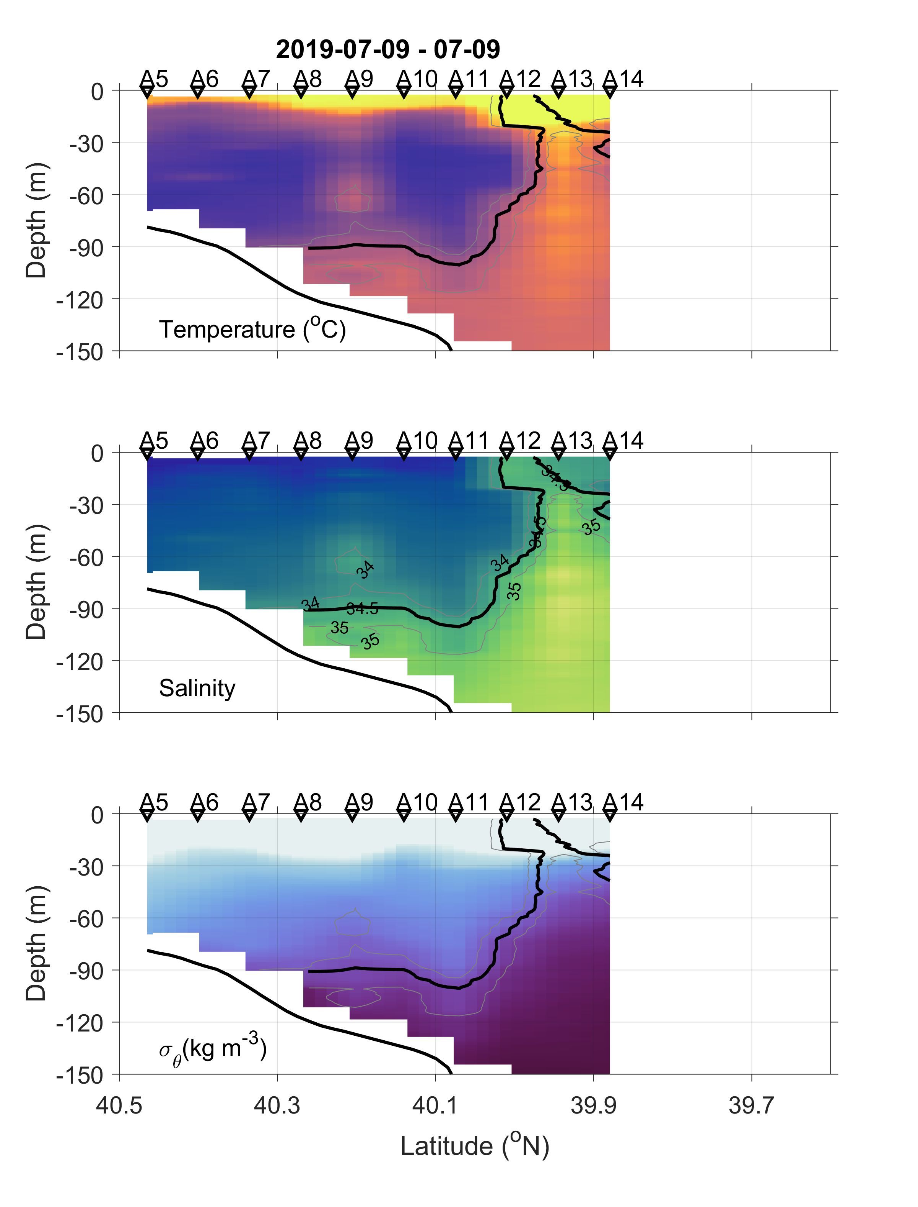
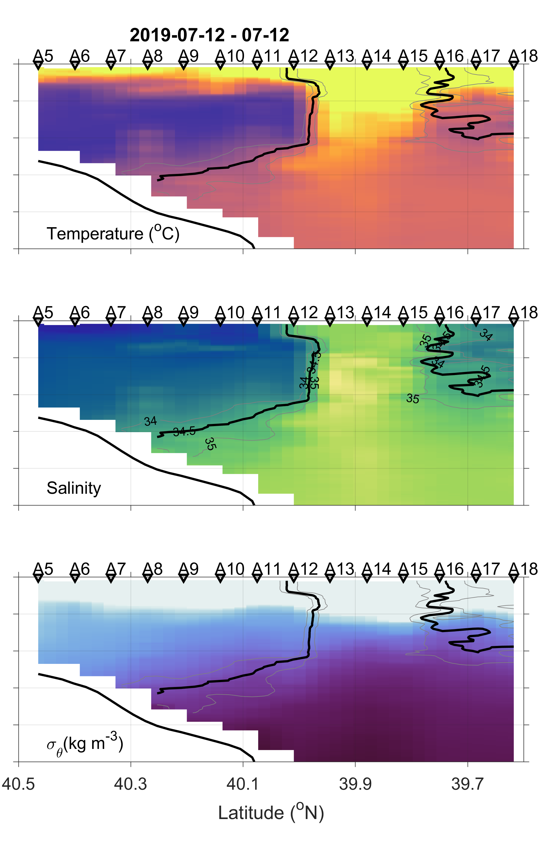
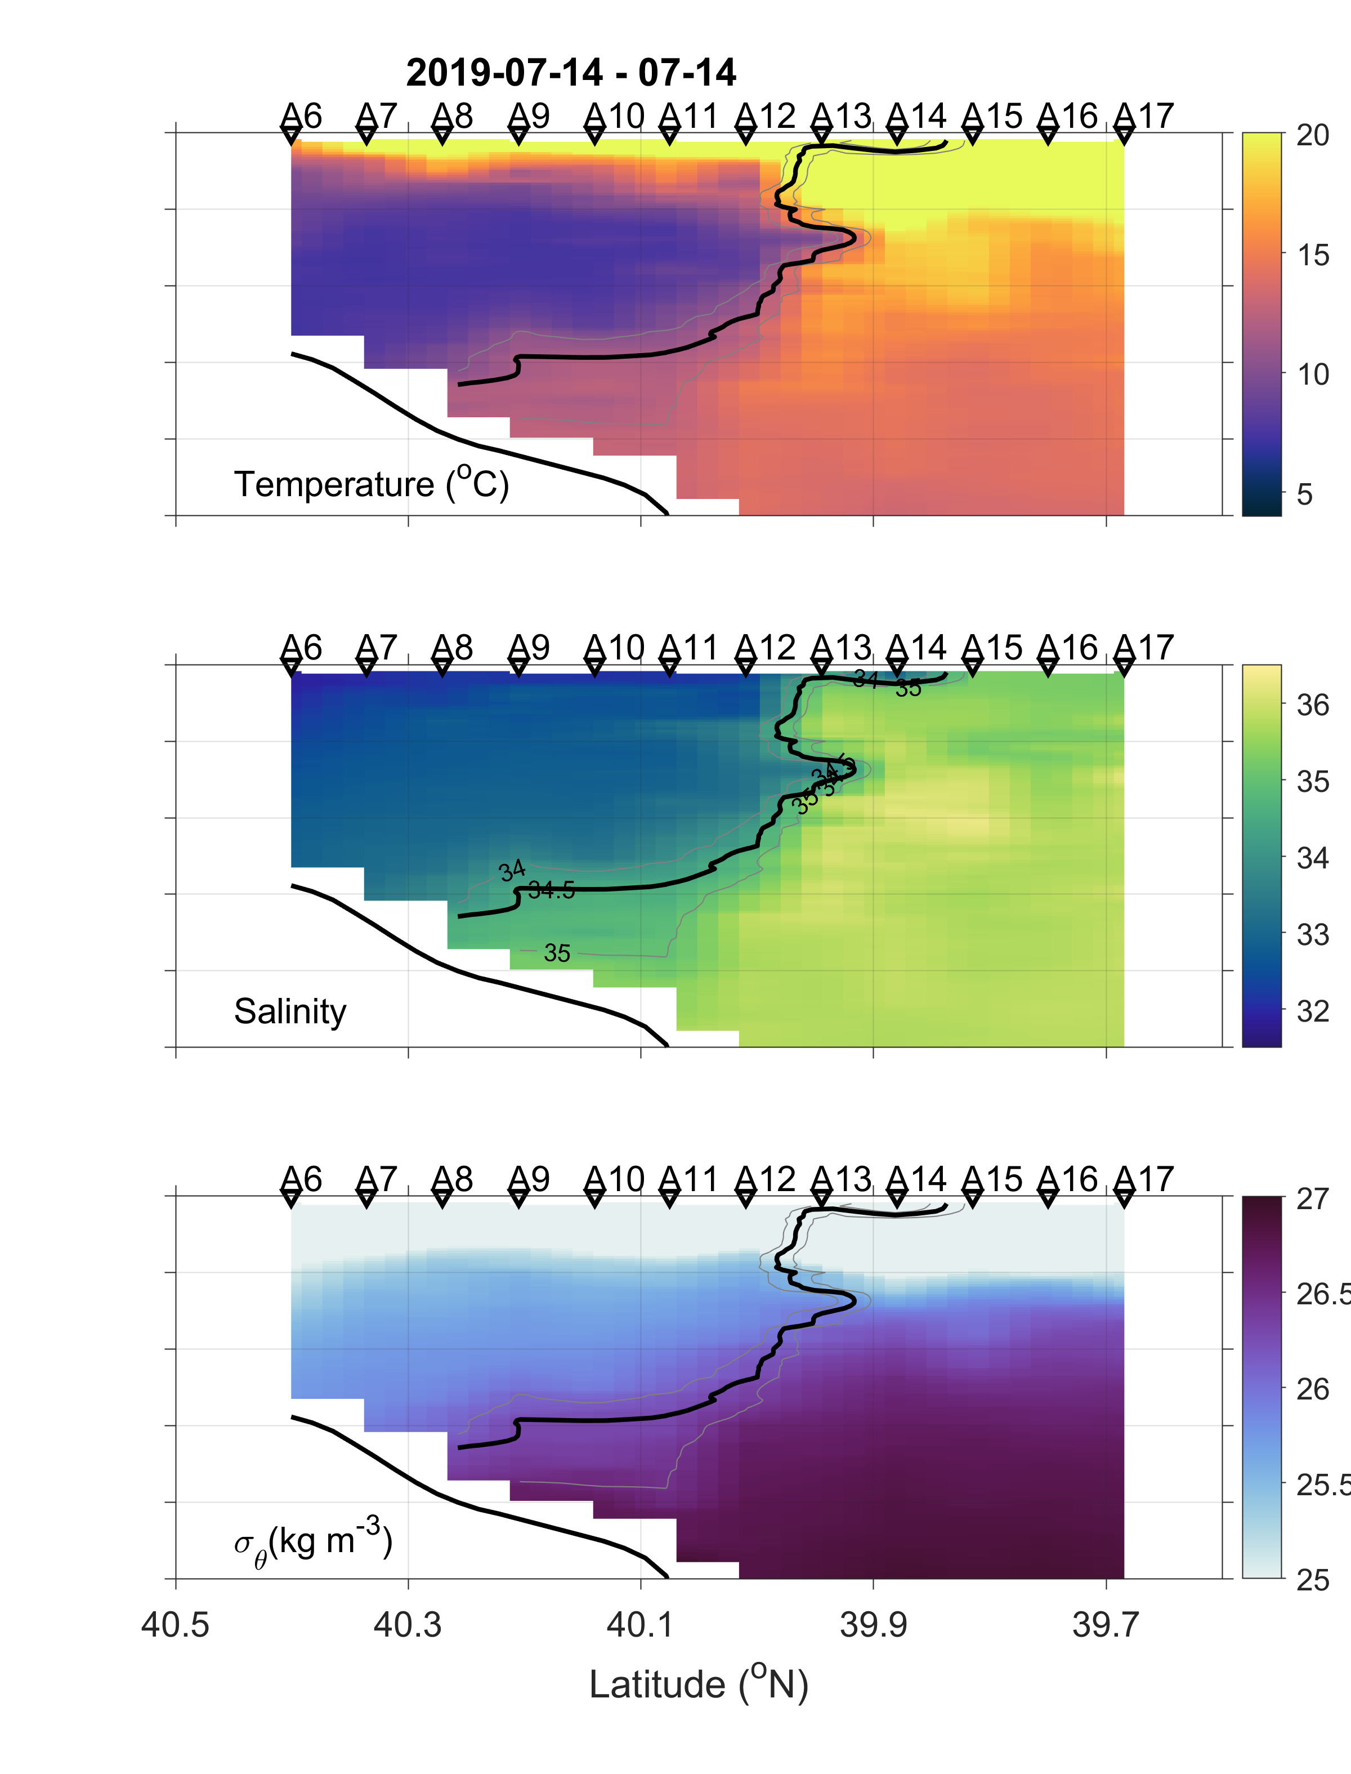
T−S structures reveal the changing nature of the front due to streamer
Black line shows isohaline of 34.5

Slide 8
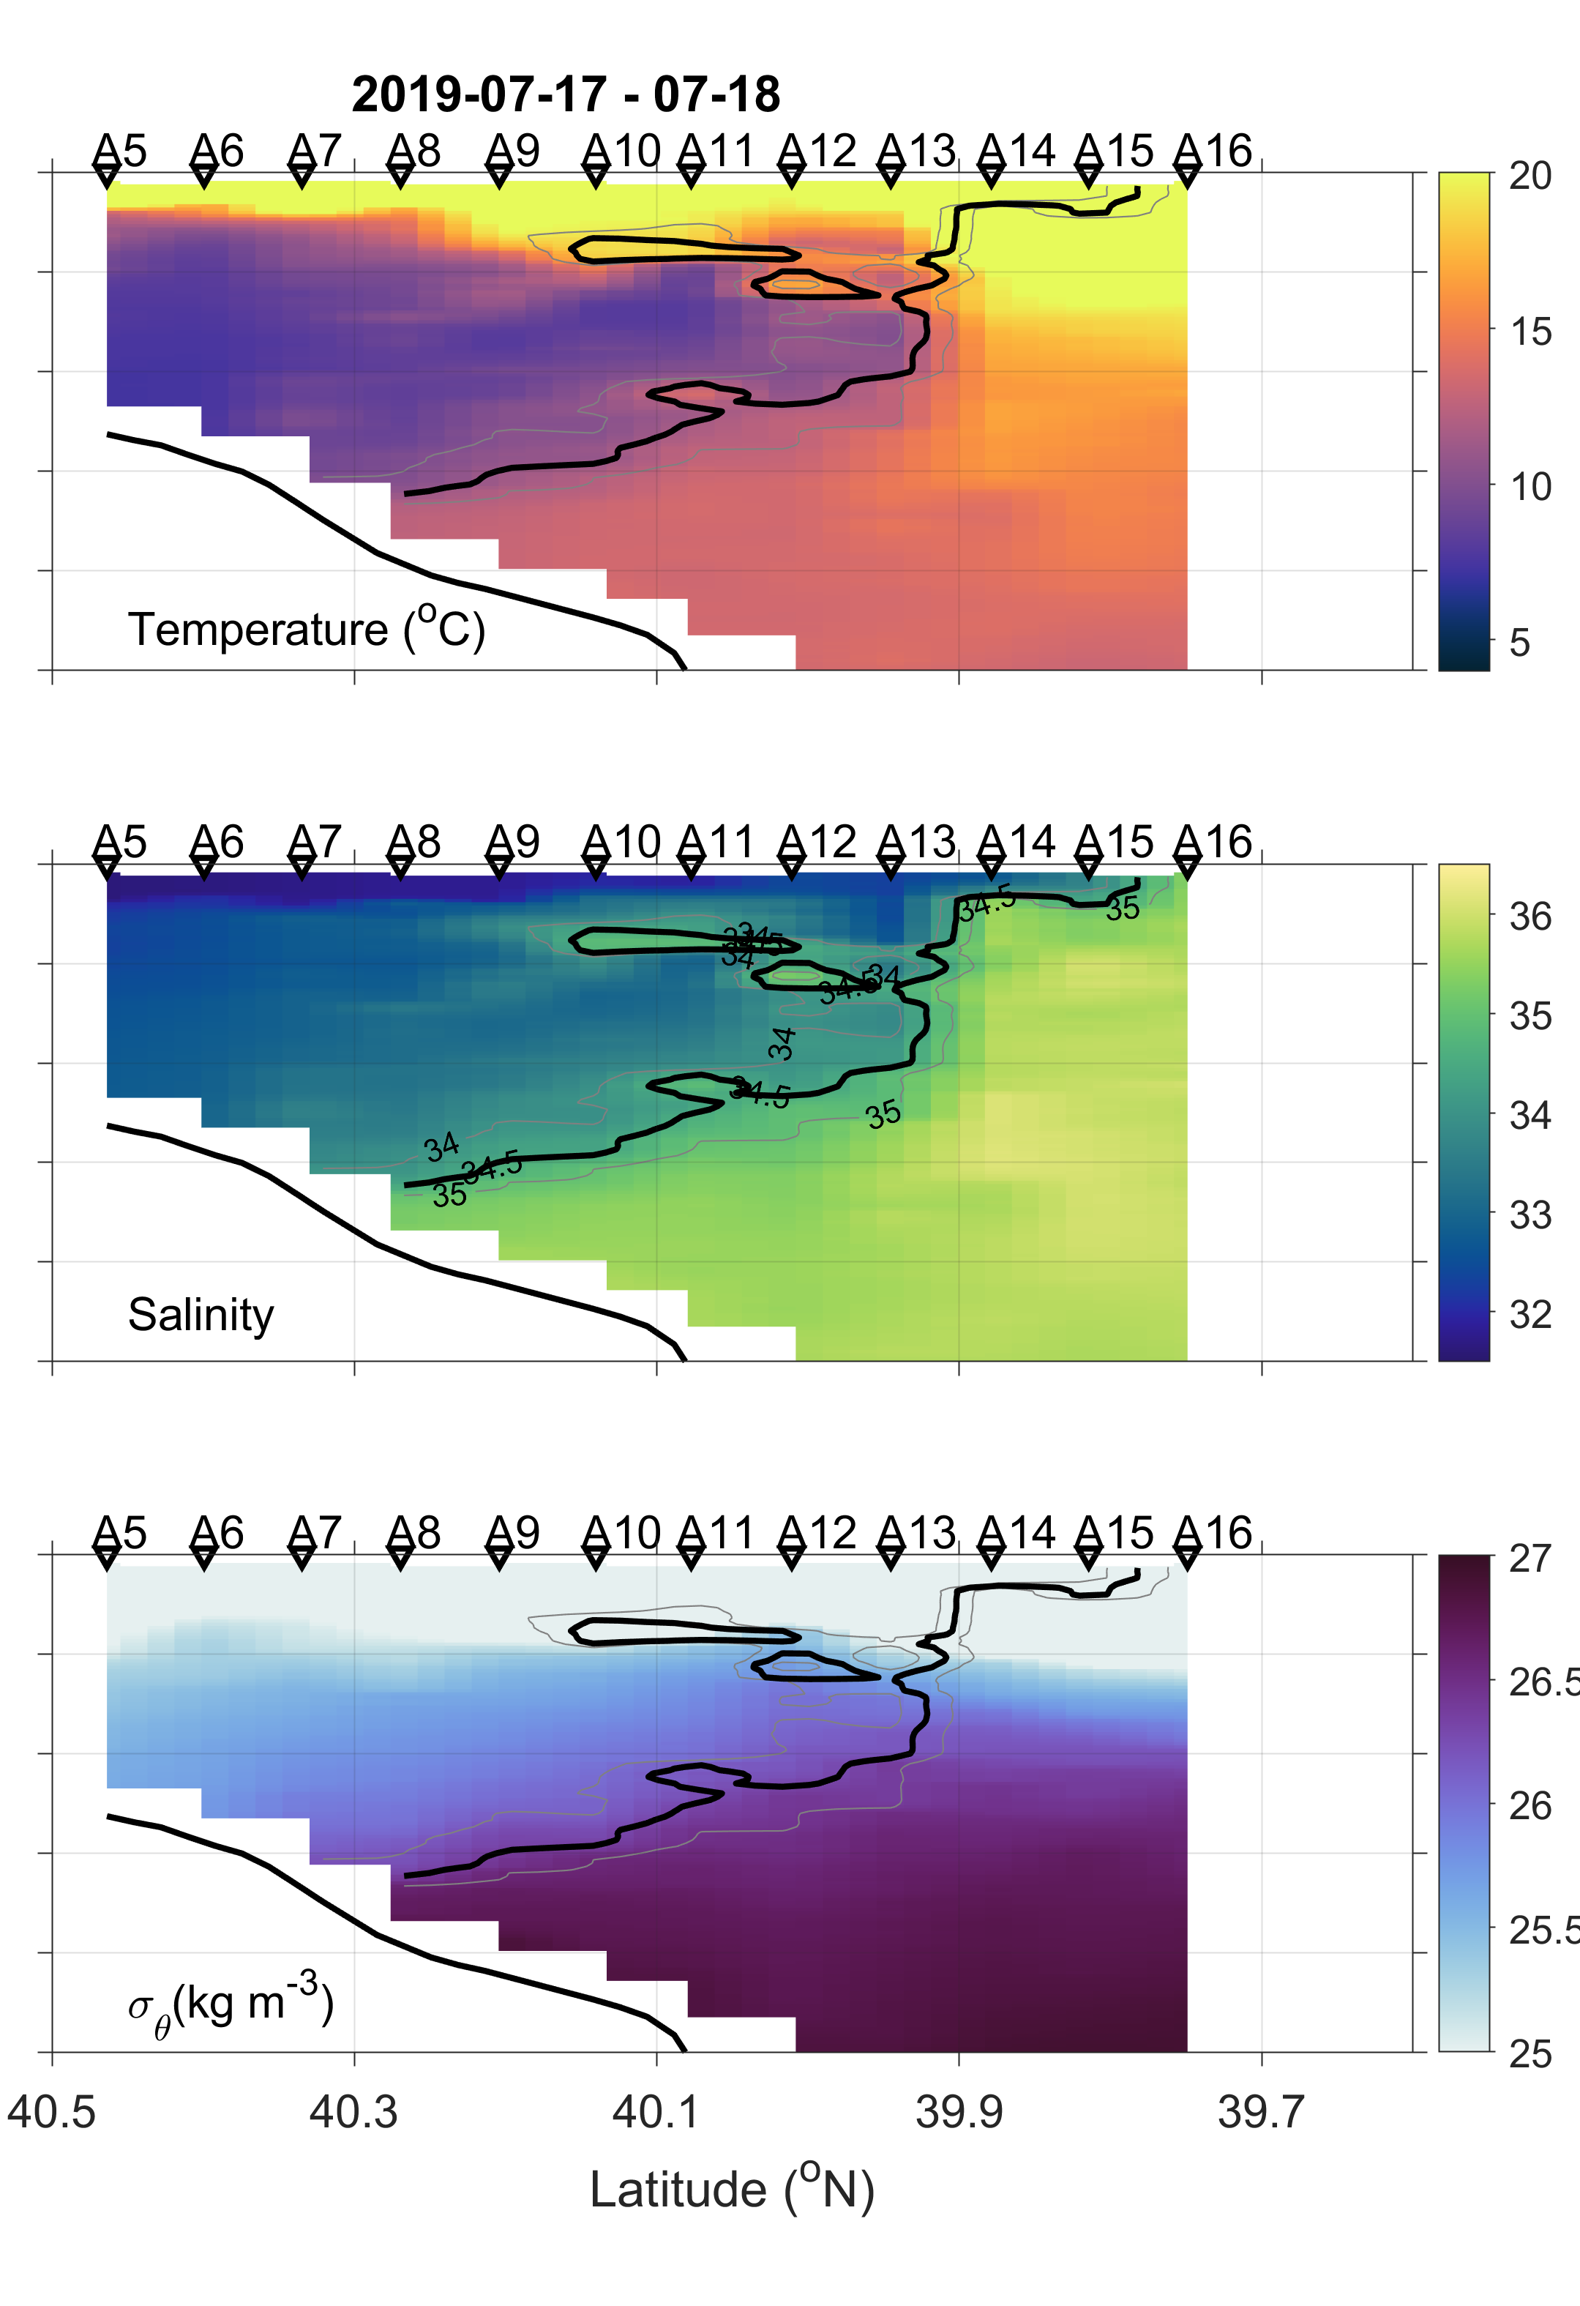
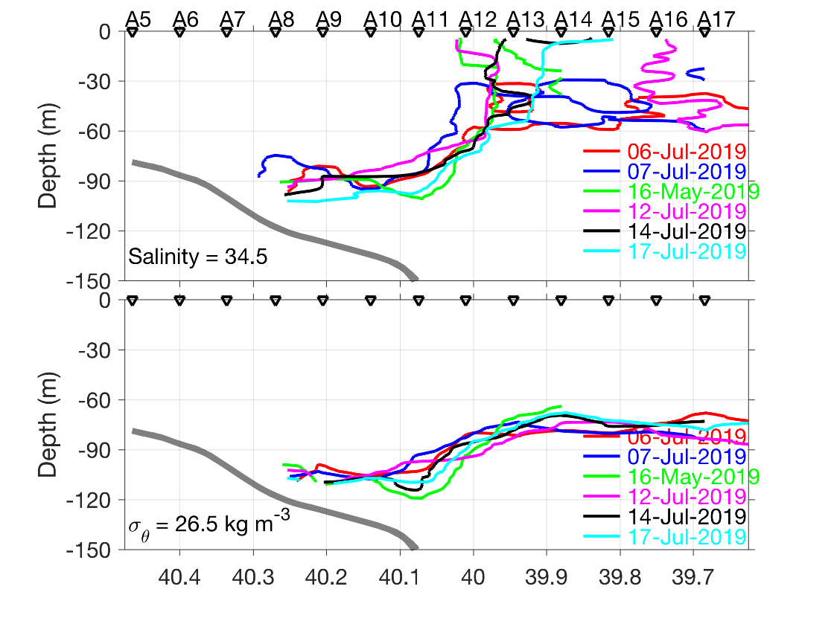
T−S structures reveal the changing nature of the front due to streamer
Black line shows isohaline of 34.5
Front variation

Slide 9
(a)
(c)
Consider the front as
$$34<S<35$$
(b)
(d)
[Chl] is controlled by nutrients at low nutrient con.
and by light when nutrients are saturating (Li and Hansell, 2016)
Other possibilities
Nutrients and light probably affect the variability of Chl at the DCMs
Two Chl hotspots were observed at shelf and slope waters

Slide 10
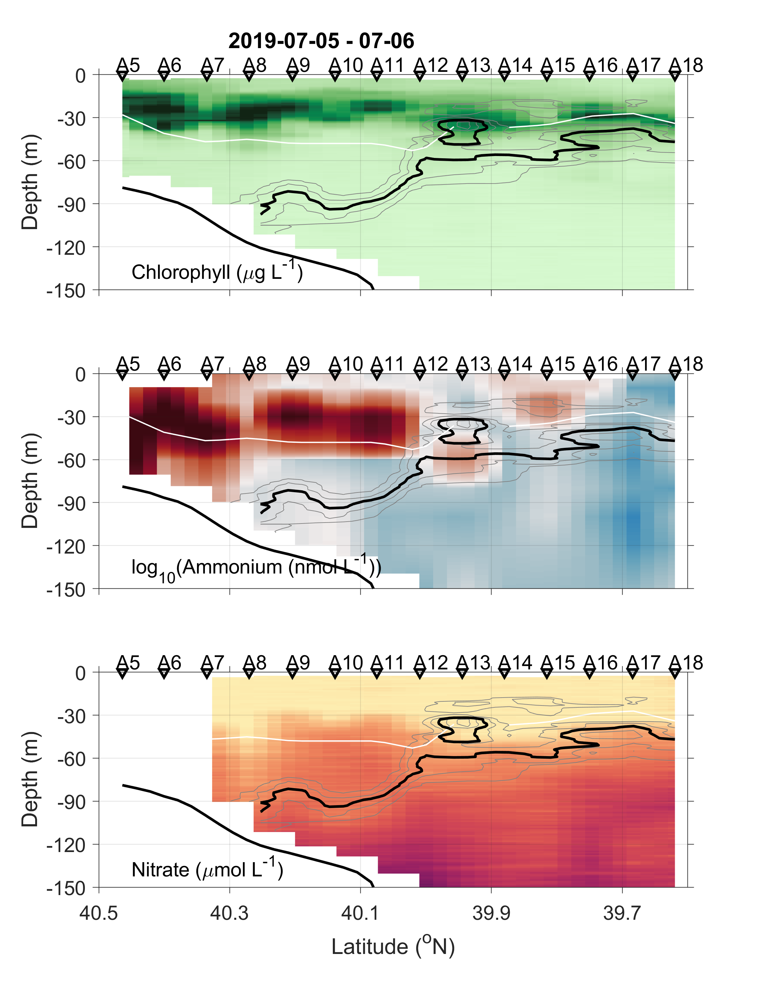
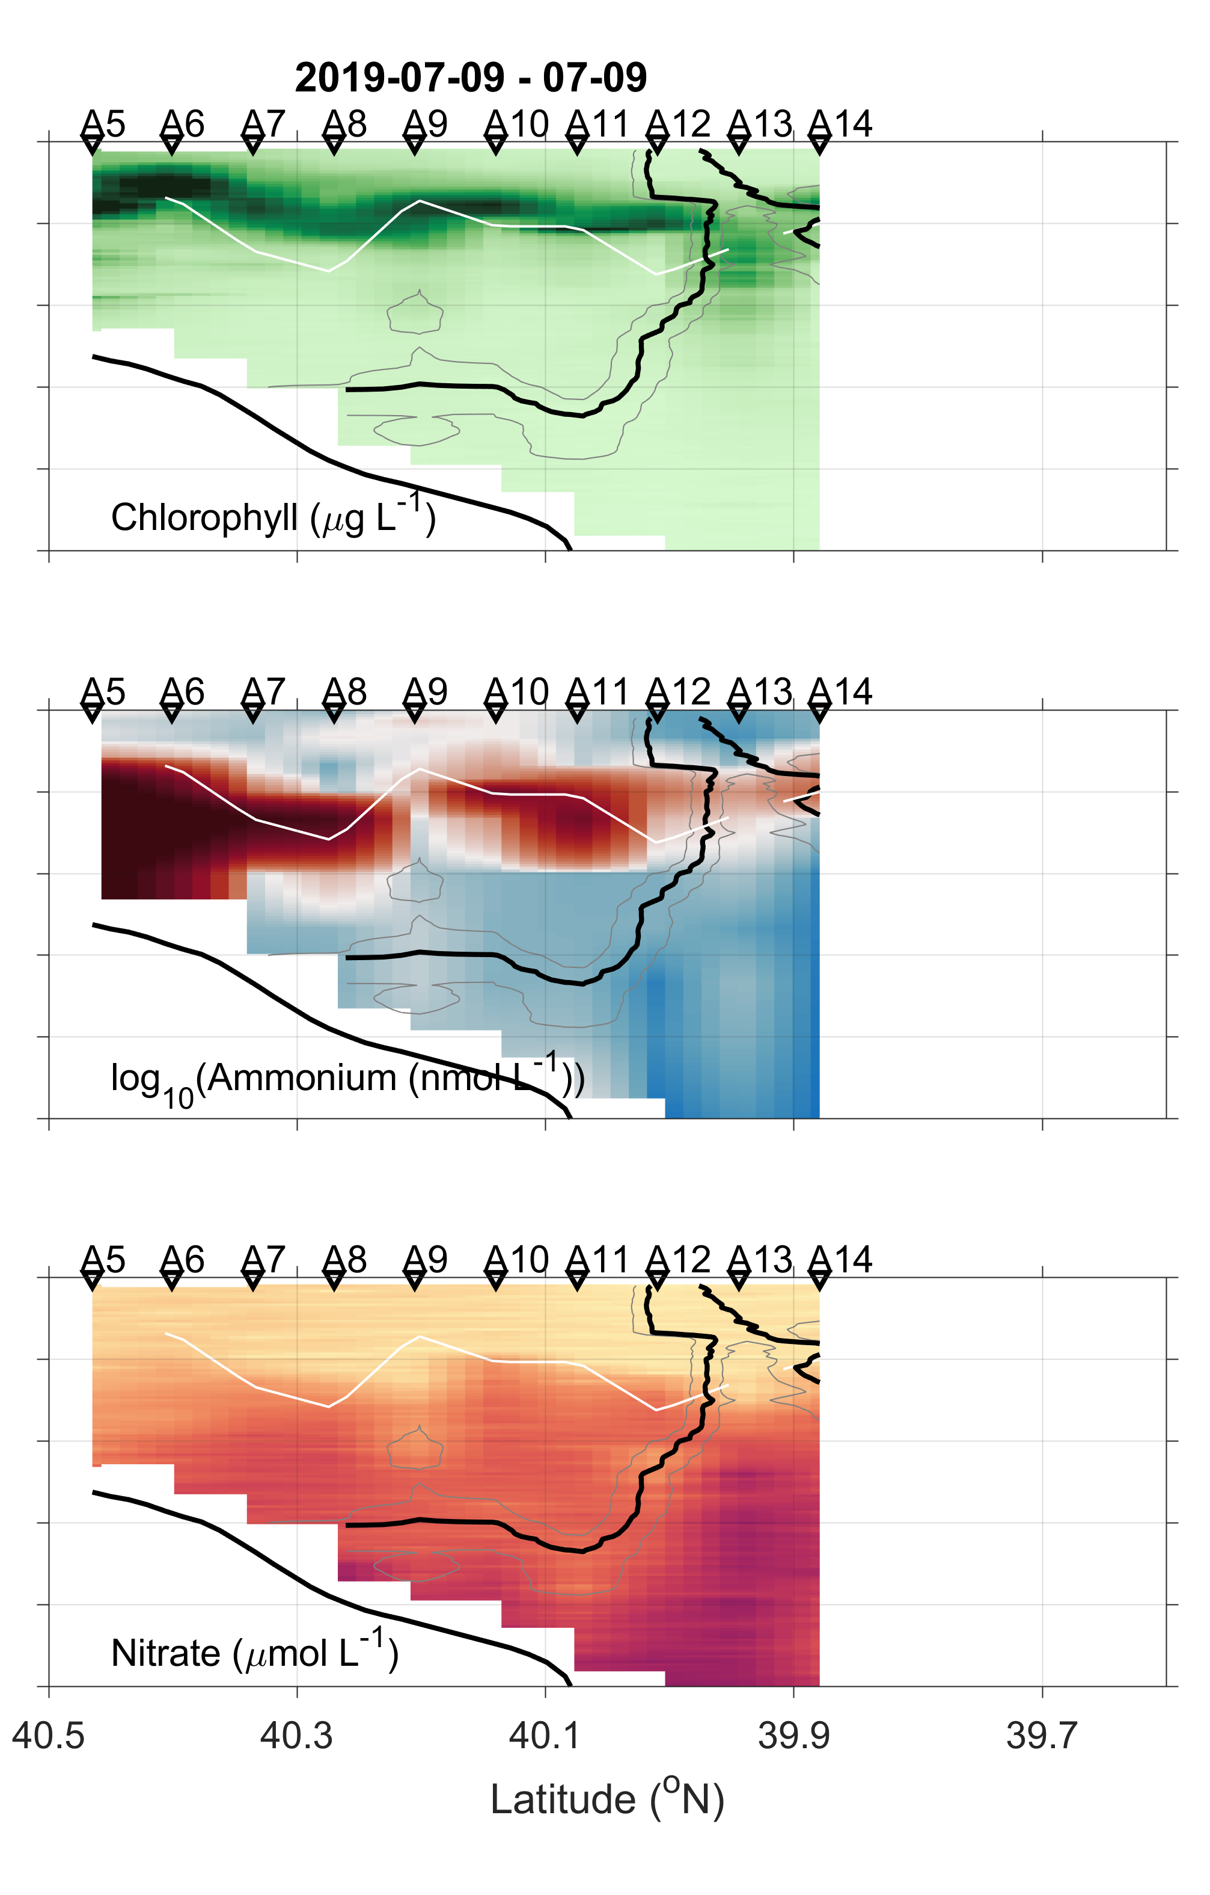
Ammonium distribution showing the subsurface maximum, closely coupled with euphotic depth and DCM
Black line shows isohaline of 34.5, white line shows euphotic depth with 1% surface PAR
(a)
(b)
(c)
(d)
(e)
(f)
(g)
(h)
(i)

Slide 11
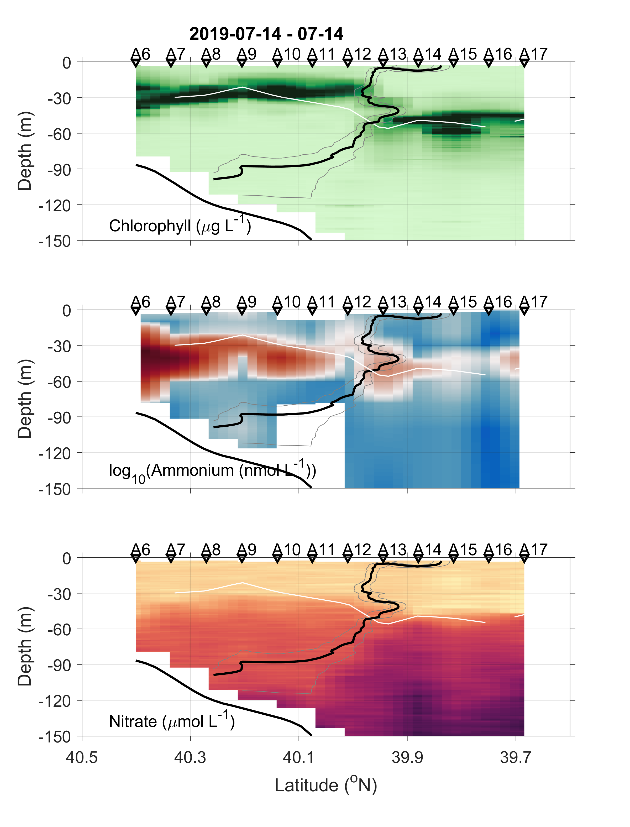
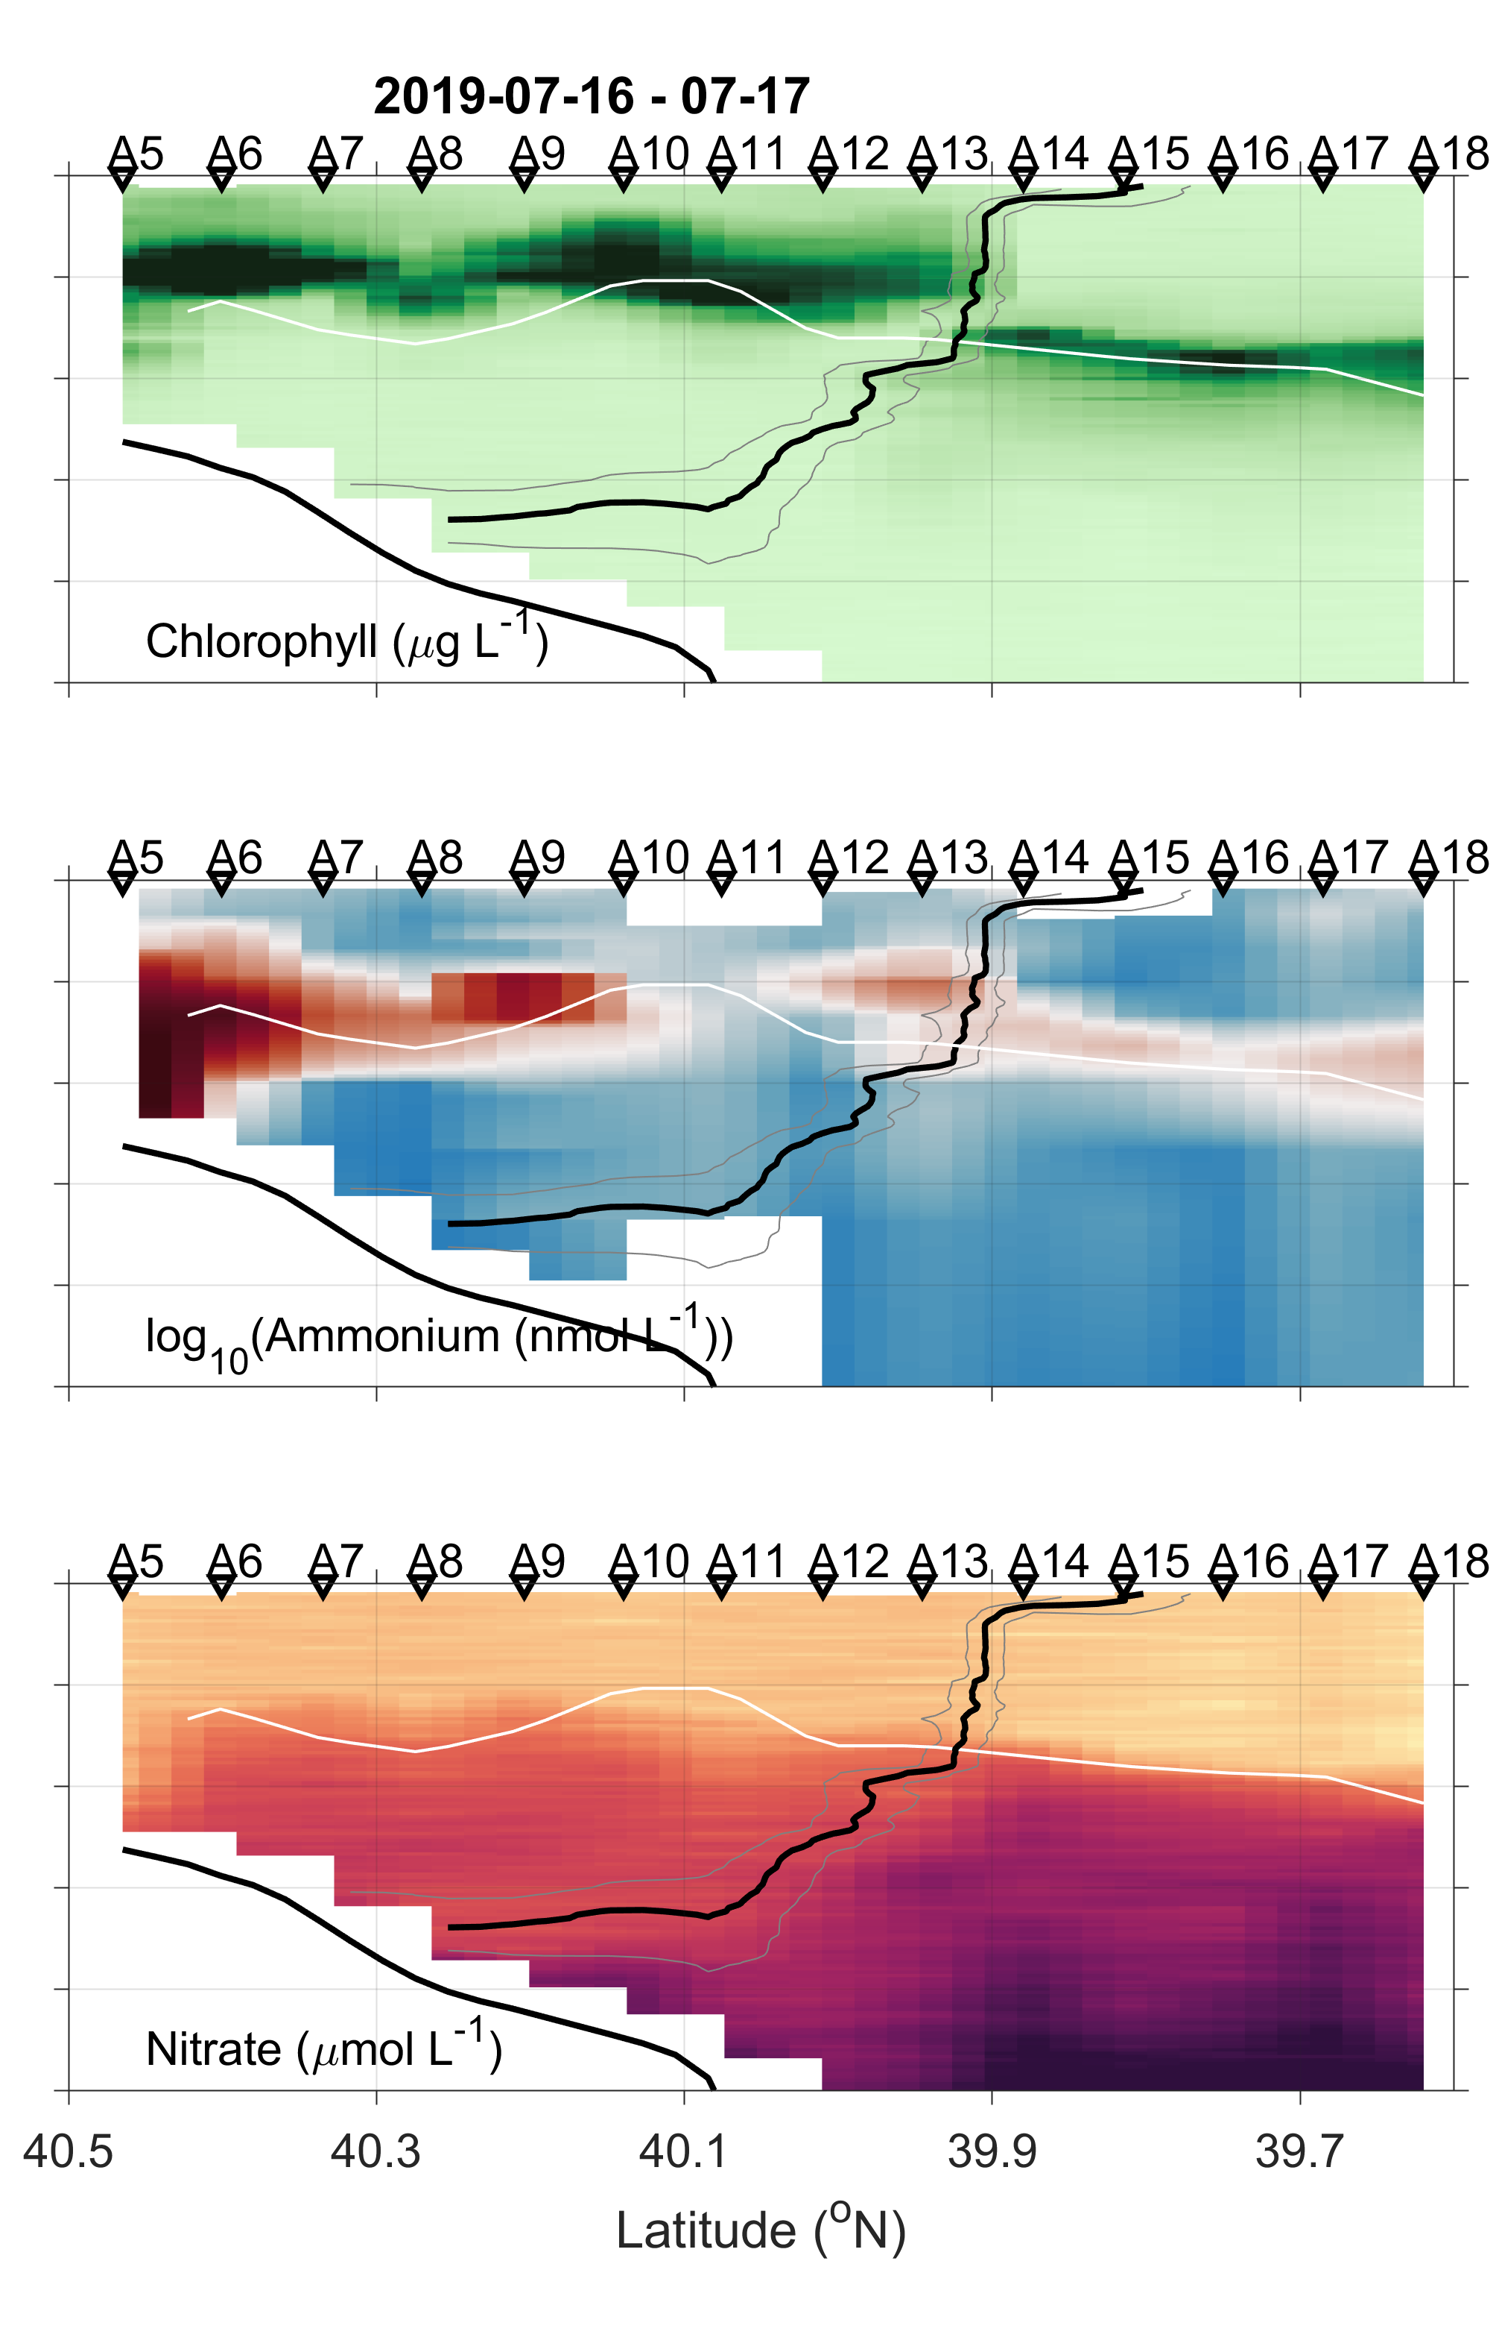
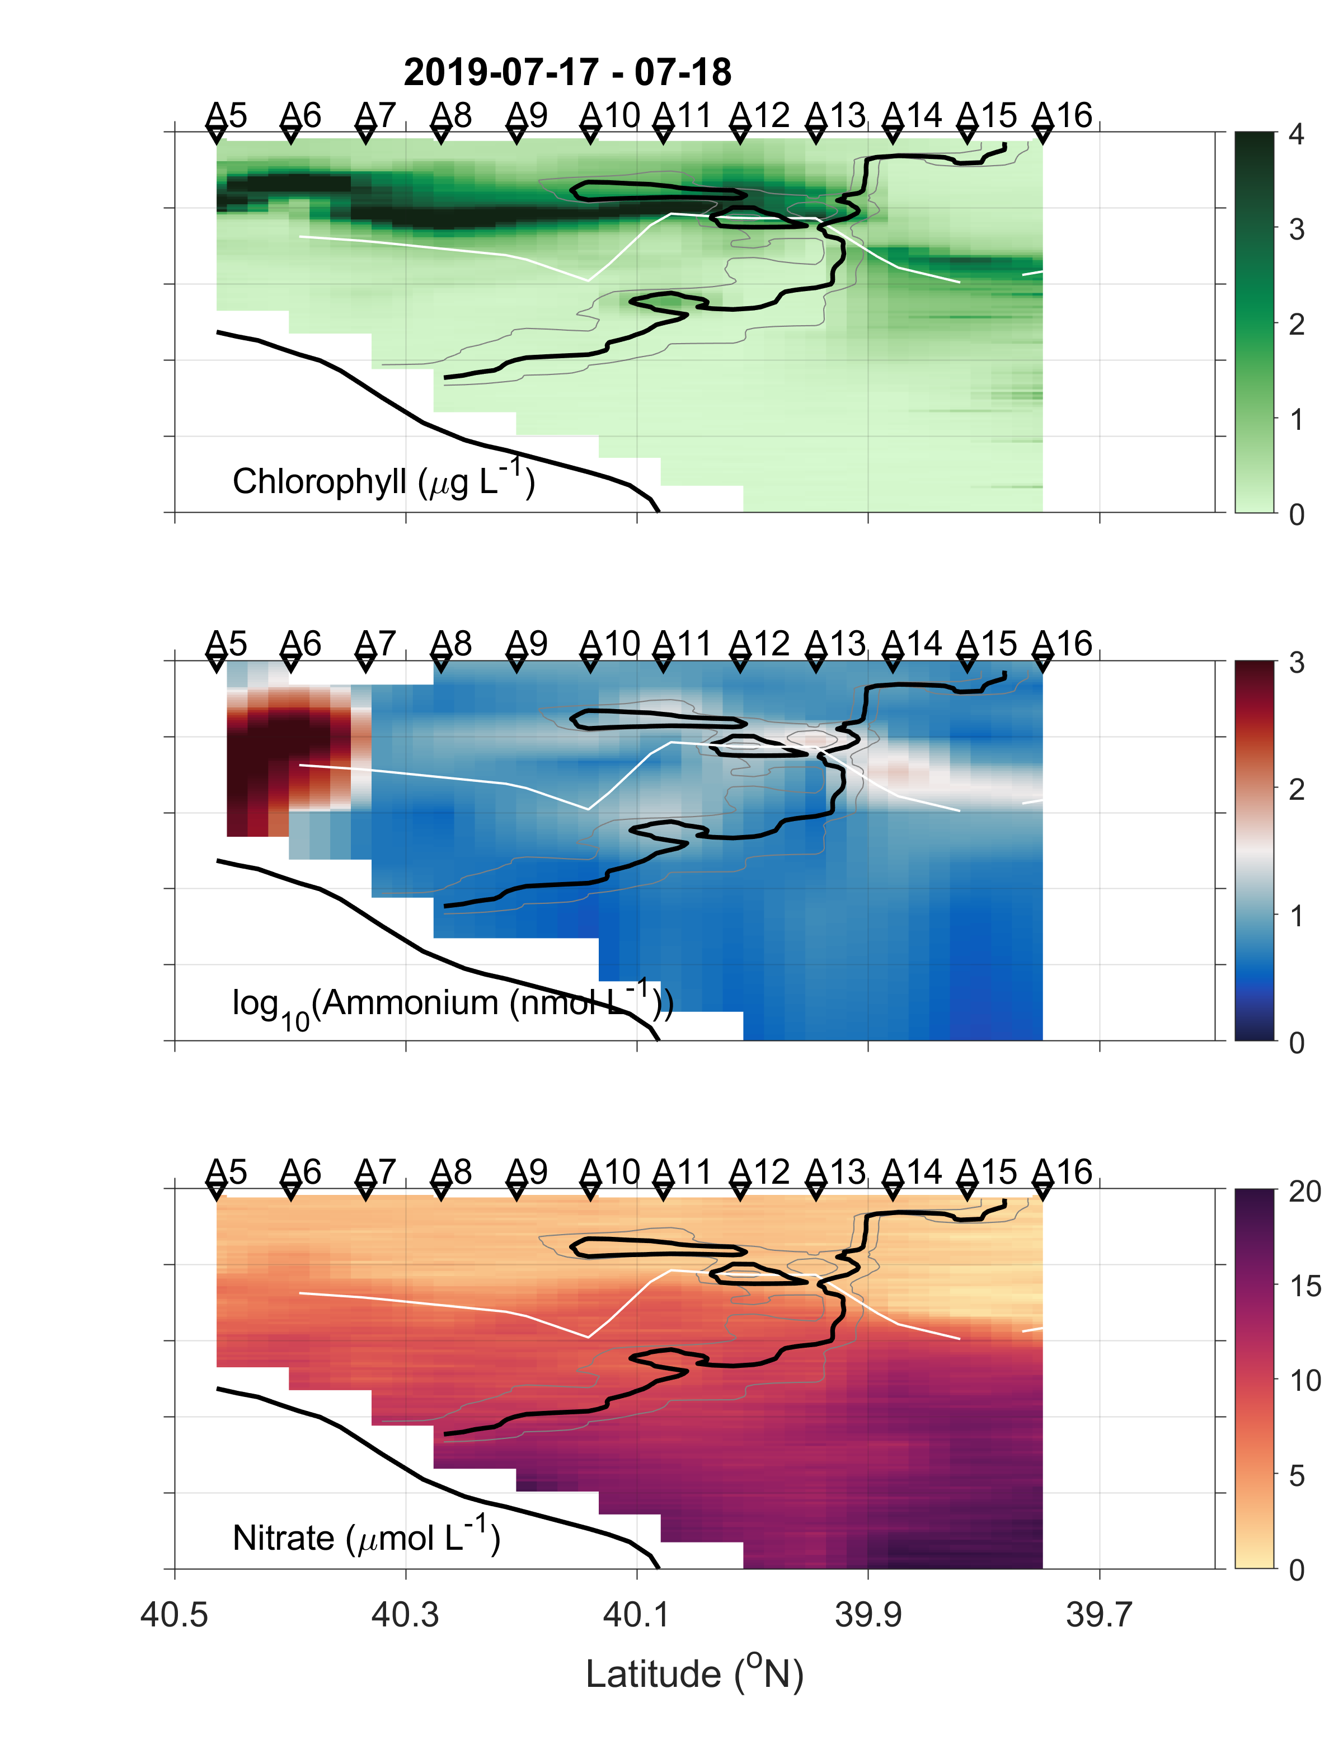
Ammonium distribution showing the subsurface maximum, closely coupled with euphotic depth and DCM
Black line shows isohaline of 34.5, white line shows euphotic depth with 1% surface PAR
(a)
(b)
(c)
(d)
(e)
(f)
(g)
(h)
(i)

Slide 12
Vertical profiles of Chl, PAR, PON, NH₄⁺, and NO₃⁻

Slide 13
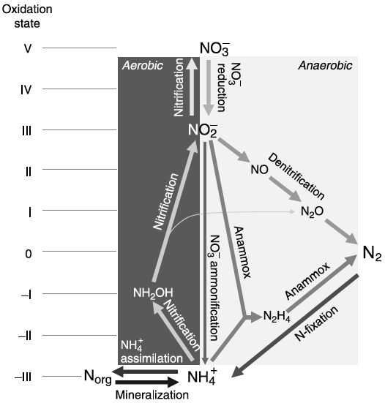
Microbial Nitrogen Transformations
Nitrification is a two-step process
AMO
HAO
Ammonia oxidation: NH₃ NH₂OH NO₂⁻
Archaeal amoA for ammonium oxidizing archaea (AOA)
Bacterial amoA for ammonium oxidizing bacteria (AOB)
16S RNA
Nitrite oxidation: NO₂⁻ NO₃⁻
16S rRNA of Nitrospina for nitrite oxidizing bacteria (NOB)
Notes:
AMO enzyme catalyzes the first and potentially rate-limiting step in nitrification, amoA gene is a useful phylogenetic marker for studying the distribution and abundance of ammonia-oxidizing organisms in the environment

Slide 14
AOA and NOB were not detected at surface depth, 48% vs 62%.
AOA increased with depth in all water sampled.
AOB and NOB increased with depth in shelf and front waters, but remained constant in slope waters

Slide 15
NOB outnumbered AOA and AOB by 1-2 order of magnitude
Shelf waters has highest AOB and NOB, but lowest AOA
Slope waters has highest AOA, but lowest AOB and NOB
Front acts like transitional regime
A shift of dominance from shelf to slope for AOA? Opposite for NOB and AOB.

Slide 16
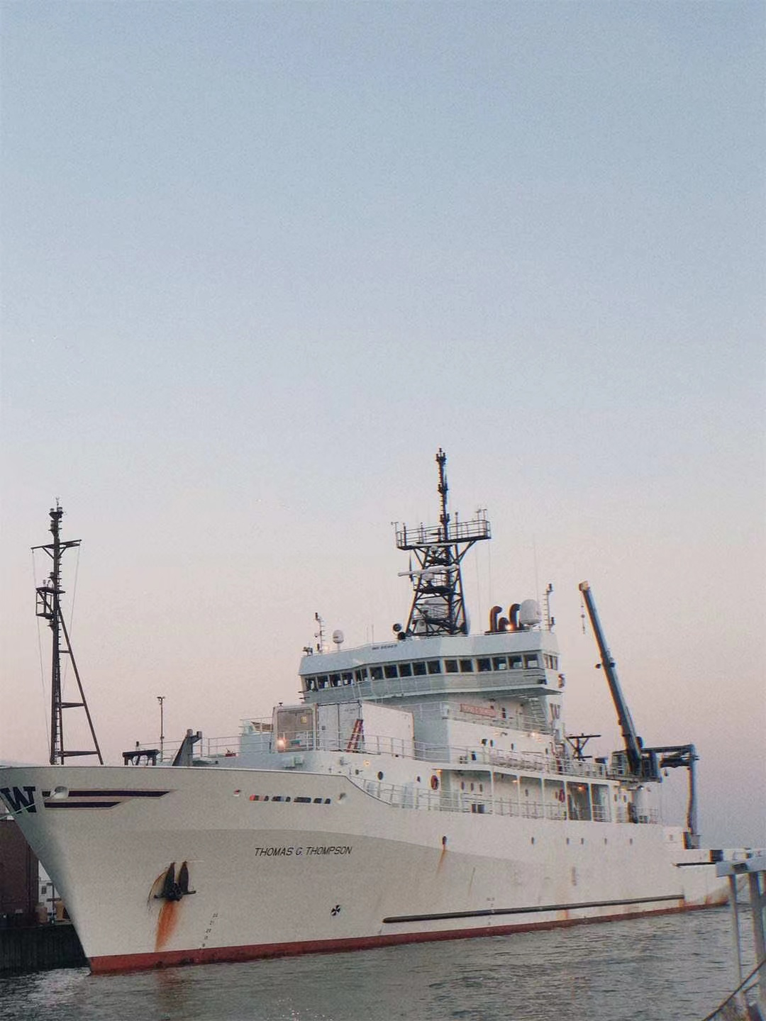
Conclusion
Acknowledgments
R/V Thomas Thompson
SPIROPA project funded by NSF
Cruise participation was supported by a grant
from OES to MRM, PDC, and SC
Hillegass & Dorothy Brown scholarships to YZ
Is ammonium cycling enhanced at the mid-Atlantic Bight shelf-break front, as observed in the South China Sea-Kuroshio front?
Seems not!
1. Chl was not enhanced at the front
2. Ammonium was not enhanced at the front
3. Nitrifiers abundance was not enhanced at the front
Future work
1. Investigate the interactions among light − nutrient − Chl maximum
2. Examine the role of environmental factor, e.g., substrate conc, temperature, and salinity on nitrifiers abundance

