Slide 1

Ekman restratification drives ephemeral surface chlorophyll enhancements at the New England shelf break
Hilde Oliver, Weifeng Gordon Zhang, Kevin M. Archibald, Andrew J. Hirzel, Walker O. Smith, Jr., Heidi M. Sosik, Rachel H. R. Stanley, Dennis J. McGillicuddy, Jr.
JGR-Oceans (2022)
https://doi.org/10.1029/2021JC017715

Slide 2


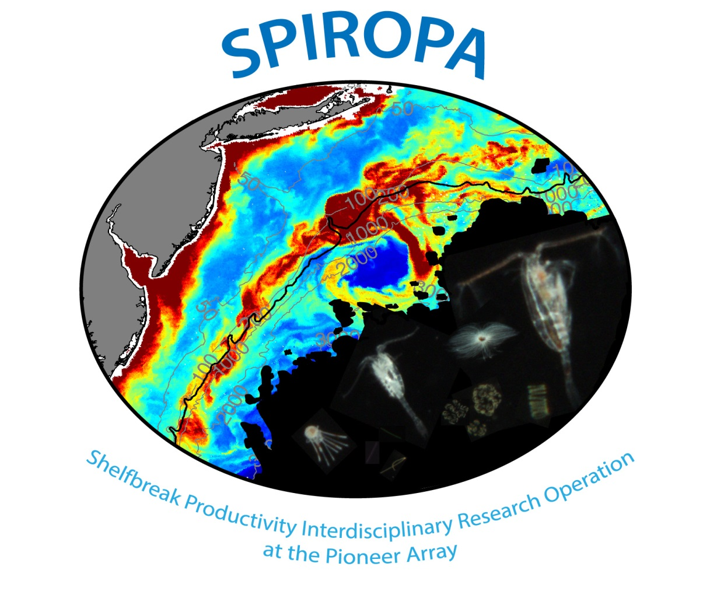






McGillicuddy
Sosik
Zhang
Turner
Petitpas
Stanley
Smith

Slide 3
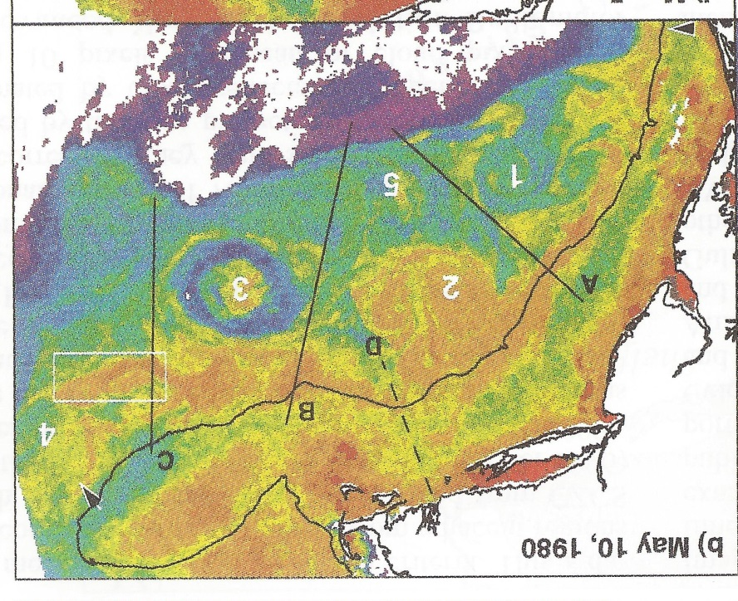
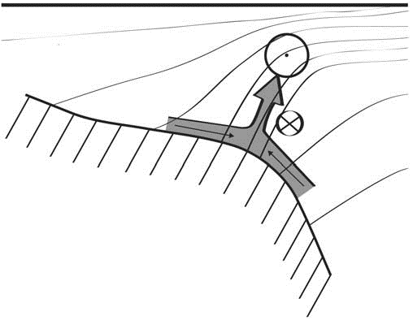
Shelfbreak frontal dynamics: mechanisms of upwelling, net community production, and ecological implications
Zhang et al. 2011
Ryan et al. 1999
Linder et al. 2004
Gawarkiewicz and Chapman 1992
Chapman and Lentz 1994
Marra et al. 1990

Slide 4


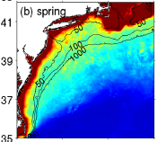

2013, JGR
Satellite CHL climatology
Why is there no mean enhancement of chlorophyll at the shelf break front?
H₁: Top-down control by zooplankton grazing
H₂: Spatial and temporal intermittency of the upwelling events causes their net impact to be smoothed out in long-term means.

Slide 5
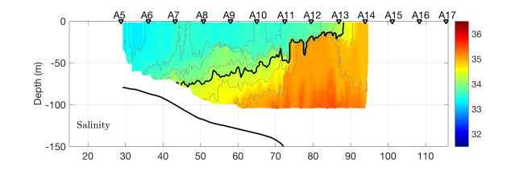
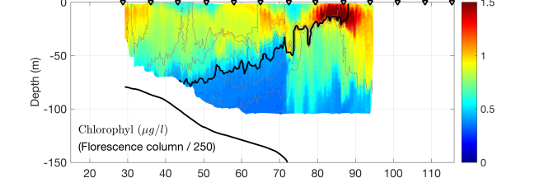
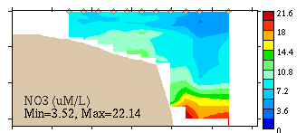
Why is enhanced chlorophyll not visible in the seasonal means?
Hypothesis 1: Spatial and temporal intermittency
S=34.5
VPR tow #1
R/V Neil Armstrong
18 April 2018
Salinity
Chlorophyll F
Across shelf distance (km)
CTD section #1
Surface nitrate > 3µM
Nitrate

Slide 6
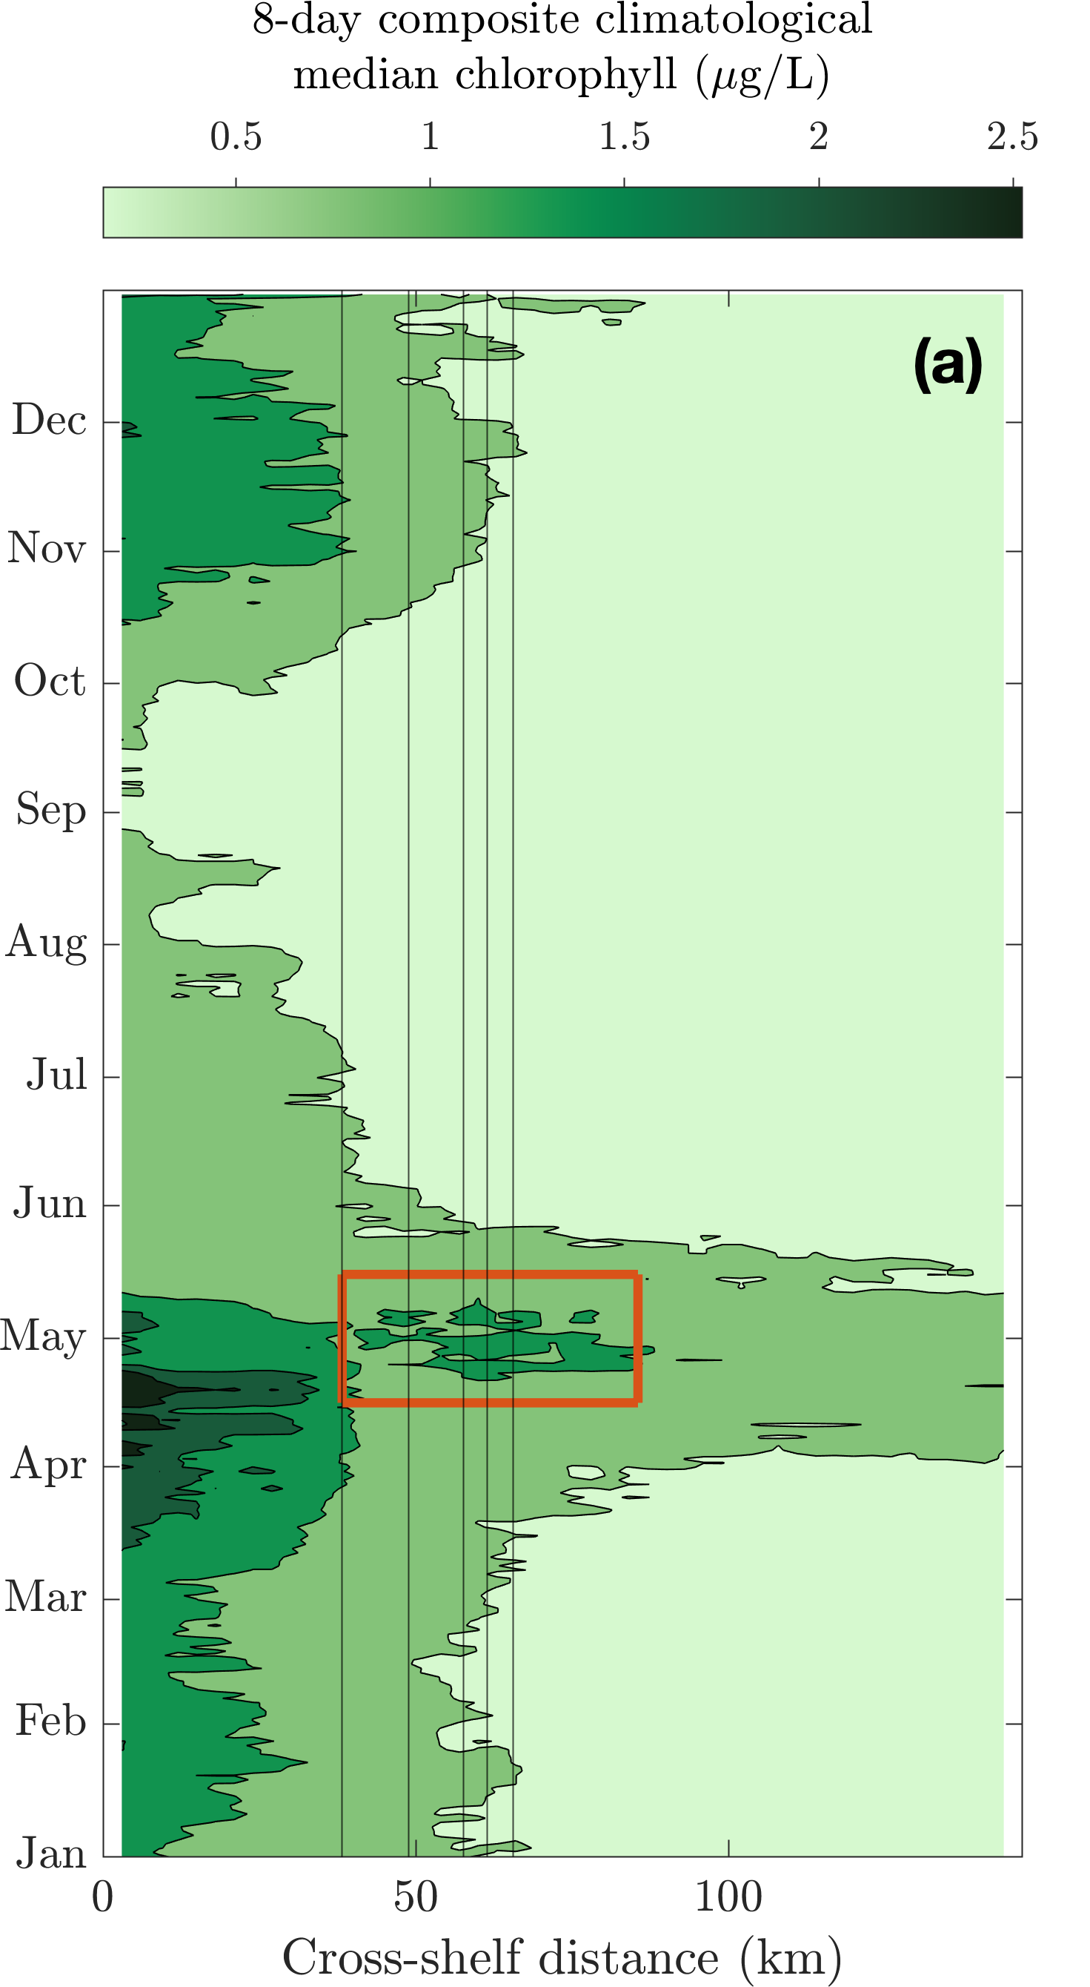
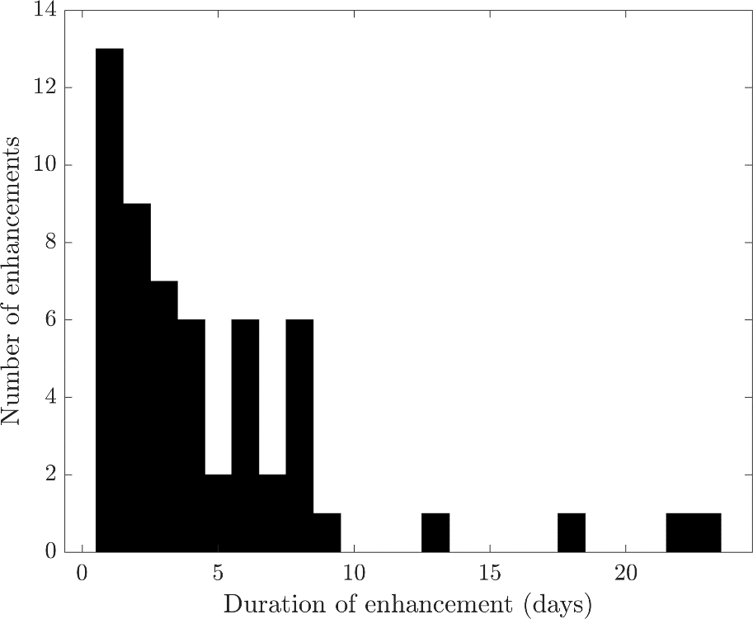
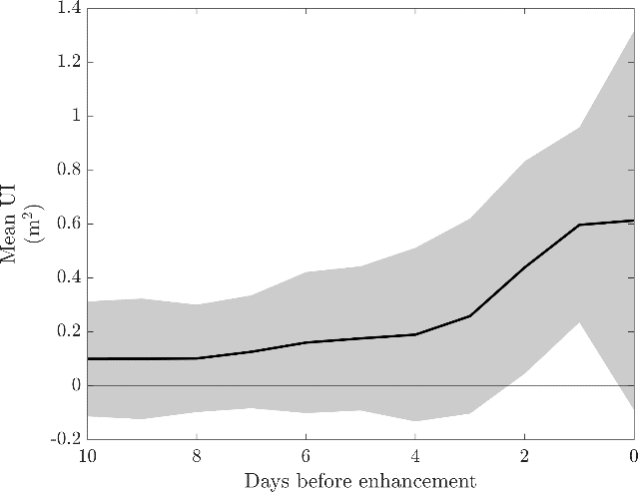
Surface enhancements are ephemeral
Number
of enhancements
Interquartile range: 1.5-6 d
75m
100m
200m
500m
1000m
Duration (days)
Wind stress in the upfront direction
Days before enhancement
Oliver et al., 2022

Slide 7
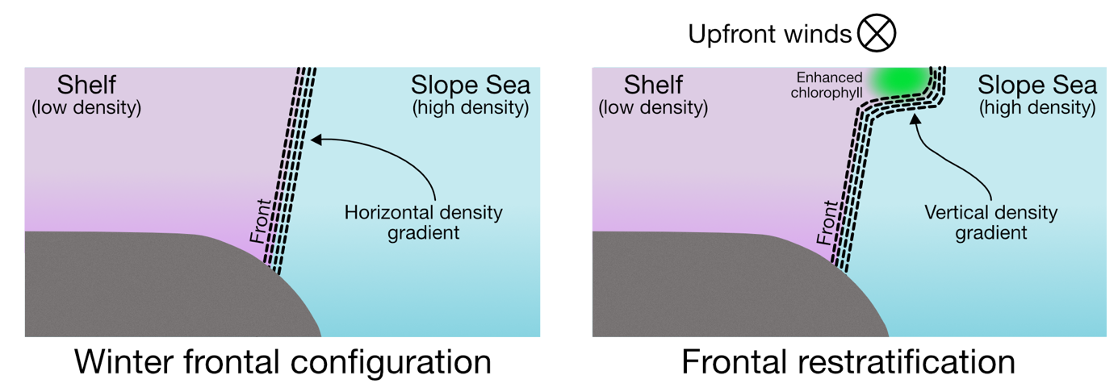
A conceptual model
Late winter / early spring
Deep mixing
Abundant nutrients
Light limited conditions
Frontal stratification driven by up-front winds
  Shallower mixing relieves light limitation
  Phytoplankton bloom

Slide 8
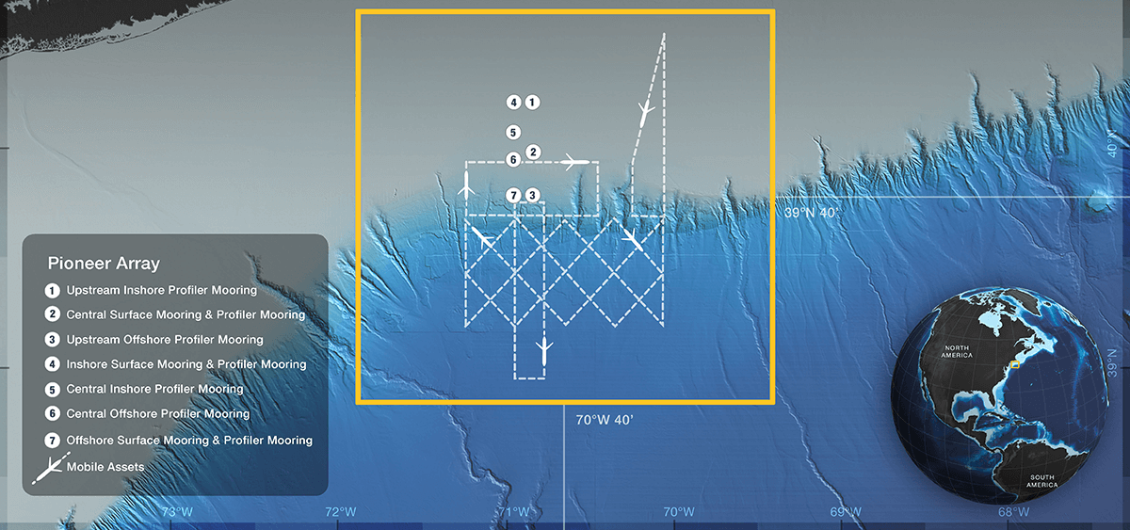
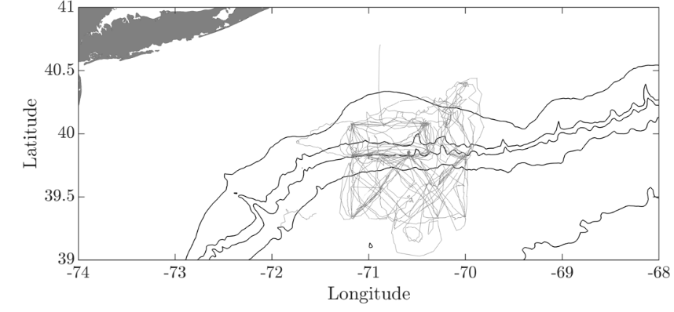
Testing the conceptual model with OOI glider data
OOI glider data: 2014-present
6 coastal gliders

Slide 9

Testing the conceptual model: OOI glider data
Vertical
stratification
Horizontal stratification
Notes:
Top 30 m glider data binned by horizontal density gradient ($\frac{δσ}{δx}$) and vertical density gradient ($\frac{δσ}{δz}$)
High $\frac{δσ}{δx}$-> near the shelf-slope front
High$\frac{δσ}{δz}$ -> front stratified near surface -> shallow MLD

Slide 10
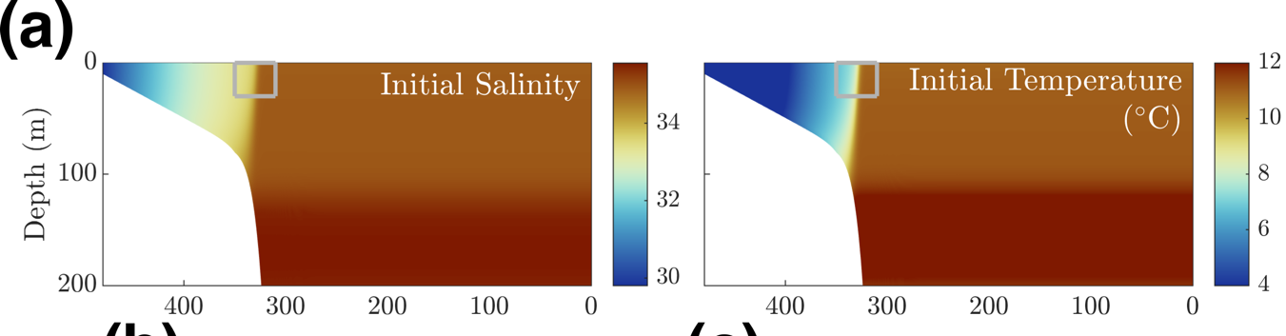
A model of the restratification process
Test role of upfront/downfront winds with 2D ROMS with NPZD-Powell (from Zhang et al. 2013)
Initialized with climatological N profile and low values of P, Z & D

Slide 11
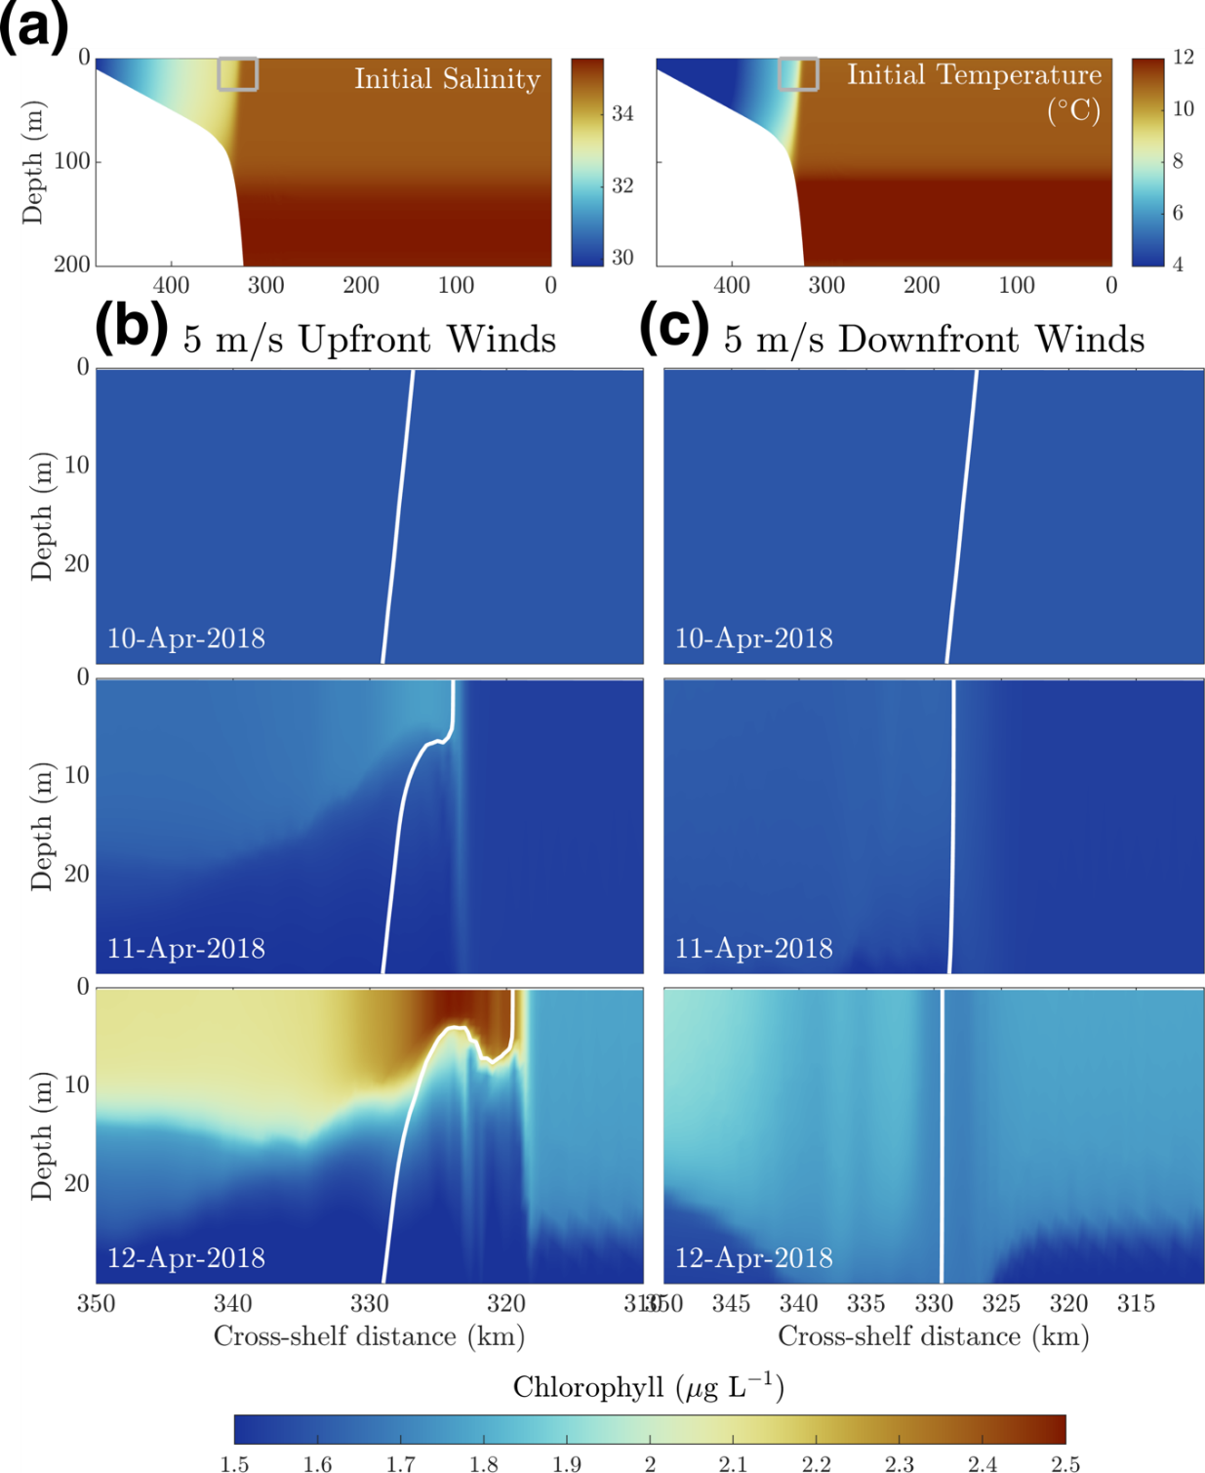

A model of the restratification process
  Shelf water
  front
  Slope water
5 m/s upfront winds -> mixed layer shoals -> rapid accumulation

Slide 12
A model of the restratification process
  Shelf water
  front
  Slope water
5 m/s downfront winds -> denser water advected over less dense water -> convective overturning -> Chl diluted

Slide 13
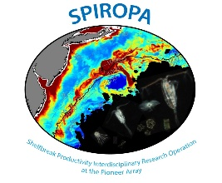
Conclusions
Surface enhancements are ephemeral
Upfront winds precede enhancements
  Driven by Ekman restratification
Ongoing Questions
Role of 3D processes/frontal eddies
Surface chlorophyll ≠ total water column productivity!
  Subsurface productivity

