Slide 1
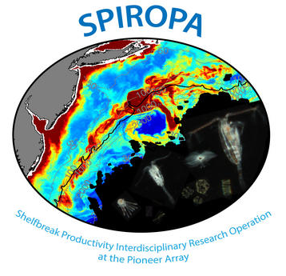
Net Community Production, Temperature, and Salinity Coupling at the Mid Atlantic Bight Shelf-break Front
Natalie A. O’Hern, Dennis J. McGillicuddy, Jr., Zoe O. Sandwith, & Rachel H. R. Stanley
SPIROPA project:
Shelfbreak Productivity Interdisciplinary Research Operation at the Pioneer Array
High resolution net community production, temperature, and salinity data was collected on all three cruises
Net Community Production (NCP)- Photosynthesis by autotrophs minus respiration by heterotrophs and autotrophs
Measured using the oxygen-argon saturation anomaly (ΔO₂/Ar)
Contact: nohern@wellesley.edu

Slide 2
We seek to understand what caused strong coupling between NCP and temperature/salinity.
Direct relationship
Inverse relationship
Noisy, no clear relationship
Moving correlations provide insight into how the relationship between NCP, temperature, and salinity changes through space and time

Slide 3
Moving correlation strength and direction did not depend on latitude or distance from the front
Spring 2018
Spring 2019
Summer 2019
NCP- Temperature
To shore
latitude
R
NCP-Salinity
longitude

Slide 4
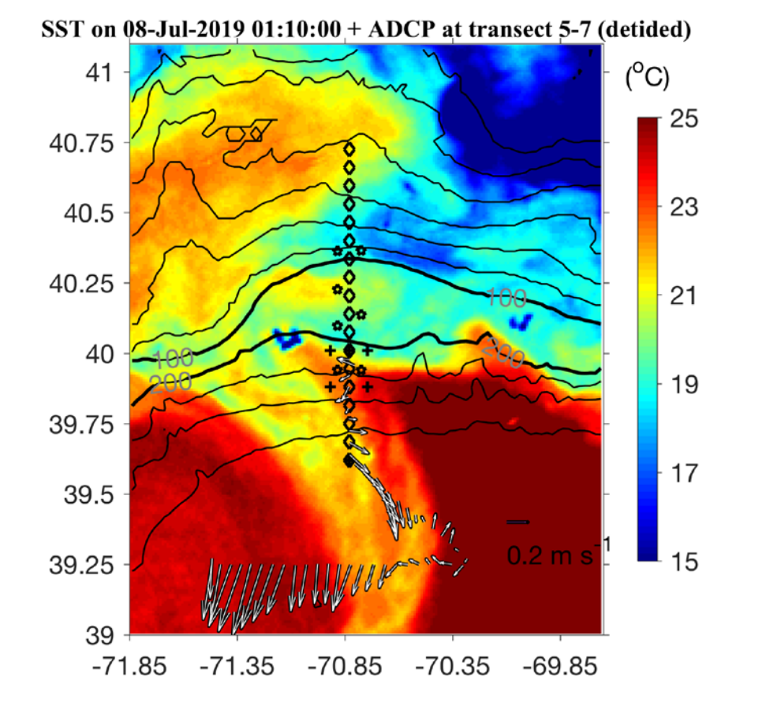
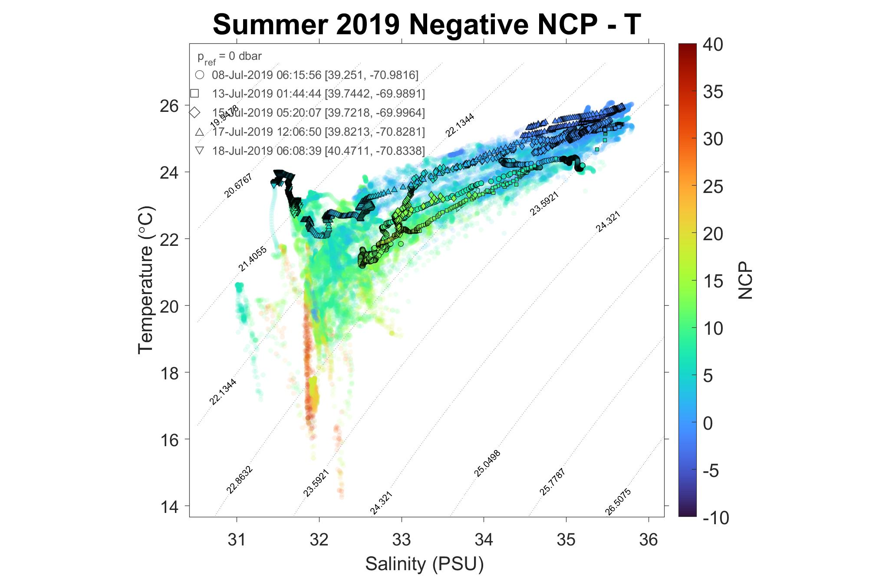
We decided to take a case-by-case approach, looking at the strongest correlations in either direction.
Used how windowed data fit into TS space to understand what processes were happening during times of strong correlation
Example: spanning TS space corresponded to crossing between water masses

Slide 5
Takeaways:
Strong correlations between NCP, salinity, and temperature were observed on all three SPIROPA cruises, with strongest correlations on the summer cruise
Strong moving correlations were found as the ship crossed between two very distinct water masses, as well as when there was submesoscale mixing within a water mass.
The causes of strong moving correlation need to be investigated using a case by case approach
Thank you to the captain and crew of the RV Armstrong, RV Ron Brown, and RV Thompson; the SPIROPA team; the National Science Foundation; and the Wellesley College Chemistry Department
Contact: nohern@wellesley.edu
Notes:
Add Acknowledgements: Captain + crew of ship, SPIROPA team, NSF, Wellesley College Chemistry Department

