Slide 1


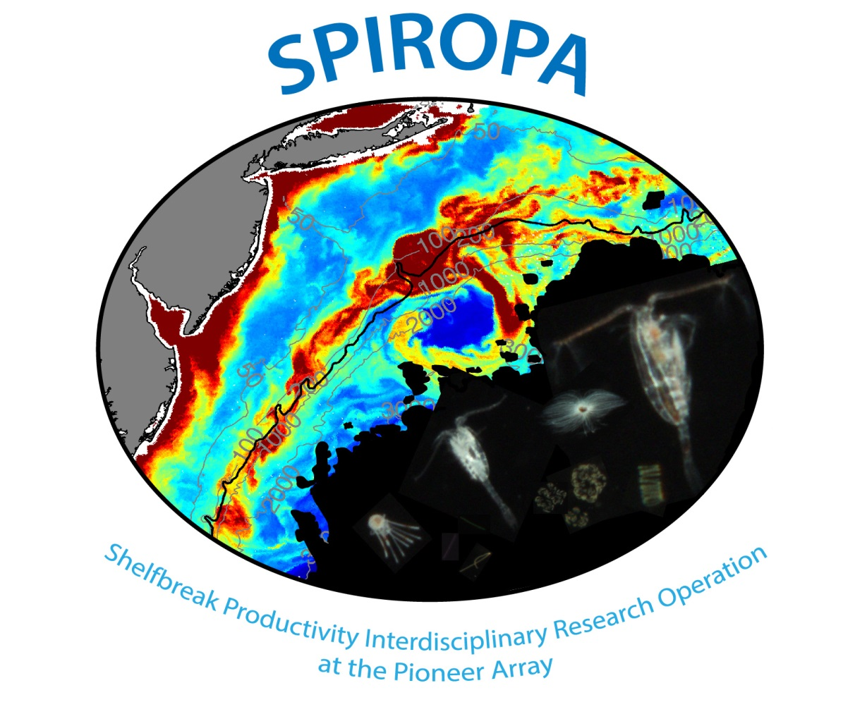






McGillicuddy
Sosik
Zhang
Turner
Petitpas
Stanley
Smith

Slide 2
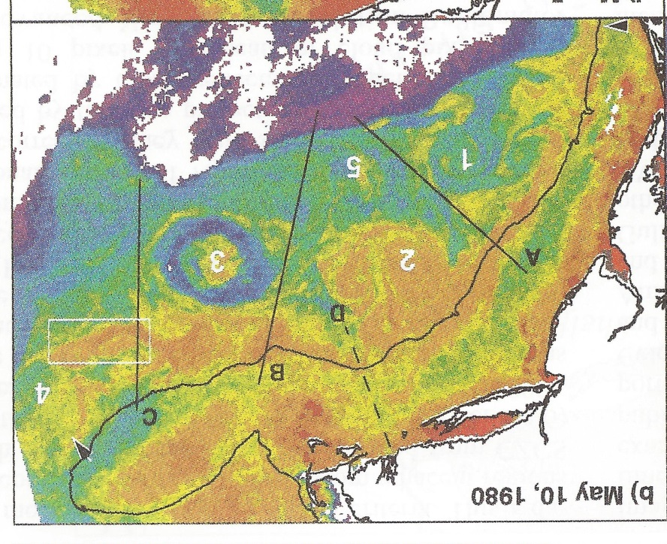
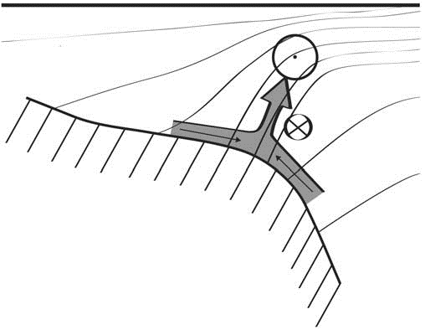
Shelfbreak frontal dynamics: mechanisms of upwelling, net community production, and ecological implications
Zhang et al. 2011
Ryan et al. 1999
Linder et al. 2004
Gawarkiewicz and Chapman 1992
Chapman and Lentz 1994
Marra et al. 1990

Slide 3


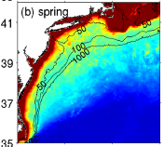

2013, JGR
Satellite CHL climatology
Why is there no mean enhancement of chlorophyll at the shelf break front?
H₁: Top-down control by zooplankton grazing
H₂: Spatial and temporal intermittency of the upwelling events causes their net impact to be smoothed out in long-term means.

Slide 4
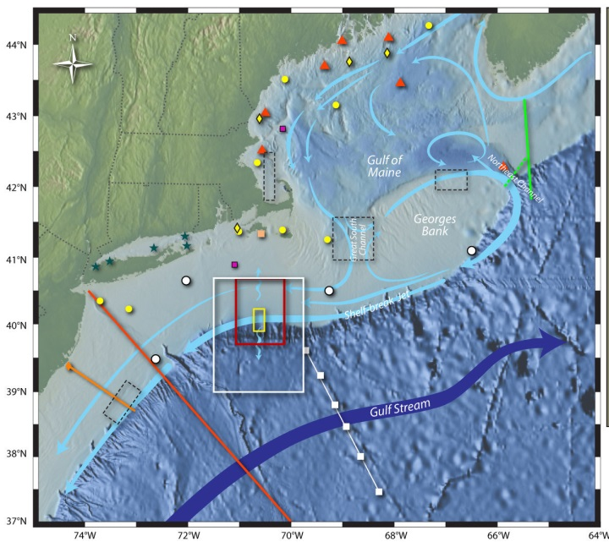
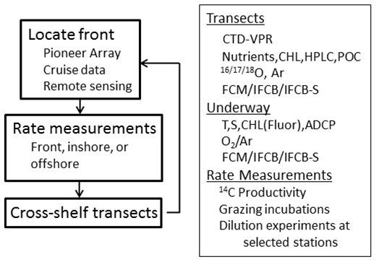
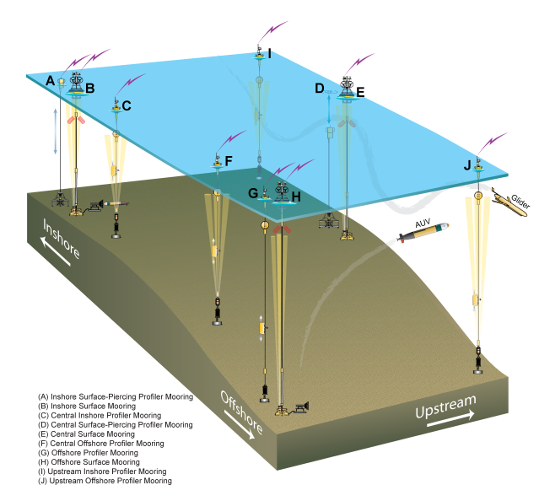
Why is enhanced chlorophyll not visible in the seasonal means?
SPIROPA sampling approach
3 Cruises: Spring 2018, 2019, Summer 2019
NSF Ocean Observatory Initiative Pioneer Array

Slide 5
Why is enhanced chlorophyll not visible in the seasonal means?
Initial results from the SPIROPA Program
Hypothesis 1 – Intermittency
Hypothesis 2 – top down control
Unexpected hotspots driven by Gulf Stream intrusions
4. Conclusions: How will this system respond to climate change?

Slide 6
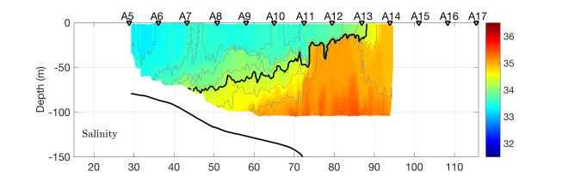
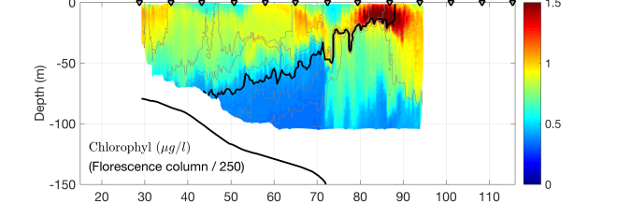
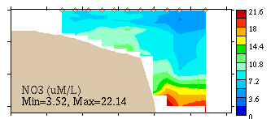
Why is enhanced chlorophyll not visible in the seasonal means?
Hypothesis 1: Spatial and temporal intermittency
S=34.5
VPR tow #1
R/V Neil Armstrong
18 April 2018
Salinity
Chlorophyll F
Across shelf distance (km)
CTD section #1
Surface nitrate > 3µM
Nitrate

Slide 7
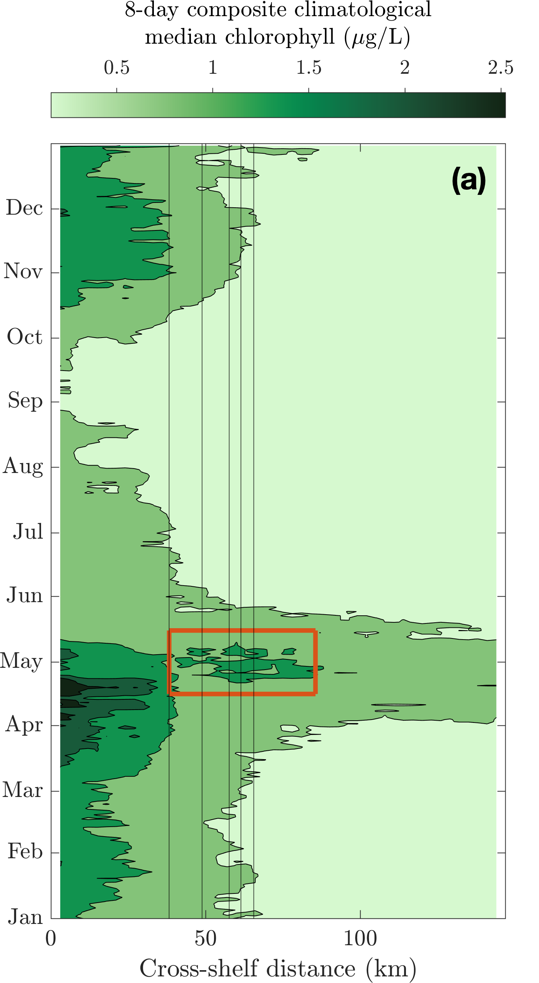
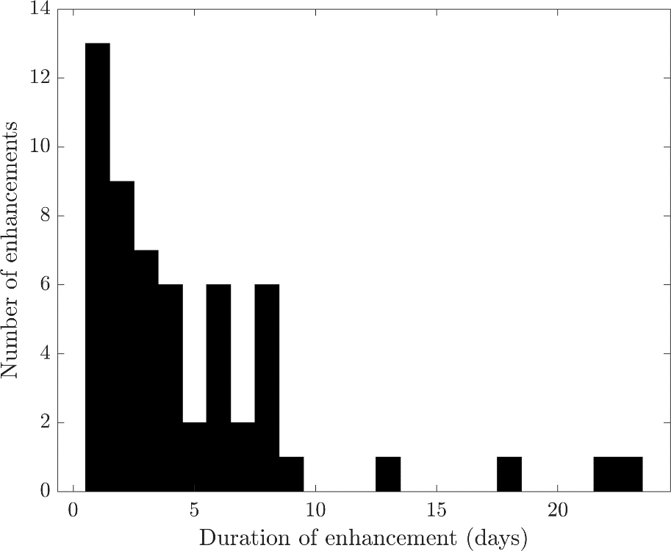
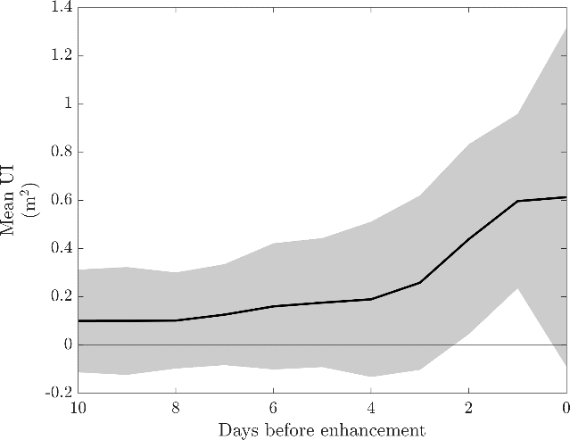
Surface enhancements are ephemeral
Number
of enhancements
Interquartile range: 1.5-6 d
75m
100m
200m
500m
1000m
Duration (days)
Wind stress in the upfront direction
Days before enhancement
Oliver et al., 2022

Slide 8
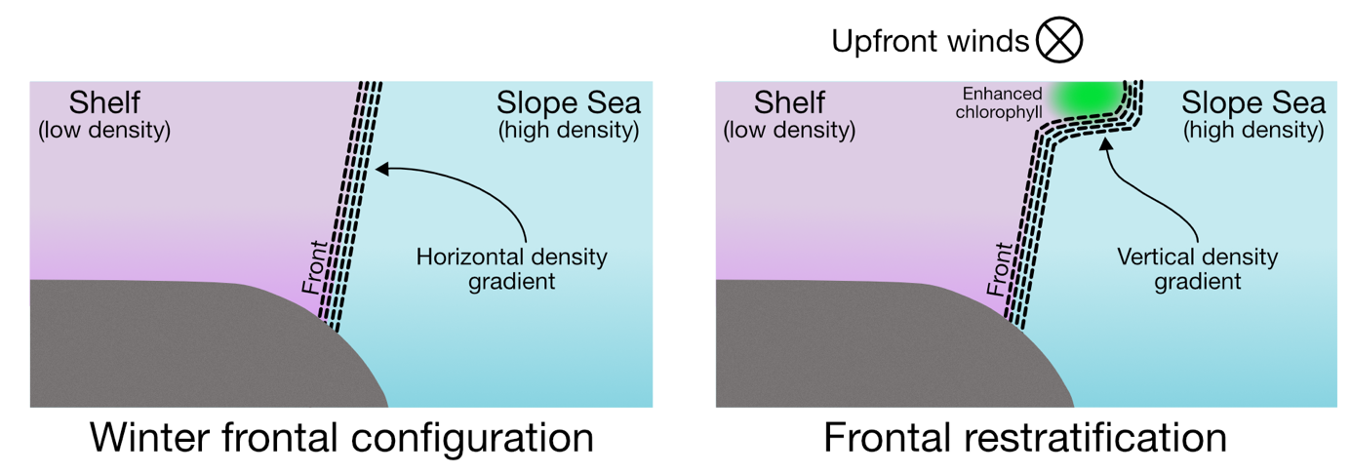
A conceptual model
Late winter / early spring
Deep mixing
Abundant nutrients
Light limited conditions
Frontal stratification driven by up-front winds
  Shallower mixing relieves light limitation
  Phytoplankton bloom
  Oliver, H., Zhang, W.G., Archibald, K.M., Hirzel, A.J., Smith, W.O., Sosik, H.M., Stanley, R.H.R., and D.J. McGillicuddy, 2022. Ephemeral surface chlorophyll enhancement at the New England shelf break driven by Ekman restratification. Journal of Geophysical Research: Oceans, 127, e2021JC017715. https://doi.org/10.1029/2021JC017715. Oliver et al. PI05
Conceptual model tested with
OOI Pioneer glider data
2-D physical – biological model

Slide 9
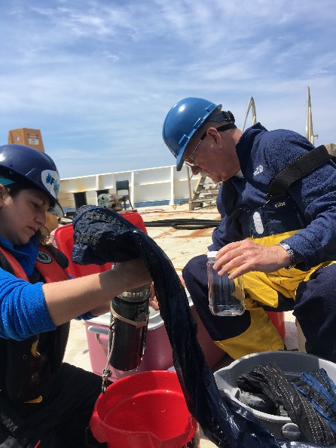
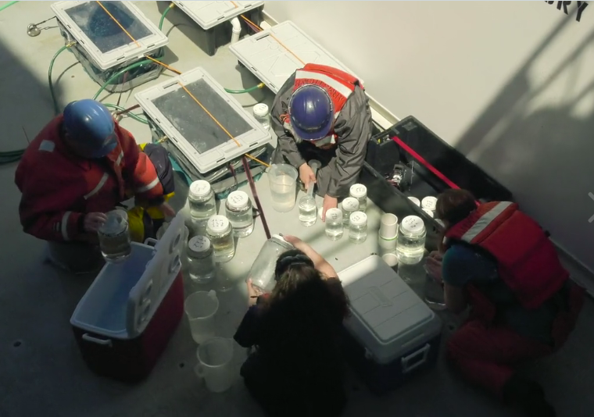
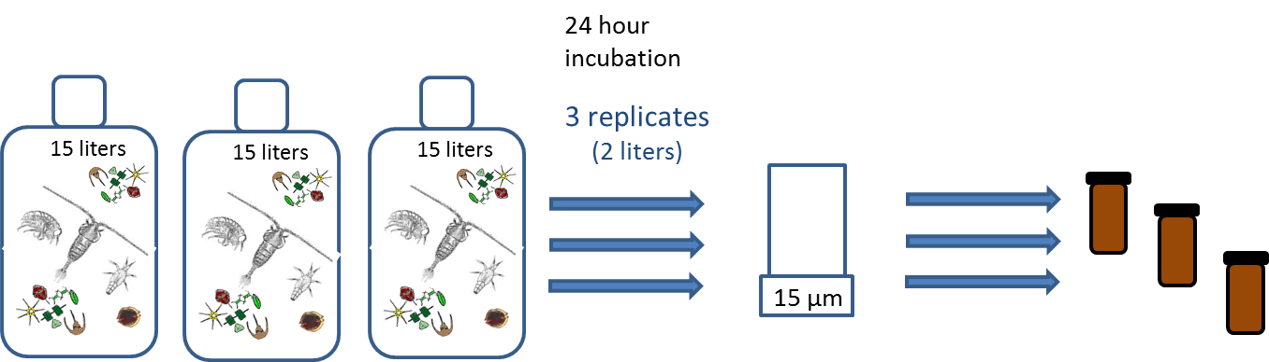
Why is enhanced chlorophyll not visible in the seasonal means?
What about the top-down control hypothesis?
Jefferson Turner Christian Petitpas
PI05
PI05
Analysis underway:
MOCNESS net tows
Grazing experiments
FCM subsample
IFCB
Samples preserved with
Utermöhl’s solution
An “Initial” 2-liter sample collected from each carboy

Slide 10

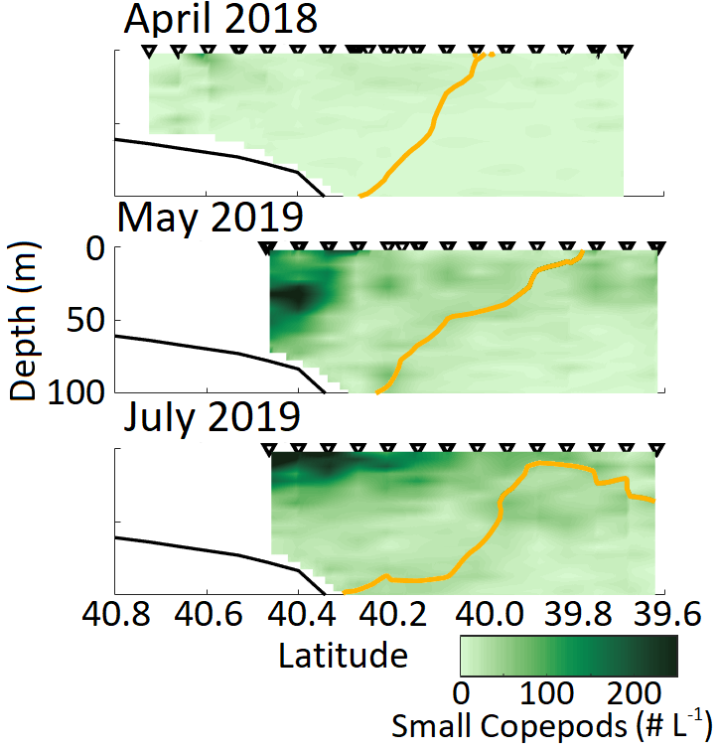
Why is enhanced chlorophyll not visible in the seasonal means?
What about the top-down control hypothesis?
Initial results from the DAVPR:
Eulerian mean of all transects
Andrew Hirzel
JP Student
Small copepods
PI05
Spring 2018
N=10
May 2019
N=6
July 2019
N=7
S=34.5

Slide 11
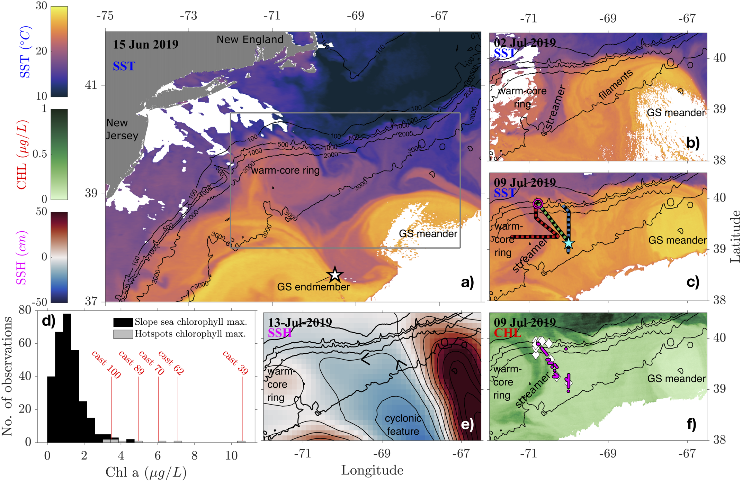
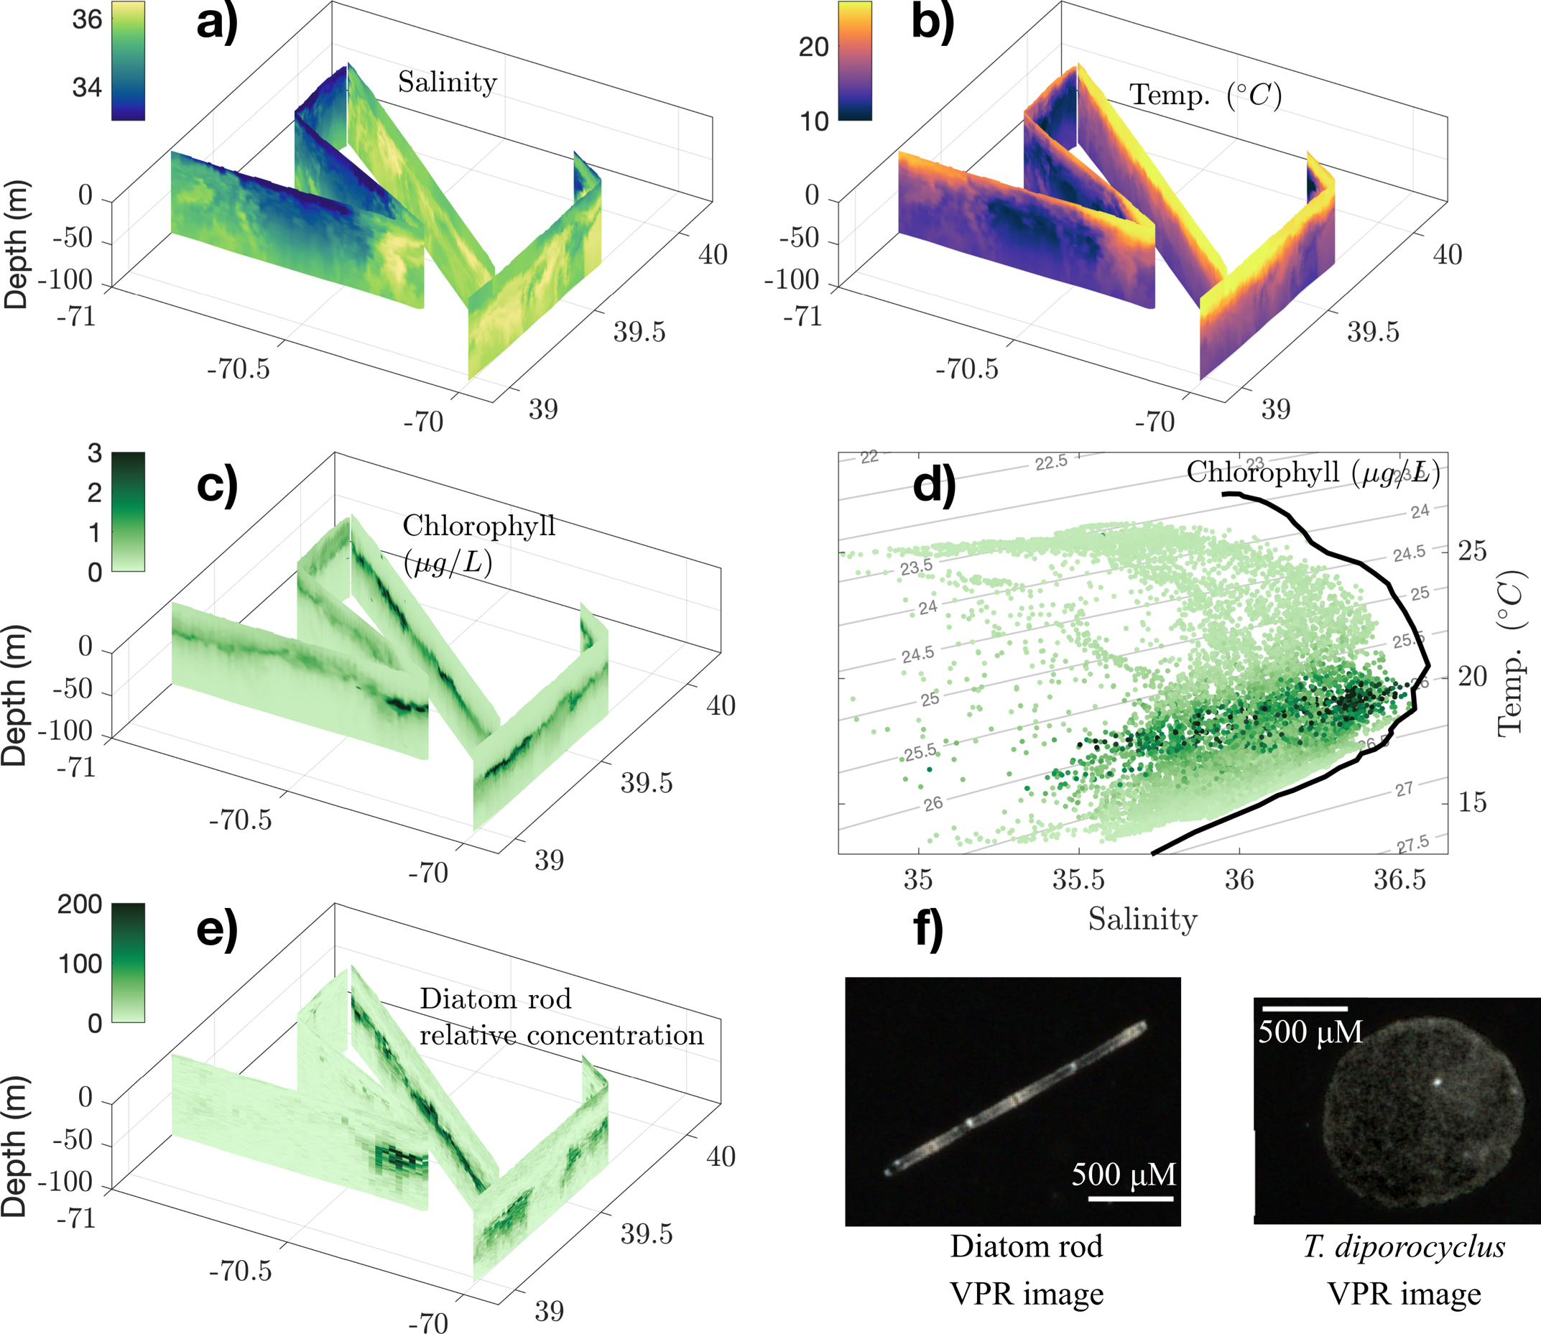
Slope Sea Subsurface Chlorophyll Hotspots
Longitude
Latitude
Hotspots (> 4 µg Chl/L) in 1/3 of slope sea VPR profiles
~50 m below the surface
Hotspots
Depth (m)
Latitude
Longitude

Slide 12
Unusually High Chlorophyll Concentrations
CTD Chlorophyll from Fluorescence
1.9 – 8.8 standard deviations above mean slope sea climatological chlorophyll max
Some hotspot casts with chlorophyll maximum > maximum in climatology

Slide 13
Hotspots Associated with High Salinities
Gulf Stream northern wall T-S profile
Depth (m)
Latitude
Longitude
Latitude
Longitude
Depth (m)
High chlorophyll associated with salinity > 35.6
High chlorophyll corresponds to σ_{θ} = 26.0 kg m⁻³ isopycnal
Latitude
Longitude
Latitude
Longitude

Slide 14
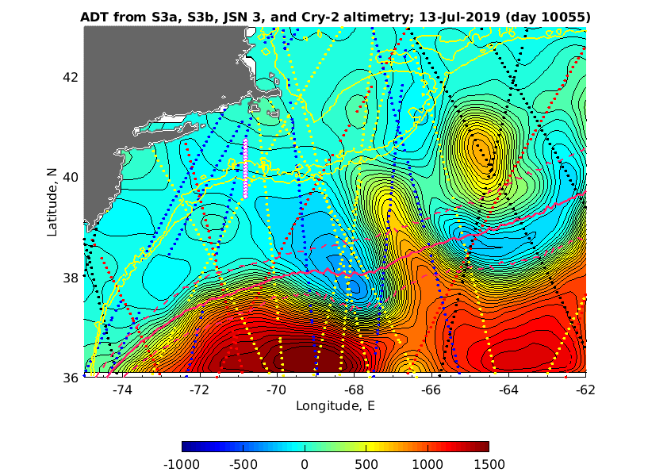


How did the Gulf Stream water reach the shelf edge?
Observed hotspots
Valery Kosnyrev
Olga Kosnyrev

Slide 15
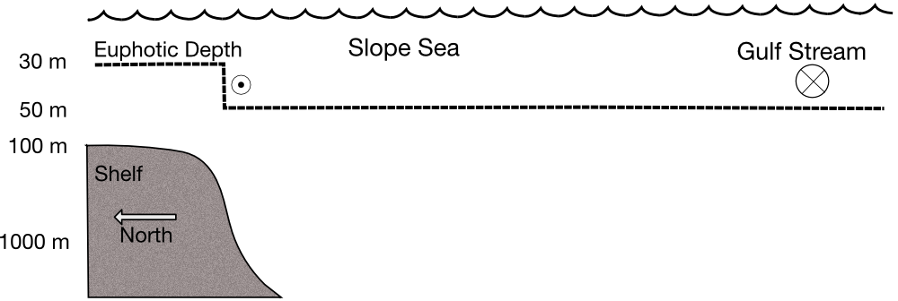
Summary: Conceptual Model

Slide 16
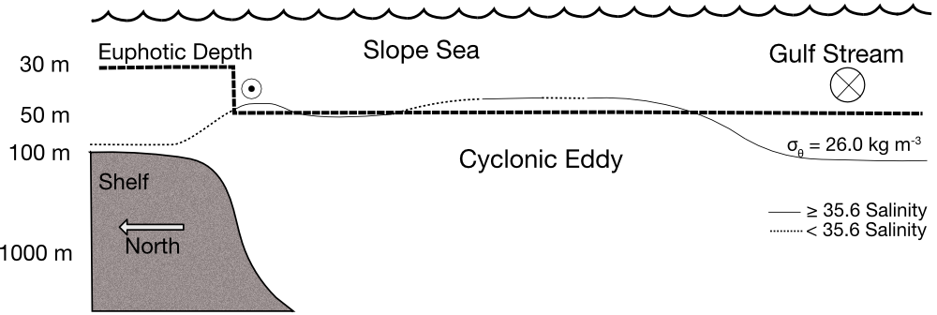
Summary: Conceptual Model
Hotspots found where
The σ_{θ} = 26.0 kg m⁻³ isopycnal outcrops into the euphotic zone
Salinity > 35.6

Slide 17
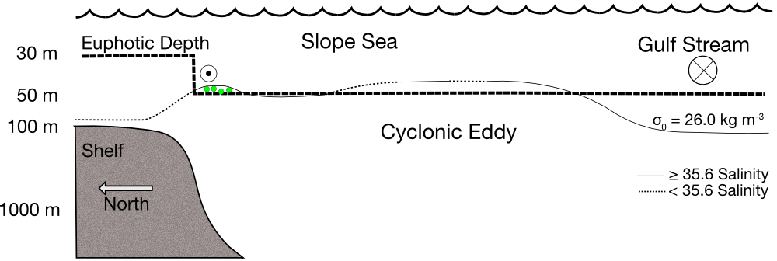
Summary: Conceptual Model
Hotspots found where
The σ_{θ} = 26.0 kg m⁻³ isopycnal outcrops into the euphotic zone
Salinity > 35.6
Shelf – slope interface

Slide 18
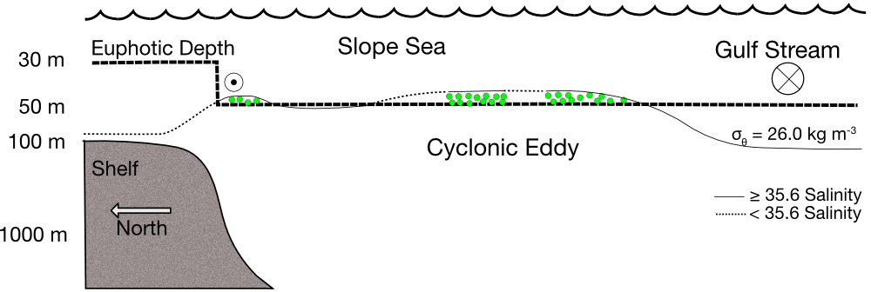
Summary: Conceptual Model
Hotspots found where
The σ_{θ} = 26.0 kg m⁻³ isopycnal outcrops into the euphotic zone
Salinity > 35.6
Shelf – slope interface Cyclonic eddy

Slide 19
Summary: Conceptual Model
Hotspots found where
The σ_{θ} = 26.0 kg m⁻³ isopycnal outcrops into the euphotic zone
Salinity > 35.6
Shelf – slope interface Cyclonic eddy
Back-of-the envelope:
- Hotspots in 1/3 of Slope Sea
- 50-150% higher productivity within hotspots
Up to 50% more productive Slope Sea
Oliver et al. (2021)

Slide 20
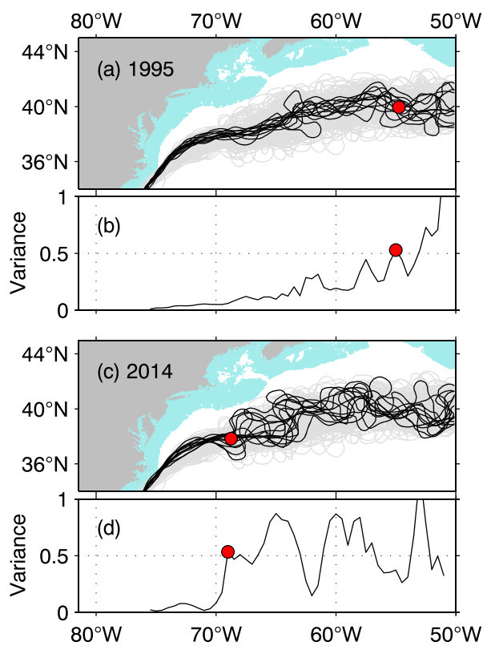
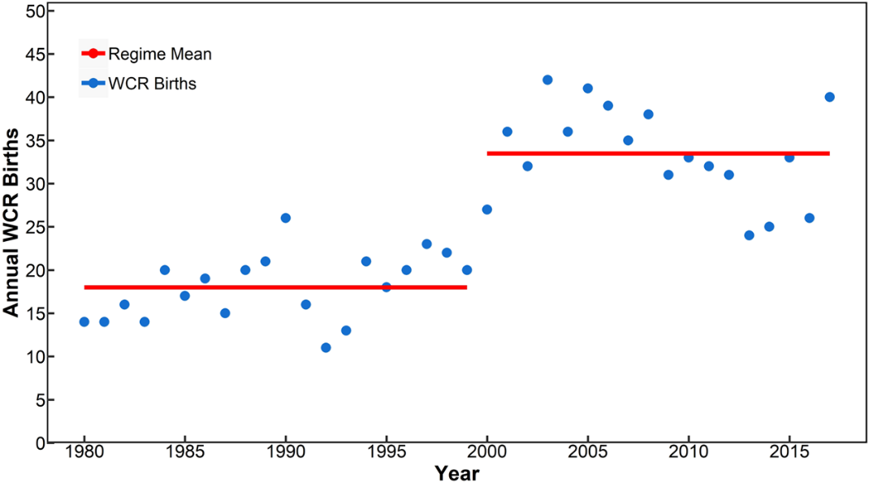
How will a changing climate affect regional productivity?
Westward shift in Gulf Stream destabilization point
Increasing frequency of Gulf Stream rings in the slope sea
Latitude
﻿Black lines = monthly mean Gulf Stream paths
﻿Red dots = destabilization point
Longitude
Gangopadhyay et al., 2019
Andres, 2016

Slide 21
Why is enhanced chlorophyll not visible in the seasonal means?
Initial conclusions from the SPIROPA program
H₁: Intermittency – Ephemeral springtime enhancements of Chl driven by Ekman restratification
Oliver (PI05) Oliver et al., 2022
H₂: Top down control: Not likely, but analysis still underway
Hirzel (PI05); Petitpas (PI05); Turner (PI105); Zhu (PI05)
Is productivity enhanced at the shelf break front? Signs point to no…
O’Hern (PI05); Stanley (PIP01); Ma (PIP01)
Selden (PI05); Zhu (PI05)
Unexpected hotspots in productivity driven by Gulf Stream intrusions
Clayton (PIP01) Oliver et al., 2021
This system may have counter-intuitive responses to climate change

Slide 22

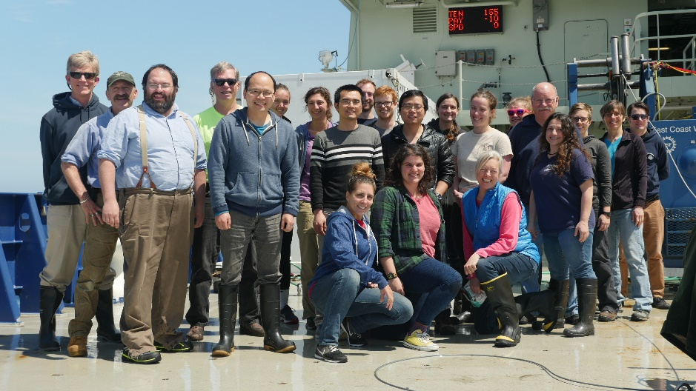
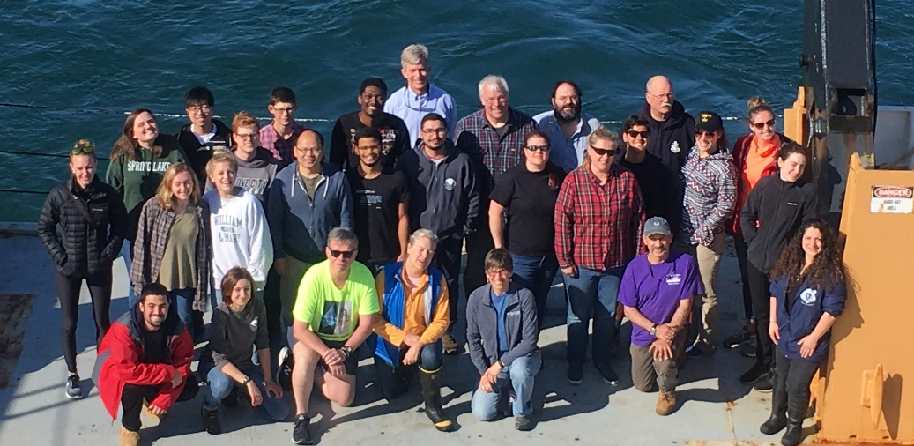
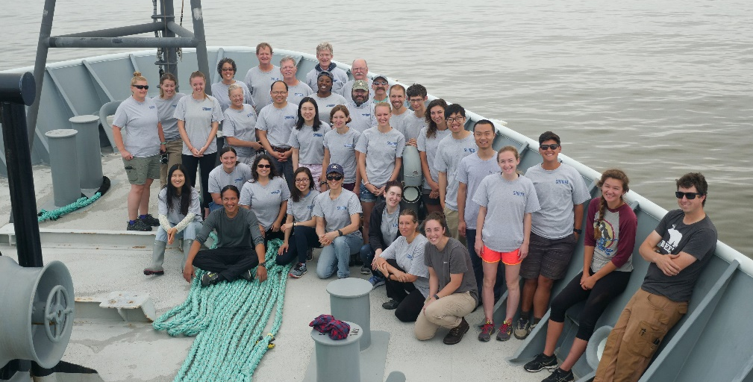
April 2018, R/V Neil Armstrong
May 2019, R/V Ronald H. Brown
http://science.whoi.edu/users/olga/SPIROPA/SPIROPA.html
https://www.bco-dmo.org/project/748894
July 2019, R/V Thomas G. Thompson

