Slide 1
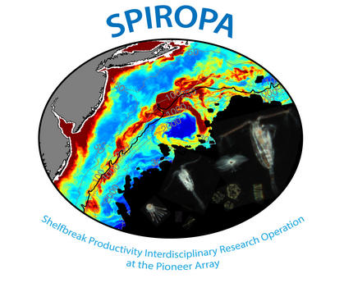
Mesoplankton Distributions at the Middle Atlantic Bight Shelf-Break Front
Presented by: Andrew J. Hirzel¹
Coauthors: Philip Alatalo¹, Hilde Oliver¹, and Dennis J. McGillicuddy Jr¹
¹Woods Hole Oceanographic Institution

Slide 2
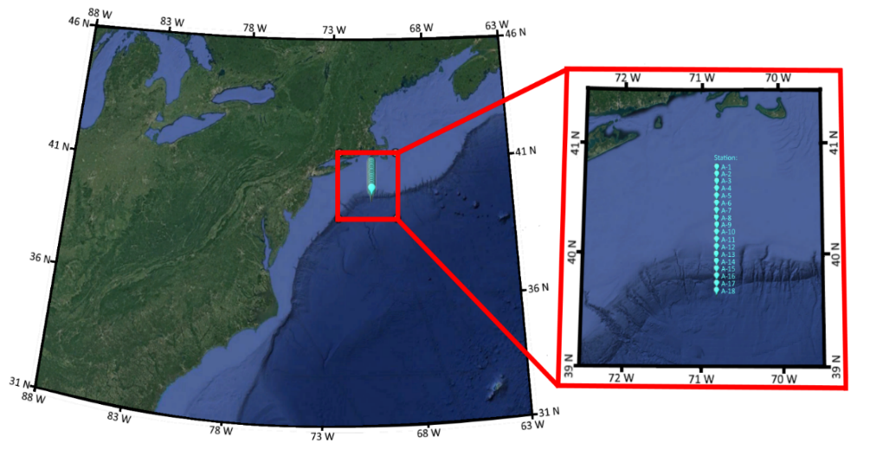
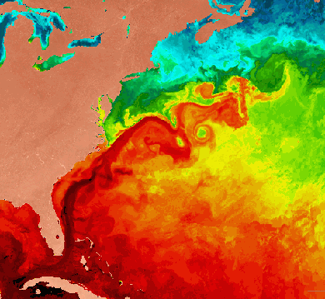
SPIROPA Transect Location Relative to the Front
Satellite Sea
Surface Temperature

Slide 3
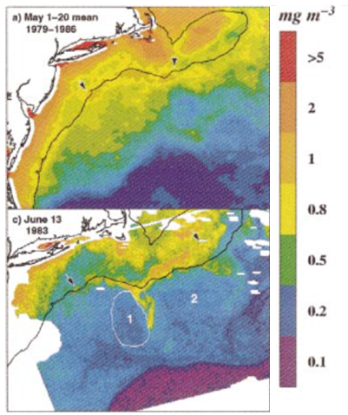
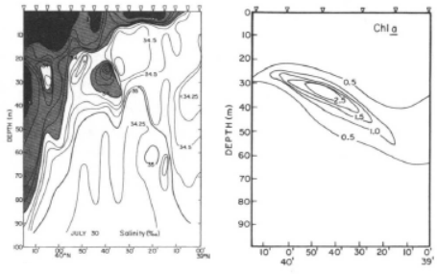
Chlorophyll is Enhanced at the Front
Salinity Chlorophyll
^{Single Day Monthly Mean}
Ryan JP, Yoder JA, Cornillon PC (1999). Enhanced chlorophyll at the shelfbreak of the Mid-Atlantic Bight and Georges Bank during the spring transition. Limnol. Oceanogr., 44(1): 1–11.
Marra J, Houghton RW, Garside C (1990). Phytoplankton growth at the shelf-break front in the Middle Atlantic Bight. J. Mar. Res., 48: 851–868.

Slide 4
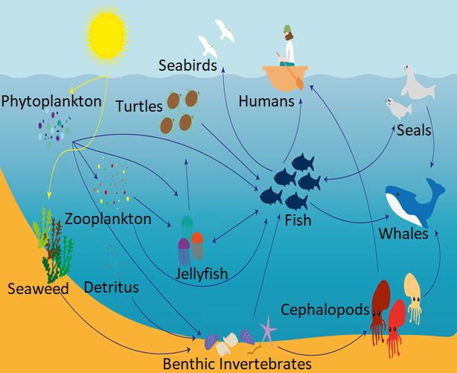
Chlorophyll is Enhanced at the Front
Salinity Chlorophyll
^{Single Day Monthly Mean}
Ryan JP, Yoder JA, Cornillon PC (1999). Enhanced chlorophyll at the shelfbreak of the Mid-Atlantic Bight and Georges Bank during the spring transition. Limnol. Oceanogr., 44(1): 1–11.
Marra J, Houghton RW, Garside C (1990). Phytoplankton growth at the shelf-break front in the Middle Atlantic Bight. J. Mar. Res., 48: 851–868.

Slide 5
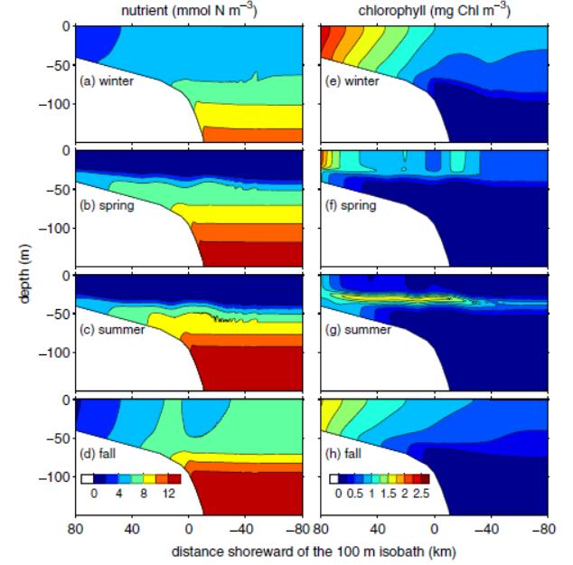
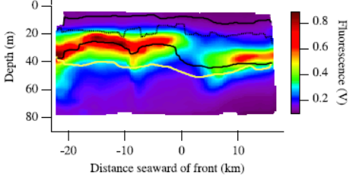
Chlorophyll is Enhanced at the Front
… Or is it?
Hales B, Vaillancourt R, Prieto L, Marra J, Houghton R, Hebert D (2009a). High-resolution surveys of the biogeochemistry of the New England shelfbreak front during Summer, 2002. J. Mar. Syst., 78: 426-441.
Zhang, WG, McGillicuddy DJ, Gawarkiewicz GG (2013), Is biological productivity enhanced at the New England shelfbreak front? J. Geophys. Res. Oceans, 118: 517–535.

Slide 6
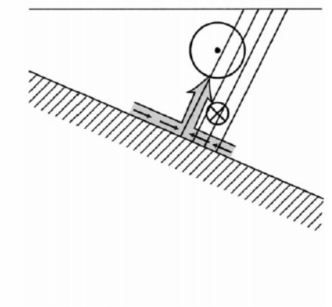
Possible Mechanisms for Upwelling at the Front
Bottom boundary layer convergence and detachment:
^{FRONT}
Chapman DC, Lentz SJ (1994). Trapping of a Coastal Density Front by the Bottom Boundary Layer. J. Phys. Oceanogr., 24: 1464–1479.

Slide 7
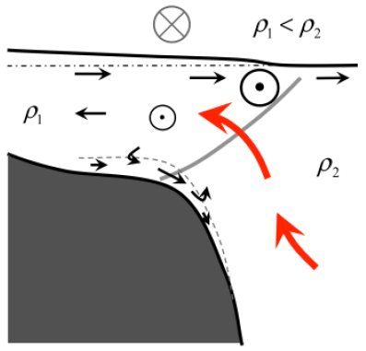
Possible Mechanisms for Upwelling at the Front
Mean upward motion driven by divergence in the onshore interior flow:
Bottom boundary layer convergence and detachment:
^{FRONT}
Chapman DC, Lentz SJ (1994). Trapping of a Coastal Density Front by the Bottom Boundary Layer. J. Phys. Oceanogr., 24: 1464–1479.
Zhang WG, Gawarkiewicz GG, McGillicuddy DJ, Wilkin JL (2011). Climatological Mean Circulation at the New England Shelf Break. J. Phys. Oceanogr., 41: 1874–1893.

Slide 8
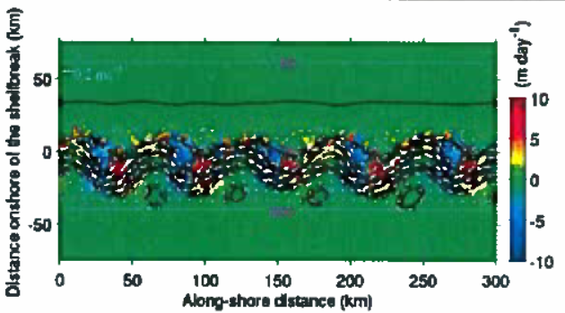
Possible Mechanisms for Upwelling at the Front
Mean upward motion driven by divergence in the onshore interior flow:
Bottom boundary layer convergence and detachment:
Frontal meander
instability-driven upwelling:
^{FRONT}
Zhang WG, Gawarkiewicz G (2015). Length scale of the finite-amplitude meanders of shelfbreak fronts. J. Phys. Oceanogr., 45:2598-2620.
Chapman DC, Lentz SJ (1994). Trapping of a Coastal Density Front by the Bottom Boundary Layer. J. Phys. Oceanogr., 24: 1464–1479.
Zhang WG, Gawarkiewicz GG, McGillicuddy DJ, Wilkin JL (2011). Climatological Mean Circulation at the New England Shelf Break. J. Phys. Oceanogr., 41: 1874–1893.

Slide 9
Possible Explanations for Chlorophyll Intermittency
Suppression by grazing:
Intermittency due to variability:
Satellite Sea Surface Temperature

Slide 10
3 Two Week Cruises Sampling transect once every two days
SPIROPA Transect
April 2018
R/V Armstrong – AR29: 10 transects
May 2019
R/V Ronald Brown – RB19-04: 6 transects
July 2019
R/V Thompson – TN368: 7 transects

Slide 11
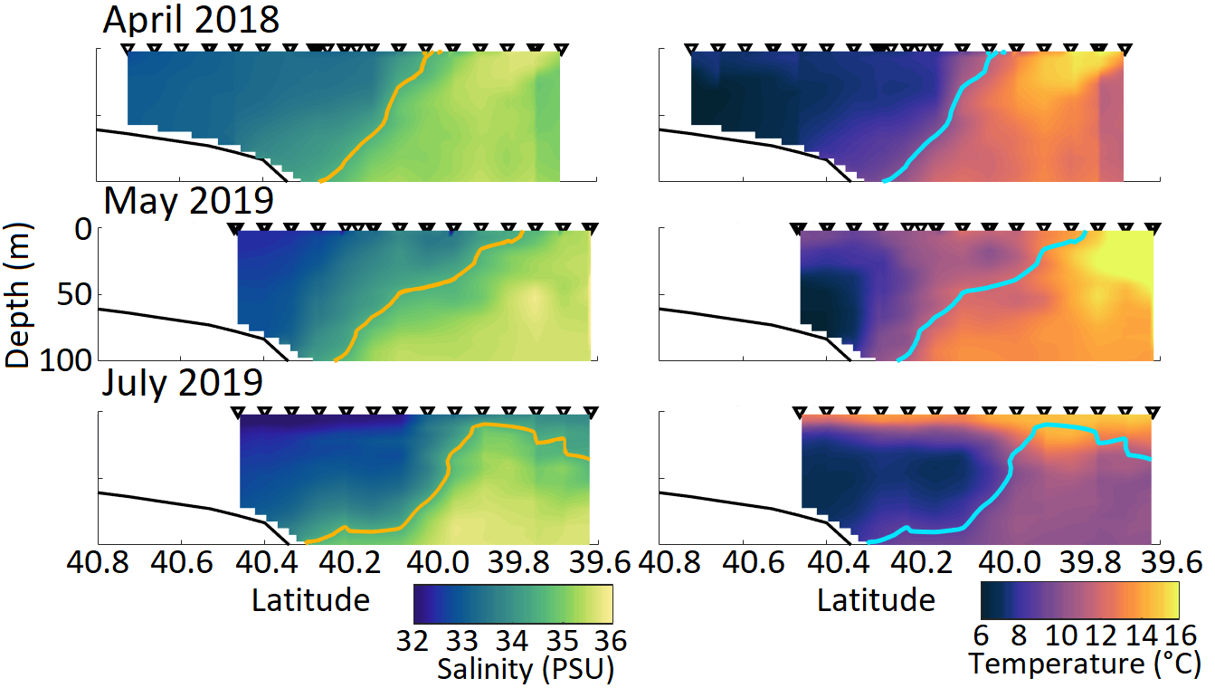
Mean Salinity and Temperature by Cruise
34.5 Isohaline
34.5 Isohaline

Slide 12
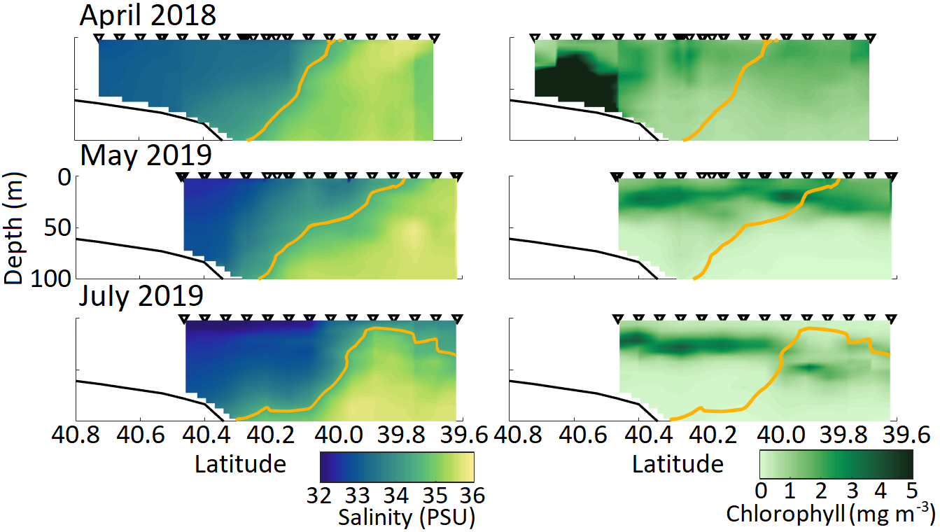
Mean chlorophyll is enhanced at the front in May
34.5 Isohaline

Slide 13
Mean chlorophyll is enhanced at the front in May
34.5 Isohaline

Slide 14
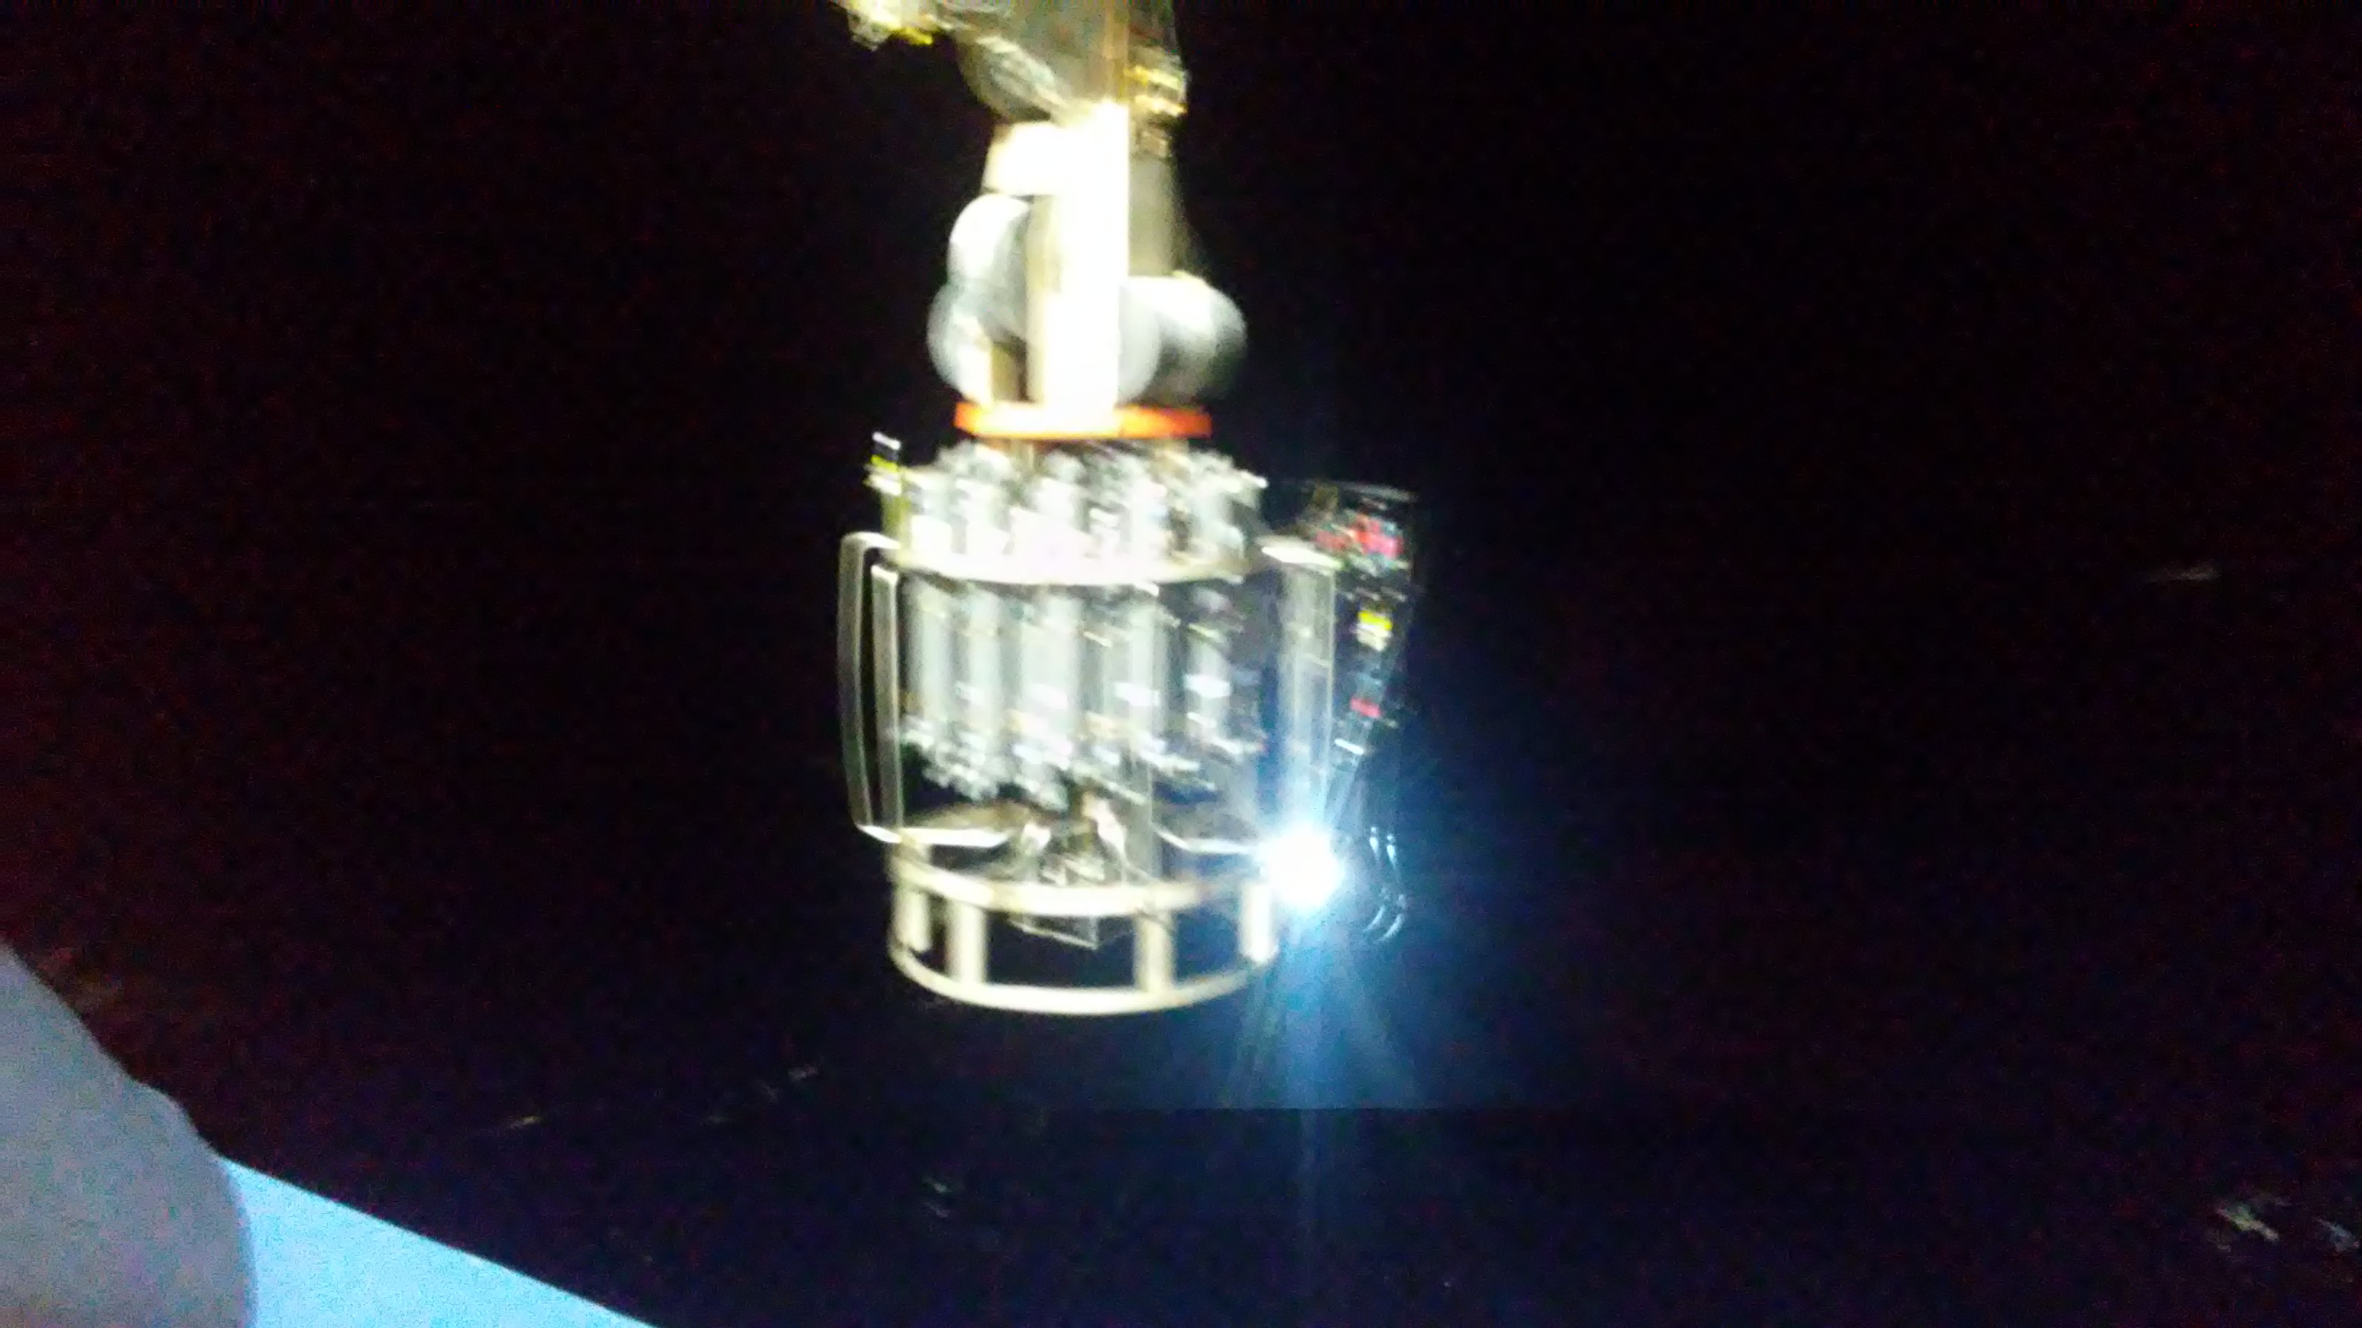
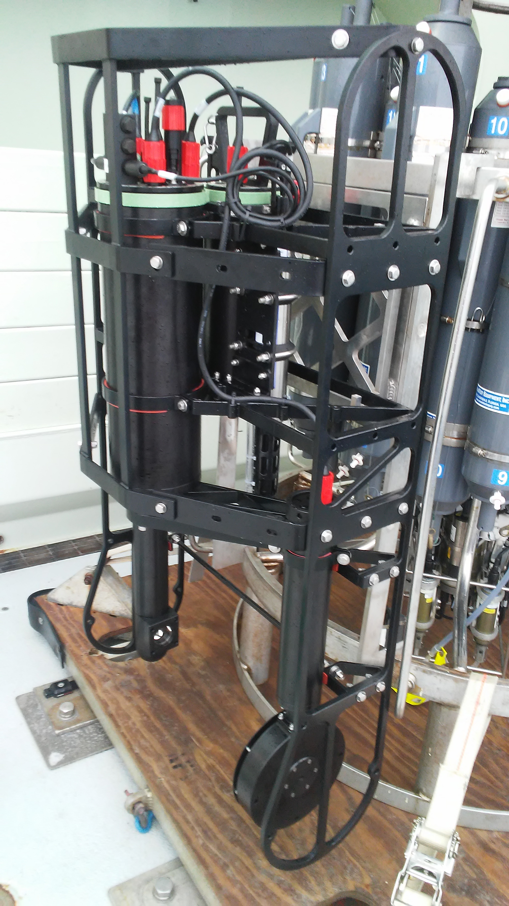
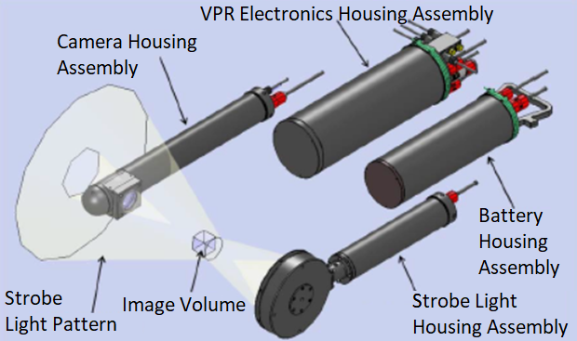
Digital Auto Video Plankton Recorder (DAVPR)
(≈3 mL)

Slide 15
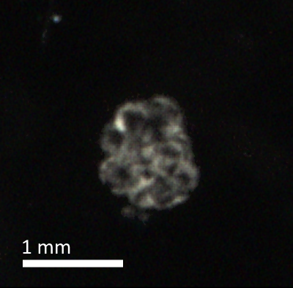
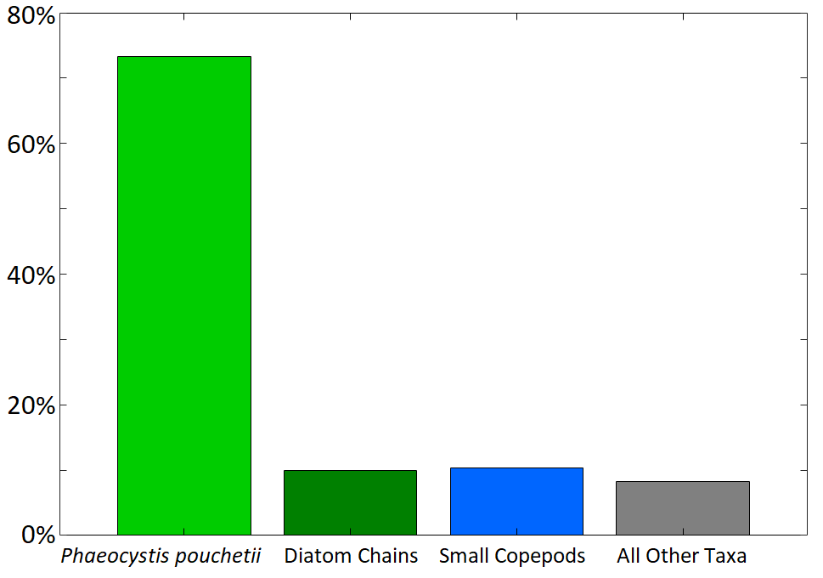
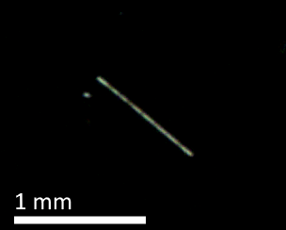
Distribution of ROIs by Taxon
of All ROIs from All 3 Cruises
Phaeocystis pouchetii
Diatom Chains
Small Copepods

Slide 16
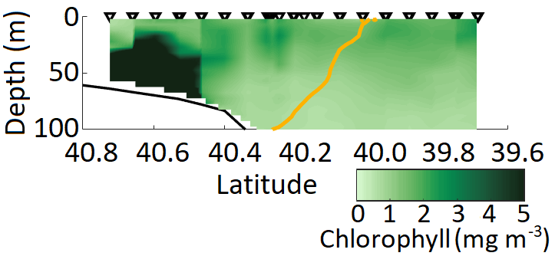
Distribution of ROIs by Taxon
of All ROIs from All 3 Cruises
April 2018 Mean Chlorophyll
Phaeocystis pouchetii
Phaeocystis pouchetii
Diatom Chains
Smith WO, Zhang WG, Hirzel A, Stanley RM, and others. 2021. A regional early spring bloom of Phaeocystis pouchetii on the New England Continental Shelf. J. Geophys. Res. Oceans. 126.
Small Copepods

Slide 17
Distribution of ROIs by Taxon
of All ROIs from All 3 Cruises
April 2018 Mean Chlorophyll
Phaeocystis pouchetii
Phaeocystis pouchetii
Diatom Chains
Smith WO, Zhang WG, Hirzel A, Stanley RM, and others. 2021. A regional early spring bloom of Phaeocystis pouchetii on the New England Continental Shelf. J. Geophys. Res. Oceans. 126.
Small Copepods

Slide 18
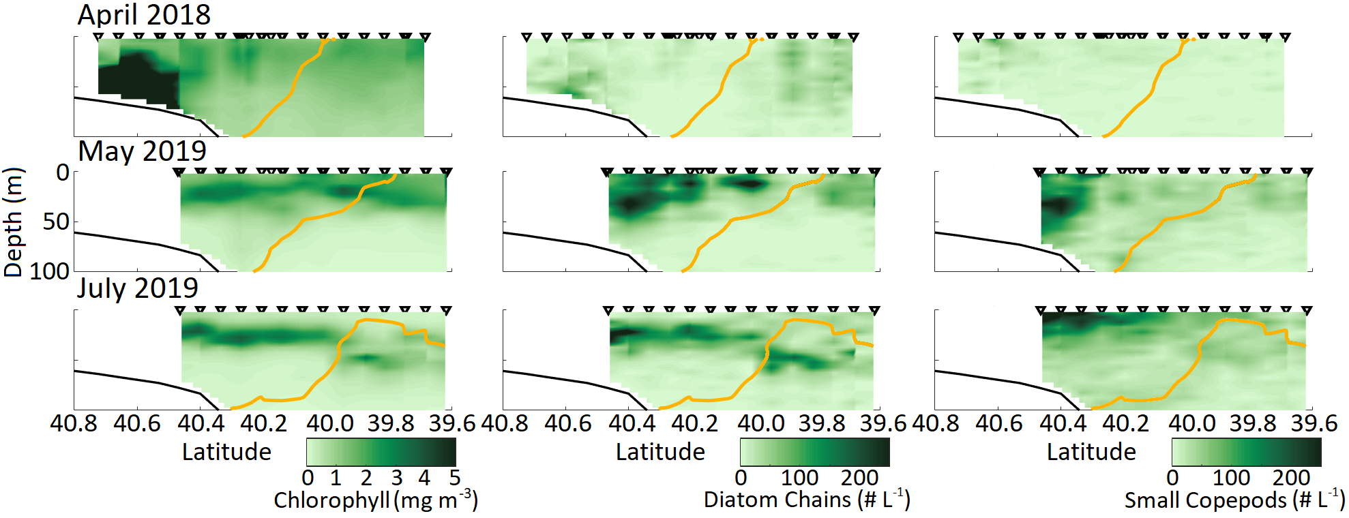
Mean diatom and copepod distributions were approximately similar to mean chlorophyll distribution
34.5 Isohaline

Slide 19
Mean diatom and copepod distributions were approximately similar to mean chlorophyll distribution
34.5 Isohaline

Slide 20
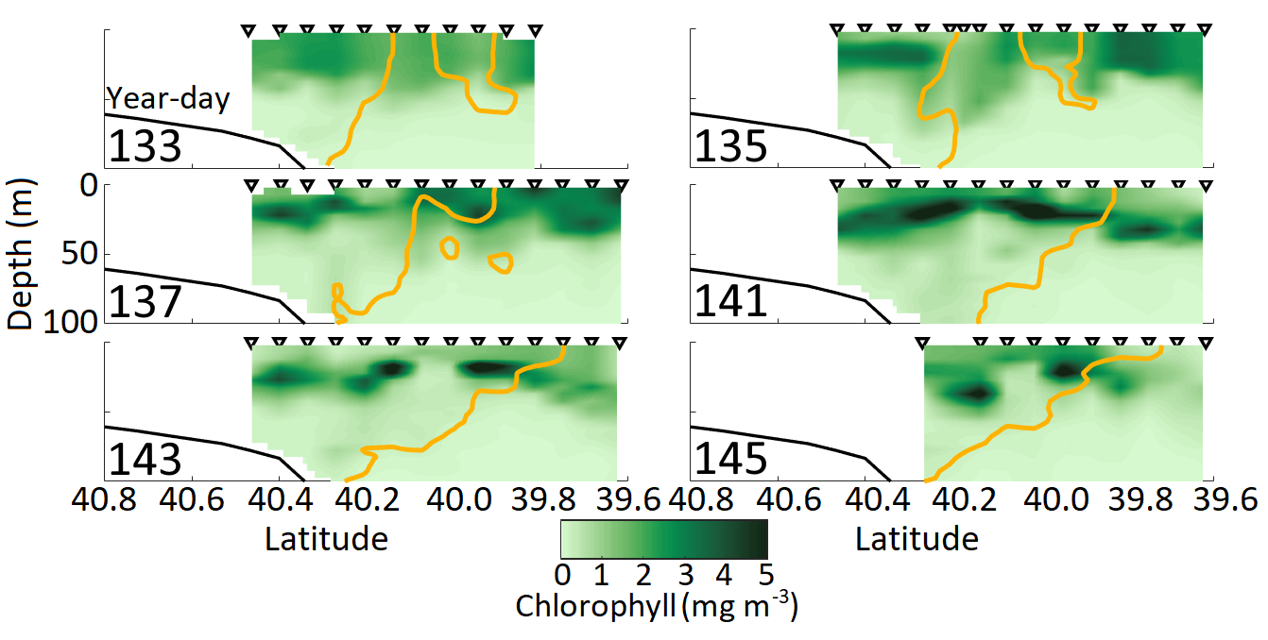
May 2019 transects are influenced by eddies
34.5 Isohaline

Slide 21
May 2019 transects are influenced by eddies
34.5 Isohaline

Slide 22
May 2019 transects are influenced by eddies
34.5 Isohaline

Slide 23
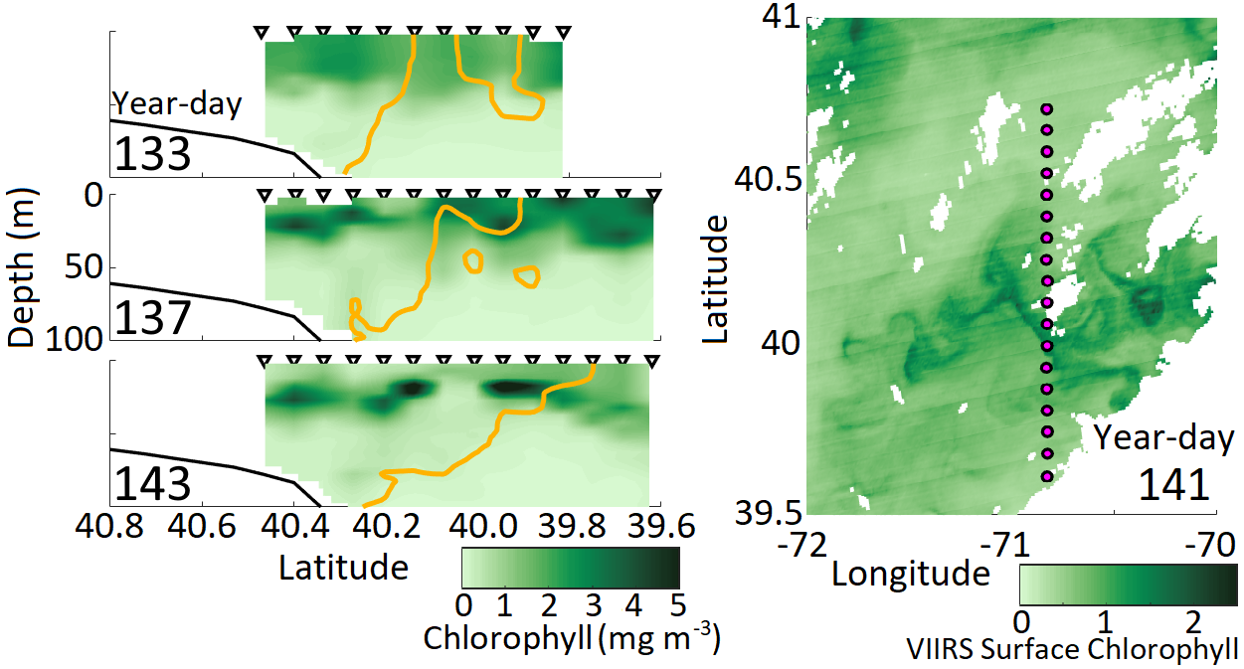
May 2019 transects are influenced by eddies
34.5 Isohaline

Slide 24
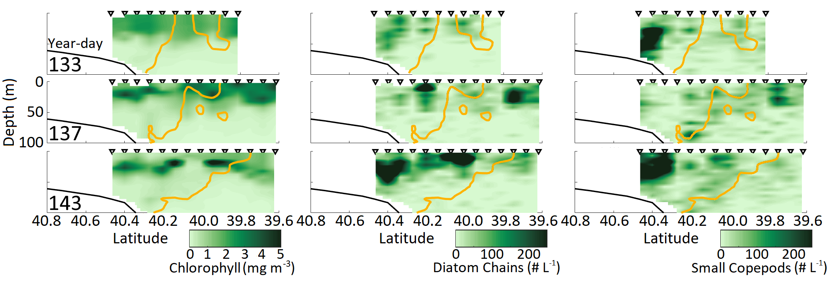
Diatom and copepod distributions in eddies differ from that of chlorophyll
34.5 Isohaline

Slide 25
Conclusions
Chlorophyll was not regularly enhanced in the mean at the front, nor were any plankton taxa observed with the DAVPR enhanced in the mean at the front. Diatoms and copepods were enhanced inshore in both May and July.

Slide 26
Conclusions
Chlorophyll was not regularly enhanced in the mean at the front, nor were any plankton taxa observed with the DAVPR enhanced in the mean at the front. Diatoms and copepods were enhanced inshore in both May and July.
Chlorophyll and DAVPR planktonic taxa were intermittently enhanced due to frontal eddies, but spatial relationships were variable.

Slide 27
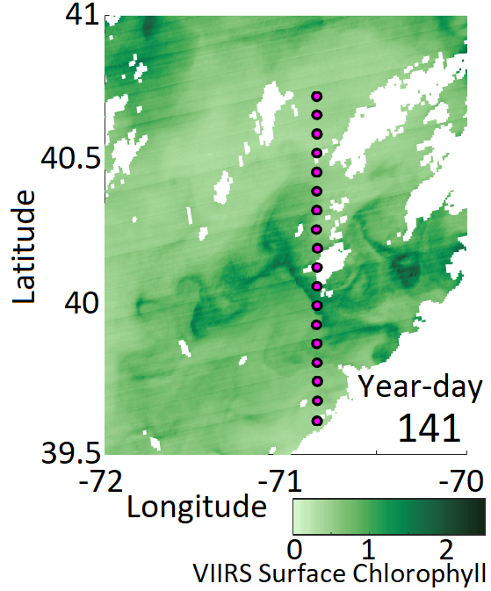
Conclusions
Chlorophyll was not regularly enhanced in the mean at the front, nor were any plankton taxa observed with the DAVPR enhanced in the mean at the front. Diatoms and copepods were enhanced inshore in both May and July.
Chlorophyll and DAVPR planktonic taxa were intermittently enhanced due to frontal eddies, but spatial relationships were variable.
High variability of the region obscures impact of intermittent enhancement on mean observations and provides an argument for favoring 3D models over 2D.

Slide 28
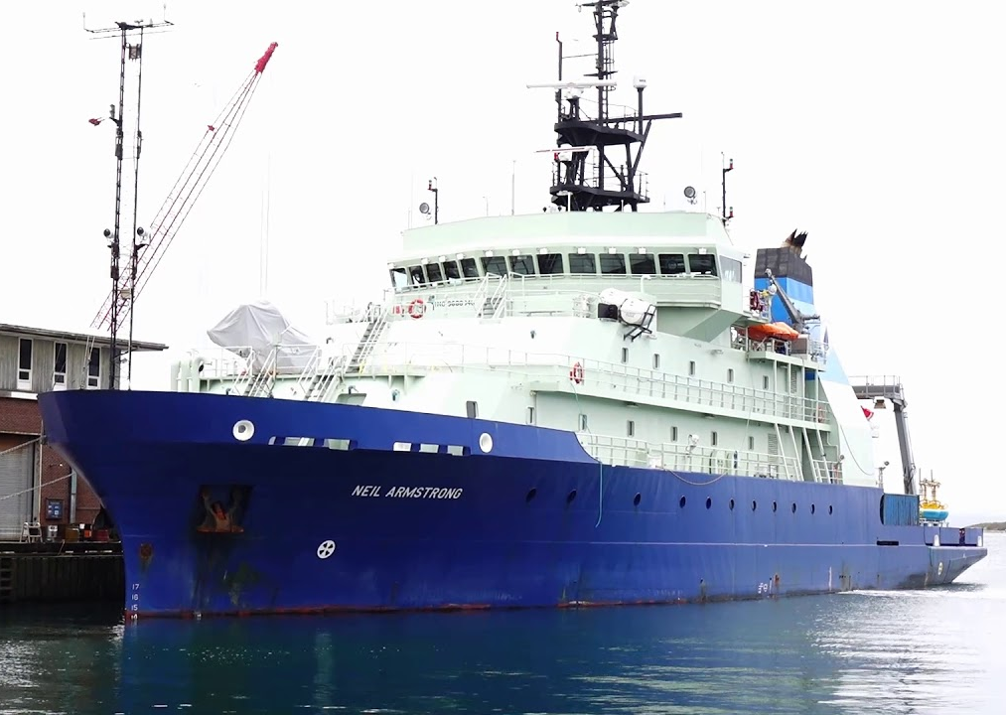
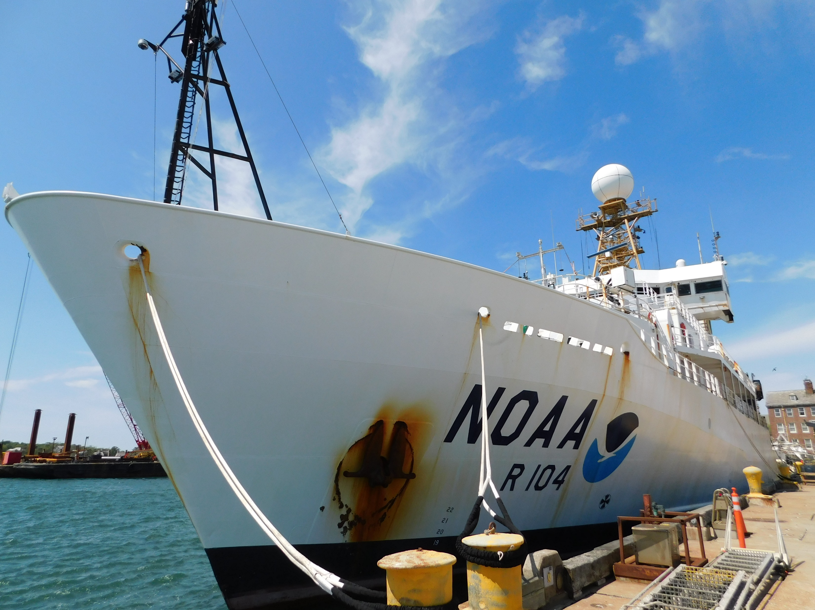
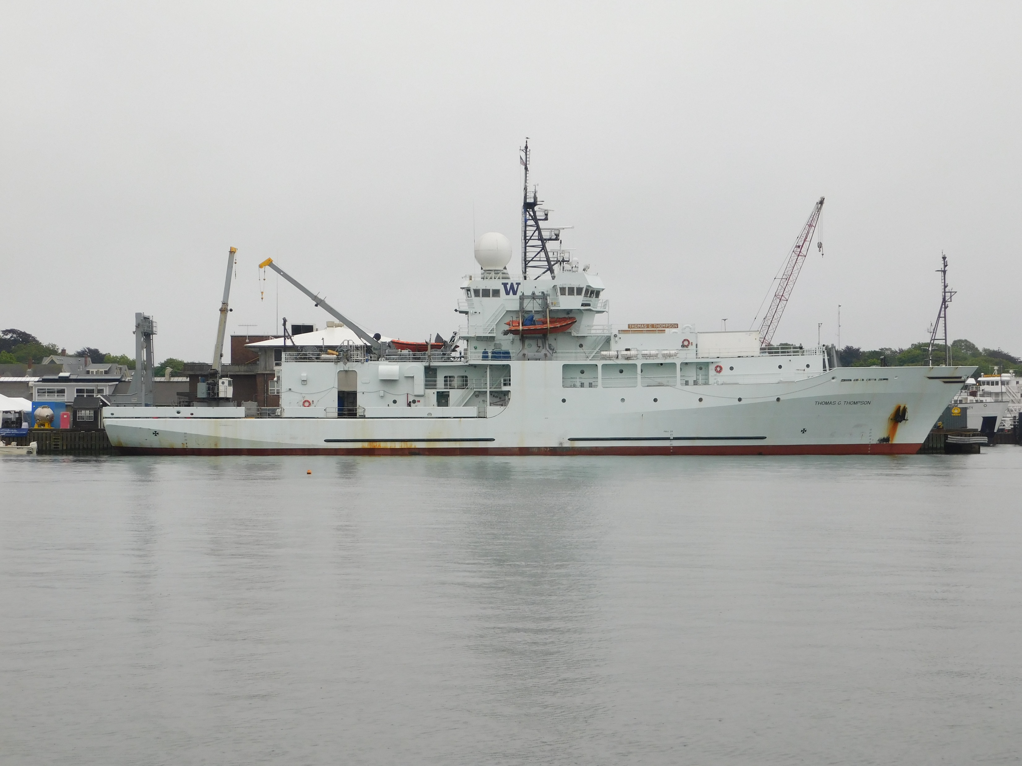
Acknowledgements

