Slide 1
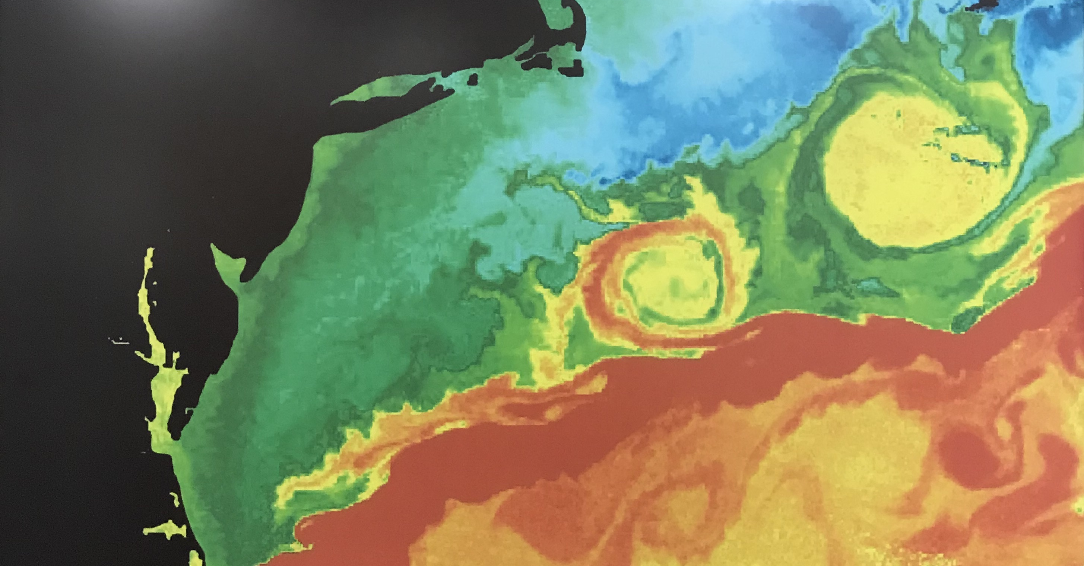
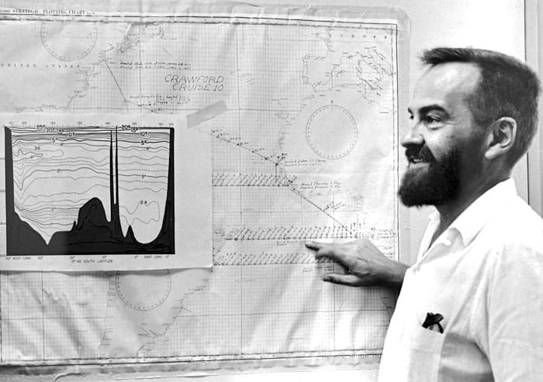
Warm Spiral Streamers over Gulf Stream Warm-Core Rings
Weifeng (Gordon) Zhang
Dennis McGillicuddy
Woods Hole Oceanographic Institution
Fritz Fuglister (1909-1987)
An oceanographer, Artist, and Musician

Slide 2
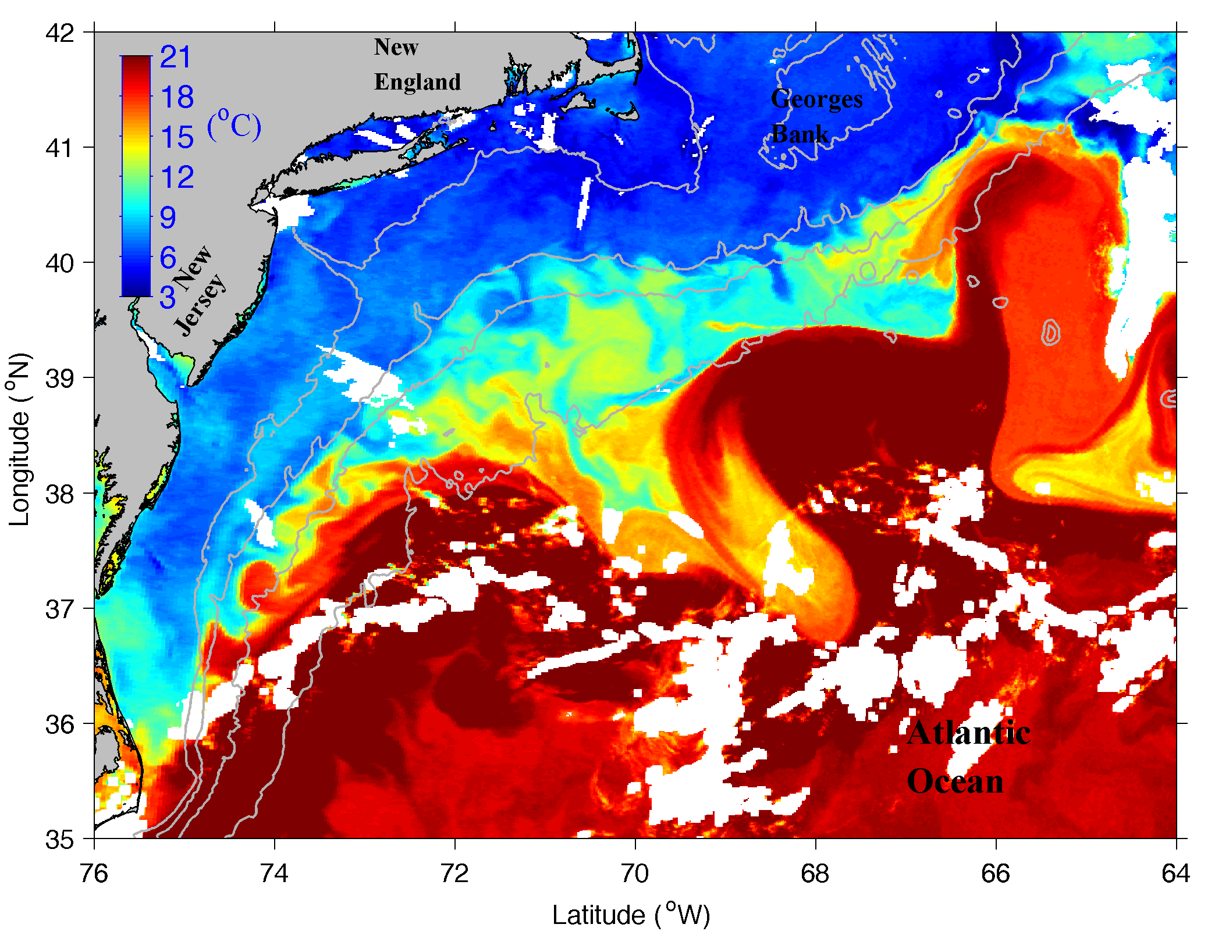
Regional Setup Mid-Atlantic Bight (MAB)
SST on 13 April 2014
cold fresh shelf water
Warm-Core Ring
Gulf Stream

Slide 3
Warm Spiral Streamers over WCRs
Occurs when a relatively old WCR interacts with Gulf Stream or with another new WCR
Warm water from the Gulf Stream or the new ring moves around the old ring
It also moves toward its center, creating a radial offset and then a spiral pattern

Slide 4
Questions
What is the vertical structure of the warm spiral streamers
What is the formation mechanism

Slide 5
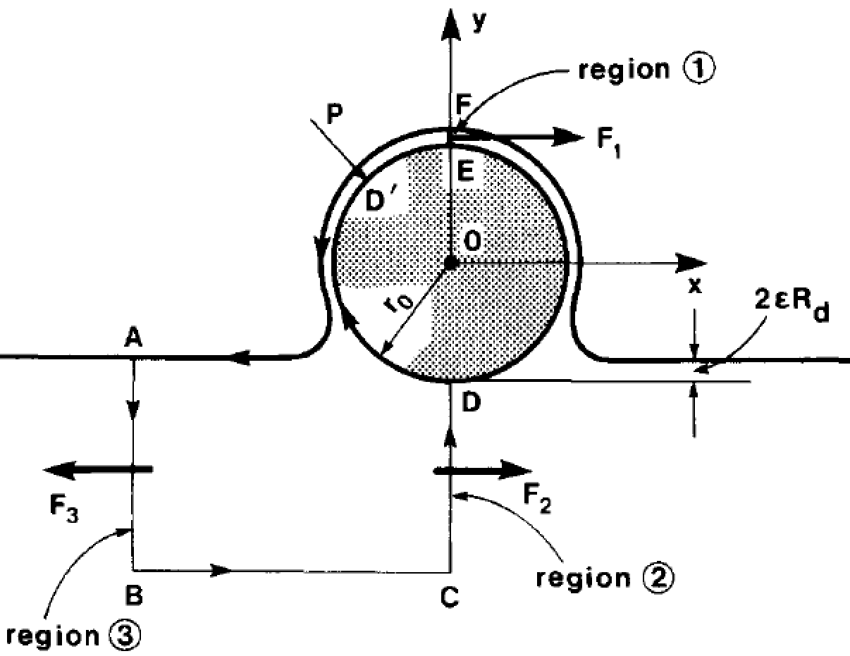
A Conceptual Model of Ring-Gulf Stream Interaction
(Nof, DSR, 1986)
A two-layer model
$Ω$–shaped filament
Cylinder
WCR
Surface outcrop the vertical interface
Upper layer
Gulf Stream
Impingement of a cylindrical WCR onto the Gulf Stream create a surface filament of Gulf Stream water moving clockwise around the ring and later reattaches itself to the Gulf Stream, forming a $Ω$-shape

Slide 6
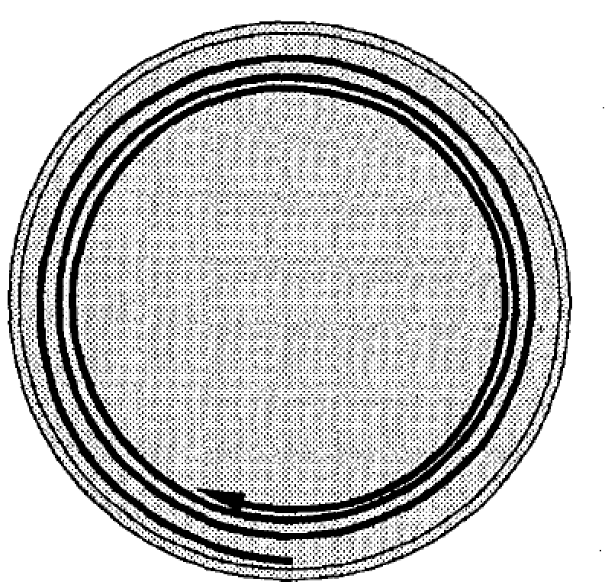
The Sinking of WCR in the Slope Sea
(Chapman and Nof, JPO, 1988)
Top view
Side view
Trajectory of a parcel of surface slope water
Slope water
WCR loses heat (buoyancy) to air and then sinks to the surround slope water
Surface slope water from all direction washes over and are carried by the anticyclonic ring current
A parcel of the surface slope water would moving toward the ring center following a spiral pattern
This process does not produce the pattern of warm spiral streamer

Slide 7
Our Approaches
Satellite SST imagery to show the development of a warm spiral streamer in April 2018
Ship-board in situ data to reveal the vertical structure of the warm spiral streamer in April 2018
An idealized model to reproduce the basic pattern and then disclose the formation mechanism

Slide 8
Satellite SST in April 2018
An old WCR formed in Nov 2017 had moved around in the slope sea
The old ring encountered a ‘bump’ in the Gulf Stream
A filament of the warm Gulf Stream water was entrained by the ring
The warm filament moved around the ring forming a spiral streamer

Slide 9
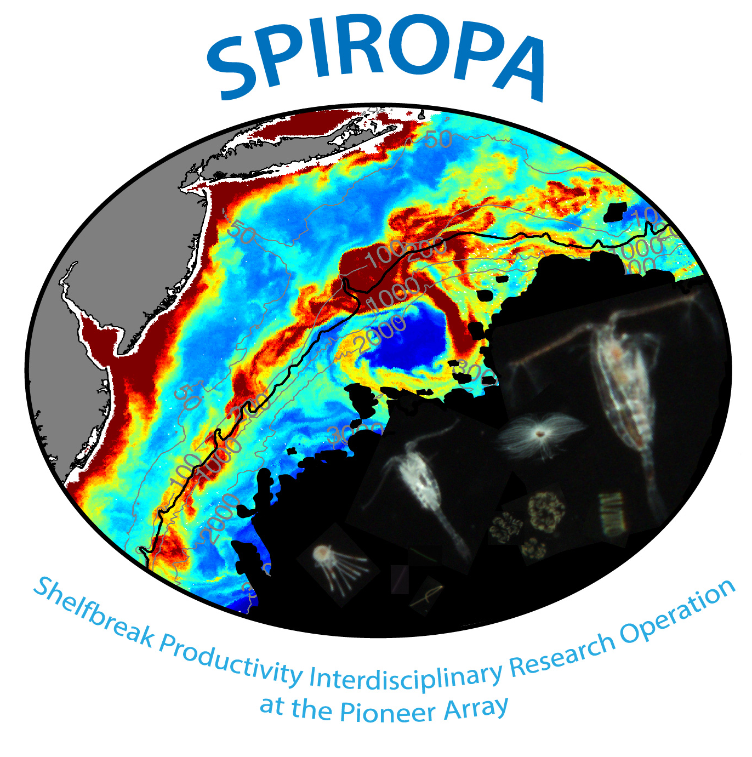
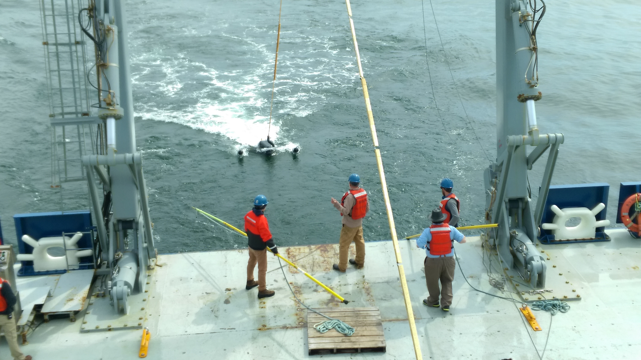
SPIROPA Cruise 1 – AR29
Video Plankton Recorder
CTD

Slide 10
SPIROPA Data
Video Plankton Recorder
Ship-board CTD
Warm streamer is 60-80 m thick
Density of the warm streamer water is lower than the surrounding shelf and ring water
Slanted layers of lower temperature, lower salinity water, high chlorophyll and high oxygen on both sides of the warm streamer ---- subduction

Slide 11
SPIROPA Data
Video Plankton Recorder
CTD
Warm streamer is 60-80 m thick
Density of the warm streamer water is lower than the surrounding shelf and ring water
Slanted layers of lower temperature, lower salinity water, high chlorophyll and high oxygen on both sides of the warm streamer ---- subduction

Slide 12
An Idealized 3D Model
Top view
Cross-section
$$ρ_{e}$$
$$ρ_{r}$$
$$ρ_{r}$$
Color: eddy water passive tracer
$$ρ_{s}$$
$$ρ_{e}$$
Color: density
Rectangular domain: 2000 km x 500 km
Flat bottom of ~1000 m deep;
Horizontal resolution: 500 m; 60 vertical layers
An idealized WCR
A shallow warm buoyant eddy represent the northern edge of the Gulf Stream
${{ρ_{e}<ρ}_{r}<ρ}_{s}$
Thermal-wind balanced initial velocity and geostrophically balanced SSH
Passive tracers to track the eddy water and surface ring water

Slide 13
Modeled Spiral pattern
Color:
passive tracer concentration
Model reproduces the pattern of a spiral streamer over the WCR
As the streamer water moves around the ring, it also migrates towards the ring center
Vertical structure of the model spiral streamer matches observations
Color: Density

Slide 14
Modeled Spiral pattern
Color:
passive tracer concentration
Model reproduces the pattern of a spiral streamer over the WCR
As the streamer water moves around the ring, it also migrates towards the ring center
Vertical structure of the model spiral streamer matches observations

Slide 15
A Zoom-in view of the radial motion
Color: density
$$ρ_{r}$$
Key ingredient:
${ρ_{e}<ρ}_{r}$
Density front persists at the interface between the eddy and ring waters
Thermal-wind balance drives a local anticyclonic flow at the interface
Rossby number of the local flow
Ro = U/fL ~ O(1)
Submesoscale process
Centrifugal force pushes the buoyant eddy water toward the ring center while being carried around the ring by the underlying ring current
$$ρ_{e}$$

Slide 16
Summary
Warm spiral streamers form over old WCRs after they collide with the Gulf Stream or other newer WCRs
Observations show the warm spiral streamer is a thin surface layer of low density water
Model simulations reveal the key ingredient is the intruding new Gulf Stream water having density lower than the ring water
The spiral pattern is formed locally by nonlinear momentum advection (i.e., centrifugal force) at the submesoscale front at the interface between the intruding Gulf Stream water and old ring water
It could also be considered as ‘localized overwash’ of the old ring by the new buoyant Gulf Stream water or just the buoyant Gulf Stream water flowing ‘uphill’
Submesoscale frontal subduction on both sides of the streamer resulted from the stretching-induced frontogenesis widens the streamer and enhances its surface expression

