Slide 1
Changes of the Physical Environment during the April 2018 Cruise
---- Interaction between the Shelfbreak Front and a Warm-Core Ring

Slide 2
A quick review of the physical processes at the shelf break front

Slide 3
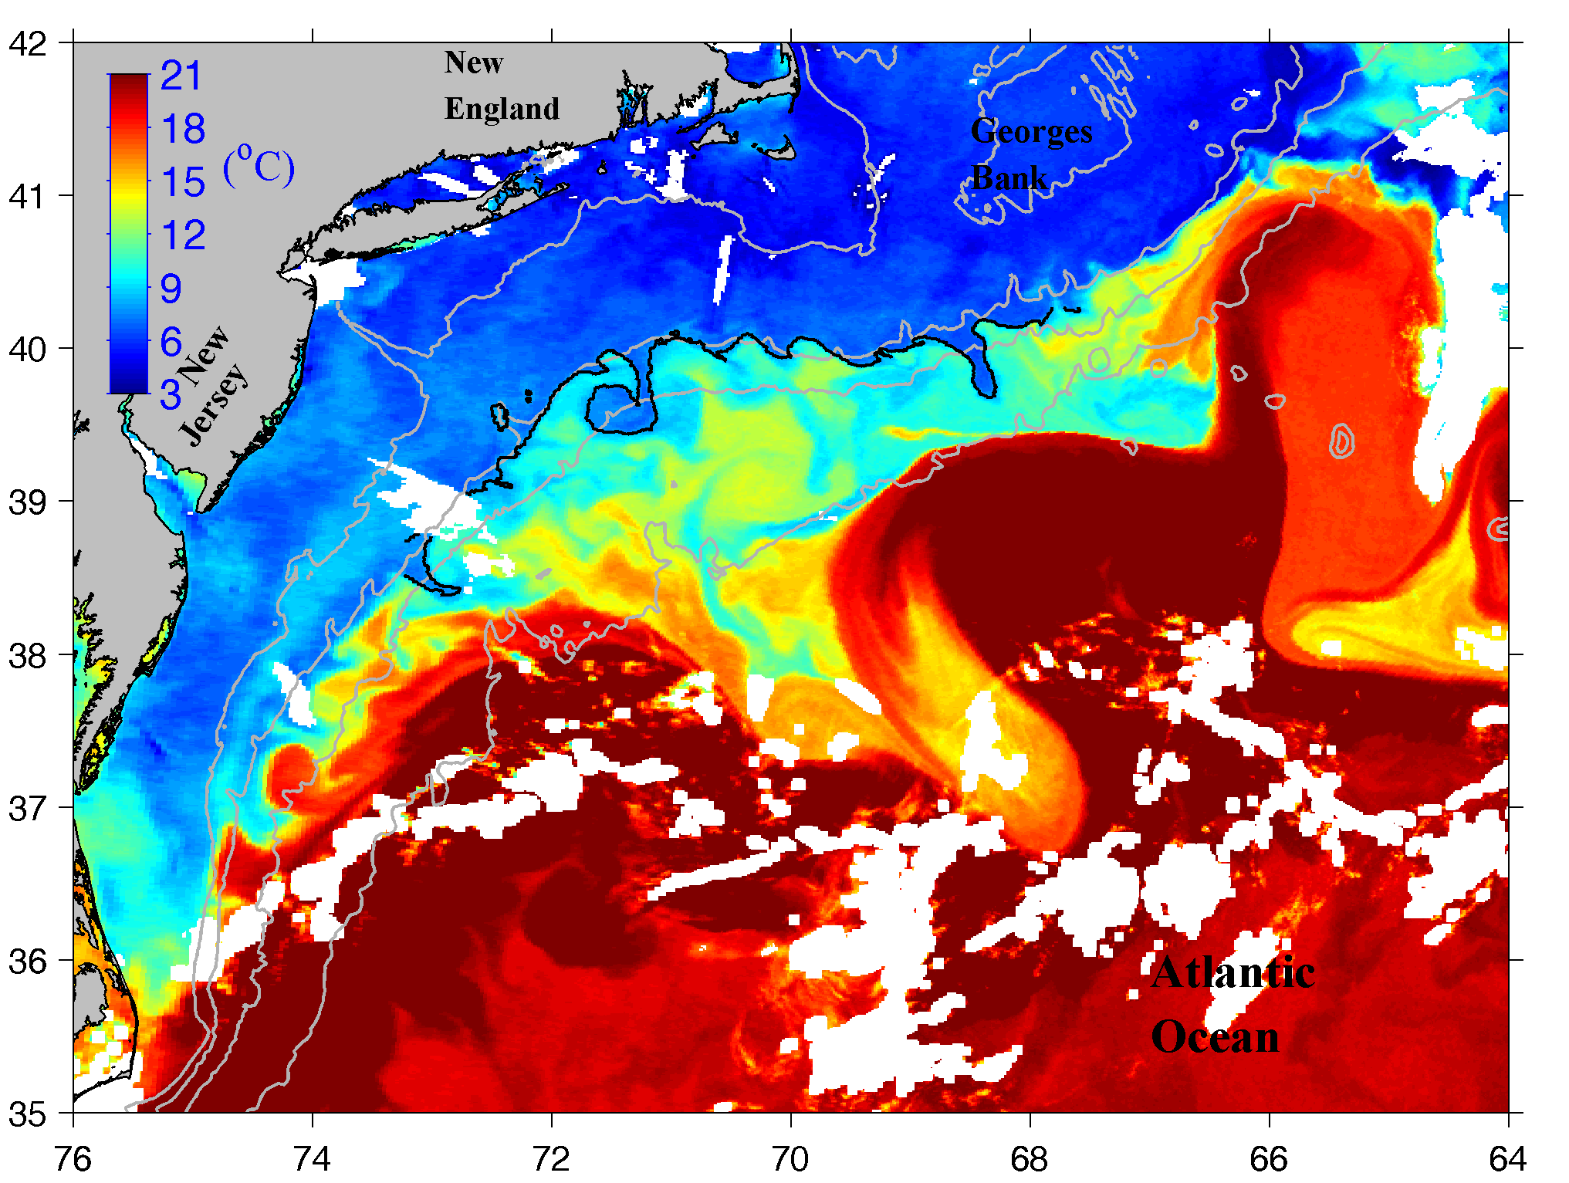
Regional Setup Mid-Atlantic Bight (MAB)
Sea Surface Temperature on 13 April 2014
cold fresh
Less dense
Shelfbreak front
Slope water
denser
Warm-Core Ring
warm saline
Gulf Stream

Slide 4
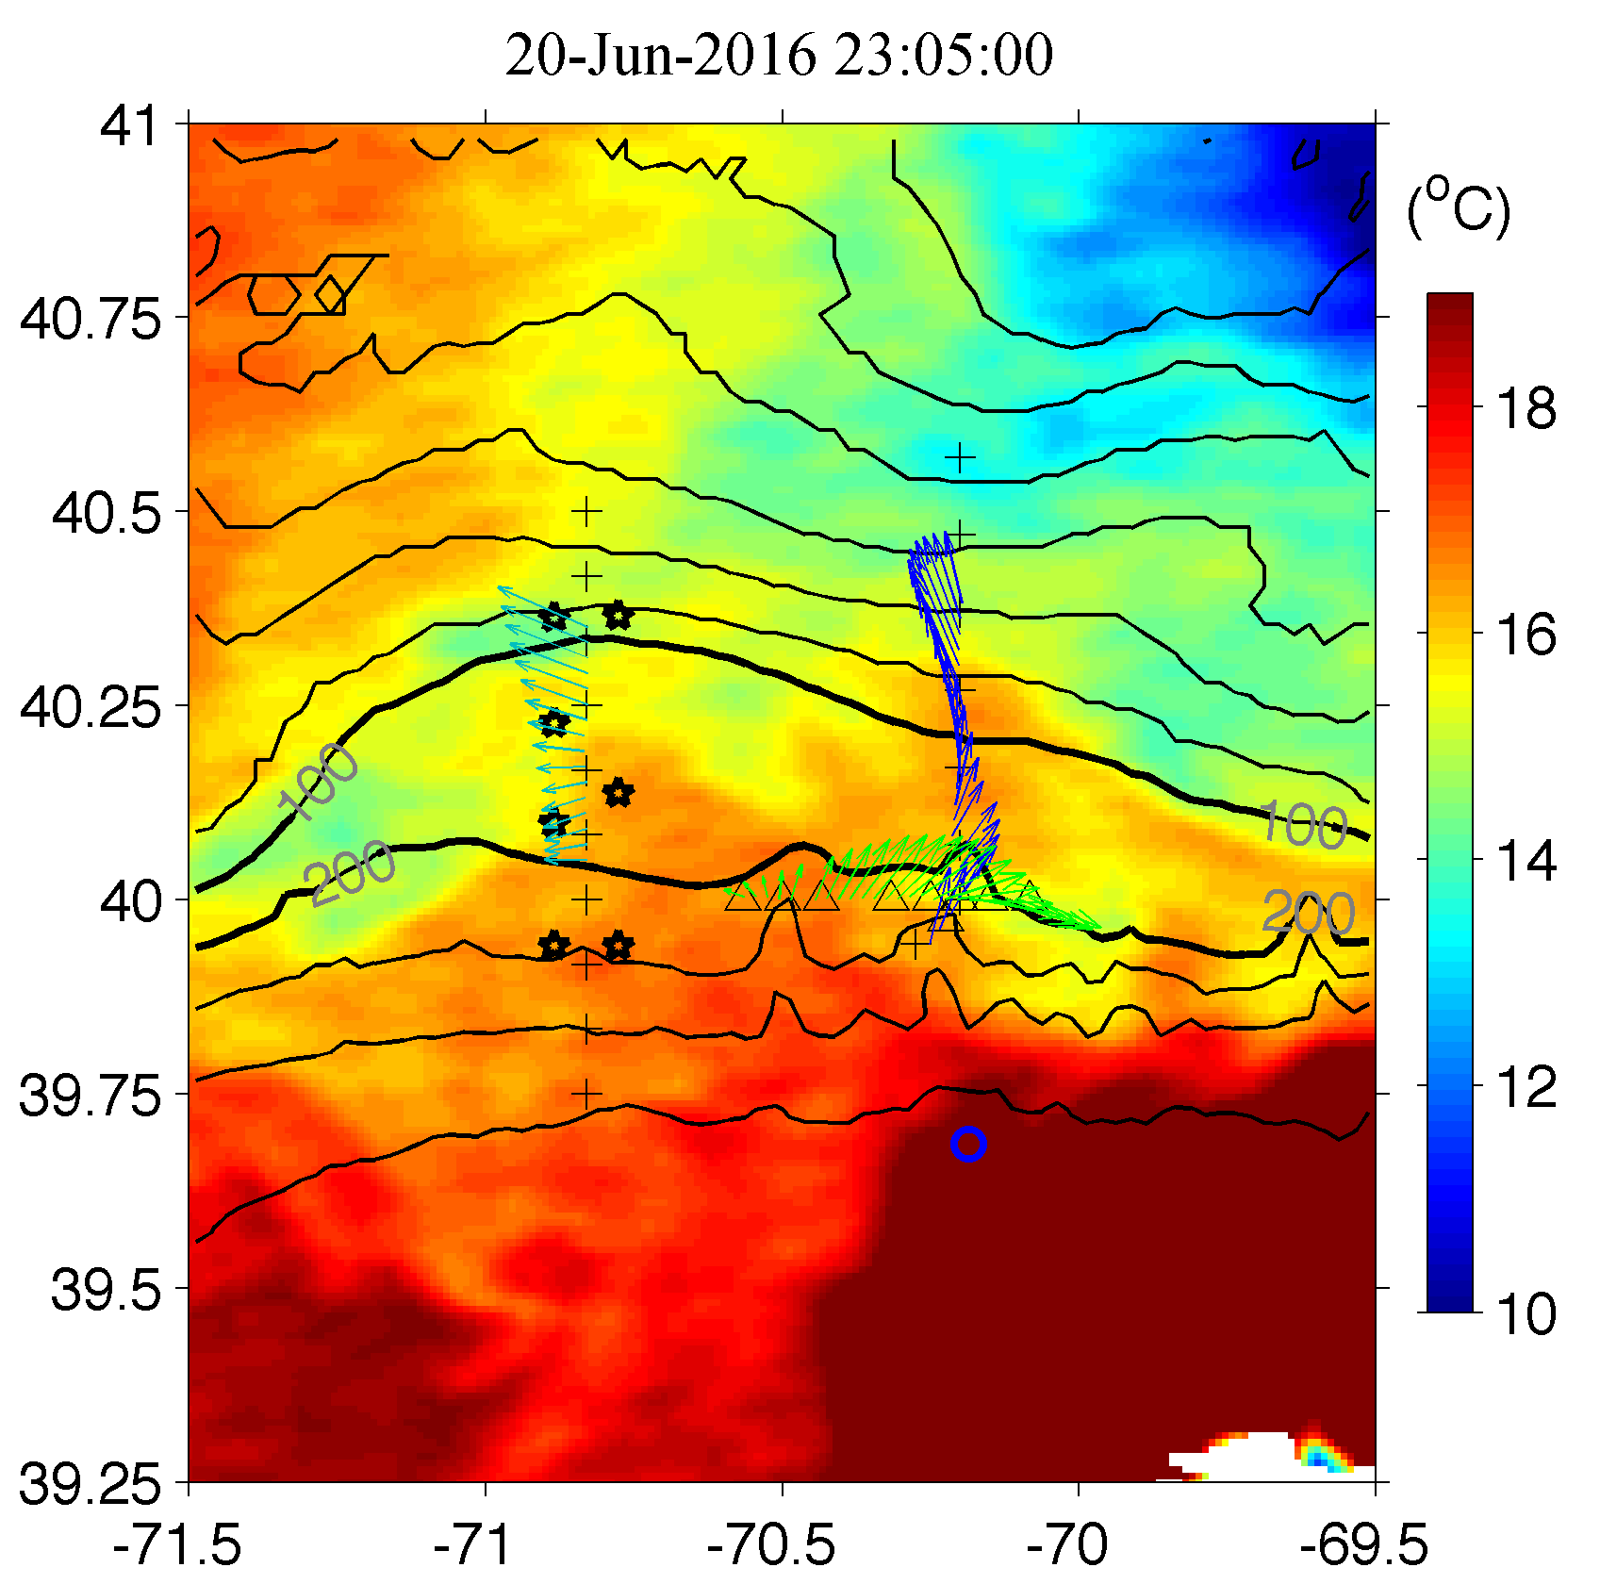
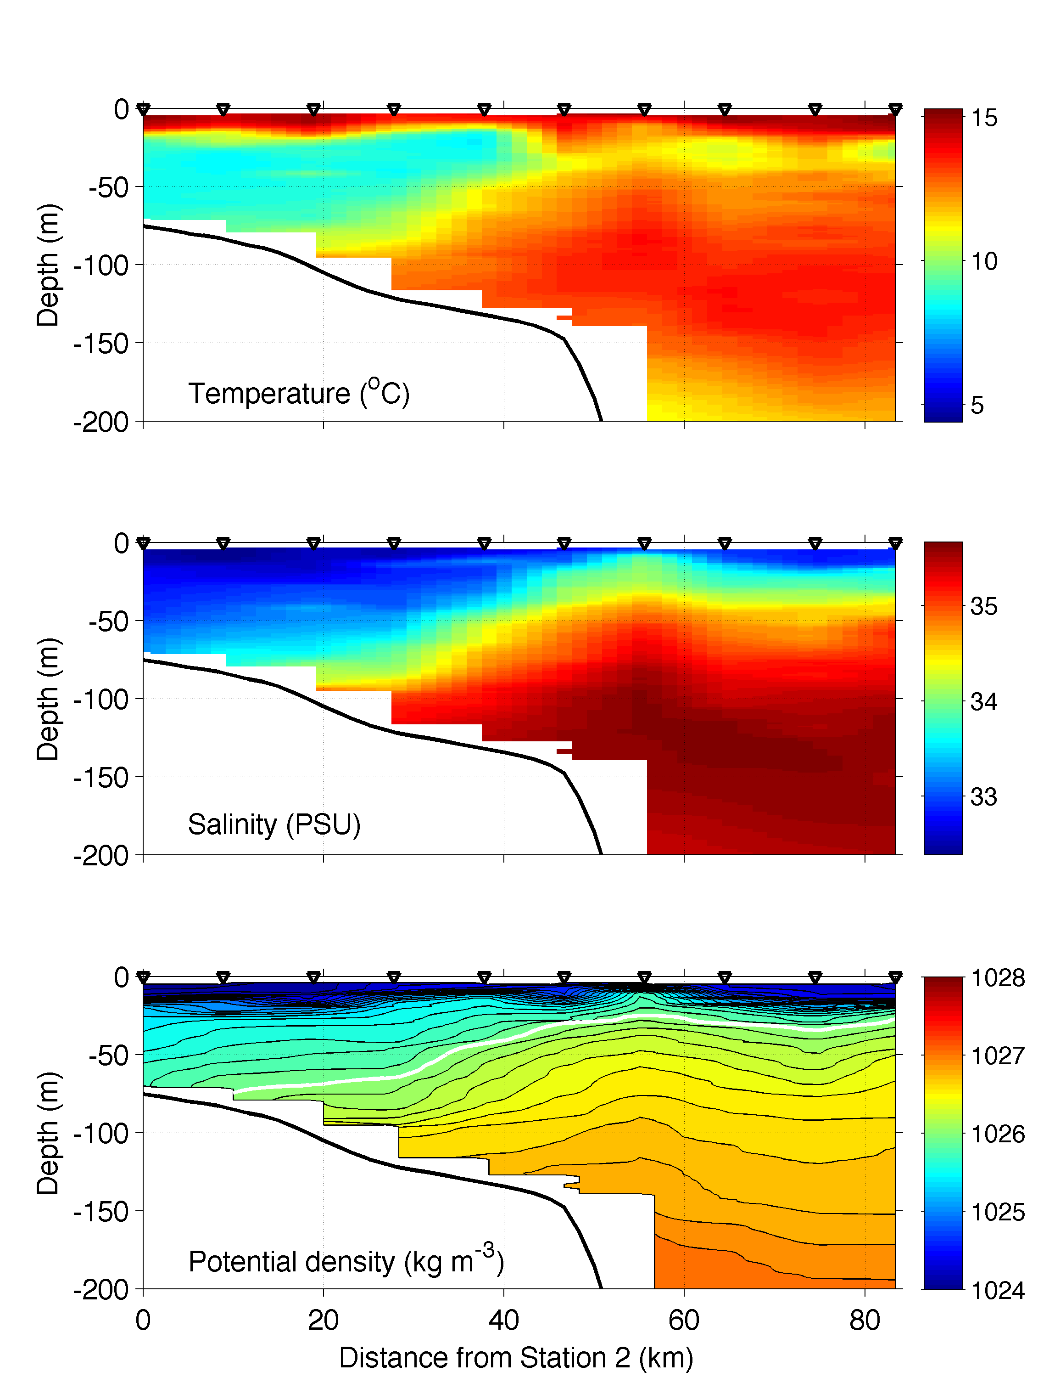
Shelfbreak front in Jun 2016

Slide 5
Short-term variability of the shelfbreak front
1. Frontal instability
Frontal instability develops into finite-amplitude meanders in 2-3 days
Frontal meanders propagate westward in the speed of ~0.1 m/s (~10 km/day)

Slide 6
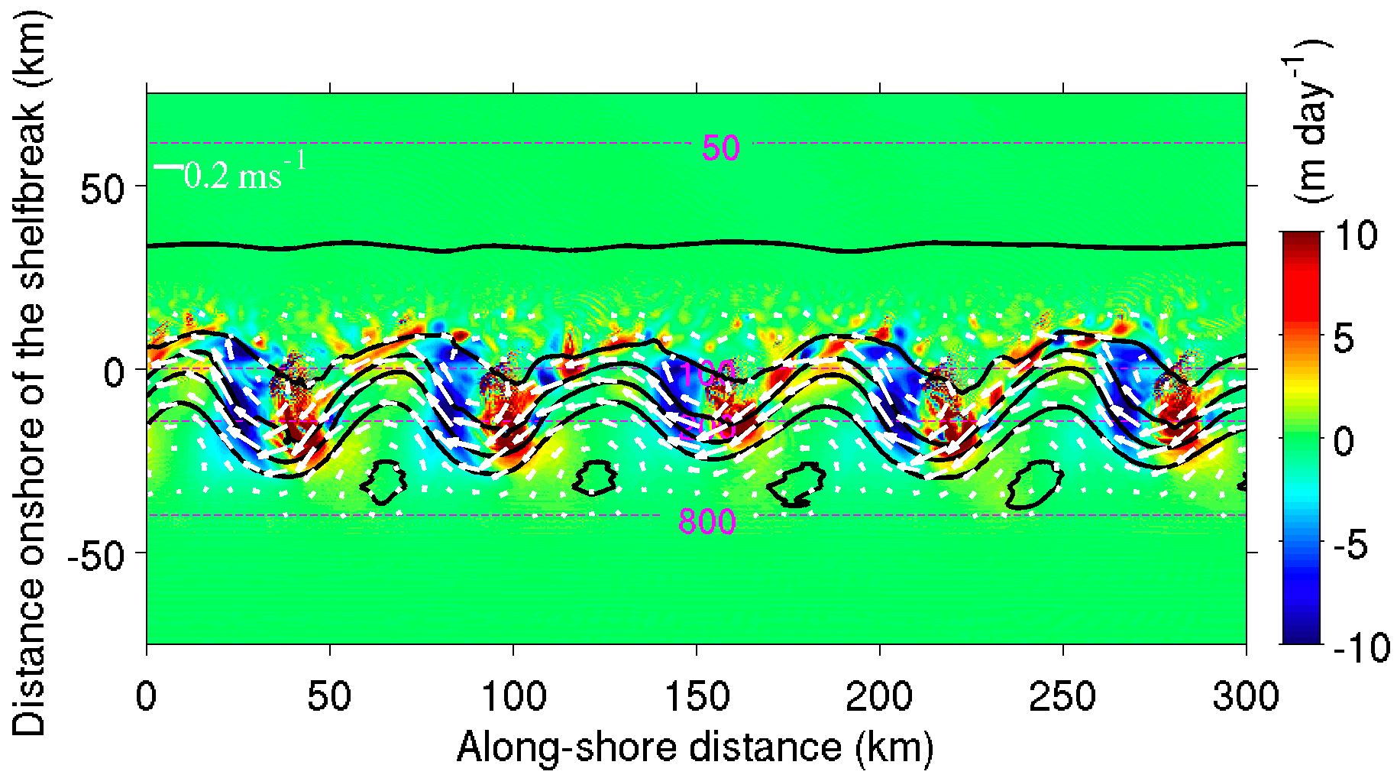
Vertical Motion Associated with the Instability

Slide 7
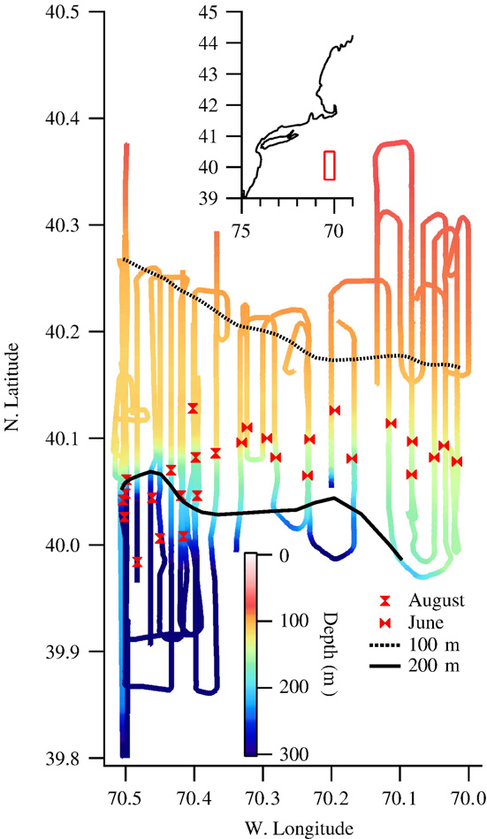
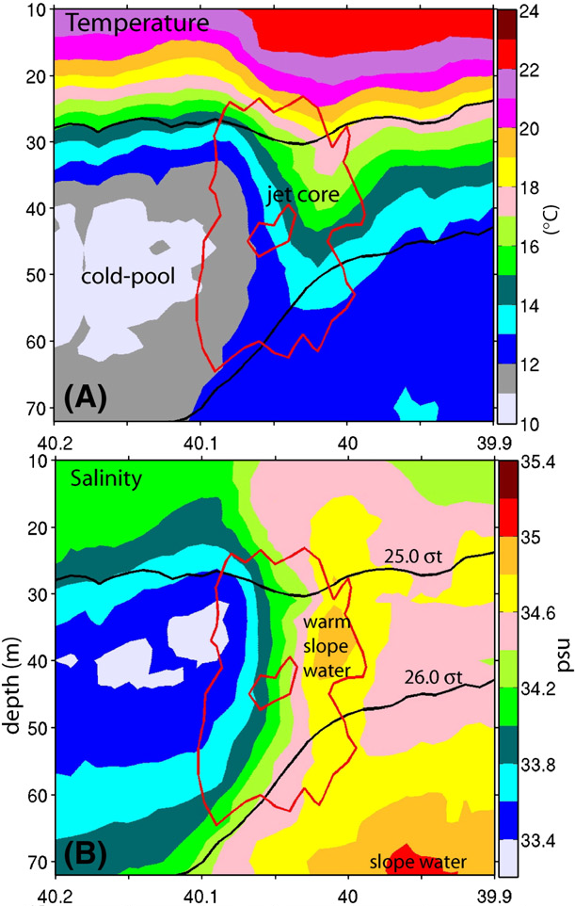
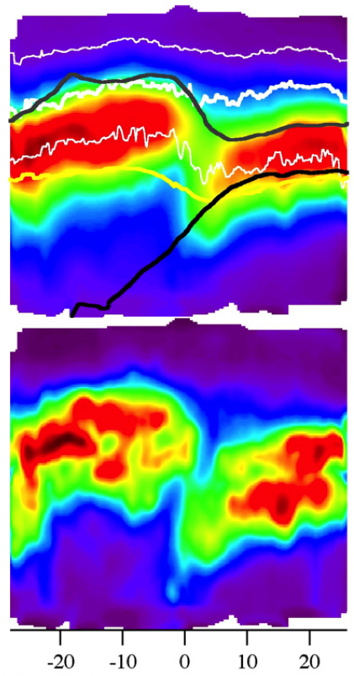
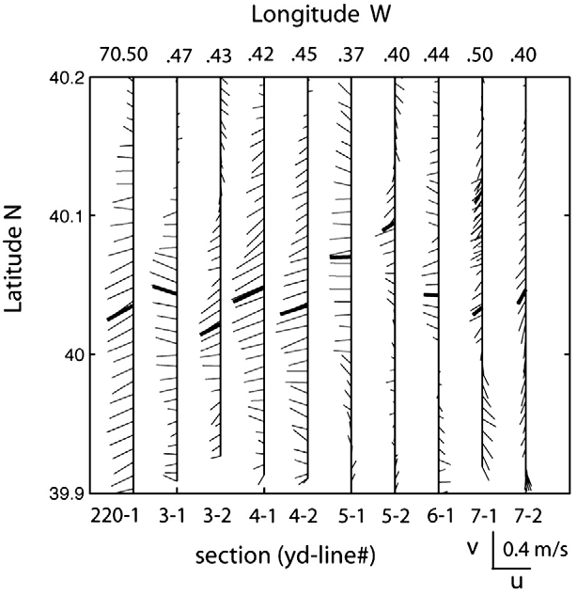
Observed frontal subduction
Hydrographic survey in 8-18 Aug 2002
No influence of warm-core ring
Fluorescence
Fluorescence deviation
(Hale et al, JMS, 2009; Houghton et al, JMS, 2009)

Slide 8
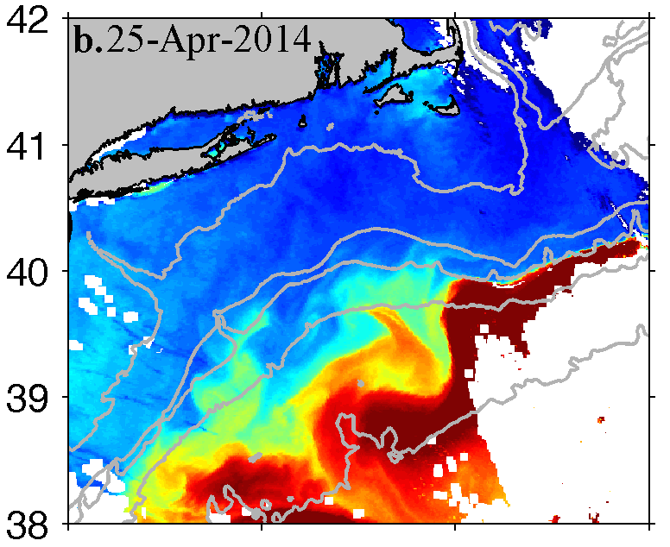
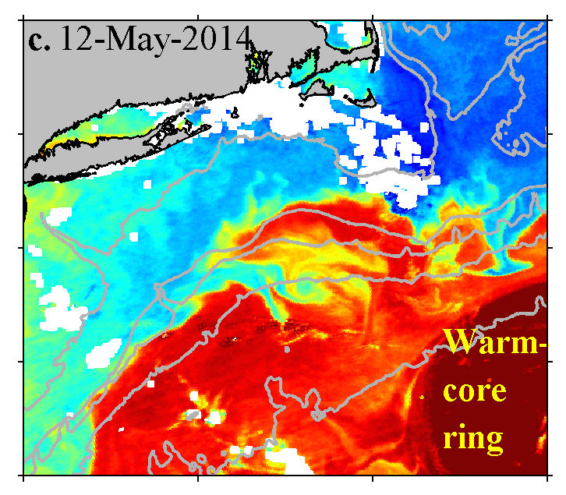
Short-term variability of the shelfbreak front
2. Impact of the warm-core ring
Sea Surface Temperature
Ring-water onshore intrusion develops several days
The intrusion feature propagates westward in the speed of O(10 km/day)

Slide 9
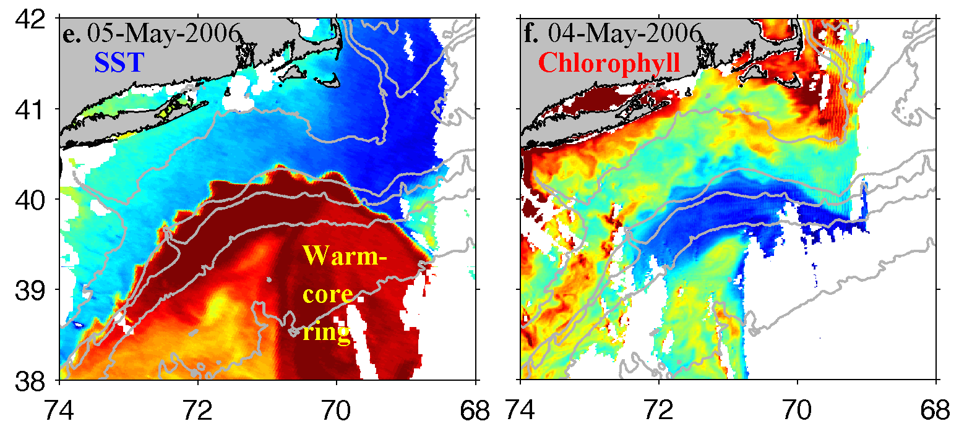
Biological impacts of the Warm-core ring
Low chlorophyll ring water

Slide 10
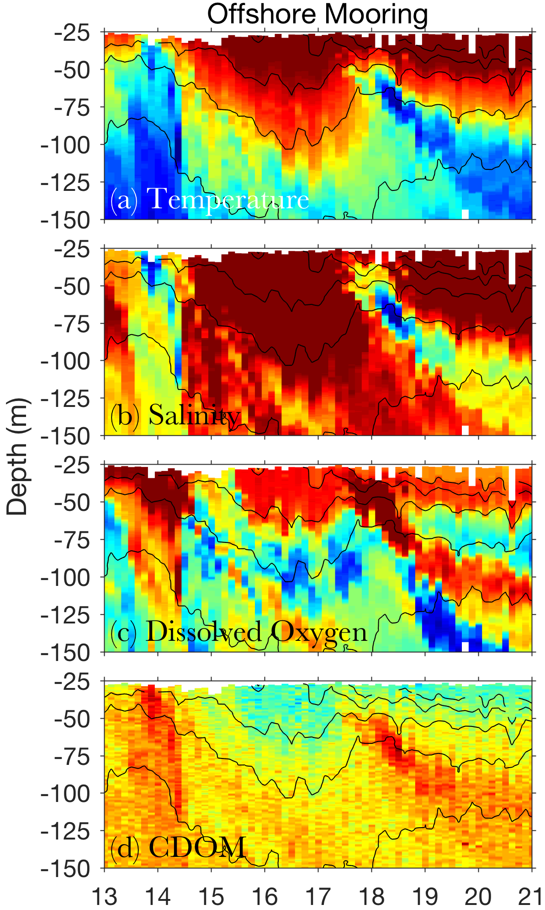
Frontal subduction on the edge of a warm-core ring
Shelf water streamer
Day in Jun 2014

Slide 11
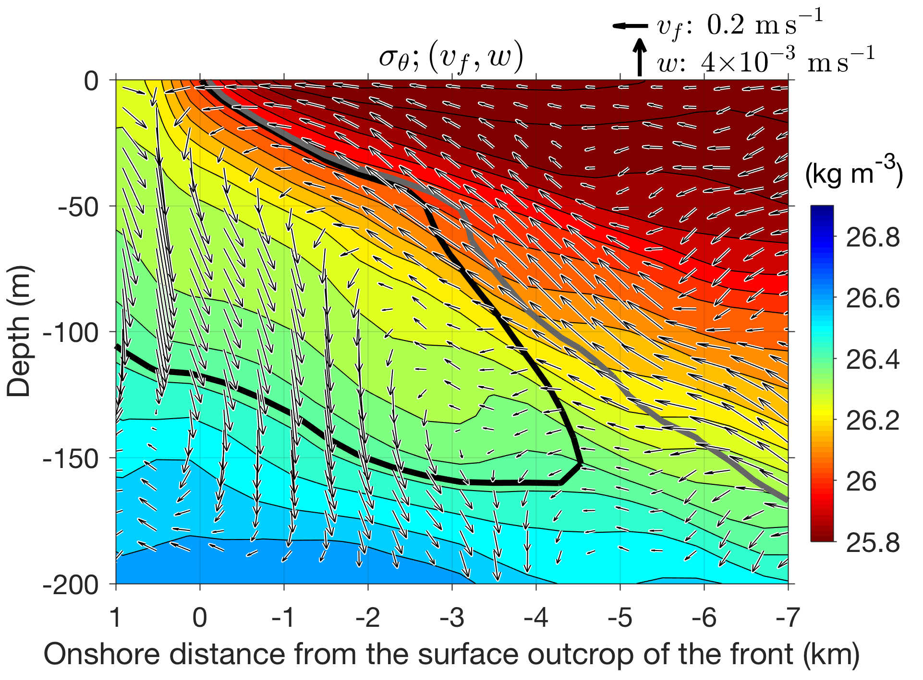
Mechanism of the frontal subduction
Acceleration
u_{g}
Confluence flow (due to ring impingement) sharpens the front and strengthens the frontal flow

Slide 12
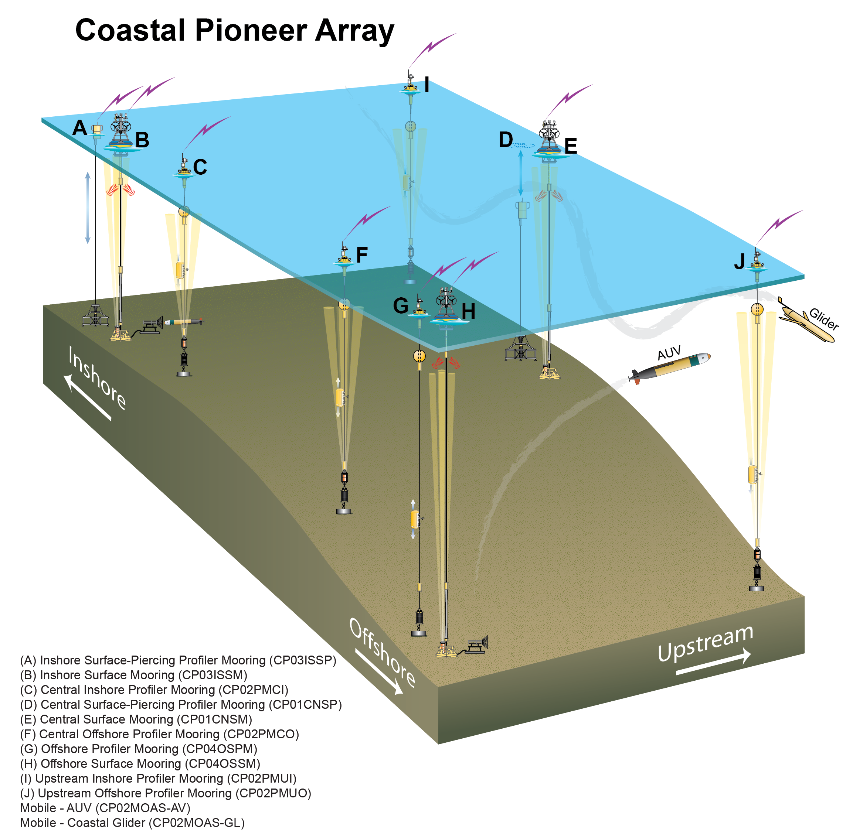
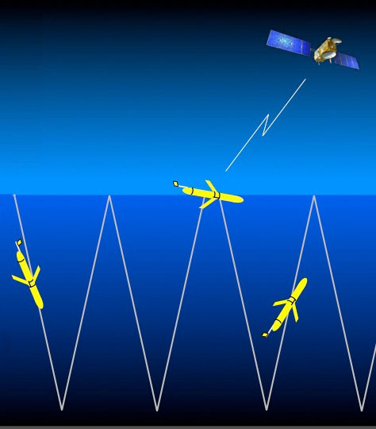
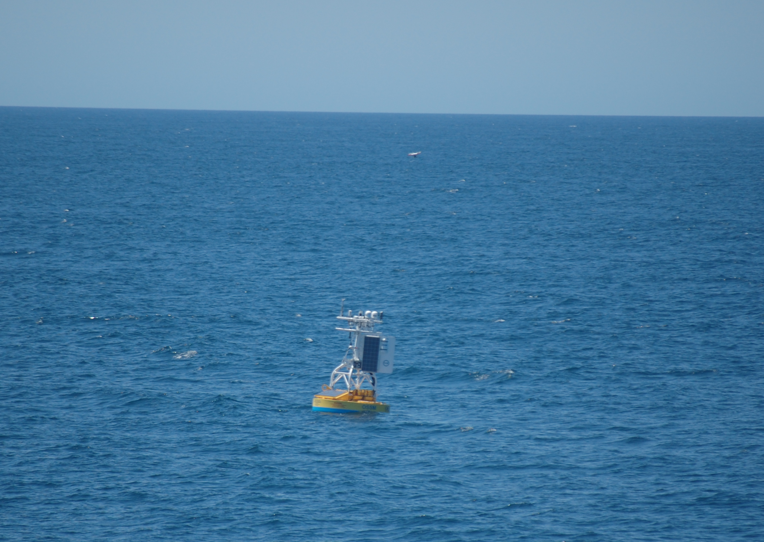
OOI Pioneer Array
(http://oceanobservatories.org/array/coastal-pioneer/)

Slide 13
Changes of the Physical Environment during the April 2018 Cruise
---- Complex Interaction between the Shelfbreak Front and a Warm-Core Ring

Slide 14
Satellite-measured Sea Surface Temperature
2017 Nov 29

Slide 15
Satellite-measured Sea Surface Temperature
2018 Jan 10

Slide 16
Satellite-measured Sea Surface Temperature
2018 Feb 19

Slide 17
Satellite-measured Sea Surface Temperature
2018 Mar 19

Slide 18
Satellite-measured Sea Surface Temperature
2018 Apr 14
Beginning of the cruise

Slide 19
Satellite-measured Sea Surface Temperature
2018 Apr 19
Shelf/slope water streamer
Ring streamer

Slide 20
Satellite-measured Sea Surface Temperature
2018 Apr 22

Slide 21
Satellite-measured Sea Surface Temperature
2018 Apr 23
Ring streamer
Shelf/slope water streamer

Slide 22
Satellite-measured Sea Surface Temperature
2018 Apr 27
It is an old warm-core ring with weak surface temperature signal, but complex surface structure: interleaving filaments of ring, shelf and slope waters

Slide 23
Zoom-in view of the SST
2018 April 14

Slide 24
Zoom-in view of the SST
2018 April 18
Already under the influence of the ring

Slide 25
Zoom-in view of the SST
2018 April 19

Slide 26
Zoom-in view of the SST
2018 April 21

Slide 27
Zoom-in view of the SST
2018 April 21
Ring streamer
Shelf water streamer

Slide 28
Zoom-in view of the SST
2018 April 22

Slide 29
Zoom-in view of the SST
2018 April 23
Ring streamer
Slope water streamer?

Slide 30
Zoom-in view of the SST
2018 April 27

Slide 31
Zoom-in view of the SST
2018 April 28
Strong spatial and temporal variation along the ring edge

Slide 32
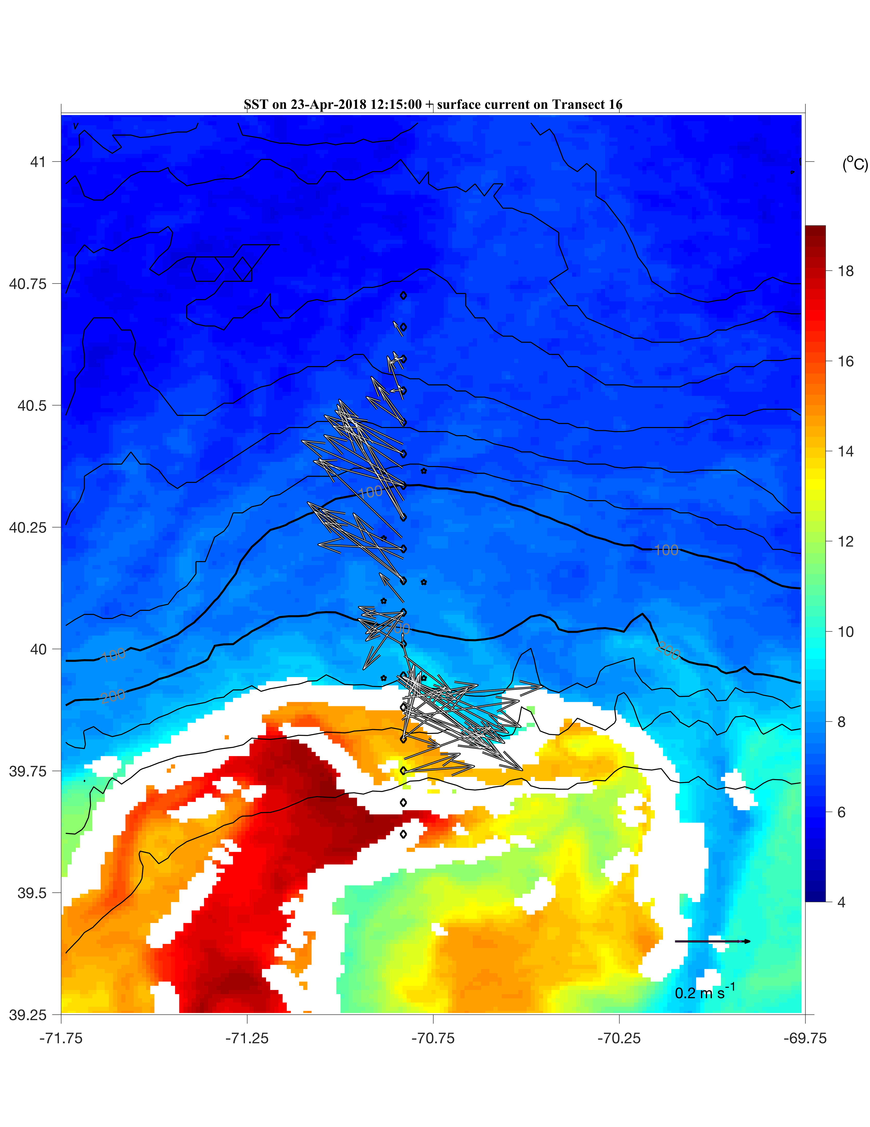
OOI Mooring Data
Temperature
Salinity
Chlorophyll
Arrival of the ring edge at Offshore and Upstream Offshore mooring on April 24 with elevated Chl signal
Oxygen

Slide 33
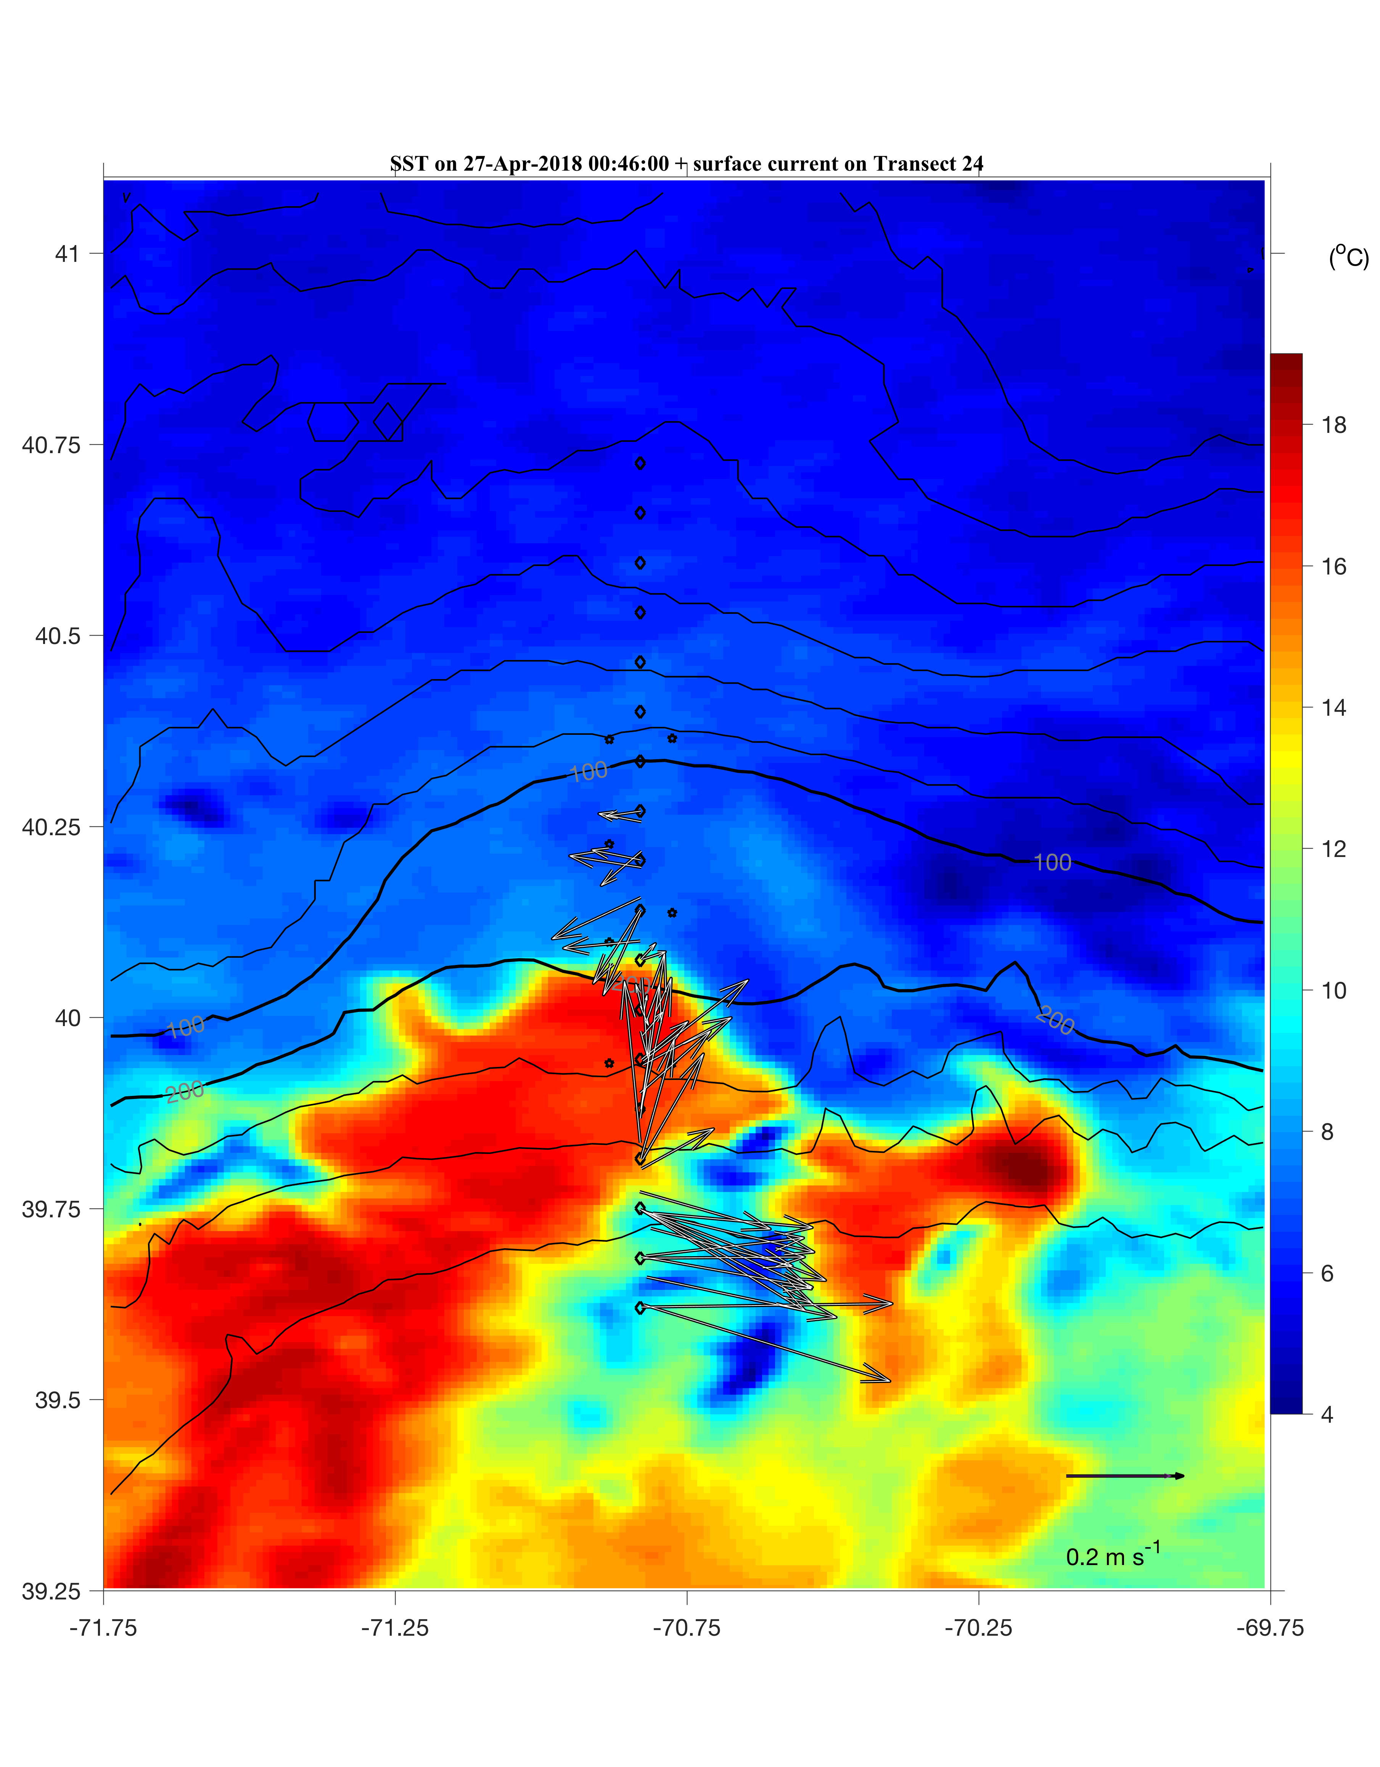
OOI Mooring Data
Temperature
Salinity
Chlorophyll
Oxygen
Arrival of the ring edge at Central Offshore mooring on April 27

Slide 34
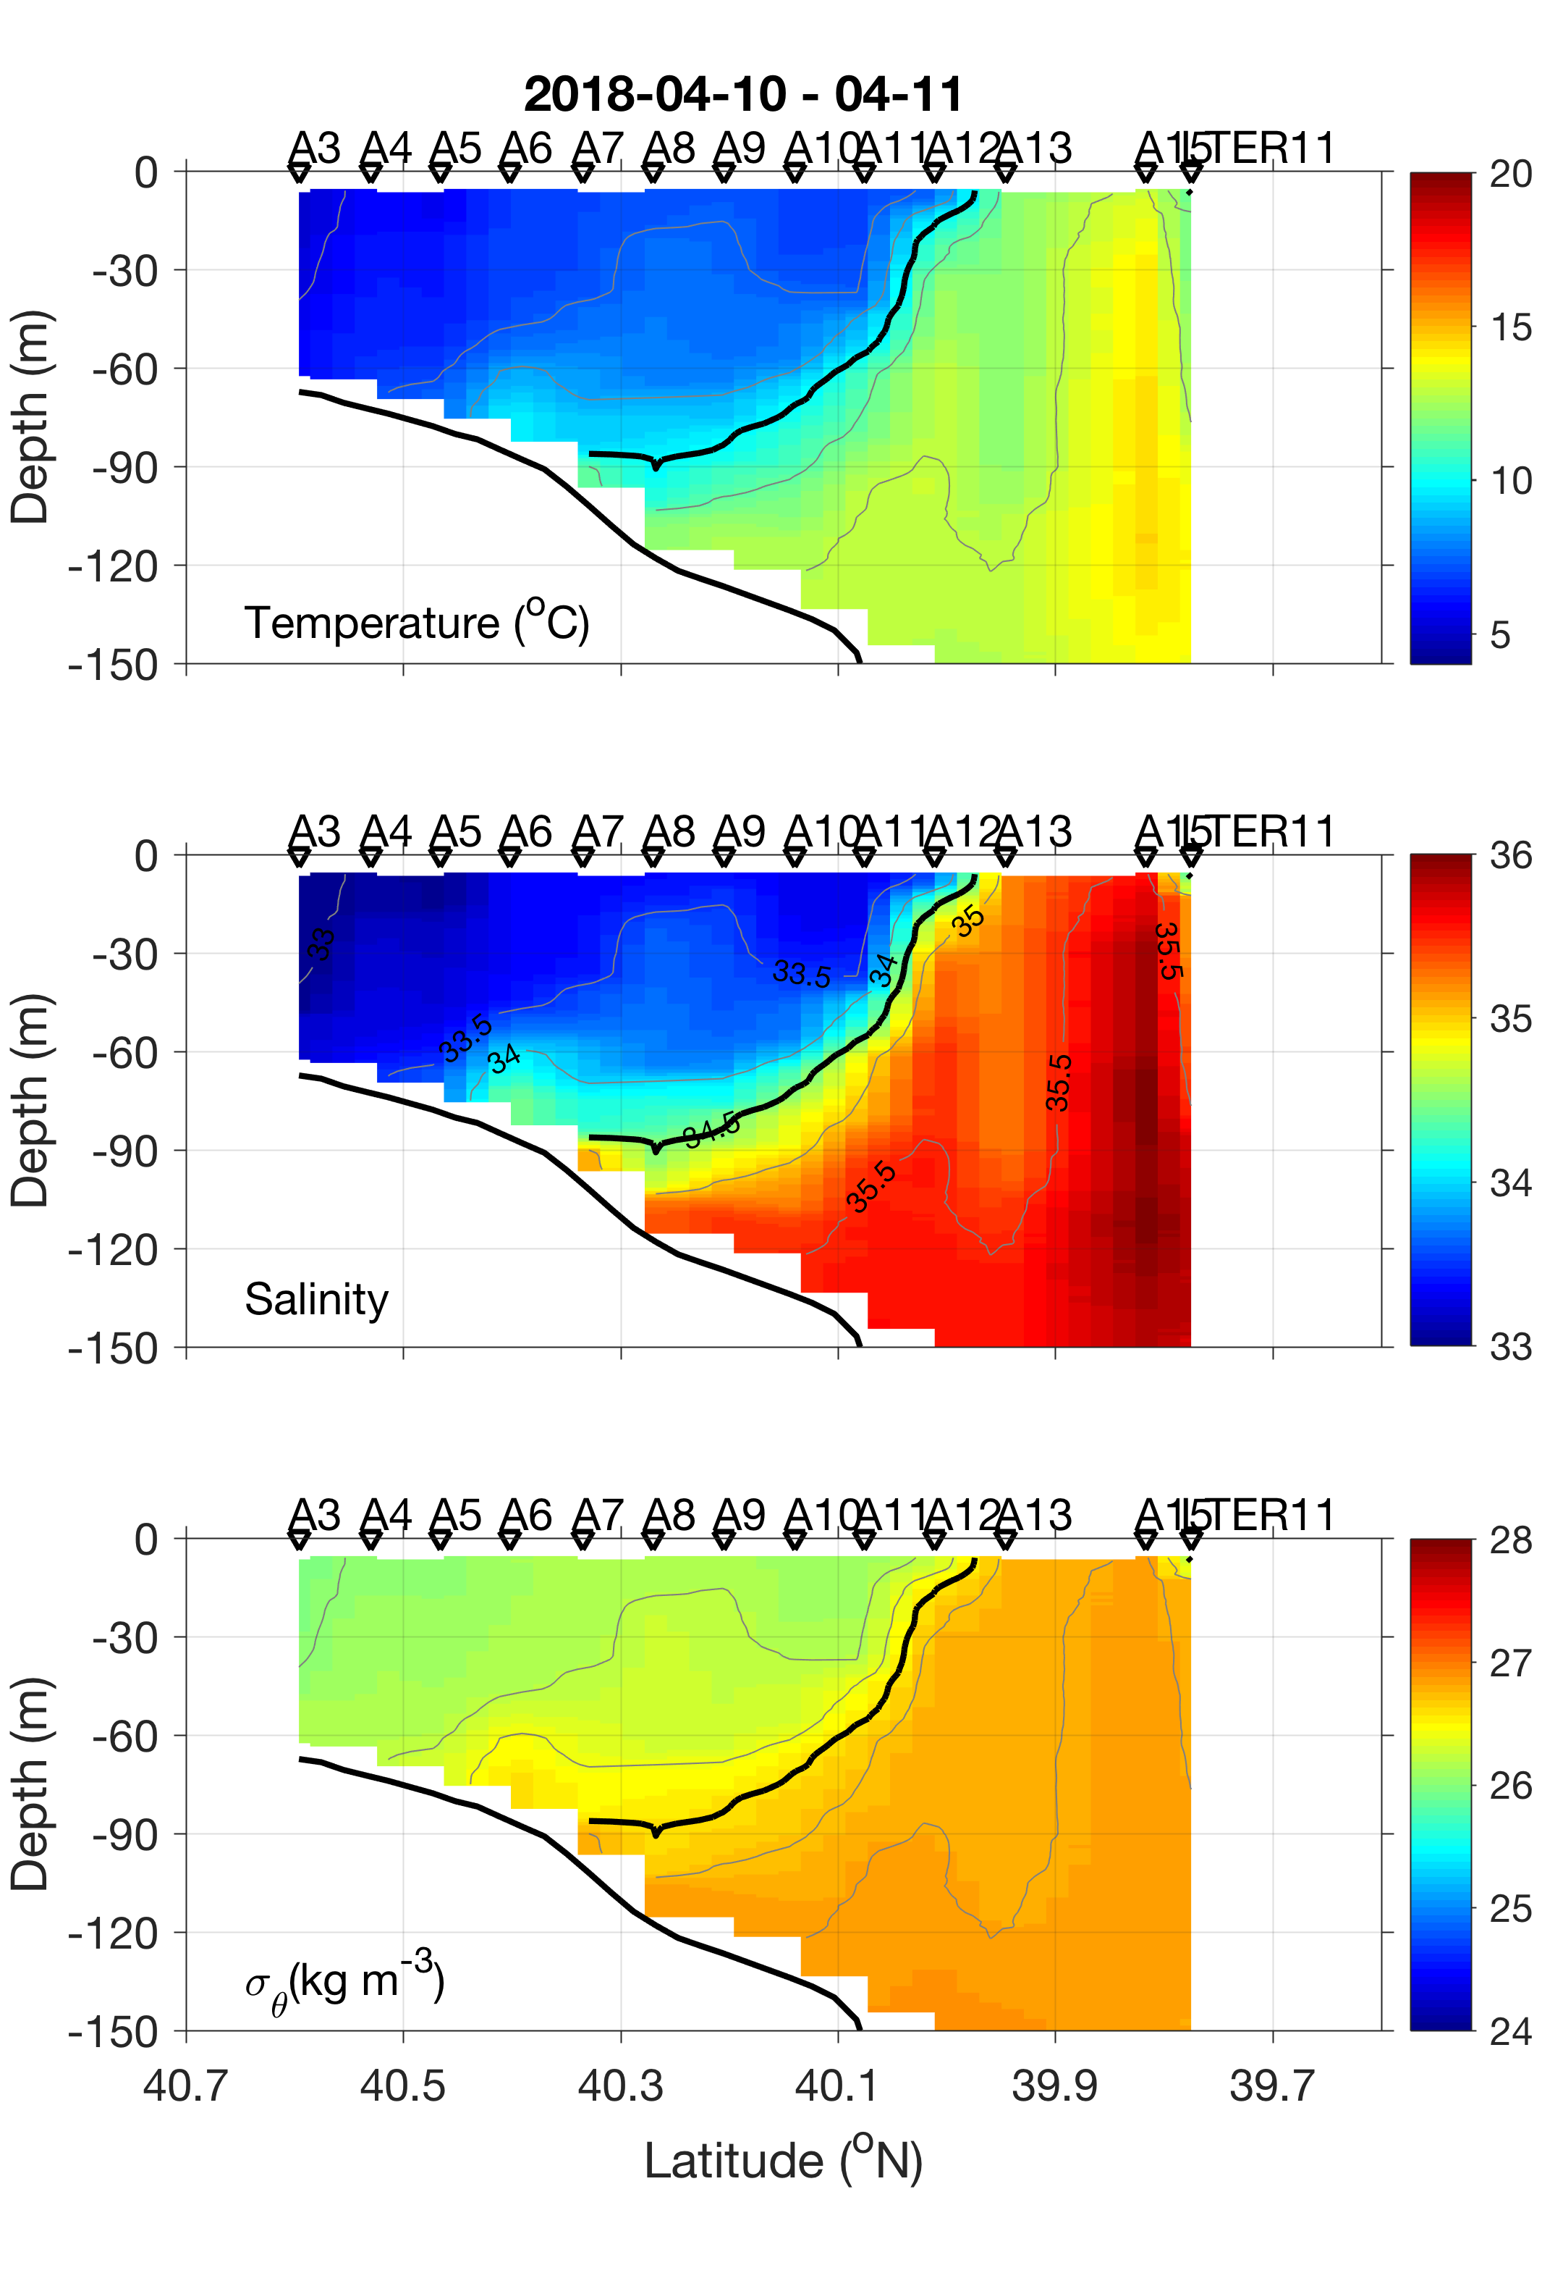
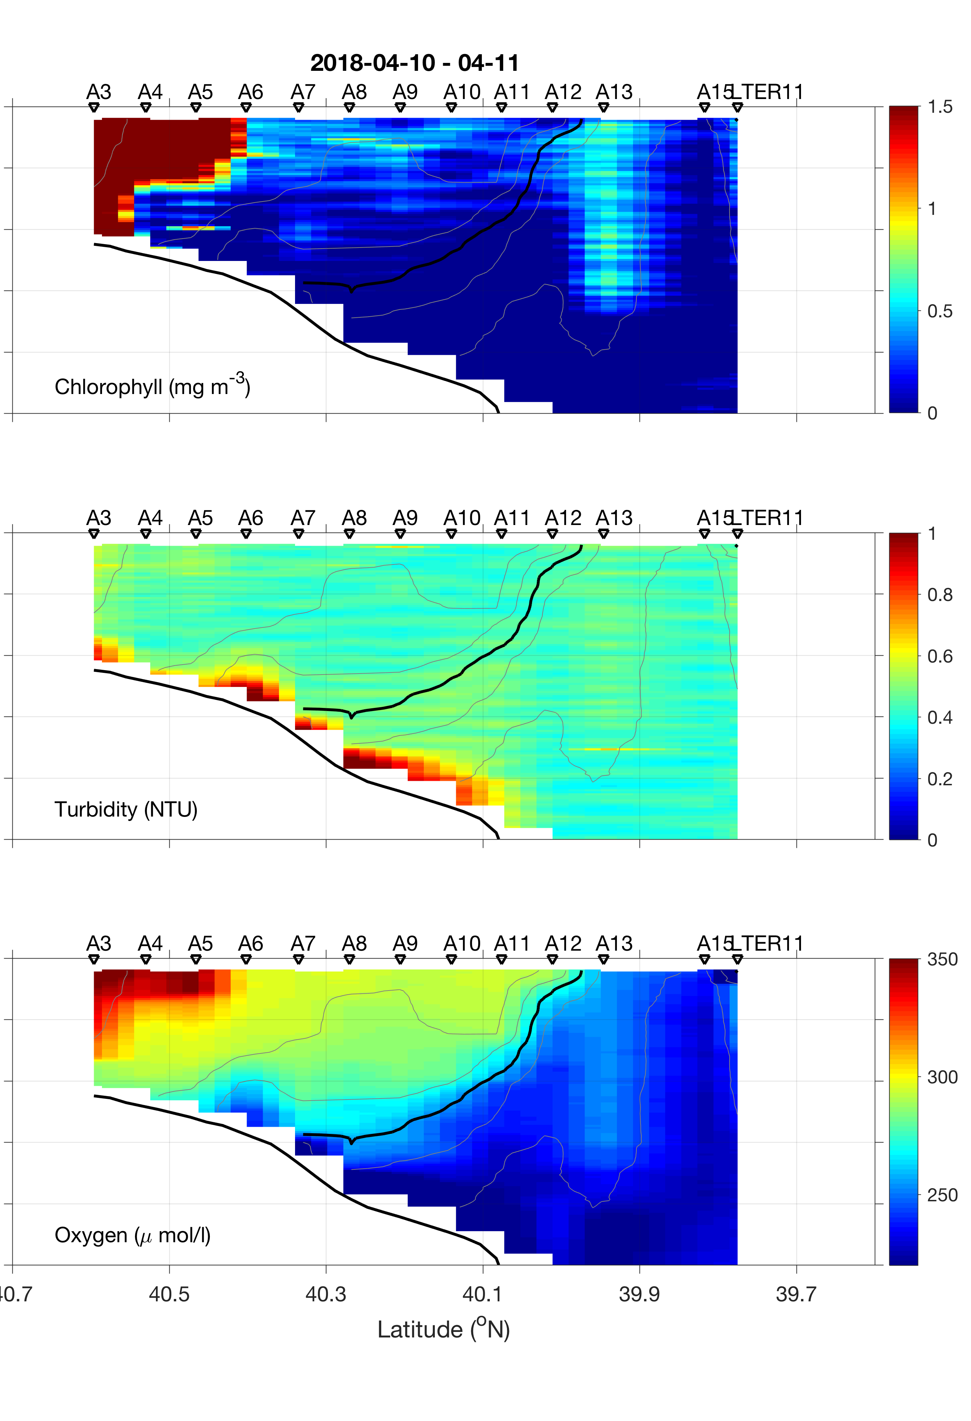
Before the Cruise
2018 Apr 14
A typical shelfbreak front

Slide 35
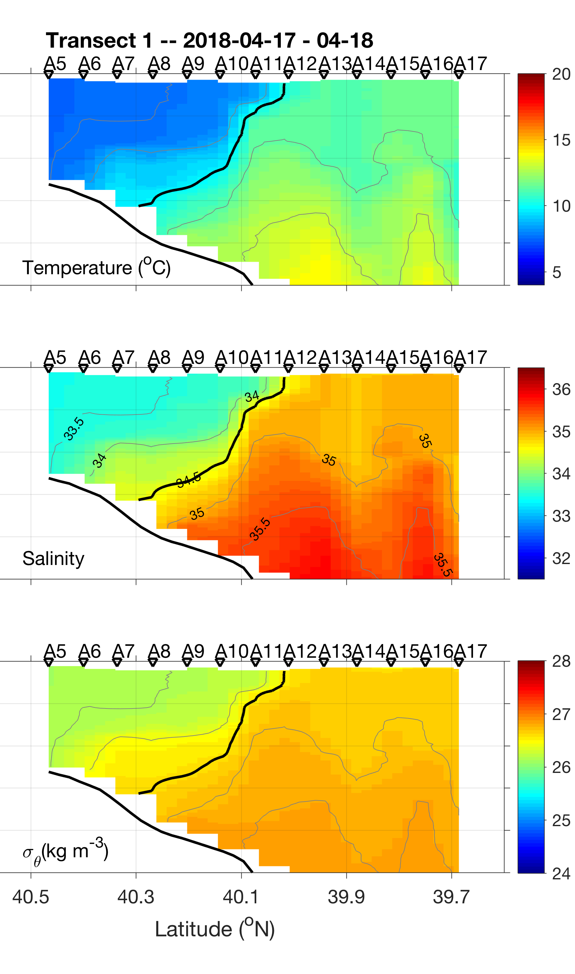
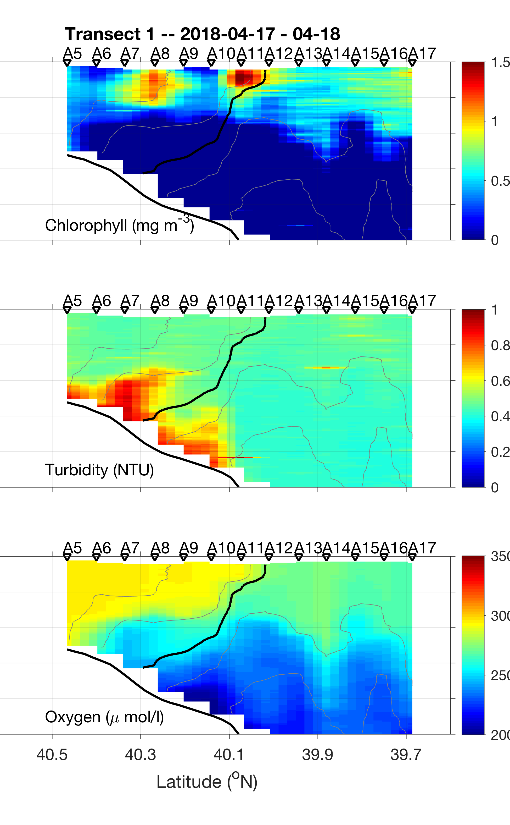
Cruise Data
2018 Apr 18
Ring-edge jet at A11-A13, already influencing the shelfbreak front

Slide 36
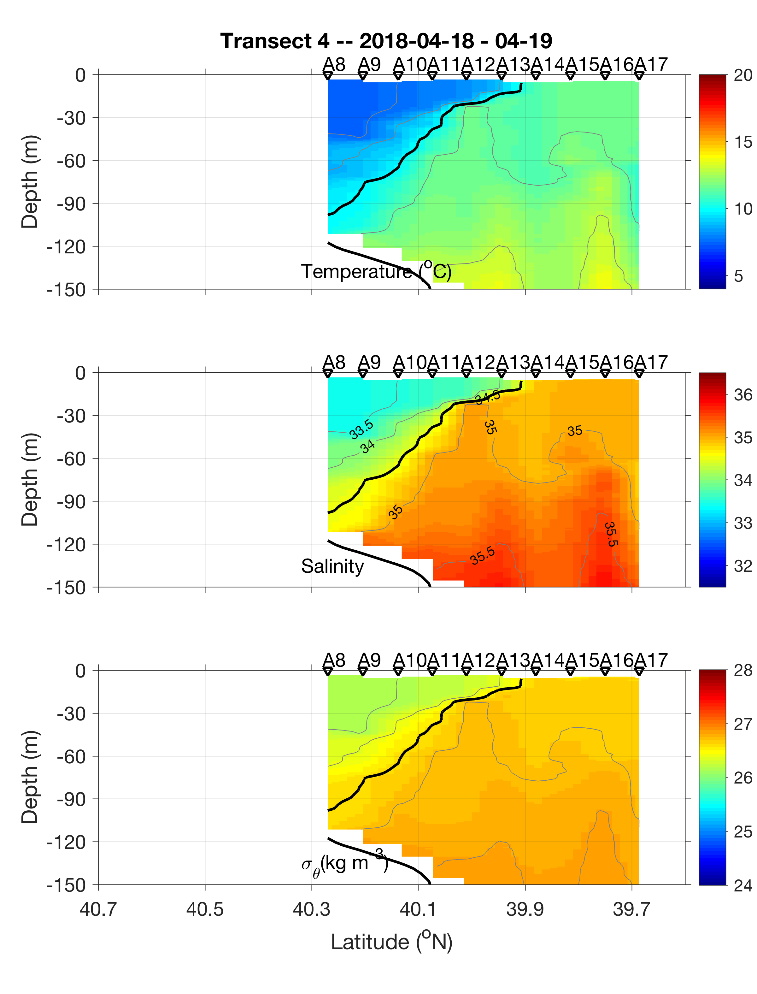
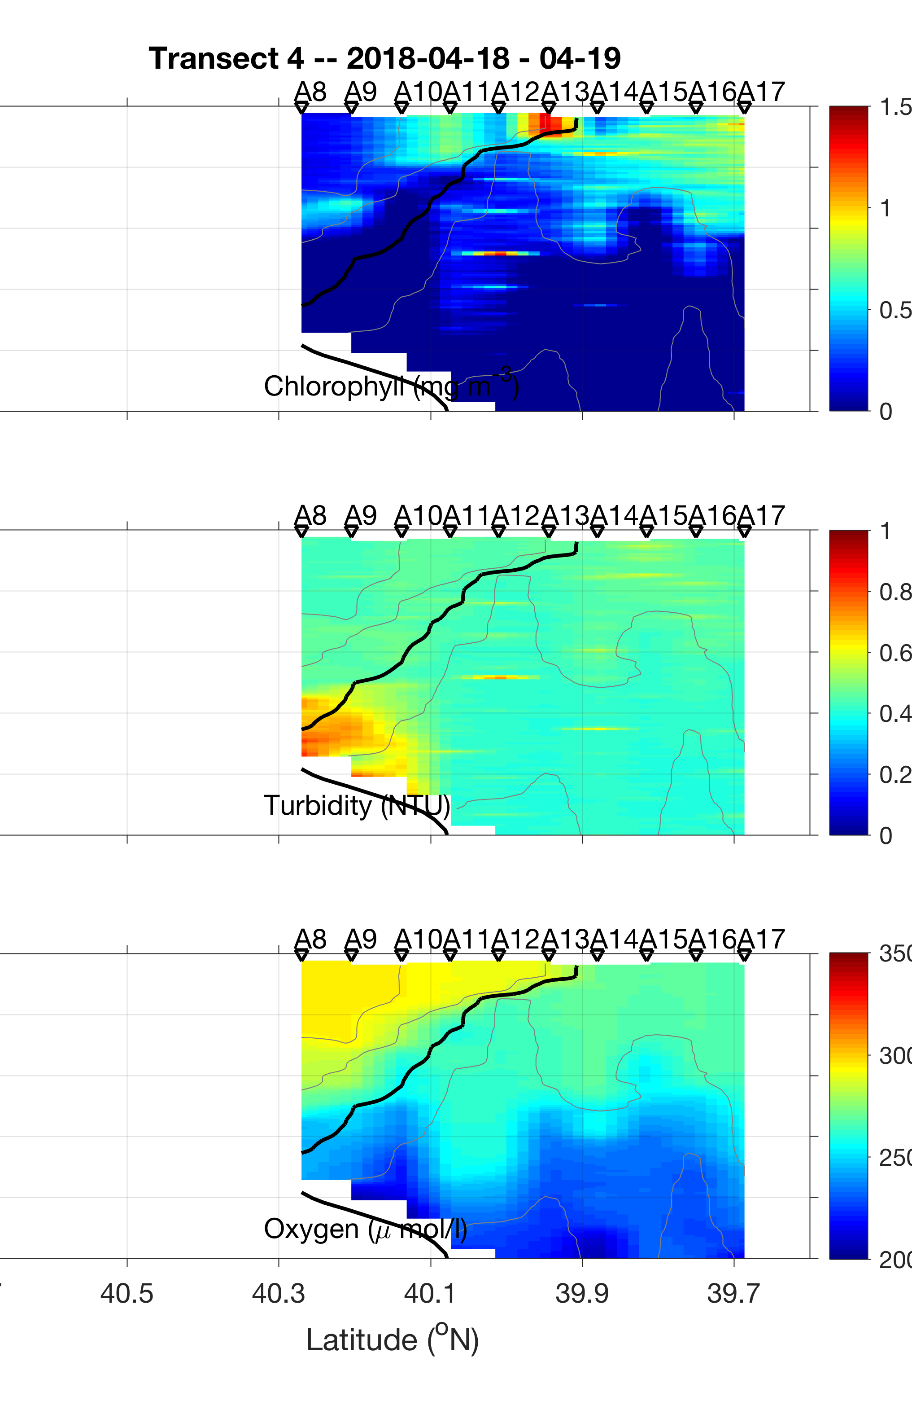
Cruise Data
2018 Apr 19

Slide 37
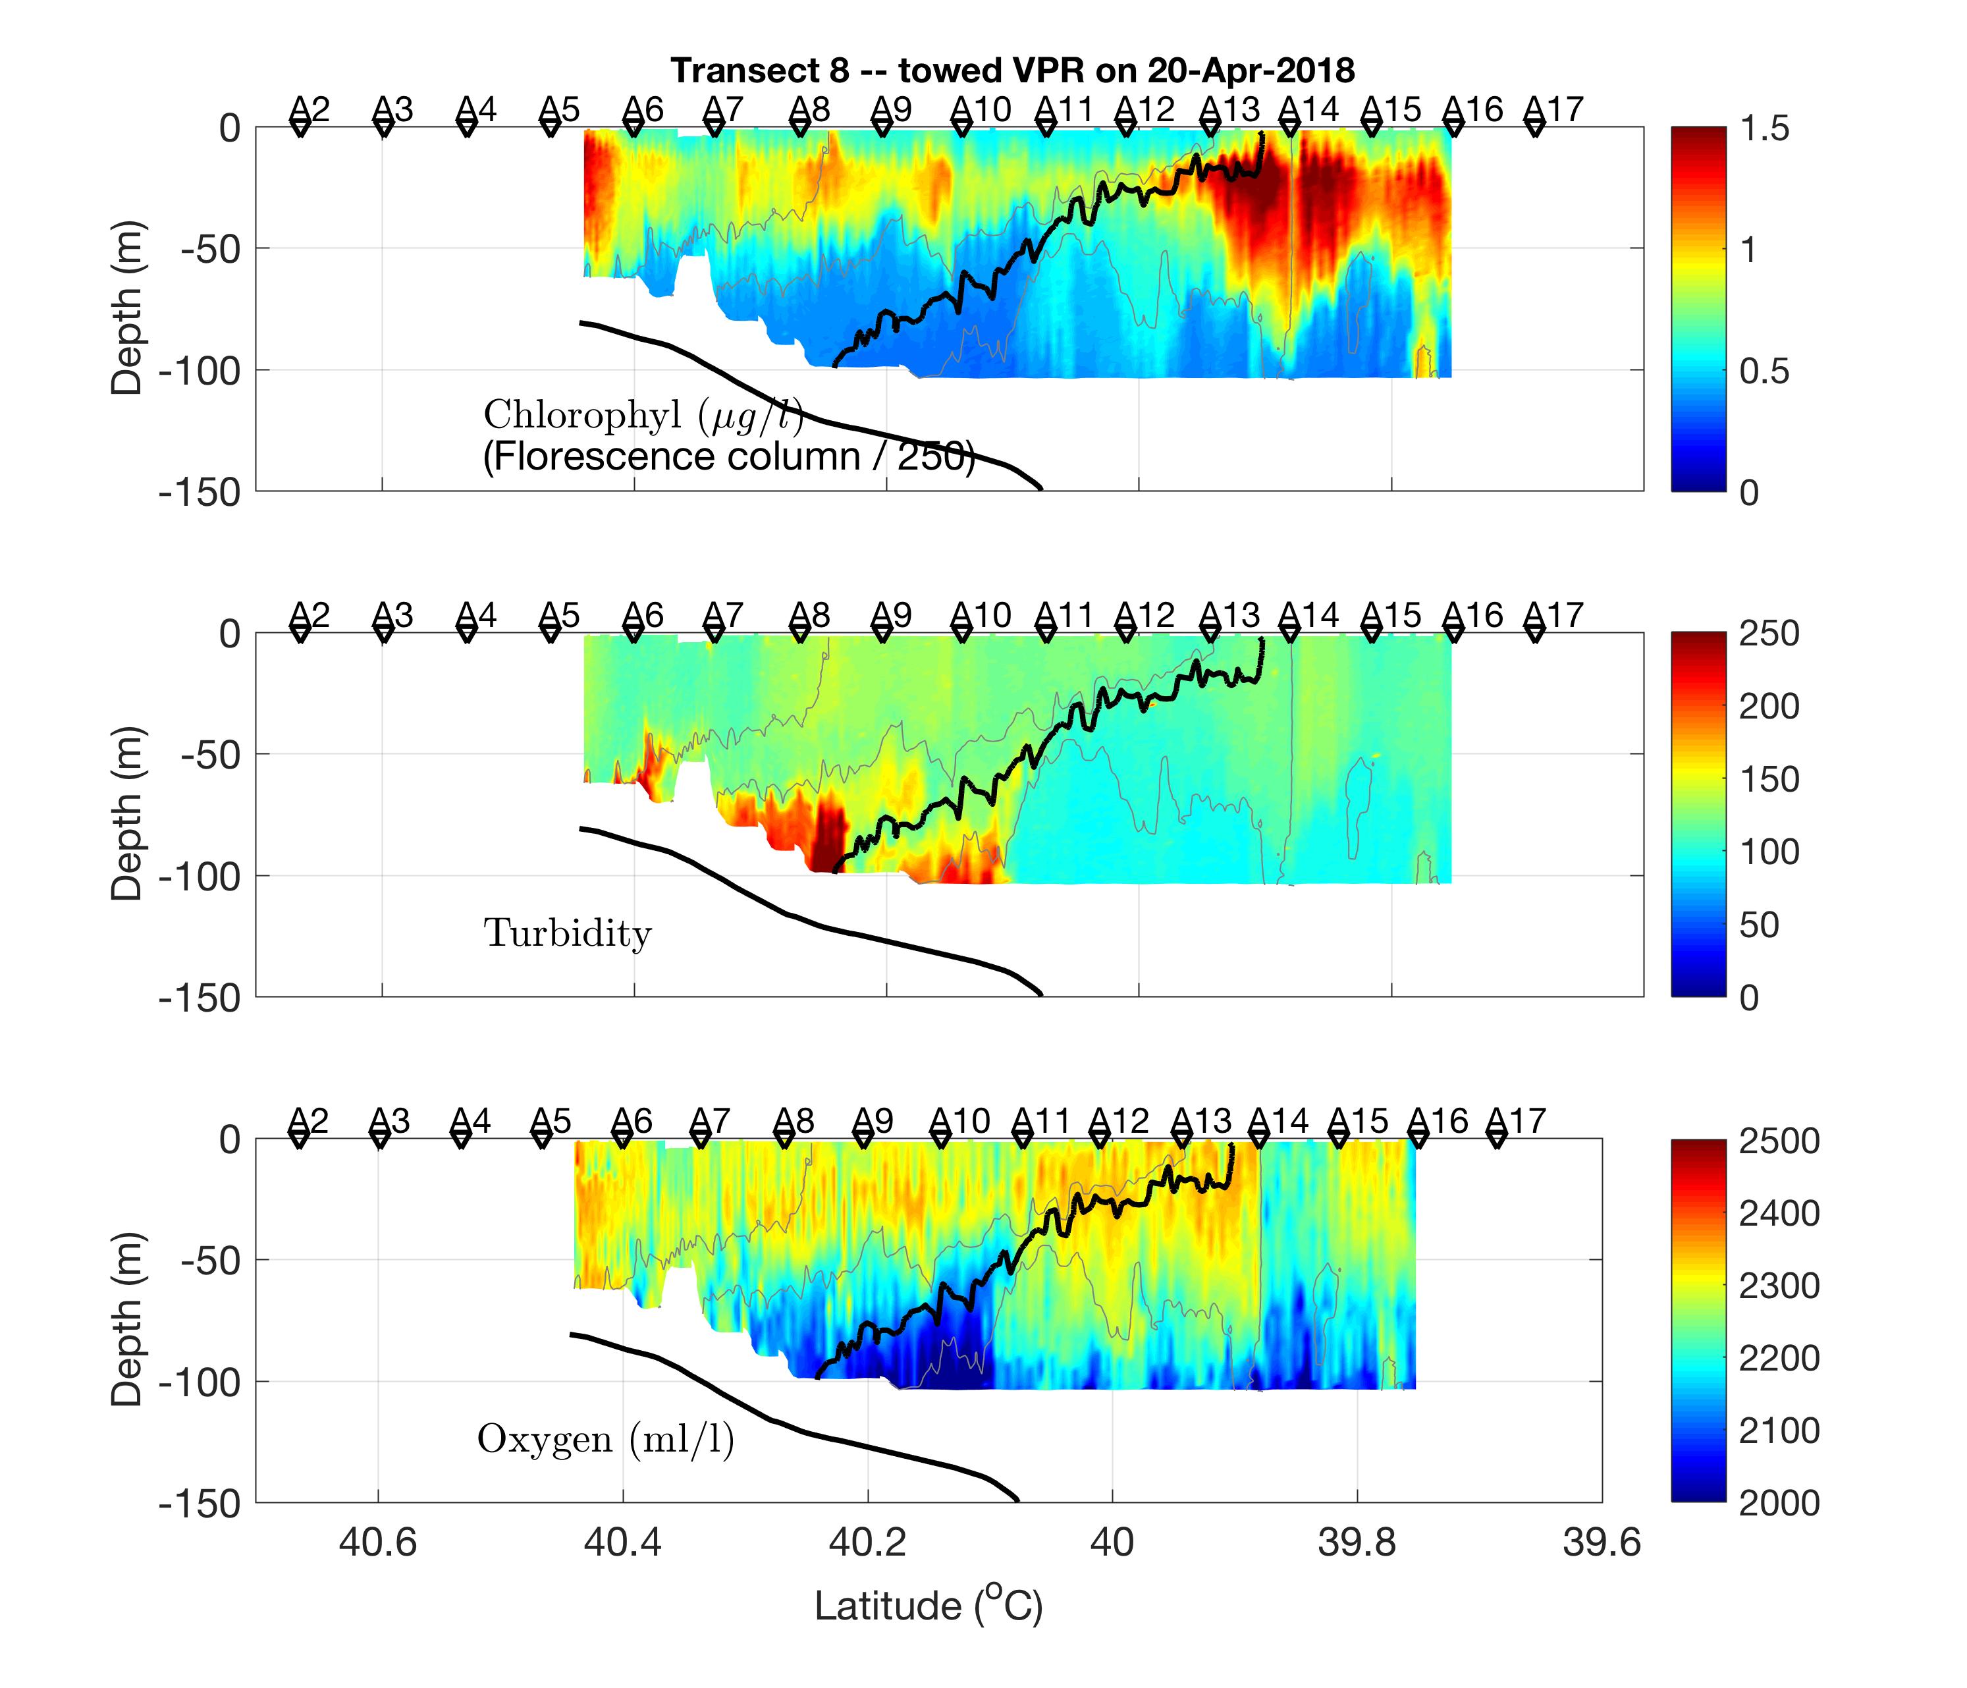
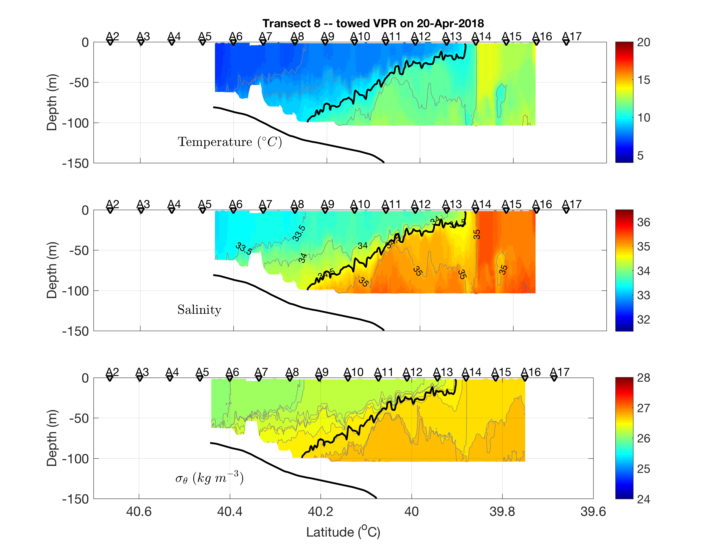
Cruise Data
2018 Apr 21

Slide 38
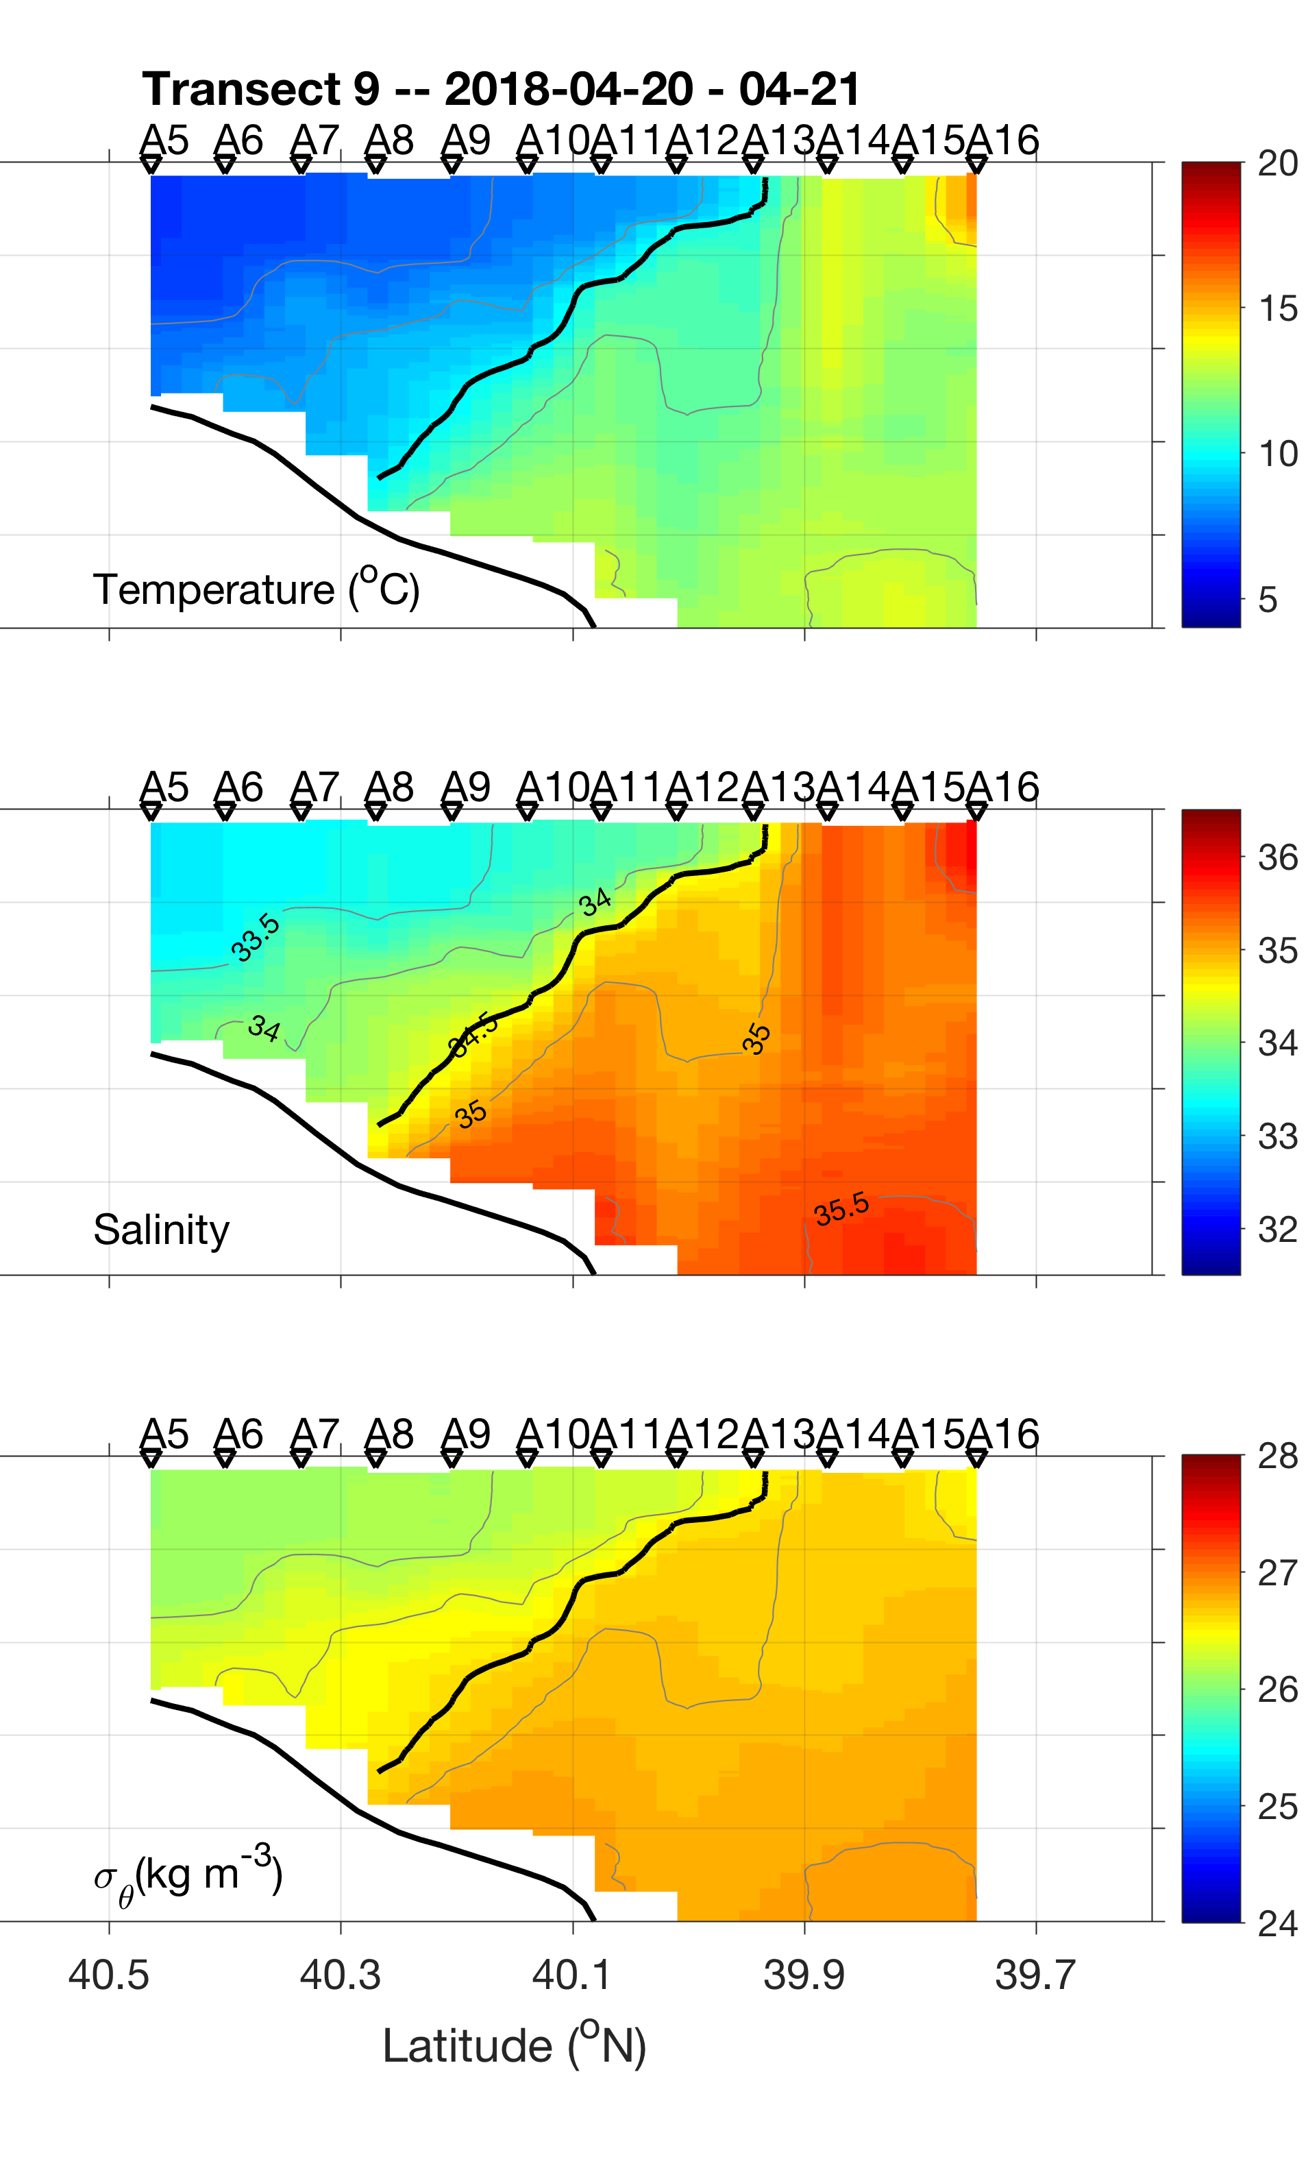
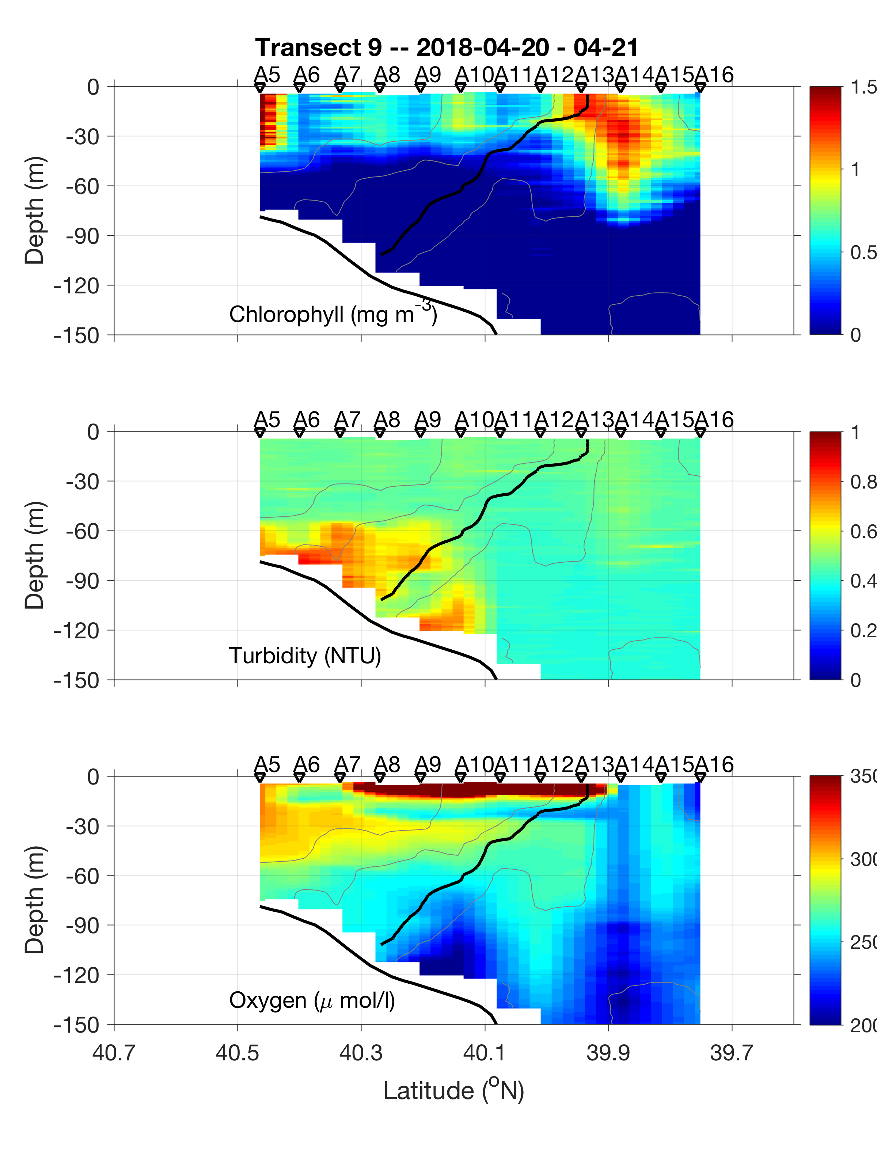
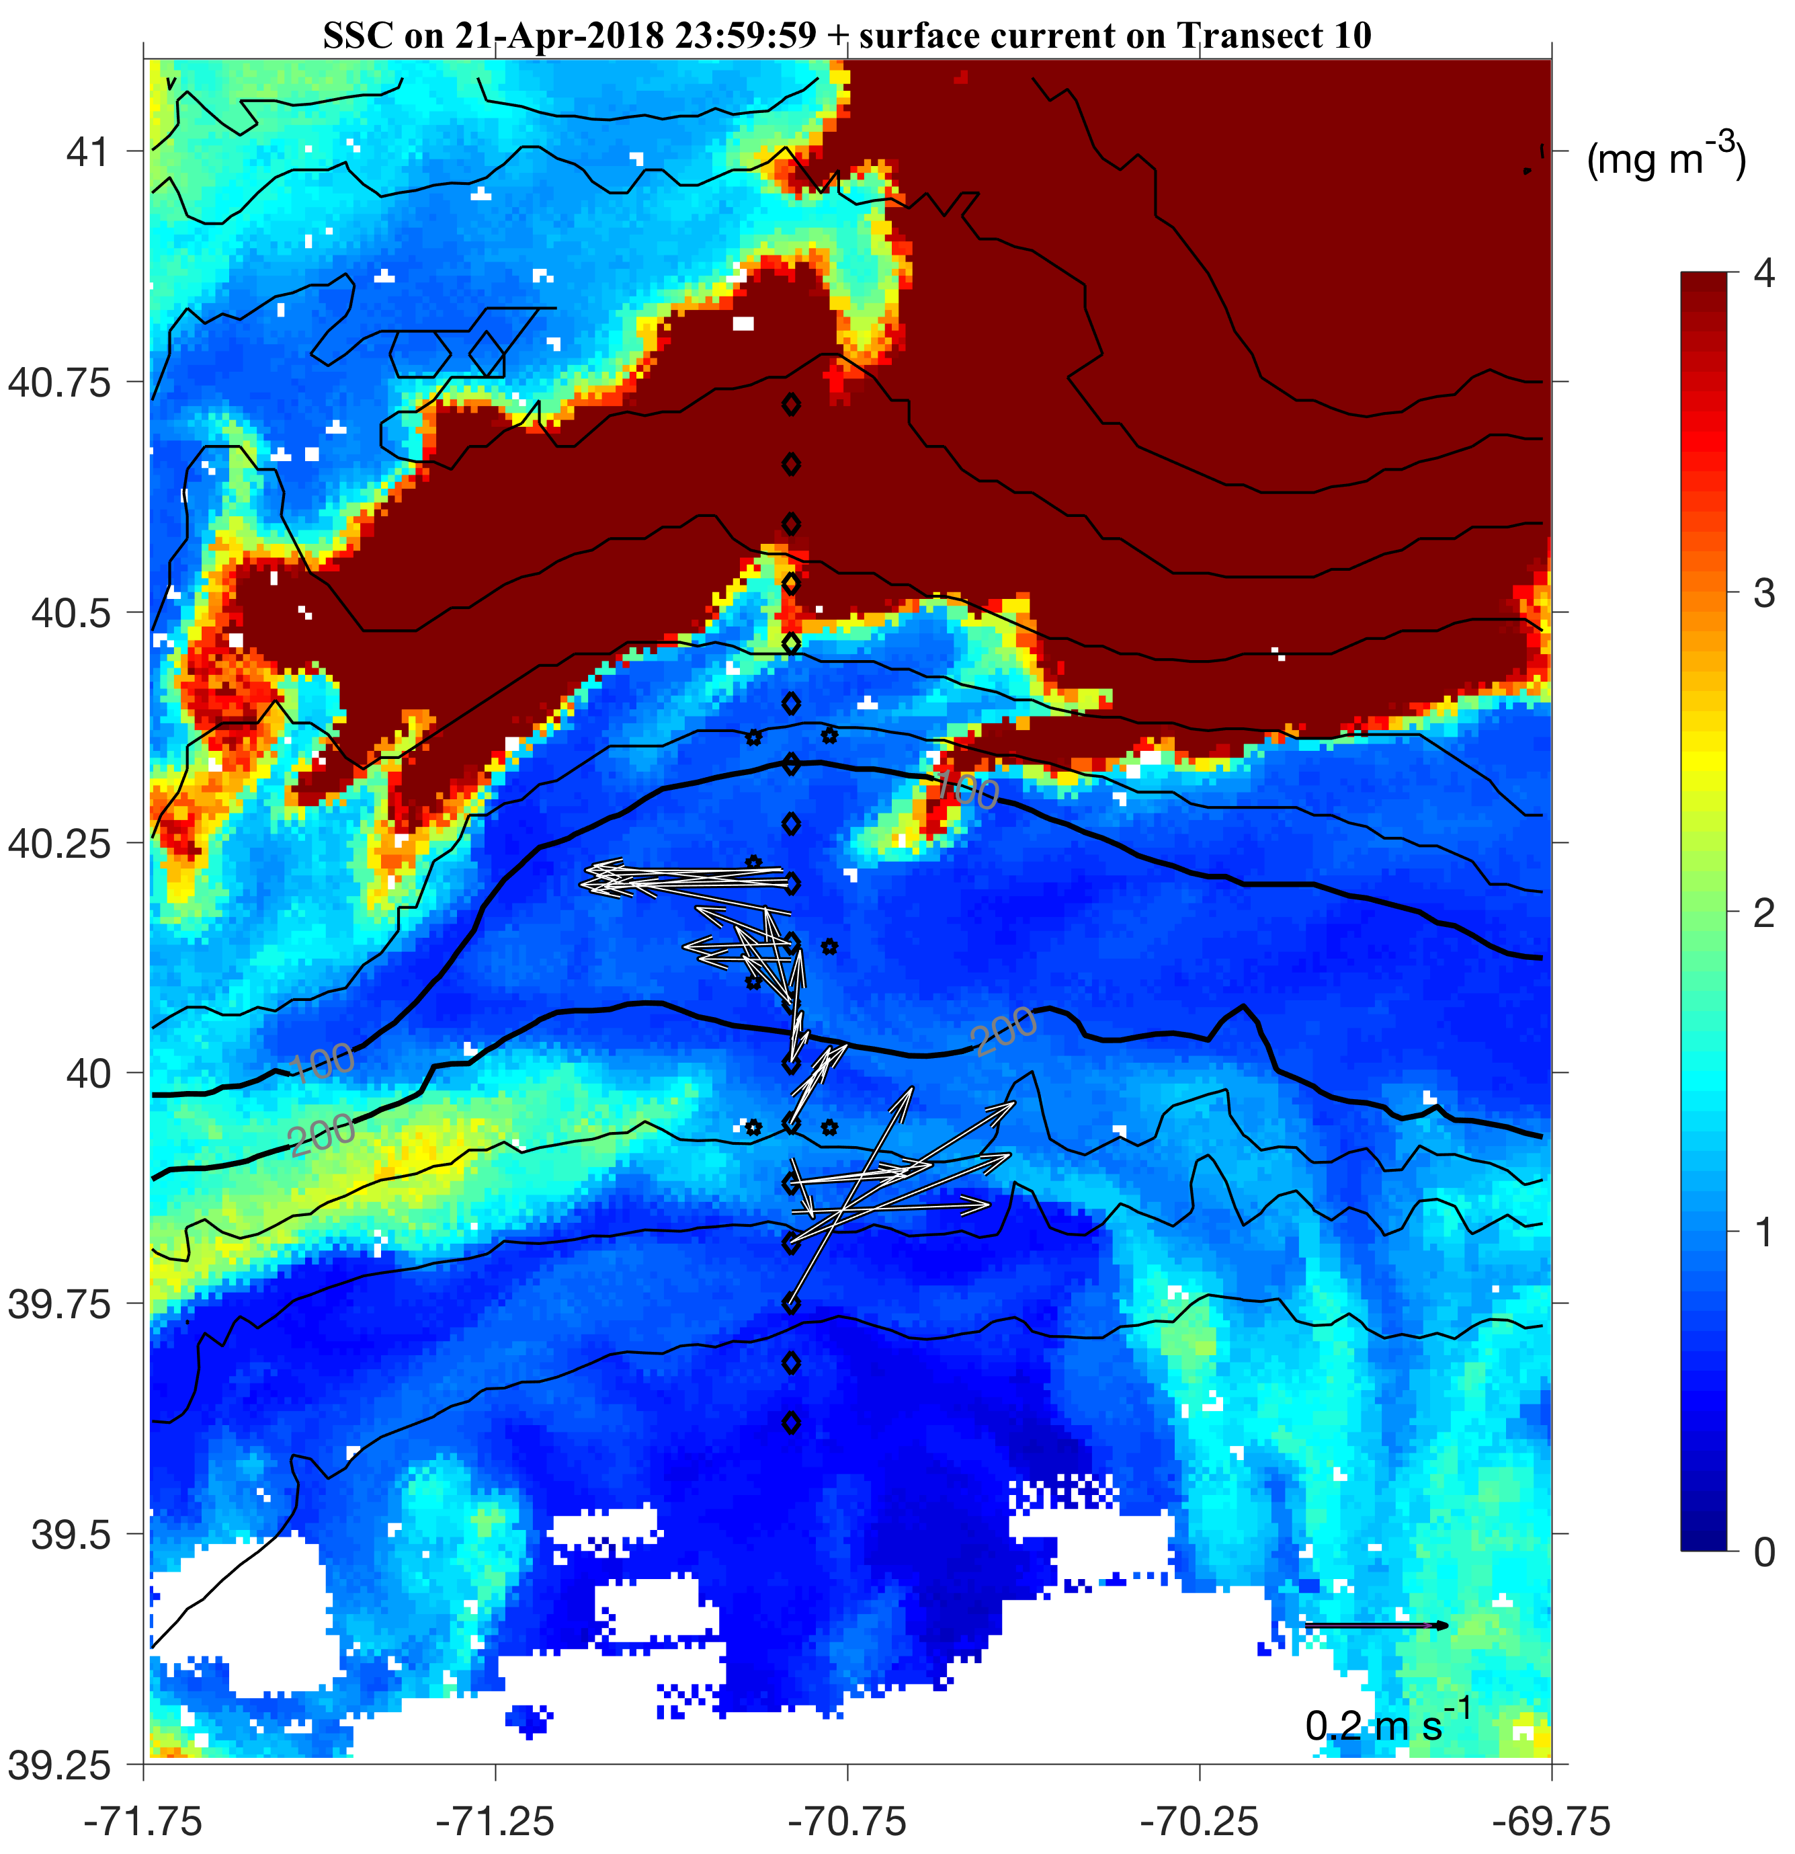
Cruise Data
2018 Apr 21
Along-front inhomogeneous chlorophyll concentration

Slide 39
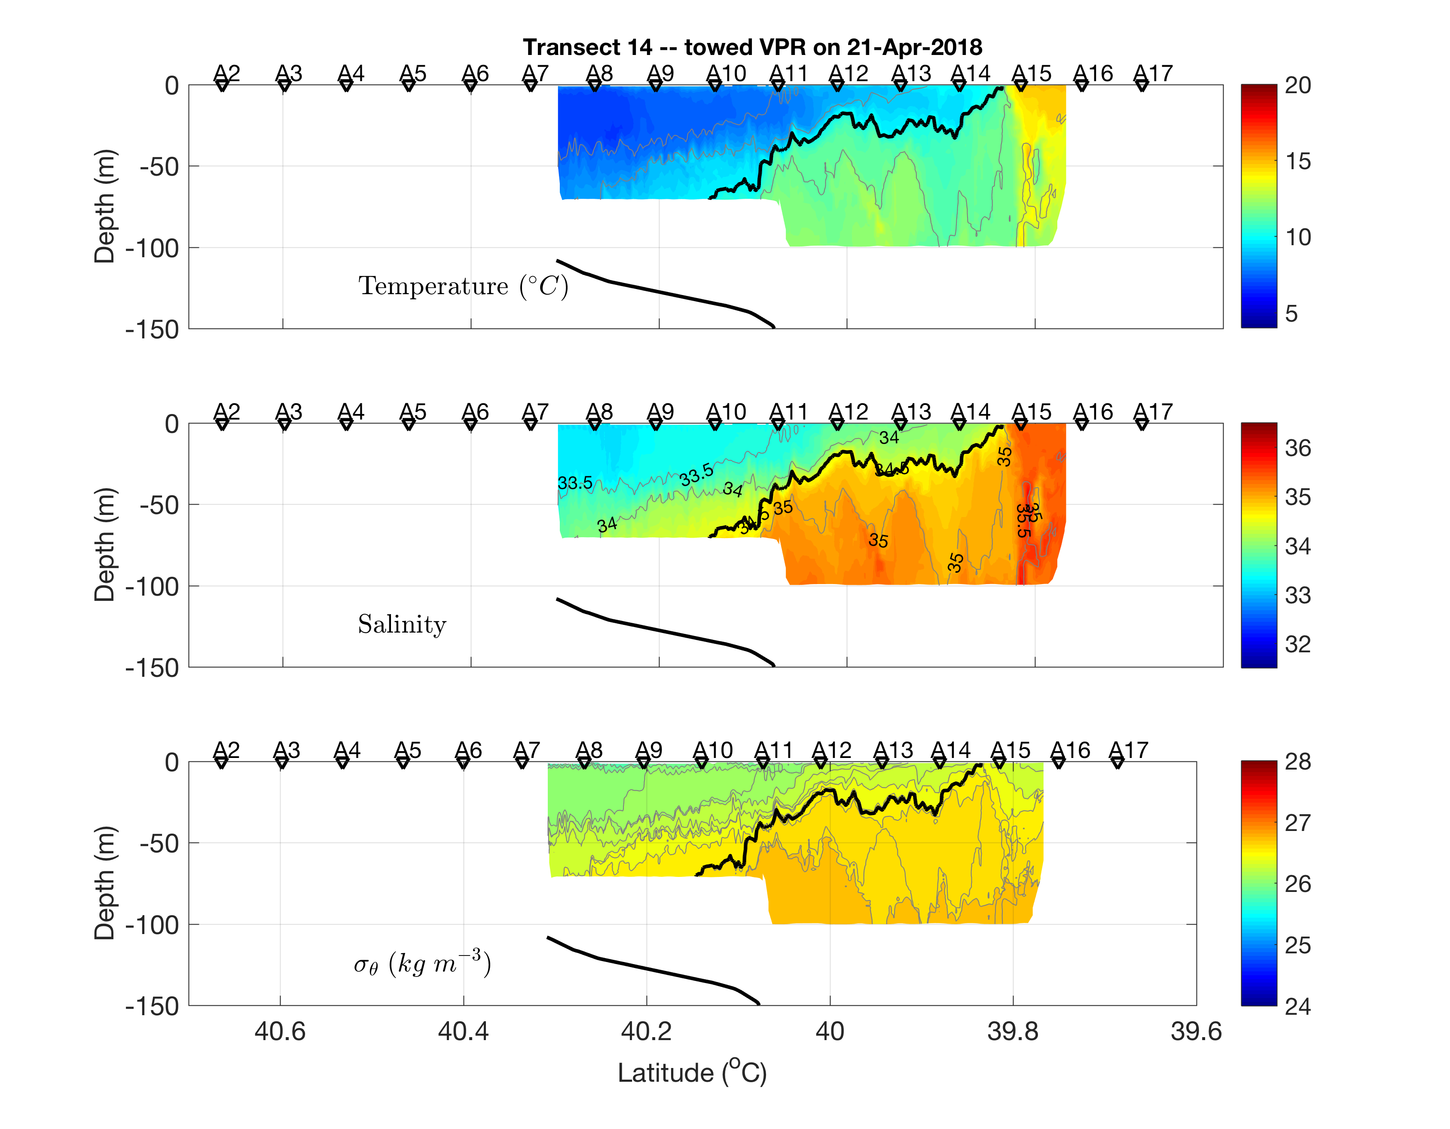
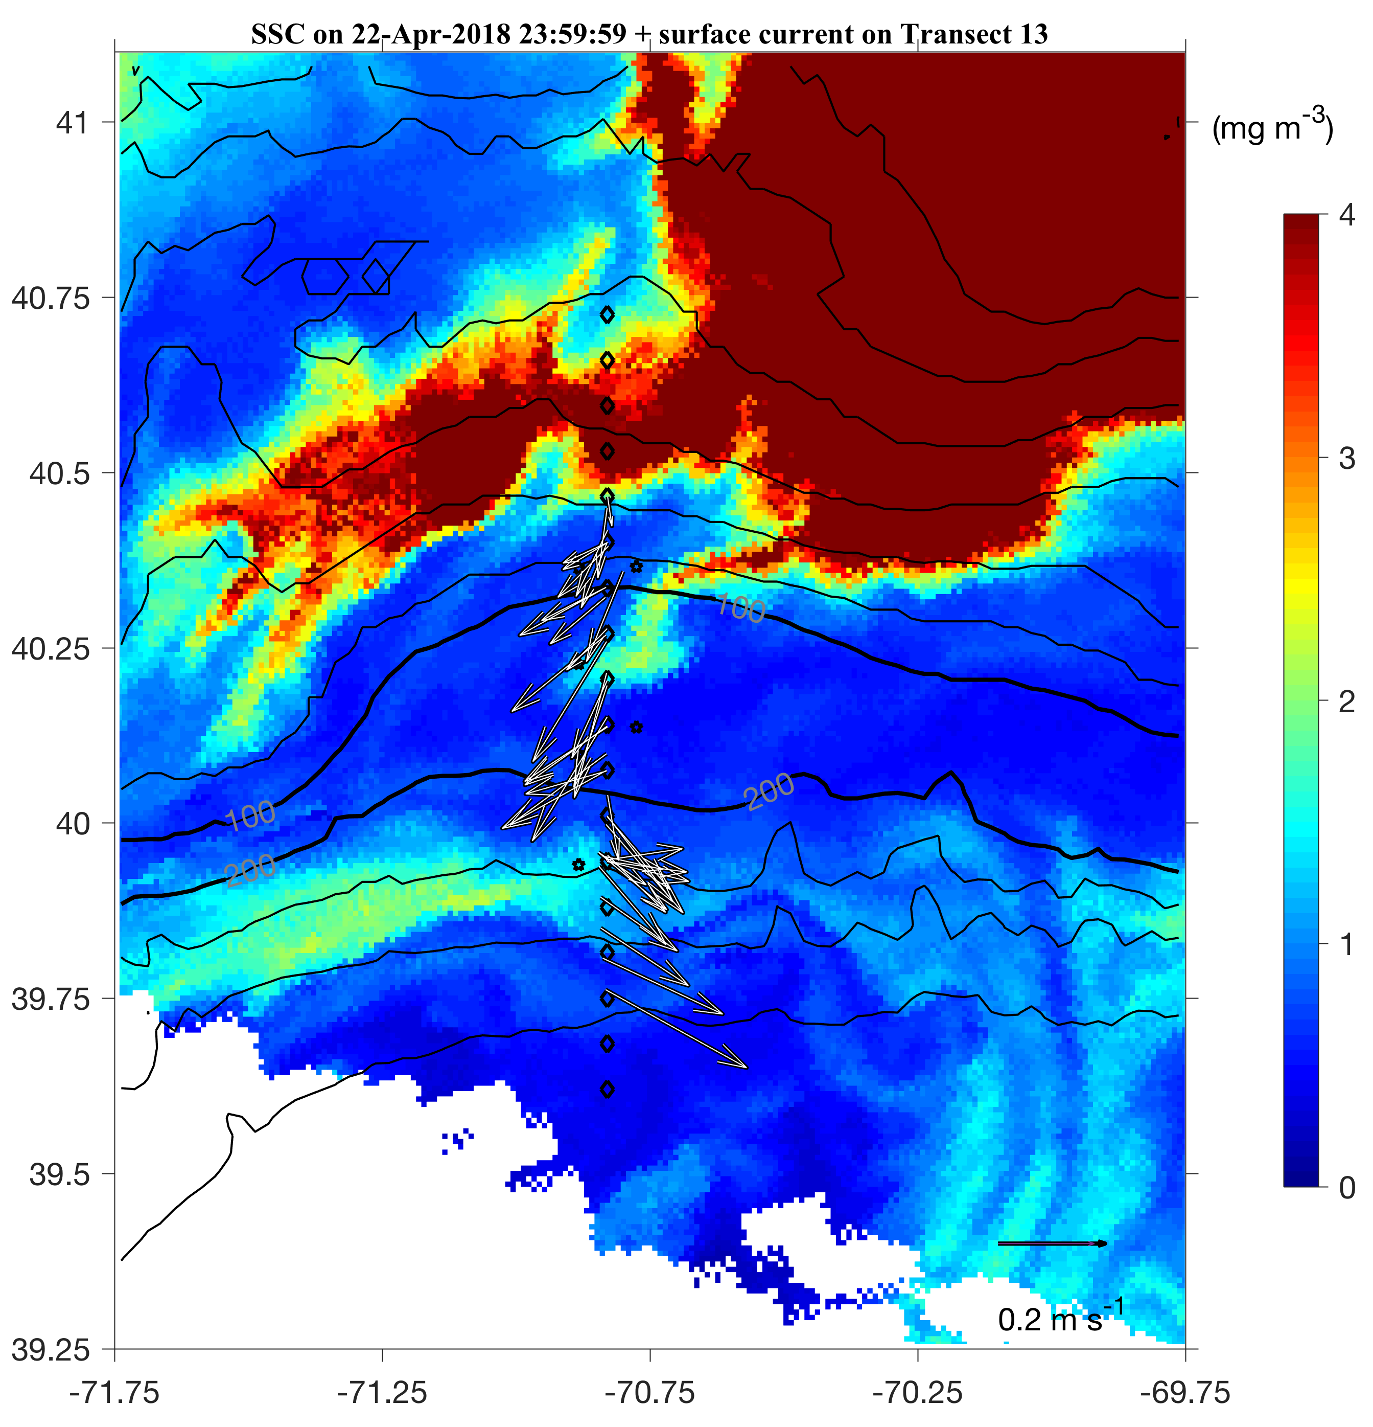
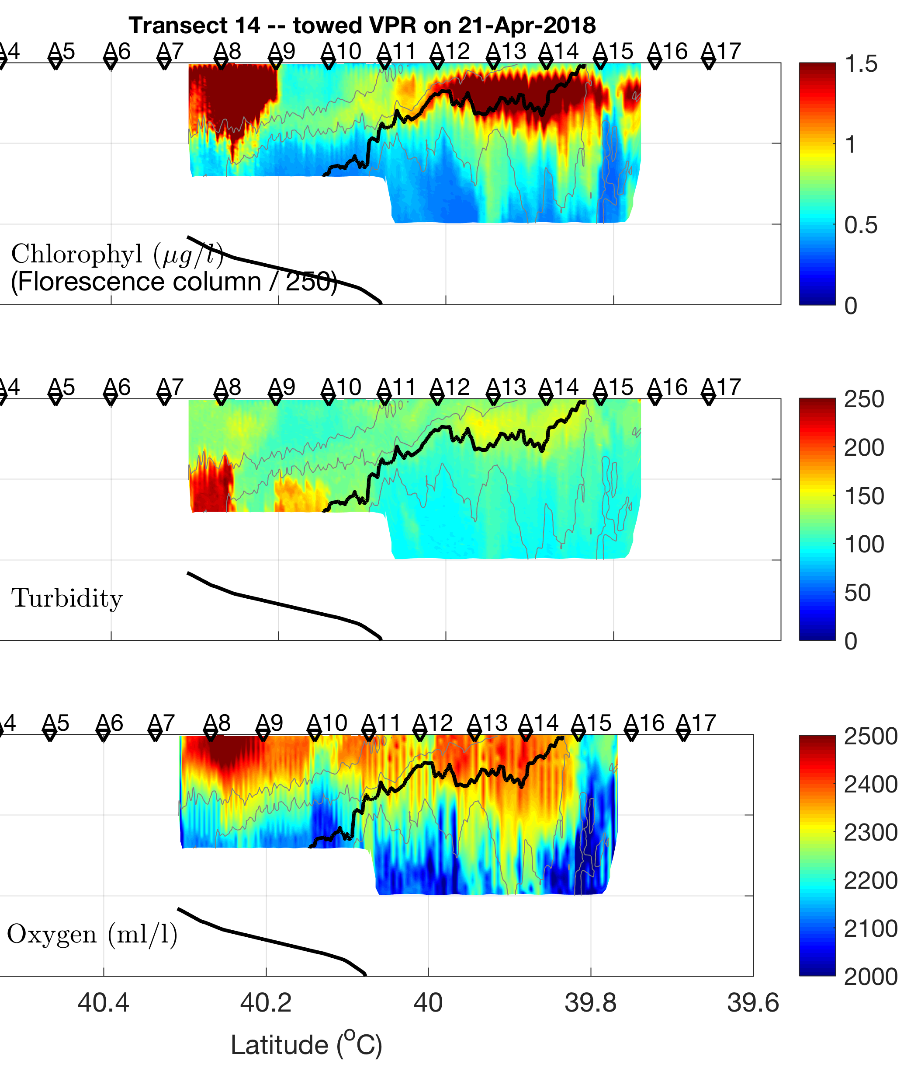
2018 Apr 22

Slide 40
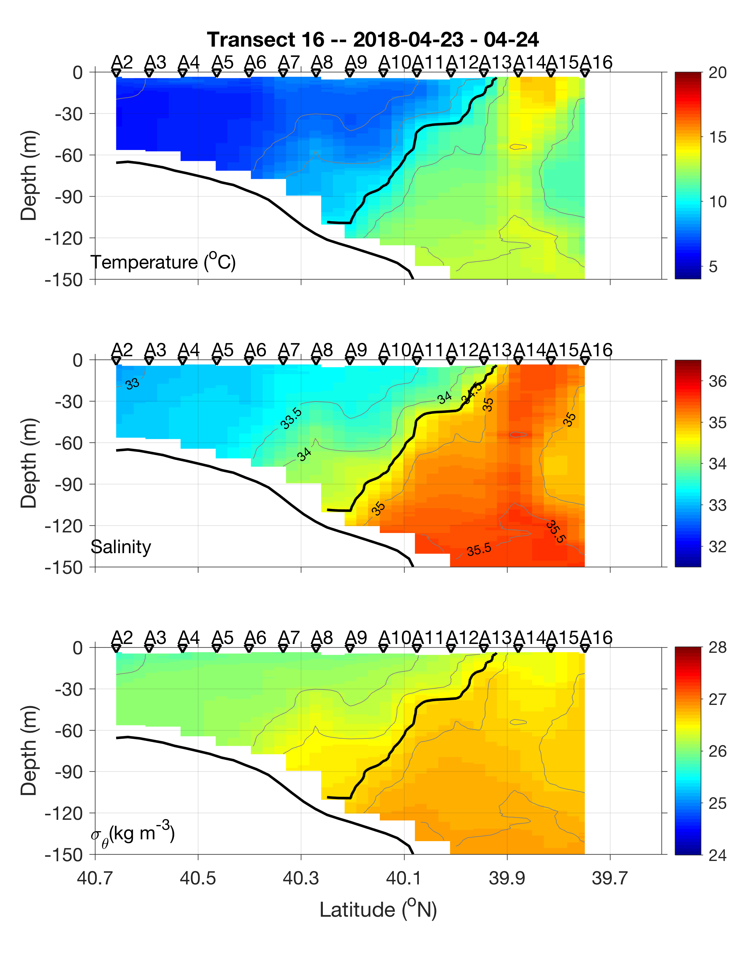
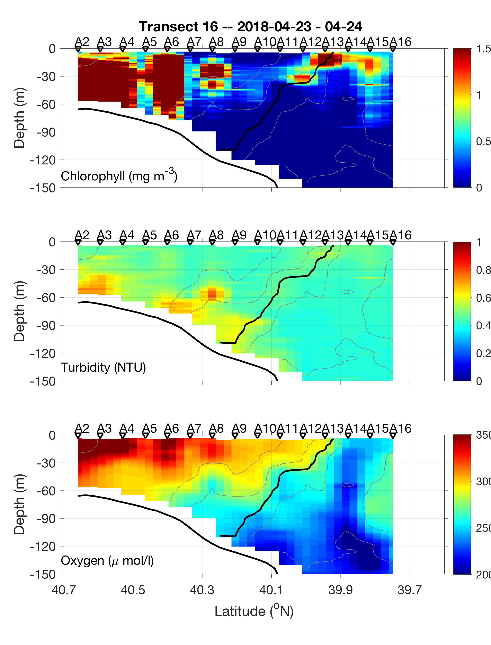
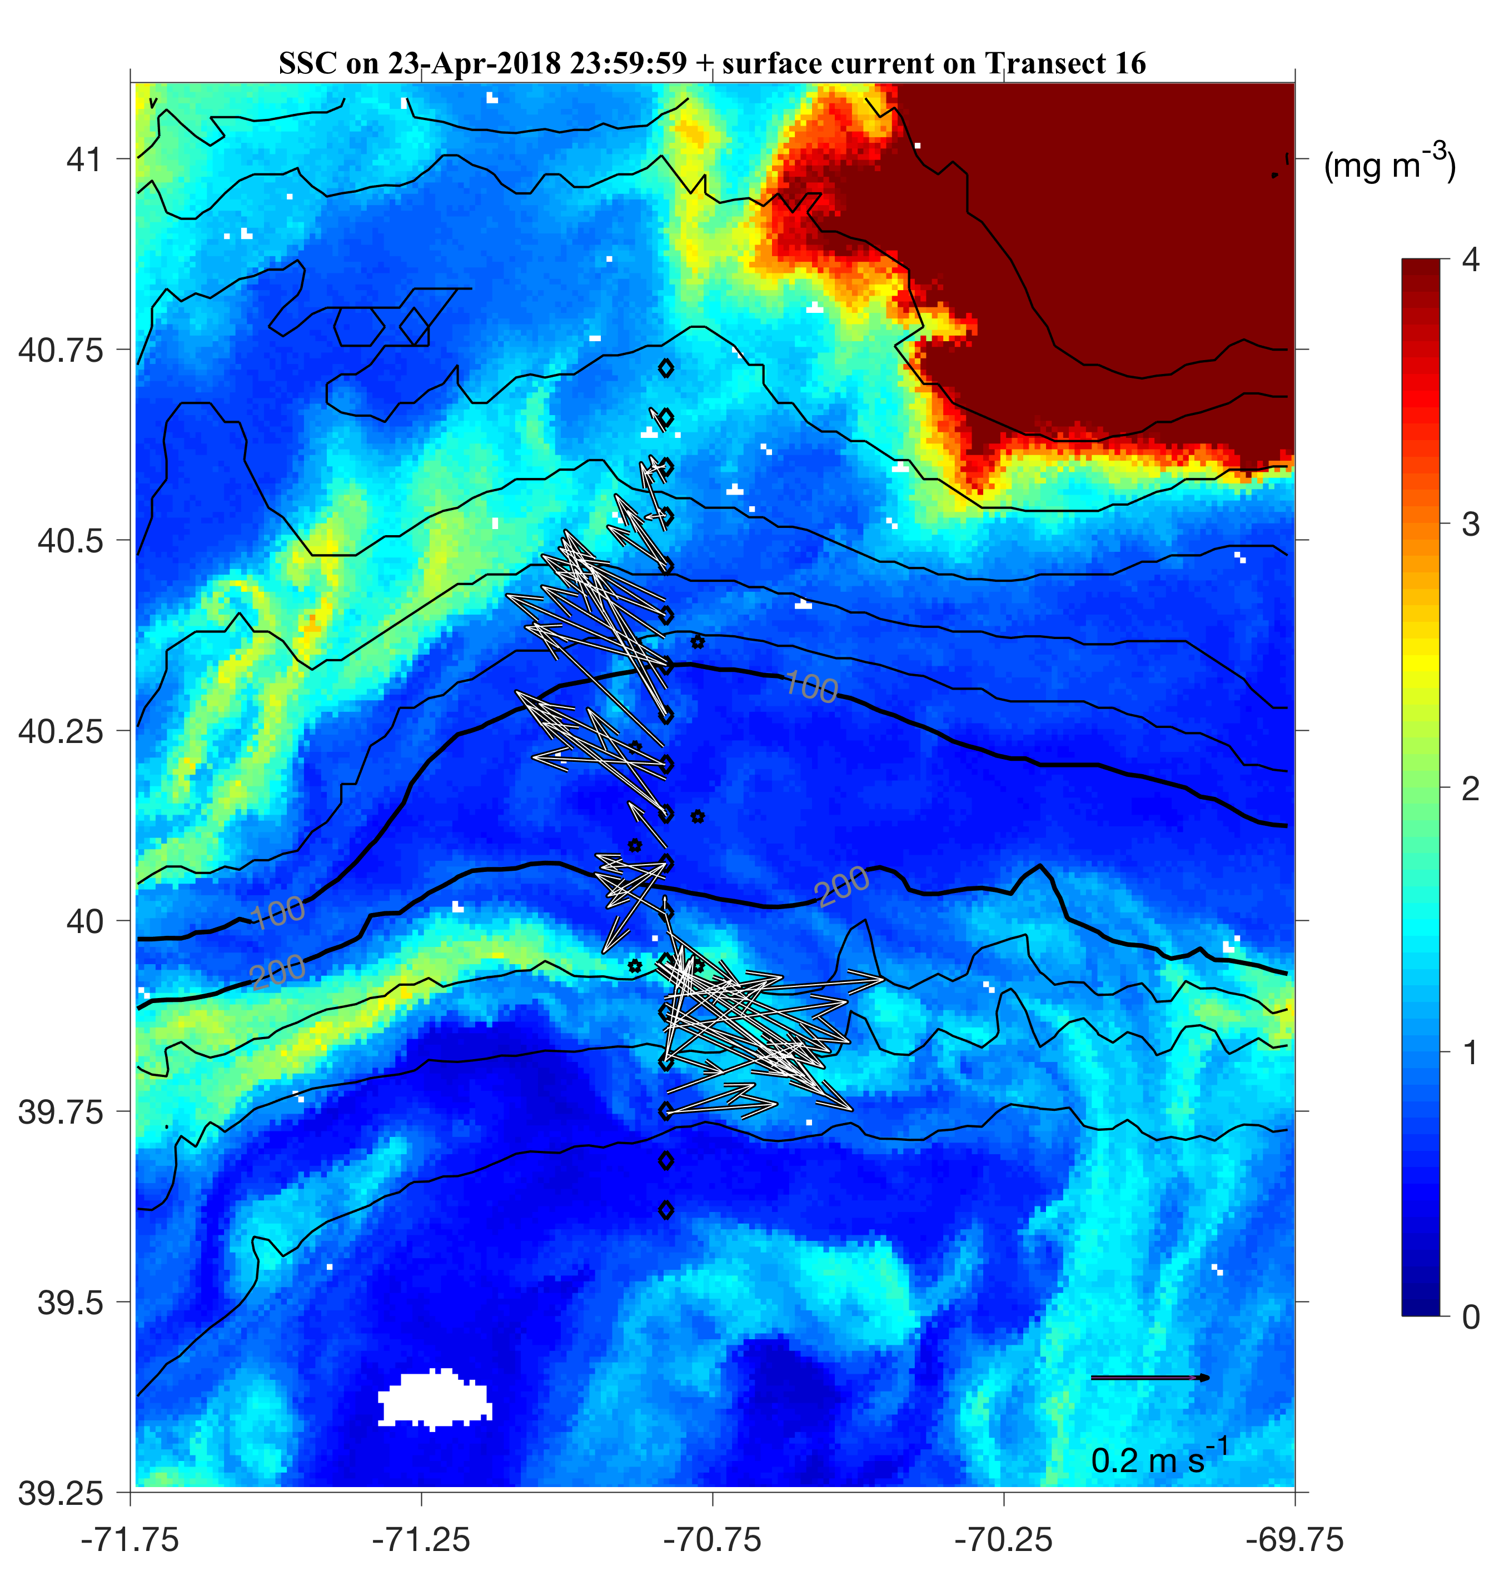
Cruise Data
2018 Apr 23

Slide 41
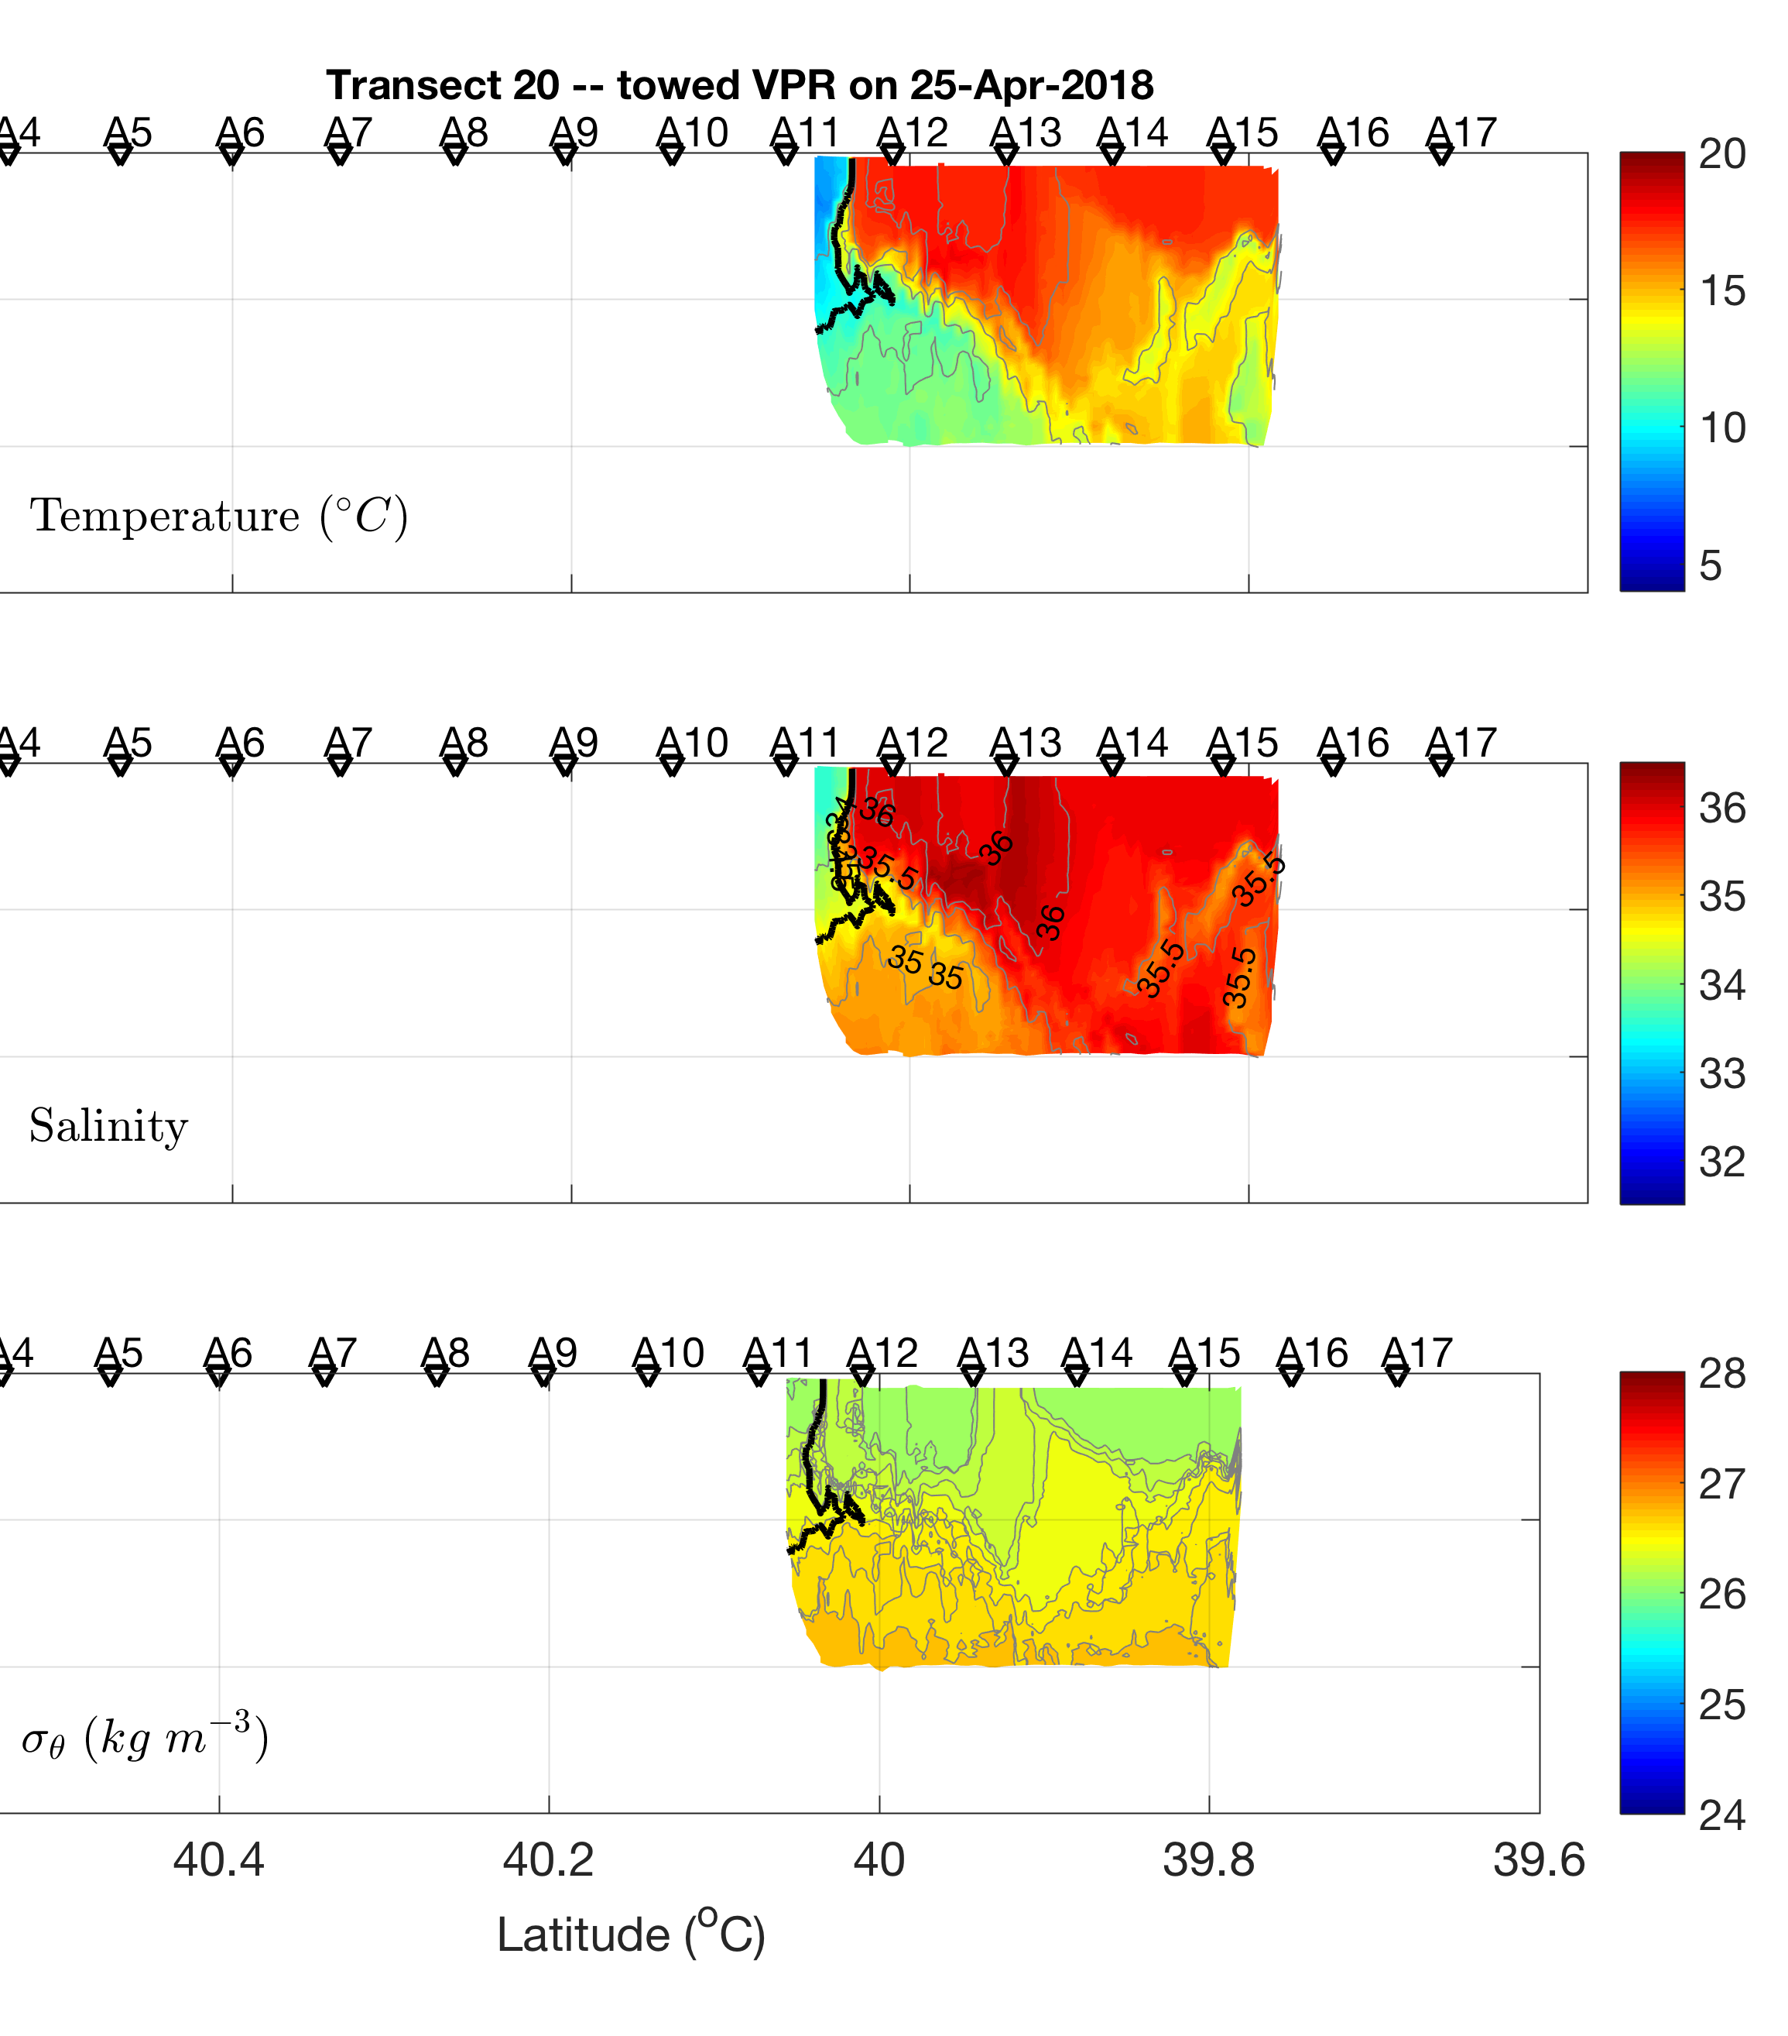
Cruise Data
2018 Apr 25
Frontal subduction and upwelling?

Slide 42
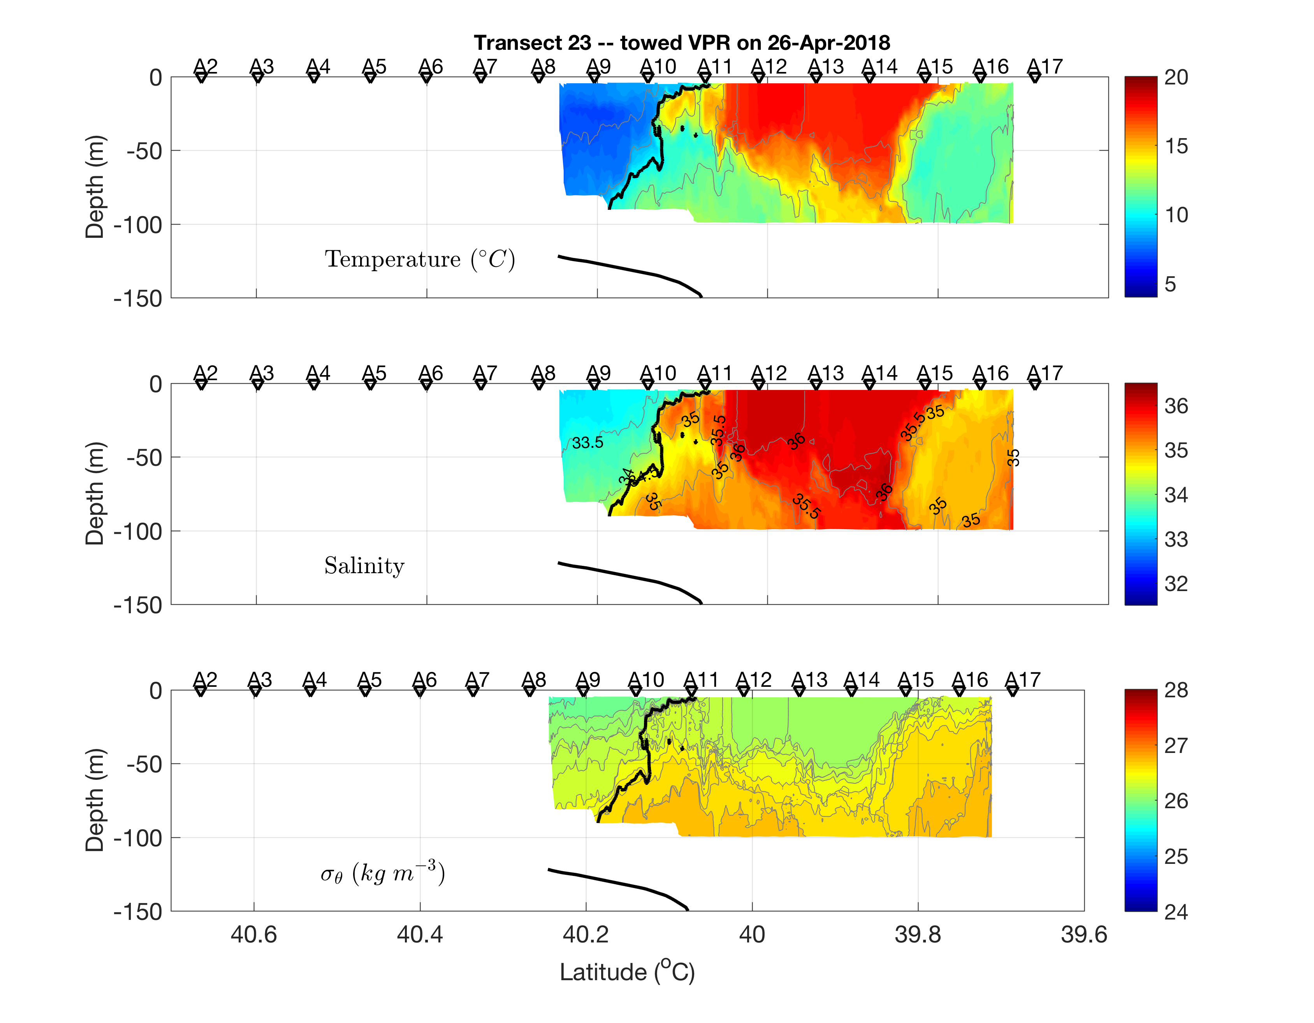
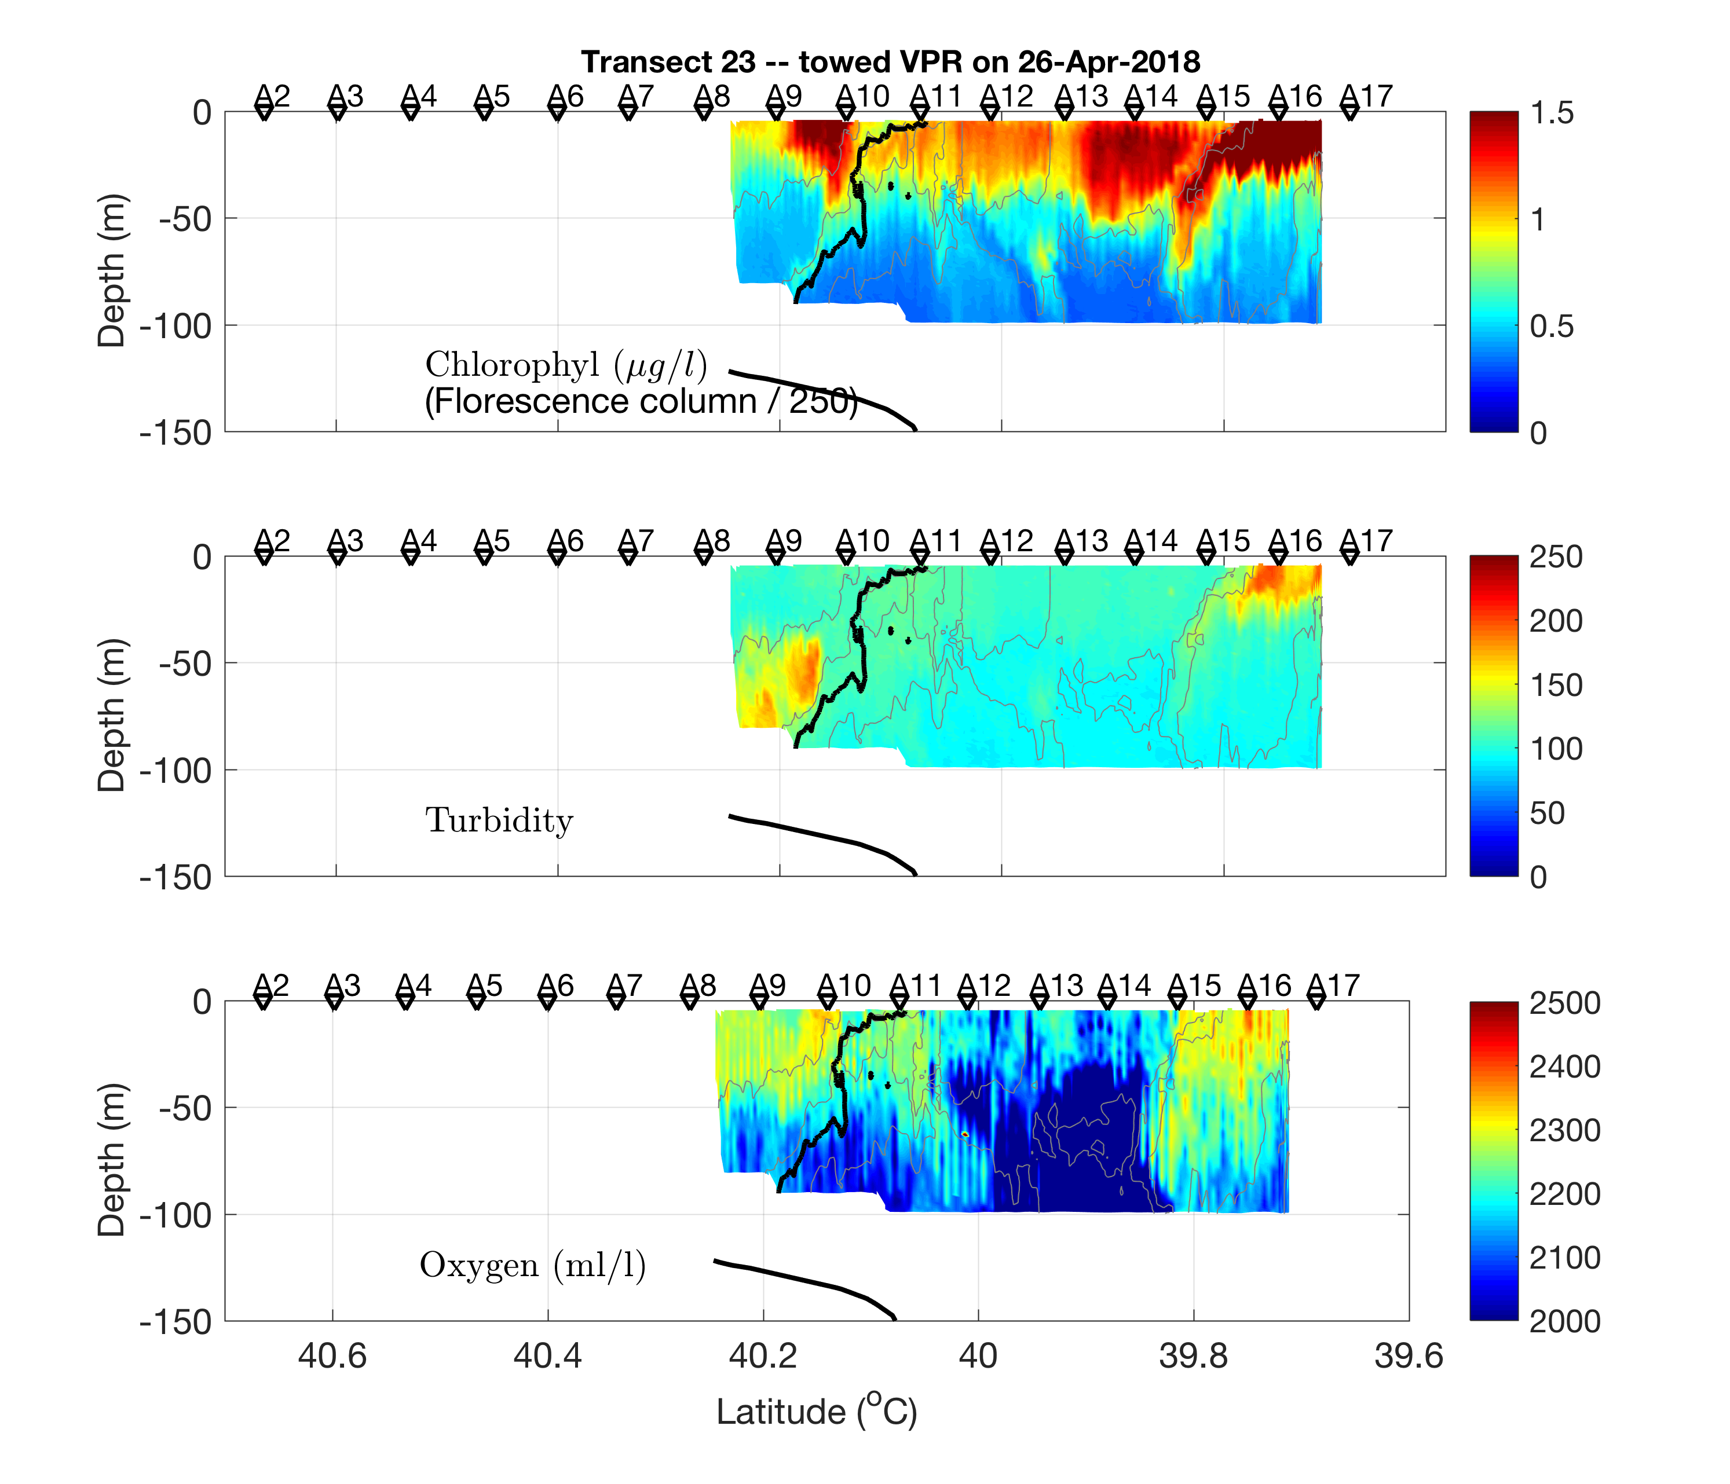
Cruise Data
2018 Apr 27
Frontal subduction

Slide 43
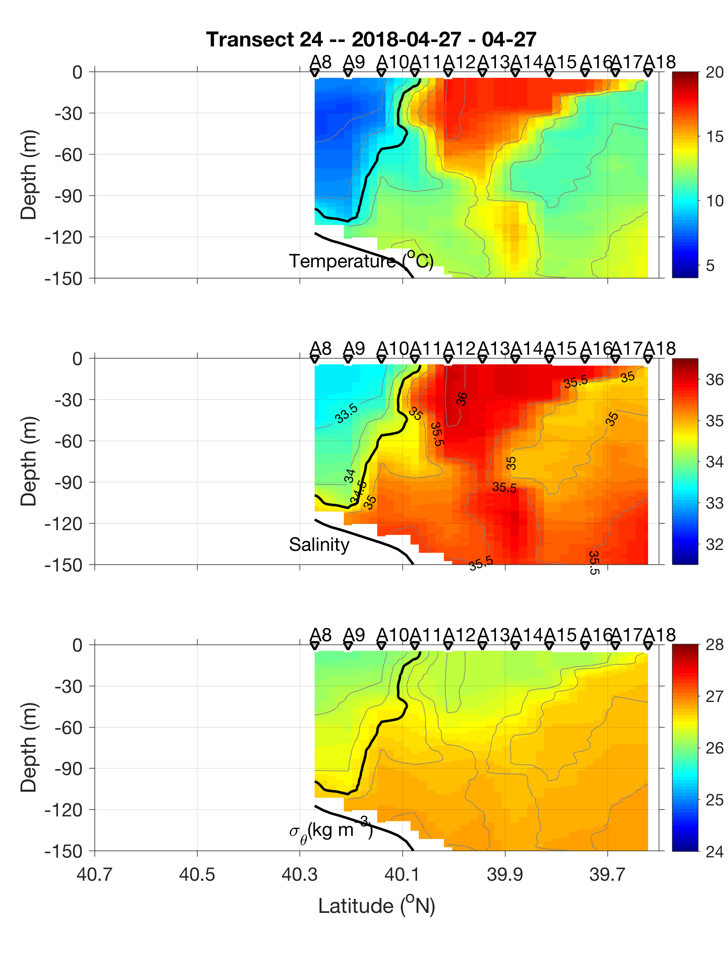
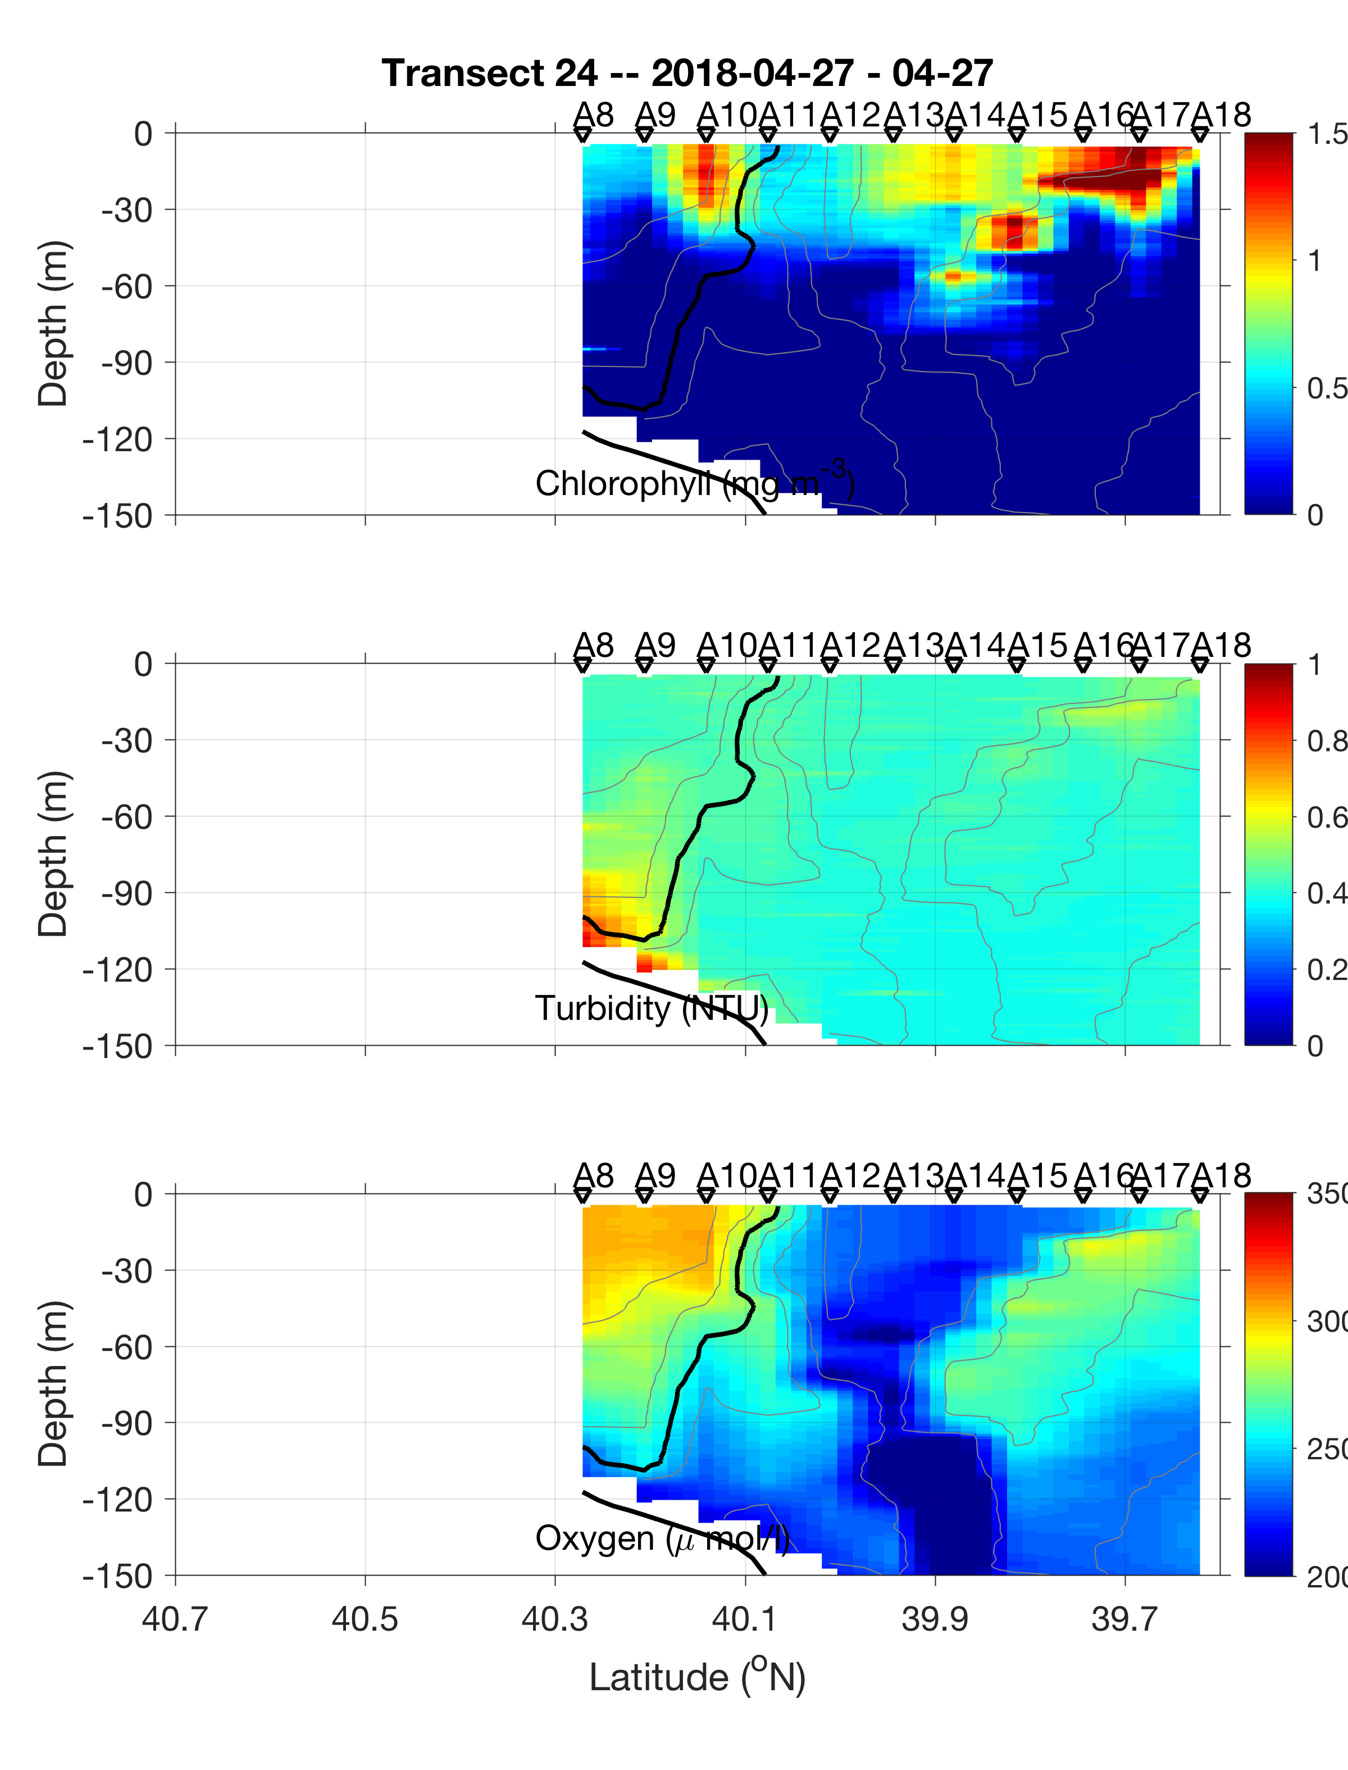
Cruise Data
2018 Apr 27
Frontal subduction

Slide 44
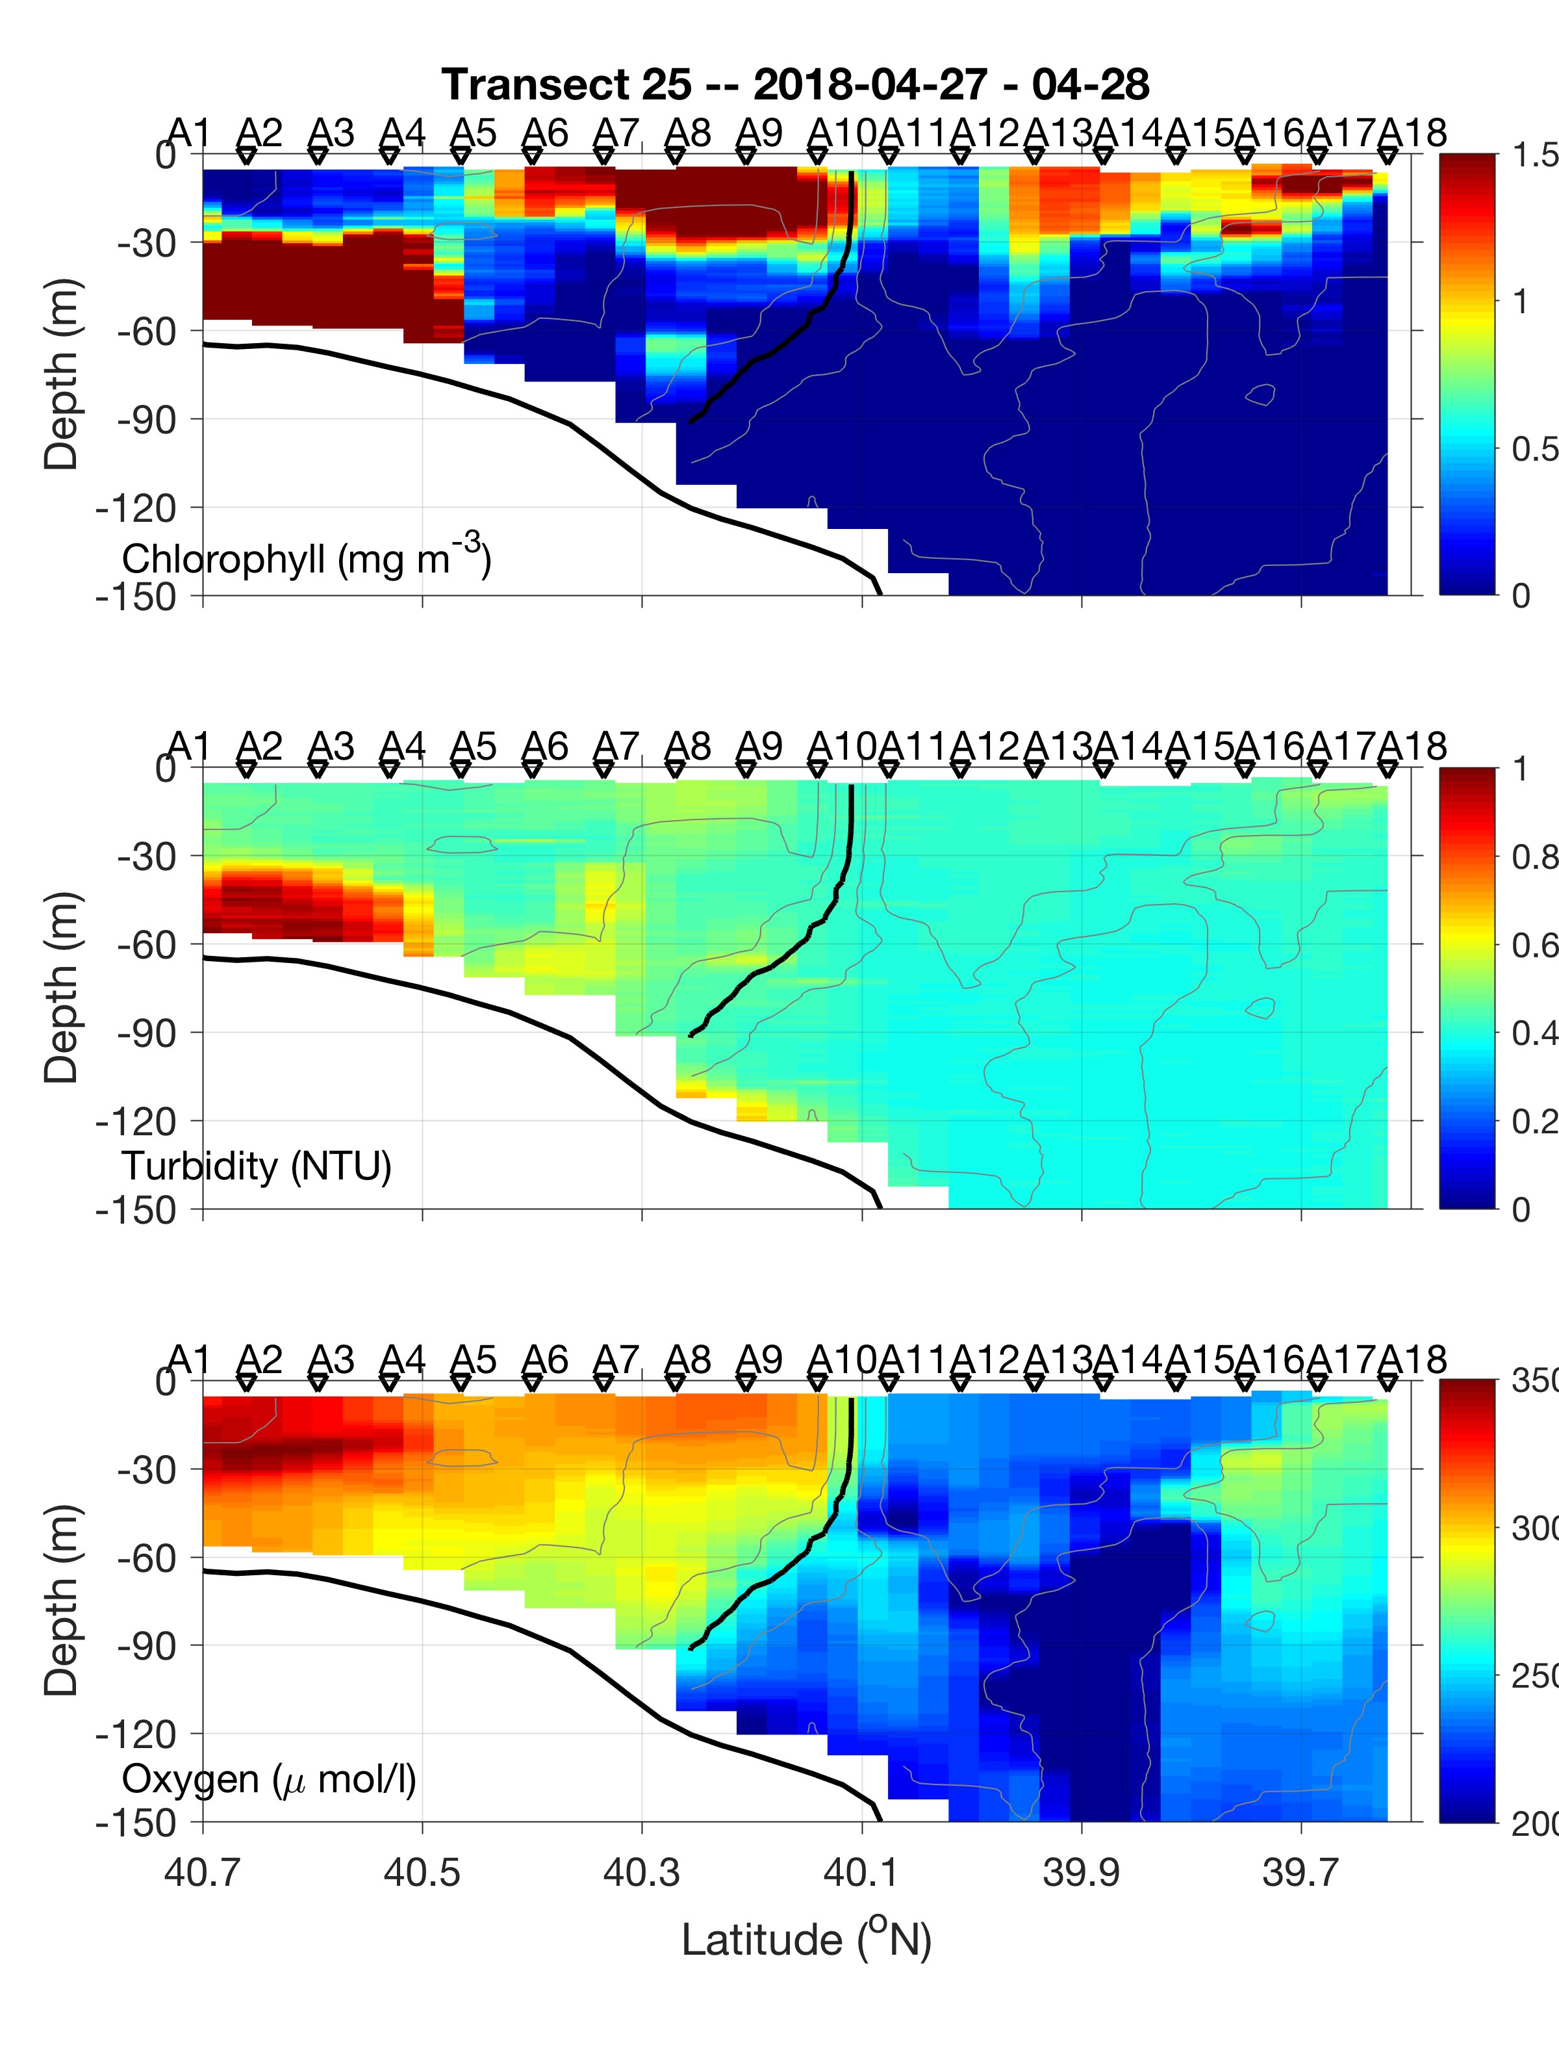
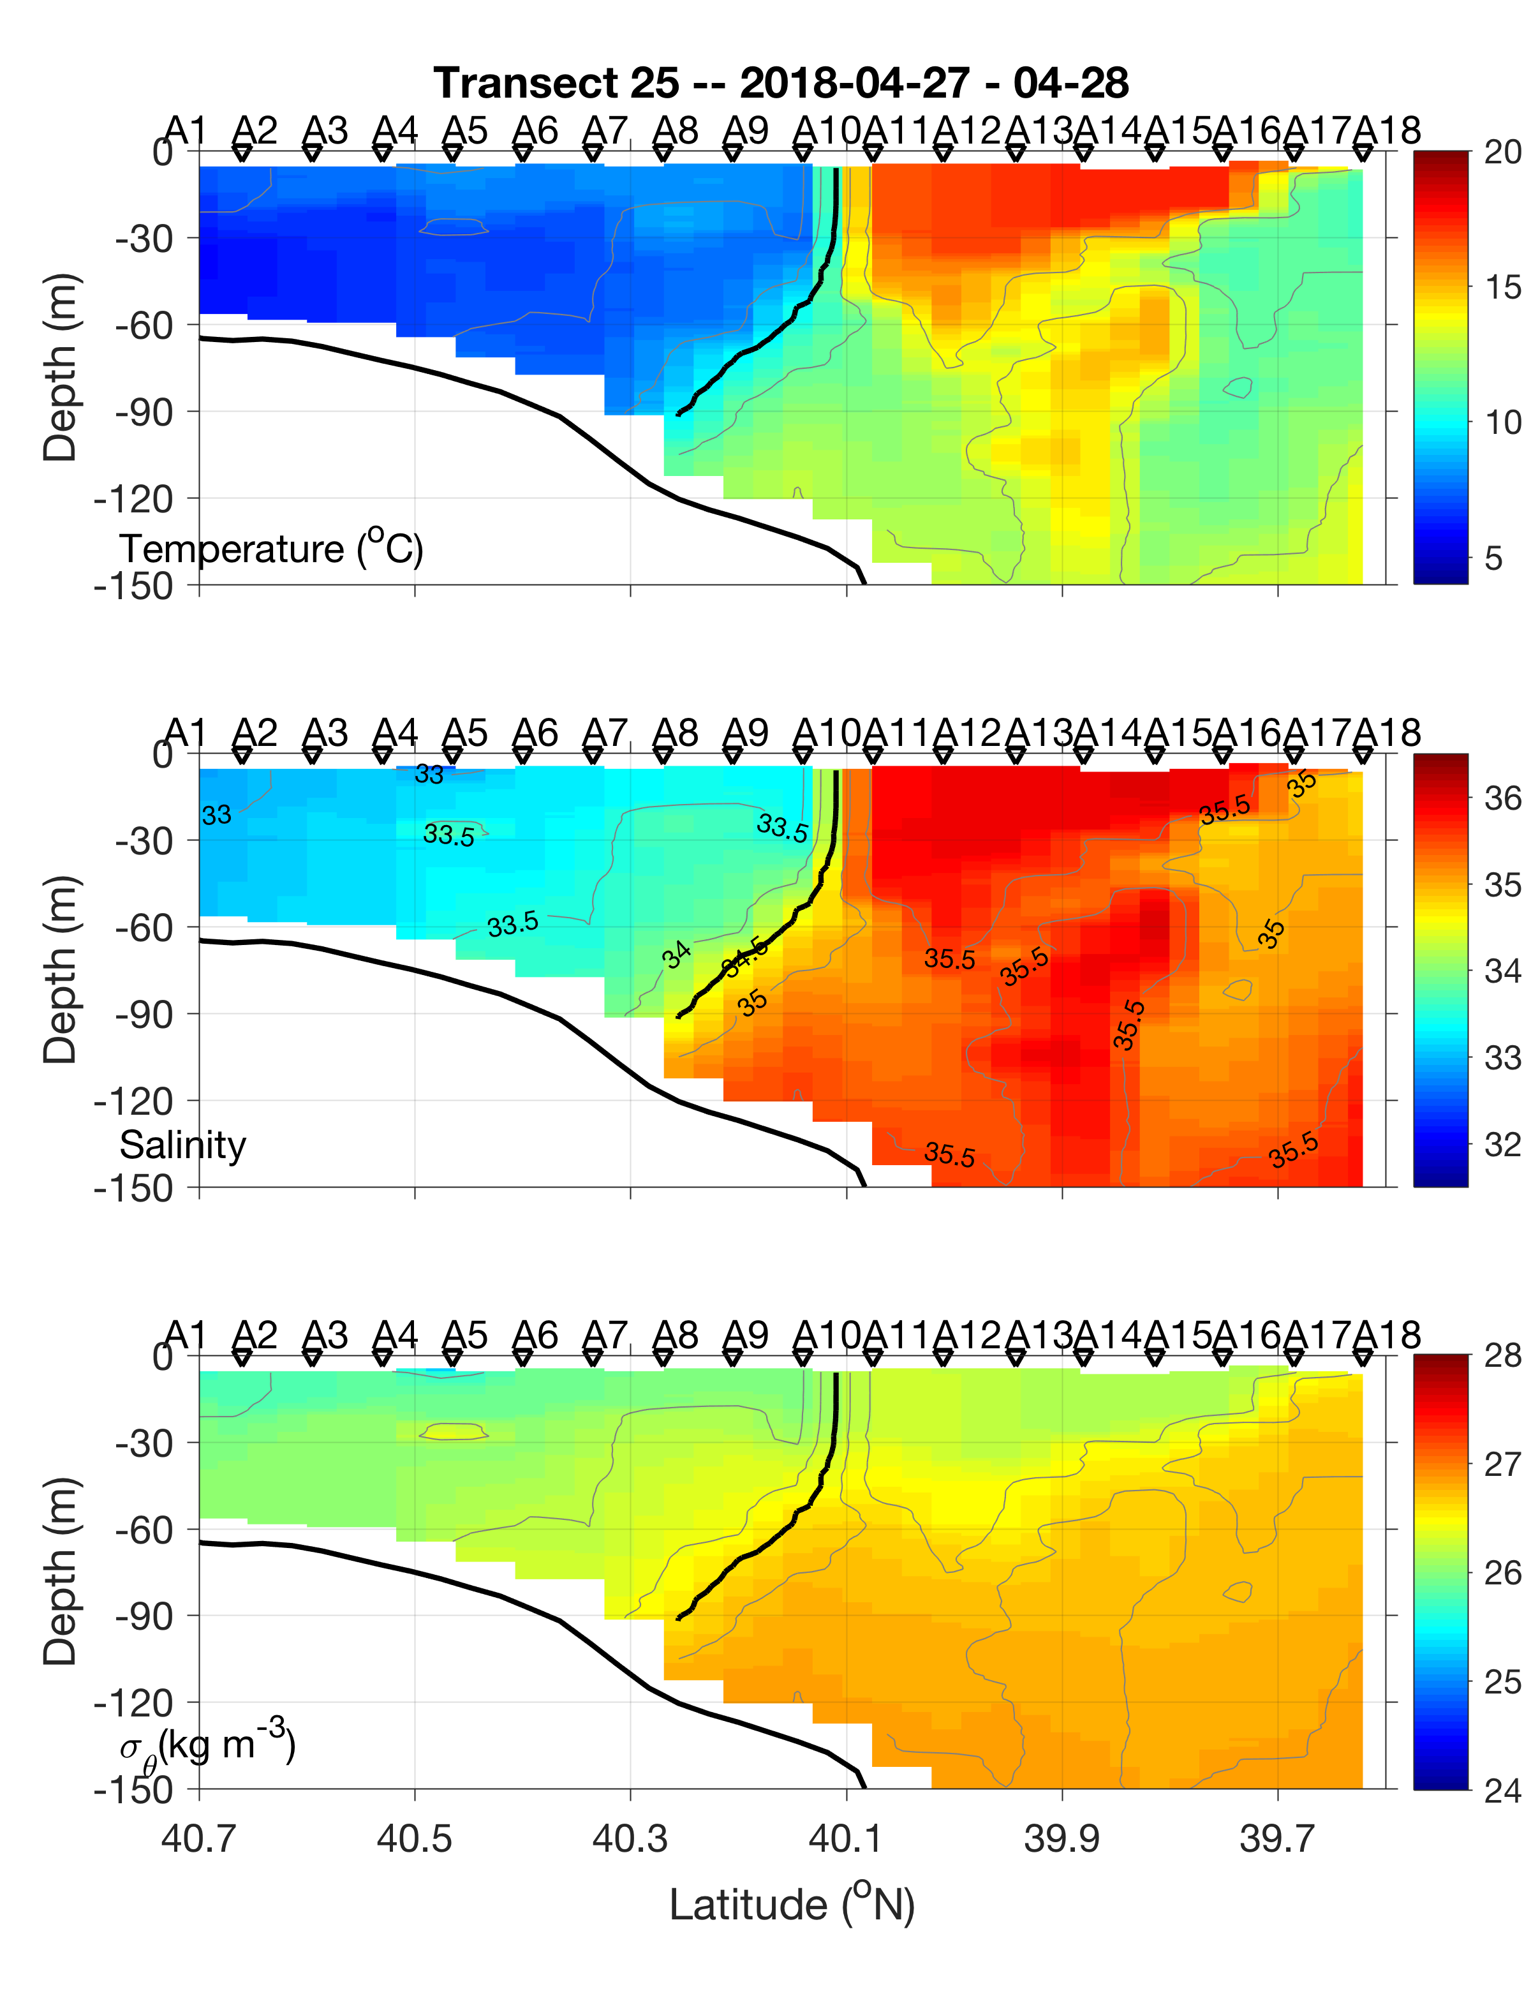
Cruise Data
2018 Apr 28
Ring edge came further onshore

Slide 45
Summary
The shelfbreak frontal system was influenced by the old warm-core ring over the entire cruise period
The surface temperature signal of the old warm-core ring is weak, and the interaction process between the ring and the shelfbreak front is complex
The interface between the shelf and ring water is inhomogeneous, and some of the observed temporal variation reflect the spatial inhomogeneity
There are indications of frontal upwelling and subduction at the interface between the ring and shelf/slope waters on both sides of the ring streamer
Implication for the modeling?

