Slide 1
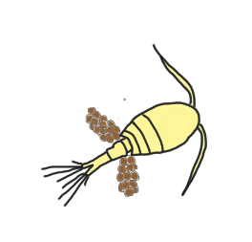
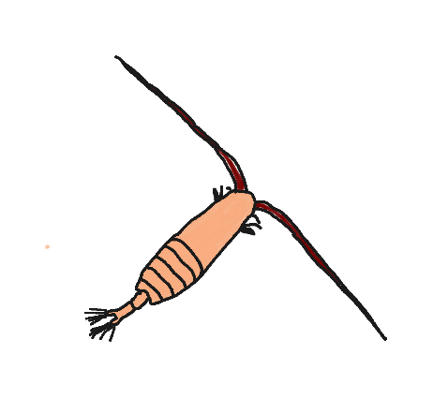
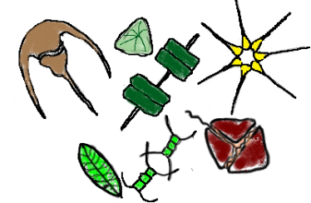
SPIROPA PI MEETING:
Shelfbreak Frontal Dynamics: mechanisms of upwelling, net community production, and ecological implications
Zooplankton Grazing Component
Jefferson Turner
University of Massachusetts Dartmouth School for Marine Science and Technology
Christian Petitpas
Massachusetts Division of Marine Fisheries
and
University of Massachusetts Dartmouth School for Marine Science and Technology
November 28-29, 2018

Slide 2
NO DATA

Slide 3
copepod nauplii
Calanus
finmarchicus
Oithona
similis
Paracalanus
parvus
other copepods
non-copepod

Slide 4
Some variation with depth:
Generally, total zooplankton abundance was lower below the chlorophyll max (if one existed) than near surface and the depth where incubation water was collected. This was the case regardless of time of day collected
There were shifts in dominant copepod taxa with depth
Total zooplankton = 3033 animals/m³
Total zooplankton = 3315 animals/m³
Total zooplankton = 1052 animals/m³

Slide 5
