Slide 1
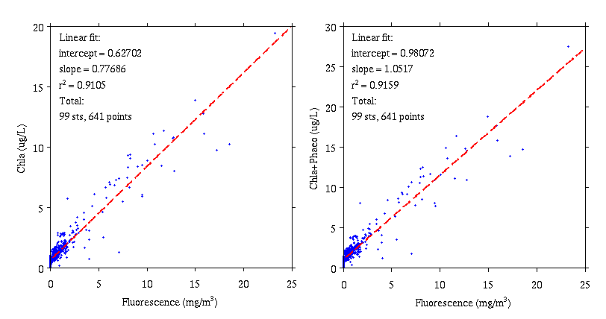
Phytoplankton – Sosik Lab
Fluorometric chlorophyll concentration
~1600 samples filtered and frozen (duplicates from 800 Niskins)
~1250 extracted and analyzed, integrated with bottle data
~350 remain frozen
HPLC pigment concentrations
236 samples filtered and frozen (near surface and “chl max”)

Slide 2
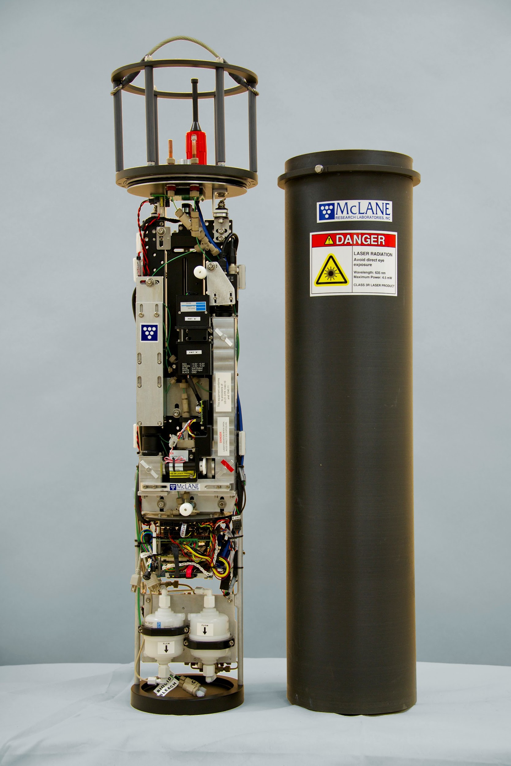
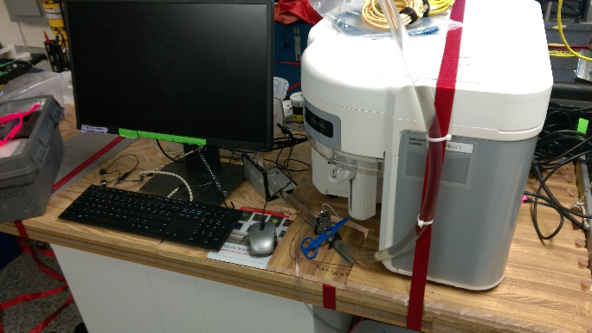
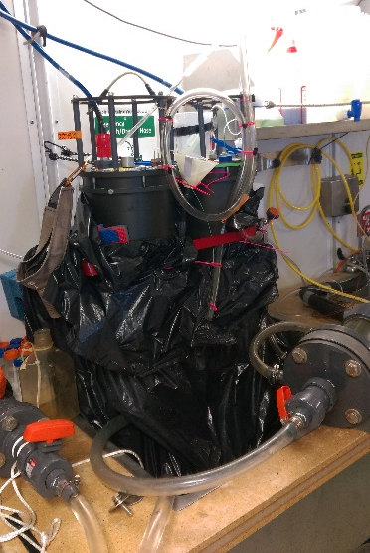
Phytoplankton – Sosik Lab
Attune NxT
IFCB
Attune NxT flow cytometer
~6000 automated samples (0.4 ml every 2 min) from underway seawater flow
~1130 samples from Niskins, preserved and frozen, awaiting analysis (typically same depths as nutrients)
IFCB (Imaging FlowCytobot)
~750 automated samples (~2-5 ml every 20 min) from underway seawater flow
~220 samples from Niskins (typically surface and “chl max”)
Staining IFCB
~670 automated samples (~2-5 ml every 20 min) from underway seawater flow

Slide 3
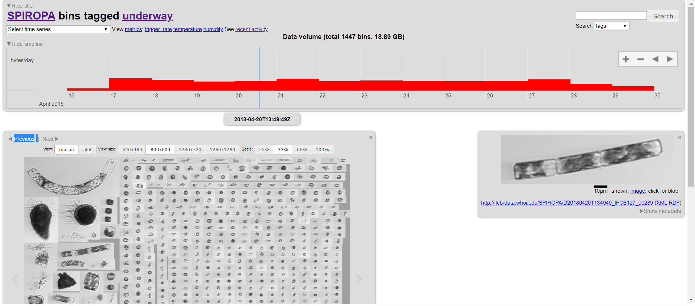
https://ifcb-data.whoi.edu/SPIROPA

Slide 4
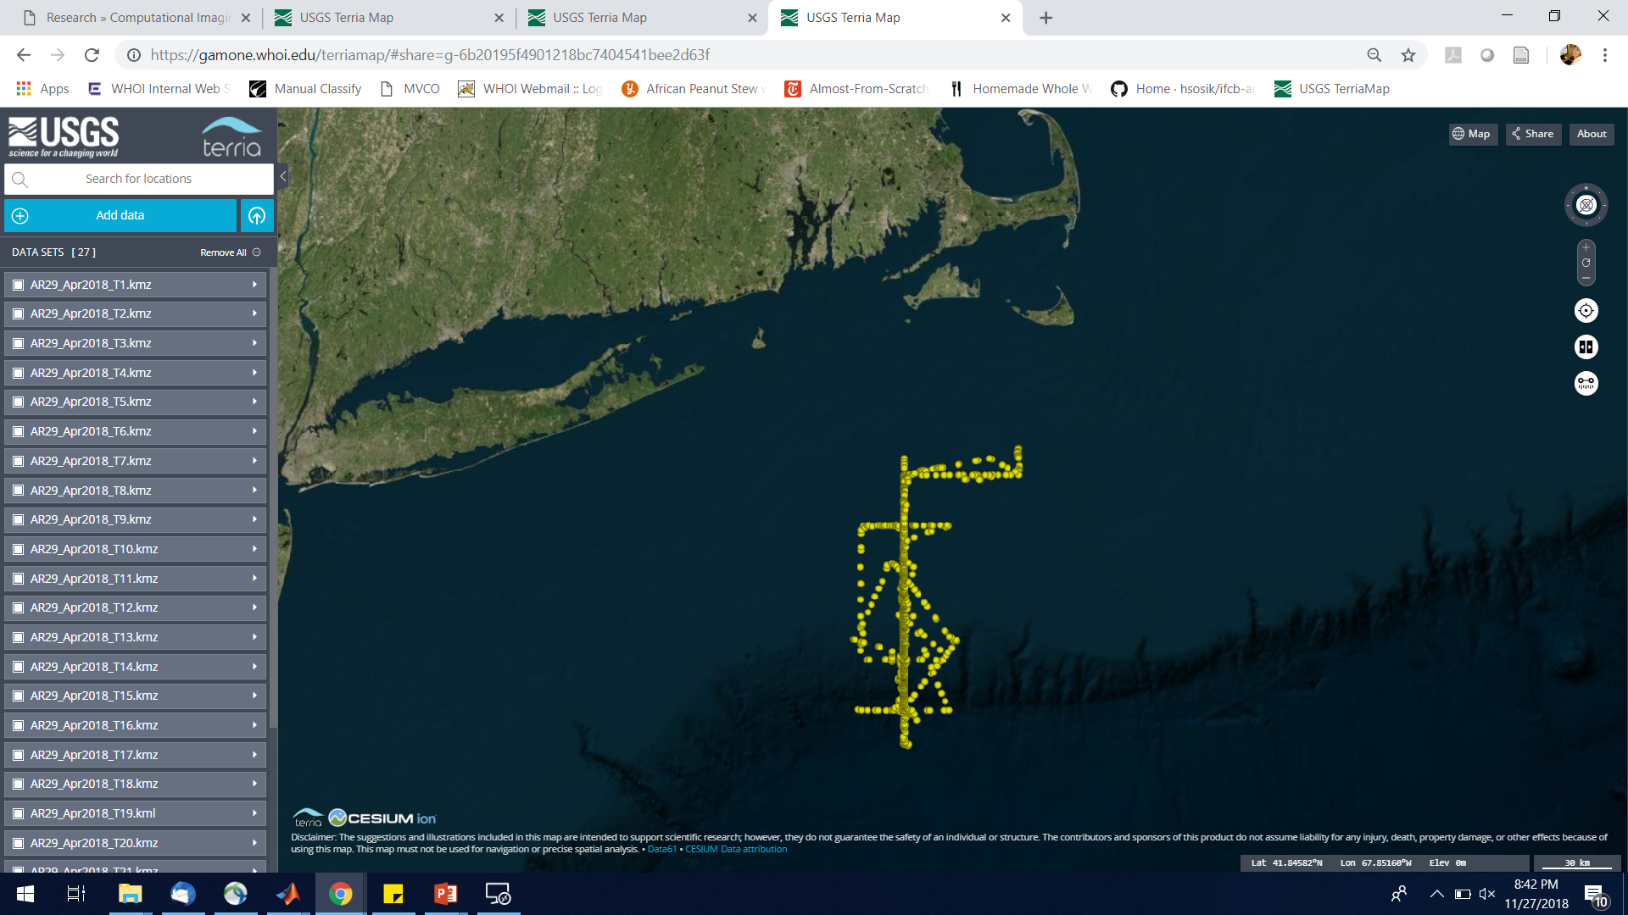
https://tinyurl.com/IFCB998

Slide 5
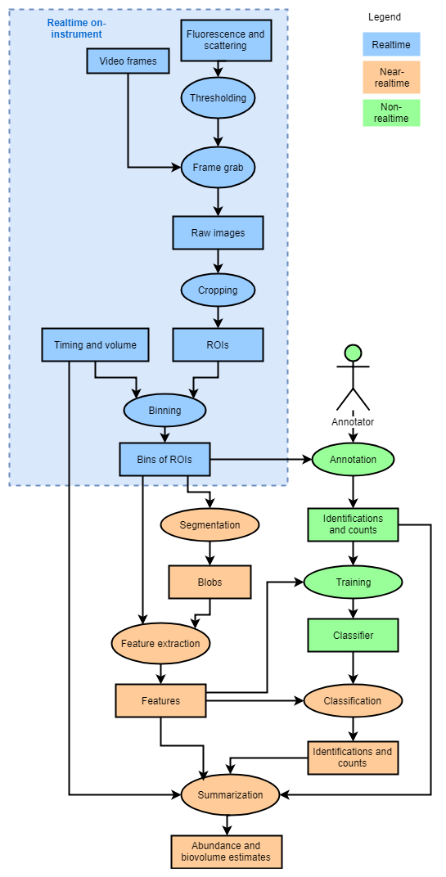
IFCB Analysis Workflow

Slide 6
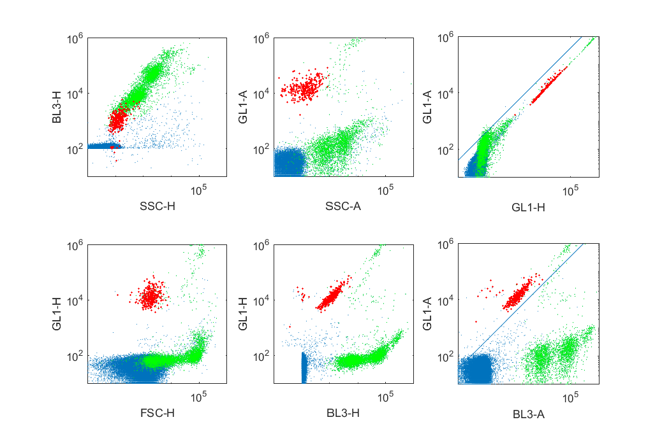
Attune data analysis and quality control

Slide 7
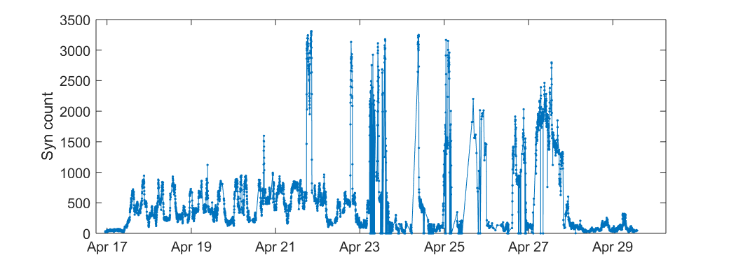
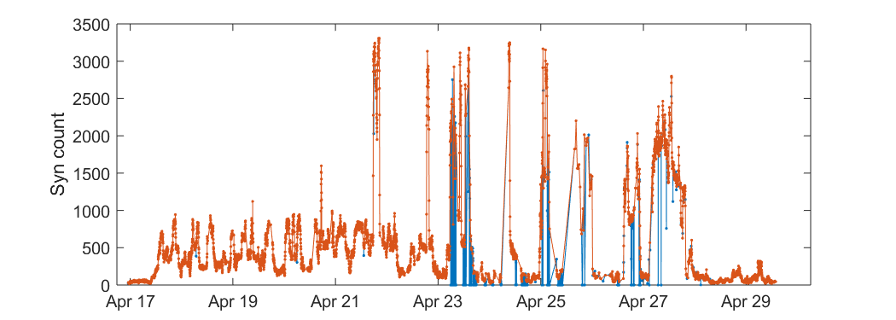
Attune data analysis and quality control

Slide 8
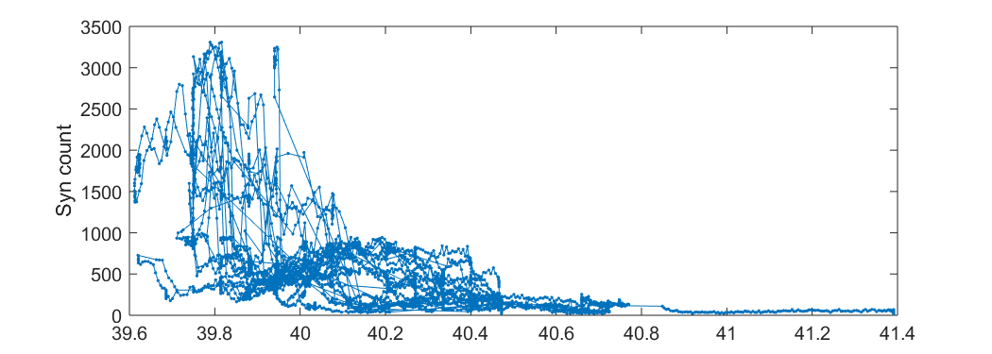
Attune data analysis and quality control

Slide 9
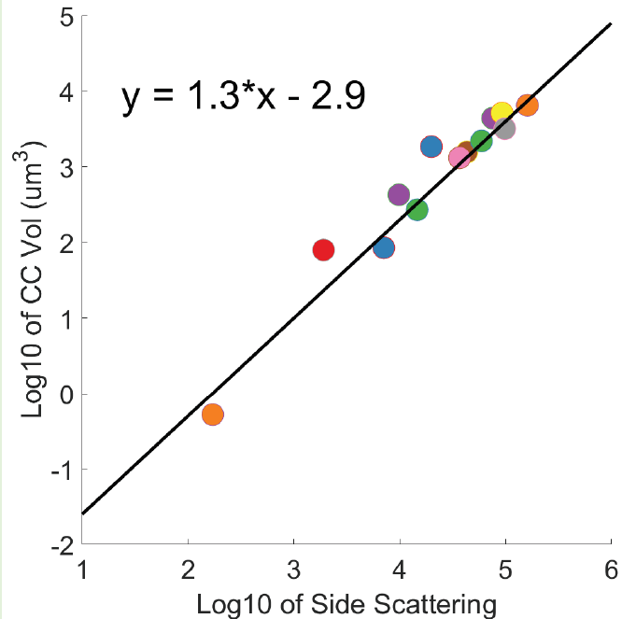


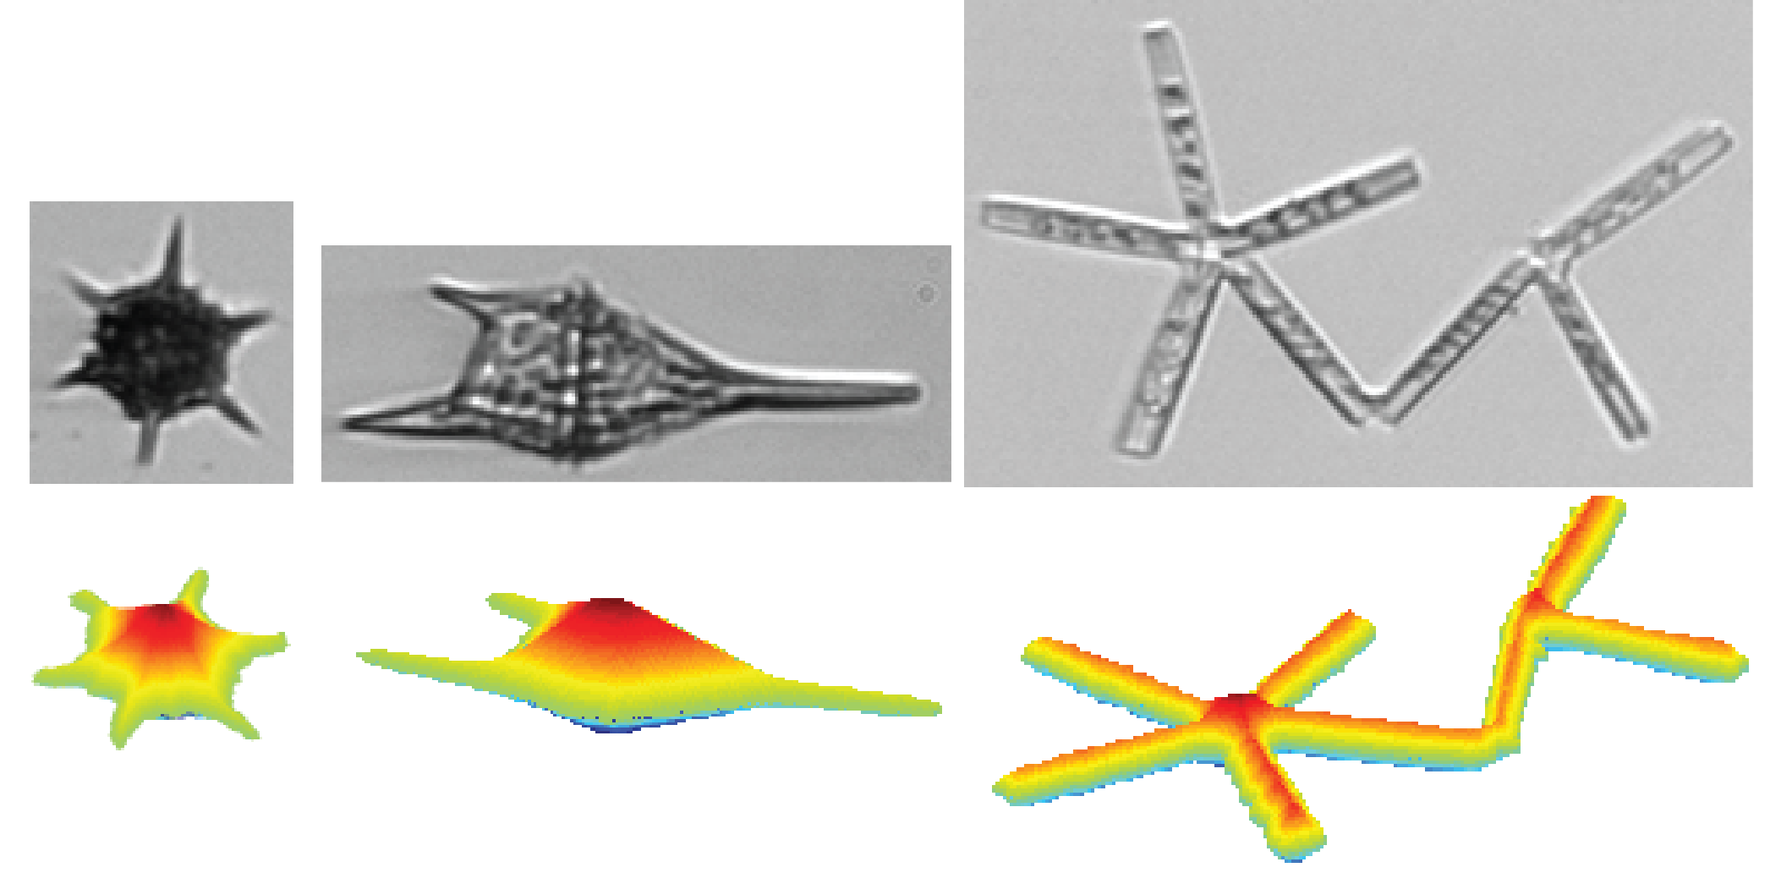

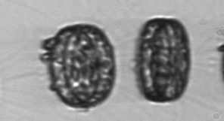
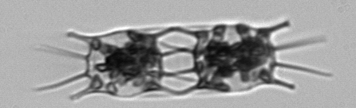

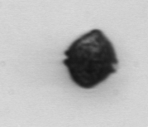
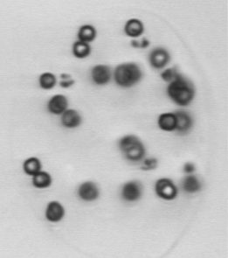

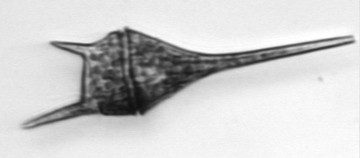

Size and biomass budgets
Pico/nanoplankton
Cell carbon from cell volume
$C_{i}=$ ${f(V}_{i})$
$$Carbon=\sum_{i}{C_{i}}$$
Cell volume from laser scattering
e.g., Menden-Deuer
& Lessard 2000
Nano/microplankton
Imaging FlowCytobot
Cell volume from image analysis
“distance map” approach
Sosik and Olson 2007
Moberg & Sosik 2012

Slide 10
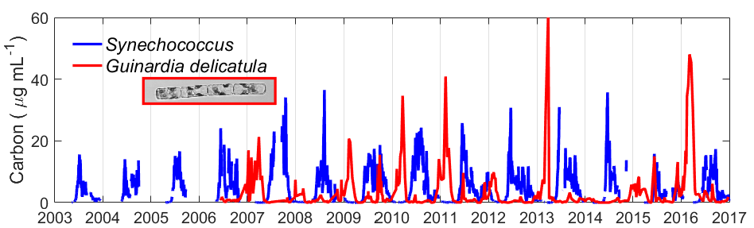
Size and biomass budgets – MVCO example
Individual cells → Taxa → Communities
Cyanobacteria
Diatoms
Individual cells → Size classes → Communities

Slide 11
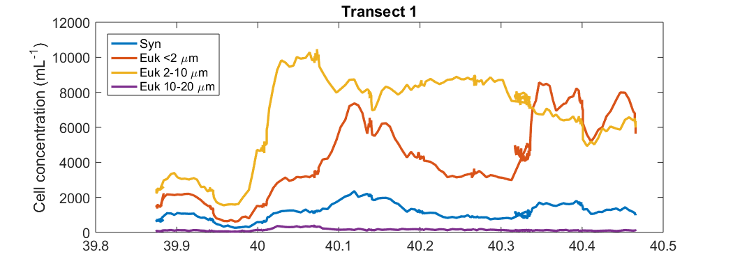
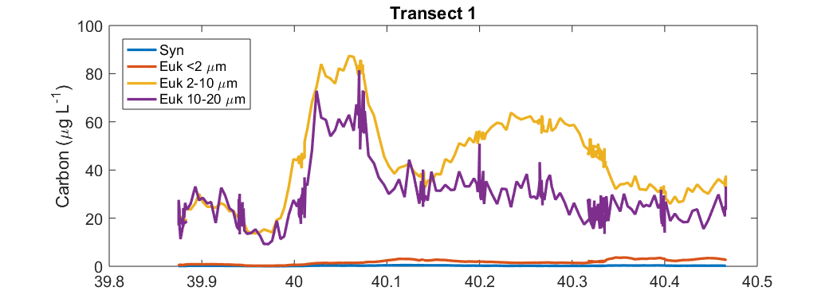
Offshore
Onshore

Slide 12
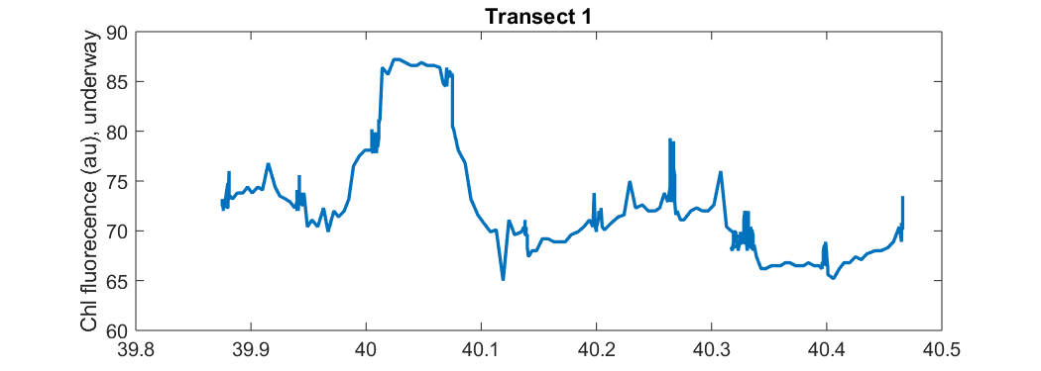
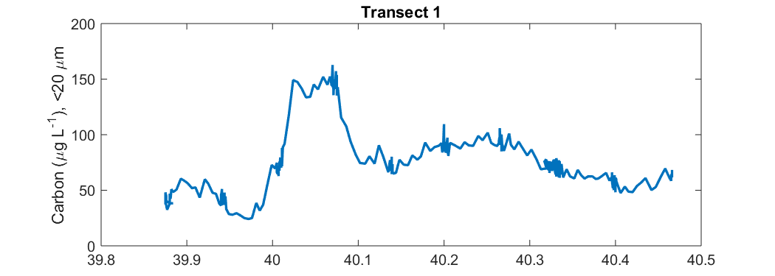

Slide 13

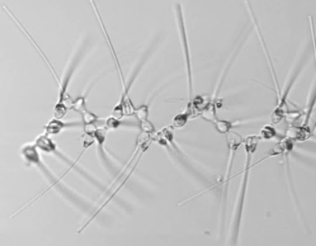
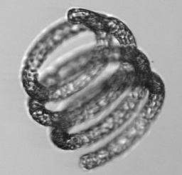

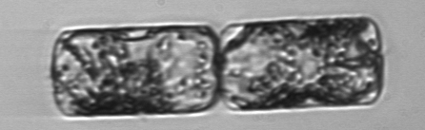
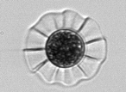
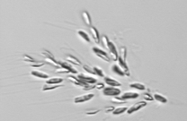
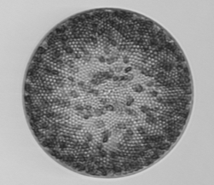
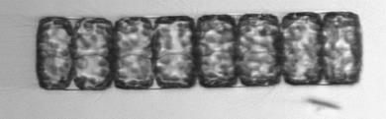
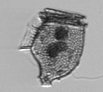
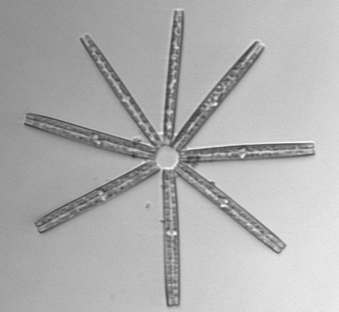
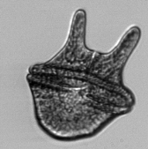
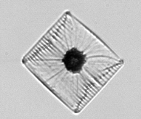
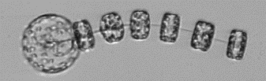




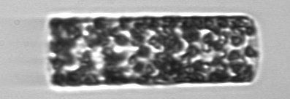

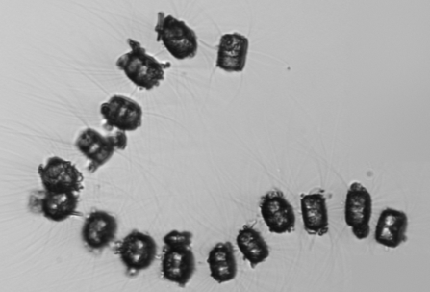
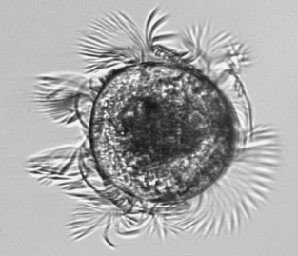

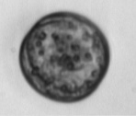
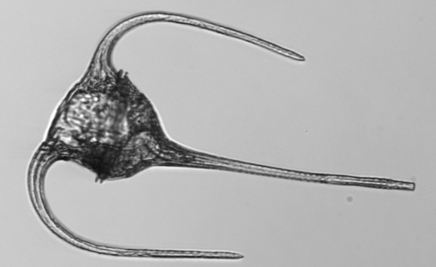


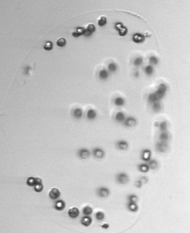





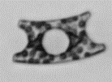





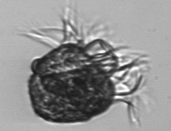
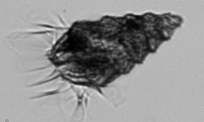

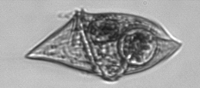
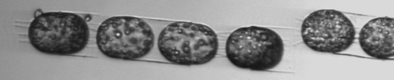
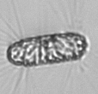
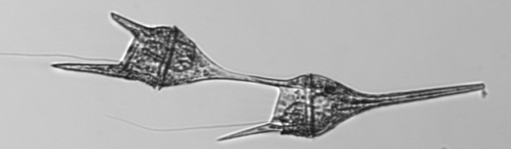
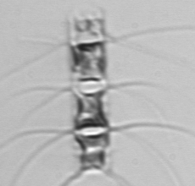

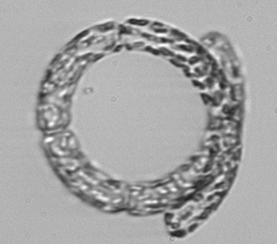




















https://beagle.whoi.edu/redmine/projects/ifcb-man/wiki/Expanded_version
Notes:
What we often gloss over, however, is how diverse these plankton are. These images were taken automatically underwater at the Martha’s Vineyard CO. They show a small slice of the diversity in size and shape—these organisms also vary genetically, physiologically, in their ecological interactions and biogeochemical roles.
This diversity presents a major challenge for our understanding of how plankton influence marine ecosystems.
A take home message of my talk is that we need–and now have the capability to–move way beyond our conventional approaches of measuring things like bulk chlorophyll fluorescence that have the disadvantage of lumping all this diversity into one box.
-------------
As ecologists, we are broadly interested in classic questions about the factors that control diversity in the plankton, as well as the regulation of their population and community dynamics…And the ways they are responding to environmental change.
A major challenge is not just this huge biological diversity, but also the range of space/time scales of variability in marine environments that demand intensive sampling.
This is an exciting time for overcoming this challenge because ocean observatories are rapidly emerging and providing opportunities to sample in more detail than possible with conventional approaches like chl fluorometers that only provide an index of bulk biomass.

Slide 14



