Slide 1
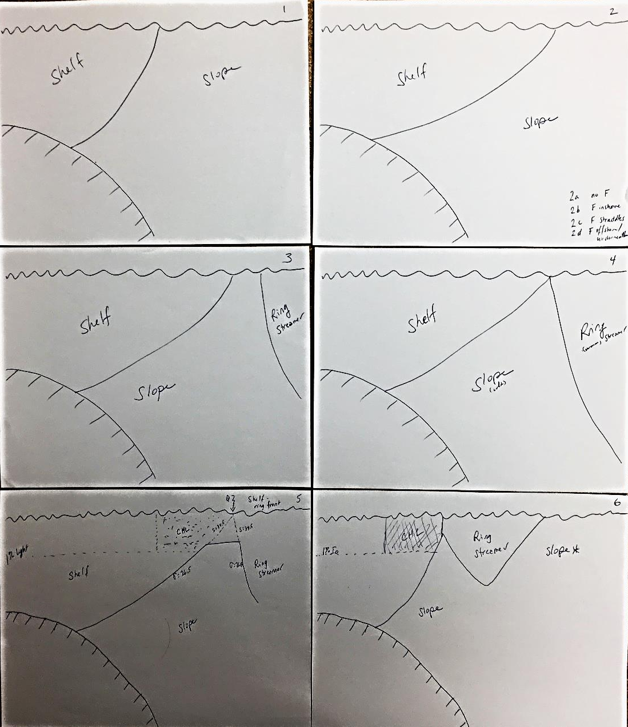
Ring streamer
Pulls front offshore

Slide 2
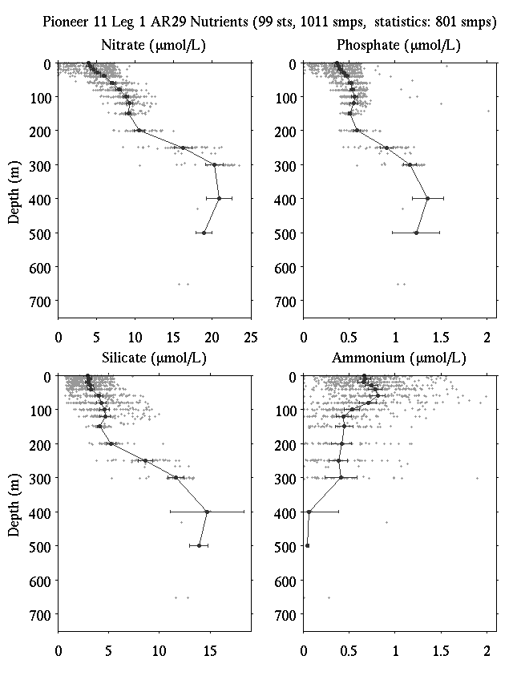
Composite nutrient profiles

Slide 3
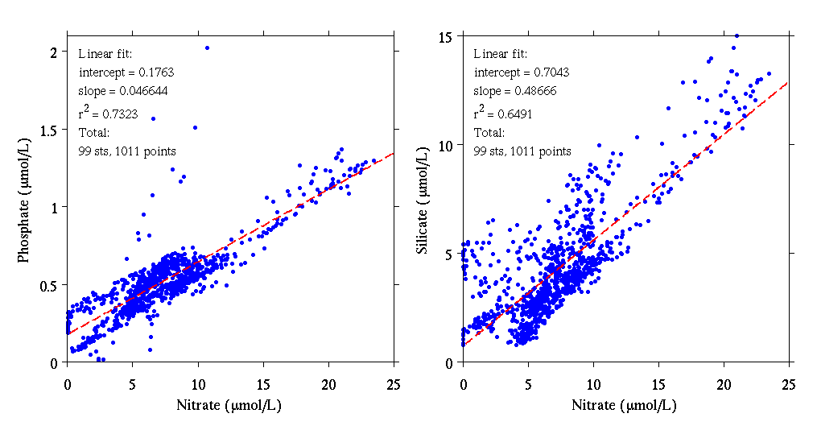
Nutrient ratios

Slide 4
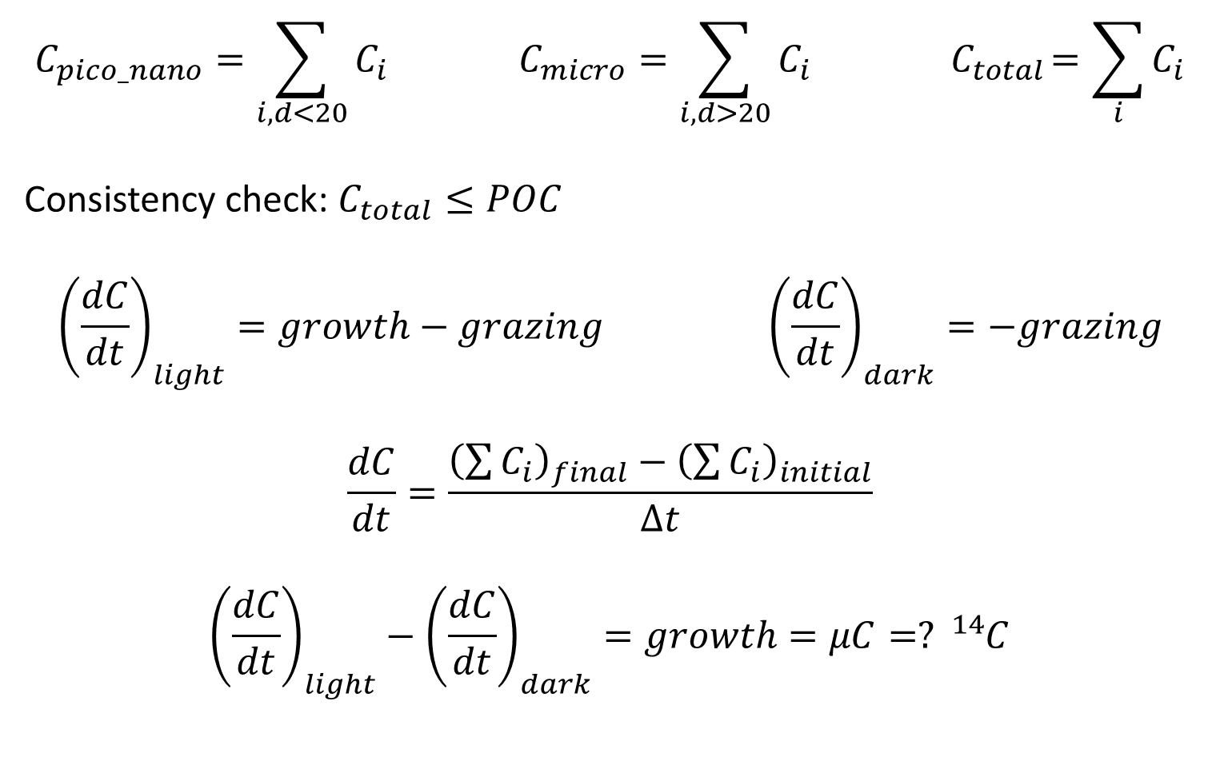
Synthesis
$$C_{pico_nano}=\sum_{i, d<20}{C_{i}} C_{micro}=\sum_{i, d>20}{C_{i}}{ C}_{total}=\sum_{i}{C_{i}}$$
Consistency check: $C_{total}≤POC$
$${\left(\frac{dC}{dt}\right)}_{light}=growth−grazing {\left(\frac{dC}{dt}\right)}_{dark}=−grazing$$
$$\frac{dC}{dt}=\frac{{\left(\sum{C_{i}}\right)}_{final}−{\left(\sum{C_{i}}\right)}_{initial}}{∆t}$$
$${\left(\frac{dC}{dt}\right)}_{light}−{\left(\frac{dC}{dt}\right)}_{dark}=growth=μC=? {}_{}^{14}C$$

Slide 5
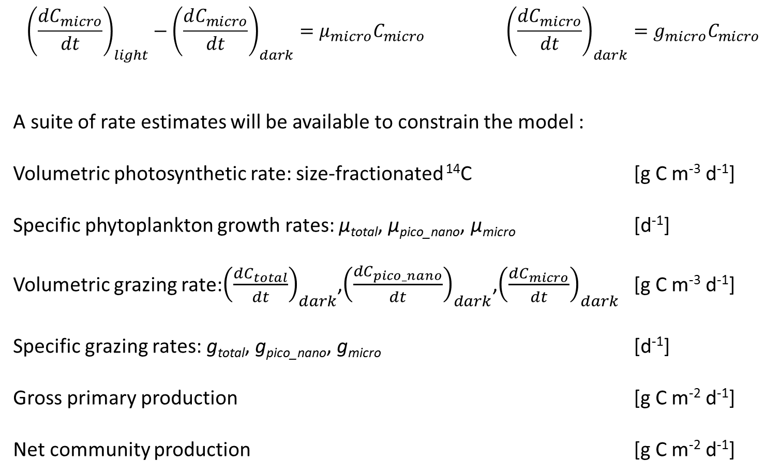
Synthesis (2)
$${\left(\frac{dC_{micro}}{dt}\right)}_{light}−{\left(\frac{dC_{micro}}{dt}\right)}_{dark}=μ_{micro}C_{micro} {\left(\frac{dC_{micro}}{dt}\right)}_{dark}=g_{micro}C_{micro}$$
A suite of rate estimates will be available to constrain the model :
Volumetric photosynthetic rate: size-fractionated ¹⁴C [g C m⁻³ d⁻¹]
Specific phytoplankton growth rates: μ_{total}, μ_{pico_nano}, μ_{micro} [d⁻¹]
Volumetric grazing rate:${\left(\frac{dC_{total}}{dt}\right)}_{dark}$,${\left(\frac{dC_{pico_nano}}{dt}\right)}_{dark}$,${\left(\frac{dC_{micro}}{dt}\right)}_{dark}$ [g C m⁻³ d⁻¹]
Specific grazing rates: g_{total}, g_{pico_nano}, g_{micro} [d⁻¹]
Gross primary production [g C m⁻² d⁻¹]
Net community production [g C m⁻² d⁻¹]

Slide 6
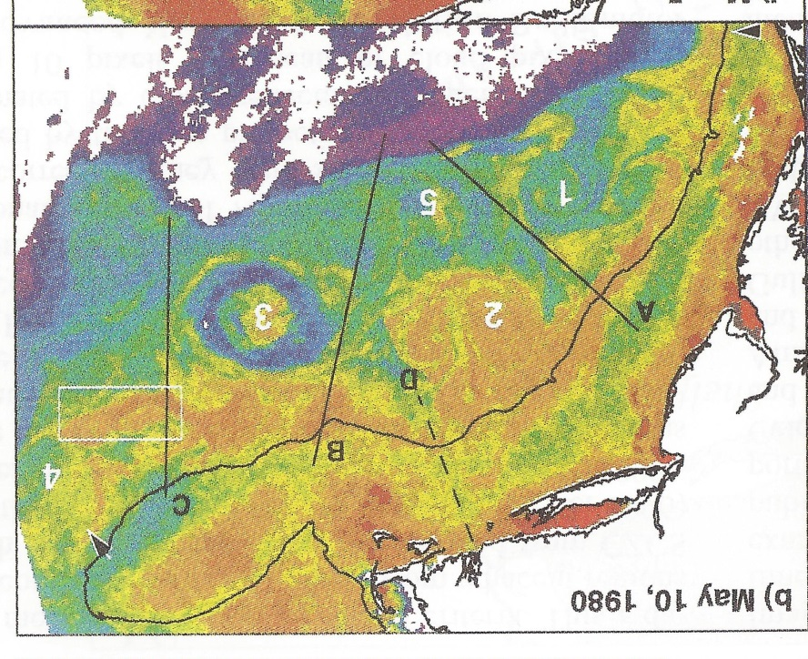
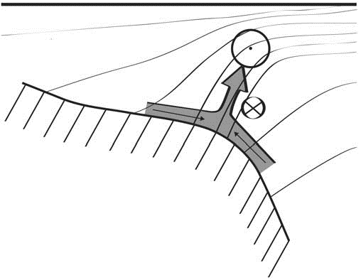
Shelfbreak frontal dynamics: mechanisms of upwelling, net community production, and ecological implications
Satellite ocean color (Chl) In situ Chl a Upwelling models
Ryan et al. 1999
Linder et al. 2004
Gawarkiewicz and Chapman 1992
Chapman and Lentz 1994
Zhang et al. 2011
Marra et al. 1990

Slide 7


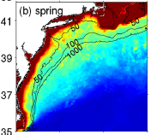

2013, JGR
Satellite CHL climatology
Why is there no mean enhancement of chlorophyll at the shelf break front?
H₁: Top-down control by zooplankton grazing
H₂: Spatial and temporal intermittency of the upwelling events causes their net impact to be smoothed out in long-term means.

Slide 8

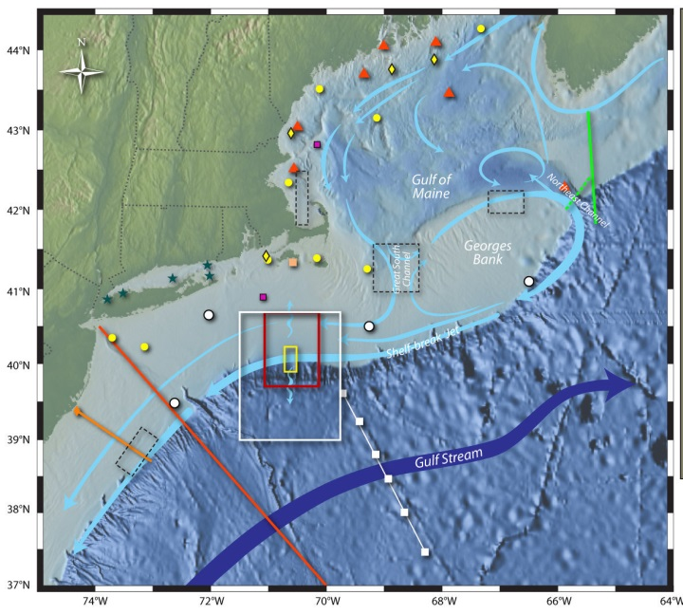
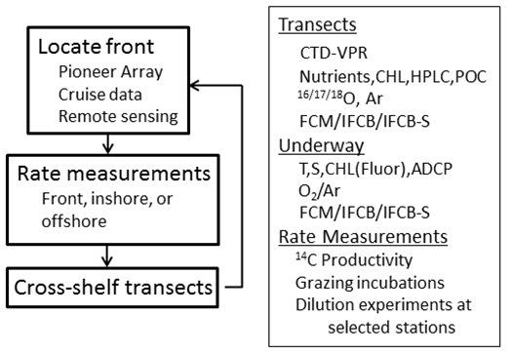
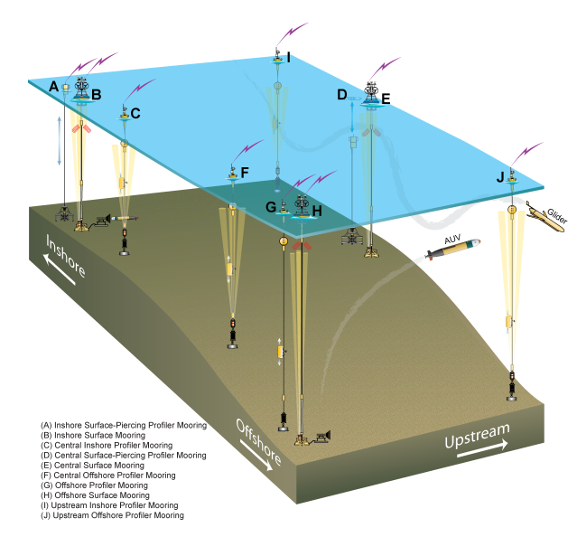
Shelfbreak frontal dynamics: mechanisms of upwelling, net community production, and ecological implications
Dennis McGillicuddy, Heidi Sosik, Gordon Zhang (WHOI)
Walker Smith (VIMS) Rachel Stanley (Wellesley College)
Jefferson Turner, Christian Petitpas (UMass Dartmouth)
NSF Ocean Observatory Initiative Pioneer Array

Slide 9
Hypotheses
H₁: Upwelling at the shelfbreak front results from a combination of (1) onshore interior flow driven by an along-shelf pressure gradient, (2) convergence in the bottom boundary layer, (3) vortex stretching driven by frontal meandering and associated mesoscale / submesoscale dynamics, and (4) Ekman divergence in the surface boundary layer.
H₂: These upwelling processes result in local enhancement of nutrient fluxes into the euphotic zone.
H₃: Enhanced nutrient availability stimulates increased primary productivity in the front and leads to changes in the phytoplankton species assemblage.
H_{4a}: Autotrophic biomass does not accumulate in areas of frontal upwelling because of zooplankton grazing; this grazer-mediated control is reflected in both zooplankton biomass and species composition.
H_{4b}: Autotrophic biomass does accumulate in areas of frontal upwelling, but the spatial and temporal intermittency of these events causes their net impact to be smoothed out in long-term means of historical observations of nutrients and chlorophyll.

Slide 10
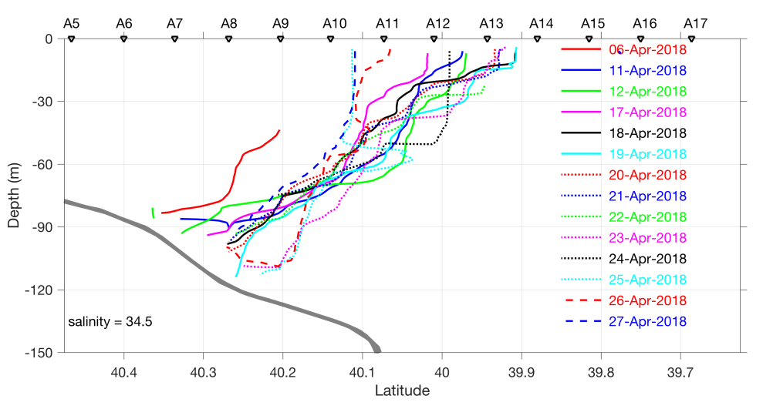
Frontal positions (S=34.5)
~20 km
AR28B
AR29
12-13
Offshore 13-14
movement
Ring streamer 12
Onshore movement 10-11

Slide 11
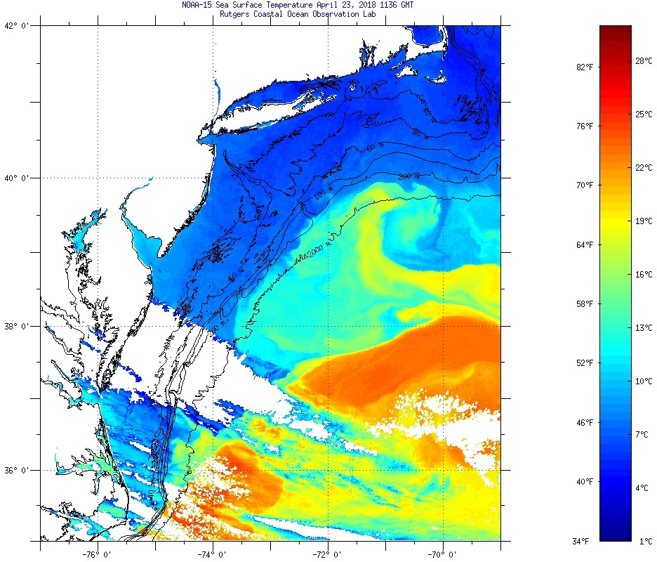
Apr 23
1136 GMT

Slide 12
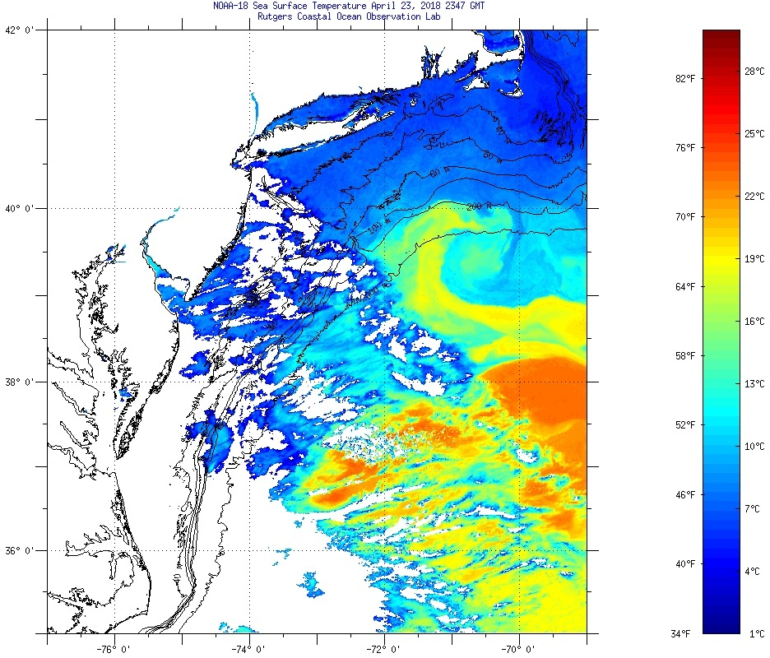
Apr 23
2347 GMT

Slide 13
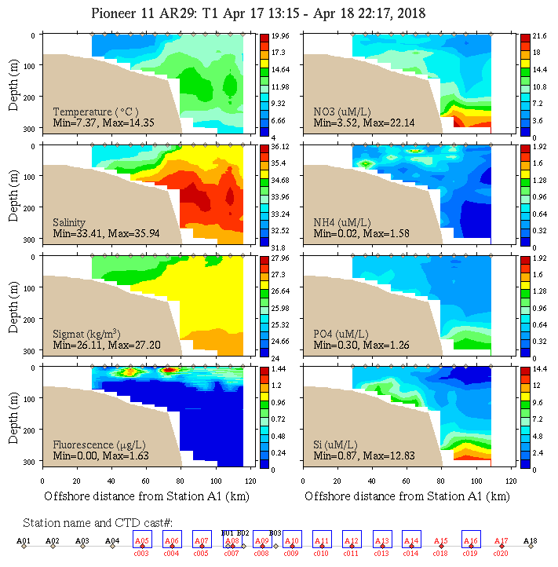
Apr 17
Front inshore
Fluor inshore of front
Temp
Sal
Density
Fluor
NO₃
NH₄
PO₄
Si

Slide 14
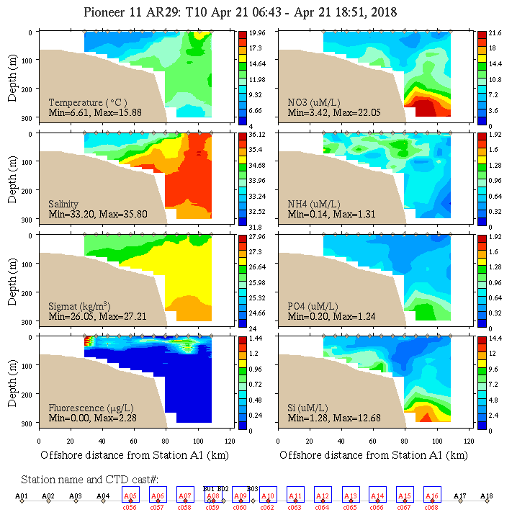
Apr 21
Front offshore
Fluor inshore, offshore of front
Temp
Sal
Density
Fluor
NO₃
NH₄
PO₄
Si

Slide 15
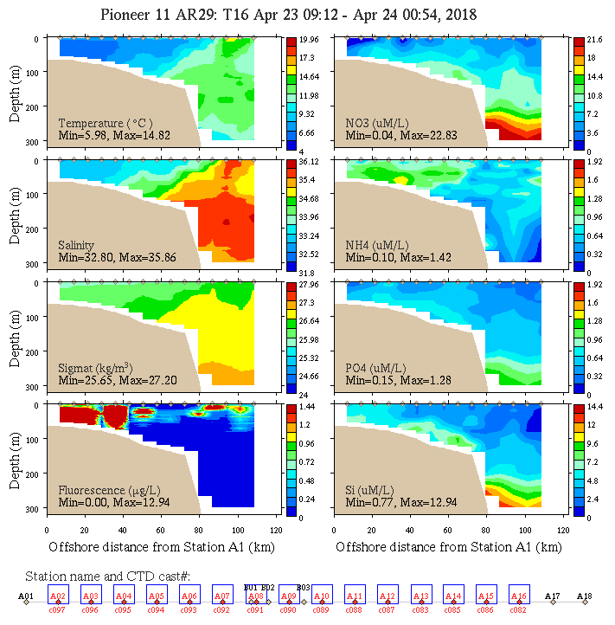
Apr 23
Front offshore
Sfc NO₃
Depletion
Phaeocystis bloom inshore, fluor offshore of front
Temp
Sal
Density
Fluor
NO₃
NH₄
PO₄
Si

Slide 16
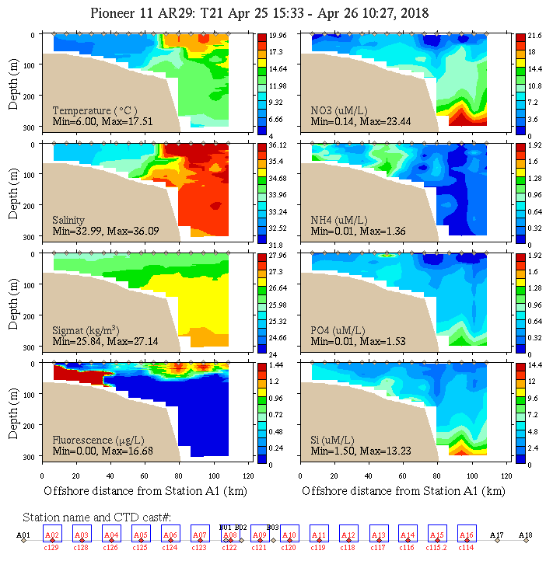
Apr 25
Ring streamer
Sfc NO₃
depletion
inshore, offshore
Phaeocystis in BBL
Fluor offshore of front
Temp
Sal
Density
Fluor
NO₃
NH₄
PO₄
Si

Slide 17
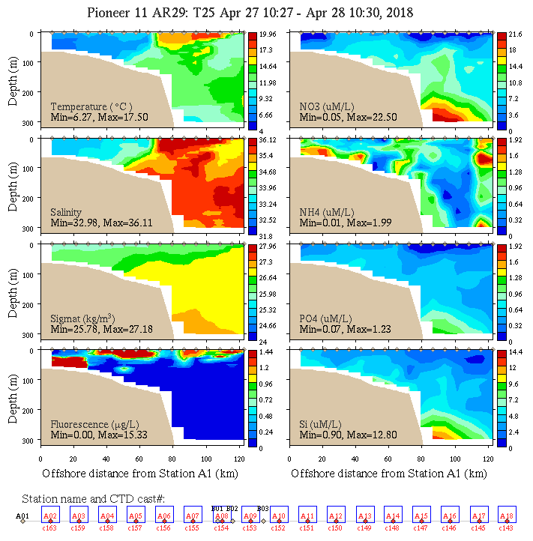
Apr 23
Ring streamer
Sfc NO₃
Depletion
Phaeocystis in BBL
Fluor inshore (high NO₃), offshore of front
Temp
Sal
Density
Fluor
NO₃
NH₄
PO₄
Si

Slide 18
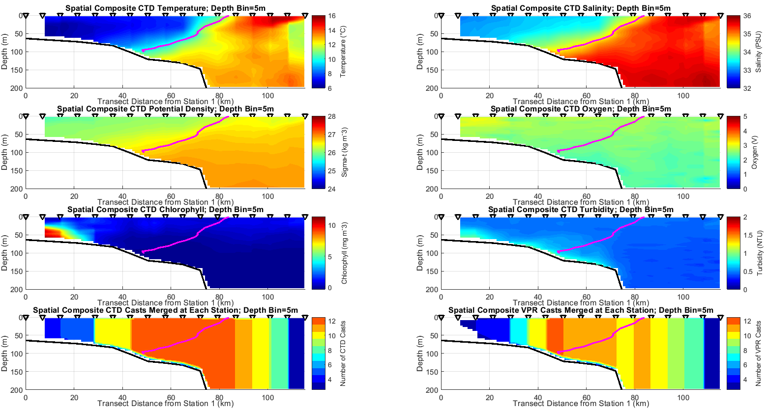
DAVPR data: spatial composites
Temperature
Salinity
Density
Oxygen
Chlorophyll
Turbidity
#CTD Casts/Station
#VPR Casts/Station

Slide 19
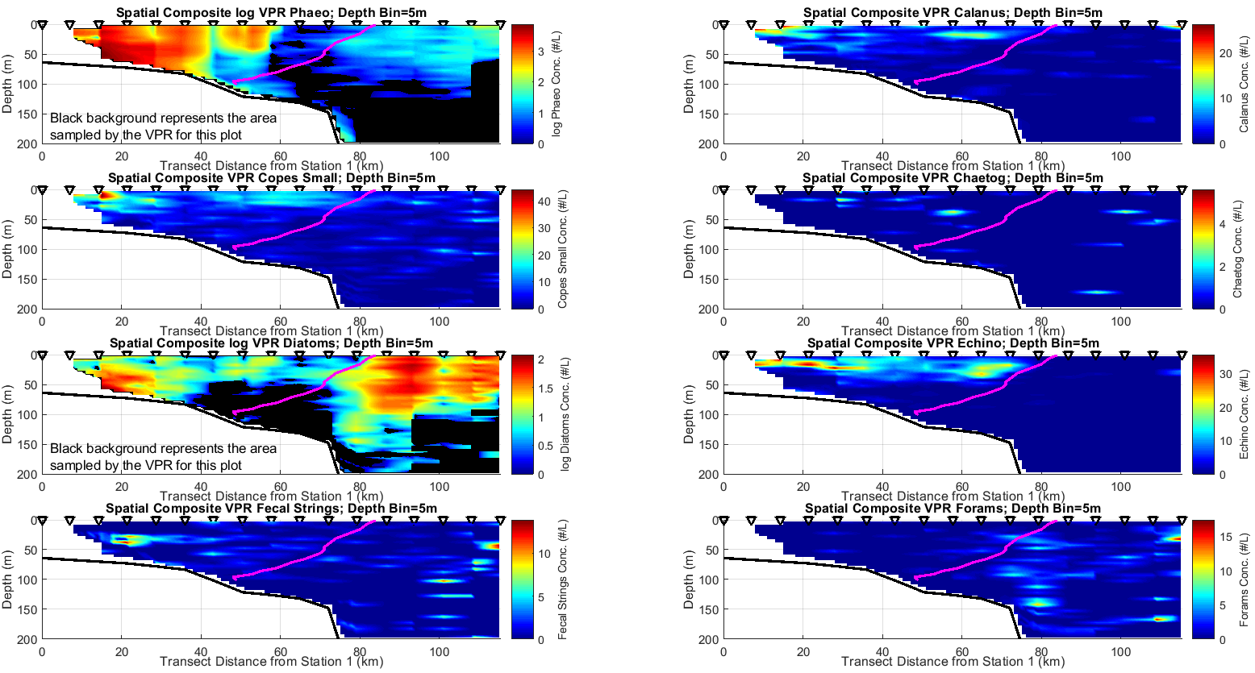
DAVPR data: spatial composites
Phaeocystis
Calanus
Small Copepods
Chaetognaths
Diatoms
Echinoderms
Fecal Strings
Foraminifera

Slide 20
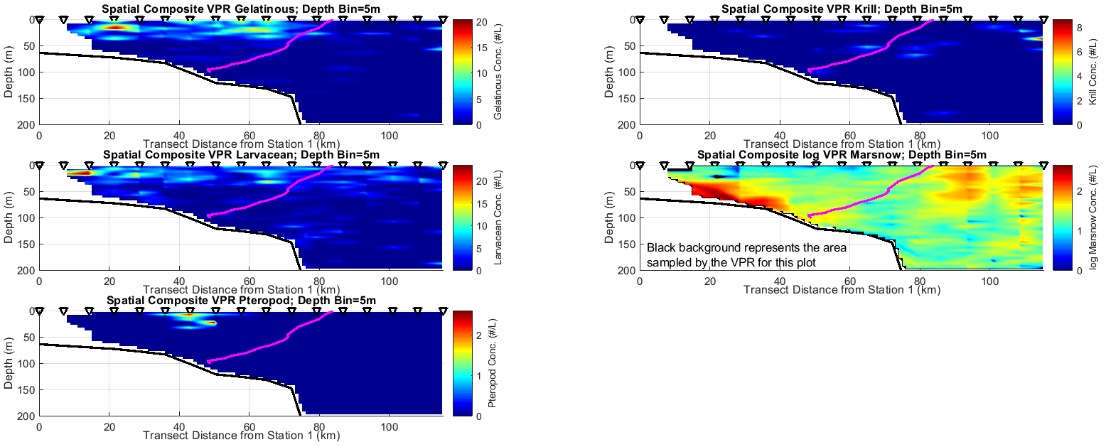
DAVPR data: spatial composites
Gelatinous
Krill
Larvaceans
Marine Snow
Pteropods

Slide 21
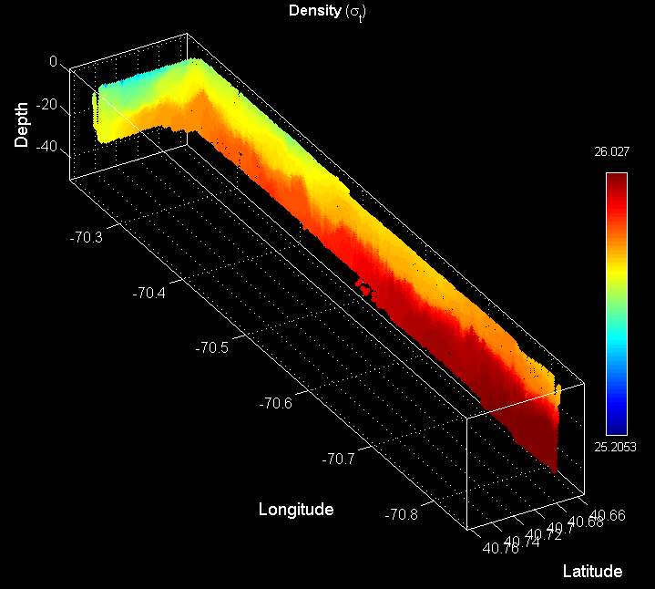
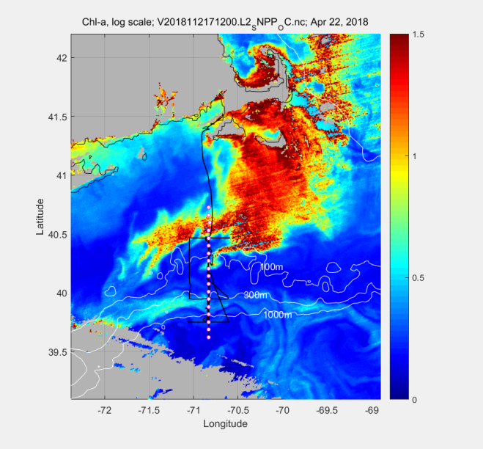
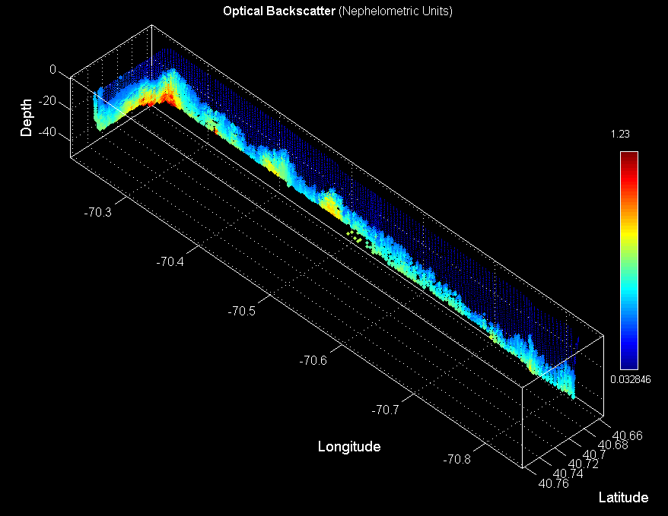
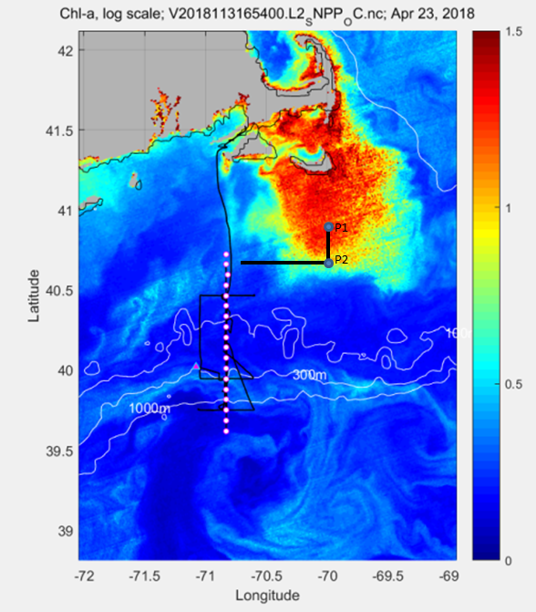
A regional Phaeocystis bloom
VPR density
April 22
April 23
VPR optical backscatter

Slide 22
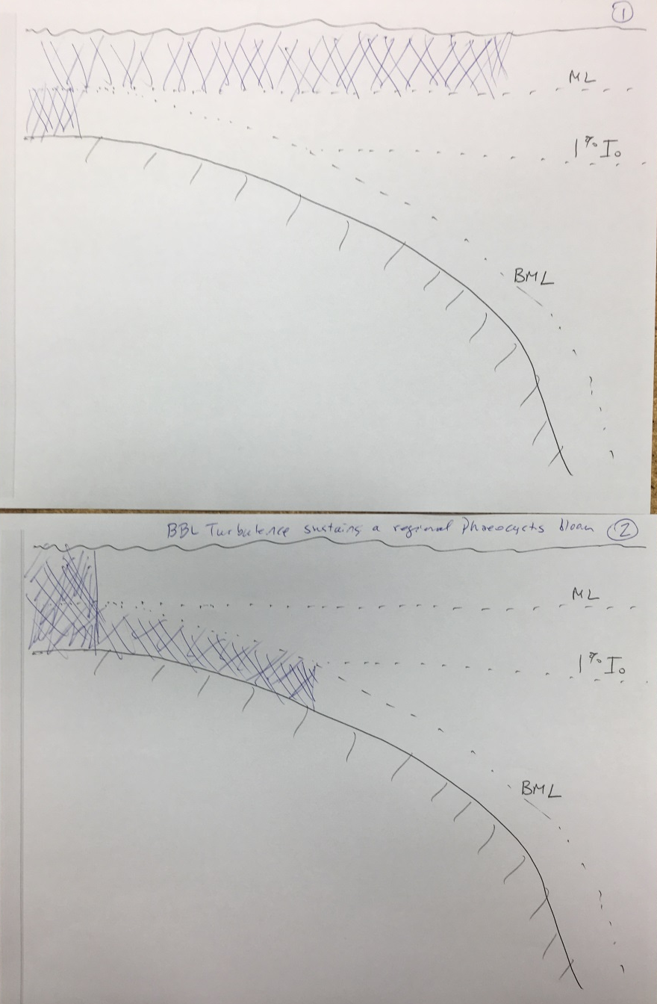
Conceptual model for how bottom boundary layer turbulence could sustain a regional bloom of Phaeocystis

Slide 23
Backup

Slide 24
Outreach
1 Interdisciplinary science of a highly productive frontal region: physics, chemistry, biology.
2 Use of OOI assets together with shipboard observations for adaptive sampling.
3 Impact of what is learned on stewardship of living marine resources, with specific connection to
the fishing community.
4 Summary of the projects highlights & scientific conclusions.

