Slide 1
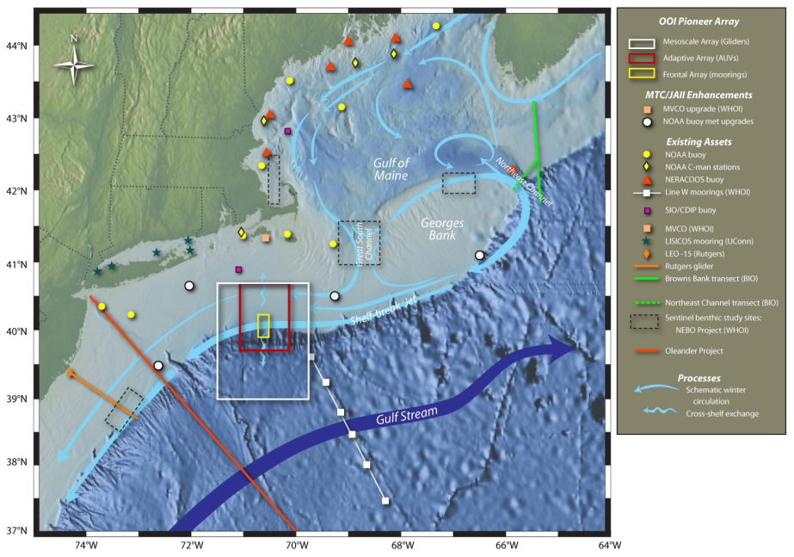
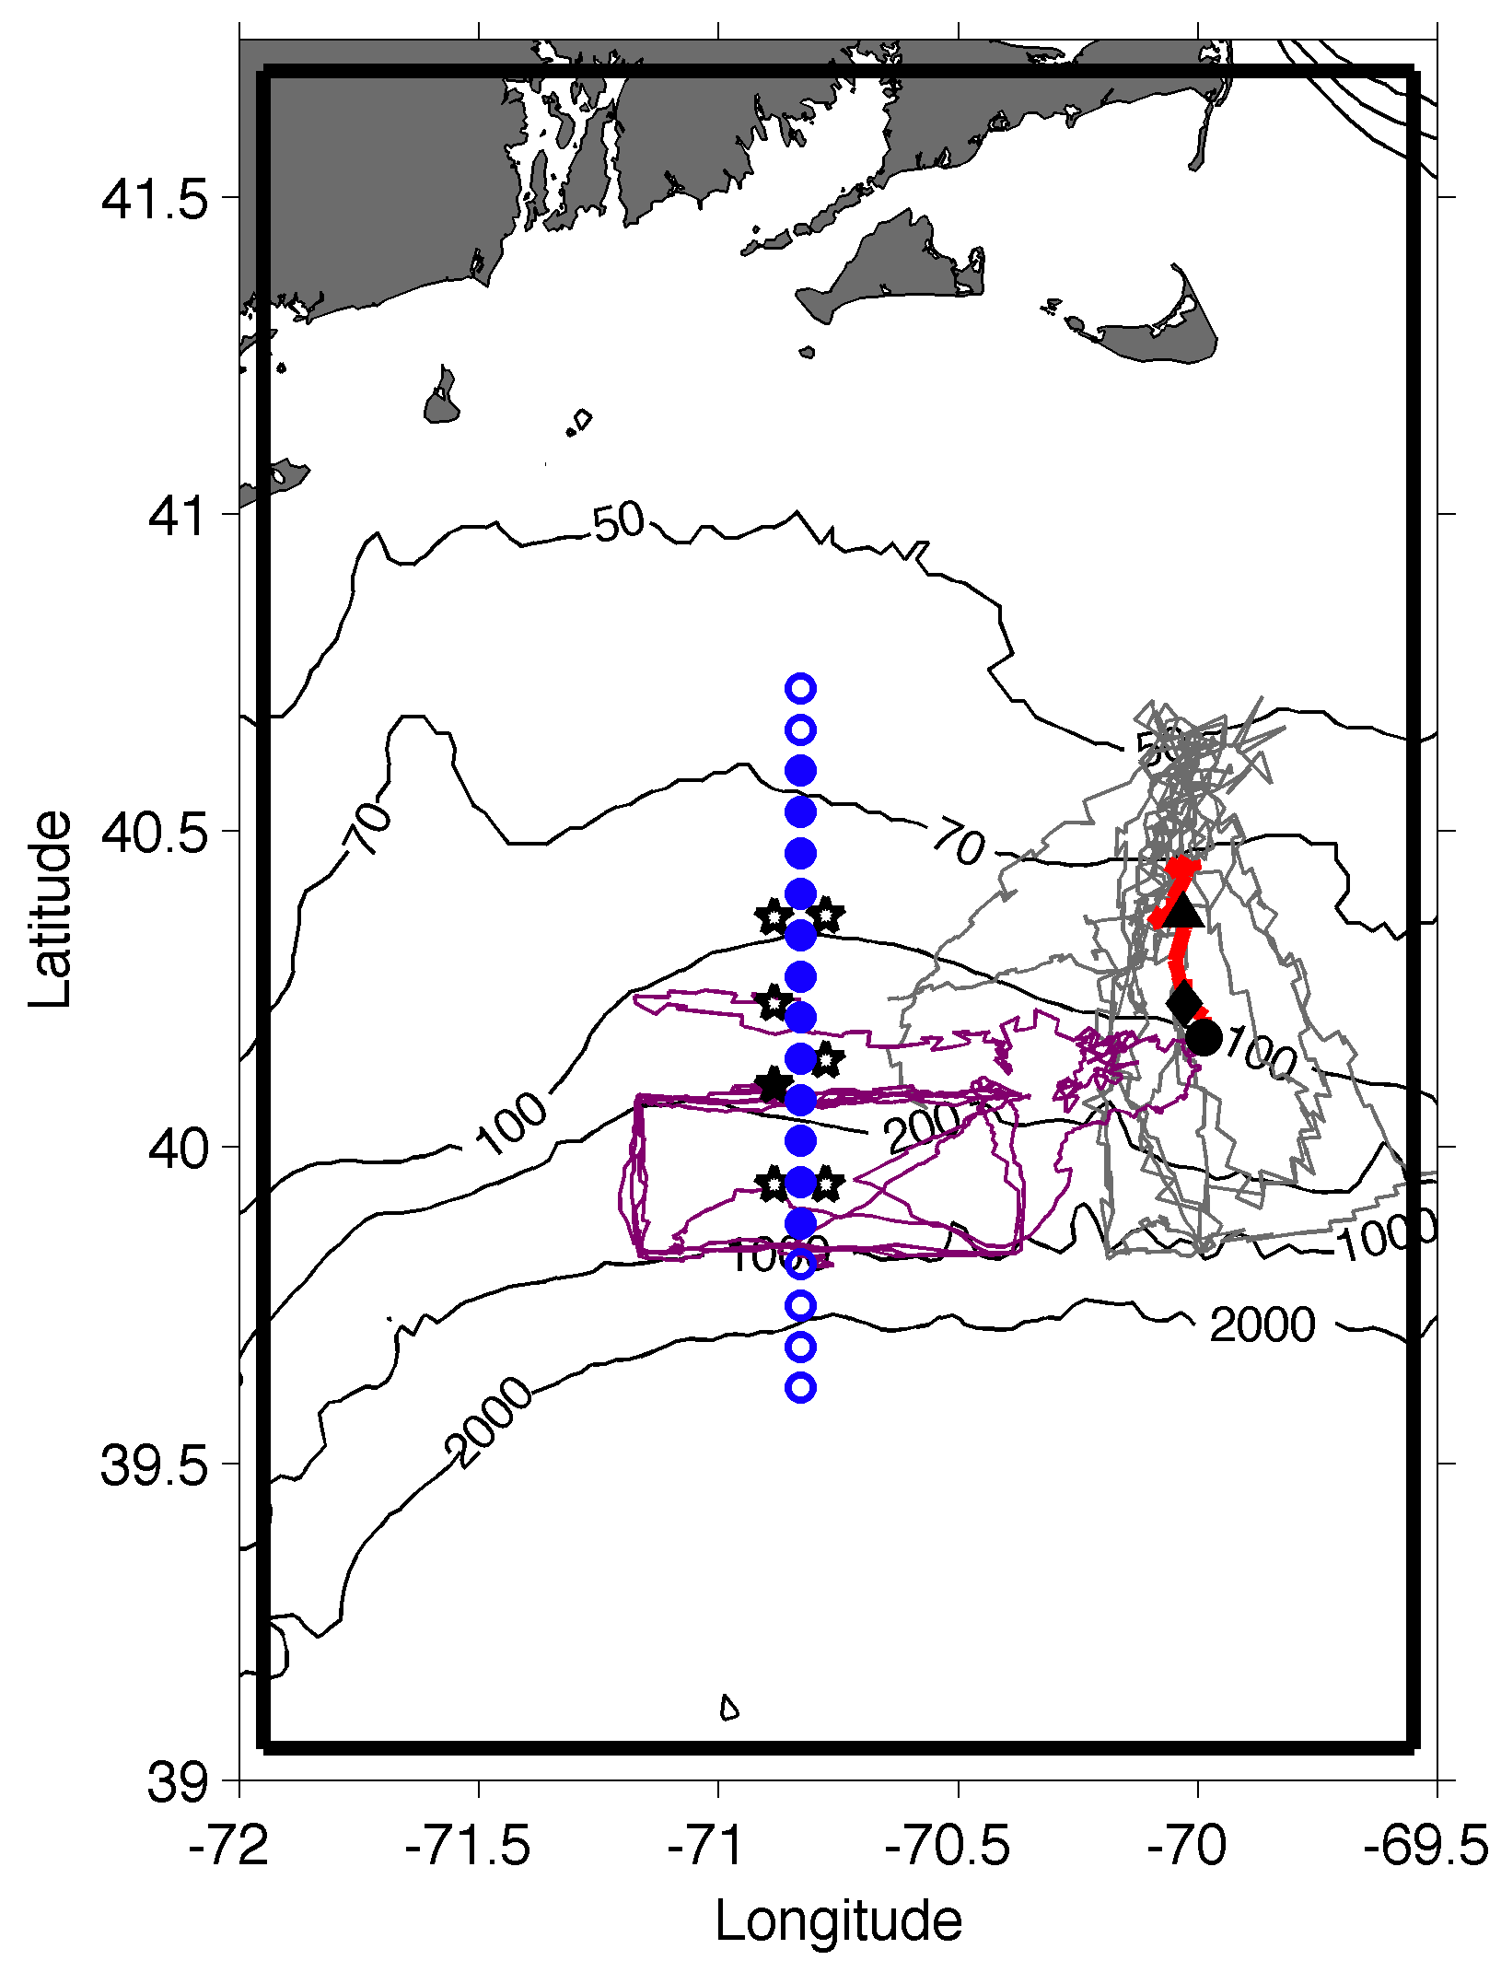
Shelfbreak frontal dynamics:
mechanisms of upwelling, net community production, and ecological implications

Slide 2
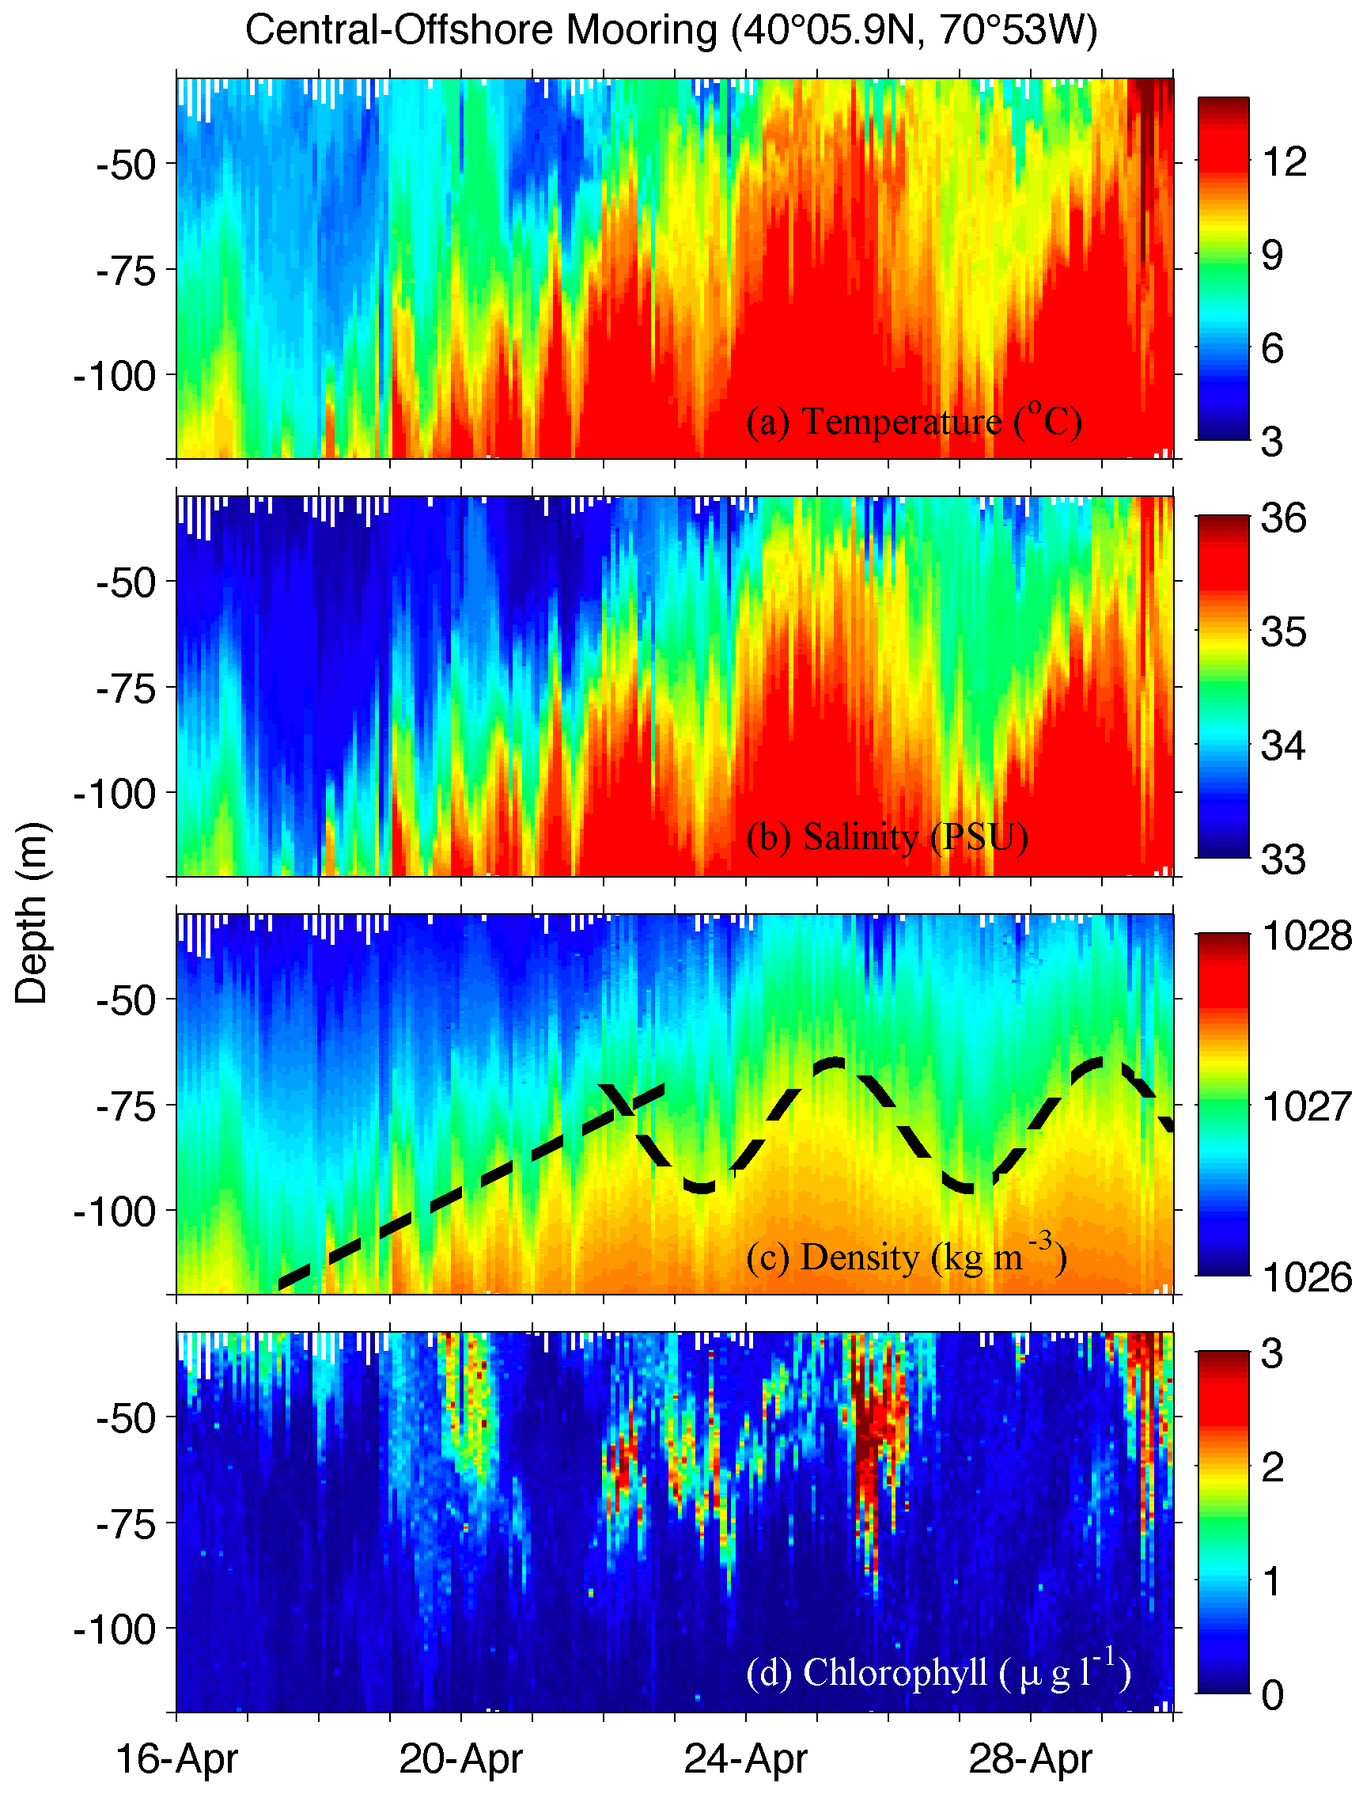

Slide 3
Sunrise 4/15/18: 0523
Sunset 4/15/18: 1840
Sunrise 4/30/18: 0502
Sunset 4/30/18: 1855
All times local

Slide 4
Plexiglas tubes (7) placed inside a box within a box, plumbed with hoses for flowing seawater; entire box to be placed on a metal frame 3’ off deck; double “box” (not shown) intended to reduce deck spillage of seawater
Brass eyebolts for tie downs (or could be holes drilled in side that rope can pass through); need ~1/2” diameter
Tubes (only 4 pictured; need 7)

Slide 5
Measurements to be completed
¹⁴C-uptake measurements (simulated in situ)
Particulate organic carbon filtrations
Irradiance near incubator (continuous)
Biogenic silica filtrations (not in proposal; if desired by group)
DIC and alkalinity measurements on discrete samples (not in proposal ; if desired by group)
Underway pCO₂measurements (not in proposal ; if desired by group)
Rationale: BSi provides a measure of diatom biomass and is of value when compared to POC & PON (along with visual diatom estimates); CO₂ system parameters will allow an independent measure of NCP

Slide 6
Questions to be addressed
¹⁴C-uptake measurements: 3 stations per day; Locations? Timing? Suggest 0700, 1200, & 1700 at shelf, break and slope locations
Particulate organic carbon filtrations; 12 stations with 12 depths is a LOT of samples; link with HPLC sampling frequency?
Biogenic silica filtrations: same as POC (?)
DIC and alkalinity measurements on discrete samples: numbers?
Underway pCO₂measurements
Rationale: BSi provides a measure of diatom biomass and is of value when compared to POC & PON (along with visual diatom estimates); CO₂ system parameters will allow an independent measure of NCP

