Slide 1
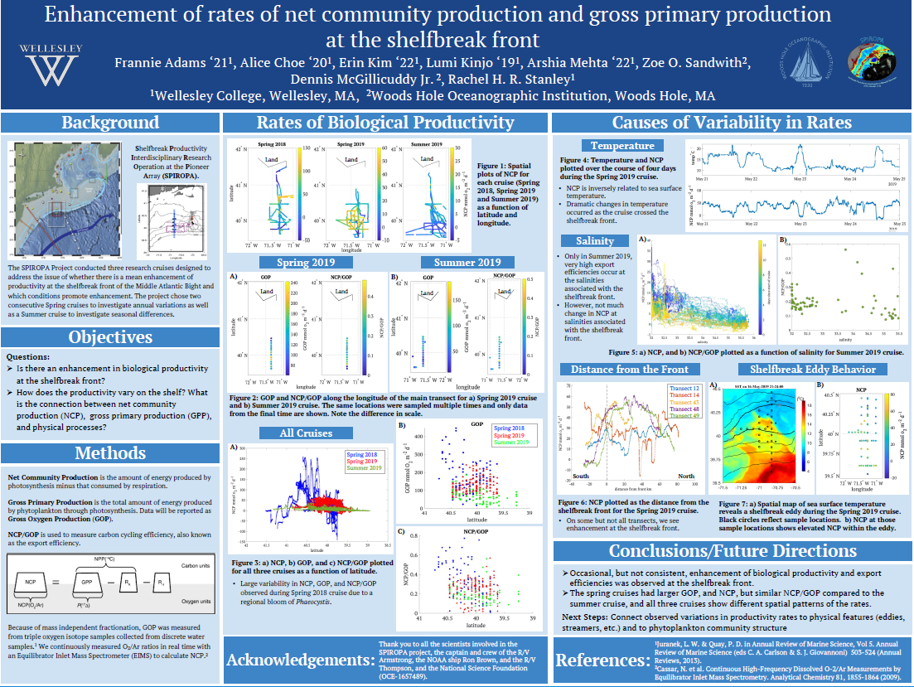

Slide 2
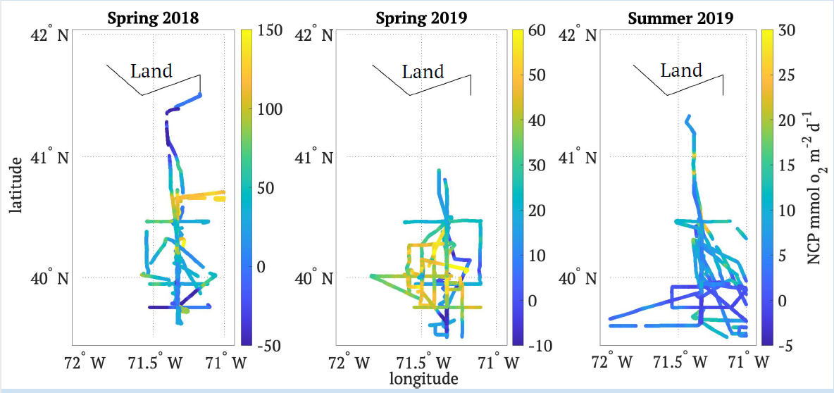
NCP on the 3 cruises

Slide 3
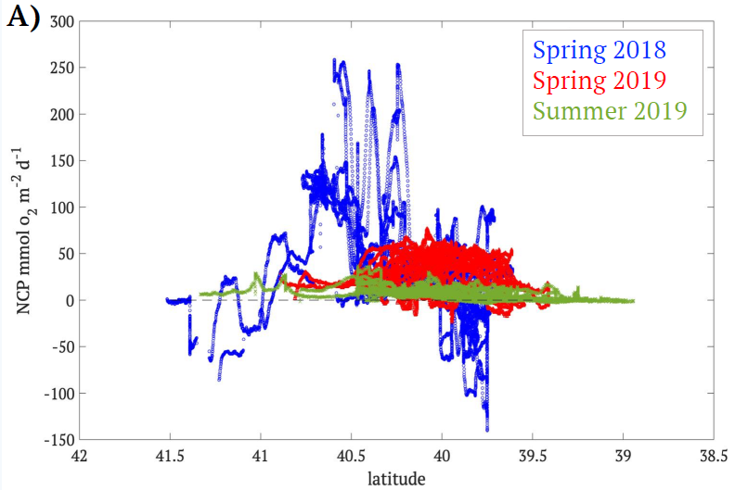
Comparing NCP as function of latitude

Slide 4
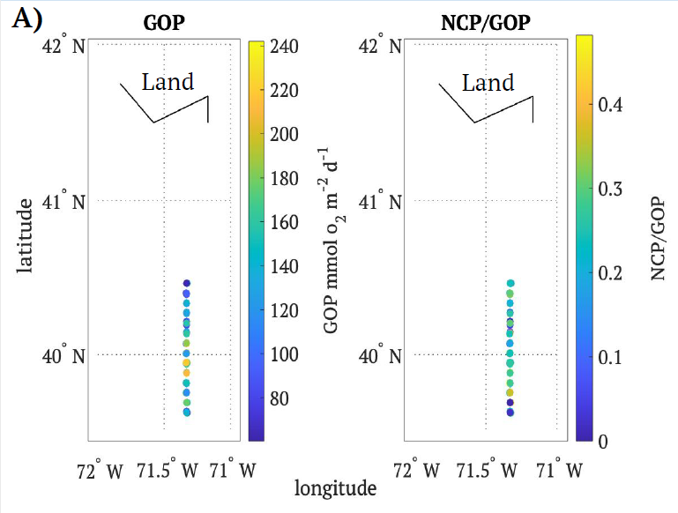
RB1904: Spring 2019

Slide 5
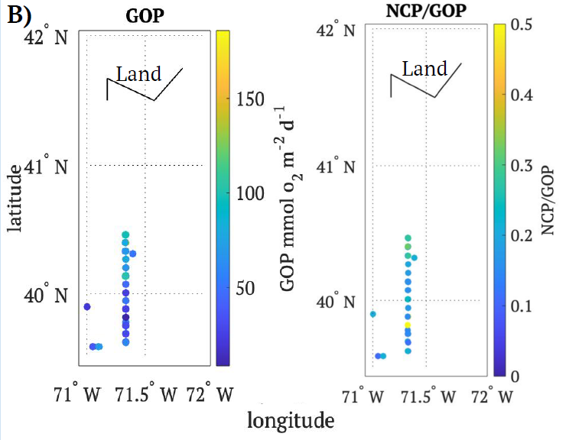
TN368 Summer 2019

Slide 6
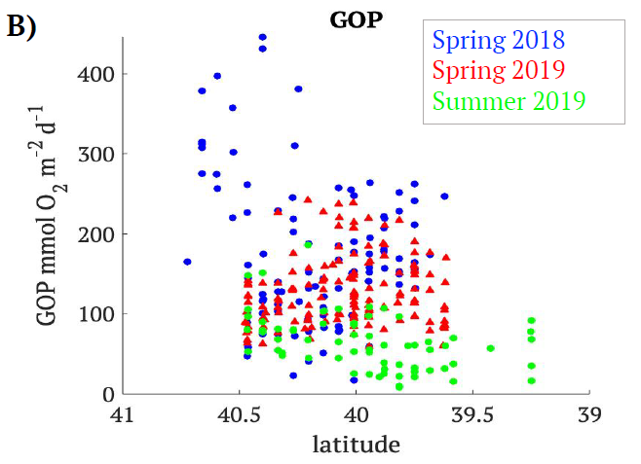
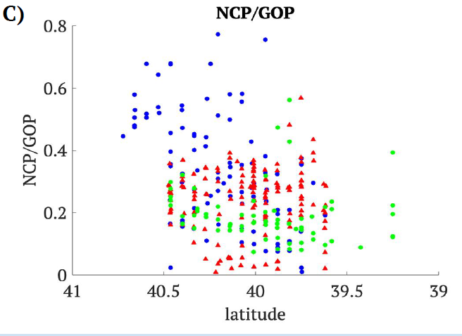
Comparing all 3 cruises

Slide 7
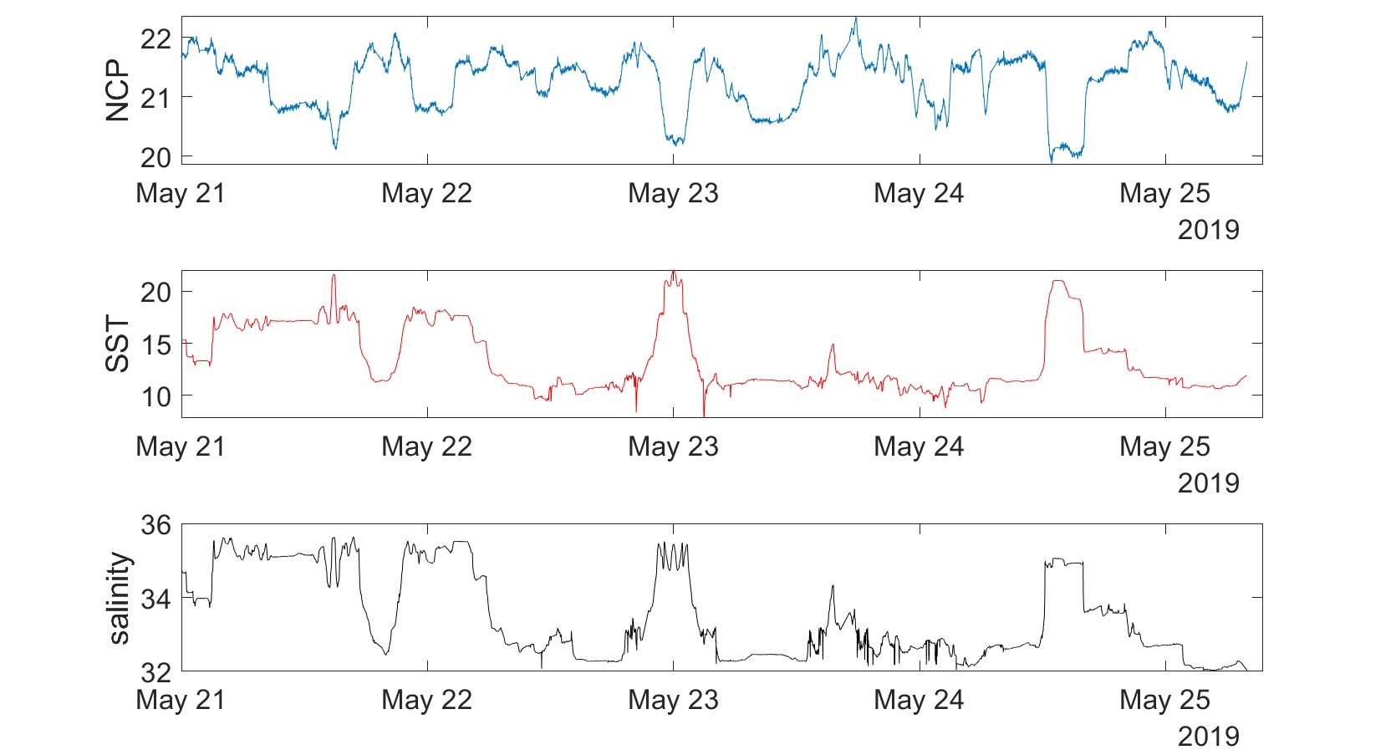
Coherence between NCP, temperature and salinity
RB1904
O2/Ar

Slide 8
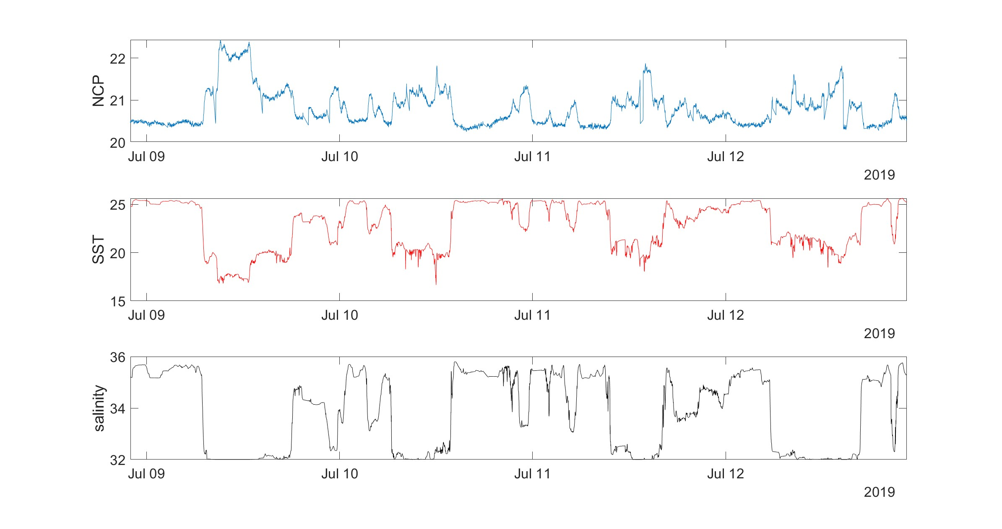
We see same coherence in TN368
Tn368
O2/Ar

Slide 9
NCP vs distance from the front RB1904

Slide 10
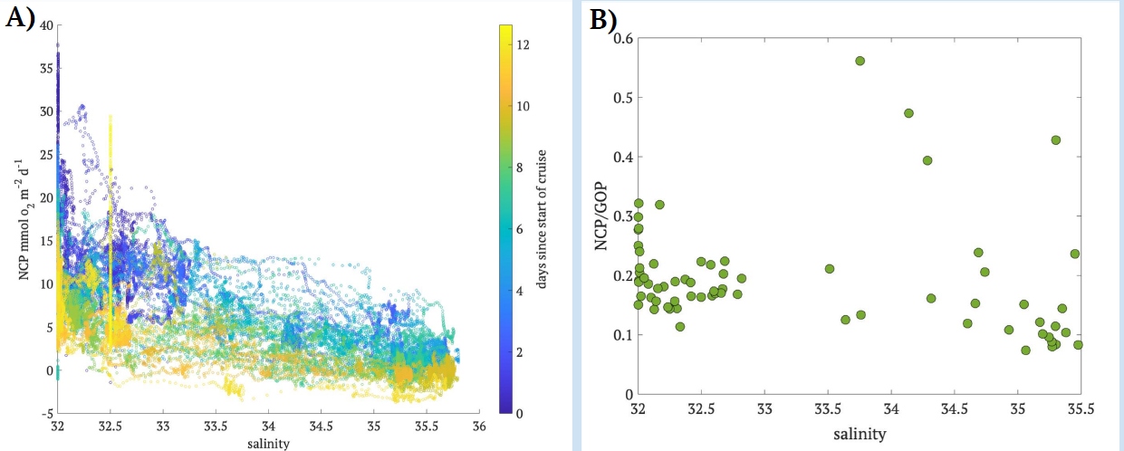
Connection to Salinity on TN368

Slide 11
Shelfbreak eddy had elevated NCP
RB1904

