Slide 1
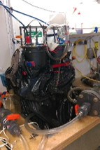
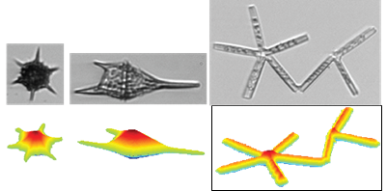
https://ifcb-data.whoi.edu/SPIROPA/
Biovolume precisely estimated for each image (automated edge detection and computations of geometric measures)
Convolutional Neural Network (CNN) to classify each image into one of 145 classes (taxonomic and other)
⇒ Sum up contributions by class or group (or size), absolute concentration

Slide 2
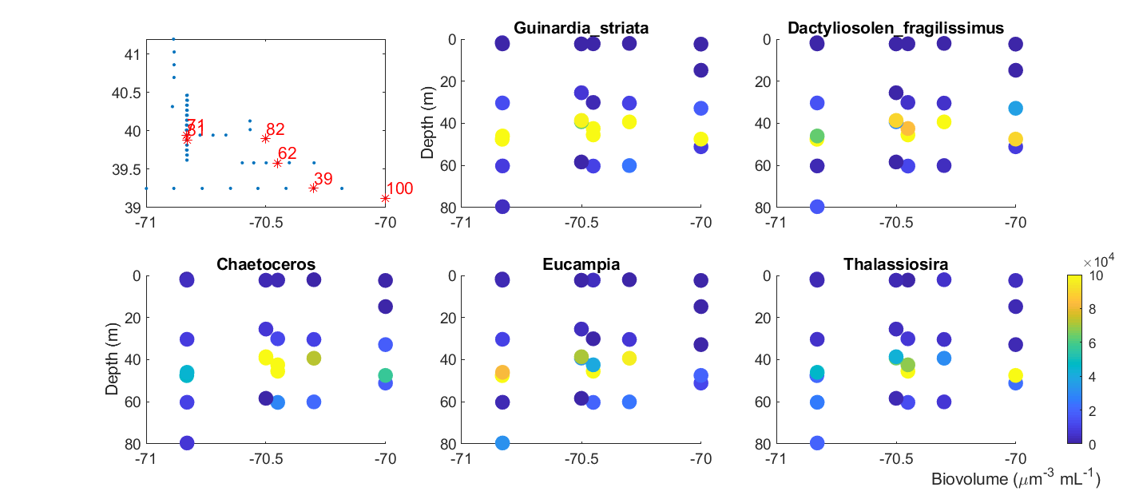

Slide 3
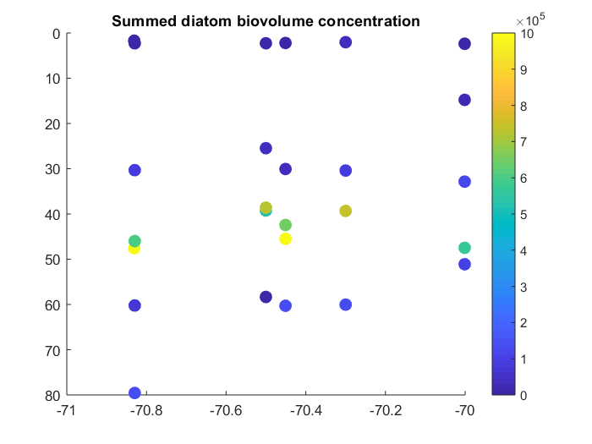
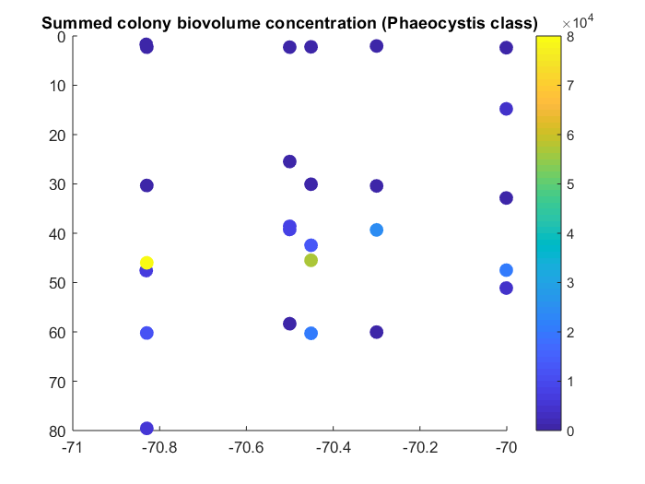

Slide 4
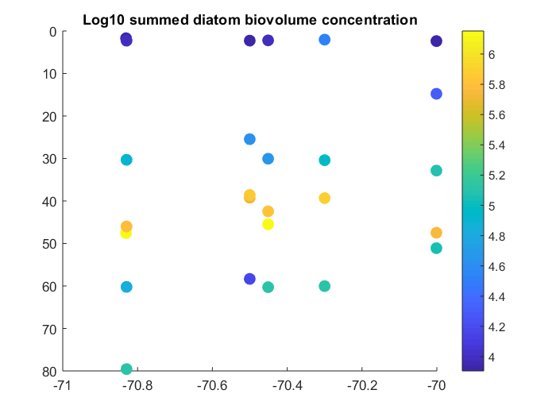
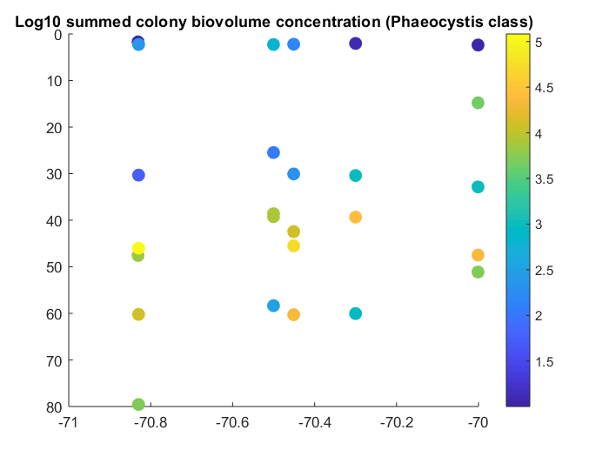

Slide 5
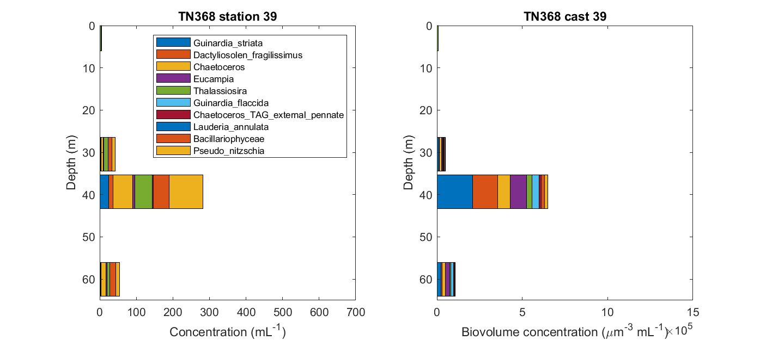

Slide 6
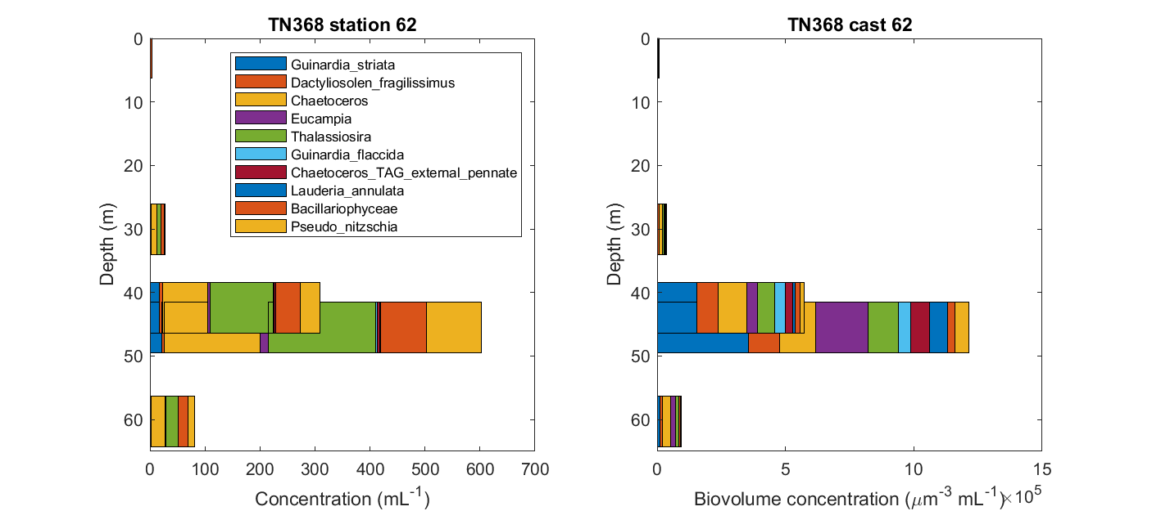

Slide 7
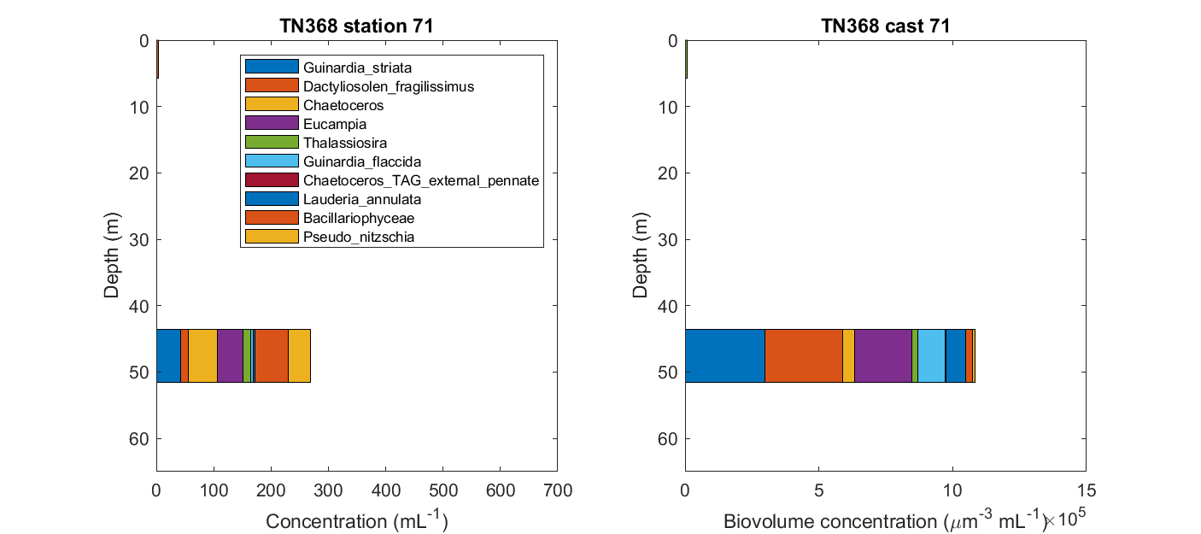

Slide 8
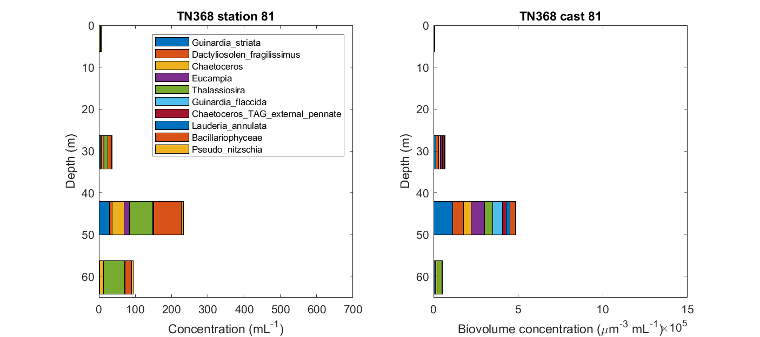

Slide 9
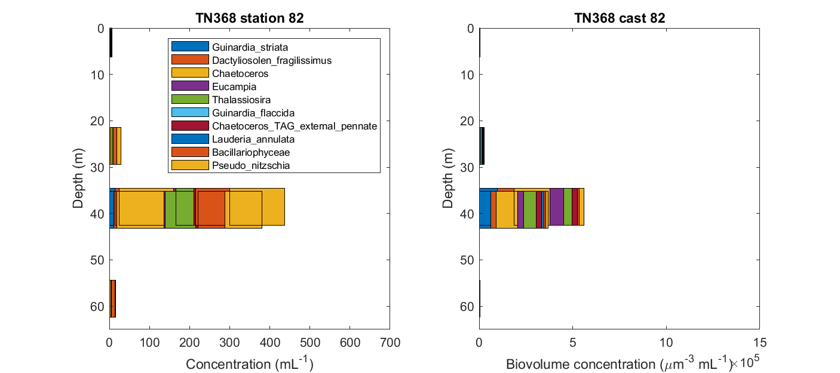

Slide 10
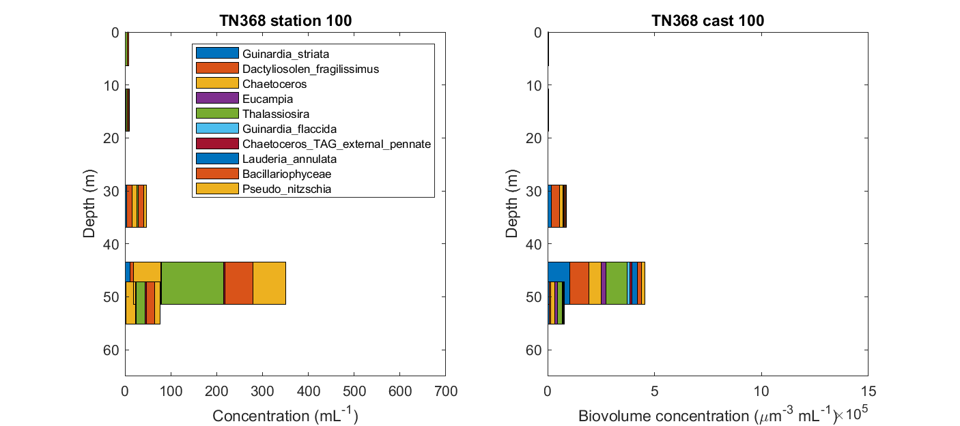

Slide 11
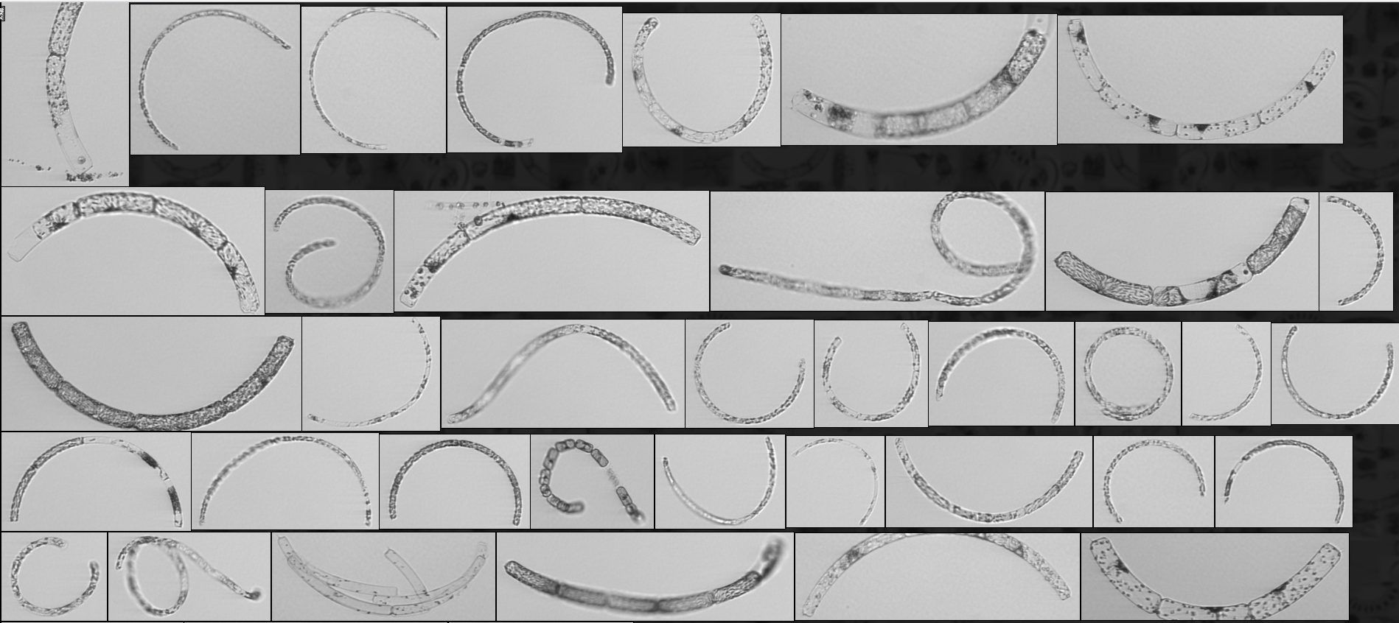
Example predicted by class for deep max samples: Guinardia striata
Notes:
33% zoom in chrome

Slide 12
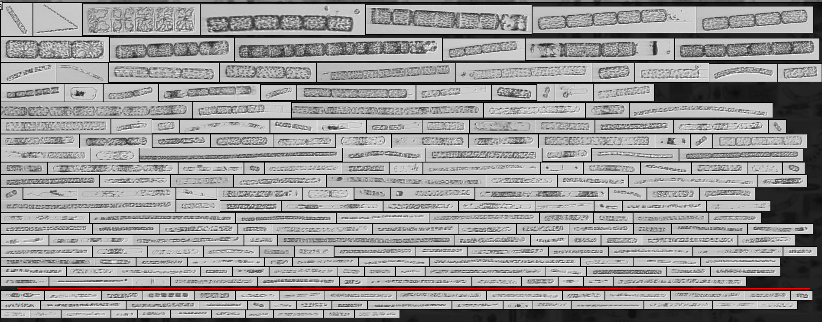
Example predicted by class for deep max samples: Dactyliosolen fragilissimus

Slide 13
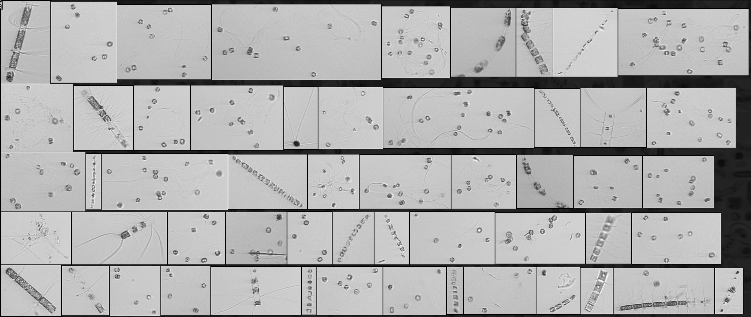
Example predicted by class for deep max samples: Chaetoceros
[heavily false positive with mystery colonies (??Thalasiosira)]

Slide 14
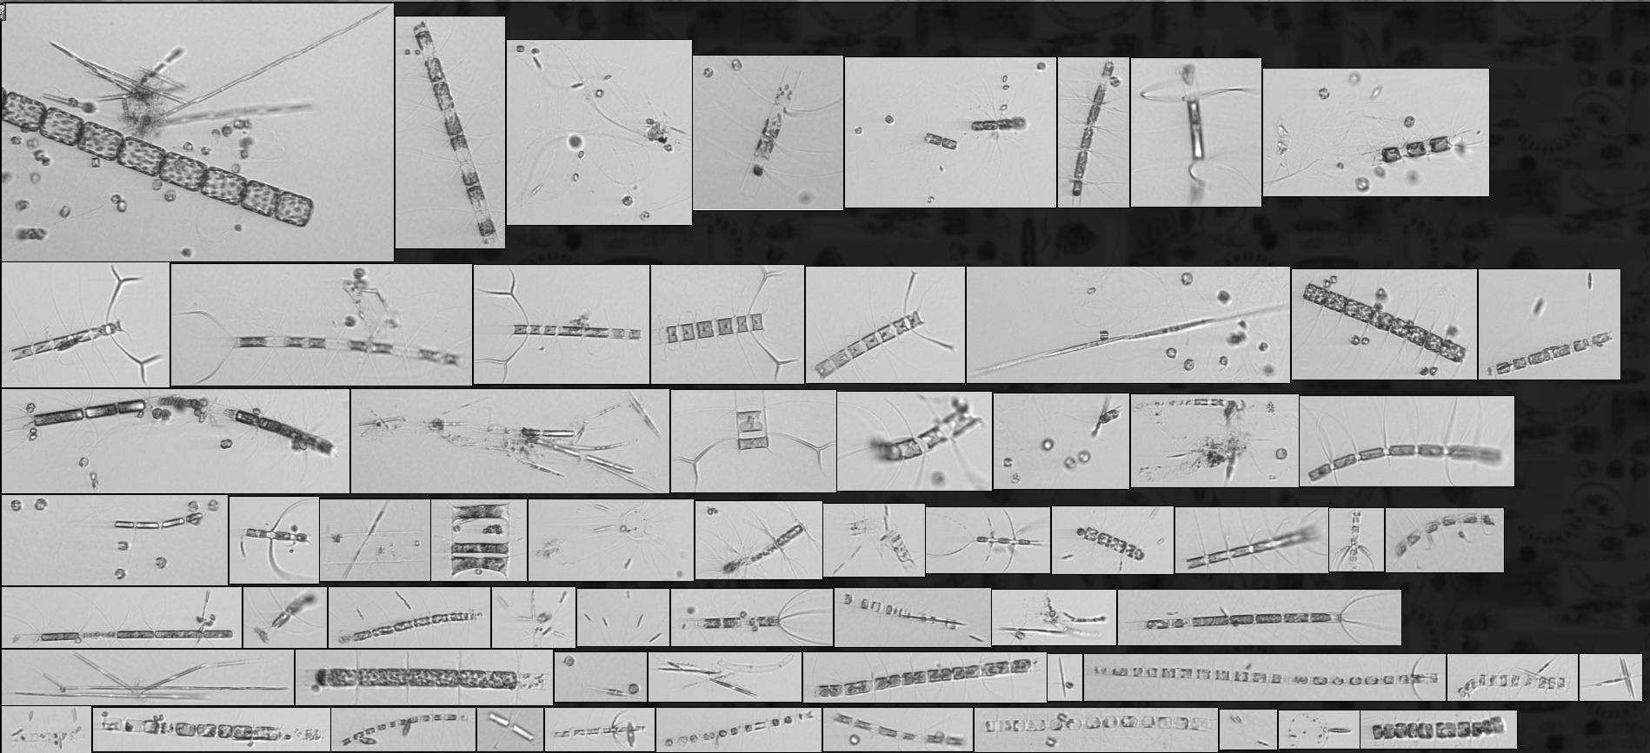
Example predicted by class for deep max samples: Chaetoceros_TAG_external_pennate

Slide 15
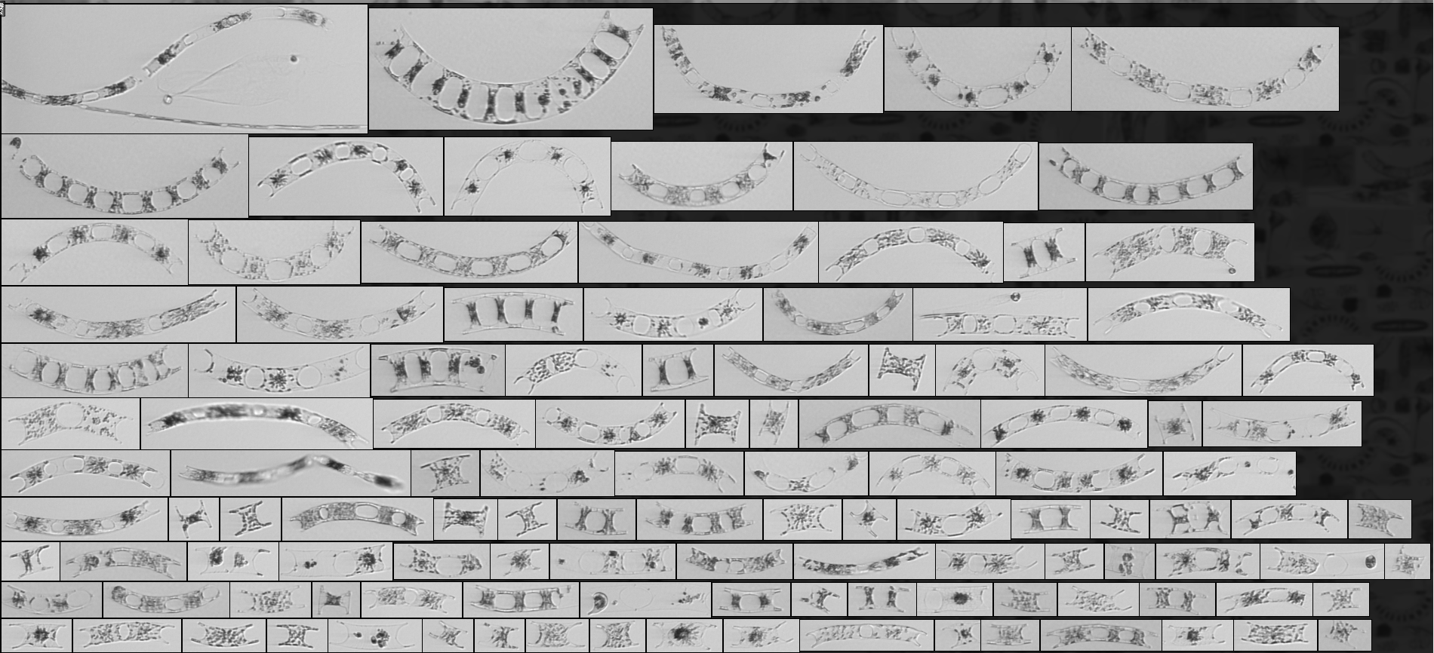
Example predicted by class for deep max samples: Eucampia

Slide 16
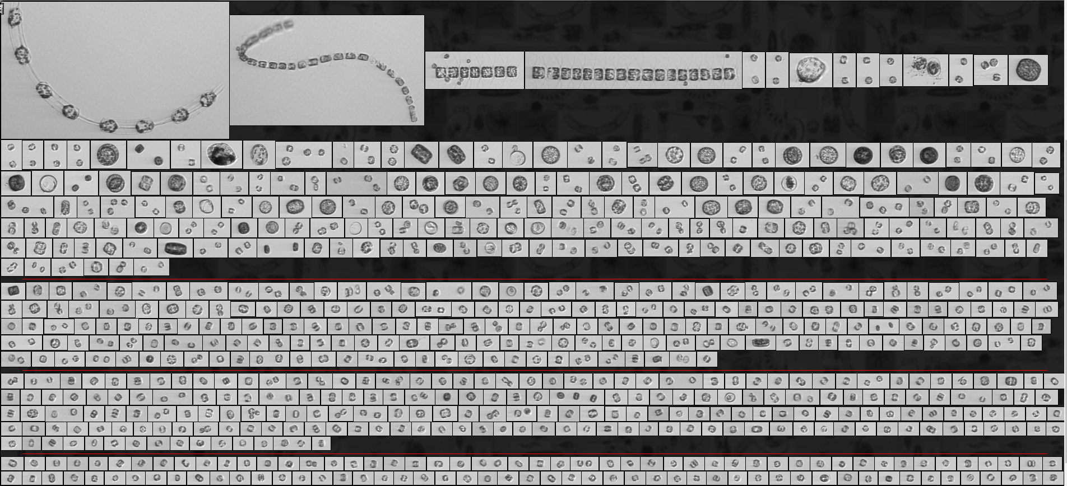
Example predicted by class for deep max samples: Thalassiosira

Slide 17
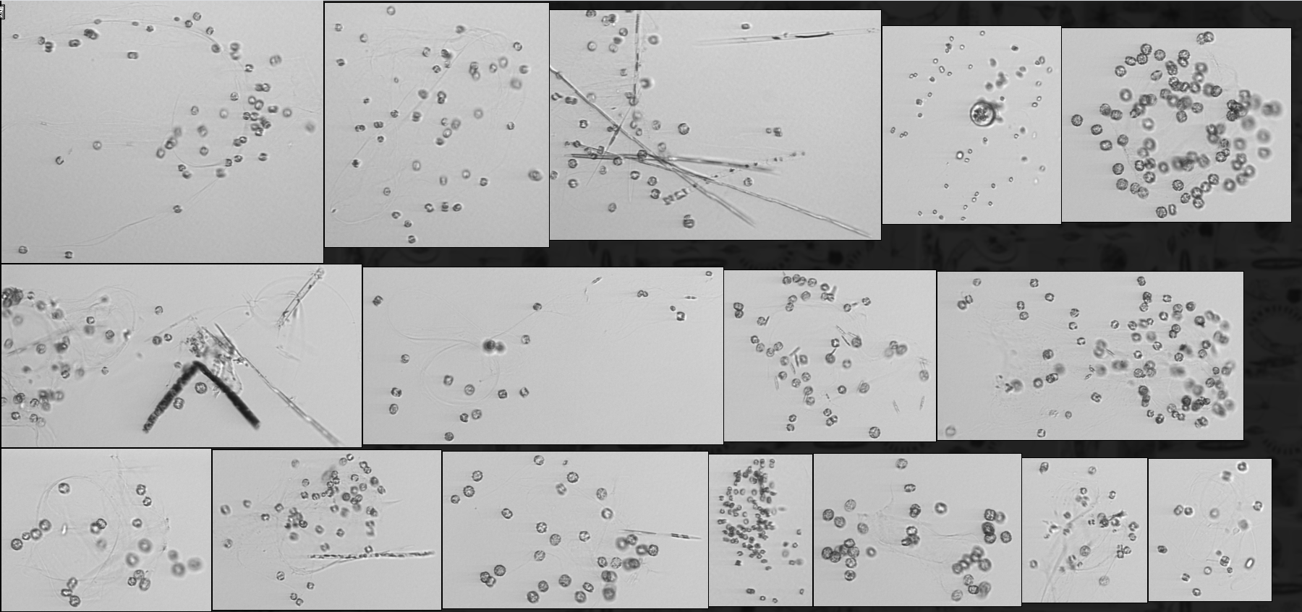
Example predicted by class for deep max samples: Phaeocystis
Tentatively: Thalassiosira subtilis or Thalassiosira mala?

Slide 18
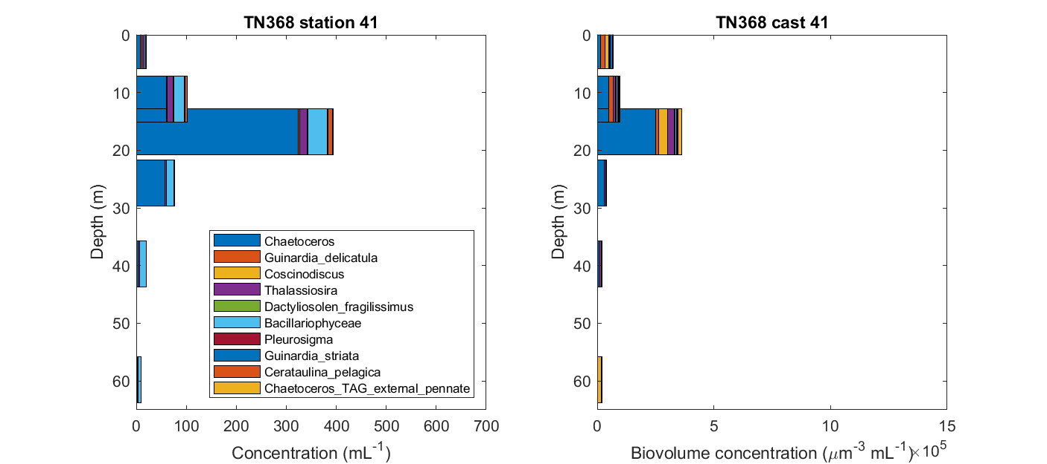
Notes:
https://ifcb-data.whoi.edu/bin?bin=D20190709T102616_IFCB109
https://ifcb-data.whoi.edu/timeline?dataset=SPIROPA&bin=D20190709T114409_IFCB109

Slide 19
