Slide 1
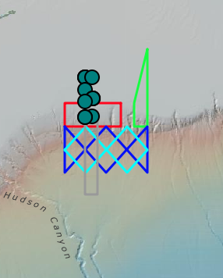
TN368 diatom bloom paper action items list
Smith bio-optical model
Sosik taxa analysis + synthesis
New casts to look at under expanded hotspot definition (in addition to 39, 62, 71, 82 and 100): 56, 70, 81, 84, 86, 89, 118
Stanley continued conversations re gases in and around hotspots, gas tracers in PWP model?
ODU sequencing
Oliver thresholds for “extraordinary” – OOI mobile assets

