Slide 1
TN368 hotspot paper possible discussion topics
IDs
Triple oxygen isotope D17
NCP:GOP
Productivity
Z_{euph} calculation

Slide 2
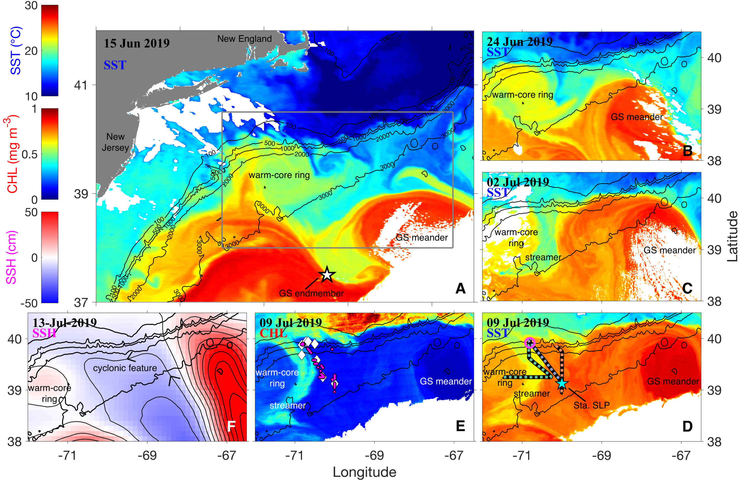

Slide 3
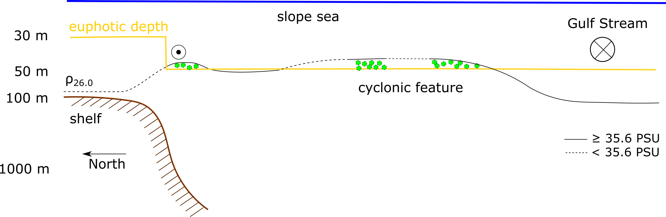

Slide 5
in-situ productivity

Slide 6
triple oxygen isotope D17

Slide 7
Z_{euph} calculation

