Slide 1
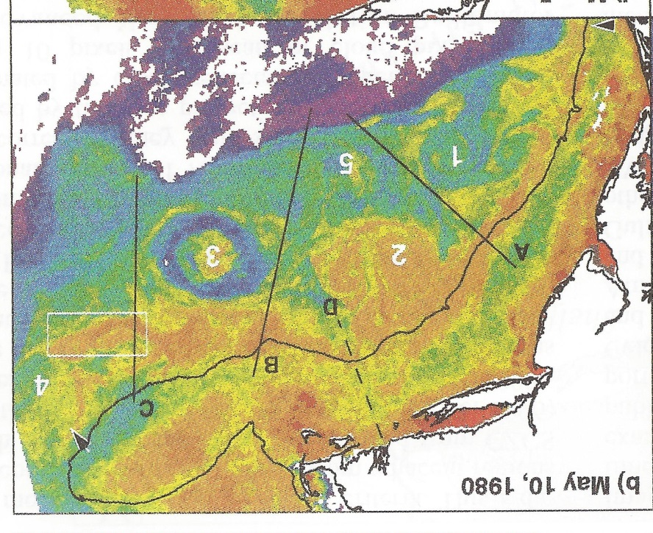
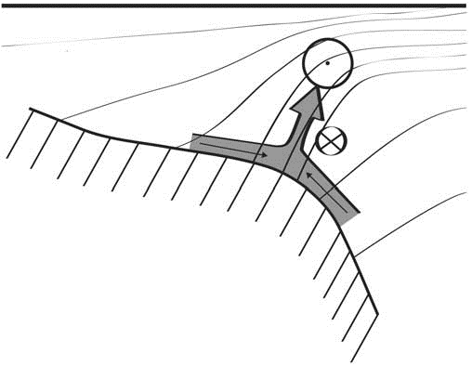
Shelfbreak frontal dynamics: mechanisms of upwelling, net community production, and ecological implications
Ryan et al. 1999
Linder et al. 2004
Gawarkiewicz and Chapman 1992
Chapman and Lentz 1994
Marra et al. 1990
Science Meeting #1 5/12/19

Slide 2


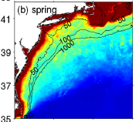

2013, JGR
Satellite CHL climatology
Why is there no mean enhancement of chlorophyll at the shelf break front?
H₁: Top-down control by zooplankton grazing
H₂: Spatial and temporal intermittency of the upwelling events causes their net impact to be smoothed out in long-term means.

Slide 3

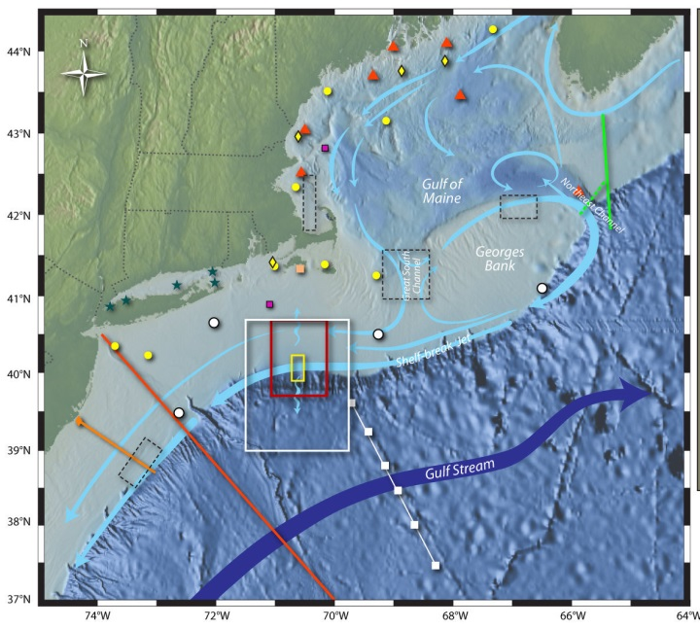
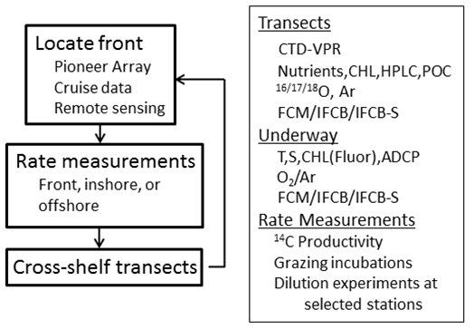
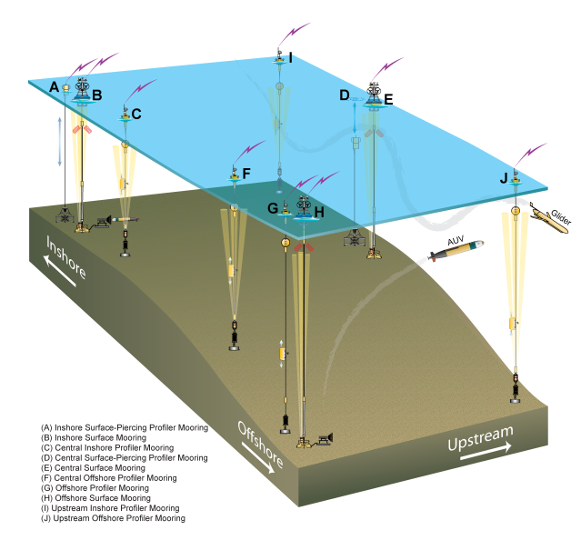
Shelfbreak frontal dynamics: mechanisms of upwelling, net community production, and ecological implications
Dennis McGillicuddy, Heidi Sosik, Gordon Zhang (WHOI)
Walker Smith (VIMS) Rachel Stanley (Wellesley College)
Jefferson Turner, Christian Petitpas (UMass Dartmouth)
3 Cruises R/V Neil Armstrong
NSF Ocean Observatory Initiative Pioneer Array

Slide 4
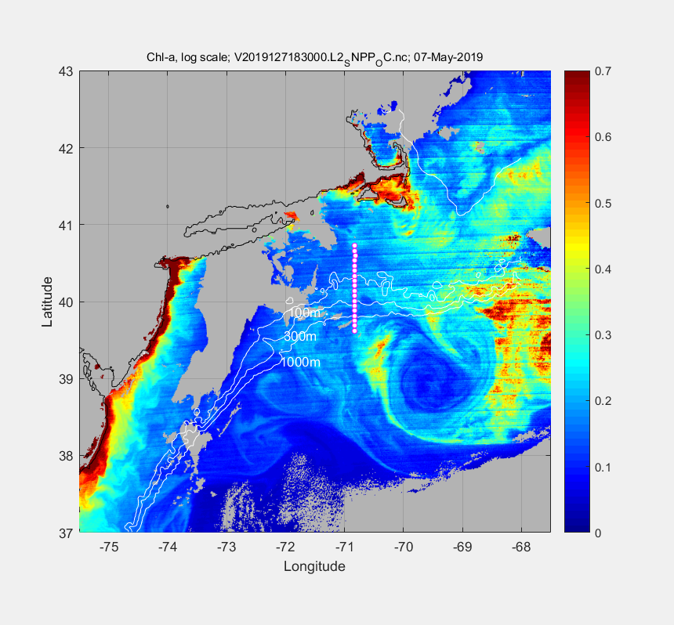
May 7 2019

Slide 5
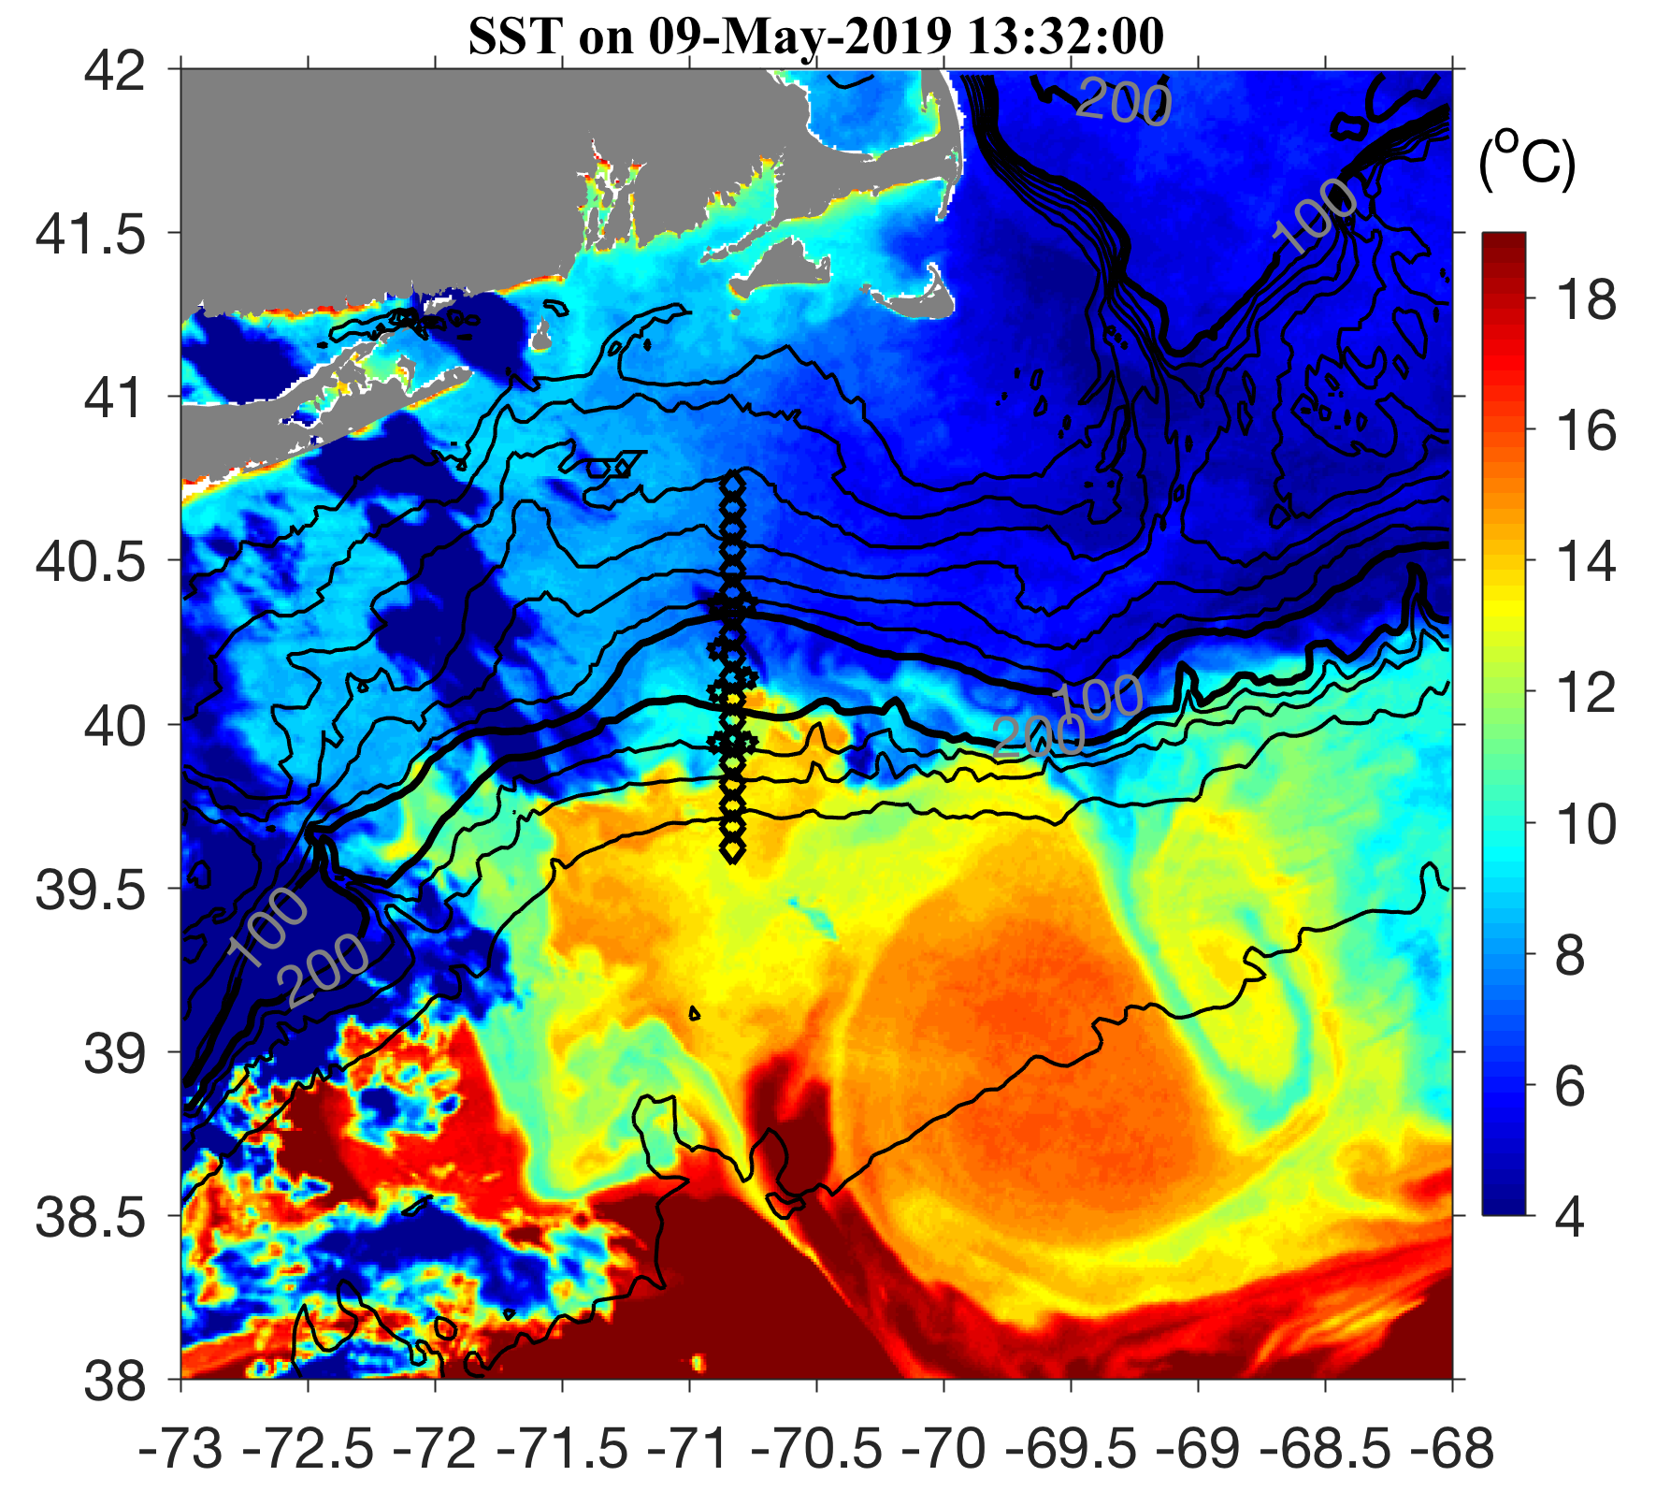
May 9 2019

Slide 6
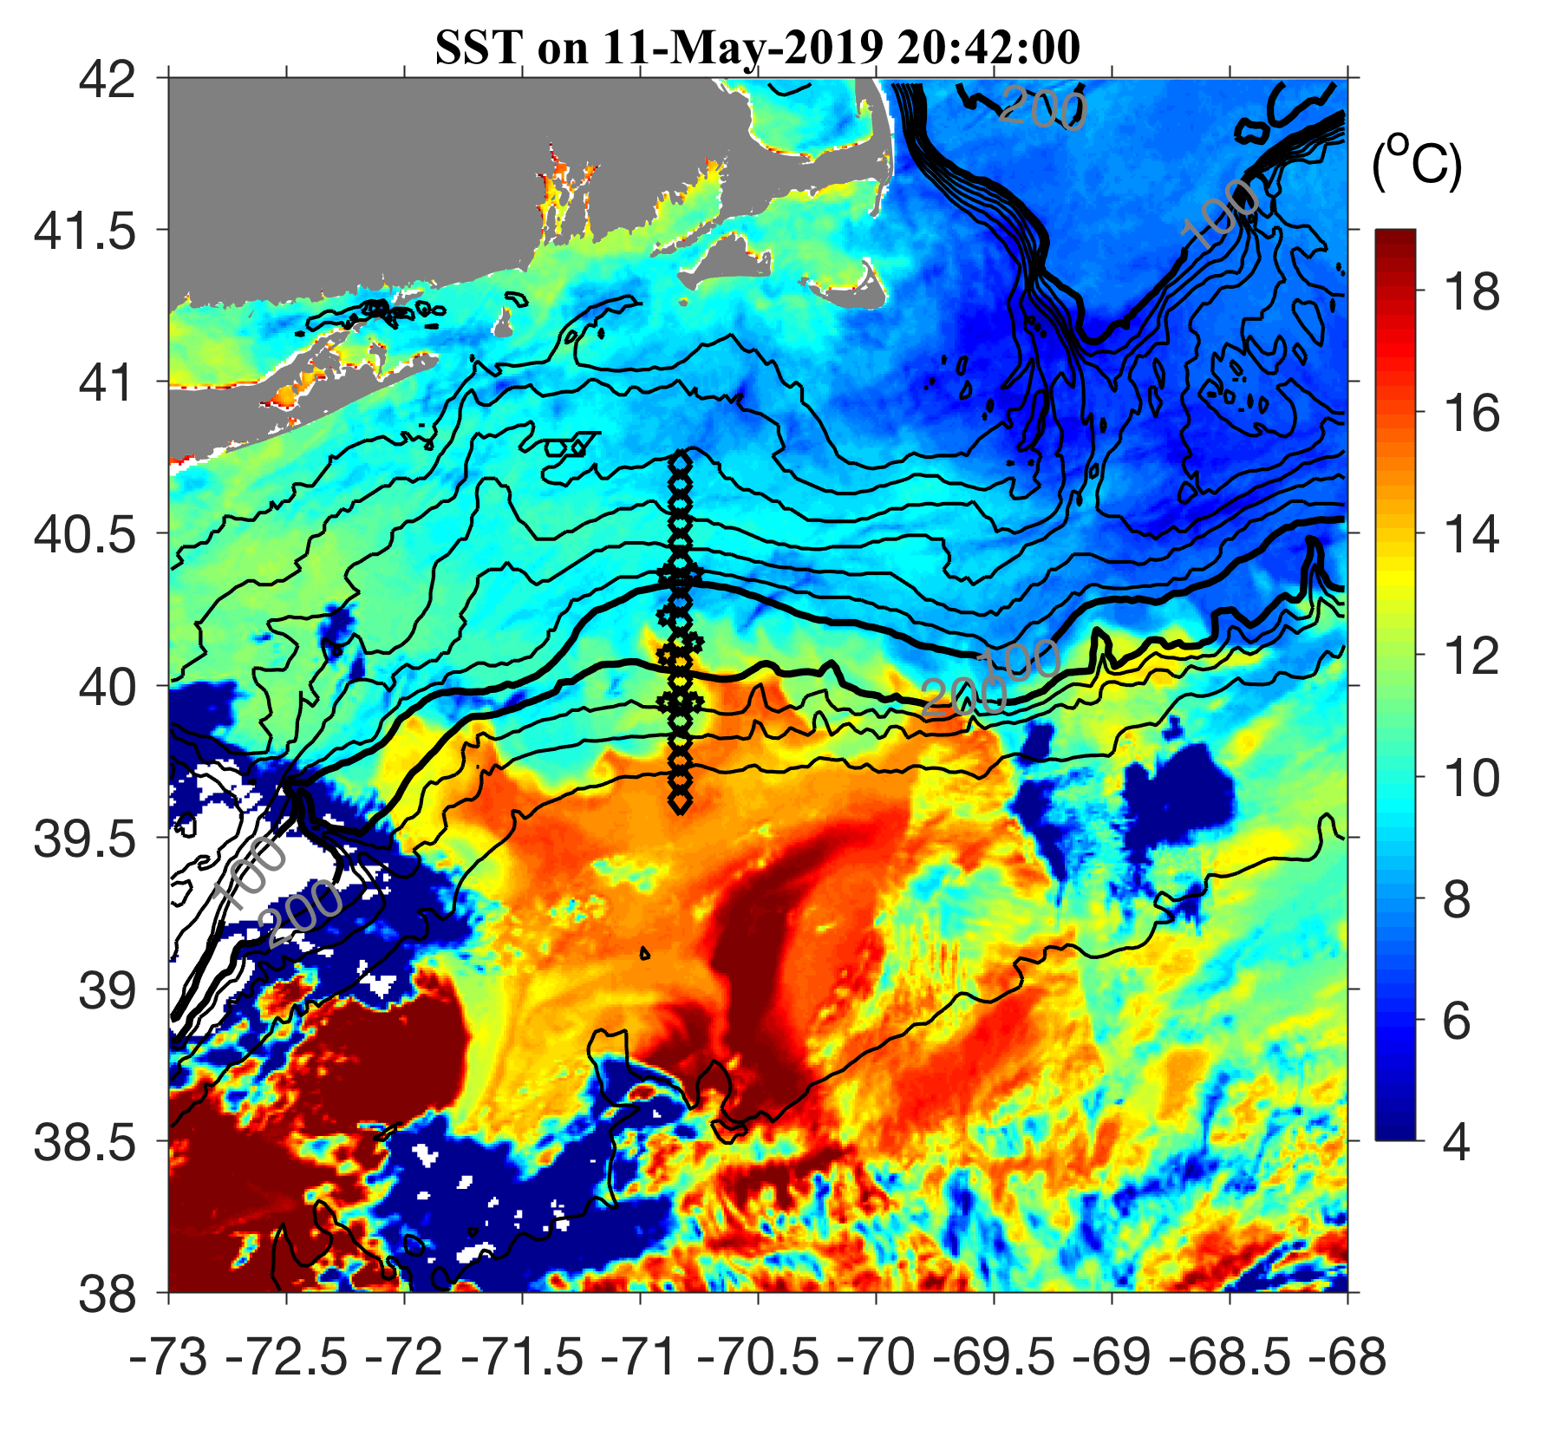
May 11 2019

Slide 7
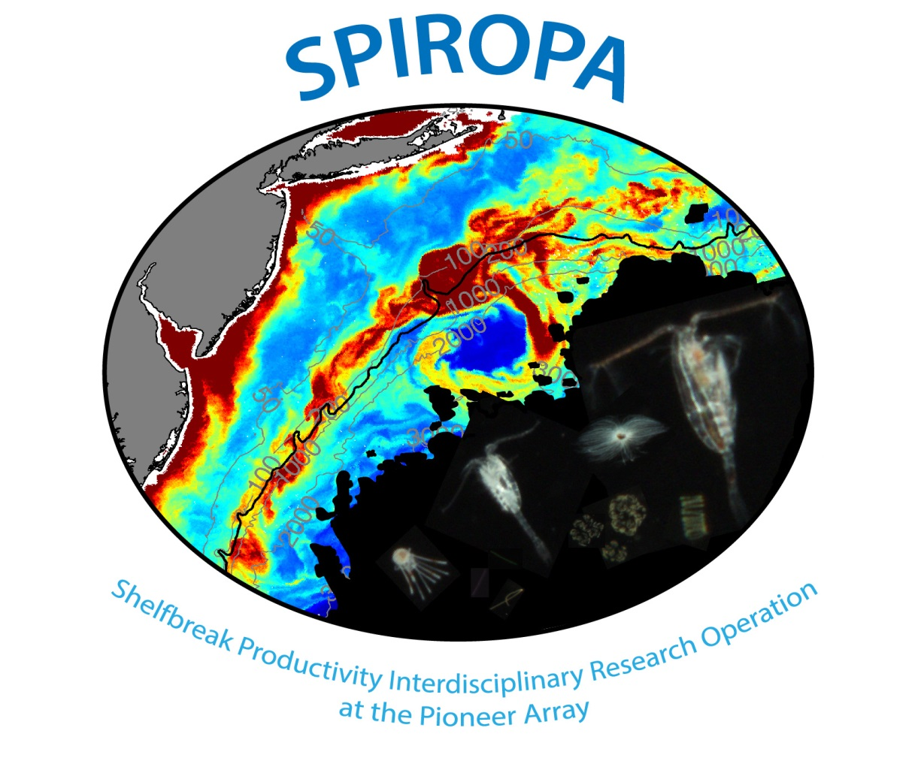
Science Meeting #2

Slide 8
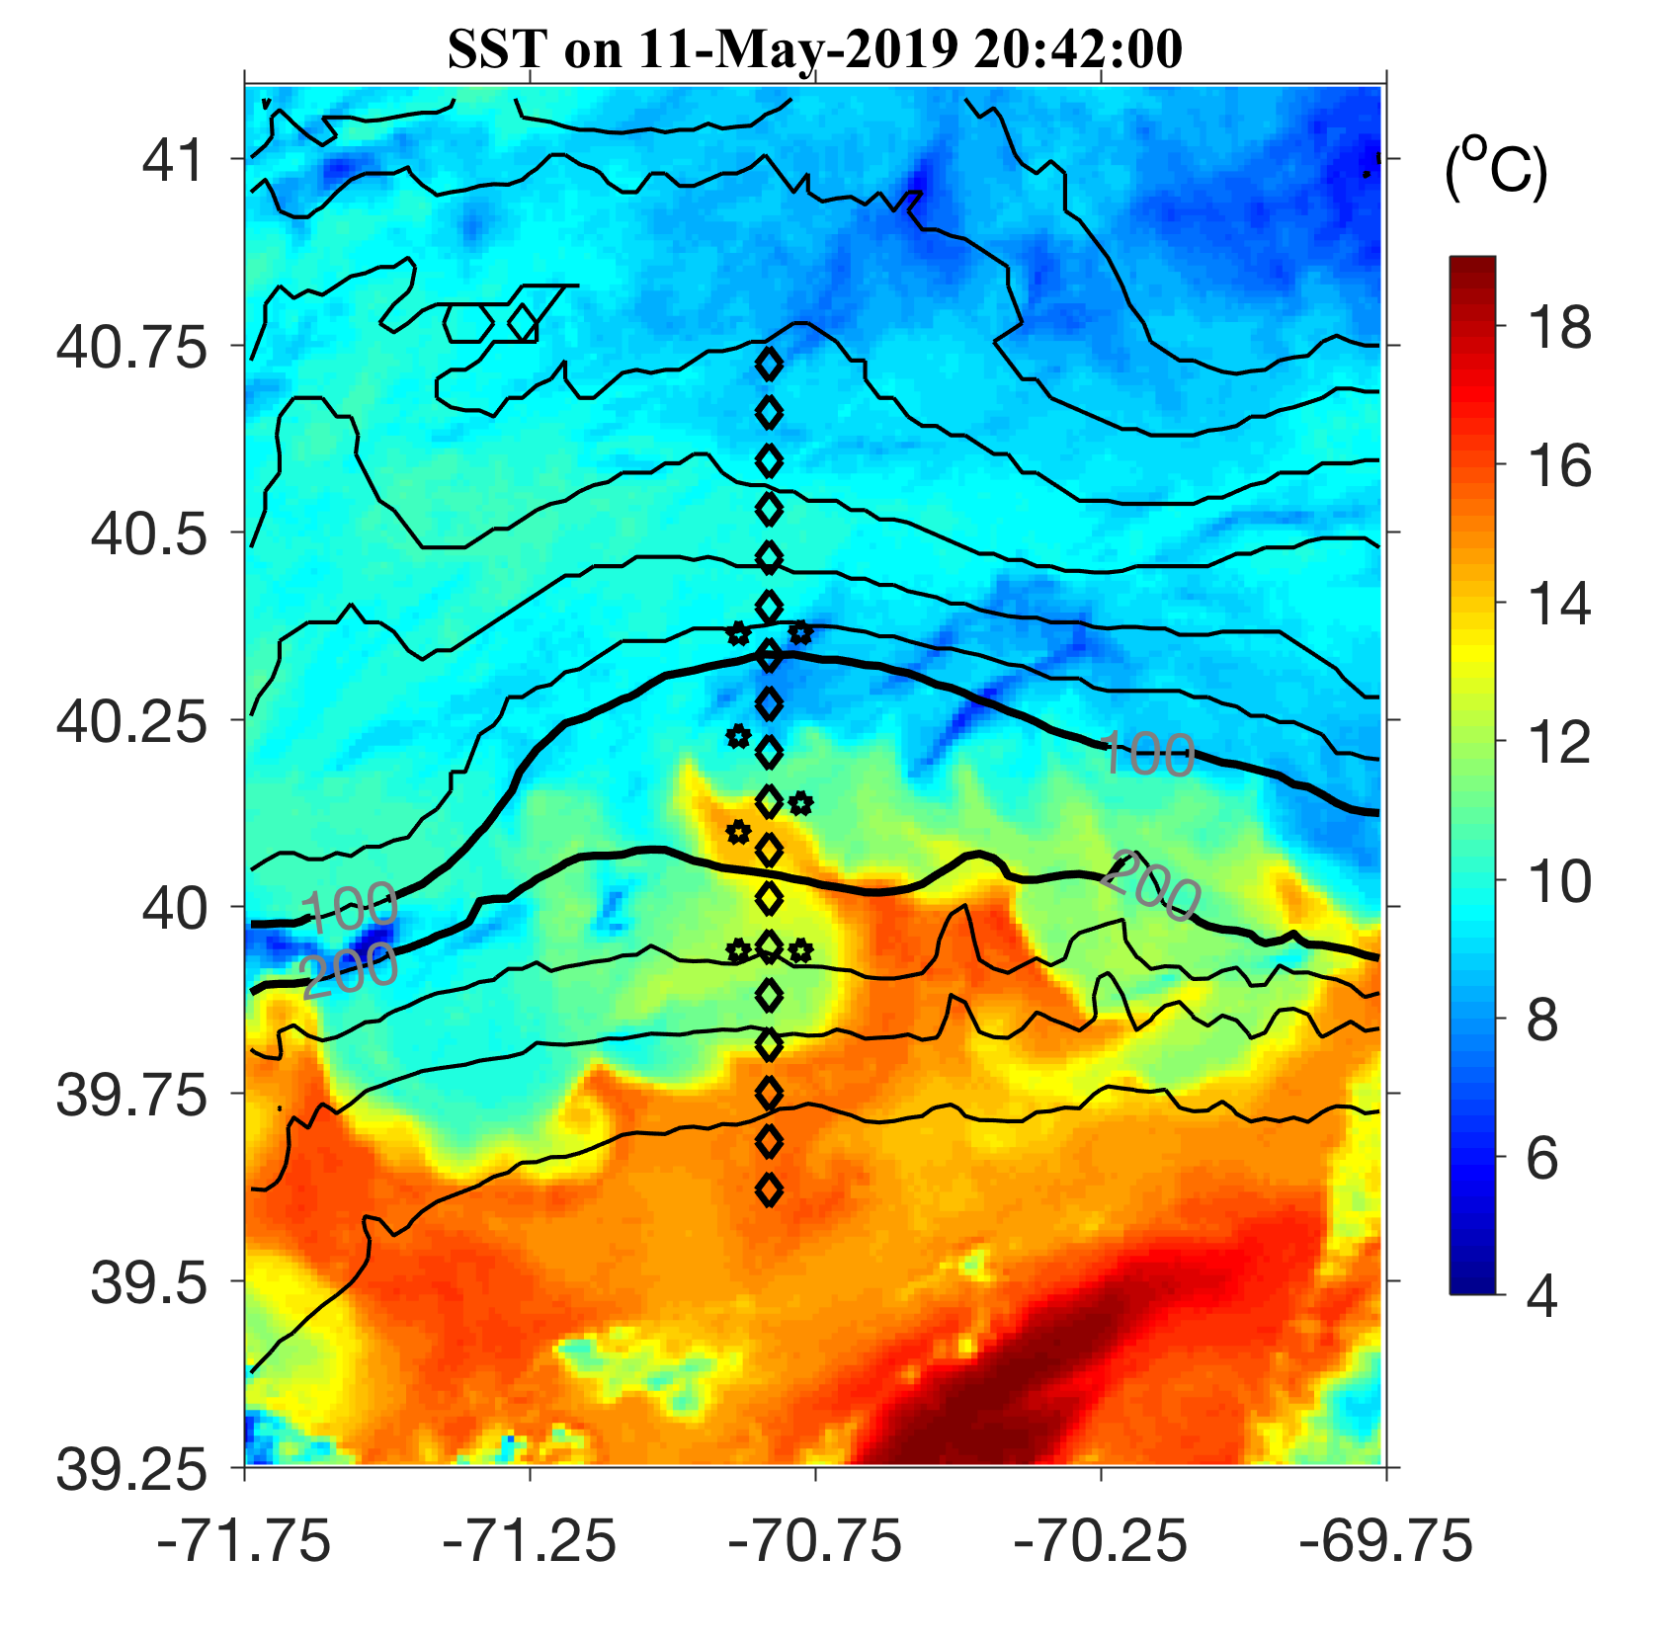
May 11 2019

Slide 9
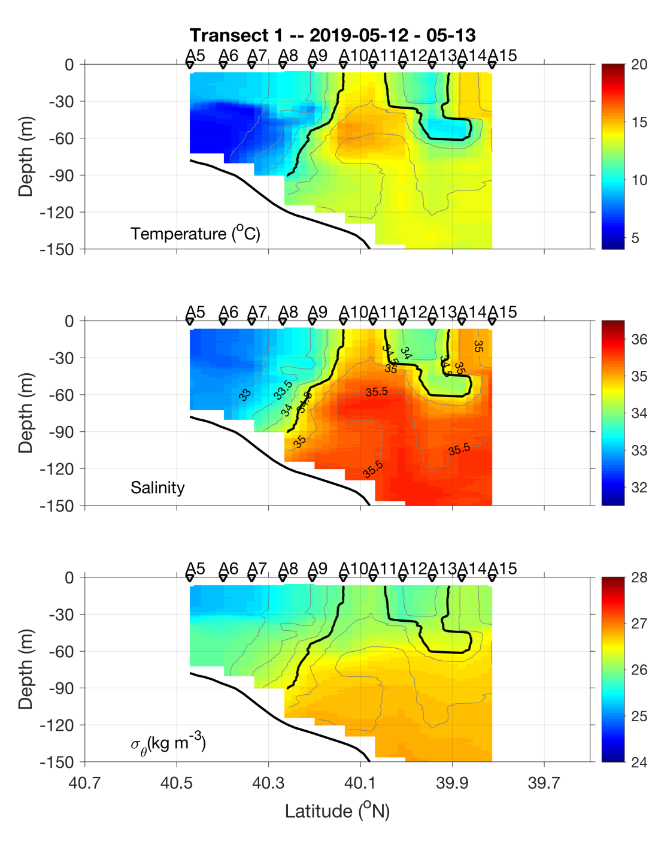
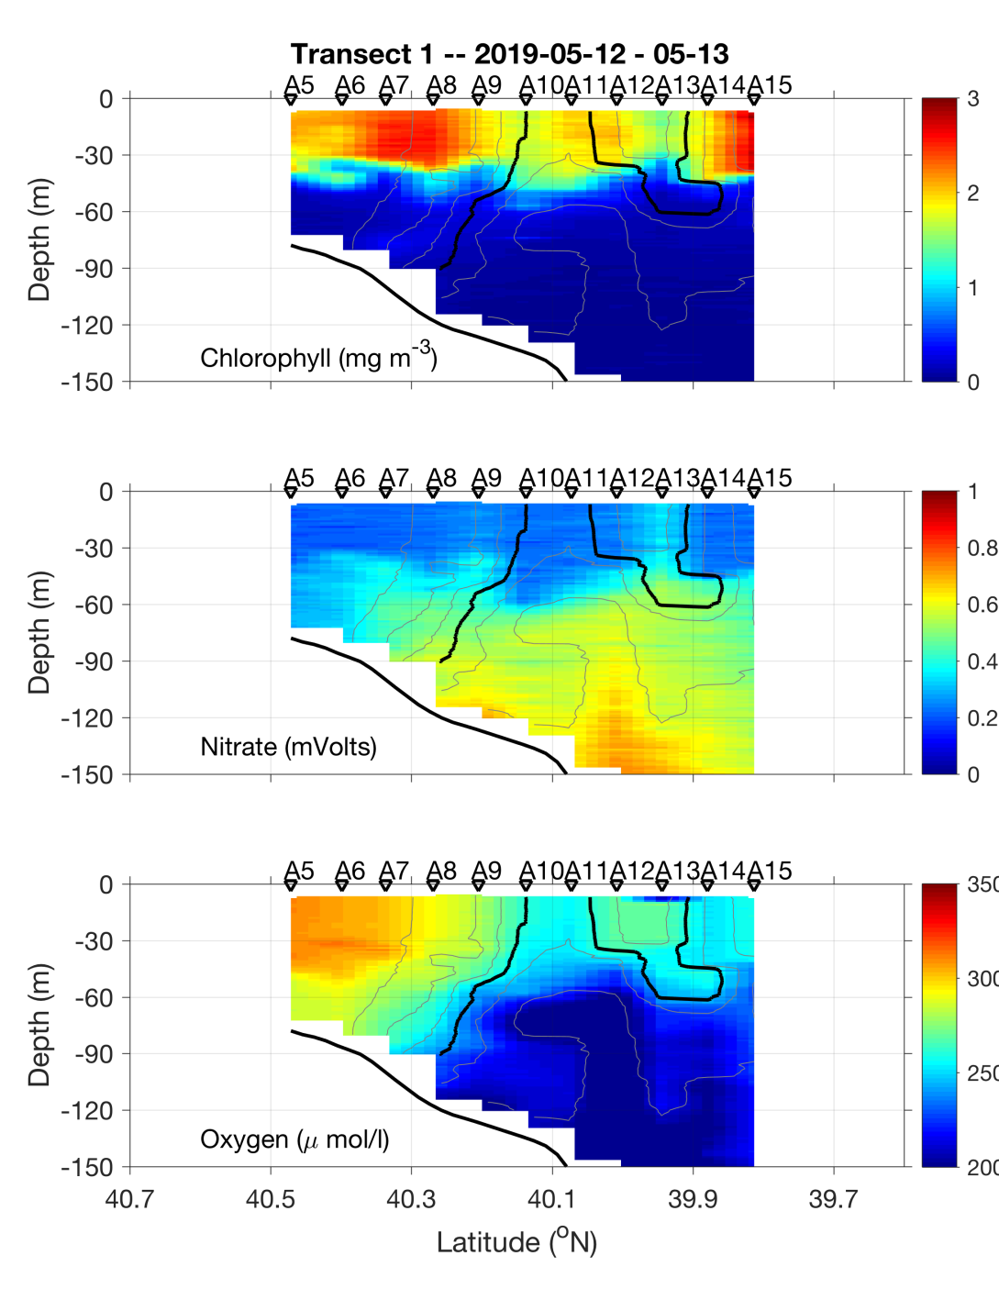
Transect 1 – May 12-13

Slide 10
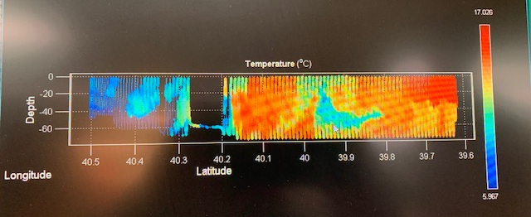
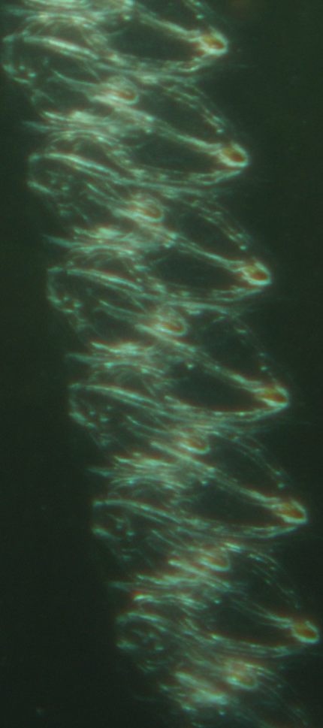
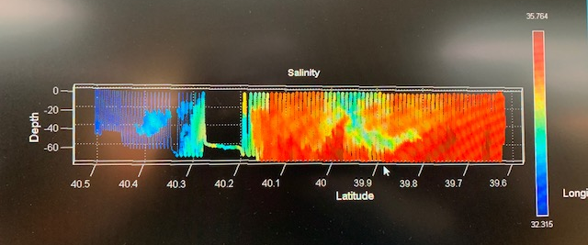
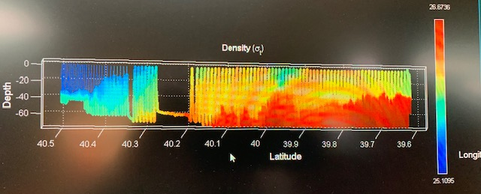
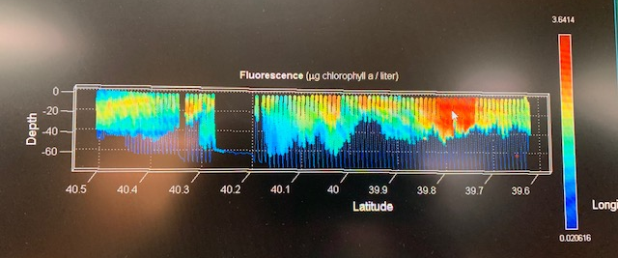
VPR Survey
May 14

Slide 11
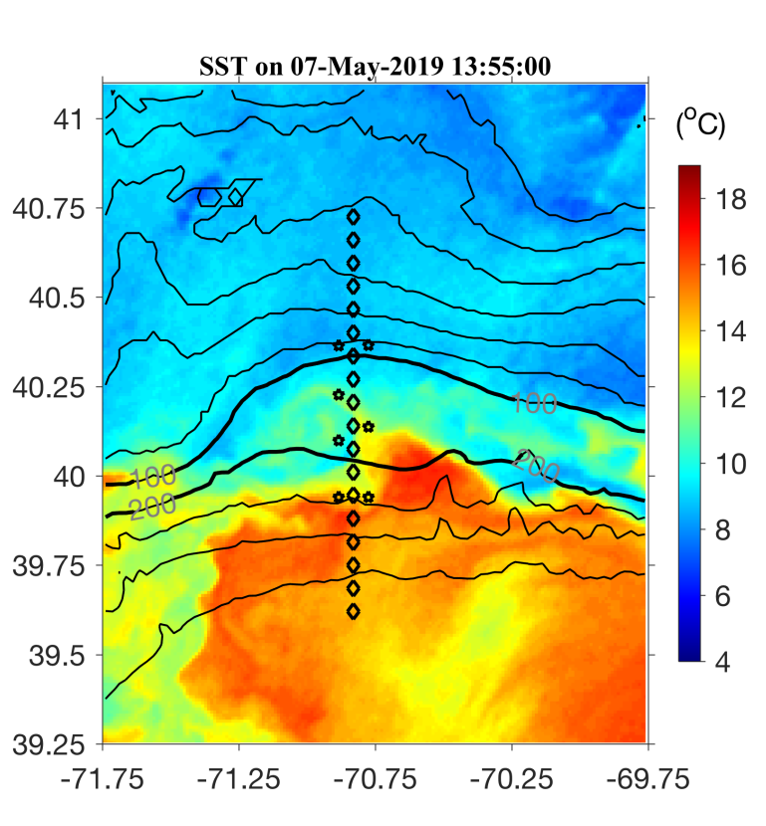
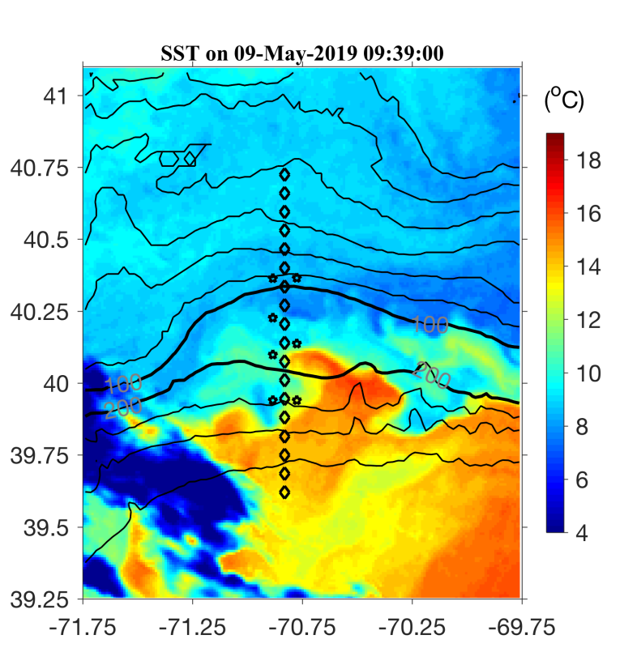

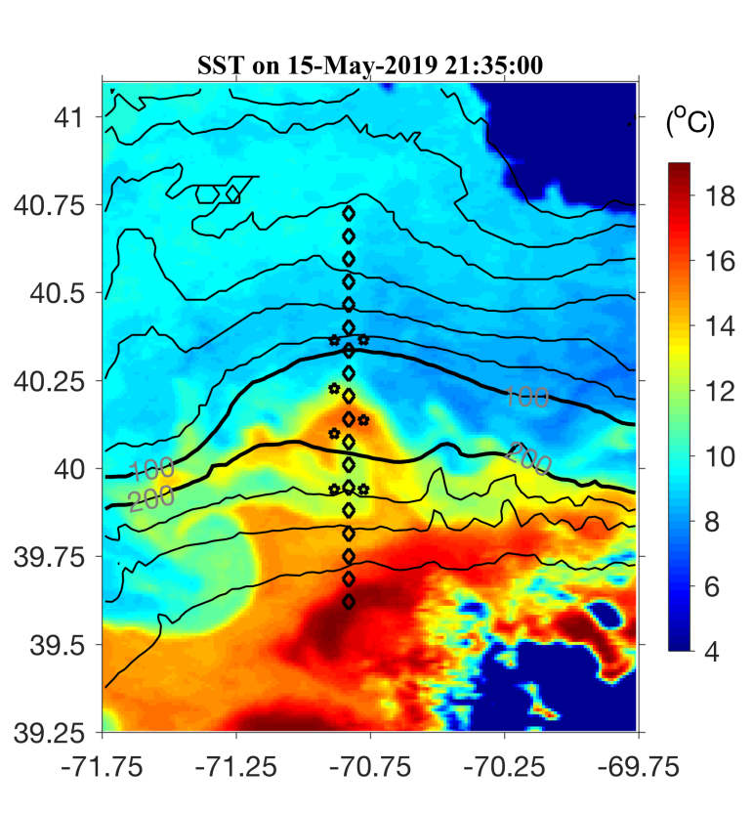
May 7 May 9
May 11 May 15

Slide 12
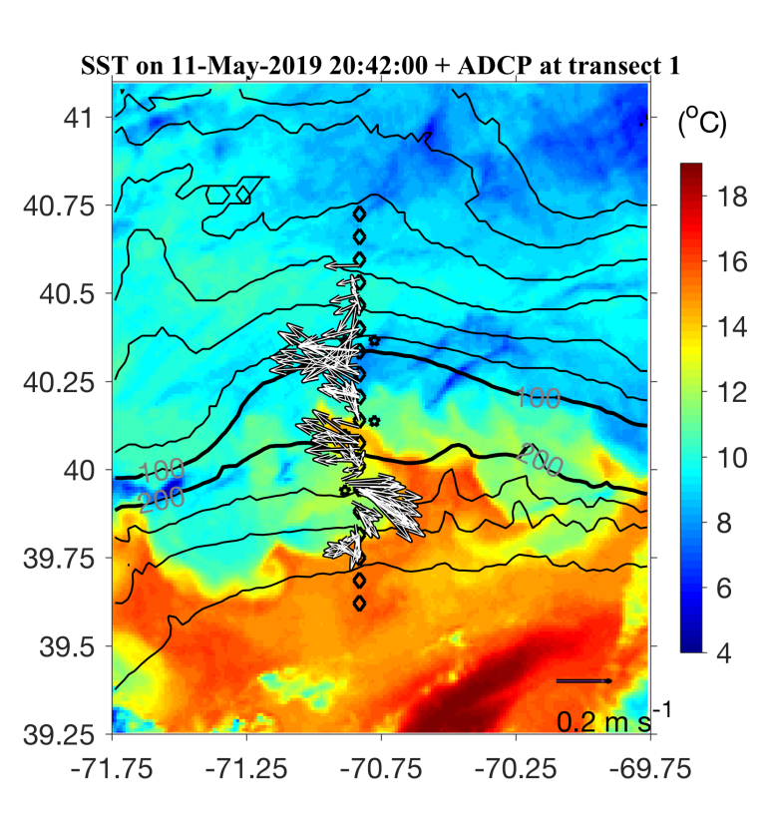
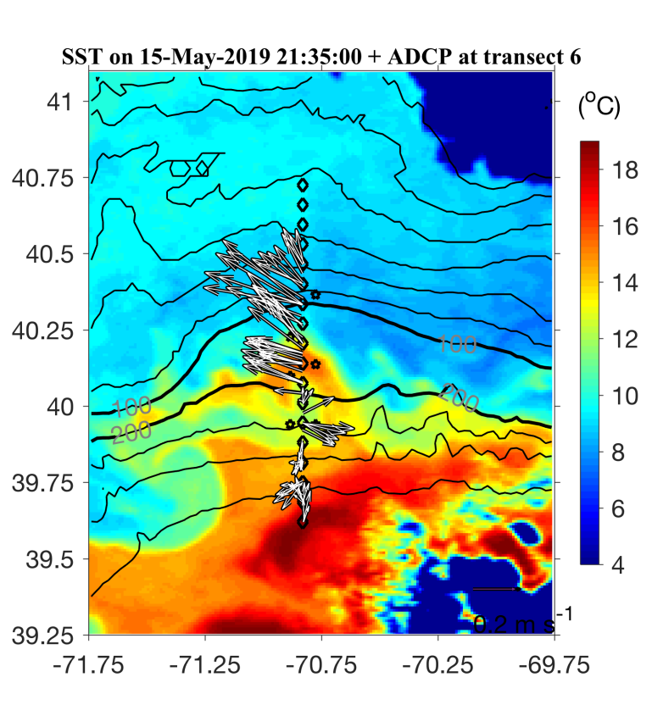
May 7 May 9
May 11 May 15

Slide 13
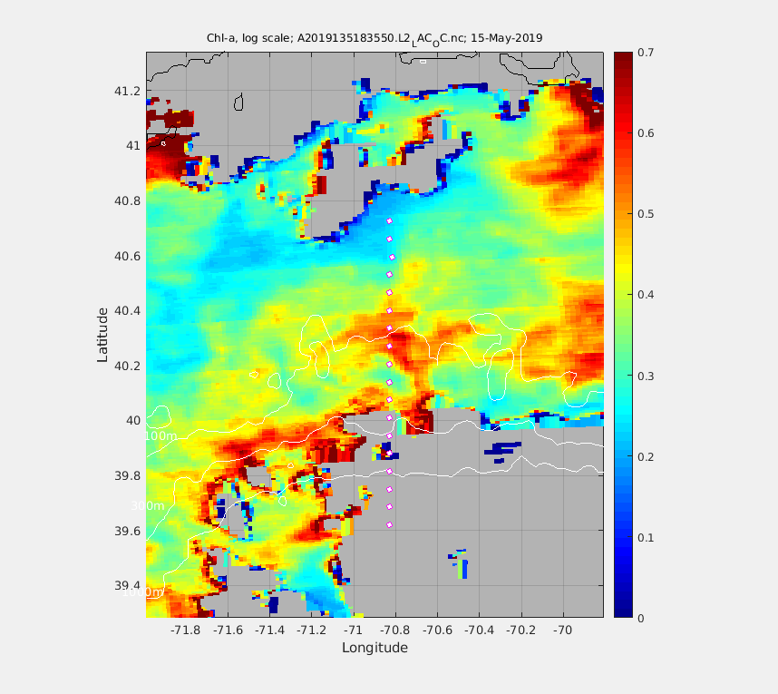
MODIS Chl 15 May 2019
A6
A8

Slide 14
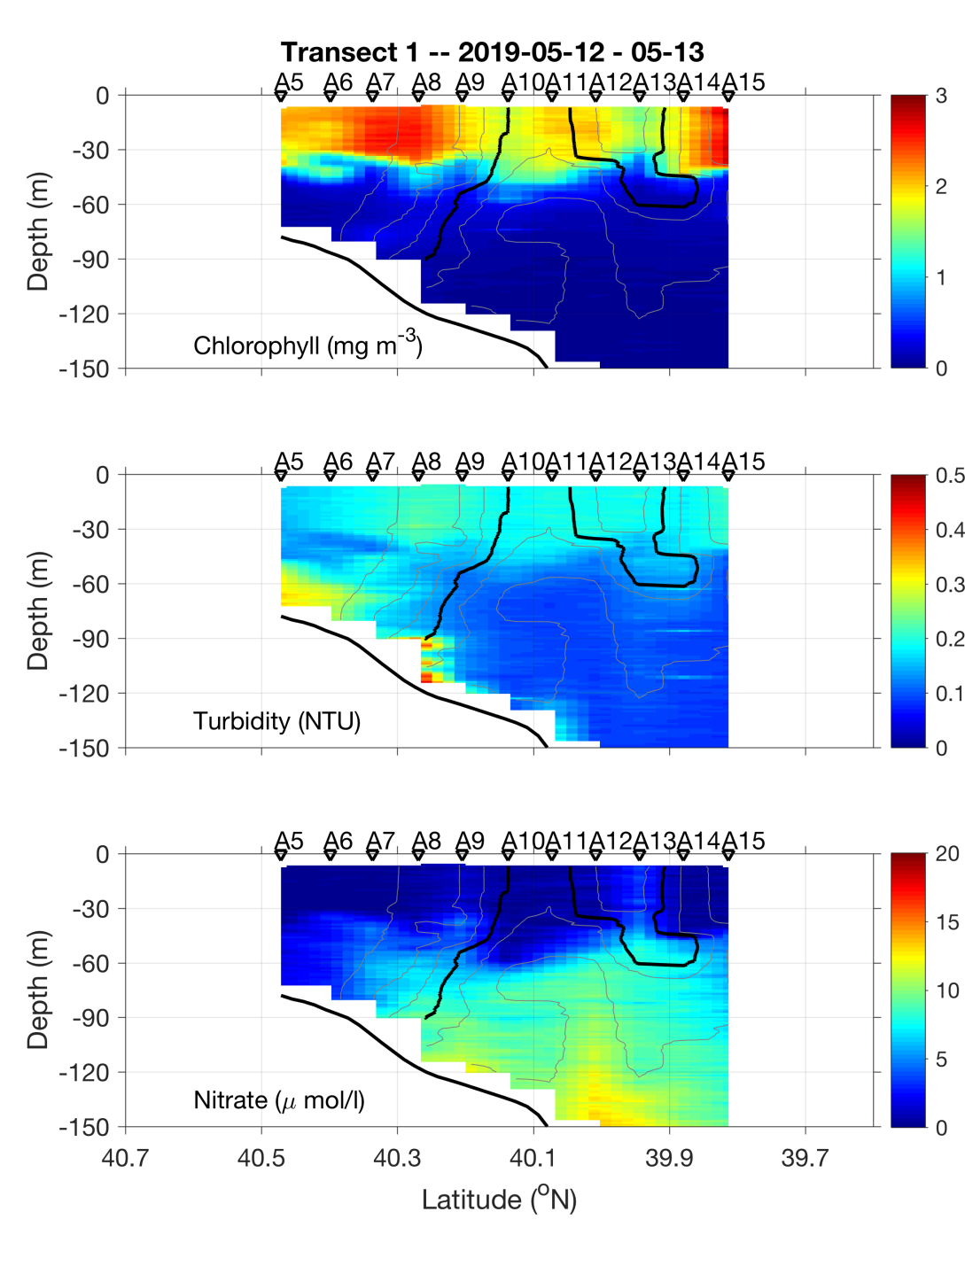
May 12-13

Slide 15
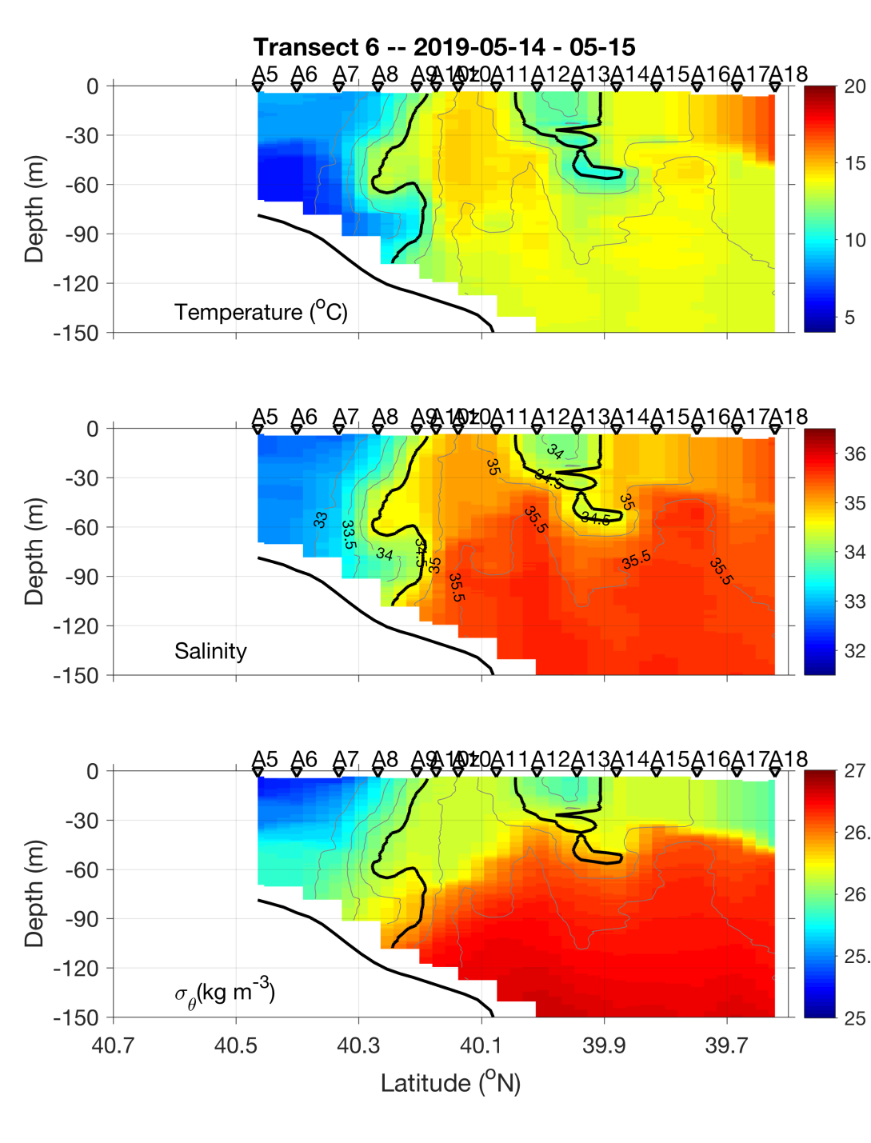
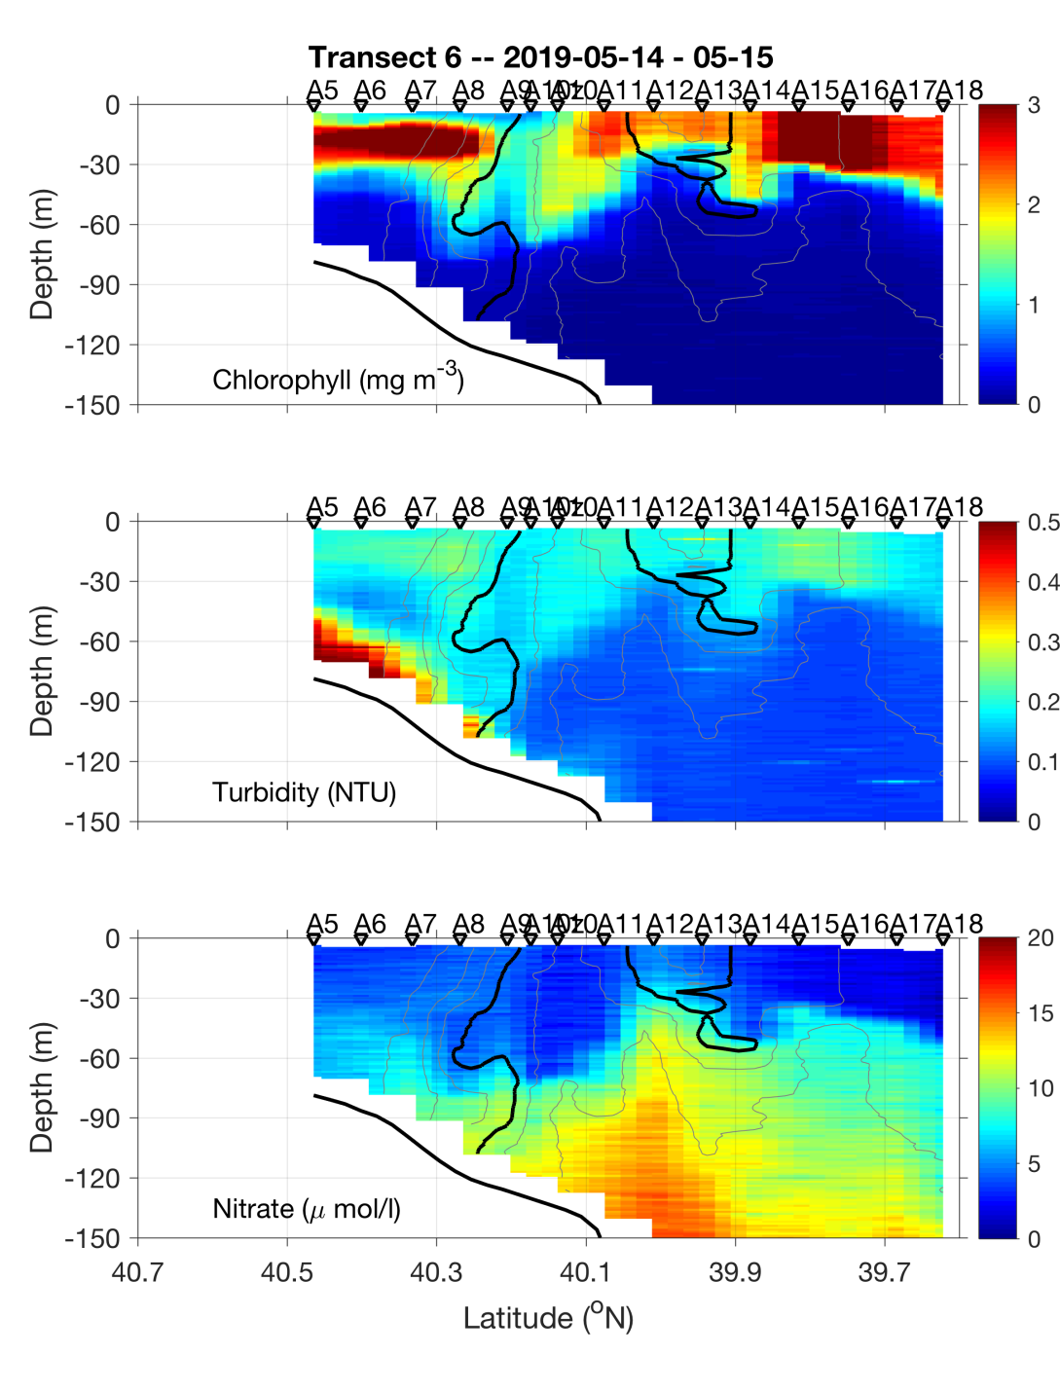
May 14-15

Slide 16
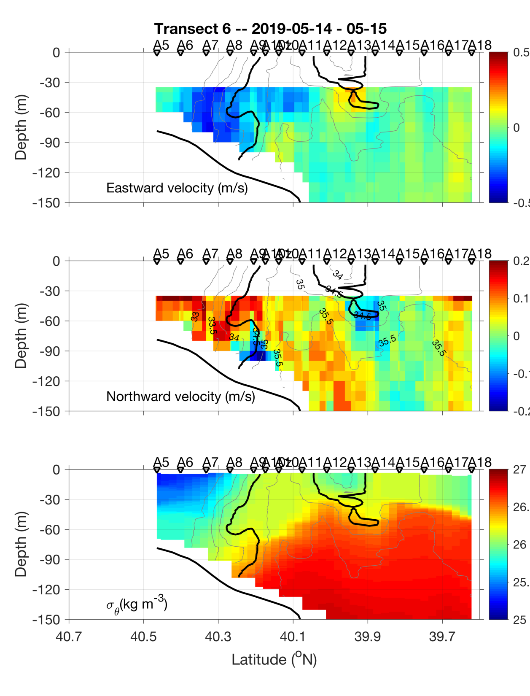
ADCP velocities
Eastward
Northward

Slide 18
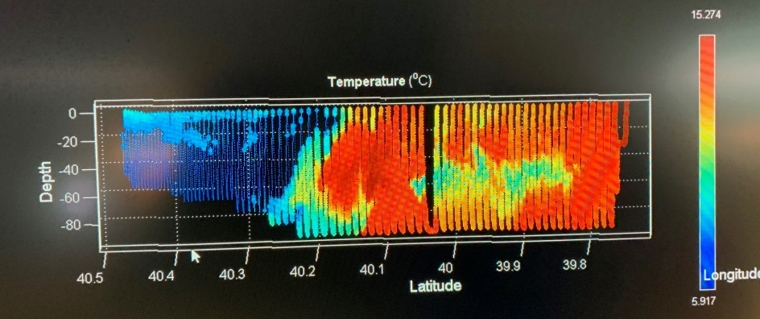
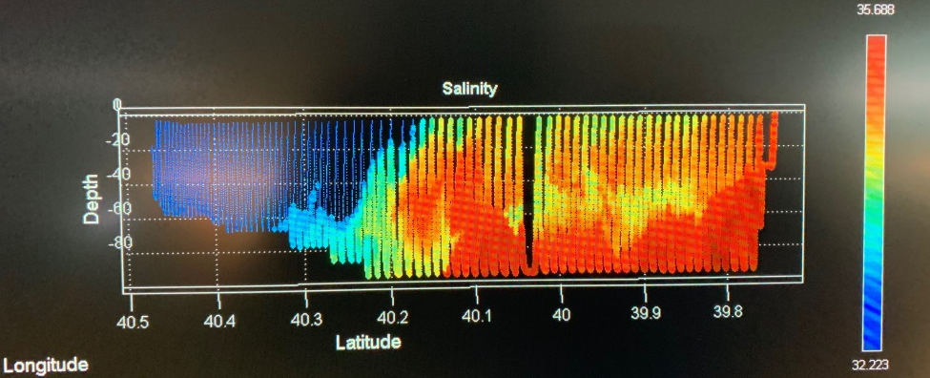
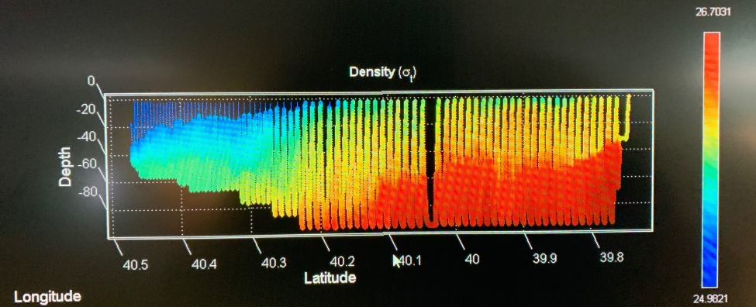
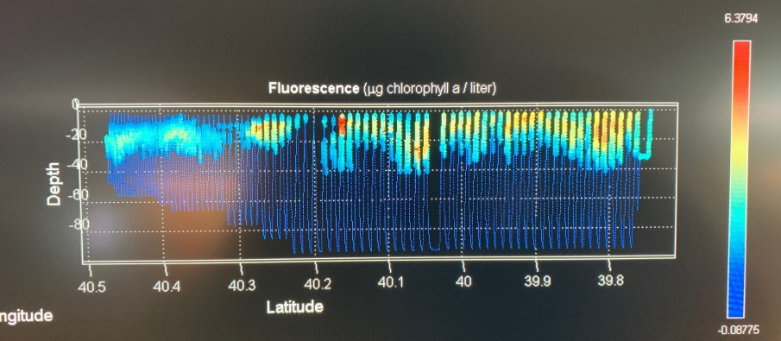
VPR Survey
May 16

Slide 19
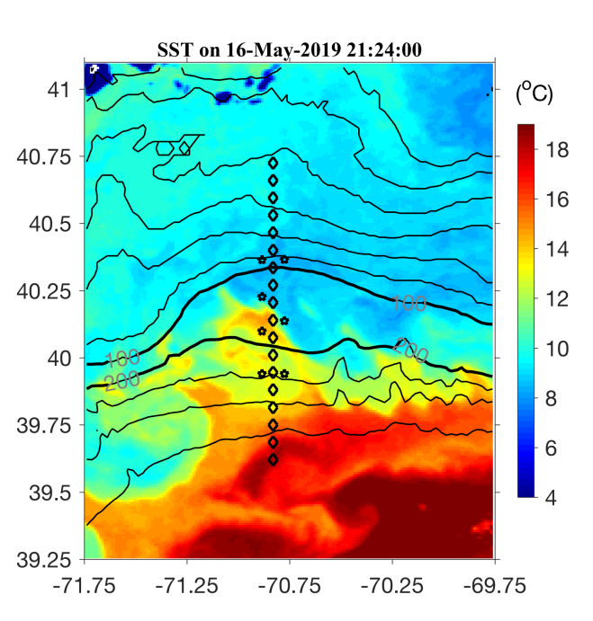
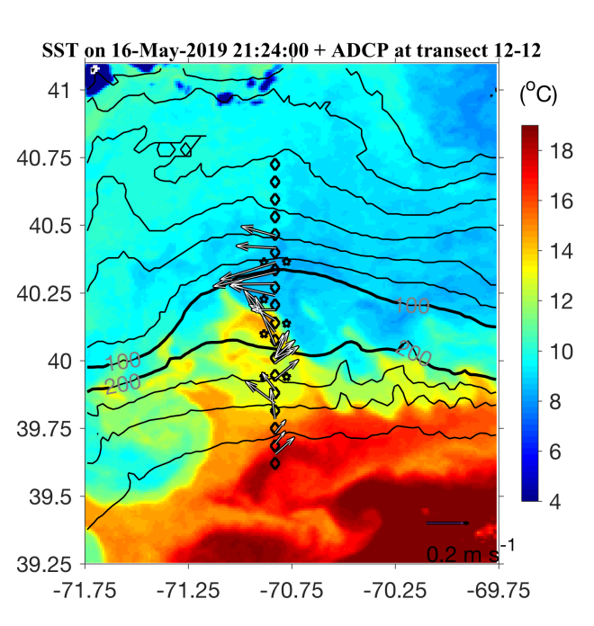
SST 16 May 2019

Slide 20
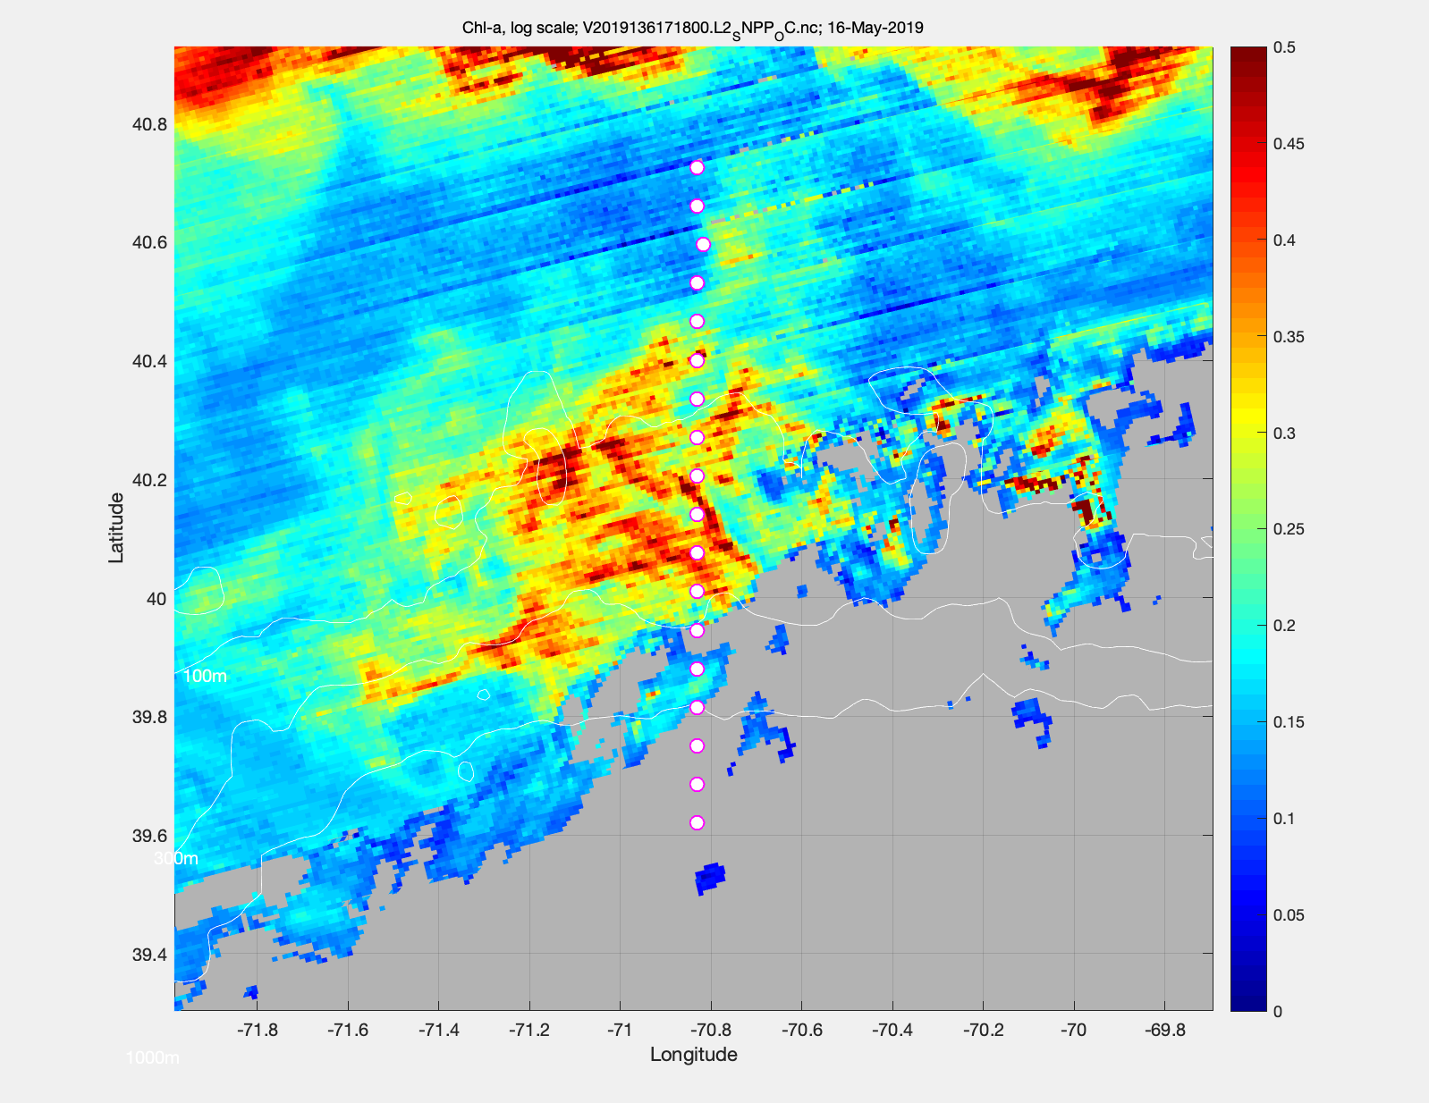
Chl 16 May 2019

Slide 21
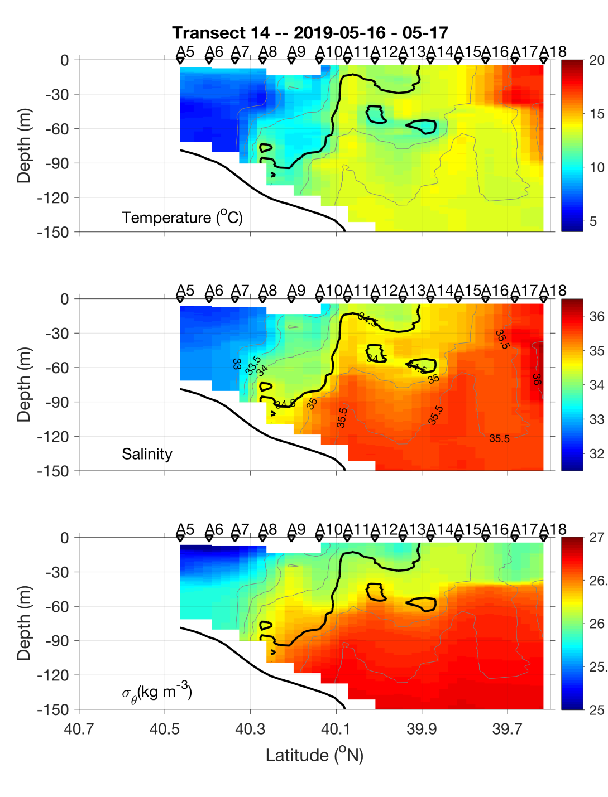
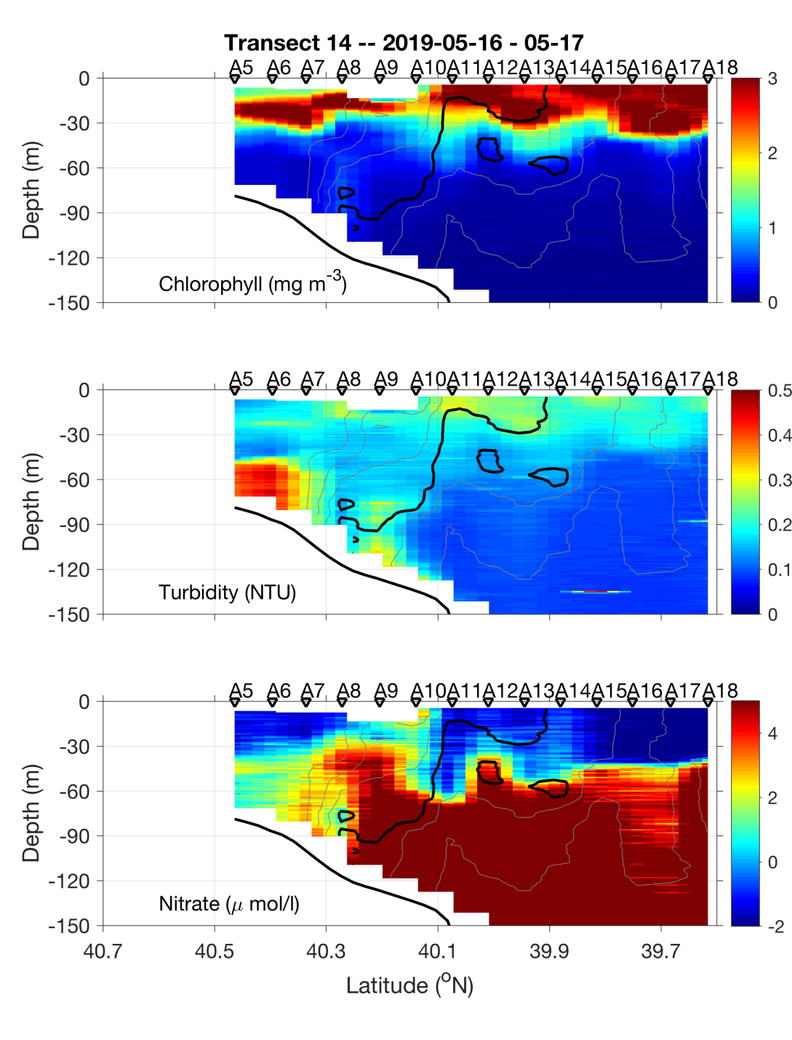
May 16-17

Slide 22
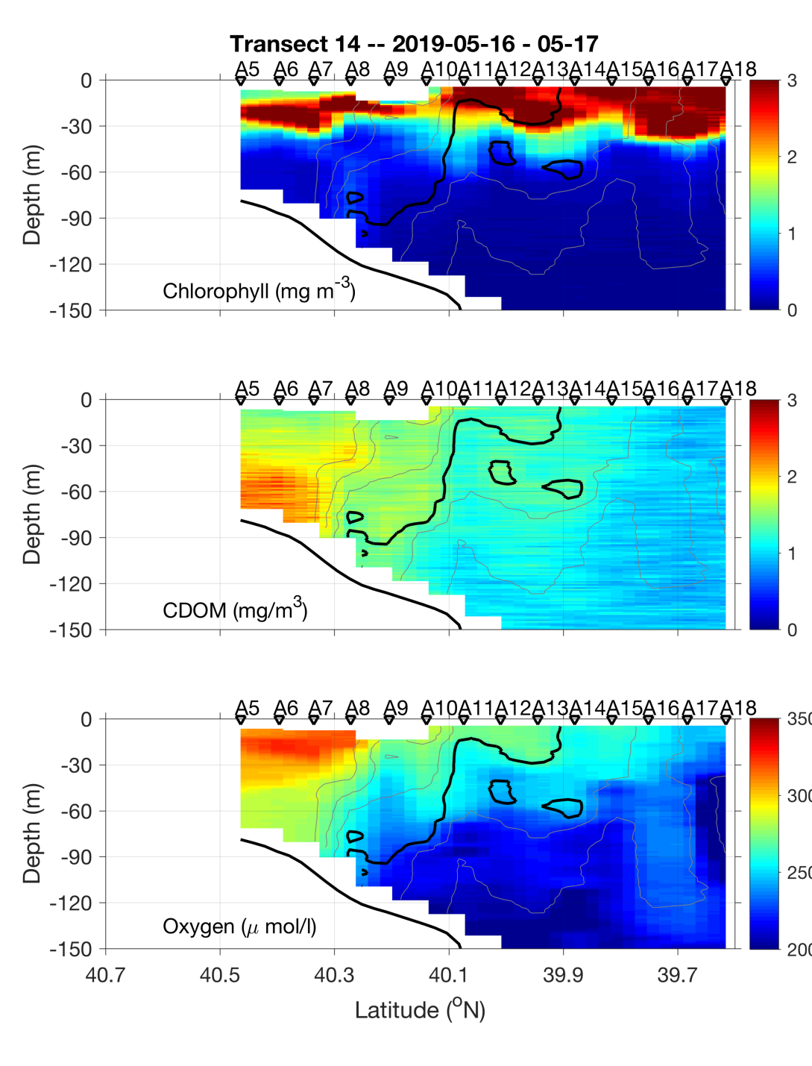
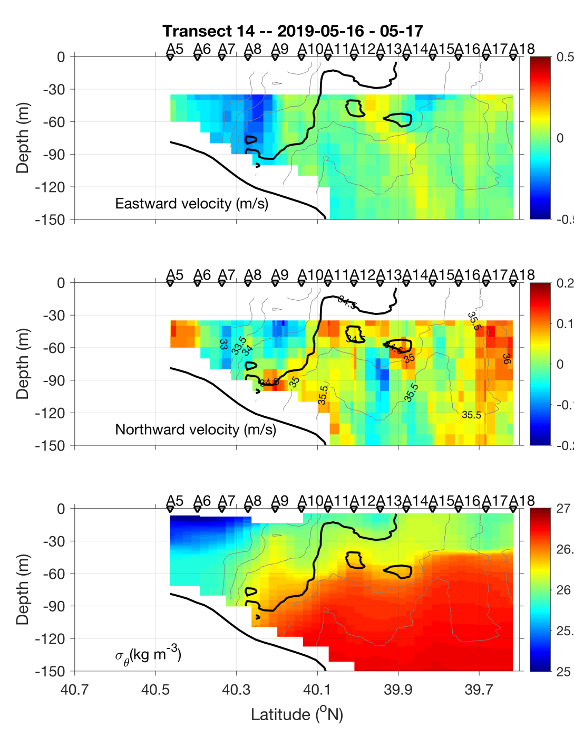
May 16-17

Slide 23
Science Meeting 5/20/19

Slide 24
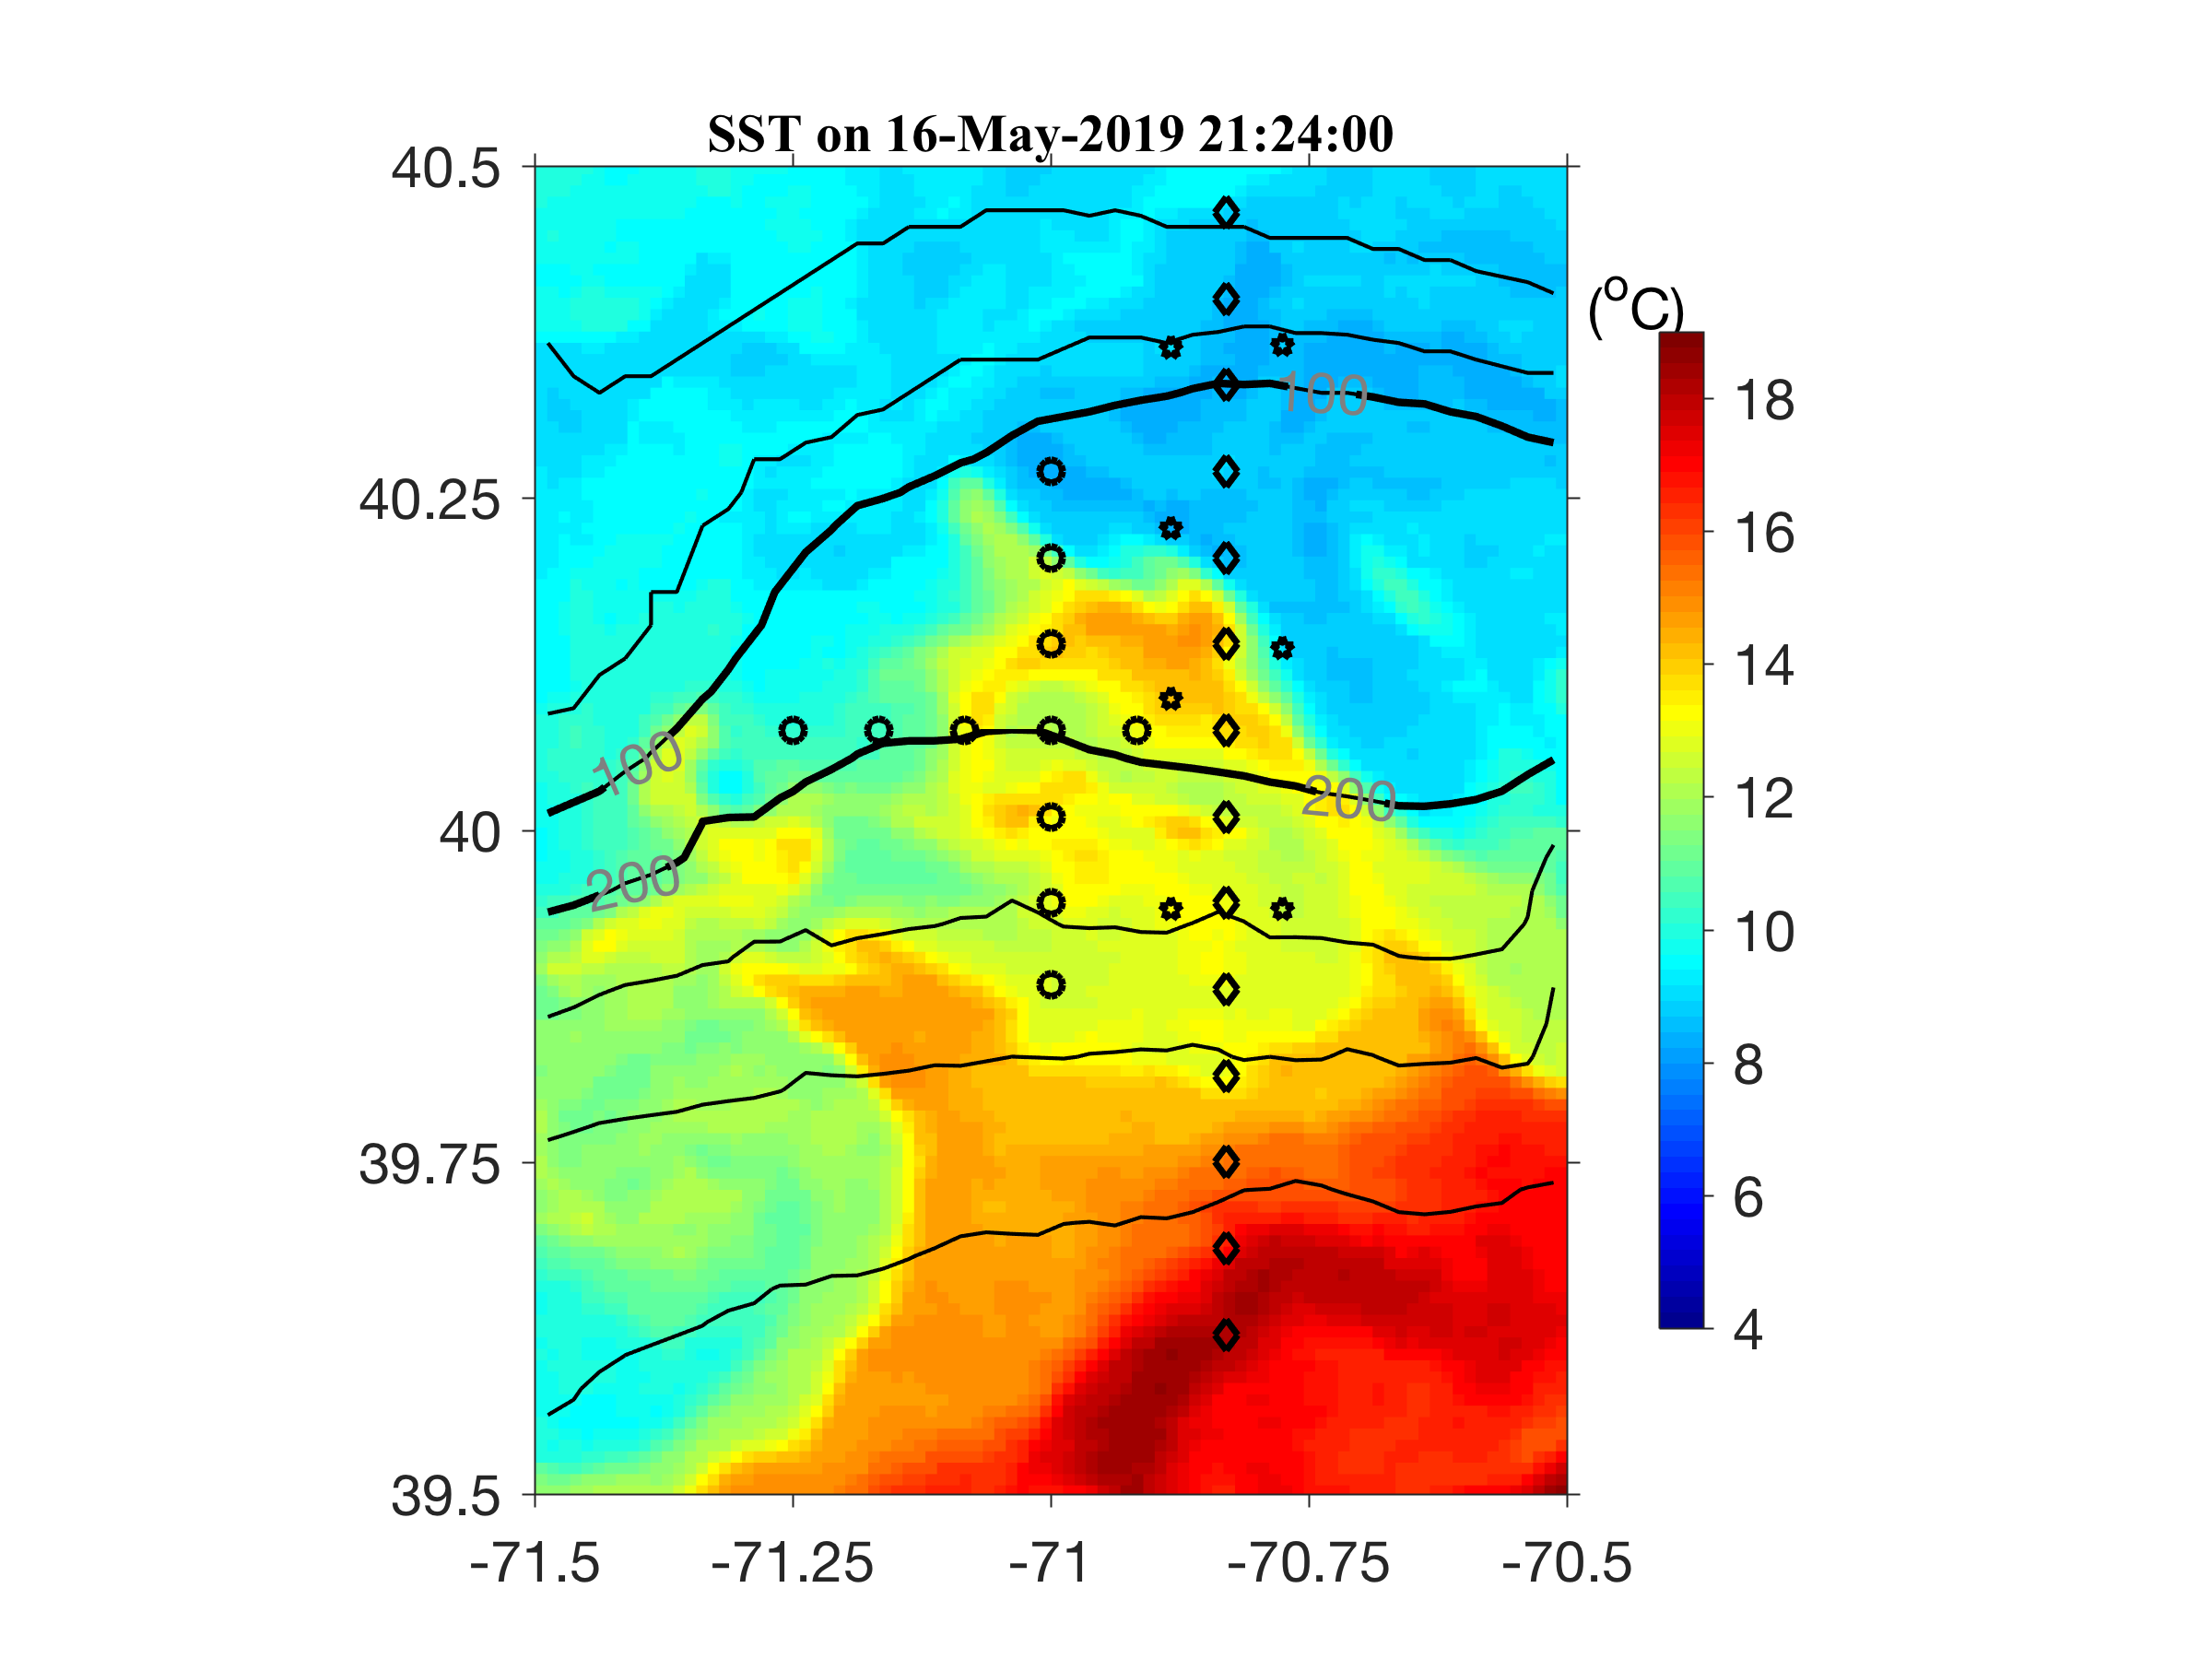
Eddy survey 17-18 May

Slide 25
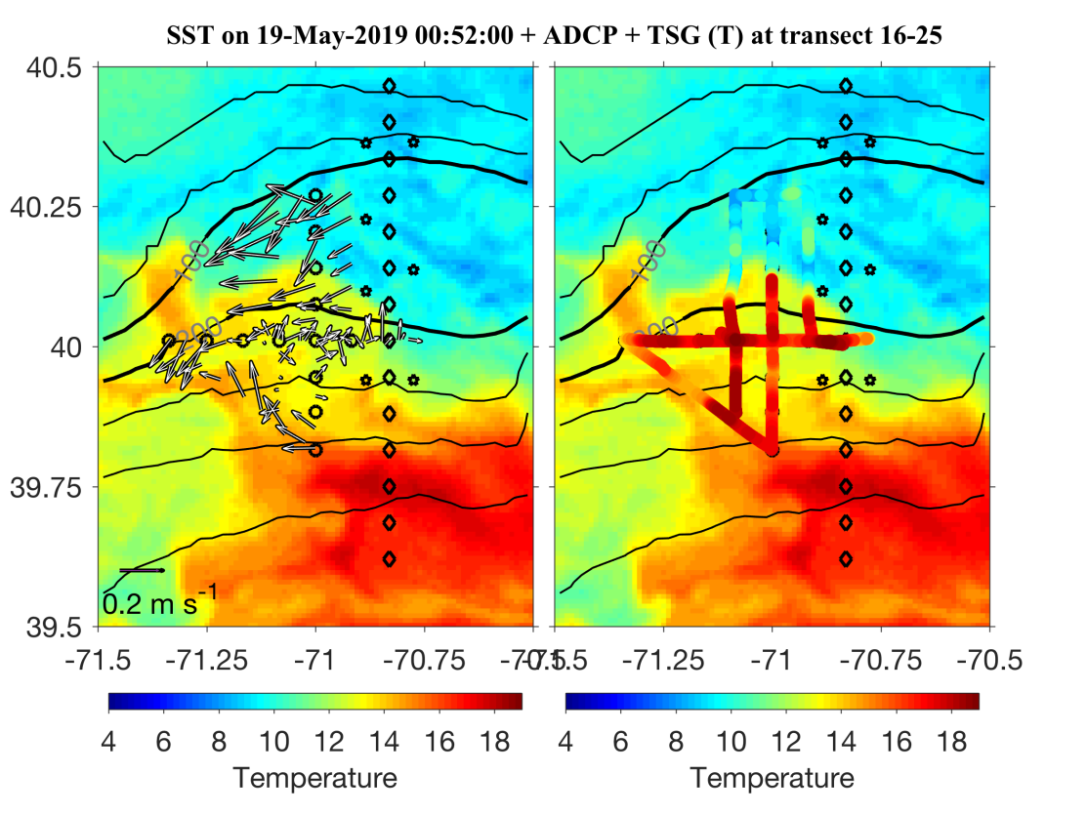
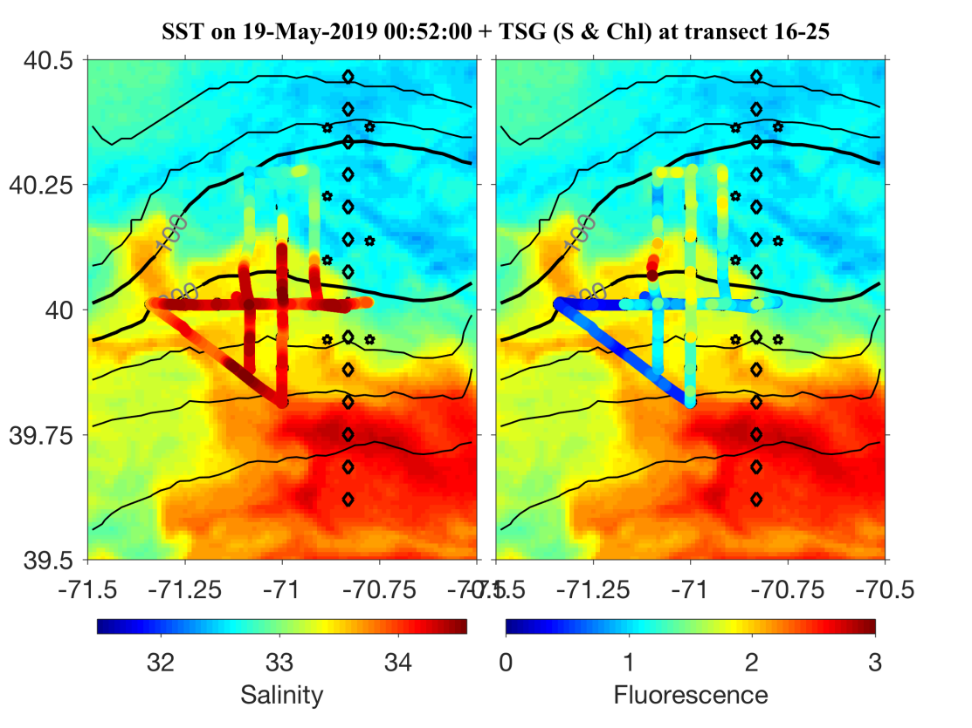
Eddy – hunting dashboard:
Underway properties overlayed on SST
Gordon and Hilde
ADCP Temp
Salinity Fluorescence

Slide 26
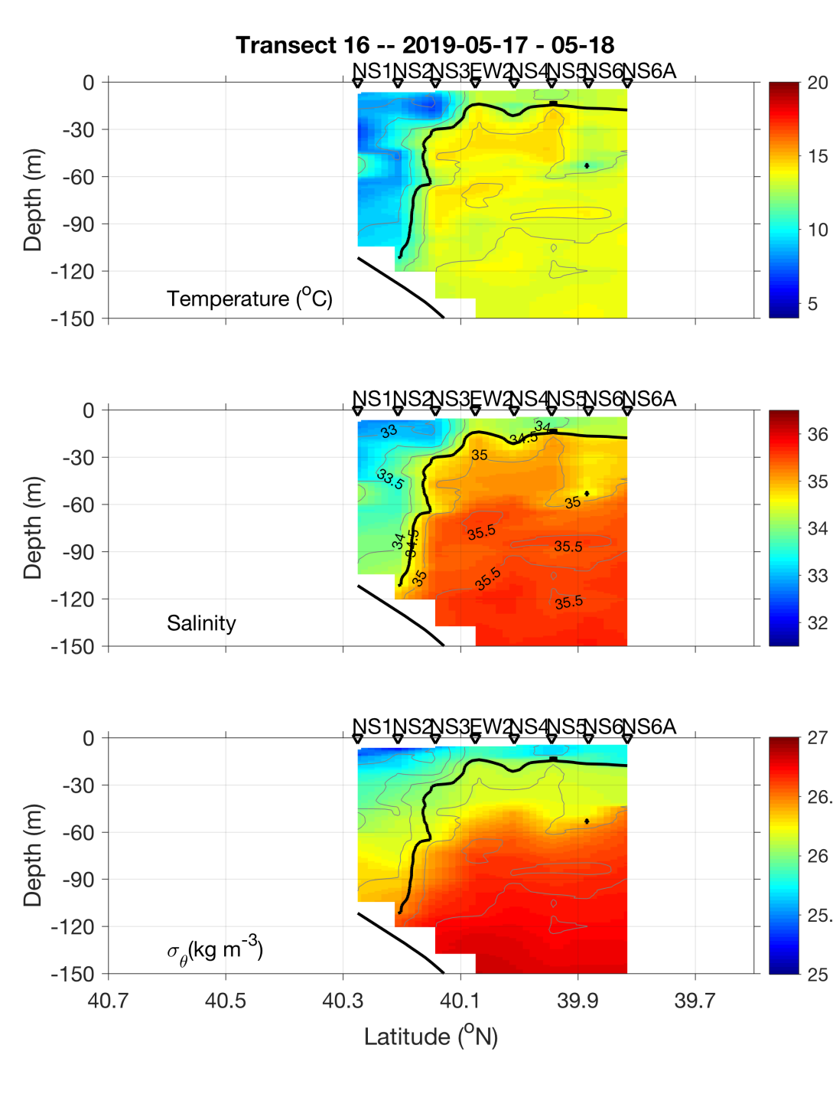
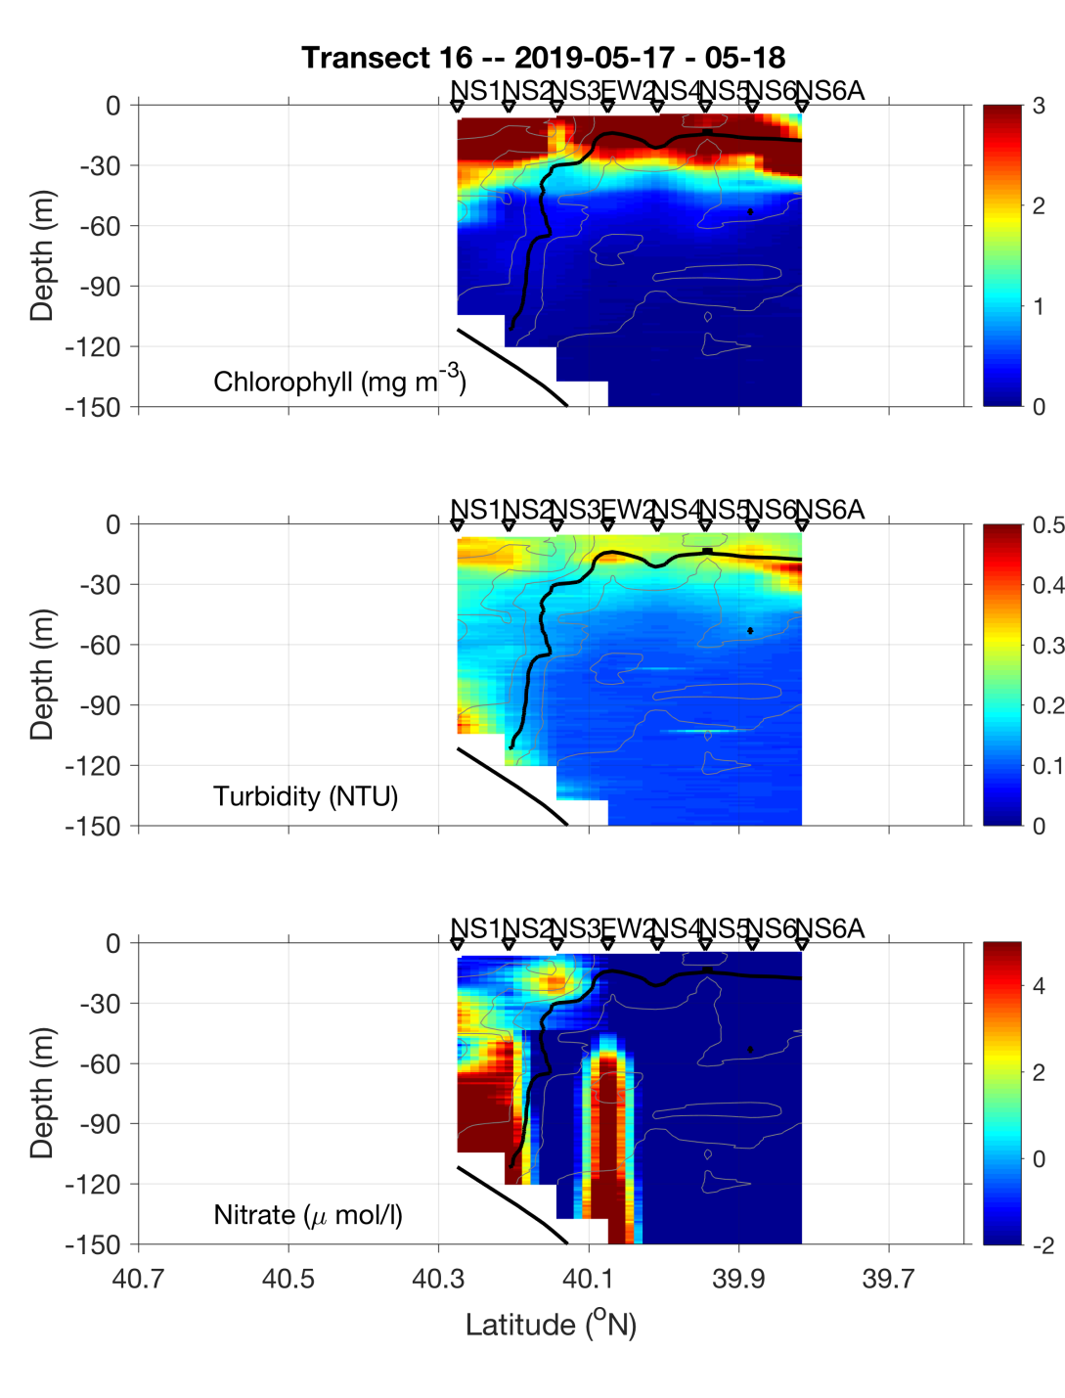
Eddy Survey – NS Section
Eddy
Center
Eddy
Center

Slide 27
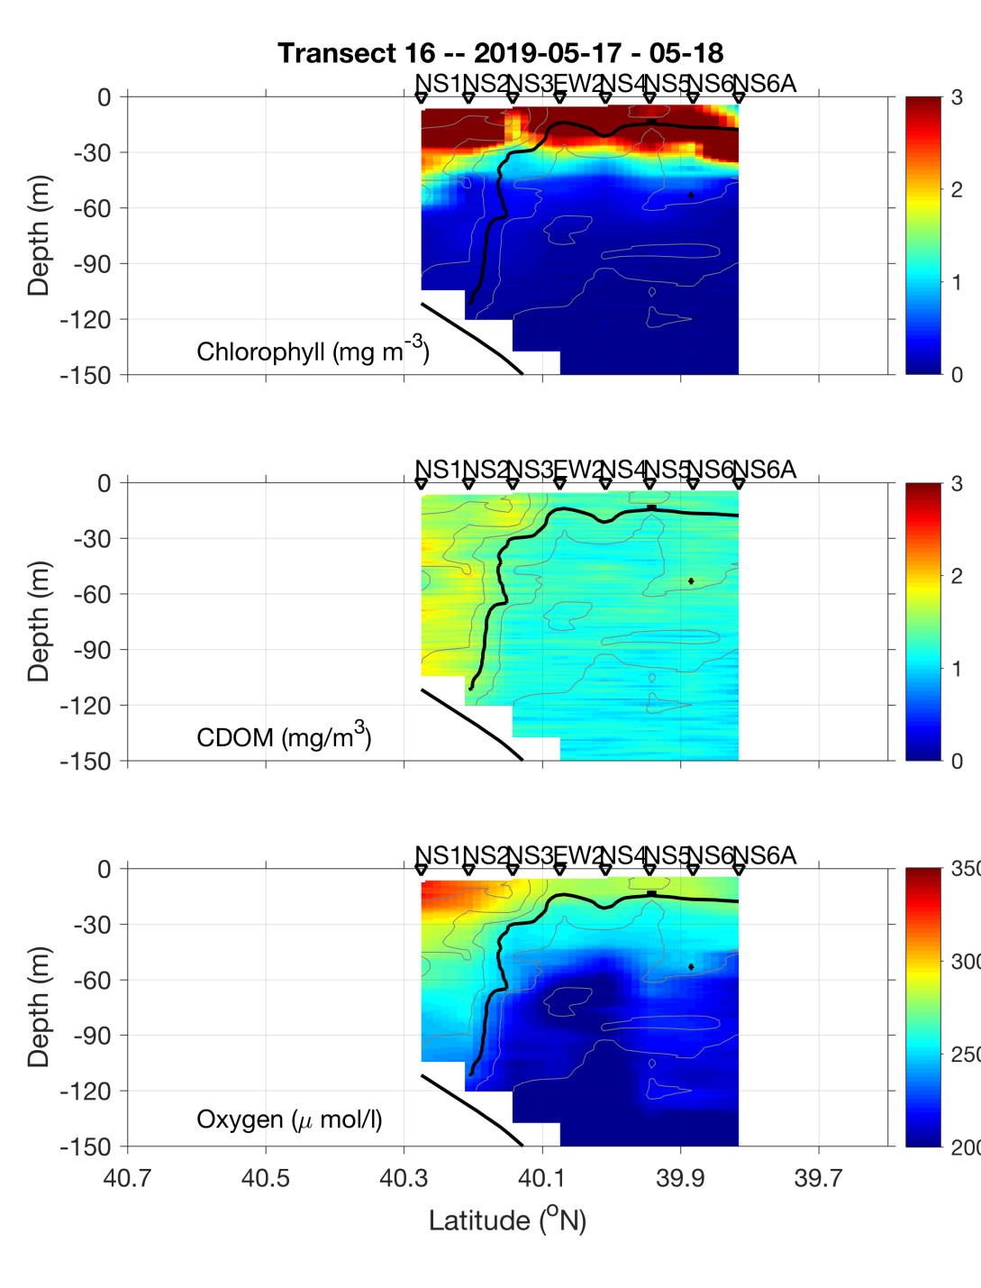
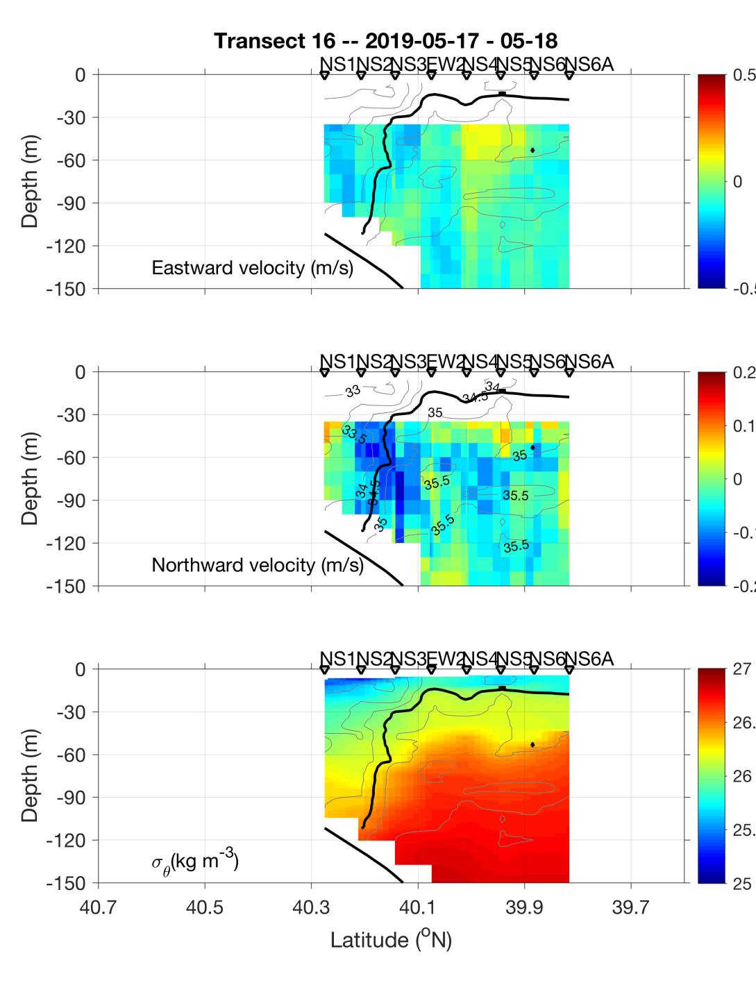
Eddy Survey – NS Section
Eddy
Center
Eddy
Center

Slide 28
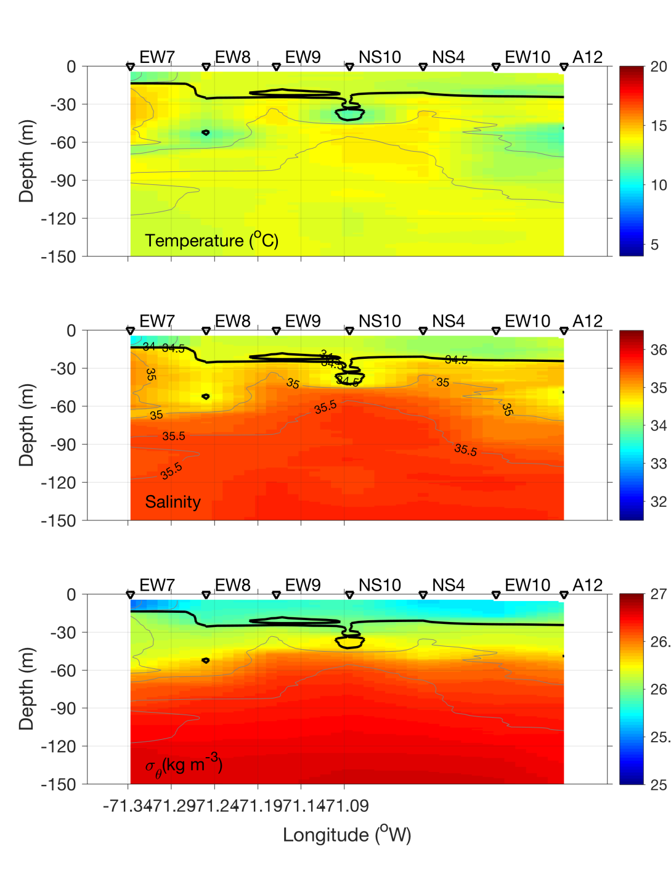
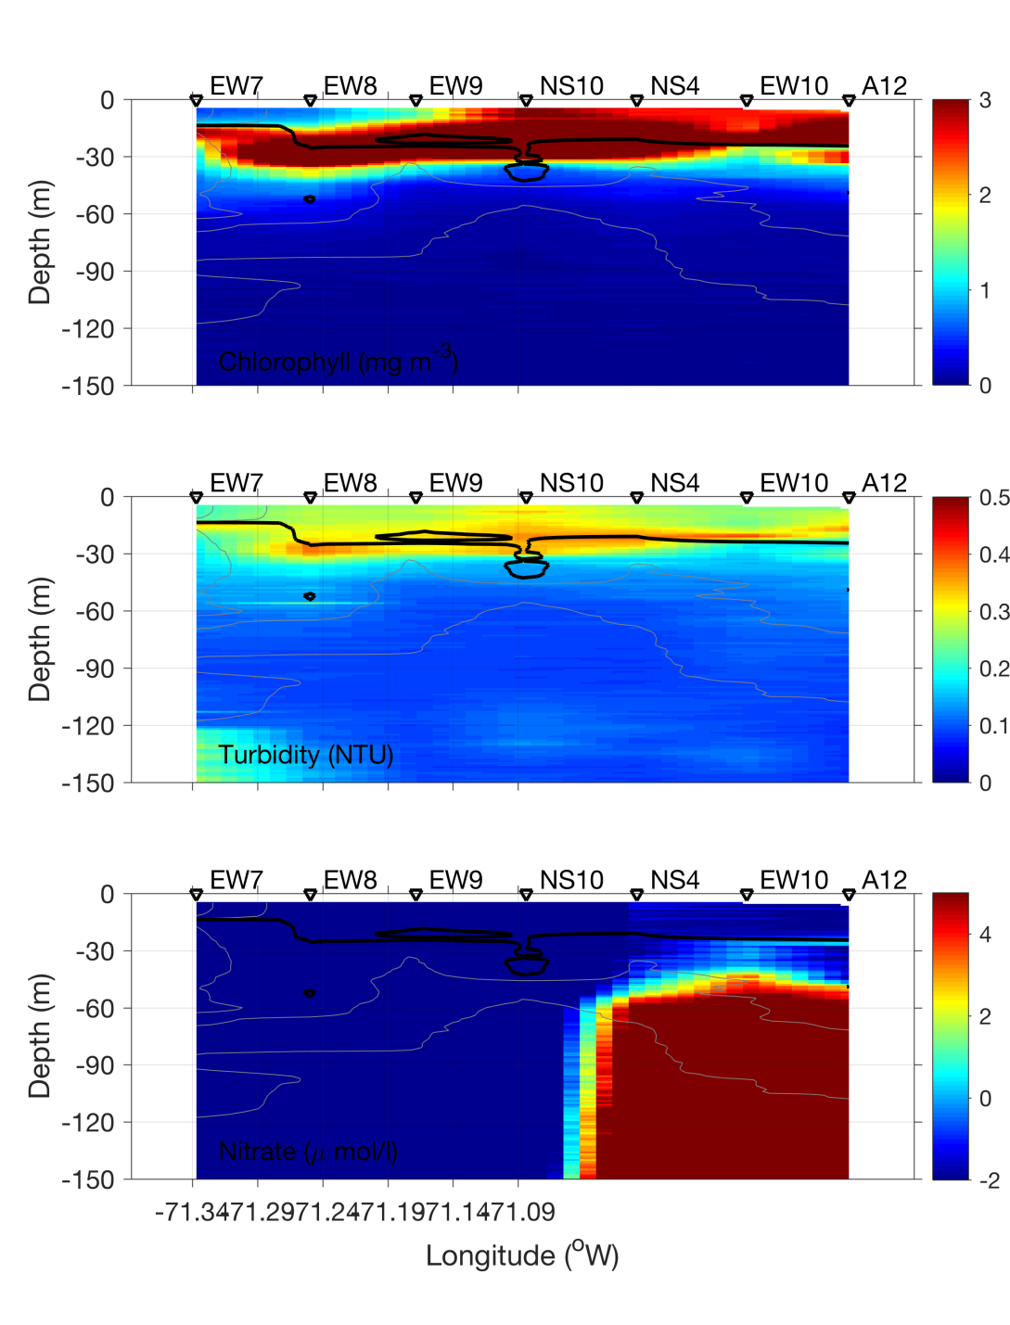
Eddy Survey – EW Section
Eddy
Center
Eddy
Center

Slide 29
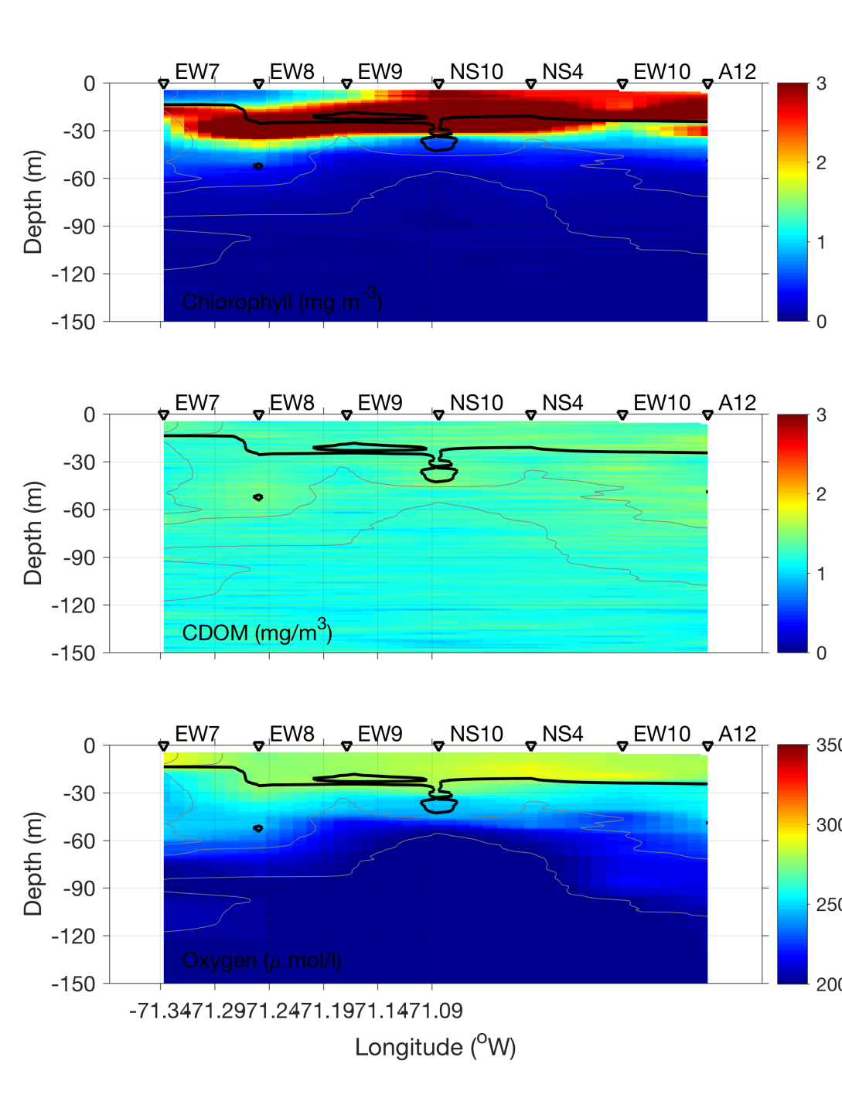
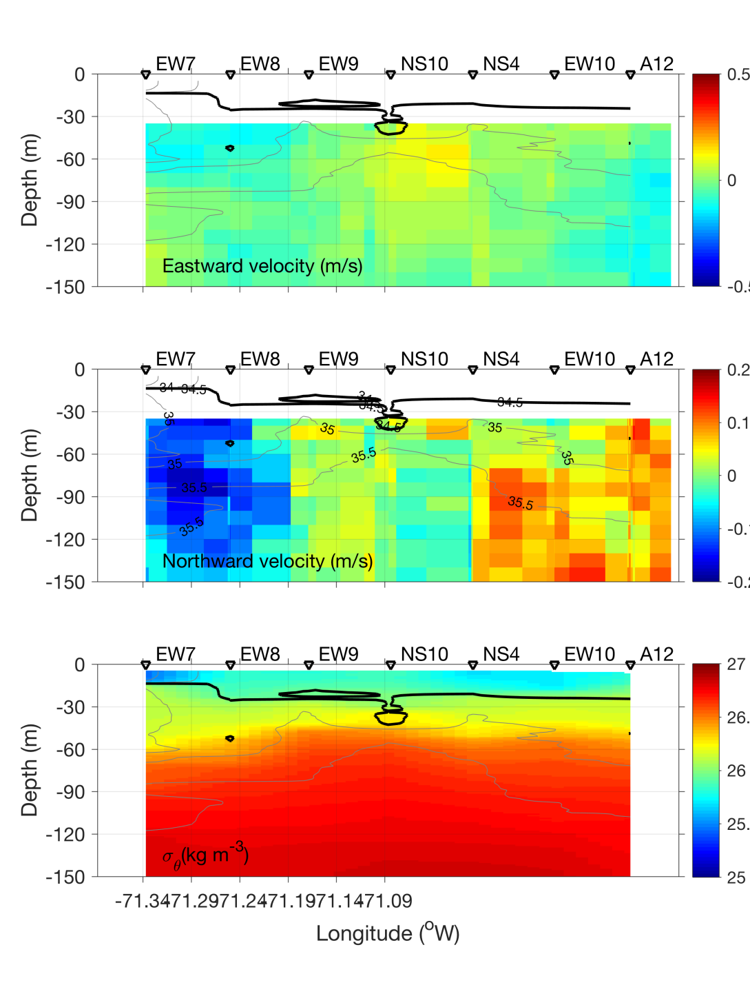
Eddy Survey – EW Section
Eddy
Center
Eddy
Center

Slide 30




VPR radial survey May 18
Eddy center
Eddy edge
Temperature Salinity
Density Fluorescence

Slide 31

VIIRS Chl May 18

Slide 32

VIIRS Chl May 18
Our eddy?

Slide 33


SST on 18 and 20 May

Slide 34




VPR Survey May 19
North
Temperature Salinity
Density Fluorescence
A5
A12
South
Diatoms aplenty

Slide 35
VPR diatom images

Slide 37
VPR diatom images

Slide 38




Temperature
9.7-21.6
Salinity
33.0-36.6
A18
A17
A16
A15
A14
A13
Density
24.8-26.7
Fluorescence
0-2.9
VPR Surveys 5 and 6 – May 21

Slide 39




SST
May 18
May 21
May 20
May 22

Slide 40

VIIRS Chl image May 20
Our eddy?
A12

Slide 41


May 19-20

Slide 42


May 19-20

Slide 43


VIIRS Chl
May 20
May 21

Slide 44




VPR 7 – May 22
Temperature
6.3-21.6
Salinity
32.3-36.5
Fluorescence
0.0-9.5
Density
24.4-26.7
A18
A17
A16
A15
A14
A13
Fluorescence
0-2.9
Diatoms
Desert

Slide 45


May 22-23

Slide 46


May 22-23

Slide 47




VPR Surveys 8 and 9 – May 23
Temperature
6.0-16.3
Salinity
32.2-35.7
Eddy “Zoe”
Diatoms
A13
Density
24.7-26.8
Fluorescence
0-9.5

Slide 48


May 23-24 Eddy survey

Slide 49


May 23-24 Eddy survey

Slide 50

Shelf break jet: mean state

Slide 51

Meander formation

Slide 52

Shingle formation

Slide 53

Shelf break eddy formation

Slide 54

Vertical section: mean state

Slide 55

Vertical section: meander formation

Slide 56

Vertical section: shelf break eddy formation

Slide 57

VIIRS Chl May 22
A
C
D
B

Slide 58

Bird and marine mammal sightings

Slide 60

VIIRS Chl May 19

Slide 61

VIIRS Chl May 19

Slide 62

Satellite Altimetry May 15, 2019

Slide 63


Slide 64



Chl
May 18
May 20
May 19
May 21
Note different color bars and domains

