Slide 1
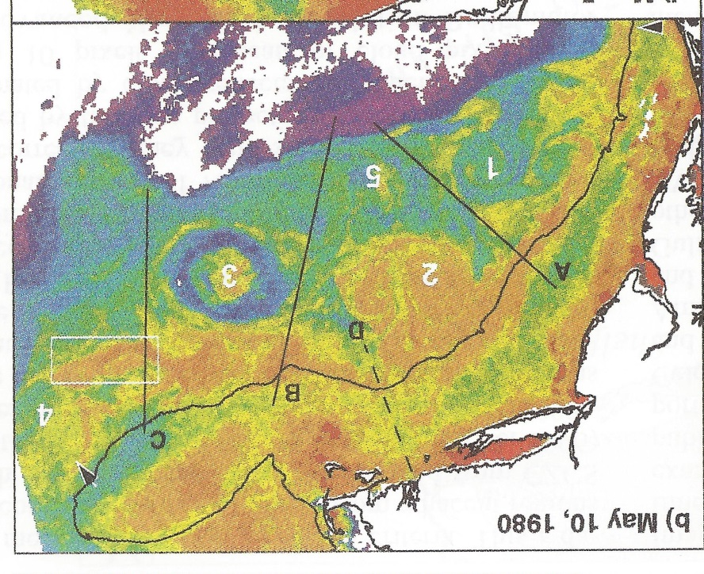
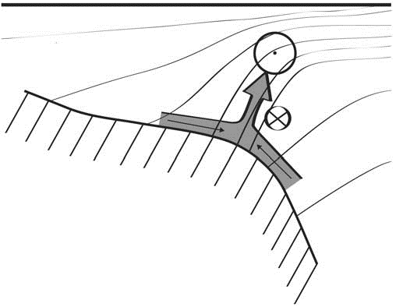
Shelfbreak frontal dynamics: mechanisms of upwelling, net community production, and ecological implications
Ryan et al. 1999
Linder et al. 2004
Gawarkiewicz and Chapman 1992
Chapman and Lentz 1994
Marra et al. 1990
Science Meeting #1 5/12/19

Slide 2


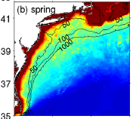

2013, JGR
Satellite CHL climatology
Why is there no mean enhancement of chlorophyll at the shelf break front?
H₁: Top-down control by zooplankton grazing
H₂: Spatial and temporal intermittency of the upwelling events causes their net impact to be smoothed out in long-term means.

Slide 3

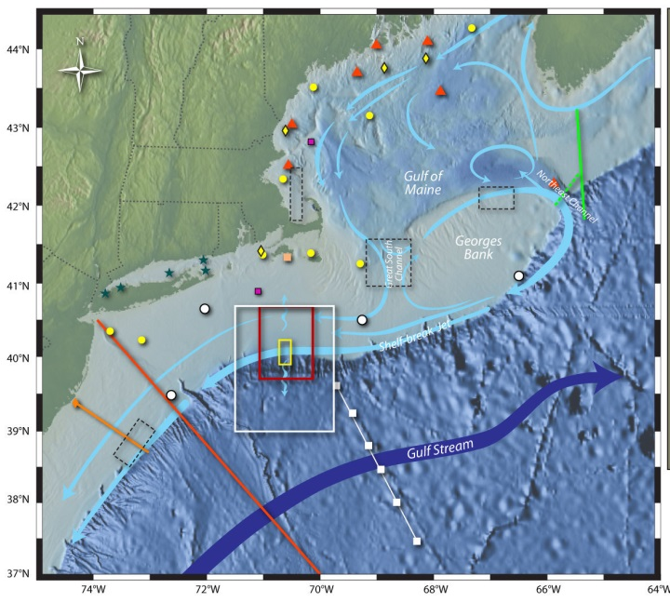
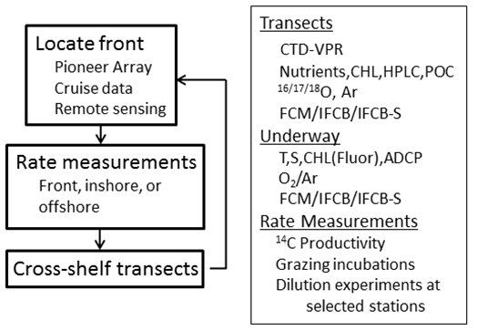
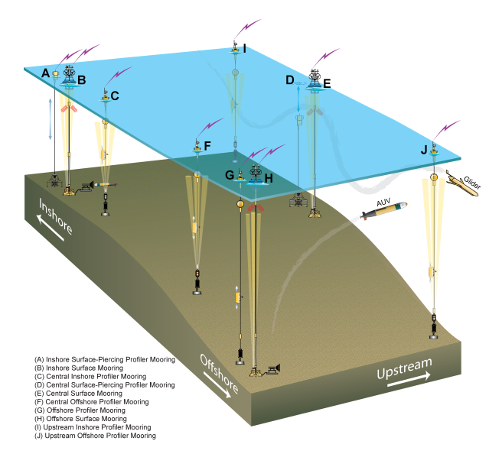
Shelfbreak frontal dynamics: mechanisms of upwelling, net community production, and ecological implications
Dennis McGillicuddy, Heidi Sosik, Gordon Zhang (WHOI)
Walker Smith (VIMS) Rachel Stanley (Wellesley College)
Jefferson Turner, Christian Petitpas (UMass Dartmouth)
3 Cruises R/V Neil Armstrong
NSF Ocean Observatory Initiative Pioneer Array

Slide 4
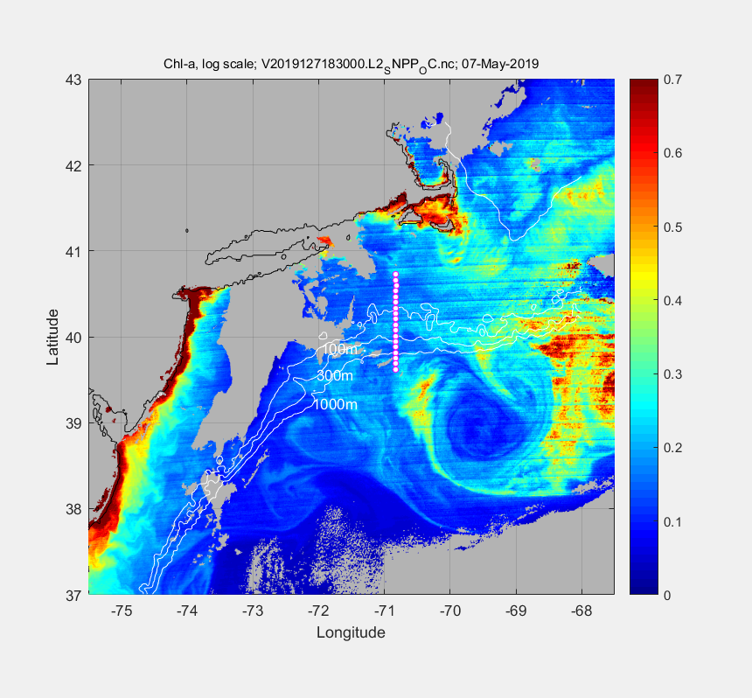
May 7 2019

Slide 5
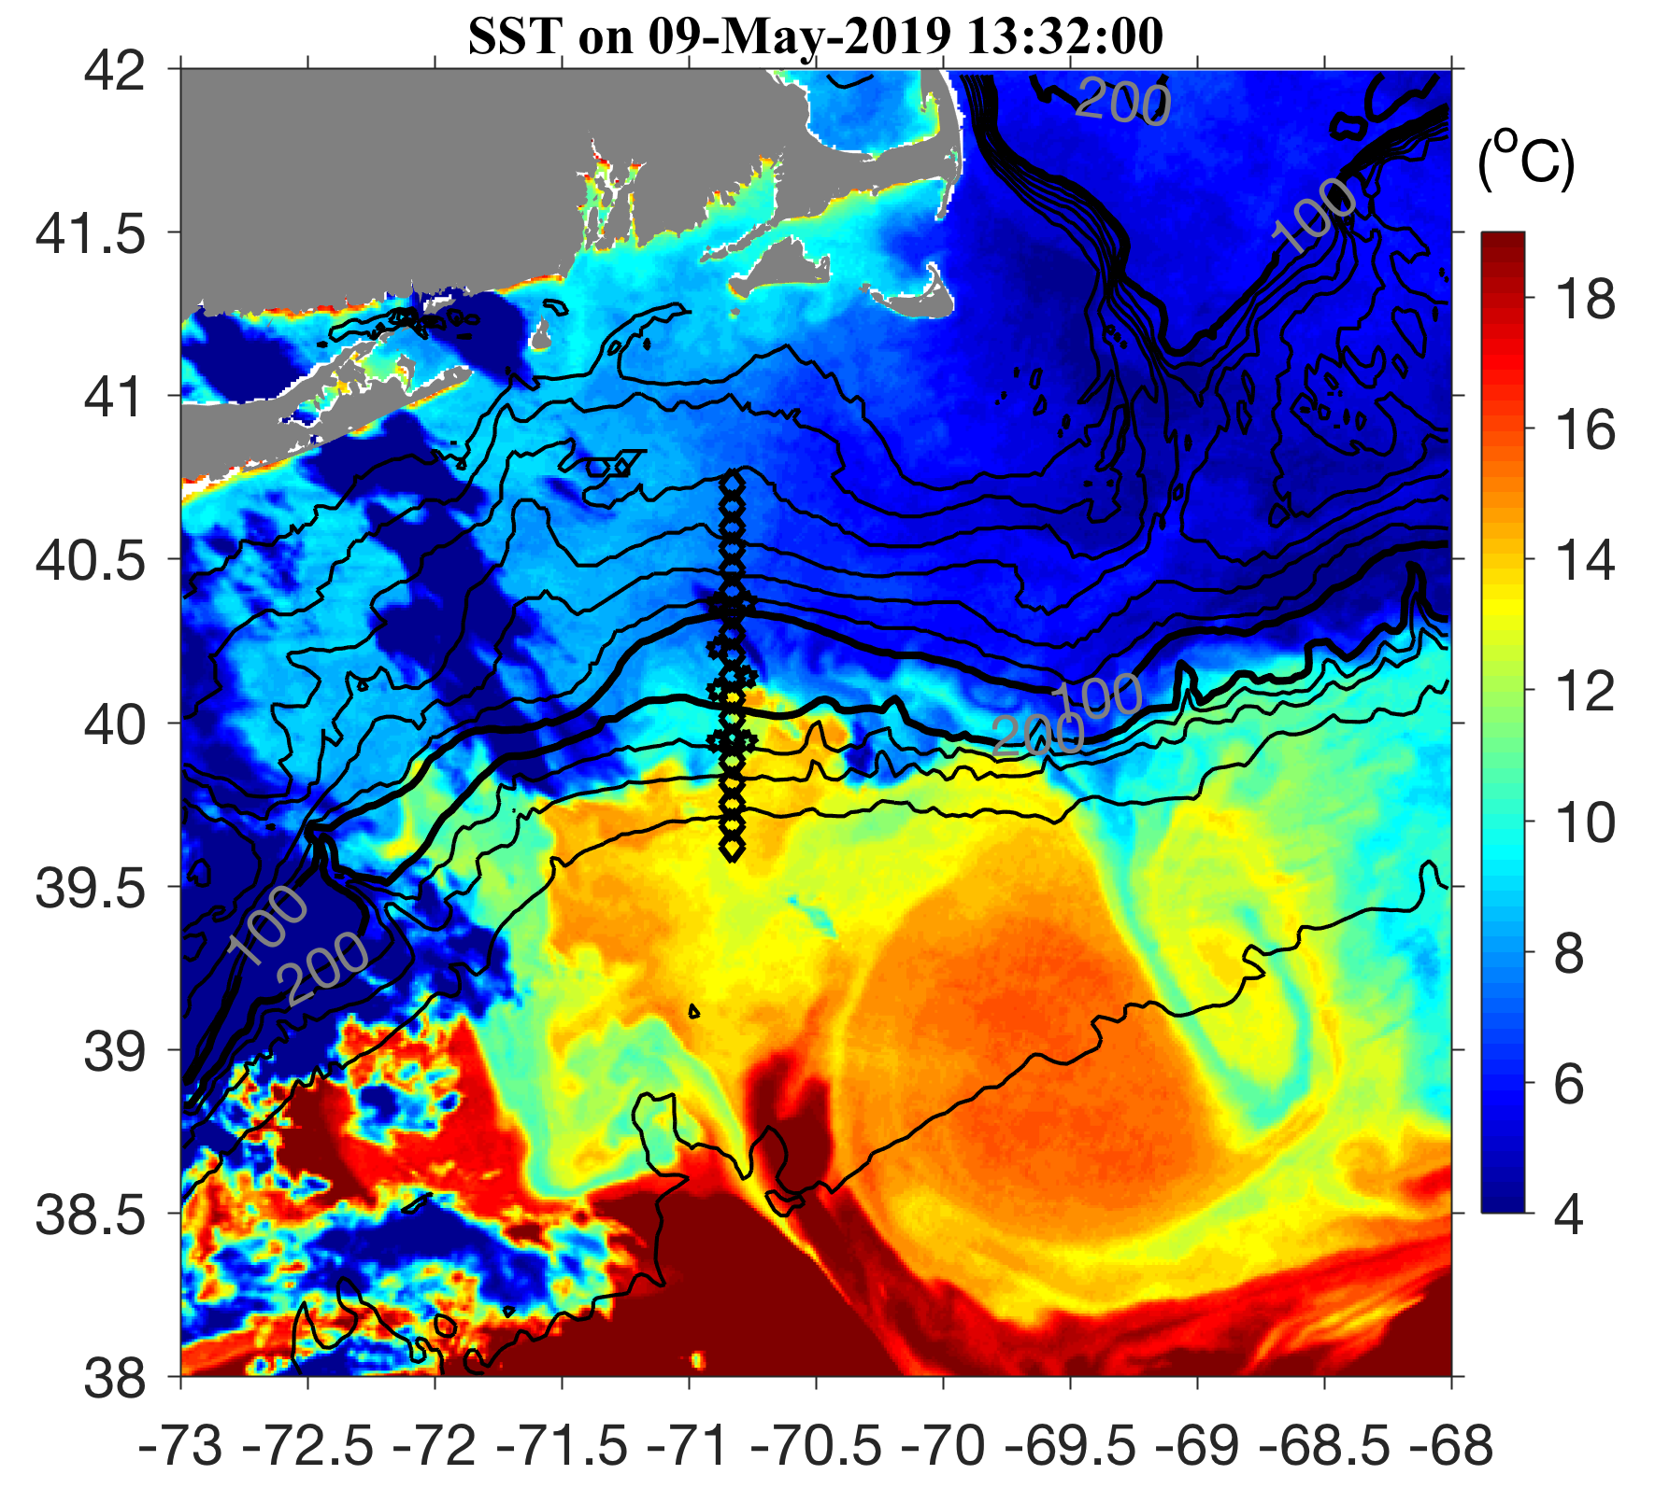
May 9 2019

Slide 6
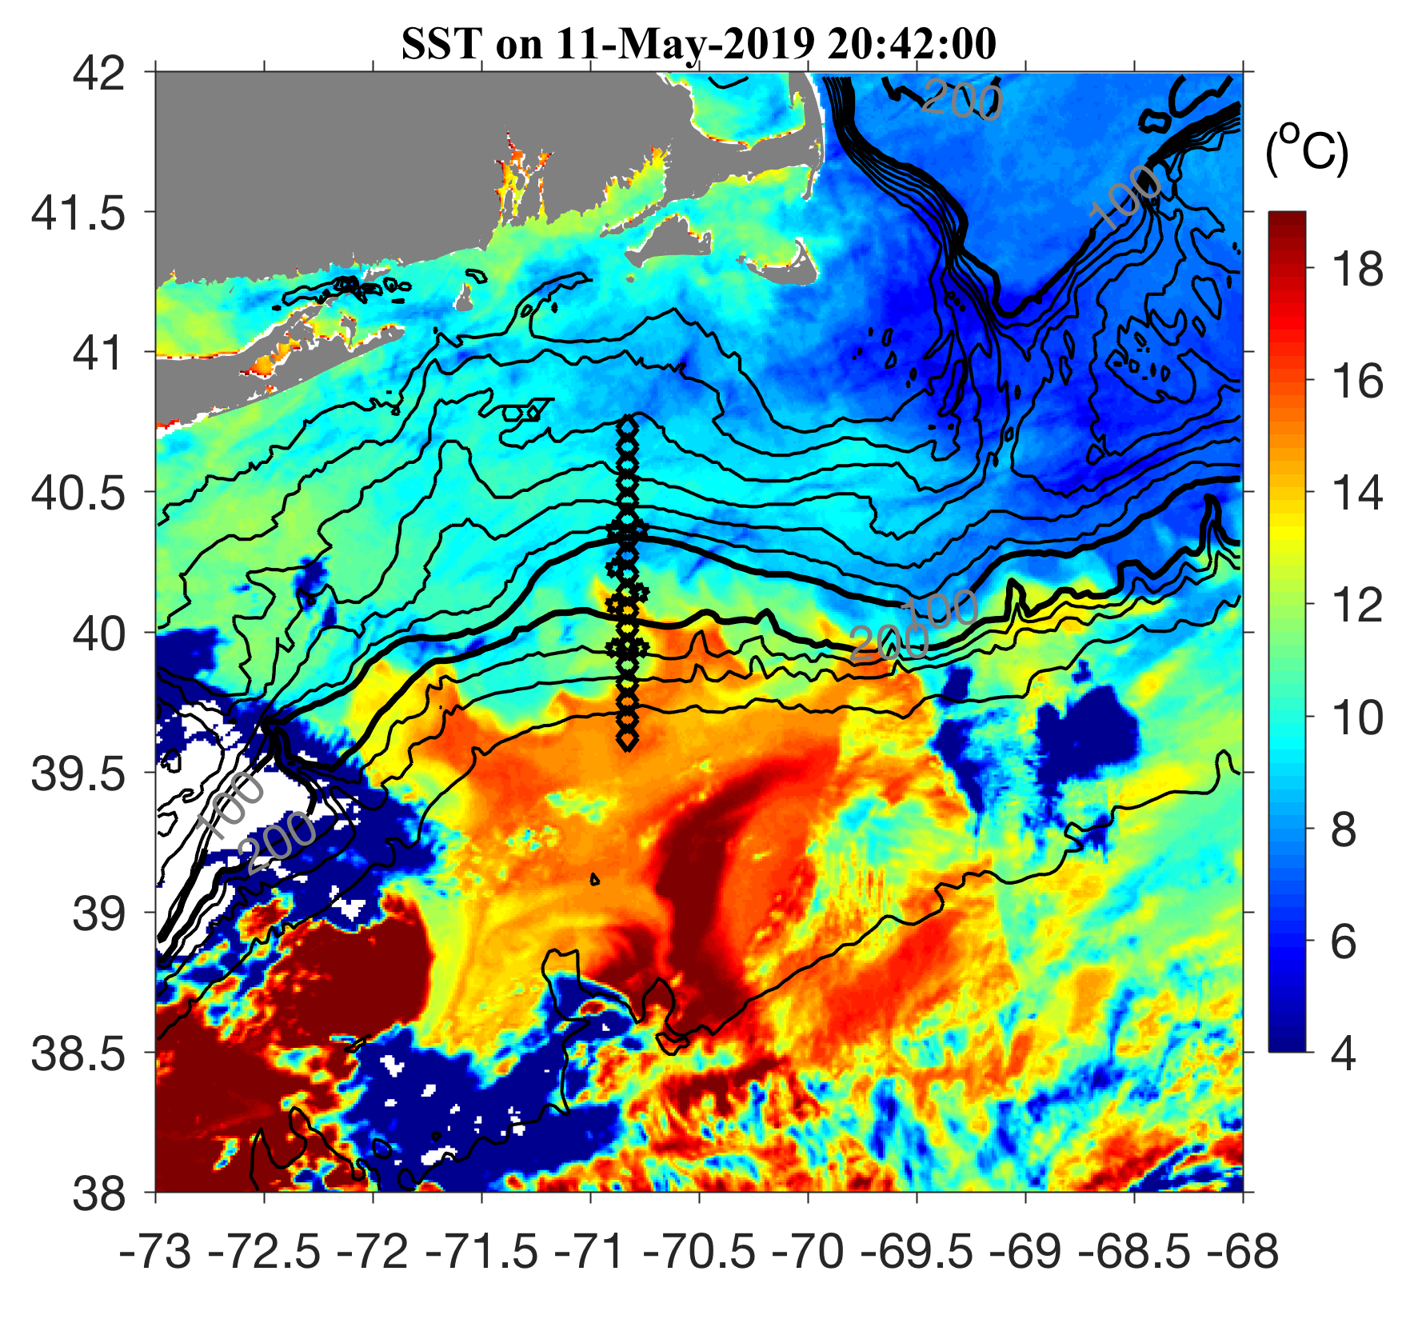
May 11 2019

Slide 7
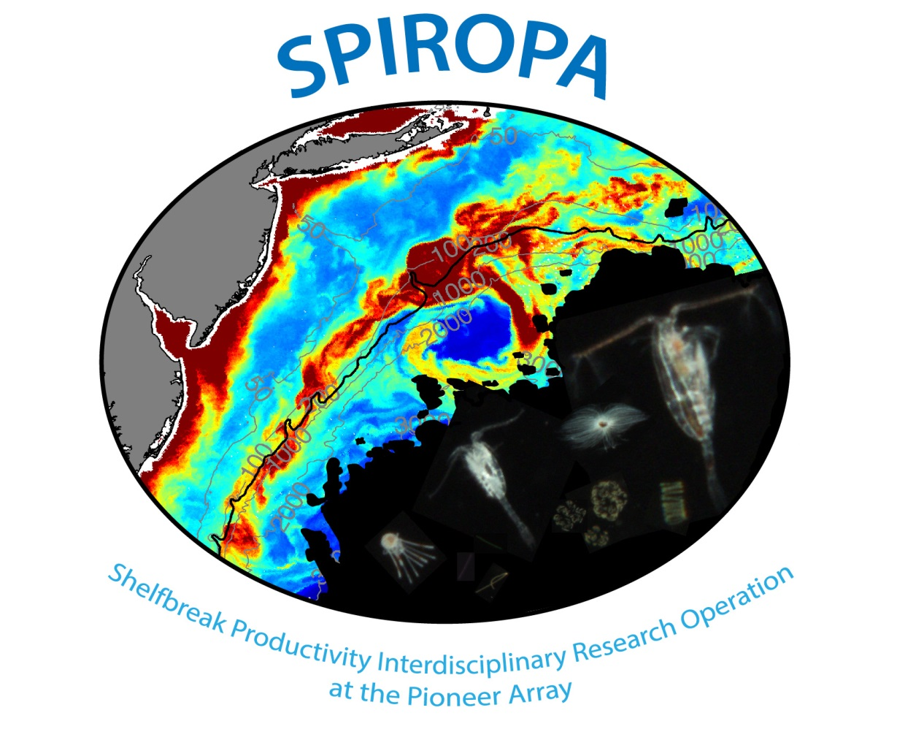
Science Meeting #2

Slide 8
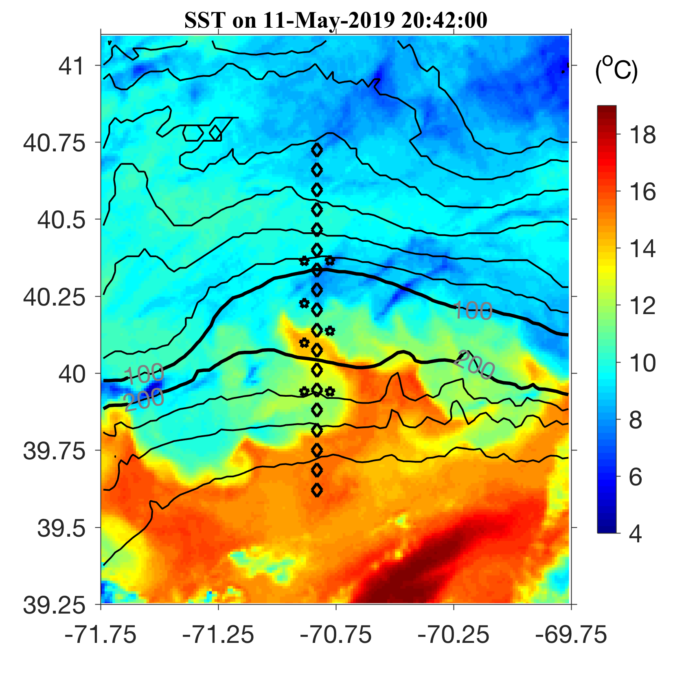
May 11 2019

Slide 9
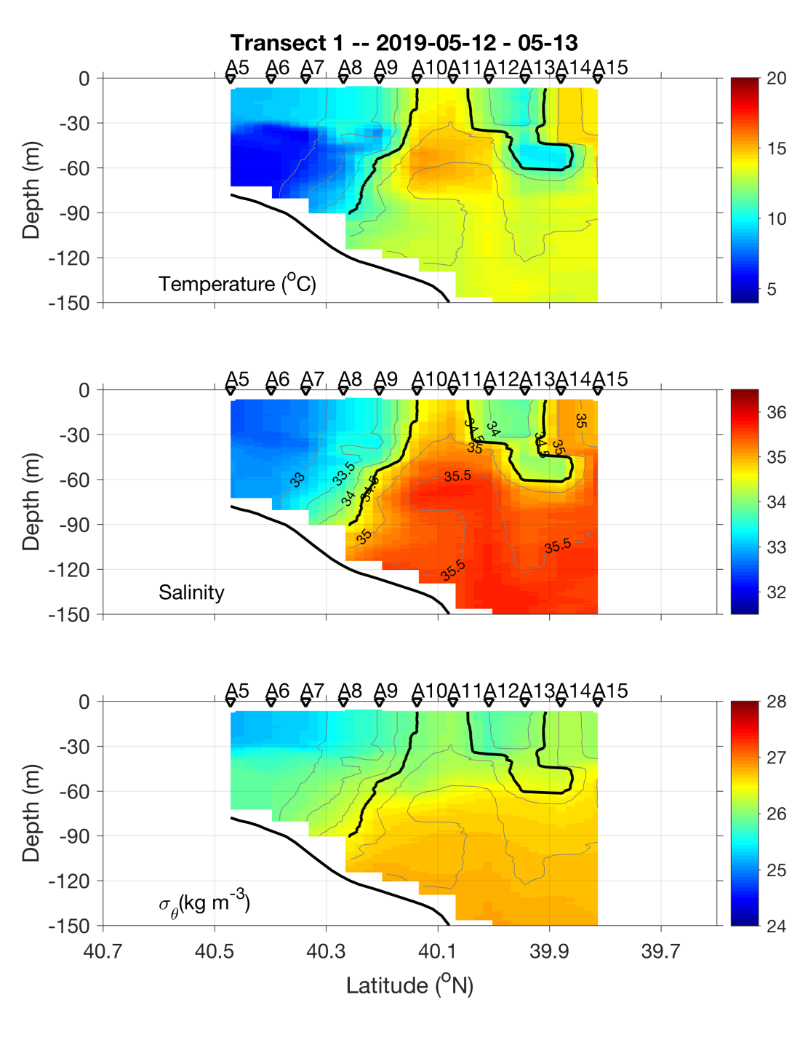
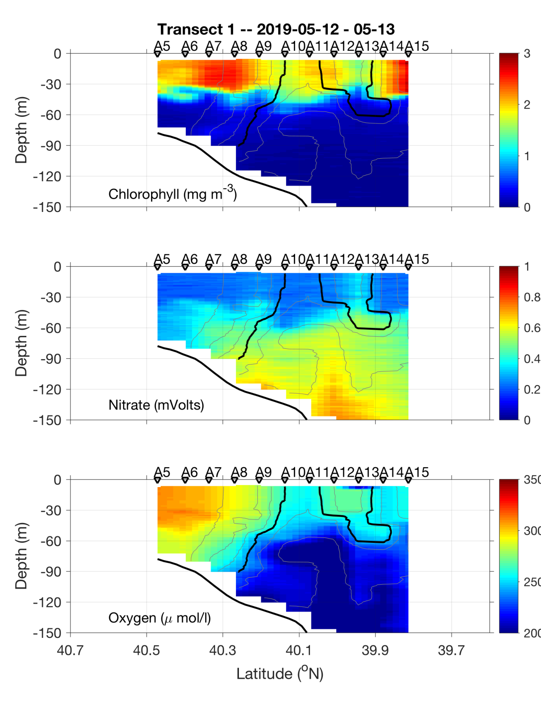
Transect 1 – May 12-13

Slide 10
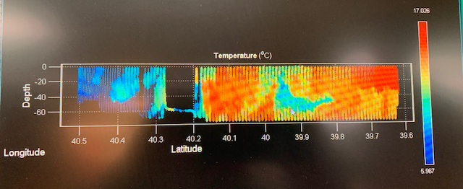
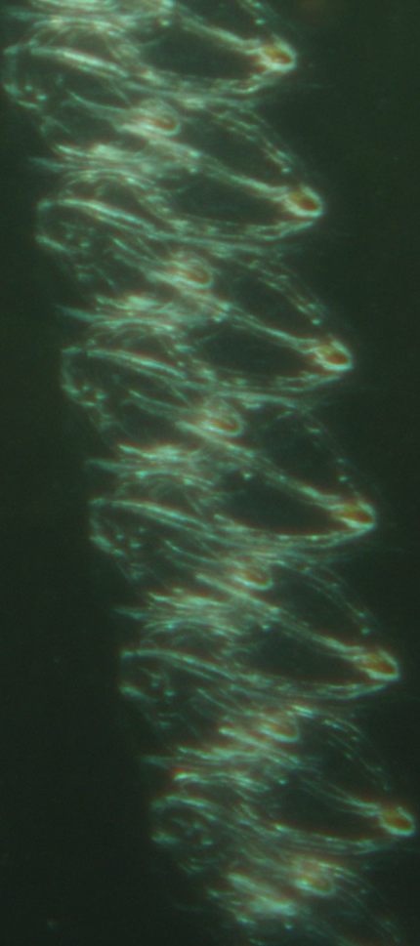
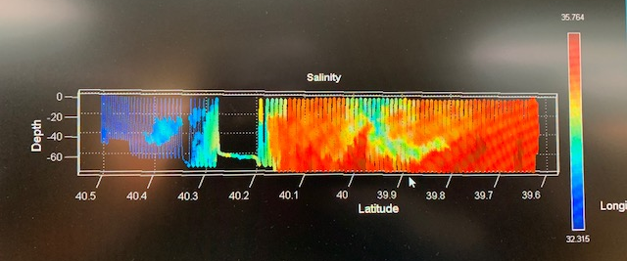
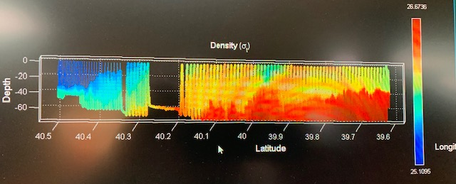
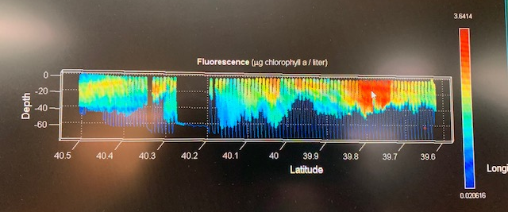
VPR Survey
May 14

Slide 11
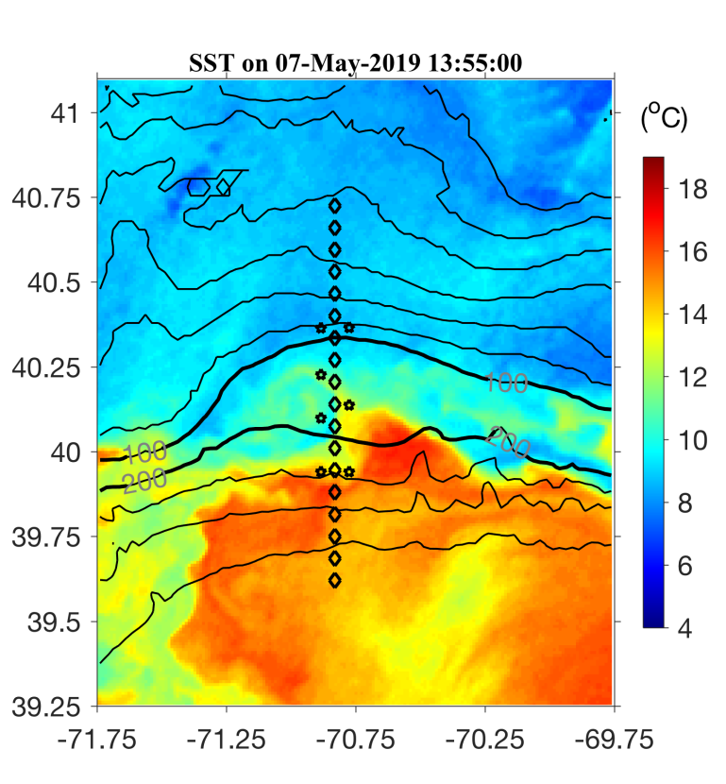
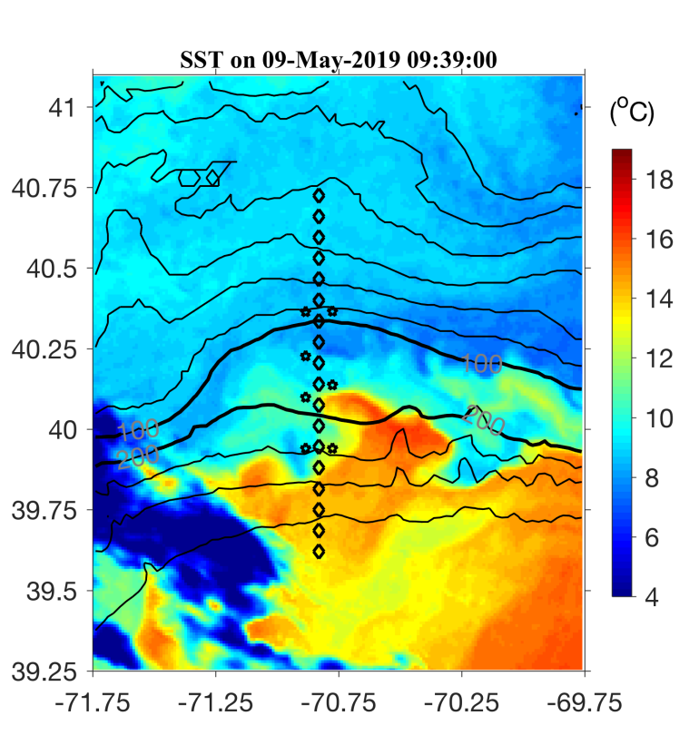

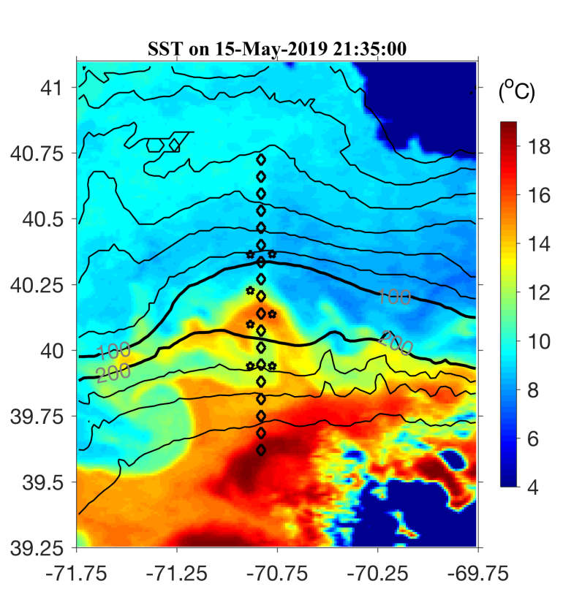
May 7 May 9
May 11 May 15

Slide 12
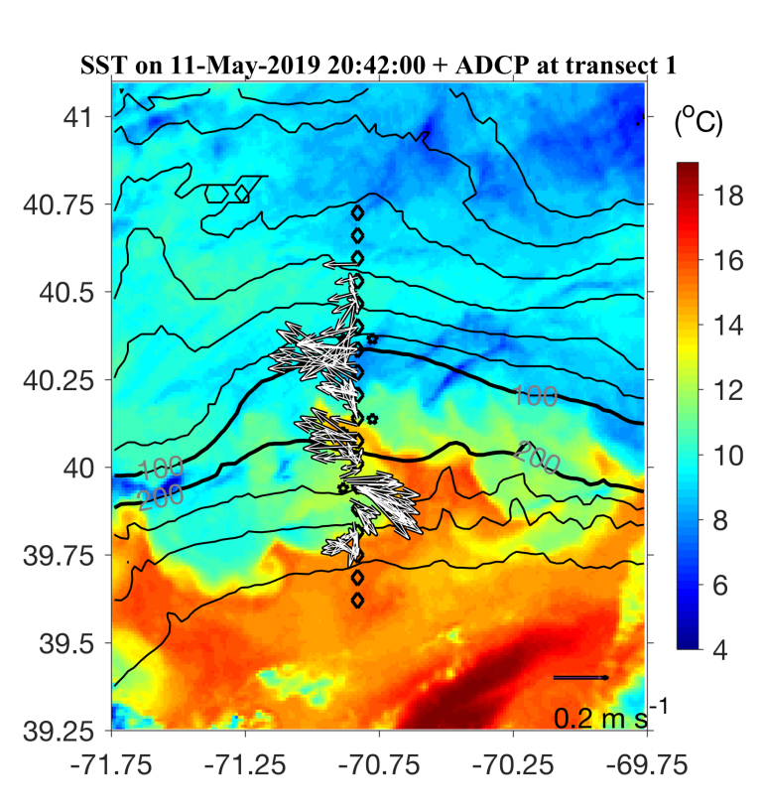
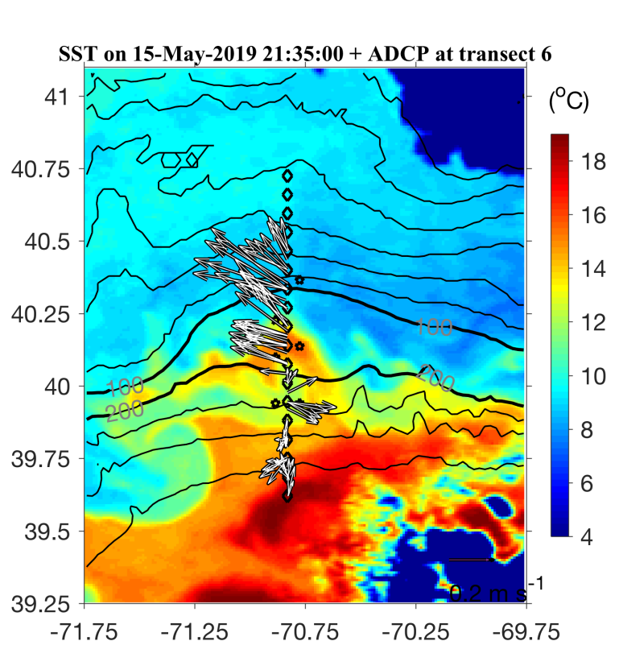
May 7 May 9
May 11 May 15

Slide 13
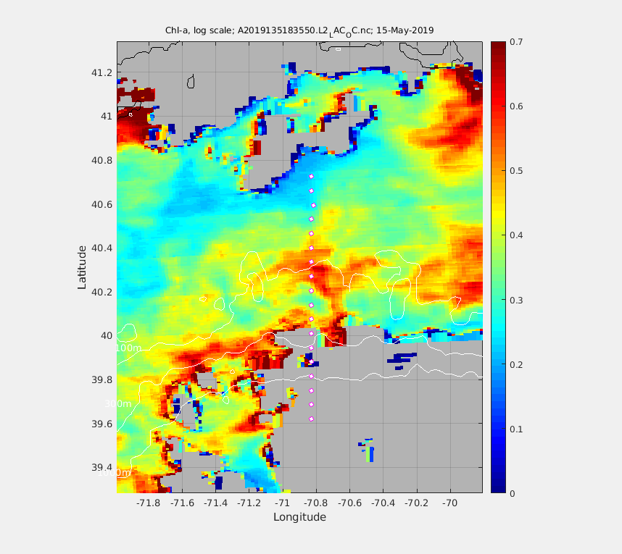
MODIS Chl 15 May 2019
A6
A8

Slide 14
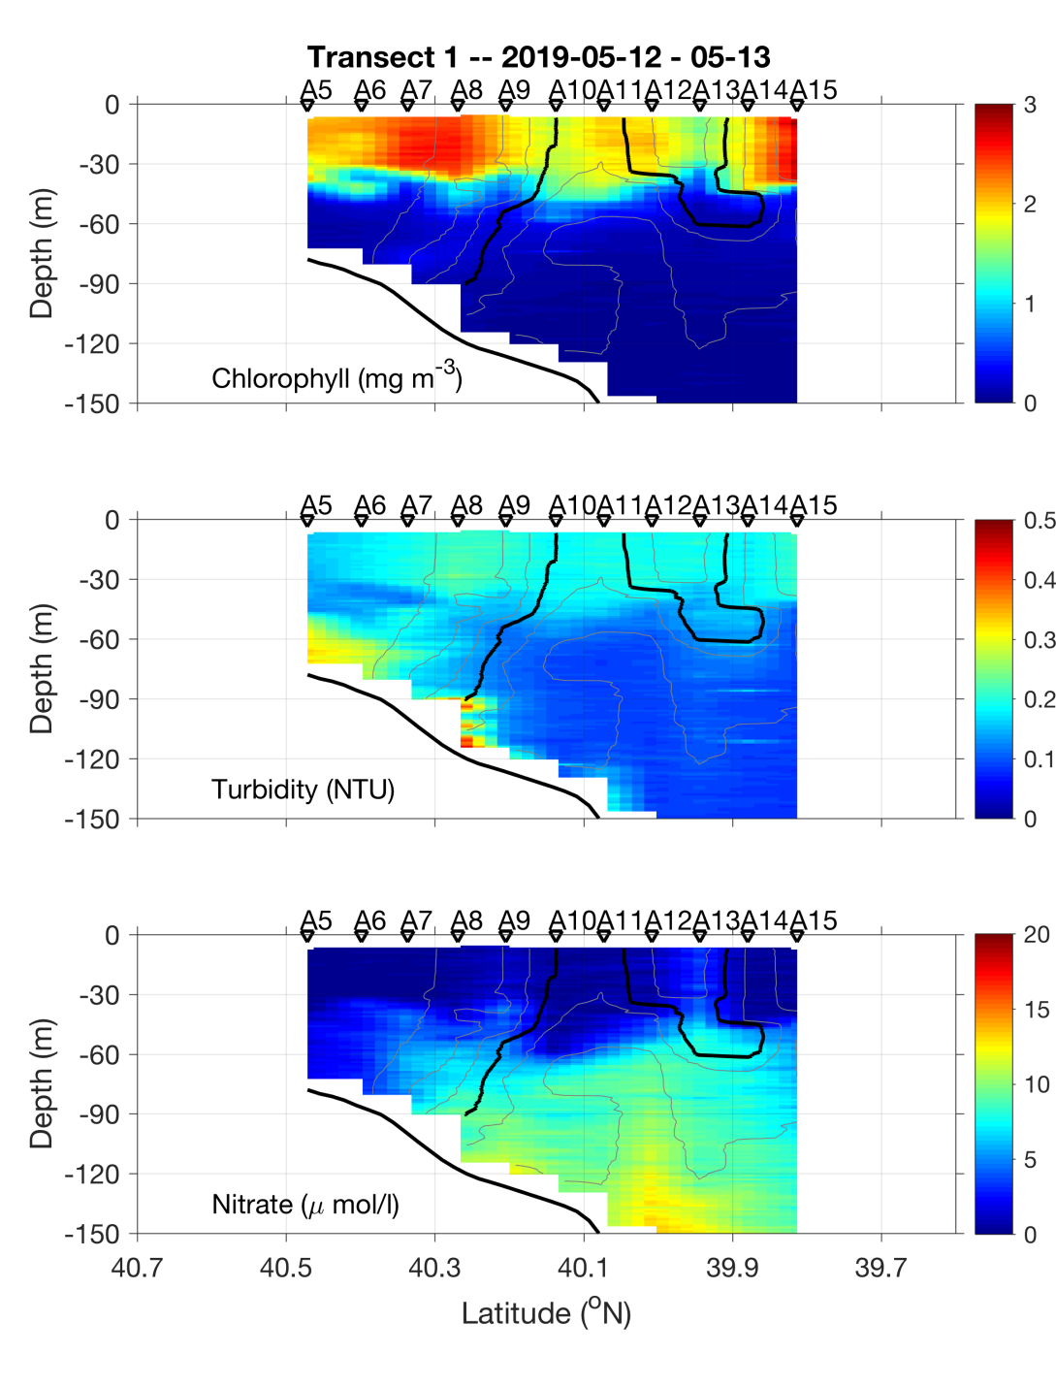
May 12-13

Slide 15
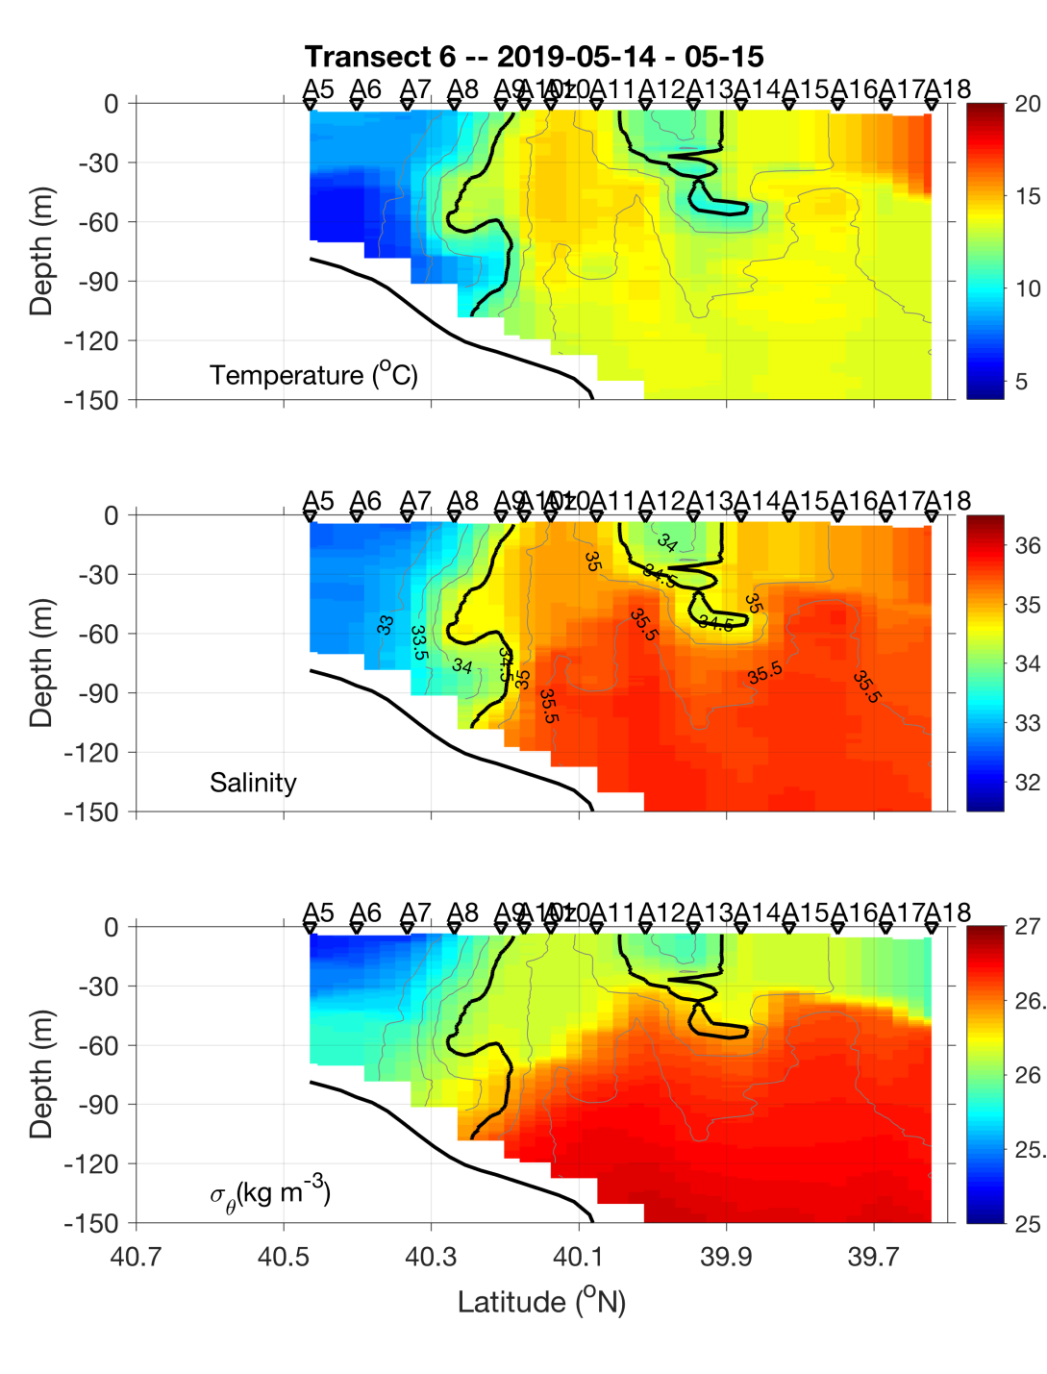
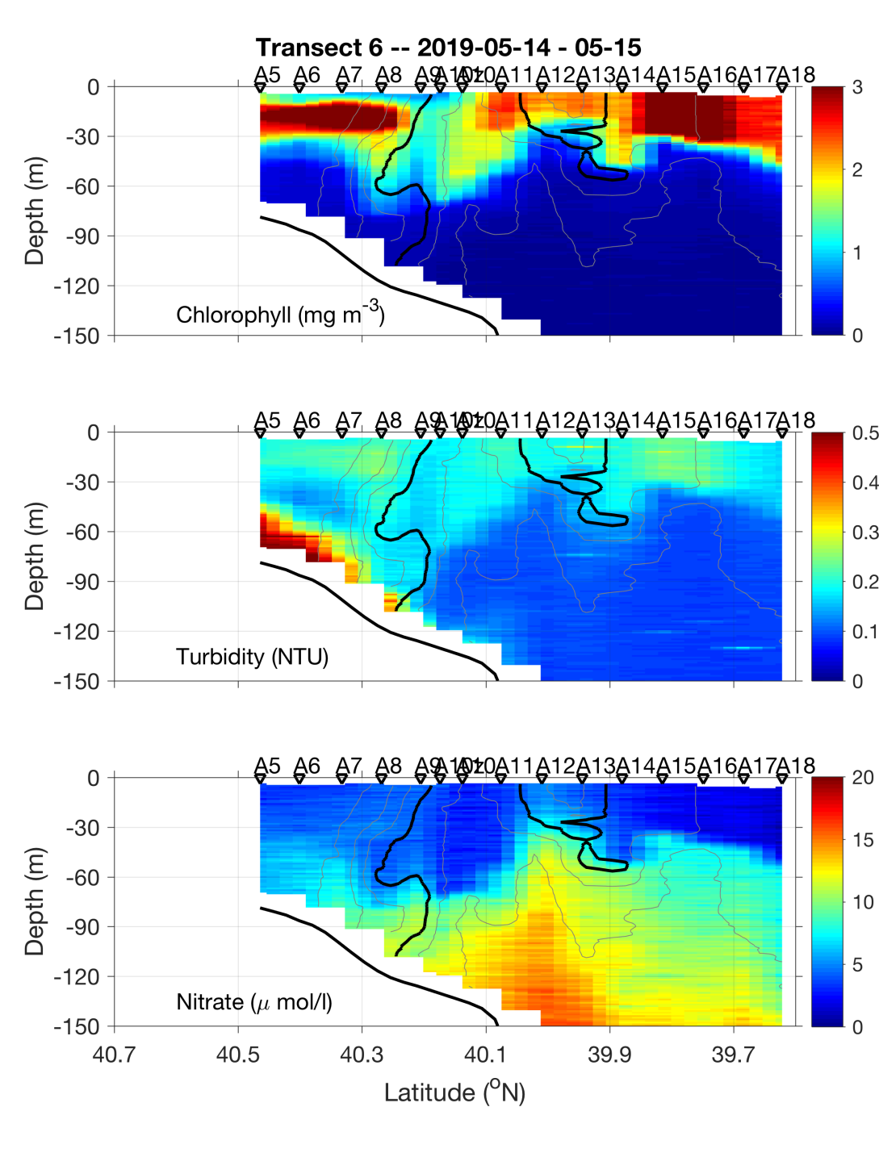
May 14-15

Slide 16
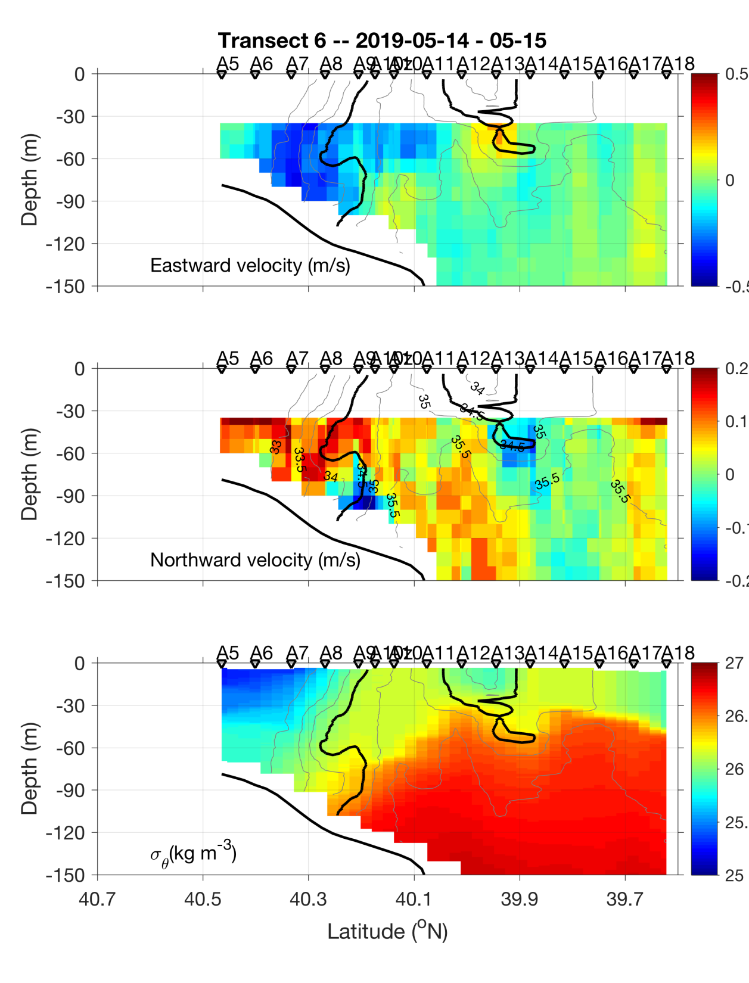
ADCP velocities
Eastward
Northward

Slide 18
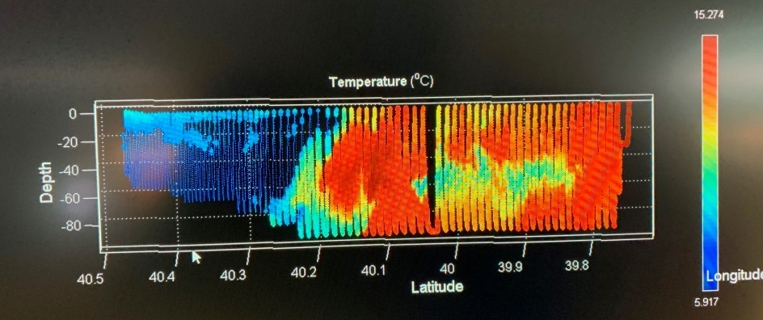
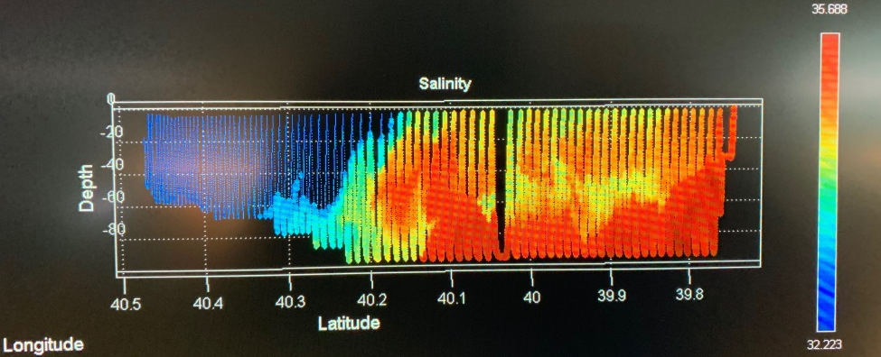
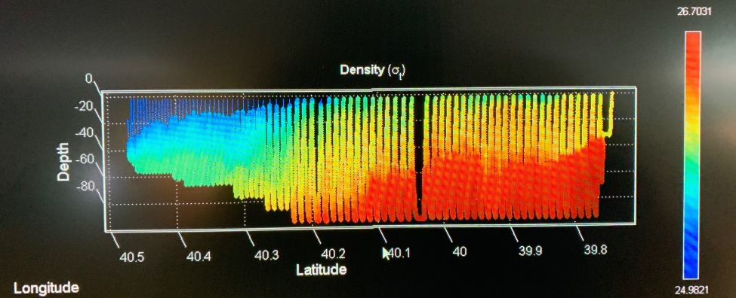
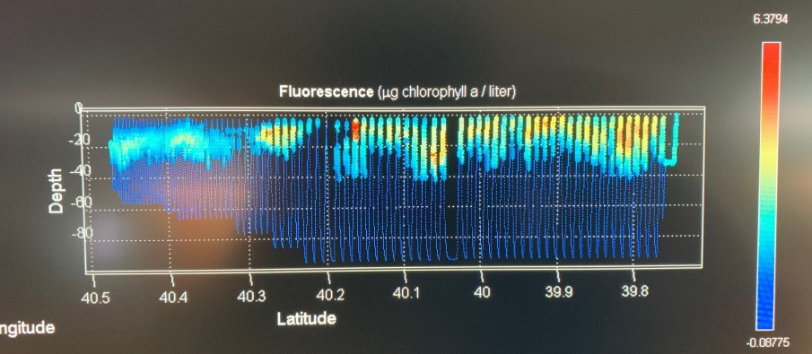
VPR Survey
May 16

Slide 19
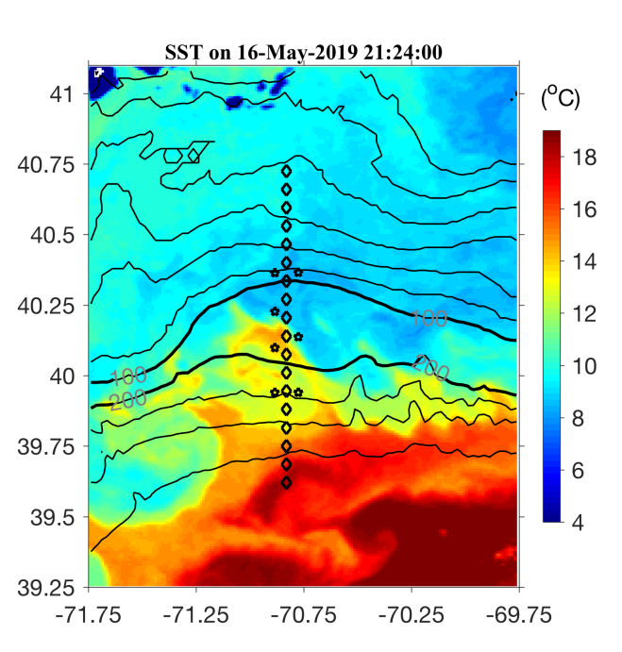
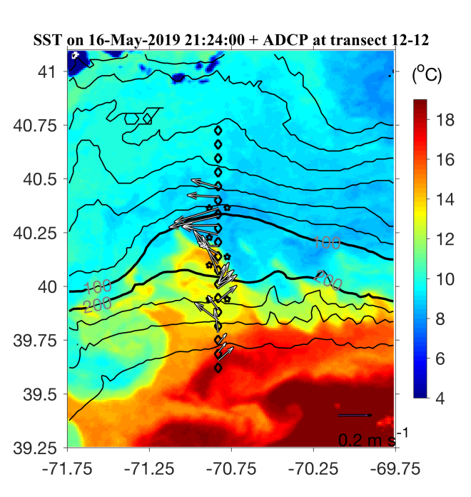
SST 16 May 2019

Slide 20
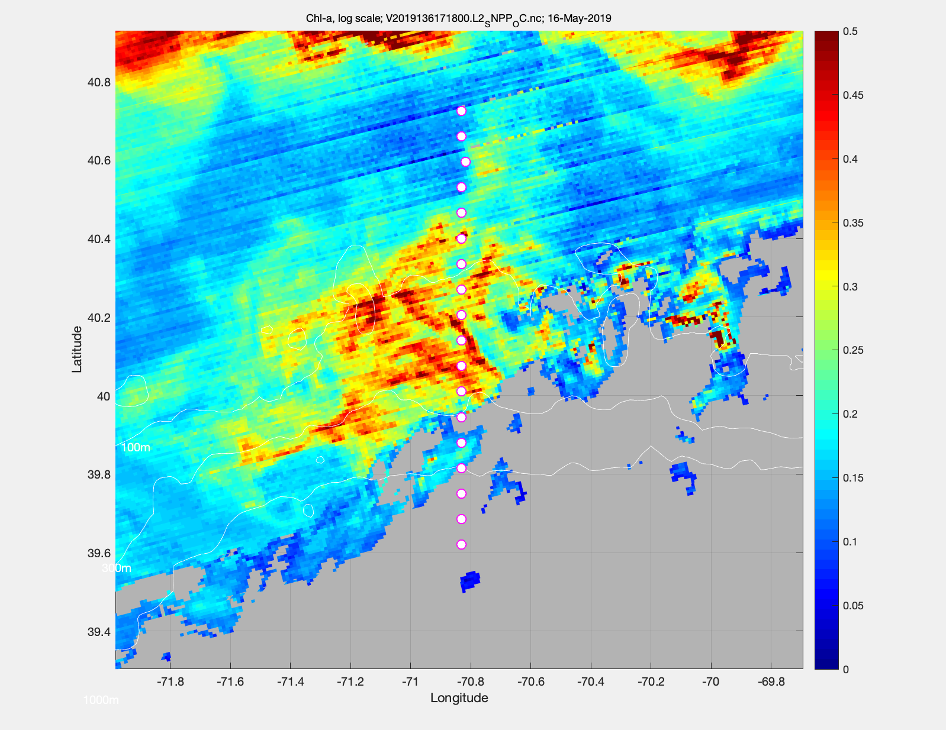
Chl 16 May 2019

Slide 21
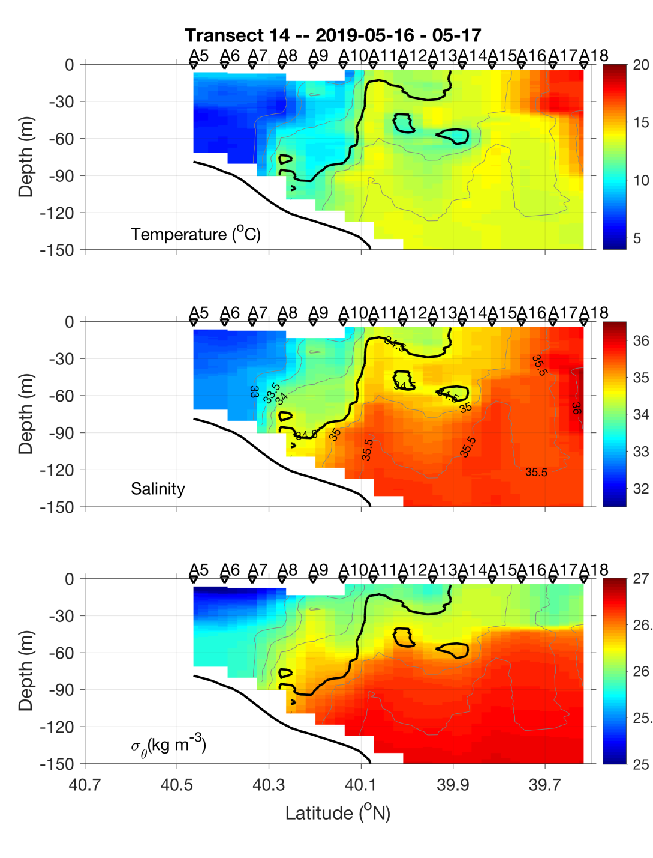
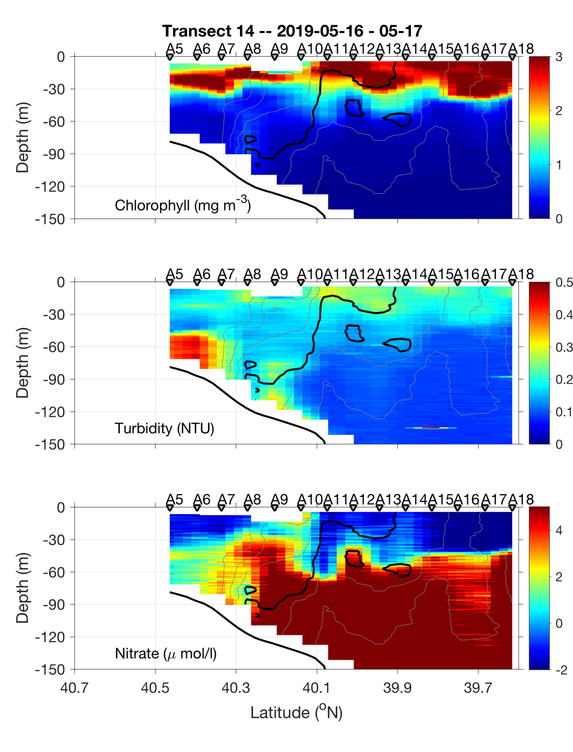
May 16-17

Slide 22
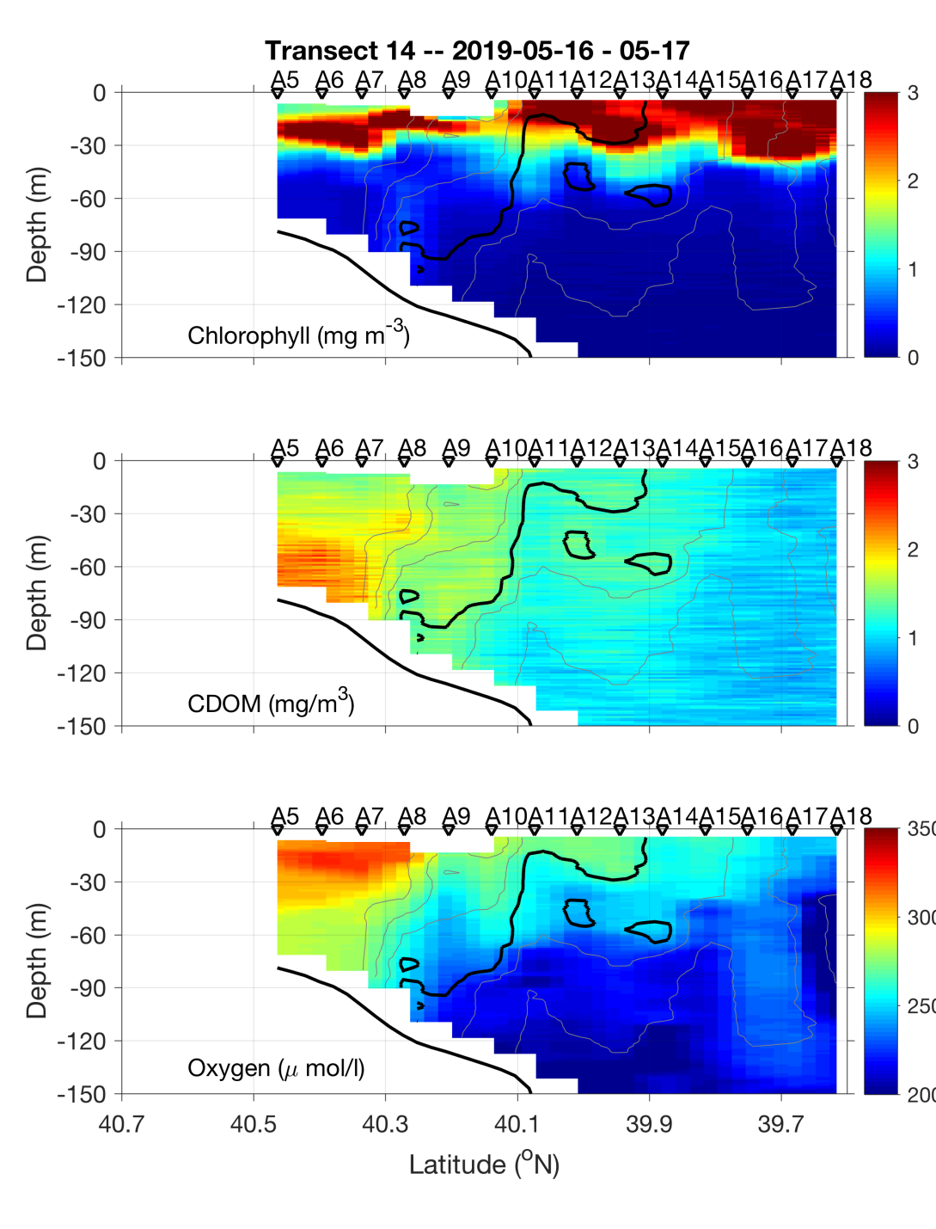
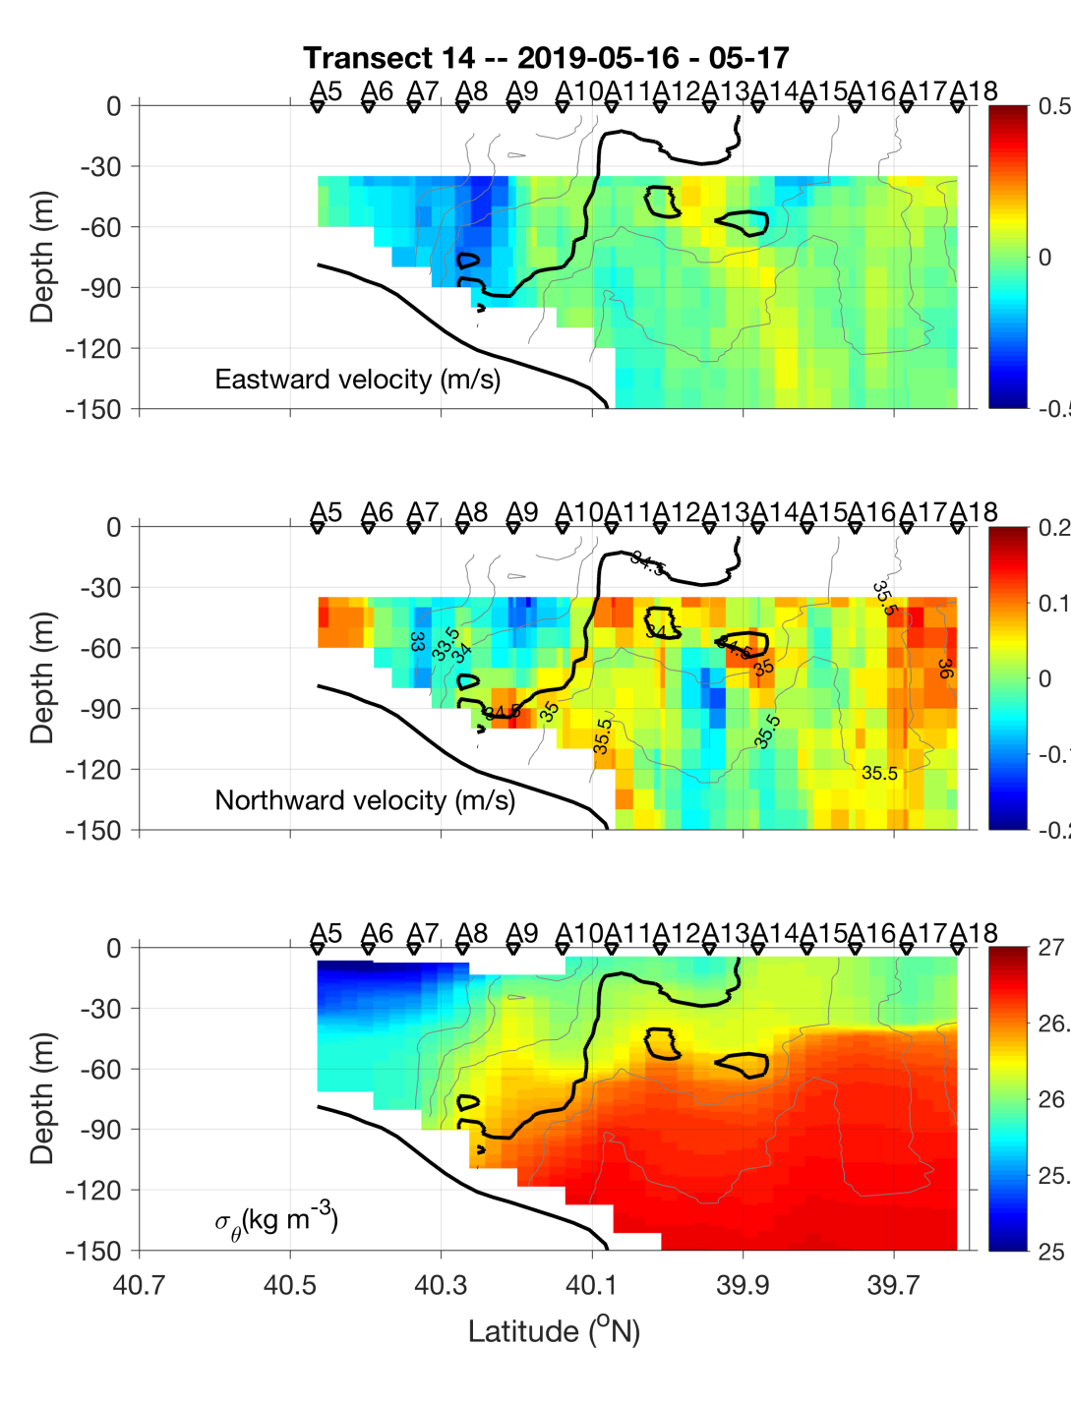
May 16-17

Slide 23
Science Meeting 5/20/19

Slide 24
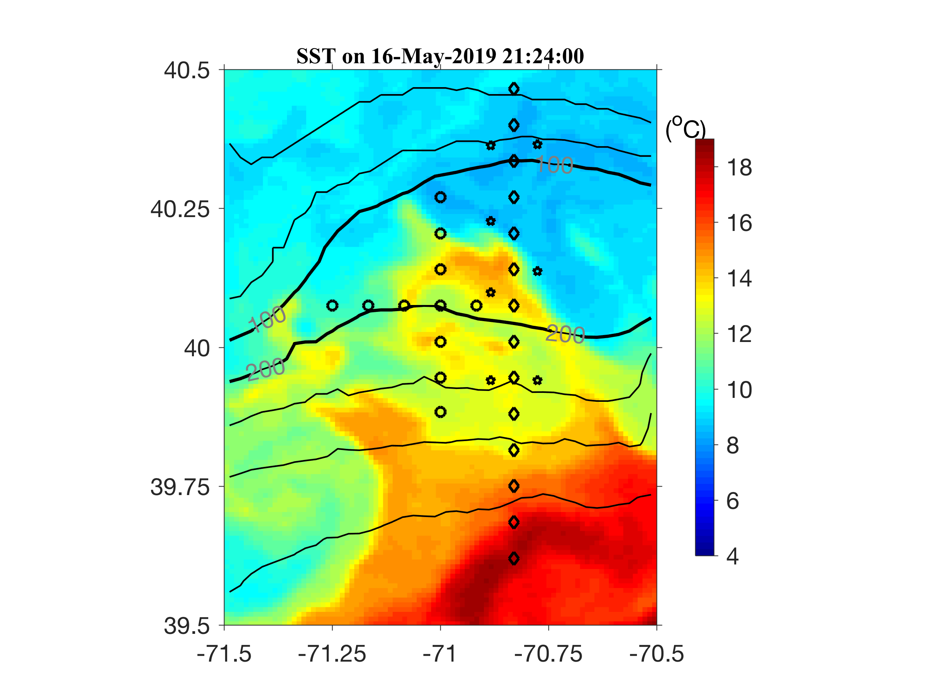
Eddy survey 17-18 May

Slide 25
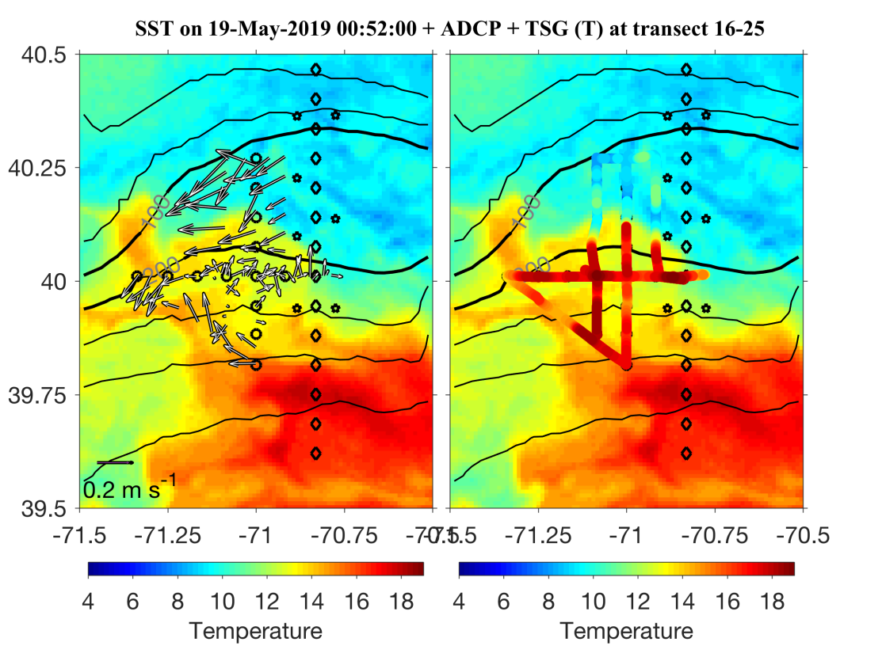
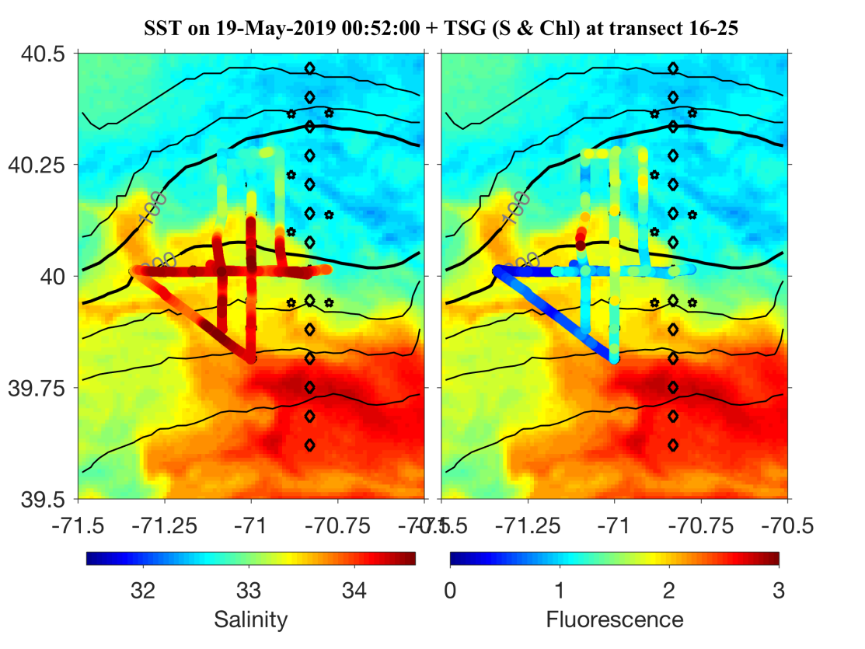
Eddy – hunting dashboard:
Underway properties overlayed on SST
Gordon and Hilde
ADCP Temp
Salinity Fluorescence

Slide 26
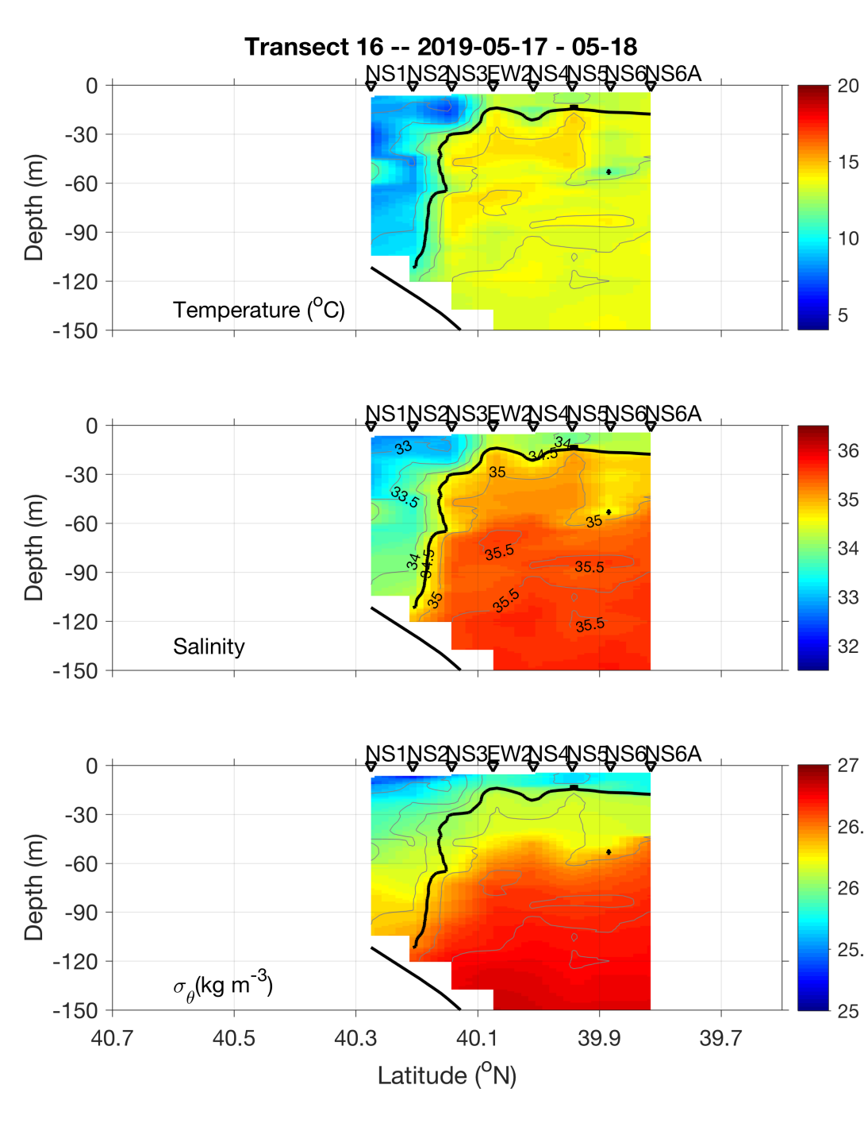
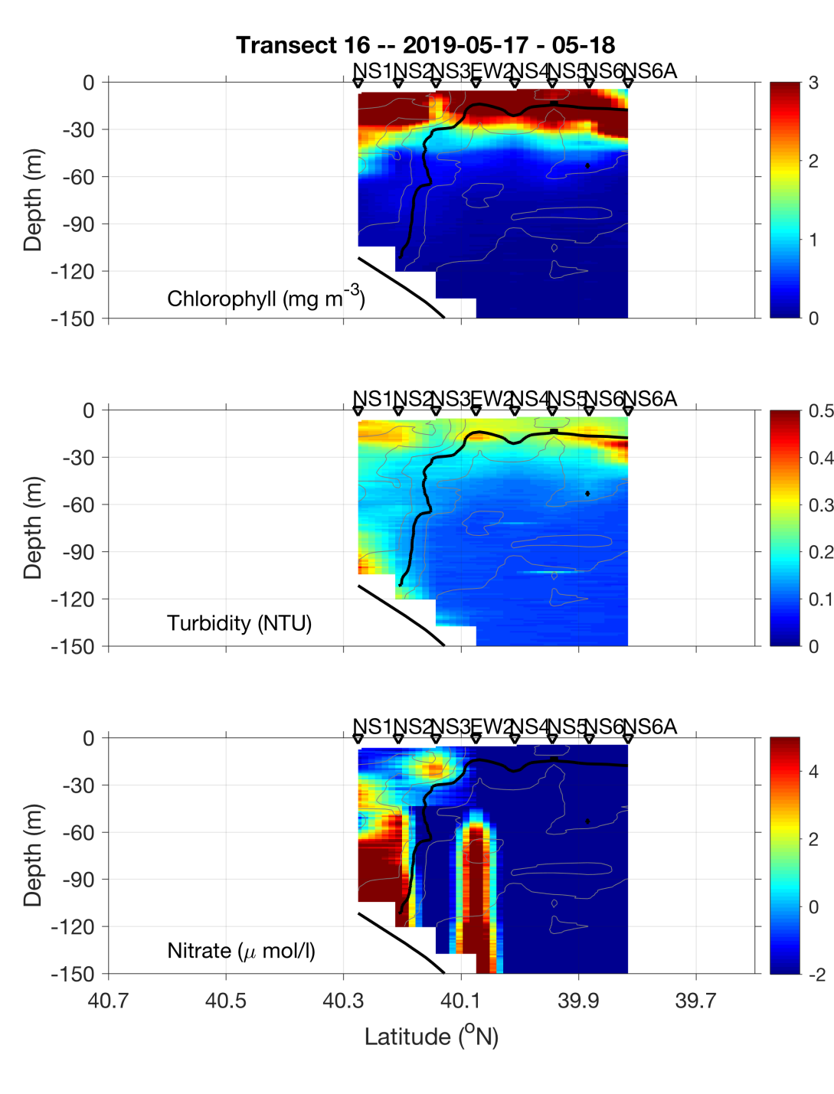
Eddy Survey – NS Section
Eddy
Center
Eddy
Center

Slide 27
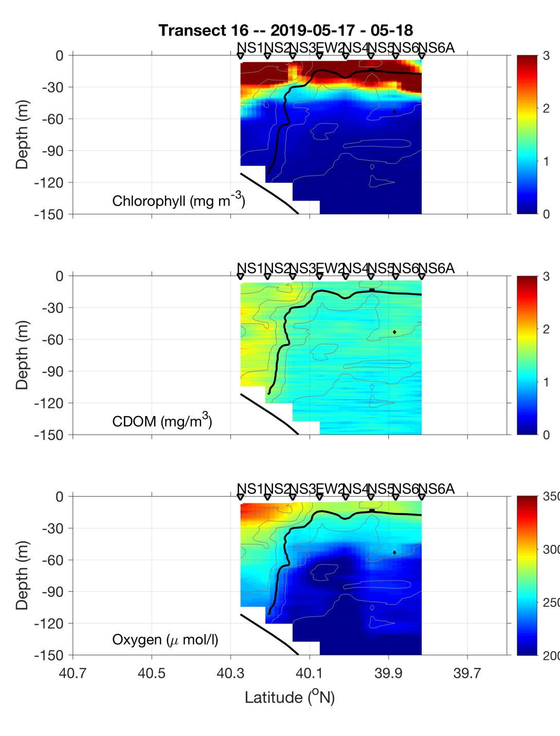
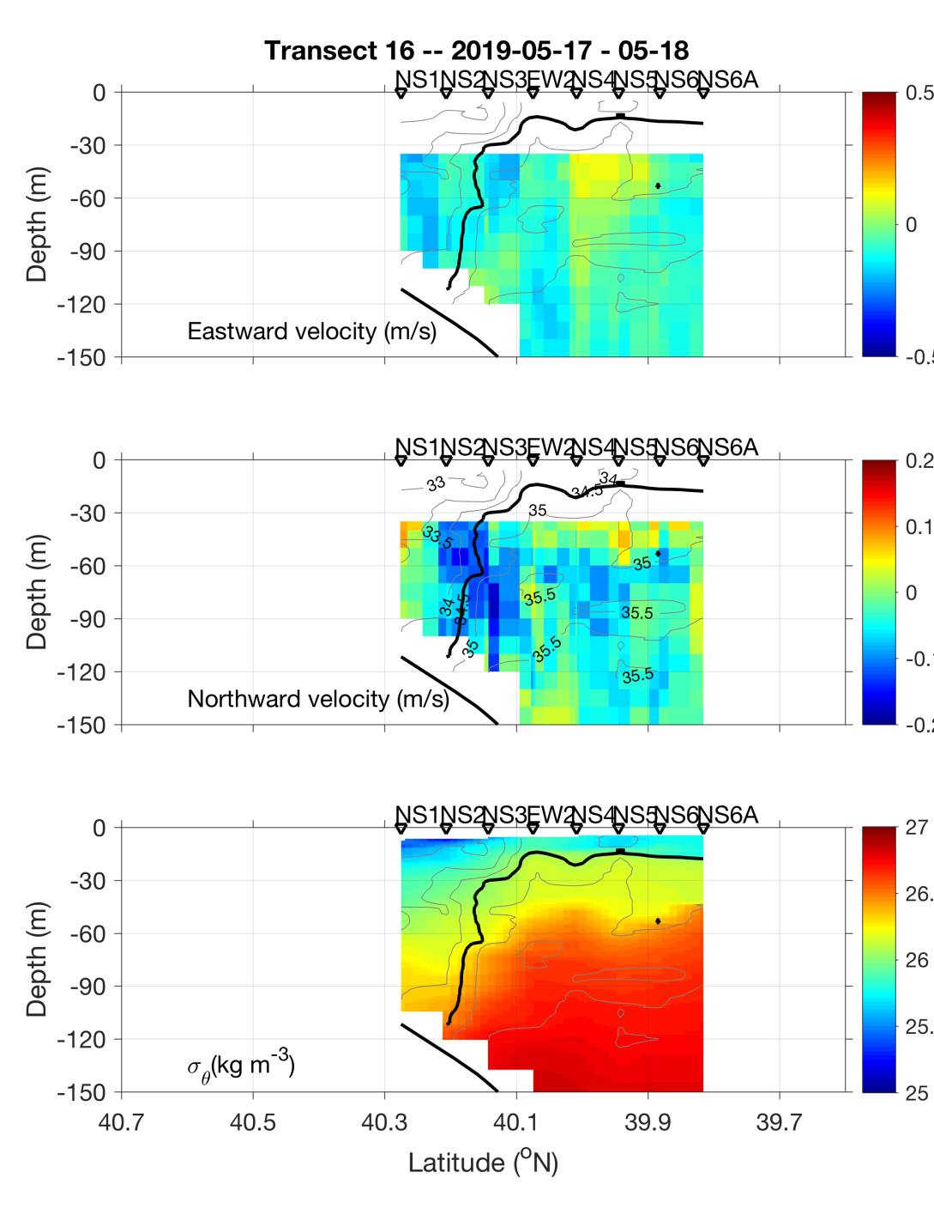
Eddy Survey – NS Section
Eddy
Center
Eddy
Center

Slide 28
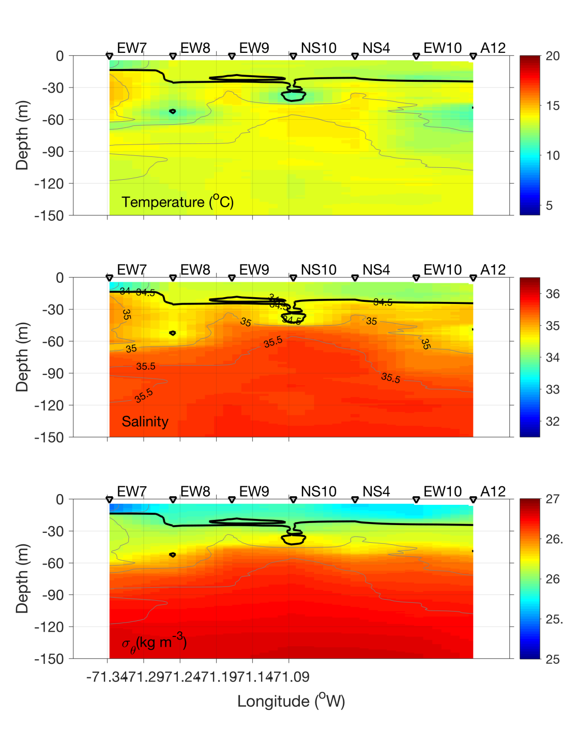
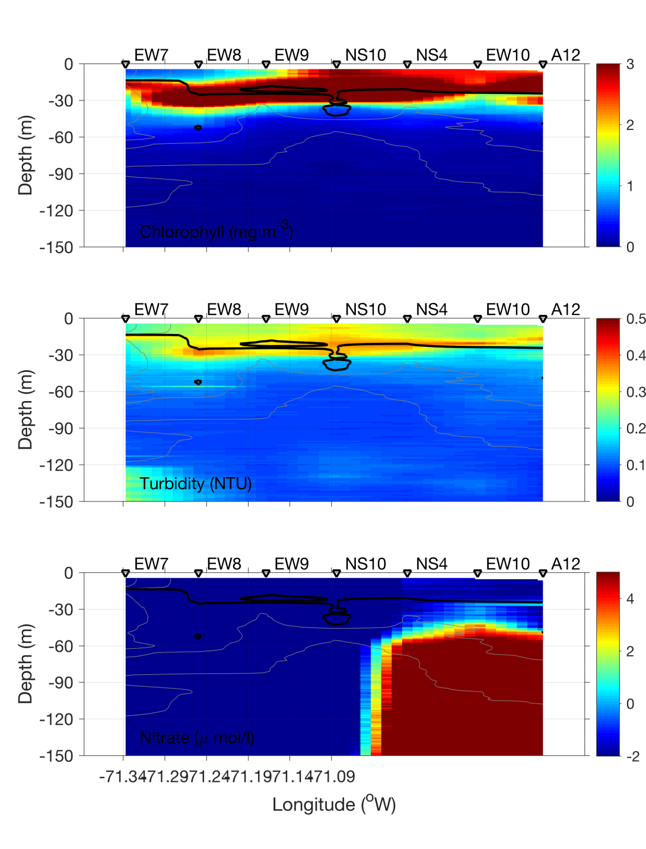
Eddy Survey – EW Section
Eddy
Center
Eddy
Center

Slide 29
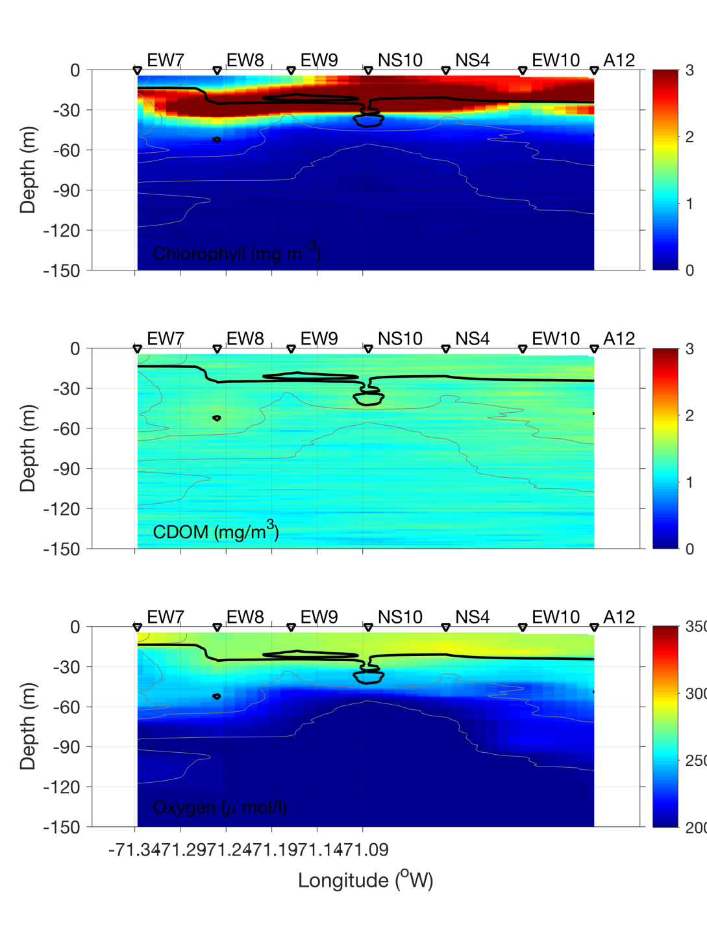
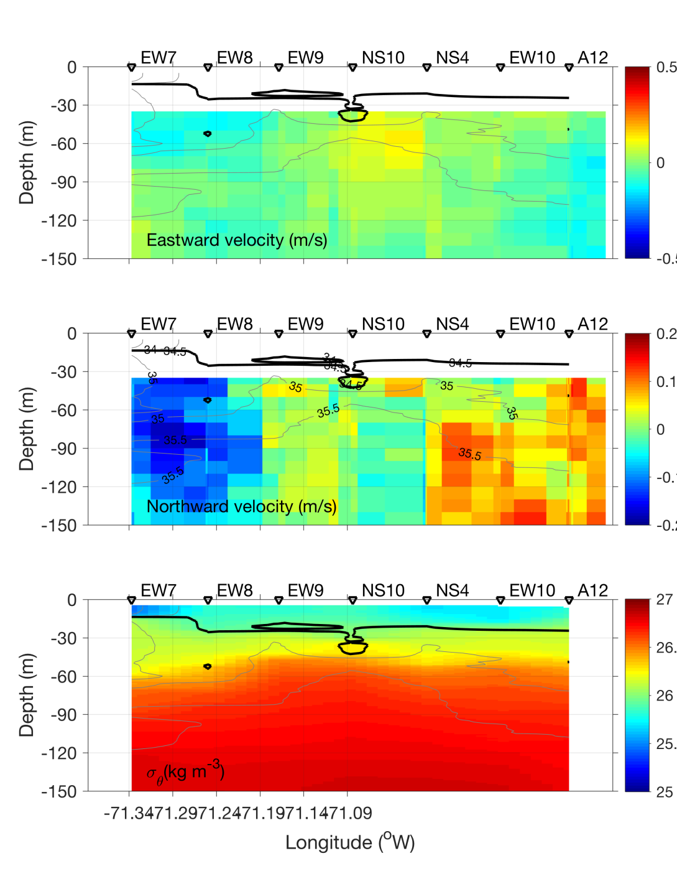
Eddy Survey – EW Section
Eddy
Center
Eddy
Center

Slide 30




VPR radial survey May 18
Eddy center
Eddy edge
Temperature Salinity
Density Fluorescence

Slide 31

VIIRS Chl May 18

Slide 32

VIIRS Chl May 18
Our eddy?

Slide 33


SST on 18 and 20 May

Slide 34




VPR Survey May 19
North
Temperature Salinity
Density Fluorescence
A5
A12
South
Diatoms aplenty

Slide 35
VPR diatom images

Slide 37

VIIRS Chl May 19

Slide 38

VIIRS Chl May 19

Slide 39

Satellite Altimetry May 15, 2019

Slide 40


