Slide 1
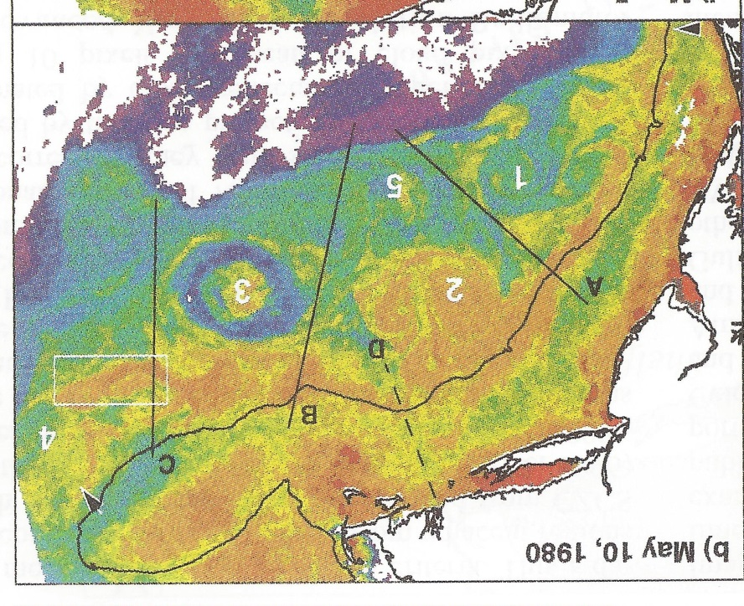
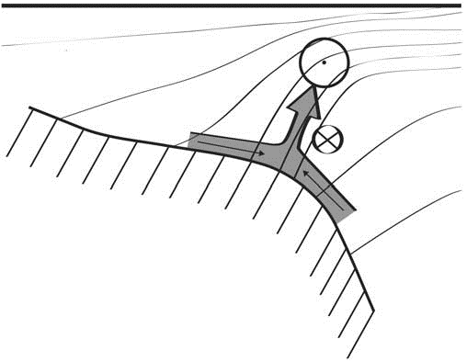
Shelfbreak frontal dynamics: mechanisms of upwelling, net community production, and ecological implications
Ryan et al. 1999
Linder et al. 2004
Gawarkiewicz and Chapman 1992
Chapman and Lentz 1994
Marra et al. 1990

Slide 2


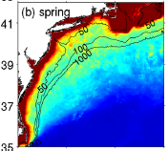

2013, JGR
Satellite CHL climatology
Why is there no mean enhancement of chlorophyll at the shelf break front?
H₁: Top-down control by zooplankton grazing
H₂: Spatial and temporal intermittency of the upwelling events causes their net impact to be smoothed out in long-term means.

Slide 3

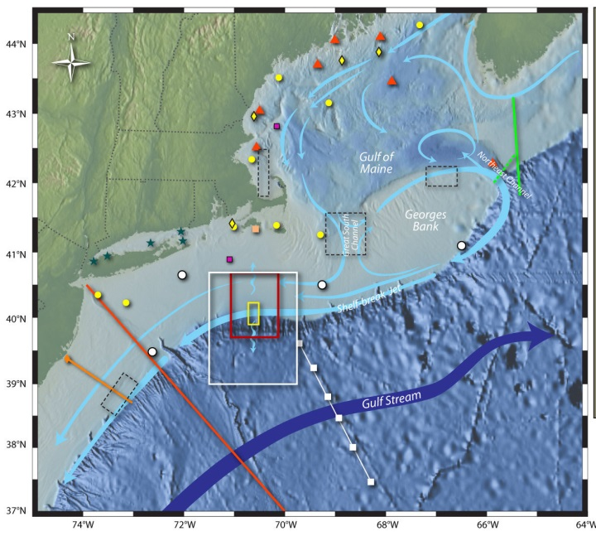
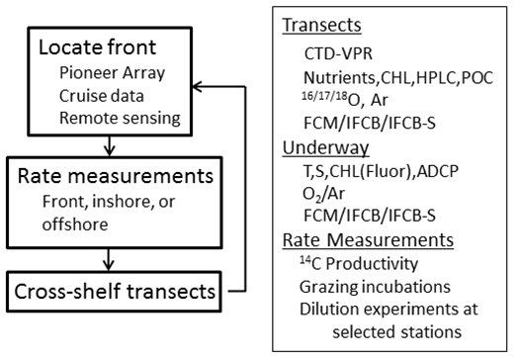
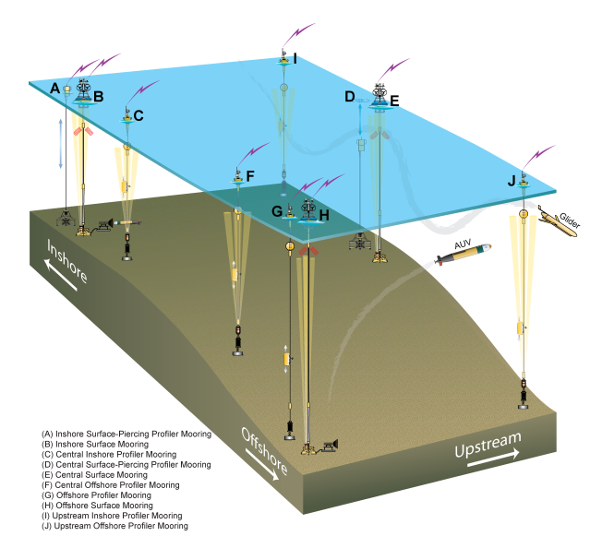
Shelfbreak frontal dynamics: mechanisms of upwelling, net community production, and ecological implications
Dennis McGillicuddy, Heidi Sosik, Gordon Zhang (WHOI)
Walker Smith (VIMS) Rachel Stanley (Wellesley College)
Jefferson Turner, Christian Petitpas (UMass Dartmouth)
3 Cruises R/V Neil Armstrong
NSF Ocean Observatory Initiative Pioneer Array

Slide 4
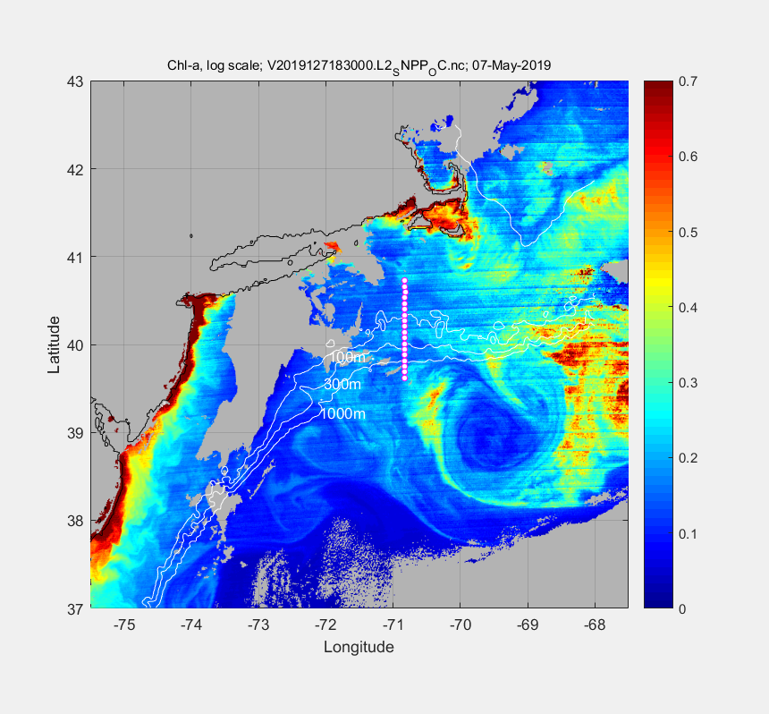
May 7 2019

Slide 5
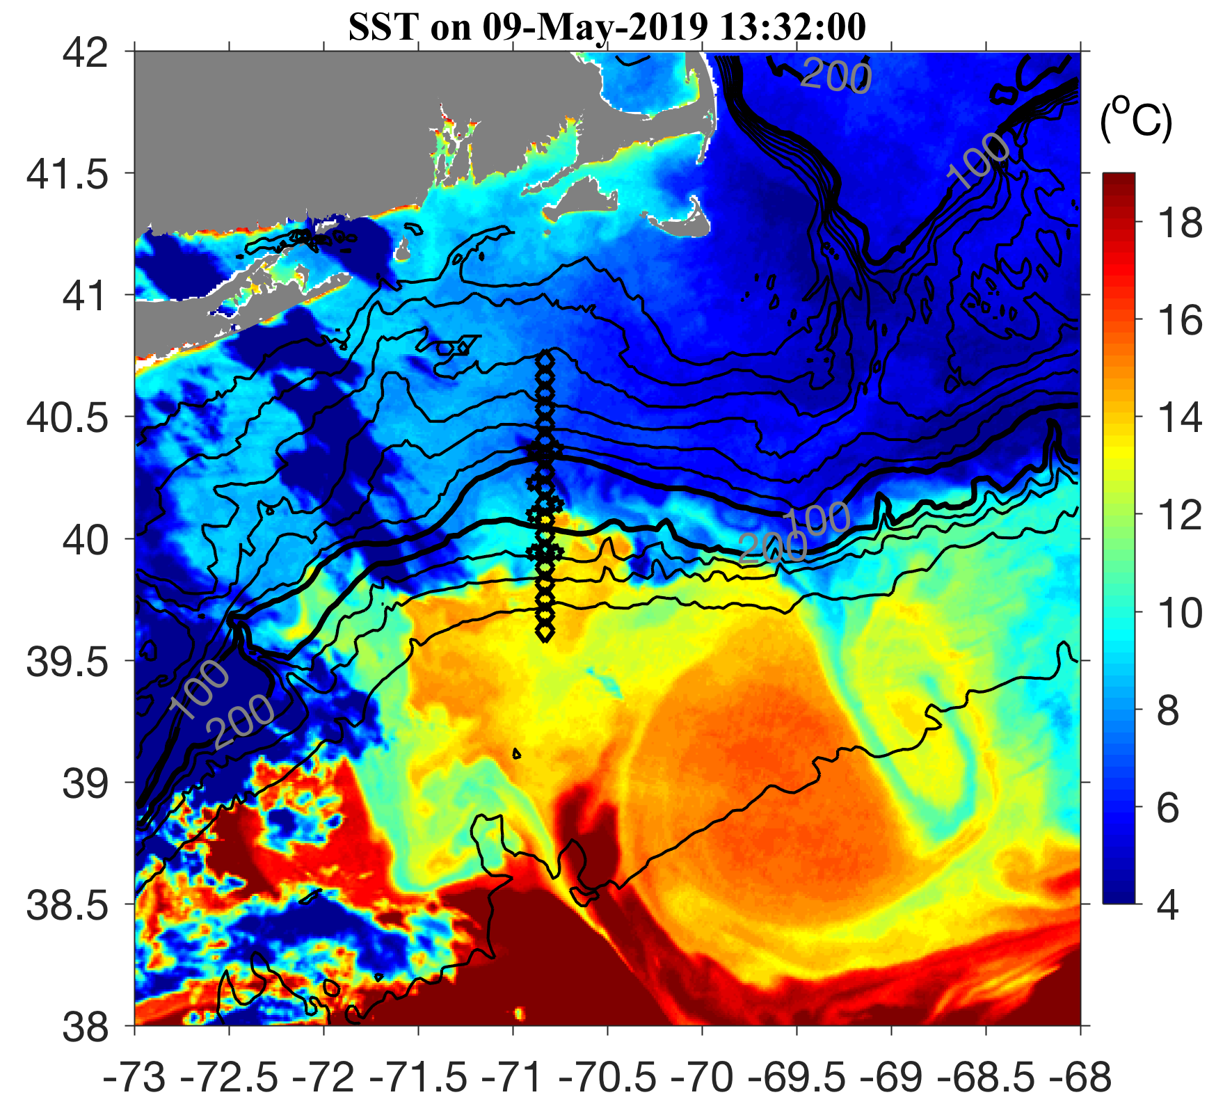
May 9 2019

Slide 6
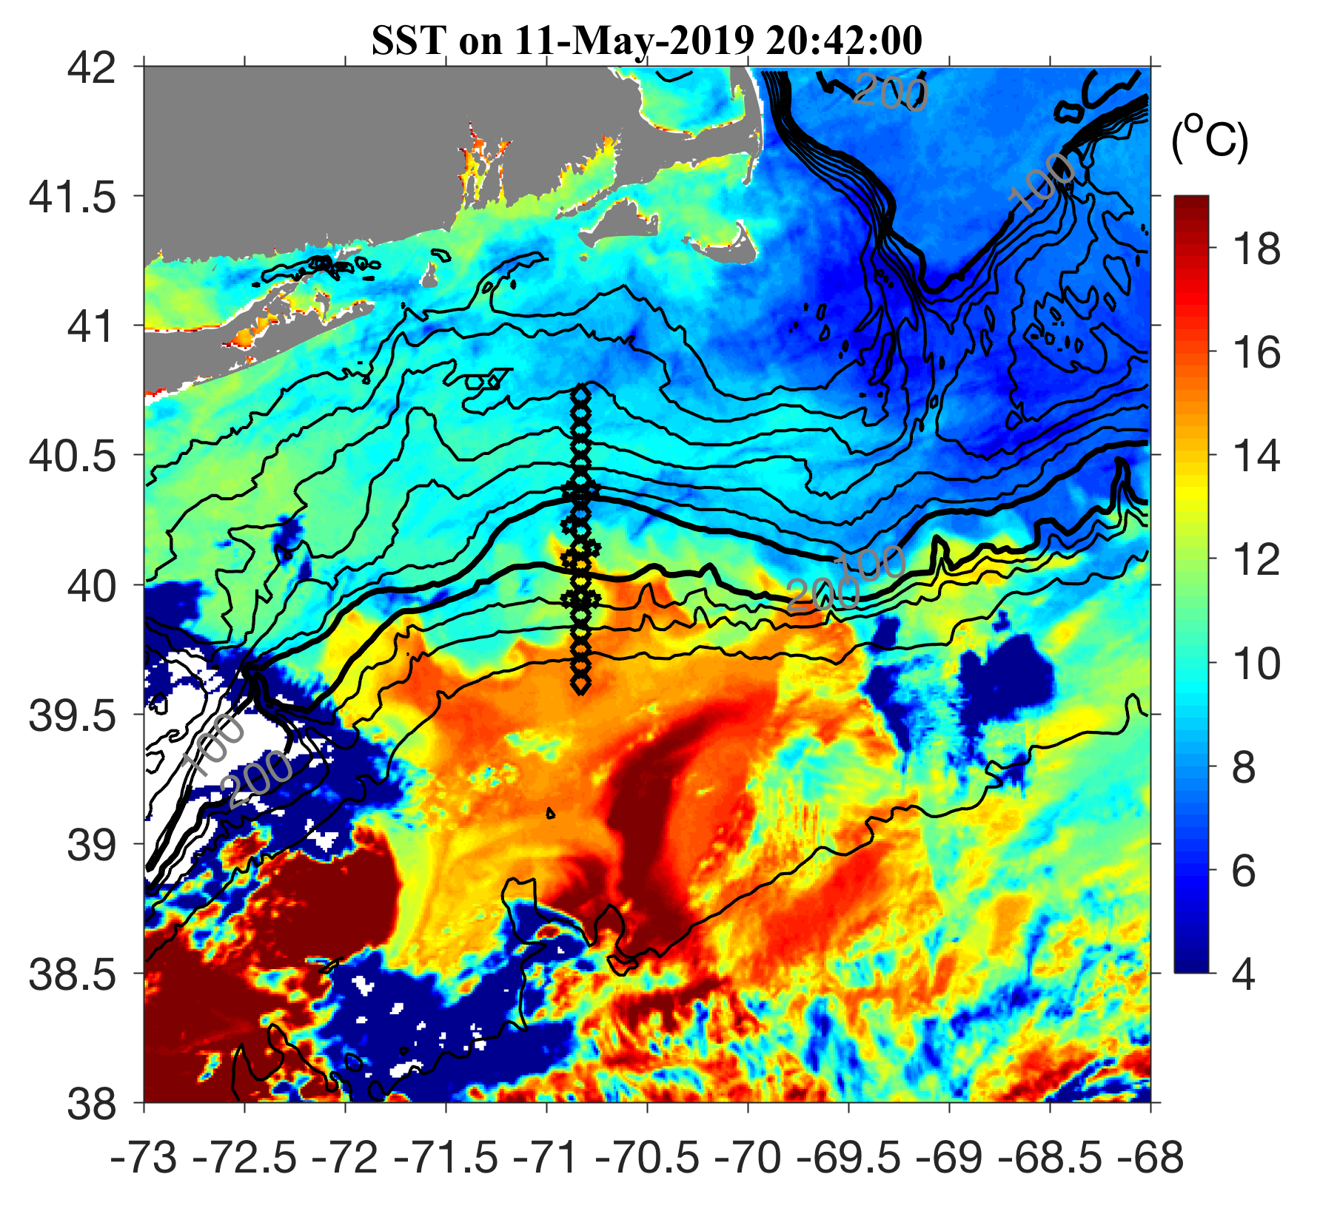
May 11 2019

Slide 7
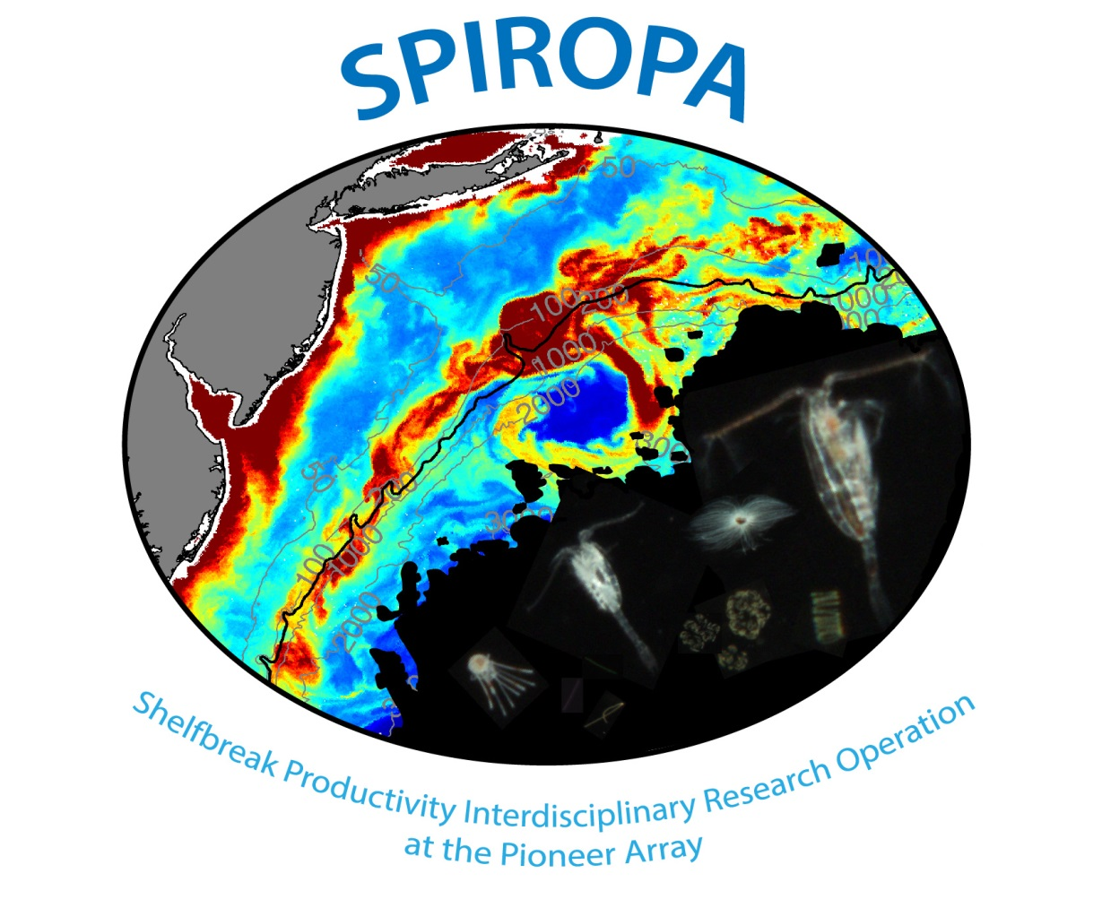

Slide 8
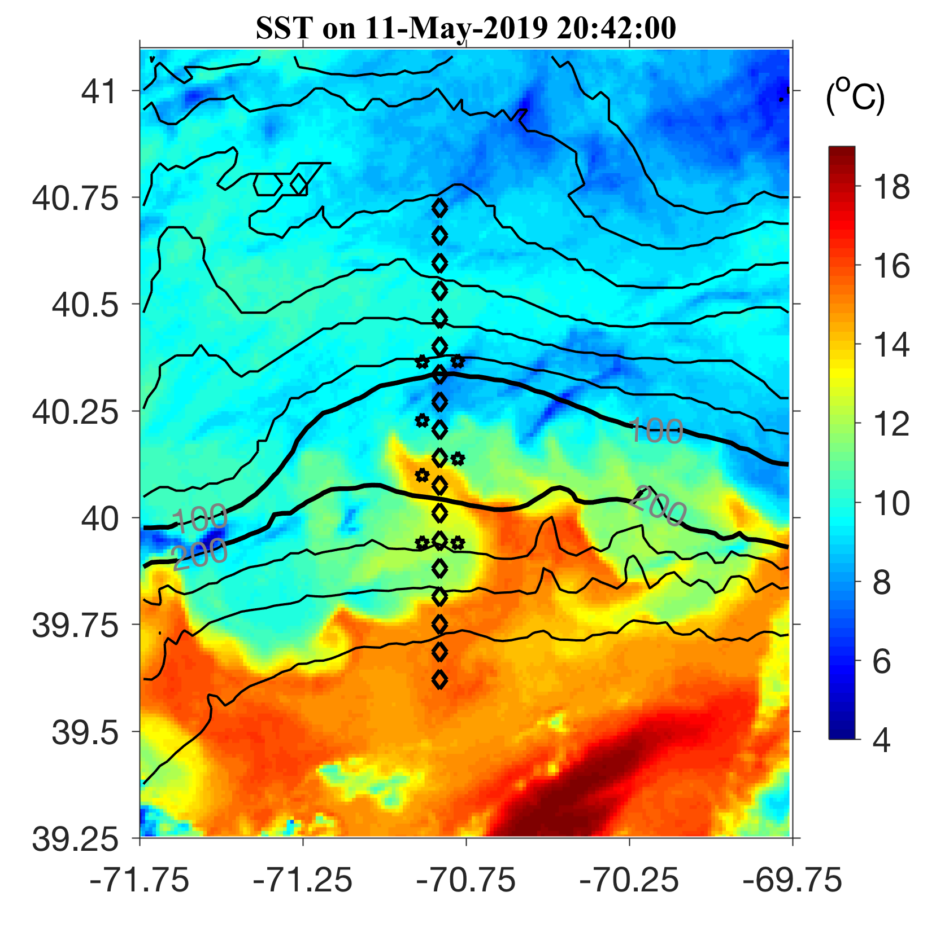
May 11 2019

Slide 9
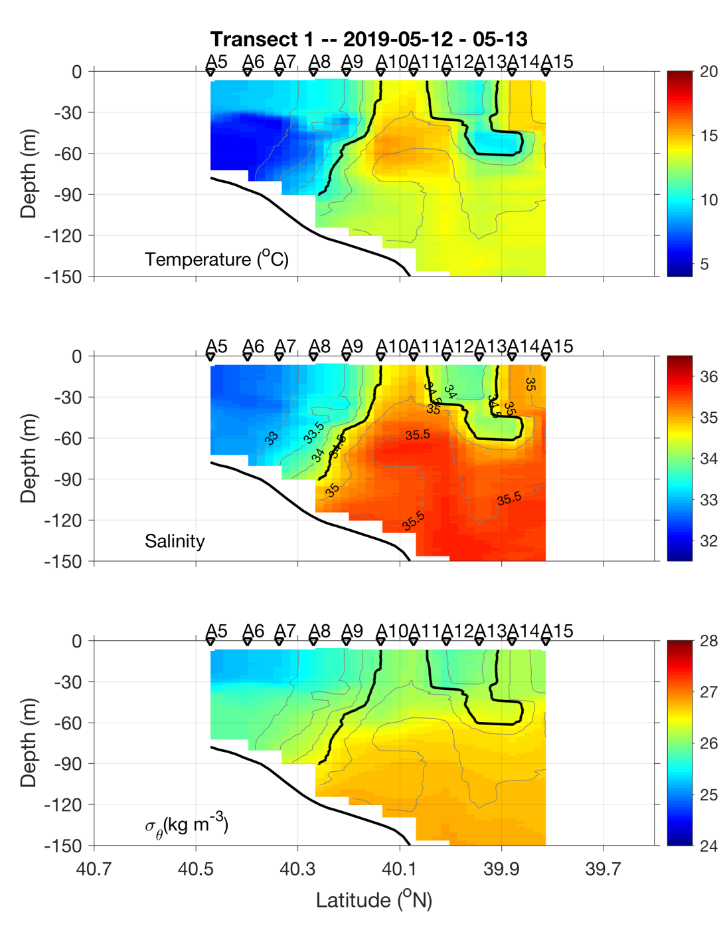
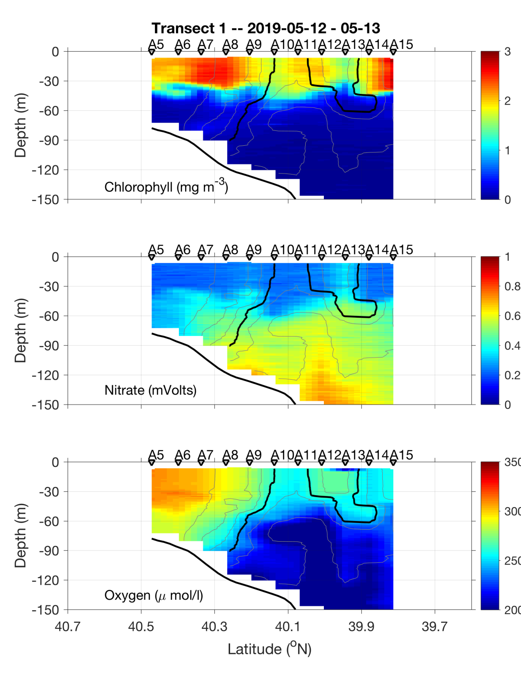
Transect 1 – May 12-13

Slide 10
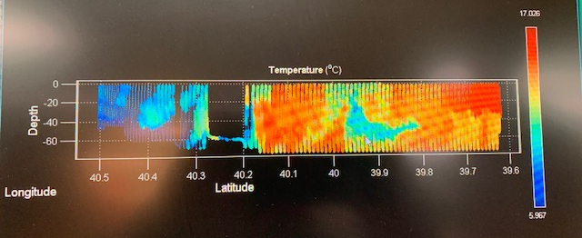
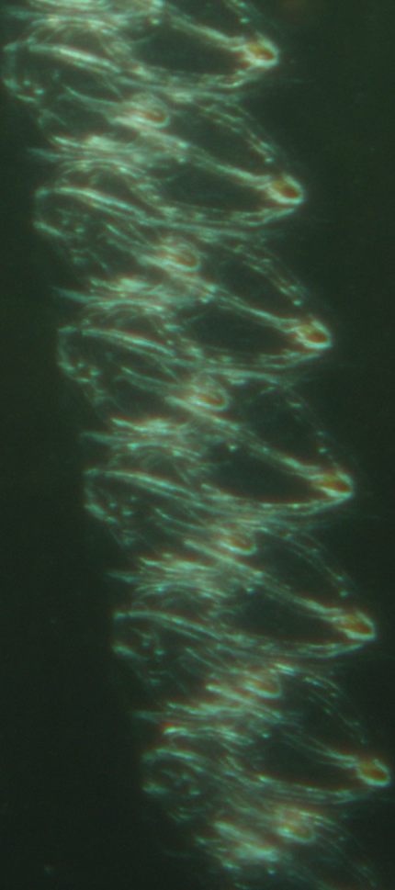
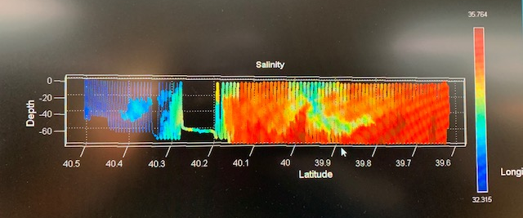
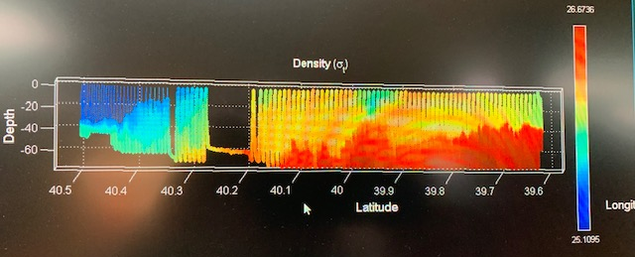
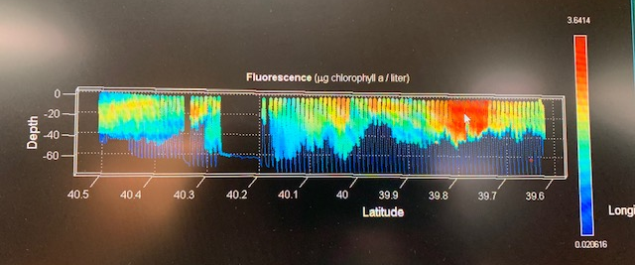
VPR Survey
May 14

Slide 11
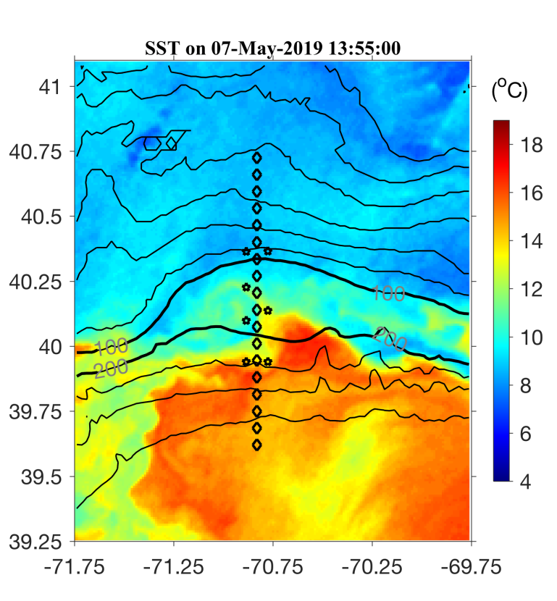
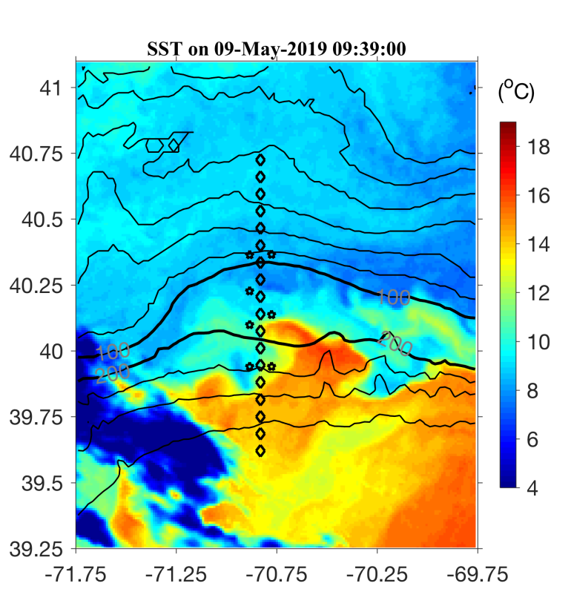

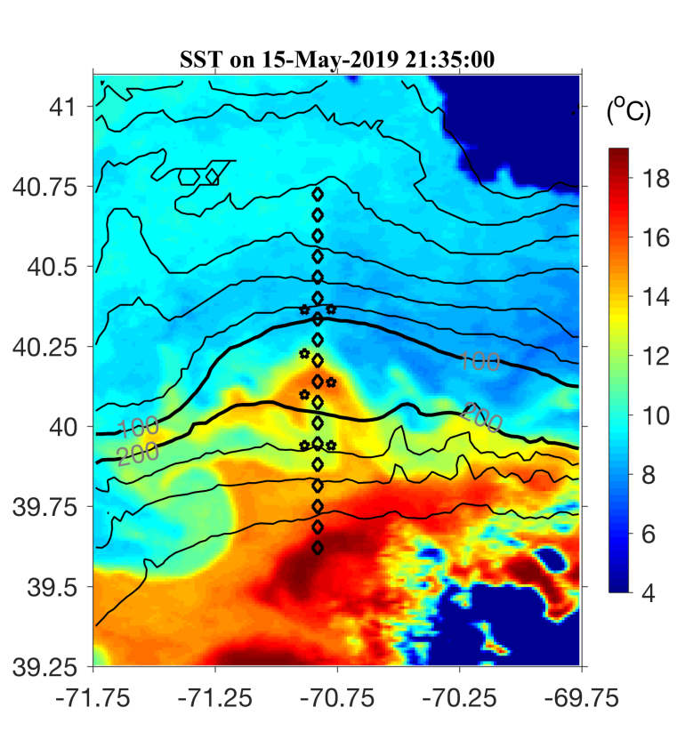
May 7 May 9
May 11 May 15

Slide 12
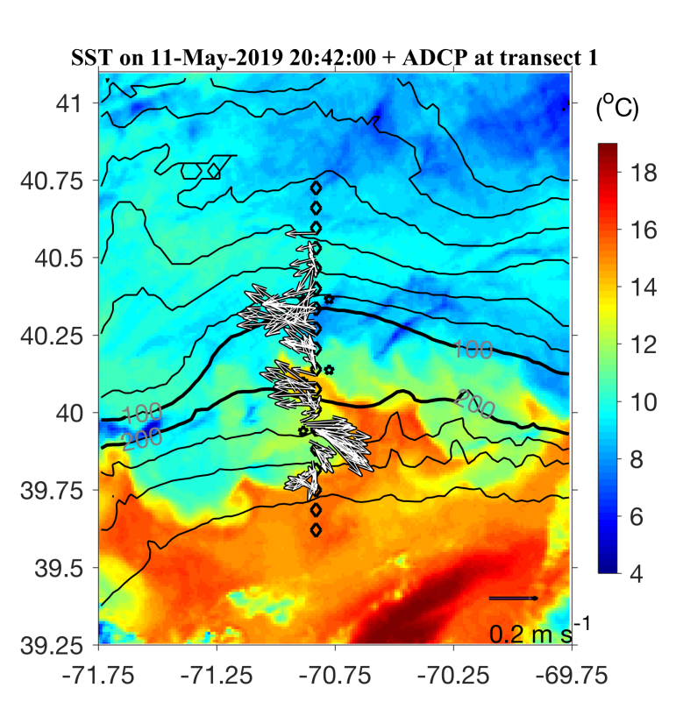
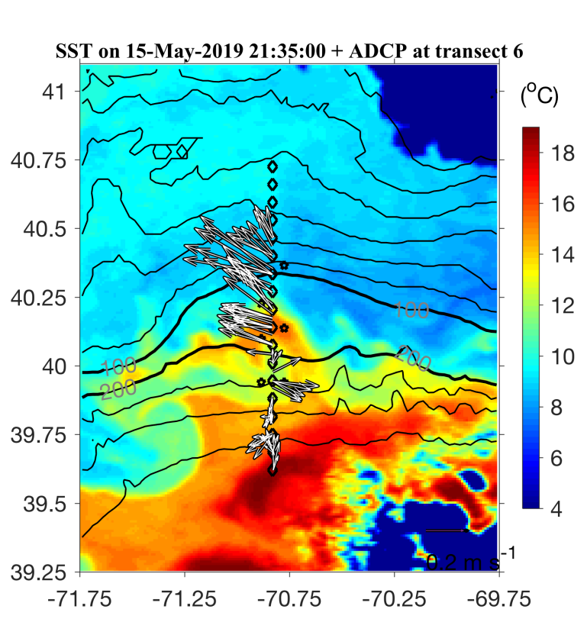
May 7 May 9
May 11 May 15

Slide 13
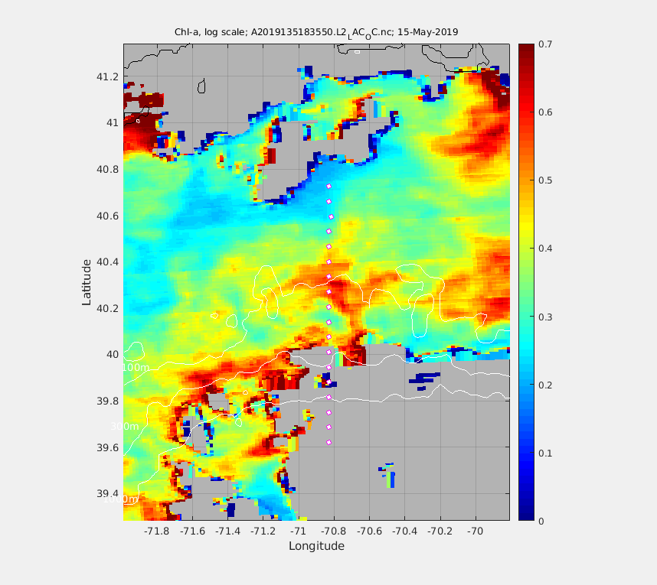
MODIS Chl 15 May 2019
A6
A8

Slide 14
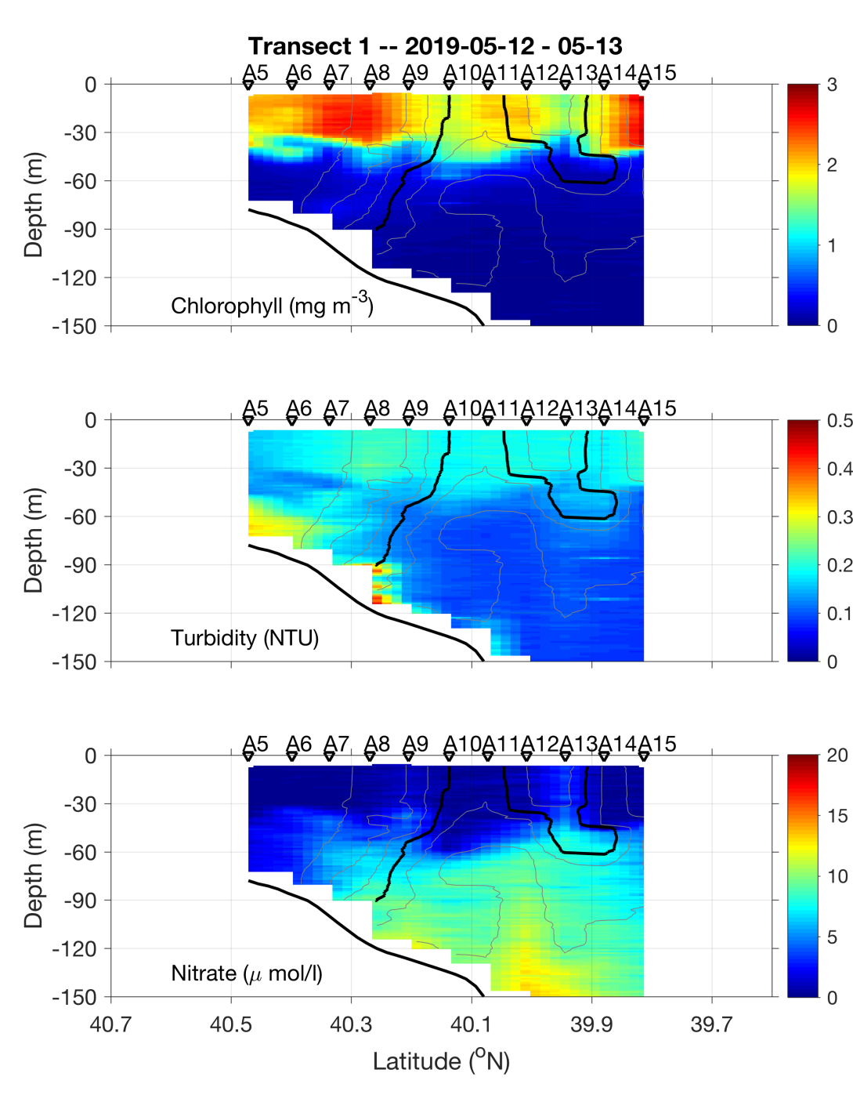
May 12-13

Slide 15
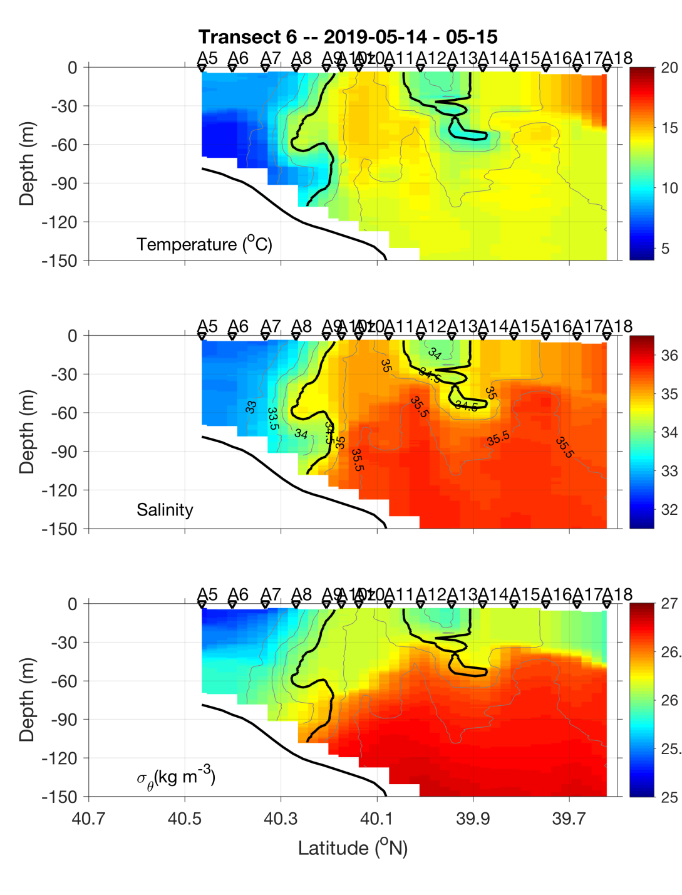
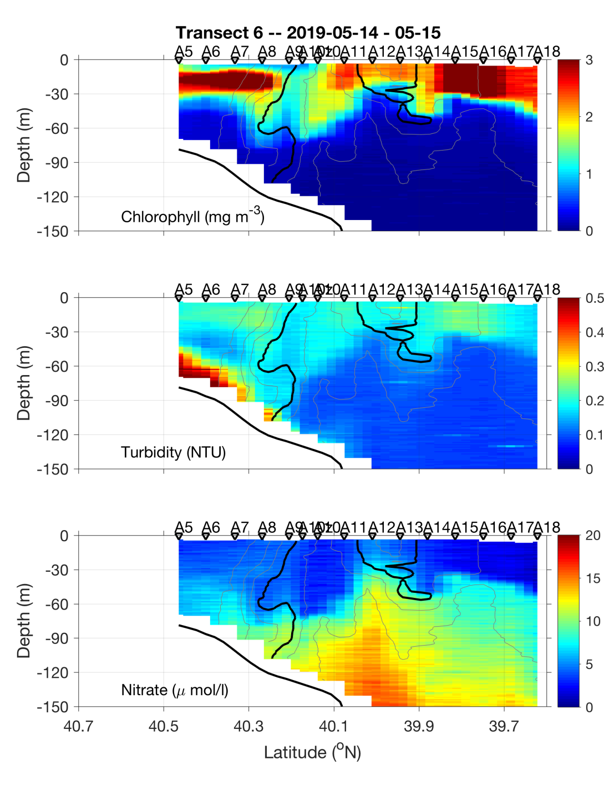
May 14-15

Slide 16
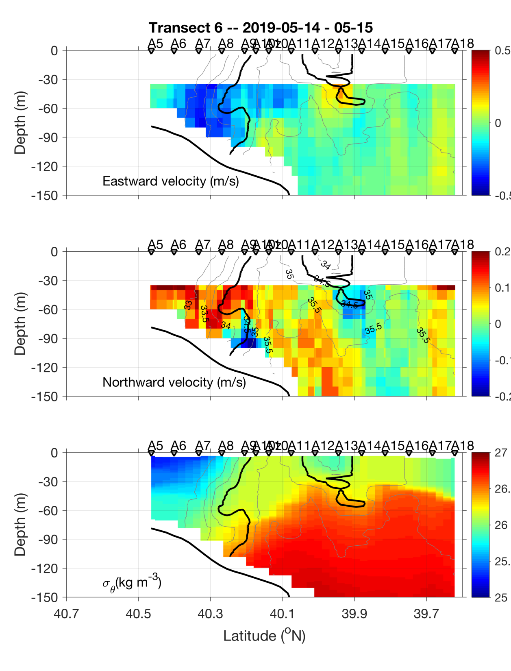
ADCP velocities
Eastward
Northward

Slide 18
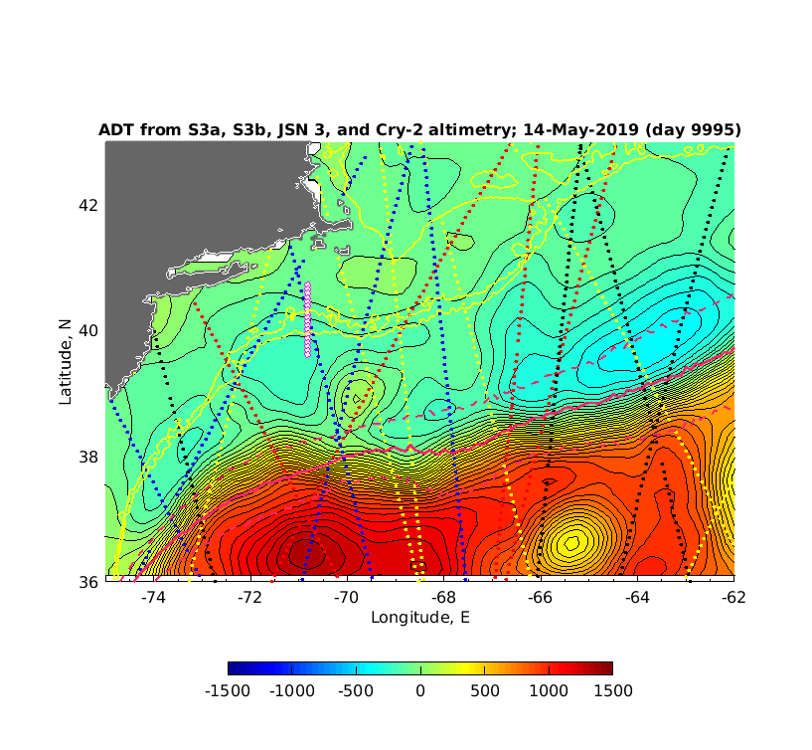
Satellite Altimetry May 15, 2019

Slide 24
