Slide 1
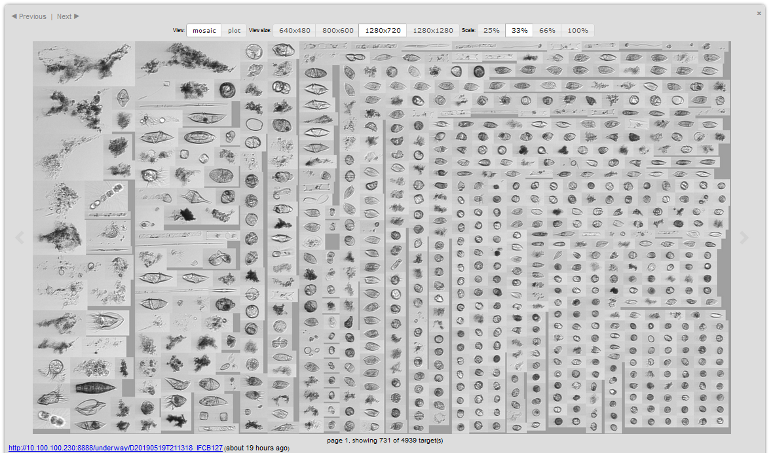
19 May 21:13

Slide 2
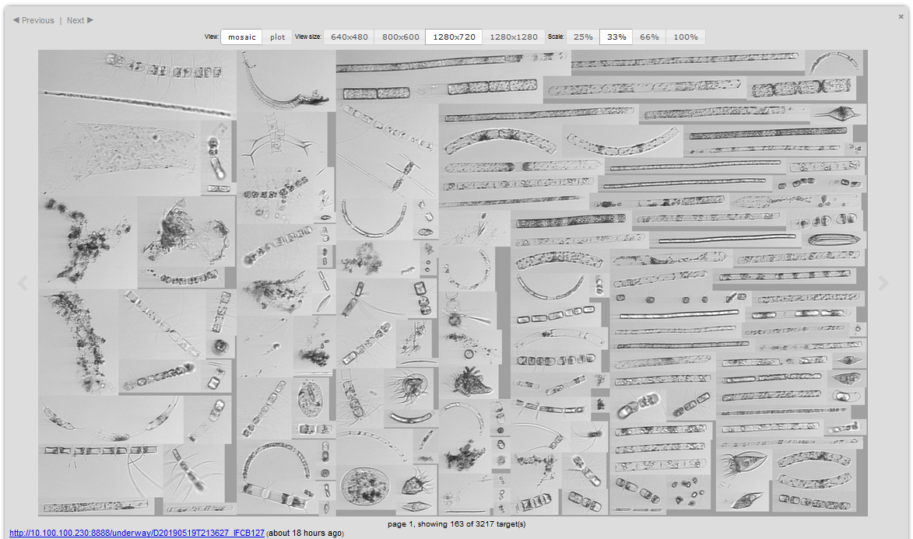
19 May 21:36

Slide 3
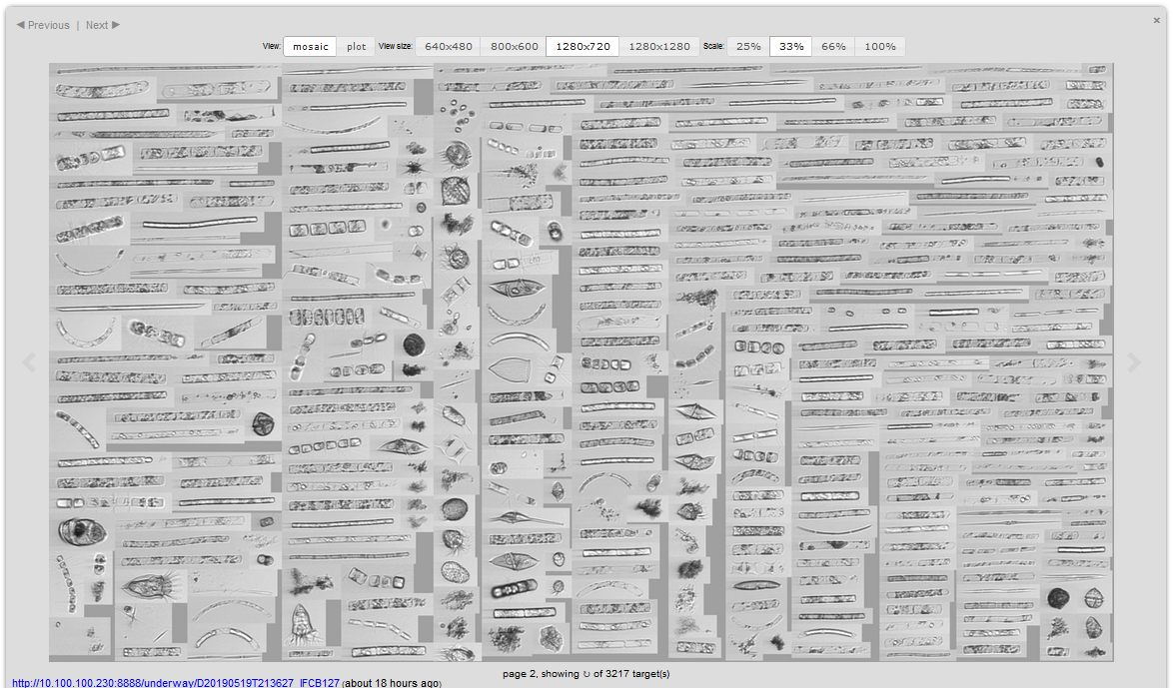
19 May 21:36, p. 2

Slide 7
Eddy NS
Eddy

Slide 8
Eddy NS
Eddy EW

Slide 9
Transects 16-25, Eddy

