Slide 1

Modeling Blooms of Alexandrium fundyense in the Gulf of Maine: From Climatology to Forecasting
Gulf of Maine Toxicity (GOMTOX) - NOAA
Anderson, McGillicuddy, Keafer (WHOI)
Townsend, Pettigrew, Thomas (UMaine)
Turner, Pilskaln (UMass D), Bricelj (RU)
He (NCSU) Manning, Mountain, P. Fratantoni (NMFS)
Haskell (NOS) Martin (DFO)
Hall, DeGrasse, Deeds (FDA)
Hickey, Whittaker (DMF) Couture (DMR) Nash (DES)

Slide 2
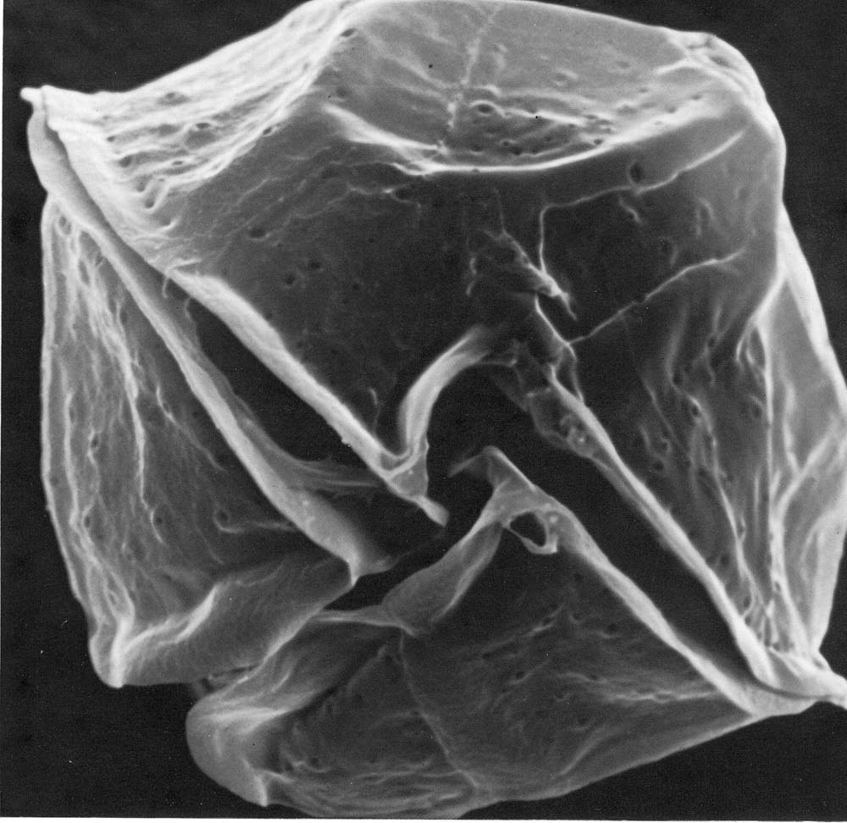
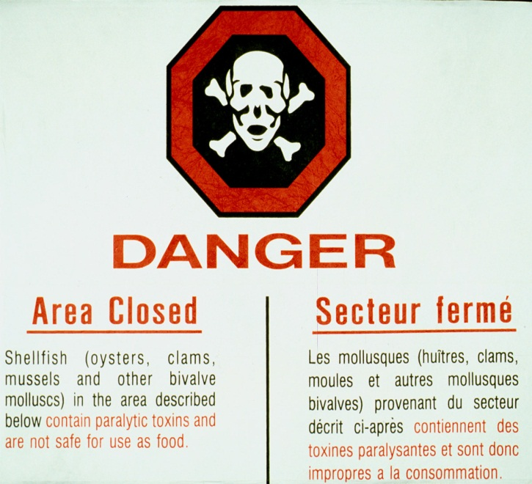
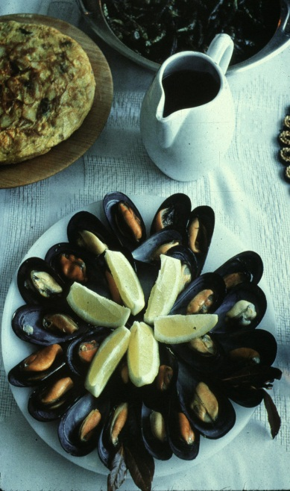
Alexandrium fundyense
Dinoflagellate
~40 microns
Produces saxitoxins
Leads to Paralytic Shellfish Poisoning (PSP)
Notes:
Alexandrium is a species of dinoflagellate approximately 40 microns in diameter. It produces saxitoxins which can accumulate in the tissues of filter-feeding organisms such as mussels and clams. Blooms of Alexandrium can cause buildup of toxins within shellfish sufficient to cause Paralytic Shellfish Poisoning, which can be a serious threat to human health. Because of this threat, shellfish beds in affected areas are monitored on a regular basis and harvesting closures occur frequently throughout the region.

Slide 3
Life Cycle of Alexandrium
Notes:
Alexandrium has a very complex life cycle, as illustrated in this cartoon. It can lie dormant as a resting cyst in the sediments for very long time periods, perhaps a decade or more. Germination is regulated by a complex set of processes, including an endogenous clock and physiological responses to environmental factors such as light and temperature. Once emerged from the sediments, the cells swim upward into the light and begin a phase of vegetative growth. When faced with environmental stress such as nutrient limitation, the vegetative cells form gametes which then fuse into a zygote. The zygote then encysts.

Slide 4
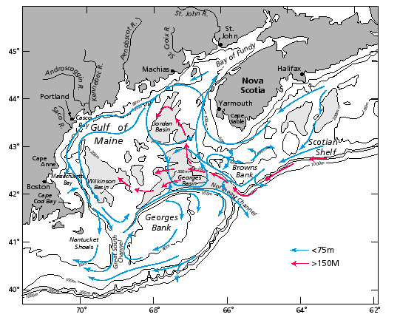
General circulation during the stratified season
Beardsley et al. (1997)

Slide 5
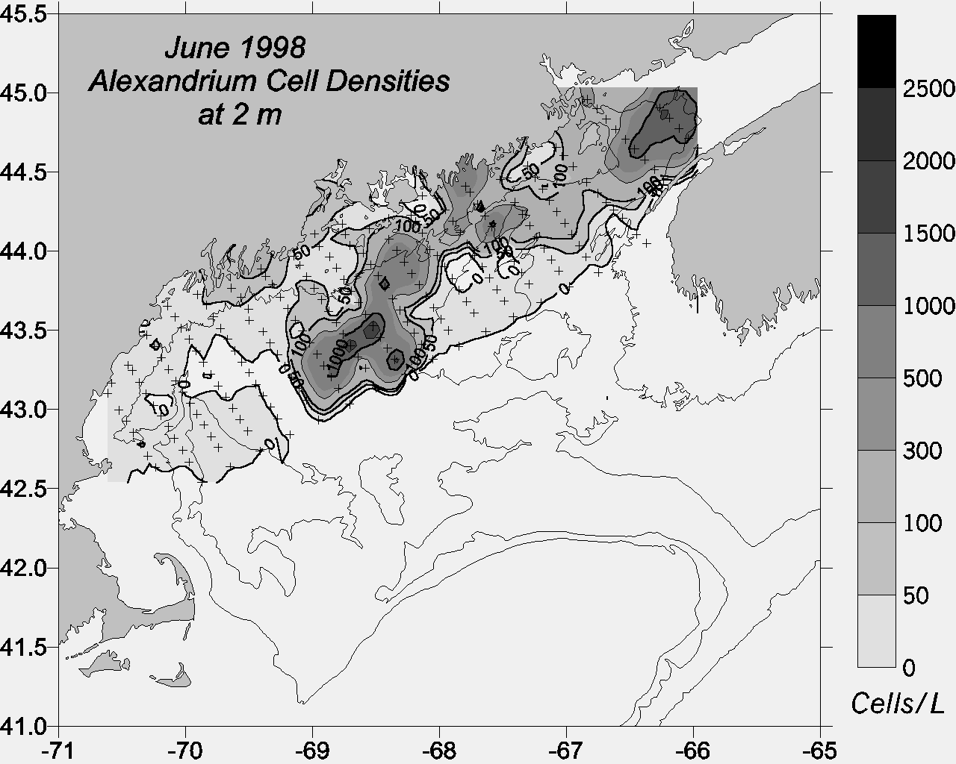
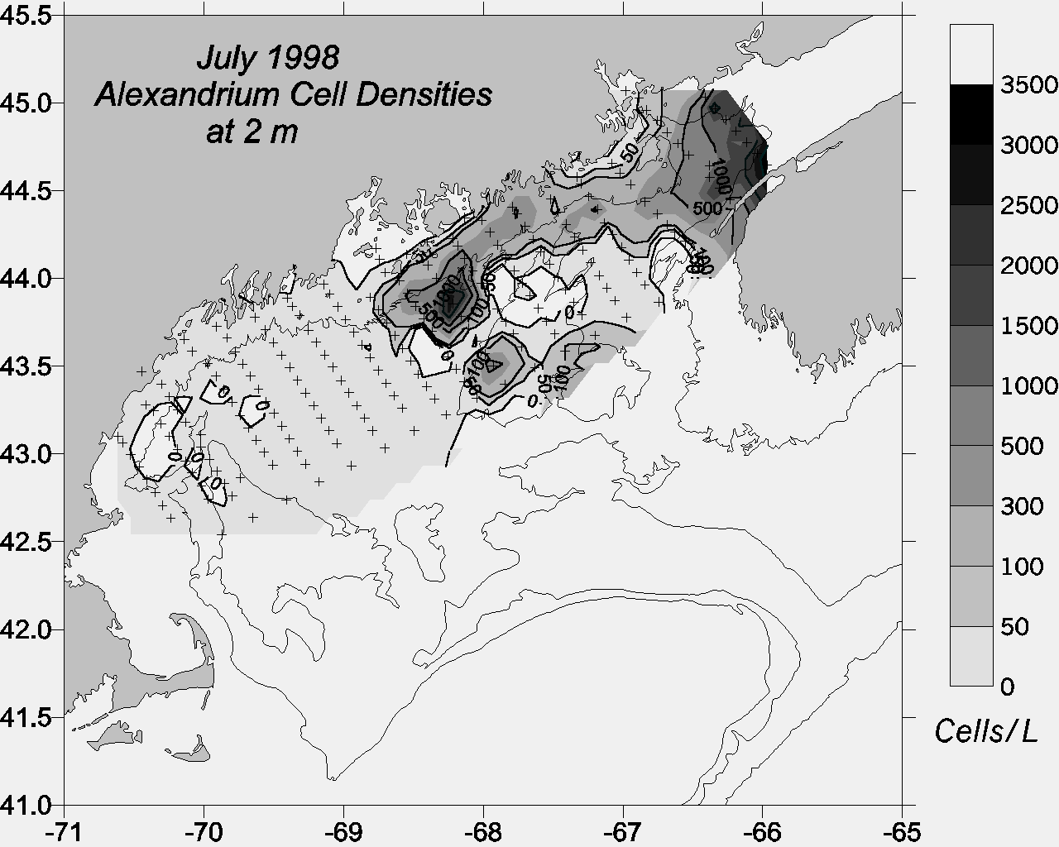
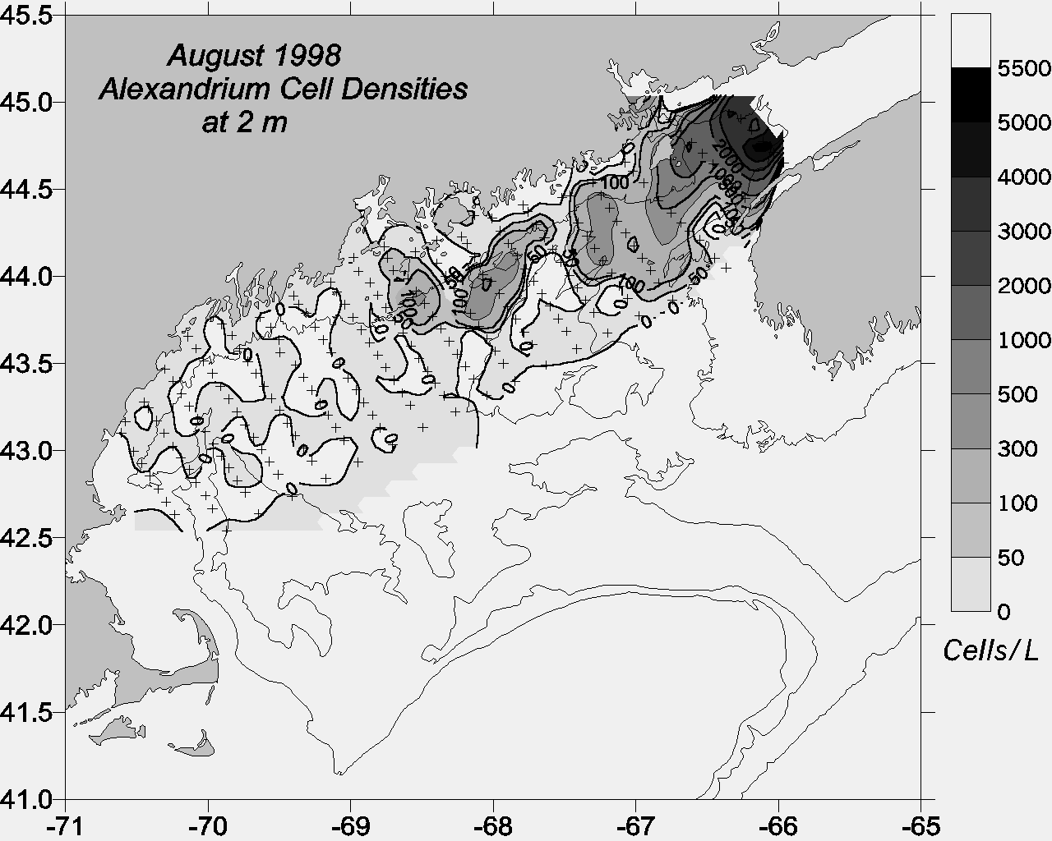
ECOHAB-GOM Observations
Gulf-wide
distribution
2) Association with coastal
current
3) Center of mass
shifts west-to-east
as season progresses
Townsend et al.
(2001)

Slide 6
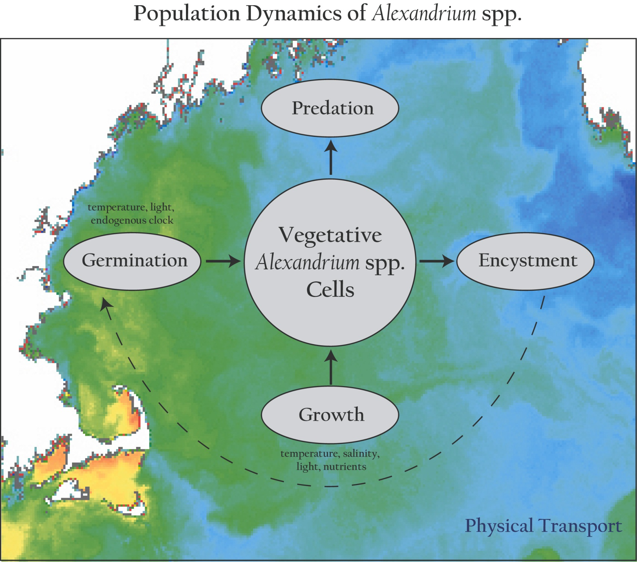
Population dynamics of Alexandrium spp.
Notes:
Our approach in this modeling effort is to incorporate what is known about the population dynamics of Alexandrium into 3-d circulation models of the region.
Fundamental to this approach is the concept that the ecosystem in which A.f. resides is not explicitly modeled. This is justified on the basis that, with very few exceptions, A.f. constitutes a very small fraction of the total phytoplankton species assemblage in the GOM. As such, it does not materially affect either the ambient nutrient concentrations nor predator abundances. Therefore these “ecosystem effects” can be parameterized through their influence on the vital rates of A.f.’s population dynamics.
These processes within the population dynamics are complex functions of environmental parameters, such as temperature, salinity, light and nutrients in the case of vegetative growth, and temperature, light and an endogenous clock in the case of germination.
All of this takes place in an complex, turbulent, three-dimensional fluid medium, some characteristics of which are evident in the sea surface temperature image on which this cartoon is overlayed.
What I’d like to emphasize here is that the linkage between the population dynamics of Alexandrium (or any other planktonic species for that matter) and the physical environment is twofold: first, the rates of the population dynamics processes are influenced by environmental variables, and second, the spatial distributions of the populations themselves are constantly being stirred and rearranged the currents. The duality of this linkage between the population dynamics and the physical environment is what makes coupled physical/biological problems in the ocean so incredibly complex. Our hope is that the use of models will help untangle this complexity, and provide insight into what controls blooms of Alexandrium in the Gulf of Maine.

Slide 7
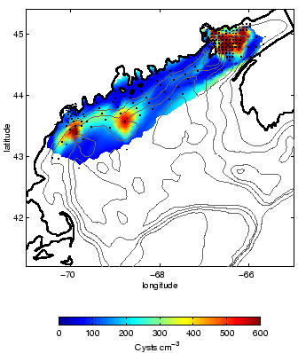
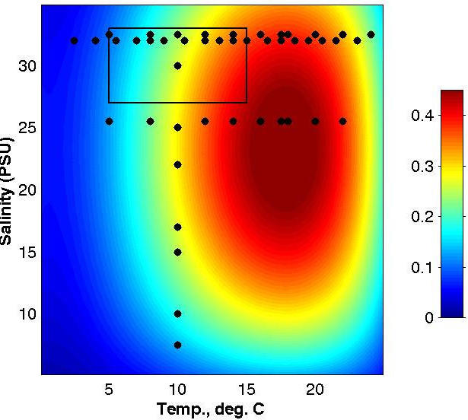
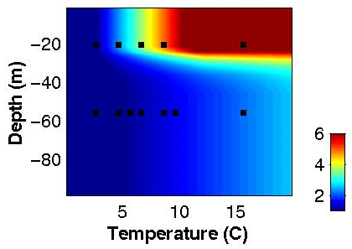
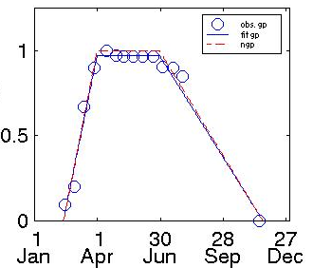
Alexandrium Population Dynamics Model
Cyst Dist. (# / cm^2)
Endogenous Clock
Germ. rate (% / day)
Growth (per day)
Growth = min ( f(PAR) , g(T,S,nutrients) )
Upward swimming 10 m/day
“Mortality” = 0.1 per day
Salinity
Temperature
Notes:
This is a summary of the population dynamics model.
These top panels show the various factors which contribute to the input of cells due to germination. On the far left is the observed distribution of cysts, showing the peak offshore of Casco Bay. In the middle is our functional fit to the laboratory data on the endogenous clock, shown as open circles. On the right is the germination rate as a function of light and temperature, based on the laboratory data indicated by black dots. The vertical axis actually represents light intensity but has been scaled to depth to give you a feeling for the rates at which the cyst beds in the deeper offshore waters are germinating. I think it is worth pointing out here that even with the heroic efforts to determine the germination input experimentally, we are still doing a lot of interpolation and extrapolation to specify a germination rate at every gridpoint of the model.
Our growth function is based on data from Watras et al. which suggest that Alexandrium has a preferred temperature and salinity range for optimal growth, shown by the red spot here. The range of temperature and salinity conditions that Alexandrium cells encounter in these simulations is indicated by this black rectangle. So the overall growth rate is based on this function and is modulated by the ambient light field as indicated here. We specify an upward swimming rate of 10m/day and a net mortality of 0.1 per day. Mortality is in quotes here because it represents the net effect of all loss processes, which include respiration, predation and encystment.

Slide 8
Simulations of A. fundyense in the Gulf of Maine Based on Climatology
Objective: To determine the factors controlling the initiation
and large-scale seasonal development of blooms.
Approach: Incorporate Alexandrium population dynamics
into climatological hydrodynamic simulations.
Numerical Experiments:
1. Germination Source (3 runs)
2. Vegetative Source (1 run)

Slide 9
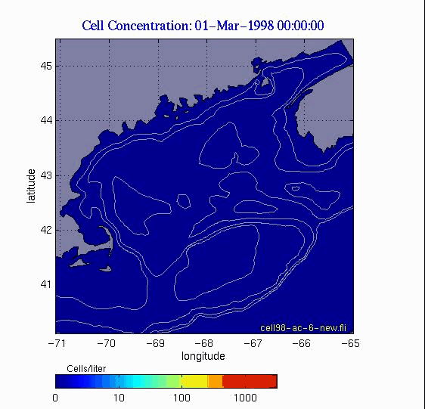
Germination Only

Slide 10
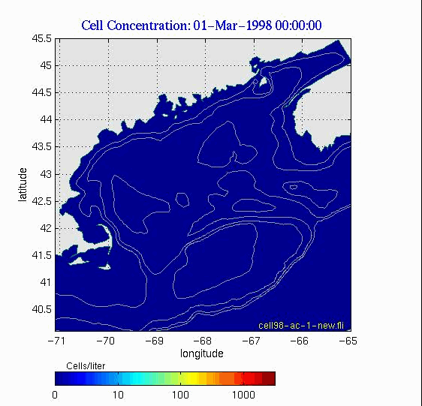
Germination, Growth, ‘Mortality’

Slide 11

Germination, Growth, ‘Mortality’, Nut. Limit.

Slide 12
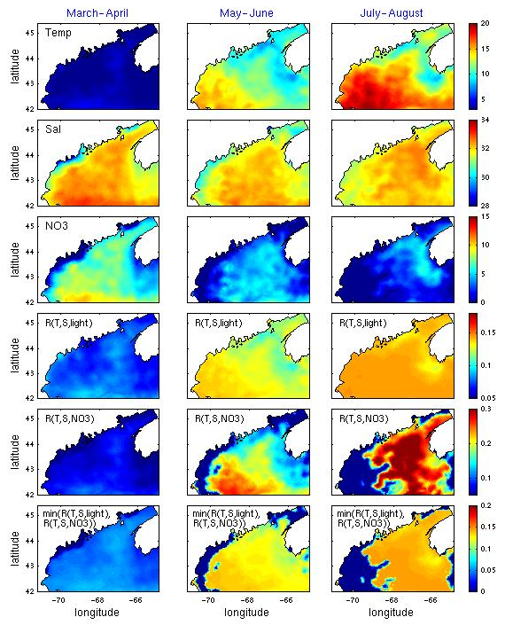
Growth Rate Diagnosis
Temperature
Salinity
NO₃
G(T,S,I)
G(T,S,NO₃)
G(T,S,I,NO₃)
Lynch et al.
(1996)
Lynch et al.
plus Garside
et al. (1996)
Mar-Apr May-Jun Jul-Aug
Notes:
Now that we have a simulation that seems to capture the essential characteristics of the observations, it is of some interest to diagnose the mechanisms controlling the large-scale seasonal dynamics of A.f. in this region.
These top three panels show the climatological temperature and salinity fields for the region used to drive the Lynch et al. model. The nutrient field is based on empirical relationships between nitrate and temperature and salinity, as expressed in the polynomial fits between those variables published by Garside et al. 1996. Notice the scale goes from zero to 15 micromolar nitrate, such that limiting nutrient concentrations of less than 3 micromolar are indicated by the dark blue shading. Thus from A.f.’s point of view, nutrients are in abundance in March-April and May-June, but then become limiting in the western gulf in July-Aug.
In these three lower panels we break down the various components of our growth model for A.f. : T,S,light and T.S, nutrients, and the composite growth function which is Liebig’s law of the minimum applied to these two panels.
Generally speaking, growth is temperature limited everywhere in the domain during March and April, with growth rates that are fairly uniform throughout the gulf (as is the T distribution).
Vernal warming in the western gulf precedes that of the eastern gulf, such that we see much warmer temperatures in the west during May-June. As nutrients are still in abundance, this leads to higher growth rates in the western gulf.
This situation changes dramatically in Jul-Aug, when nutrients are depleted in the western gulf. Warming temperatures in the eastern gulf lead to high growth rates in that region, whereas growth has all but shut down in the west.
Therefore, the eastward shift in the center of mass in the gulfwide distribution of cells can be explained by this transition from temperature limitation in spring to nutrient limitation in summer.

Slide 13
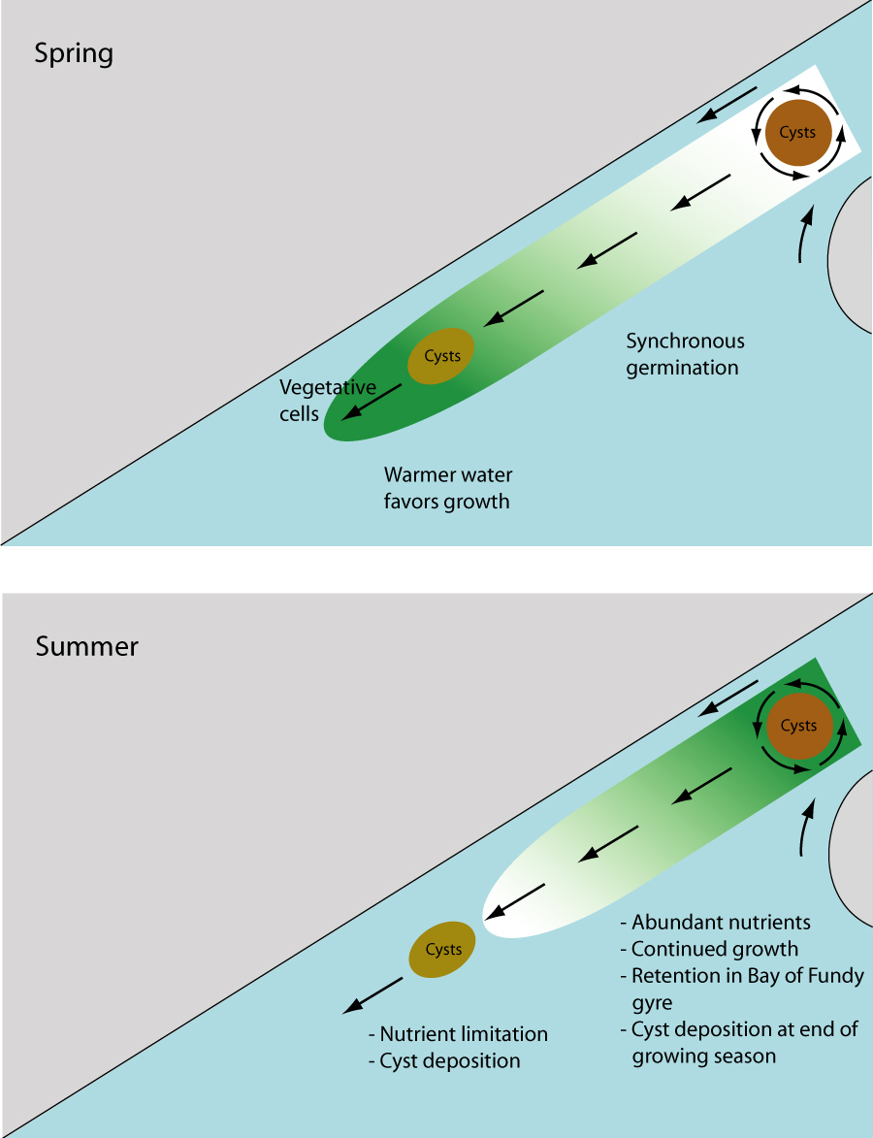
A conceptual model for the large scale seasonal variability of A. fundyense in the Gulf of Maine
Spring:
Temperature
limitation
Summer:
Nutrient
limitation
McGillicuddy et al., 2005

Slide 14
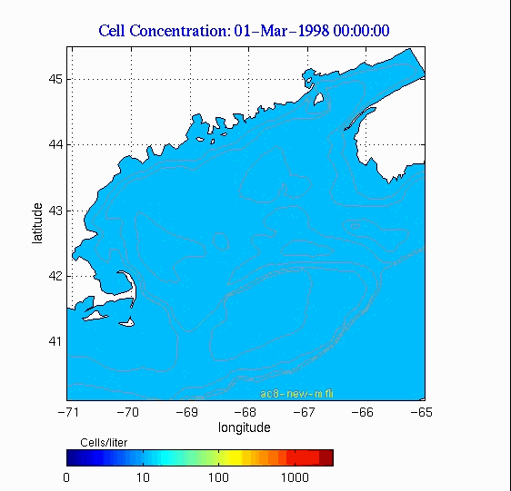
Vegetative Source (10 cells l⁻¹ )
Hypothesis: Uniform distribution combined with local selection.
Notes:
In the model I just showed you, blooms of A.f. were initiated by germination from resting cysts, but vegetative growth played a key role in regulating the large-scale seasonal patterns in abundance. It is of course relevant to inquire whether or not the cyst-driven source is a key aspect of the system. In fact, one hypothesis raised during the ECOHAB-GOM program was that the large scale patterns of A.f. cells are purely a result of vegetative growth, and all that is needed is a uniform inoculum of overwintering cells. We tested that hypothesis with the following simulation initialized with a uniform distribution of 10 cells per liter…
Thus it appears that the cyst bed is an essential characteristic of the system that sets the coastal character of the blooms.

Slide 15
What happened in 2005?

Slide 16
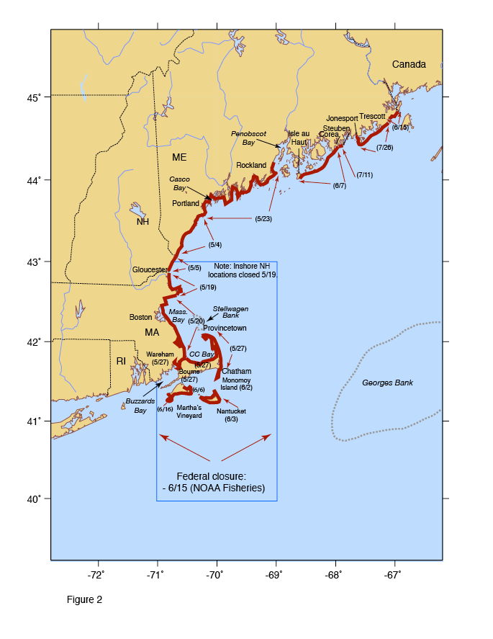
The 2005 bloom
Most widespread and intense bloom in at least 33 years, perhaps longer
Record levels of toxicity in some locations; first-time ever records of toxicity in others
Record high A. fundyense cell concentrations (for this region)
Large closure of federal (offshore) waters
> $50M loss to shellfish industry in MA alone
Maine, MA - disaster declarations
Anderson et al., 2005
Notes:
Cell concentrations usually 200- 1000 cells/L max in past in Mass Bay. This year, up to 40,000 cells/L.

Slide 17
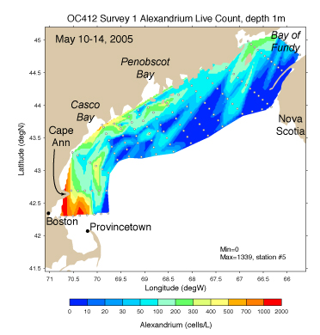
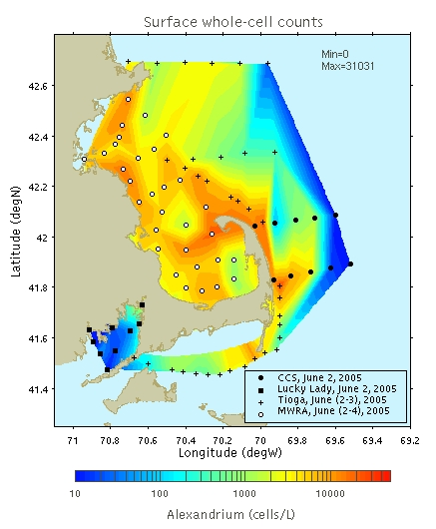
A. fundyense concentrations
WHCOHH cruise OC402 May 10-18 2005
WHOI/MWRA/CCS/SMAST
Surveys June 2-4 2005

Slide 18
Hypotheses
Source: High abundance of A. fundyense cysts in western GOM sediments.
Transport: Northeast winds caused strong onshore advection of A. fundyense populations
Anomalously high river runoff resulted in enhanced alongshore transport, and higher micro- and macro-nutrient concentrations.

Slide 19
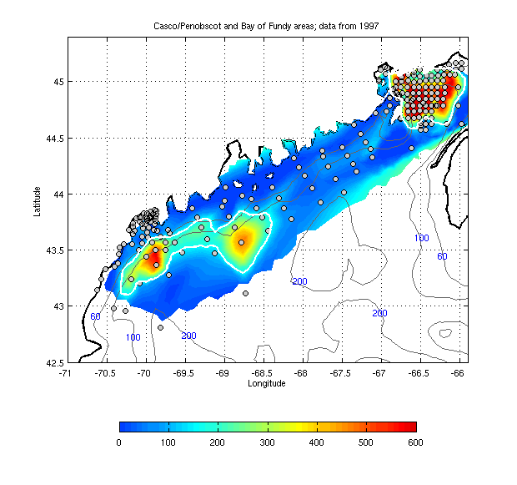
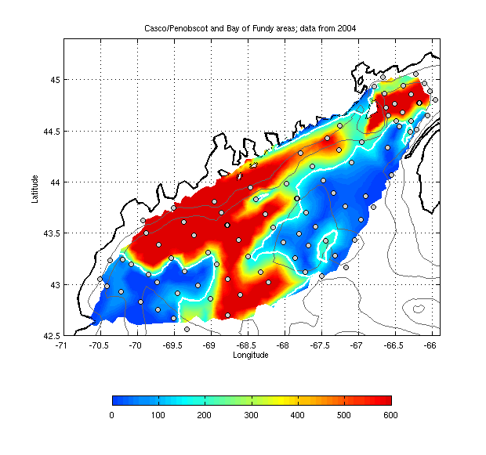
Interannual variability in cyst population
1997 2004
Bay of Fundy cyst bed stable over time
WGOM cyst bed: 2004 = 10 X 1997

Slide 20
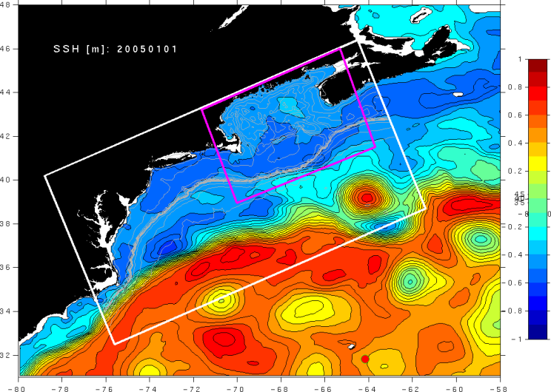
Multiply nested circulation models
ROMS (GOM)
1-3 km resolution
ROMS (MAB - GOM)
3-10 km resolution
Operational HYCOM
(10 km resolution)
He et al. (2008)
HYCOM: Hybrid Coordinate Ocean Model (NRL and U. Miami)
ROMS: Regional Ocean Modeling System

Slide 21
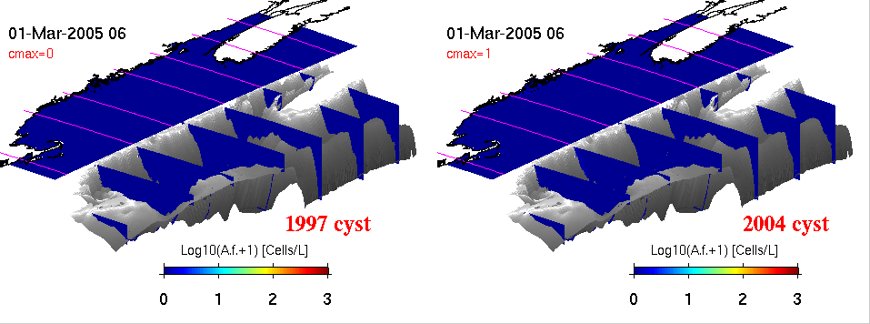
2005 physics +
fall 1997 cyst map
2005 physics +
fall 2004 cyst map

Slide 22
Summary – 2005 Hindcasting
The high abundance of cysts in the western GOM was the main cause of the 2005 bloom.
Wind forcing was an important regulator, in the form of both episodic bursts of northeast winds and the downwelling-favorable mean condition, causing onshore advection of offshore populations.
The anomalously high river runoff enhanced alongshore transport near the coast, but had limited impact on the gulf-wide bloom distribution.
He and McGillicuddy, 2008; He et. al. 2008, Journal of Geophysical Research

Slide 23
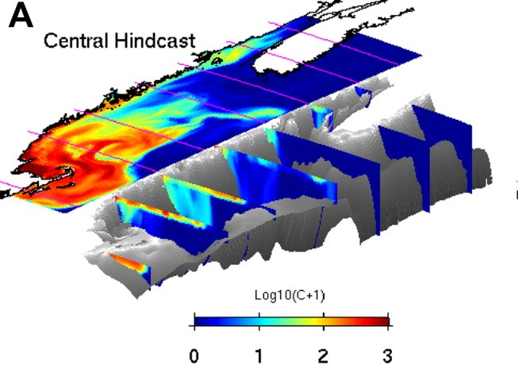
Theses
Cyst abundance is a first-order predictor of overall bloom severity.
Coupled hydrodynamic / population dynamics models forecast large scale seasonal characteristics of the bloom.

Slide 24
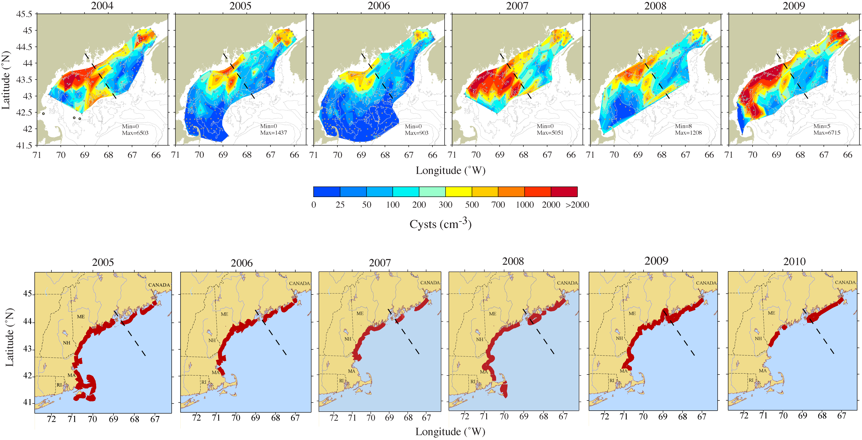
Cysts and toxicity 2004-2009

Slide 25
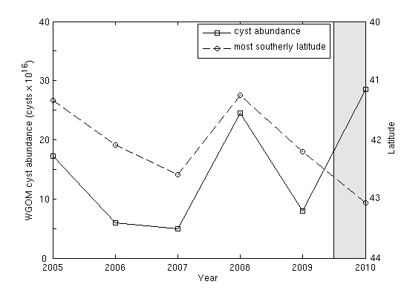
Cyst abundance and toxicity 2005-2009: r=-0.93

Slide 26
Seasonal Ensemble Forecast for 2008
Weather &
hydrodynamics
2008
seasonal forecast
2004
2005
2006
2007
Benthic cyst
abundance
Scenario 1
Scenario 2
Scenario 3
Scenario 4
Fall
2007

Slide 27
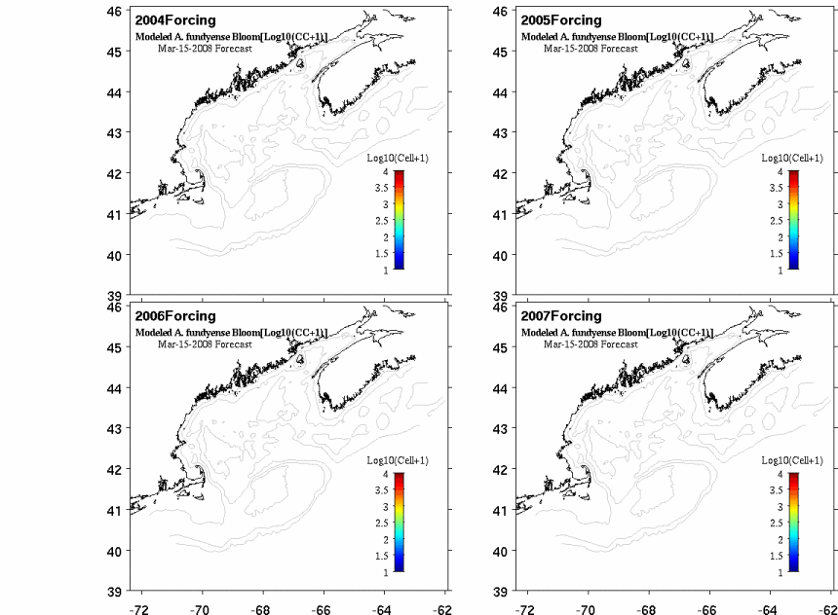
Ensemble forecast for 2008
2008 Bloom Forecast using 2004, 05, 06, 07 atmosphere and ocean forcing (online java animation)
http://omglnx3.meas.ncsu.edu/yli/simulation_new/08forecast/dino_08.htm

Slide 28
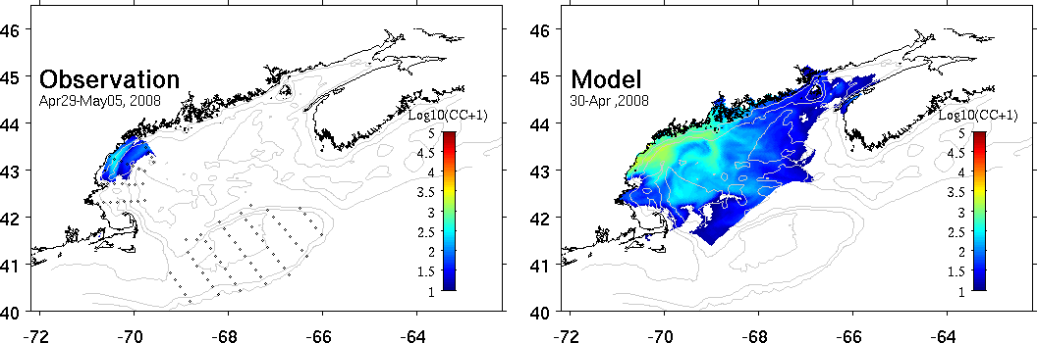
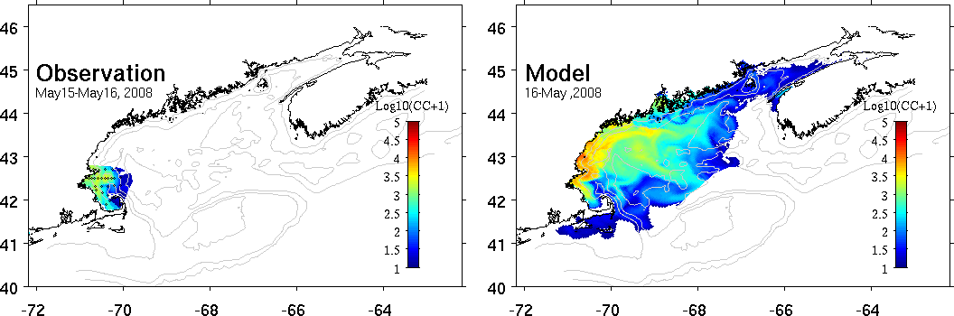
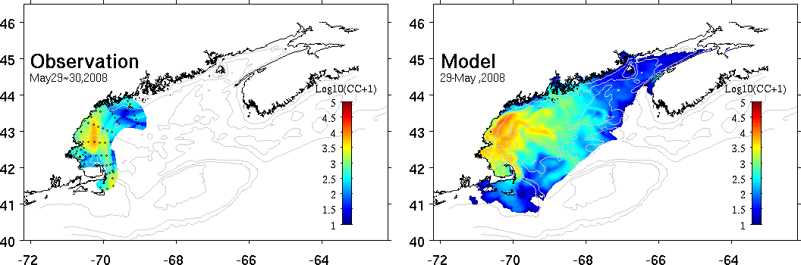
2008 model-data comparisons
Apr 29-May 5
May 15-16
May 29-30

Slide 29
Quantitative skill evaluation: regional hindcast simulations
r² = 1 - var(misfits)/var(observations).
Stock et al. (2005)

Slide 30
Cyst abundance and toxicity 2005-2009: r=-0.93

Slide 31
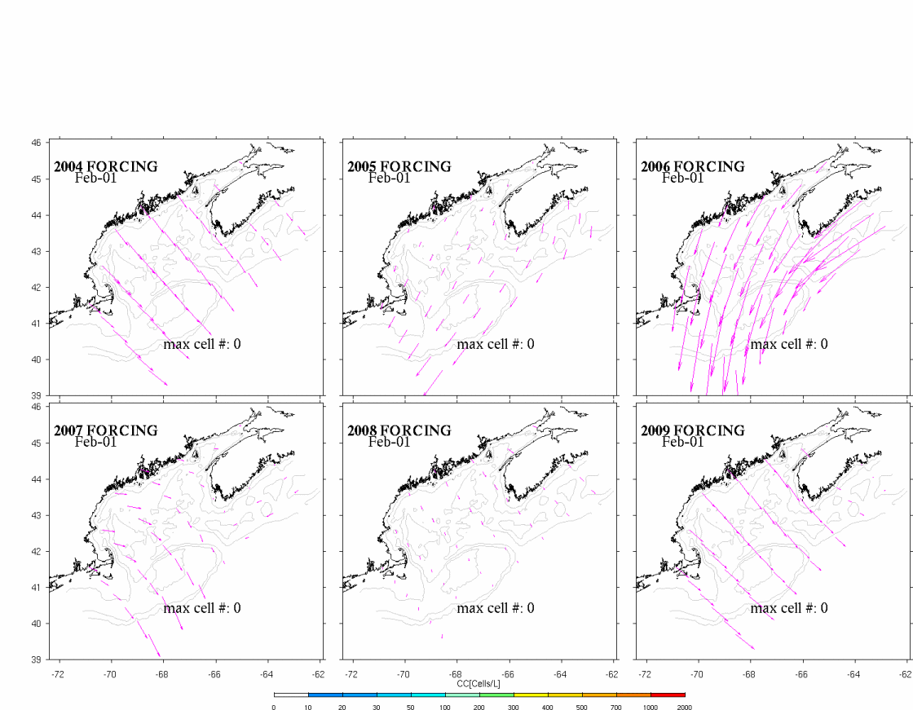
Surface wind field and simulated A. fundyense bloom
from each of scenario simulations

Slide 32
Cyst abundance and toxicity 2005-2009: r=-0.93

Slide 33
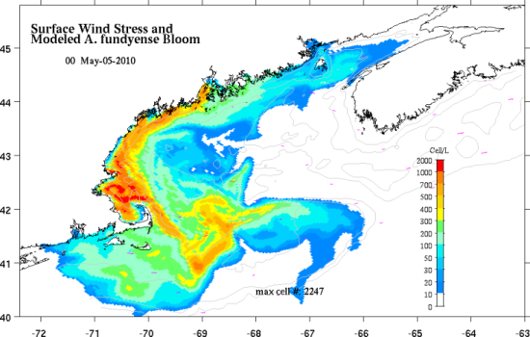
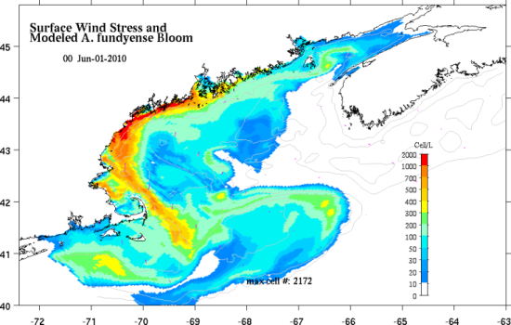
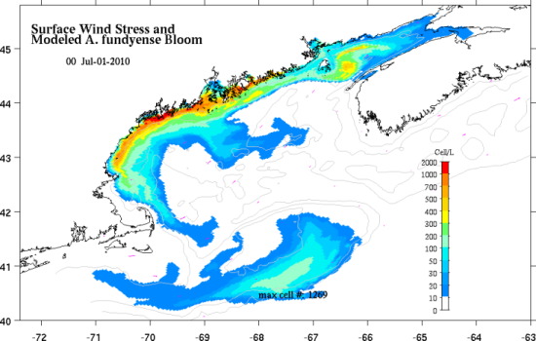
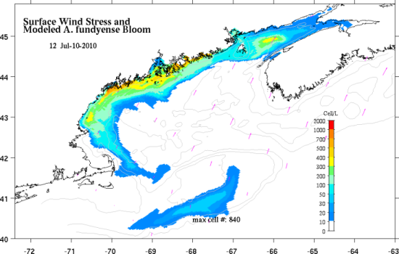
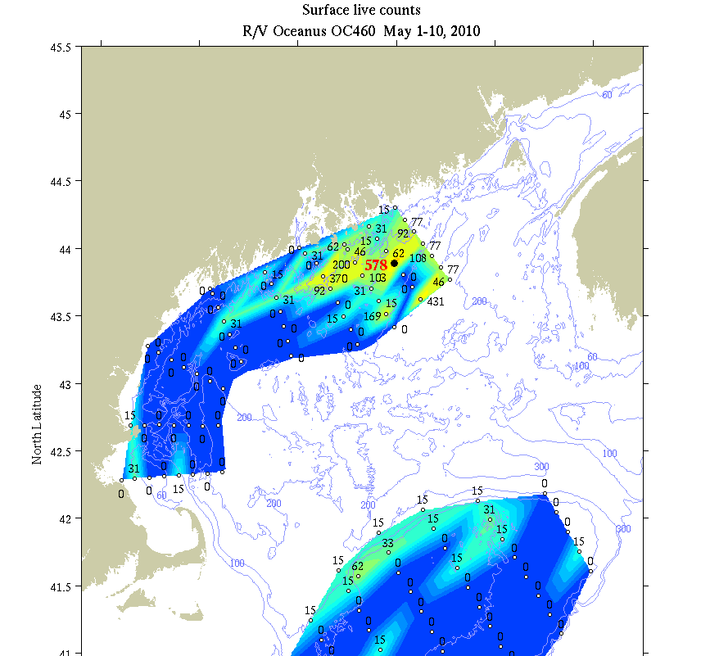
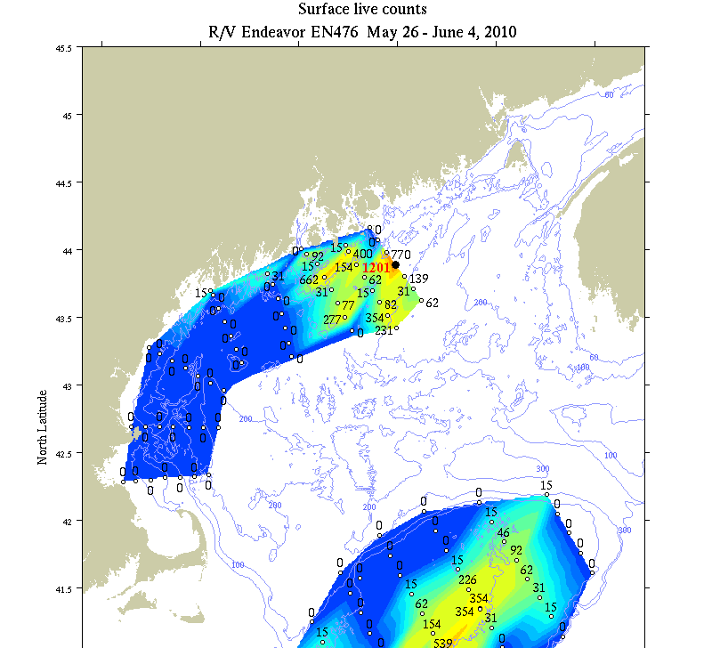
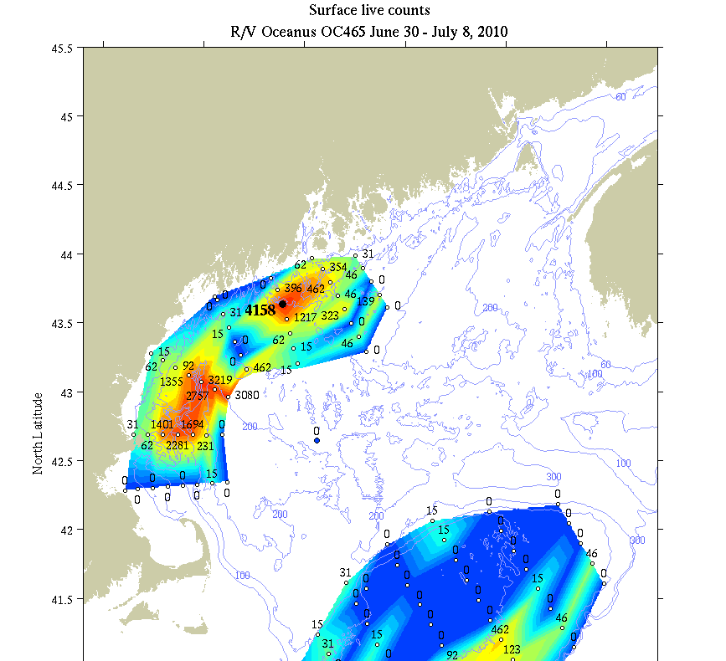
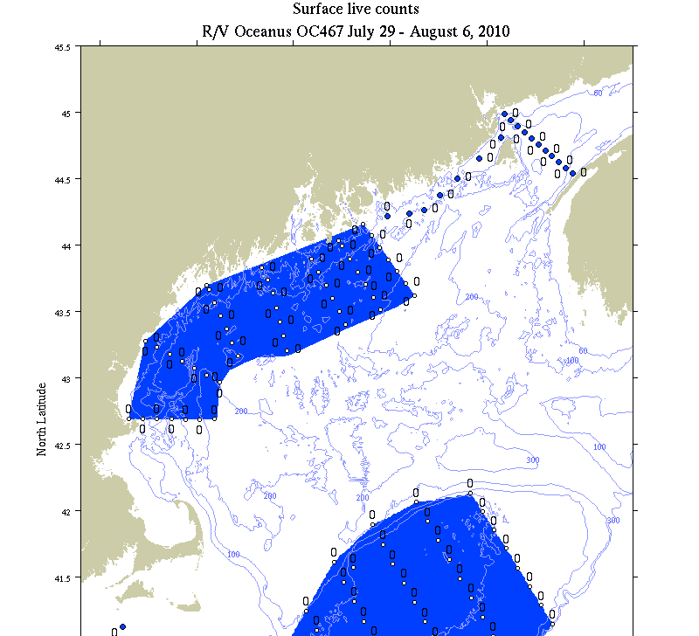
2010 Model – Data Comparisons
Model: May 5 June 1 July 1 Aug 1
Obs: May 5 June 1 July 1 Aug 1

Slide 34
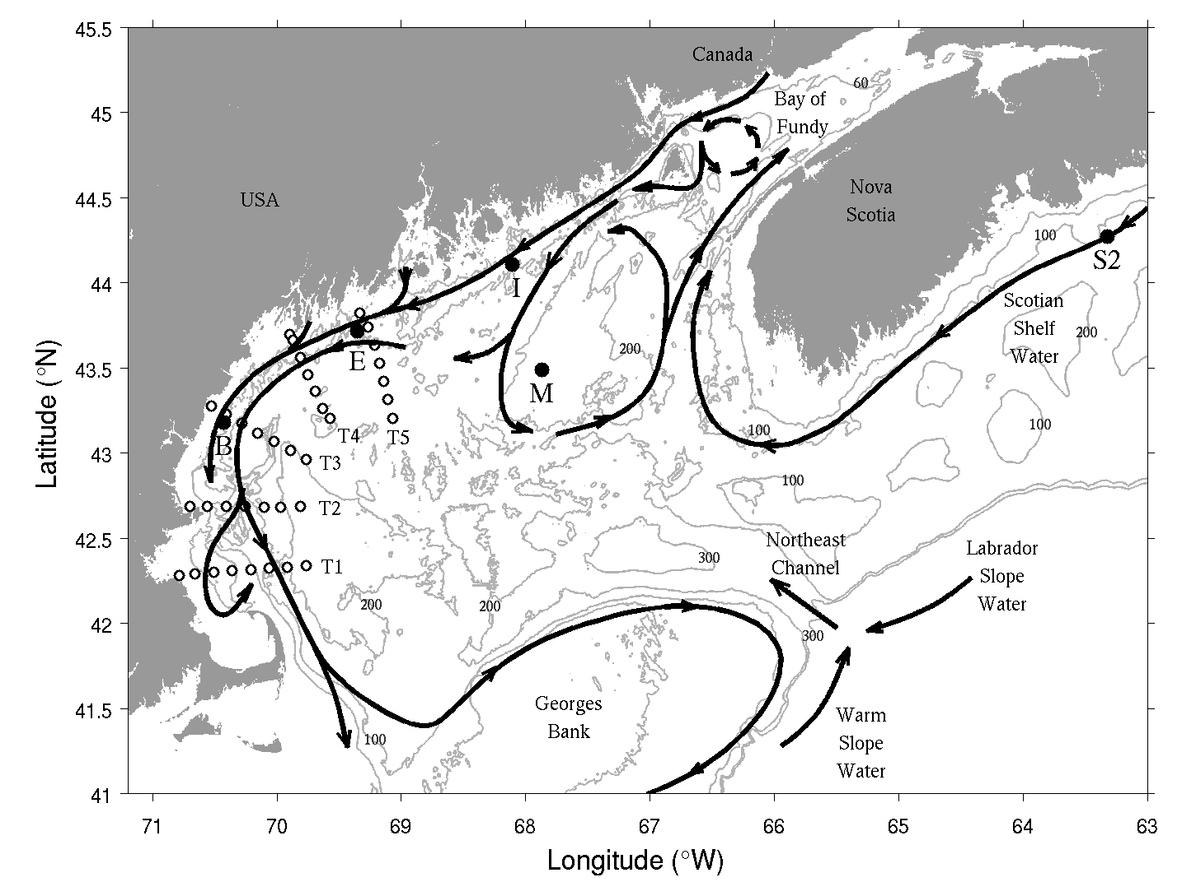
Why did the 2010 bloom not materialize?

Slide 35
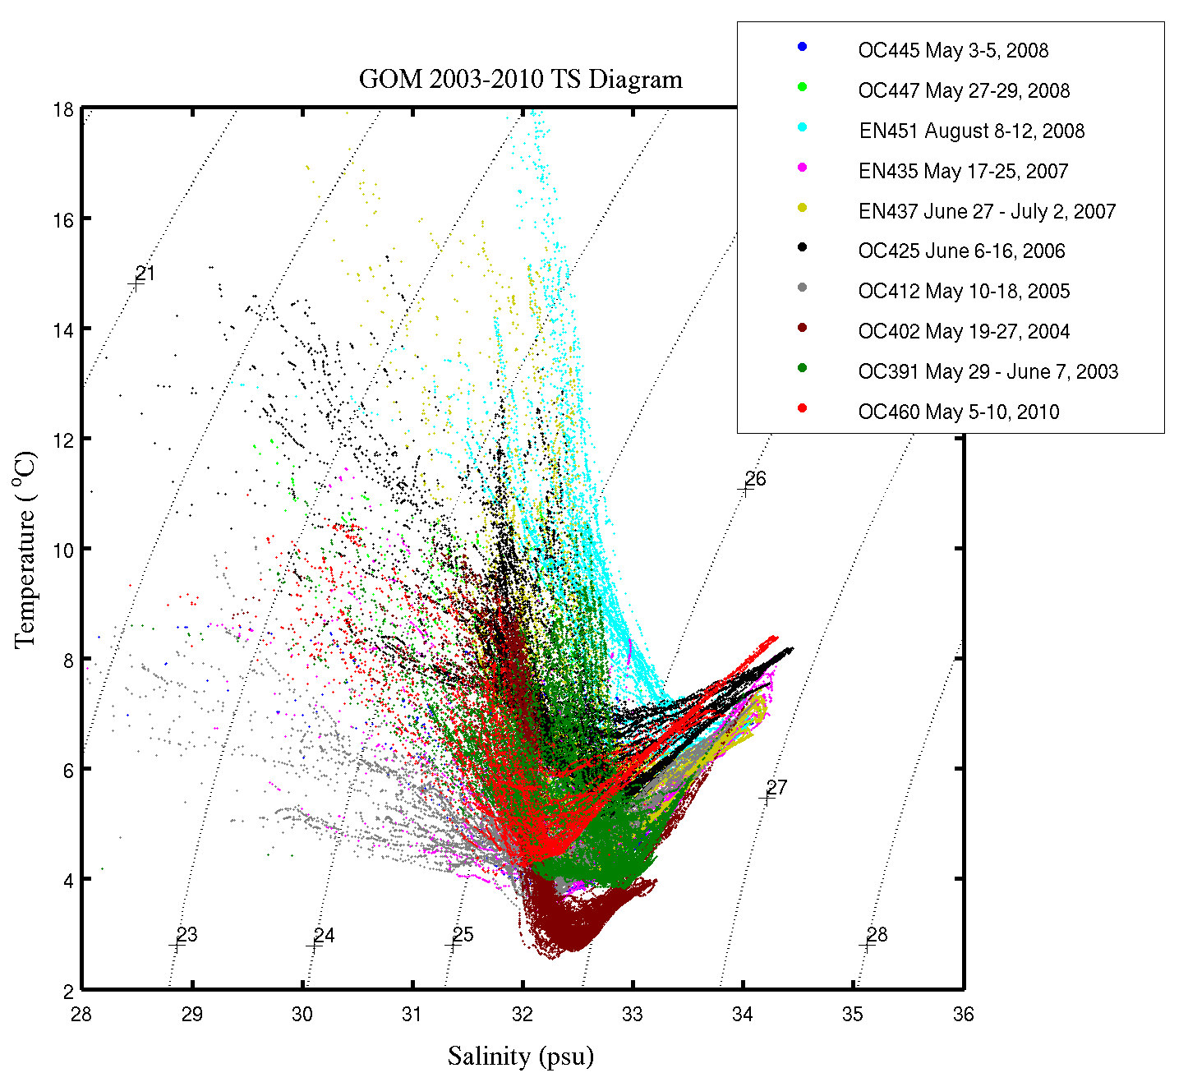
Springtime TS Variability 2003-2010
2010 Deep water end-member outside the envelope of prior observations 2003-2009
2010 MIW fresher than all but 2005, when MIW was colder
Red: 2010

Slide 36
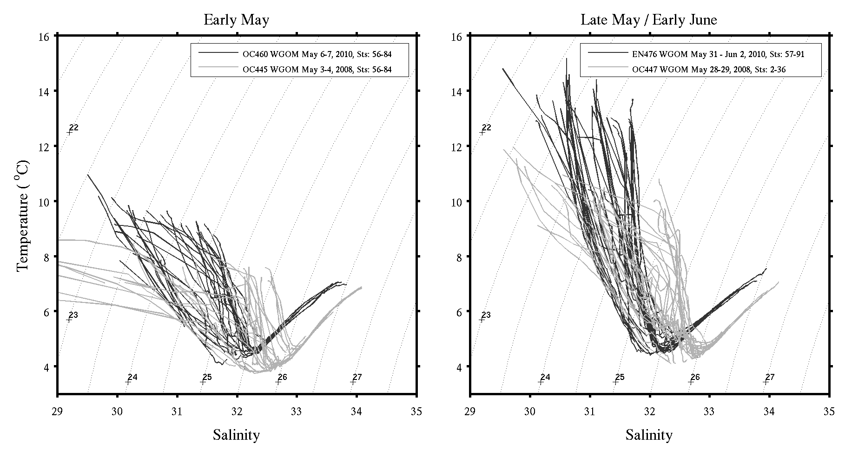
Interannual variations in T-S 2008 vs. 2010

Slide 37
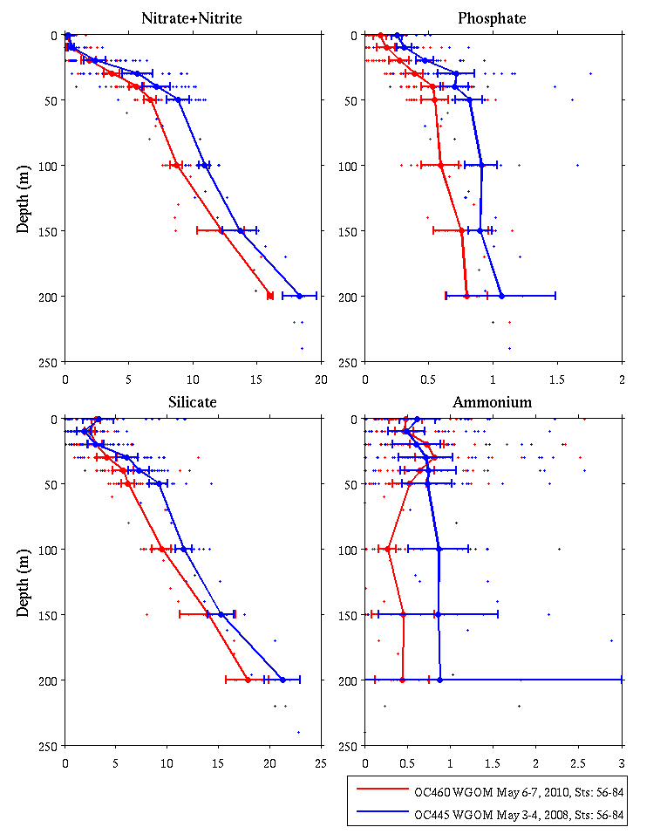
WGOM Nutrients – 2008 vs 2010
Early May 2008
Early May 2010
Dave Townsend
Maura Thomas

Slide 38
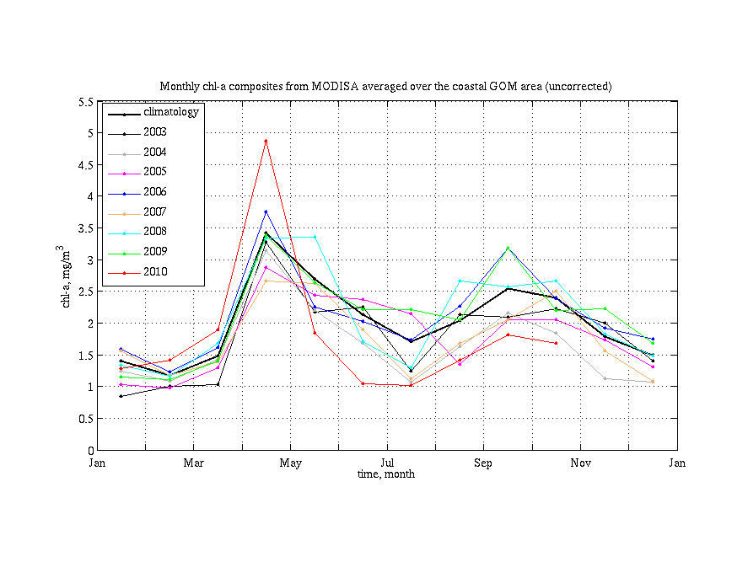
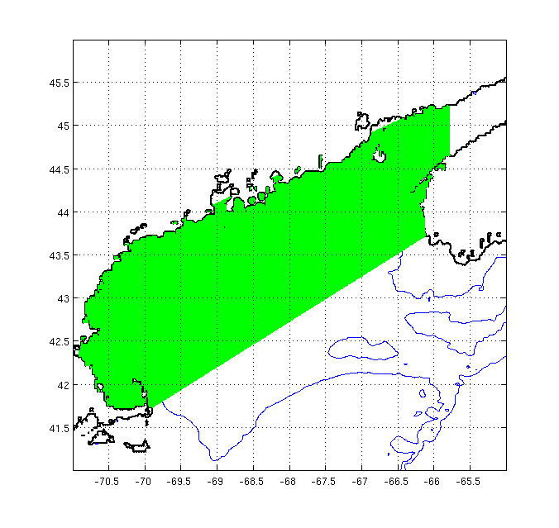
MODIS Ocean Color Observations
2010
A. fundyense
growing season
Spring 2010 phytoplankton bloom started earlier, was more intense, and crashed earlier than usual

Slide 39
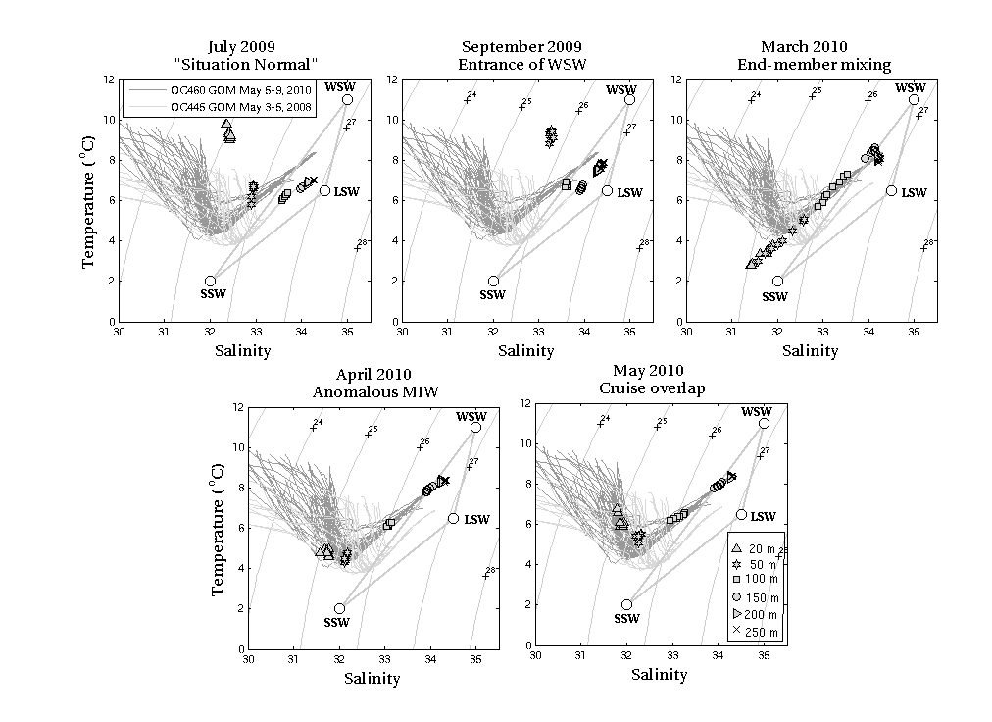
NERACOOS M – Jordan Basin

Slide 40
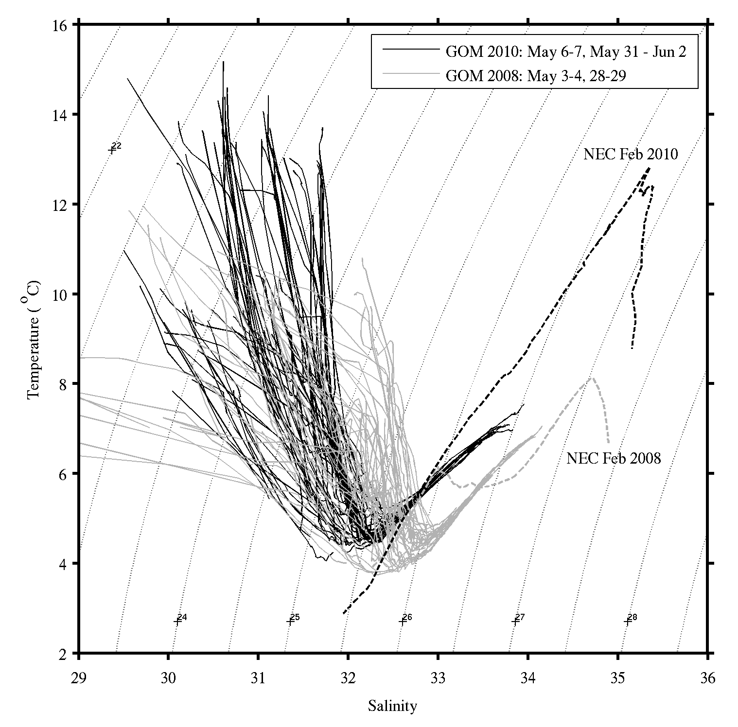
NE Channel – Feb 2008 vs Feb 2010 NMFS-NEFSC EcoMon hydrography
D. Mountain
P. Fratantoni

Slide 41
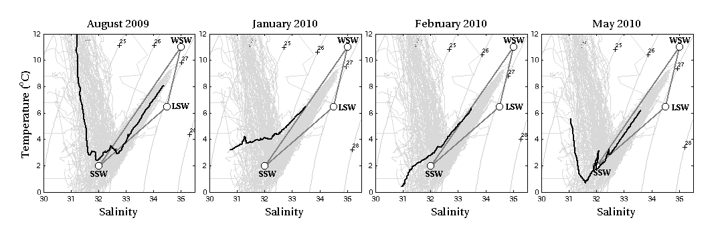
AZMP – Station 2 (Halifax)
Freshening on the Scotian Shelf detected in January 2010

Slide 42
Why was the 2010 forecast wrong?
Conditions were outside the envelope of prior observations used to construct the ensemble forecast
Water mass anomalies indicate a regional-scale change in circulation with direct influence on A. fundyense niche (warmer, more stratified, lower nutrients)
Weaker-than-normal coastal current lessened A.fundyense transport into WGOM and Mass Bay
Spring 2010 phytoplankton bloom more intense and crashed earlier than usual
Did earlier-than-normal nutrient depletion cause a mismatch with A. fundyense’s endogenous clock?
McGillicuddy, D.J., Townsend, D.W., He, R., Keafer, B.A., Kleindinst, J.L., Li , Y., Manning, J.P., Mountain, D.G., Thomas, M.A., and D.M. Anderson, 2011. Limnology and Oceanography, 56(6), 2411–2426.

Slide 43
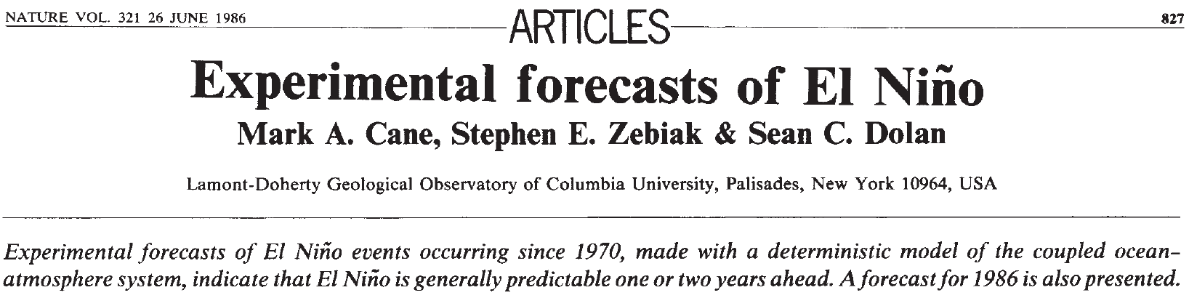
Toward ecological forecasting in the ocean: a cautionary tale from the physical climate system
Notes:
Lessons learned here are in some ways reminiscent of the development of El Niño – Southern Oscillation (ENSO) phenomena. The introduction of dynamical forecast models in the 1980s (Cane et al. 1986) led to several years of remarkably skillful predictions (Latif et al. 1998). In the 1990s, there was a significant drop in forecast skill when ENSO entered a distinctly different mode of variability (Ji et al. 1996)—which ushered in a new wave of model improvement (Chen et al. 1995). Indeed, long-term hindcasting studies suggest interdecadal variations in ENSO predictability that reflect temporal changes the underlying dynamics of the system (Chen et al. 2004). It can be argued that ecological forecasting will be even more prone to fluctuations in predictability than the physical climate system, owing to even stronger nonlinearities in biological dynamics (Frank et al. 1994). As such, assimilation of data will be essential to keep predictive ecological models on track. Although data assimilation into coupled physical-biological models is still in its infancy (Hofmann and Friedrichs 2002), there are some promising inroads being made (Gregg et al. 2009). In any case, the 2010 A. fundyense bloom in the Gulf of Maine highlights the need for intimate connection between observational networks and forecast systems, and how these aspects must evolve together to meet the grand challenge of ecological forecasting in the ocean.

Slide 44

Regime shifts can change the underlying dynamics
Ji et al. (1996) Journal of Climate 9, 3105-3120.
1982-1992
W
Correlation
(forecast, obs)
C
1992-1995
W
Lag (months)
C
Chen et al. (1995) Science 269, 1699-1702. An improved procedure for El Nino forecasting: implications for predictability.
W

Slide 45


Changing dynamics can lead to variations in predictability
Monthly analysis LDEO5 6-mo lead
Correlation
(forecast, obs)
Chen et al. (2004) Nature 428, 733-736. Predictability of El Nino over the last 148 years.

Slide 46


Looking forward
Long-term observational networks are essential
Data assimilation to keep models on track
Process studies to understand changing dynamics
Coordinated interdisciplinary process studies of the scale of ECOHAB / GLOBEC are needed to understand ecological dynamics on local, regional, and global scales.

Slide 47
End

