Slide 1
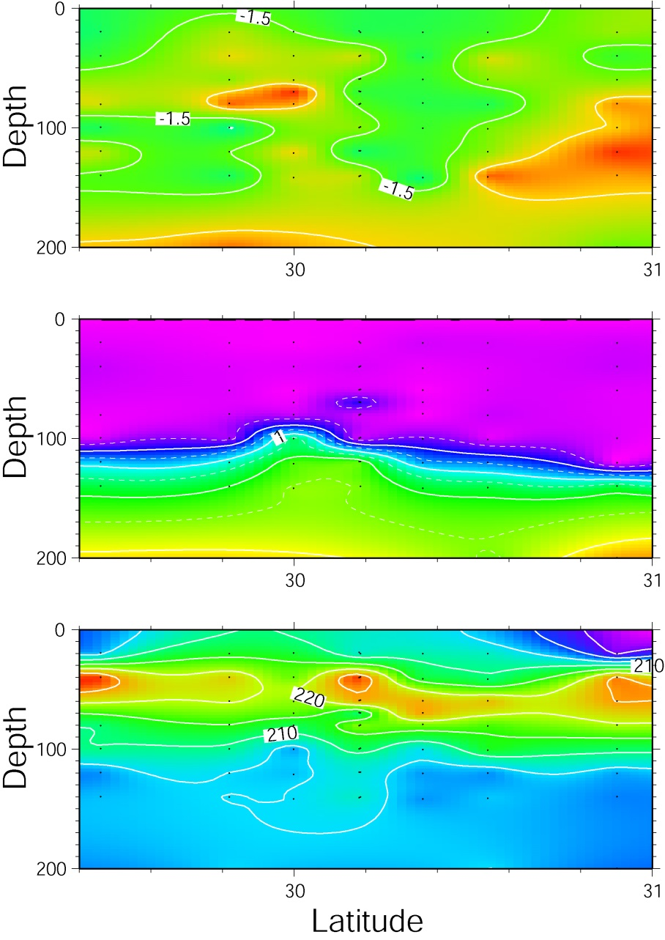
An Anticyclonic Eddy
Del³He
N-S Section through an Anticylcone
Nitrate
Oxygen

Slide 2
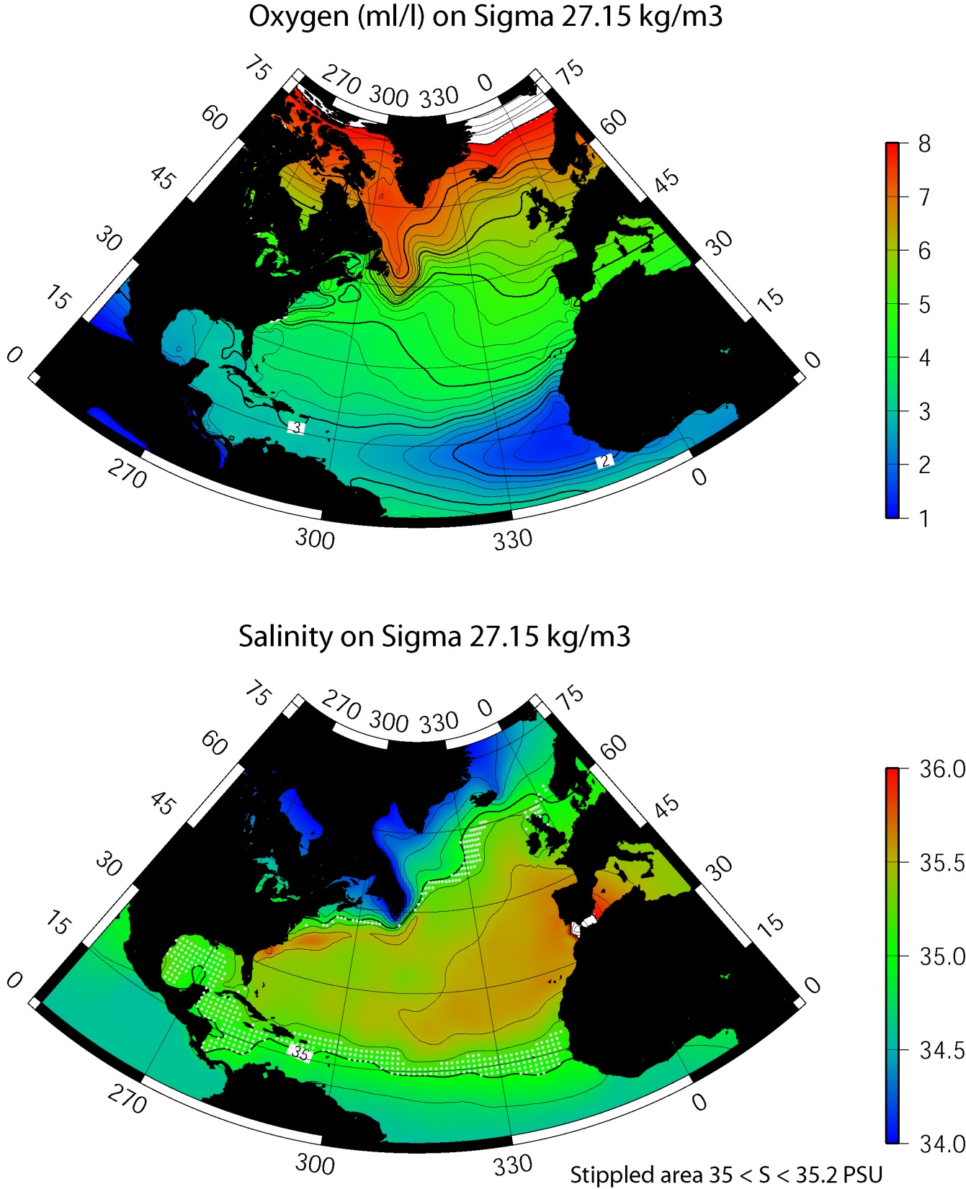
Origin of an Anticyclone?
From the Levitus Atlas
Looking at the deep oxygen minimum & T-S anomaly isopycnal

Slide 3
Origin of an Anticyclone?
From the Levitus Atlas
Looking at the deep oxygen minimum & T-S anomaly isopycnal

Slide 4
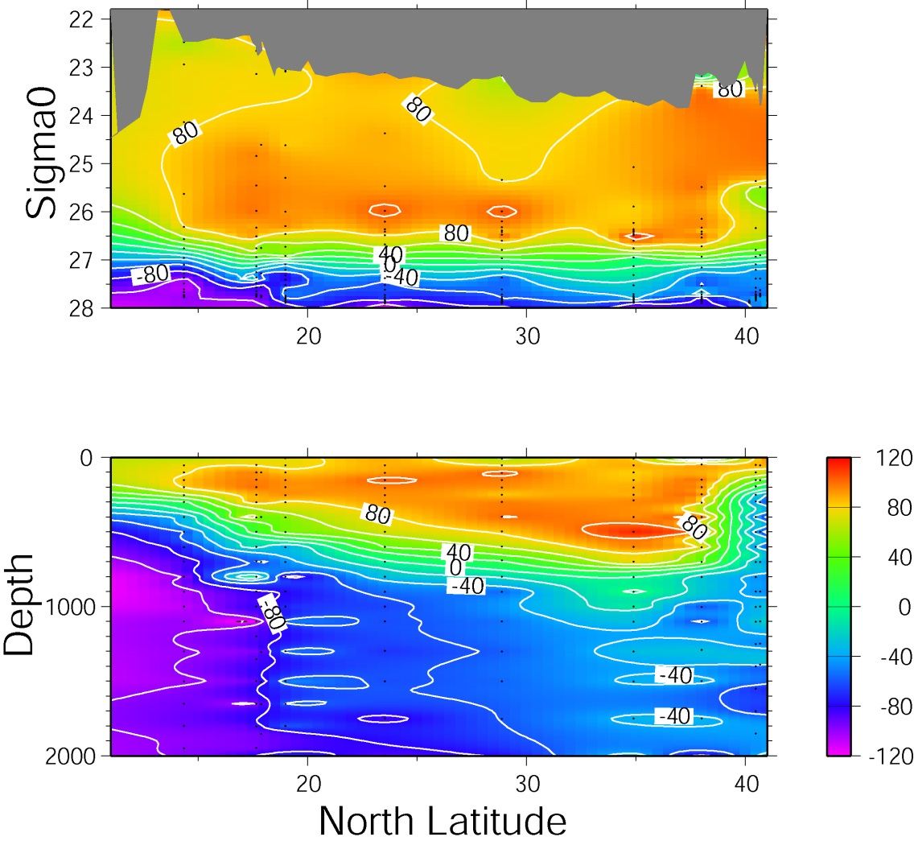
Origin of an Anticyclone?
A22 ¹⁴C Section (1997)
Remember ¹⁴C is a transient tracer

Slide 5
Origin of an Anticyclone?
A22 ¹⁴C Section (1997)
Remember ¹⁴C is a transient tracer
Radiocarbon results from station 67

Slide 6
Origin of an Anticyclone?
A22 ¹⁴C Section (1997)
Remember ¹⁴C is a transient tracer
Radiocarbon results from station 67

