Slide 1
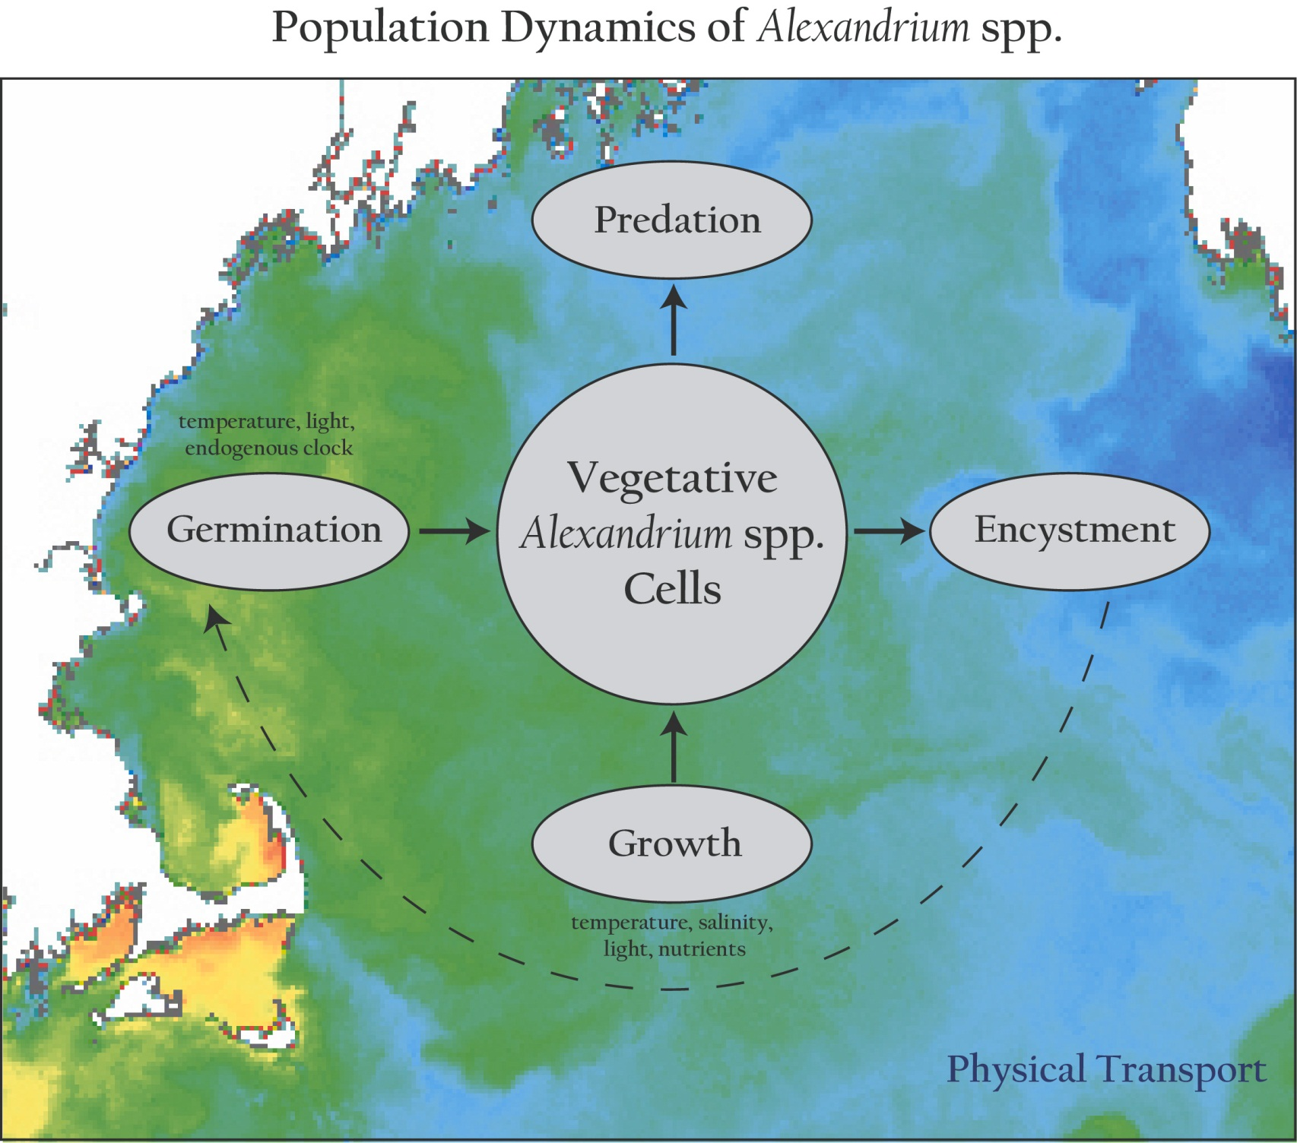
Population dynamics of Alexandrium spp.
Notes:
Our approach in this modeling effort is to incorporate what is known about the population dynamics of Alexandrium into 3-d circulation models of the region.
Fundamental to this approach is the concept that the ecosystem in which A.f. resides is not explicitly modeled. This is justified on the basis that, with very few exceptions, A.f. constitutes a very small fraction of the total phytoplankton species assemblage in the GOM. As such, it does not materially affect either the ambient nutrient concentrations nor predator abundances. Therefore these “ecosystem effects” can be parameterized through their influence on the vital rates of A.f.’s population dynamics.
These processes within the population dynamics are complex functions of environmental parameters, such as temperature, salinity, light and nutrients in the case of vegetative growth, and temperature, light and an endogenous clock in the case of germination.
All of this takes place in an complex, turbulent, three-dimensional fluid medium, some characteristics of which are evident in the sea surface temperature image on which this cartoon is overlayed.
What I’d like to emphasize here is that the linkage between the population dynamics of Alexandrium (or any other planktonic species for that matter) and the physical environment is twofold: first, the rates of the population dynamics processes are influenced by environmental variables, and second, the spatial distributions of the populations themselves are constantly being stirred and rearranged the currents. The duality of this linkage between the population dynamics and the physical environment is what makes coupled physical/biological problems in the ocean so incredibly complex. Our hope is that the use of models will help untangle this complexity, and provide insight into what controls blooms of Alexandrium in the Gulf of Maine.

Slide 2
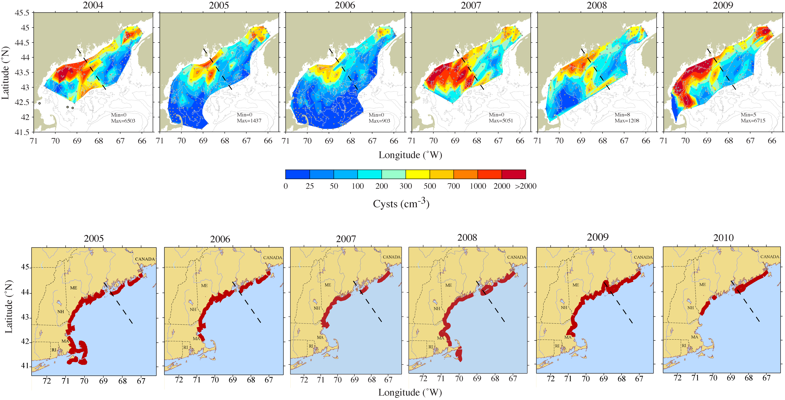
Cysts and toxicity 2004-2009
McGillicuddy et al., 2011

Slide 3
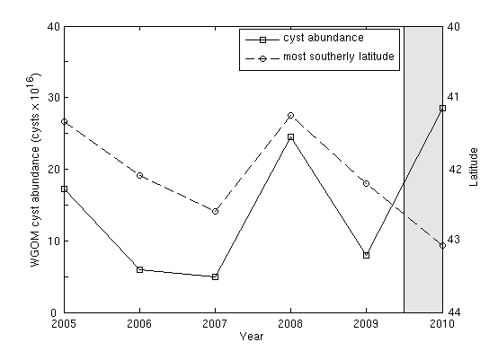
Cyst abundance and toxicity
2005-2009: r=-0.93
McGillicuddy et al., 2011

Slide 4
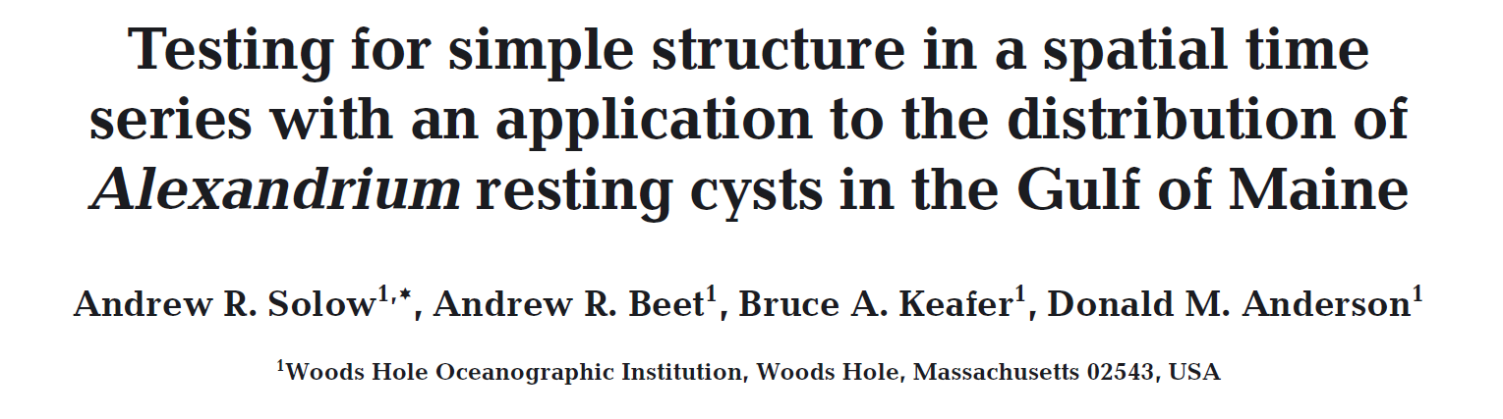
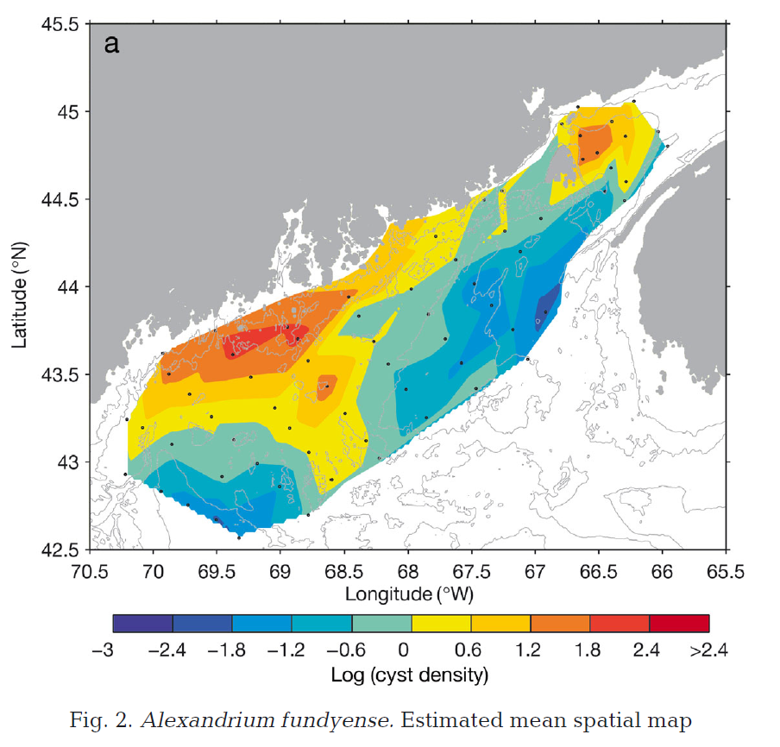
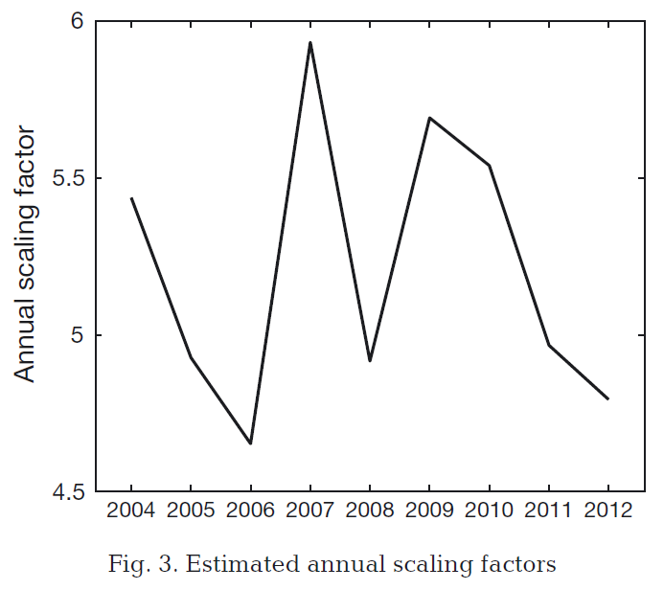
Solow et al., 2014

Slide 5
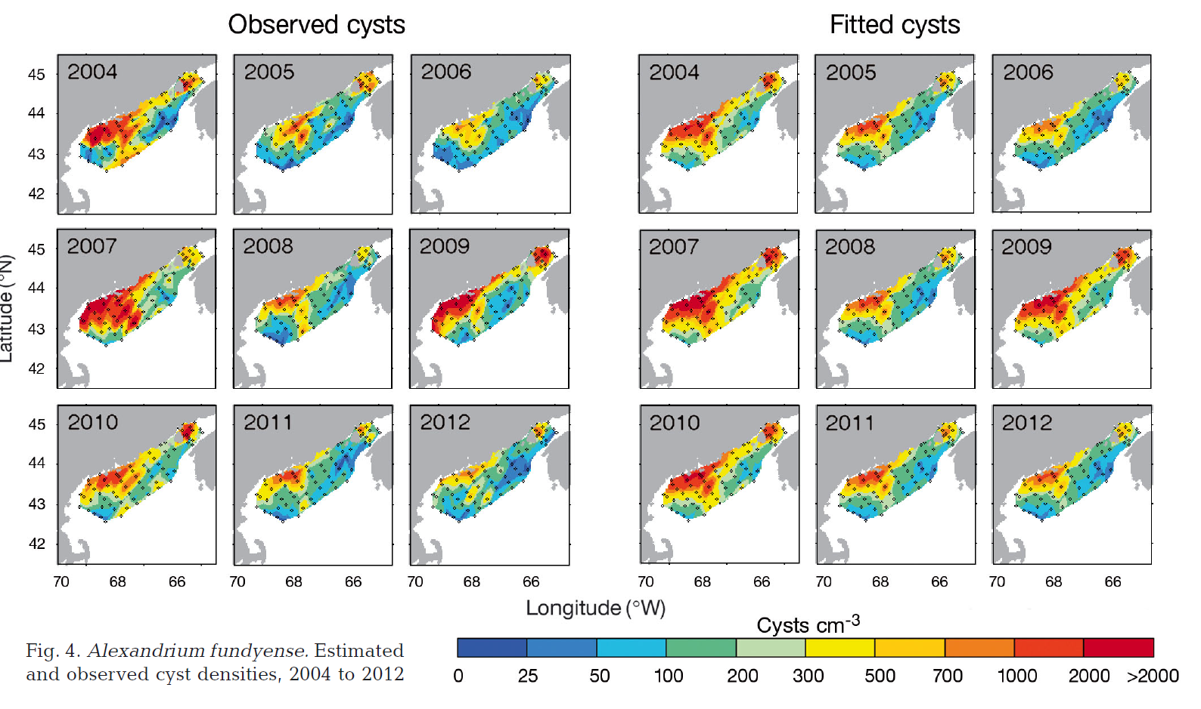
Results of the Solow et al. algorithm

Slide 6
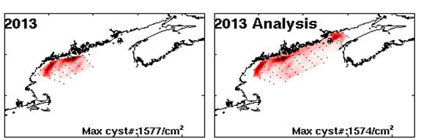
Application to the fall 2013 cyst map

Slide 7
Hydrodynamics
Benthic Cyst
2014 Bloom Forecast
2004
Scenario 1
Scenario 2
Scenario 3
Scenario 4
Scenario 5
Scenario 6
Scenario 7
Scenario 8
Scenario 9
Scenario 10
2005
2006
2007
2008
2009
2010
2011
2012
2013
Notes:
7

Slide 8
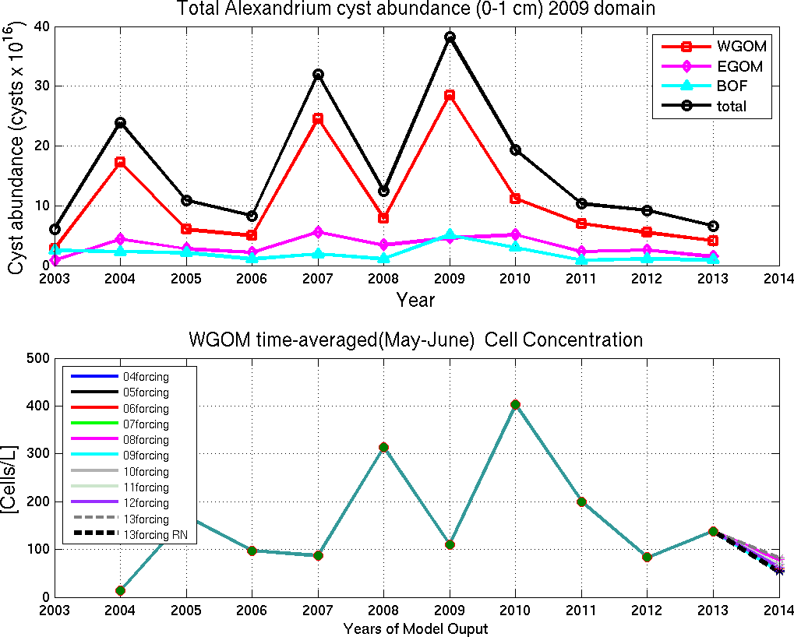

Slide 9
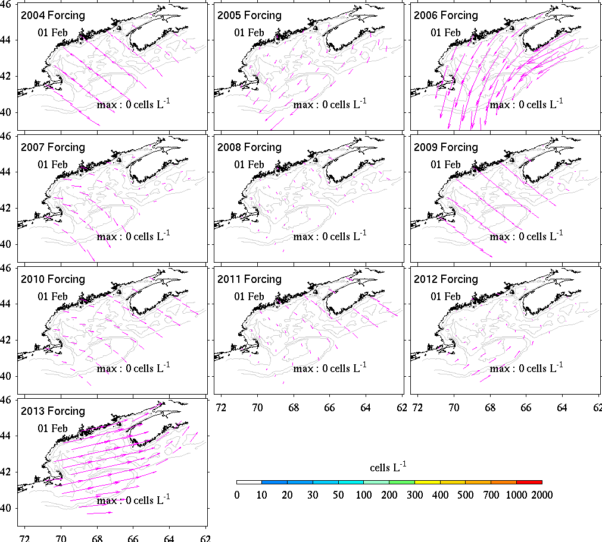

Slide 10
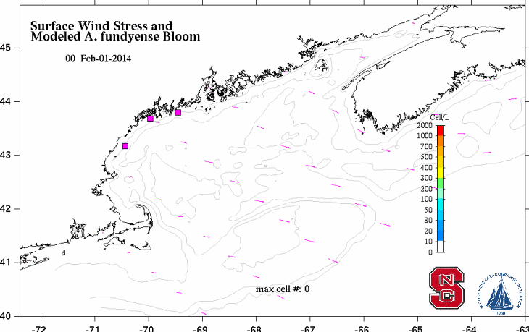
2014 Forecast

Slide 11
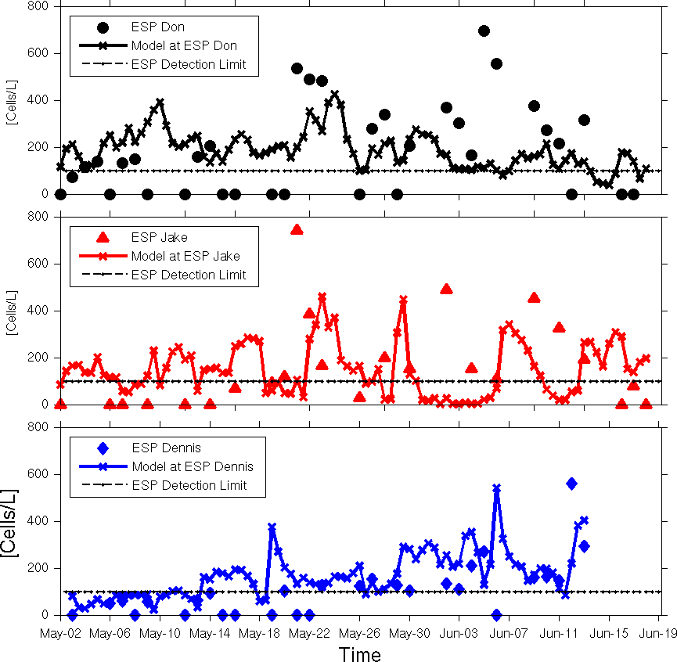
Model evaluation with ESP data

Slide 12
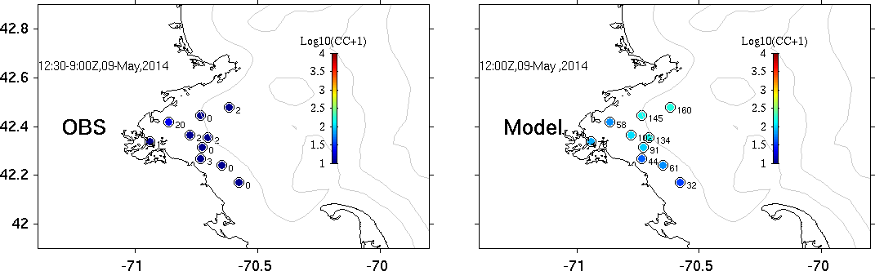
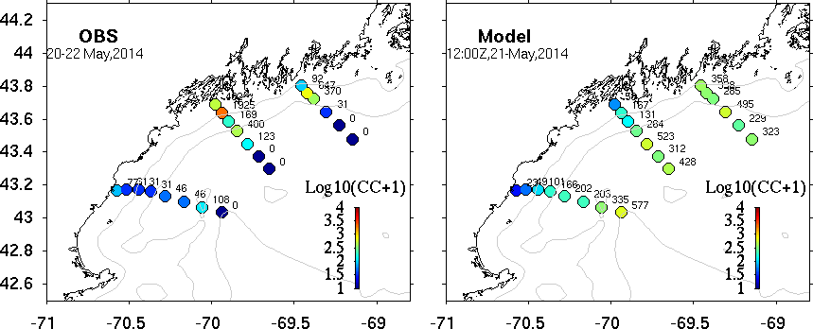
MWRA – May 9
R/V Tioga – May 20-22

Slide 13
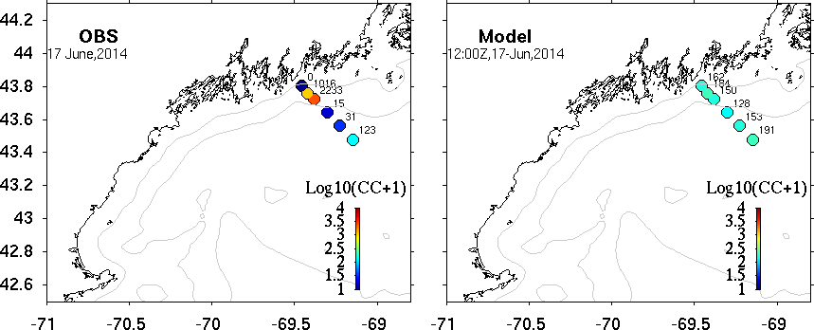
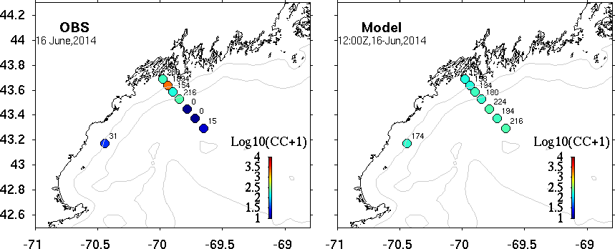
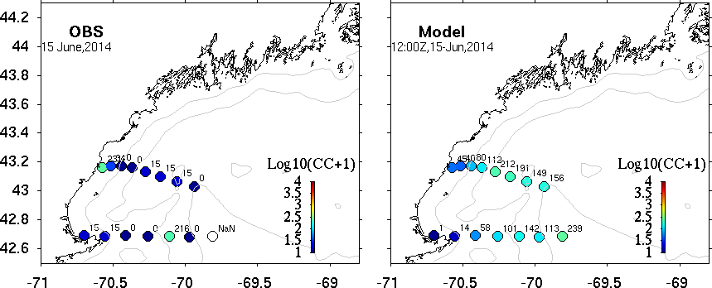
R/V Tioga – June 15-17

Slide 14
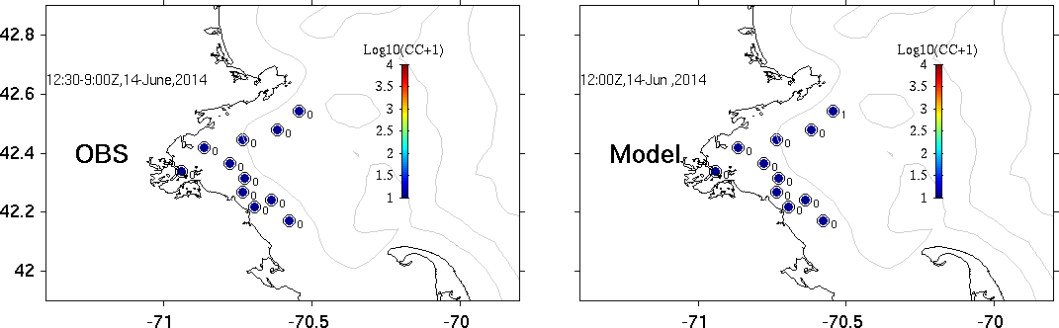
MWRA – June 14

Slide 15
Quantitative skill evaluation: regional hindcast simulations
r² = 1 - var(misfits)/var(observations).
Stock et al. (2005)
Notes:
Point-to-point comparisons: correlation is low, var(misfits) similar to that of the obs.
Averaging over larger scales, r increases and variance of misfits is 1/3 that of the obs.
Simulate large-scale seasonal distributions; no skill on the individual patch level.

