Slide 1
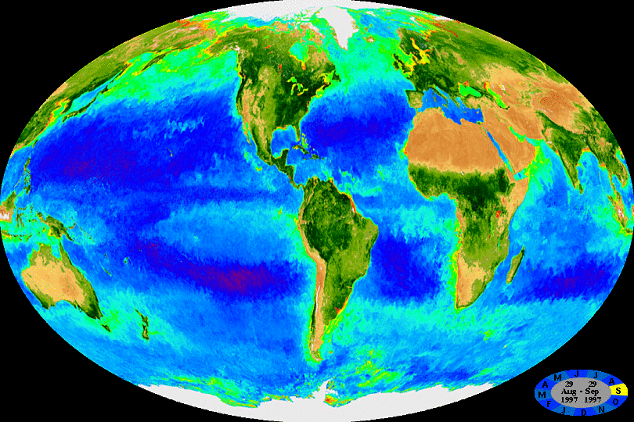

Blooms of algae in the ocean
Notes:
The animated GIF below is composed of 362 32-day SeaWiFS composites. Each 32-day composite in the sequence has a starting (and ending) date that is eight days later than the previous frame. The time period covered is from the beginning of the SeaWiFS mission through July 2005.
http://oceancolor.gsfc.nasa.gov/SeaWiFS/HTML/SeaWiFS.BiosphereAnimation.70W.html
Chl as a proxy for phytoplankton biomass
Seasonal cycles
Eddies
Amazon/Orinoco
Upwelling
W Africa
Equatorial Pacific
West coast US, South America

Slide 2
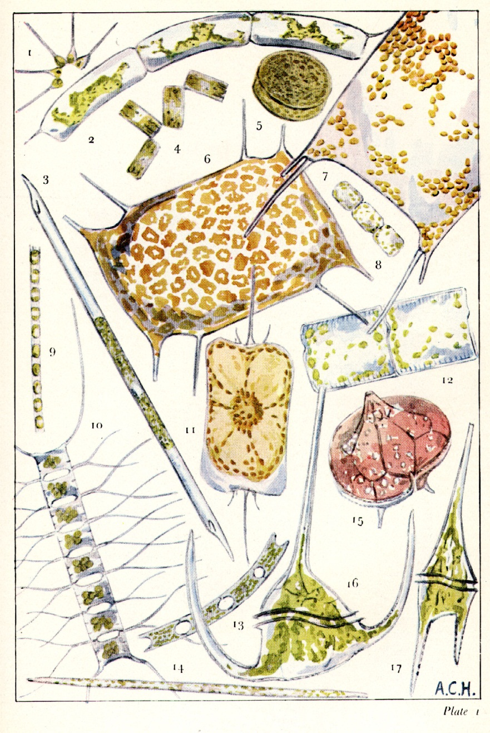
Phytoplankton: The Base of the Marine Food Web
______
0.1 mm
Sir Alistair Hardy, The Open Sea (1956)
Notes:
Chain-forming diatoms
10 Chaetoceros (10-50 u width)
9 Skeletonema costatum
Centric diatoms
5 Coscinodiscus
Elongate forms
3 Rhizosolenia
Dinoflagellates
15 Peridinium
16,17 Ceratium
Picoplankton: Synechococcus, Prochlorococcus (size of dot)

Slide 3
Plankton Production in the
Open Ocean
Sea Surface
Zooplankton Fish
100m
Notes:
½ the photosynthesis on earth takes place in the ocean

Slide 4
The biological pump
Sea Surface
Photosynthesis
100m
Respiration
Notes:
Greenhouse gas – 30C warmer than otherwise
Bio pump strong
w/o 2X pCO2
no polar ice caps
seal level 100m higher
Industrial revolution: 1/3 atm, 1/3 land, 1/3 ocean
Will this equipartitioning continue? Climate feedback

Slide 5
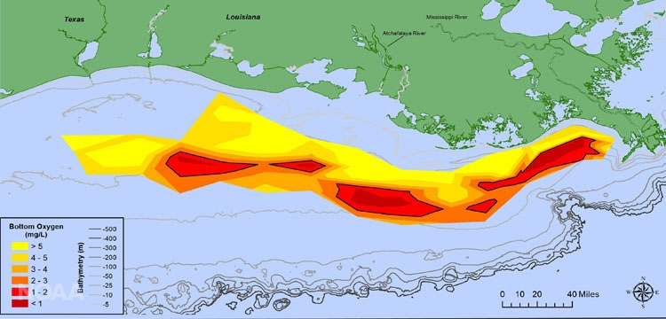
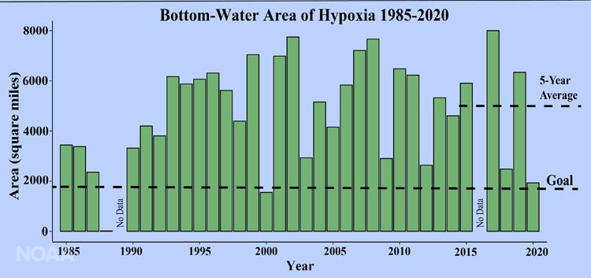
“Dead Zone” 2020
1985 - 2020
https://www.noaa.gov/media-release/smaller-than-expected-gulf-of-mexico-dead-zone-measured

