Slide 1
Woods Hole Center for Oceans and Human Health
Dennis McGillicuddy
Senior Scientist, Applied Ocean Physics & Engineering
John Stegeman
Senior Scientist, Biology

Slide 2
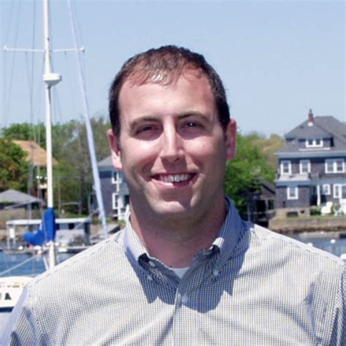
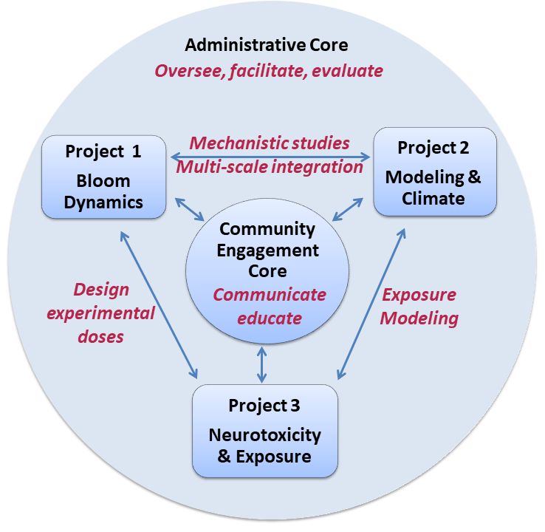
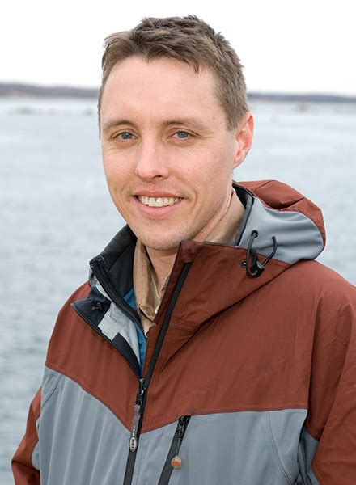
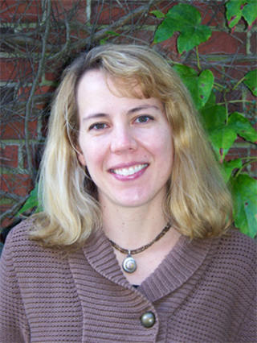
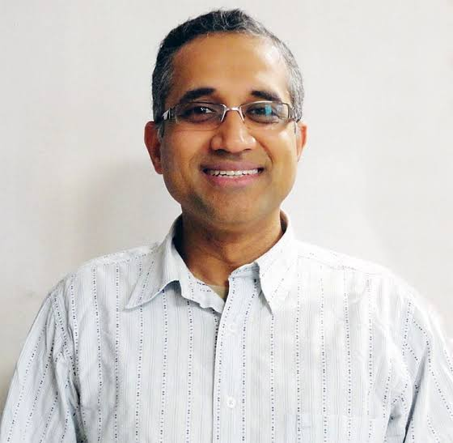
Mike Brosnahan
Dave Ralston
Mindy Richlen
Neel Aluru

Slide 3
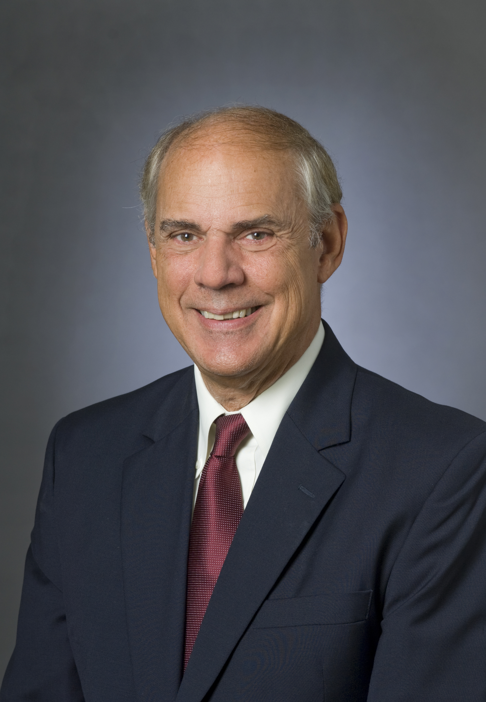
Remarks – Dennis McGillicuddy
John, thank you for your kind words and for your leadership. It is a privilege and an honor to succeed you in this role. You have been a great mentor to me over the years, and I have learned so very much from you. One of the things you mentioned in your description of the initial RFA for OHH was the intent to “create new interactions and have scientists from different disciplines learn to talk with one another.” That reminded me of the open meetings that you convened among researchers from WHOI, MBL, and MIT to discuss a response to the RFA. And I remember very clearly that the communication barrier was a significant one. I recall hearing the comments from people leaving the meeting along the lines of “what was that all about?” And I have to admit that I struggled to get my mind around what this new way of doing research would look like.
John, it was your vision and leadership that inspired me to go back to the second meeting, which had roughly half the number of people. You have preserved every day since then, to the great benefit of the WHCOHH and the field itself. Today’s audience may not be fully aware of that latter aspect, so we’re going to go a little off-script and hear from a few others who can attest to your impact on the field of OHH.

Slide 4

Dr. Frederick Tyson, inaugural NIEHS Program Director for Oceans and Human Health

Slide 5
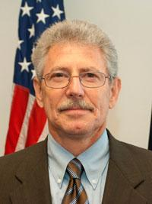
Dr. Paul A. Sandifer
Director, Center for Coastal Environmental and Human Health
College of Charleston
I’ve known John Stegeman for about 20 years, going back to the very early days of the OHH programs.
While I cannot remember exactly when we met, I recall an early encounter, perhaps at the first meeting of all OHH Center directors. There was some issue about which we had very different opinions, and we ended up in a bit of a stare-down. Actually, it was more of John staring down and me staring up, considering the substantial differences in our respective heights. While John can be a bit intimidating, for me that marked the beginning of what, over time, became a “beautiful friendship.”
I admire John for many reasons, including the fact that he can really sing and I cannot, but a couple of other things stand out to me. In addition to being a world-class researcher and science leader, he is committed to ensuring that the great work accomplished not only at Woods Hole but throughout the OHH network is translated into information that can be used by various constituencies. He was also an early and loud champion for the OHH Gordon Conferences to help ensure broad communication of OHH science to other scientists. But, what most impressed me is his willingness to share his considerable wisdom and experience to assist other groups as they developed OHH programs.
A case in point occurred here in South Carolina. When Geoff Scott and I were setting up our OHH Center at the University of SC in 2018, John Stegeman was the first person we thought to ask for help, and he immediately accepted our invitation to come and help us get it going. He participated in the first formal OHH conference session that we organized at the Oceans ‘18 conference in Charleston, lending his substantial reputation and stature to it, and provided excellent advice and support as we got underway and throughout following years. He played a key role in organizing the first meeting of the four then “new” OHH Centers held in SC, providing ideas, enthusiasm, and key insights. This meeting focused on ensuring that our community engagement cores were connected and collaborating from the outset. He offered similar advice and encouragement to the other Centers, kicked off our monthly inter-Center calls and interactions, and led many of them.
To conclude, I think of John as an honorary “Godfather” for our Center and for the OHH meta-discipline overall, wherever it is practiced. Although we will not be continuing under the new OHH funding, we will always be grateful for his assistance, encouragement, and advice. John is not only the longest standing of the OHH Directors, but probably its greatest proponent and cheerleader, and thus it is appropriate in my mind to consider him the “Dean of OHH Directors.”
Congratulations on a job extraordinarily well done, Dean John, and best wishes Dennis – you have HUGE shoes to fill.

Slide 6

Prof. Lora Fleming, MD PhD MPH MSc Hon CBE, University of Exeter

Slide 7
Join us for a reception
4:30 pm
Smith Conference Room

