Slide 1
Forecasting New England “Red Tides”

Slide 2
Plankton Production in the
Open Ocean
Sea Surface
Zooplankton Fish
100m

Slide 3
The biological pump
Sea Surface
Photosynthesis
100m
Respiration

Slide 4
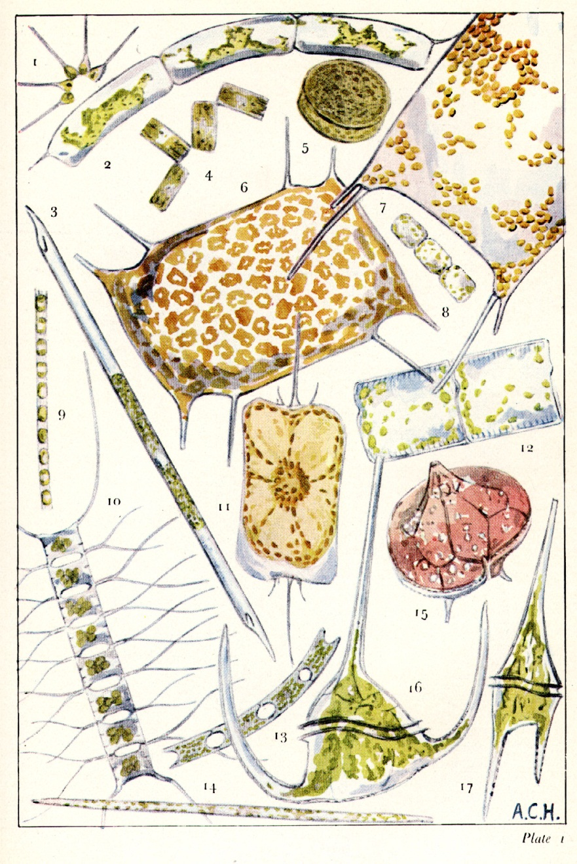
Phytoplankton: The Base of the Marine Food Web
______
0.1 mm
Sir Alistair Hardy, The Open Sea (1956)

Slide 5
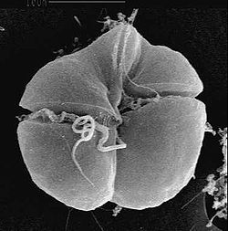
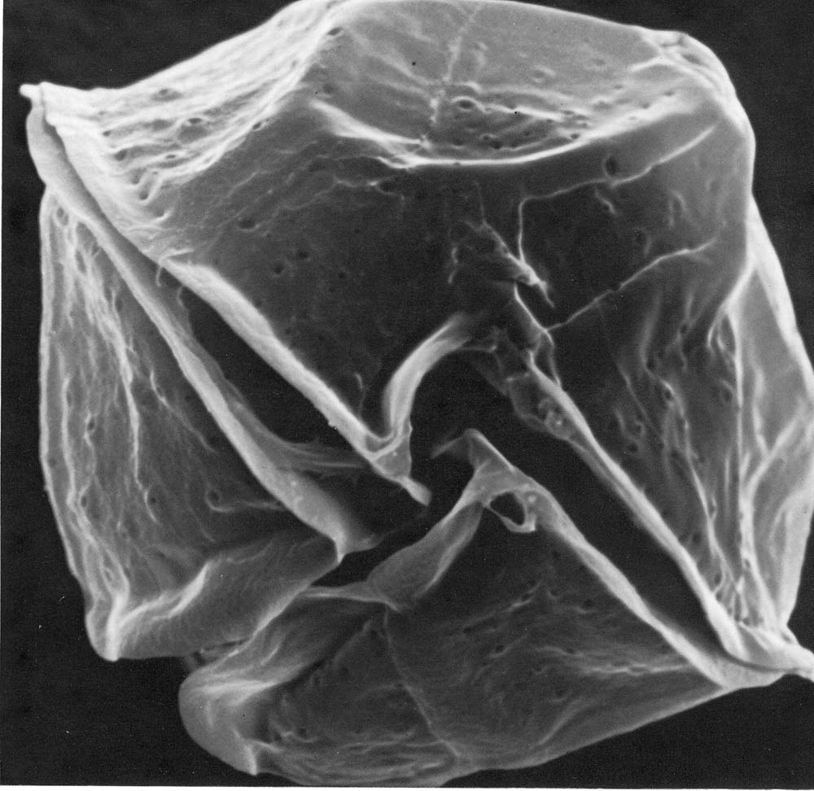
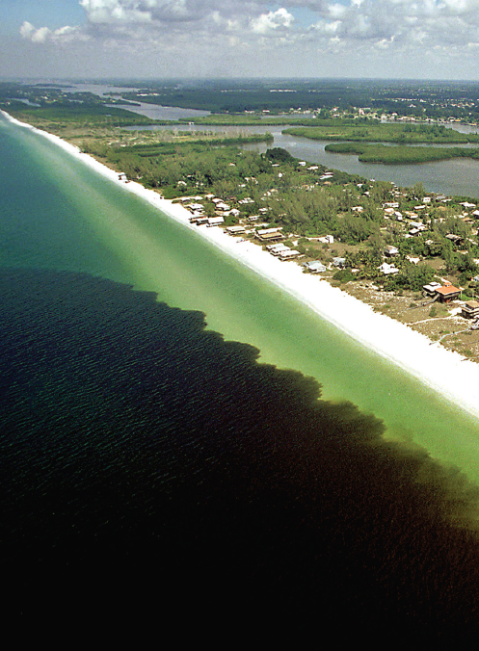
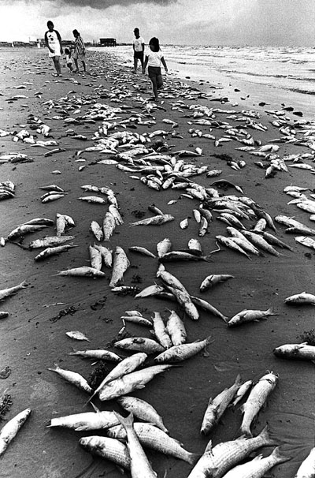
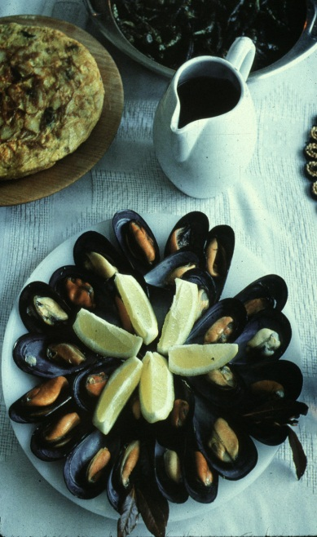
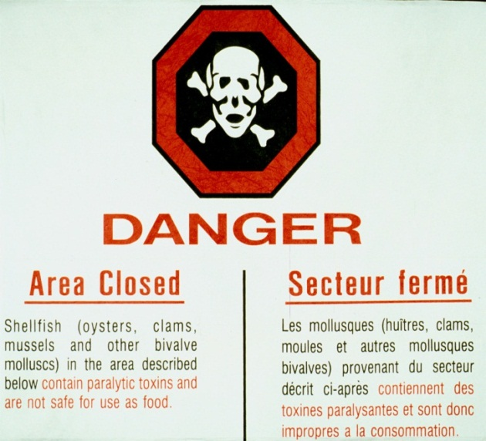
Gulf of Mexico: Gulf of Maine:
Karenia brevis Alexandrium fundyense
Dinoflagellates
~40 microns diameter
Produces brevetoxins
Neurotoxic Shellfish
Poisoning (NSP)
Produces saxitoxins
Paralytic Shellfish
Poisoning (PSP)
Paul Schmidt, Charlotte Sun
Notes:
Class: Dinophyceae
Genus: Karenia
Species: K. brevis
Alexandrium is a species of dinoflagellate approximately 40 microns in diameter. It produces saxitoxins which can accumulate in the tissues of filter-feeding organisms such as mussels and clams. Blooms of Alexandrium can cause buildup of toxins within shellfish sufficient to cause Paralytic Shellfish Poisoning, which can be a serious threat to human health. Because of this threat, shellfish beds in affected areas are monitored on a regular basis and harvesting closures occur frequently throughout the region.
Saxitoxin, one of the most potent natural toxins known to man– fatal human dose is about 1mg.

Slide 6
Life Cycle of Alexandrium

Slide 7
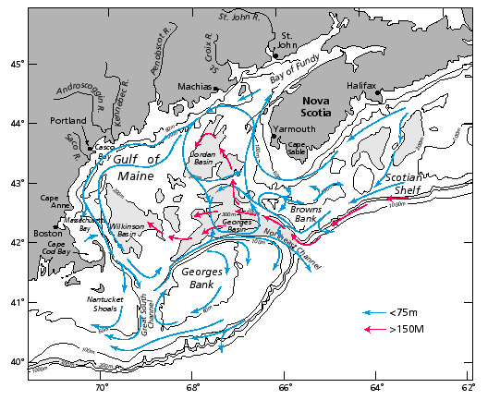
General circulation during the stratified season
Beardsley et al. (1997)

Slide 8
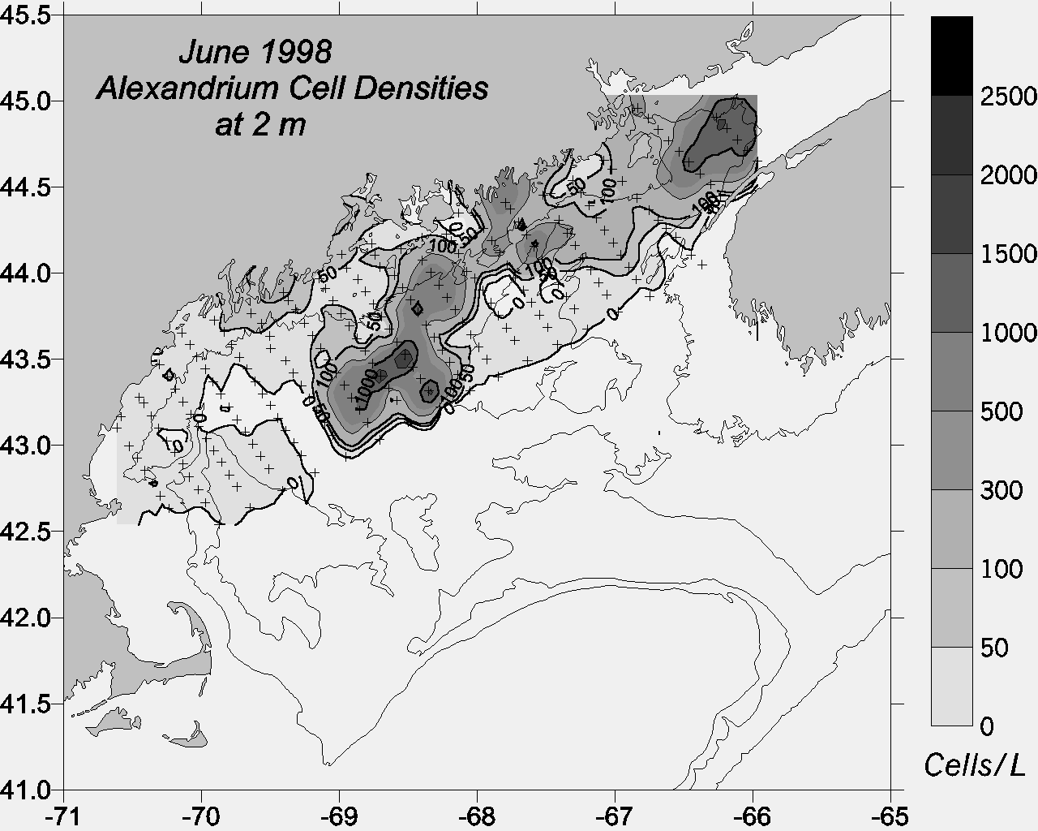
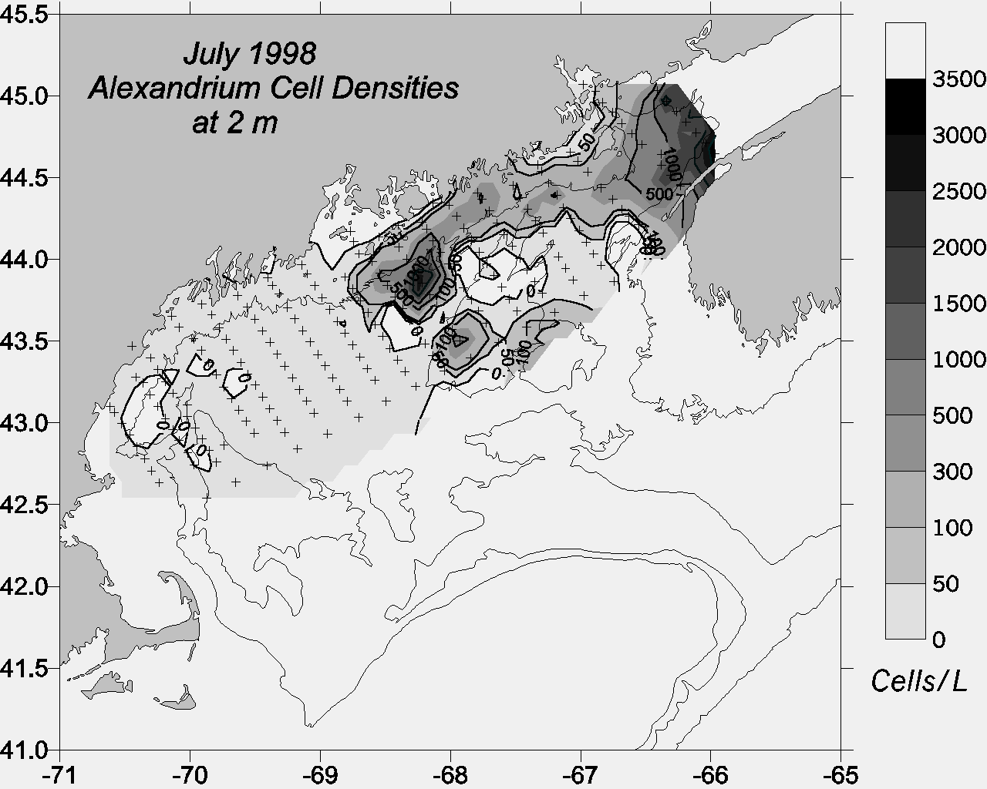
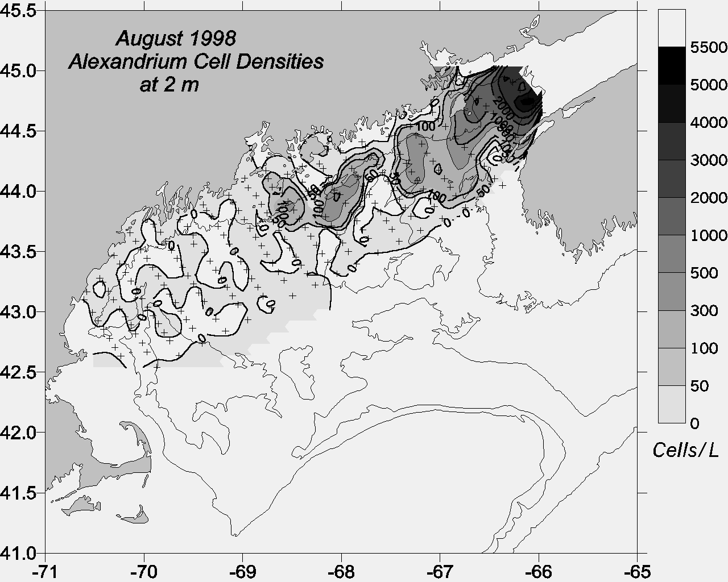
ECOHAB-GOM Observations
Gulf-wide
distribution
2) Association with coastal
current
3) Center of mass
shifts west-to-east
as season progresses
Townsend et al.
(2001)

Slide 9
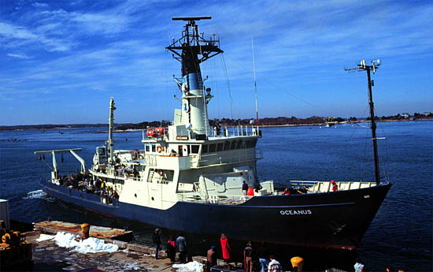
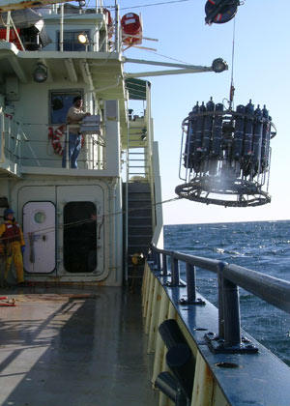
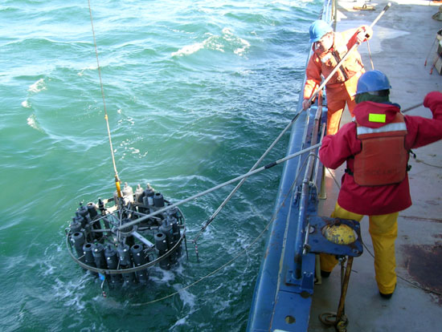
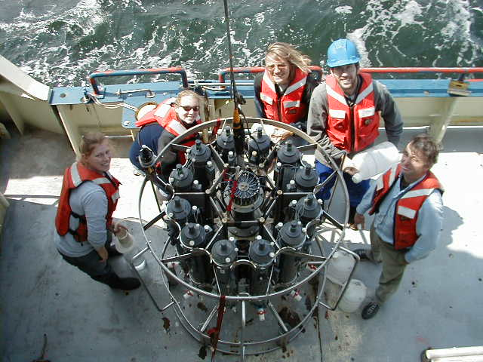
R/V Oceanus

Slide 10
ECOHAB-GOM Observations
Gulf-wide
distribution
2) Association with coastal
current
3) Center of mass
shifts west-to-east
as season progresses
Townsend et al.
(2001)

Slide 11
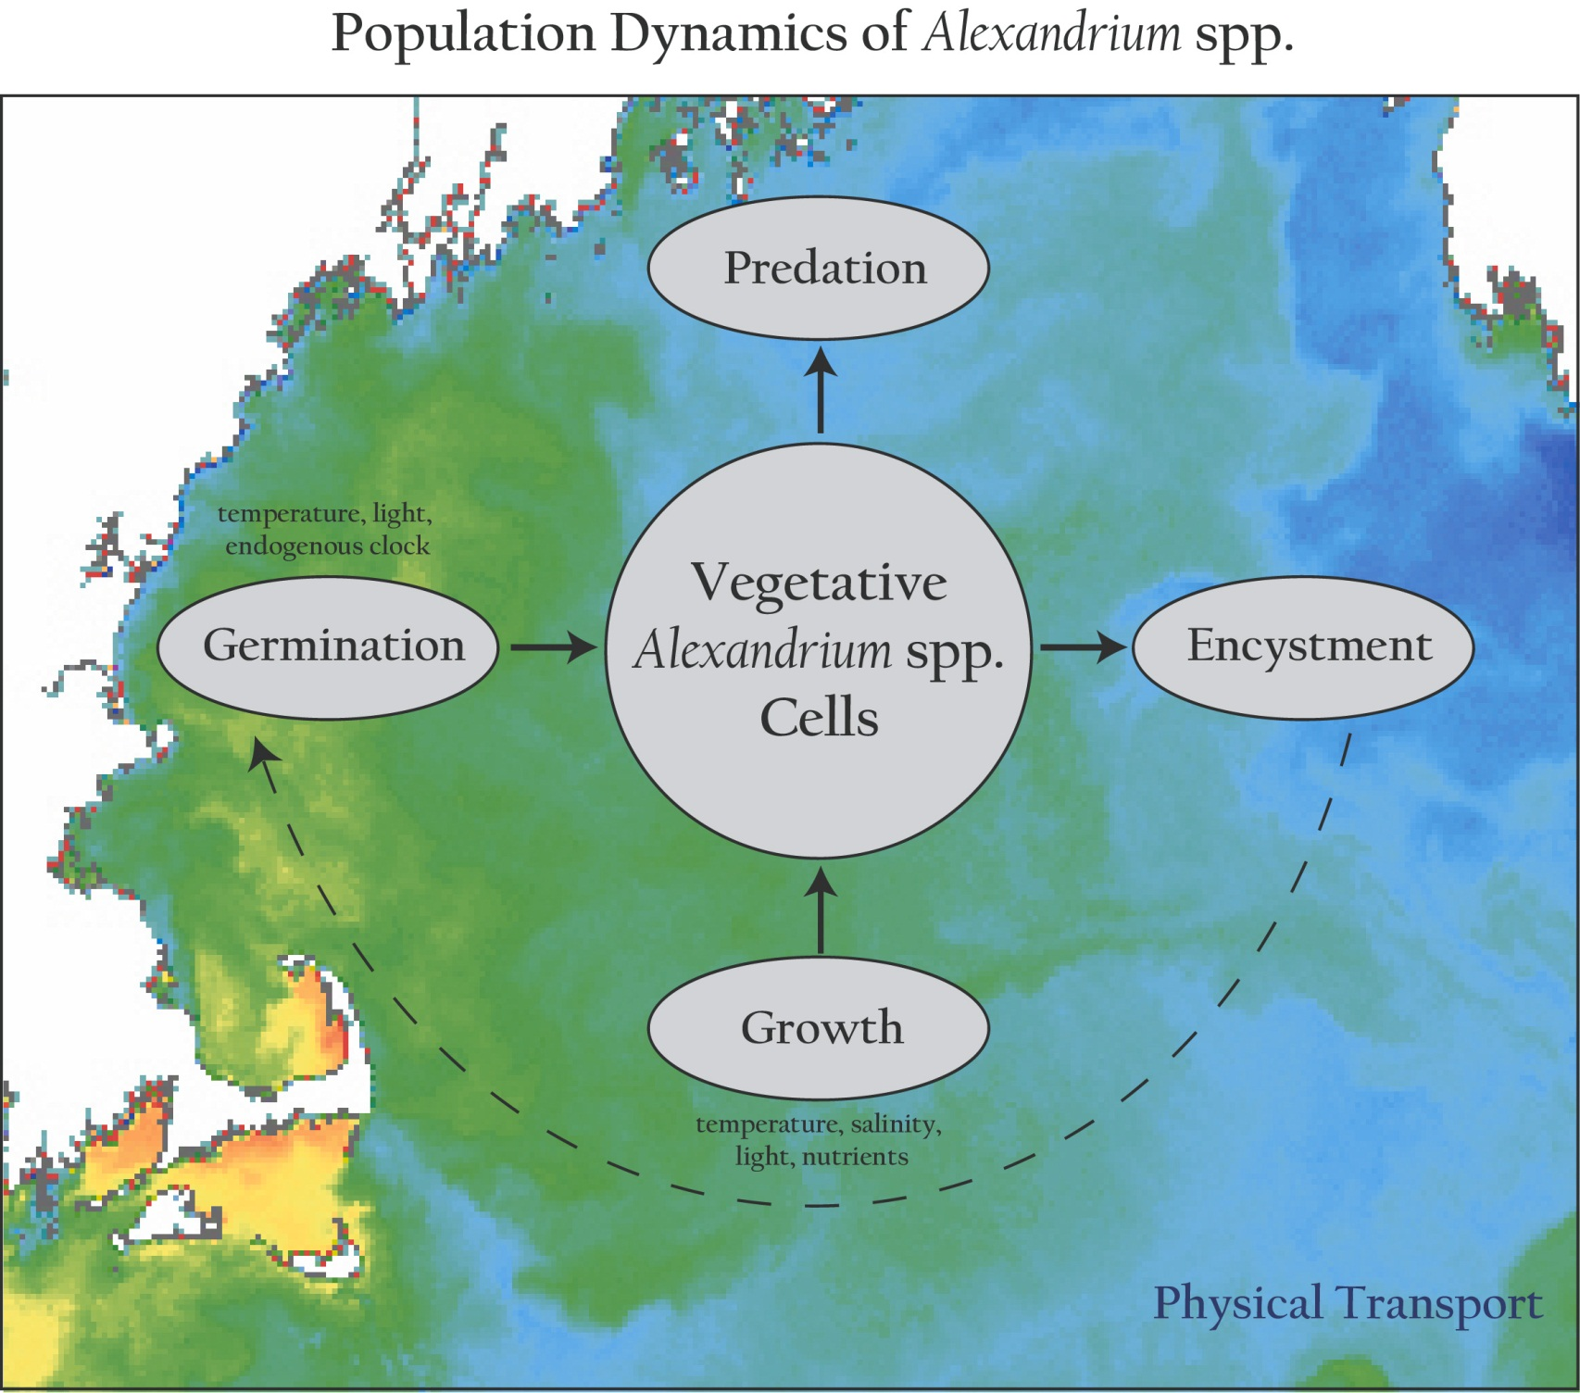
Population dynamics of Alexandrium spp.

Slide 12
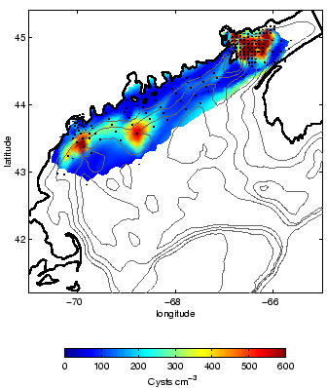
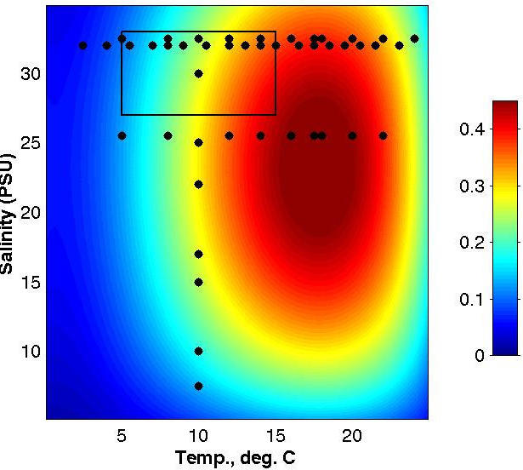
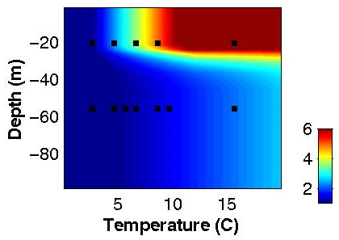
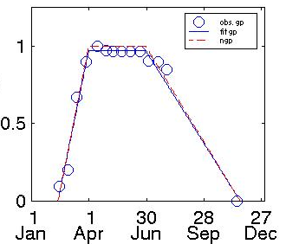
Alexandrium Population Dynamics Model
Cyst Dist. (# / cm^2)
Endogenous Clock
Germ. rate (% / day)
Growth (per day)
Growth = min ( f(PAR) , g(T,S,nutrients) )
Upward swimming 10 m/day
“Mortality” = 0.1 per day
Salinity
Temperature

Slide 13
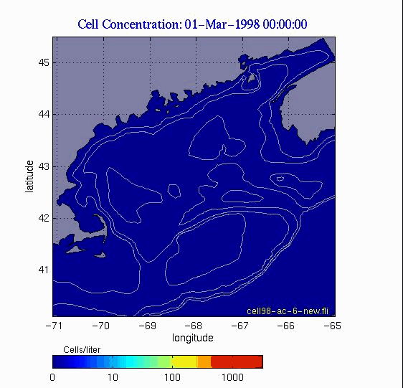
Germination Only

Slide 14
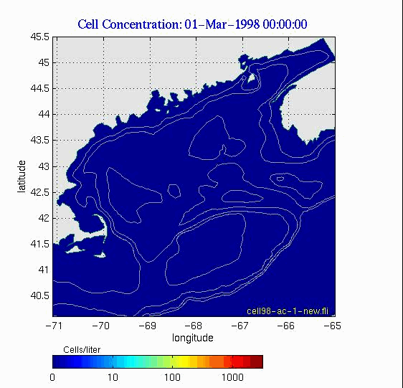
Germination, Growth, ‘Mortality’

Slide 15

Germination, Growth, ‘Mortality’, Nut. Limit.

Slide 16
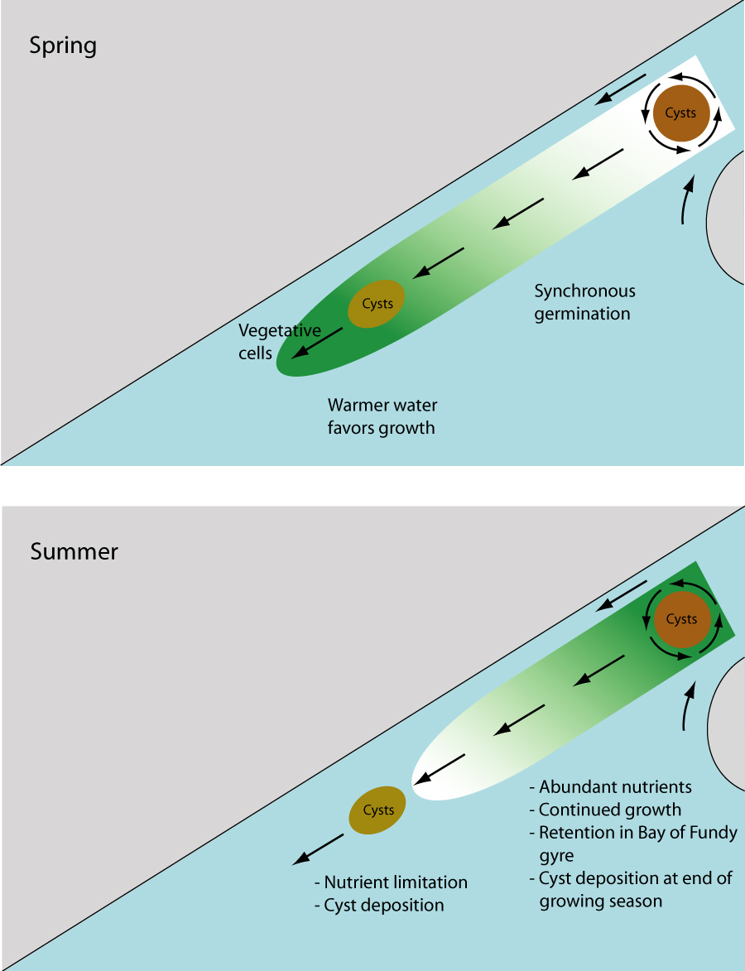
A conceptual model for the large scale seasonal variability of A. fundyense in the Gulf of Maine
Spring:
Temperature
limitation
Summer:
Nutrient
limitation
McGillicuddy et al., 2005

Slide 17
What happened in 2005?

Slide 18
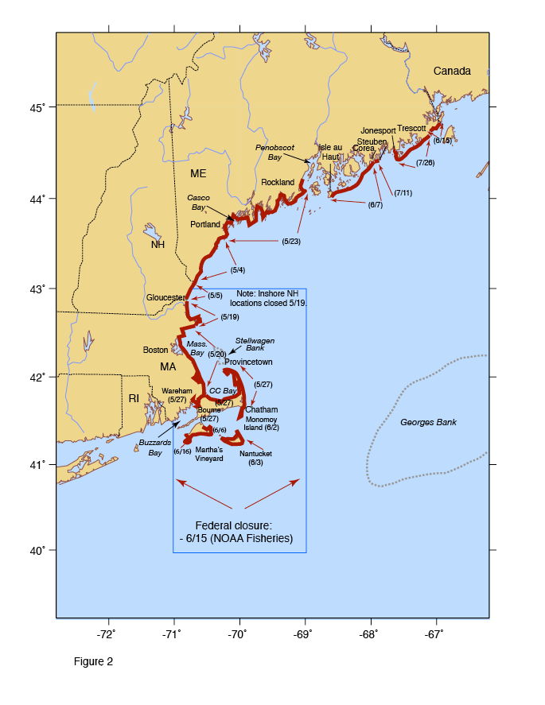
The 2005 bloom
Most widespread and intense bloom in at least 33 years, perhaps longer
Record levels of toxicity in some locations; first-time ever records of toxicity in others
Record high A. fundyense cell concentrations (for this region)
Large closure of federal (offshore) waters
> $50M loss to shellfish industry in MA alone
Maine, MA - disaster declarations
Anderson et al., 2005

Slide 19

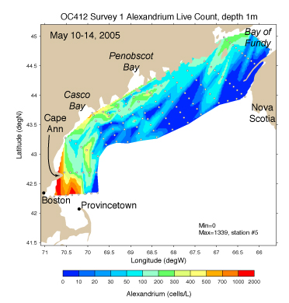
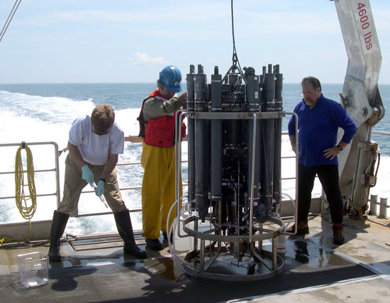
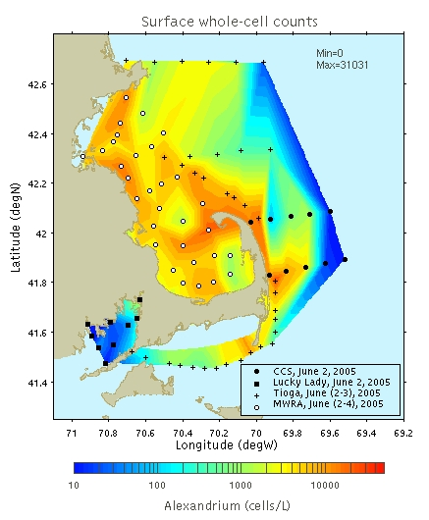
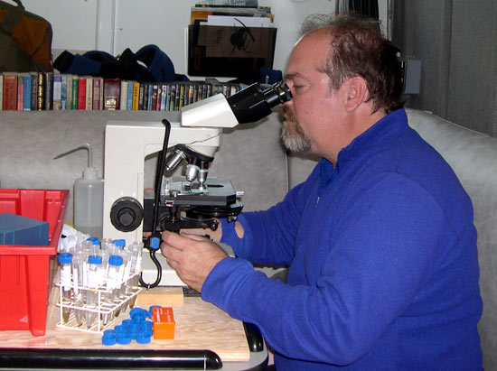
A. fundyense concentrations
WHCOHH cruise OC402 May 10-18 2005
Rapid response
surveys

Slide 20
Hypotheses
Source: High abundance of A. fundyense cysts in western GOM sediments.
Transport: Northeast winds caused strong onshore advection of A. fundyense populations
Anomalously high river runoff resulted in enhanced alongshore transport, and higher micro- and macro-nutrient concentrations.

Slide 21
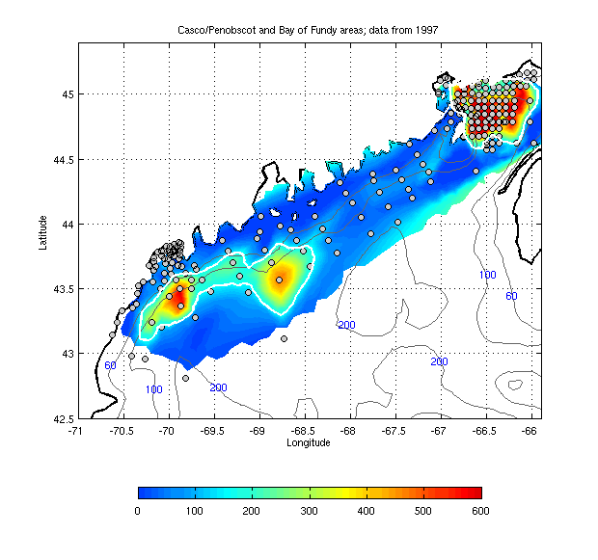
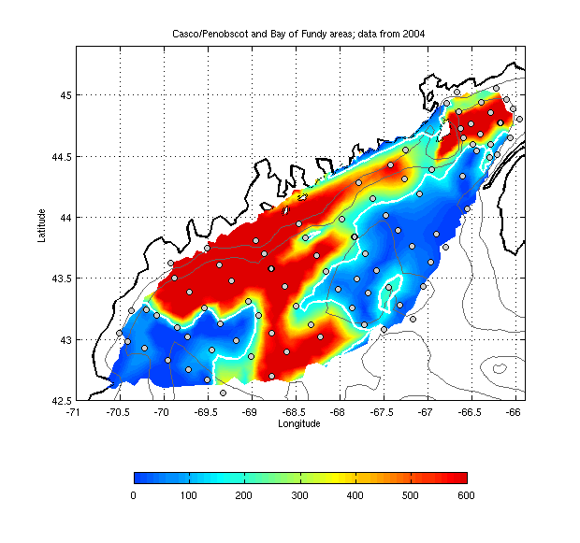
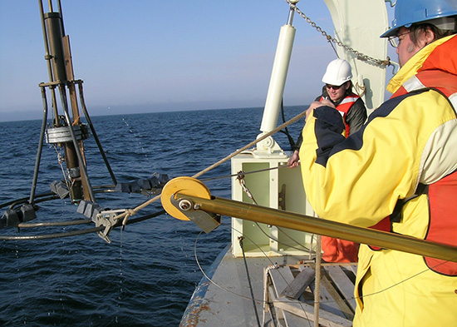
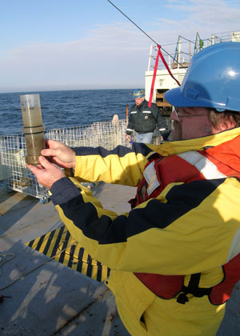
Interannual variability in cyst population
1997 2004
Bay of Fundy cyst bed stable
WGOM cyst bed: 2004 = 10 X 1997

Slide 22
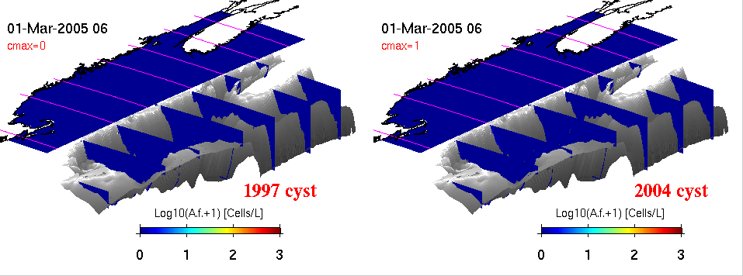
2005 physics +
fall 1997 cyst map
2005 physics +
fall 2004 cyst map

Slide 23
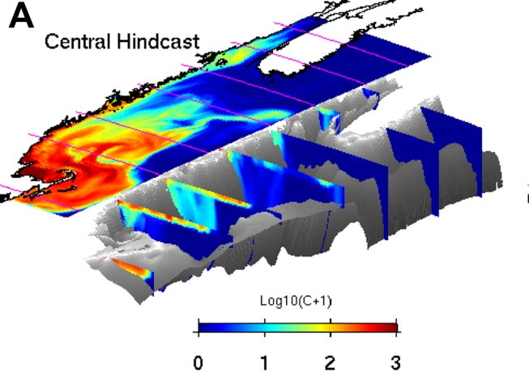
Theses
Cyst abundance is a first-order predictor of overall bloom severity.
Coupled hydrodynamic / population dynamics models forecast large scale seasonal characteristics of the bloom.

Slide 24
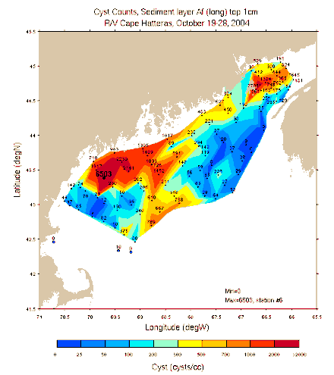
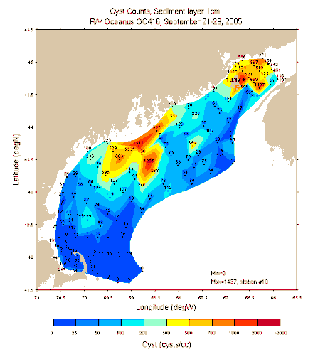
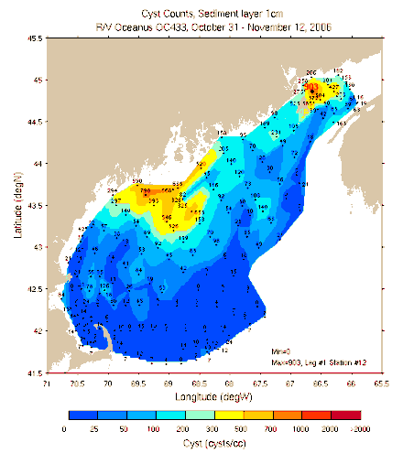
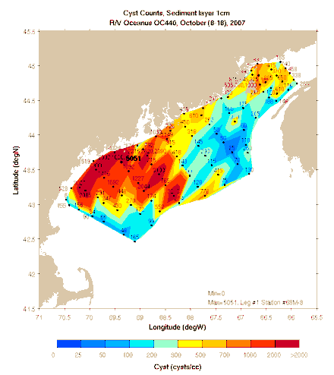
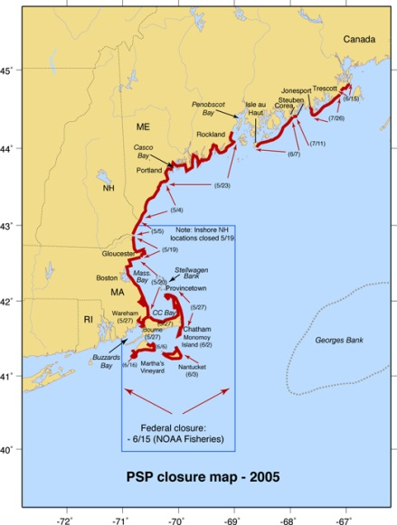
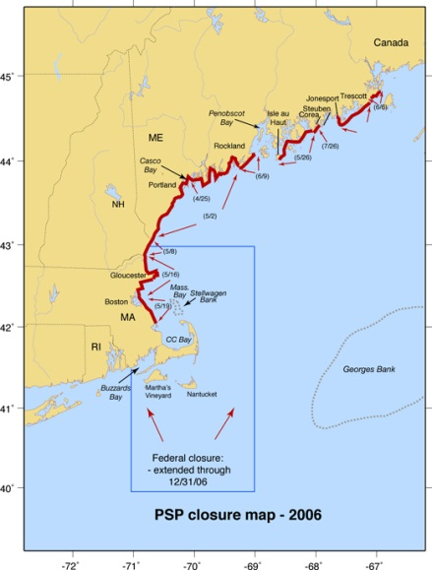
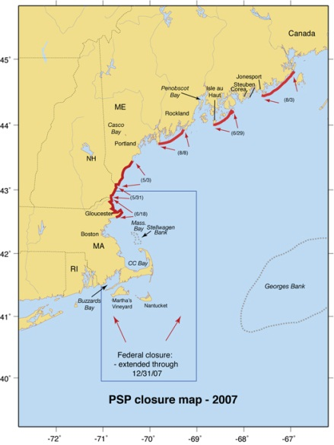
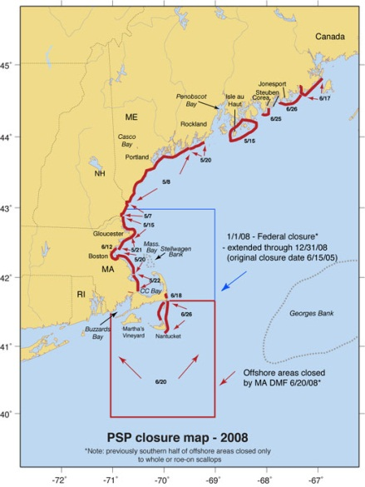
H₁: Interannual variations in bloom severity result from fluctuations in cyst abundance
Cysts 2004 2005 2006 2007
Toxicity 2005 2006 2007 2008

Slide 25
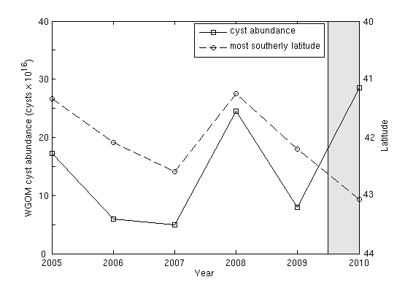
Cyst abundance and toxicity
2005-2009: r=-0.93
Toxicity extent
Cysts

Slide 26
Seasonal Ensemble Forecast for 2008
Weather &
hydrodynamics
2008
seasonal forecast
2004
2005
2006
2007
Benthic cyst
abundance
Scenario 1
Scenario 2
Scenario 3
Scenario 4
Fall
2007

Slide 27
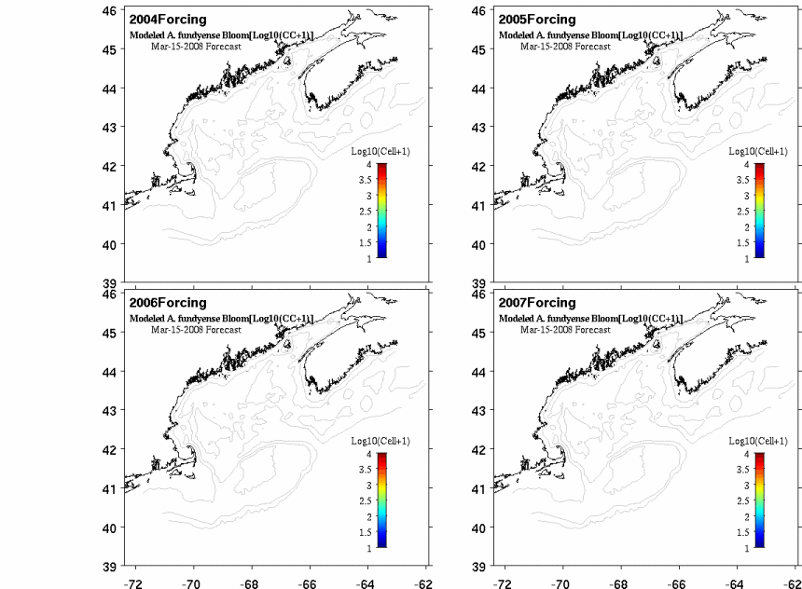
Ensemble forecast for 2008
2008 Bloom Forecast using 2004, 05, 06, 07 atmosphere and ocean forcing (online java animation)
http://omglnx3.meas.ncsu.edu/yli/simulation_new/08forecast/dino_08.htm

Slide 28
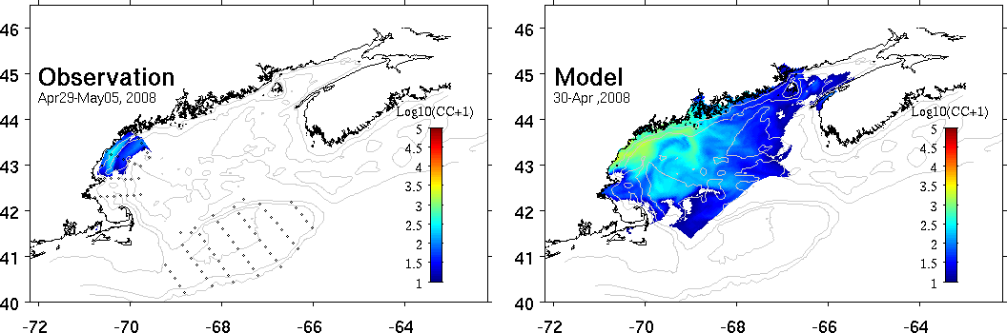
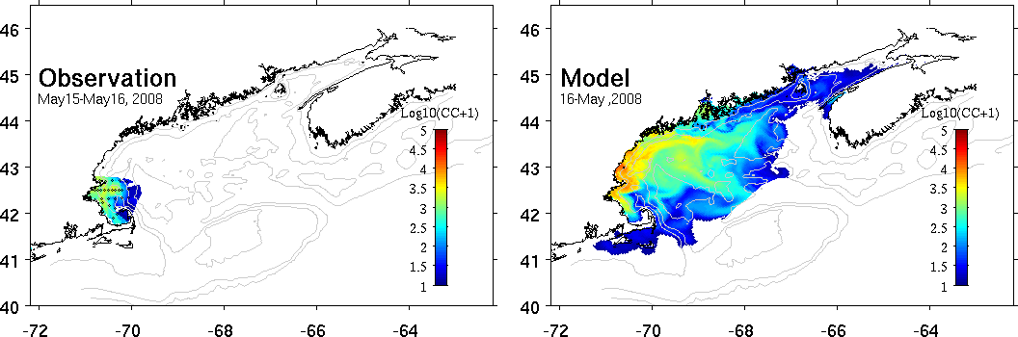
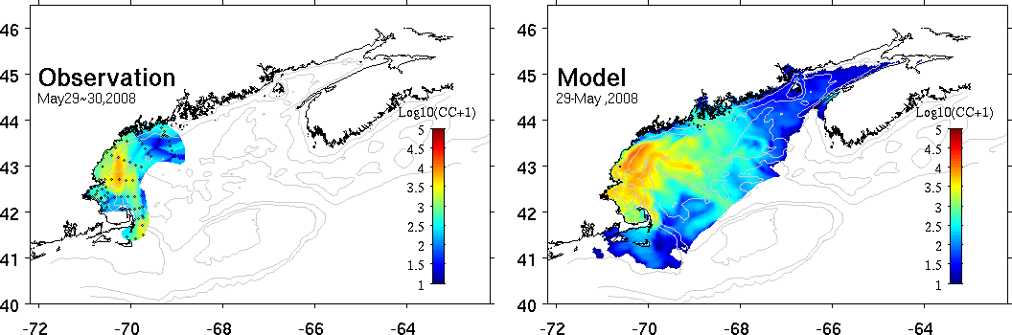
2008 model-data comparisons
Apr 29-May 5
May 15-16
May 29-30

Slide 29
Cyst abundance and toxicity
2005-2009: r=-0.93
Toxicity extent
Cysts

Slide 30
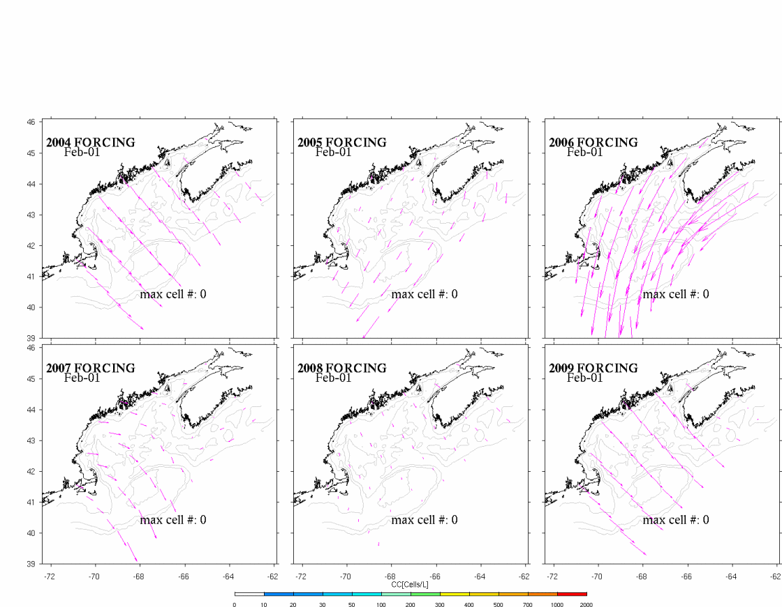
Surface wind field and simulated A. fundyense bloom
from each of scenario simulations

Slide 31
Cyst abundance and toxicity
2005-2009: r=-0.93
Toxicity extent
Cysts

Slide 32
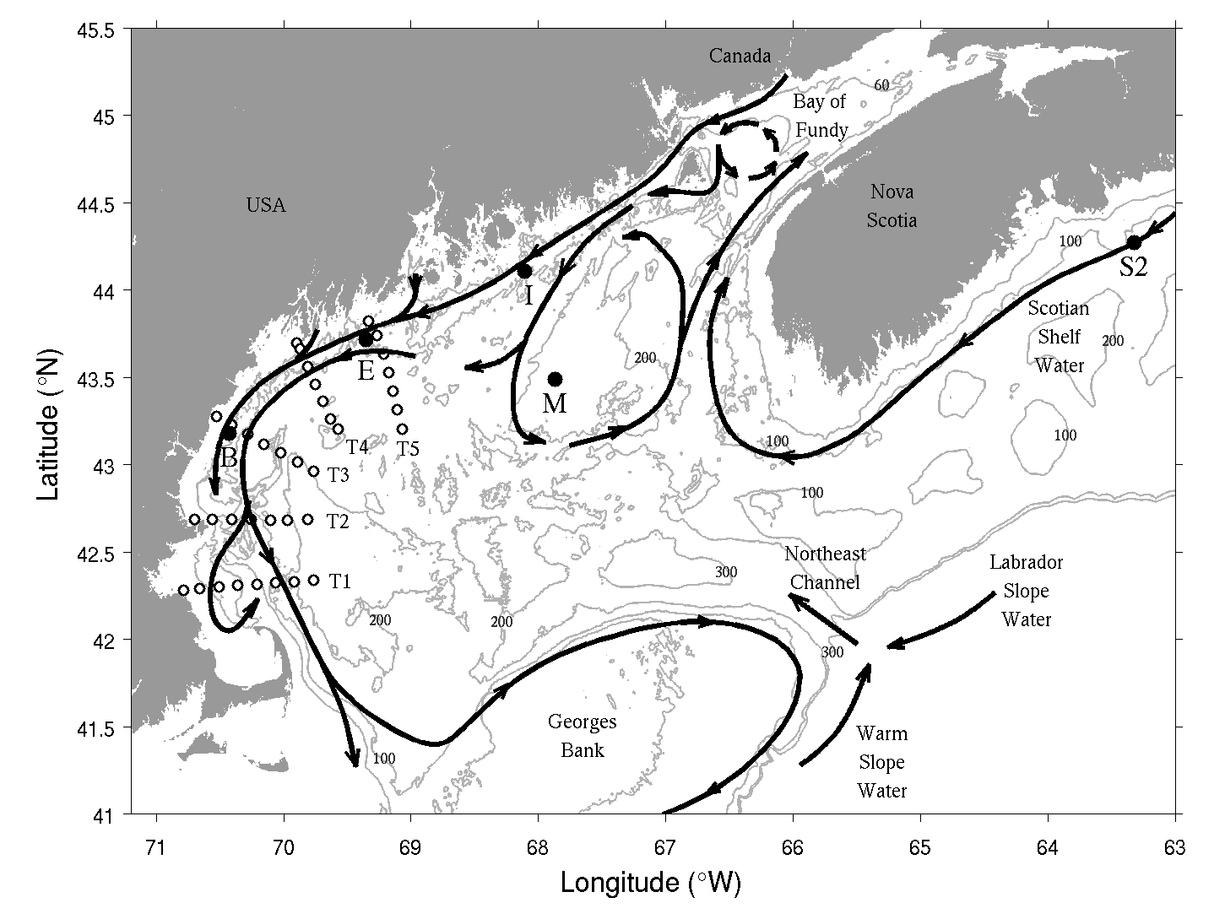
Why did the 2010 bloom not materialize?

Slide 33
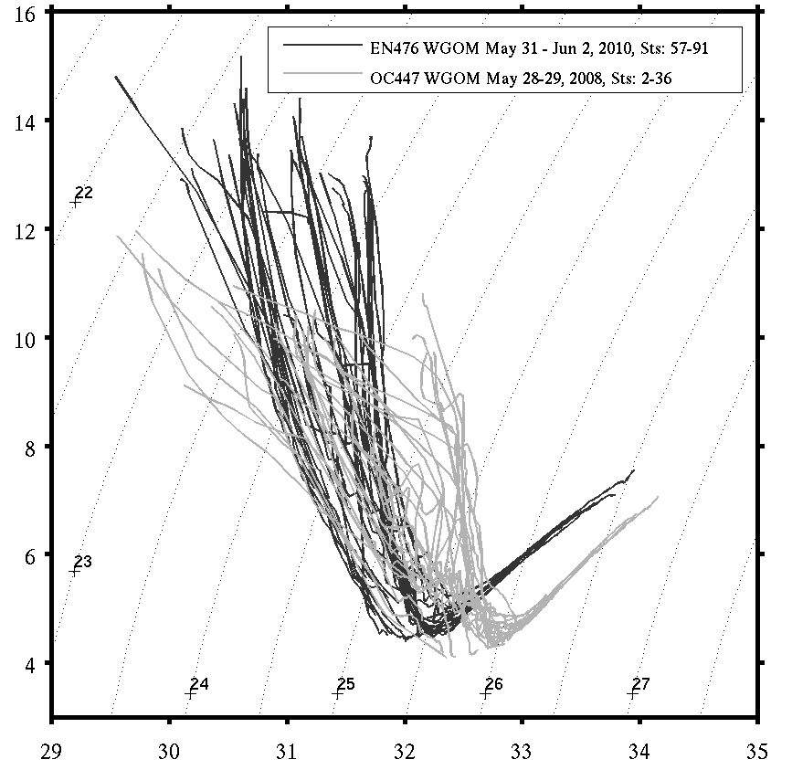
Interannual variations in temperature and salinity
Temperature
2010
2008
Salinity

Slide 34

Nutrients – 2008 vs 2010
Early May 2008
Early May 2010
Dave Townsend
Maura Thomas

Slide 35
Why was the 2010 forecast wrong?
Conditions were outside the envelope of prior observations used to construct the ensemble forecast
Water mass anomalies indicate a regional-scale change in circulation with direct influence on A. fundyense niche (warmer, more stratified, lower nutrients)
Weaker-than-normal coastal current lessened A.fundyense transport into WGOM and Mass Bay
Did earlier-than-normal nutrient depletion cause a mismatch with A. fundyense’s endogenous clock?
McGillicuddy, D.J., Townsend, D.W., He, R., Keafer, B.A., Kleindinst, J.L., Li , Y., Manning, J.P., Mountain, D.G., Thomas, M.A., and D.M. Anderson, 2011. Limnology and Oceanography, 56(6), 2411–2426.

Slide 36

Toward ecological forecasting in the ocean: a cautionary tale from the physical climate system
Notes:
Lessons learned here are in some ways reminiscent of the development of El Niño – Southern Oscillation (ENSO) phenomena. The introduction of dynamical forecast models in the 1980s (Cane et al. 1986) led to several years of remarkably skillful predictions (Latif et al. 1998). In the 1990s, there was a significant drop in forecast skill when ENSO entered a distinctly different mode of variability (Ji et al. 1996)—which ushered in a new wave of model improvement (Chen et al. 1995). Indeed, long-term hindcasting studies suggest interdecadal variations in ENSO predictability that reflect temporal changes the underlying dynamics of the system (Chen et al. 2004). It can be argued that ecological forecasting will be even more prone to fluctuations in predictability than the physical climate system, owing to even stronger nonlinearities in biological dynamics (Frank et al. 1994). As such, assimilation of data will be essential to keep predictive ecological models on track. Although data assimilation into coupled physical-biological models is still in its infancy (Hofmann and Friedrichs 2002), there are some promising inroads being made (Gregg et al. 2009). In any case, the 2010 A. fundyense bloom in the Gulf of Maine highlights the need for intimate connection between observational networks and forecast systems, and how these aspects must evolve together to meet the grand challenge of ecological forecasting in the ocean.

Slide 37

Regime shifts can change the underlying dynamics
Ji et al. (1996) Journal of Climate 9, 3105-3120.
1982-1992
W
Correlation
(forecast, obs)
C
1992-1995
W
Lag (months)
C
Chen et al. (1995) Science 269, 1699-1702. An improved procedure for El Nino forecasting: implications for predictability.
W

Slide 38

Looking forward
Long-term observational networks are essential
Data assimilation to keep models on track
Process studies to understand changing dynamics

Slide 39

Environmental Sample Processor (C. Scholin)

Slide 40



2015 Forecast and
ESP Observations

Slide 41
End

