Slide 1

Forecasting Blooms of Alexandrium fundyense in the Gulf of Maine:
Key insights from the coastal observing network
Anderson, McGillicuddy, Keafer (WHOI)
Townsend, Pettigrew, Thomas (UMaine)
Turner, Pilskaln (UMass D), Bricelj (RU)
He (NCSU) Manning, Mountain, P. Fratantoni (NMFS)
Haskell (NOS) Martin (DFO)
Hall, DeGrasse, Deeds (FDA)
Hickey, Whittaker (DMF) Couture (DMR) Nash (DES)
Gulf of Maine Toxicity (GOMTOX) – NOAA
PCMHAB / MERHAB – NOAA
WHCOHH – NSF & NIEHS

Slide 2
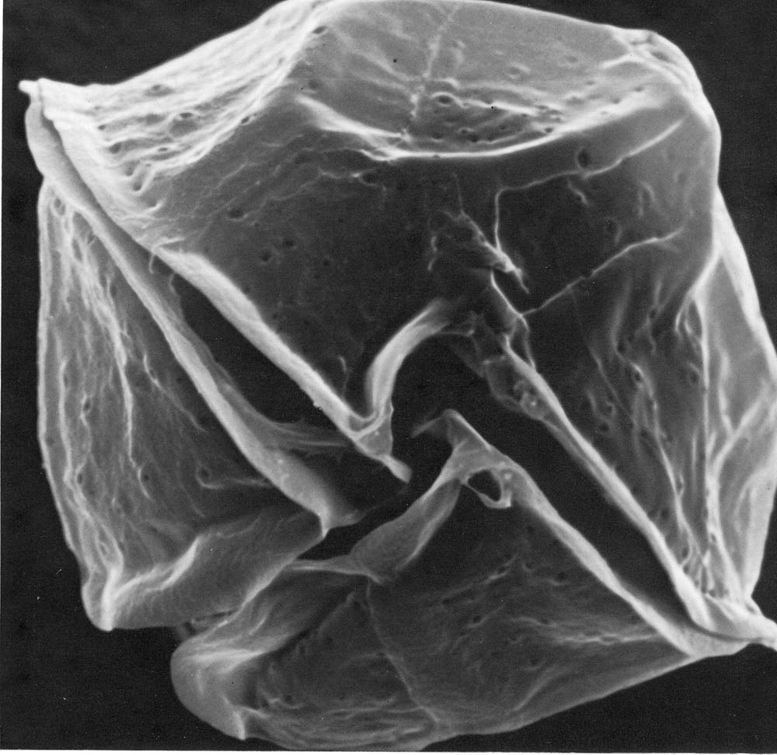
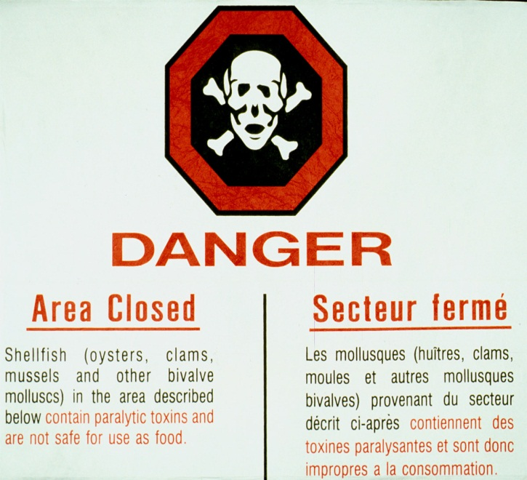
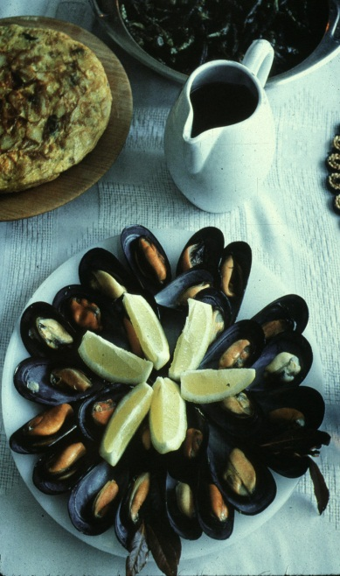
Alexandrium fundyense
Dinoflagellate
~40 microns
Produces saxitoxins
Leads to Paralytic Shellfish Poisoning (PSP)

Slide 3
Life Cycle of Alexandrium

Slide 4
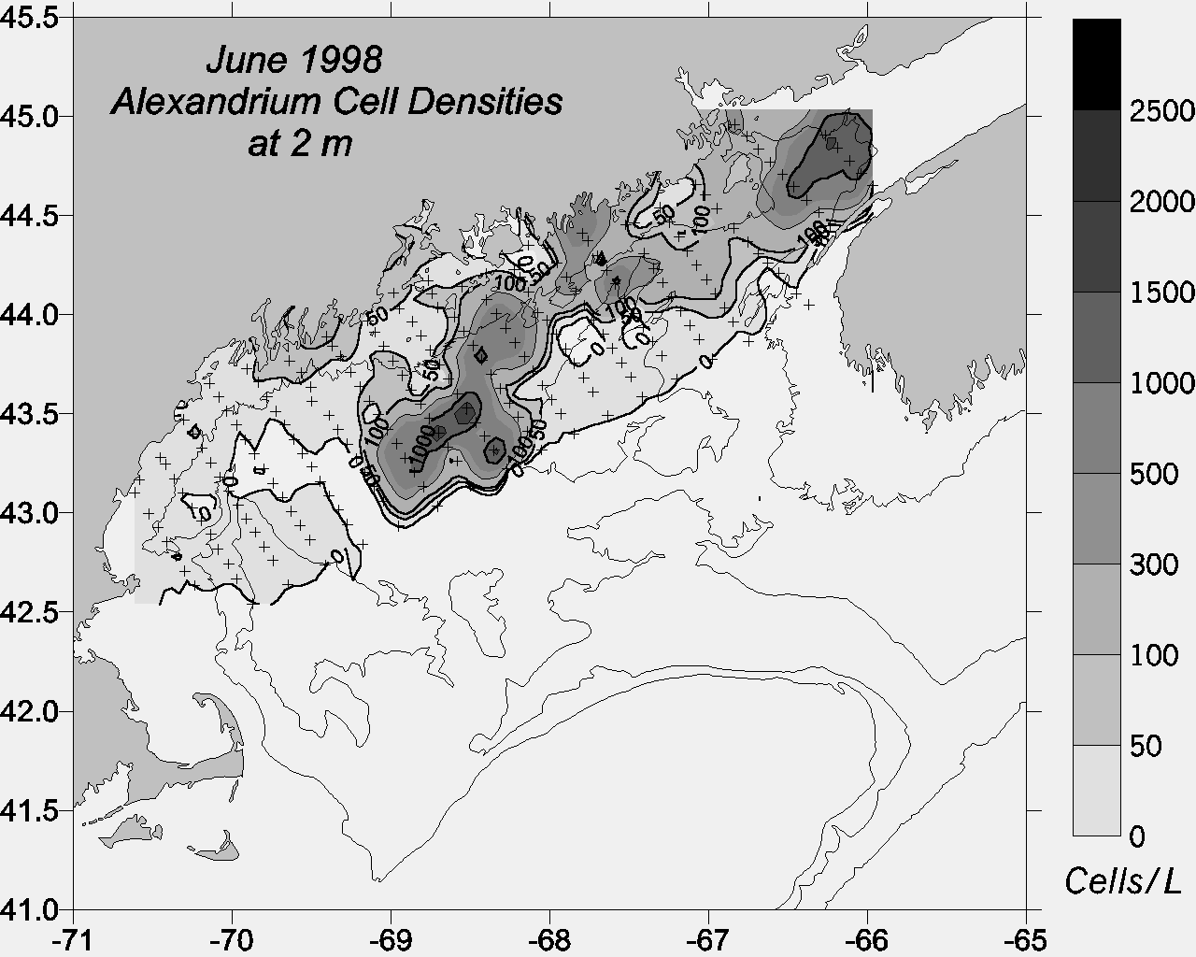
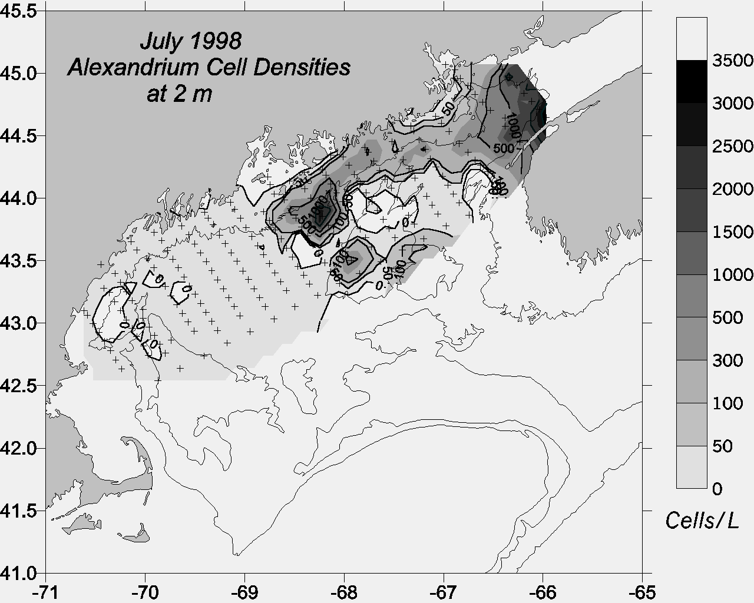
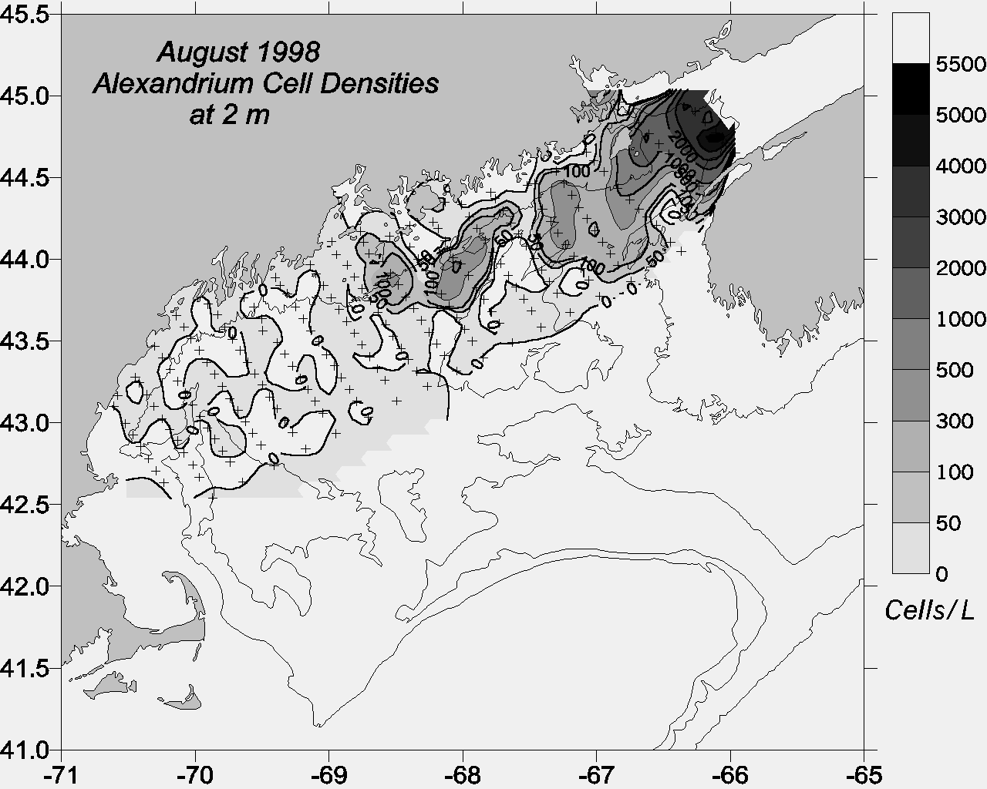
ECOHAB-GOM Observations
Gulf-wide
distribution
2) Association with coastal
current
3) Center of mass
shifts west-to-east
as season progresses
Townsend et al.
(2001)

Slide 5
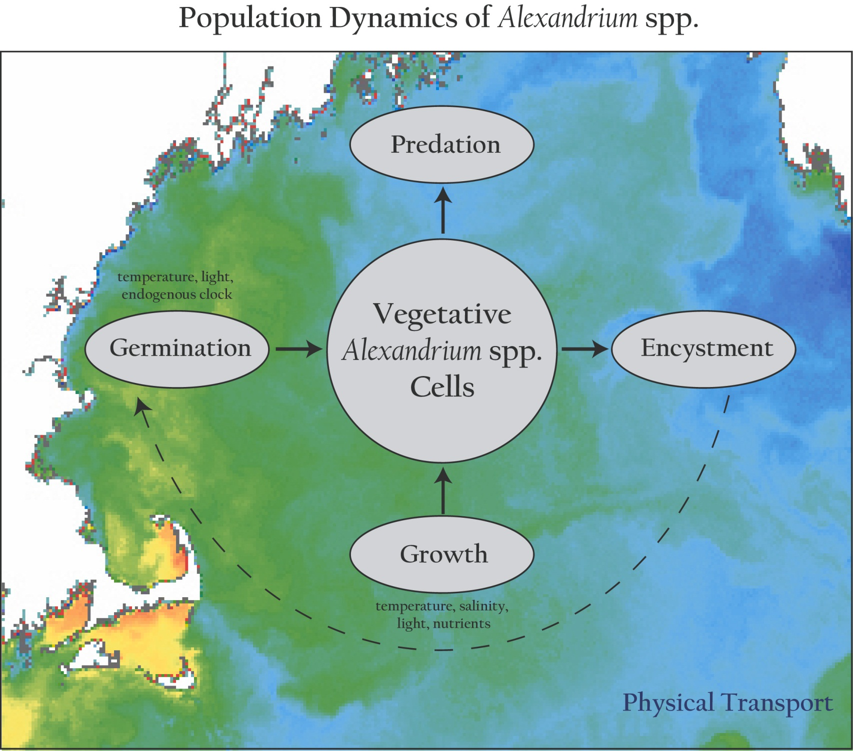
Population dynamics of Alexandrium spp.

Slide 6
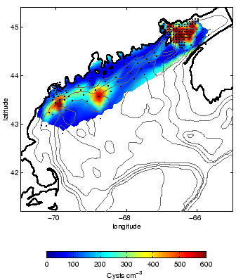
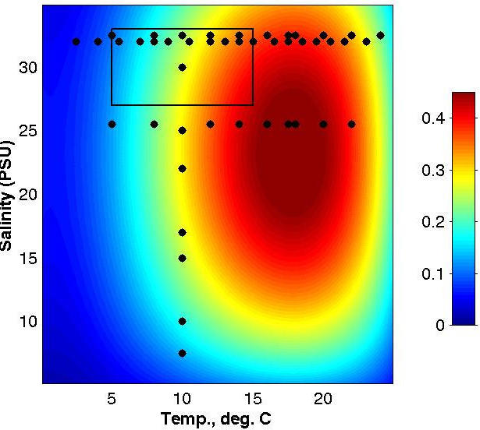
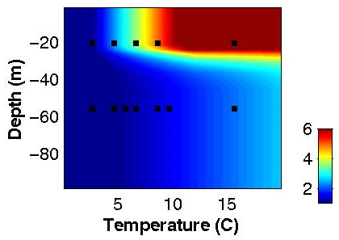
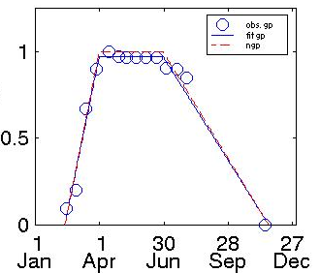
Alexandrium Population Dynamics Model
Cyst Dist. (# / cm^2)
Endogenous Clock
Germ. rate (% / day)
Growth (per day)
Growth = min ( f(PAR) , g(T,S,nutrients) )
Upward swimming 10 m/day
“Mortality” = 0.1 per day
Salinity
Temperature

Slide 7
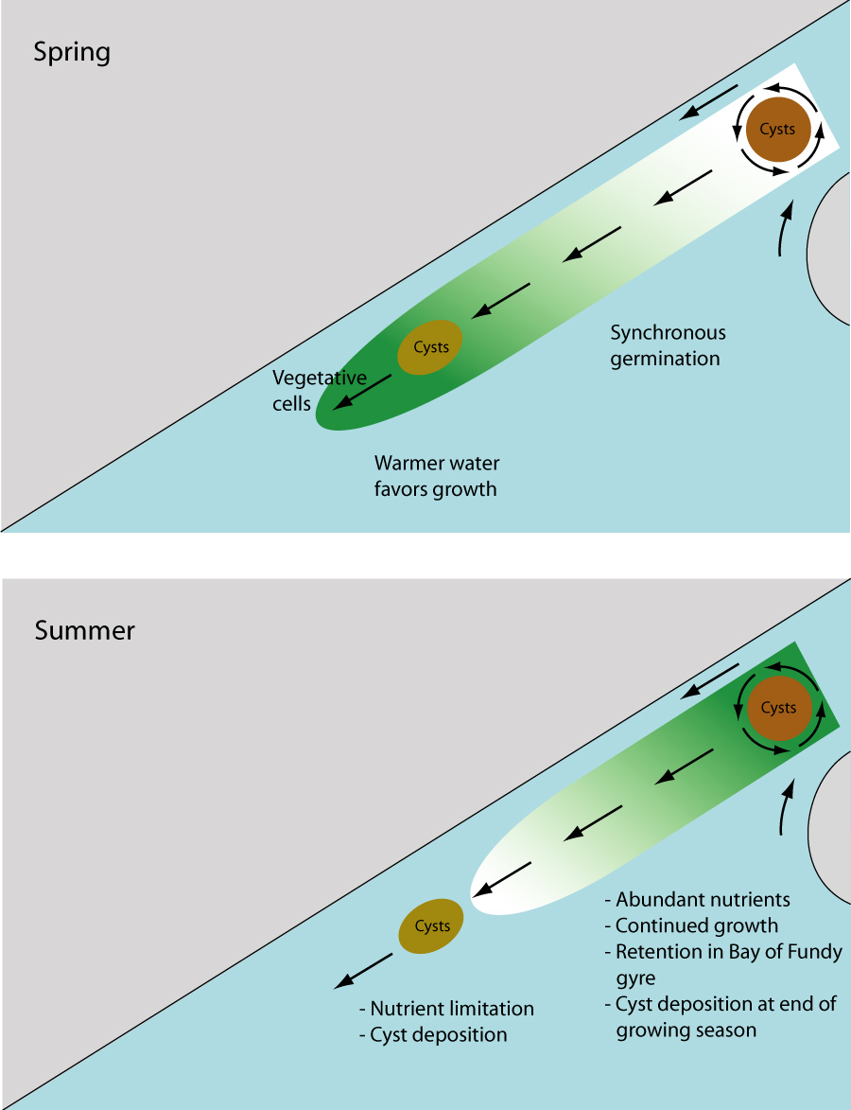
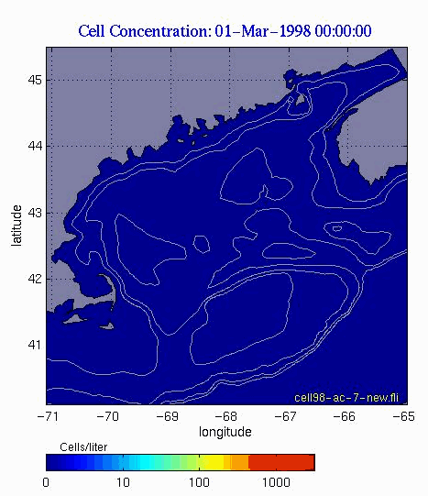
Simulation Based on Climatological Conditions
Spring:
Temperature
limitation
Summer:
Nutrient
limitation

Slide 8
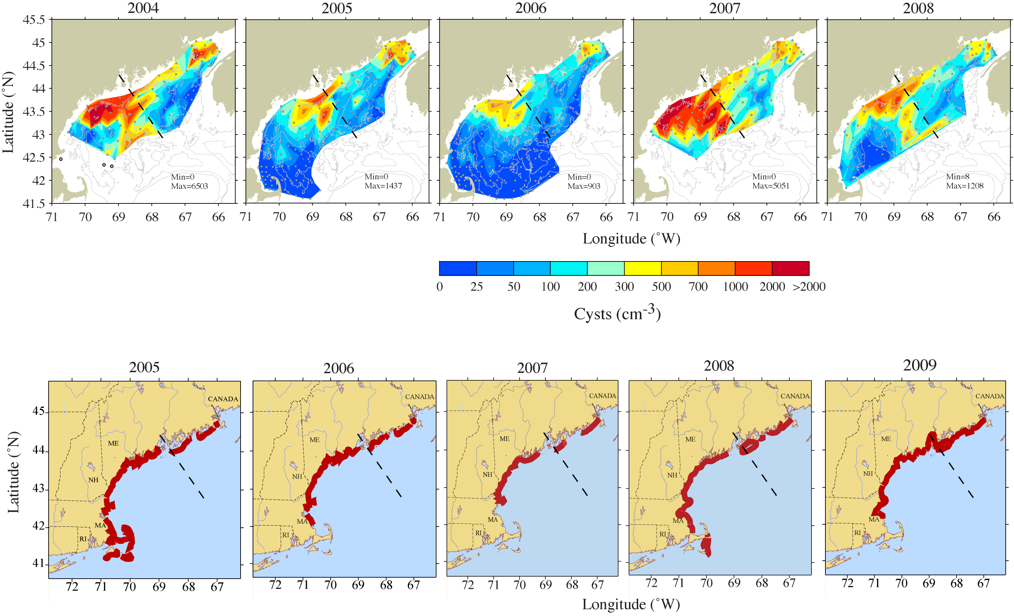
Cysts and toxicity 2004-2009
Anderson lab; Bruce Keafer

Slide 9
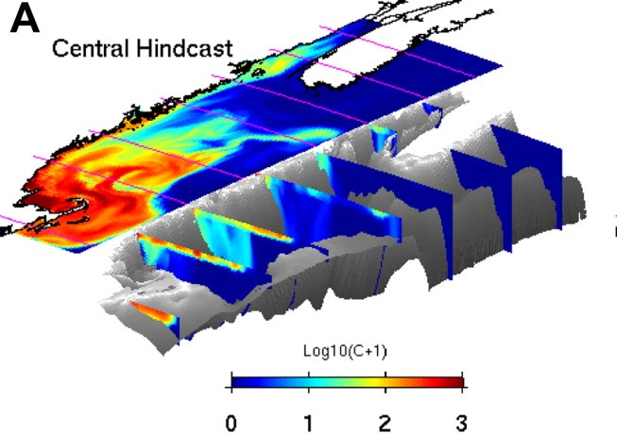
Theses
Cyst abundance is a first-order predictor of overall bloom severity.
Coupled hydrodynamic / population dynamics models forecast large scale seasonal characteristics of the bloom.

Slide 10
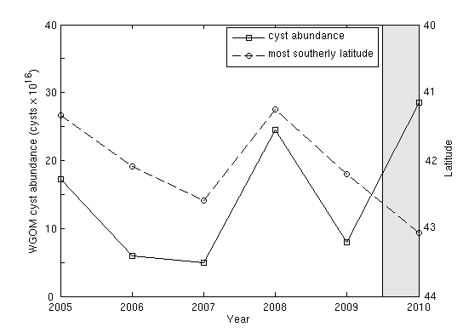
Cyst abundance and toxicity
2005-2009: r=-0.93

Slide 11
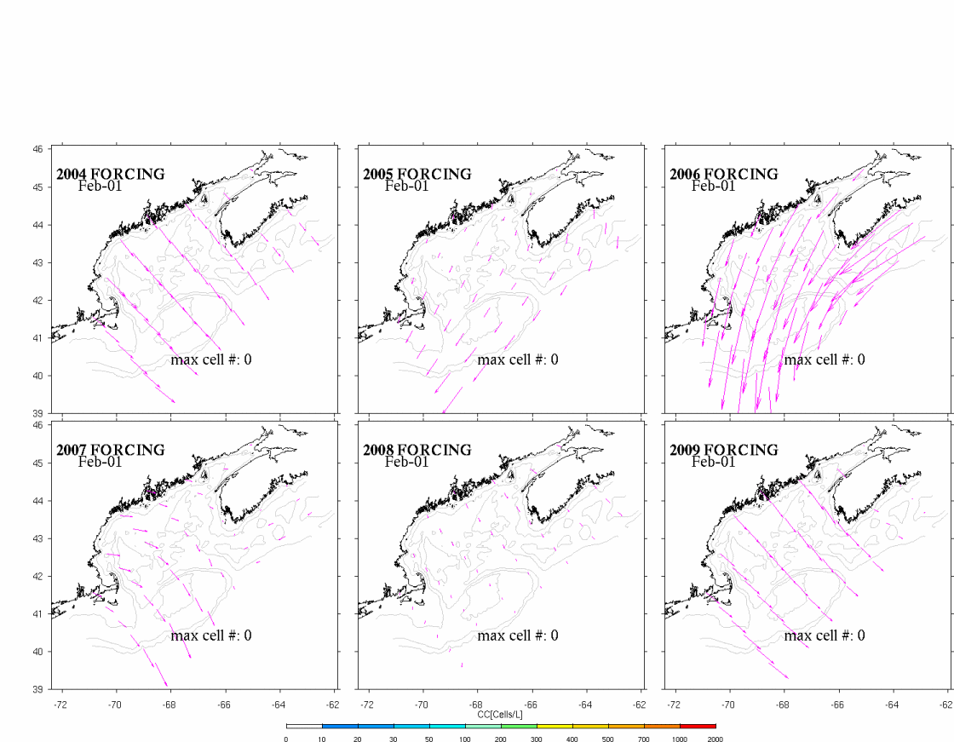
Surface wind field and simulated A. fundyense bloom
from each of scenario simulations

Slide 12
Cyst abundance and toxicity
2005-2009: r=-0.93

Slide 13
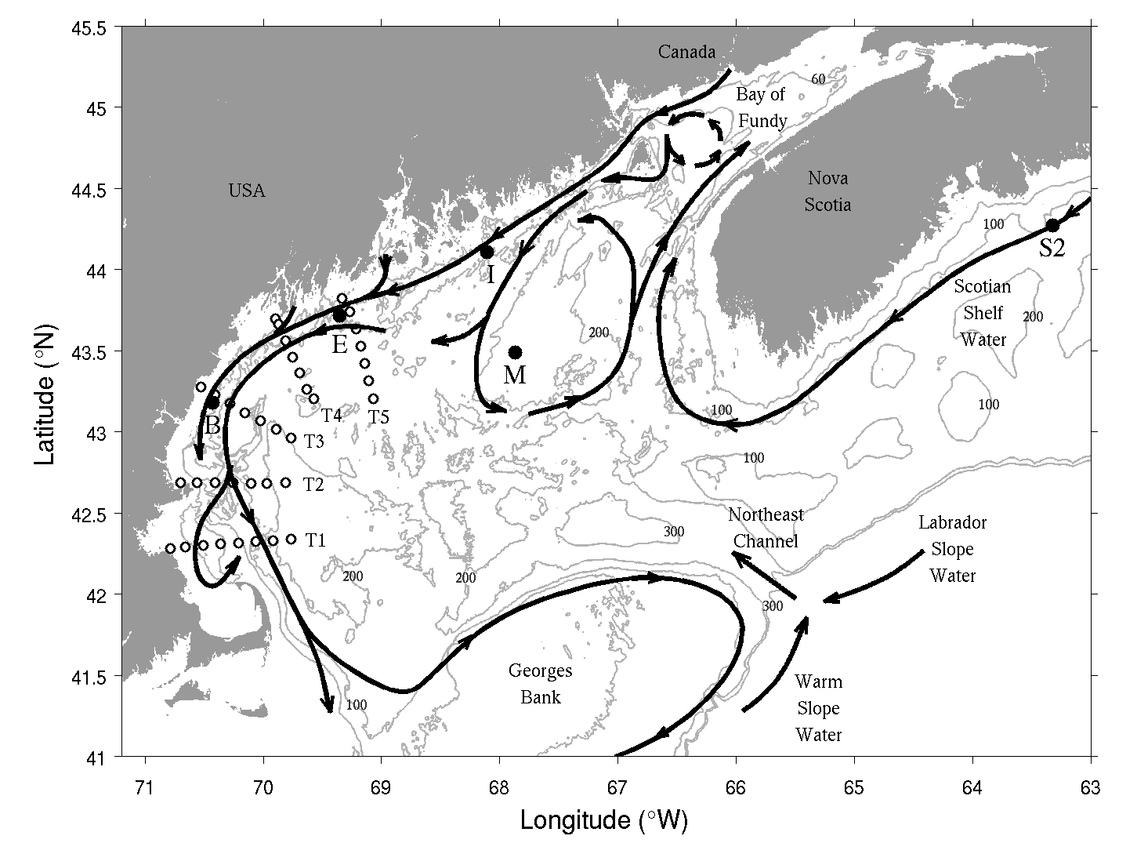
Why did the 2010 bloom not materialize?

Slide 14
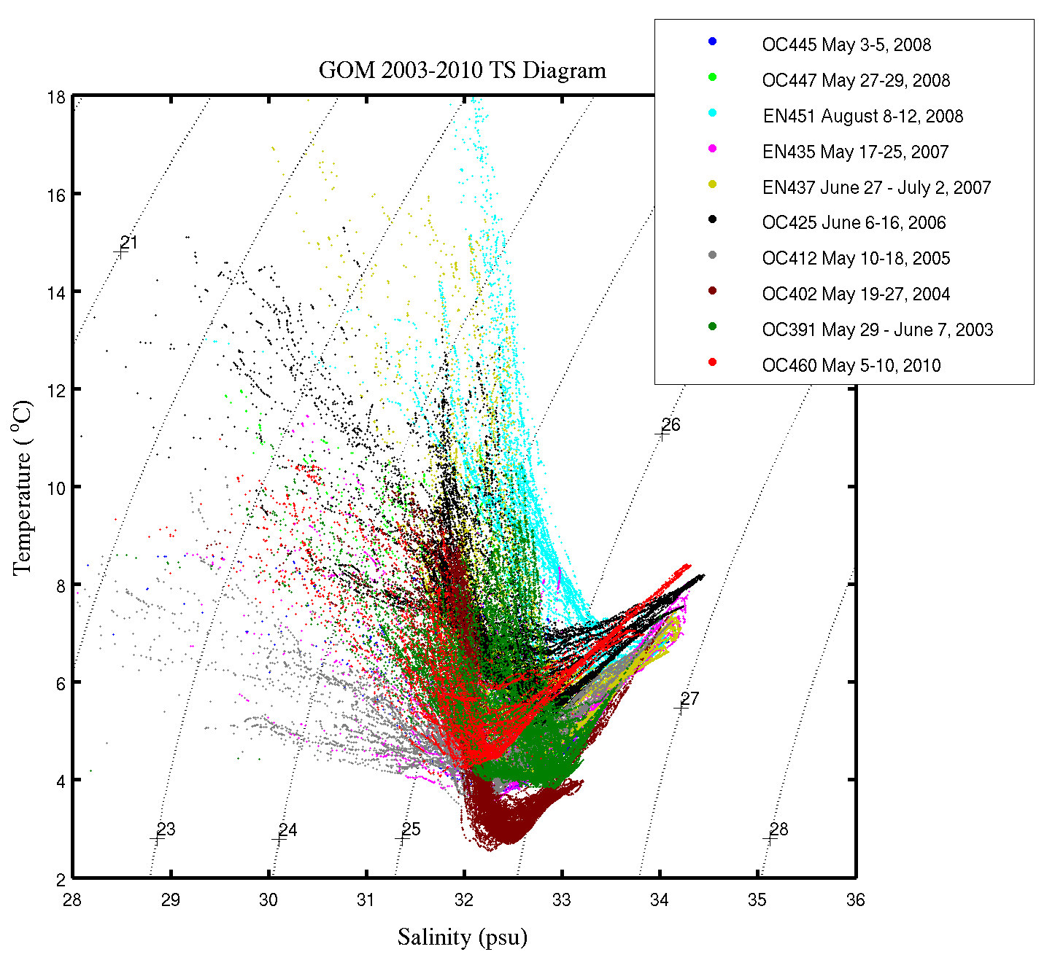
Springtime TS Variability 2003-2010
2010 Deep water end-member outside the envelope of prior observations 2003-2009
2010 MIW fresher than all but 2005, when MIW was colder
Red: 2010

Slide 15
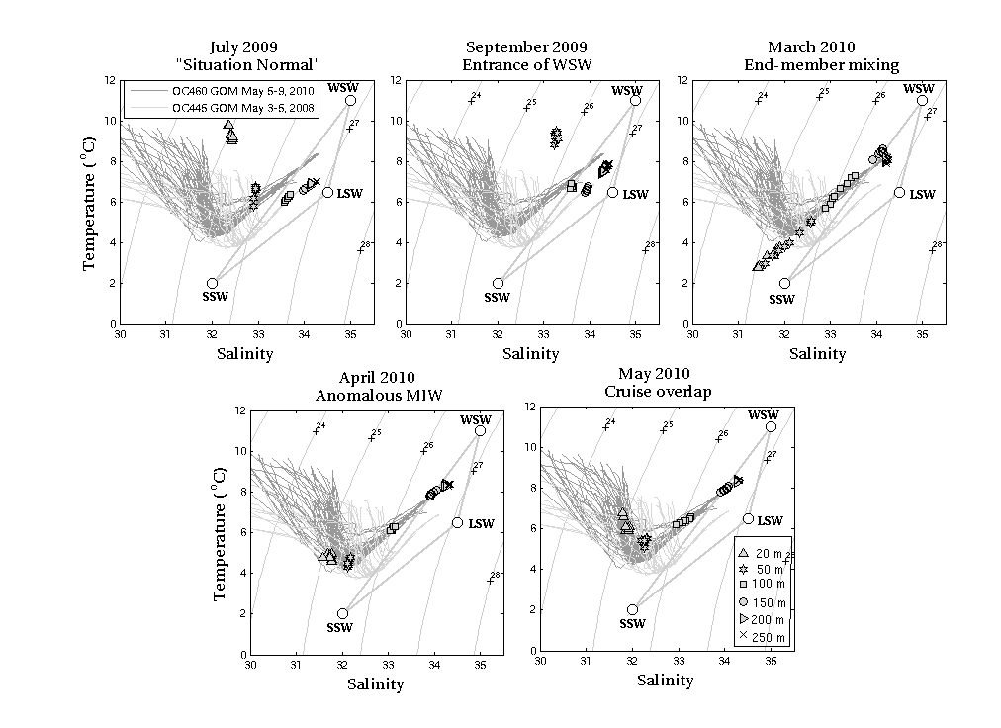
NERACOOS M – Jordan Basin

Slide 16
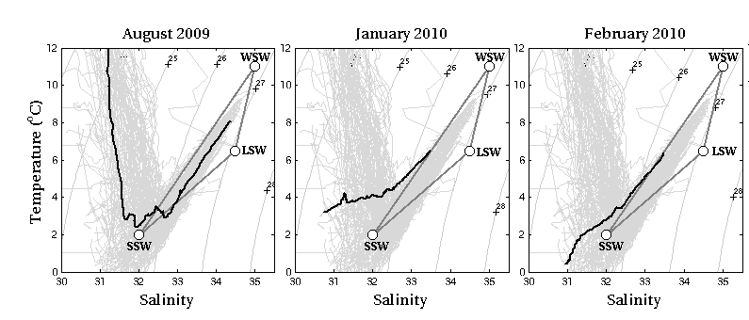
AZMP – Station 2 (Halifax)
Freshening on the Scotian Shelf detected in January 2010
Blair Greenan
Dave Hebert

Slide 17
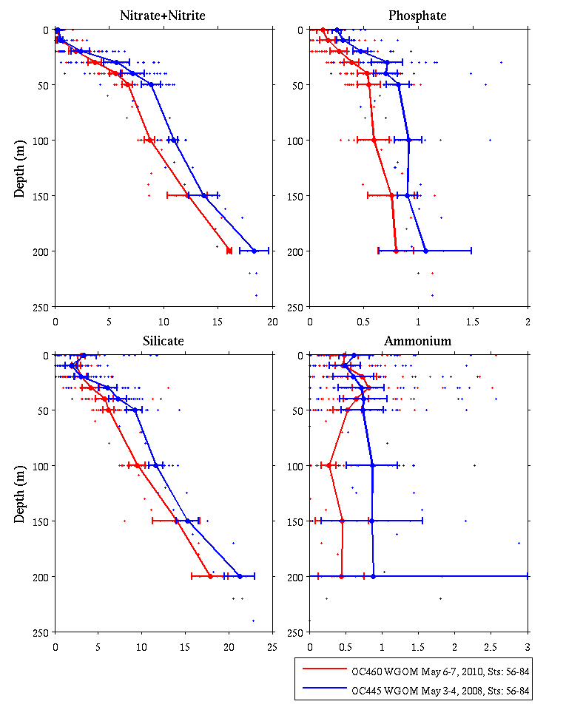
WGOM Nutrients – 2008 vs 2010
Early May 2008
Early May 2010
Dave Townsend
Maura Thomas

Slide 18
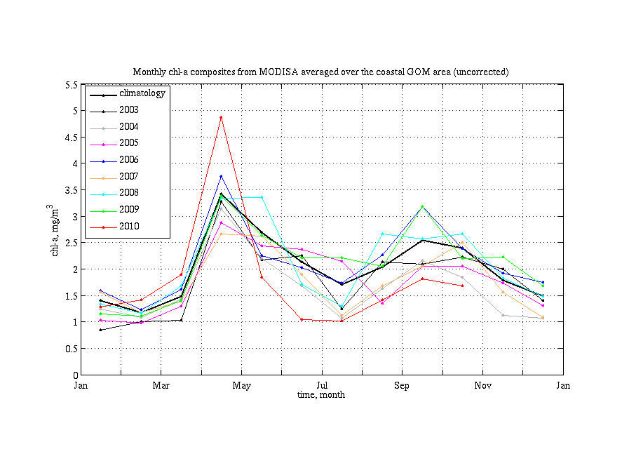
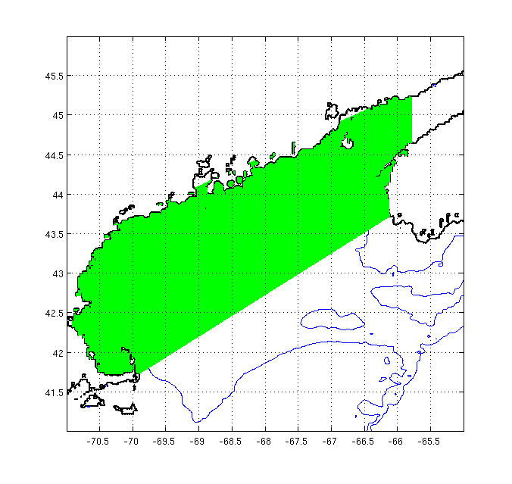
MODIS Ocean Color Observations
2010
A. fundyense
growing season
Spring 2010 phytoplankton bloom started earlier, was more intense, and crashed earlier than usual

Slide 19
Why was the 2010 forecast wrong?
Conditions were outside the envelope of prior observations used to construct the ensemble forecast
Water mass anomalies indicate a regional-scale change in circulation with direct influence on A. fundyense niche (warmer, more stratified, lower nutrients)
Weaker-than-normal coastal current lessened A.fundyense transport into WGOM and Mass Bay
Spring 2010 phytoplankton bloom more intense and crashed earlier than usual
Did earlier-than-normal nutrient depletion cause a mismatch with A. fundyense’s endogenous clock?
McGillicuddy, D.J., Townsend, D.W., He, R., Keafer, B.A., Kleindinst, J.L., Li , Y., Manning, J.P., Mountain, D.G., Thomas, M.A., and D.M. Anderson, 2011. Limnology and Oceanography, 56(6), 2411–2426.

Slide 20
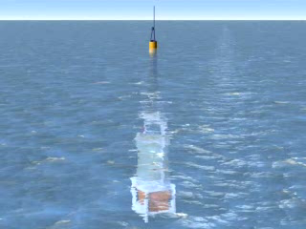
Environmental Sample Processor (C. Scholin)

Slide 21
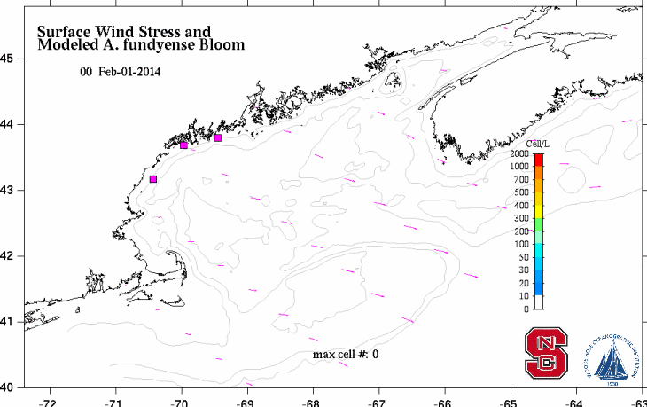
2014 Forecast and ESP measurements

Slide 22
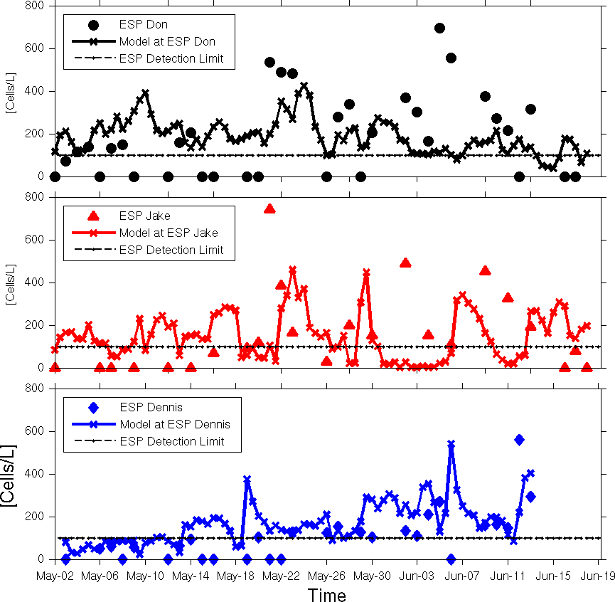
Model evaluation with ESP data

Slide 23

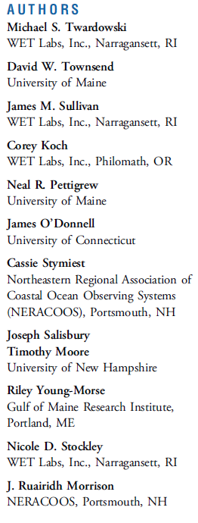
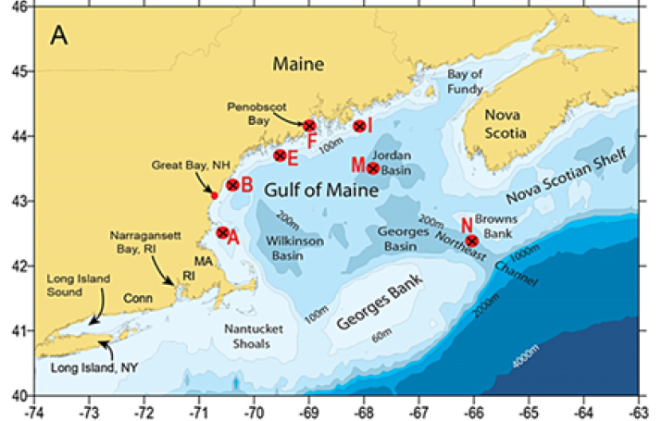

Notes:
Twardowski et al., 2015

Slide 24
Value of the coastal ocean observing system
Extraordinarily useful information for understanding A. fundyense bloom dynamics
Monitoring / forecasting needs feeding back into observing system design: ESPs, nutrient sensors
Initial inroads into biological data assimilation

Slide 25
End

Slide 26
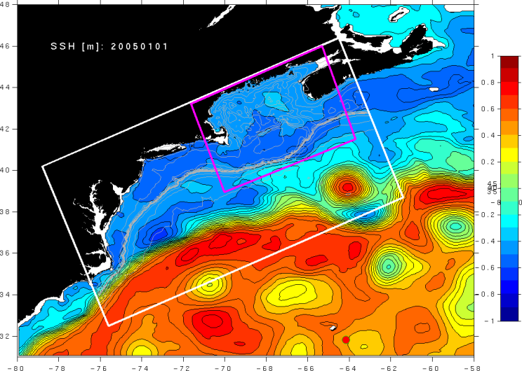
Multiply nested circulation models
ROMS (GOM)
1-3 km resolution
ROMS (MAB - GOM)
3-10 km resolution
Operational HYCOM
(10 km resolution)
He et al. (2008)
HYCOM: Hybrid Coordinate Ocean Model (NRL and U. Miami)
ROMS: Regional Ocean Modeling System

Slide 27

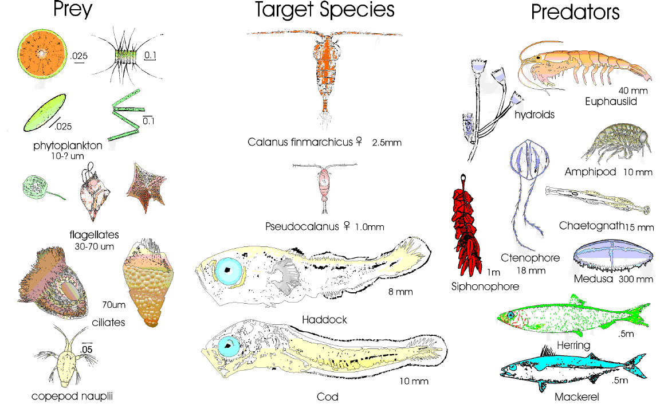
Looking forward
Long-term observational networks are essential
Data assimilation to keep models on track
Process studies to understand changing dynamics
Coordinated interdisciplinary process studies of the scale of ECOHAB / GLOBEC are needed to understand ecological dynamics on local, regional, and global scales.

Slide 28
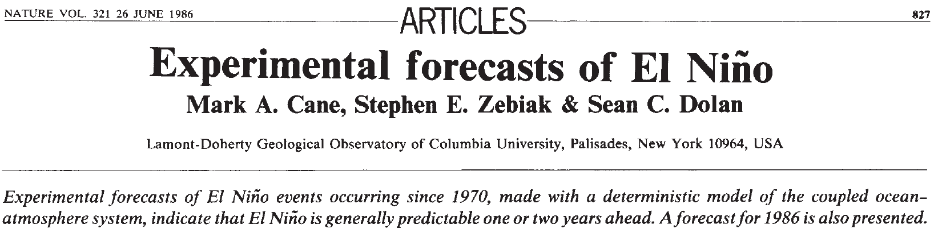
Toward ecological forecasting in the ocean: a cautionary tale from the physical climate system
Notes:
Lessons learned here are in some ways reminiscent of the development of El Niño – Southern Oscillation (ENSO) phenomena. The introduction of dynamical forecast models in the 1980s (Cane et al. 1986) led to several years of remarkably skillful predictions (Latif et al. 1998). In the 1990s, there was a significant drop in forecast skill when ENSO entered a distinctly different mode of variability (Ji et al. 1996)—which ushered in a new wave of model improvement (Chen et al. 1995). Indeed, long-term hindcasting studies suggest interdecadal variations in ENSO predictability that reflect temporal changes the underlying dynamics of the system (Chen et al. 2004). It can be argued that ecological forecasting will be even more prone to fluctuations in predictability than the physical climate system, owing to even stronger nonlinearities in biological dynamics (Frank et al. 1994). As such, assimilation of data will be essential to keep predictive ecological models on track. Although data assimilation into coupled physical-biological models is still in its infancy (Hofmann and Friedrichs 2002), there are some promising inroads being made (Gregg et al. 2009). In any case, the 2010 A. fundyense bloom in the Gulf of Maine highlights the need for intimate connection between observational networks and forecast systems, and how these aspects must evolve together to meet the grand challenge of ecological forecasting in the ocean.

Slide 29
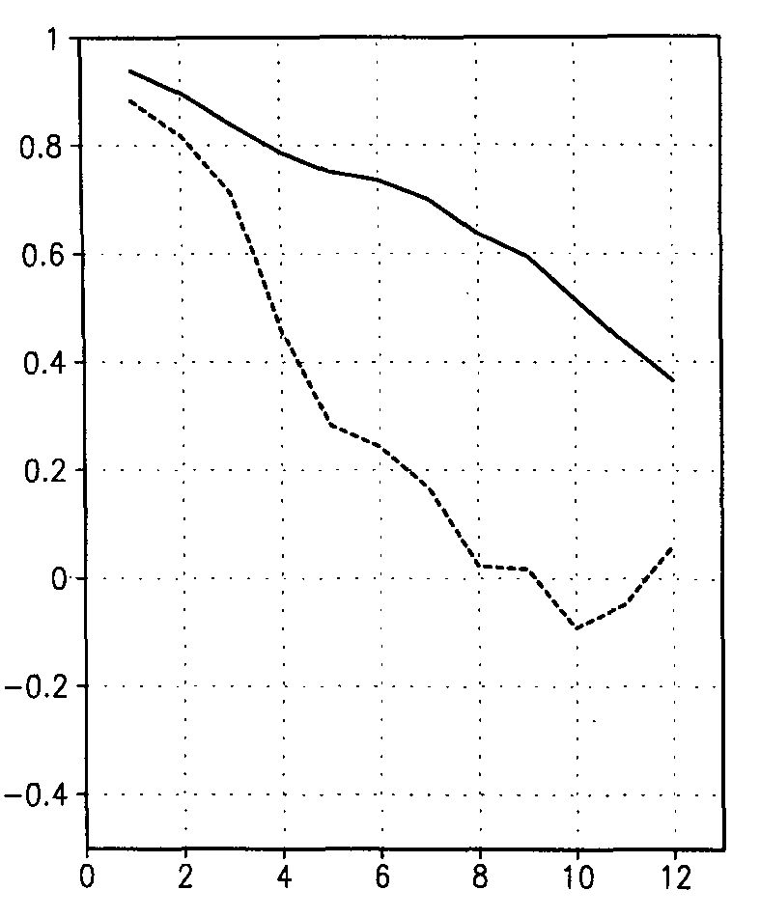
Regime shifts can change the underlying dynamics
Ji et al. (1996) Journal of Climate 9, 3105-3120.
1982-1992
W
Correlation
(forecast, obs)
C
1992-1995
W
Lag (months)
C
Chen et al. (1995) Science 269, 1699-1702. An improved procedure for El Nino forecasting: implications for predictability.
W

Slide 30
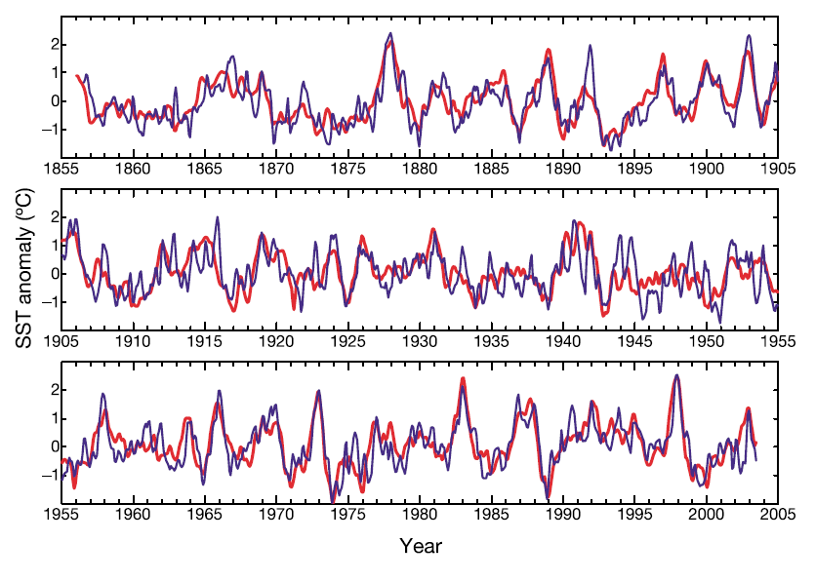
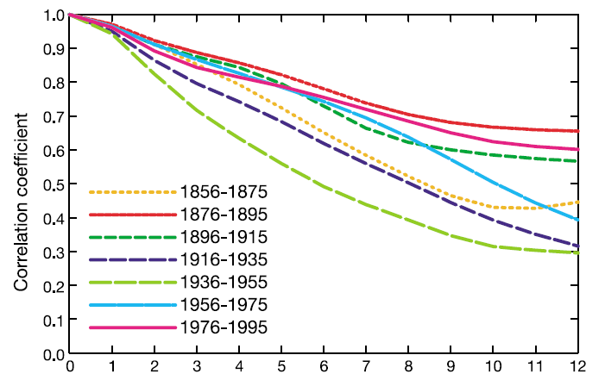
Changing dynamics can lead to variations in predictability
Monthly analysis LDEO5 6-mo lead
Correlation
(forecast, obs)
Chen et al. (2004) Nature 428, 733-736. Predictability of El Nino over the last 148 years.

