Slide 1
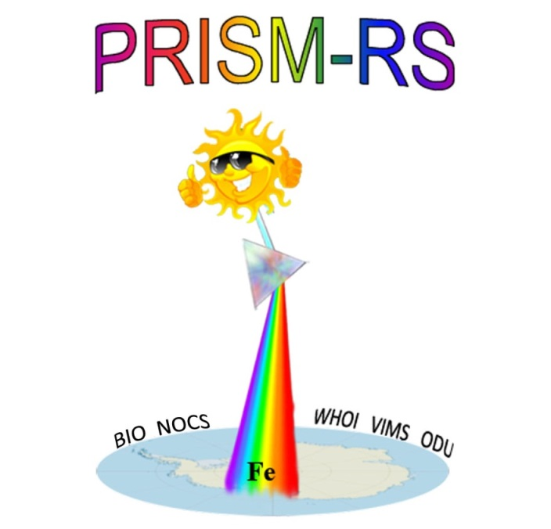
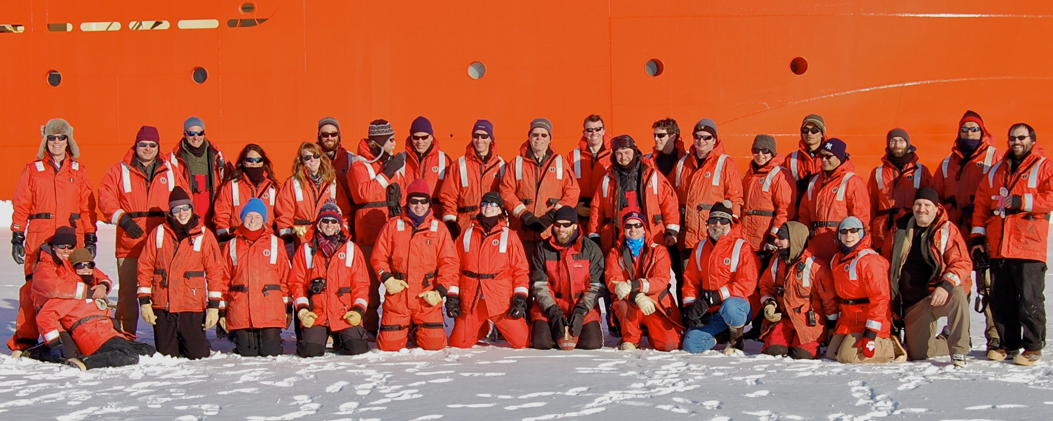
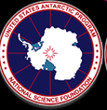

Iron supply and demand in an Antarctic shelf ecosystem
D.J. McGillicuddy, Jr., P.N. Sedwick, M.S. Dinniman, K.R. Arrigo, T.S. Bibby, B.J.W. Greenan, E.E. Hofmann, J.M. Klinck, W.O. Smith, Jr., S. Mack, C.M. Marsay, B.M. Sohst, and G.L. van Dijken
WHOI ODU VIMS
NOCS BIO
Notes:
PRISM stands for “processes regulating iron supply at the mesoscale”, and although we did learn quite a bit about mesoscale processes in the Ross Sea, my focus this morning will be on the use of observations to quantify iron supply and to compare it with the demand inferred from satellite-based estimates of productivity.
In this latter aspect we are particularly grateful that Kevin Arrigo and Gert van Dijken joined the PRISM team for that component of the analysis.

Slide 2
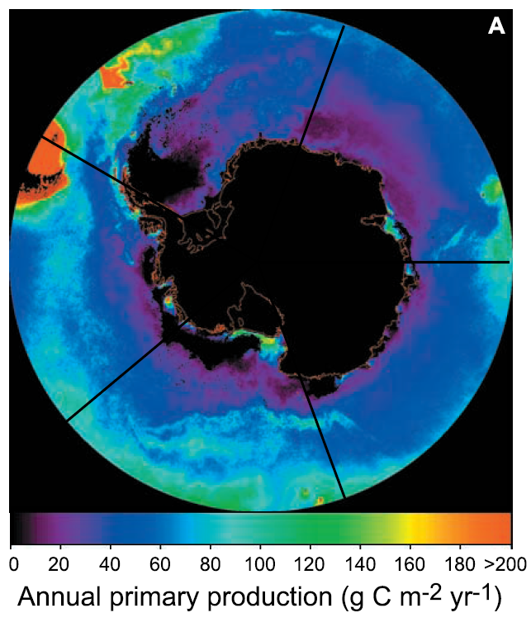
Quantifying iron demand: satellite-based estimates of productivity
Arrigo et al. 2008, updated using MODIS 2002-2013:
6.9 mol C m⁻² yr⁻¹
Using an f-ratio of 0.5±0.1
Asper and Smith 1999
Sweeney et al. 2000
Long et al. 2011
Annual new production: 3.45 mol C m⁻² yr⁻¹
Using C:Fe of 390,000±150,000:
8.8±6.4 µmol Fe m⁻² yr⁻¹

Slide 3
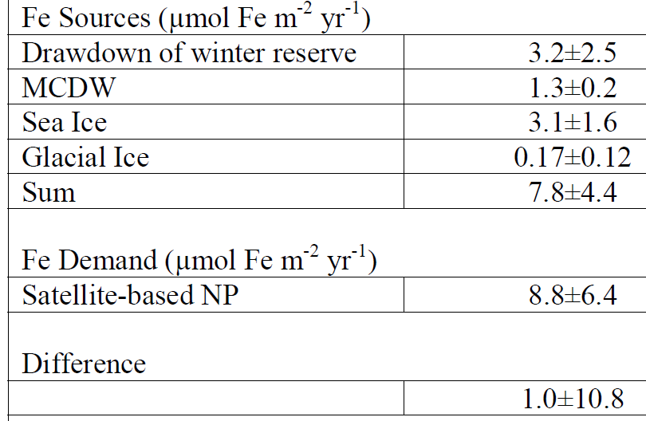
Iron Supply and Demand in the Ross Sea
Notes:
To our shock and amazement, the sum of the various iron sources is nearly the same as the iron demand inferred from satellite estimates of productivity, with the difference between them being less than 10% of the uncertainty.
The two largest sources are the winter reserve and sea ice melt, providing roughly equal contributions that comprise more than 80% of the totoal.
MCDW supplies most of the remainder, with the contribution from glacial ice melt an order of magnitude less.

Slide 4
Conclusions
Ross Sea iron supply and demand are in approximate balance
Winter reserve, sea ice are the largest sources (80%)
Benthos plays a large role in winter reserve
MCDW also a significant contributor (20%)
Glacial ice input negligible
(c.f. Amundsen Sea, Pine Island Glacier)
Heterogeneity in iron supply processes along the Antarctic continental margin
Notes:
Our findings illustrate the complexities of iron cycling in the Southern Ocean, highlighting the heterogeneity of the underlying processes along the Antarctic continental margin.
Explicit representation of these complexities will be necessary in order to understand how a changing climate will affect this important ecosystem and its influence on biogeochemical cycles.
Atmospheric sources
Extraterrestrial sources

