Slide 1
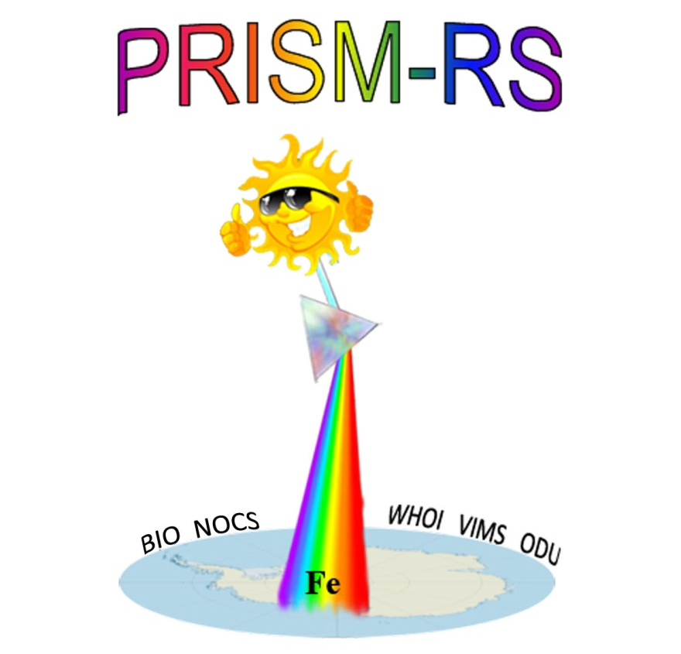

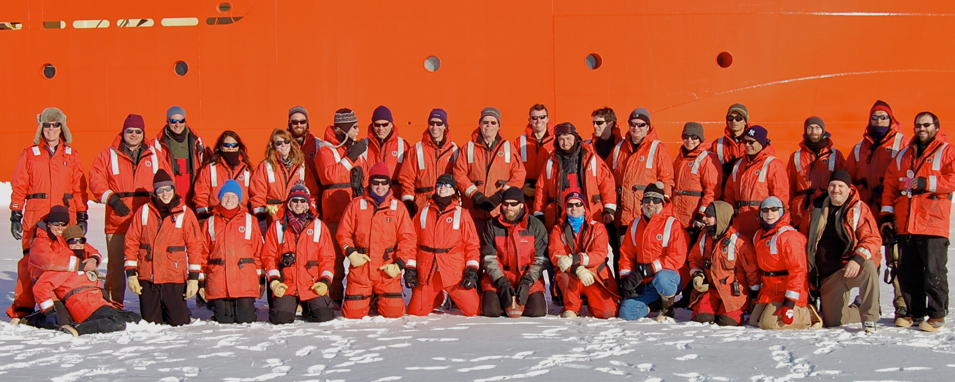


Processes Regulating Iron Supply at the Mesoscale
WHOI Dennis McGillicuddy
ODU Peter Sedwick, Eileen Hofmann,
John Klinck, Mike Dinniman
VIMS Walker Smith
NOCS Tom Bibby
BIO Blair Greenan
Valery Kosnyrev
shore support
Yours truly
Olga Kosnyrev
Josh Eaton
Elise
Olson
Robb Hagg

Slide 2
Plankton Production in the
Open Ocean
Sea Surface
100m

Slide 3
The biological pump
Sea Surface
Photosynthesis
100m
Respiration

Slide 4
Plankton Production in the
Open Ocean
Sea Surface
Fe
CO₂ + H₂O CH₂O + O₂
100m

Slide 5
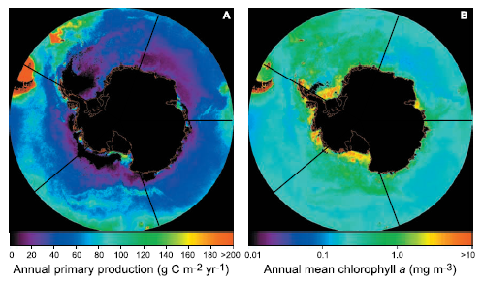
Southern Ocean Productivity
Primary Production Chlorophyll a
Arrigo et al. 2008
SO mediates glacial-interglacial changes in atmospheric CO₂
Future warming may impact SO productivity due to changes in
stratification, ice cover, and dust (Fe) deposition
Goal: understand feedbacks between physical forcing, productivity, and the biological pump.

Slide 6
Antarctic continental shelves are among the most productive regions of the Southern Ocean
Summertime polynya: Phaeocystis antarctica, Diatoms
Polynya area Chlorophyll Primary Production
Fe regulation
Macronutrients not depleted
Fe addition experiments (Martin et al., 1990)
Low grazing pressure (Caron et al., 2000)

Slide 7
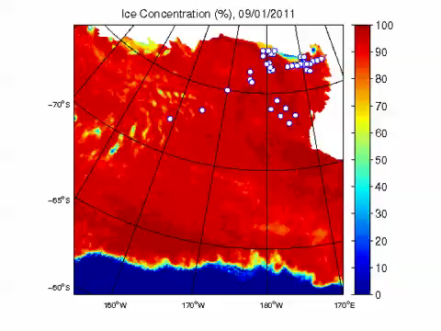
SSMI/S Ice coverage 9/1/11 – 2/5/12
http://www.iup.uni-bremen.de:8084/ssmis/index.html

Slide 8
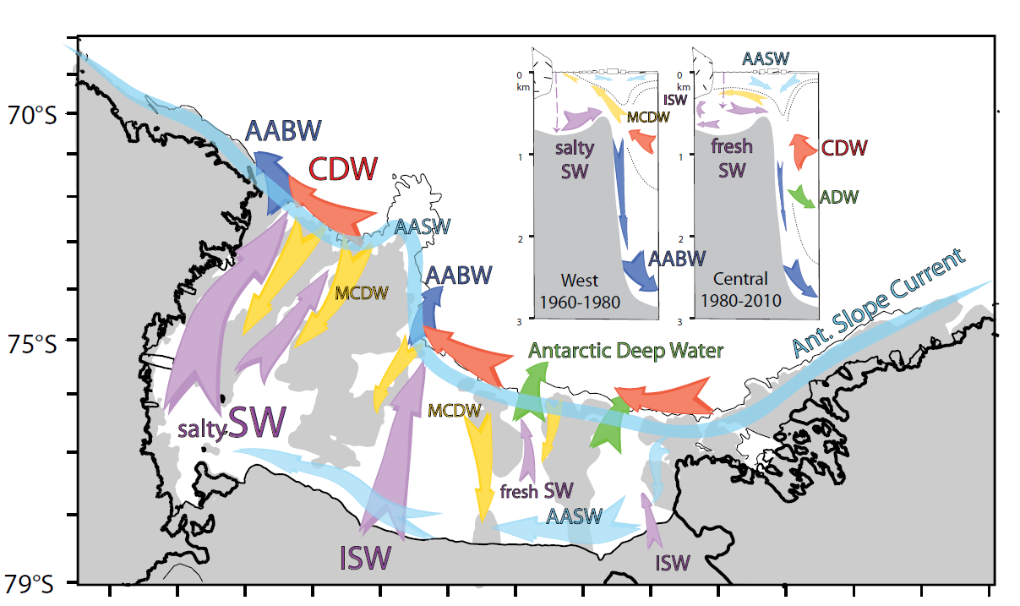
Ross Sea Circulation
Smith et al., 2012
Notes:
Slope current visible in ice flow
Bifurcation feeds cold and fresh coastal current
Water gets saltier toward the west; Ross Sea is the most active sea ice factory around Antarctica, exporting fresh water as ice and leaving the salt behind.
Deep water formation through the troughs, typically exits on the western side.
CDW penetration typically on the eastern side; mixing leads to CDW
Warm, salty, nutrient, Fe rich water, important to physics and biology.

Slide 9
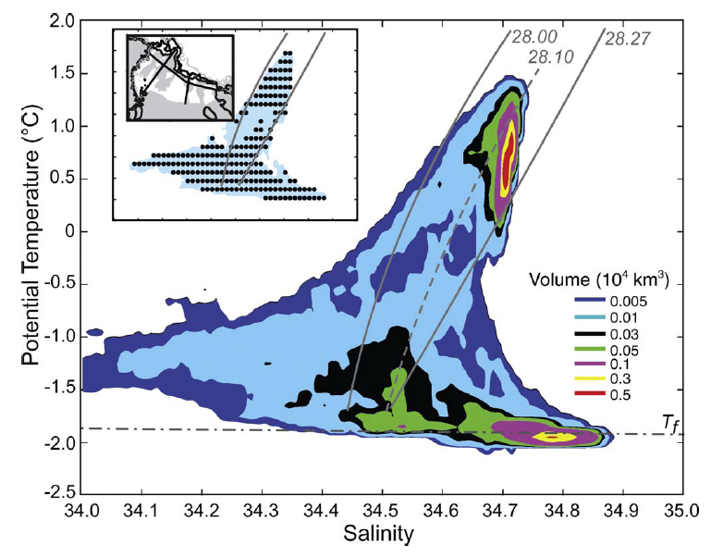
Water mass volumes
Ross Sea < 2000m; Orsi and Wiederwohl (2009)
CDW
MCDW
AASW
LSSW HSSW (S=35.0, p=0)
ISW
Notes:
Freezing point at the surface with S=35.0

Slide 10
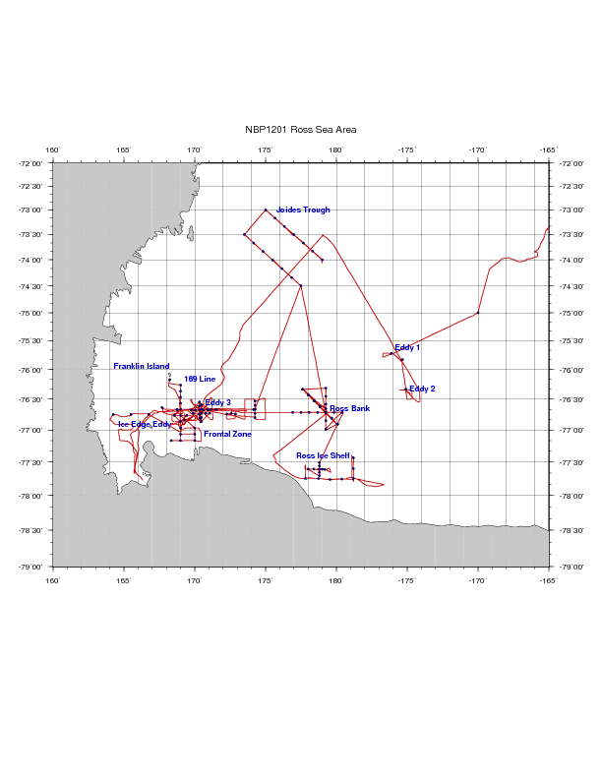
PRISM cruise track
Iron Sources
H₁: CDW
H₂: Sediment: banks/coastal
H₃: Sea ice
H₄: Glacial melt
ACC Sea Ice
H₅: ISW
H₆: Dry Valleys
H₇: Vents
I. ACC Sea Ice
II. Eastern Ross Sea Eddies
III. Western Ross Sea
IV. Ross Bank
V. Ross Ice Shelf
VI. Joides Trough
VII. Western Ross Sea II

Slide 11
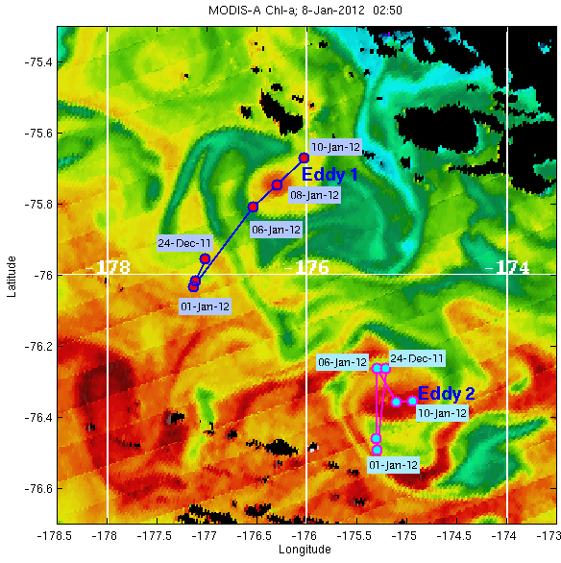

Eastern Ross Sea Eddies
MODIS Chl a Jan 8, 2012
Valery Kosnyrev
shore support

Slide 12
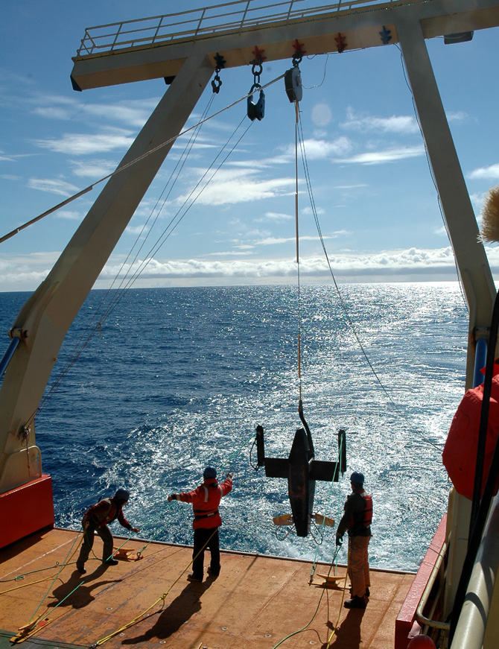
Video Plankton Recorder
(Davis et al. 2005)
Specifications:
Tow speed: 8-10 knots
Tow depth: 0-120 m
Dig. images: 1Kx1Kx10b
Sample rate: 30 frames/sec
Image volume ~1 cm³; resolution ~10μm
Sensors: CTD, fluorometer, PAR, turbidity, oxygen

Slide 13
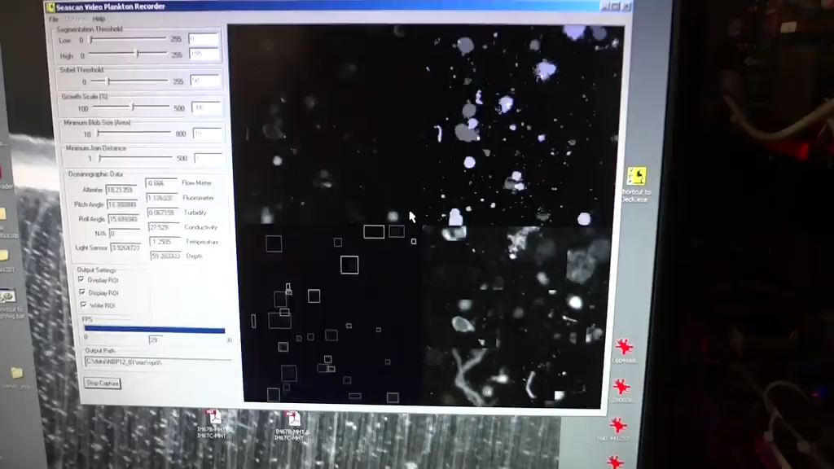

Slide 14
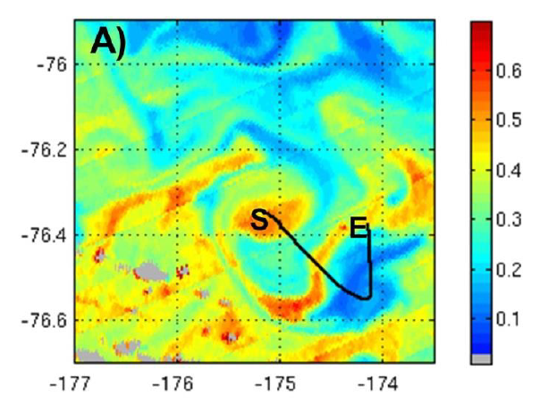
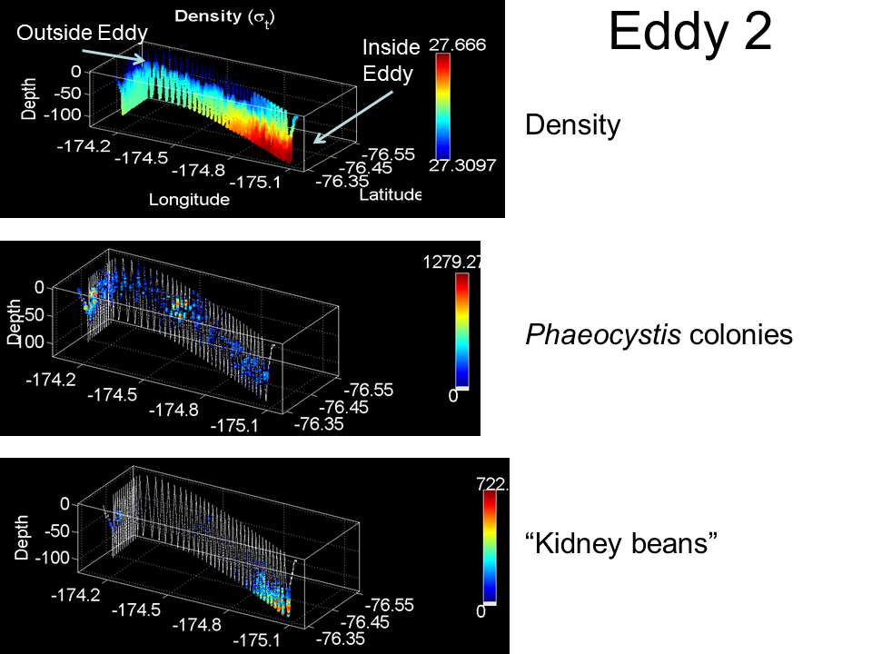
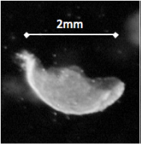
Eastern Ross Sea Eddies
Density
# L⁻¹
Ghost colonies
# L⁻¹
Smith et al., submitted

Slide 15
PRISM cruise track
H₁: CDW
H₂: Sediment: banks/coastal
H₃: Sea ice
H₄: Glacial melt
ACC Sea Ice
H₅: ISW
H₆: Dry Valleys
H₇: Vents
I. ACC Sea Ice
II. Eastern Ross Sea Eddies
III. Western Ross Sea
IV. Ross Bank
V. Ross Ice Shelf
VI. Joides Trough
VII. Western Ross Sea II

Slide 16
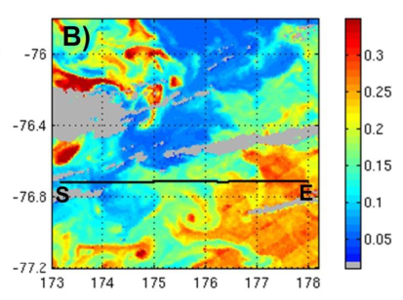
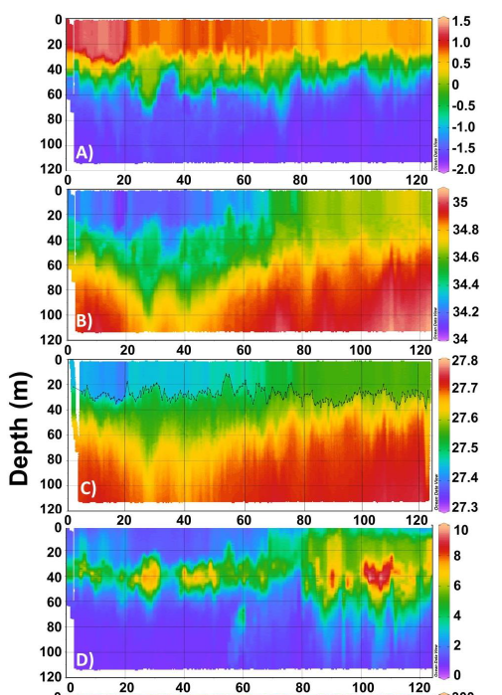
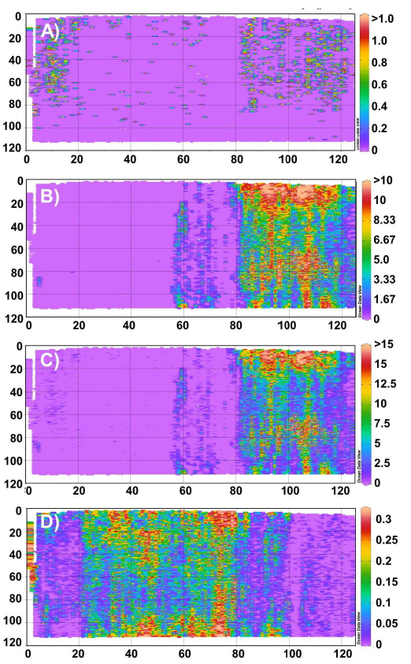
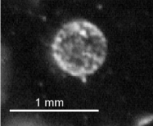
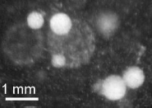
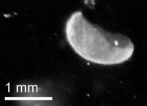
VPR 8 – Frontal transect
Log₁₀ Chl a (μg L⁻¹)
Temperature
Salinity
Density
Fluorescence
“Normal”
Translucent
Total
Ghost
# ml⁻¹
Distance (km) Distance (km)
Smith et al., submitted
Notes:
Strong contrast in surface chlorophyll coincides with salinity front: CF to the east, WS to the west.
“Normal” phaeo less abundant than translucent form, which we did not see in the eddy 3 transect.
Biomass dominated by translucent form, especially east of the front.
Ghost colonies more abundant west of the front; bimodal vertical distribution. Peaks about half as high as in eastern Ross Sea eddy; note change in units.

Slide 17
PRISM cruise track
H₁: CDW
H₂: Sediment: banks/coastal
H₃: Sea ice
H₄: Glacial melt
ACC Sea Ice
H₅: ISW
H₆: Dry Valleys
H₇: Vents
I. ACC Sea Ice
II. Eastern Ross Sea Eddies
III. Western Ross Sea
IV. Ross Bank
V. Ross Ice Shelf
VI. Joides Trough
VII. Western Ross Sea II

Slide 18
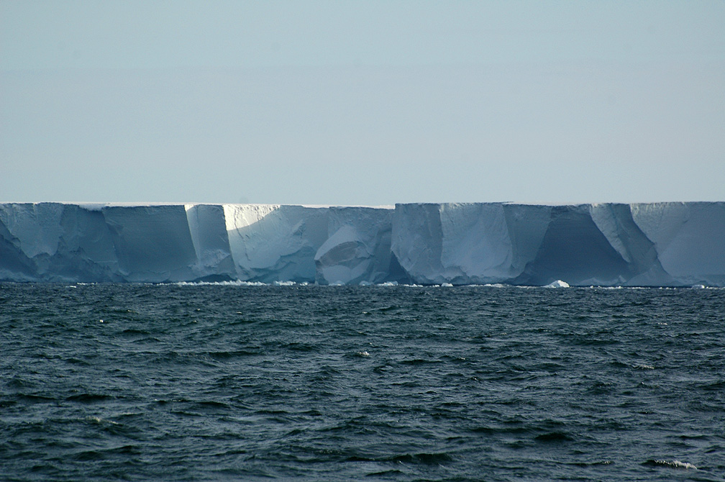
Ross Ice Shelf
150’

Slide 19
Ross Ice Shelf Circulation
Smethie and Jacobs, 2005
RIS 750 m thick in places; the size of France; moves seaward 1-3 m/day
Notes:
Melting in the upper part of the water column due to the inflow of relatively warm MCDW; source of iron
Inflow of shelf waters causes melting at the grounding line
buoyant fluid rises
freezing point increases with decreasing pressure
refreezing; cooling, brine rejection form ISW with higher density that arrests the buoyant rise
ISW flows out at mid-depth
Temps are below the surface freezing point, allowing easy targeting of that water mass

Slide 20
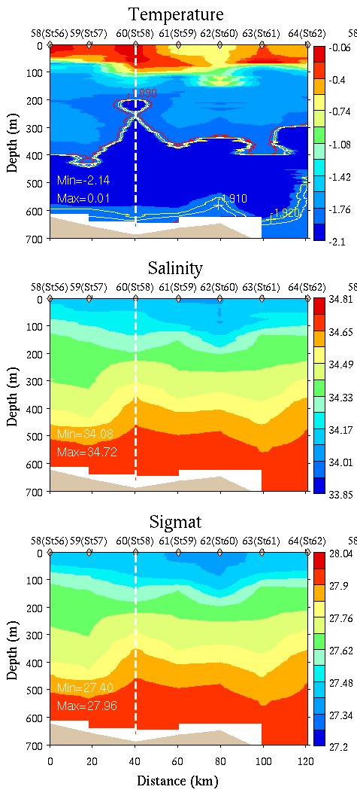
Ice Shelf CTD Survey

Slide 21
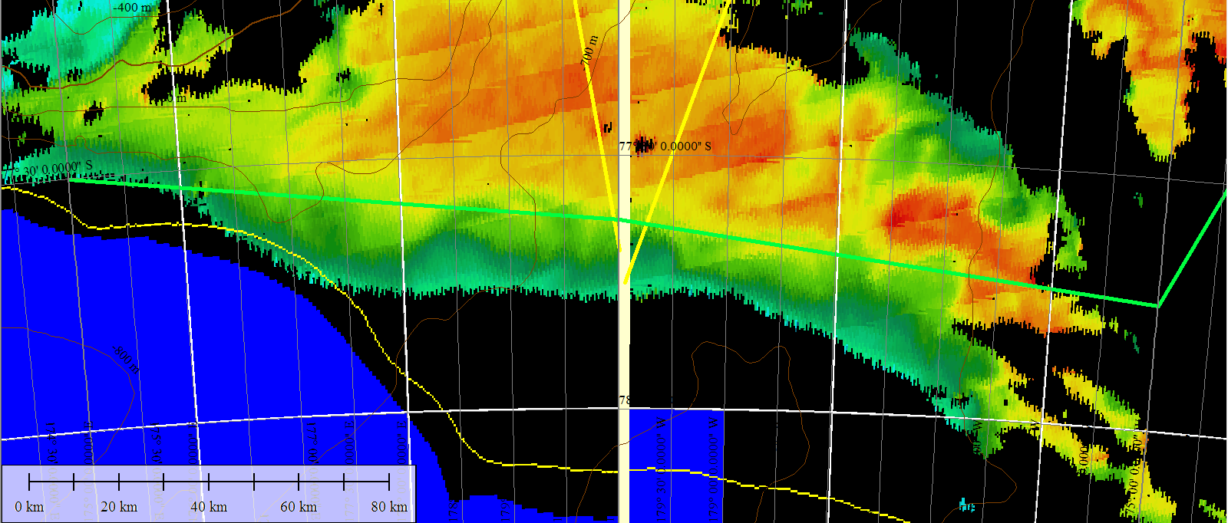
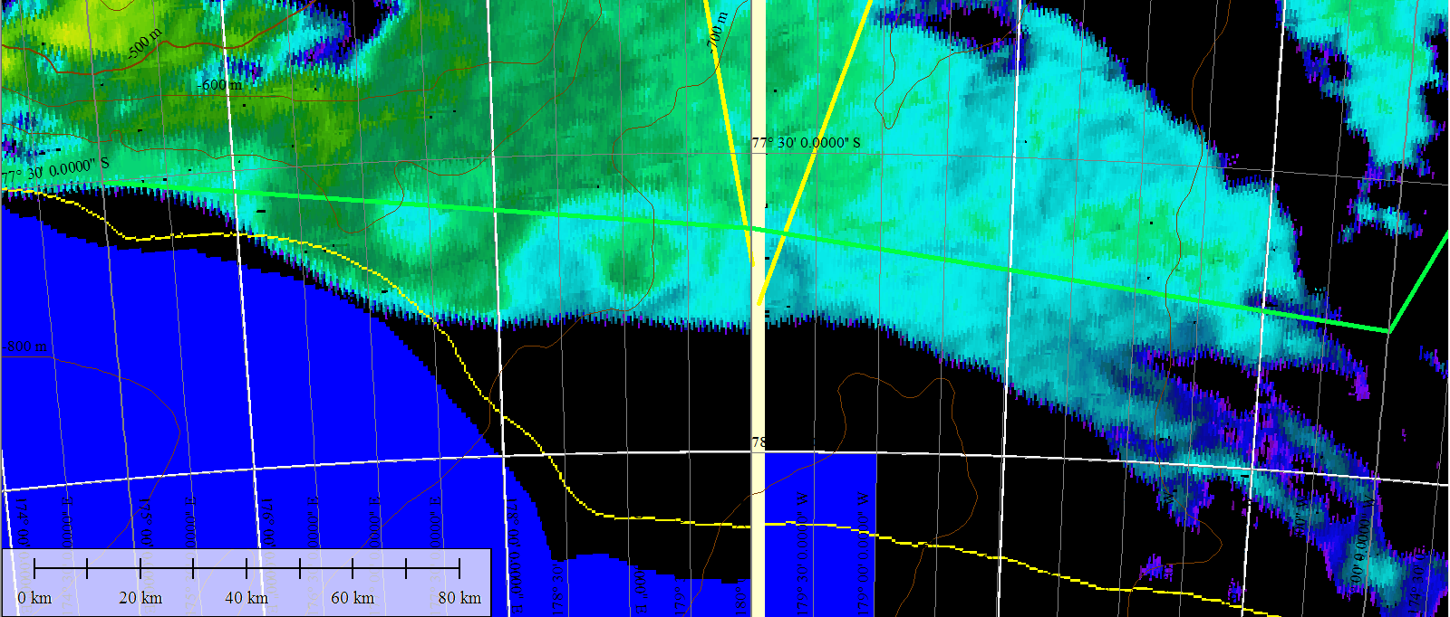
Ross Ice Shelf satellite imagery – Jan 22
Chl
SST

Slide 22
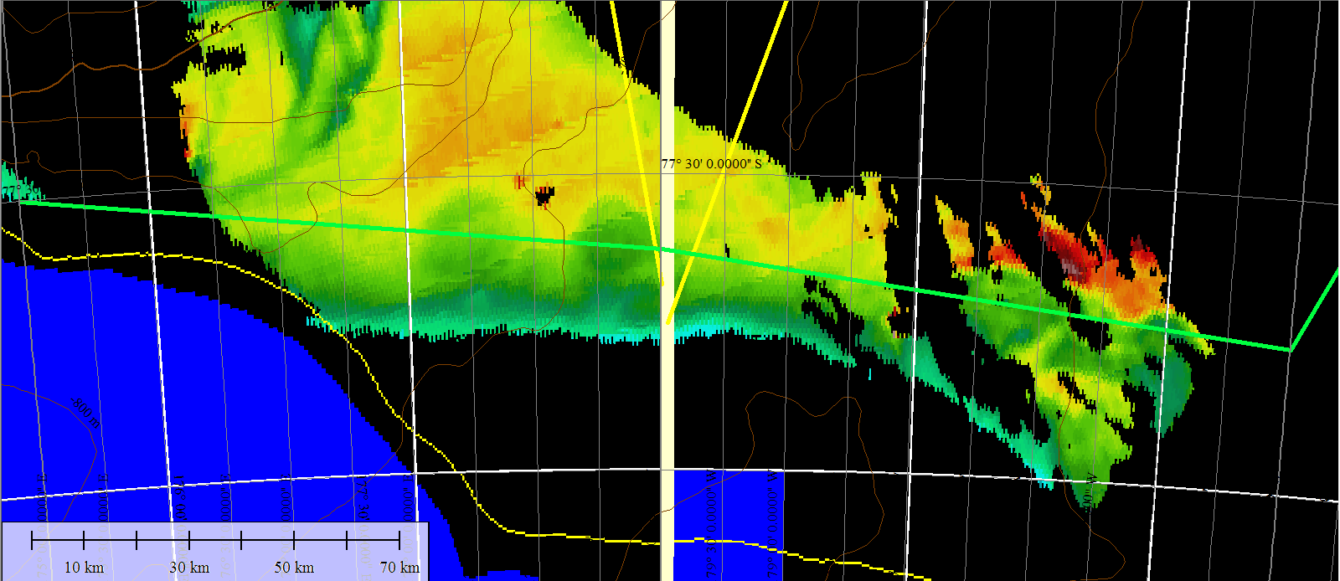
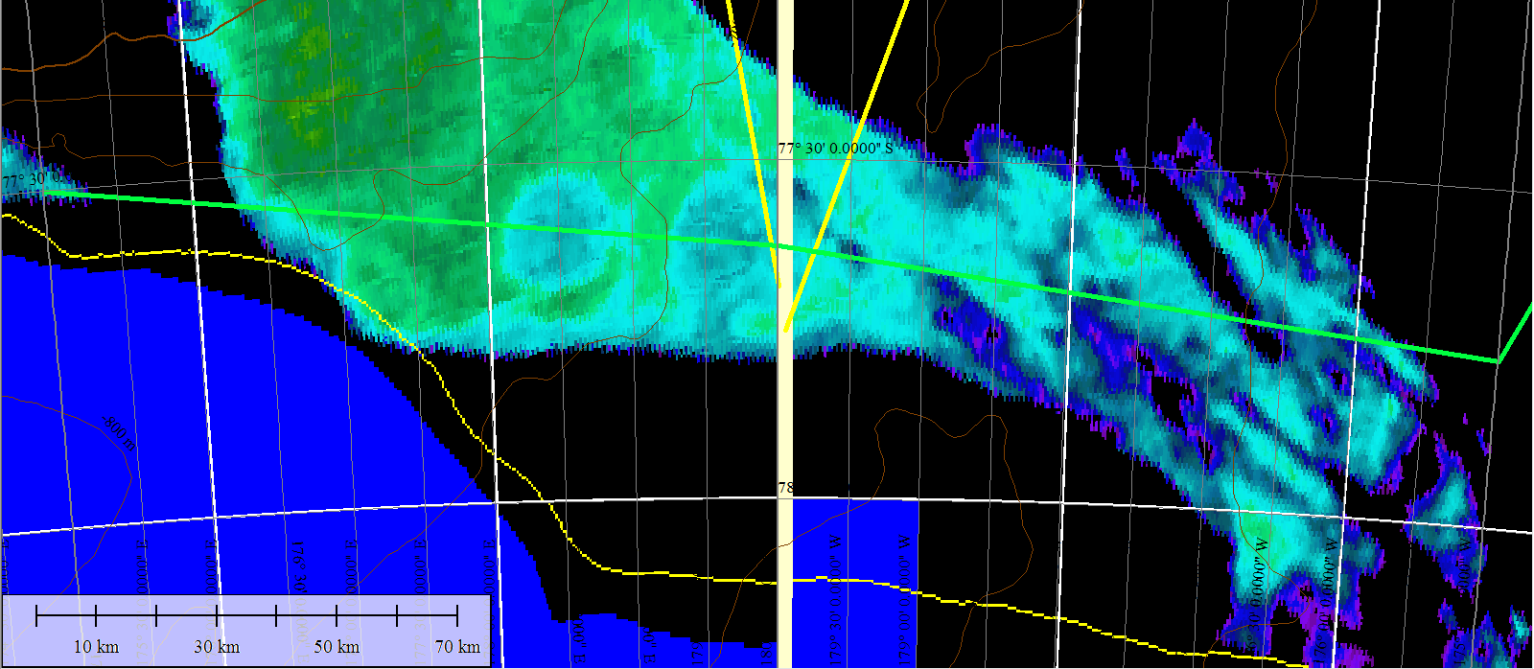
Ross Ice Shelf satellite imagery – Jan 25
Chl
SST

Slide 23
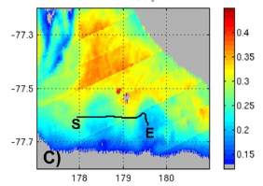
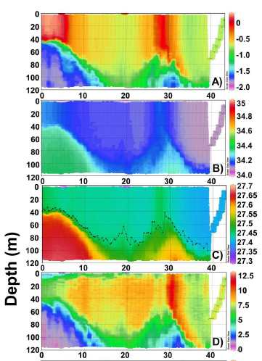
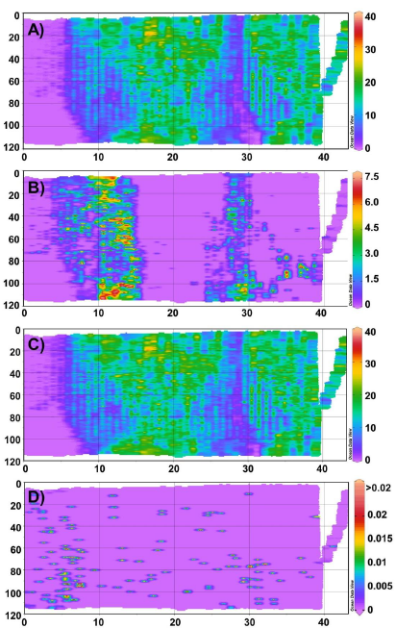
VPR 9 – Ross Ice Shelf Eddies
Temperature
Salinity
Density
Fluorescence
“Normal”
Translucent
Total
Ghost
Log₁₀ Chl a (μg L⁻¹)
Depth (m)
# ml⁻¹
Distance (km) Distance (km)
Smith et al., submitted

Slide 24
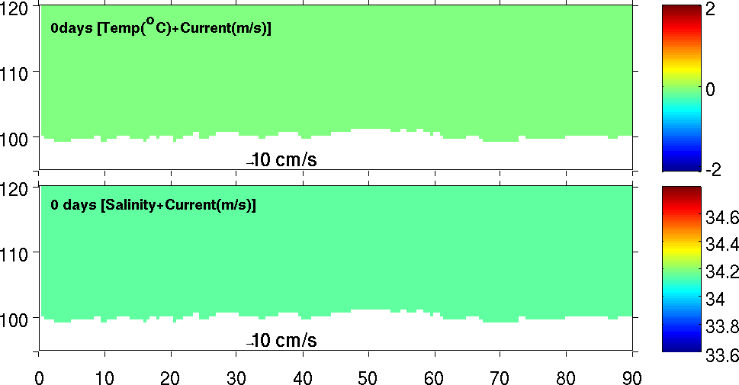
Model simulation of RIS eddy formation
Yizhen Li et al. (submitted)
Temperature
Distance (km)
Salinity
Distance (km)
RIS basal melting creates low-salinity plume; instability facilitated by RIS roughness
Notes:
Same as exp.2 but with basal melting turned off (update)

Slide 25
PRISM cruise track
H₁: CDW
H₂: Sediment: banks/coastal
H₃: Sea ice
H₄: Glacial melt
ACC Sea Ice
H₅: ISW
H₆: Dry Valleys
H₇: Vents
I. ACC Sea Ice
II. Eastern Ross Sea Eddies
III. Western Ross Sea
IV. Ross Bank
V. Ross Ice Shelf
VI. Joides Trough
VII. Western Ross Sea II

Slide 26
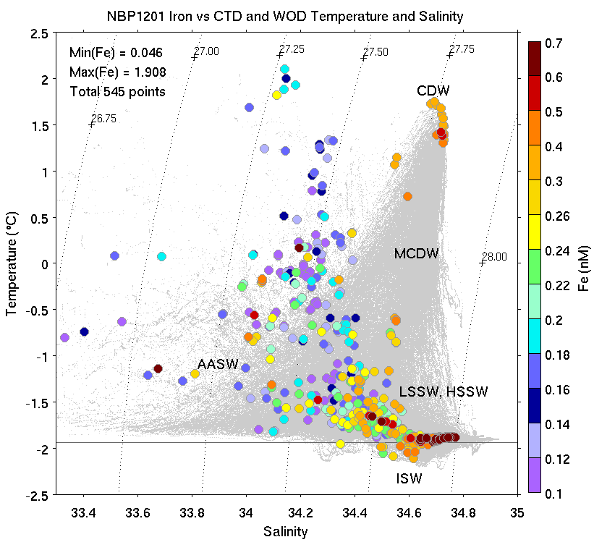
PRISM dissolved iron (dFe) observations (Sedwick)
Temperature
WOA climatology
(after Orsi and Wiederwohl, 2009)
Salinity
Notes:
It was our intention to sample as many of these water masses as possible, and here is a superposition of Pete Sedwick’s iron measurements on the T-S climatology, ranging from 0.1nM in purple to 0.7nM and higher in red.
The CDW and ISW end member concentrations are approximately the same, at about 0.4nM.
Surface waters tend to be depleted in iron as a result of uptake [not outside climatology].
Highest values (0.6nM and greater) found in this water mass. What is it?

Slide 27
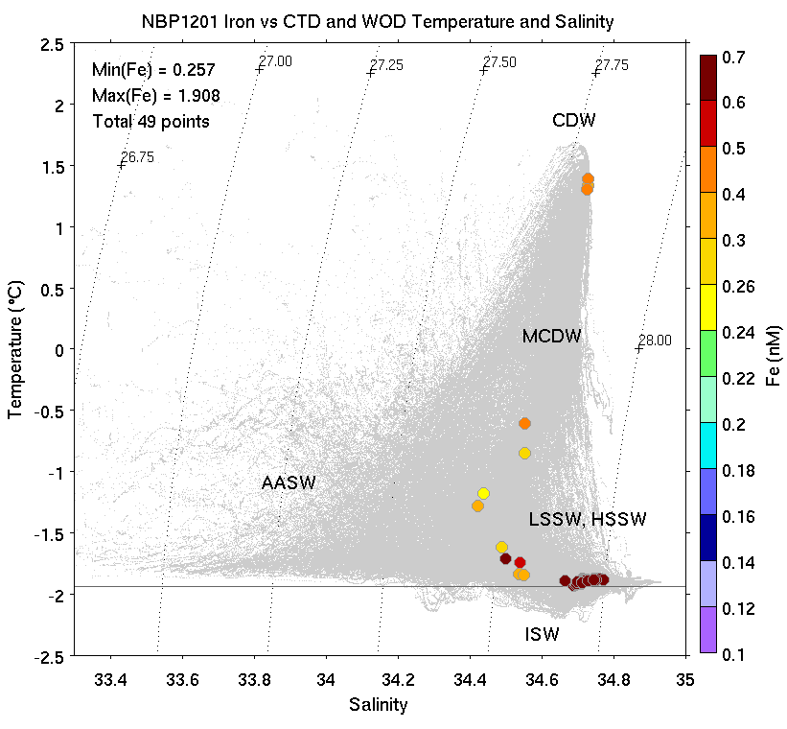
Deepest sample from every cast
Temperature
WOA climatology
(after Orsi and Wiederwohl, 2009)
Salinity

Slide 28
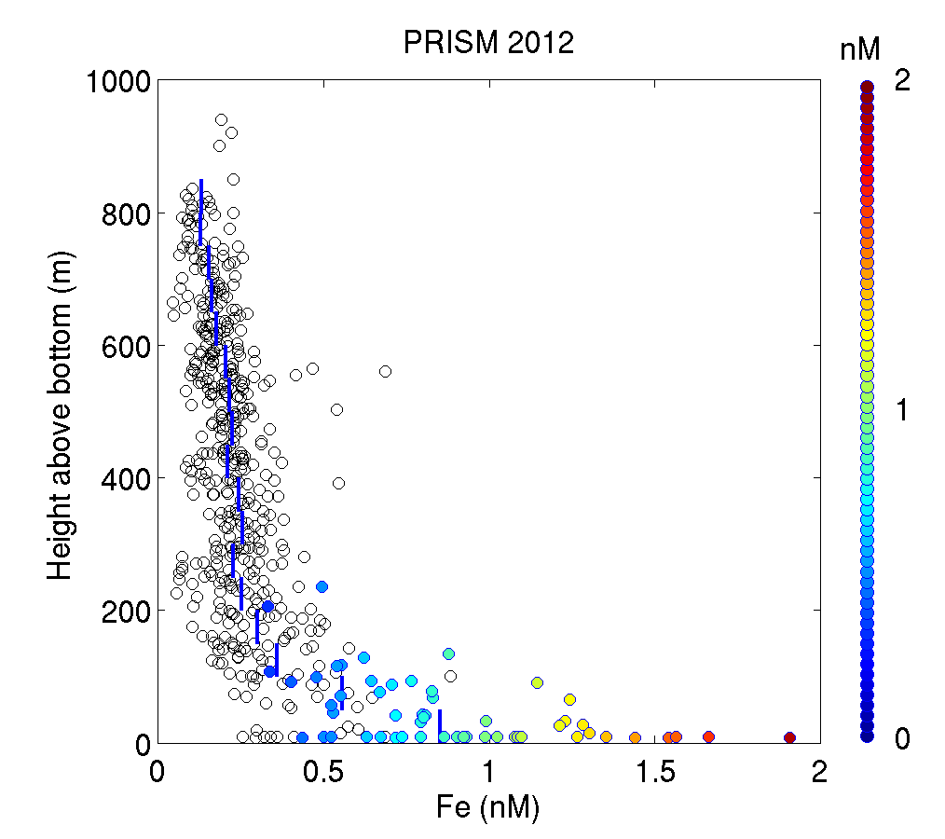
Composite profiles of dFe
Height above bottom (m)
Colored circles: samples within benthic nepheloid layer
dFe (nm)

Slide 29
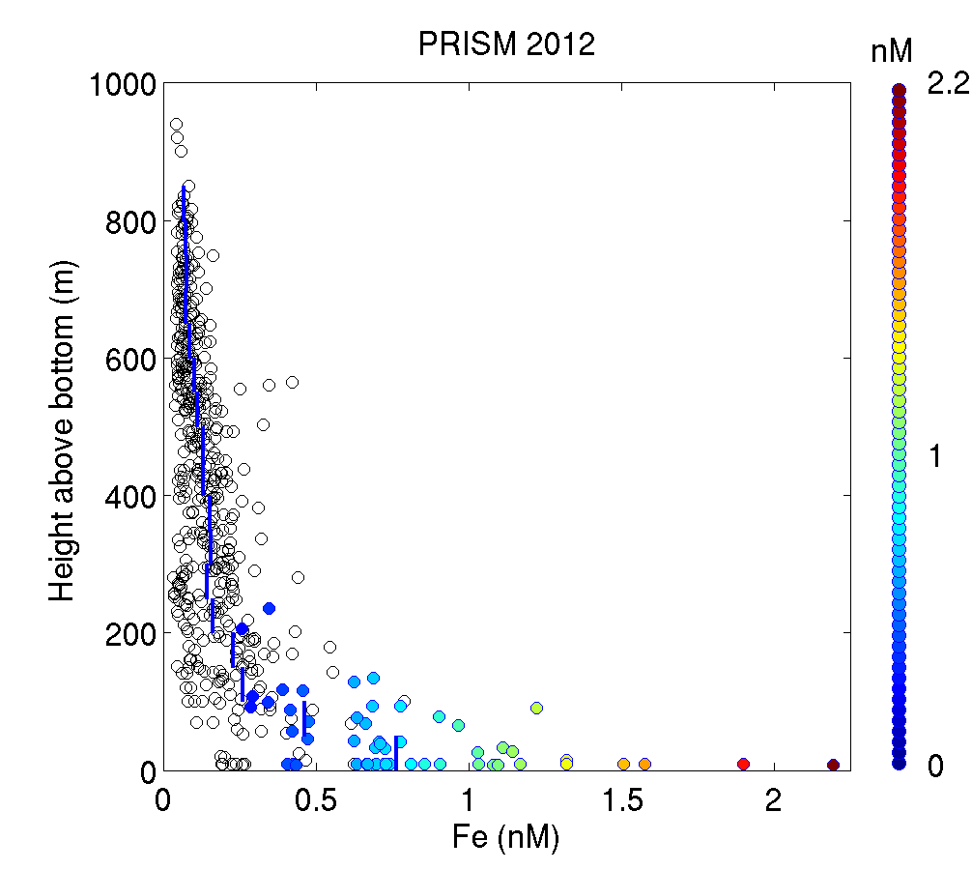
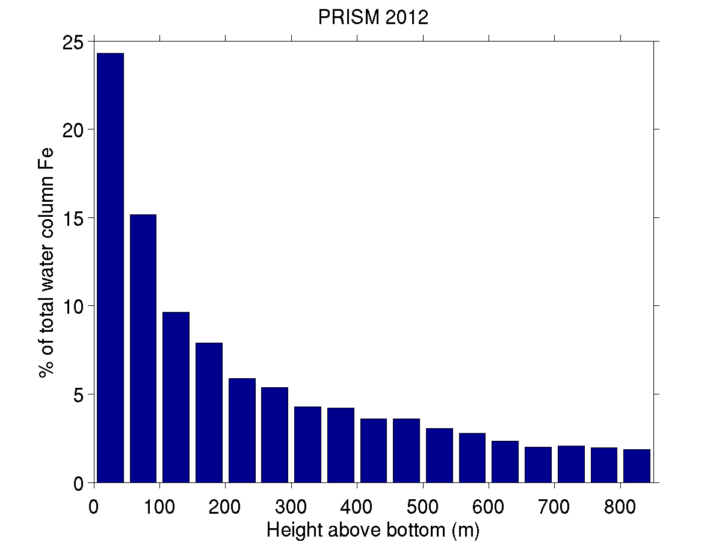
~40% of dFe resides within 100 mab
Marsay et al. 2014
% of water column dFe
Height above bottom (m)

Slide 30
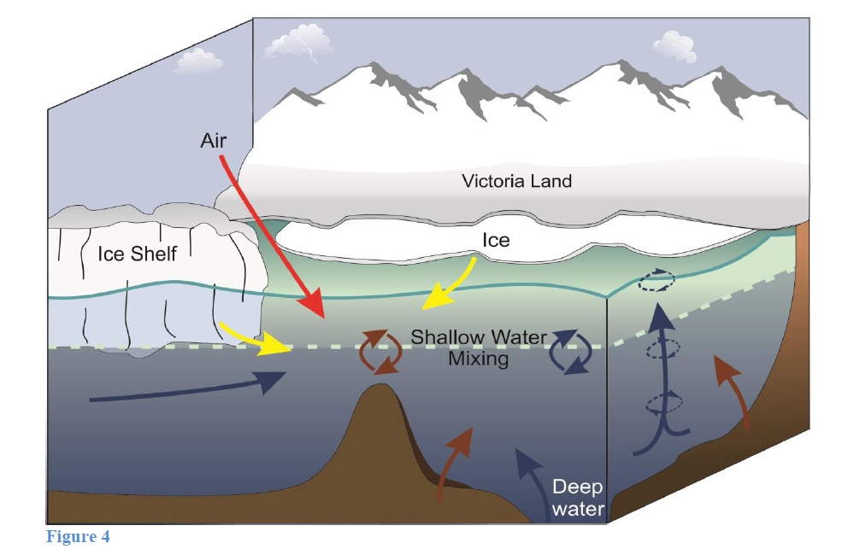
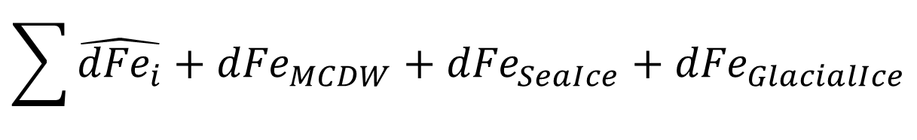

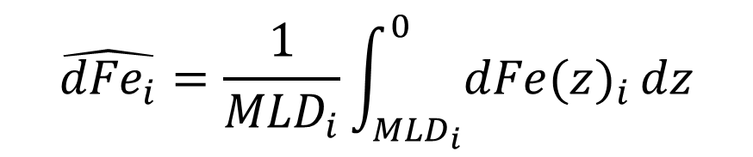
Quantifying iron sources in the
Ross Sea
Observations:
Winter Reserve:
Iron Sources:
$${dFe(z)}_{i}$$
Smith et al. (2014)
$$\hat{{dFe}_{i}}=\frac{1}{{MLD}_{i}}\int_{{MLD}_{i}}^{0}{{dFe(z)}_{i}}dz$$
$$\sum{\hat{{dFe}_{i}}+{dFe}_{MCDW}+{dFe}_{SeaIce}+{dFe}_{GlacialIce}}$$
Notes:
Our intent is to quantify iron supply in the Ross Sea, and this conceptual model recently published by Walker Smith in Annual Reviews of Marine Science provides a context in which to do so.
The major sources include the winter reserve, MCDW, sea ice, and glacial ice.
McMurdo Dry Valleys may provide a source that is significant locally, but the integrated input from atmospheric sources is thought to be very low.
The winter reserve is determined by convective mixing in the winter, and we can estimate that concentration from the PRISM data by homogenizing the dFe profile over that interval.

Slide 31
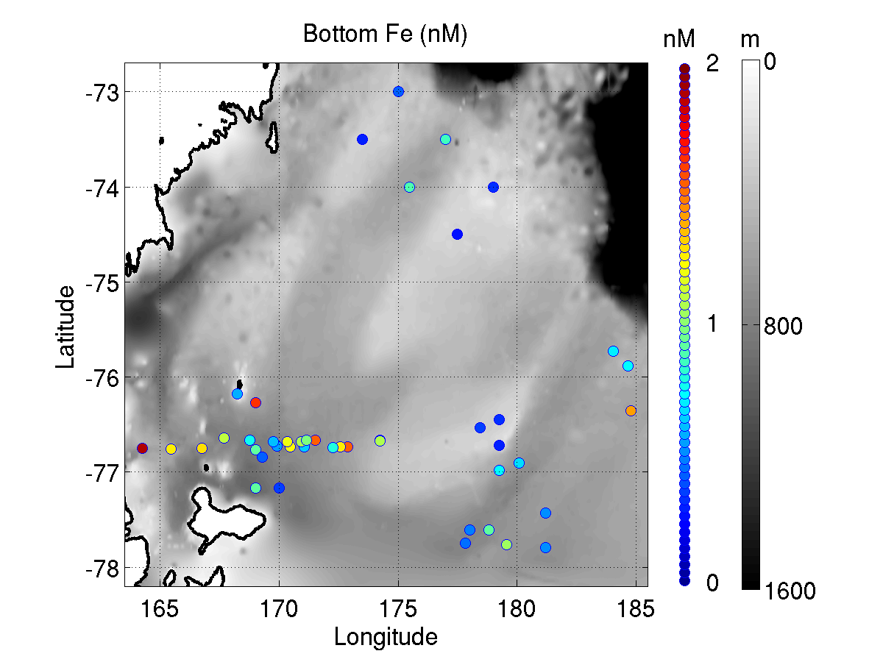
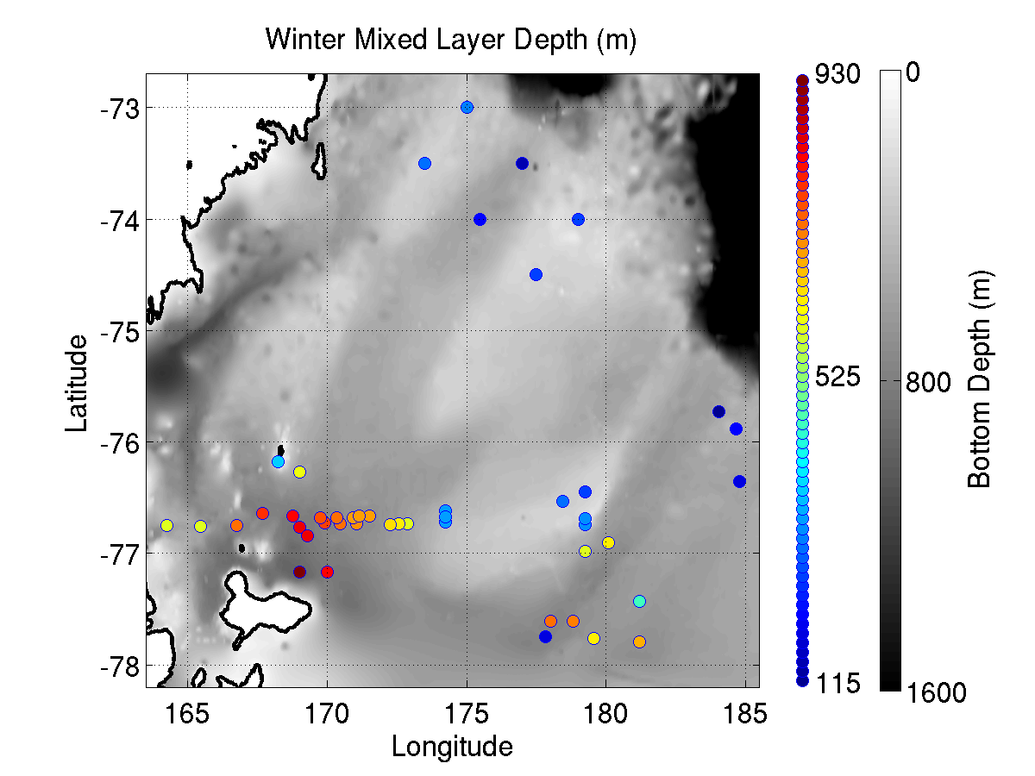
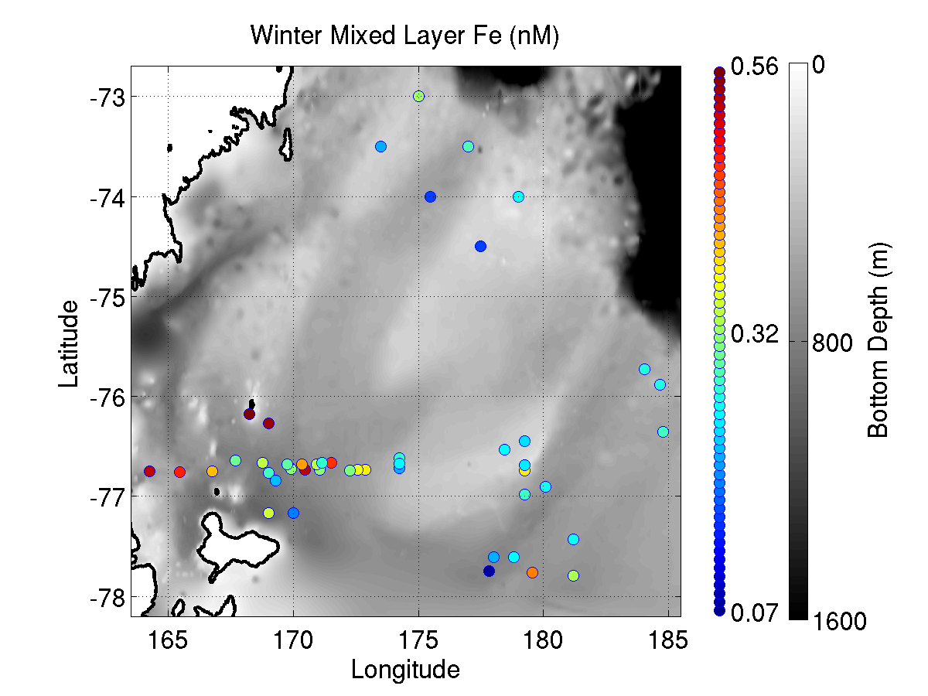
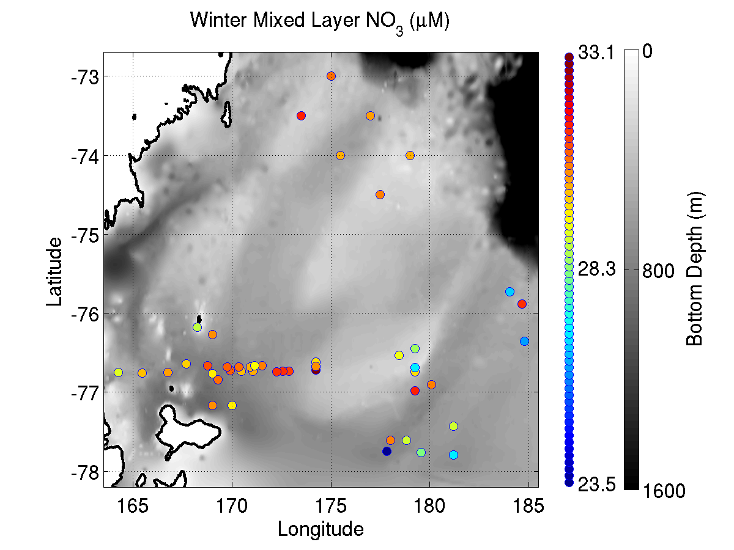
Winter reserves
Bottom Fe (obs)
Winter MLD (model)
North
Inferred winter ML Fe
Inferred winter ML NO₃

Slide 32
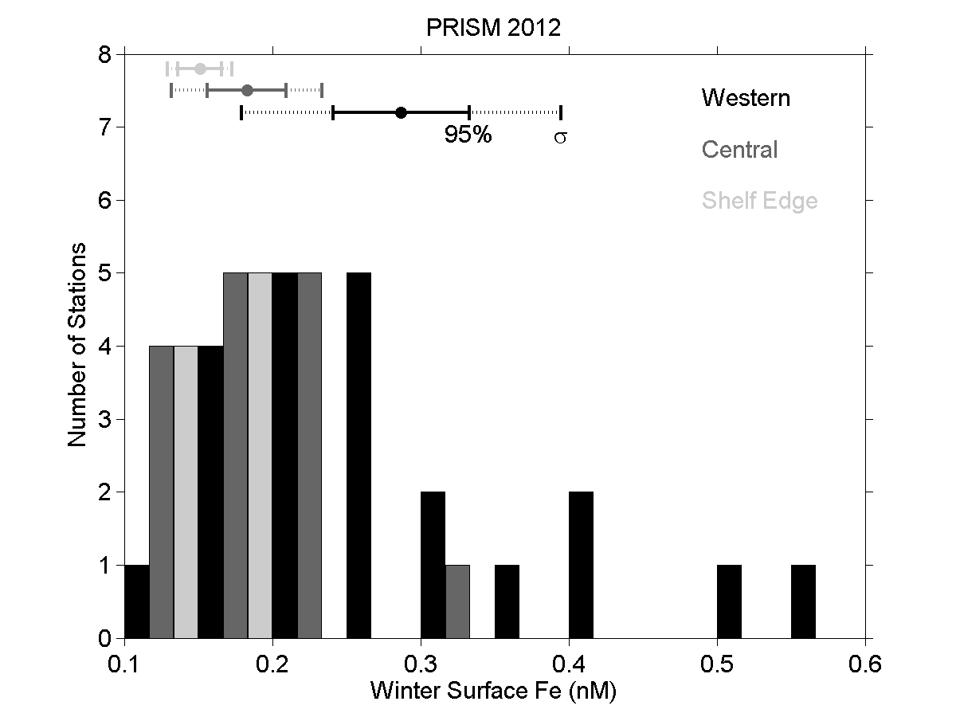
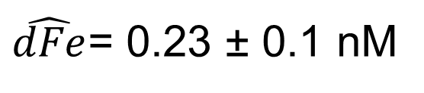
Fe winter reserve
$\hat{dFe}$= 0.23 ± 0.1 nM

Slide 33
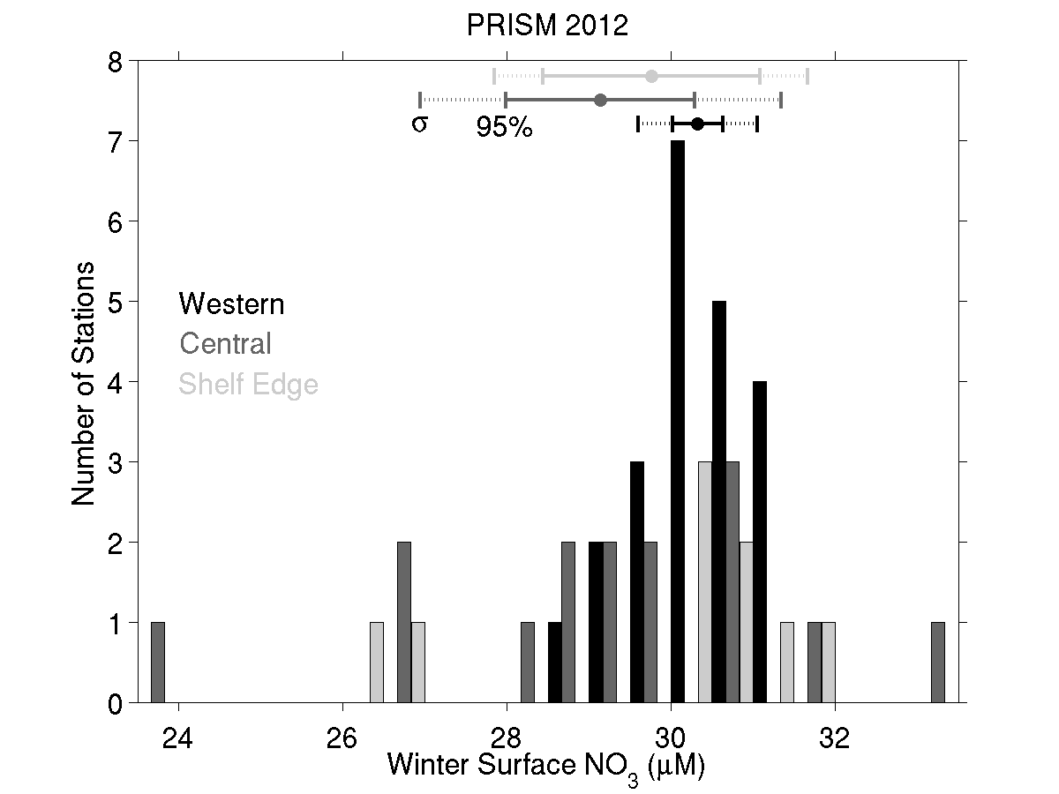
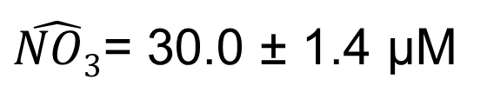
NO₃ winter reserve
$\hat{NO3}$= 30.0 ± 1.4 μM

Slide 34
Quantifying iron sources in the
Ross Sea
Observations:
Winter Reserve:
Iron Sources:
$${dFe(z)}_{i}$$
Smith et al. (2014)
$$\hat{{dFe}_{i}}=\frac{1}{{MLD}_{i}}\int_{{MLD}_{i}}^{0}{{dFe(z)}_{i}}dz$$
$$\sum{\hat{{dFe}_{i}}+{dFe}_{MCDW}+{dFe}_{SeaIce}+{dFe}_{GlacialIce}}$$

Slide 35
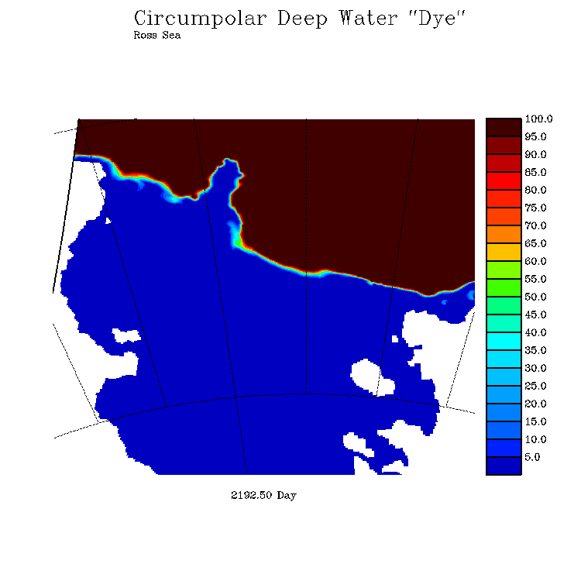
Simulation of CDW penetration onto the continental shelf
Model level 12 (250-300 m)
Dye = 100 where
T>0 seaward
of 1200 m isobath
5 km resolution model; 1.5 km resolution model underway
End-member concentrations
dFe = 0.27 ± 0.05 nM
NO₃ = 29.9 ± 1.4 µM
Mike Dinniman
Stefanie Mack
ODU
Notes:
[similar simulations for sea ice and glacial ice]

Slide 36
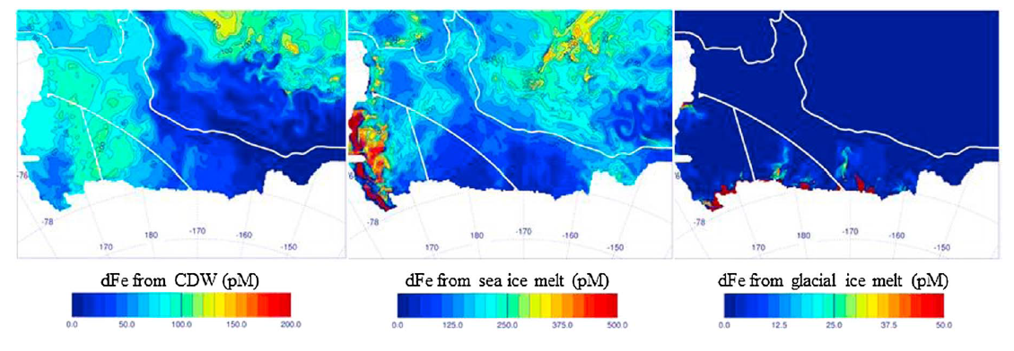
Simulated dFe supply
CDW Sea Ice Melt Glacial Ice Melt
0 200 0 500 0 50
End-member concentrations
dFe = 0.27 ± 0.05 nM dFe = 10 ± 5 nM dFe = 29 ± 21 nM
NO₃ = 29.9 ± 1.4 µM NO₃ = 0 µM NO₃ = 0 µM
Notes:
Simulated concentration at the end of the growing season – assumes no uptake during transport

Slide 37
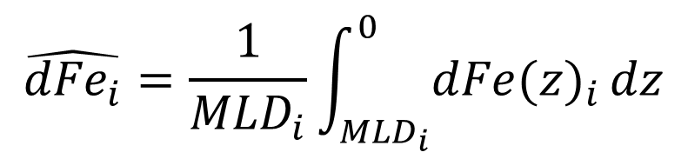
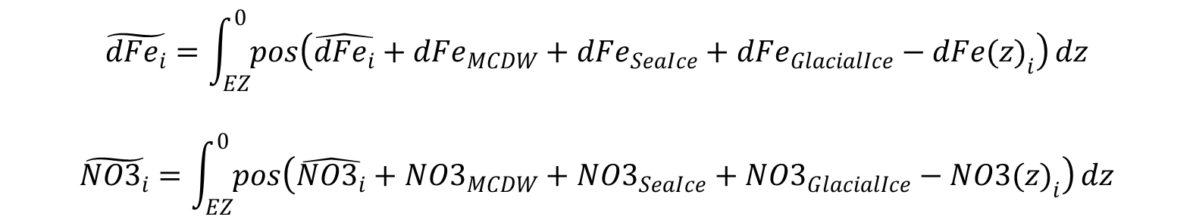
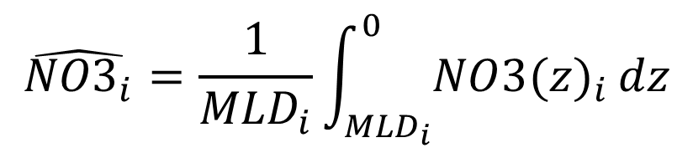
Calculating Fe and NO₃ drawdown
Winter reserves
Apparent drawdown
$$\hat{{dFe}_{i}}=\frac{1}{{MLD}_{i}}\int_{{MLD}_{i}}^{0}{{dFe(z)}_{i}}dz$$
$$\hat{{NO3}_{i}}=\frac{1}{{MLD}_{i}}\int_{{MLD}_{i}}^{0}{{NO3(z)}_{i}}dz$$
$$\tilde{{dFe}_{i}}=\int_{EZ}^{0}{pos\left({\hat{{dFe}_{i}}+{dFe}_{MCDW}+{dFe}_{SeaIce}+{dFe}_{GlacialIce}−dFe(z)}_{i}\right)}dz$$
$$\tilde{{NO3}_{i}}=\int_{EZ}^{0}{pos\left({\hat{{NO3}_{i}}+{NO3}_{MCDW}+{NO3}_{SeaIce}+{NO3}_{GlacialIce}−NO3(z)}_{i}\right)}dz$$
Notes:
If we want to make the connection between iron supply and primary production, we need to know something about phytoplankton uptake stoichiometry. The ratio of nitrate to iron drawdown provides a means to do so.
We can use the PRISM data to compute the difference between the concentrations of Fe and NO3 at the time of our observations and the initial values we estimated from the winter reserve.
However, the continued inputs from the other sources, namely MCDW, sea ice, and glacial ice, must be accounted for, and we use the tracer simulations to estimate those terms.

Slide 38

NO₃:Fe drawdown ratio
Mean NO₃:Fe drawdown ratio, including inputs from MCDW, sea ice, glacial ice:
59,000 ± 22,000 mol N / mol Fe
Using Redfield to convert to carbon units:
390,000 ± 150,000 mol C / mol Fe
Algal C:Fe assimilation ratios
Feng et al. 2000 250,000-400,000
Twining et al. 2004 166,000-390,000
Boyd et al. 2012 5000-450,000
Strzepek et al. 2011,2012 10,000-2,500,000

Slide 39

Quantifying iron demand: satellite-based estimates of productivity
Arrigo et al. 2008, updated using MODIS 2002-2013:
6.9 mol C m⁻² yr⁻¹
Using an f-ratio of 0.5±0.1
Asper and Smith 1999
Sweeney et al. 2000
Long et al. 2011
Annual new production: 3.45 mol C m⁻² yr⁻¹
Using C:Fe of 390,000±150,000:
8.8±6.4 µmol Fe m⁻² yr⁻¹

Slide 40

Iron Supply and Demand in the Ross Sea
McG et al. 2015
Notes:
To our shock and amazement, the sum of the various iron sources is nearly the same as the iron demand inferred from satellite estimates of productivity, with the difference between them being less than 10% of the uncertainty.
The two largest sources are the winter reserve and sea ice melt, providing roughly equal contributions that comprise more than 80% of the totoal.
MCDW supplies most of the remainder, with the contribution from glacial ice melt an order of magnitude less.

Slide 41
Conclusions
Ross Sea iron supply and demand are in approximate balance
Winter reserve, sea ice are the largest sources (80%)
Benthos plays a large role in winter reserve
MCDW also a significant contributor (20%)
Glacial ice input negligible
(c.f. Amundsen Sea, Pine Island Glacier)
Heterogeneity in iron supply processes along the Antarctic continental margin
Notes:
Our findings illustrate the complexities of iron cycling in the Southern Ocean, highlighting the heterogeneity of the underlying processes along the Antarctic continental margin.
Explicit representation of these complexities will be necessary in order to understand how a changing climate will affect this important ecosystem and its influence on biogeochemical cycles.
Atmospheric sources
Extraterrestrial sources

Slide 42
Southern Ocean Productivity
Primary Production Chlorophyll a
Arrigo et al. 2008

Slide 43
End

