Slide 1
A red tide of Alexandrium fundyense in the Gulf of Maine (2009)
D.J. McGillicuddy Jr., M.L. Brosnahan, D.A. Couture, R. He, B.A. Keafer, Y. Li,
J.P. Manning, J.L. Martin, C.H. Pilskaln, R.P. Stumpf, D.W. Townsend, D.M. Anderson
Deep-Sea Research II (2014)
Prior red-water events associated with A. fundyense in the Gulf of Maine:
1972 - near Cape Ann
1980 - Bay of Fundy
2003 - Bay of Fundy
2004 - Bay of Fundy
Notes:
Typical blooms concentrations 1000s
Water discoloration – 100,000s to 1,000,000s
Red water events have 100 to 1000x higher cell concentrations than average

Slide 2
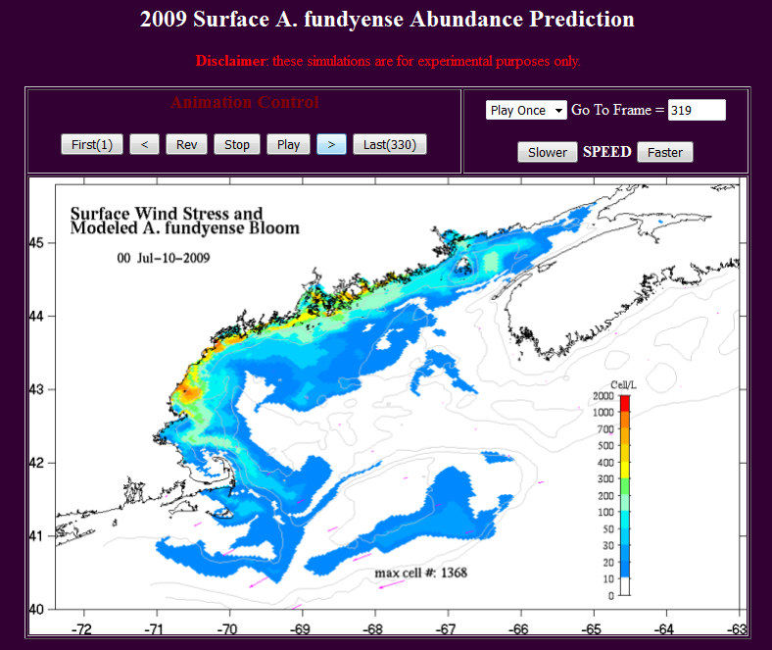
http://omgsrv1.meas.ncsu.edu/GoMaine_Redtide/2009/weekly_nowcast_forecast/dino_09.htm

Slide 3
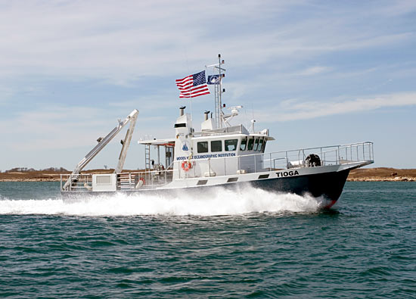
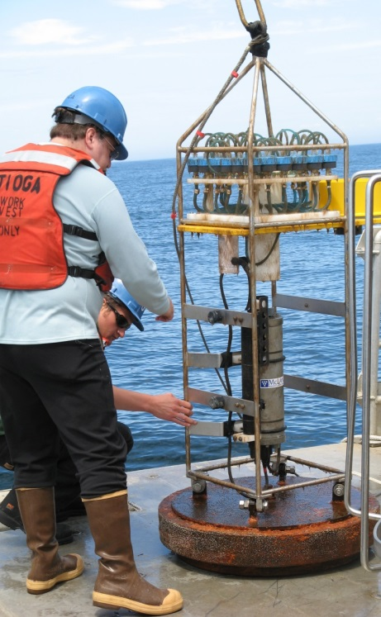
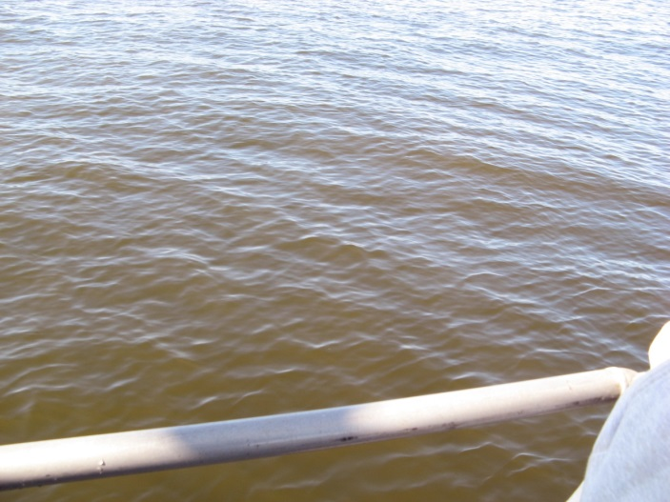
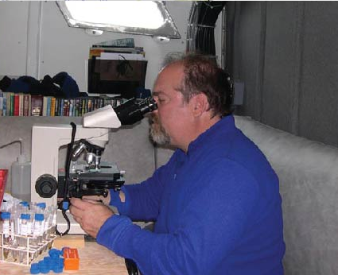
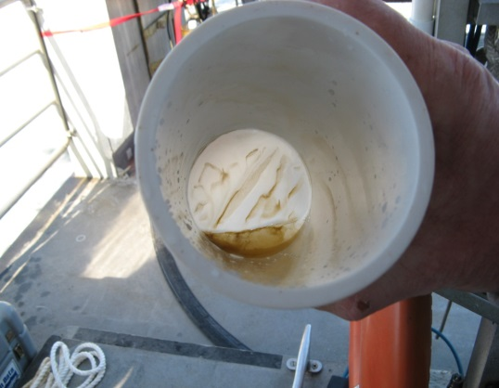
Serendipitous discovery
Bruce Keafer

Slide 4

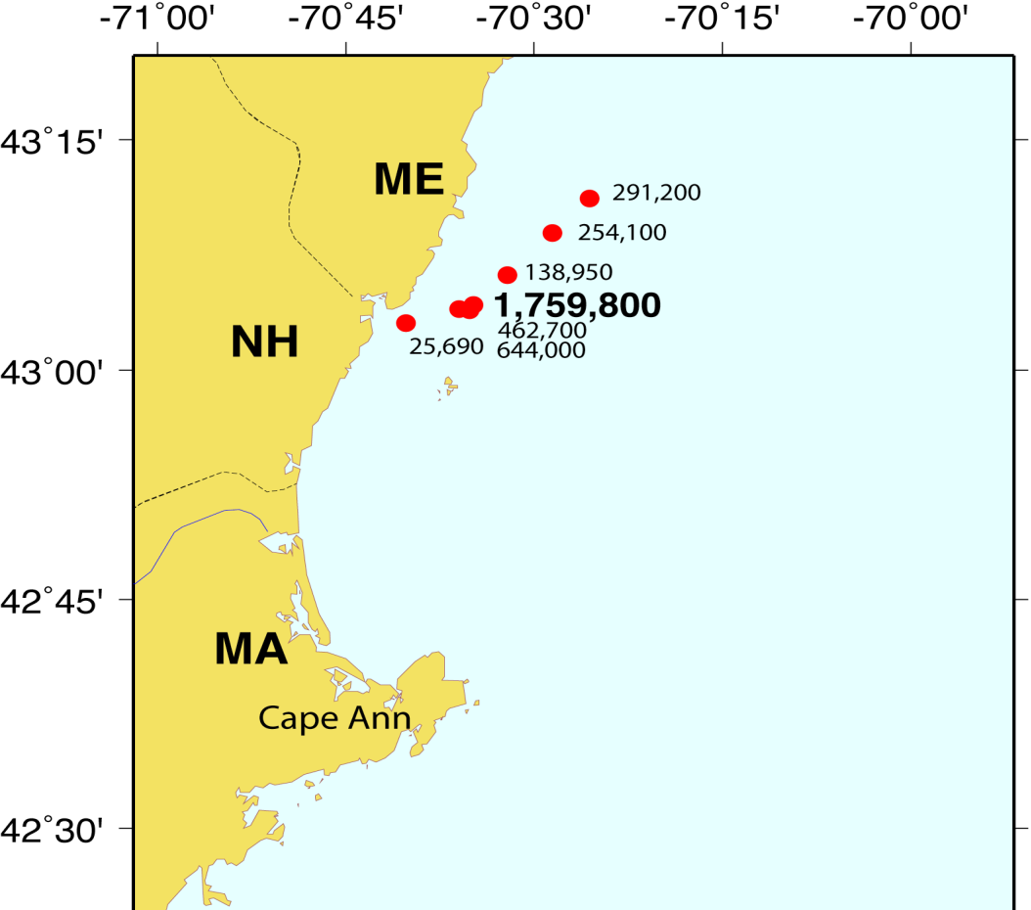
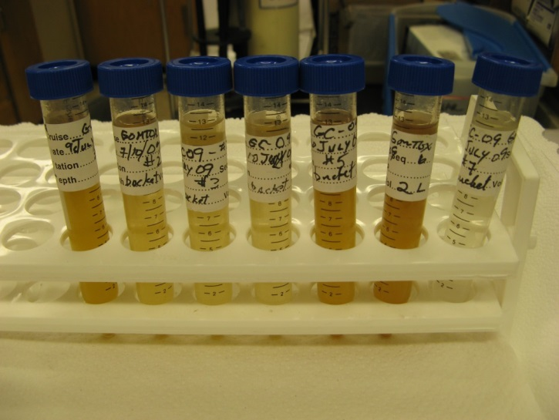
Alexandrium fundyense concentrations
July 10, 2009: The highest A. fundyense concentration ever observed in the western Gulf of Maine

Slide 5
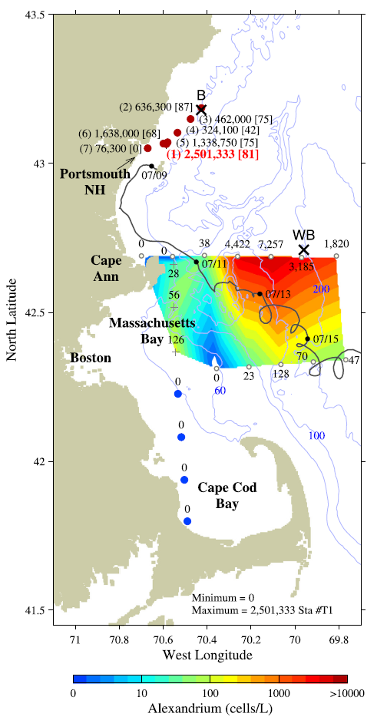
Rapid response survey:
July 12
July 10
Max 10⁶ cells l⁻¹
July 12
Max 10⁴ cells l⁻¹
Notes:
Fig. 1. Dots north of 431N: surface A. fundyense concentrations (cells l−1) observed
on July 10, 2009 (whole cell counts). Station numbers (in parentheses) precede the
cell counts, and the percentage of planozygotes follows in brackets. Map, dots, and
plus signs south of 431N: surface A. fundyense concentrations observed on R/V Tioga
383 July 12, 2009 (live counts). Black crosses indicate the locations of NERACOOS
mooring “B” where the McLane PPS sampler was located, and the Wilkinson Basin
“WB” sediment trap. Trajectory of surface drifter #97201 released on July 9 is
plotted as a gray line, with dates provided every two days along track.

Slide 6
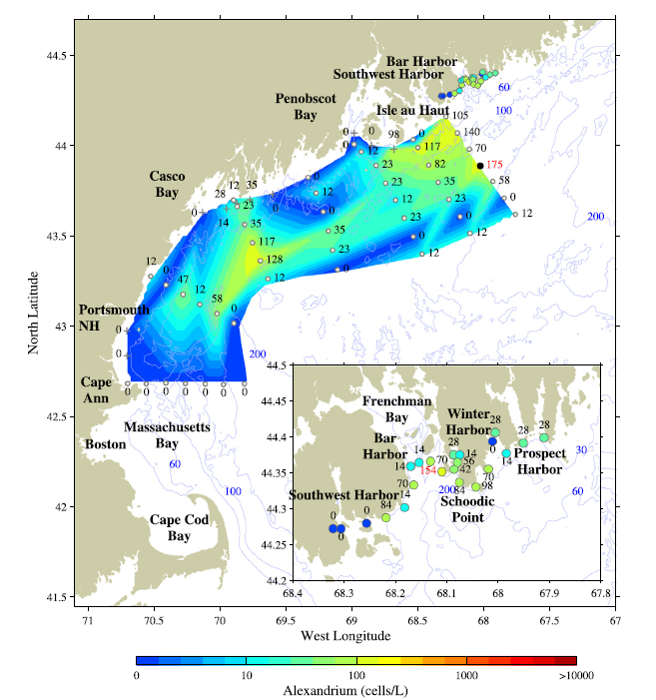
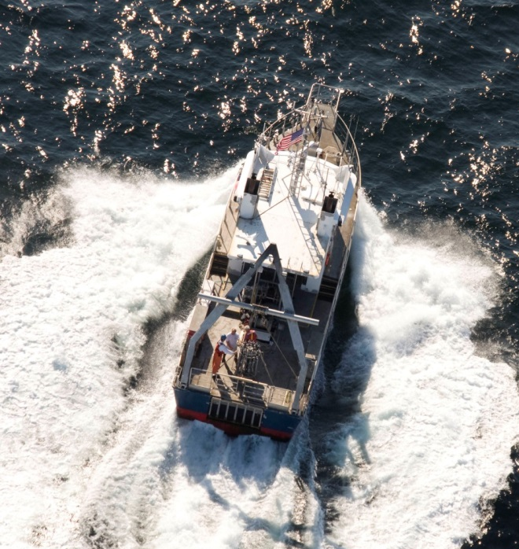
Rapid response survey # 2:
July 19-23
Max 175 cells l⁻¹
Aerial survey: July 19
Notes:
Fig. 2. Surface of A. fundyense concentrations observed on R/V Tioga 386 July 19–23, 2009 (live counts). Inset shows a zoom view of the near shore underway data collected
at the northern terminus of the survey.
Another pilot reported seeing “red water” two weeks earlier
near Portsmouth, NH--no report on how extensive
“Atmospheric conditions were ideal…Altitude was maintained at 700-1000 feet for the duration of our morning tracks” -- to 5mi offshore
“No red water was observed in waters around
Portsmouth or Cape Ann”
“In the afternoon, altitude was increased to 1250-1500 feet and our track was held 1-2 miles offshore”--ENE to Bar Harbor, ME”
Bottom Line:
“we did not observe red water in the survey area” (Cape Cod Bay, MA to Boothbay, ME).

Slide 7

McLane PPS time series
- Sampling frequency- 2-3 days
- 5m depth
- 2 Liters onto 15µm Nitex
- Formalin preserved - ~ 5% final
- 24 samples per deployment
2 deployments (April-Sept)
location near GOMOOS Buoy B

Slide 8
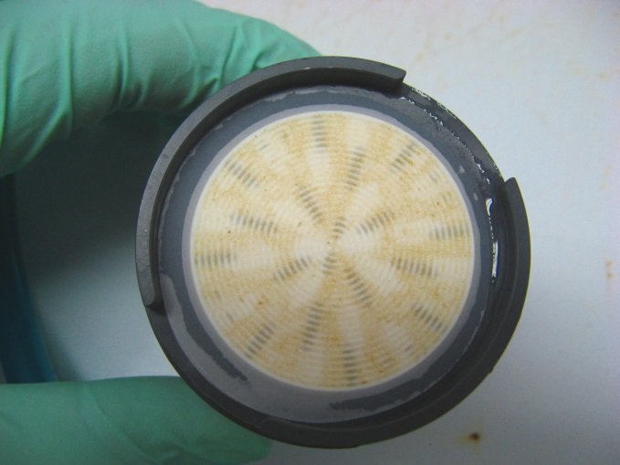
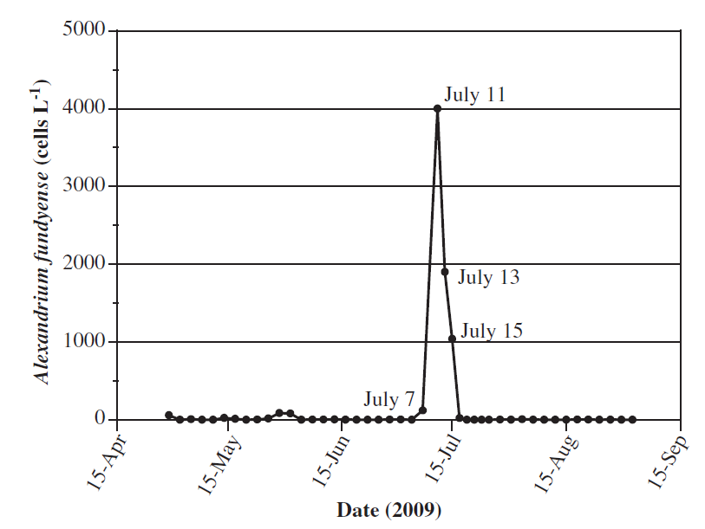
McLane PPS time series
Captured the timing of the event, but not the magnitude

Slide 9
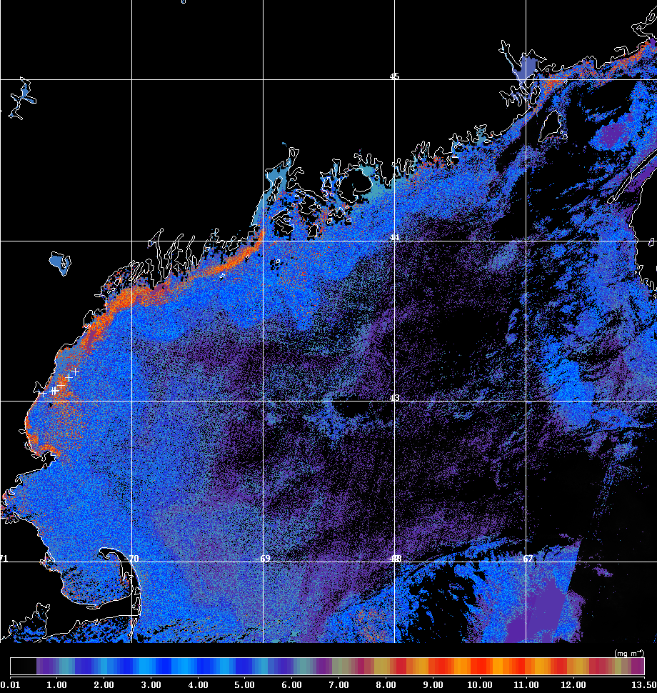
MERIS image July 9, 2009
“Algal 2”
Chl product for case-2 waters

Slide 10
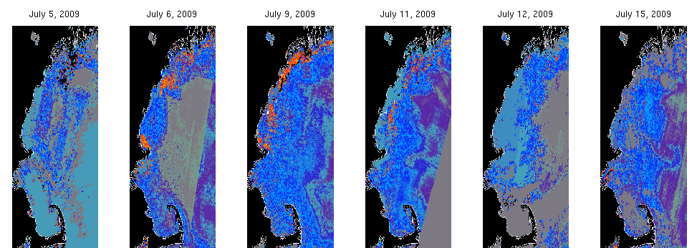
Time-series of MERIS “algal 2” images
July 5 July 6 July 9 July 11 July 12 July 15

Slide 11
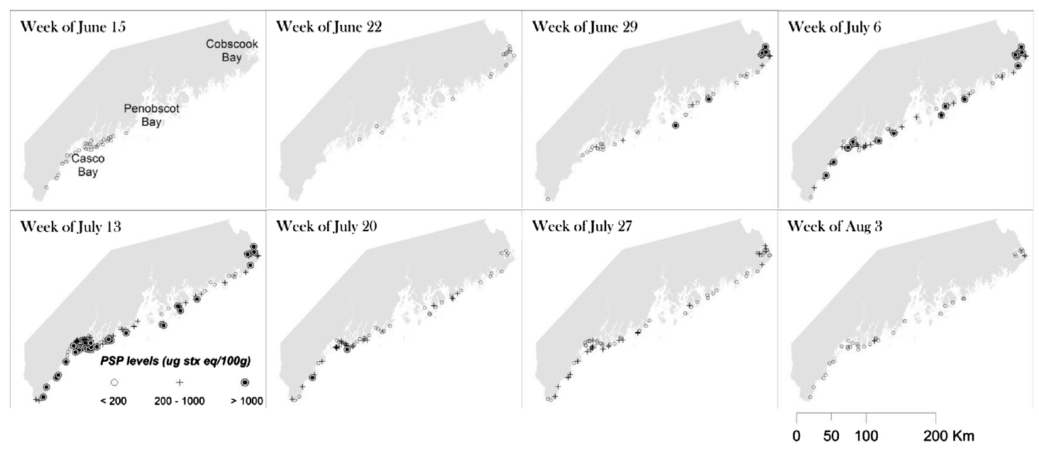
Weekly toxicity maps
Darcy Couture
June 15
June 22
June 29
July 6
July 13
July 20
July 27
August 3
Toxicity – 10² – 10³ cells L⁻¹
Discoloration – 10⁵ – 10⁶ cells L⁻¹
Notes:
Fig. 4. Weekly toxicity maps for the coast of Maine from mid-June to early August, 2009.

Slide 12
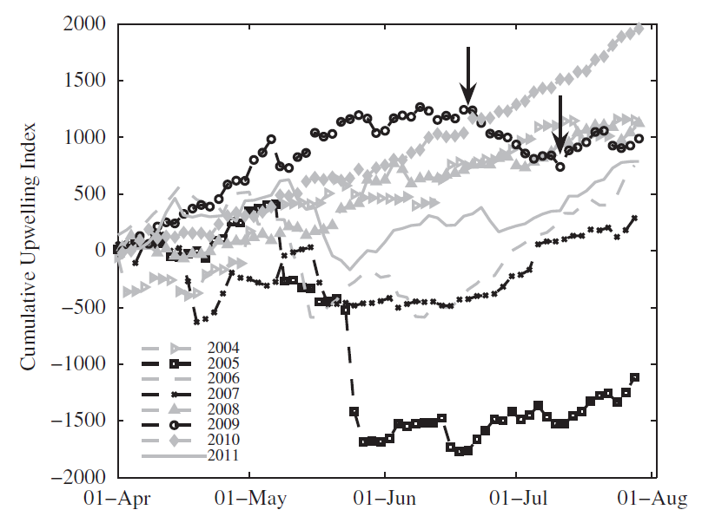

Cumulative upwelling index: NERACOOS B
$$CUI=\int{\frac{τ_{x}}{ρf}dt}$$
Downwelling-favorable Upwelling-favorable
Notes:
Fig. 10. Time-series of cumulative upwelling index (m3 (100 m coastline)−1 d−1) for
2004–2011 at NERACOOS buoy B (see Fig. 1 for buoy location). Vertical arrows
bracket the time period of unusual downwelling during the summer of 2009.

Slide 13
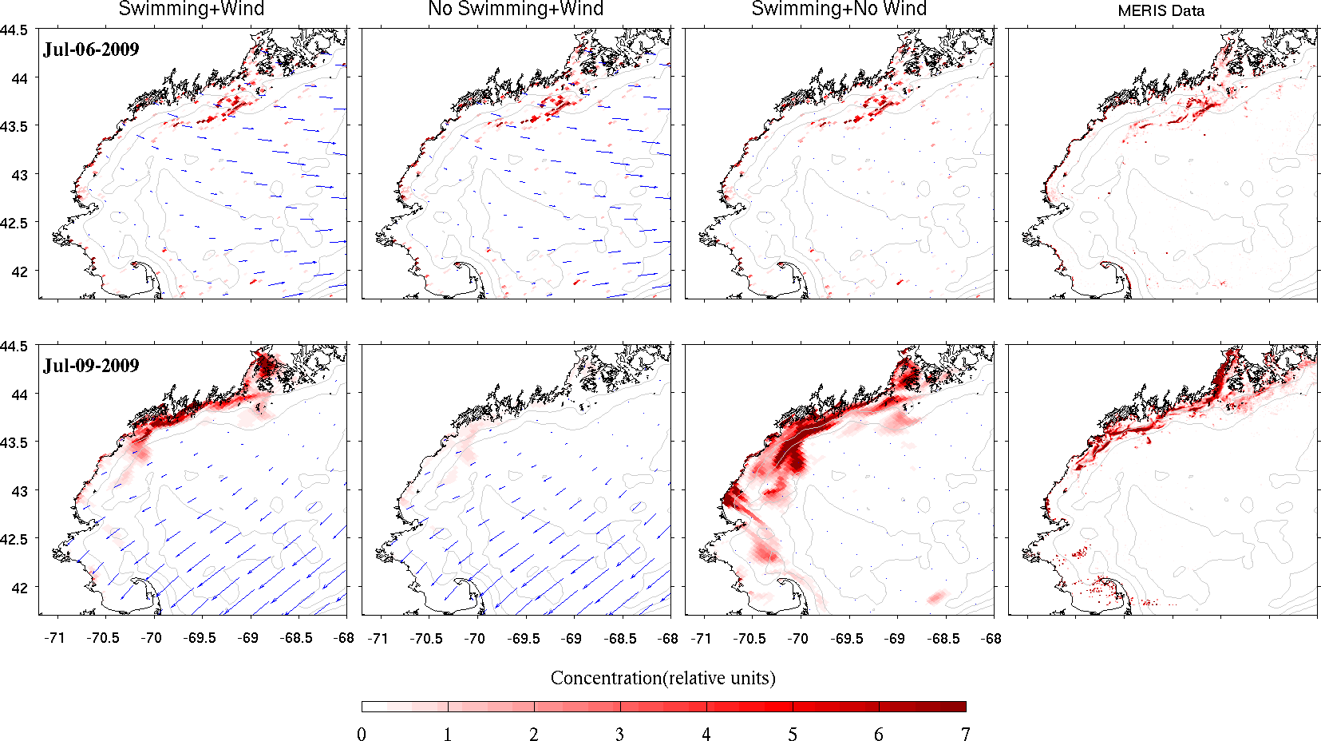
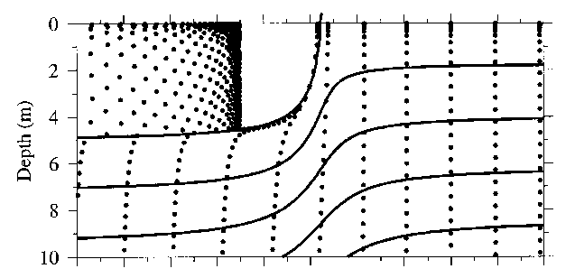
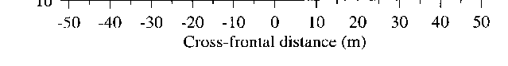
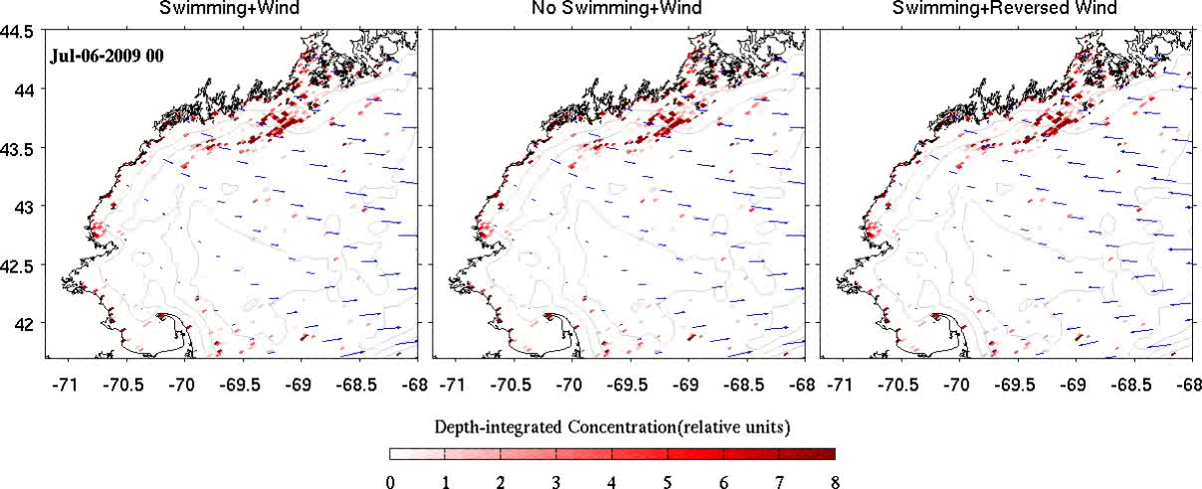
Can wind-driven transport explain shoreward transport of the bloom?
Satellite Observations
July 6
July 9
Frontal motion
Rick Stumpf
Franks (1997)
Model
Wind, swimming Wind, no swimming No wind, swimming
Yizhen Li

Slide 14
Cumulative upwelling index: NERACOOS B
Accumulation?
Landfall
$$CUI=\int{\frac{τ_{x}}{ρf}dt}$$
Downwelling-favorable Upwelling-favorable
Notes:
Fig. 10. Time-series of cumulative upwelling index (m3 (100 m coastline)−1 d−1) for
2004–2011 at NERACOOS buoy B (see Fig. 1 for buoy location). Vertical arrows
bracket the time period of unusual downwelling during the summer of 2009.

Slide 15
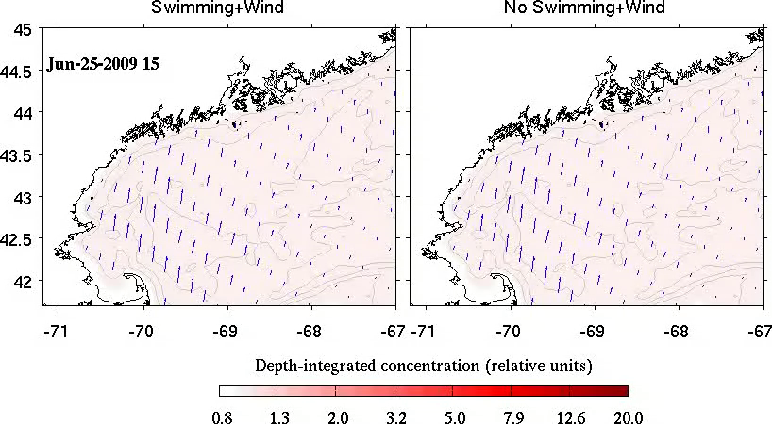
To what extent can the anomalously high concentrations be explained by wind-driven convergence?

Slide 16
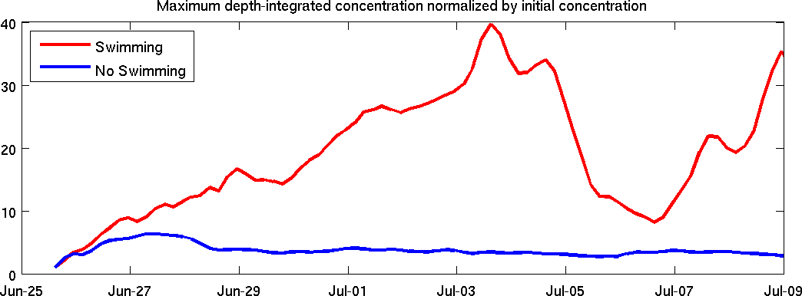
Concentration increases in both cases, with and without swimming.
Maximum concentration increases much more in the case with swimming, up to a factor of 40X initial concentration.
“Typical” concentration: 10³ cells L⁻¹
“Red water” concentration: 10⁶ cells L⁻¹
1000x increase
40x convergence
25x surface seeking (25m layer -> 1m layer) ???

Slide 17
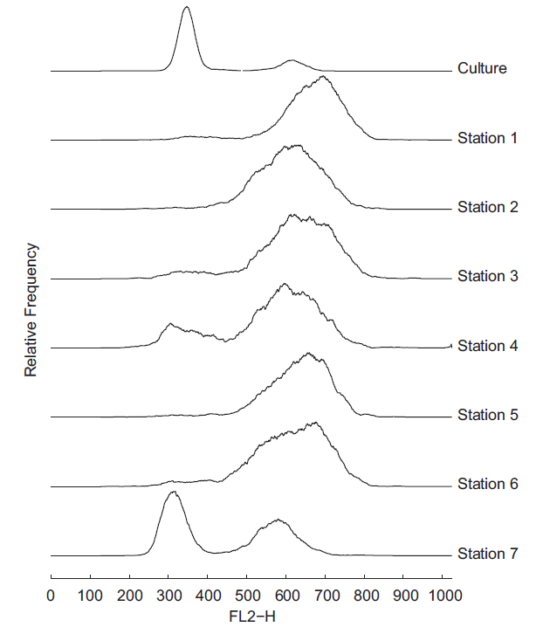
Flow cytometry
G1 phase
G2 phase
Culture
Station 1 Peak
Station 2
Station 3
Station 4
Station 5
Station 6
Station 7 Inshore
Mike Brosnahan
Peak
FL2-H fluorescence
(proxy for DNA content)
Notes:
Fig. 7. Relative frequency of FL2-H (DNA-associated) fluorescence from flow cytometry
analysis of a log-phase culture of vegetative A. fundyense (top curve) and red tide
samples taken from stations 1–7 on July 10 (Fig. 1). The frequency distributions have
been smoothed and are plotted as deviations fromzero (e.g. no cells were observed with
FL2-H fluorescence less than 200). Stations 1–6 are the offshore locations where A.
fundyense concentrations were sufficient to discolor the water (highest A. fundyense
concentration at Station 1), whereas station 7 was the near-coastal location where the
concentration of A. fundyense was 25,690 cells l−1.

Slide 18
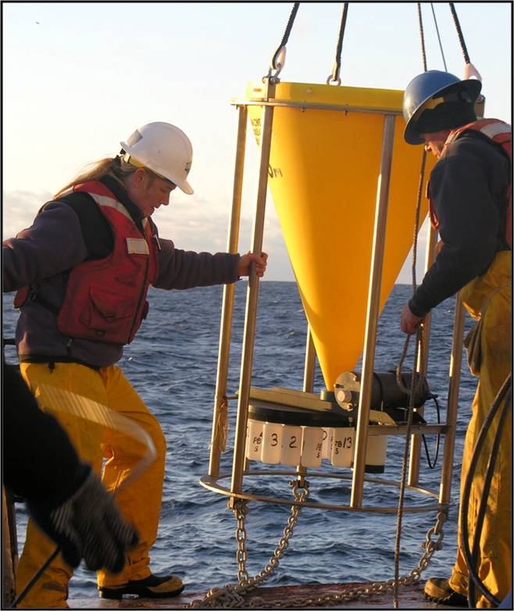
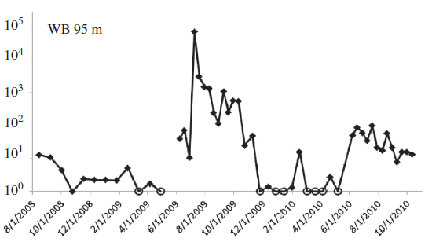
Cyst fluxes observed with sediment traps
Cindy Pilskaln
July 9-19
Largest cyst flux measured in the GOM 1995-97 and 2005-2009
Cyst flux
at 95 m
# m⁻² d⁻¹
Notes:
Fig. 8. Cysts fluxes measured at the northern Wilkinson Basin site (Fig. 1, “WB”) at
95 m (top) and 180 m (bottom). Open circles indicate zero cyst flux/no cysts
collected in the trap cup during the particular collection period. Peak cyst fluxes in
2009 occurred in consecutive samples 4–7 of the deployment starting in June 2009.
The time intervals for samples 4–7 were: July 9–19, July 19–30, July 30–August 9,
August 9–19. Note that each dot in the time-series is plotted at the beginning of
each sampling interval. Modified from Pilskaln et al. (2014).

Slide 19
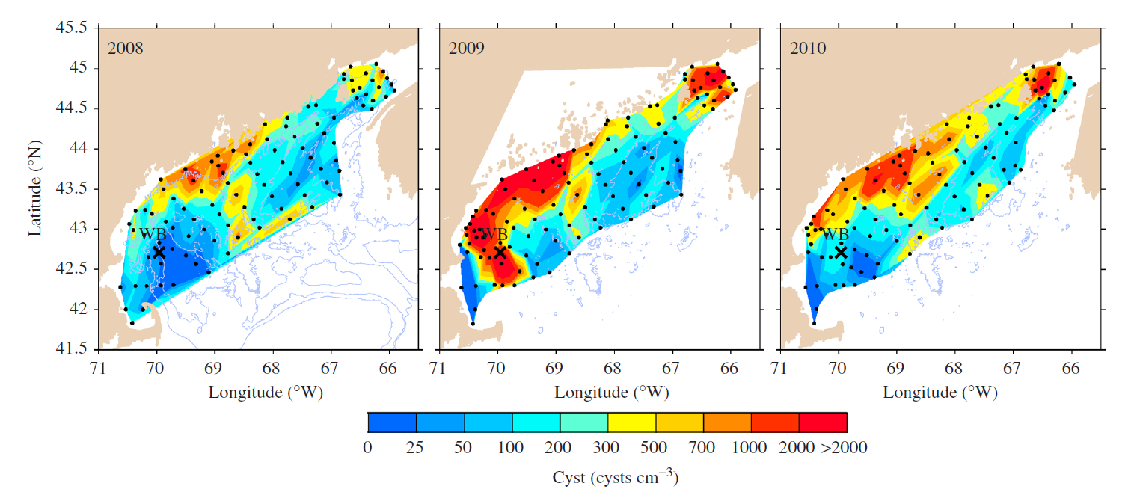
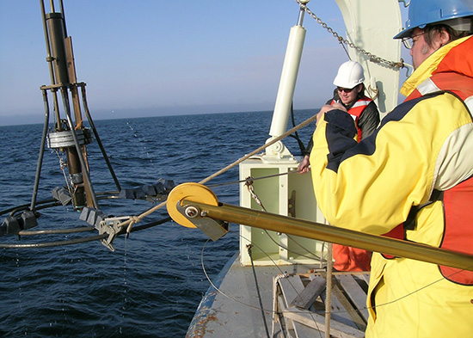
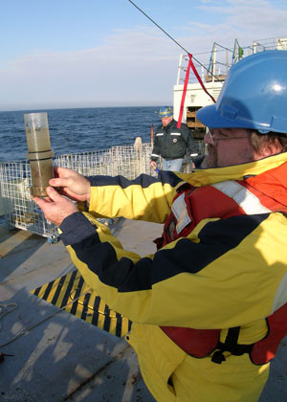
Time-series of cyst distributions
2008 2009 2010
Sediment trap
Notes:
Fig. 9. A. fundyense cyst abundance in the upper 1 cm layer of sediment observed in October 2008 (left), 2009 (middle), and 2010 (right). Black dots denote the locations of
sediment samples used to construct the maps. Location of the Wilkinson Basin “WB” sediment trap is indicated by a black cross. Fig. 9. A. fundyense cyst abundance in the upper 1 cm layer of sediment observed in October 2008 (left), 2009 (middle), and 2010 (right). Black dots denote the locations of
sediment samples used to construct the maps. Location of the Wilkinson Basin “WB” sediment trap is indicated by a black cross. Fig. 9. A. fundyense cyst abundance in the upper 1 cm layer of sediment observed in October 2008 (left), 2009 (middle), and 2010 (right). Black dots denote the locations of
sediment samples used to construct the maps. Location of the Wilkinson Basin “WB” sediment trap is indicated by a black cross.

Slide 20
Conclusions
Serendipitous discovery of an “unusual” red tide in the WGOM.
Surface discoloration was ephemeral; duration < 1 week.
The red water appears to have been the southern terminus of a coast-wide event, leading to widespread toxicity from the Bay of Fundy to western Maine.
Anomalous downwelling-favorable winds led to
Shoreward transport
Accumulation (40x)
IFCB measurements indicated a sexual reproduction event.
Is behavior the missing 25x?
The event yielded a large recruitment of new cysts, extending the mid-coast Maine cyst bed farther south than previously observed.
Implications for forecasting:
How “unusual” are such events?
Do such events drive cyst recruitment? Are they predictable?
If not, will have to continue annual surveys of the cyst distribution.

