Slide 1
Modeling Blooms of Alexandrium catanella in the Gulf of Maine:
From Climatology to Forecasting
ECOHAB: NOAA & NSF
MERHAB: NOAA
PCMHAB: NOAA
COHH: NSF & NIEHS
Anderson, McGillicuddy, Keafer (WHOI)
He (NCSU), Townsend, Pettigrew, Thomas (UMaine)
Turner, Pilskaln (UMass D), Bricelj (RU),
Manning, Mountain, P. Fratantoni (NMFS)
Haskell (NOS) Martin (DFO) Hall, DeGrasse, Deeds (FDA)
Hickey, Whittaker (DMF) Kanwit (DMR) Nash (DES)
Stumpf, Li (NOAA)

Slide 2
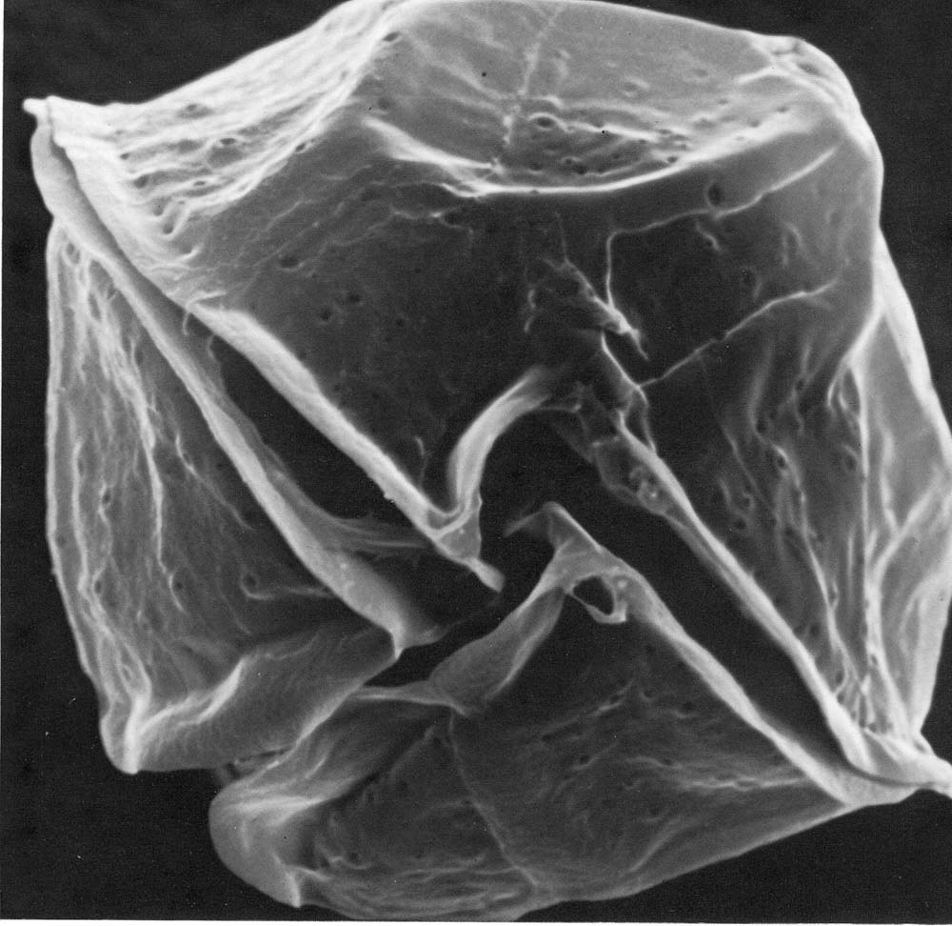
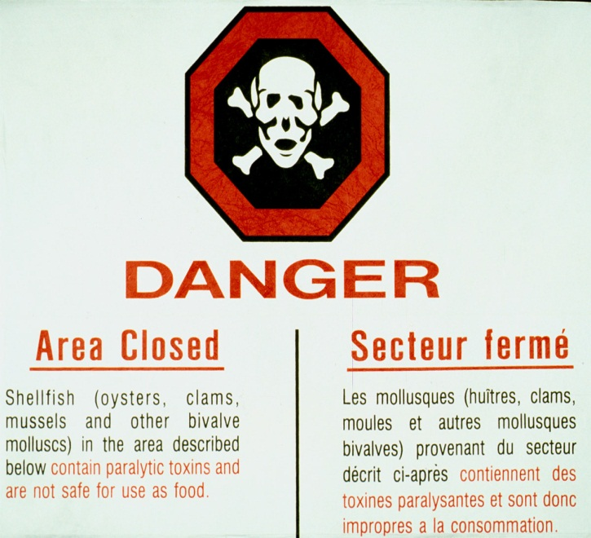
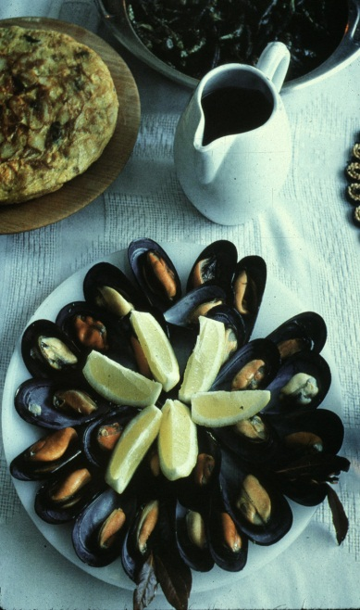
Alexandrium catanella
Dinoflagellate
~40 microns
Produces saxitoxins
Leads to Paralytic Shellfish Poisoning (PSP)

Slide 3
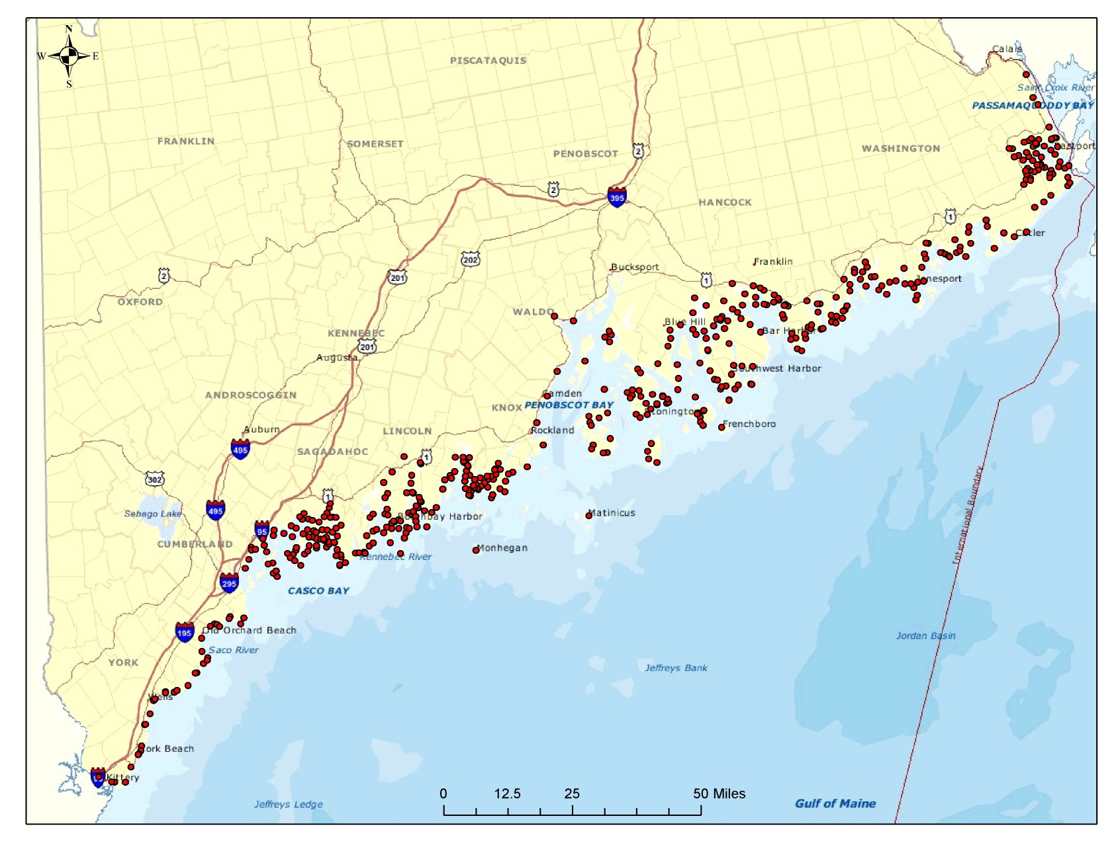
Maine PSP Sampling Stations 1977 - 2012

Slide 4
Life Cycle of Alexandrium

Slide 5
Chapter 1. ECOHAB-GOM 1997-2001
The mean seasonal cycle

Slide 6

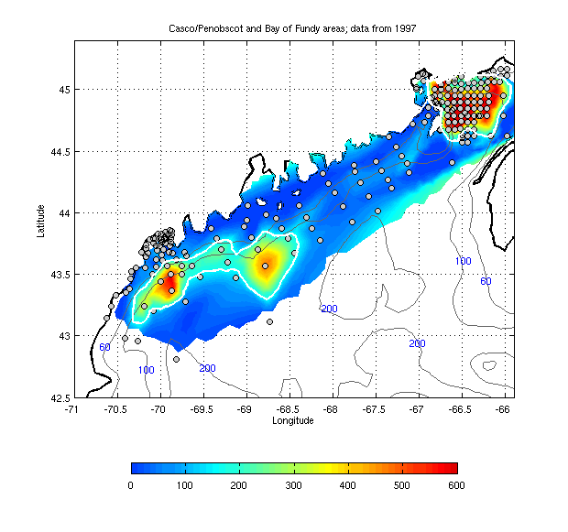
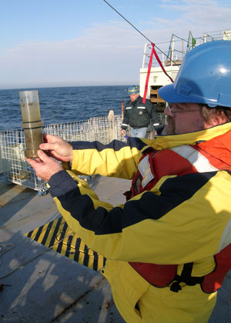
Benthic cyst distribution
Cysts per cm³

Slide 7
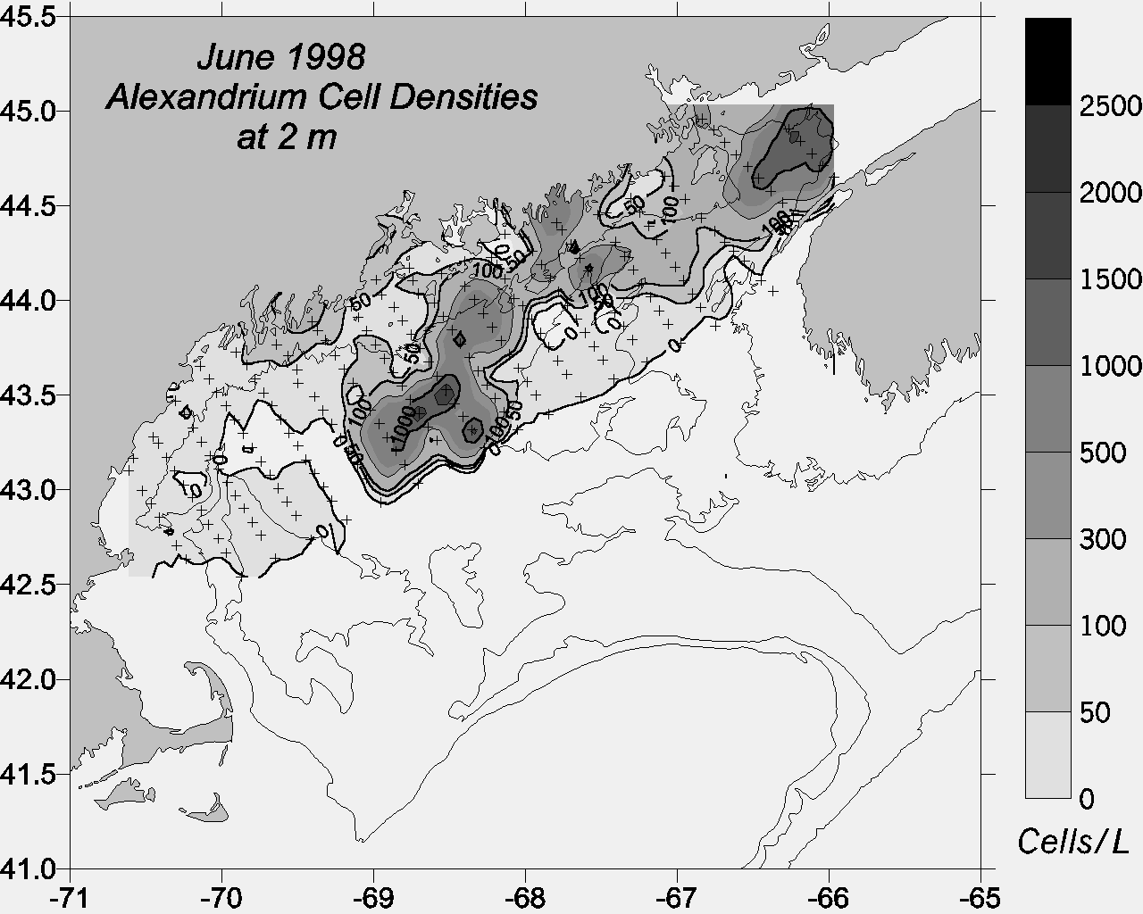
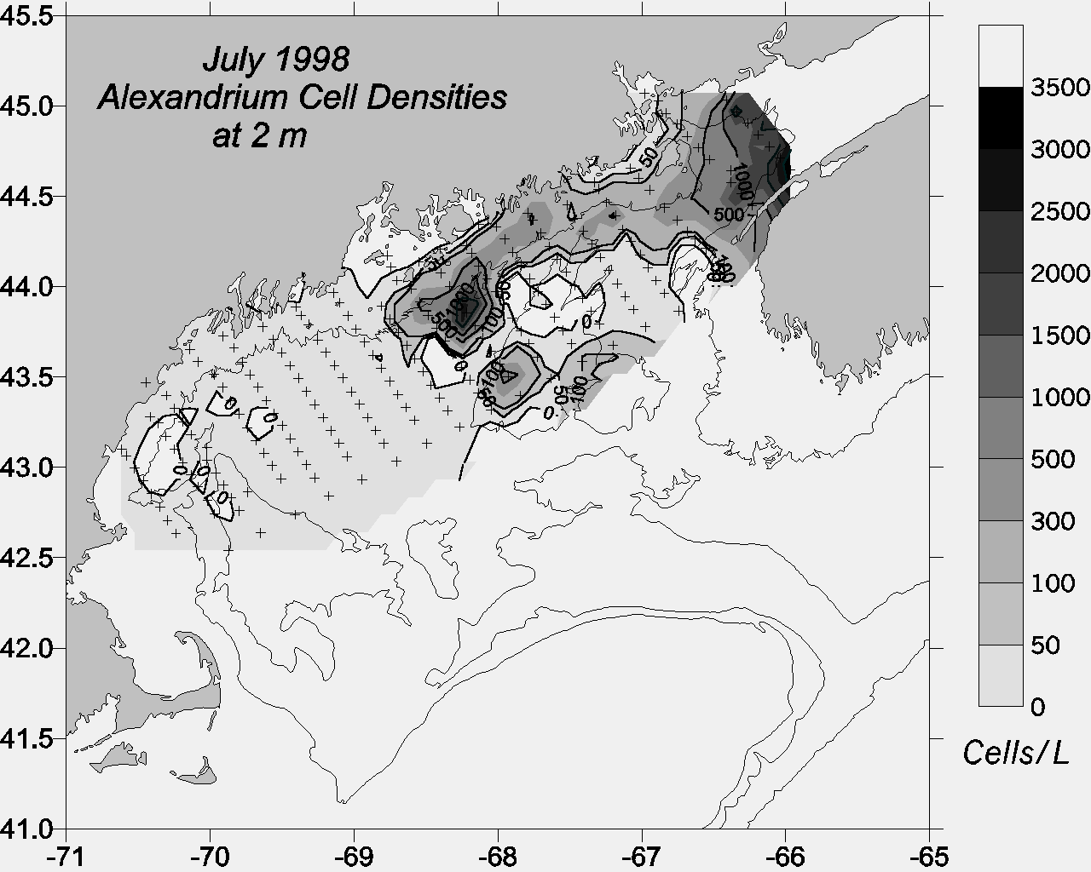
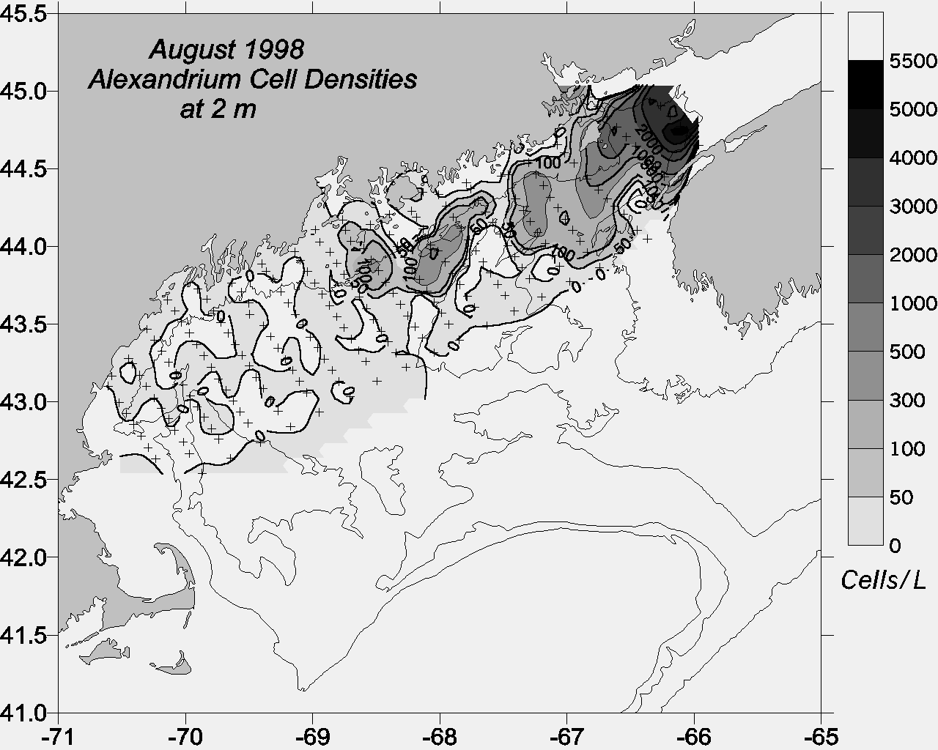
ECOHAB-GOM Observations
Gulf-wide
distribution
2) Association with coastal
current
3) Center of mass
shifts west-to-east
as season progresses
Townsend et al.
(2001)

Slide 8
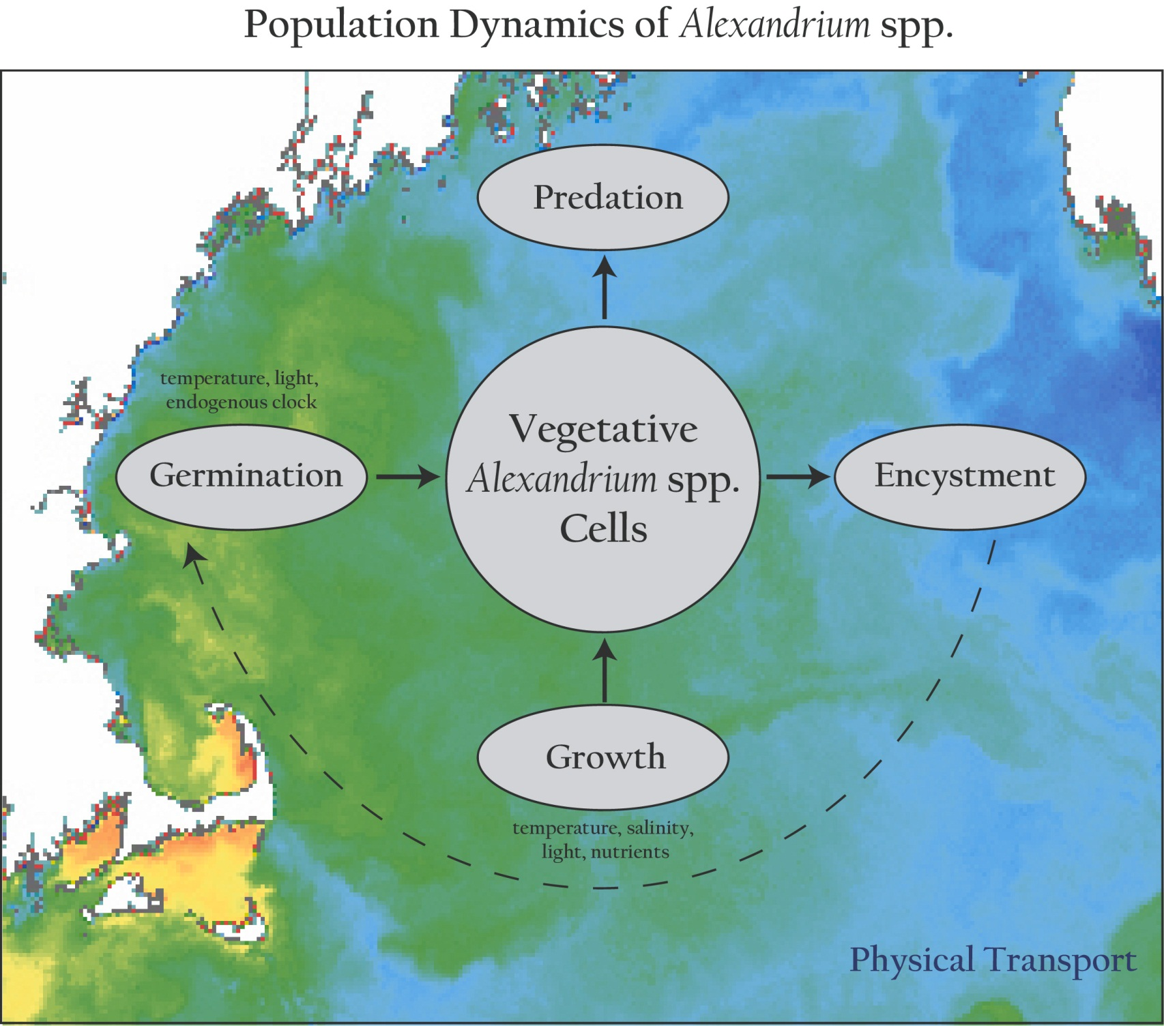
Population dynamics of Alexandrium spp.

Slide 9
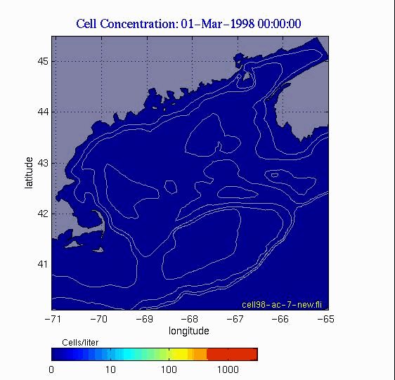
Germination, Growth, ‘Mortality’, Nut. Limit.

Slide 10
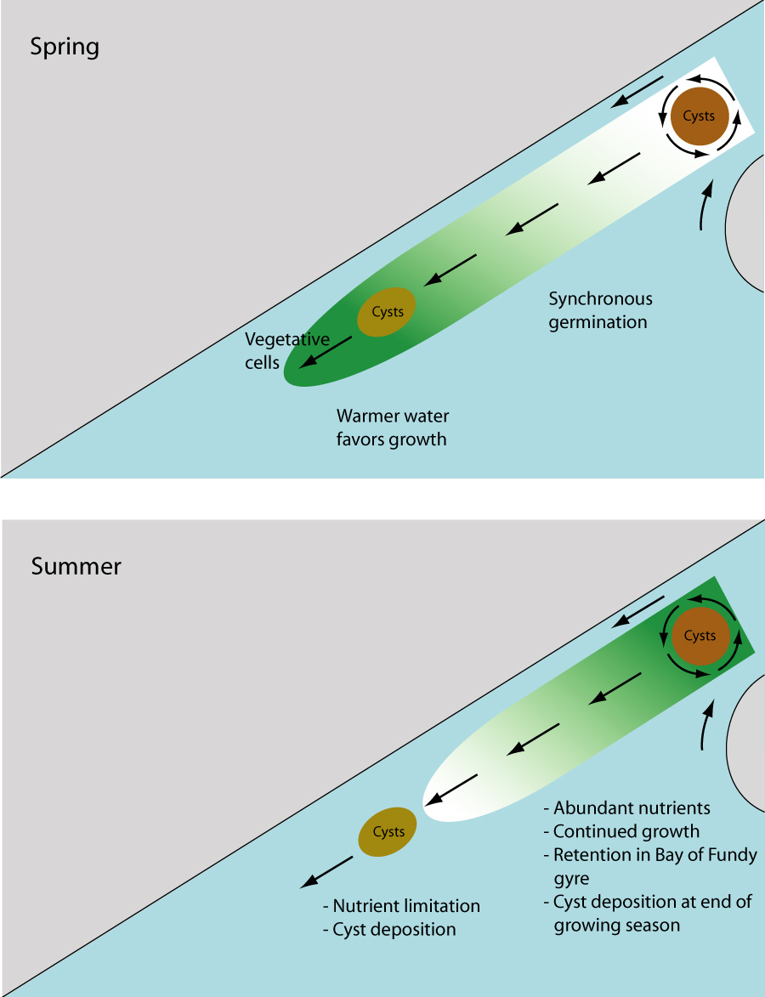
A conceptual model for the large scale seasonal variability of A. catanella in the Gulf of Maine
Spring:
Temperature
limitation
Summer:
Nutrient
limitation

Slide 11
Chapter 2. MERHAB/COHH/GOMTOX
2005 bloom and a regime shift

Slide 12
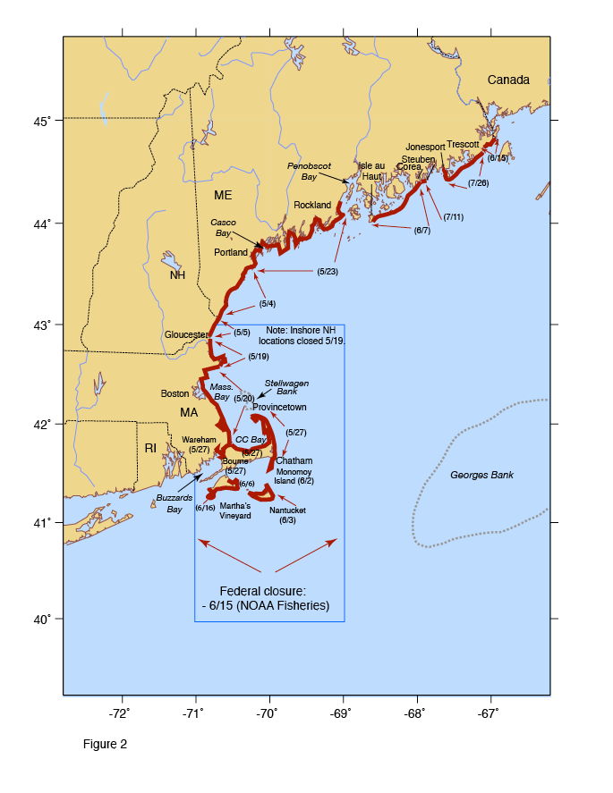
The 2005 bloom
Most widespread and intense bloom in at least 33 years, perhaps longer
Record levels of toxicity in some locations; first-time ever records of toxicity in others
Record high A. catanella cell concentrations (for this region)
Large closure of federal (offshore) waters
> $50M loss to shellfish industry in MA alone
Maine, MA - disaster declarations
Anderson et al., 2005

Slide 13
Hypotheses
Source: High abundance of A. catanella cysts in western GOM sediments.
Transport: Northeast winds caused strong onshore advection of A. catanella populations
Anomalously high river runoff resulted in enhanced alongshore transport, and higher micro- and macro-nutrient concentrations.

Slide 14
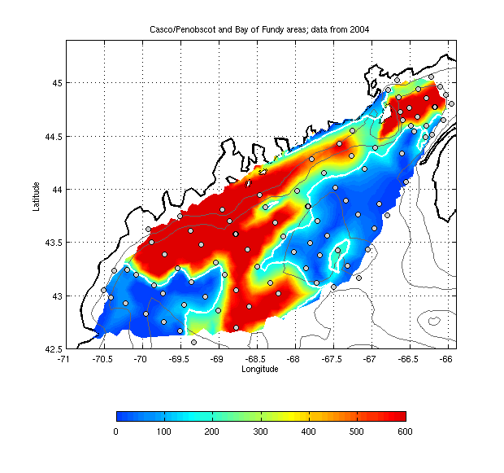
Interannual variability in cyst population
1997 2004
Bay of Fundy cyst bed stable over time
WGOM cyst bed: 2004 = 10 X 1997

Slide 15
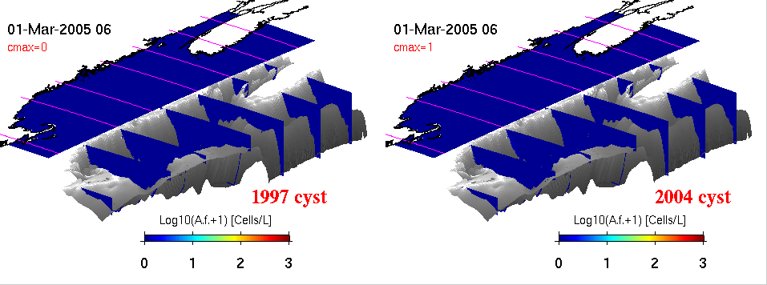
2005 physics +
fall 1997 cyst map
2005 physics +
fall 2004 cyst map

Slide 16
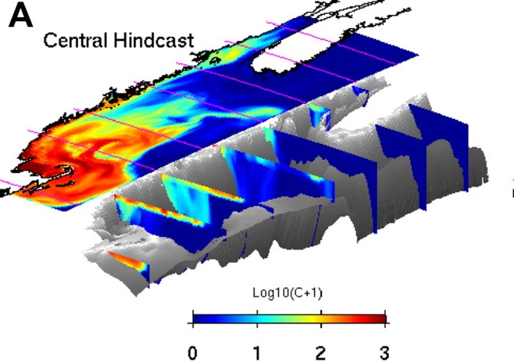
Theses
Cyst abundance is a first-order predictor of overall bloom severity.
Coupled hydrodynamic / population dynamics models forecast large scale seasonal characteristics of the bloom.

Slide 17
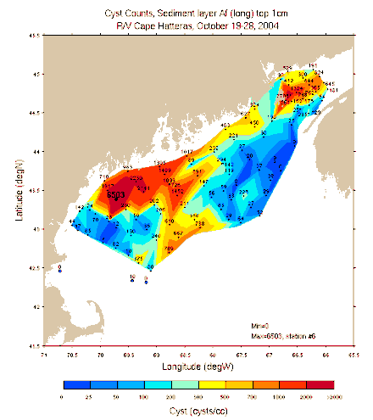
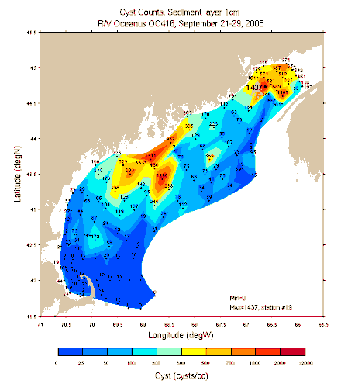
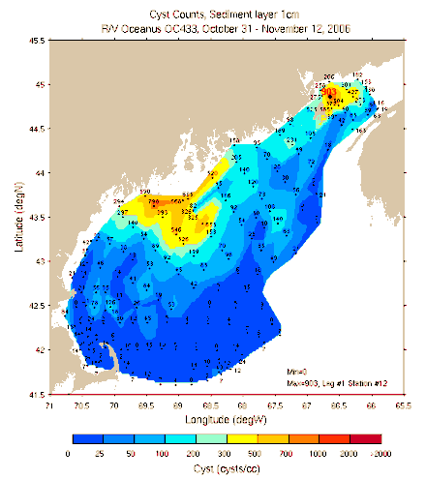
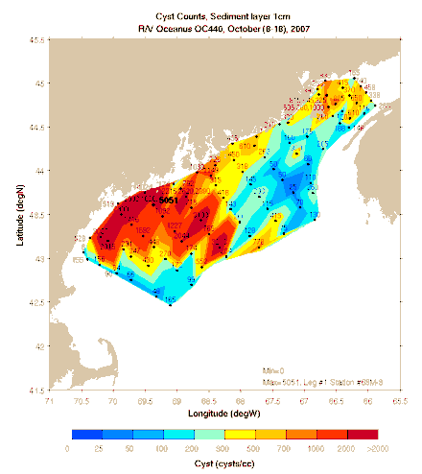
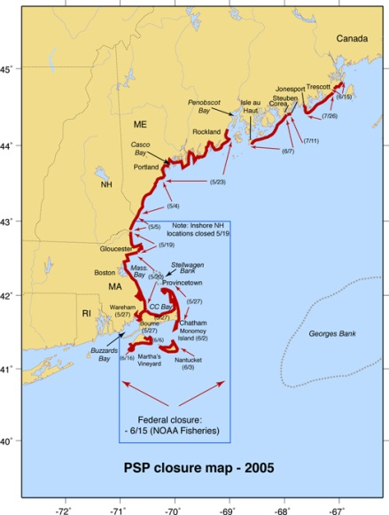
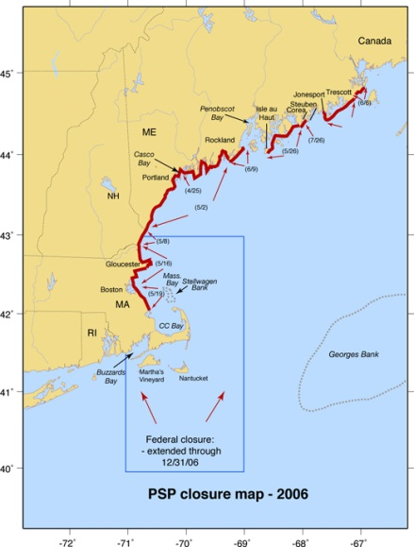
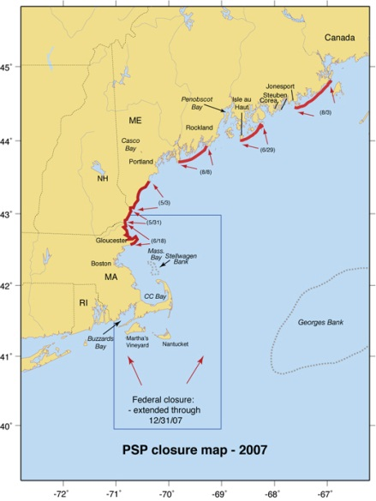
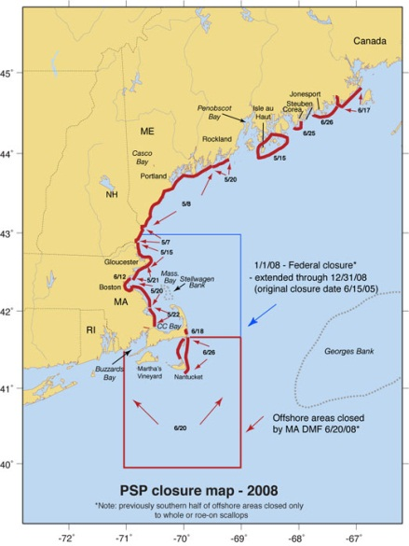
H₁: Interannual variations in bloom severity result from fluctuations in cyst abundance
Cysts 2004 2005 2006 2007
Toxicity 2005 2006 2007 2008

Slide 18
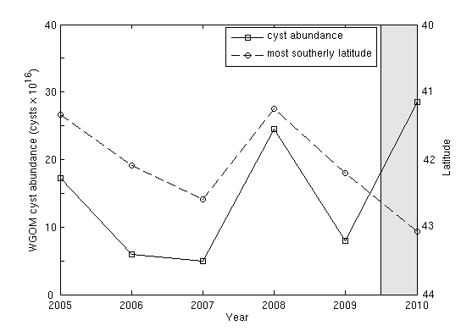
Cyst abundance and toxicity
2005-2009: r=-0.93
Toxicity extent
Cysts
McGillicuddy et al. 2011 L&O

Slide 19
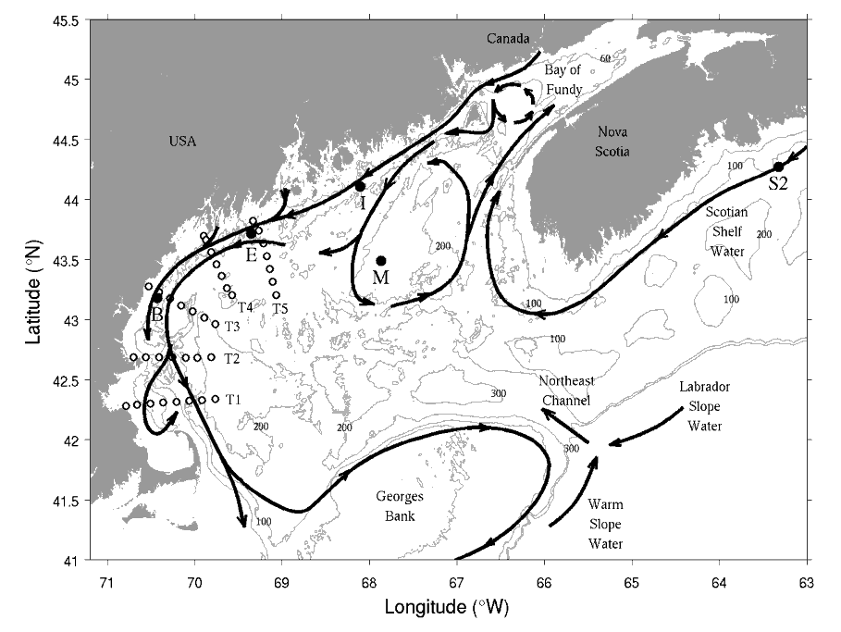
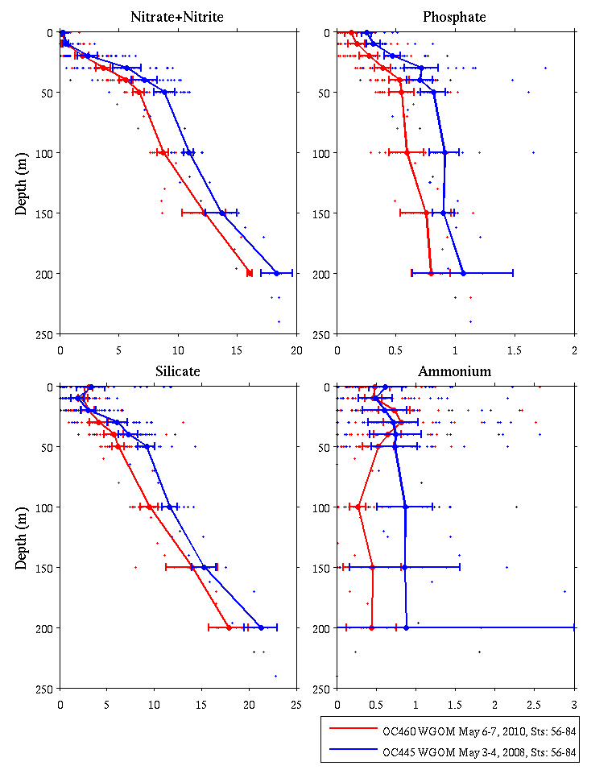
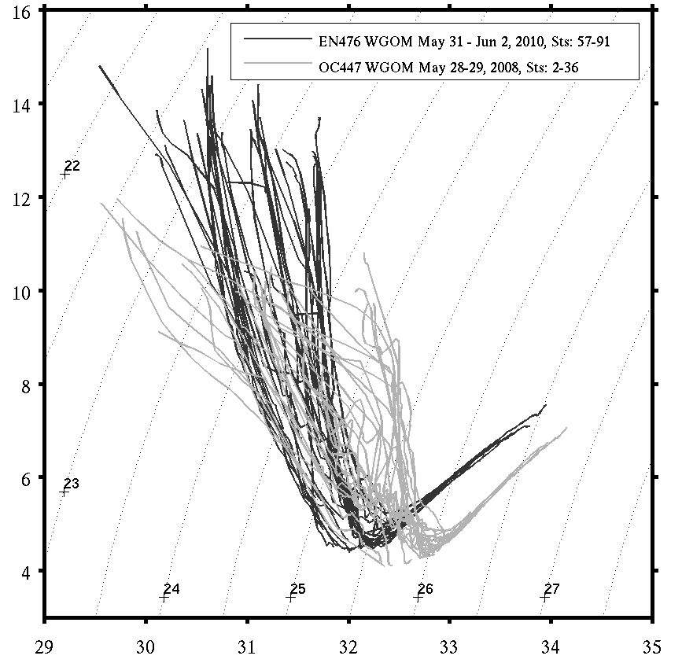
Why did the 2010 bloom not materialize?
Nutrients: 2008 vs 2010
NO₃
PO₄
2008
2010
SiO₂
NH₄
2010
Temperature
2008
Salinity

Slide 20
Thesis - revised
Cyst abundance is a first-order predictor of overall bloom severity potential; whether or not that potential is realized depends on the growing conditions.

Slide 21
Chapter 3. MERHAB/COHH/PCMHAB
Transition to operations and ESP detection

Slide 22
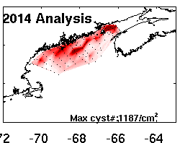
Ensemble Forecasting
Hydrodynamics
2015 seasonal forecast
2004
Scenario 1
Scenario 2
Scenario 3
Scenario 4
Scenario 5
Scenario 6
Scenario 7
Scenario 8
Scenario 9
Scenario 10
Scenario 11
2005
2006
Benthic Cyst
2007
Fall 2014
2008
2009
2010
2011
2012
2013
2014
Notes:
22

Slide 23
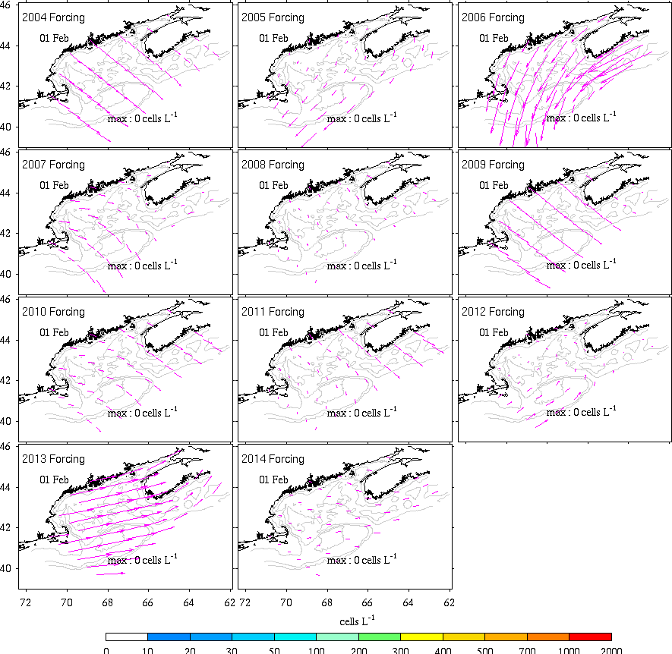

Slide 24
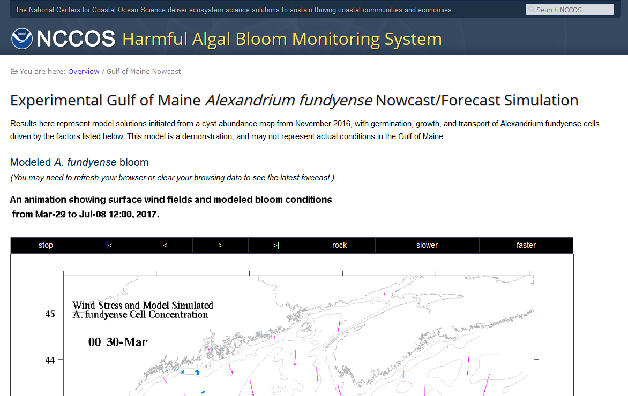
2017 Hindcast/Nowcast / Forecast https://products.coastalscience.noaa.gov/hab/gomforecast.aspx

Slide 25
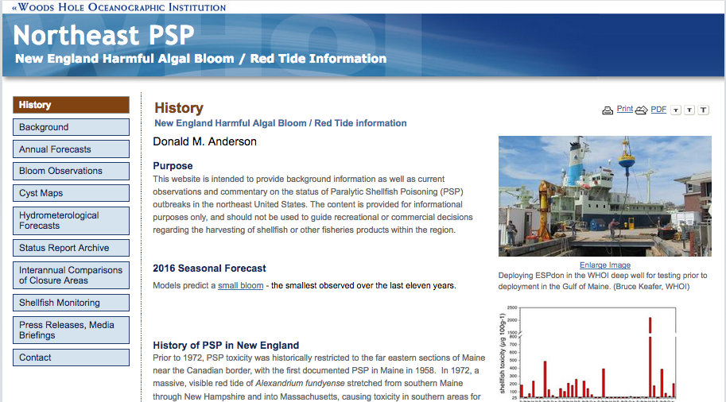
Stakeholder Communication Network
Northeast PSP website (to be expanded and renamed Northeast HABs)
Northeast PSP listserve has ~ 275 members (also to be renamed)
Regional HAB conference calls with ~35 participants
Rhode Island Department of Environmental Management, RI Dept of Health, NH Dept of Env Services, Maine Dept of Mar Resources, Mashpee Wampanoag Tribe, Wampanoag Tribe of Gay Head (Aquinnah), Massachusetts Div Mar Fisheries, Town of Mashpee, MA, New York State Department of Environmental Conservation, CT Bureau of Aquaculture & Laboratory Services, FL Fish and Wildlife Res Inst, US FDA, NOAA, WHOI, UMass Dartmouth, URI, Bigelow Laboratory for Ocean Sciences

Slide 26
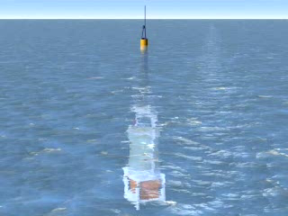
Environmental Sample Processor (C. Scholin)

Slide 27
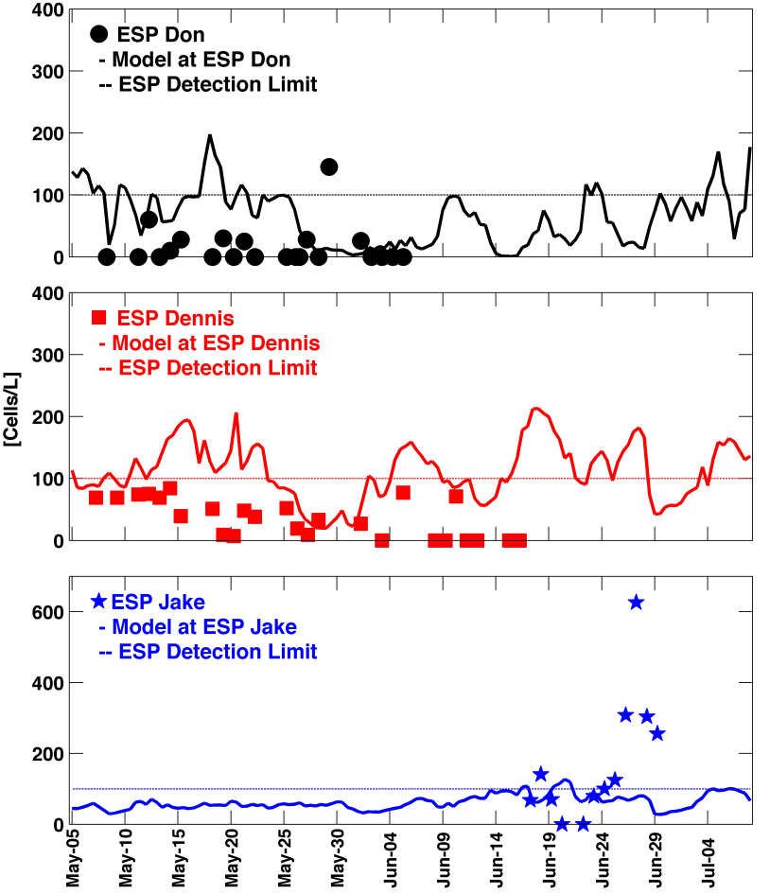
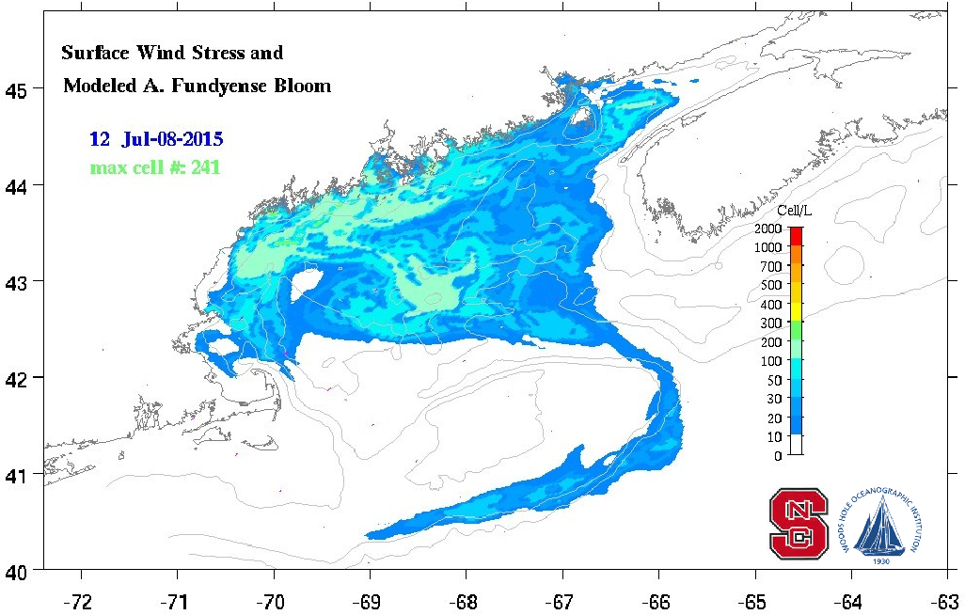

2015 Forecast and
ESP Observations

Slide 28
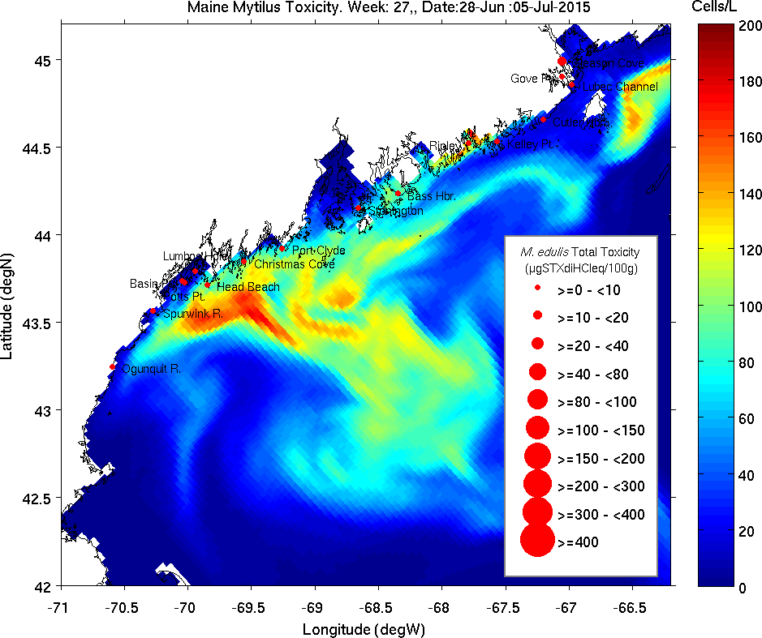
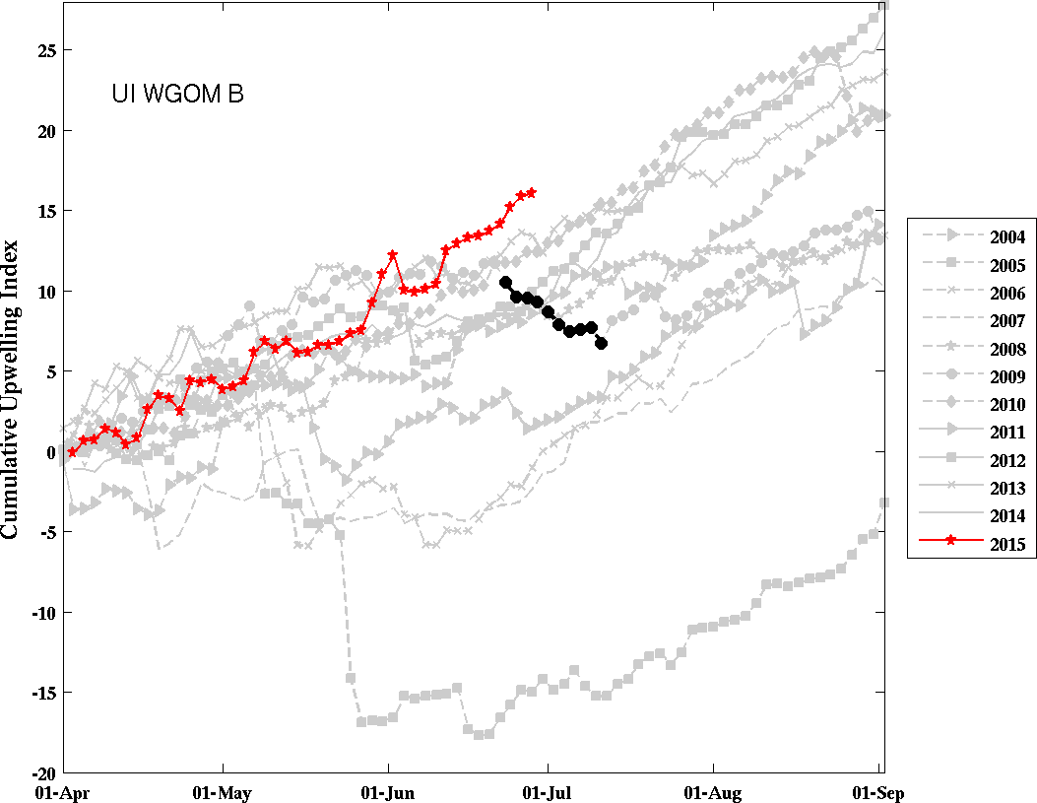
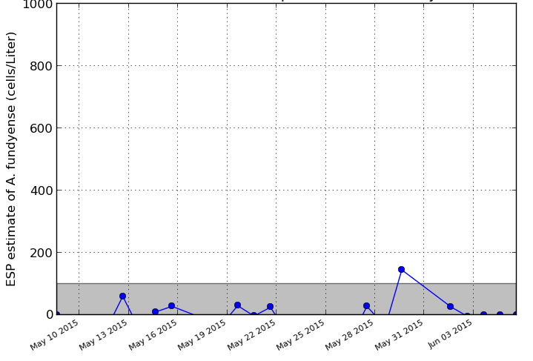
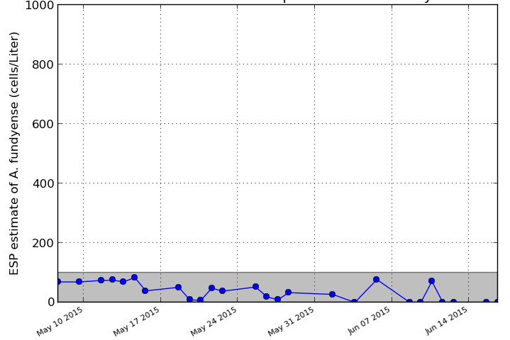
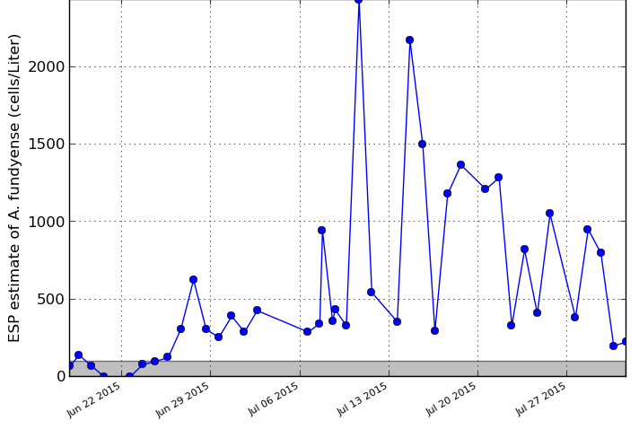
Stakeholder Dashboard
Date: June 29, 2015
Predicted A. catanella concentration
ESP observations
Toxicity measurements
Cumulative upwelling index – Buoy B
ESP 3
ESP 2
Obs wind
Fcast wind
ESP 1
2009 downwelling event
ESP 1
ESP 2
ESP 3

Slide 29
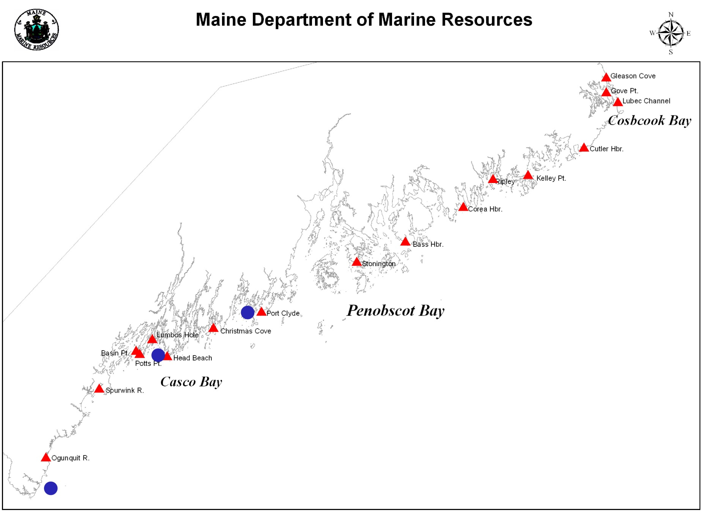
Estimating shellfish toxicity from ESP data
Toxicity submodel
[STX] at shellfish monitoring stations
[Alex] at ESP locations

Slide 30
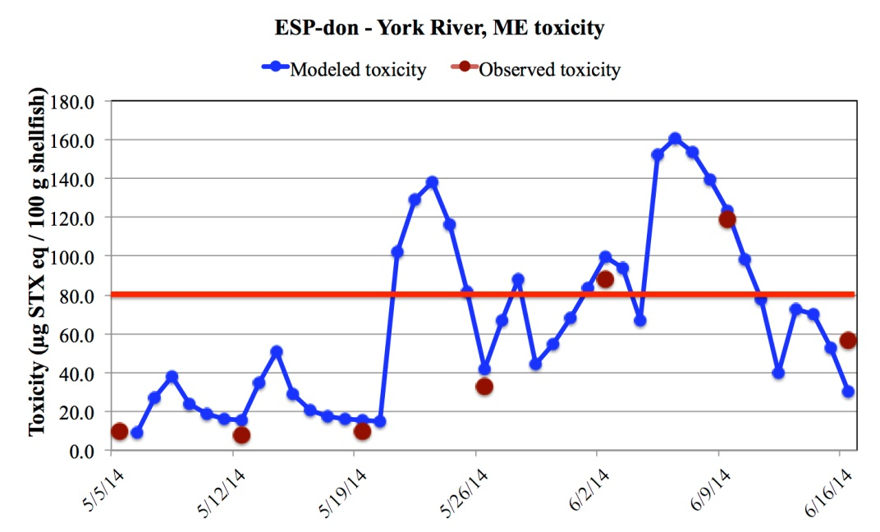
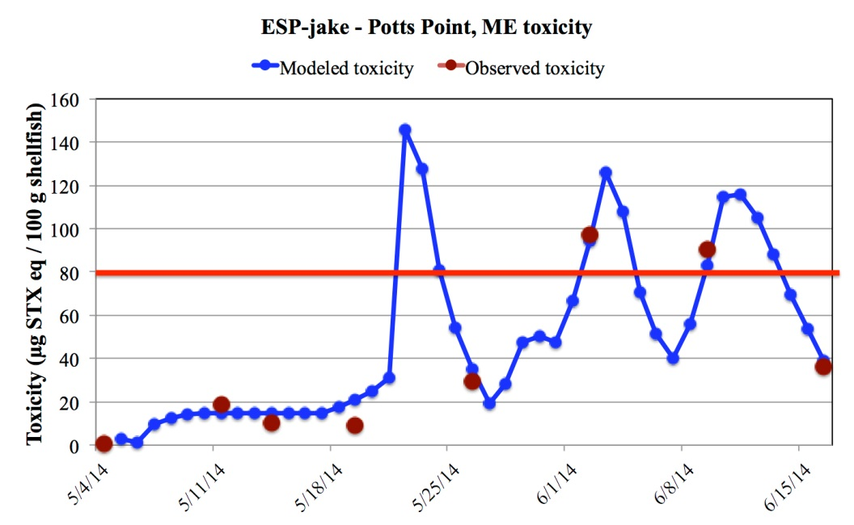
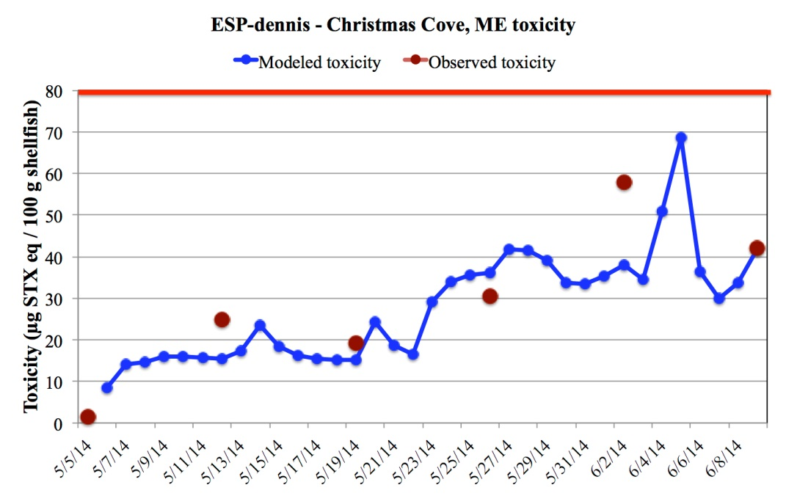
Quarantine
Quarantine
Modeled toxicity vs. measured toxicity in shellfish (Maine DMR) - 2014
Quarantine

Slide 31

Looking forward
Long-term observational networks are essential
Data assimilation to keep models on track
Process studies to understand changing dynamics

Slide 32
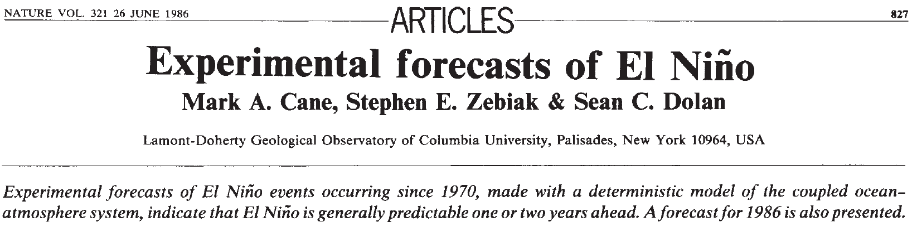
Toward ecological forecasting in the ocean: a cautionary tale from the physical climate system
Notes:
Lessons learned here are in some ways reminiscent of the development of El Niño – Southern Oscillation (ENSO) phenomena. The introduction of dynamical forecast models in the 1980s (Cane et al. 1986) led to several years of remarkably skillful predictions (Latif et al. 1998). In the 1990s, there was a significant drop in forecast skill when ENSO entered a distinctly different mode of variability (Ji et al. 1996)—which ushered in a new wave of model improvement (Chen et al. 1995). Indeed, long-term hindcasting studies suggest interdecadal variations in ENSO predictability that reflect temporal changes the underlying dynamics of the system (Chen et al. 2004). It can be argued that ecological forecasting will be even more prone to fluctuations in predictability than the physical climate system, owing to even stronger nonlinearities in biological dynamics (Frank et al. 1994). As such, assimilation of data will be essential to keep predictive ecological models on track. Although data assimilation into coupled physical-biological models is still in its infancy (Hofmann and Friedrichs 2002), there are some promising inroads being made (Gregg et al. 2009). In any case, the 2010 A. fundyense bloom in the Gulf of Maine highlights the need for intimate connection between observational networks and forecast systems, and how these aspects must evolve together to meet the grand challenge of ecological forecasting in the ocean.

Slide 33
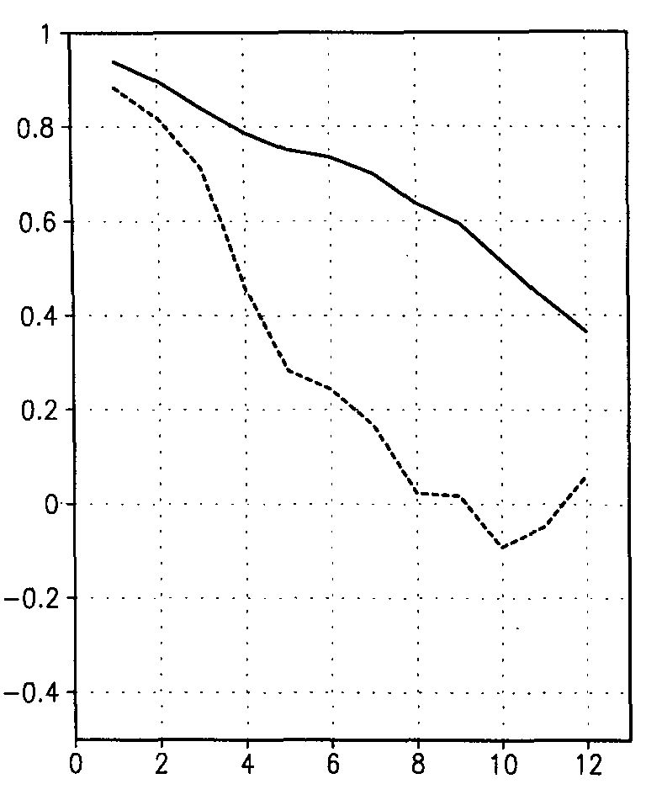
Regime shifts can change the underlying dynamics
Ji et al. (1996) Journal of Climate 9, 3105-3120.
1982-1992
W
Correlation
(forecast, obs)
C
1992-1995
W
Lag (months)
C
Chen et al. (1995) Science 269, 1699-1702. An improved procedure for El Nino forecasting: implications for predictability.
W

Slide 34
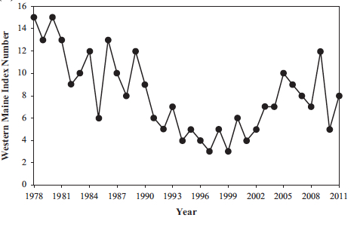
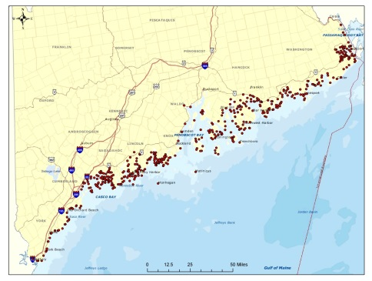
Gulf of Maine HAB index from PSP monitoring stations
ECOHAB-GOM
COHH
GOMTOX
Regional studies

Slide 35
End

Slide 36
Extras

Slide 37
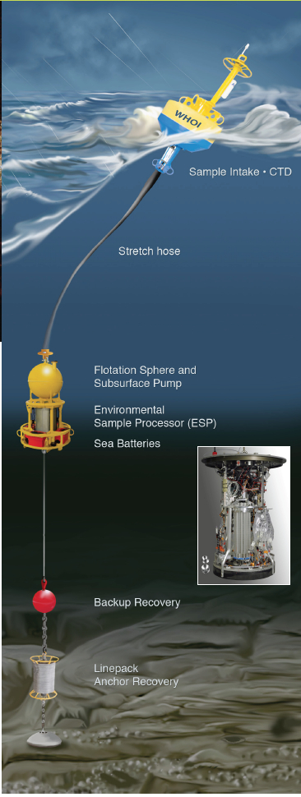
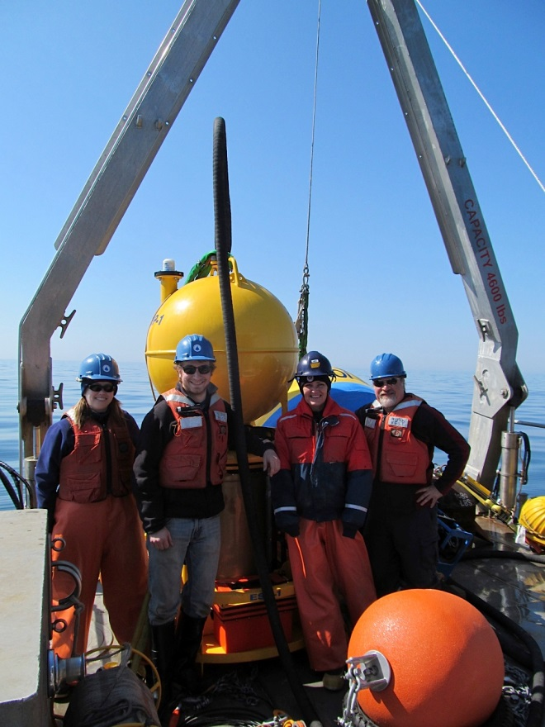

ESP Deployment

Slide 38


ESP Deployments 2017

Slide 39
Example criteria
[A] = concentration of A. catanella at ESP mooring
CUI⁺ = increasing CUI, upwelling-favorable
CUI⁻ = decreasing CUI, downwelling-favorable
ESP Wind Onshore / downstream
Low
[A] < 200 No threat
Moderate
200 < [A] < 500 CUI⁺ No threat: moderate cells, offshore transport
CUI- Moderate threat: moderate cells, onshore transport
High
[A] > 500 CUI⁺ Moderate threat: high cells, offshore transport
CUI- High threat: high cells, onshore transport
If [A] out of date (e.g. no data or ESP recovered), then ESP shown in white with black circle.
Note: coastal projection of ESP data needs quantification in the alongshore/downstream direction; could involve along-shore correlation scale, known areas on low impact (e.g. Pen Bay).

Slide 40


Slide 41




Alexandrium Population Dynamics Model
Cyst Dist. (# / cm^2)
Endogenous Clock
Germ. rate (% / day)
Growth (per day)
Growth = min ( f(PAR) , g(T,S,nutrients) )
Upward swimming 10 m/day
“Mortality” = 0.1 per day
Salinity
Temperature

Slide 42

Multiply nested circulation models
ROMS (GOM)
1-3 km resolution
ROMS (MAB - GOM)
3-10 km resolution
Operational HYCOM
(10 km resolution)
He et al. (2008)
HYCOM: Hybrid Coordinate Ocean Model (NRL and U. Miami)
ROMS: Regional Ocean Modeling System

Slide 43


Hindcast skill assessment
WHCOHH cruise OC412
Cells
l⁻¹
Cells
l⁻¹
Data
Model
0
Histogram of Data/Model Misfit
Log₁₀(DATA)-Log₁₀(Model)
-1
1
He et al., 2008 JGR

Slide 44
Quantitative skill evaluation: regional hindcast simulations
r² = 1 - var(misfits)/var(observations).
Stock et al. (2005)

Slide 45
Maximum Likelihood Estimation
Misfit ε_{i}
Likelihood (L) and error covariance C_{εε}
MLRT: Likelihood ratio λ
Stock et al.
(2005)

Slide 46

MLE Assessment of Mortality
Confidence limits set based on properties of maximum likelihood parameter estimates
90%
99%
Reject null hypothesis: mortality≠0
0.1 0.2 0.3
Mortality (days⁻¹)

Slide 47

MLE assessment of nutrient dependence
Reject null hypothesis: K_{N} ≠0
90%
99%
K_{N} = half saturation
constant for nutrient
uptake

Slide 48

Nutrient Dependence and/or Mortality?
Reject null model for mortality and nutrient dependence
Cannot determine if loss limitation is best imposed by mean mortality, nutrients or some combination.
99%
90%

