Slide 1
Adaptive sampling of hotspots in net community production using the VPR, REMUS, and traditional hydrographic methods
Dennis McGillicuddy, Mike Purcell (WHOI)
Rachel Stanley (Wellesley College)

Slide 2
Plankton Production in the
Open Ocean
Sea Surface
100m
Biological pump

Slide 3
Satellite observations of ocean eddies
Tracks for eddies with lifetimes > 16 weeks

Slide 4
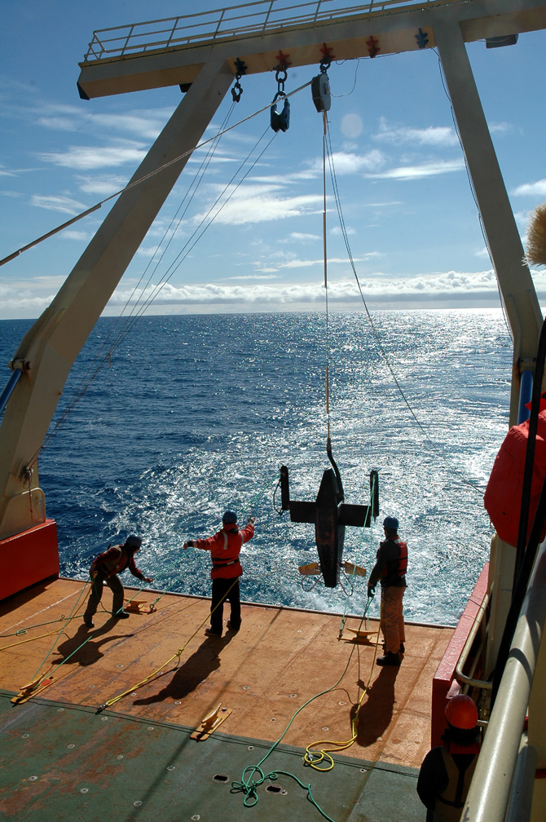
The Video Plankton Recorder

Slide 5
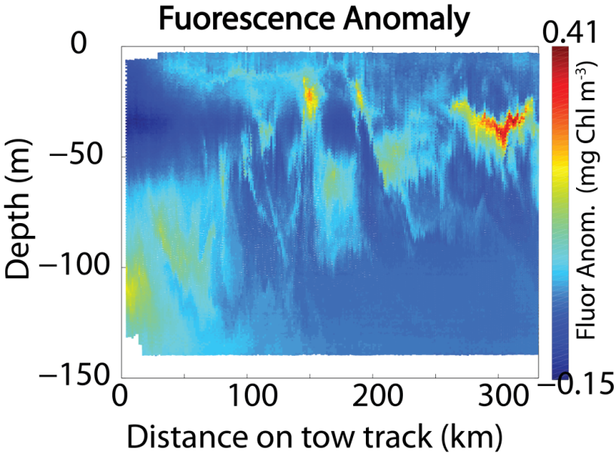
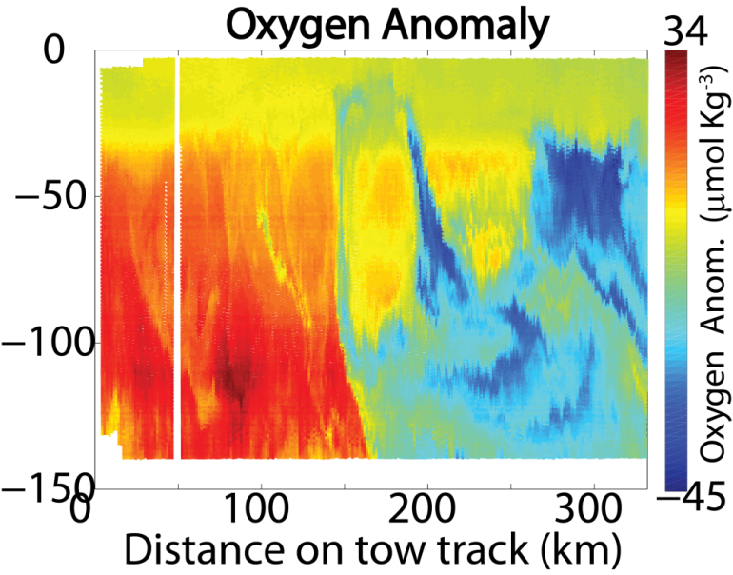
Prior sampling of hotspots with the VPR reveals a conundrum
Fluorescence Anomaly
Oxygen Anomaly
Why is ΔO₂ more often negative than positive? Is it physics or biology?
Need 4-D (space and time) adaptive sampling
Satellite data – identify target features
VPR surveys – locate and map hotspots
REMUS – fine scale surveys
CTD/Rosette sampling – triple O₂ isotopes, NCP

