Slide 1
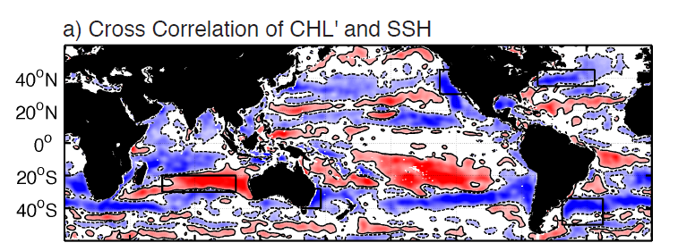
Processes
Stirring
Trapping
Formation/Intensification
Eddy-Ekman
Eddy-MLD
Restratification
Submesoscale

Slide 2
MOBY papers
Observations
Gaube, P., McGillicuddy, D.J., Chelton, D.B., Behrenfeld, M.J., and P.G. Strutton, 2014. Regional variations in the influence of mesoscale eddies on near-surface chlorophyll. JGR 119, 8195–8220.
Global eddy resolving model
Large scale distributions, fluxes, and term balances. Long et al.
Global SLA-CHL correlations: simulated and observed. Gaube et al.
Regional studies
Gulf Stream – Gaube & McG (in prep)
Southern Indian Ocean – Gaube et al.
Song, H., Marshall, J., Gaube, P., and D.J. McGillicuddy, 2015. Anomalous chlorofluorocarbon uptake by mesoscale eddies in the Drake Passage region. JGR, 120, 1065–1078.
Song et al. – CO2 fluxes in the DIMES patch

Slide 3
MOBY papers
Future prospects
Global covariance vs. correlation in SLA-CHL’ (Pete)
Eddy demographics
DIMES patch – Hajoon?
Global - ?
SLA-CHL’ correlation in the Southern Ocean (Hajoon?)
seasonal resolution
more sophisticated mapping/projection
MLD-eddy correlations from SLA and Argo – Ute

