Slide 1
Red Tides in the Gulfs of Maine and Mexico
Dennis McGillicuddy, Sr. Scientist and Chair, Department of Applied Ocean Physics and Engineering

Slide 2
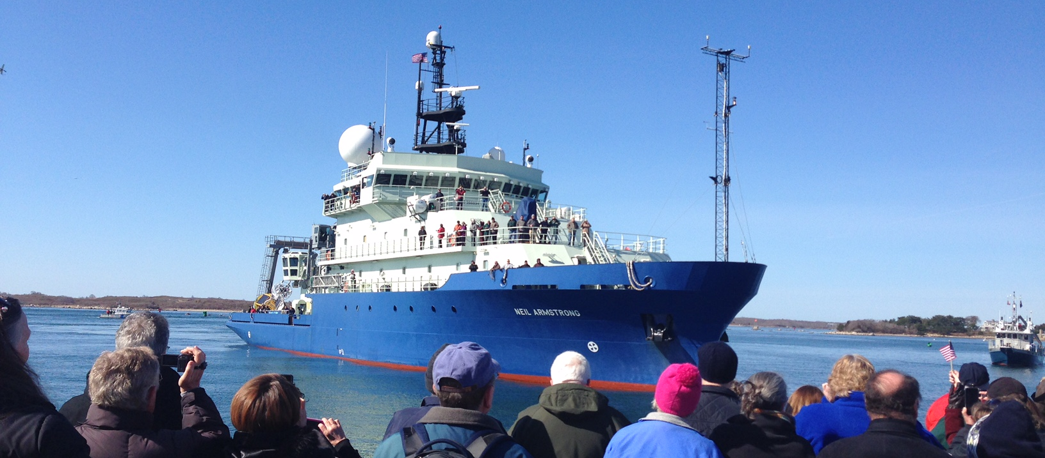
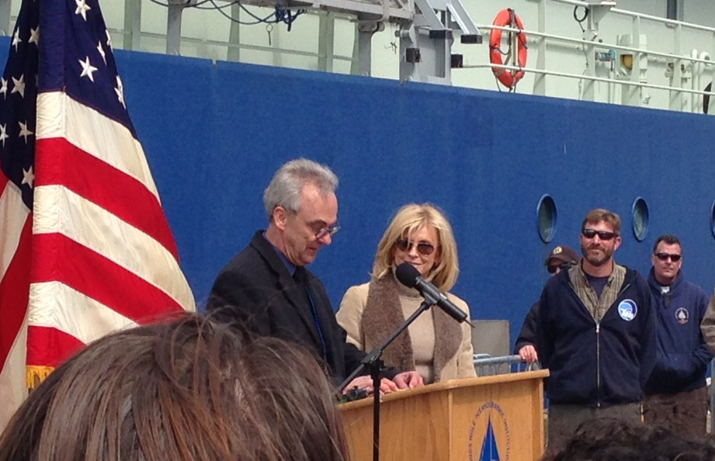

Slide 3
Red Tides in the Gulfs of Maine and Mexico
Dennis McGillicuddy, Sr. Scientist and Chair, Department of Applied Ocean Physics and Engineering

Slide 4
Plankton Production in the
Open Ocean
Sea Surface
100m
Notes:
The scientific question motivating this study revolves around the issue of what controls new production in the open ocean. This cartoon schematizes the process of new production, in which phytoplankton…
CO2 is a greenhouse gas – a good thing – without it the earth’s sfc temp would be 30C colder
How do phytoplankton affect CO2 in the atmosphere? The biological pump.
The biological pump is strong: without it, 2X pCO2, no polar ice caps, sea level 100m higher.
Industrial revolution, CO2 release, 1/3 atm, 1/3 land, 1/3 ocean.

Slide 5
The biological pump
Sea Surface
Photosynthesis
100m
Respiration
Notes:
The scientific question motivating this study revolves around the issue of what controls new production in the open ocean. This cartoon schematizes the process of new production, in which phytoplankton…
CO2 is a greenhouse gas – a good thing – without it the earth’s sfc temp would be 30C colder
How do phytoplankton affect CO2 in the atmosphere? The biological pump.
The biological pump is strong: without it, 2X pCO2, no polar ice caps, sea level 100m higher.
Industrial revolution, CO2 release, 1/3 atm, 1/3 land, 1/3 ocean.

Slide 6
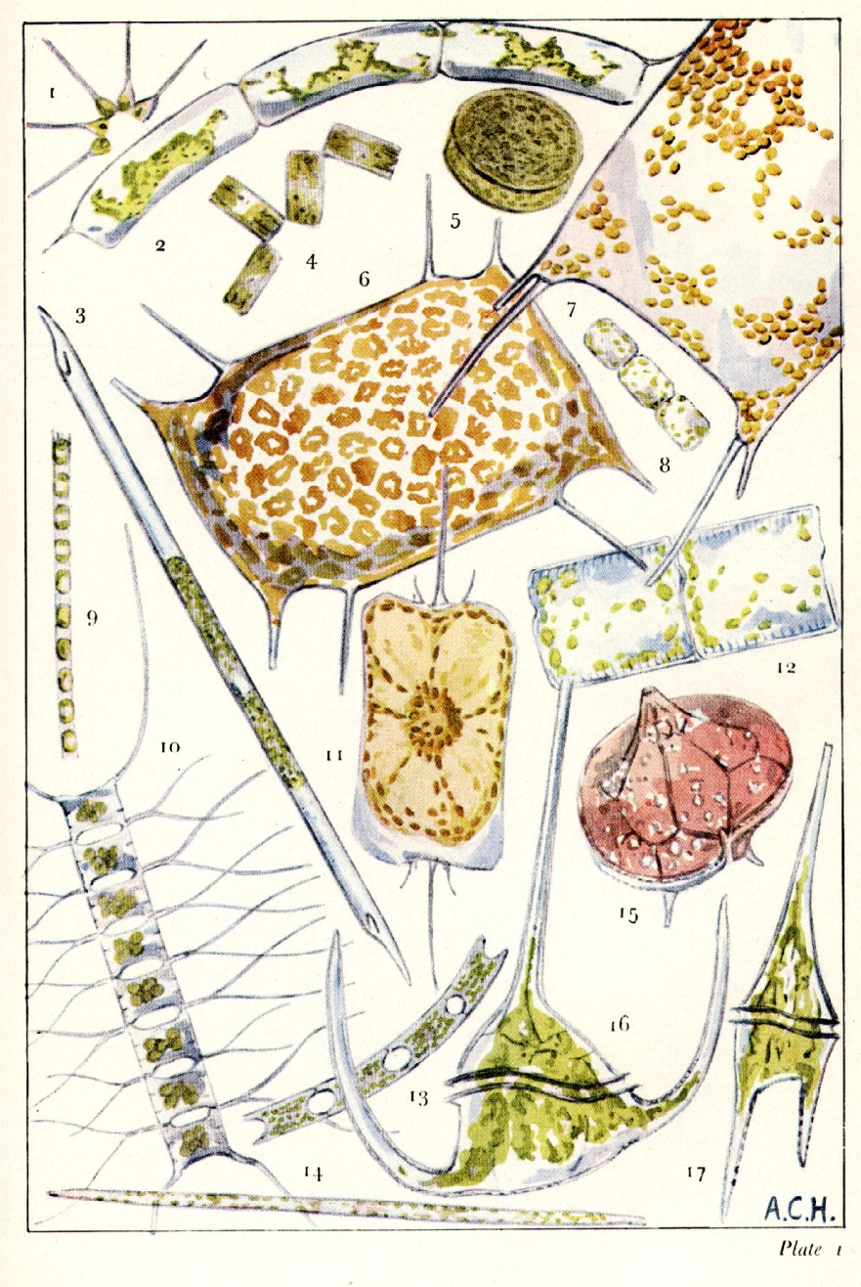
Phytoplankton: The Base of the Marine Food Web
______
0.1 mm
Sir Alistair Hardy, The Open Sea (1956)

Slide 7
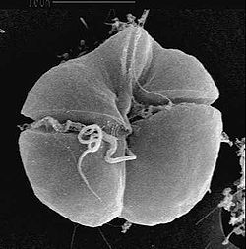
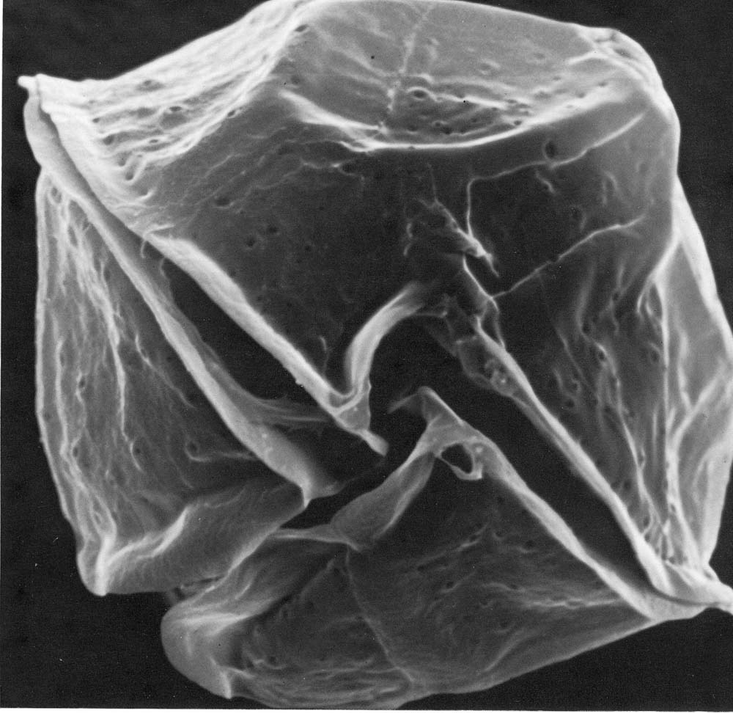
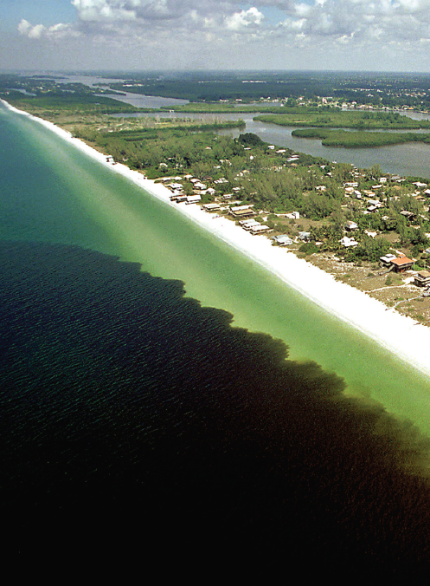
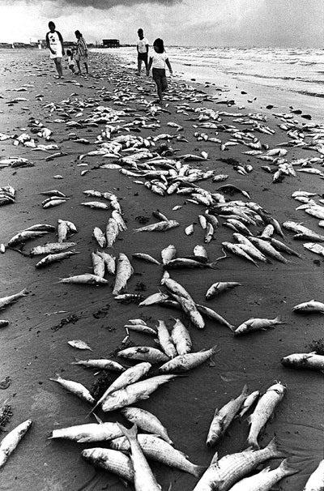
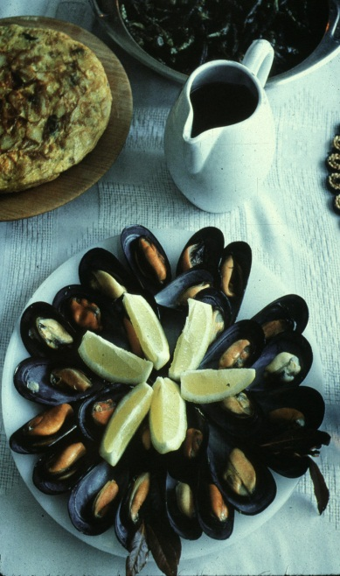
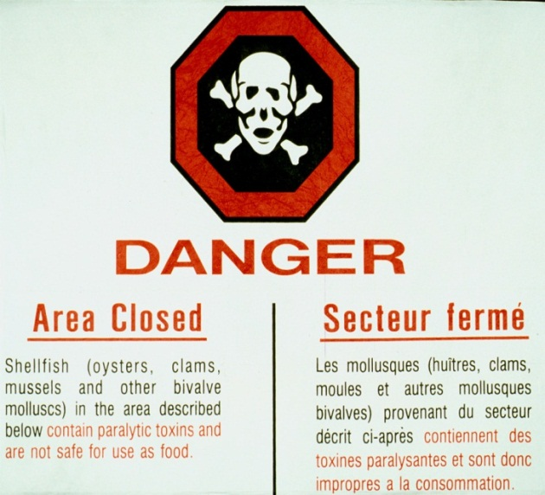
Gulf of Mexico: Gulf of Maine: Karenia brevis Alexandrium fundyense
Dinoflagellates
~40 microns diameter
Produces brevetoxins
Neurotoxic Shellfish
Poisoning (NSP)
Produces saxitoxins
Paralytic Shellfish
Poisoning (PSP)
Paul Schmidt, Charlotte Sun
Notes:
Class: Dinophyceae
Genus: Karenia
Species: K. brevis
Little Gasparilla Island Sept 1999
Alexandrium is a species of dinoflagellate approximately 40 microns in diameter. It produces saxitoxins which can accumulate in the tissues of filter-feeding organisms such as mussels and clams. Blooms of Alexandrium can cause buildup of toxins within shellfish sufficient to cause Paralytic Shellfish Poisoning, which can be a serious threat to human health. Because of this threat, shellfish beds in affected areas are monitored on a regular basis and harvesting closures occur frequently throughout the region.

Slide 8
Life Cycle of Alexandrium
Notes:
Alexandrium has a very complex life cycle, as illustrated in this cartoon. It can lie dormant as a resting cyst in the sediments for very long time periods, perhaps a decade or more. Germination is regulated by a complex set of processes, including an endogenous clock and physiological responses to environmental factors such as light and temperature. Once emerged from the sediments, the cells swim upward into the light and begin a phase of vegetative growth. When faced with environmental stress such as nutrient limitation, the vegetative cells form gametes which then fuse into a zygote. The zygote then encysts.

Slide 9
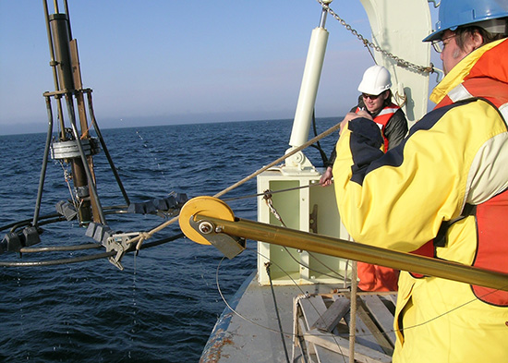
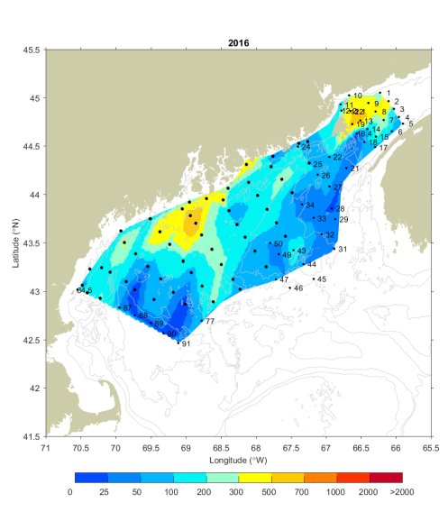
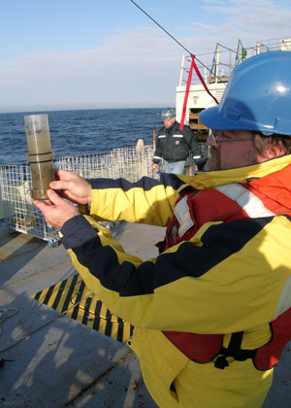
Benthic cyst distribution
Maine
Nova
Scotia
Cysts per cm³

Slide 10
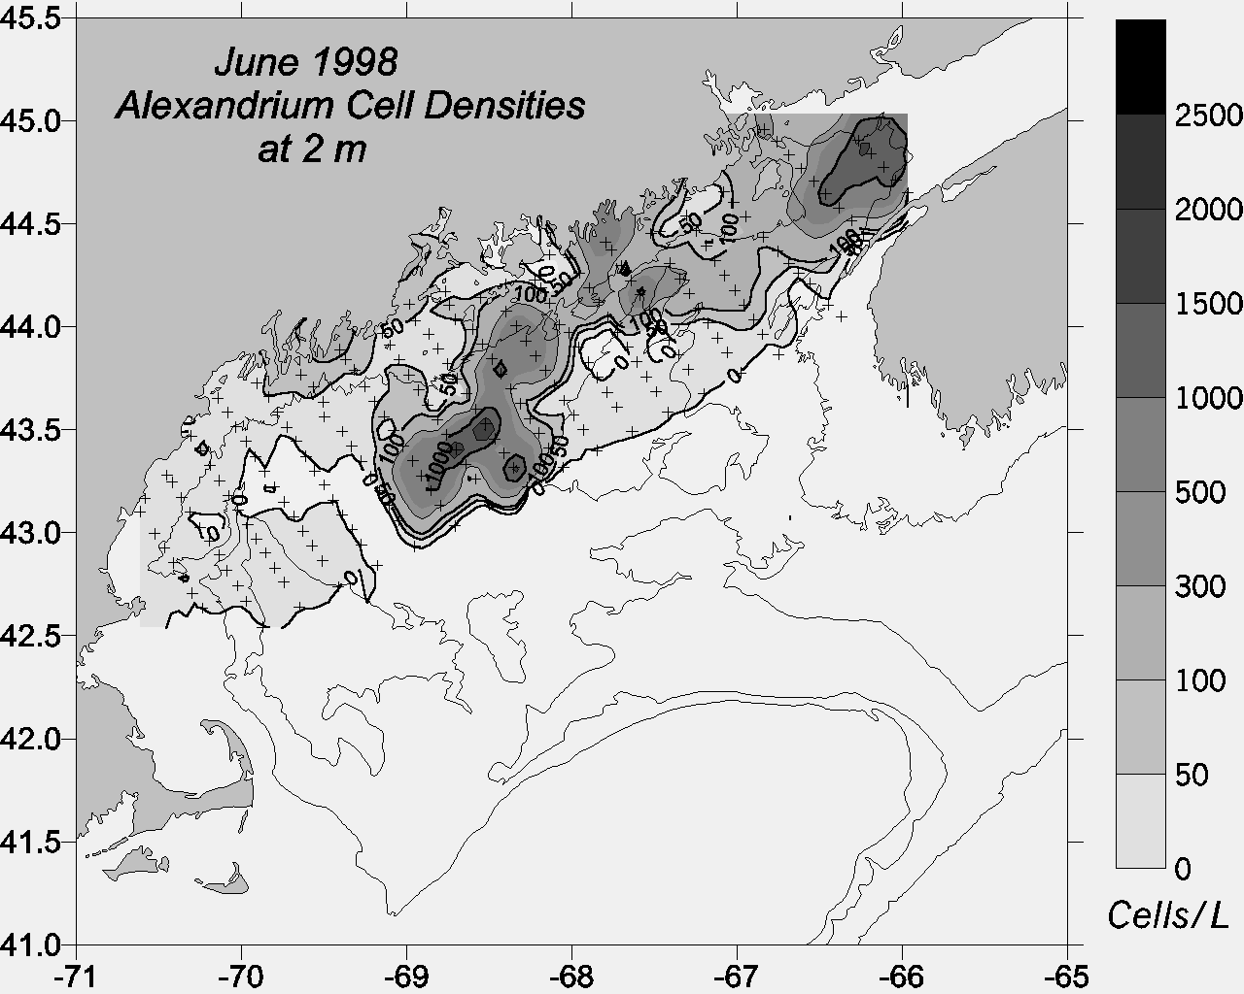
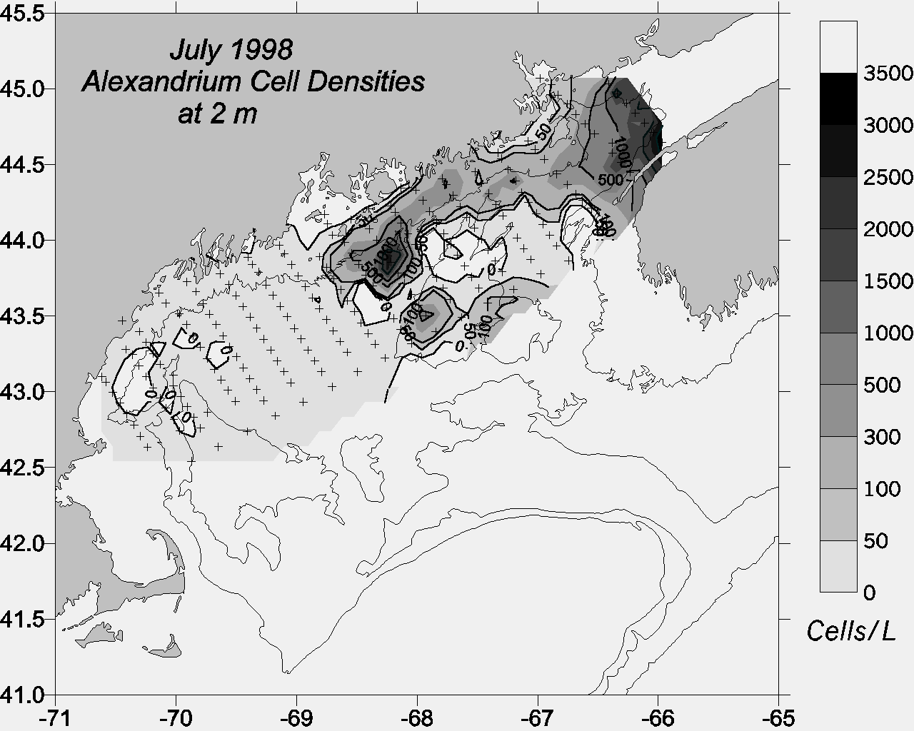
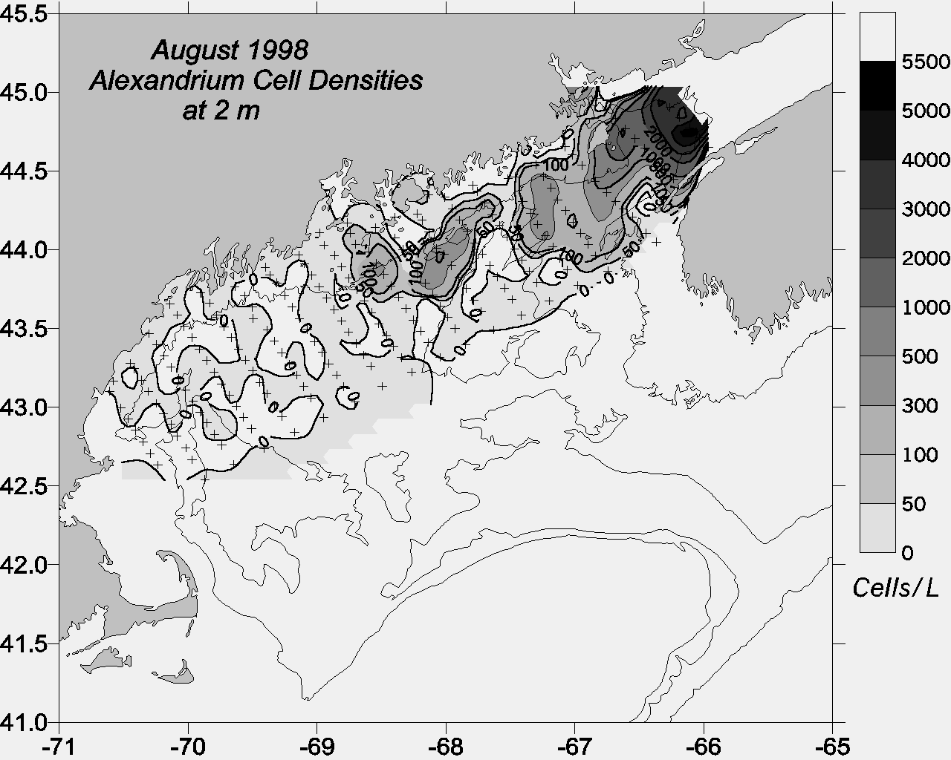
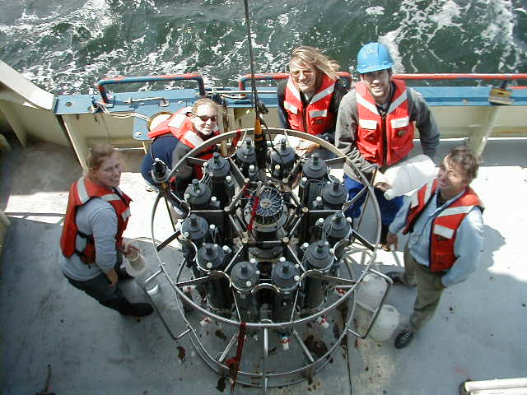
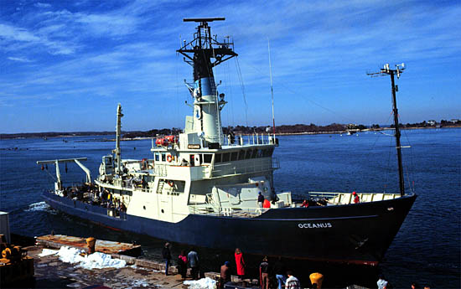
Observations of Alexandrium cells
Gulf-wide
distribution
2) Association with coastal
current
3) Center of mass
shifts west-to-east
as season progresses

Slide 11
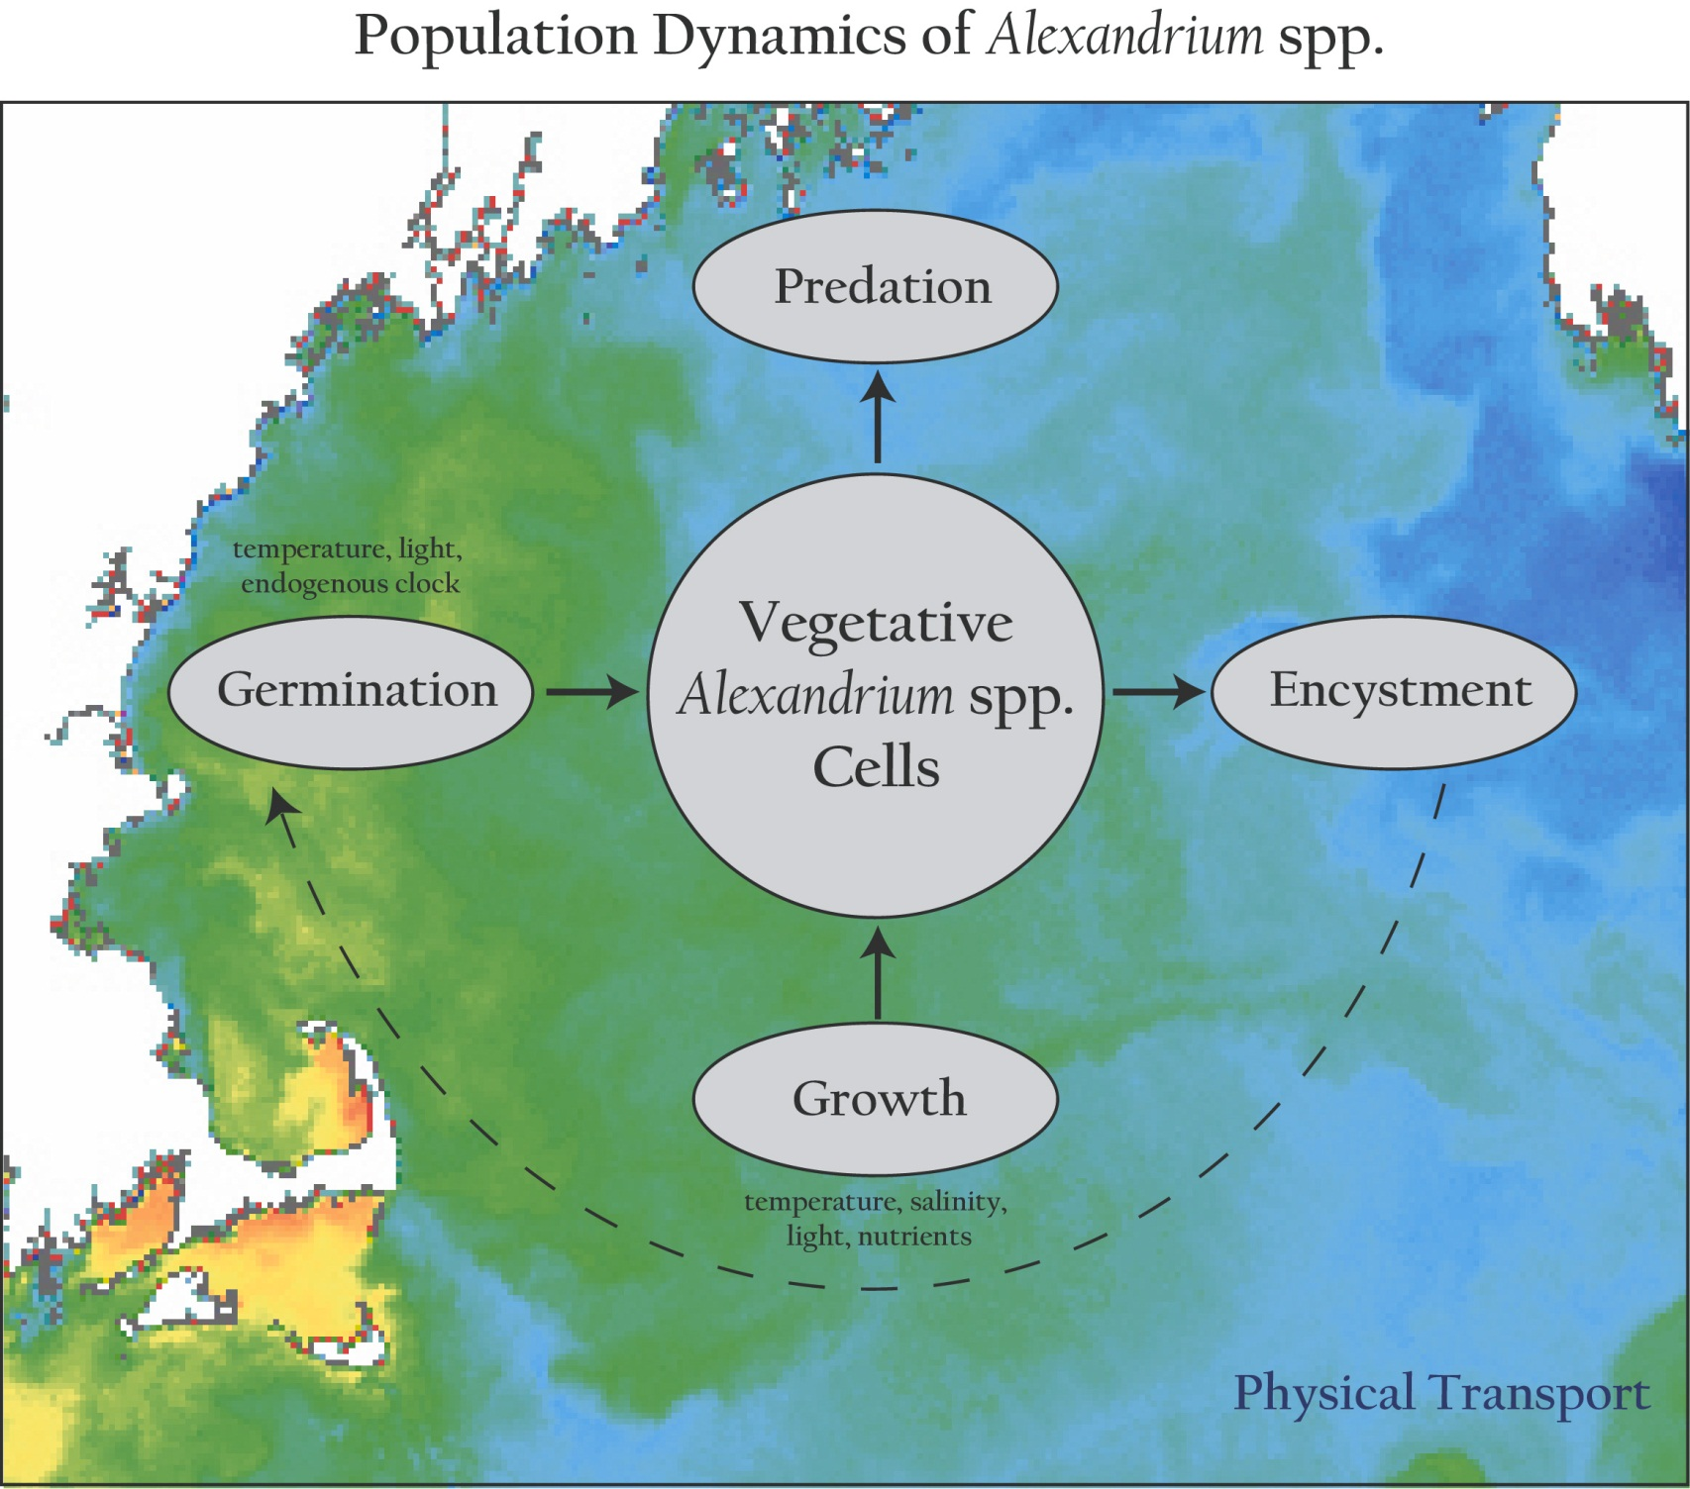
Population dynamics of Alexandrium spp.
Notes:
Our approach in this modeling effort is to incorporate what is known about the population dynamics of Alexandrium into 3-d circulation models of the region.
Fundamental to this approach is the concept that the ecosystem in which A.f. resides is not explicitly modeled. This is justified on the basis that, with very few exceptions, A.f. constitutes a very small fraction of the total phytoplankton species assemblage in the GOM. As such, it does not materially affect either the ambient nutrient concentrations nor predator abundances. Therefore these “ecosystem effects” can be parameterized through their influence on the vital rates of A.f.’s population dynamics.
These processes within the population dynamics are complex functions of environmental parameters, such as temperature, salinity, light and nutrients in the case of vegetative growth, and temperature, light and an endogenous clock in the case of germination.
All of this takes place in an complex, turbulent, three-dimensional fluid medium, some characteristics of which are evident in the sea surface temperature image on which this cartoon is overlayed.
What I’d like to emphasize here is that the linkage between the population dynamics of Alexandrium (or any other planktonic species for that matter) and the physical environment is twofold: first, the rates of the population dynamics processes are influenced by environmental variables, and second, the spatial distributions of the populations themselves are constantly being stirred and rearranged the currents. The duality of this linkage between the population dynamics and the physical environment is what makes coupled physical/biological problems in the ocean so incredibly complex. Our hope is that the use of models will help untangle this complexity, and provide insight into what controls blooms of Alexandrium in the Gulf of Maine.

Slide 12
Germination Only

Slide 13
Germination, Growth, ‘Mortality’

Slide 14
Germination, Growth, Mortality, Nutrient Limitation

Slide 15
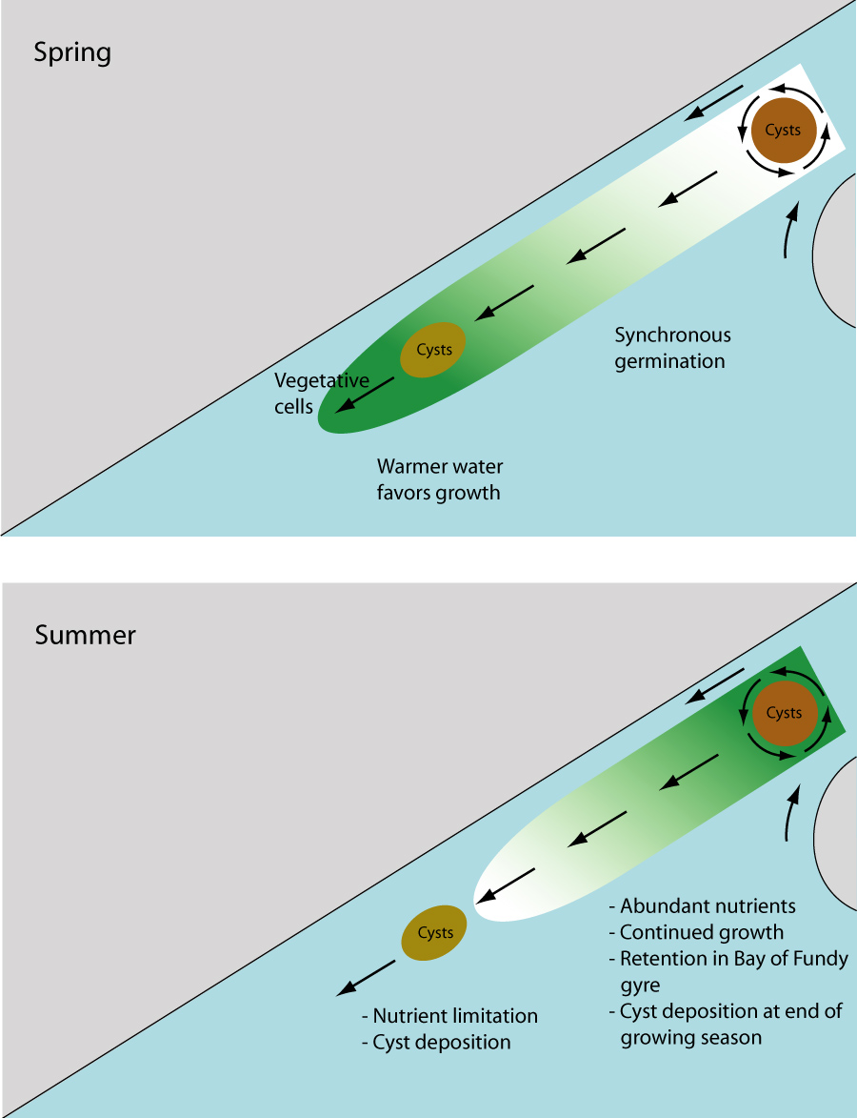
A conceptual model for the large scale seasonal variability of Alexandrium in the Gulf of Maine
Spring:
Temperature
limitation
Summer:
Nutrient
limitation

Slide 16
Cysts and toxicity 2004-2009
2004 2005 2006 2007 2008
Cysts
Closed
Area
2005 2006 2007 2008 2009
Cyst abundance and toxicity 2005-2009: r=-0.93

Slide 17
Theses
Cyst abundance is a first-order predictor of overall bloom severity.
Coupled hydrodynamic / population dynamics models forecast large scale seasonal characteristics of the bloom.

Slide 18
Hydrodynamics
2017 Bloom seasonal forecast
2004
Scenario 1
Scenario 2
Scenario 3
Scenario 4
Scenario 5
Scenario 6
Scenario 7
Scenario 8
Scenario 9
Scenario 10
Scenario 11
2005
2006
Benthic Cyst
Fall 2016
2007
2008
2009
2010
2011
2012
2013
2014
Notes:
18

Slide 19
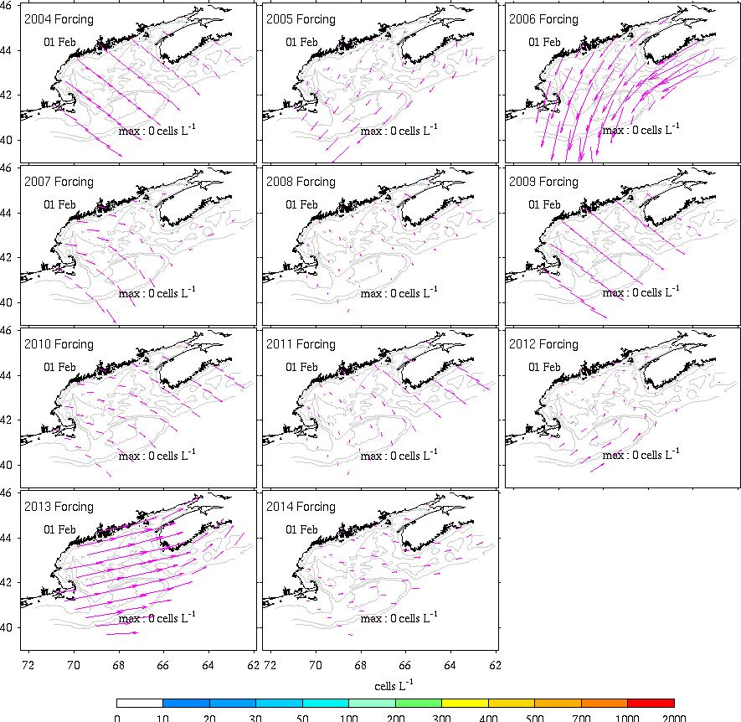

Slide 20
Looking forward
Long-term observational networks are essential
Data assimilation to keep models on track
Process studies to understand changing dynamics

Slide 22
Environmental Sample Processor (C. Scholin)

Slide 23
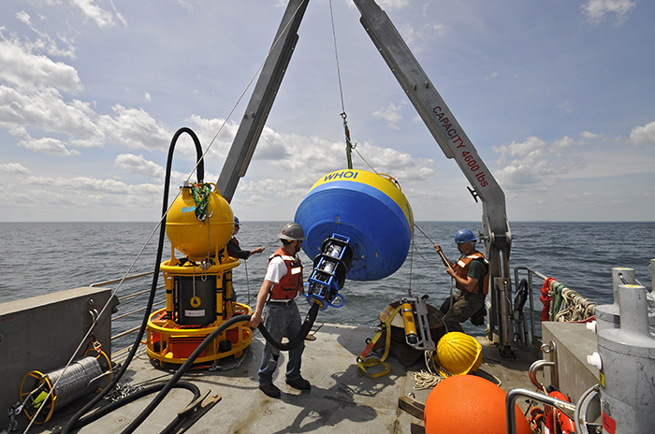

Slide 24
Gulf of Mexico: Gulf of Maine: Karenia brevis Alexandrium fundyense
Dinoflagellates
~40 microns diameter
Produces brevetoxins
Neurotoxic Shellfish
Poisoning (NSP)
Produces saxitoxins
Paralytic Shellfish
Poisoning (PSP)
Paul Schmidt, Charlotte Sun
Notes:
Class: Dinophyceae
Genus: Karenia
Species: K. brevis
Little Gasparilla Island Sept 1999
Alexandrium is a species of dinoflagellate approximately 40 microns in diameter. It produces saxitoxins which can accumulate in the tissues of filter-feeding organisms such as mussels and clams. Blooms of Alexandrium can cause buildup of toxins within shellfish sufficient to cause Paralytic Shellfish Poisoning, which can be a serious threat to human health. Because of this threat, shellfish beds in affected areas are monitored on a regular basis and harvesting closures occur frequently throughout the region.

Slide 25
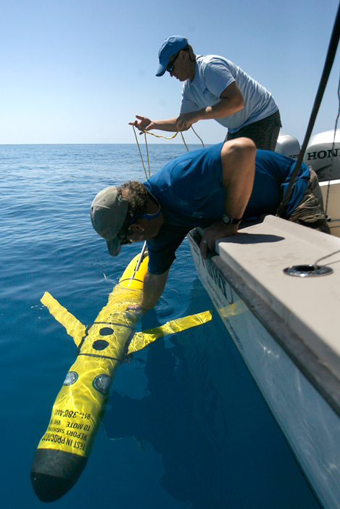
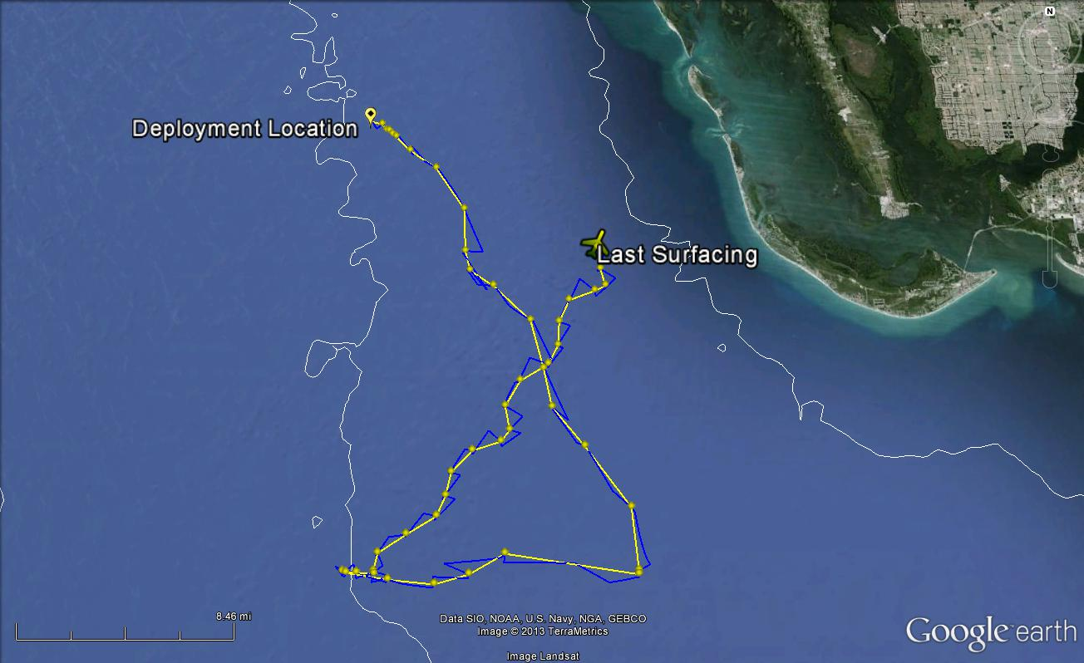
http://gcoos.tamu.edu/

Slide 26
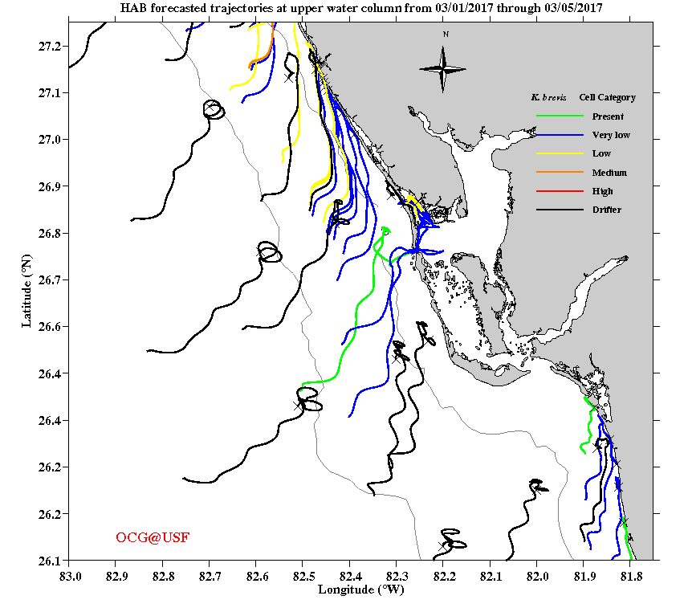
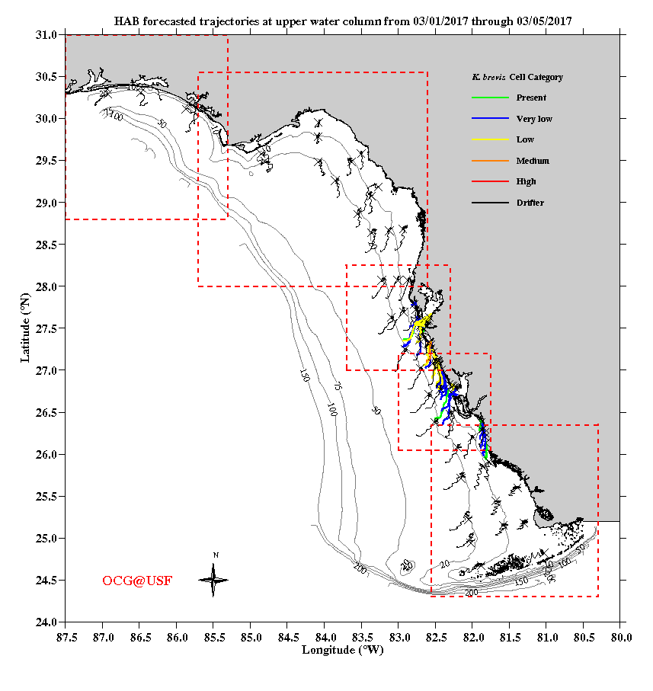
http://ocgweb.marine.usf.edu/hab_tracking/HAB_trajectories.html
Notes:
Between captiva and pine island

Slide 27
Gulf of Mexico: Gulf of Maine: Karenia brevis Alexandrium fundyense
Dinoflagellates
~40 microns diameter
Produces brevetoxins
Neurotoxic Shellfish
Poisoning (NSP)
Produces saxitoxins
Paralytic Shellfish
Poisoning (PSP)
Paul Schmidt, Charlotte Sun
Notes:
Class: Dinophyceae
Genus: Karenia
Species: K. brevis
Little Gasparilla Island Sept 1999
Alexandrium is a species of dinoflagellate approximately 40 microns in diameter. It produces saxitoxins which can accumulate in the tissues of filter-feeding organisms such as mussels and clams. Blooms of Alexandrium can cause buildup of toxins within shellfish sufficient to cause Paralytic Shellfish Poisoning, which can be a serious threat to human health. Because of this threat, shellfish beds in affected areas are monitored on a regular basis and harvesting closures occur frequently throughout the region.

Slide 28
End

