Slide 1
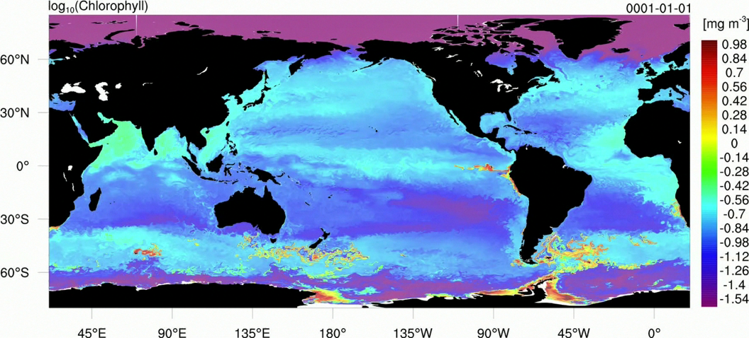
A 0.1⁰ Resolution Global Simulation
Long et al., in preparation (NSF EaSM; Marshall et al. project “MOBY”)
Log₁₀ (Chlorophyll)

Slide 2
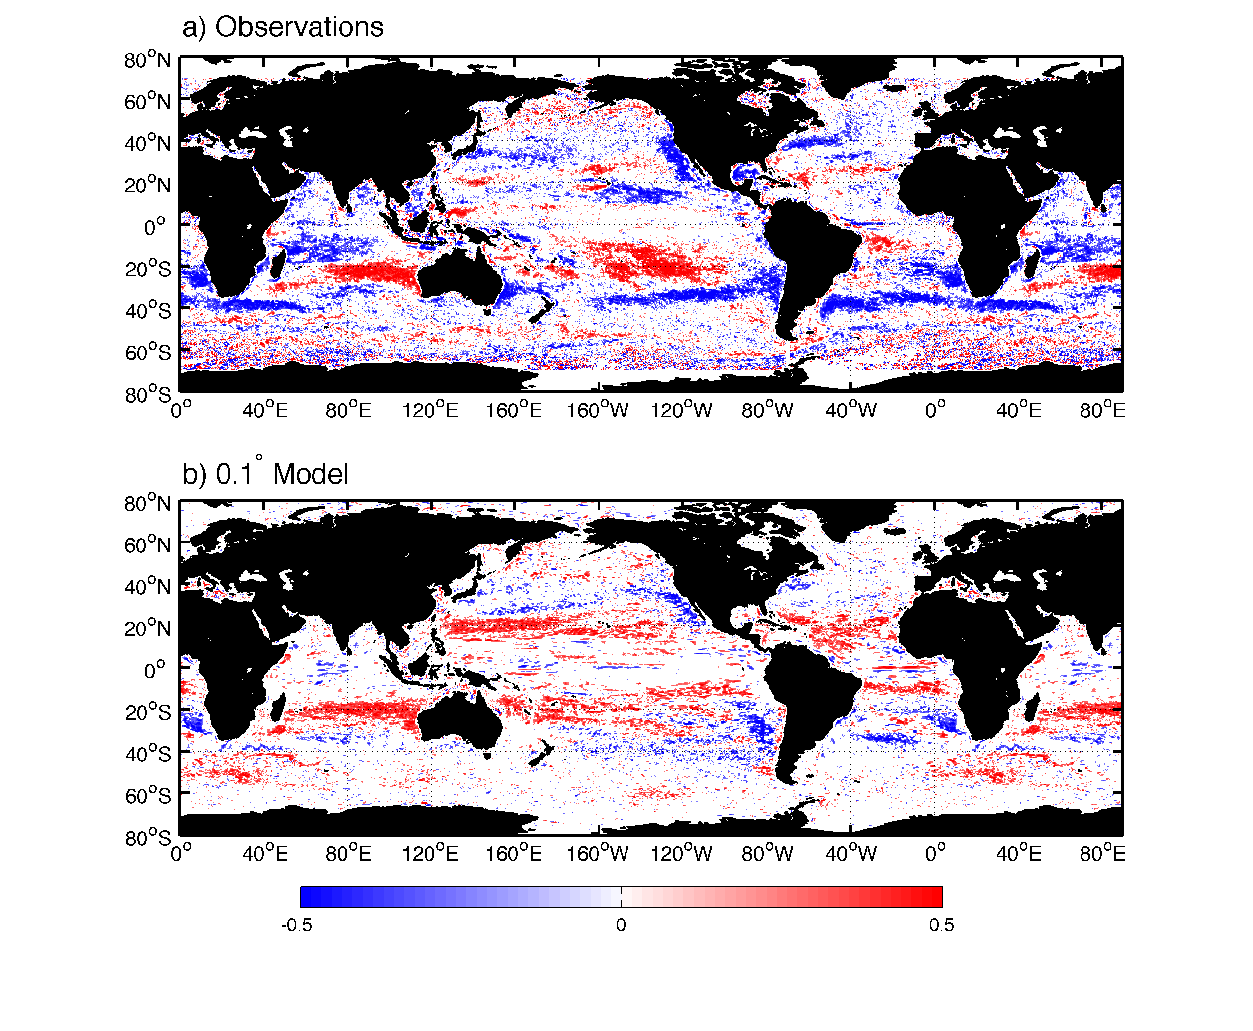
Cross-correlation of SSH and CHL anomalies
Long et al., in preparation
Observations
Model

Slide 3
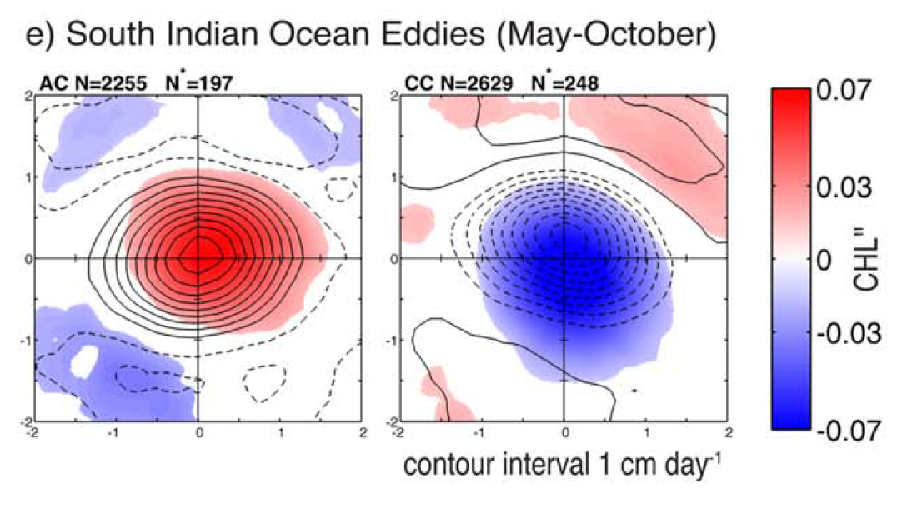
Cross-correlation of SSH and CHL anomalies
Gaube et al., in preparation
Observations
Nitracline
MLD Cyclones
MLD Anticyclones
Gaube et al. 2014
Argo float data: Dufois et al. 2014

