Slide 1
Applied ocean physics and engineering
Dennis McGillicuddy, Chair
Notes:
AOPE – a mouthful, but a meaningful mouthful.
To really understand what this department is about, one has to go back to the time of the formation of the departments– in 1962 we were know as the Applied Oceanography Department.
About 5 years later when the departments were re-organized to better align with the scientific disciplines emerging in the nascent Joint Program, the department was renamed Ocean Engineering.
It was not until about 20 years later that we assumed our current title, which formally recognizes the partnership between science and engineering. As you will see in the presentations by the other departments, this interface pervades the way we do business here at WHOI– and it is part of what makes WHOI great.
In AOPE we attempt to nurture that interface by interpreting each word in our title as broadly as possible. “Applied” means both pursuing applications, as well as applying what is known about ocean physics to address interdisciplinary questions involving links with biology, chemistry, and geology. While our center of mass is clearly in the ocean, we work at the interface with the atmosphere, geosphere, and cryosphere. Our work in engineering spans everything from basic research in the field (so called “Engineering Science”) to engineering for seagoing applications.

Slide 2
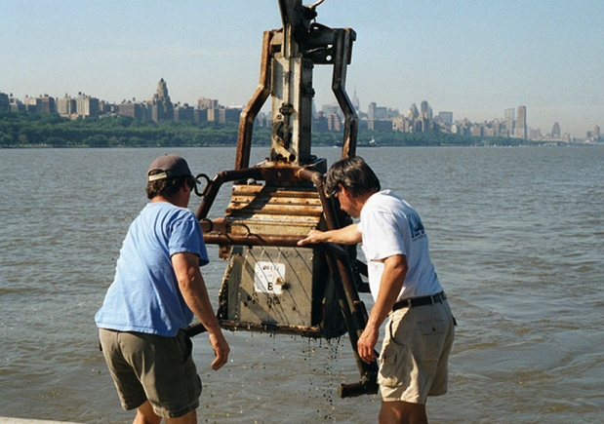
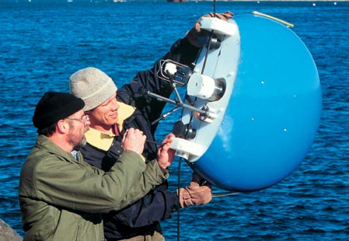
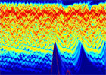
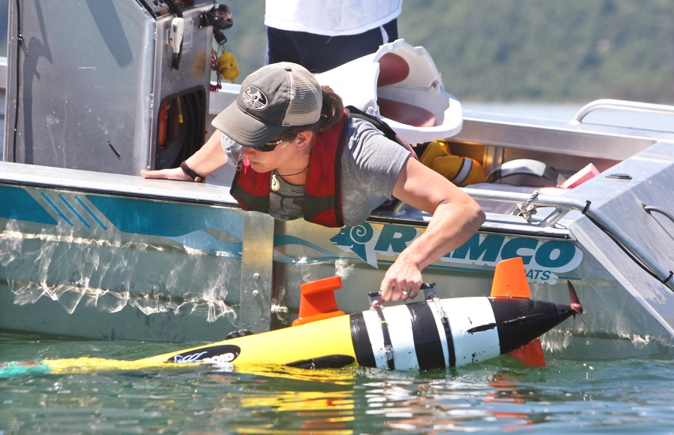
Key focus areas
Environmental fluid mechanics
Observing systems and sensors
Ocean acoustics
Vehicles and submarines
Notes:
Broadly speaking, we have four key focus areas: environmental fluid mechanics, ….
You are going to hear about ocean acoustics in a science presentation later this morning, so I’m going to give you a flavor for the other three through a few examples. This first one applies to the interface between EFM and OSS.

Slide 3
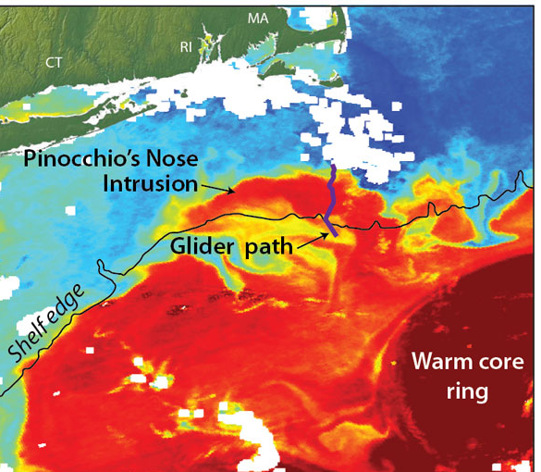
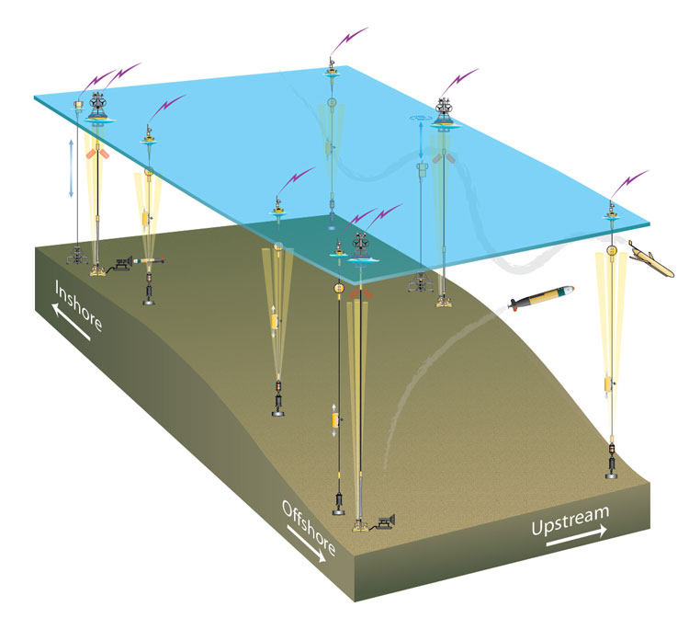

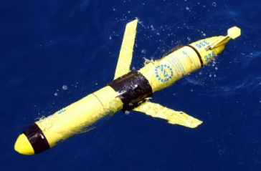

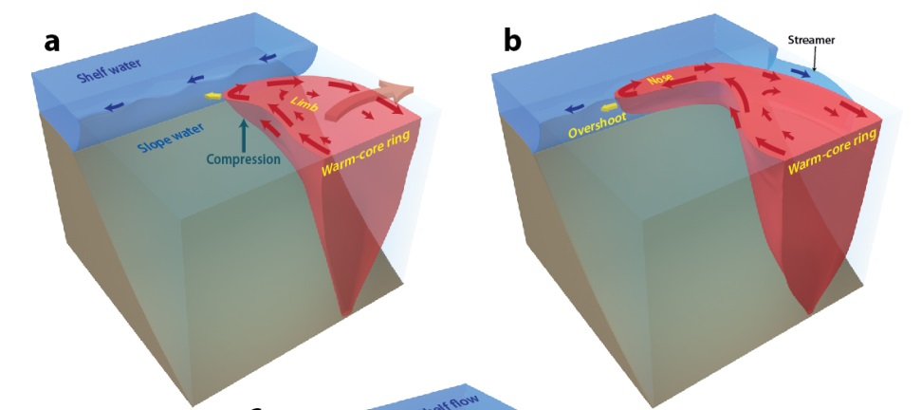

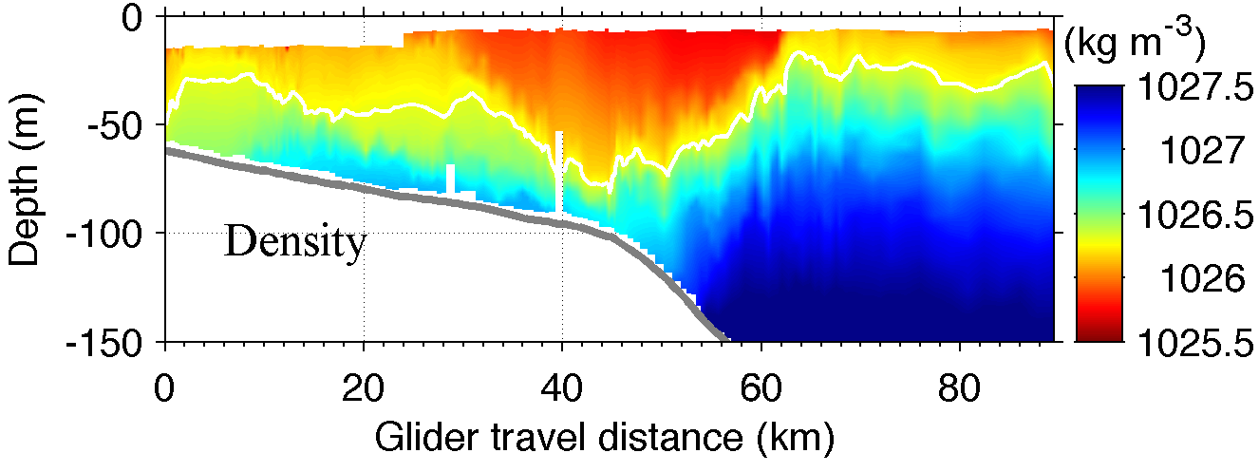
Initial science results from the OOI Pioneer Array
Gordon Zhang
Pinocchio’s Nose Intrusion
Glen
Gawarkiewicz
Notes:
I’m sure you are all aware of the Ocean Observatories Initiative Pioneer Array located to our south at the edge of the continental shelf. It is a very sophisticated array of moorings, gliders, and autonomous underwater vehicles. This particular region was chosen because it is highly biologically productive and home to a number of important commercial fisheries. However, the processes that regulate this productivity are not well understood– in part because it is such a highly dynamic region. There is a strong front right at the shelf break that flow from east to west. It is thought that upwelling at the front drives the productivity, but the circulation is frequently interrupted by features such as this warm core ring that was spun off the Gulf Stream.
Gordon Zhang, an associate scientist in our department noticed in this satellite image of sea surface temperature that a large intrusion of water from the ring was being swept down the shelf. Based on the satellite image, one might think this was a thin layer of surface water simply moving down the shelf with the ambient shelf break current. Fortunately this episode occurred shortly after deployment of the Pioneer Array, and a glider track crossed right through the feature. In this cross-section of density, you can clearly see that it is not just a surface feature, but a jet that extends almost all the way to the bottom.
This led Gordon and GG from the PO department to undertake a study of this feature using a combination of observations, computer models, and basic fluid dynamical theory. In so doing, they discovered a new type of instability process that was responsible for this nose-like intrusion: the westward flow on the south side of the intrusion overshoots the eastward flow on the north side, causing the nose of the intrusion to grow. Now, one of the privileges conferred on scientists that discover new processes is naming rights: Gordon came up with a very clever one in this case: Pinocchio’s Nose. Who says scientists don’t have a sense of humor?
One key lesson here is the tremendous value of the observations coming from the Pioneer Array. This discovery was facilitated by one of the very first preliminary data sets released in test mode… with the full complement of sensors now coming online, I think great things are to come from this observing system and WHOI is uniquely positioned to take advantage of those opportunities.

Slide 4
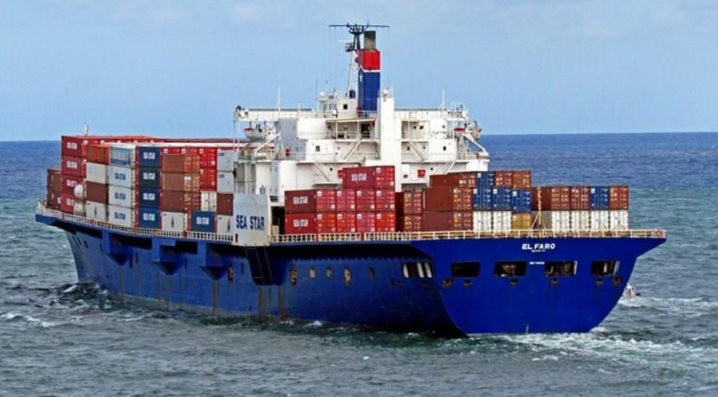

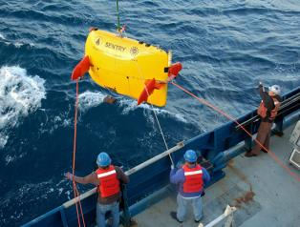
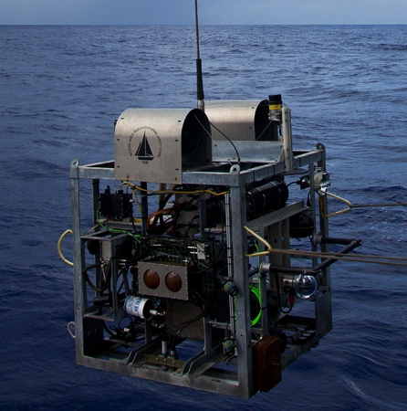
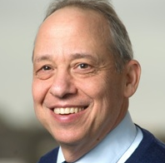

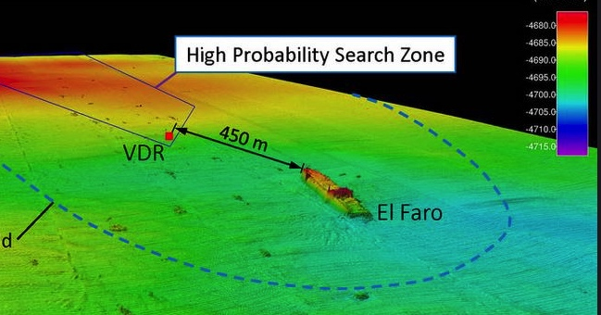
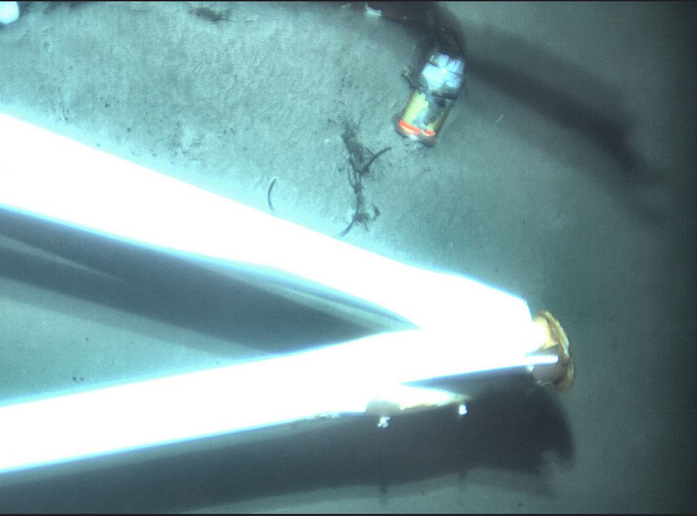
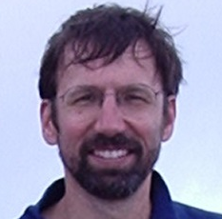
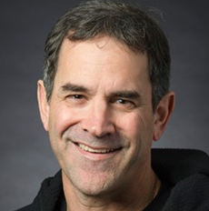
Locating El Faro Voyage Data Recorder
Andy Bowen
Dana Yoerger
Sentry
Alvin Observation Vehicle
Carl Kaiser
Jonathan Howland
Bruce Strickrott
Notes:
Turning now to vehicles and submarines, I’m sure many of you are aware of the role that WHOI played in locating the VDR of the El Faro, a container ship that sank in Hurricane Joaquin in Oct 2015 with the loss of all hands.
U.S. Navy Located Main Hull, but bridge was detached and the VDR not found.
NTSB and WHOI worked together to locate the VDR using two WHOI deep sea assets, Sentry and the Alvin Observation Vehicle
The strategy was to map out the debris field with Sentry and then look at individual objects using the AOV.
A major contributor to the success of this operation was the cutting edge technology that was used. It just so happened that CK was experimenting with the use of an ultra-high-resolution side-scan sonar for science use on Sentry. The went to sea with this new system and it worked extremely well, allowing them to discriminate objects with much more accuracy and focus the AOV on more promising targets.
The AOV was also souped-up for this particular mission. Thanks to Jon Howland and Bruce Strickrott, AOV was enhanced with a high resolution camera and a higher throughput telemetry system, both of which were borrowed from other groups at WHOI specifically for this purpose.
And here is the VDR still attached to the mast broken off from the wheelhouse.
This is an example of how technology developed for scientific purposes can make important contributions to society. Not only will the VDR provide important data to help understand why the ship sank, the mapping of the debris field provided by WHOI engineers will offer the NTSB a window into the accident scene that it not unlike what they are used to dealing with accidents on land– and this is perhaps changing the way they think about underwater accident investigation.
WHOI made detailed sonar and selected photographic maps of the wreck and debris field that will aid in the accident investigation
Analysis and eventual publication of the findings and techniques used for forensic in-situ examination of this wreck will help create an important legacy for those lost
Sentry
Part of the National Deep Submergence Facility
A Unique autonomous underwater vehicle with a wide range of sonar and imaging sensors having the capacity to adapt to a wide range of missions
Capable of 6,000 meter deep operations
Alvin Observation Vehicle
first developed and used in 2007 as Arctic Sampling and Imaging Vehicle
modified in 2013 to serve as Alvin Observation Vehicle
For El Faro Mission QWHOI added:
Still camera borrowed from OSL (first developed for Habcam)
Telemetry bottle borrowed from Singh Lab
Camera and sonar from Alvin
Computers and peripherals from DSL
Software from Jason and Alvin systems used for visual verification/location and hull/debris inspection

Slide 5
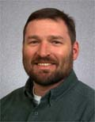
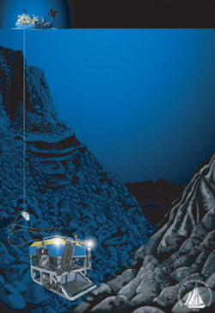
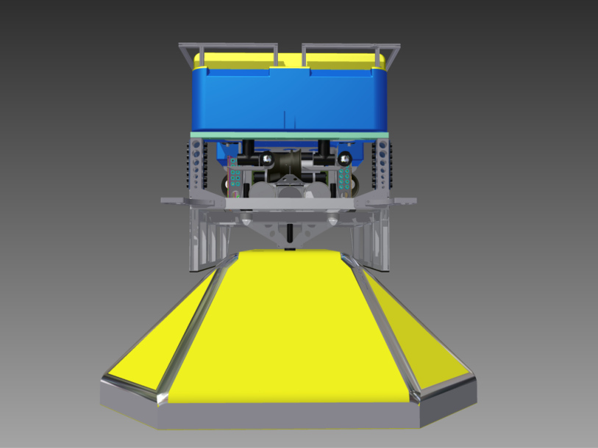
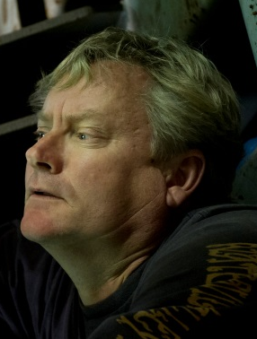
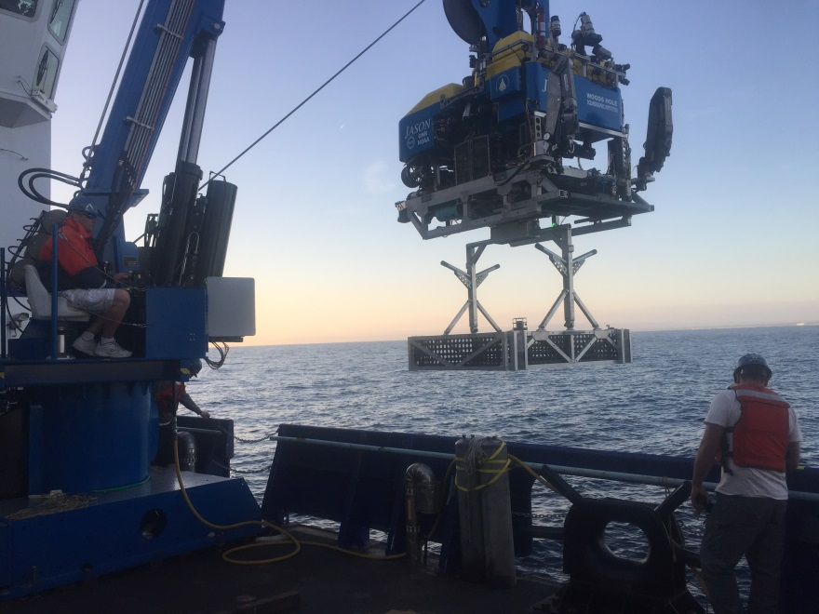
$2.4M NSF-sponsored Jason upgrade
Matt Heintz
Project manager
Bob McCabe
Mechanical Shop
Notes:
Lastly, I’d like to highlight an outstanding accomplishment in hard-boiled engineering that took place over the last year.
You may be familiar with the Remotely Operated Vehicle Jason shown here in its traditional mode of operation tethered to the intermediate vehicle Medea. This configuration has great utility in the deep sea, but the payload capacity is limited by the buoyancy provided in the flotation foam of the vehicle.
With the deployment of the OOI cabled observatory on the west coast, the need arose to service and manipulate the underwater nodes that provide power, internet, and connectivity to the suite of underwater instruments. These nodes are about the size of a car and weigh about 4000 pounds. So the idea was to reconfigure Jason with two attachment points in the undercarriage that can engage with either the node or payload baskets such as the one shown here in the sea trials.
Kudos to Matt Heintz the project manager and Bob McCabe who runs the Mechanical Shop. Close partnership between the shop and DSL was essential to the success; fabrication and welding; more formal approach to project management spearheaded by Bob McCabe.
I’m going to leave you with a time-lapse view of the so-called upgrade…
In 2015, the remotely operated vehicle Jason began a year-long, $2.4 million upgrade that culminated in a complete rebuild of the vehicle during the winter of 2016. The upgrade was funded by the National Science Foundation to make the vehicle more capable than ever by increasing its payload and range of activities and streamlined operations. This is the first upgrade of this magnitude for Jason, which was designed and built by the Woods Hole Oceanographic Institution (WHOI), since its second-generation launch in 2002. (The original Jason was launched in 1988.) Jason is operated by WHOI for the nation’s ocean science community as part of the National Deep Submergence Facility (NDSF), which also includes the human-occupied vehicle Alvin and the autonomous underwater vehicle Sentry. Read more: whoi.edu/news-release/jason-upgrade

Slide 6

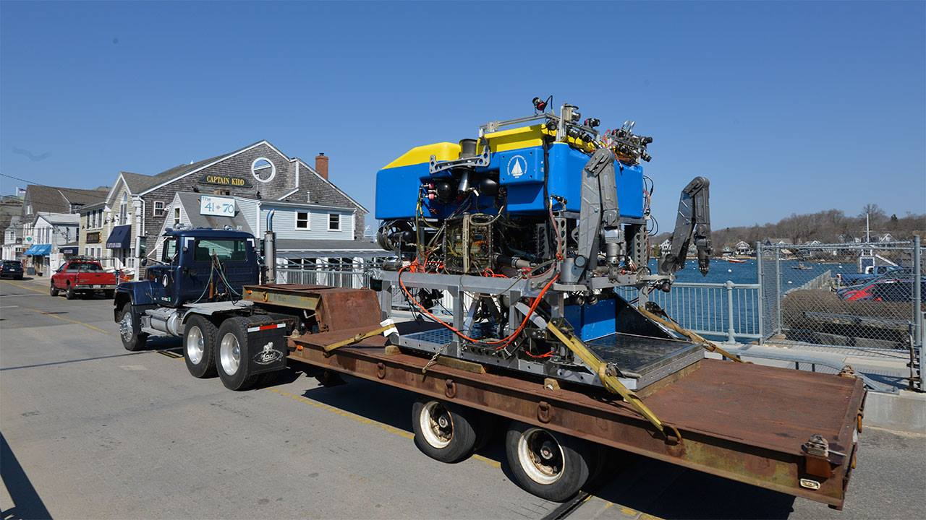
Notes:
Upgrade
Load path through the vehicle
New crane, special heave-compensated winch
Swappable tool skids, science skids
Project management
successful, on time, on budget
A new vehicle frame for increased loads
A new swappable heavy lift tool skid
New science tool skid with increased payload
A new launch and recovery system
New bigger and stronger cable tether
A modified active heave compensated winch
Additional flotation
In 2015, the remotely operated vehicle Jason began a year-long, $2.4 million upgrade that culminated in a complete rebuild of the vehicle during the winter of 2016. The upgrade was funded by the National Science Foundation to make the vehicle more capable than ever by increasing its payload and range of activities and streamlined operations. This is the first upgrade of this magnitude for Jason, which was designed and built by the Woods Hole Oceanographic Institution (WHOI), since its second-generation launch in 2002. (The original Jason was launched in 1988.) Jason is operated by WHOI for the nation’s ocean science community as part of the National Deep Submergence Facility (NDSF), which also includes the human-occupied vehicle Alvin and the autonomous underwater vehicle Sentry. Read more: whoi.edu/news-release/jason-upgrade

