Slide 1
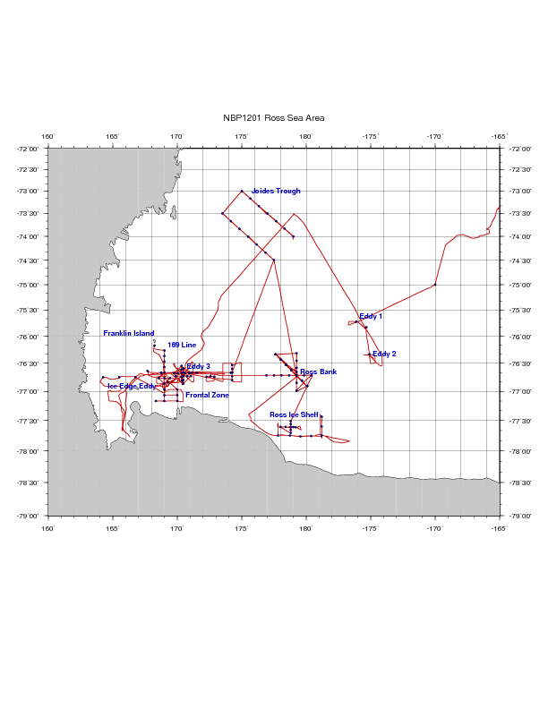
PRISM cruise track
H₁: CDW
H₂: Sediment: banks/coastal
H₃: Sea ice
H₄: Glacial melt
H₅: ISW
H₆: Dry Valleys
H₇: Vents
I. ACC Sea Ice
II. Eastern Ross Sea Eddies
III. Western Ross Sea
IV. Ross Bank
V. Ross Ice Shelf
VI. Joides Trough
VII. Western Ross Sea II

Slide 2
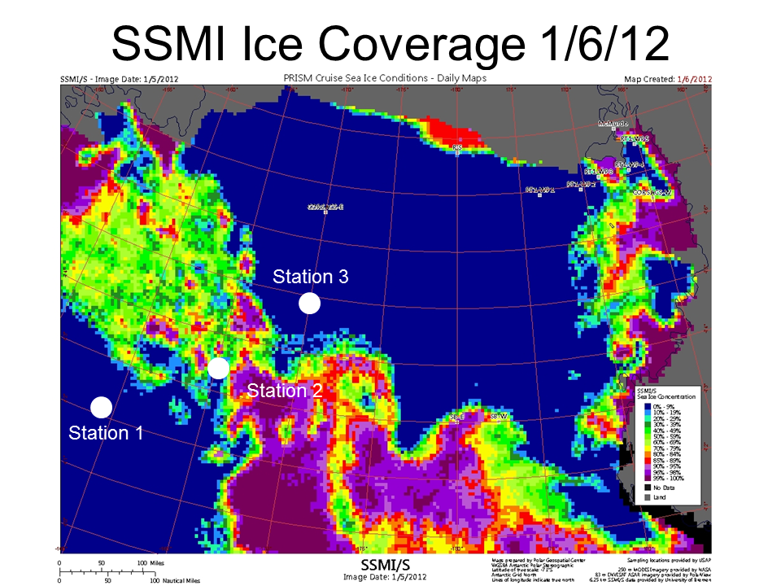
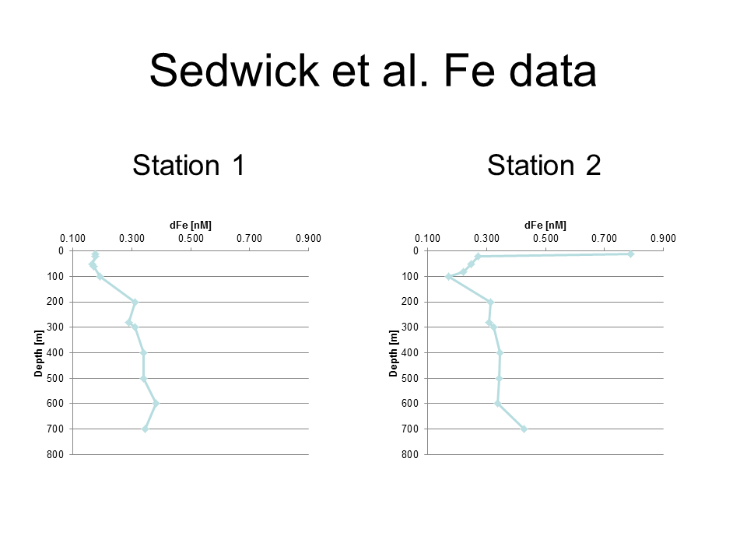
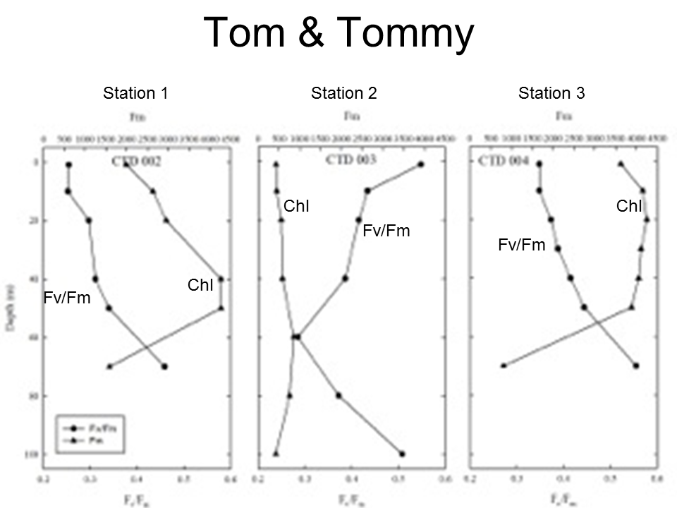
ACC Sea Ice
Station 3
Station 2
Open ocean sea ice a source of iron that improves physiological condition of phytoplankton
Iron measurements in CDW end-member consistent with previous studies.

Slide 3
Eastern Ross Sea Eddies
Cyclonic eddies driven by doming of the halocline yield elevated Chl
Phaeocystis present as both individual colonies and aggregated colonies
Covariance in the distribution of individual and aggregated colonies, both deeper in the eddy interior than outside the eddy
High abundance of abandoned colonies and marine snow at depth at eddy center
Near-surface iron concentrations of 0.3-0.4 nM both inside and outside eddies

Slide 4
Western Ross Sea Process Study
Frontal boundary separates warm, fresh, higher iron (0.2 nM) surface waters to the west from cold, salty, lower iron (0.1 nM) surface waters to the east; pattern consistent with a wake of retreating sea ice
At depth, zonal trends are reversed: salinity decreases and iron increases to the east (HSSW production, bathymetry, respectively)
Warm, fresh, higher iron near-surface waters high in biomass: diatoms near the surface, Phaeocystis down deep; phytoplankton condition better than in low-biomass waters
Trends in macronutrient data consistent with a diatom bloom (silicate drawdown)
Cyclonic eddy further elevates biomass in the high-biomass region; domed halocline and ferrocline consistent with increased iron supply, yet near-surface waters depleted in iron
Temporal increase (ca. 50%) in nitrite concentration 50-150m
Eddy heat content distinct from surrounding waters, indicating non-local origin; deep salinity suggests formation to the west
Eastward eddy flux of warm, fresh, (previously) high-iron meltwater?

Slide 5
Ross Bank
Detailed hydrographic characterization
Crest colder, saltier, less stratified
Fluorescence enhanced on the more stratified periphery
ADCP velocity suggests counter-clockwise around-bank flow
Strong spring-neap cycle, tidal speeds ranging from 35 to 15 cm s⁻¹
Dissolved iron enhanced on the crest during spring tides, much less on neap tide
Rapid removal of iron from the aphotic zone on the crest suggests advective loss; hydrographic time-series also indicative of advection
Impact of iron supply from Ross Bank could be spread into the interior Ross Sea via advection
Iron also enhanced in benthic nepheloid layers on the flanks of Ross Bank

Slide 6
Ross Ice Shelf
First ever iron measurements in Ice Shelf Water; concentrations similar to the MCDW end-member at 0.3-0.5 nM
Near-surface waters adjacent to the RIS were cold, fresh, and relatively enhanced in iron (ca. 0.2 nM) apparently due to glacial meltwater
Upper-ocean anticyclonic eddies can transport (previously) iron-rich waters northward, producing substantial blooms of Phaeocystis

Slide 7
Joides Trough
MCDW present on both eastern and western flanks of Pennell Bank, as well as its crest
Most prominent expression of MCDW on the crest of Mawson Bank; also present on the eastern flank (western flank not sampled).
Except for an area of high Phaeocystis abundance on the southwestern transect across Pennell Bank, VPR observations suggest high abundance of small chain-forming diatoms and copepods, particularly in the northwest part of the survey
Surface dissolved Fe values higher (~0.2 nM) on the northern transect, perhaps reflecting the lesser time that these waters have been free of sea ice cover.
Benthic Fe sources from shelf depressions (rather than banks) may be at least as important in supplying Fe to surface waters as intrusions of MCDW.

Slide 8
Evidence for iron supply from sea ice
Pre-bloom conditions consist of
High Fe
High Fv/Fm
Low Chl
Where did we find those conditions?
Offshore sea ice
Franklin Island
Joides Trough, northern transect
All areas in which ice was melting or recently cleared
[sea ice movie]

Slide 9
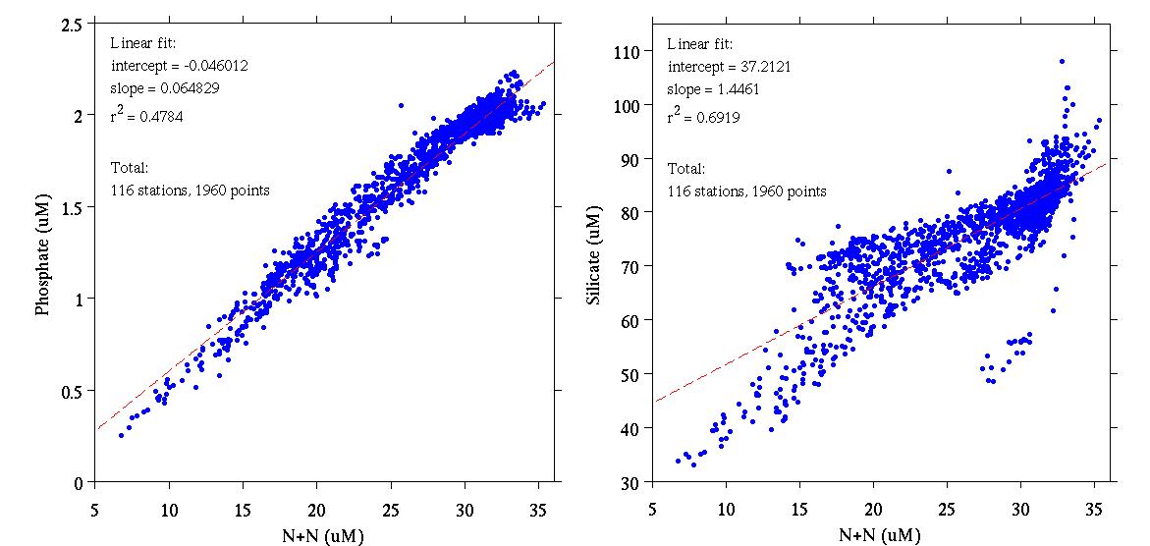
PRISM nutrient data
Phosphate
Silicate
Nitrate + Nitrite
Nitrate + Nitrite
Thank you, Lindsey!!!

Slide 10
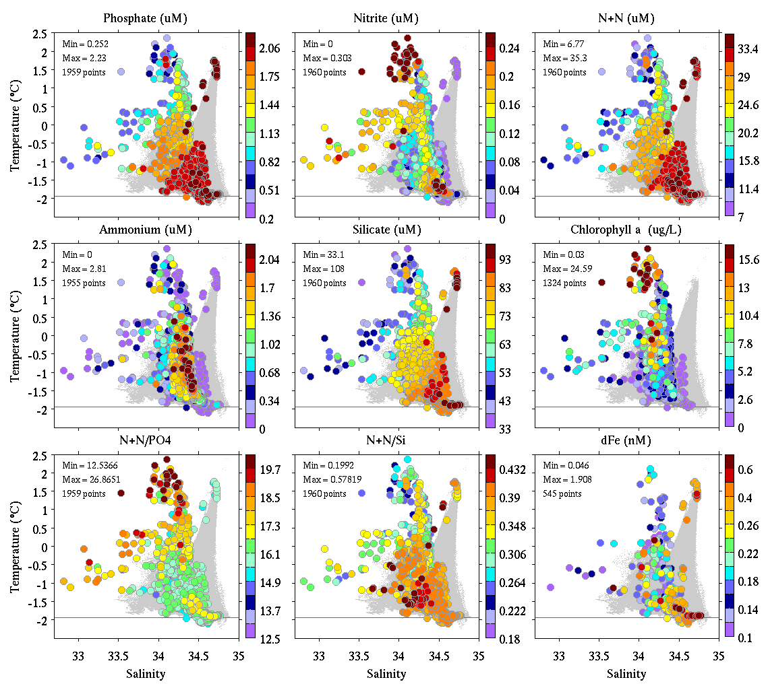
PRISM NutrientsChl, Fe
Phosphate Nitrite Nitrate+Nitrite
Ammonium Silicate Chlorophyll
N+N / P N+N/Si Fe

Slide 11
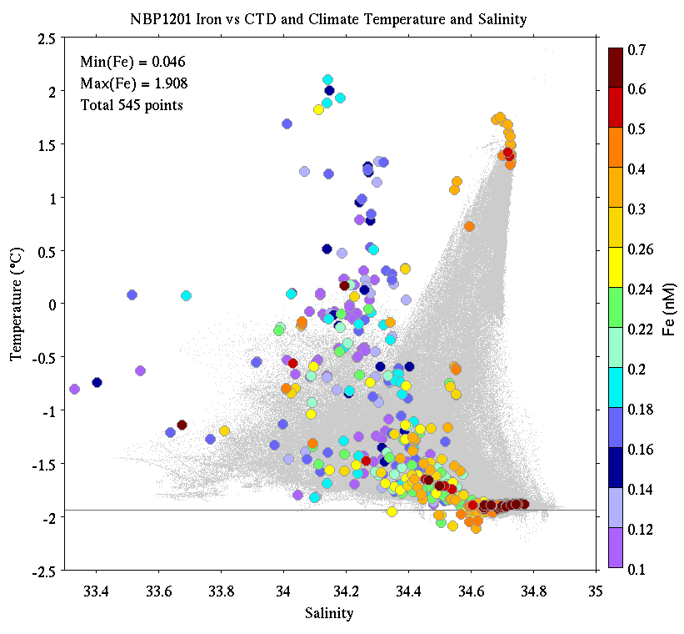
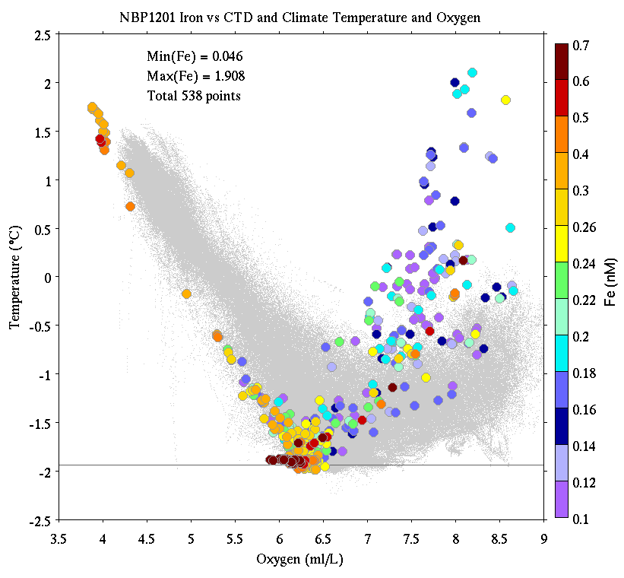
PRISM Iron Observations
CDW
Temperature
Temperature
MCDW
AASW
LSSW, HSSW
ISW
Salinity
Oxygen

Slide 12
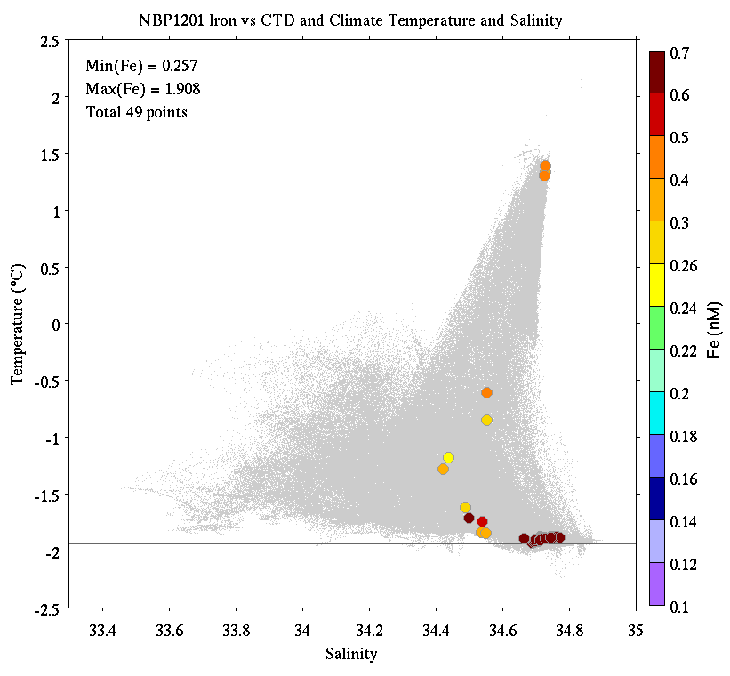
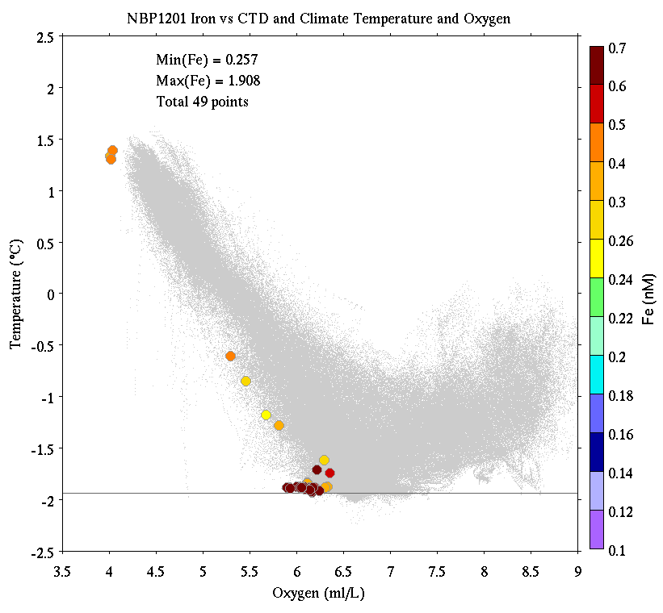
PRISM Iron Observations
Deepest Sample at Every Cast
CDW
Temperature
Temperature
MCDW
AASW
LSSW, HSSW
ISW
Salinity
Oxygen

Slide 13
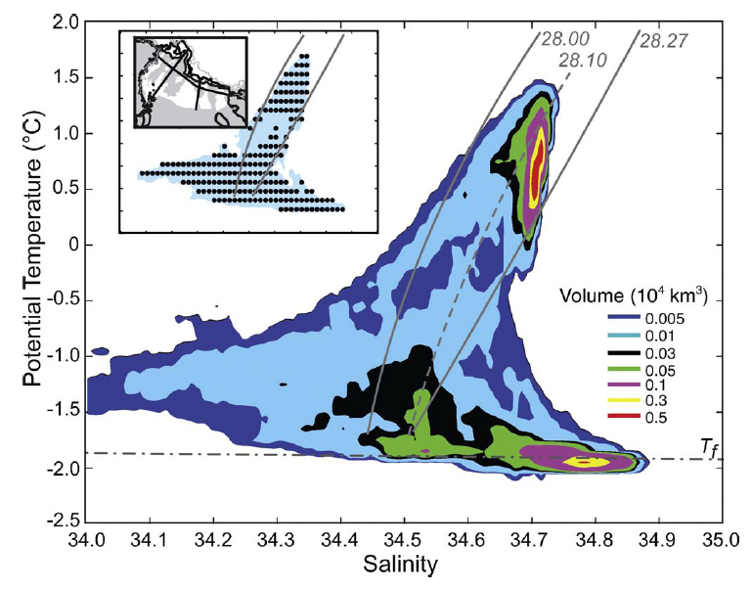
Orsi water mass volumes

Slide 14
Iron Sources
MCDW 0.3-0.5 nM offshore source; volume decreases shoreward
ISW 0.3-0.5 nM large volume on shelf
Benthic
Nepheloid
Layer 0.6-1.9 nM more available in shallow / less stratified areas
Ice melt variable most proximal source for phytoplankton
Vents - -

Slide 15
Extras

Slide 16
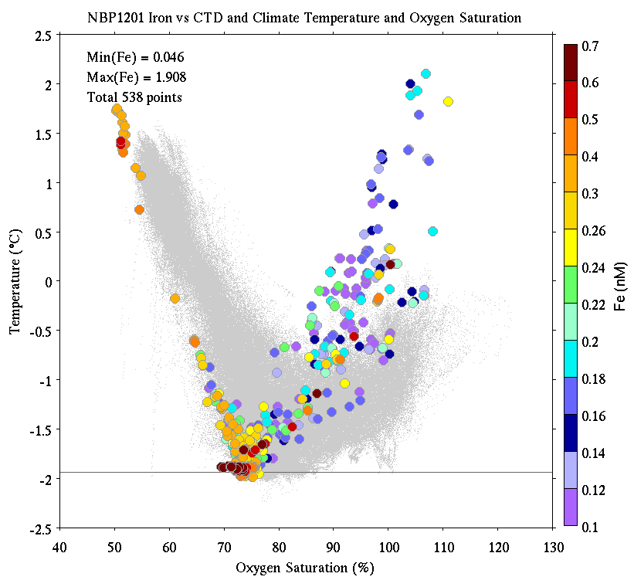
PRISM Iron Observations
CDW
Temperature
Temperature
MCDW
AASW
LSSW, HSSW
ISW
Salinity
% oxygen saturation

Slide 17
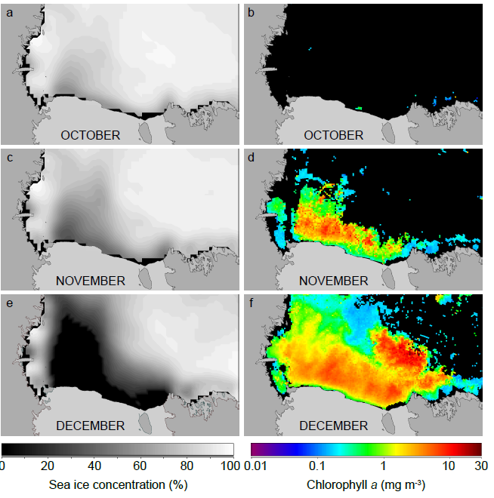
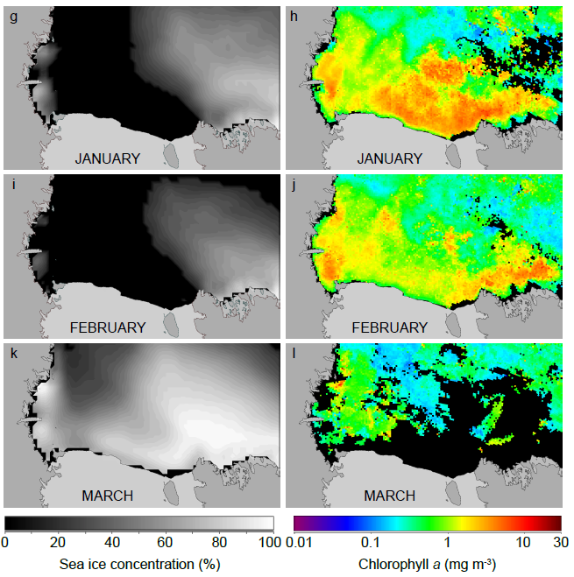
Sea Ice and Chlorophyll Climatologies
Arrigo et al.

Slide 18
Western Ross Sea Process Study

Slide 19
Ross Bank

Slide 20
Eddy 1 and Eddy 2

Slide 21
Ross Ice Shelf

Slide 22
Joides Trough

Slide 23
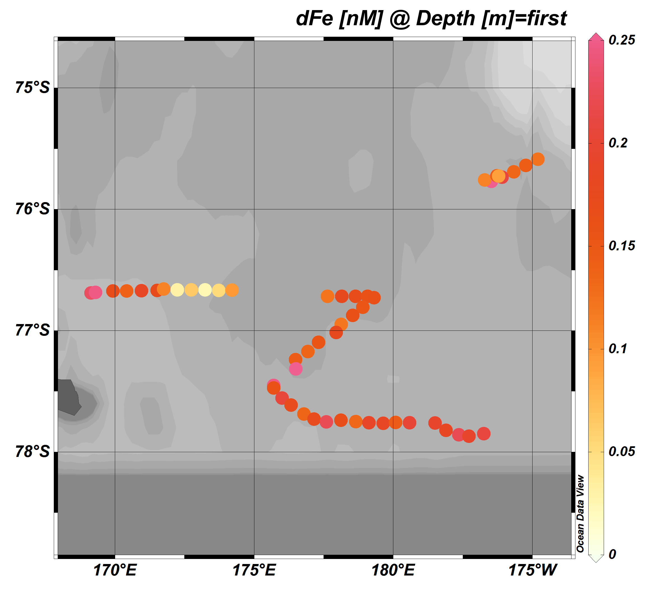
Sedwick group Fe data towfish samples

Slide 24
Science Meeting Feb 8

Slide 25
PRISM cruise track
I. ACC Sea Ice
II. Eastern Ross Sea Eddies
III. Western Ross Sea
IV. Ross Bank
V. Ross Ice Shelf
VI. Joides Trough
VII. Western Ross Sea II

Slide 26
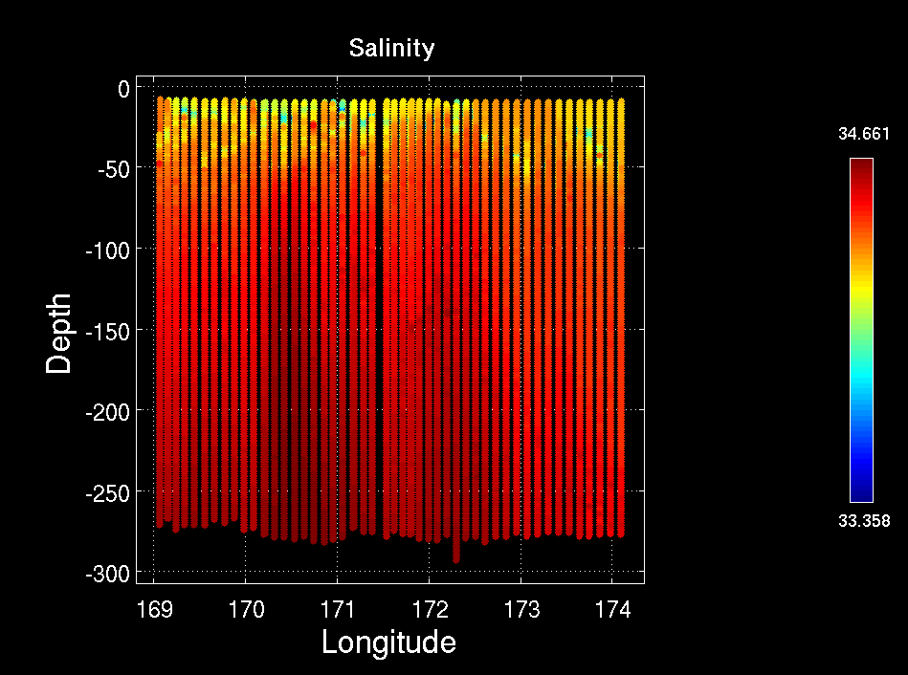
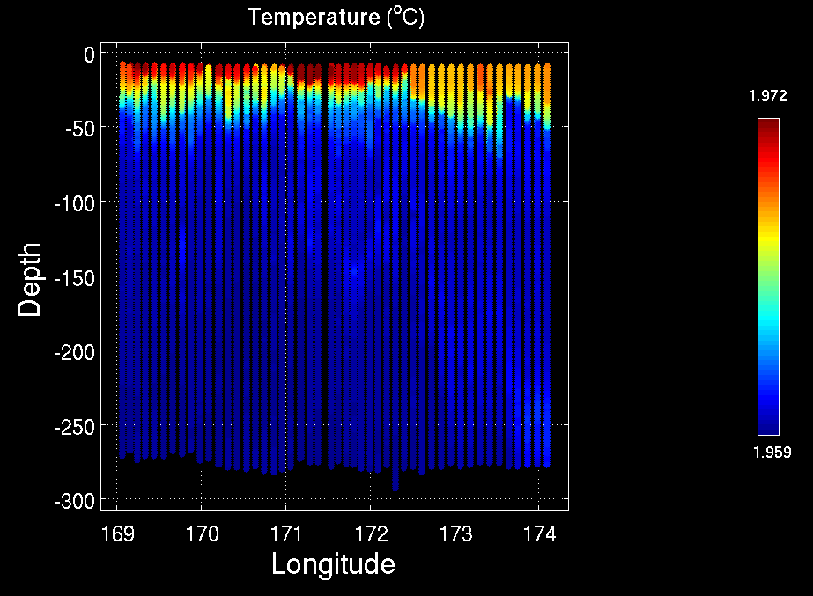
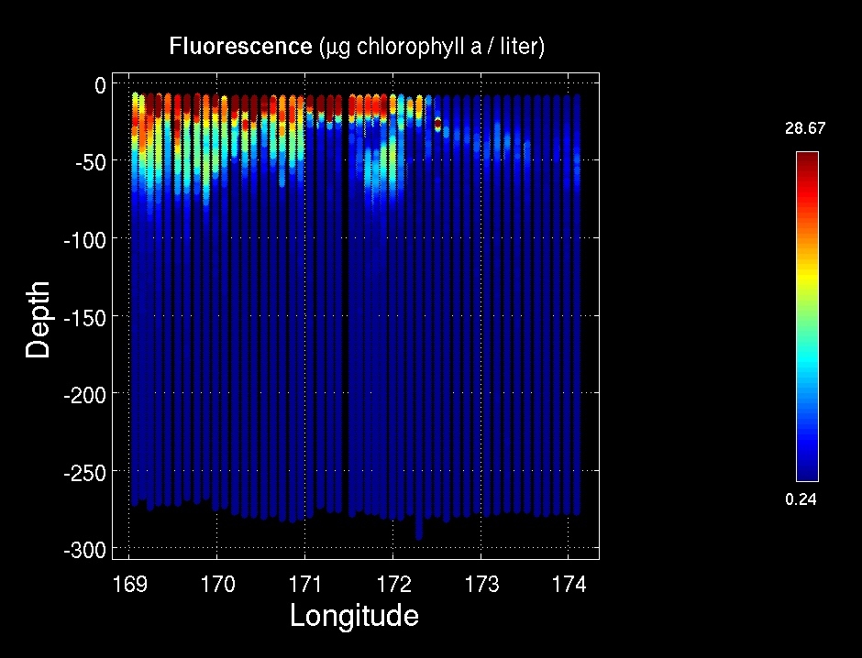
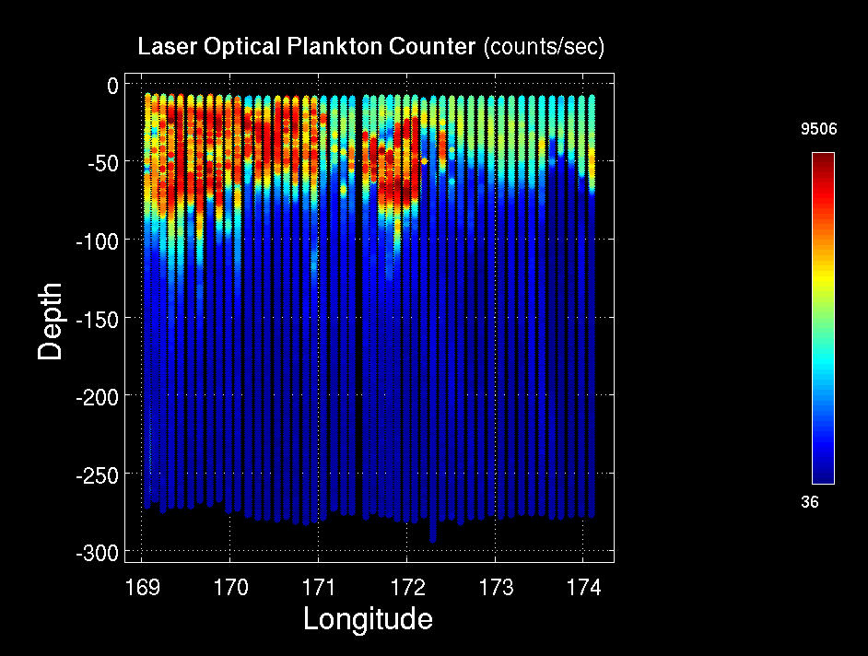
MVP Survey: Ice Edge / High Biomass / Low Biomass
Temperature
Salinity
Fluorescence
LOPC
Ice Edge HB1 LB1

Slide 27
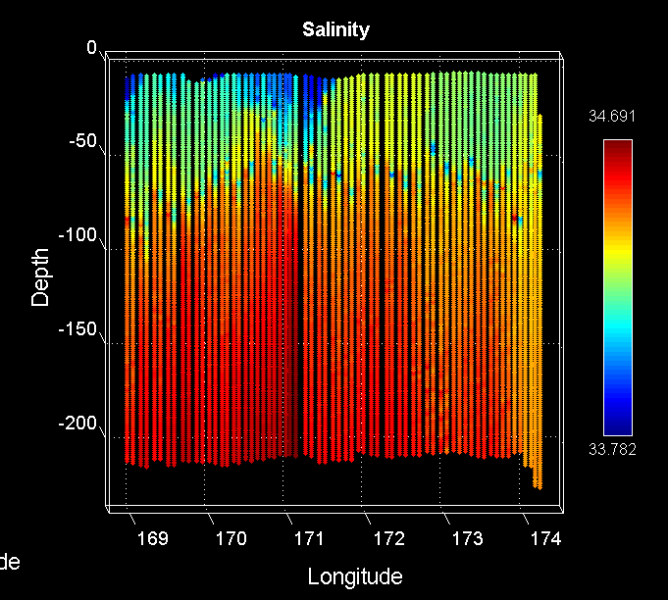
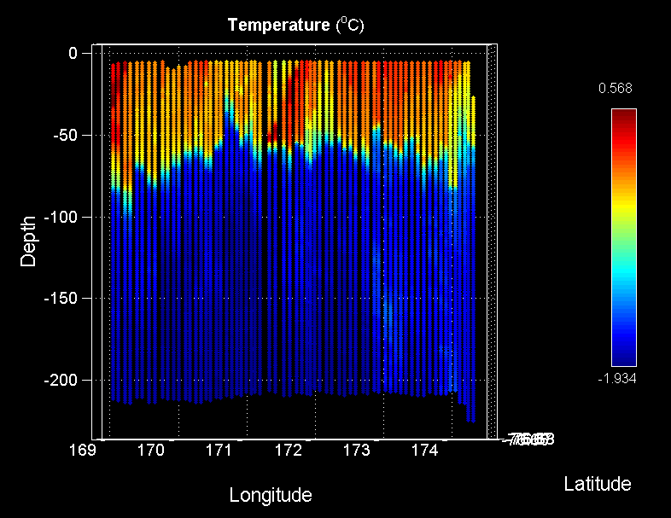
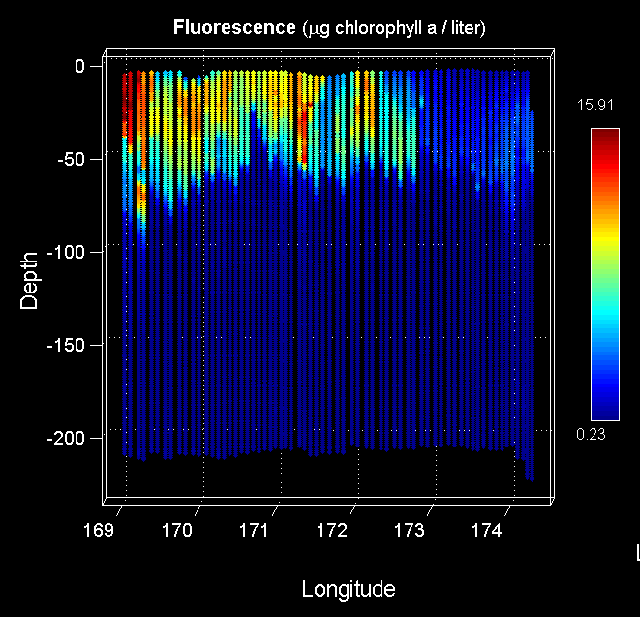
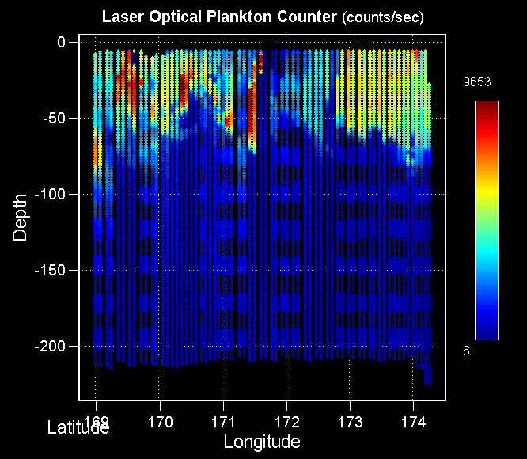
MVP Survey: Ice Edge / High Biomass / Low Biomass – 2nd
Salinity
Temperature
Fluorescence
LOPC
Ice Edge HB1 LB1

Slide 28
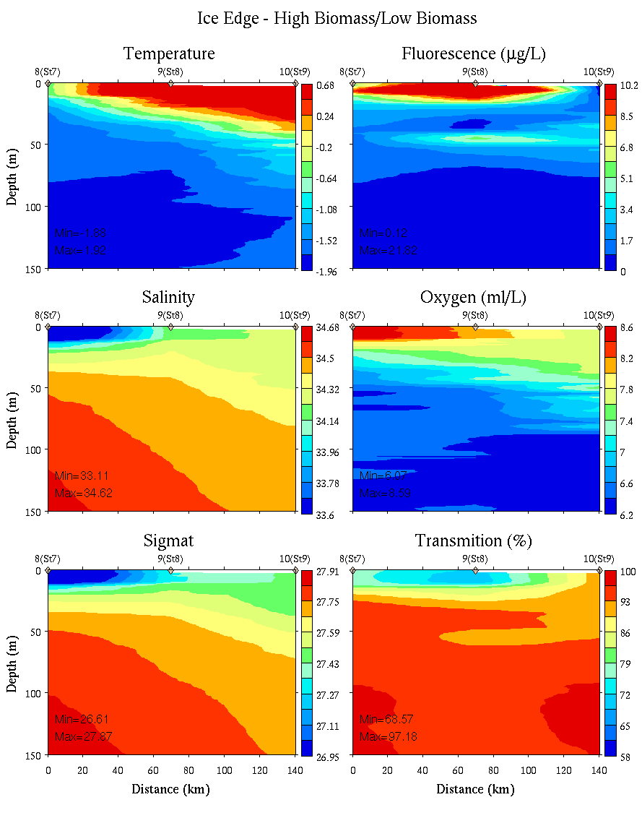
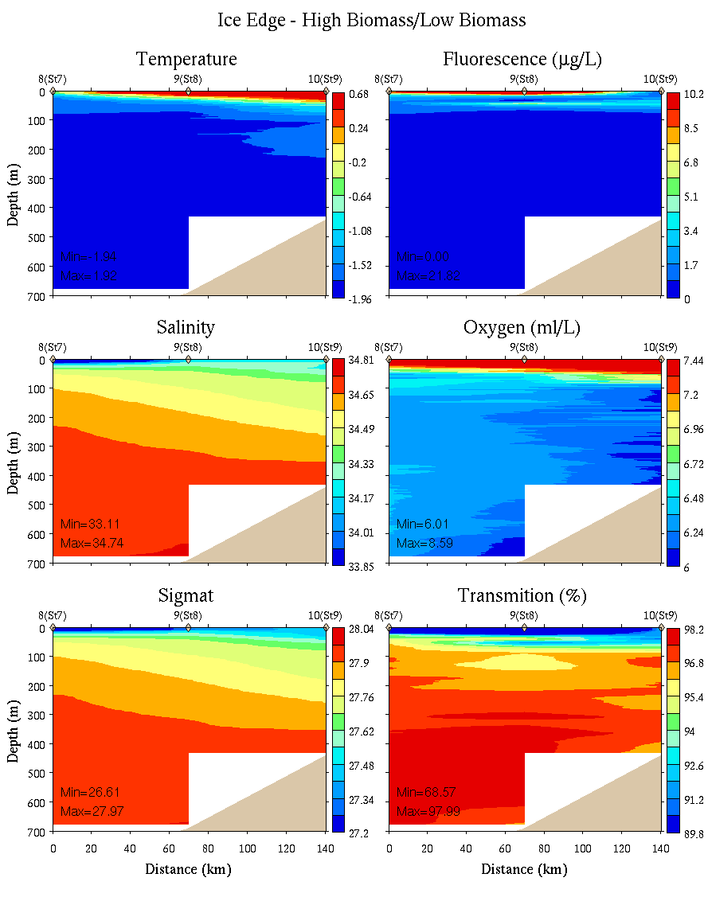
Ice Edge – High Biomass – Low Biomass
0-150m
0-700m

Slide 29
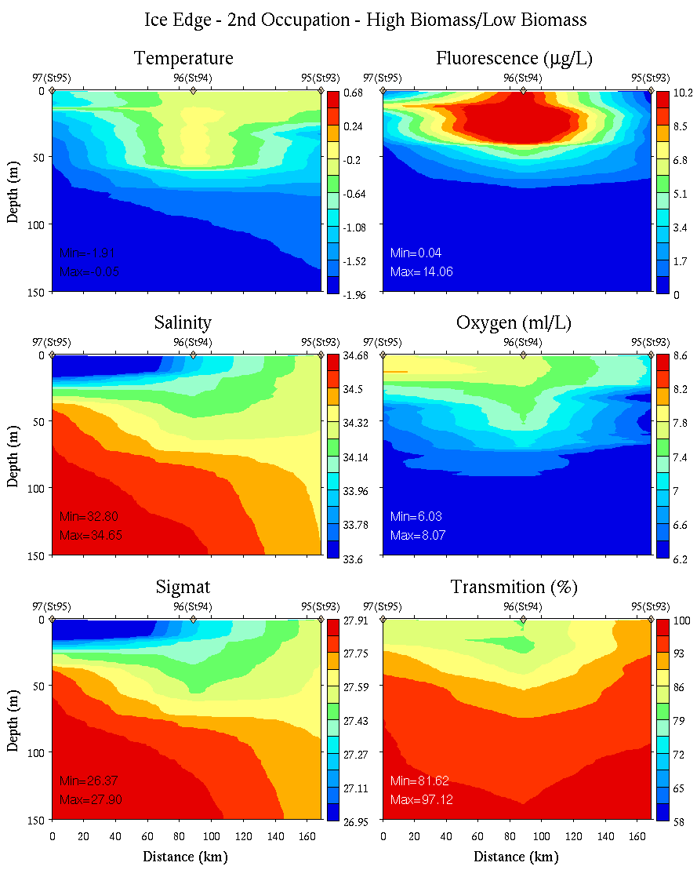
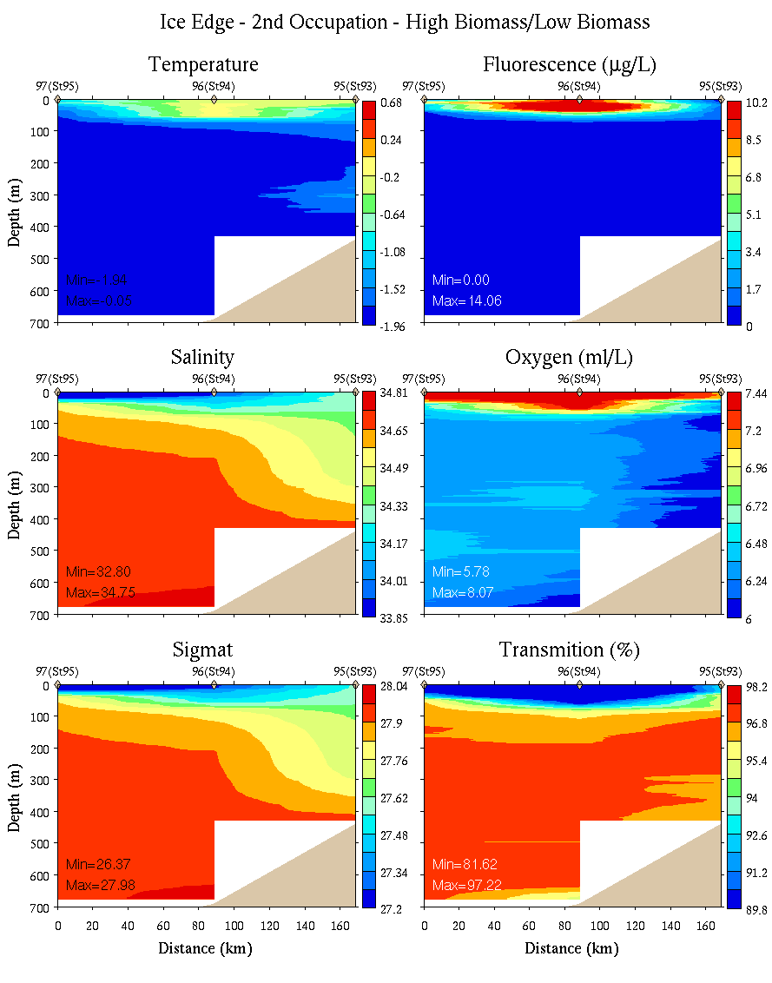
Ice Edge – High Biomass – Low Biomass: 2nd
0-150m
0-700m

Slide 30
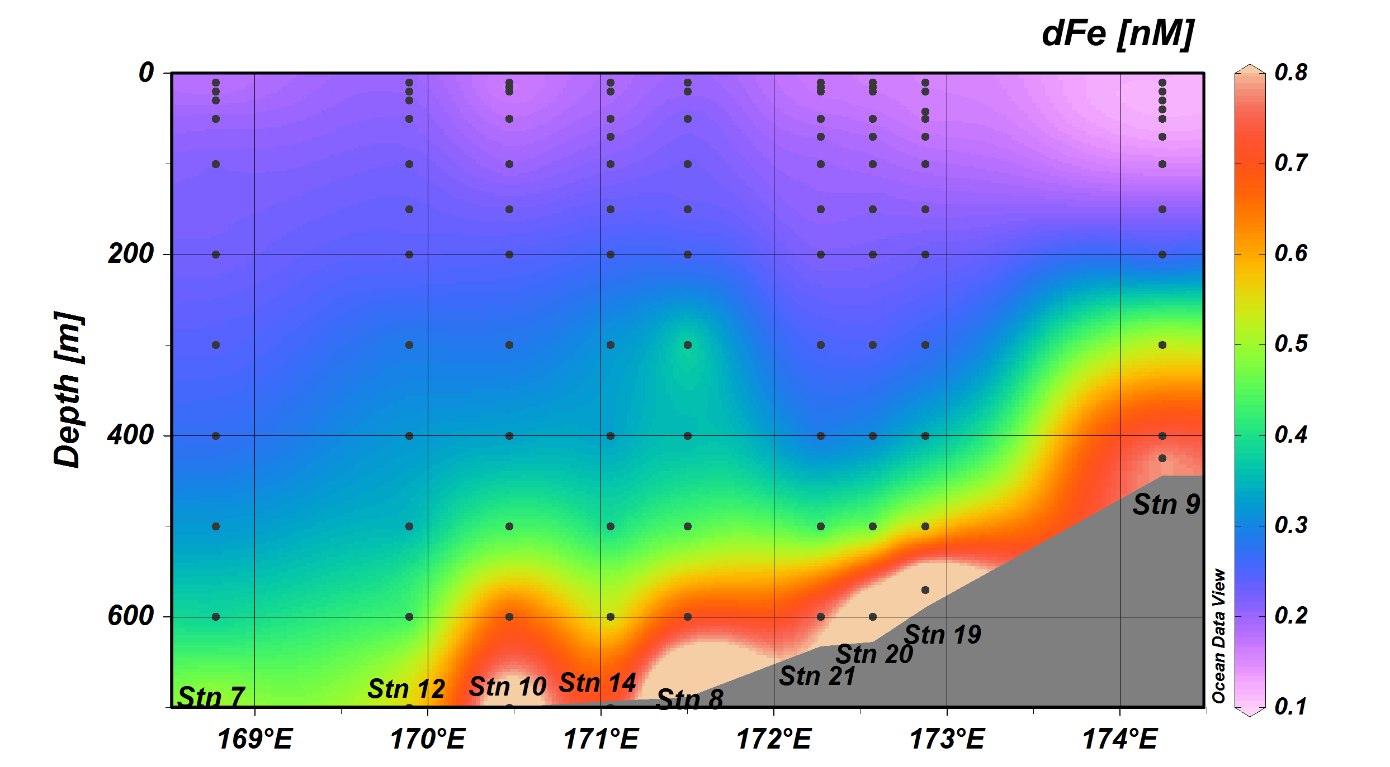
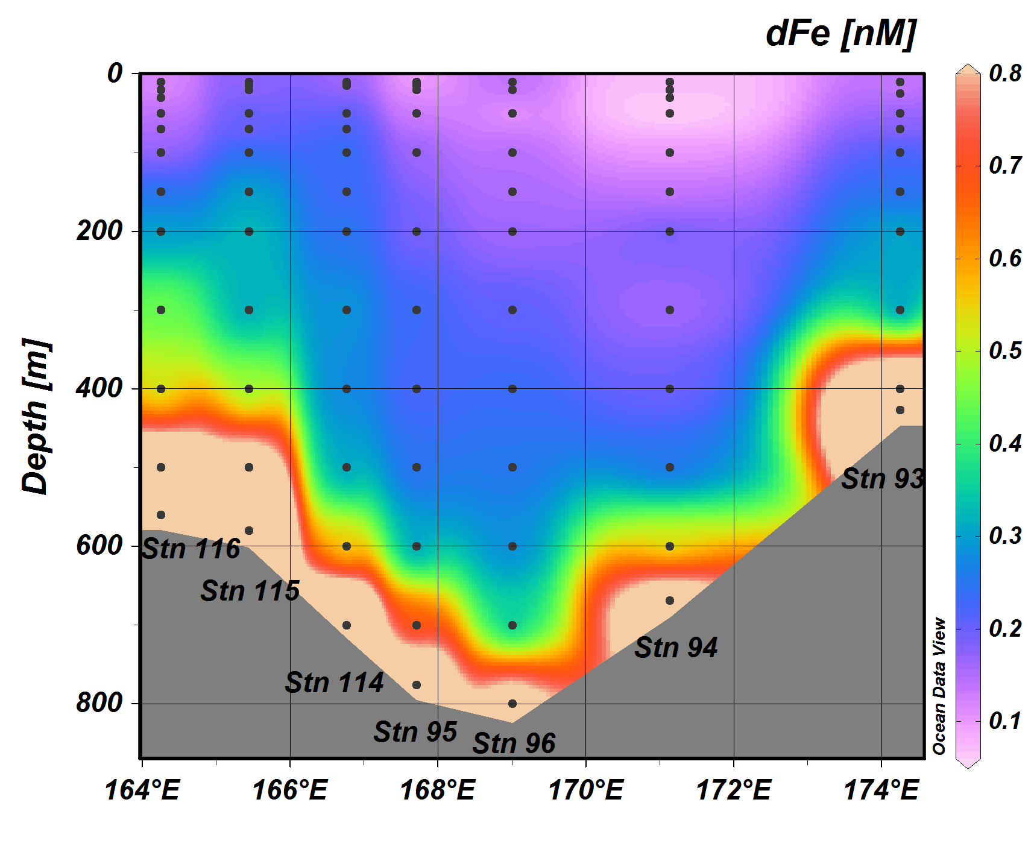
Sedwick group Fe data
Jan 11-20
Jan 30 – Feb 6

Slide 31
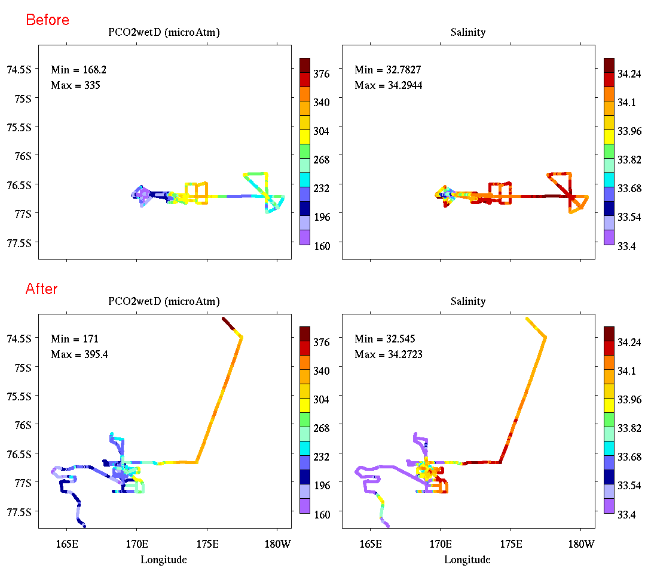
Underway pCO₂ and salinity
pCO₂
Salinity
Jan 15-20
pCO₂
Salinity
Jan 30 – Feb 6

Slide 32
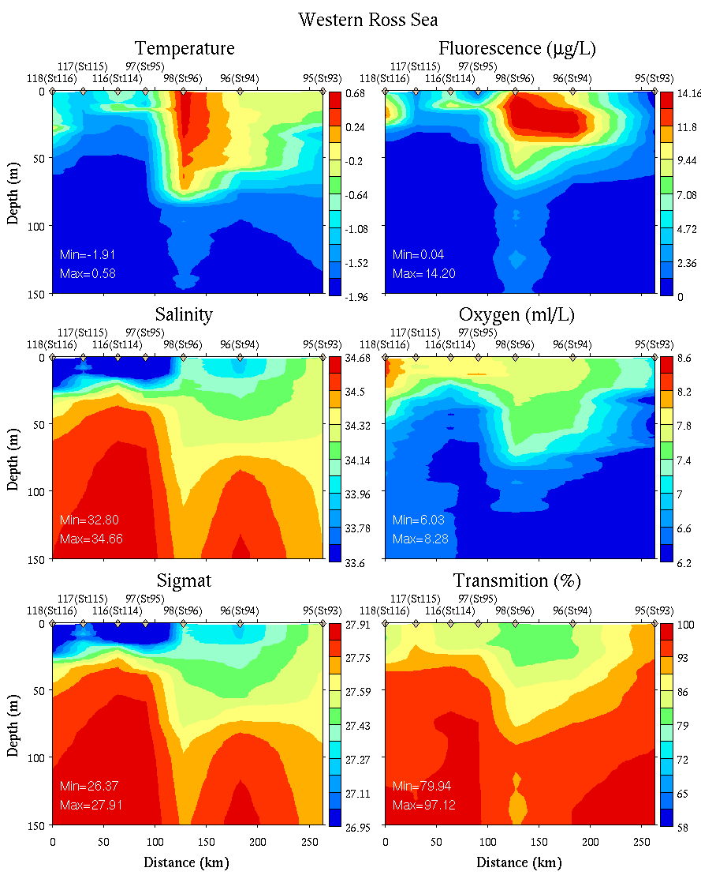
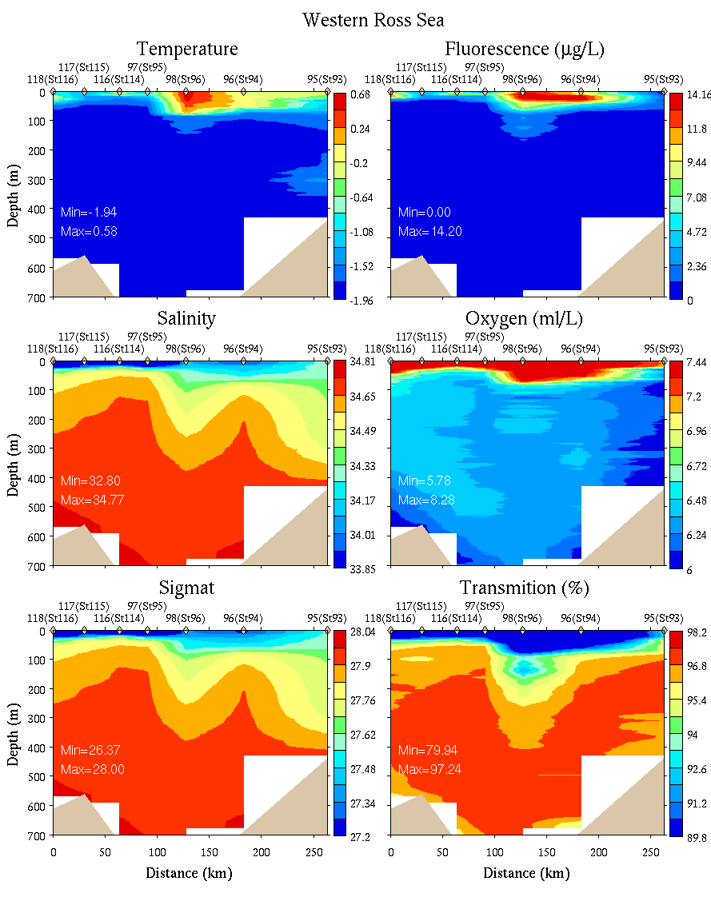
Western Ross Sea
0-150m
0-700m

Slide 33
Sedwick group Fe data
Jan 11-20
Jan 30 – Feb 6

Slide 34
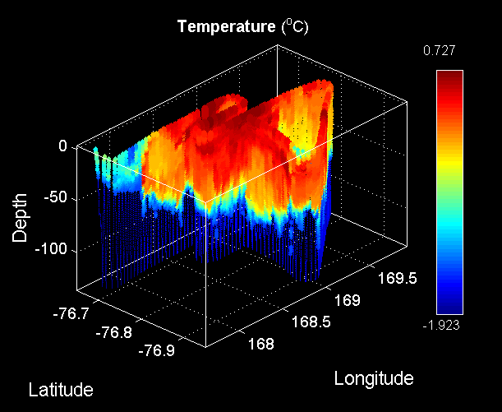
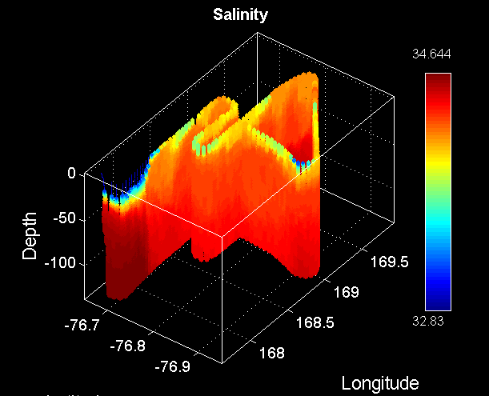
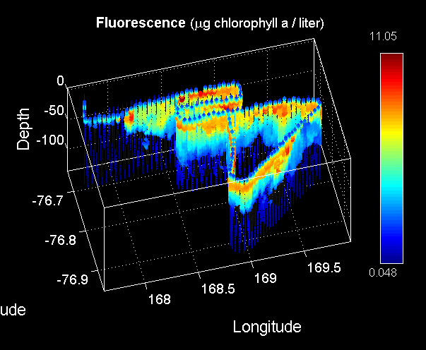
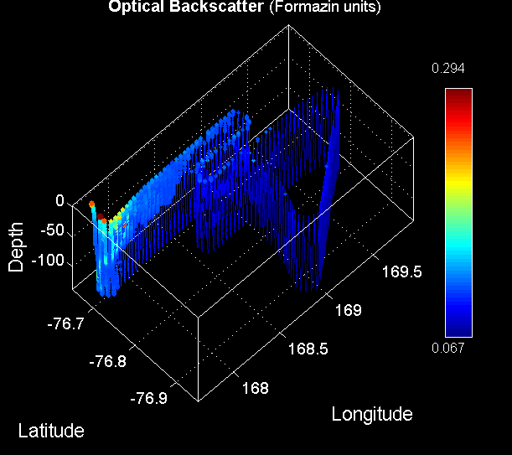
Ice Edge Eddy VPR Survey (VPR11)
Temperature
Salinity
Fluorescence
Backscatter

Slide 35
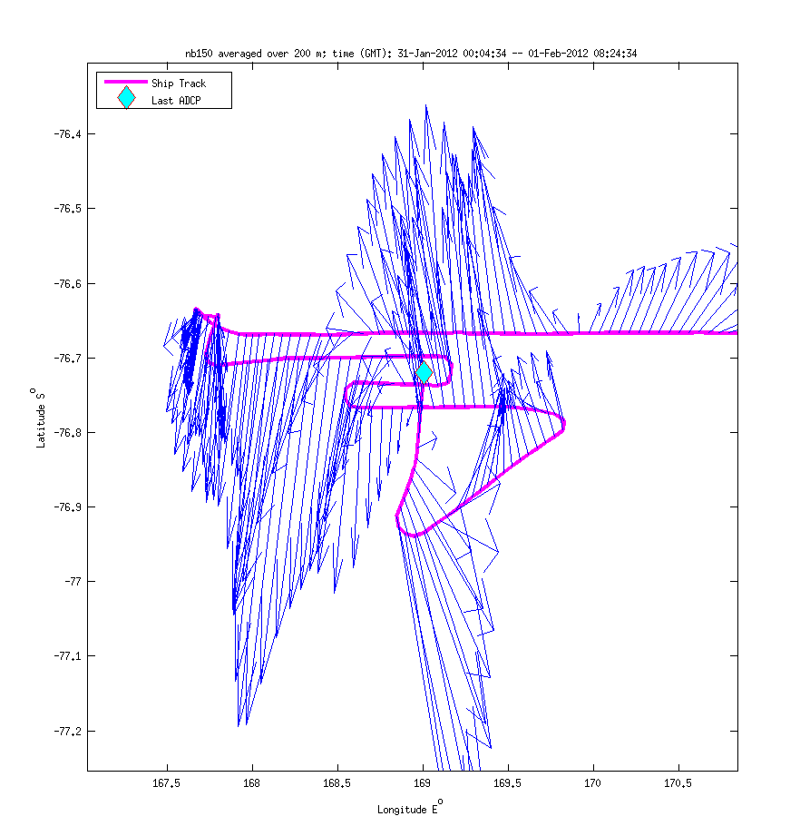
Ice Edge Eddy ADCP Survey
Anticyclone #2

Slide 36
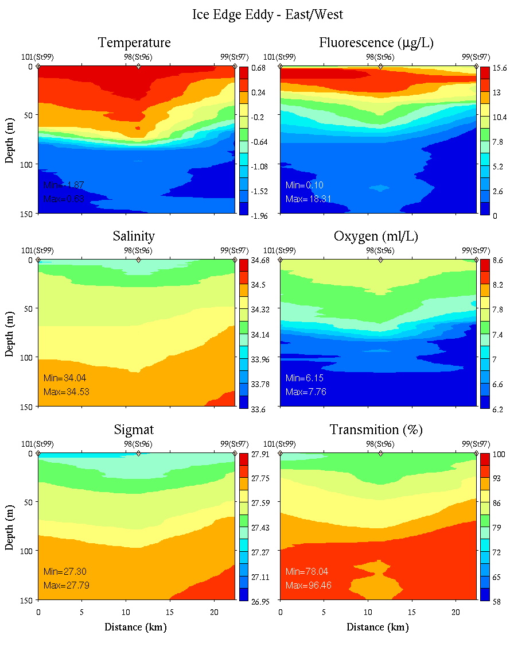
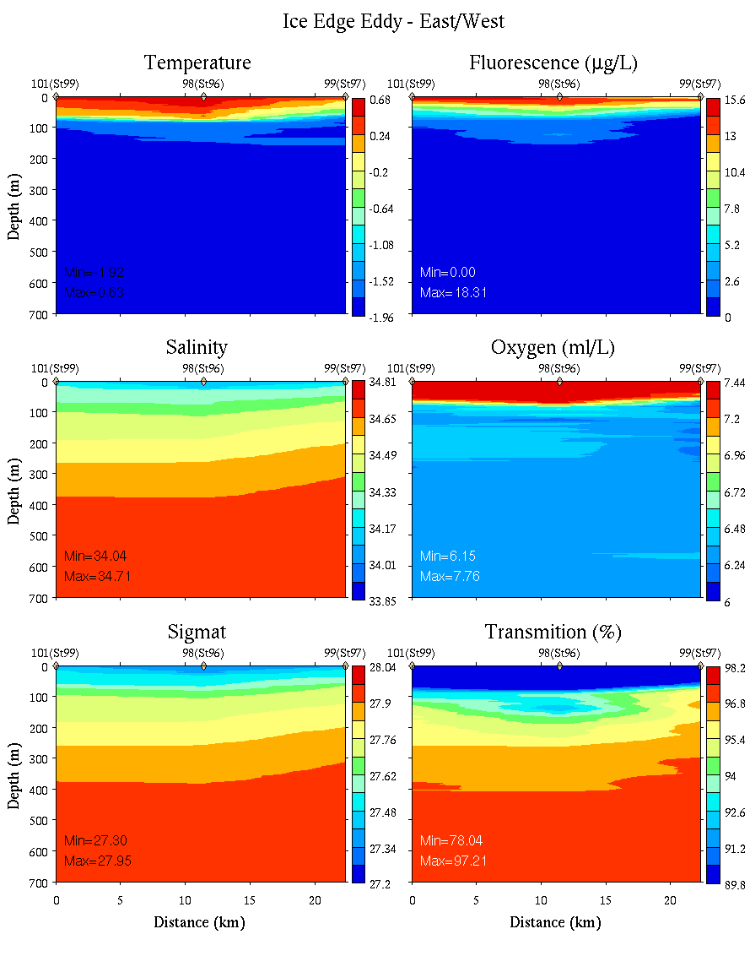
Ice Edge Eddy: East-West
0-150m
0-700m

Slide 37
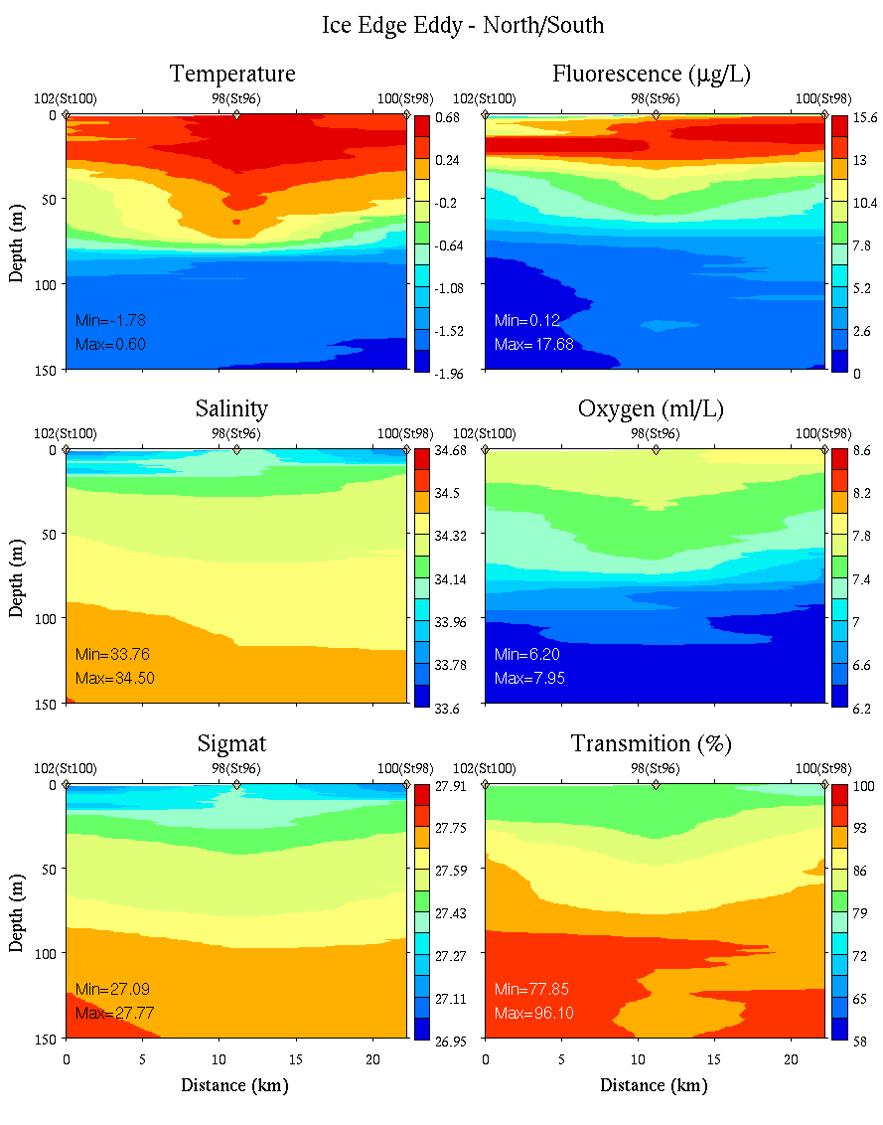
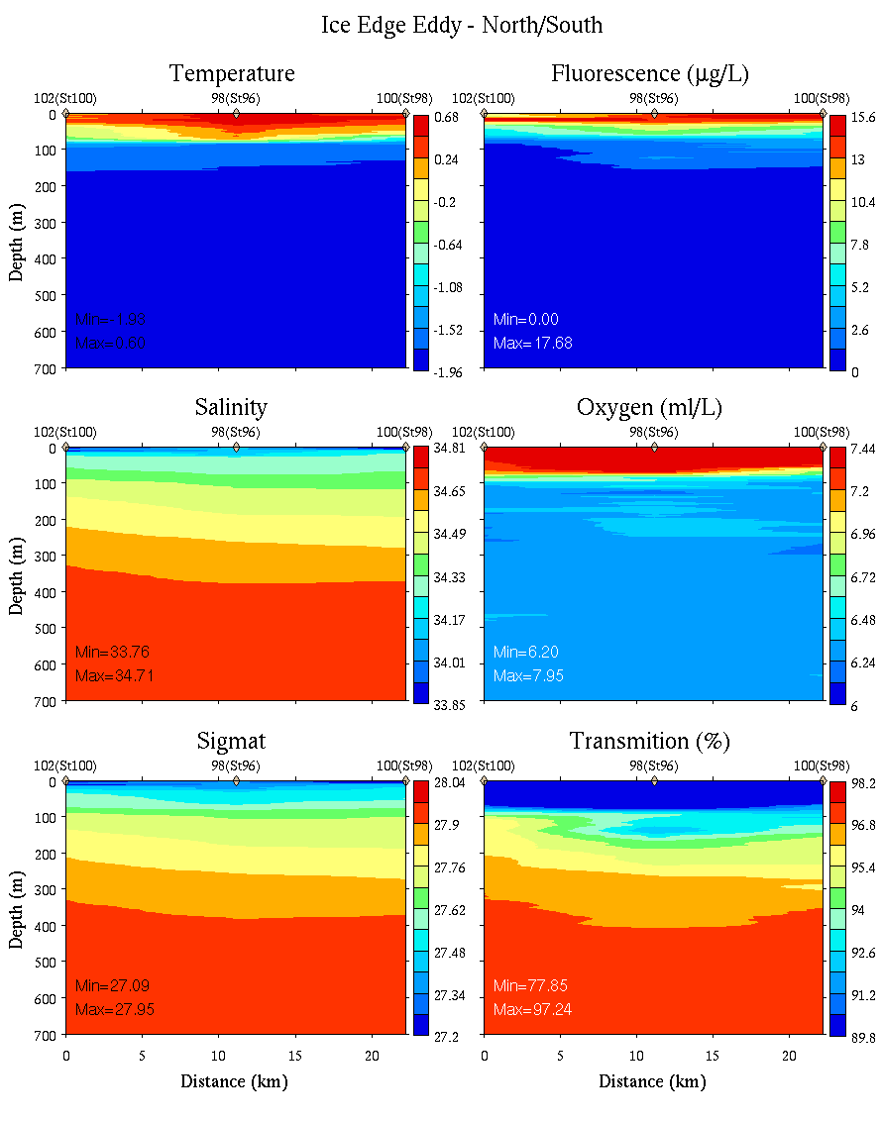
Ice Edge Eddy: North-South
0-150m
0-700m

Slide 38
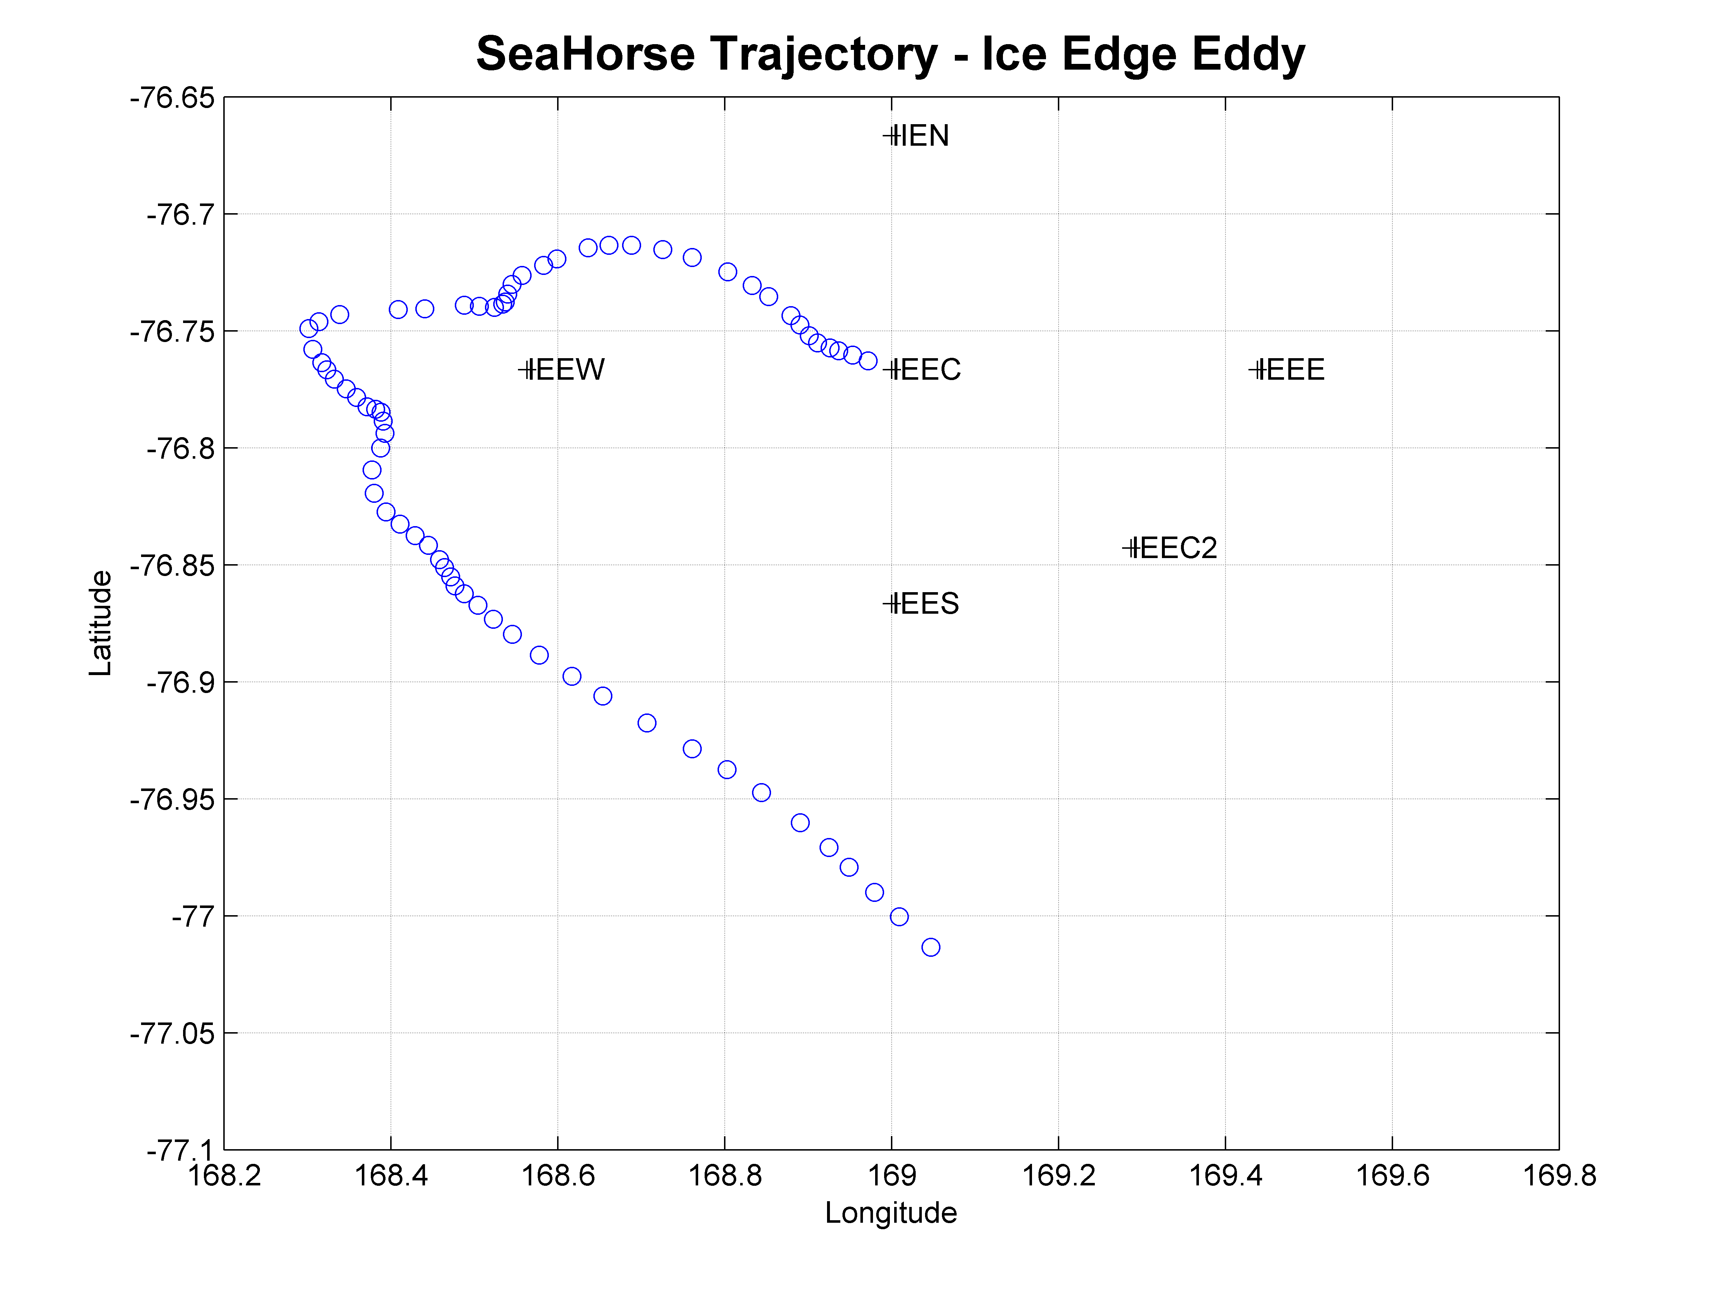
Ice Edge Eddy SeaHorse Deployment
Temperature
Chlorophyll
Salinity
Oxygen

Slide 39
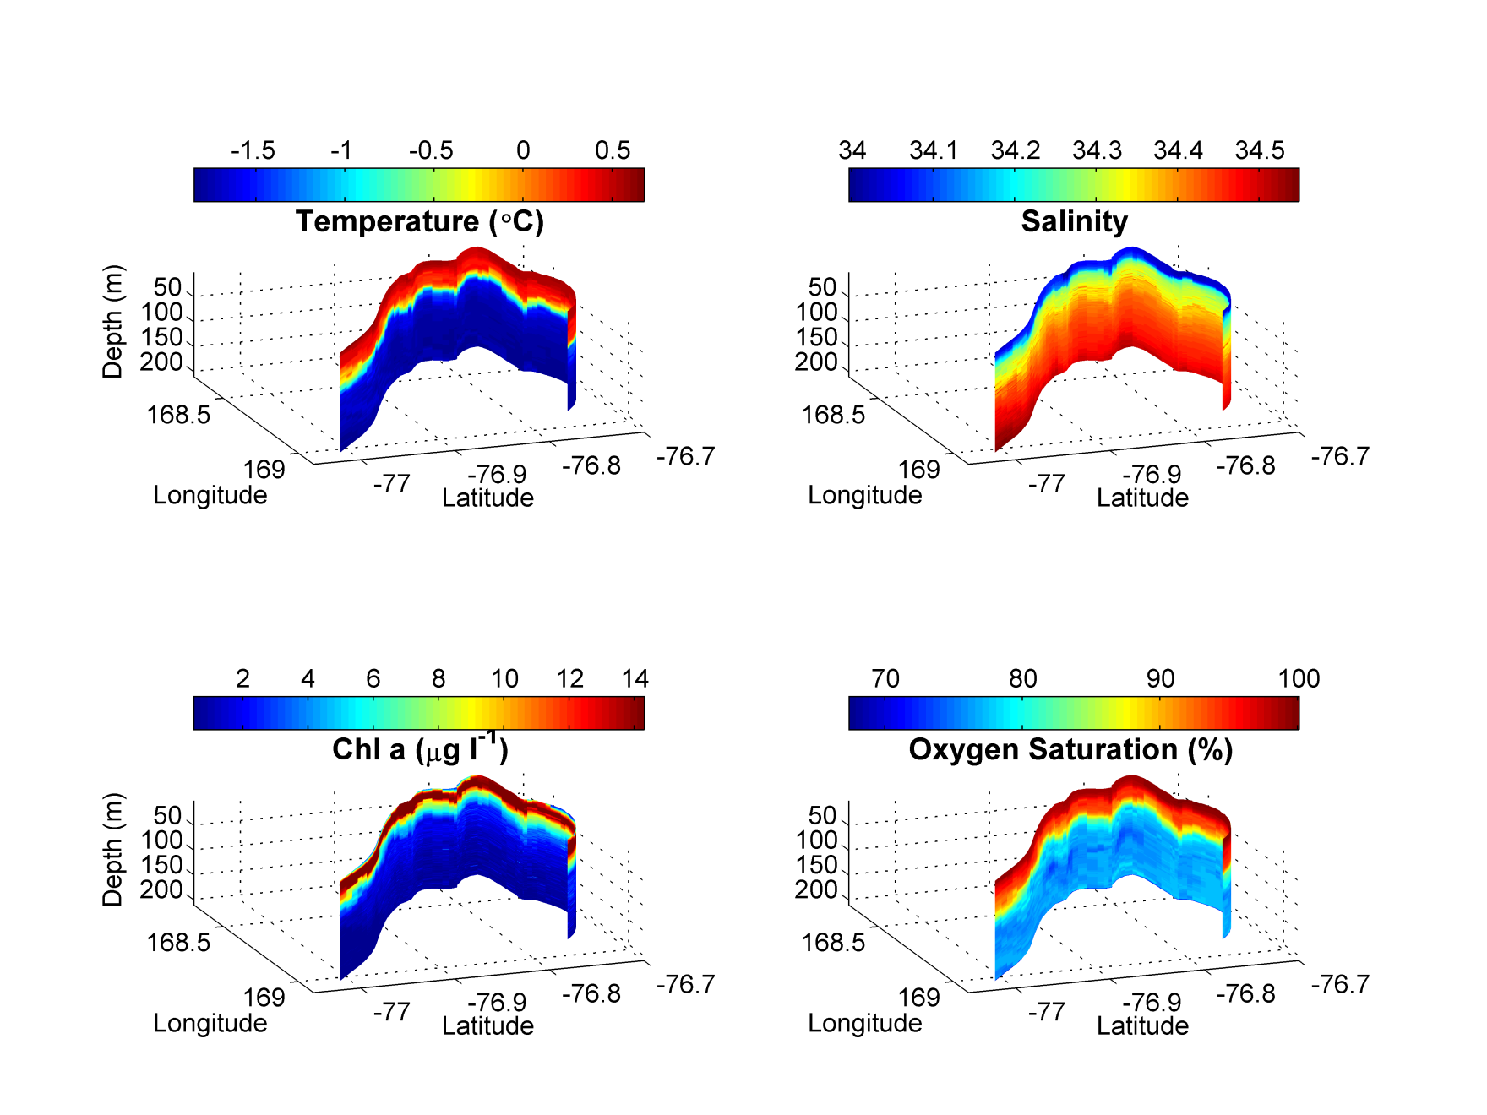
Ice Edge Eddy SeaHorse Deployment
Temperature
Chlorophyll
Salinity
Oxygen

Slide 40
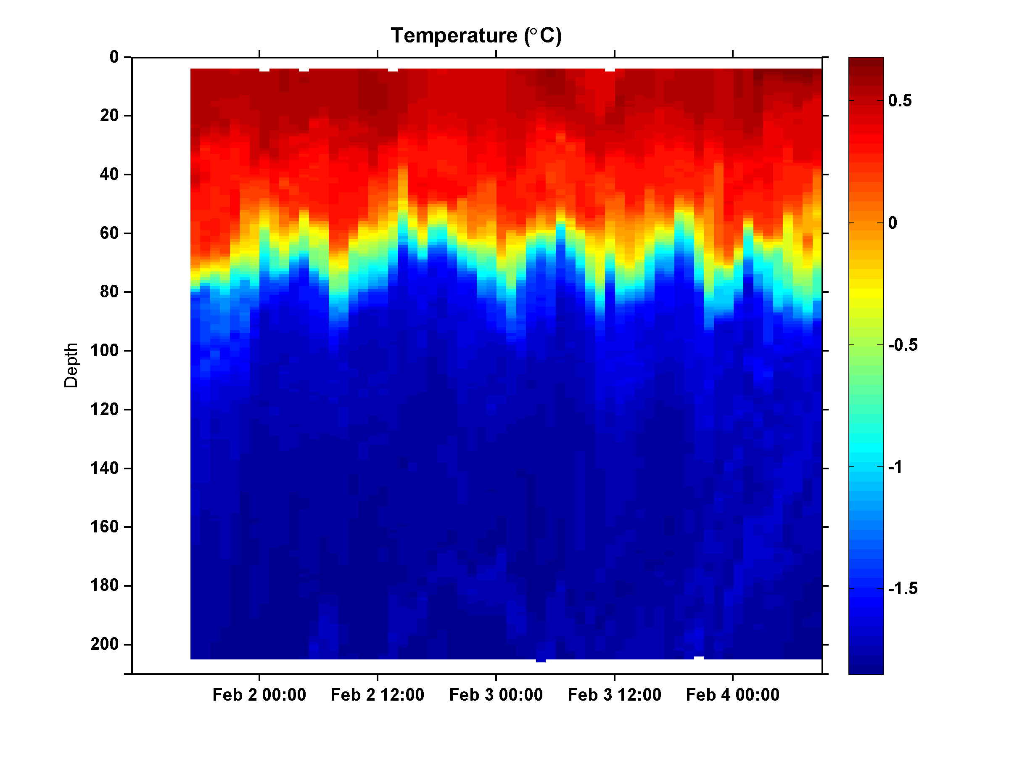
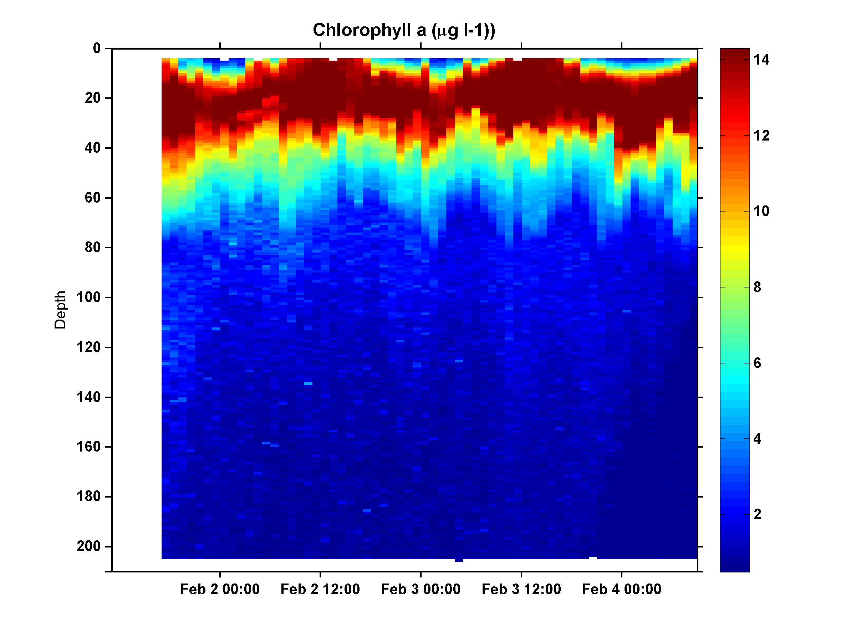
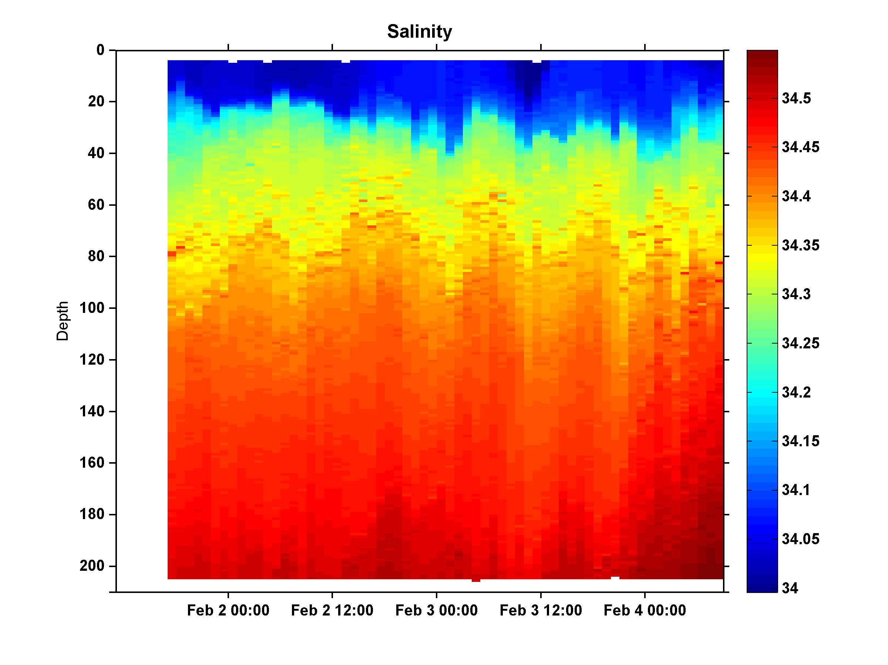
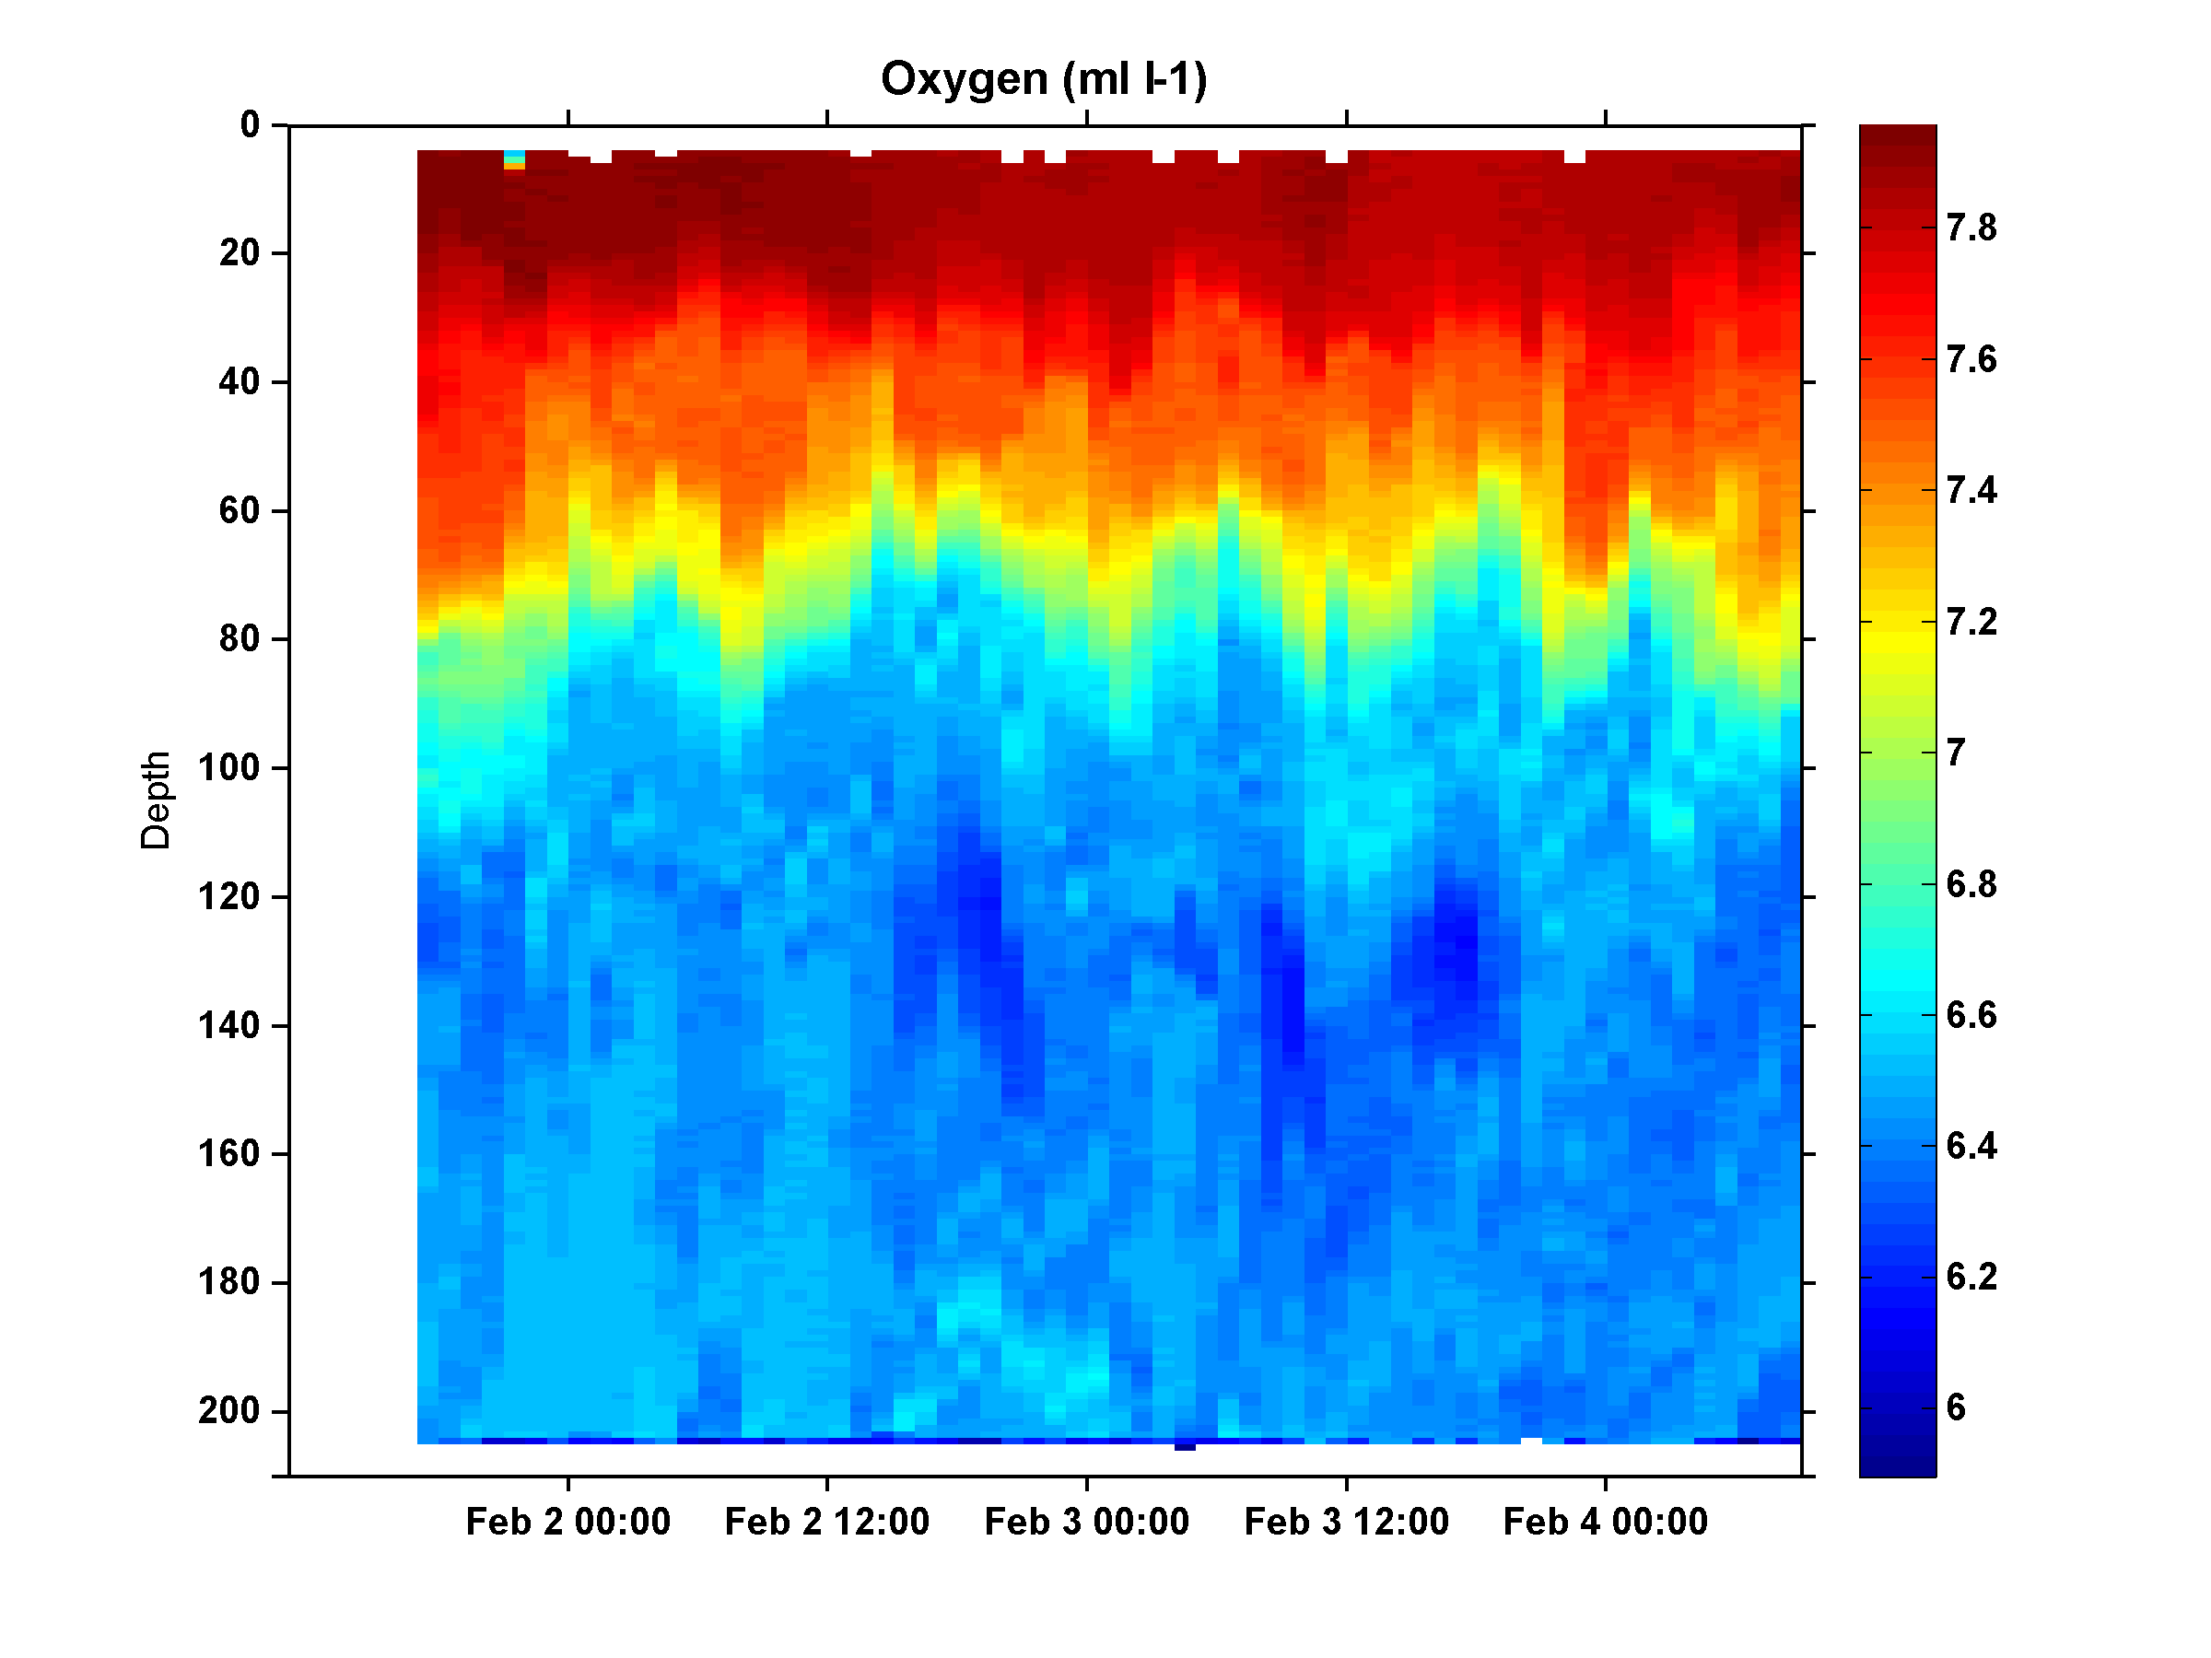
Ice Edge Eddy SeaHorse Deployment
Temperature
Chlorophyll
Salinity
Oxygen

Slide 41
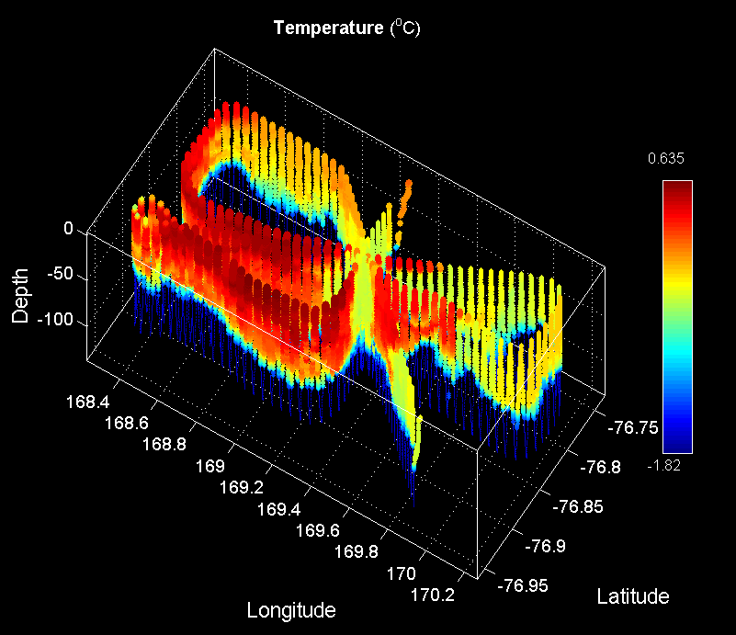
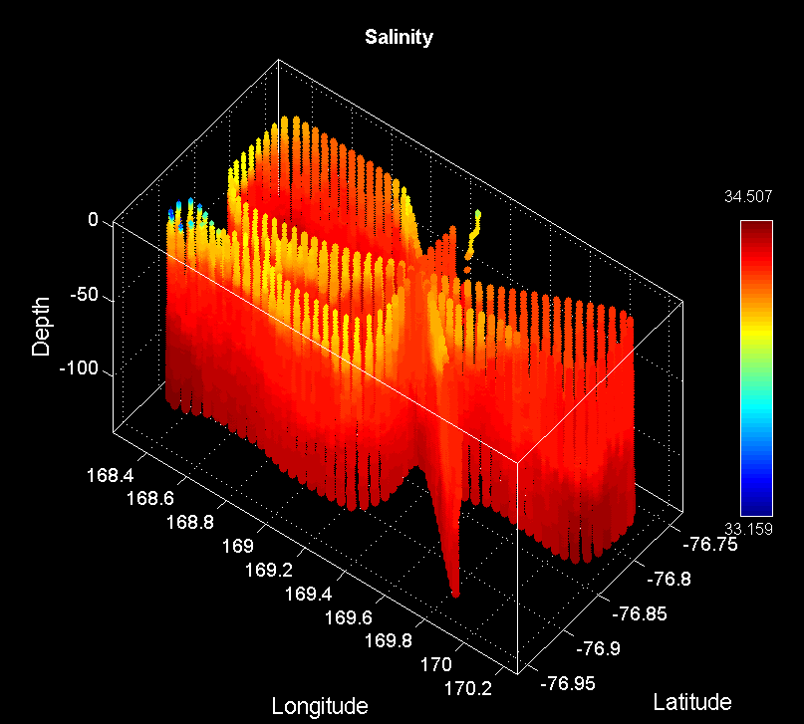
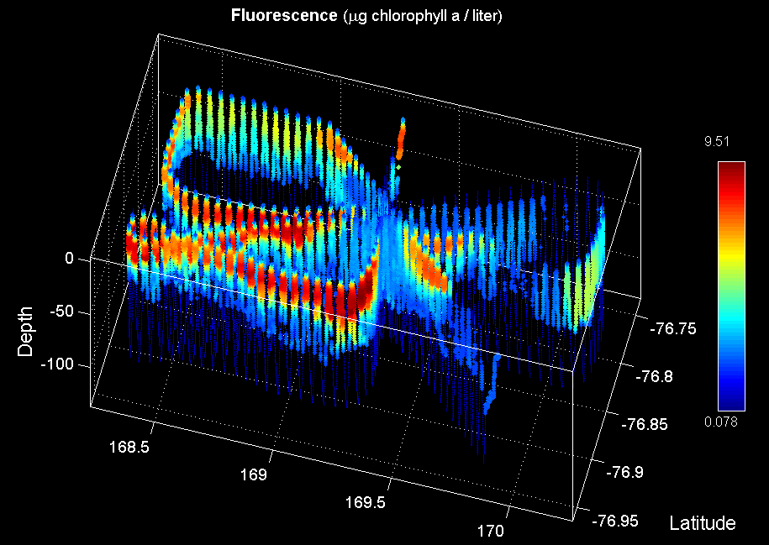

Ice Edge Eddy VPR Survey (VPR13)
Temperature
Salinity
Fluorescence
Backscatter
W,F,H
C,S,L

Slide 42


Ice Edge Eddy – Feb 4 MODIS
Chlorophyll
SST
Eddy center
Eddy center

Slide 43


N-S Section at 169E
0-150m
0-700m

Slide 44

North-South Section at 169E
0-700m
Sedwick et al. Fe data

Slide 45


VPR Frontal Survey Feb 3
MODIS Feb 1
112
106
111
107
109
110
108

Slide 46




Frontal Area VPR Survey (VPR12)
Temperature
Salinity
Fluorescence
Backscatter

Slide 47


Front - North
0-150m
0-700m

Slide 48


Front - middle
0-150m
0-700m

Slide 49


Front - South
0-150m
0-700m

Slide 50


N-S Section at 170E
0-150m
0-700m

Slide 51

Western Ross Sea – McMurdo Sound
VPR Survey trackline overlayed on Feb 4 MODIS image

Slide 52




Western Ross Sea – McMurdo Sound
VPR Survey (VPR14-15)
Temperature
Salinity
Fluorescence
Backscatter

Slide 53

And now for the exciting conclusion of the mystery of the planktonic beans…

Slide 54



Eddy 2
Outside Eddy
Inside
Eddy
Density
Phaeocystis colonies
“Kidney beans”

Slide 55

Images from dissecting scope
16x, 1mm
16x
16x
40x
16x, 1mm

Slide 56

High (Hai) magnification image of bean from St. 96, 100/120m pooled sample

Slide 57
Gut content analysis (Hai)
Hoop net, station 113
Ice Edge Eddy Center
Krill – empty
Pteropod – empty
Amphipod – lots of diatoms

Slide 58
PRISM cruise track
I. ACC Sea Ice
II. Eastern Ross Sea Eddies
III. Western Ross Sea
IV. Ross Bank
V. Ross Ice Shelf
VI. Joides Trough
VII. Western Ross Sea II

Slide 59

Short Term Experiment Locations

Slide 60
Long-Term: Incubation Experiment 1 – Eddy 2

Slide 61
Long-Term: Incubation Experiment 2 – Ross Bank

Slide 62
Long-Term: Incubation Experiment 3 – Ross Ice Shelf

Slide 63
Extras

Slide 64

Feb 5 MODIS

Slide 65

Extracted Chl versus CTD Fluorometer

Slide 66

Ice Edge – High Biomass – Low Biomass: 2nd
0-700m
Sedwick et al. Fe data

Slide 67


Ross Bank Survey: E-W transect
0-150m
0-700m

Slide 68


Ross Bank Survey: N-S transect
0-150m
0-700m

Slide 69


Ross Bank Survey: SE-NW transect
0-150m
0-700m

Slide 70
Science Meeting 2/5/12
Joides Trough

Slide 71




Ross Bank – Pennell Bank – Joides Trough – Mawson Bank VPR Survey (VPR10)
Temperature
Salinity
Fluorescence
Backscatter

Slide 72


Ross Bank – Pennell Bank – Joides Trough – Mawson Bank XBT section
Ross Pennell Mawson Pennell

Slide 73


Joides Trough – Northeastern Section
0-700m
Sedwick et al. Fe data
Note axis reversal

Slide 74


Joides Trough – Southwestern Section
0-700m
Sedwick et al. Fe data
Note axis reversal

Slide 75




Joides Trough to Western Ross Sea MVP Survey
Temperature
Salinity
Fluorescence
LOPC

Slide 76


Pennell Bank – Western Ross Sea XBT section
Pennell WRS

Slide 77

Joides Trough – Southwestern Section
0-150m
0-700m

Slide 78


Joides Trough – Northeastern Section
0-150m
0-700m

Slide 79

Joides Trough – Northeastern Section
0-150m
0-700m

Slide 80
Science Meeting1/29/12
Ross Bank Process Study
Ross Ice Shelf Process Study

Slide 81





Ross Bank VPR Survey (VPR9, 1/20-1/21)
Temperature
Salinity
Fluorescence
Backscatter

Slide 82


Ross Bank Survey: E-W transect
0-150m
0-700m

Slide 83


Ross Bank Survey: N-S transect
0-150m
0-700m

Slide 84


Ross Bank Survey: SE-NW transect
0-150m
0-700m

Slide 85


Dissolved Fe on Ross Bank
SE-NW section
N-S section

Slide 86

Ross Bank tidal velocity amplitude
SeaHorse

Slide 87




Ross Bank SeaHorse Deployment
Temperature
Chlorophyll
Salinity
Oxygen

Slide 88
Ross Bank Survey: SE-NW transect
0-150m
0-700m

Slide 89


Ross Bank Survey #2: SE-NW transect
0-150m
0-700m

Slide 90

Ross Bank SE-NW transect before and after

Slide 91
Fe on the crest of Ross Bank: before and after
Ross Bank Summit, 21 Jan 2012
dissolved Fe (nM)
depth
(m)
Ross Bank Summit, 26 Jan 2012
dissolved Fe (nM)
depth
(m)

Slide 92



Ross Bank VPR/ADCP Survey
ADCP, 0-200m Padman et al. tidal model Subtidal currents
Notes:
Dear Laurie,
Just wanted to send along a note of thanks for making your Ross Sea tidal model available. We are using it in real-time to detide the underway ADCP data in order to estimate the subtidal flow. The attached figure shows some recent results from a survey of Ross Bank, with the central crossing point of all the tracks located on the crest. Note that the line running SE-NW has been occupied twice, once when the tide was running north, and the other when the tide was running south (middle panel; two tracks indicated by black arrows). Close examination of the predicted subtidal flow (right panel) shows a consistent depiction of the residual current, which is to the north SE of the crest and to the south NW of the crest. The direction of the around-bank flow is qualitatively consistent with expectation from the Dinniman et al. ROMS model results, and we will certainly make detailed comparisons in due course. In any case, we thought you might enjoy hearing about our initial findings. Once again, thanks for providing this great resource!
Best Wishes,
Dennis McGillicuddy

Slide 93



VPR Section toward Ross Bank
(VPR8, 1/20-1/21)
Temperature
Salinity
Fluorescence

Slide 94




Ross Ice Shelf MVP Survey
Temperature
Salinity
LOPC
Fluorescence

Slide 95

Ross Ice Shelf MVP Survey

Slide 96



Ross Bank to Ice Shelf XBT Survey

Slide 97


Ice Shelf Survey
0-150m
0-700m

Slide 98


Ice Shelf Survey
Sedwick et al. Fe
0-700m

Slide 99


Ross Ice Shelf satellite imagery – Jan 22
Chl
SST

Slide 100


Ross Ice Shelf satellite imagery – Jan 25
Chl
SST

Slide 101







Ross Ice Shelf Eddy (VPR9, 1/26)
Temperature
Salinity
Fluorescence

Slide 102


Ice Shelf Eddy: East- West Section
0-150m
0-700m

Slide 103


Ice Shelf Eddy: North-South Section
0-150m
0-700m

Slide 104

Ice Shelf Eddy: East- West Section
0-700m
Sedwick et al. Fe
Lateral eddy flux of (iron) and biomass?

Slide 105
Extras

Slide 106
Ice Edge – High Biomass – Low Biomass
0-150m
0-700m

Slide 107


Ice Edge – High Biomass – Low Biomass
0-150m
0-700m

Slide 108


SST Jan 13 MODIS Chl Jan 12

Slide 109

SSMI Time-series Dec 24-Jan 26

Slide 110

Ross Ice Shelf ADCP Survey

Slide 111

Ross Ice Shelf ADCP Survey
178 30E 179 45W

Slide 112
Science Meeting1/22/12

Slide 113

SeaHorse Deployment in Eddy 3

Slide 114

SeaHorse Deployment in Eddy 3

Slide 115

Ross Bank Survey

Slide 116

PRISM cruise plan
H₁: CDW
H₂: Sediment: banks/coastal
H₃: Sea ice
H₄: Glacial melt
H₅: ISW
H₆: Dry Valleys
H₇: Vents
H₁,
H₃
H₁,
H₃
H₂,
H₃
H₂,
H₃
PHS
H₂
PHS
HV
H₁
HV
H₂
H₄
H₄
HV: Hydrothermal vent near Franklin Island
PHS: penguin hotspots - WOS
HV: Hydrothermal vent near Franklin Island
PHS: penguin hotspots - WOS

Slide 117

PRISM Sampling
H₁: CDW
H₂: Sediment: banks/coastal
H₃: Sea ice
H₄: Glacial melt
H₅: ISW
H₆: Dry Valleys
H₇: Vents
Outside ice
H₁
In ice
H₃
H₁
H₁
Outside ice
Deploy MVP,
TM Towfish
UW XBTs
H₂
H₂
Stations in MCDW
H₃
H₄
H₁
H₅
Stations in ISW

Slide 118
Science Meeting1/19/12
Western Ross Sea Mesoscale Process Study: Jan 11-19
Large-scale transect: Ice edge – High Biomass – Low Biomass
MVP
CTD transect (stations 7-9)
Eddy 3:
VPR survey (VPR 4)
CTD grid – 1st occupation (stations 10-18)
VPR survey (VPR 7)
CTD grid – 2nd occupation (stations 27-35)
Frontal region
VPR survey (VPR 5)
CTD transect (stations 19-21)
Low Biomass region
VPR survey (VPR 6)
CTD transect (stations 22-26)
Revisit Eddy 2

Slide 119

Western Ross Sea Process Study: Jan 11-19
Frontal Survey
Station 9
LB1
Eddy 3
Station 8
HB1
Ice Edge
Station 7
Low-biomass survey

Slide 120

Western Ross Sea Process study Jan 11-19

Slide 121
MVP Survey: Ice Edge / High Biomass / Low Biomass
Temperature
Salinity
Fluorescence
LOPC
Ice Edge HB1 LB1

Slide 122

Sedwick group Fe data

Slide 123

Ice-Edge to Low Biomass (With Front)

Slide 124

Frontal and low-biomass area surveys
22
23
24
25
26
21
20
19

Slide 125




VPR Frontal Survey 1/16-17
Temperature
Salinity
Fluorescence
Backscatter
Station 19
20
Station 21

Slide 126

Frontal ADCP Survey (VPR5)

Slide 127


High Biomass / Low Biomass Frontal Region
0-150m
0-700m

Slide 128

High Biomass / Low Biomass Frontal Region
0-700m CTD: Note x-axis reversal
Sedwick group Fe data

Slide 129


High Biomass / Low Biomass Frontal Region
0-150m
0-700m

Slide 130

Nutrient data stations 1-12
Phosphate Nitrite Nitrate+Nitrite
Ammonium Silicate Chlorophyll
N+N / P N+N/Si CORSACS Fe

Slide 131

Nutrient data stations 1-12
Phosphate
Silicate
Nitrate + Nitrite
Nitrate + Nitrite

Slide 132




Low biomass area survey – 1/17/12
Temperature
Salinity
Fluorescence
Backscatter
Station 22
Station 26

Slide 133

Low Biomass ADCP Survey (VPR6)

Slide 134


Low Biomass CTD transect
0-150m
0-700m

Slide 135


Low Biomass Area
0-150m
0-700m

Slide 136

Fm
FvFm
Low Biomass

Slide 137


CTD Fluorometer vs. Extracted Pigments
Smith lab extracted Chl
CTD
Sfc
150m
Frontal
region
Sfc
150m
Low
Biomass

Slide 138


Eddy 3 VPR Survey: VPR 4, Jan 14-15
Station 10
Station 9

Slide 139




VPR Survey of Eddy 3
Temperature
Salinity
Fluorescence
Optical Backscatter

Slide 140
Eddy 3 CTD Survey, 1st occupation
18
17
10
13
14
12
11
16
15

Slide 141


Eddy 3, First Occupation: East-West Transect
0-150m
0-700m

Slide 142


Eddy 3, First Occupation: East-West Transect
0-150m
0-700m

Slide 143


Eddy 3, First Occupation: North-South Transect
0-150m
0-700m

Slide 144


Eddy 3, First Occupation: North-South Transect
0-150m
0-700m

Slide 145

Eddy 3, First Occupation: East-West Transect
0-700m
Sedwick group Fe data

Slide 146

Fm
Fv/Fm
EDDY 3 – First Pass

Slide 147


CTD Fluorometer vs. Extracted Pigments
Smith lab extracted Chl
CTD
Sfc
150m
East-
West
Sfc
150m
North-
South

Slide 148


MODIS 1/18/11
SST
Chlorophyll
Eddy 3
Eddy 3

Slide 149




VPR Survey of Eddy 3
Temperature
Salinity
Fluorescence
Optical Backscatter

Slide 150

ADCP from 2nd VPR Survey of Eddy 3

Slide 151

SeaHorse Trajectory

Slide 152


Eddy 3, 2nd Occupation: East-West Transect
0-150m
0-700m

Slide 153


Eddy 3, 2nd Occupation: East-West Transect
0-150m
0-700m

Slide 154


Eddy 3, 2nd Occupation: North-South Transect
0-150m
0-700m

Slide 155


Eddy 3, 2nd Occupation: North-South Transect
0-150m
0-700m

Slide 156

Eddy 3, 2nd Occupation: East-West Transect
0-700m
Sedwick group Fe data

Slide 157

Hai’s microscopy

Slide 158
Analysis of VPR observations
Focus on Eddy 3 survey
Temperature, Salinity and Fluorescence in top 100 m

Slide 159


Low Salinity near surface (20 m)
High Salinity at depth (100 m)
Density is mainly controlled by salinity at these temperatures.
Dense core eddy is a cyclone.
Circulation is clockwise.

Slide 160


High temperature on the western side of the eddy center.
Higher temperatures extend through 60 m but not much deeper.

Slide 161

Max Heat at
-76.74
170.25
Total heat content relative to in-situ freezing integrated 0 to 100 m.
Largest heat content is west of eddy center.

Slide 162



Section at 76.74 S
Higher Fluor west of high Temp which is west of eddy center.
Less stratification to west.

Slide 163



Section at 170.25
Warmer and fresher on west side.
Higher fluor to the west.

Slide 164
Where did the warm water in Eddy 3 come from?
Satellite SST – Jan 13

Slide 165
Well, how did it get here?
Satellite SST – Jan 13
Eastward eddy flux of warm, fresh, (previously) high-iron meltwater?
Retreating sea ice leaves a wake of warm, fresh, (previously) high-iron meltwater?
Either way, these highly stratified conditions favor diatom blooms in the Ross Sea
Deep salinity anomaly in eddy 3
1
2

Slide 166

Eddy 2
Station 6
Inside Eddy 2

Slide 167


Eddy 2 VPR Survey
Outside Eddy
Inside
Eddy

Slide 168
Eddy 2 (VPR 3) Image Categories
Phaeocystis - Many
Phaeocystis - Individual
Marine Snow
Other
“Kidney Beans”
Blurry

Slide 169

Phaeocystis distribution
Covariance of individuals and aggregated colonies
Population center of mass deeper inside the eddy than at the periphery

Slide 170

Kidney beans and marine snow
Both abundant at depth inside the eddy

Slide 171


Slide 172
Next Up
1. Finish Ross Bank Survey
2. Deploy SeaHorse
3. CTD transect on Ross Bank
4. Ross Ice Shelf – in search of ISW
5. Return to Ross Bank
6. 2nd CTD occupation
7. Recover SeaHorse
8. Joides Trough

Slide 173
Ross Bank Survey

Slide 174

PRISM Cruise Track

Slide 175
Ice edge – High Biomass – Low Biomass
Jan 11-12
Frontal Survey
Station 9
LB1
Eddy 3
Station 8
HB1
Ice Edge
Station 7
Low-biomass survey

Slide 176
Fuel Earlier?
Current plan
Feb 5 – arrive ice edge
Earlier fueling – best case
Feb 9 – arrive ice edge
Transit – .5d
Science – 6d
Transit – .5d
Fueling – 1 d
Feb 1 - arrive ice edge
Net: -4 + 6 = 2
Earlier fueling – worst case
Feb 9 – arrive ice edge
Transit – 1.5d
Science – 2.5d
Transit – 1.5d
Fueling – 2.5d
Feb 1 - arrive ice edge
Net: -4 + 2.5 = -1.5

Slide 177
Science Meeting1/15/12

Slide 178
Ice edge – High Biomass – Low Biomass
Jan 11-12
Station 9
LB1
Ice Edge
Station 7
Station 8
HB1

Slide 179
MVP Survey: Ice Edge / High Biomass / Low Biomass
Temperature
Salinity
Fluorescence
LOPC
Ice Edge HB1 LB1

Slide 180
Eddy 3 VPR Survey: Jan 14-15
Station 10
Station 9

Slide 181
Eddy 3 VPR Survey: Jan 14-15
18
17
10
13
14
12
11
16
15

Slide 182
VPR Survey of Eddy 3
Temperature
Salinity
Fluorescence
Optical Backscatter

Slide 183
Hai’s microscopy

Slide 184
Next Up
1. Finish VPR survey at eddy center
2. Deploy SeaHorse
3. CTD at Eddy Center
4. CTD grid survey

Slide 185
Science Meeting1/11/12

Slide 186

PRISM Sampling of Eddies 1 and 2
MODIS Jan 8
Station 4
Inside Geordie
H₁
Station 5
Outside Geordie
H₃
Station 6
Inside Eddy 2
H₂
H₂
H₃
H₄

Slide 187




MVP Survey of Eddies 1 and 2: View from the SW
Salinity
Temperature
Eddy 1
Eddy 2
Fluorescence
LOPC

Slide 188

The MVP MCDW-o-meter
CDW
MCDW
AASW
LSSW, HSSW
ISW

Slide 189



Sedwick Fe data

Slide 190

Eddy 1 “Geordie”
Station 4
“Inside Geordie”
Direction of
Geordie’s
propagation
Station 5
“Outside Geordie”

Slide 191

Geordie’s Velocity Field
Station 5
“Inside Geordie”
Station 6
“Outside Geordie”

Slide 192
Tom and Tommy

Slide 193
Eddy 2
Station 6
Inside Eddy 2

Slide 194

Eddy 2’s Velocity Field
VPR
Survey
Station 6
Inside Eddy 2

Slide 195




VPR Survey of Eddy 2
Temperature
Salinity
Fluorescence
Optical Backscatter

Slide 196
Sample VPR Images 1/10/12
Phaeocystis-
most abundant and very thick at surface
Collapsed Colonies?-
abundant at depth
Marine Snow-
abundant at depth
Other Stuff- rare

Slide 197
Science Planning 1/11/12
H₁: CDW
H₂: Sediment: banks/coastal
H₃: Sea ice
H₄: Glacial melt
H₅: ISW
H₆: Dry Valleys
H₇: Vents
Option 1
Ice Shelf
Ross Bank
Joides Trough
Western Ross
Opportunistic mesoscale studies
Option 2
Mesoscale process study of E-W Chl gradient
Ice Shelf
Ross Bank
Joides Trough
Western Ross
Opportunistic mesoscale studies

Slide 198

MODIS 1/11/12

Slide 199

MODIS 1/11/12

Slide 200
MODIS 1/11/12
MVP/towfish survey to high biomass area
CTD/TMC Station
VPR Survey
Deploy SeaHorse
MVP/towfish survey to low biomass area
CTD/TMC Station (s)
MVP/SeaHorse survey to high biomass area
CTD/TMC Station (s)
VPR Survey vicinity of SeaHorse
Recover SeaHorse
Stations
Stations

Slide 201
Science Planning 1/11/12
Assessment of the impact of the rescue on science operations
Develop a position on the possibility of adding days to NBP1201
Plan for what to sample next

Slide 202
Lost science time
Fueling – 2 days
Rescue
  Time of breakoff (0330 Tues) to time of departure from McMurdo
  Time of breakoff to time of recommencement of sampling
  Time of breakoff to time of return to Eddy 2
  Time of breakoff to time of location and resurvey of Eddy 2

Slide 203
Science Meeting1/8/12

Slide 204

SSMI Ice Coverage 1/6/12
Station 3
Station 2
Station 1
Station 1

Slide 205
Sedwick et al. Fe data
Station 1
Station 2

Slide 206

Tom & Tommy
Station 1 Station 2 Station 3
Chl
Chl
Fv/Fm
Fv/Fm
Chl
Fv/Fm

Slide 207

Sedwick & Di Tullio (1997)

Slide 208
PRISM Sampling
H₁: CDW
H₂: Sediment: banks/coastal
H₃: Sea ice
H₄: Glacial melt
H₅: ISW
H₆: Dry Valleys
H₇: Vents
MODIS Jan 8
Outside ice
H₁
In ice
H₃
H₁
H₁
Outside ice
Deploy MVP,
TM Towfish
UW XBTs
H₂
H₂
Stations in MCDW
H₃
H₄
H₁
H₅
Stations in ISW

Slide 209

The MVP MCDW-o-meter
CDW
MCDW
AASW
LSSW, HSSW
ISW

Slide 210
Mission planning 1/6/12

Slide 211
SSMI Ice Coverage 1/6/12
NBP

Slide 212
Orsi water mass volumes
Ross Sea < 2000m
CDW
MCDW
HSSW
AASW
LSSW
ISW

Slide 213

Sedwick Fe data on Orsi Climatology
CDW
Note change in contour interval at 0.3nM
MCDW
AASW
LSSW, HSSW
ISW

Slide 214
PRISM Sampling
H₁: CDW
H₂: Sediment: banks/coastal
H₃: Sea ice
H₄: Glacial melt
H₅: ISW
H₆: Dry Valleys
H₇: Vents
Outside ice
H₁
In ice
H₃
H₁
H₁
Outside ice
Deploy MVP,
TM Towfish
UW XBTs
H₂
H₂
Stations in MCDW
H₃
H₄
H₁
H₅
Stations in ISW

Slide 215

Simulation of CDW penetration onto the continental shelf

Slide 216

Cruise track on CDW tracer simulation

Slide 217
Phase 1 sampling overview
Station #1 – offshore of sea ice
Station #2 – inside sea ice
Station #3 – inshore of sea ice
Deploy TM Towfish
Deploy MVP
Underway XBTs
Survey toward Ross Ice Shelf, ca. 78S, 175W
Stations in MCDW along the way
Survey along Ross Ice Shelf
Transect of stations across ISW outflow

Slide 218
Station #1
Surface TMC for incubation water - 1200
CTD
TMC cast
Work permits
Lunch

Slide 219
Mission planning 1/3/12

Slide 220

SSSMI Ice Coverage
1/1/12

Slide 221
SSSMI Ice Coverage
1/1/12

Slide 222

SSMI Ice Coverage 1/3/12

Slide 223
Initial VPR results

Slide 224




VPR data Jan 1-3
Salinity
Temperature
Fluorescence
1 m s⁻¹

Slide 225










NBP1201 Plankton images: VPR2 Jan 1-3
Scale 1-10mm

Slide 226
Overview Presentation

Slide 227
Plankton Production in the
Open Ocean
Sea Surface
100m
Notes:
The scientific question motivating this study revolves around the issue of what controls new production in the open ocean. This cartoon schematizes the process of new production, in which phytoplankton…
CO2 is a greenhouse gas – a good thing – without it the earth’s sfc temp would be 30C colder
How do phytoplankton affect CO2 in the atmosphere? The biological pump.
The biological pump is strong: without it, 2X pCO2, no polar ice caps, sea level 100m higher.
Industrial revolution, CO2 release, 1/3 atm, 1/3 land, 1/3 ocean.

Slide 228
The biological pump
Sea Surface
Photosynthesis
100m
Respiration
Notes:
The scientific question motivating this study revolves around the issue of what controls new production in the open ocean. This cartoon schematizes the process of new production, in which phytoplankton…
CO2 is a greenhouse gas – a good thing – without it the earth’s sfc temp would be 30C colder
How do phytoplankton affect CO2 in the atmosphere? The biological pump.
The biological pump is strong: without it, 2X pCO2, no polar ice caps, sea level 100m higher.
Industrial revolution, CO2 release, 1/3 atm, 1/3 land, 1/3 ocean.

Slide 229
Plankton Production in the
Open Ocean
Sea Surface
Fe
CO₂ + H₂O CH₂O + O₂
100m
Notes:
The scientific question motivating this study revolves around the issue of what controls new production in the open ocean. This cartoon schematizes the process of new production, in which phytoplankton…
CO2 is a greenhouse gas – a good thing – without it the earth’s sfc temp would be 30C colder
How do phytoplankton affect CO2 in the atmosphere? The biological pump.
The biological pump is strong: without it, 2X pCO2, no polar ice caps, sea level 100m higher.
Industrial revolution, CO2 release, 1/3 atm, 1/3 land, 1/3 ocean.

Slide 230
Scientific Background
Productivity of the Southern Ocean mediates changes in atmospheric CO₂ over glacial to interglacial time scales
Brovkin et al., 2007; Kohfeld et al., 2005; Kumar et al., 1995; Martin, 1990; Sigman and Boyle, 2000; Watson and Liss, 1998
Future warming may impact Southern Ocean productivity due to changes in stratification, ice, and dust deposition
Boyd and Doney, 2002; Boyd et al., 2008; Mahowald and Luo, 2003; Sarmiento et al., 1998; Sarmiento et al., 2004; Tagliabue et al., 2008
Mechanistic understanding of the underlying processes and feedbacks between physical forcing, phytoplankton productivity, and the biological pump are needed to understand past variations and predict future changes.

Slide 231
Antarctic continental shelves are among the most productive regions of the Southern Ocean
Summertime polynya
Phaeocystis antarctica
diatoms
Fe regulation
macronutrients not depleted
low grazing pressure
Polynya area Chlorophyll Primary Production

Slide 232

CORSACS data

Slide 233
Simulation of CDW penetration onto the continental shelf

Slide 234
Hypotheses
H₁: Iron is supplied via episodic intrusions of CDW at specific sites along the shelf break. Mesoscale processes provide the vertical and horizontal transport of the CDW and associated iron to surface waters of the polynya.
H₂: Iron is supplied by sediment on banks and in nearshore areas. Mesoscale processes provide a conduit for transporting this iron into the euphotic zone.
H₃: Iron is supplied to the surface waters of the Ross Sea via melting of sea ice on the perimeter of the polynya. Mesoscale processes drive lateral transport of the iron-enriched surface meltwaters to the central polynya.
H₄: Iron is supplied to the Ross Sea through glacial ice-shelf meltwater. Mesoscale processes transport this iron-enriched meltwater laterally and vertically to surface waters of the polynya.

Slide 235
The PRISM Team
Sedwick – Iron: TMC Rosette, TM Towfish
Smith – Phytoplankton community, biomass, productivity
Bibby – Phytoplankton physiological status / response
Klinck – Physical oceanography / O₂ / multibeam
Greenan – Phys. oceanogr., bio-topics: MVP,SeaHorse
McGillicuddy – Plankton community structure: VPR
Adaptive sampling
Ice
Mesoscale structure
MVP, VPR, ADCP
MODIS imagery

Slide 236
Cruise plan in an ice-free ocean
H₁,
H₃
H₁,
H₃
H₂,
H₃
H₂,
H₃
PHS
H₂
PHS
HV
H₁
HV
H₂
H₄
H₄
HV: Hydrothermal vent near Franklin Island
PHS: penguin hotspots - WOS
HV: Hydrothermal vent near Franklin Island
PHS: penguin hotspots - WOS

Slide 237


Yesterday’s MODIS Image

Slide 238
Summary of Measurements
Large-scale surveys
MVP
Trace metal towfish
Underway FRRF
ADCP
Multi-beam
Alongtrack CTD
Process studies – 5d each
VPR – 1.5 d
Deploy SeaHorse – 0.1d
CTD – 1d
VPR – 1d
CTD – 1d
Recover SeaHorse - 0.4d

Slide 239


Towed instrumentation: Large Scale Surveys
Moving Vessel Profiler (MVP)
Trace
Metal
Towfish

Slide 240


Towed instrumentation: process studies
Video Plankton Recorder

Slide 241




Process Studies: SeaHorse Buoy

Slide 242
Sedwick Fe Climatology

Slide 243
Sedwick Fe data on Orsi Climatology
CDW
Note change in contour interval at 0.3nM
MCDW
AASW
LSSW, HSSW
ISW

Slide 244
Orsi water mass volumes

Slide 245


Slide 246


Slide 247


Slide 248


Slide 252


Eddy 3 Water mass distribution
VPR 4-5-6-7
Weiderwohl PhD thesis
All data
Climatology

Slide 253
PRISM cruise track

