Slide 1

Phytoplankton Growth and Oceanographic Variability in the Ross Sea:
More than Expected?
Walker O. Smith, Jr.
Virginia Institute of Marine Science
College of William and Mary
Gloucester Pt., VA 23062

Slide 2
380

Slide 3
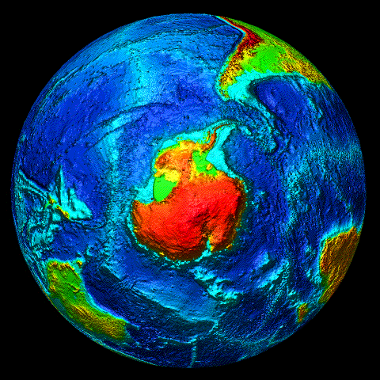
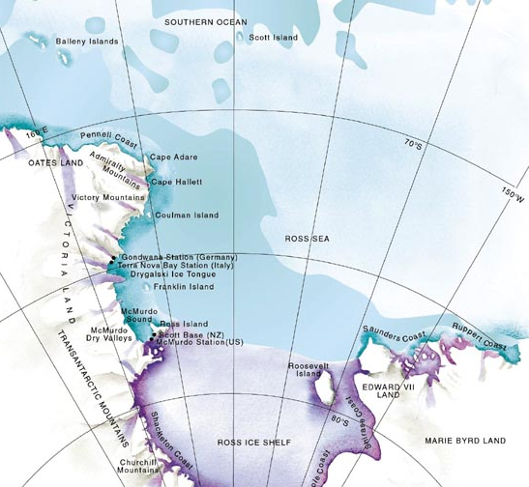
Callinectes
Xiphius

Slide 4
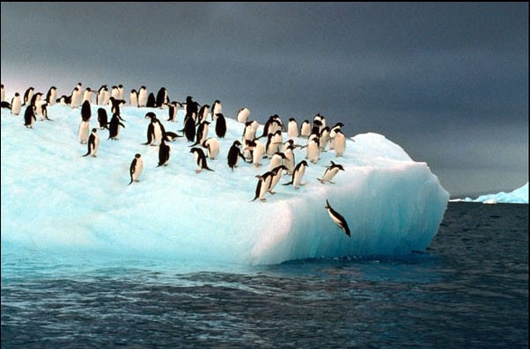
What do we think we know about the Ross Sea, its phytoplankton, food web, physical forcing, and variability?

Slide 5
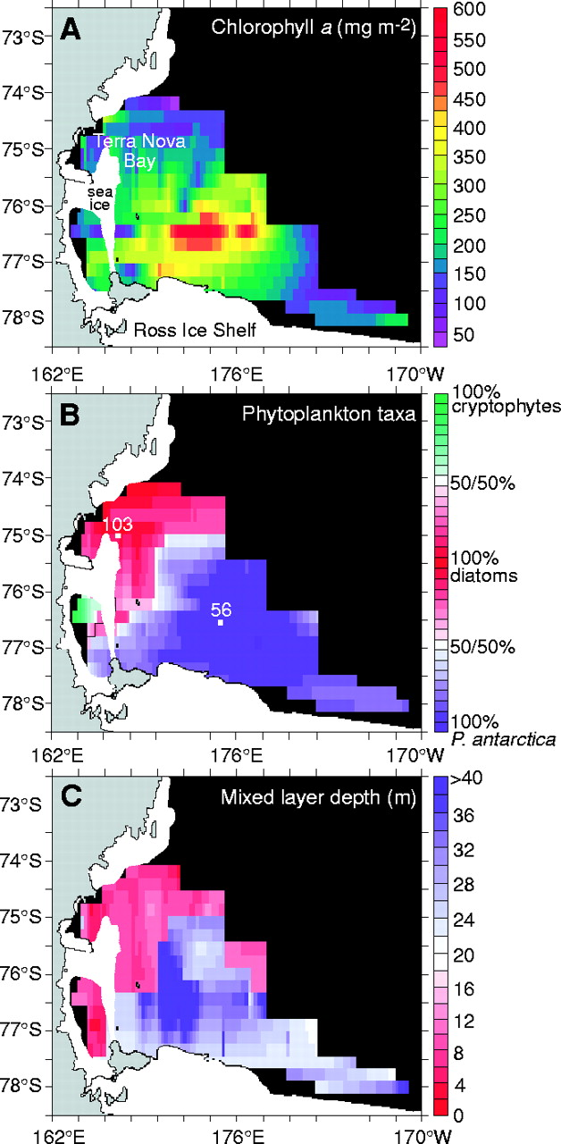
Distribution of P. antarctica
Arrigo et al. (1999)

Slide 6
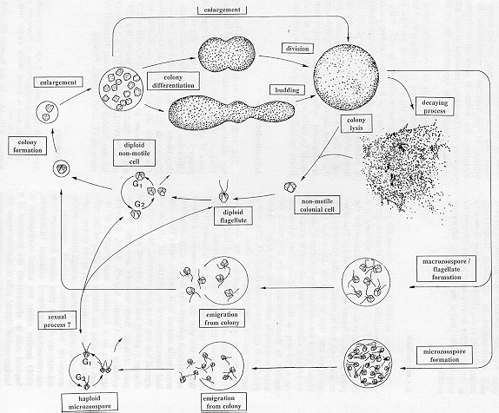
Phaeocystis life cycle
Rousseau et al. 1994

Slide 7
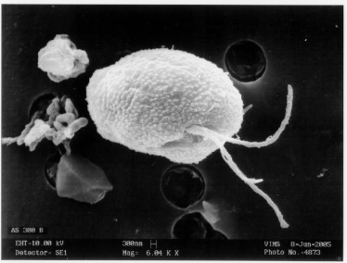
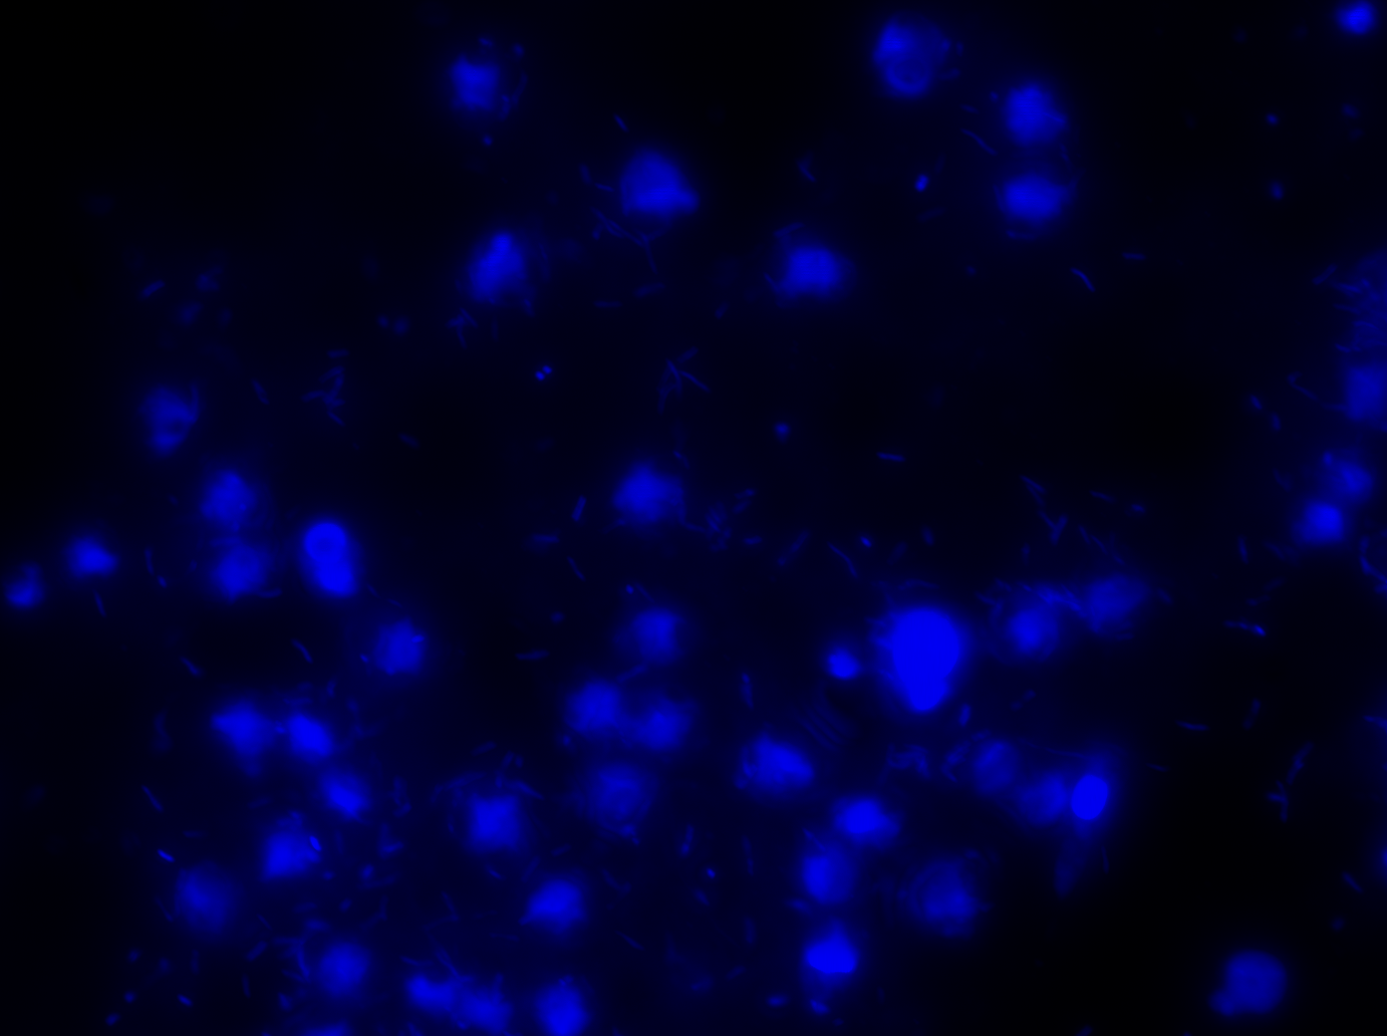
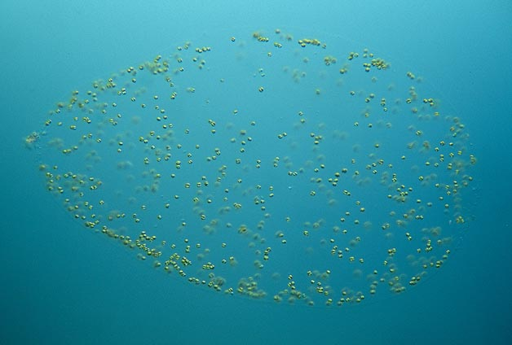
Occurrence of Phaeocystis antarctica
in the Ross Sea
Critical features:
….. Solitary, small (< 5 μm) stage, and
….. Colonial stage characterized by single cells encased in a mucilage and of large (> 2 mm) size in many forms

Slide 8
Solid line: Running Mean
Solid line: Polynomial Regression
Smith et al., 2003a

Slide 9
Therefore as the number of flagellates increases, the grazing mortality from microzooplankton increases
Therefore, as the iron concentrations decrease, the percentage of flagellates increases

Slide 10
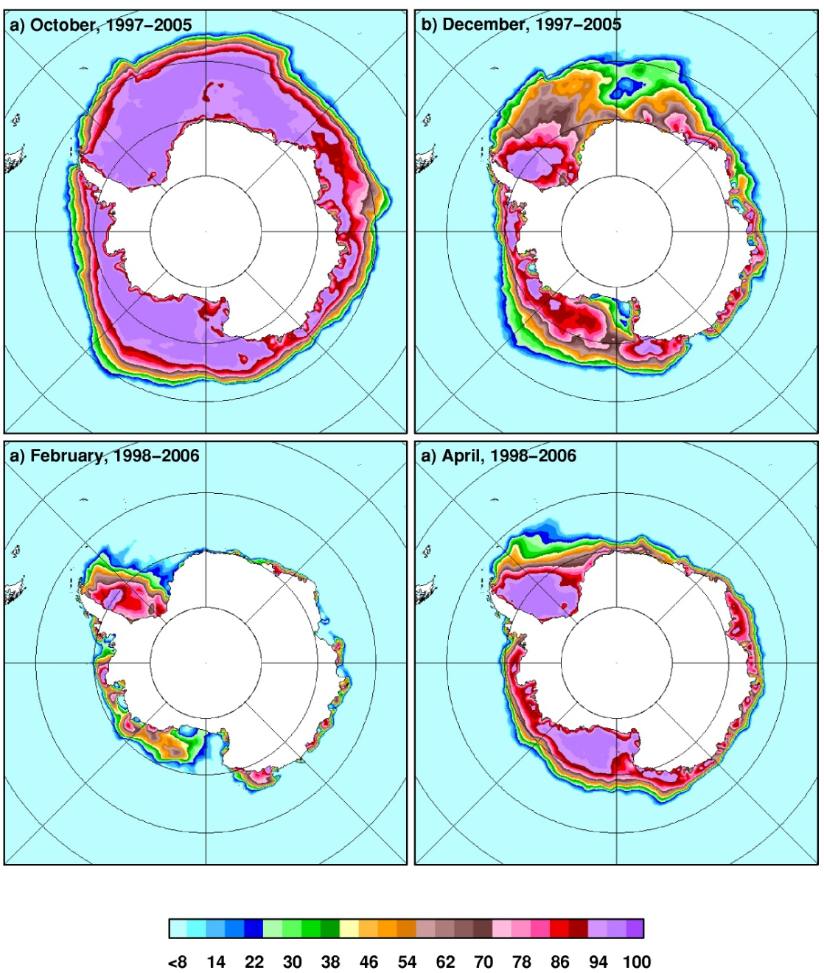
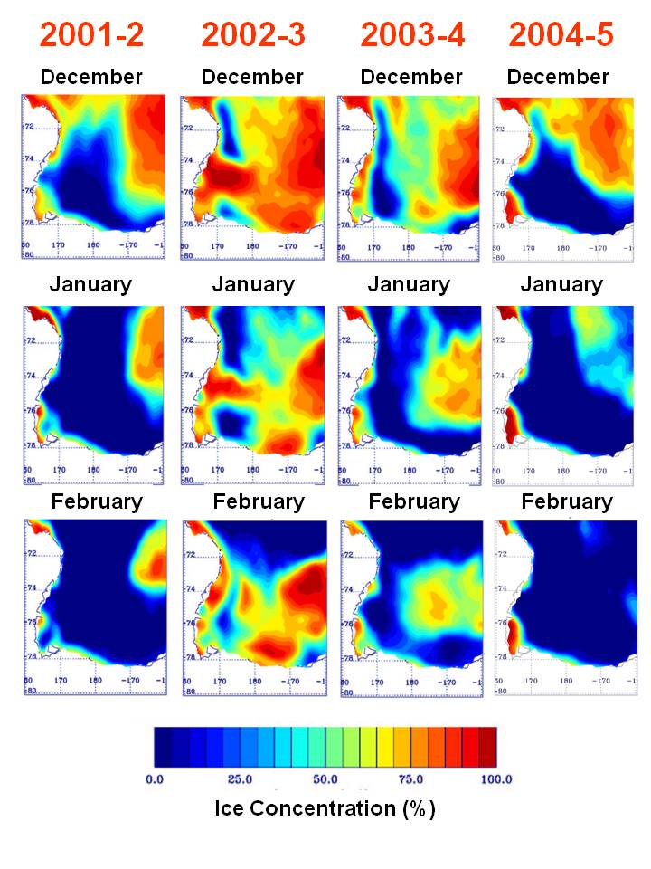
Climatology of southern Ross Sea - ice

Slide 11
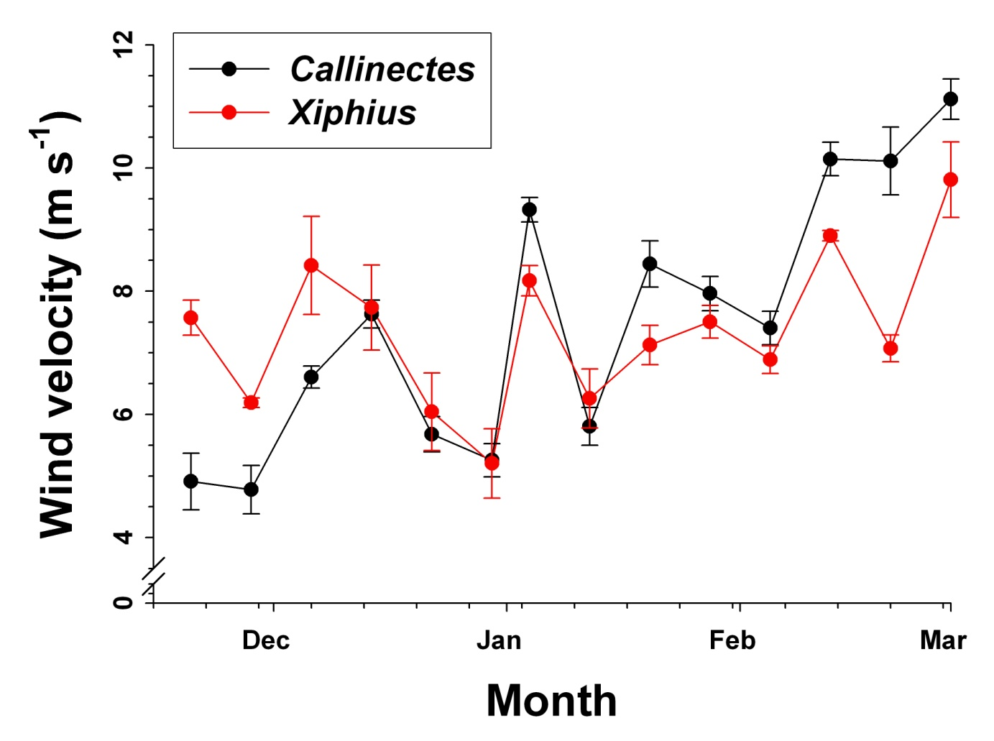
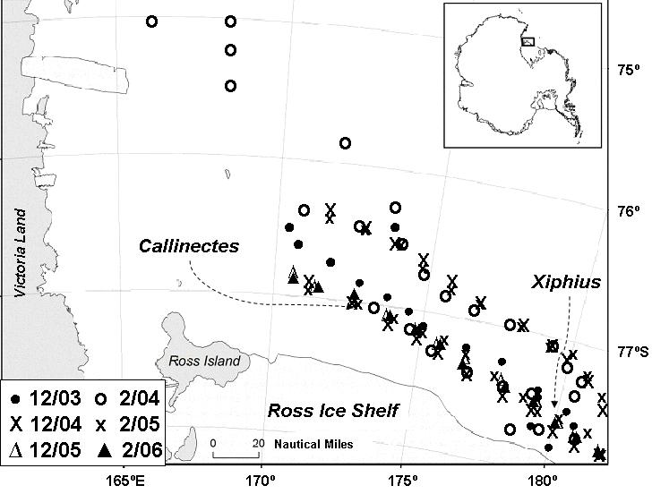
Climatology of southern Ross Sea - Winds
Winds are for two locations where moorings were placed, and derived from QuikSCAT three-day values averaged for the 2000-2008 time period

Slide 12
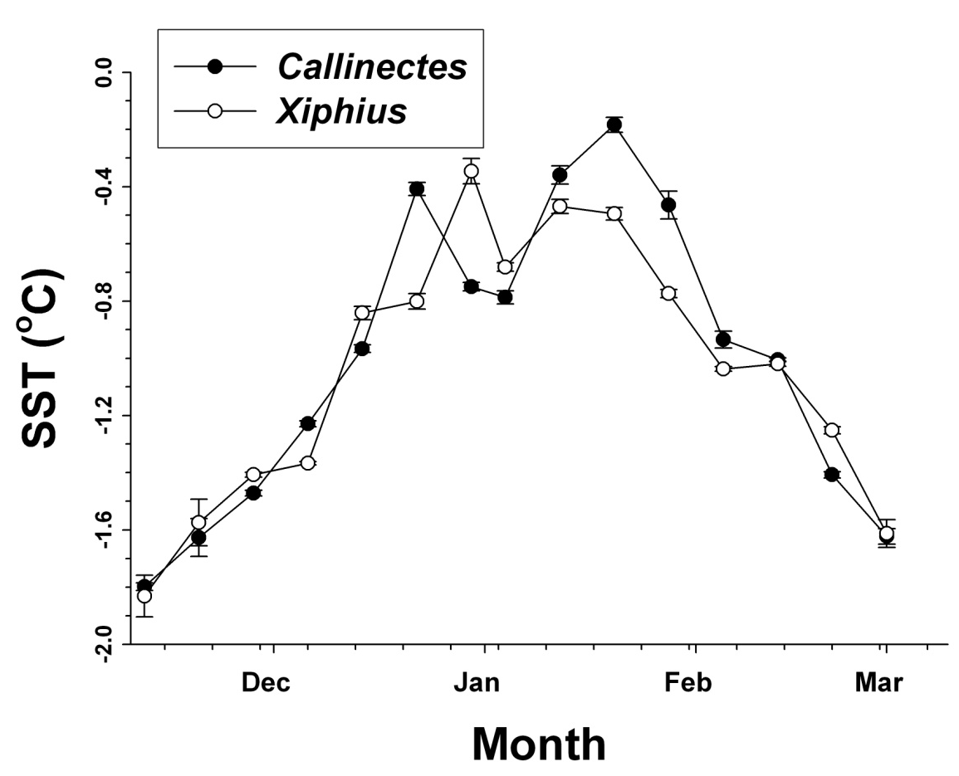
Climatology of southern Ross Sea – Sea Surface Temperature
SST for two locations where moorings were deployed; derived from Aqua MODIS SST 9 km weekly climatology from 2002-2008

Slide 13
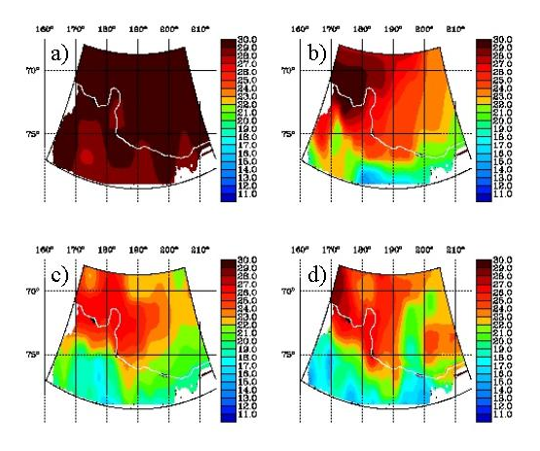
The Ross Sea Climatology: Nitrate
November
Dec
December
Nov
µM
Jan
January
Feb
February
Smith et al., 2003b

Slide 14
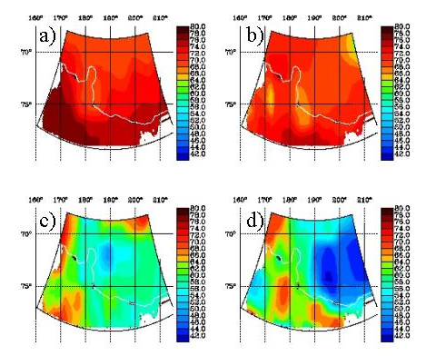
The Ross Sea Climatology: Silicic Acid
Nov
November
Dec
December
µM
Jan
January
Feb
February
Smith et al., 2003b

Slide 15
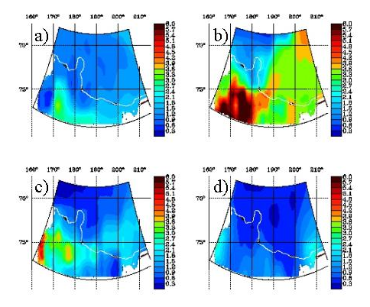
The Ross Sea Climatology: Chlorophyll
Nov
November
Dec
December
µg L⁻¹
Jan
Feb
January
February
Smith et al., 2003b

Slide 16
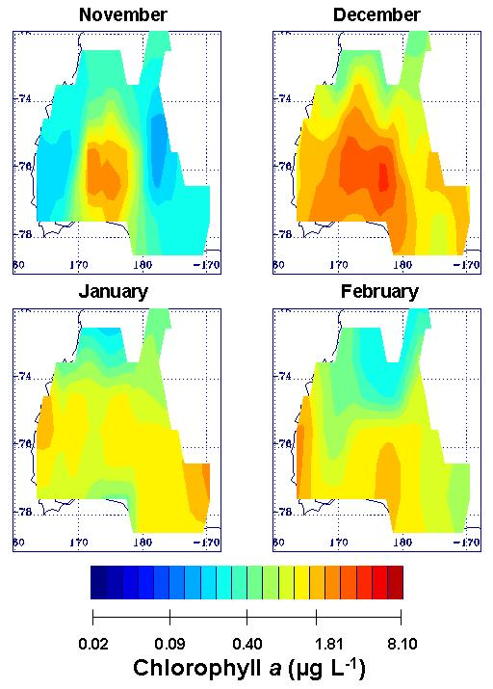
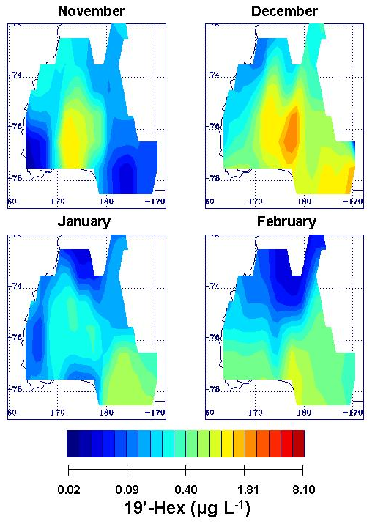
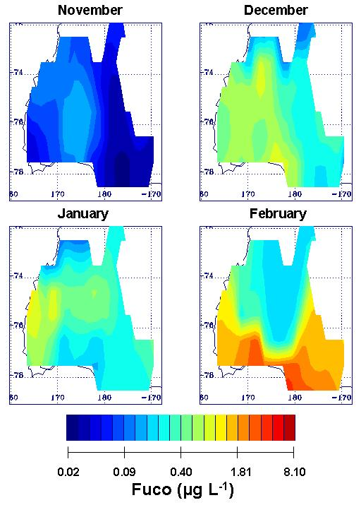
Pigment Climatology
19’-Hex: 19’-hexanoyloxyfucoxanthin; Fuco: Fucoxanthin
Note scale is logarithmic
Interpretation problem: interconversion of 19’-Hex to Fuco at high [Fe] and perhaps other factors influencing the interconversion
Smith et al. 2010

Slide 17
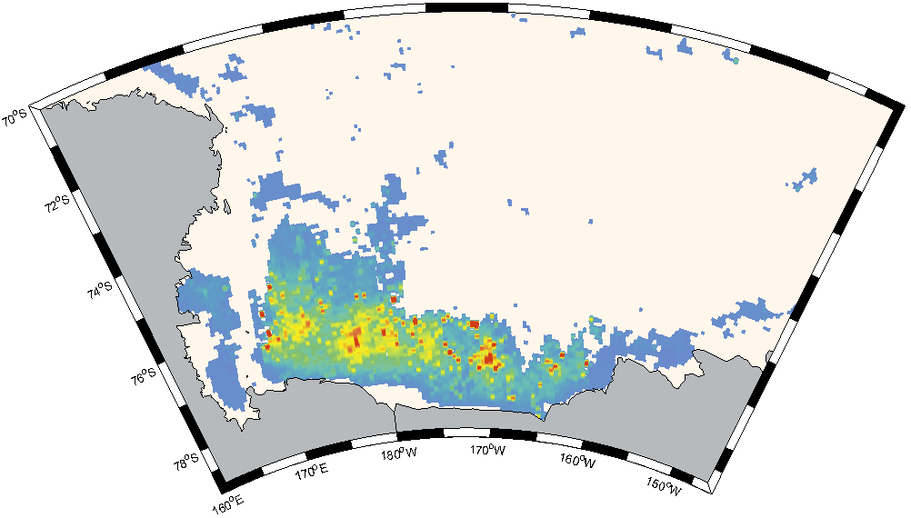
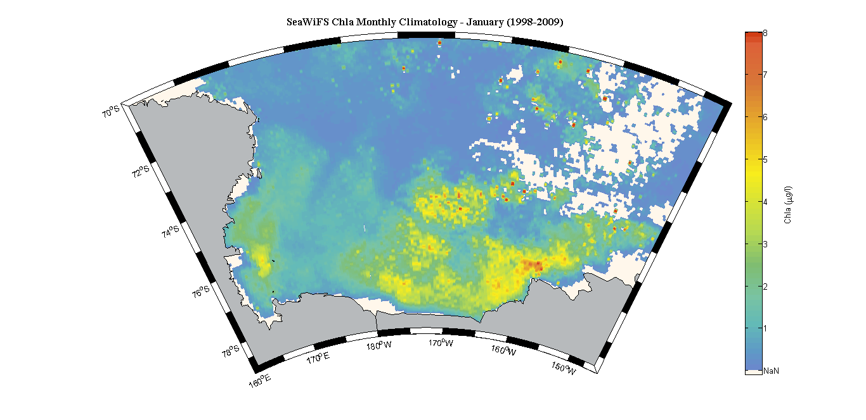
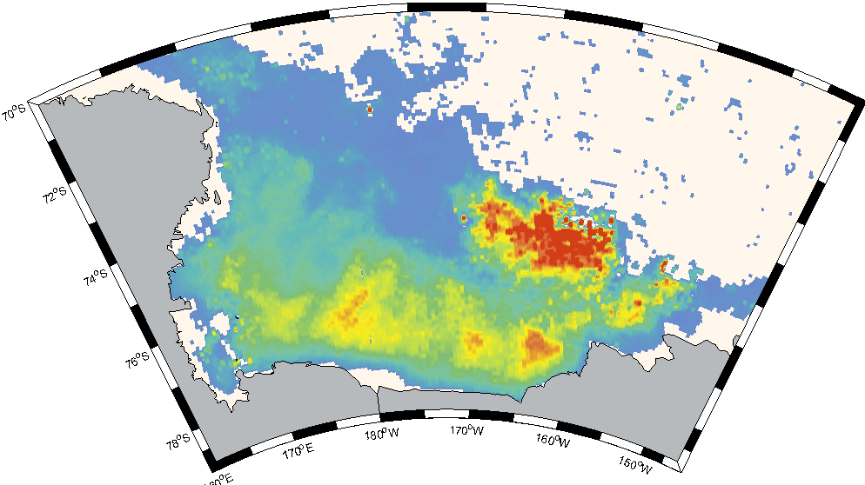
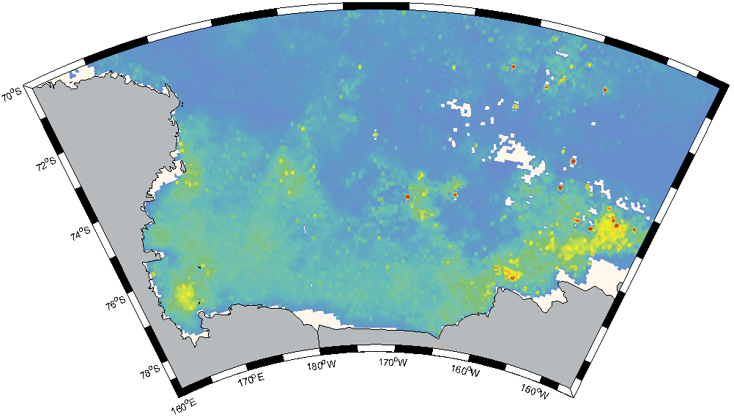
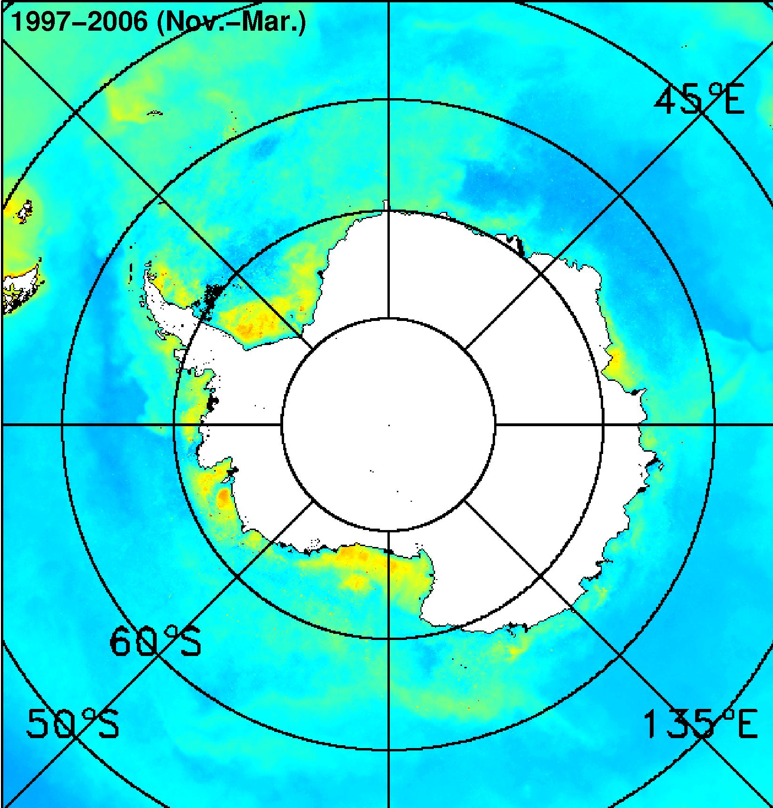
Climatology of southern Ross Sea – Pigments
8
6
4
2
0
January
November
Chlorophyll (μg L⁻¹)
February
December
???
Pigments from merged SeaWiFS-MODIS data, 1998-2009
Smith and Comiso, 2008

Slide 18
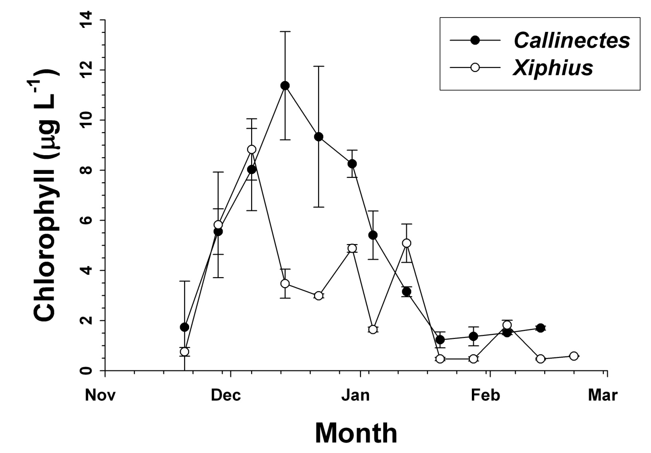
Climatology of southern Ross Sea – Pigments
Pigments from merged SeaWiFS-MODIS data, 1998-2009 & sampled from 3 pixels around the two moorings sites

Slide 19
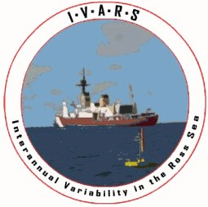
IVARS
Interannual Variability in the Ross Sea
Data were collected in three seasons, 2003-04, 2004-05, and 2005-06 in the southern Ross Sea
Two moorings were deployed at two sites: Callinectes at 76.6ºS, 172.7ºW, and Xiphius at 77ºS, 180º; both sites were ca. 600 m deep
Each mooring was deployed in late December, and recovered in early February; water samples were collected between the two sites during both cruises

Slide 20
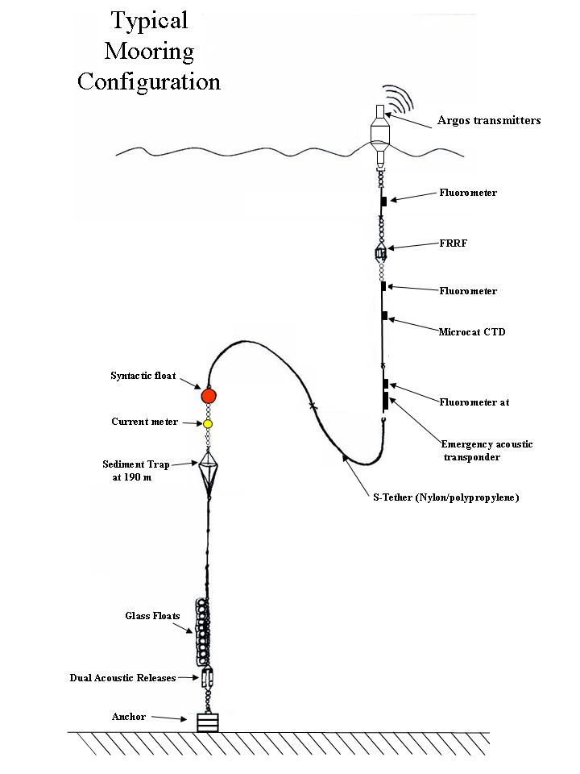
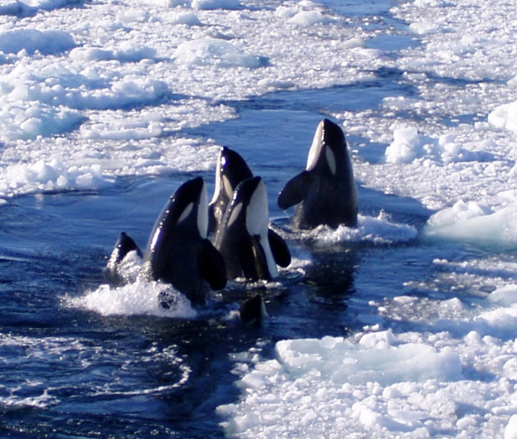
Each mooring had a surface float, fluorometers, a FRRF, and in two years, a Microcat CTD at 25 m
A S-tether connected the deep-water portion and anchor
Surface portion extended to ca. 50 m; float at ca. 175 m

Slide 21
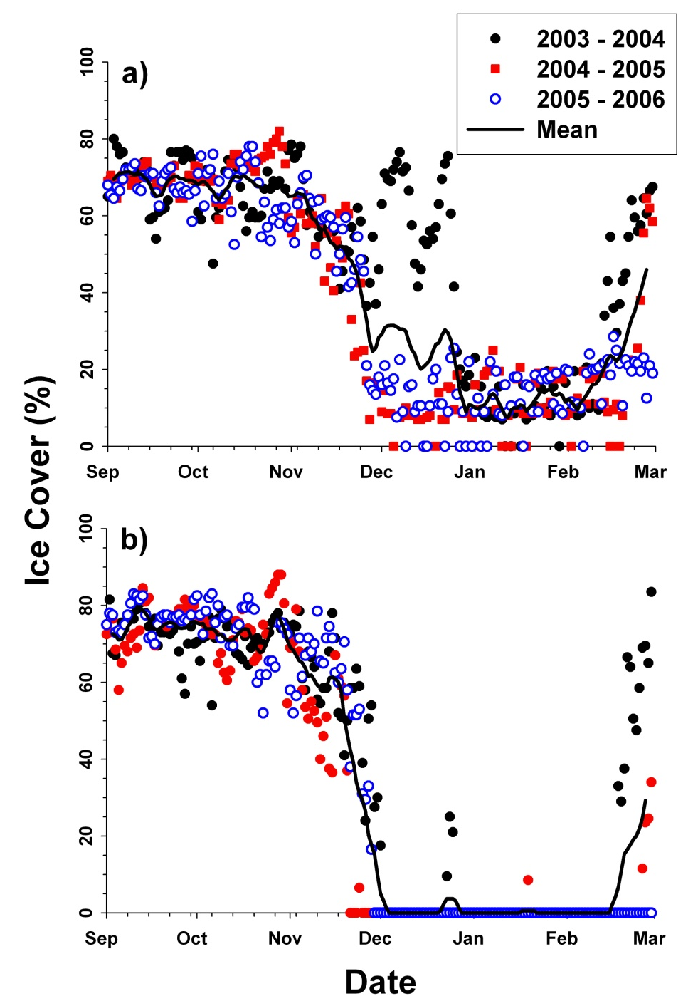
Results – Physical Forcing
Callinectes
Ice concentrations were not markedly different from the long-term mean, although in 2003 ice persisted for longer in the west
In general there was always some ice remaining in the west, but ice nearly always completely disappeared in the east
We found no relationship between biological variables and ice
Xiphius
Mooring Duration

Slide 22
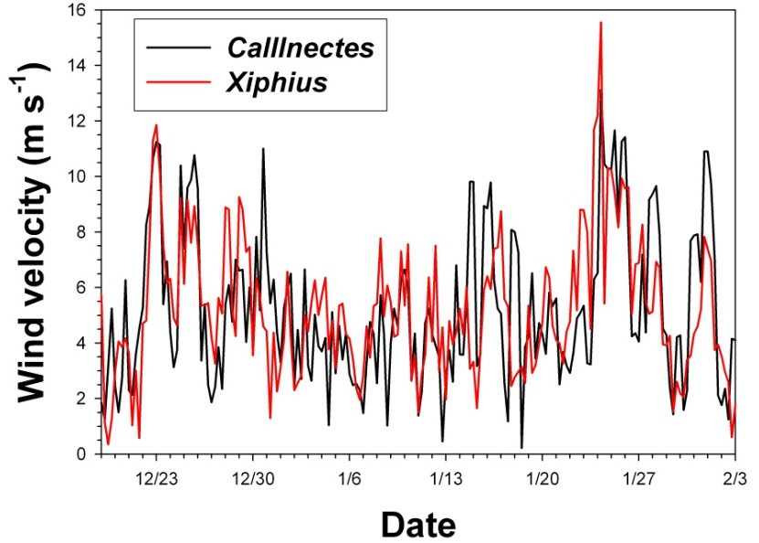
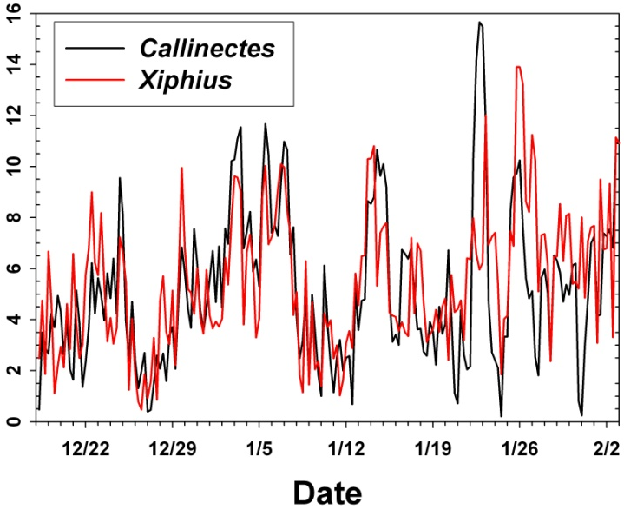
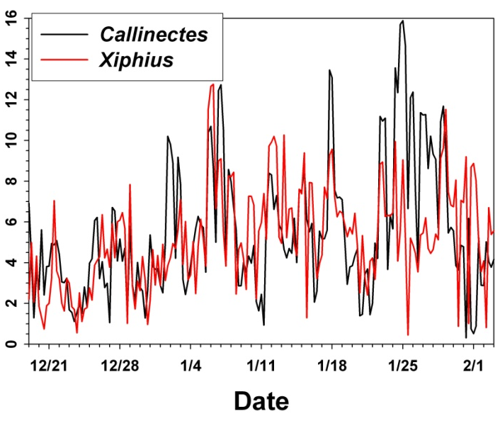
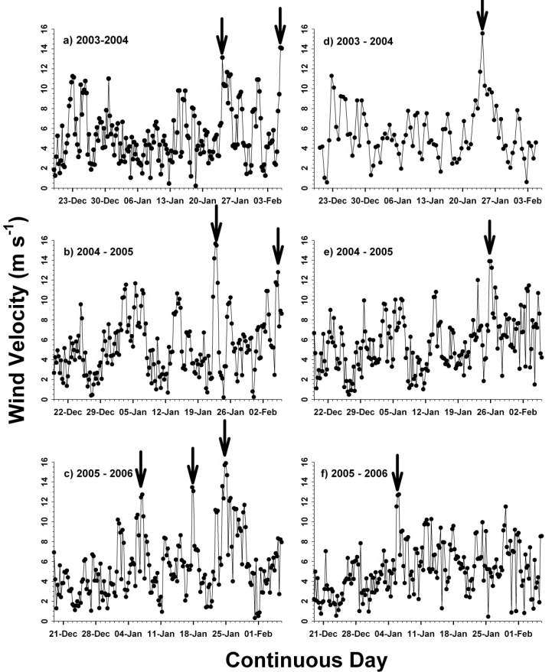
Results – Physical Forcing
Winds were characterized by strong variability over the event scale; we defined “storms” as having mean velocities over 12 m s⁻¹; those occurred largely in the west (2,2, & 3 times) relative to the west (once per season)
Potentially more influenced by katabatics?

Slide 23
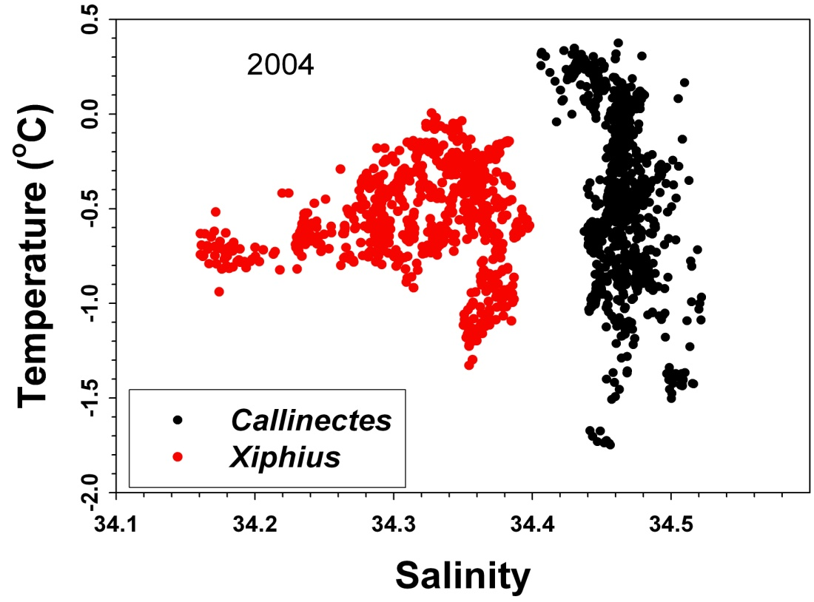
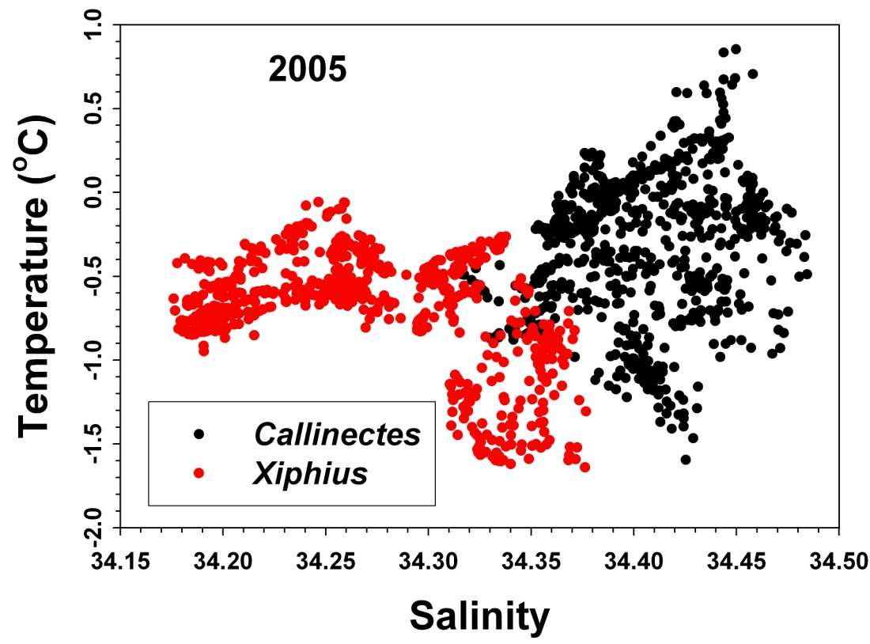
Results – Physical Forcing
2004
2005
Simple water mass properties suggested that the two sites had markedly different surface water mass signatures in both years, with less overlap in 2004-05

Slide 24
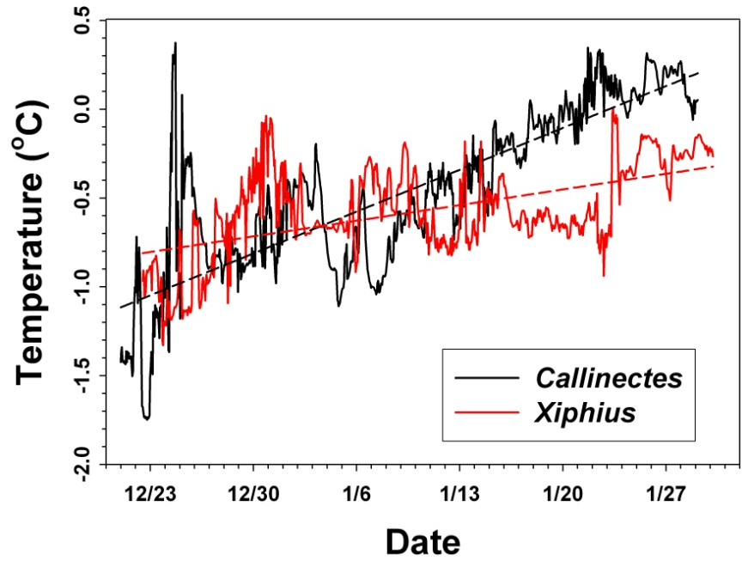
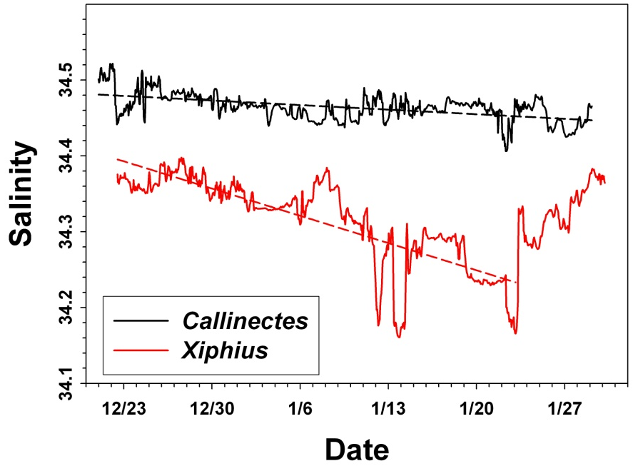
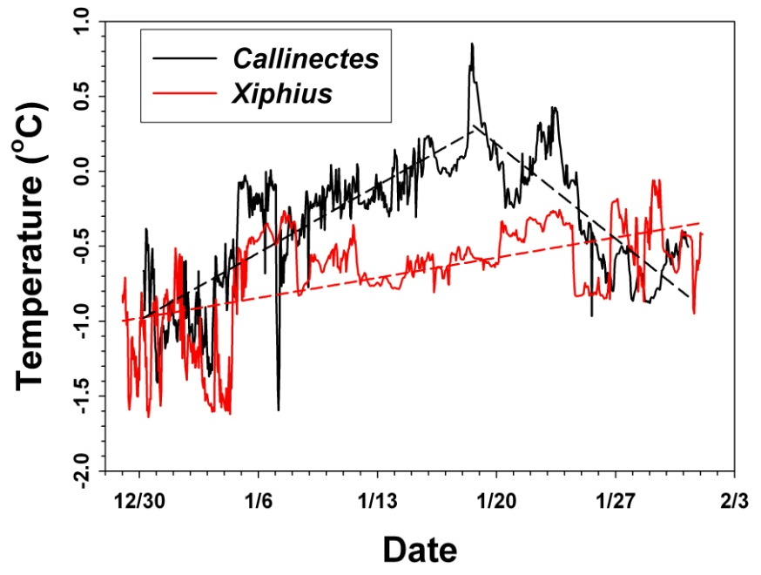
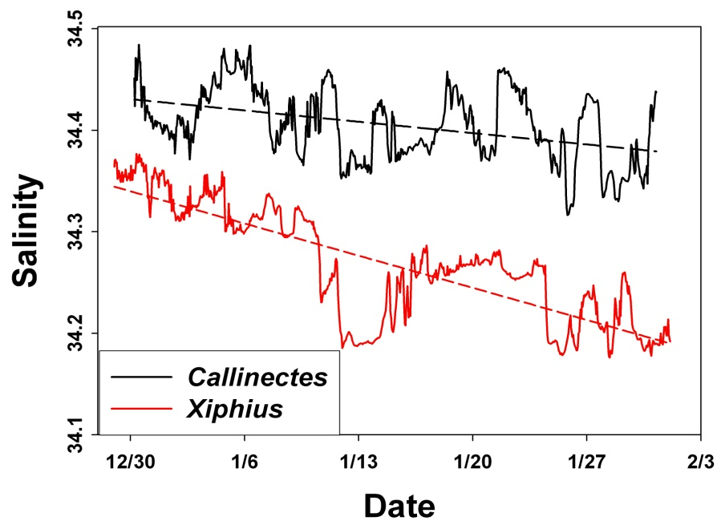
Surface layer SST (25 m) generally increased and salinity decreased
Interrupted by rapid changes linked to winds and advective events
Xiphius similar both years; Callinectes showed differences
Results – Physical Forcing
2004
2005

Slide 25
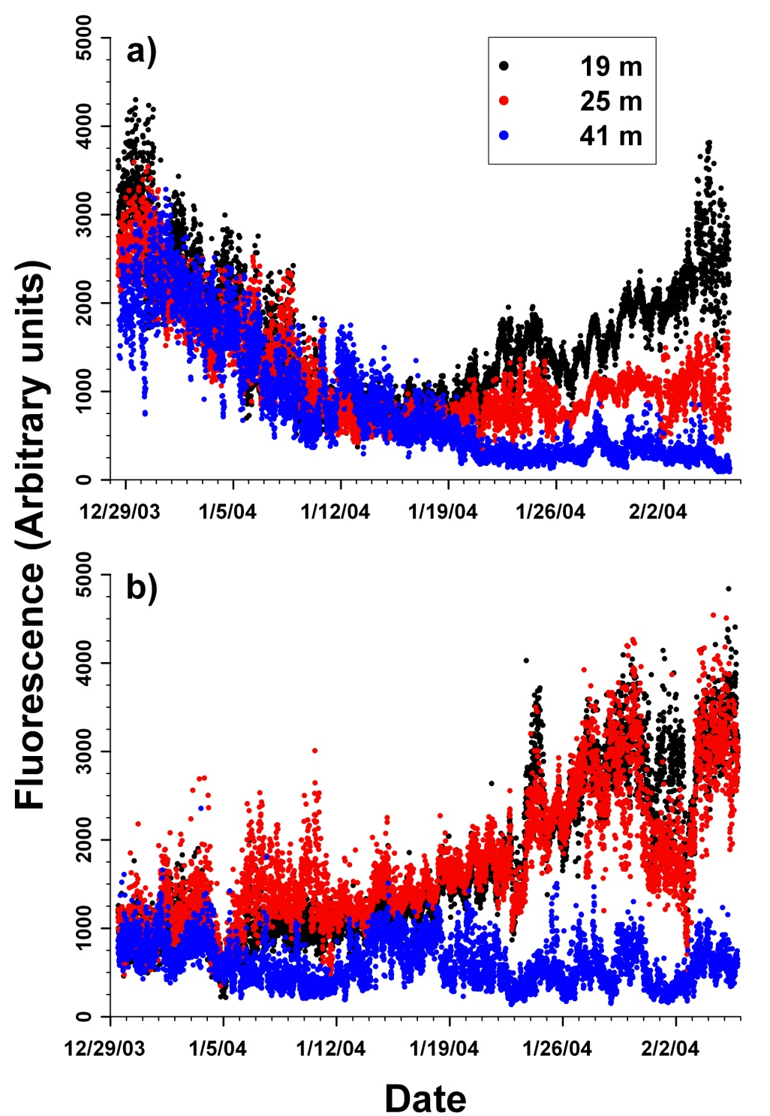
Results – Biological Response
Callinectes
In all seasons biomass is initially low and evenly distributed due to mixing
In 2003 the fluorometers showed
High fluorescence in west which decreased rapidly through mid-January, at which time biomass began to increase at the surface again
Biomass in the east started out less, but increased in the upper 25 m to levels similar to that of the west
Similarity within the upper 41 m in west suggested that the water column was dominated by Phaeocystis; depth variance due to dominance by diatoms (confirmed by discrete sampling)
Xiphius

Slide 26
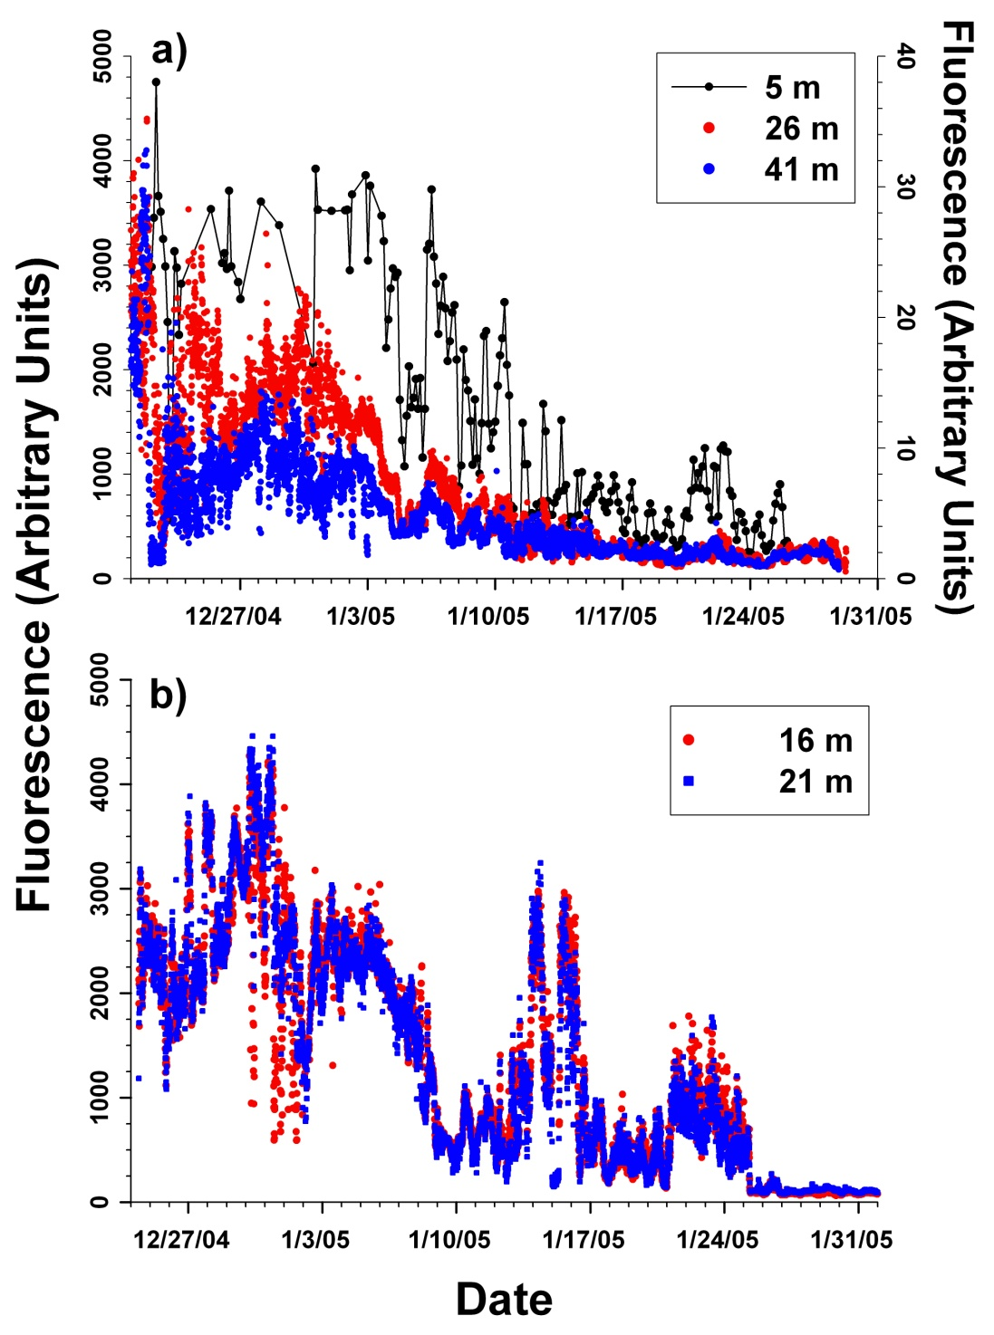
Results – Biological Response
Callinectes
In 2004 the fluorometers showed
Similar features to 2003 – that is, large initial bloom, followed by a rapid decrease; no secondary bloom
greater coherence between the two sites than in 2003
reduction to extremely low biomass at end of summer, suggestive of iron limitation
large, event-scale variations, likely linked to winds and advective events
Xiphius

Slide 27
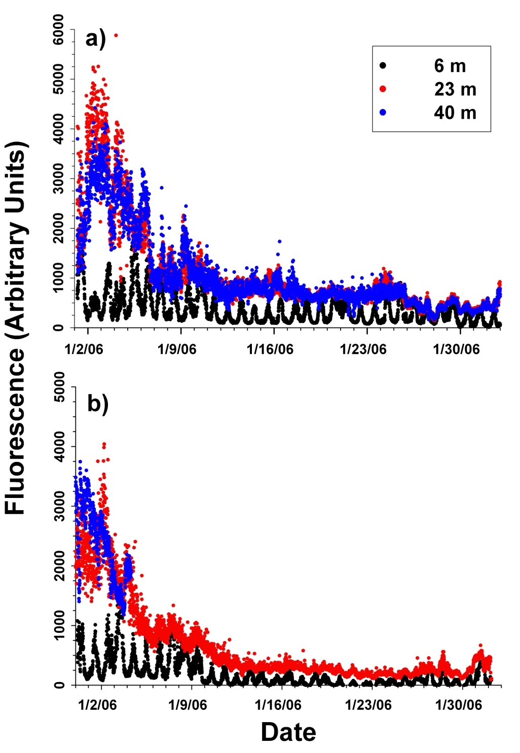
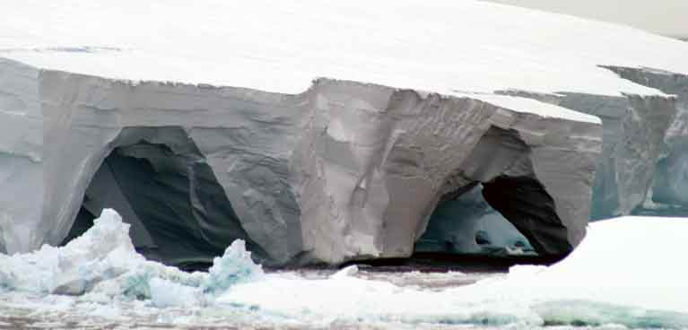
Results – Biological Response
Callinectes
In 2005 the fluorometers showed
Extremely low biomass in the surface layer (upper 10 m)
Initial large bloom that decreased to low levels earlier than in other years
Extreme diel variability in surface fluorescence
Similar patterns at both sites
Xiphius

Slide 28
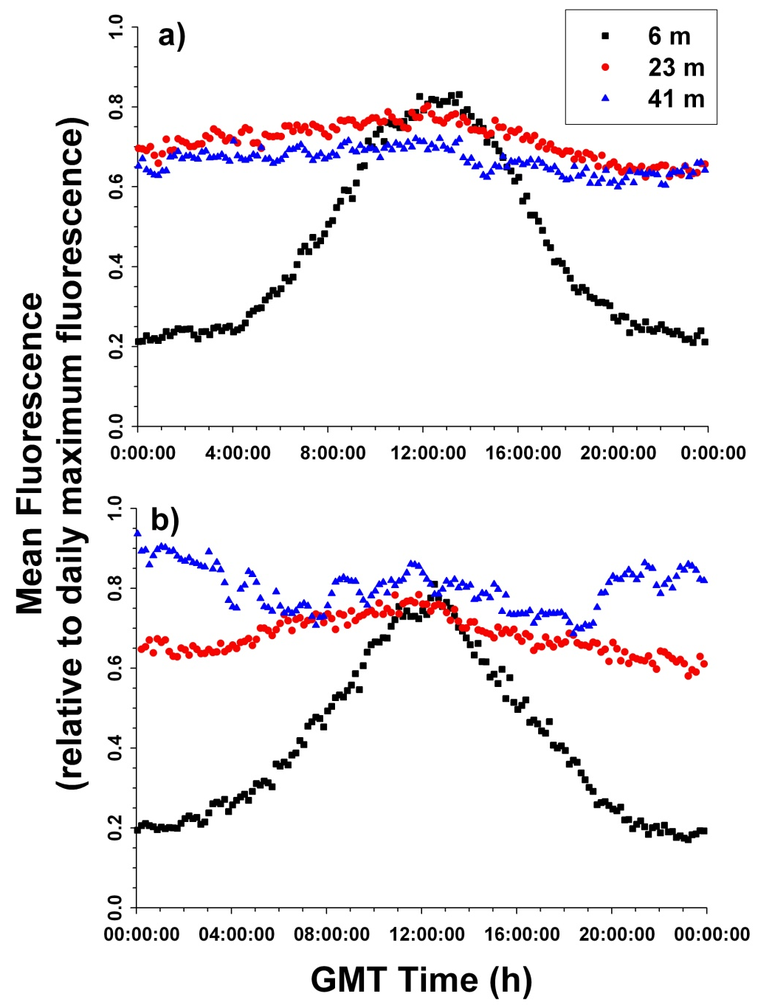
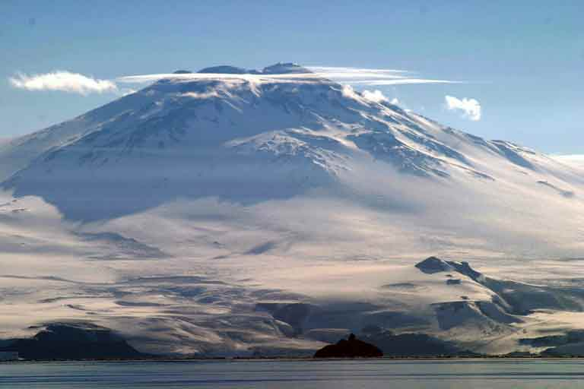
Results – Biological Response
Callinectes
Relative fluorescence (normalized to daily maximum) at 6 m approached 0.2 at the period of maximum solar radiance (GMT is 13 h behind local time)
Reflective of extreme Fe limitation???
Local Noon
Xiphius

Slide 29
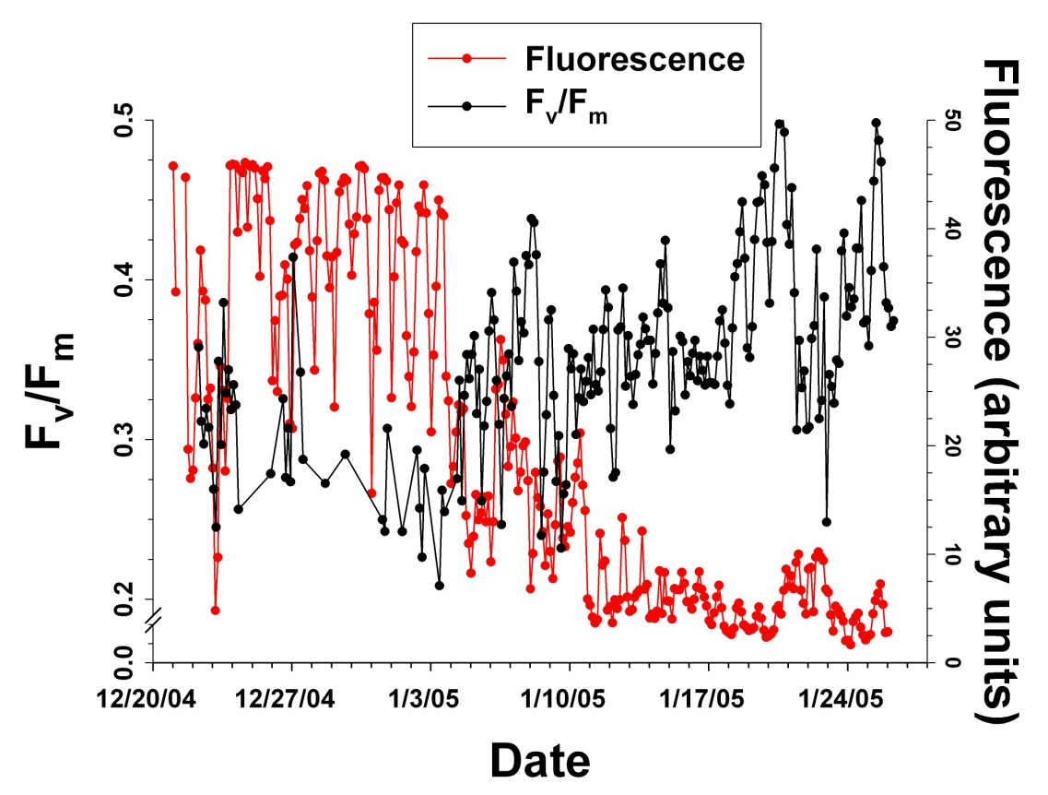
Results – Biological Response
In situ FRRF functioned only in 2004 at Callinectes (west)
Initial F_{v}/F_{m} values were ~0.45, but decreased abruptly around 1/3/05
Simultaneously, fluorescence was modest, but then abruptly increased
Change occurred with the passage of a storm
We suggest that the storm increased vertical mixing and diluted the surface plankton, providing for increased light for phytoplankton growth; the rapid growth quickly induced even stronger iron stress, which is reflected in the decreased F_{v}/F_{m} values
Note: ferricline is at ca. 90 m during summer in Ross Sea (Sedwick et al, in press), so mixing likely did not substantially affect [Fe] in upper 10 m

Slide 30
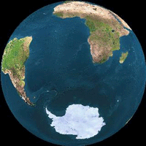
Conclusions
A surprising amount of interannual variability was observed, suggesting that a substantial amount of environmental heterogeneity is introduced by oceanographic processes
Patterns of biomass accumulation varied among years and sites; one year had a prominent secondary bloom, but the other two did not
Diel variations were observed in all years, but were greatest under low biomass conditions at the surface in 2005-06
Wind events had marked impacts on phytoplankton biomass, and may play large roles in the maintenance of blooms in the Ross Sea
Advection may influence phytoplankton biomass on short time scales, but this is superimposed on the broad seasonal patterns
Despite the large amount of data collected, variations within and between years suggest that our understanding of the Ross Sea is still evolving
Thank you for your attention

