Slide 1



PRISM Cruise Science Series
Presents
Physical Oceanography of the Ross Sea
John Klinck
Old Dominion University

Slide 2

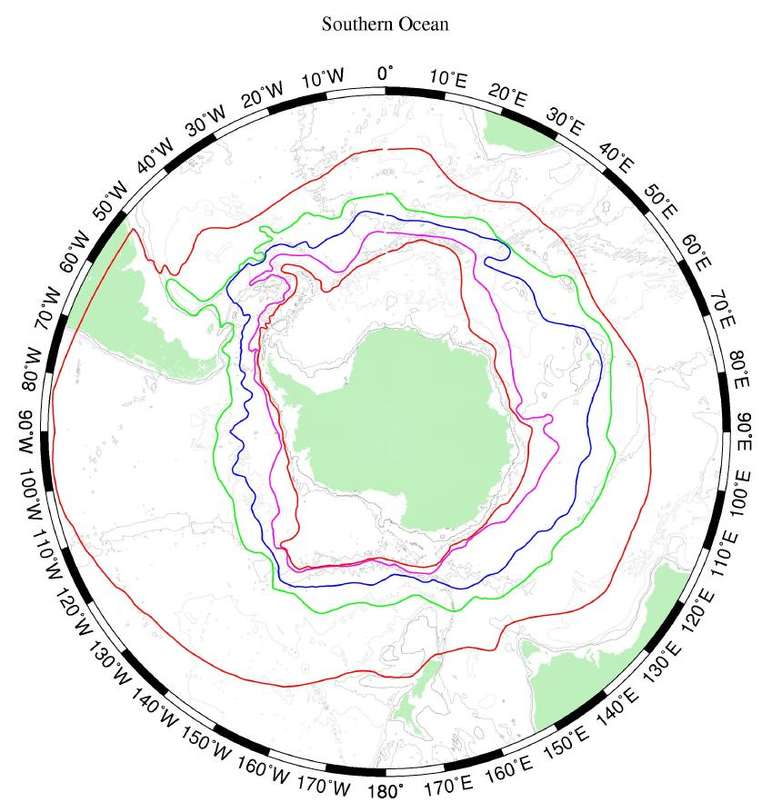
Southern Ocean Overview
Area south of Subtropical Front
Part of the global overturning circulation
Truly circumpolar and path for inter-ocean transport and exchange
ACC has narrow frontal jets and mesoscale eddies
Composed of different regions with different processes
Historical front locations Orsi et al. 1995

Slide 3
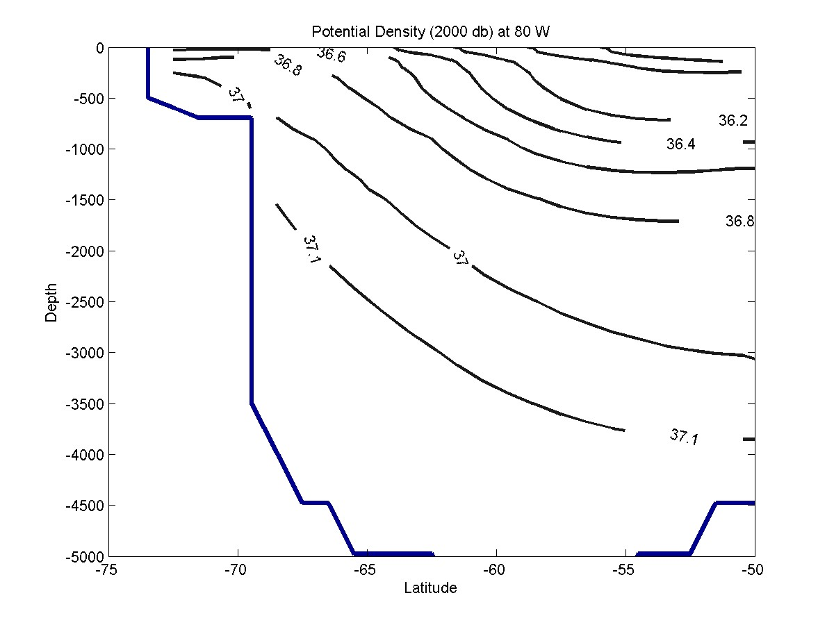
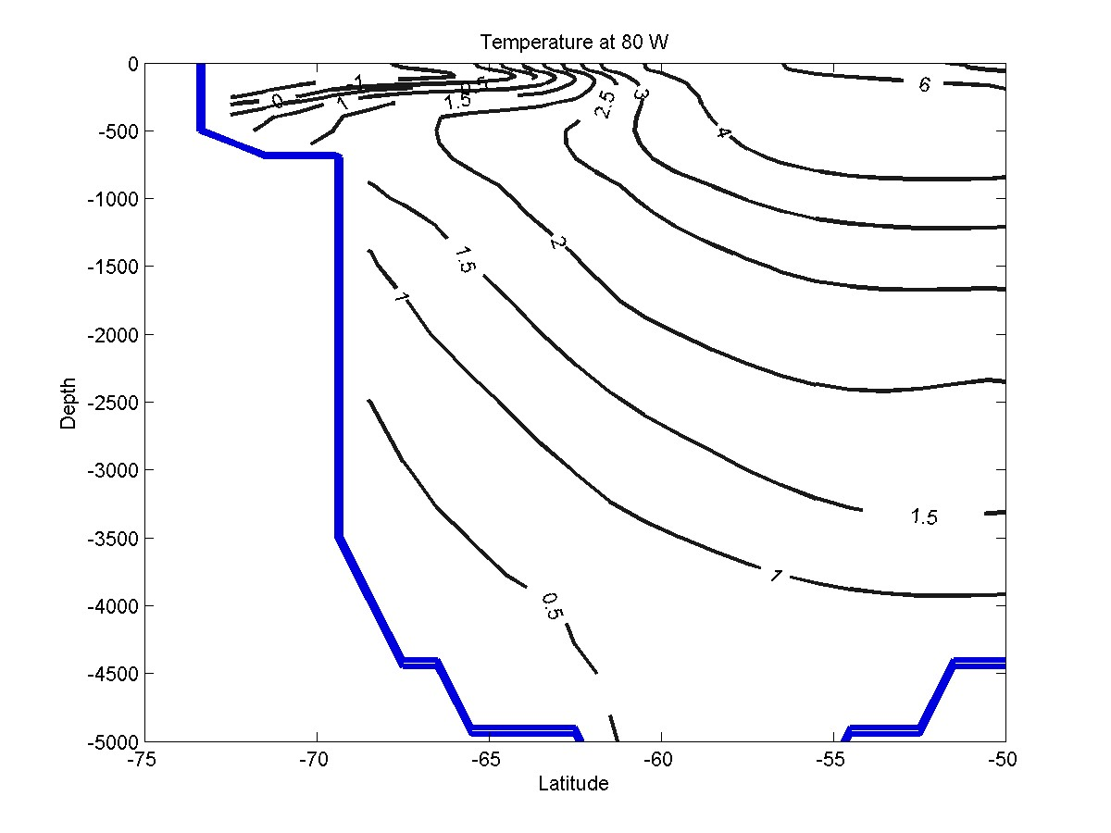
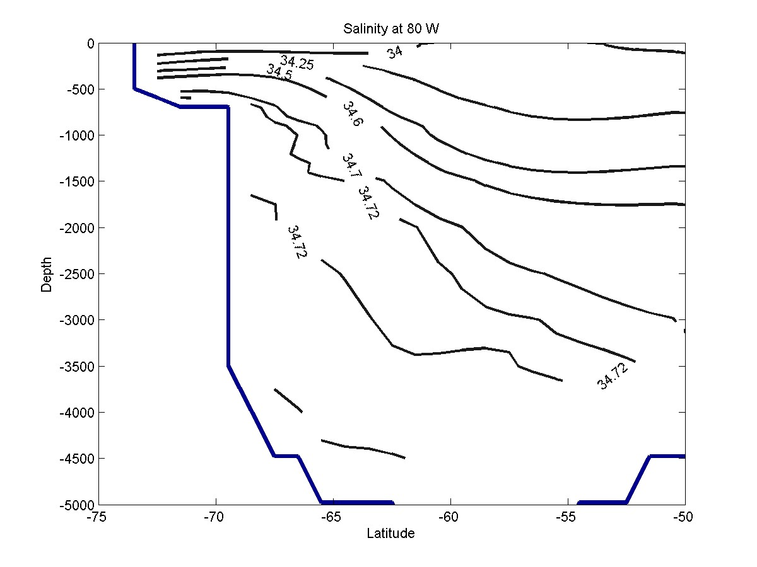
Rising limb of Global Overturning Circulation
West of Drake Passage (80 W)
(from World Ocean Atlas 2001)
T max UCDW
S max LCDW
Notes:
3
General vertical slice across the Southern Ocean.

Slide 4
Overview of Antarctic Shelves
Shelves are deep (~500 m)
Stratification is weak
Bottom topography is rugged
Surface exchange (momentum and heat) is strong
Sea ice and glacial ice are important
Winter mixed layers are deep (100+ m to bottom)
Internal radius is 5 to 10 km.
Notes:
4

Slide 5
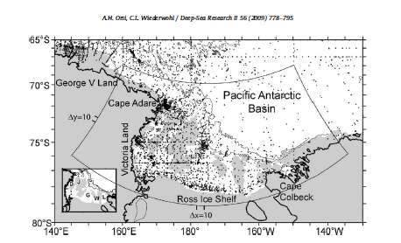
General geography of Ross Sea
hydrographic stations

Slide 6
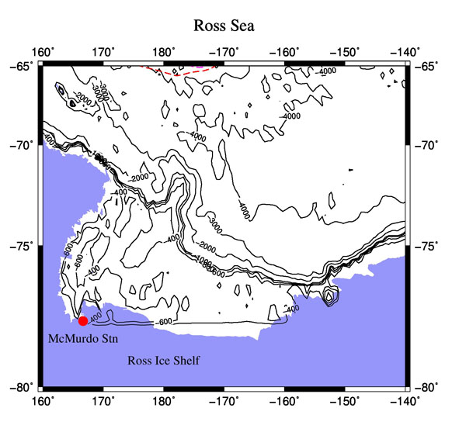
Surface Circulation
ACC
Ross Gyre
Notes:
Polar wind driven gyre.

Slide 7
Subsurface Circulation
CC
Ross Gyre
Notes:
Warm CDW onto the shelf
HSSW leaves along the west
ISW from under the Ross Ice shelf

Slide 8
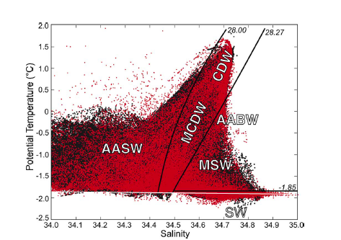
Temperature-Salinity Diagram for Ross Sea
Notes:
All data used for climatology. Surface water affected by atmosphere and change seasonally. CDW is old NADW that surfaces in the Southern Ocean. HSSW is created in polynyas to the west. ISW (SW) is created under the Ross Ice Shelf and is colder than the surface freezing point. Notice AABW is mixture of CDW, ISW and HSSW(MSW).

Slide 9
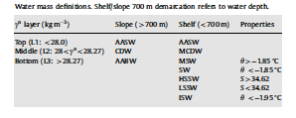
Ross Water Masses
Surface water (AASW):
top 100 m, affected by surface fluxes
Circumpolar Deep water (CDW):
modified North Atlantic Deep Water.
warm (2C), low O2, high nutrients, high Fe?
High Salinity Shelf Water (HSSW):
dense water produced in polynyas along the west coast.
Source water for Antarctic Bottom Water.
Flows off the NW Ross shelf.
Ice Shelf Water (ISW):
Created by glacial basal melt,
sub-freezing temperature (< -1.95C).
Notes:
Four general water masses. There are some regional variations of these general types.

Slide 10
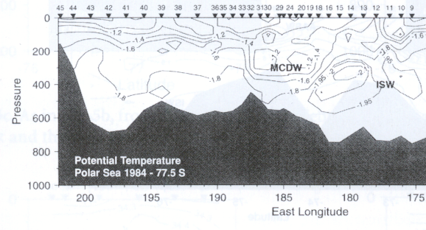
Observed Ross Ice Shelf Front
temperature cross section
(early Feb., 1984) (Jacobs and Giulivi, 1999)
Notes:
This is a check on how the model is doing. Model contours are same as observations (including -1.95/-2.0 for cold water). Note: Slightly warmer MCDW going into the ice cavity and smaller amount of ISW coming out of the cavity. Sfc. freezing pt. for this water around -1.88.

Slide 11
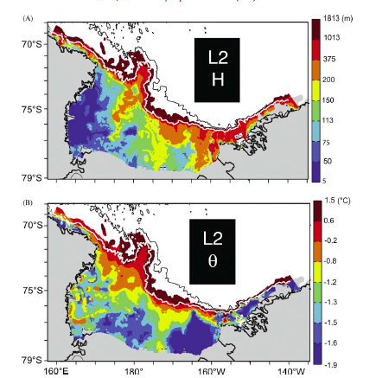
Thickness and Temperature for CDW and MCDW
From climatology
Notes:
Layer 2 is defined to cover the density range of CDW and modified forms. Flow is along density surfaces. Water is colder on shore so the flow direction is offshore to onshore.

Slide 12
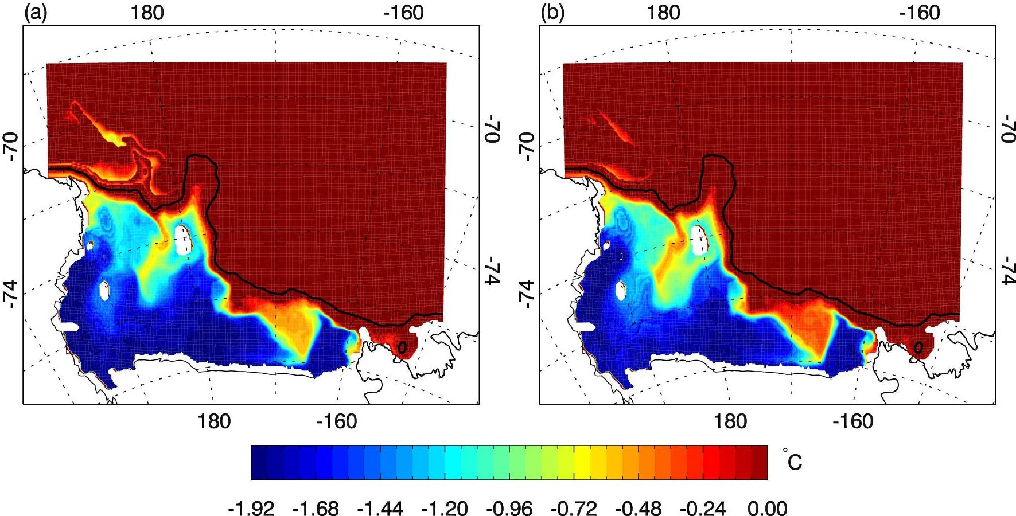
Annual Mean Temp at 300 m (model)
2000 2001
Introduction of CDW
Notes:
Annual average temperature from two successive years of the Ross model.

Slide 13
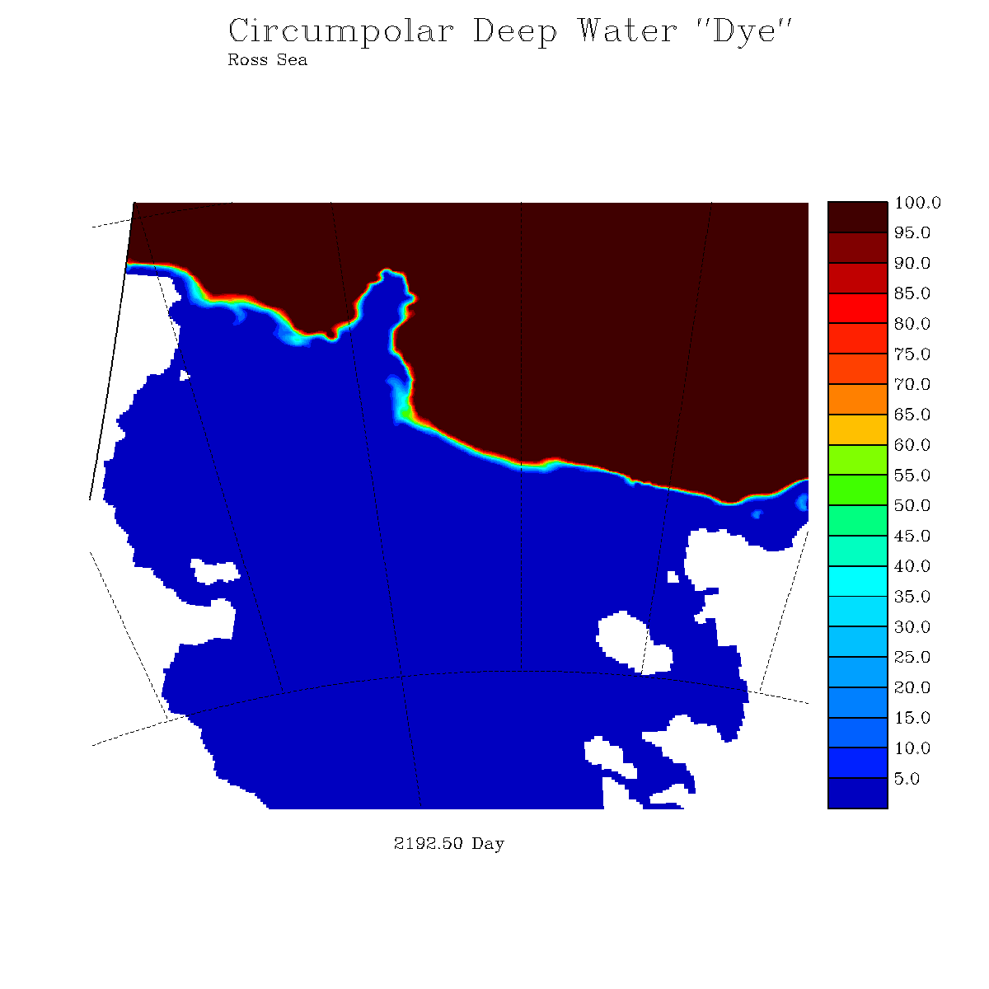
Dye concentration at depth
(model level 12): 9/15/2001 – 9/15/2003
Notes:
1200 slow. Shows a nice visualization of the pathways of CDW onto the shelf. Note the water eventually making it under the RIS

Slide 14
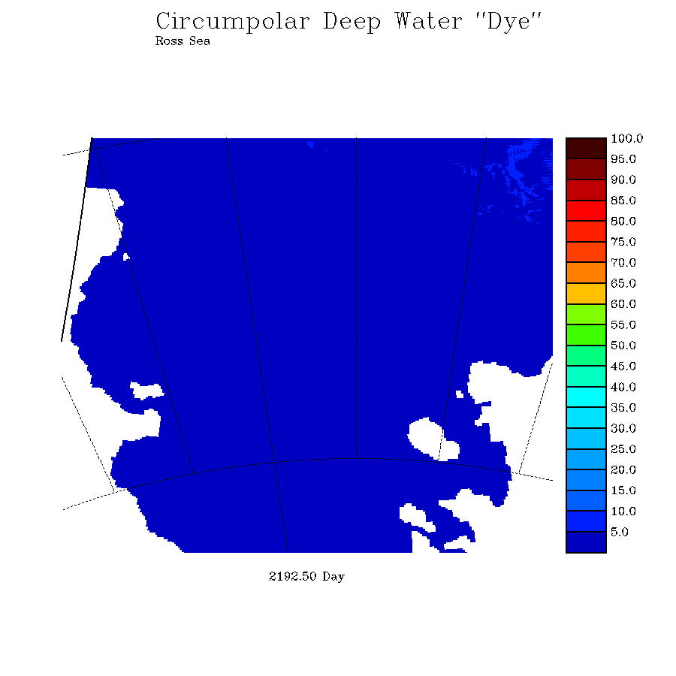
Shows vertical exchange of CDW to the surface
Ross model: surface dye concentration
Notes:
14
Hint at what’s going on: If anything, there was a higher concentration of CDW on the open shelf in the wAP model. Yet, there’s much more CDW making it up into the surface in the Ross Sea, especially in the west=>more vigorous vertical mixing going on

Slide 15
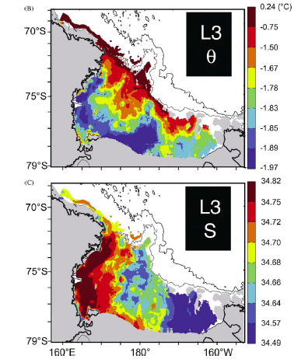
Temperature and Salinity of bottom density
From Climatology

Slide 16
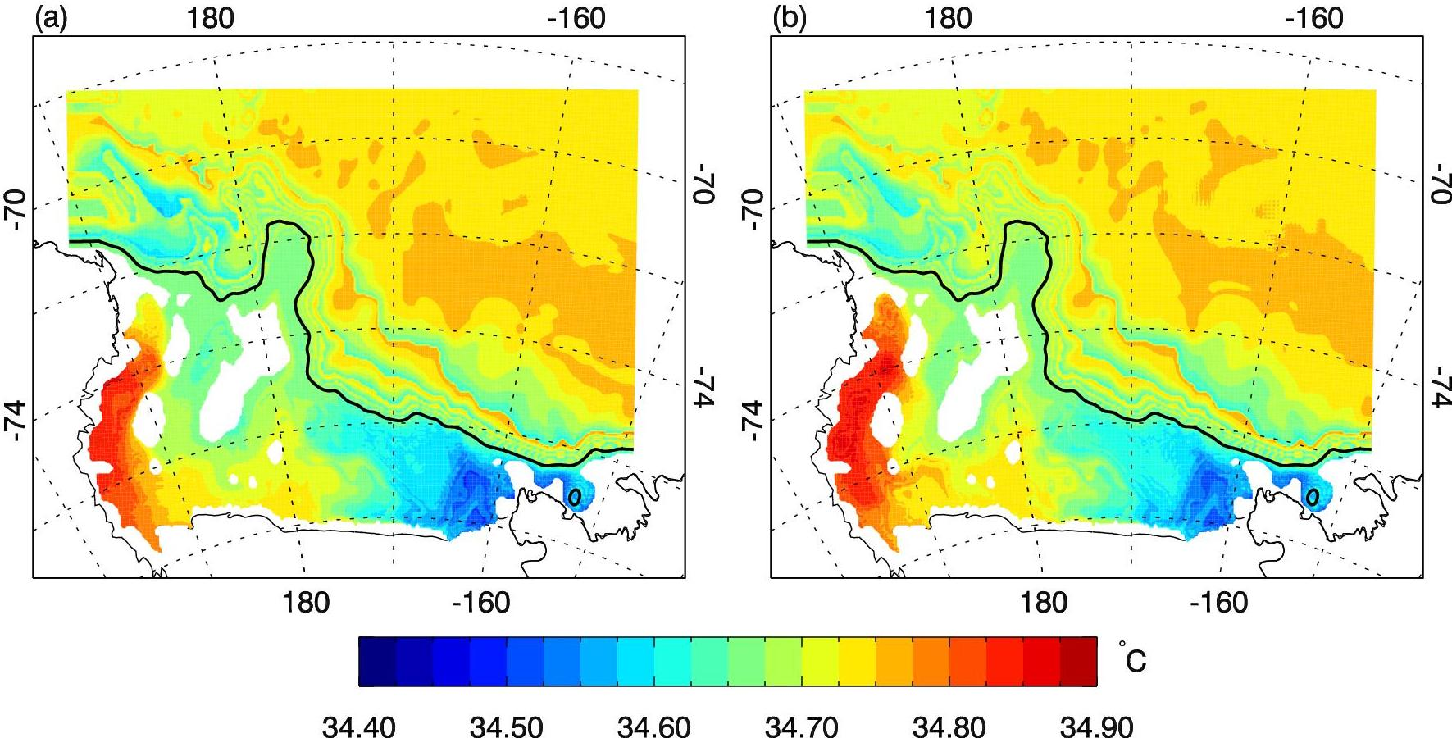
Annual Mean Salinity at 400 m (model)
2000 2001
Formation of HSSW in the southwest

Slide 17
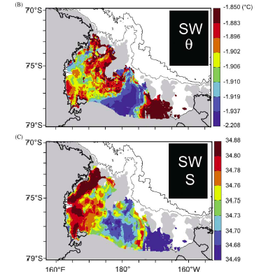
Temperature and Salinity of Ice Shelf Water
From climatology
Notes:
Low temperature shows outflow of ice shelf water. Also is a bit lower in salinity.

Slide 18
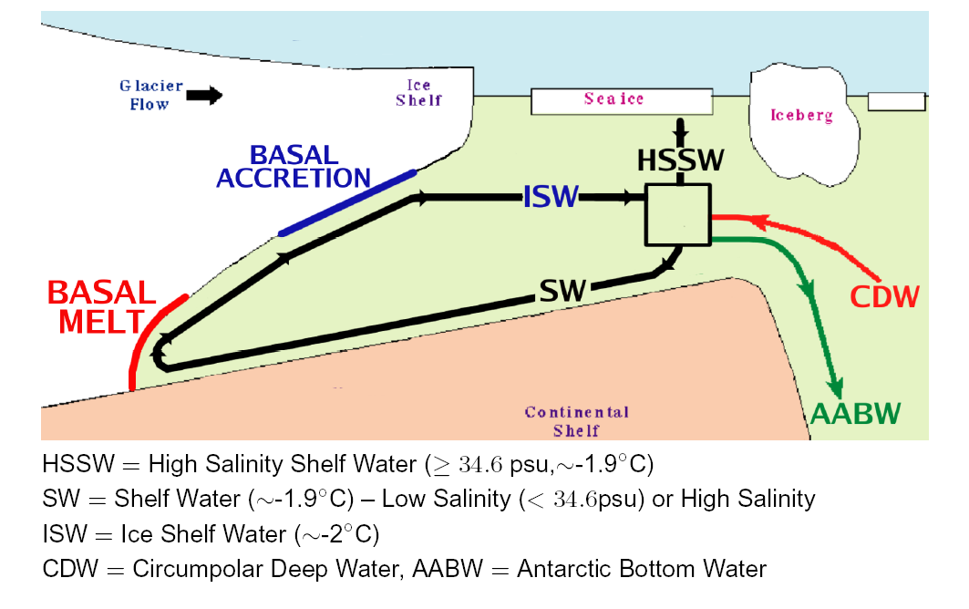
Courtesy: Ben Galton-Fenzi
Notes:
Carton of vertical circulation in a Ross Shelf system. There are lateral changes so not all of these processes happen in the same place (or the same vertical plane).

Slide 19
Thanks for your patience.
Are there any questions?
A copy of the climatology paper is online.
A recount of Ross Sea waters
Orsi and Wiederwohl, DSR II, 2009.

Slide 20
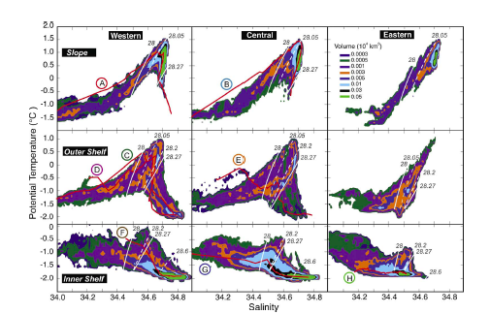
T-S diagrams for different regions

Slide 21
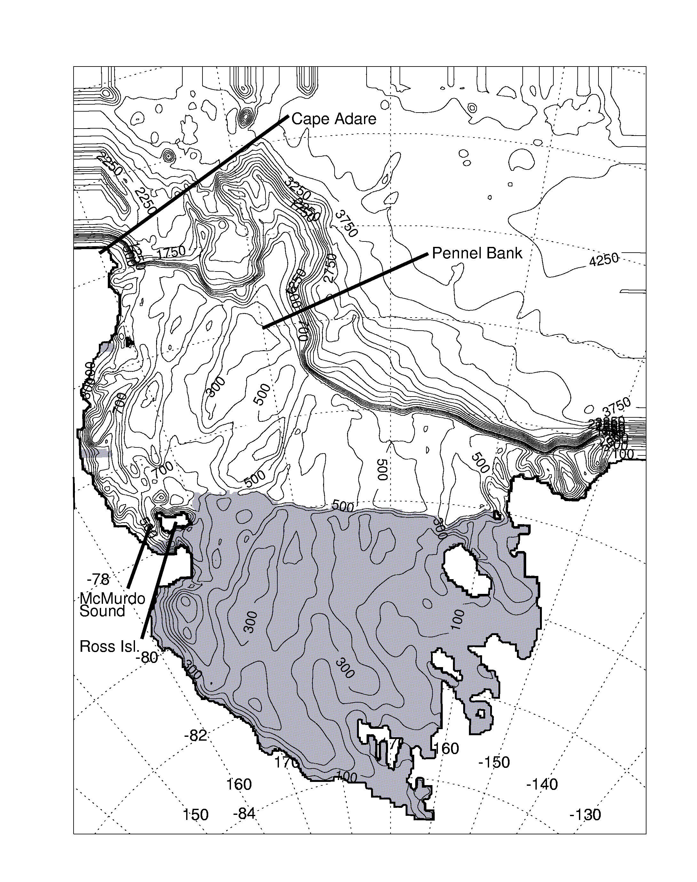
Ross Sea bathymetry
Shaded area is the Ross Ice Shelf
Notes:
21
Shaded areas represent Ice Shelves.

Slide 22
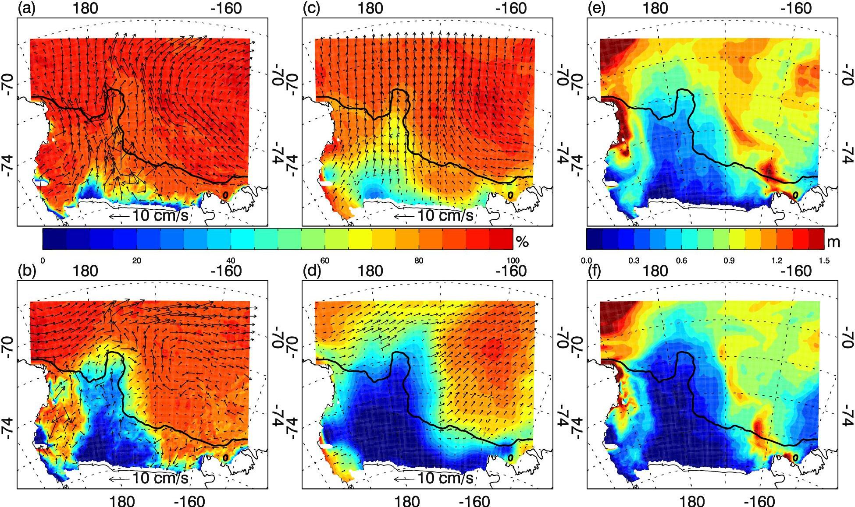
Sea Ice Concentration and Movement
Nov and Dec 2001
Simulated Observed Sim thickness
Nov
Dec

Slide 23
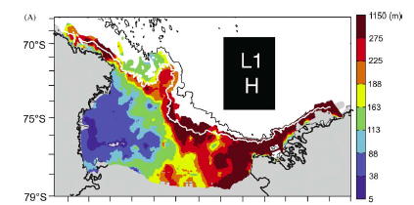
Surface Layer Thickness

Slide 24
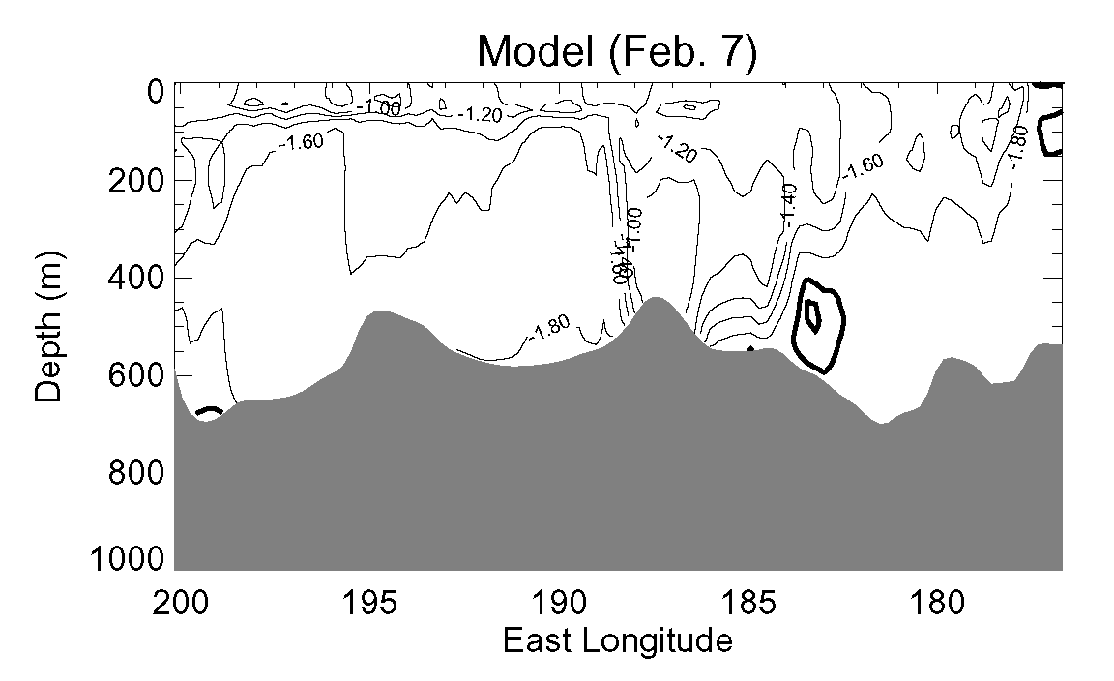
Observed Ross Ice Shelf Front temperature cross section (early Feb., 1984) (Jacobs and Giulivi, 1999)
Modeled Ross Ice Shelf Front temperature cross section
MCDW
ISW
Model mean basal
melt rate (RIS): 15 cm/yr
Notes:
This is a check on how the model is doing. Model contours are same as observations (including -1.95/-2.0 for cold water). Note: Slightly warmer MCDW going into the ice cavity and smaller amount of ISW coming out of the cavity. Sfc. freezing pt. for this water around -1.88.

