Slide 1
Science Meeting1/29/12
Ross Bank Process Study
Ross Ice Shelf Process Study

Slide 2
Ross Bank VPR Survey (VPR9, 1/20-1/21)
Temperature
Salinity
Fluorescence
Backscatter

Slide 3
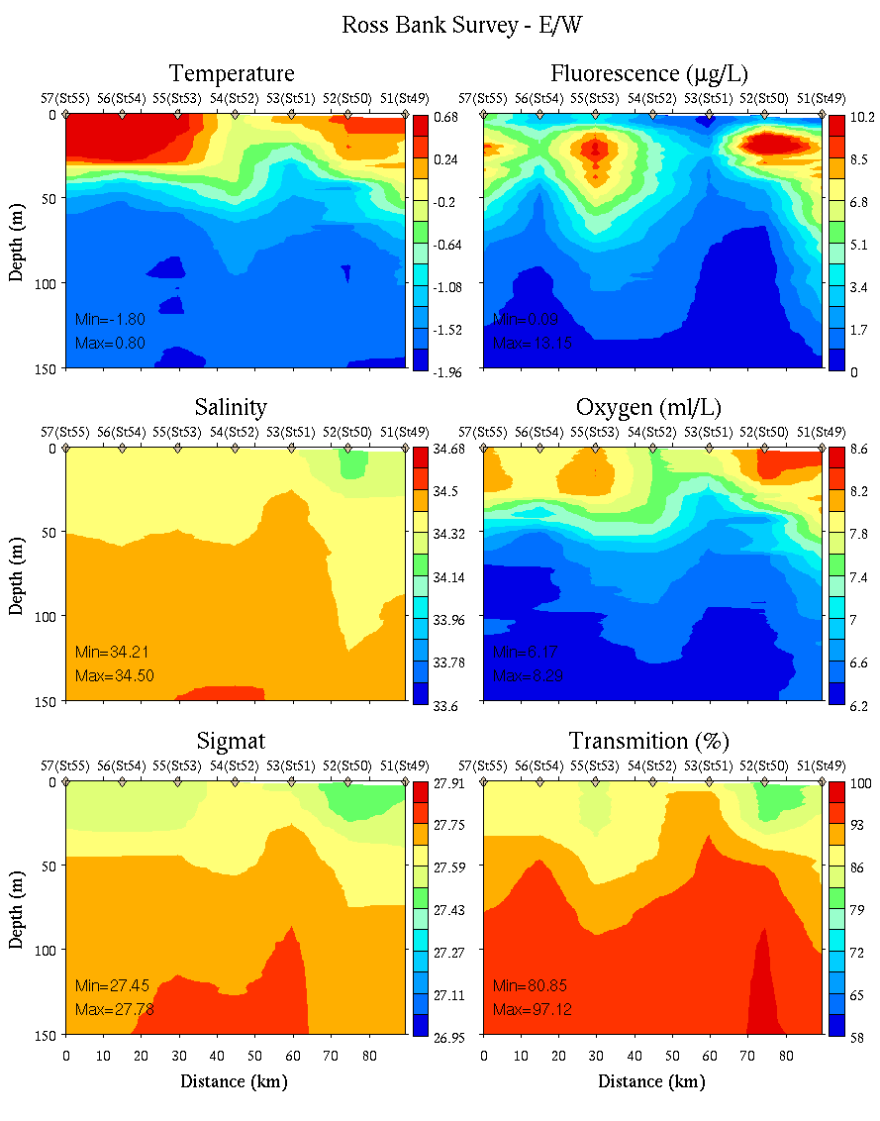
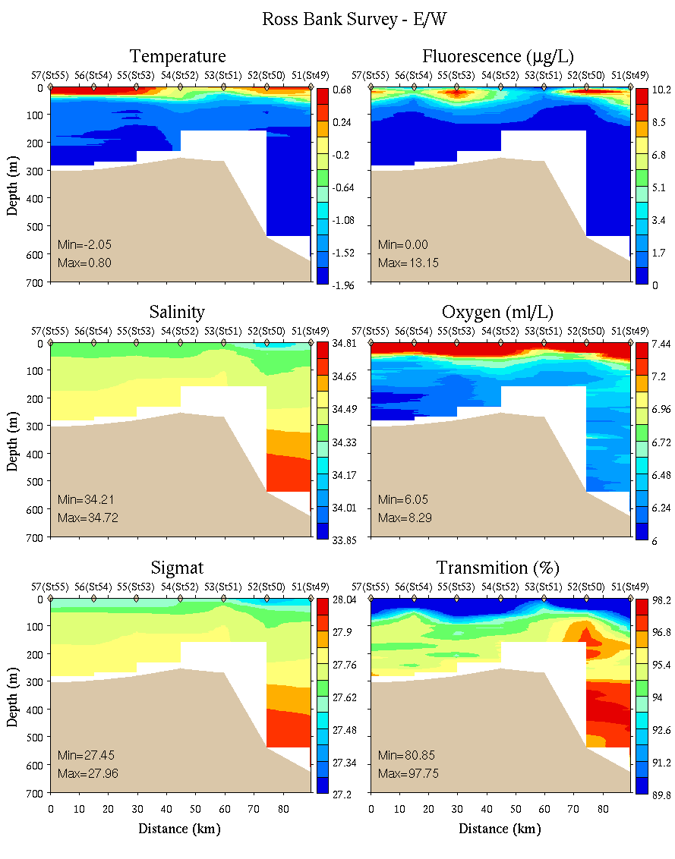
Ross Bank Survey: E-W transect
0-150m
0-700m

Slide 4
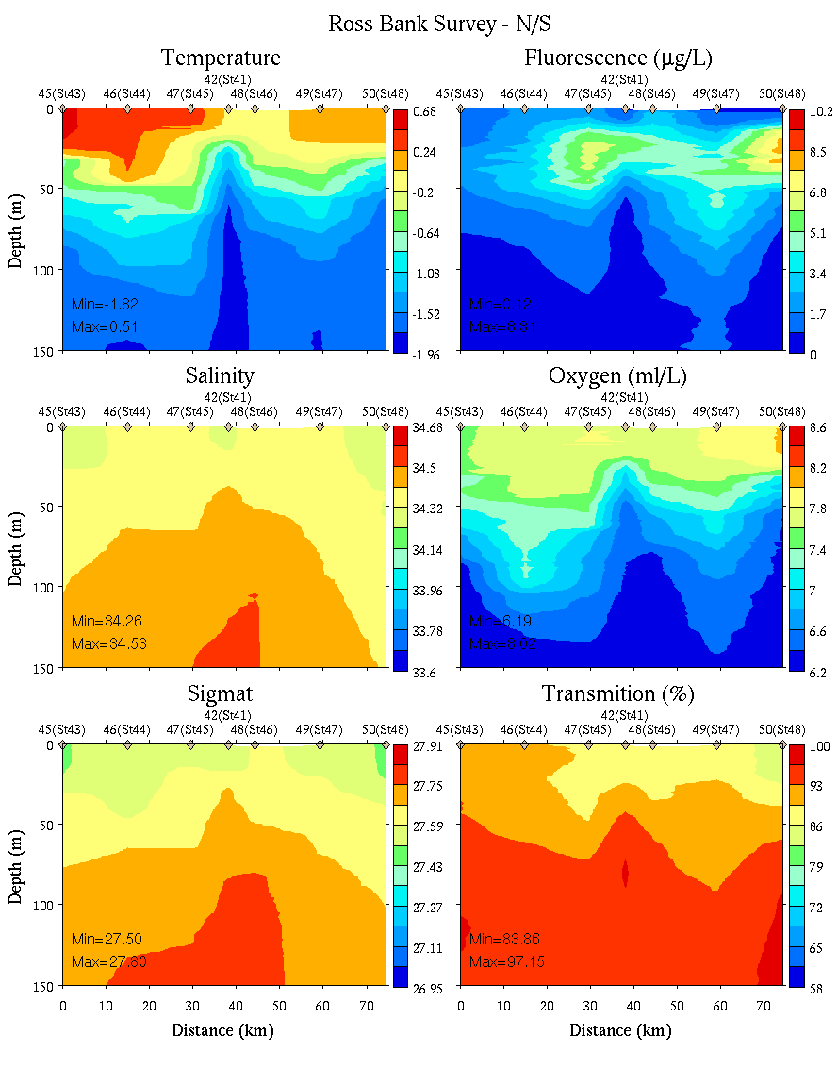
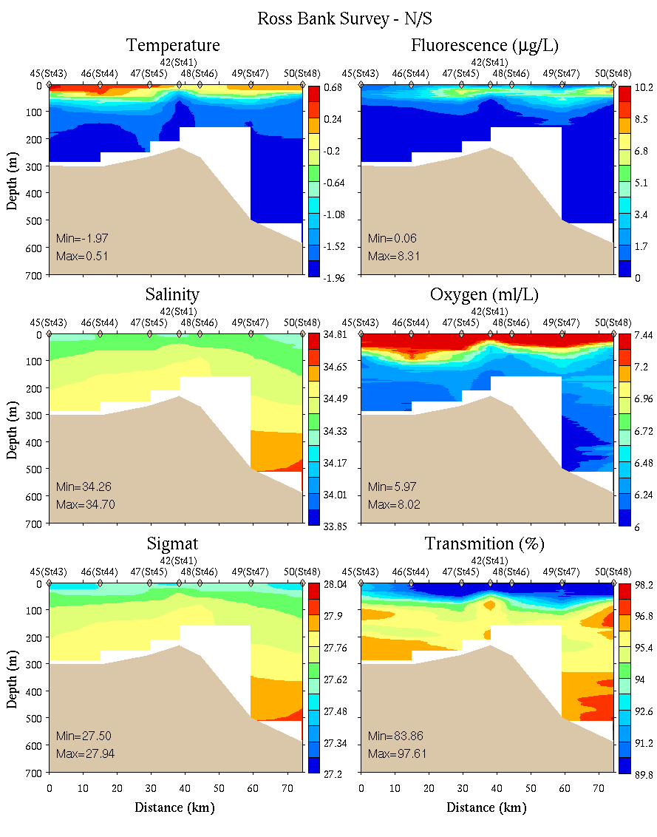
Ross Bank Survey: N-S transect
0-150m
0-700m

Slide 5
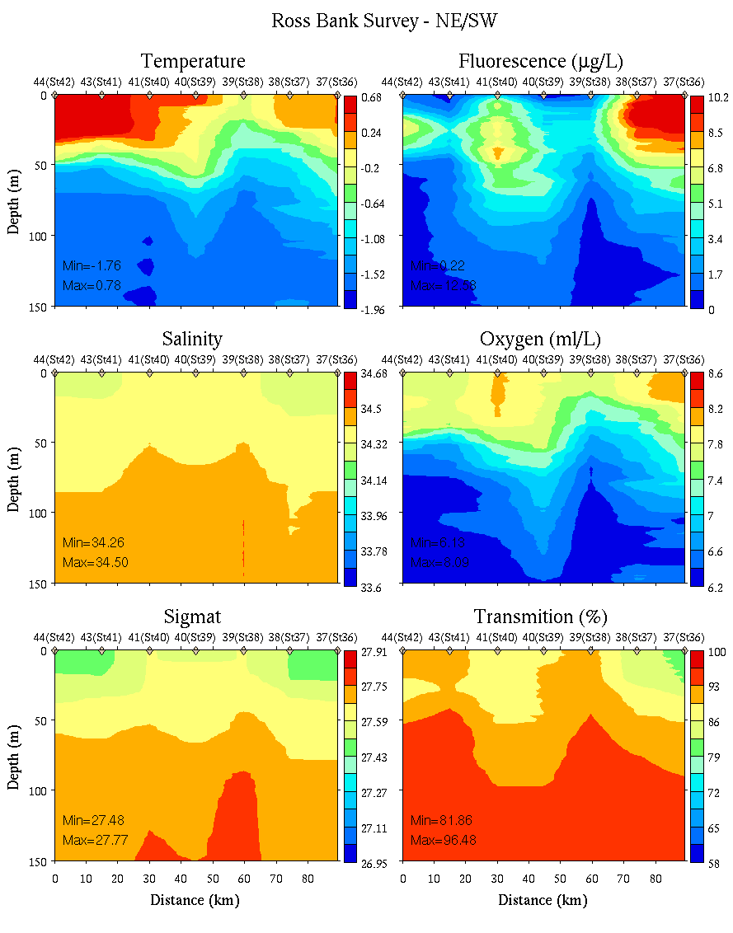
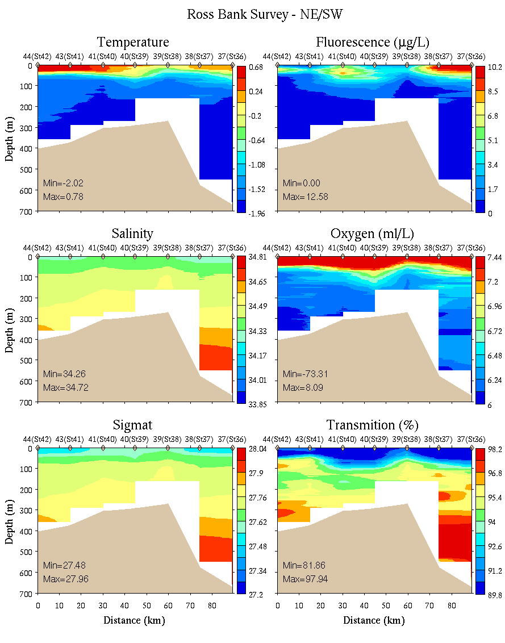
Ross Bank Survey: SE-NW transect
0-150m
0-700m

Slide 6
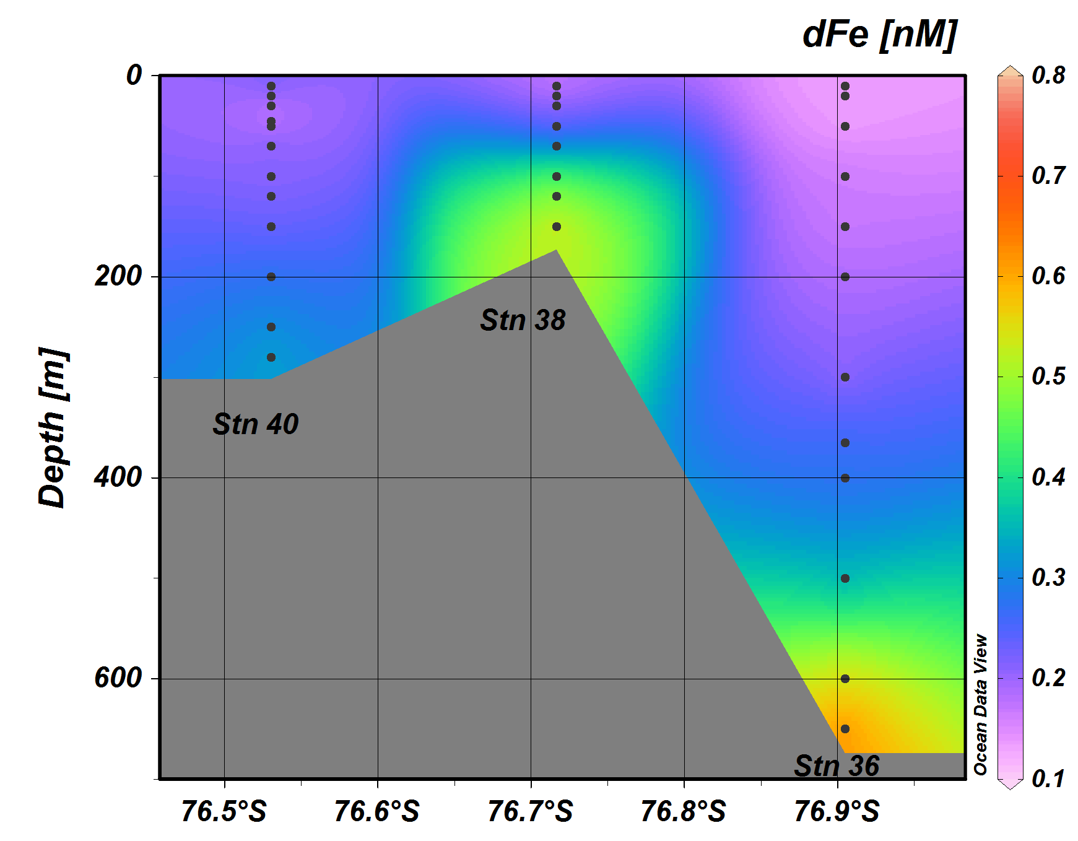
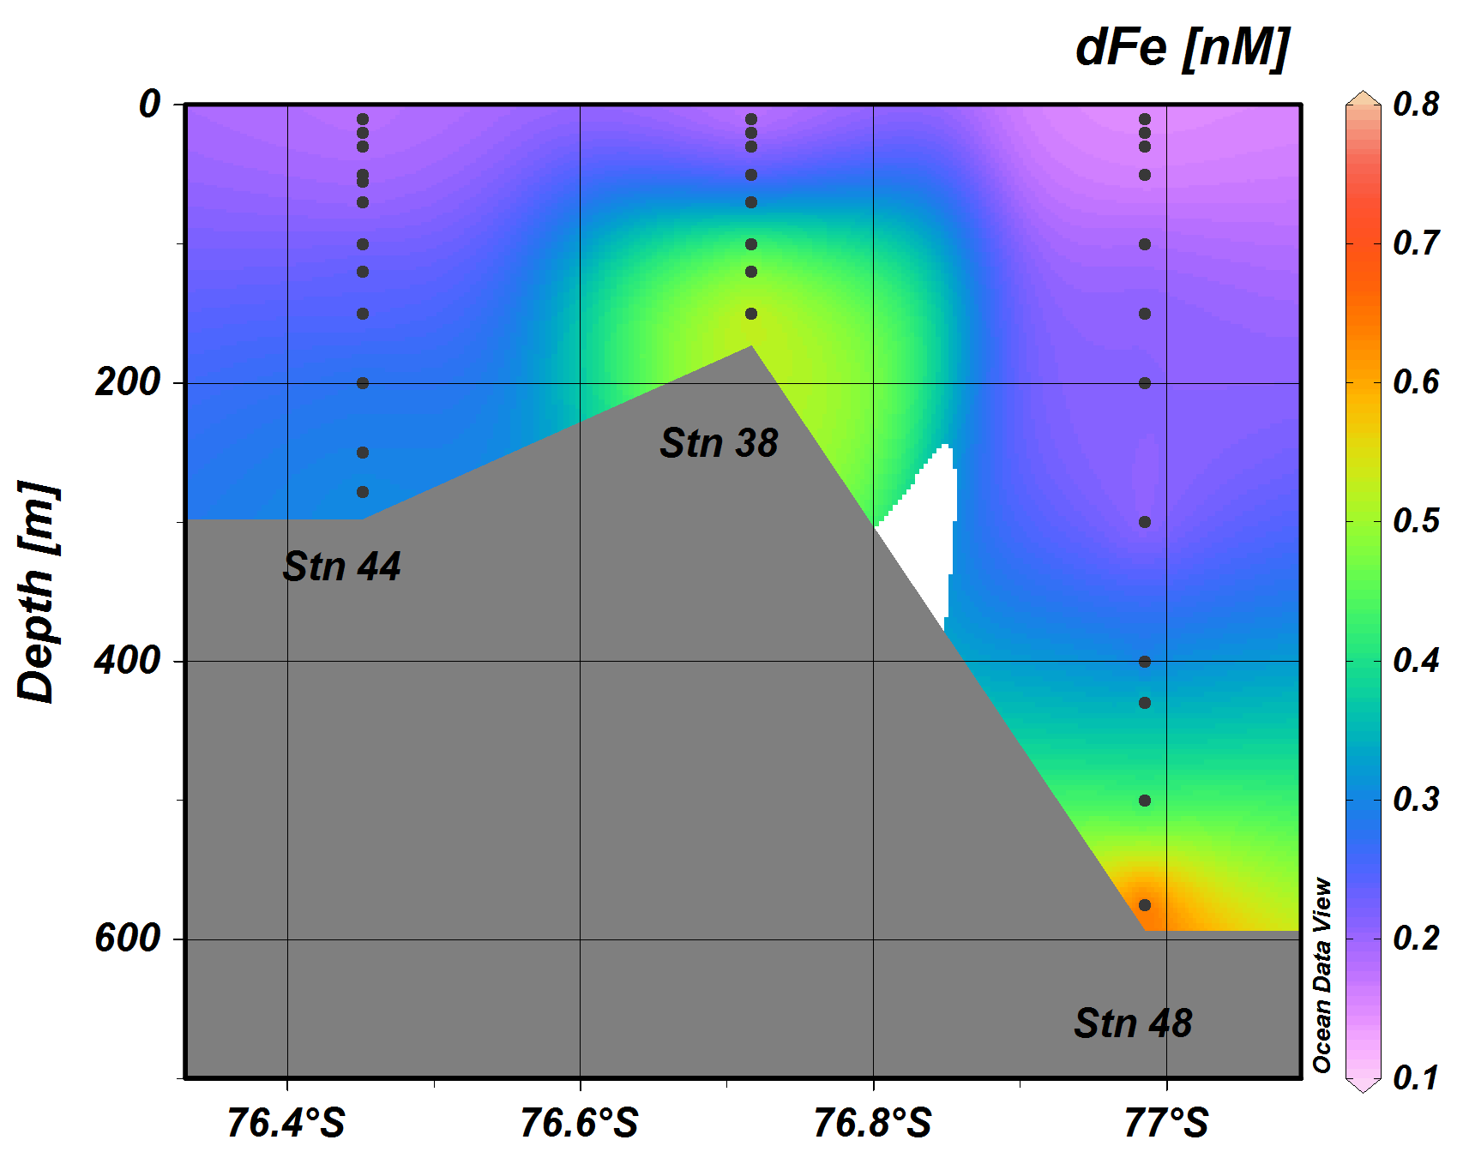
Dissolved Fe on Ross Bank
SE-NW section
N-S section

Slide 7
Ross Bank tidal velocity amplitude
SeaHorse

Slide 8
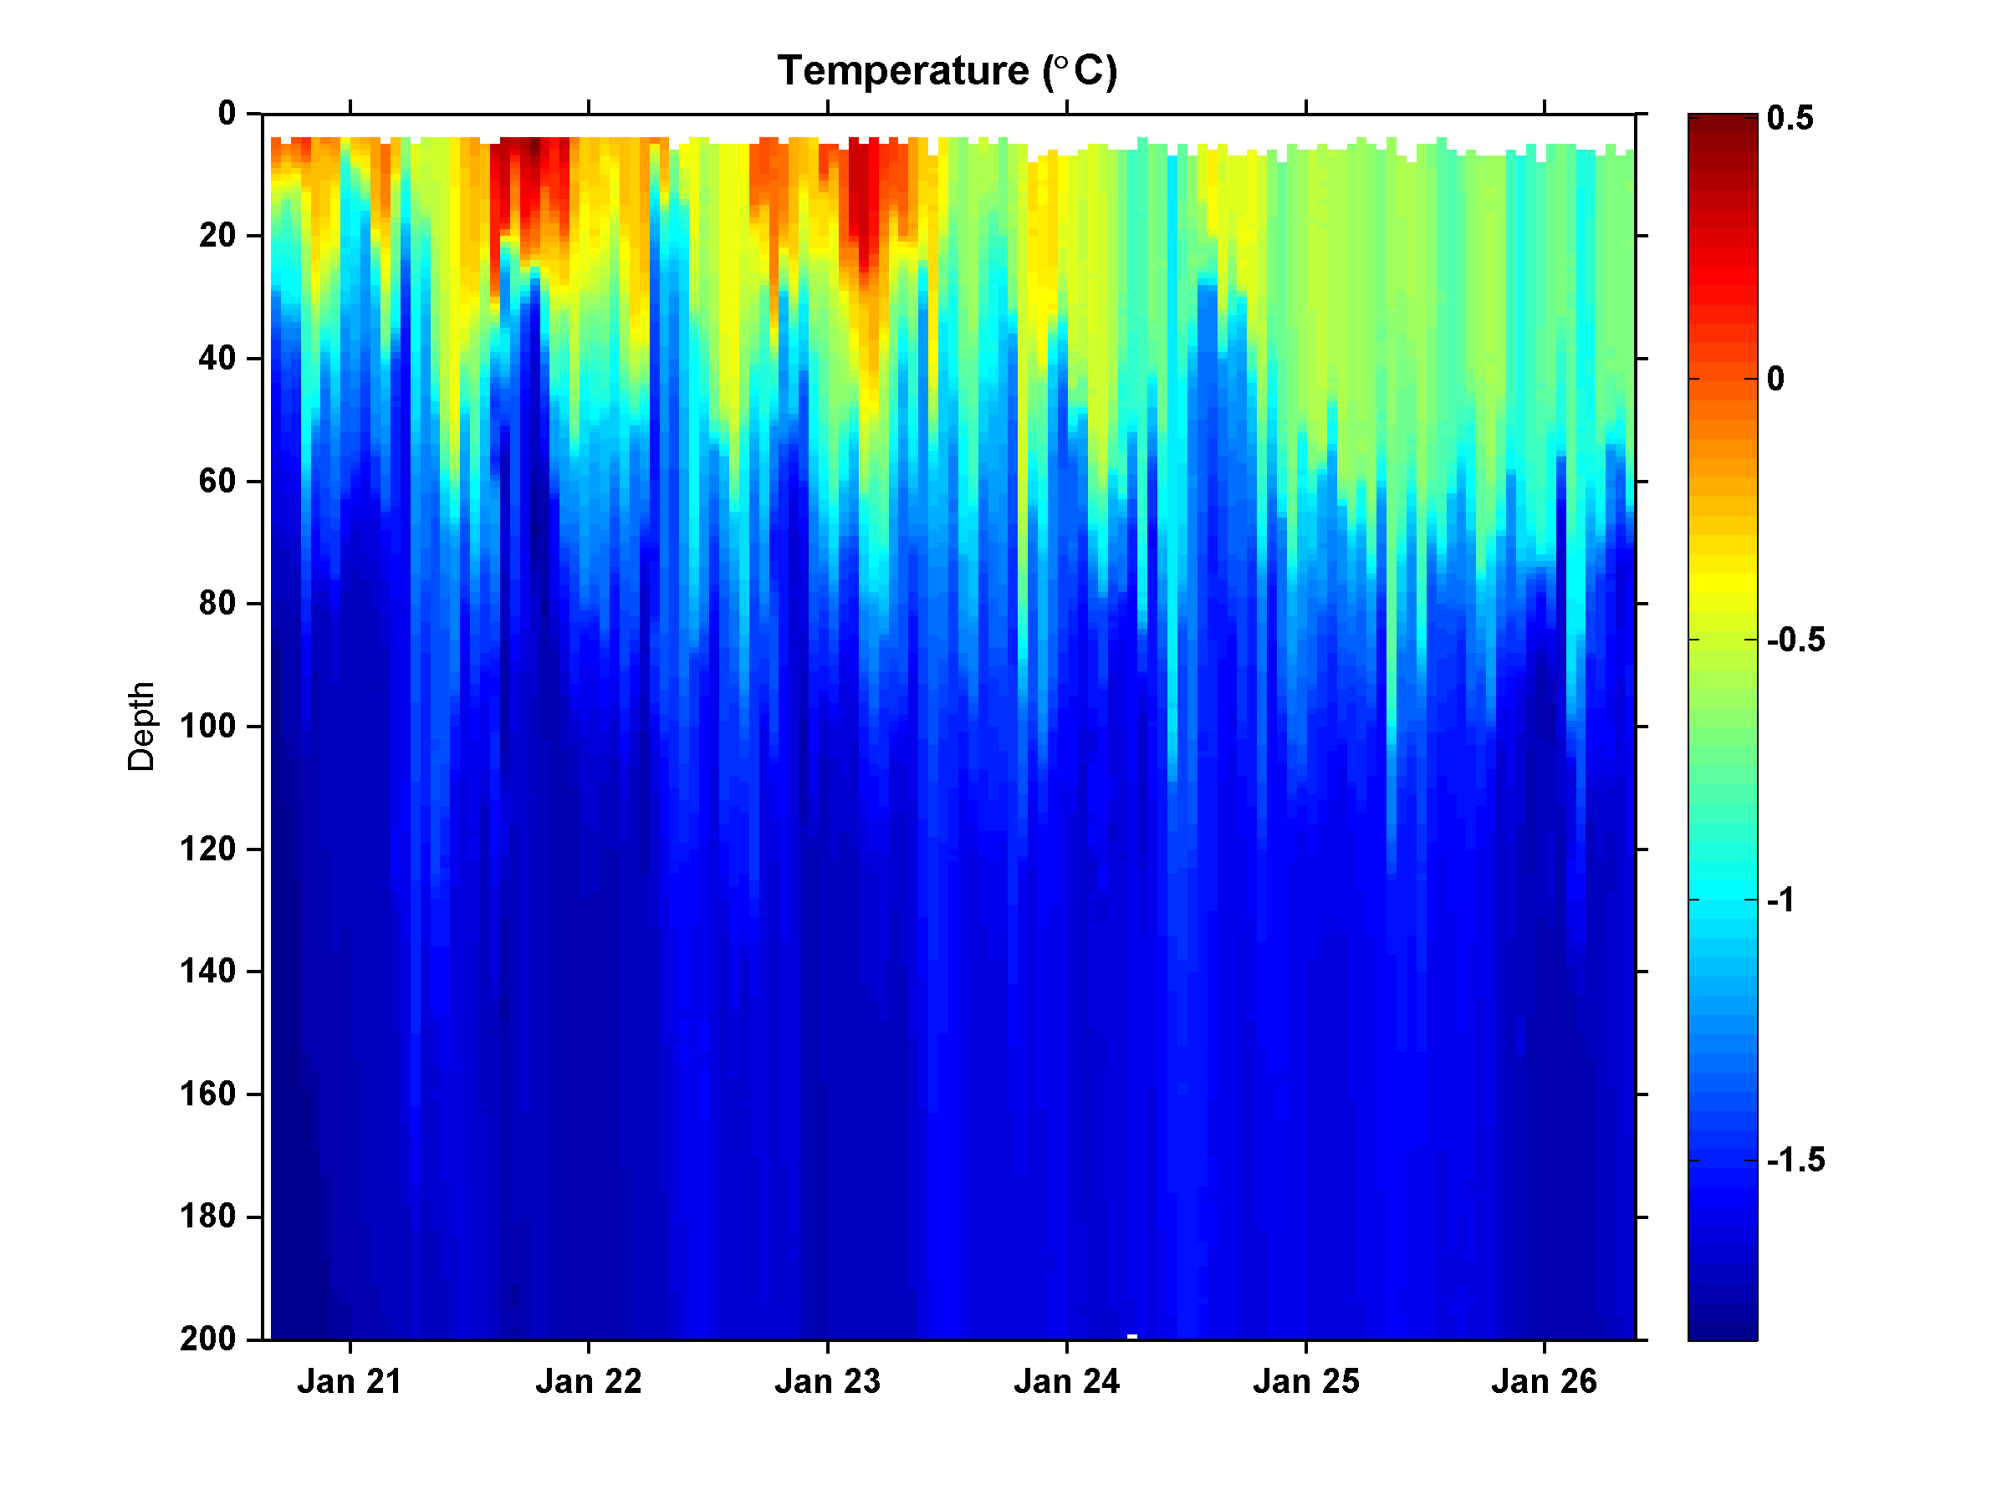
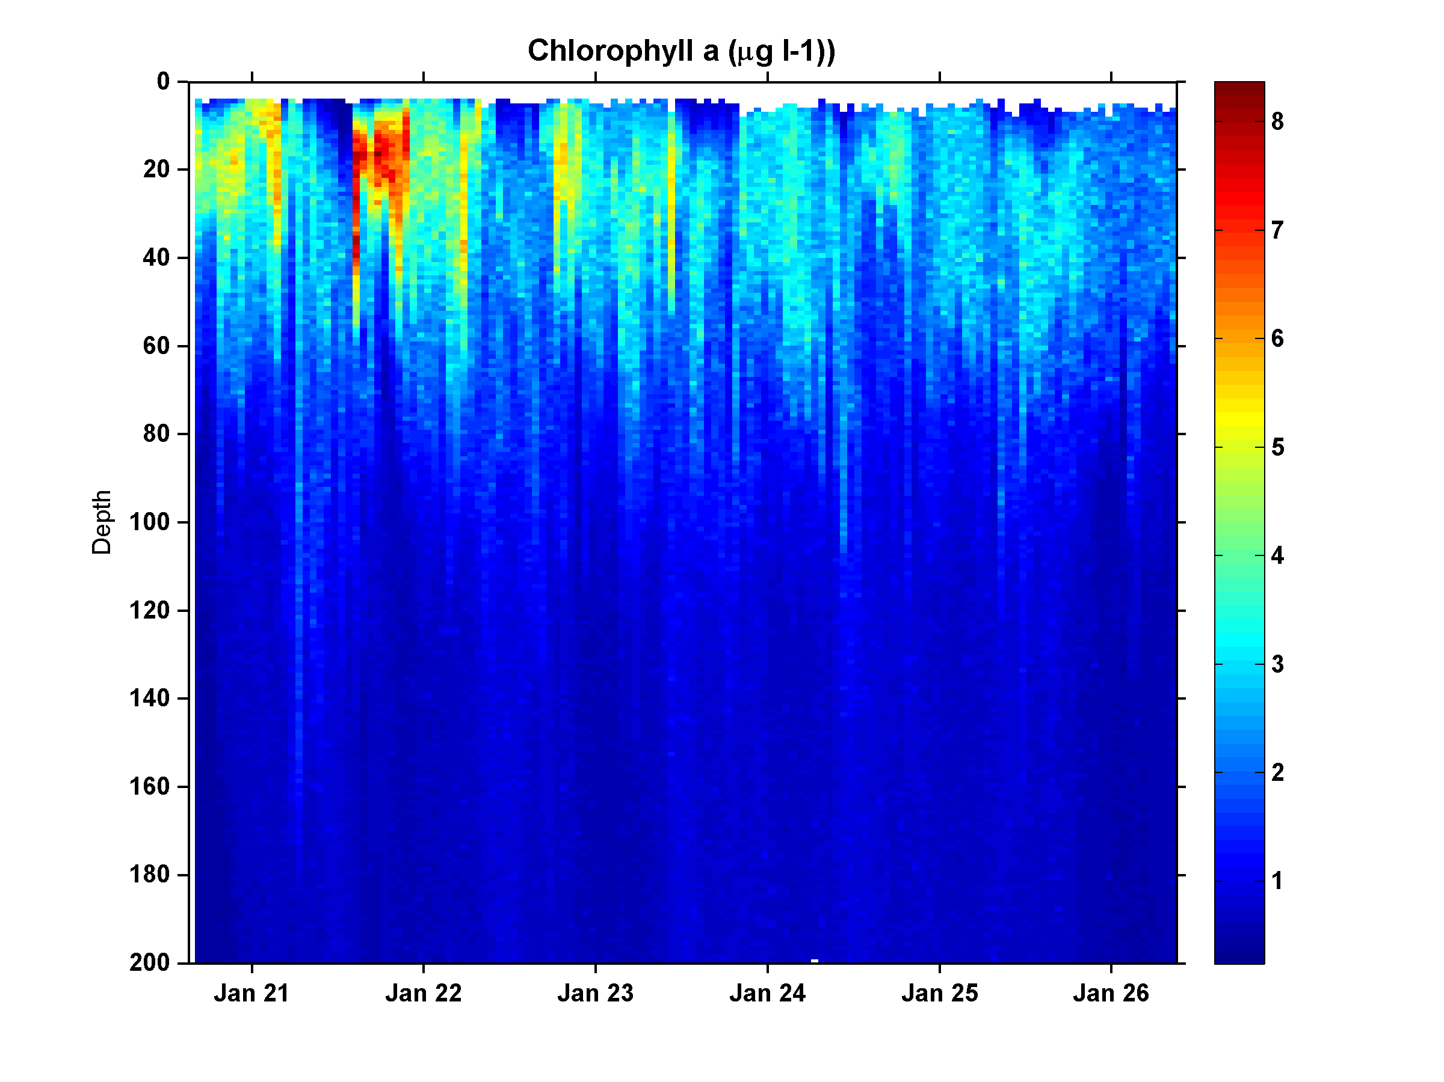
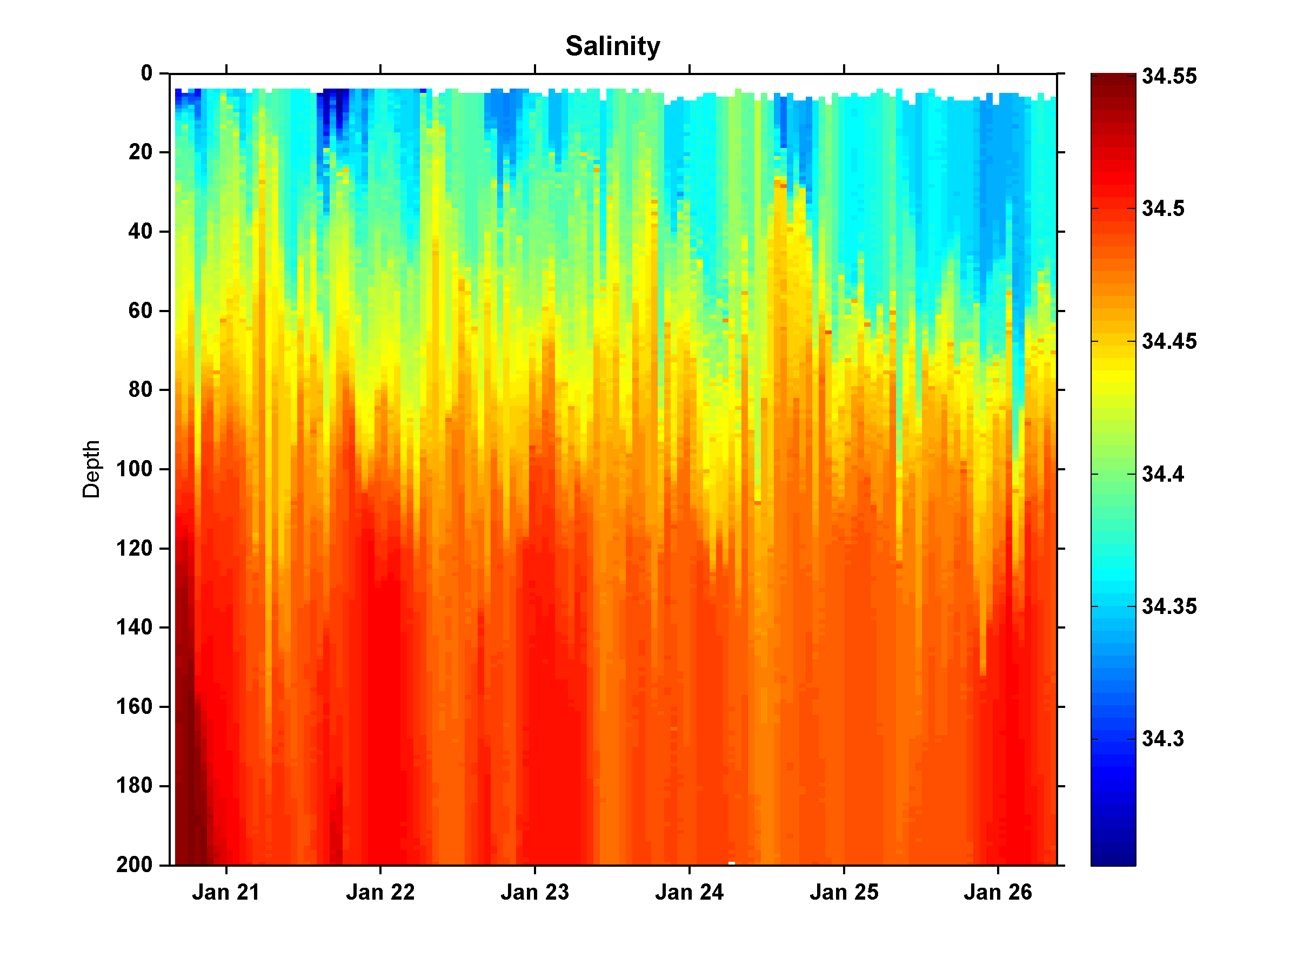
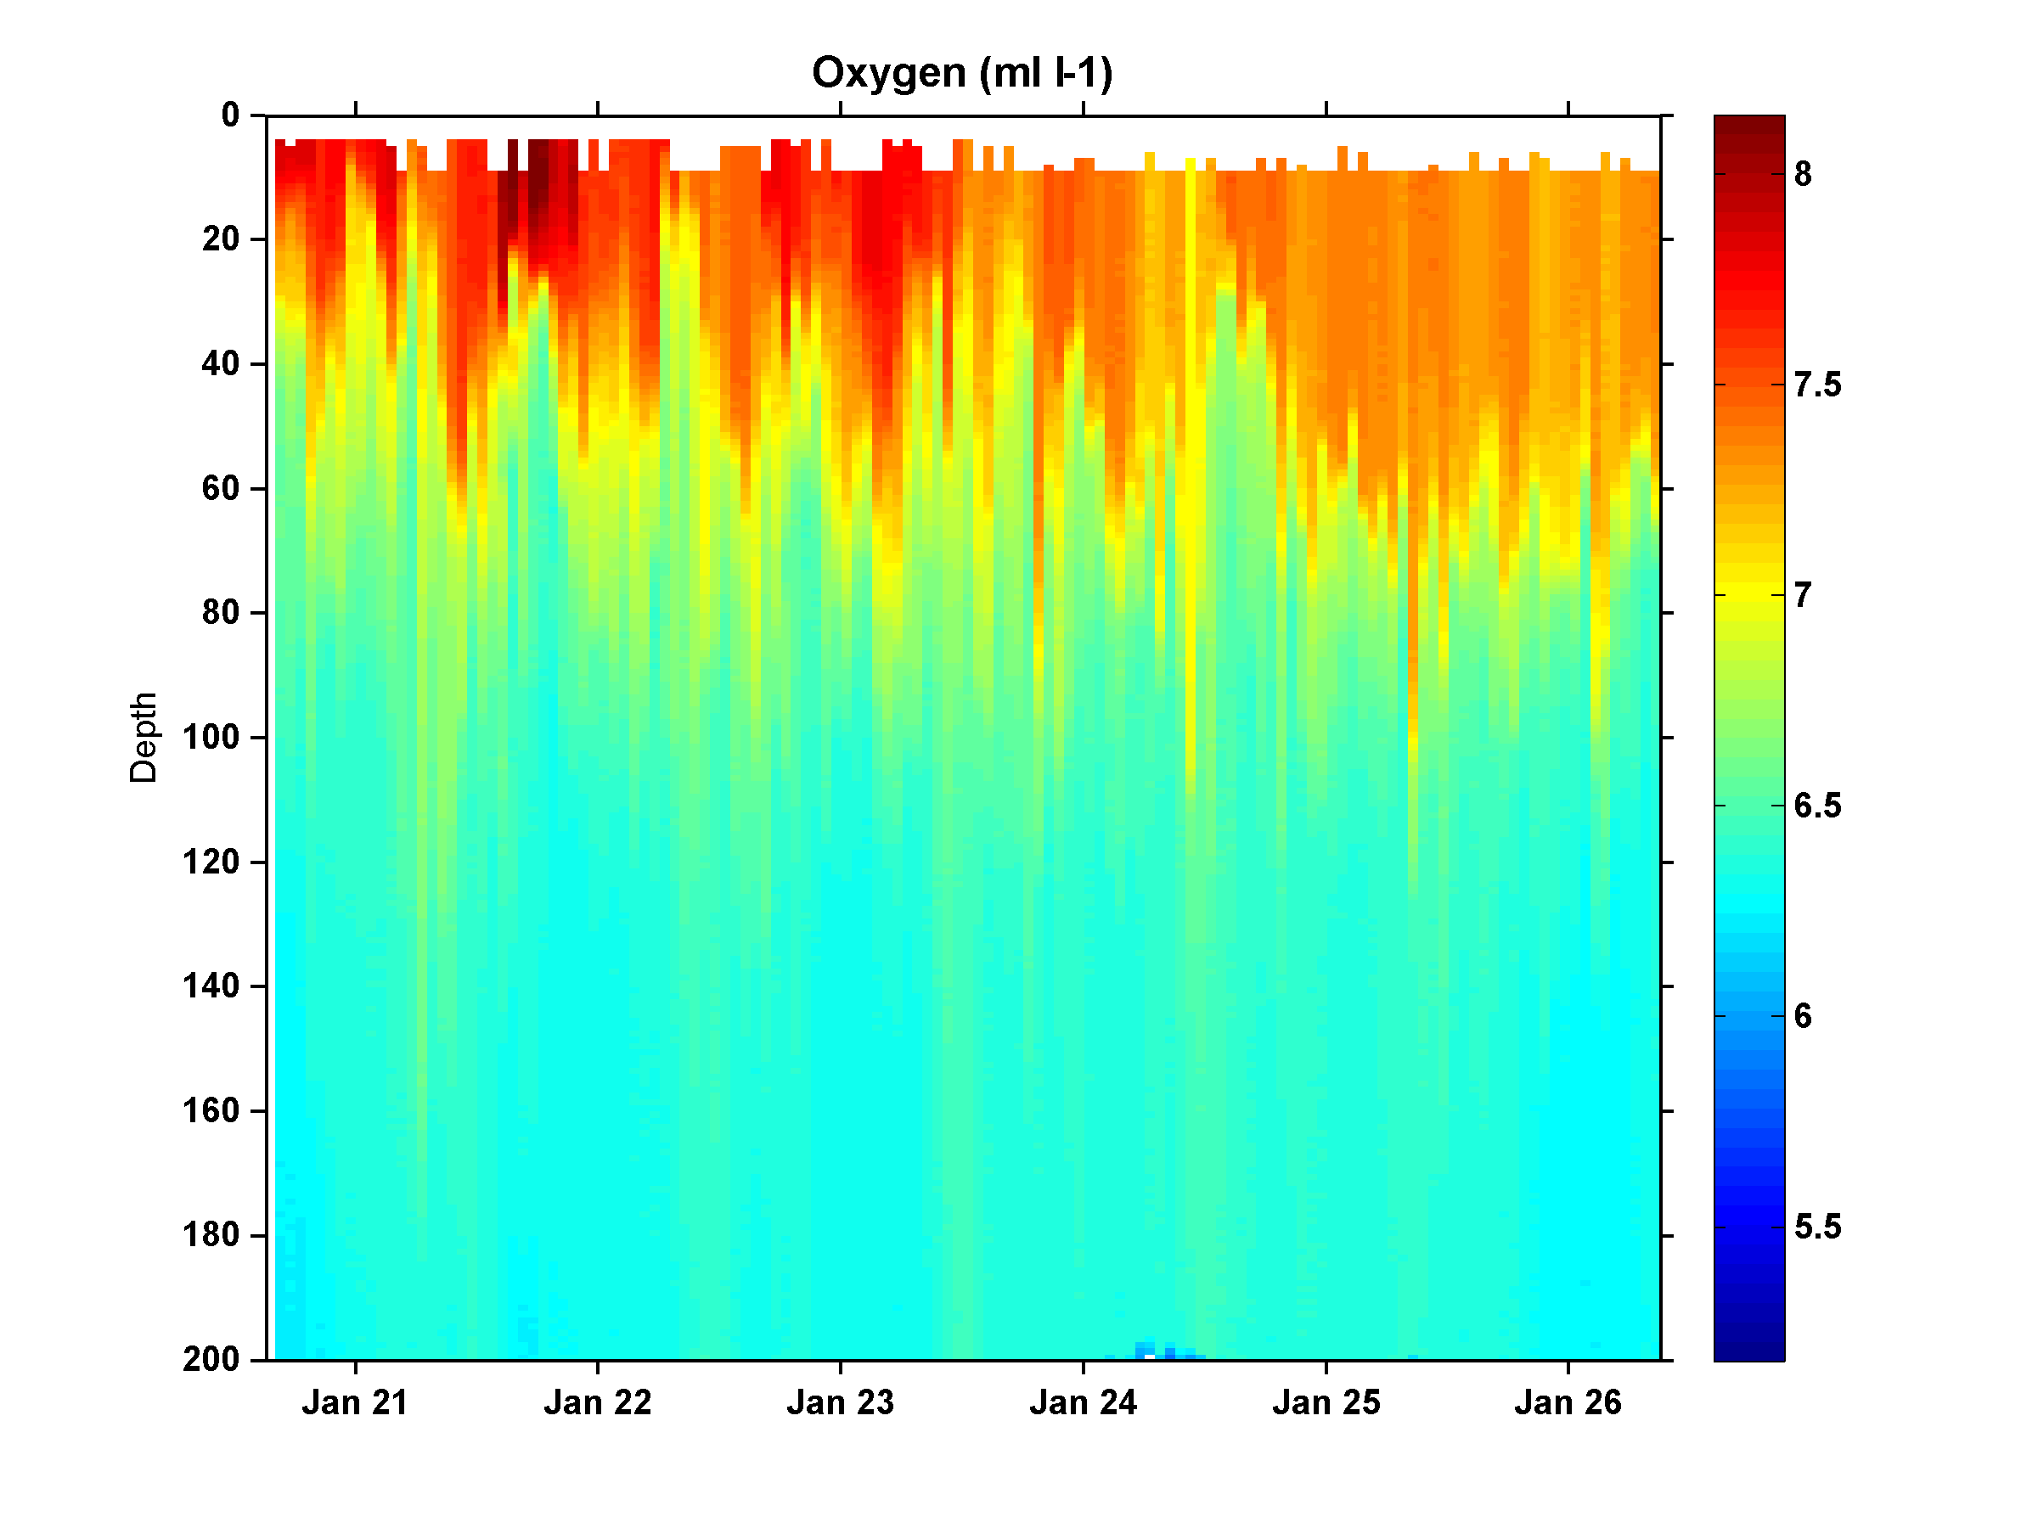
Ross Bank SeaHorse Deployment
Temperature
Chlorophyll
Salinity
Oxygen

Slide 9
Ross Bank Survey: SE-NW transect
0-150m
0-700m

Slide 10
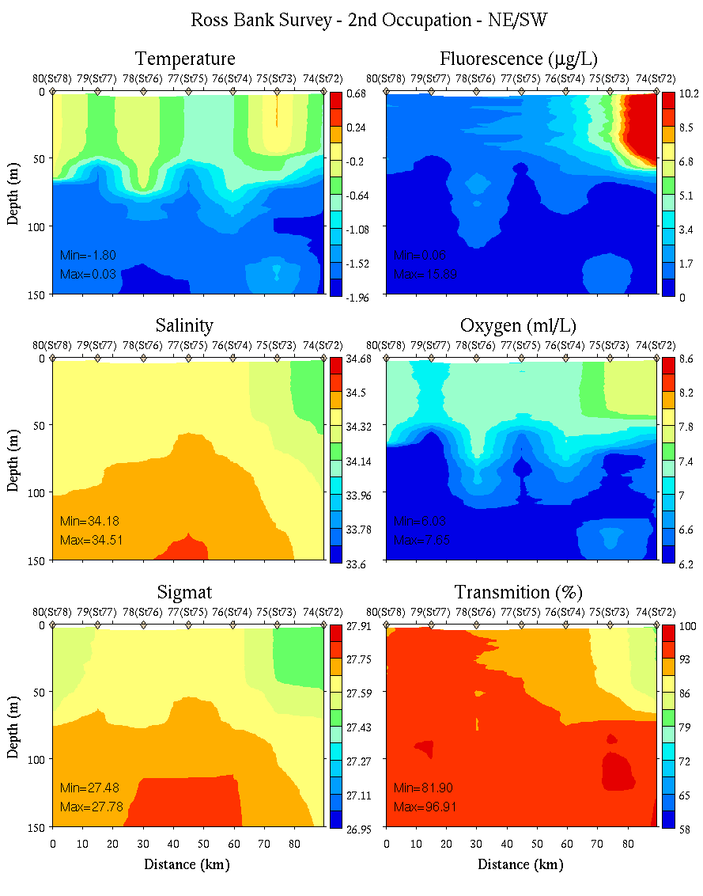
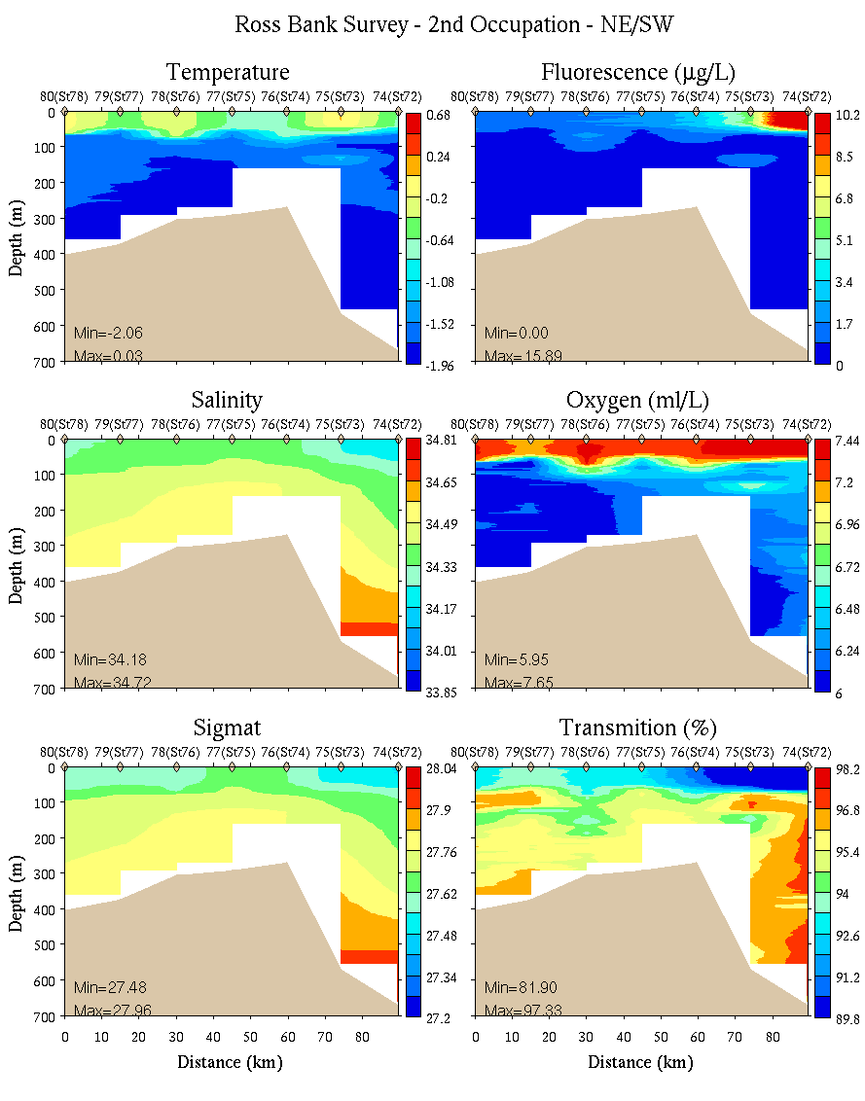
Ross Bank Survey #2: SE-NW transect
0-150m
0-700m

Slide 11
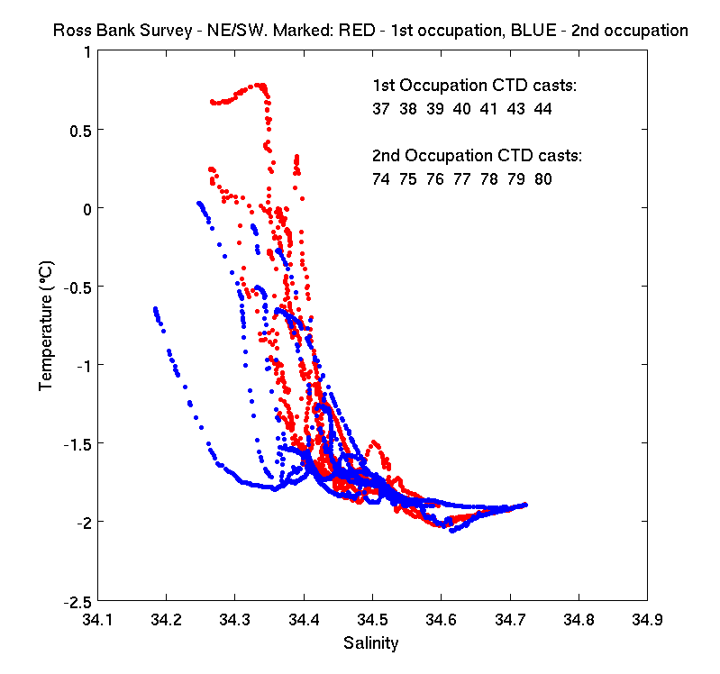
Ross Bank SE-NW transect before and after

Slide 12
Ross Bank Summit, 21 Jan 2012
dissolved Fe (nM)
depth
(m)
Ross Bank Summit, 26 Jan 2012
dissolved Fe (nM)
depth
(m)

Slide 13
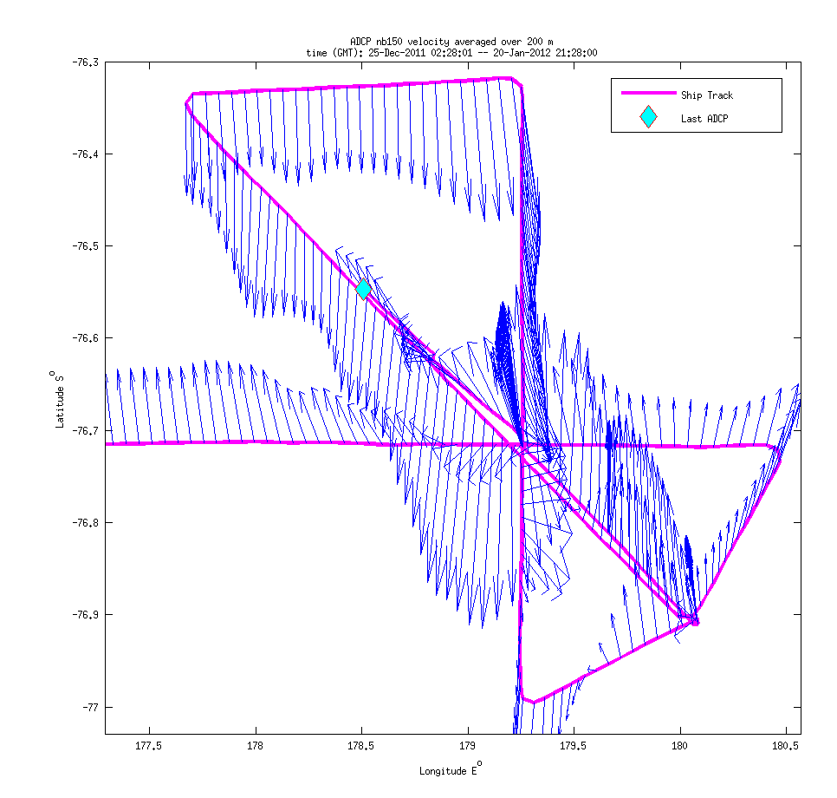
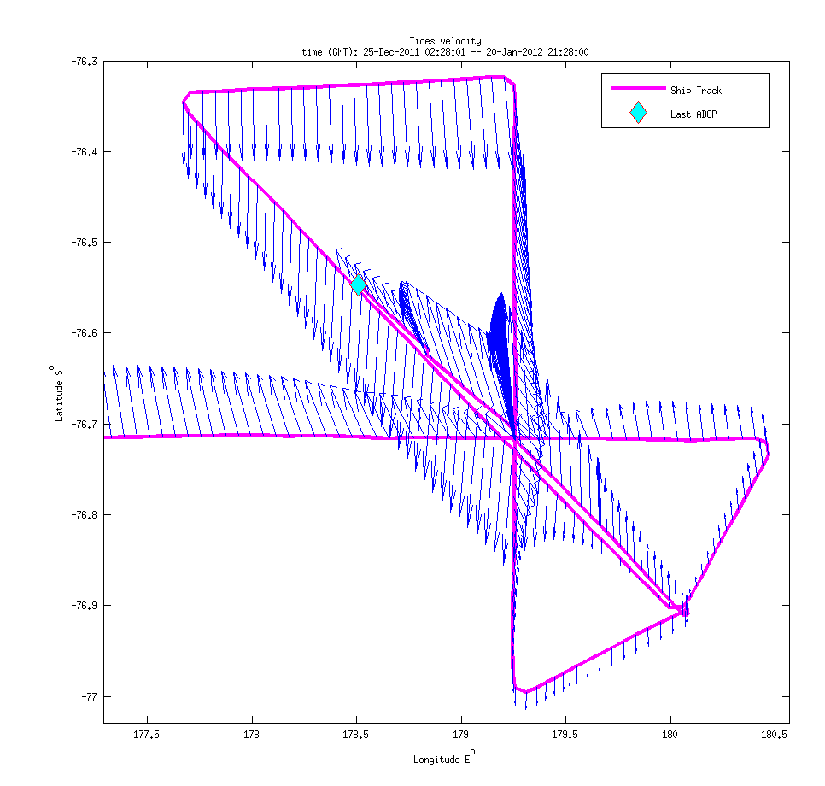
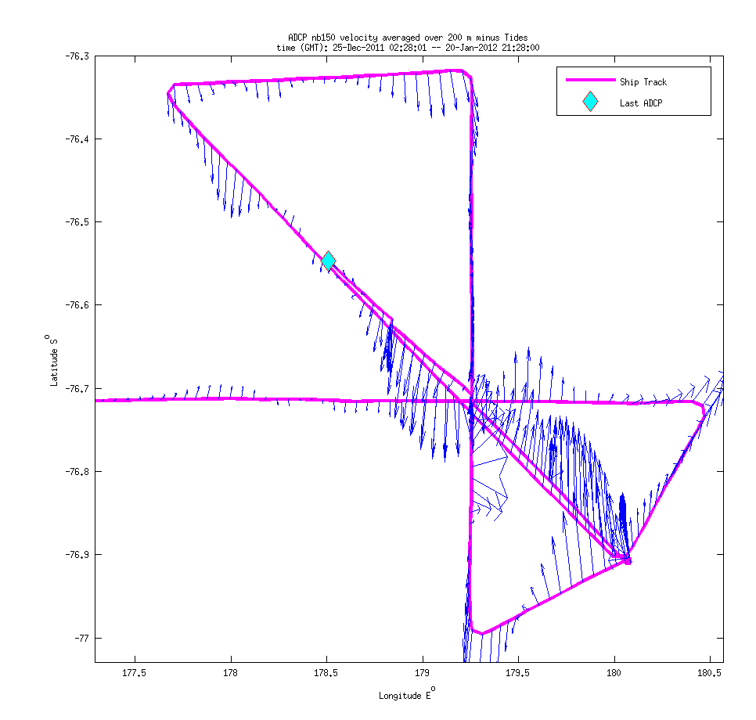
Ross Bank VPR/ADCP Survey
ADCP, 0-200m Padman et al. tidal model Subtidal currents

Slide 14
VPR Section toward Ross Bank (VPR8, 1/20-1/21)
Temperature
Salinity
Fluorescence

Slide 15
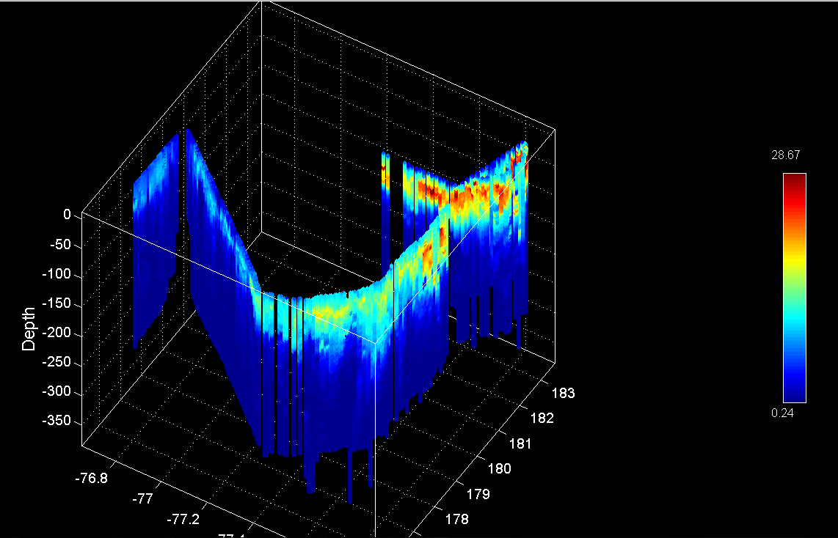
Ross Ice Shelf MVP Survey
Temperature
Salinity
LOPC
Fluorescence

Slide 16
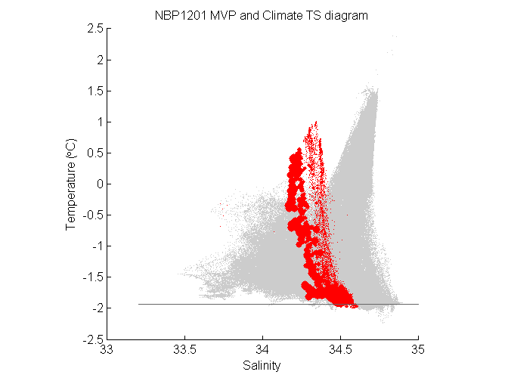
Ross Ice Shelf MVP Survey

Slide 17
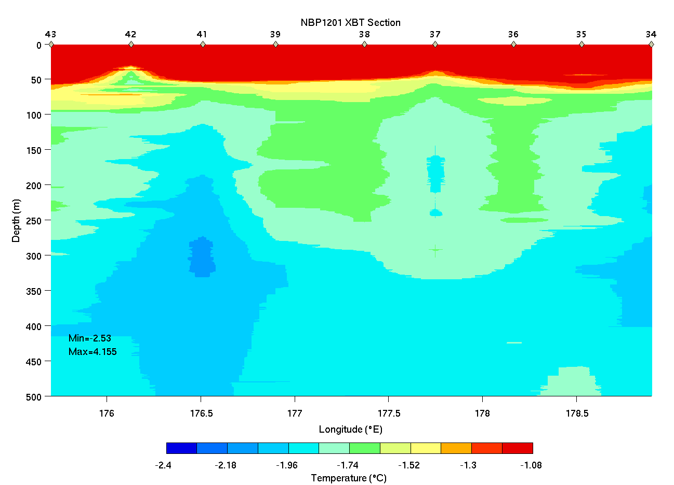
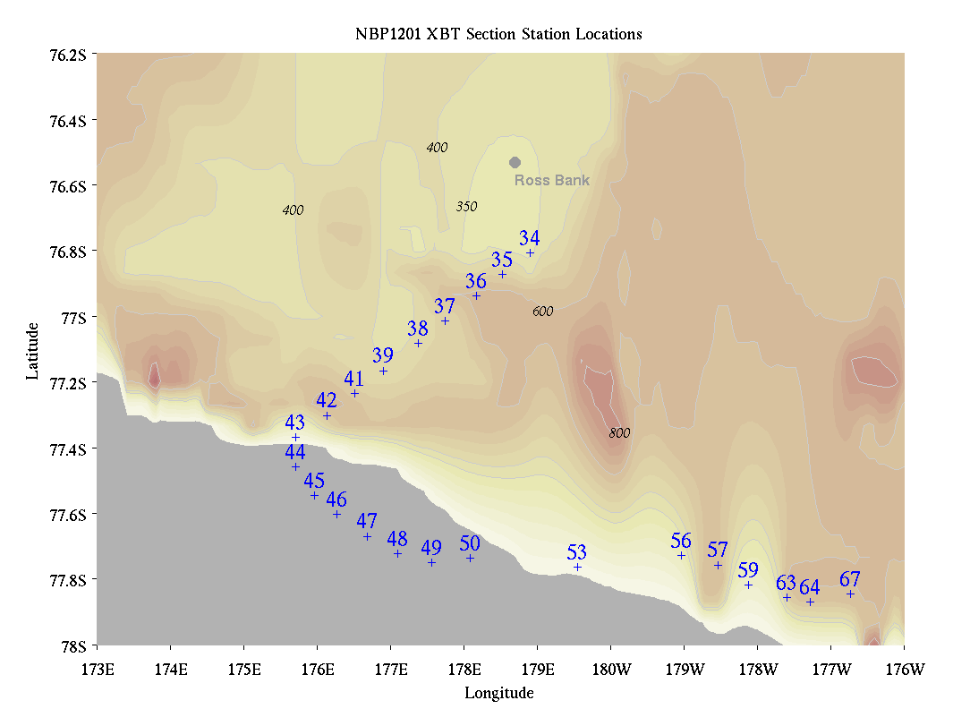
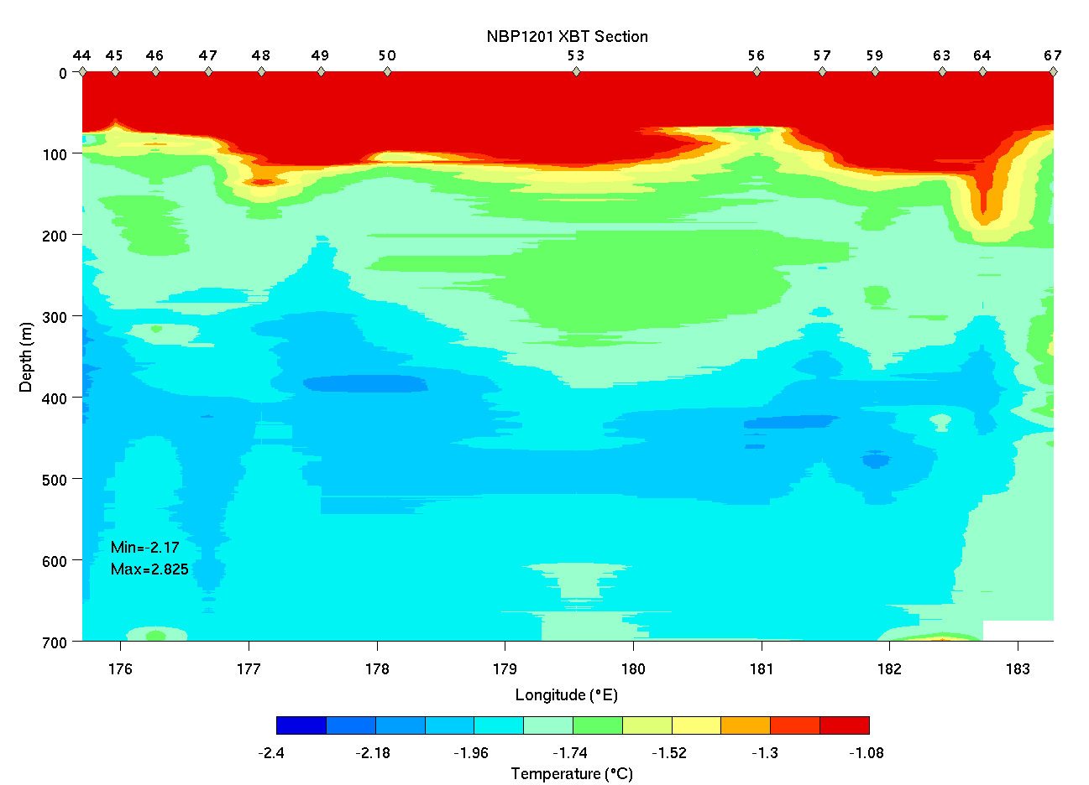
Ross Bank to Ice Shelf XBT Survey

Slide 18
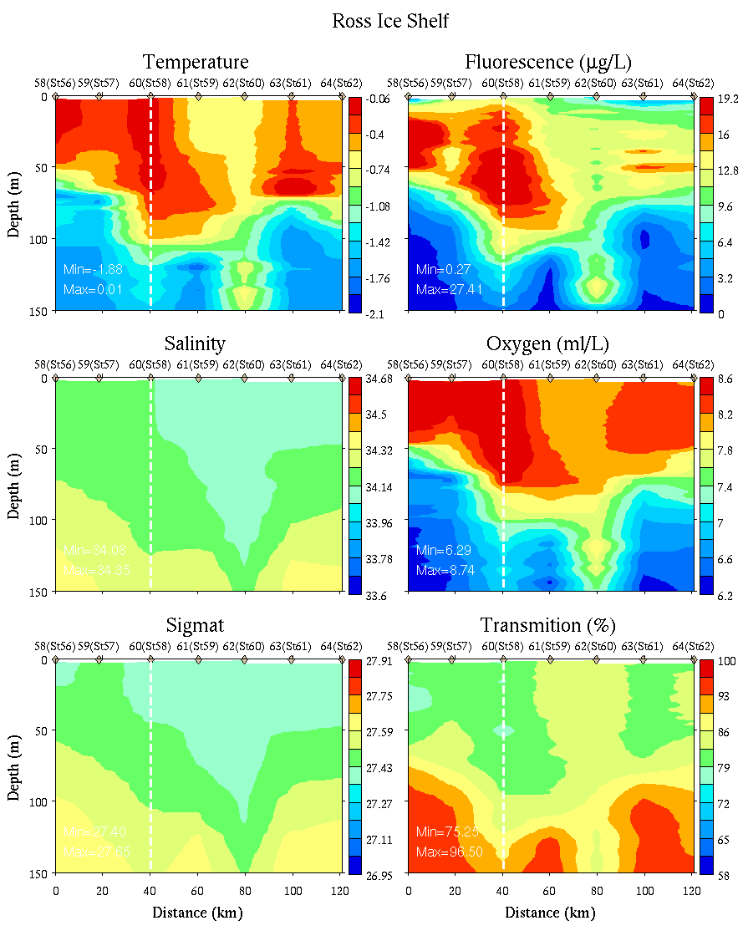
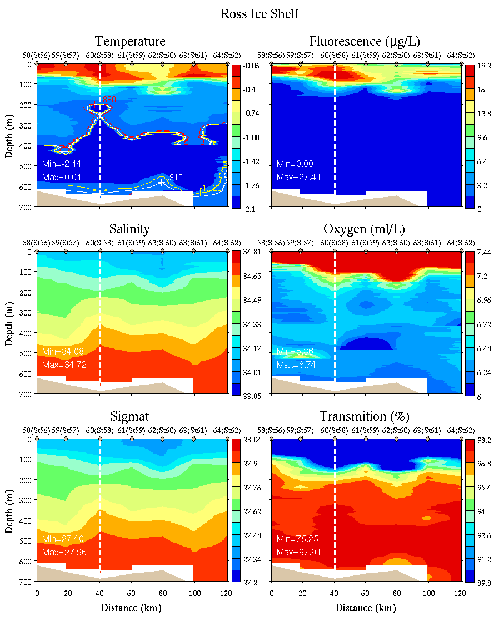
Ice Shelf Survey
0-150m
0-700m

Slide 19
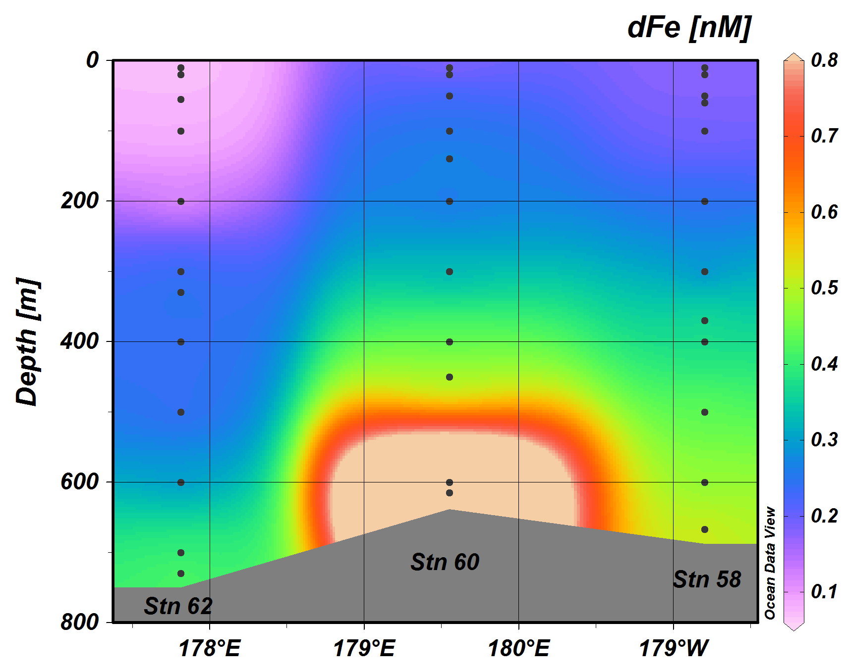
Ice Shelf Survey
Sedwick et al. Fe
0-700m

Slide 20
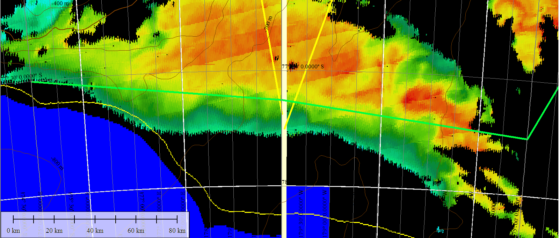
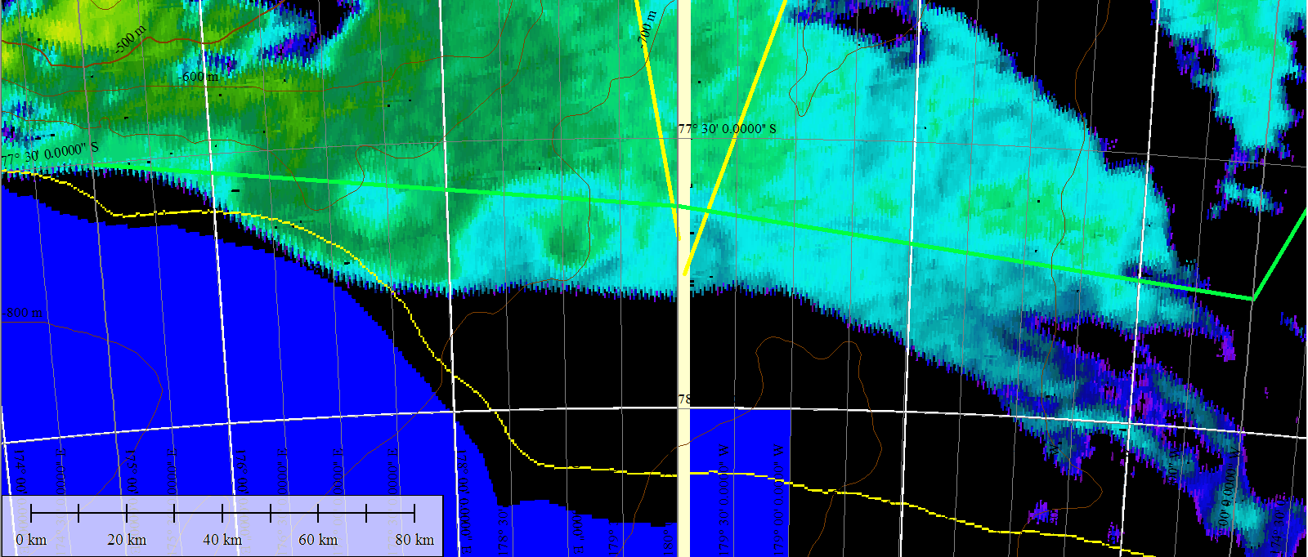
Ross Ice Shelf satellite imagery – Jan 22
Chl
SST

Slide 21
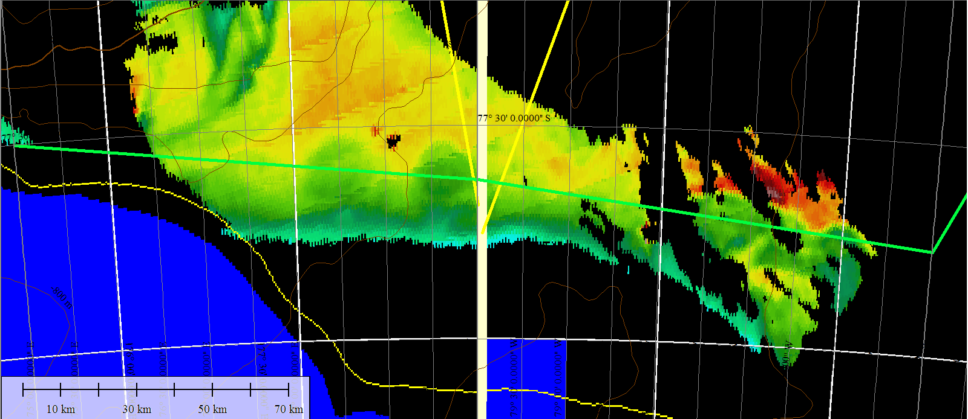
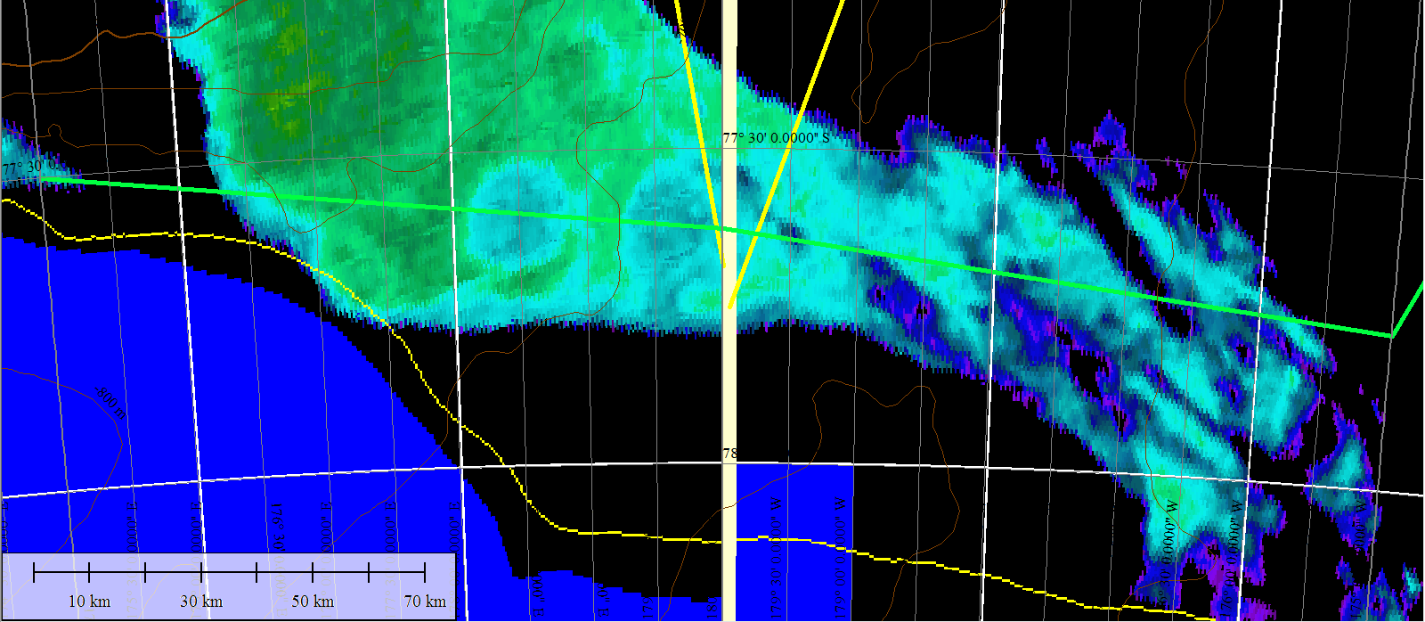
Ross Ice Shelf satellite imagery – Jan 25
Chl
SST

Slide 22
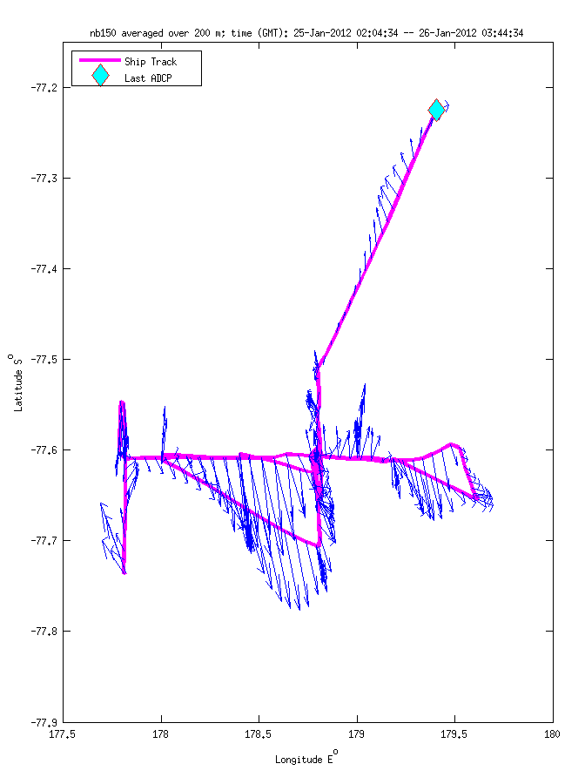
Ross Ice Shelf Eddy (VPR9, 1/26)
Temperature
Salinity
Fluorescence

Slide 23
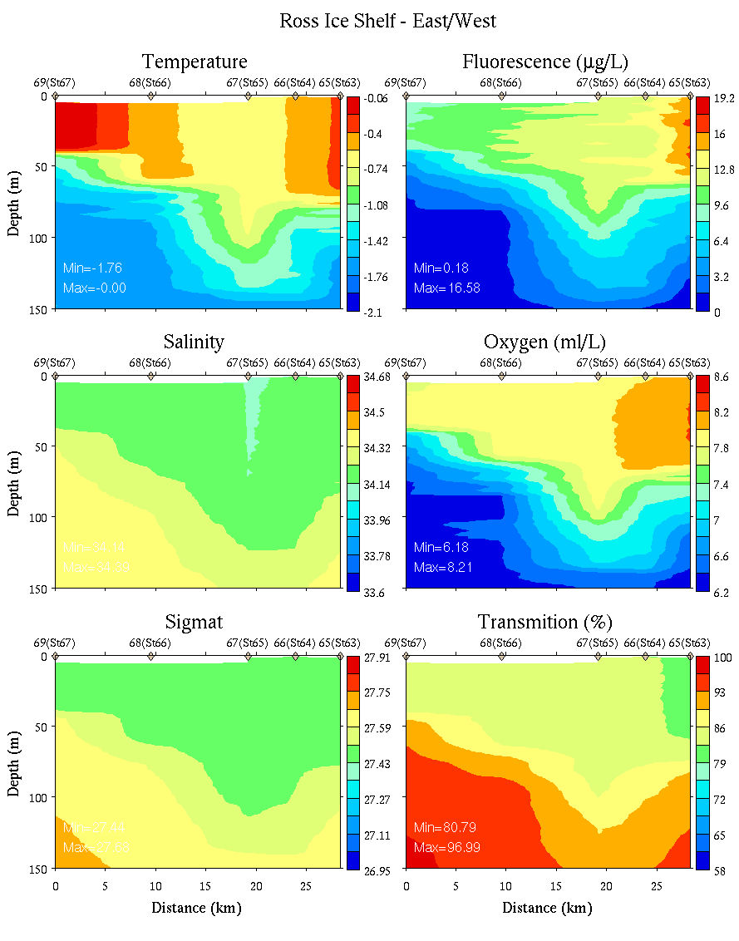
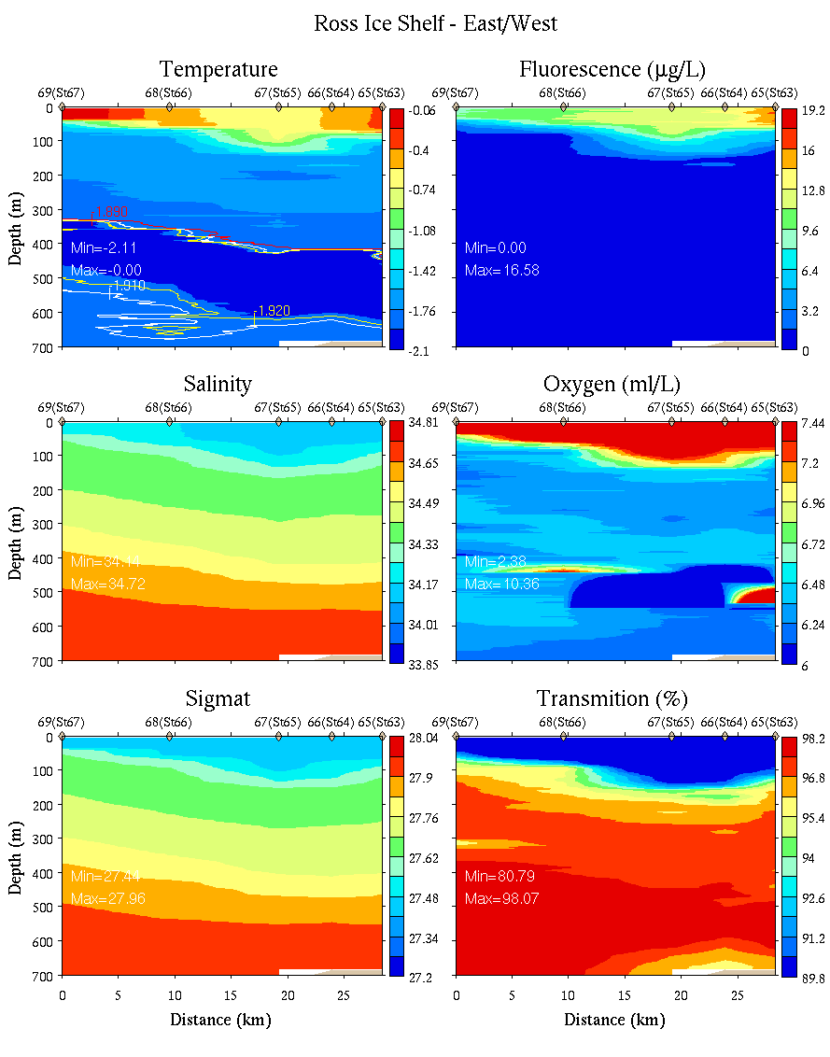
Ice Shelf Eddy: East- West Section
0-150m
0-700m

Slide 24
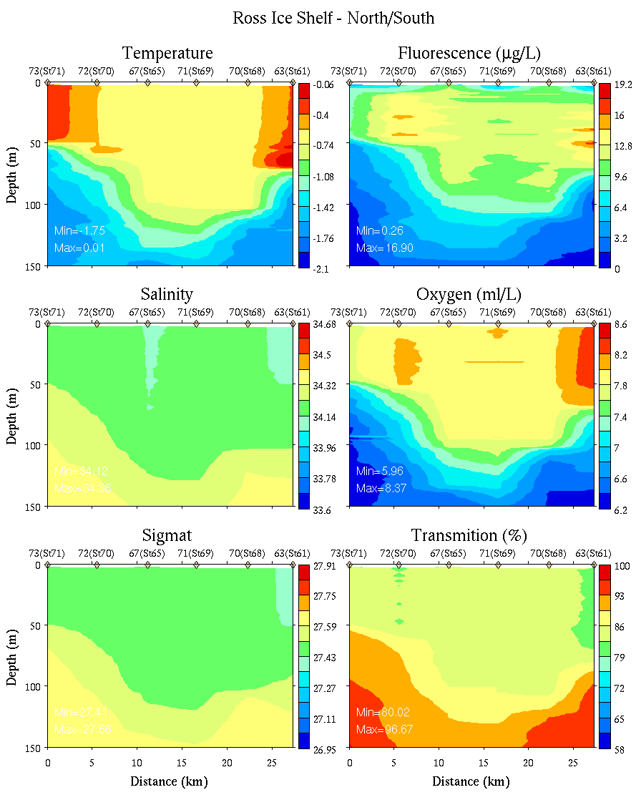
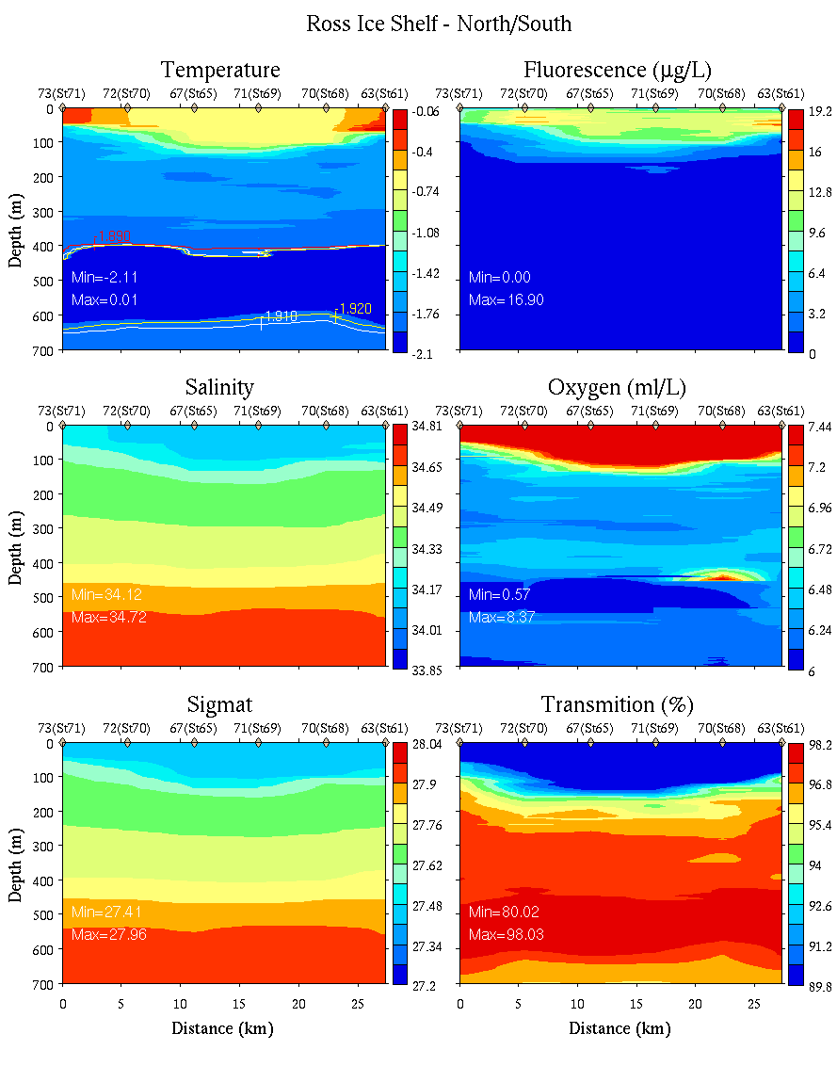
Ice Shelf Eddy: North-South Section
0-150m
0-700m

Slide 25
Ice Shelf Eddy: East- West Section
0-700m
Sedwick et al. Fe
Lateral eddy flux of (iron) and biomass?

