Slide 1
Science Meeting1/20/12
Western Ross Sea Mesoscale Process Study: Jan 11-19
Large-scale transect: Ice edge – High Biomass – Low Biomass
MVP
CTD transect (stations 7-9)
Eddy 3:
VPR survey (VPR 4)
CTD grid – 1st occupation (stations 10-18)
VPR survey (VPR 7)
CTD grid – 2nd occupation (stations 27-35)
Frontal region
VPR survey (VPR 5)
CTD transect (stations 19-21)
Low Biomass region
VPR survey (VPR 6)
CTD transect (stations 22-26)
Revisit Eddy 2

Slide 2
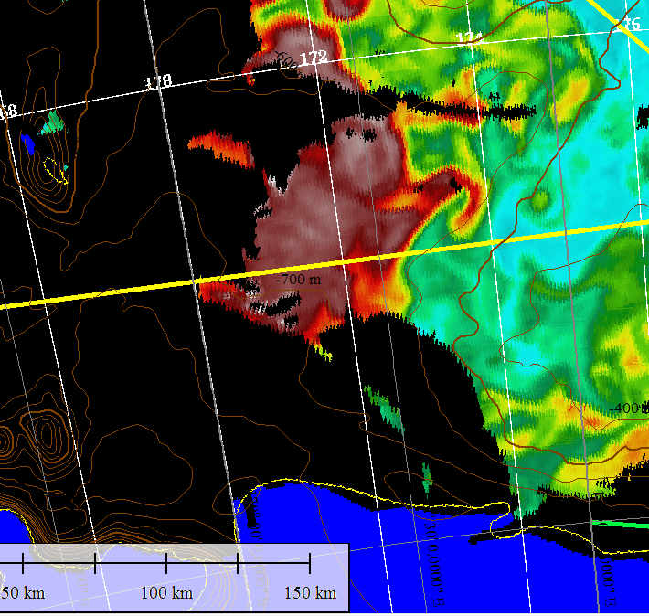
Western Ross Sea Process Study: Jan 11-19
Frontal Survey
Station 9
LB1
Eddy 3
Station 8
HB1
Ice Edge
Station 7
Low-biomass survey

Slide 3
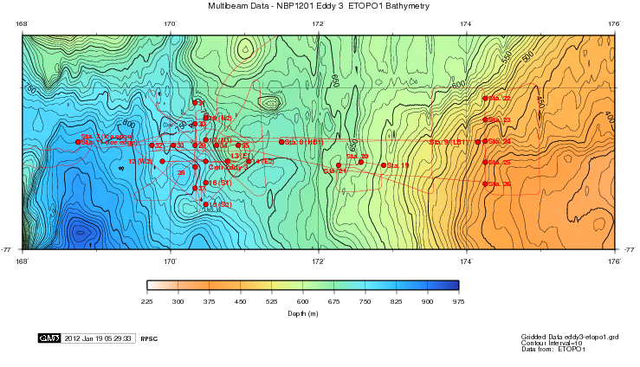
Western Ross Sea Process study Jan 11-19

Slide 4
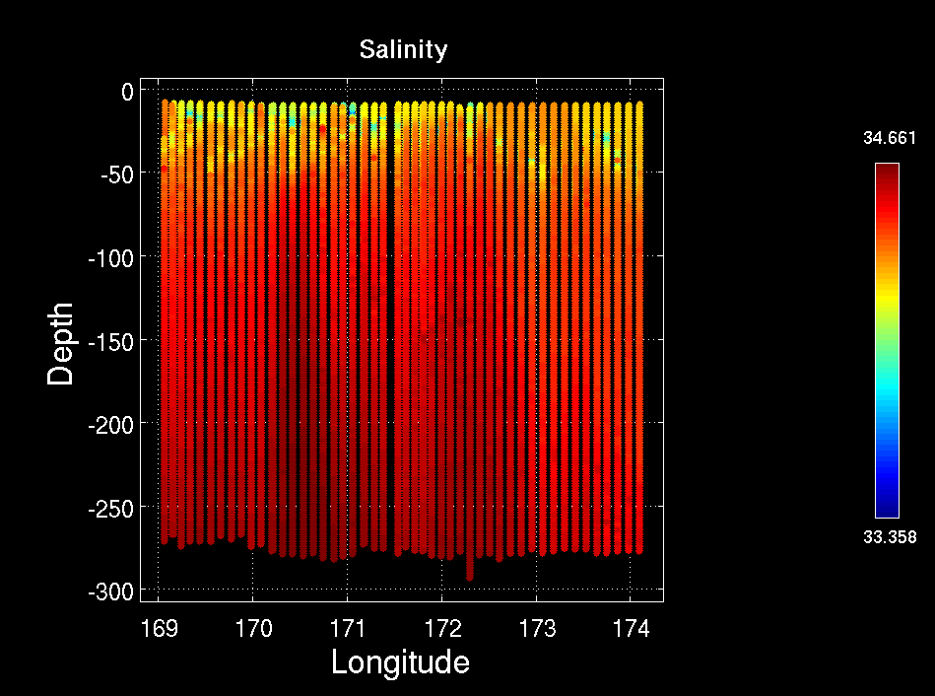
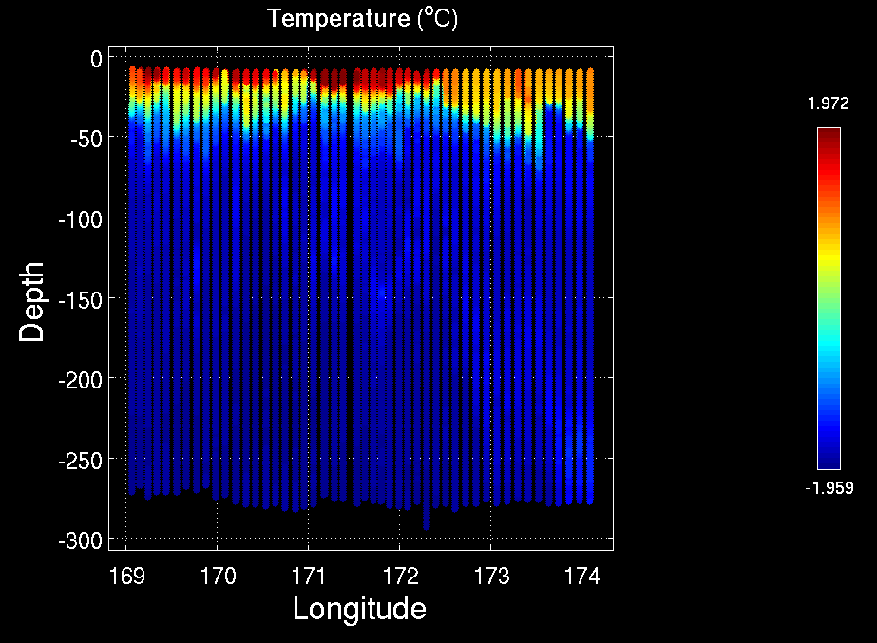
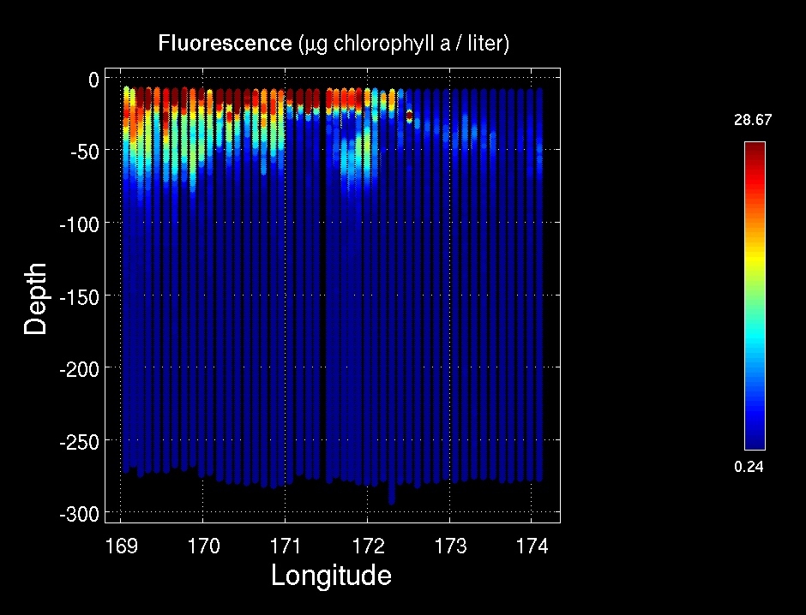
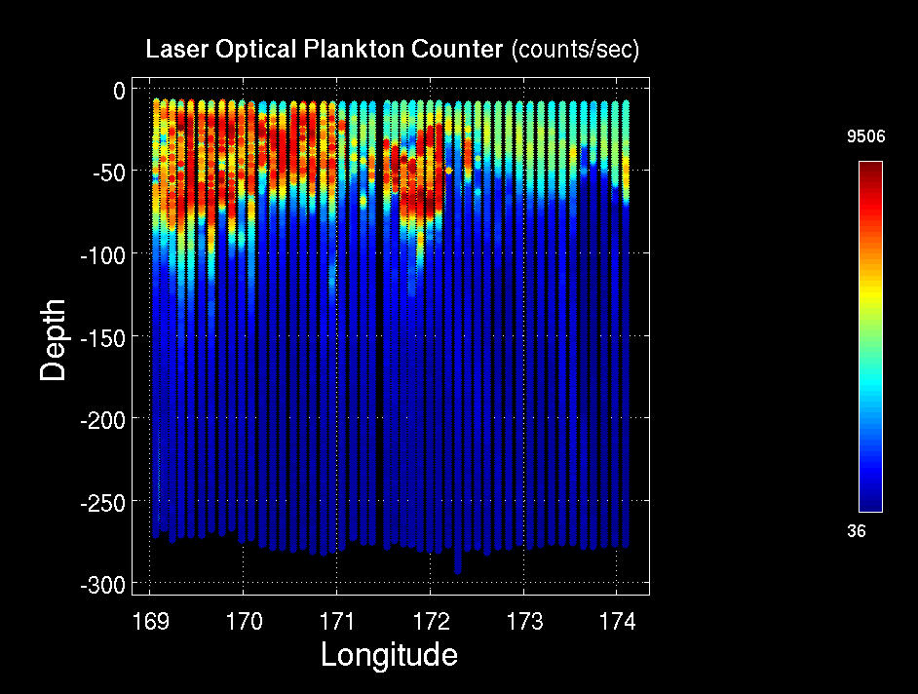
MVP Survey: Ice Edge / High Biomass / Low Biomass
Temperature
Salinity
Fluorescence
LOPC
Ice Edge HB1 LB1

Slide 5
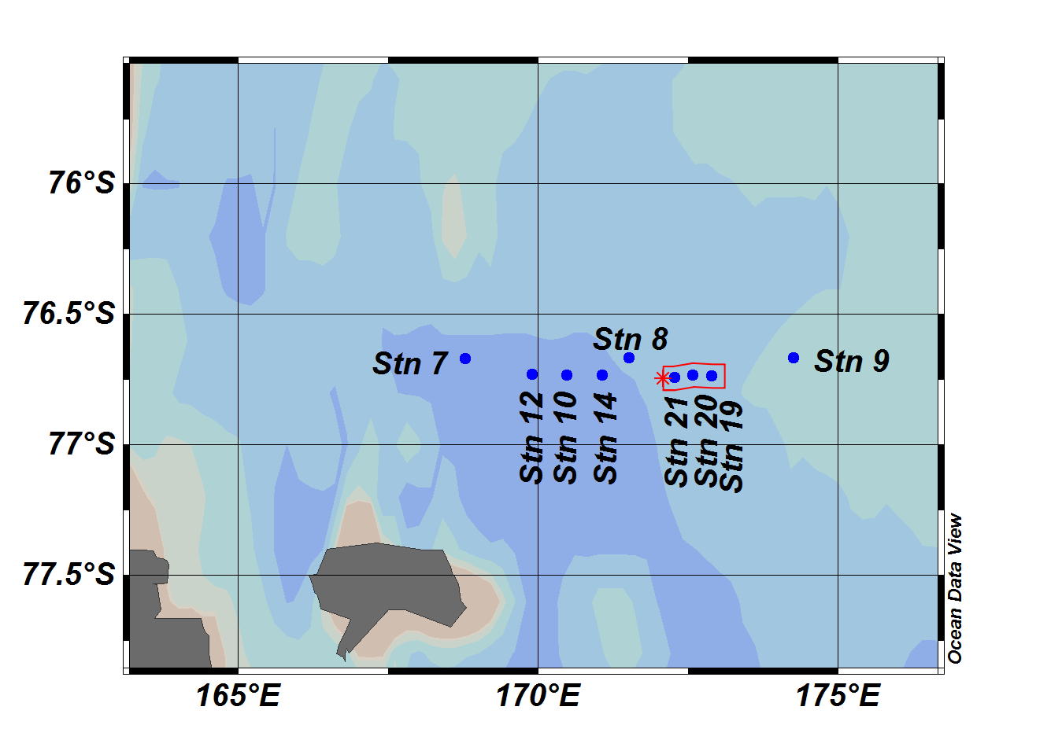
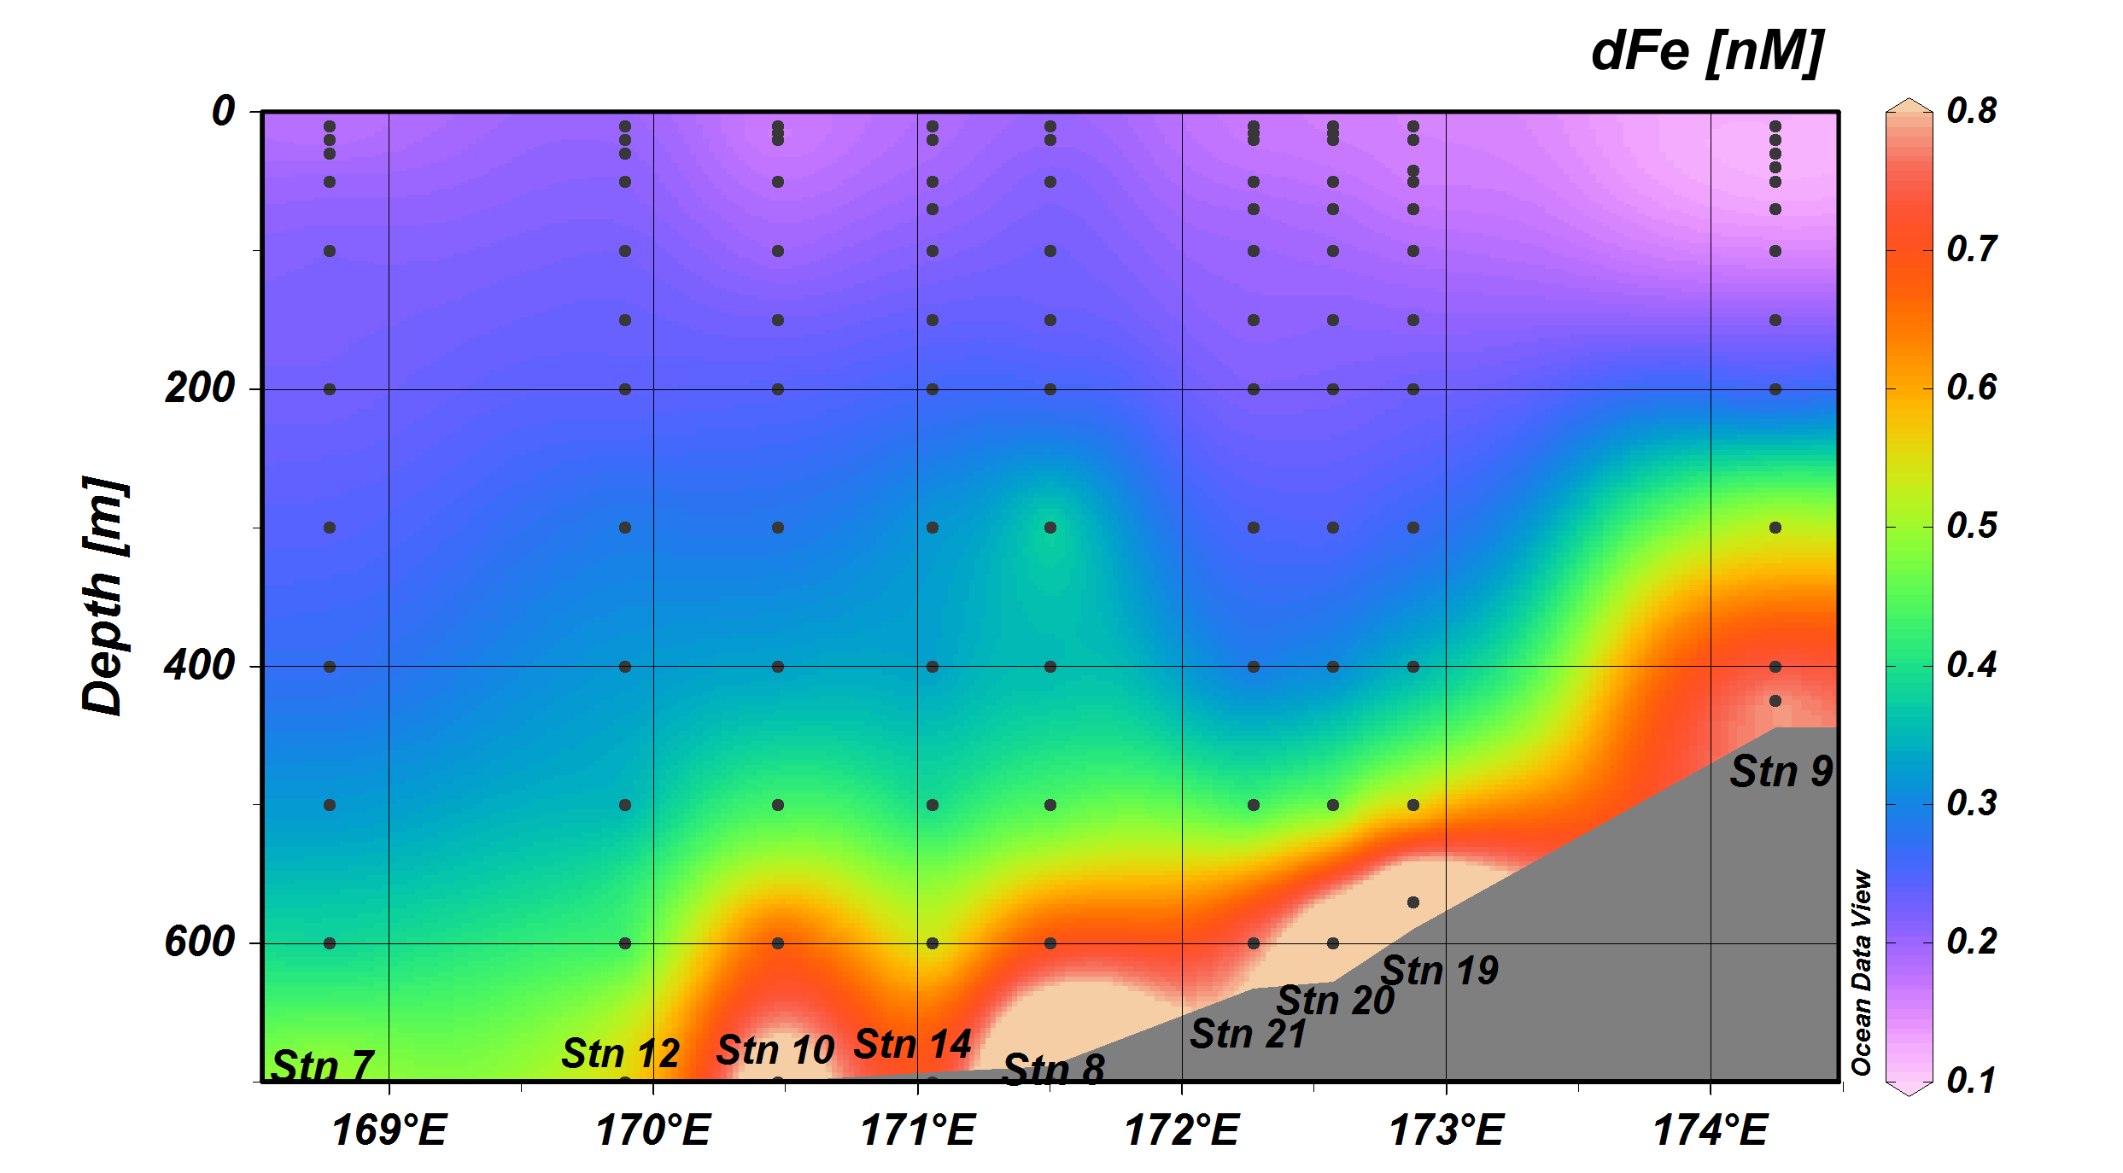
Sedwick group Fe data

Slide 6
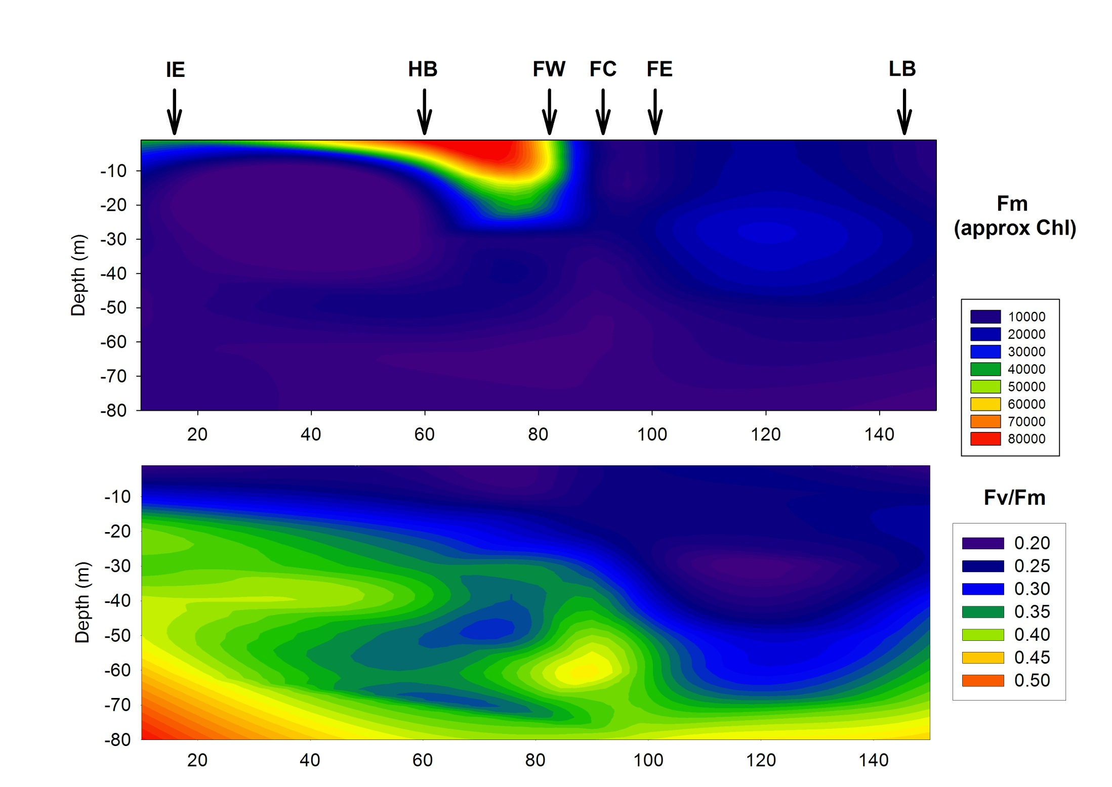
Ice-Edge to Low Biomass (With Front)

Slide 7
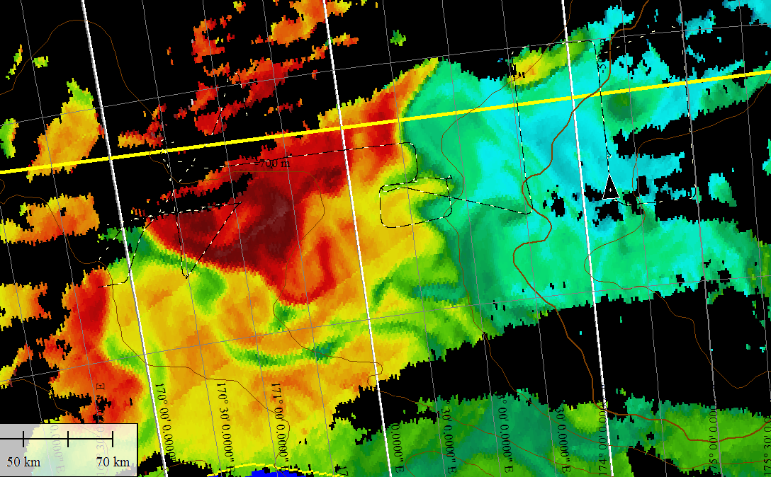
Frontal and low-biomass area surveys
22
23
24
25
26
21
20
19

Slide 8
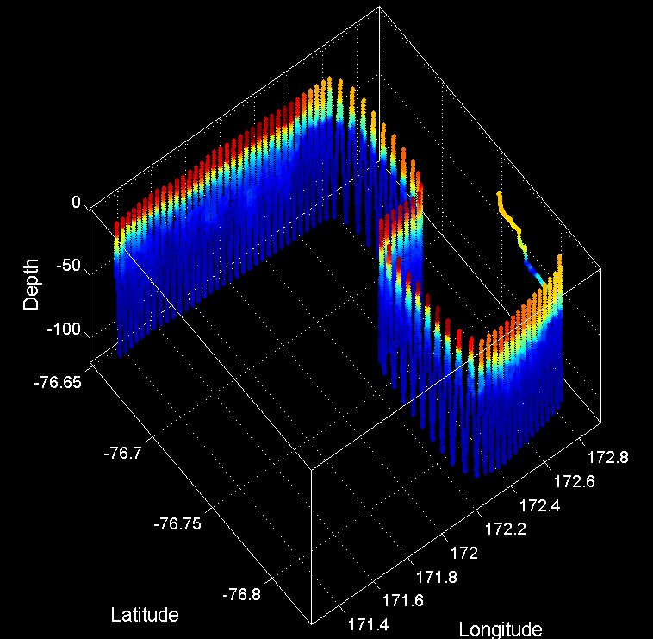
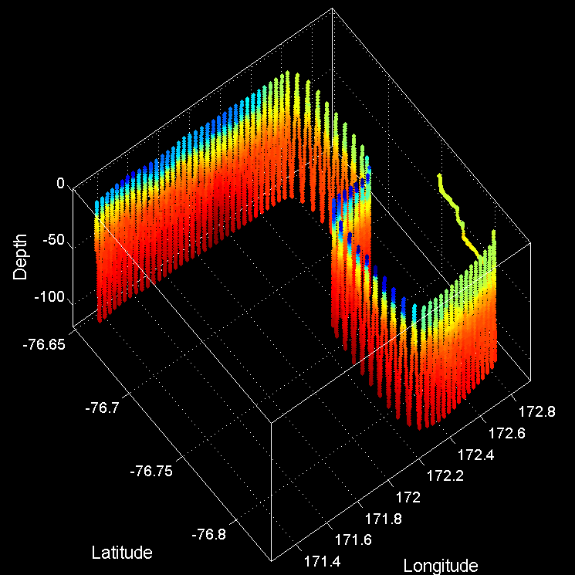
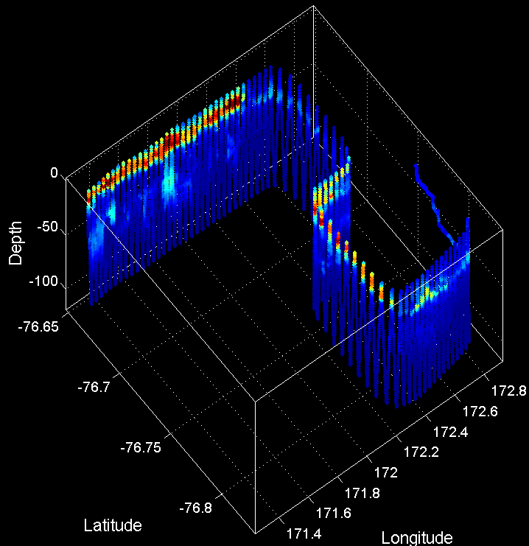
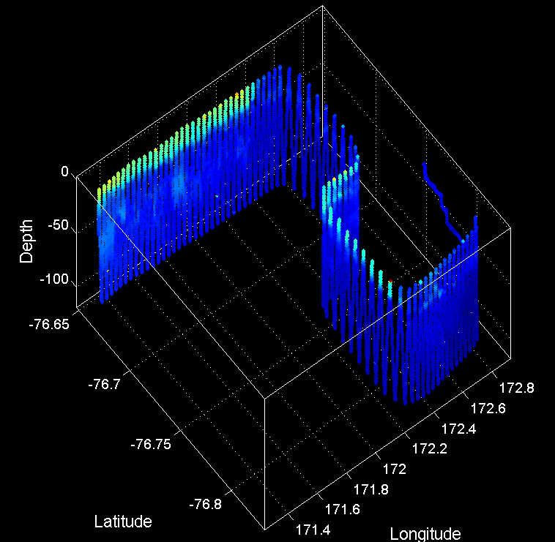
VPR Frontal Survey 1/16-17
Temperature
Salinity
Fluorescence
Backscatter
Station 19
20
Station 21

Slide 9
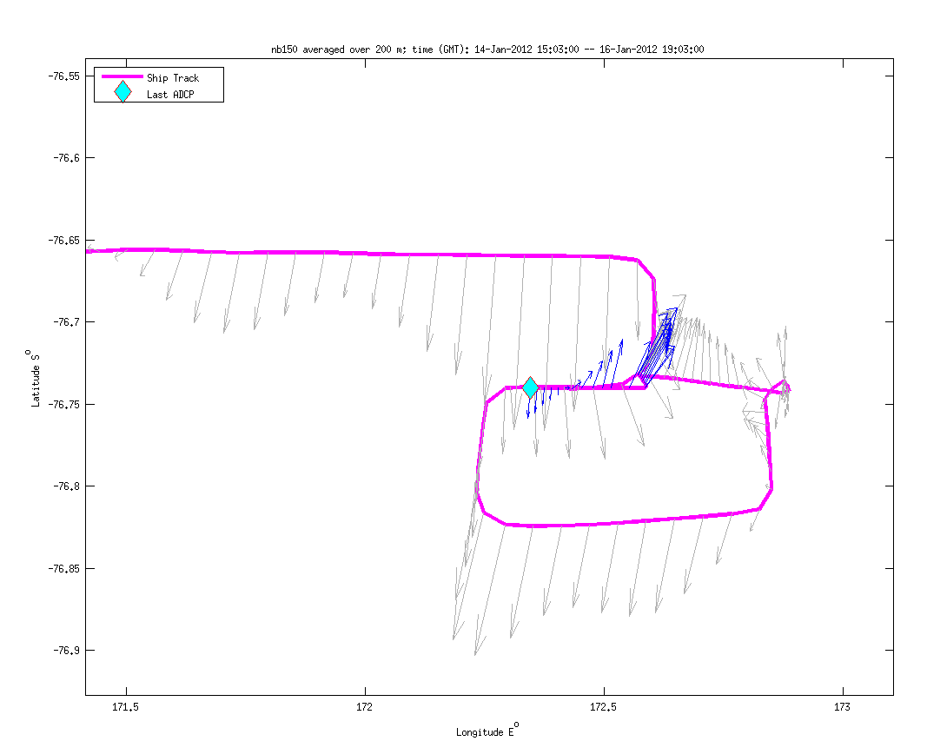
Frontal ADCP Survey (VPR5)

Slide 10
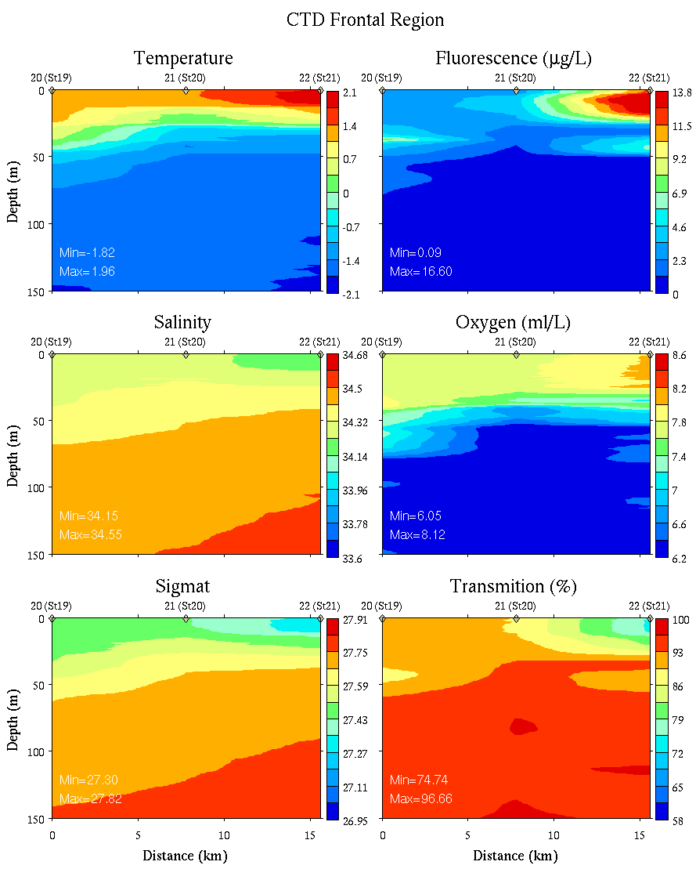
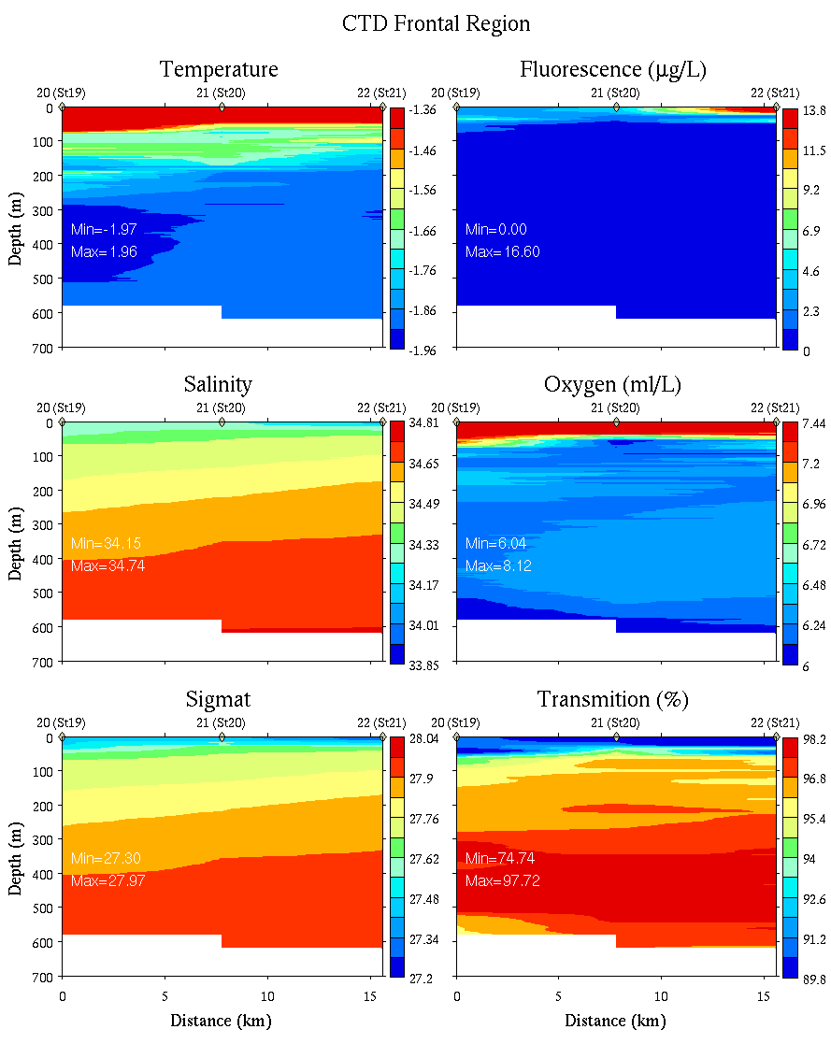
High Biomass / Low Biomass Frontal Region
0-150m
0-700m

Slide 11
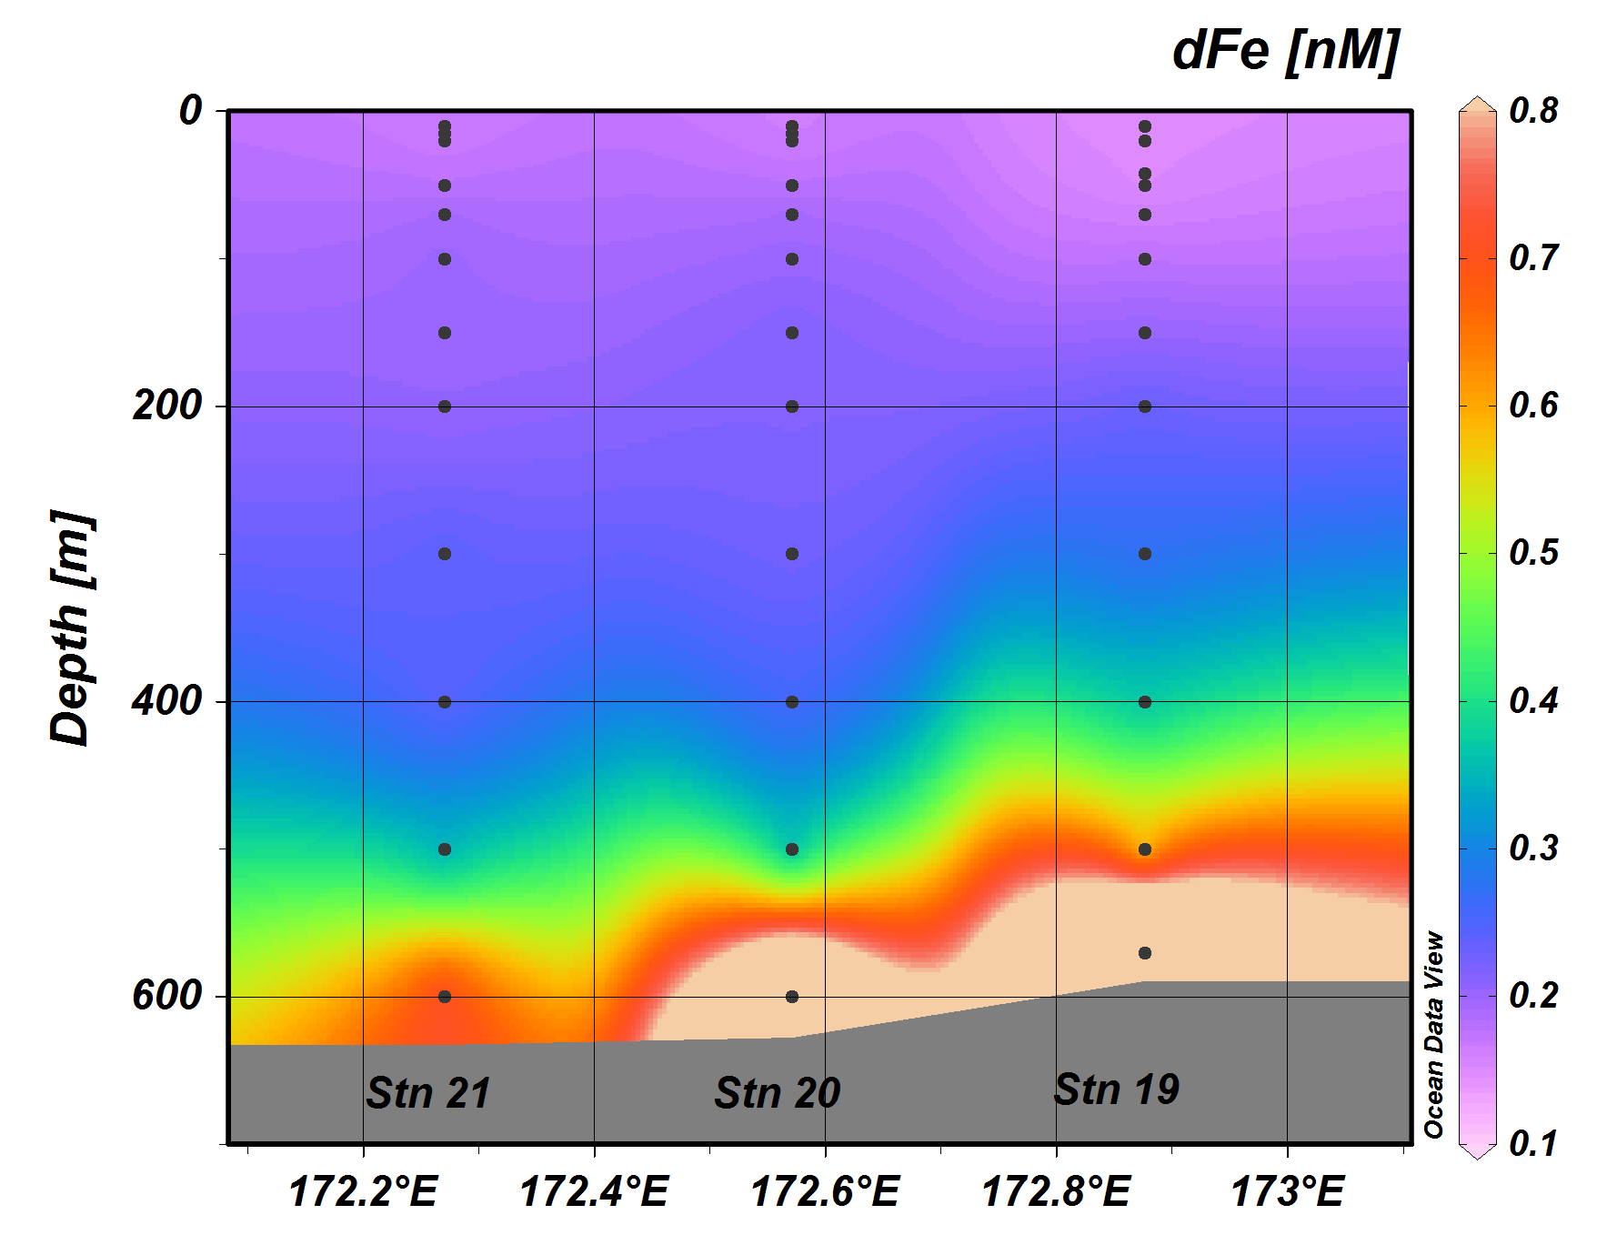
High Biomass / Low Biomass Frontal Region
0-700m CTD: Note x-axis reversal
Sedwick group Fe data

Slide 12
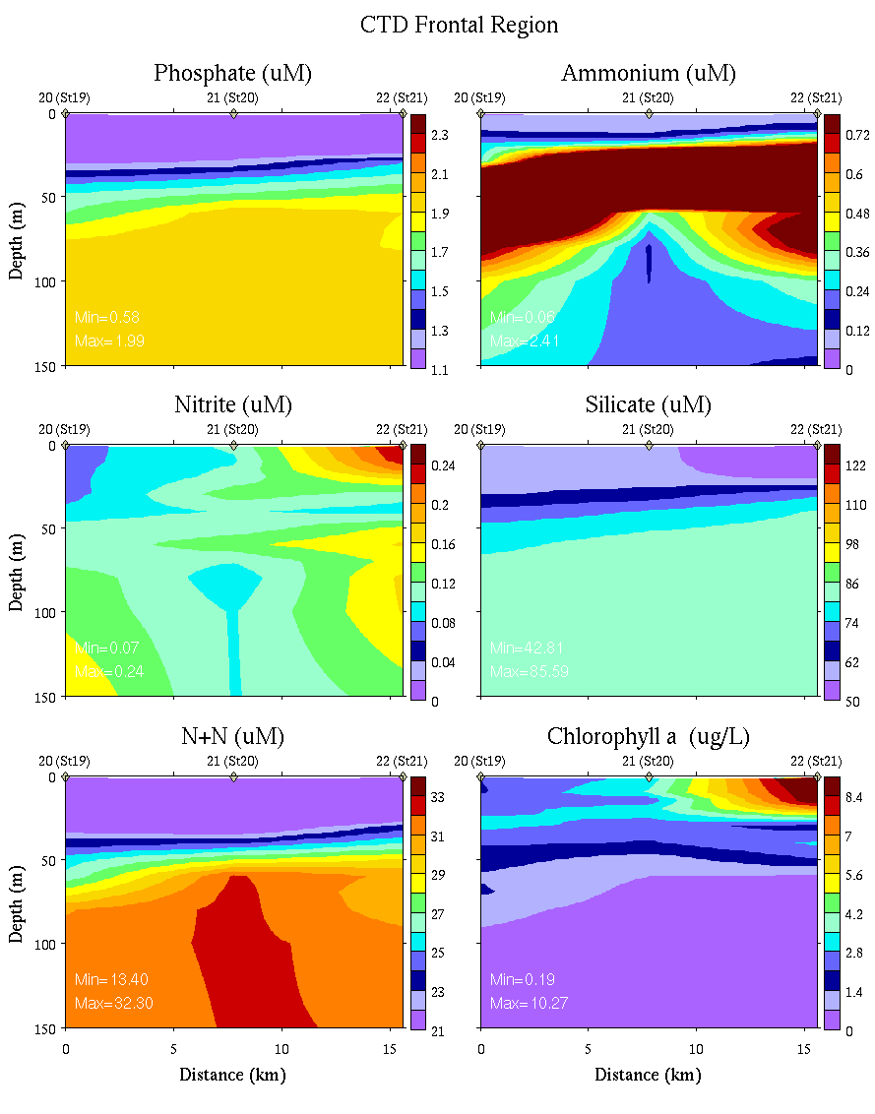
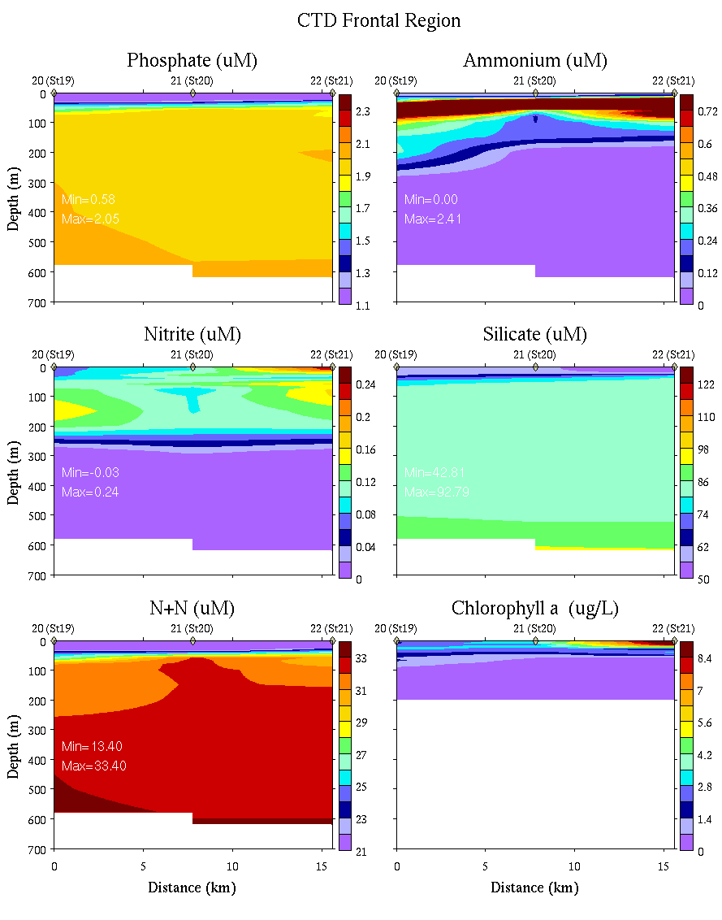
High Biomass / Low Biomass Frontal Region
0-150m
0-700m

Slide 13
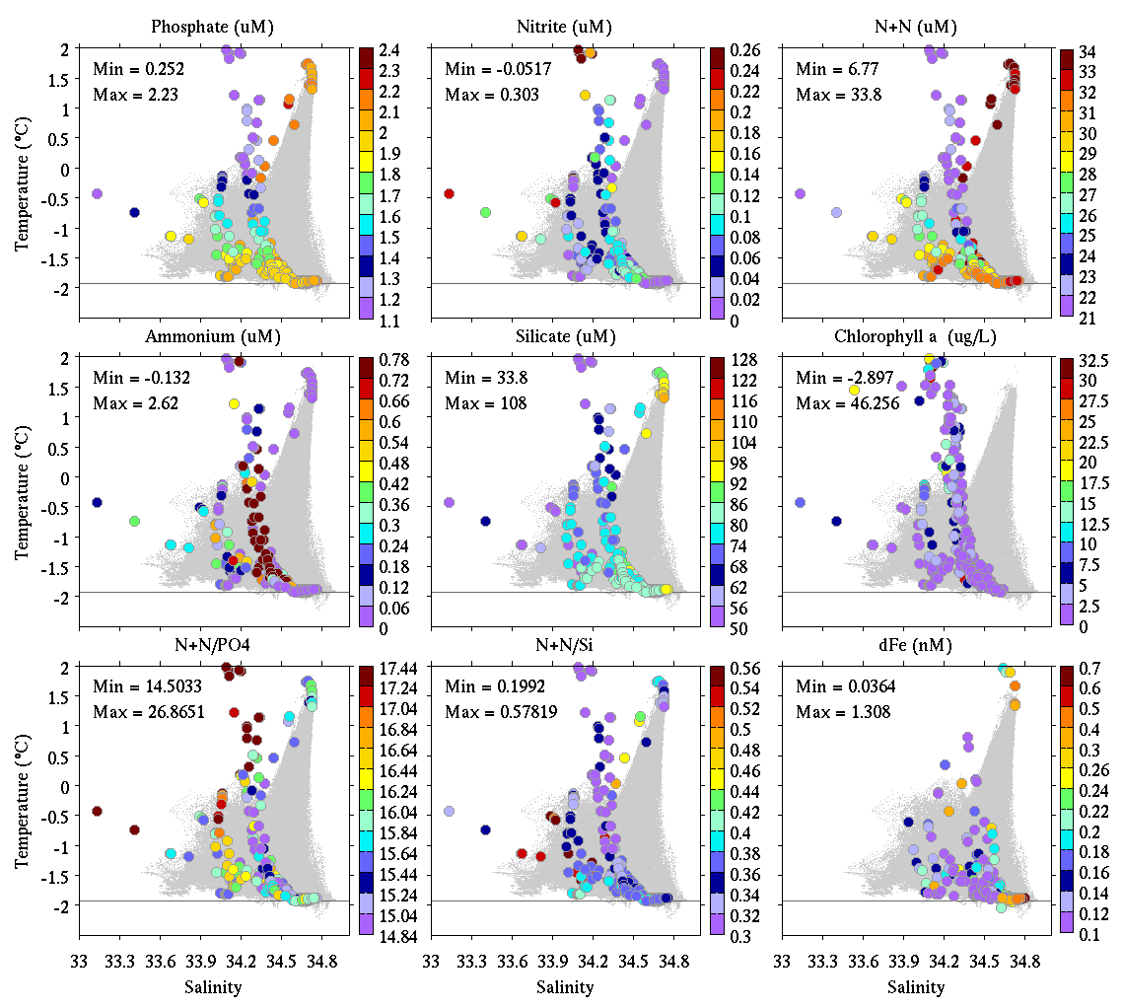
Nutrient data stations 1-12
Phosphate Nitrite Nitrate+Nitrite
Ammonium Silicate Chlorophyll
N+N / P N+N/Si CORSACS Fe

Slide 14
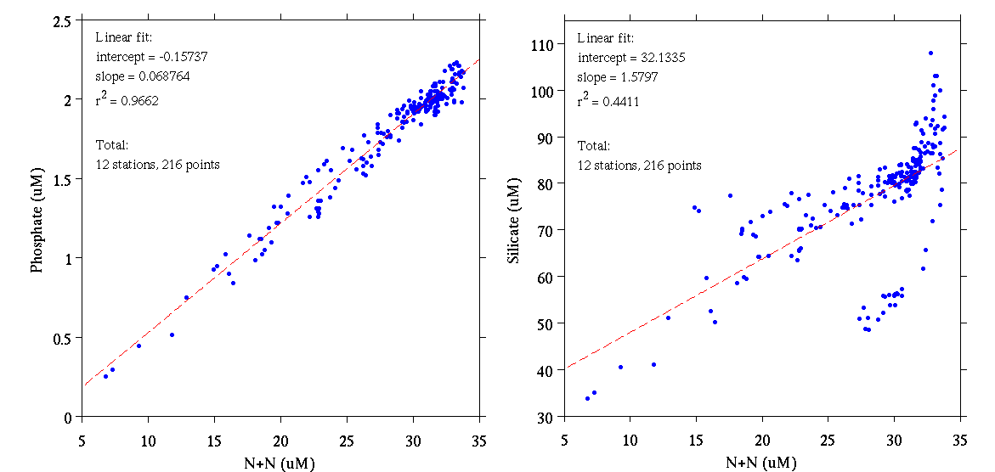
Nutrient data stations 1-12
Phosphate
Silicate
Nitrate + Nitrite
Nitrate + Nitrite

Slide 15
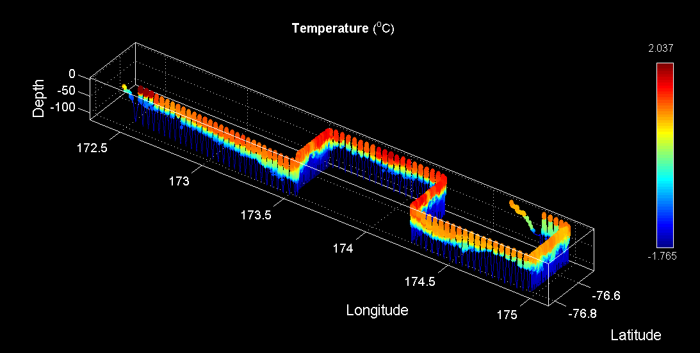
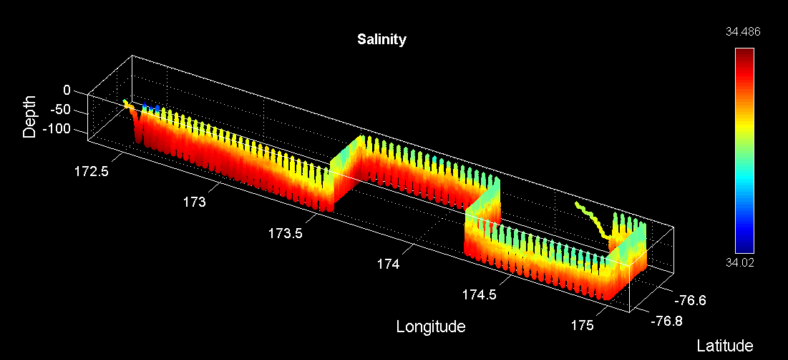
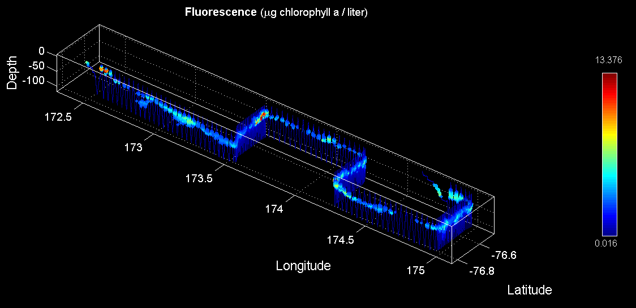
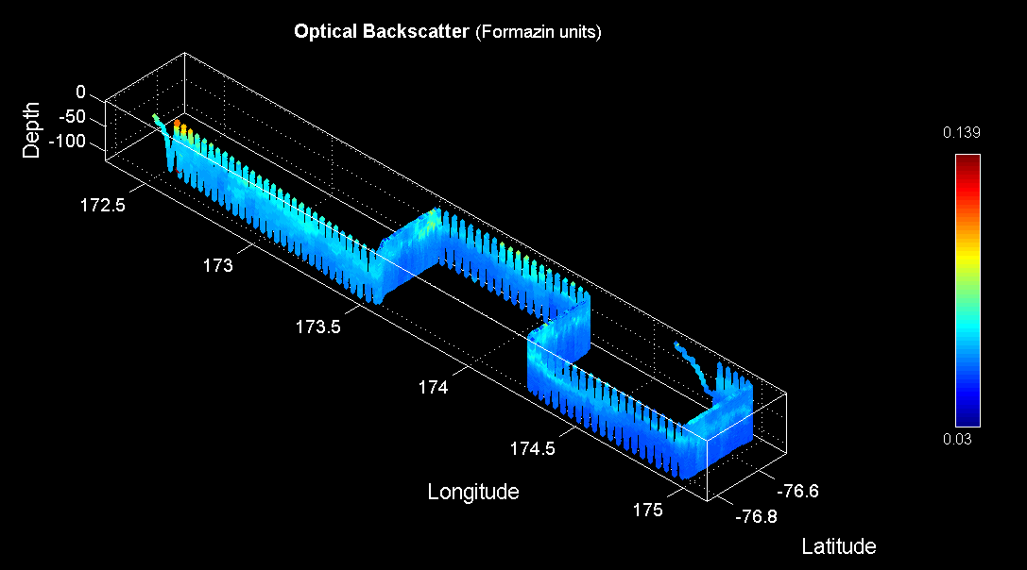
Low biomass area survey – 1/17/12
Temperature
Salinity
Fluorescence
Backscatter
Station 22
Station 26

Slide 16
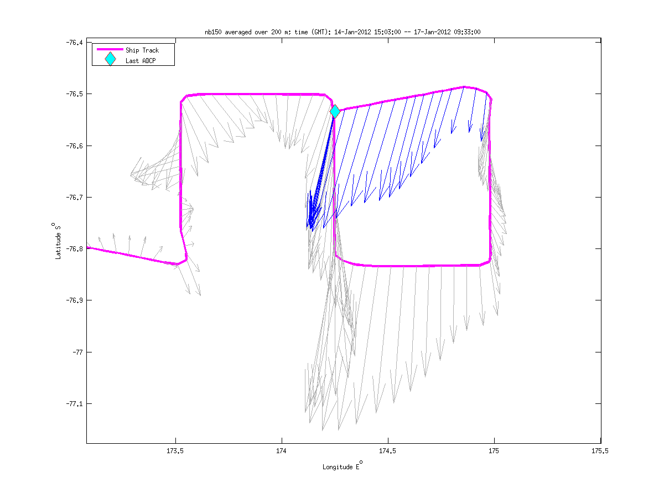
Low Biomass ADCP Survey (VPR6)

Slide 17
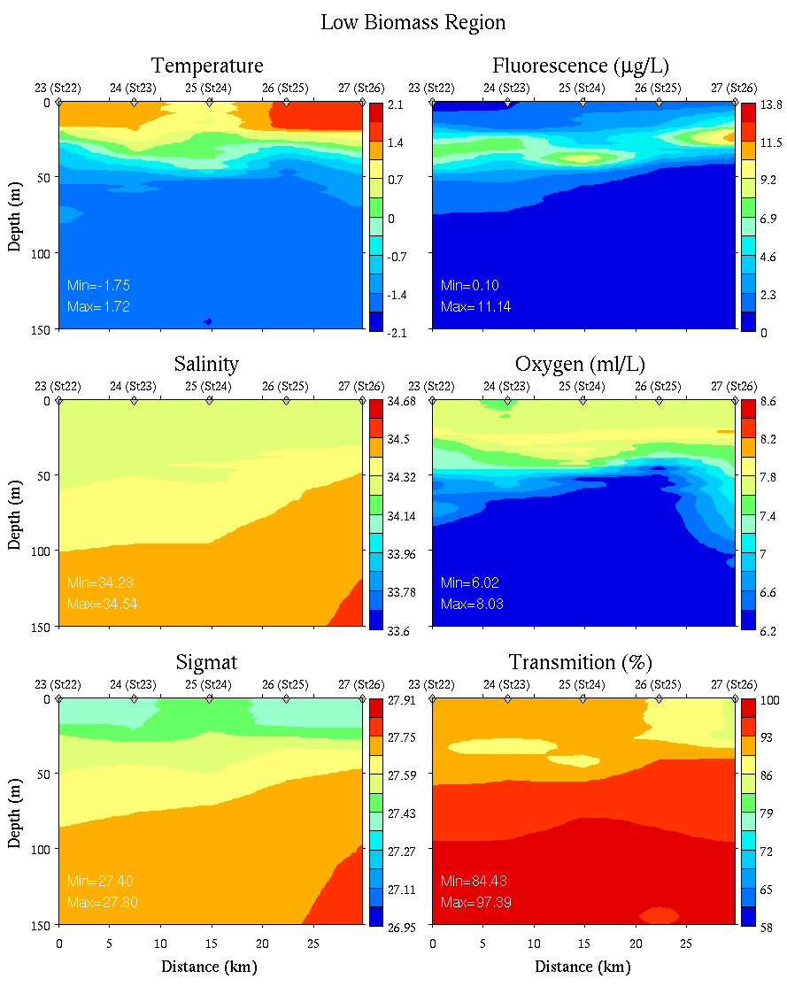
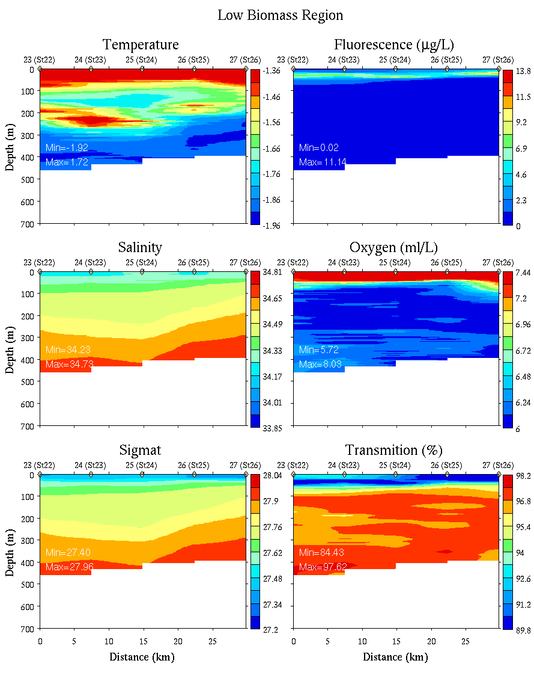
Low Biomass CTD transect
0-150m
0-700m

Slide 18
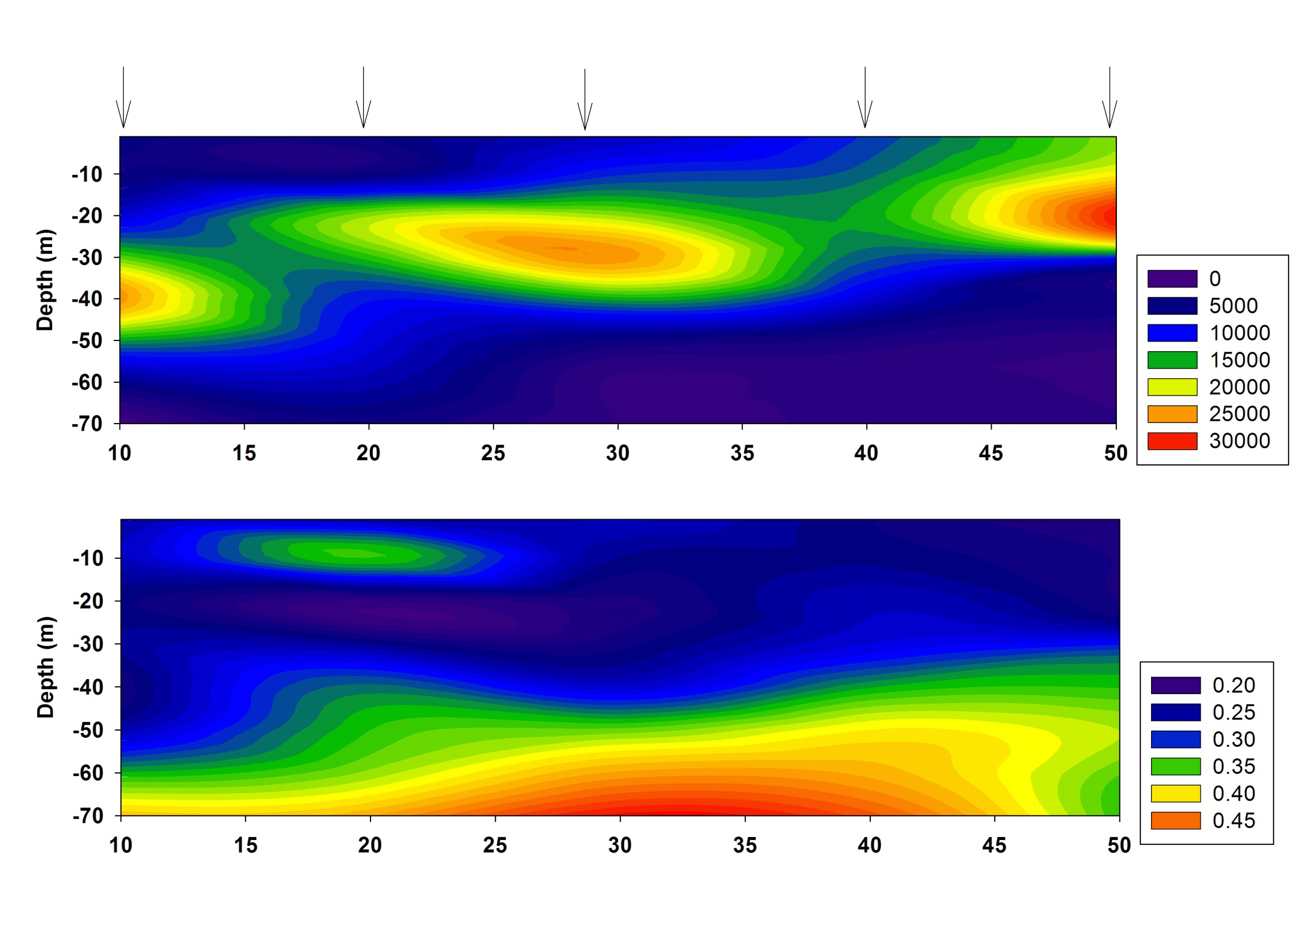
Fm
FvFm
Low Biomass

Slide 19
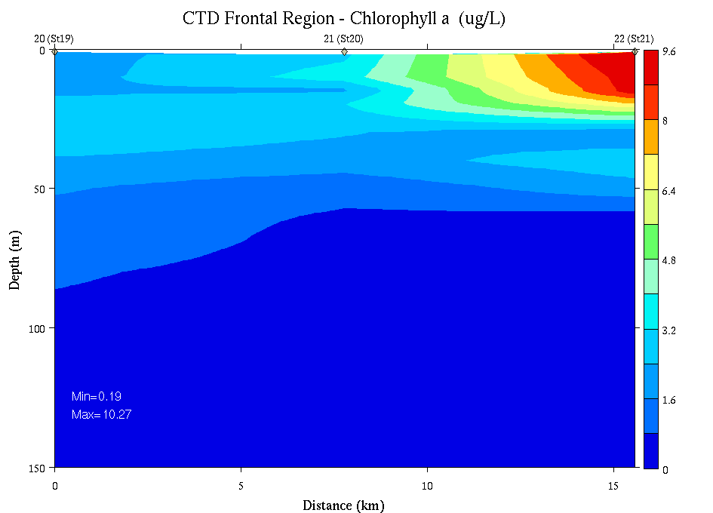
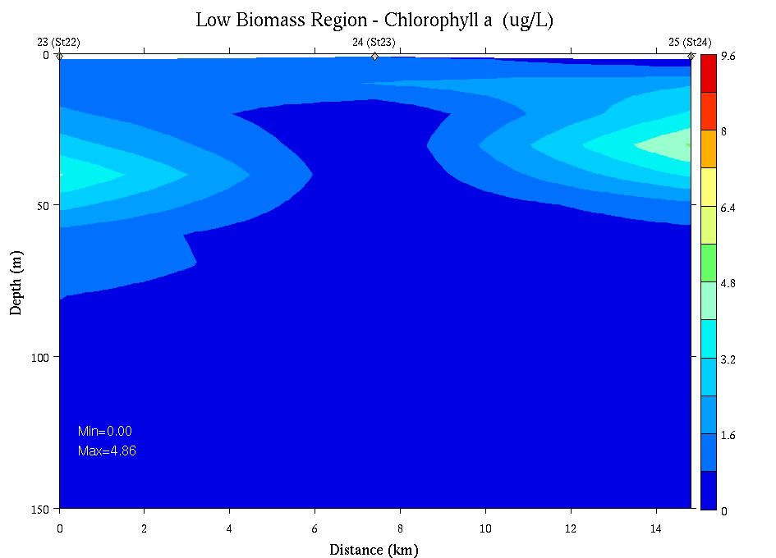
CTD Fluorometer vs. Extracted Pigments
Smith lab extracted Chl
CTD
Sfc
150m
Frontal
region
Sfc
150m
Low
Biomass

Slide 20
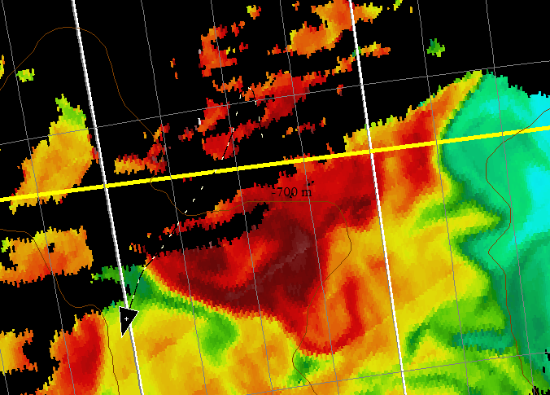
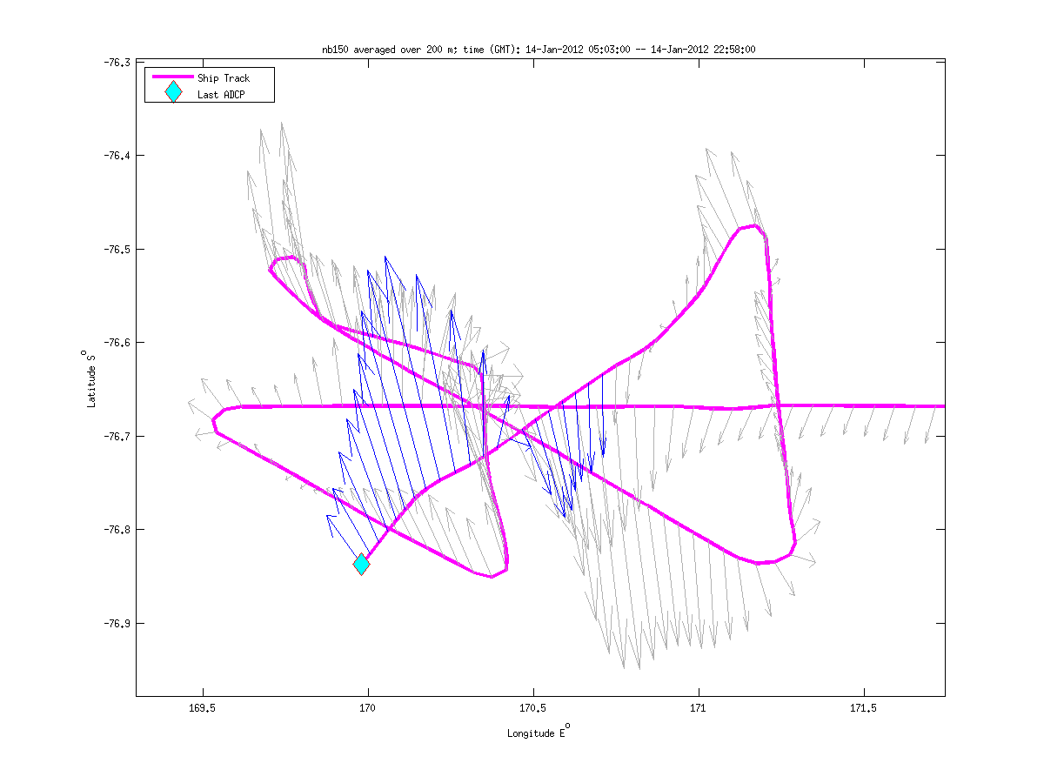
Eddy 3 VPR Survey: VPR 4, Jan 14-15
Station 10
Station 9

Slide 21
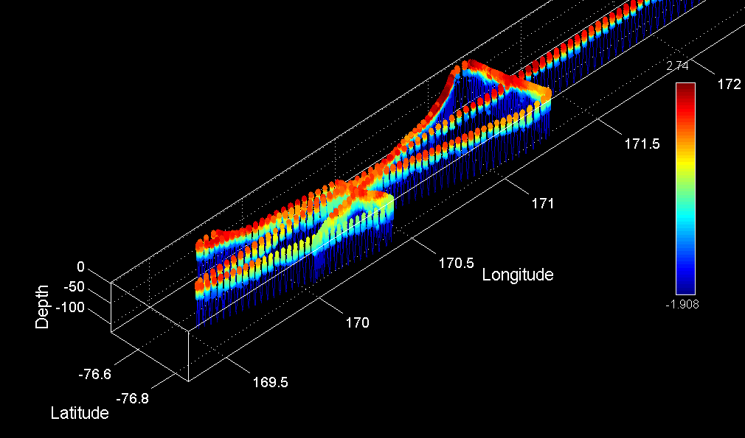
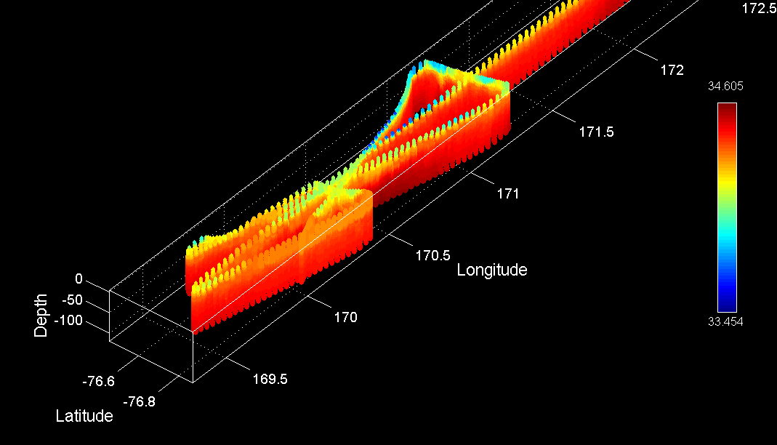
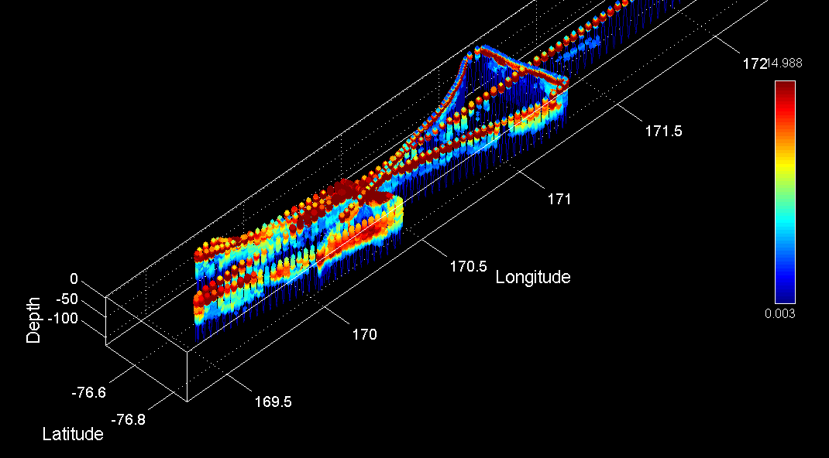
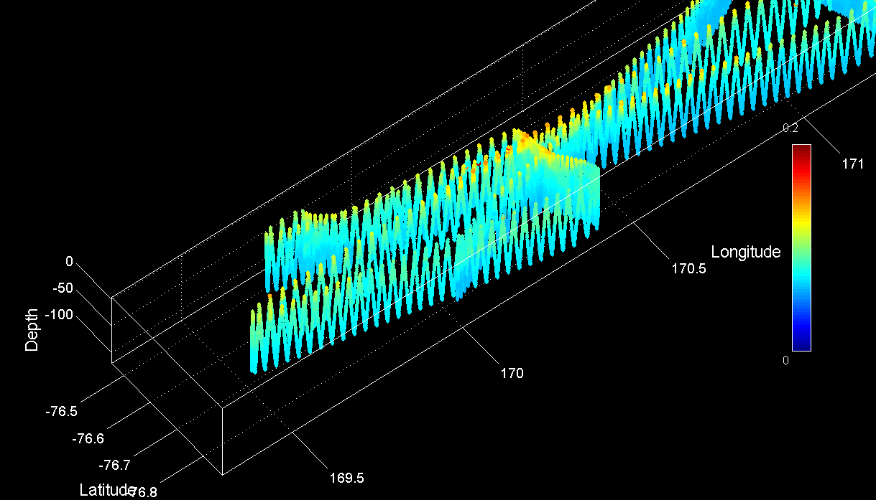
VPR Survey of Eddy 3
Temperature
Salinity
Fluorescence
Optical Backscatter

Slide 22
Eddy 3 CTD Survey, 1st occupation
18
17
10
13
14
12
11
16
15

Slide 23
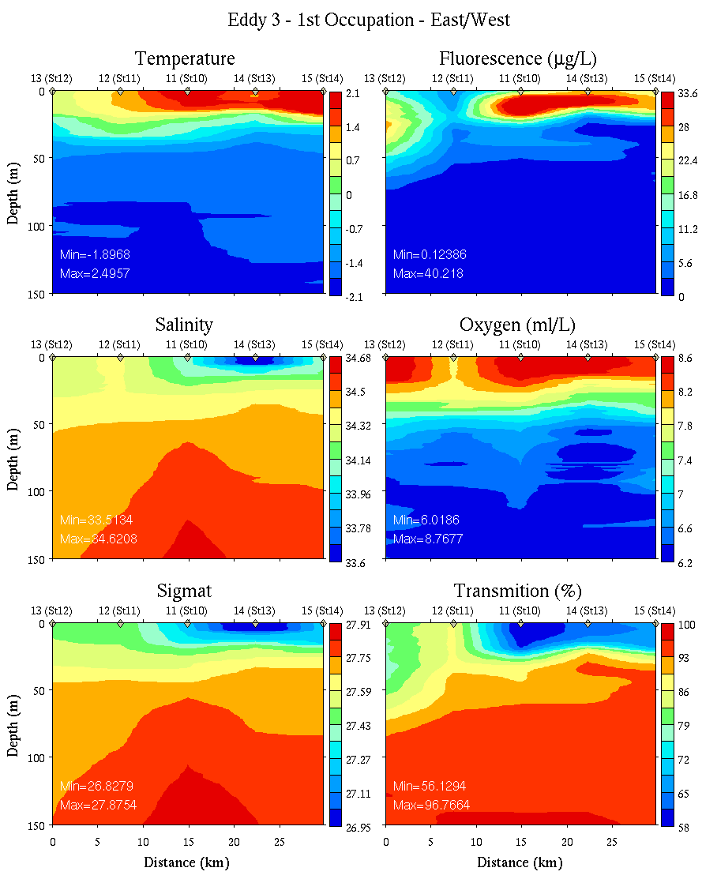
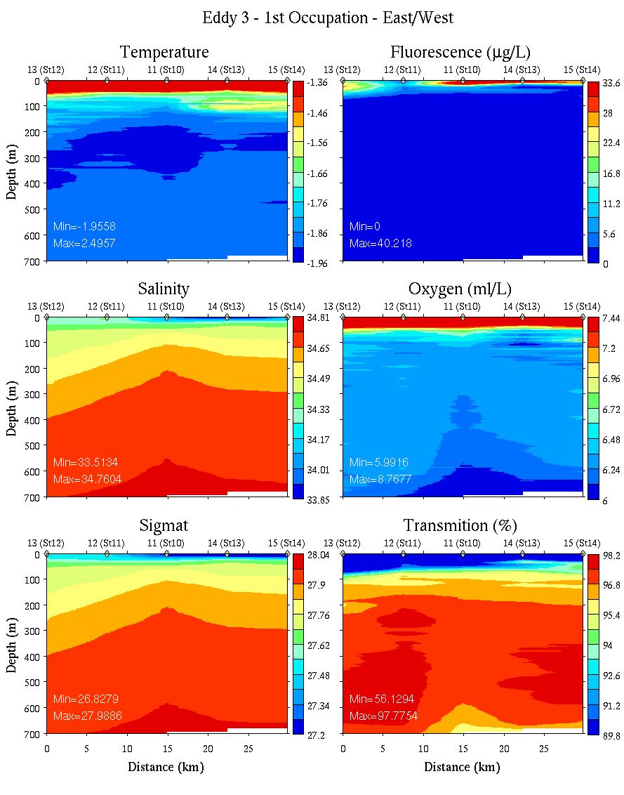
Eddy 3, First Occupation: East-West Transect
0-150m
0-700m

Slide 24
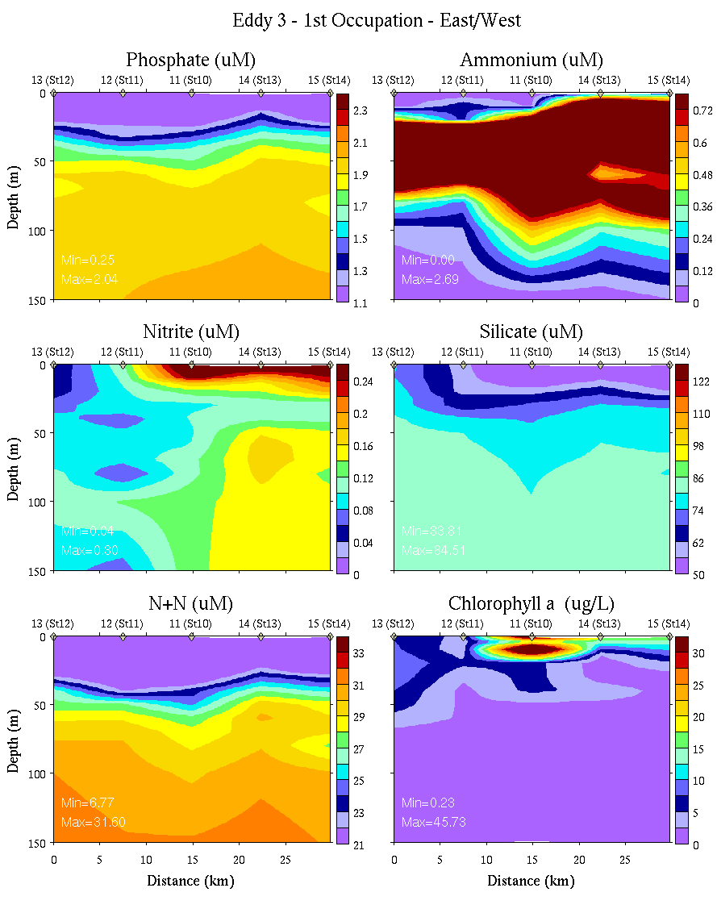
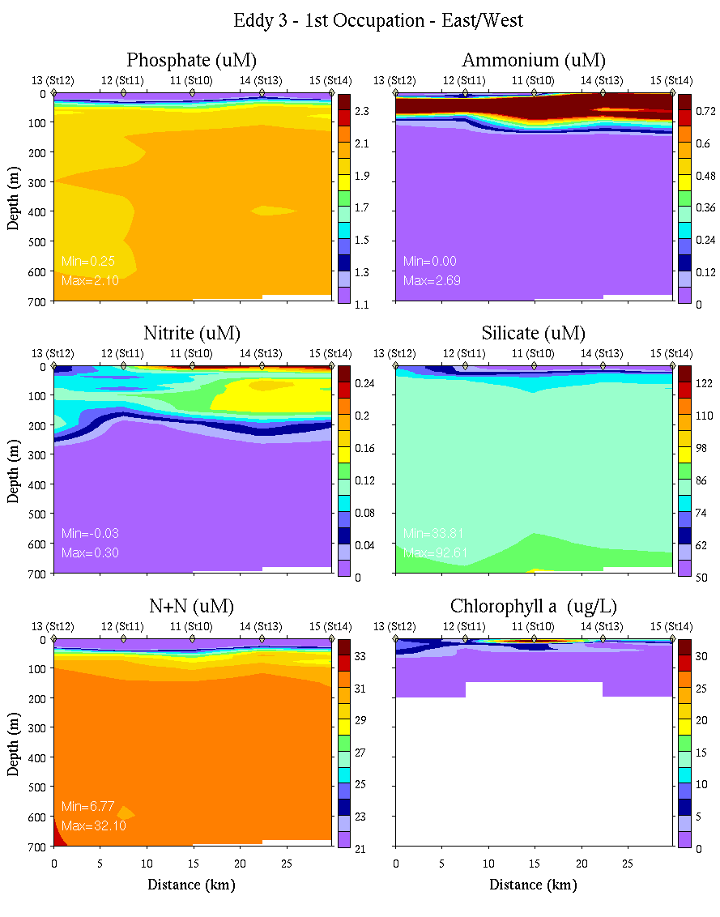
Eddy 3, First Occupation: East-West Transect
0-150m
0-700m

Slide 25
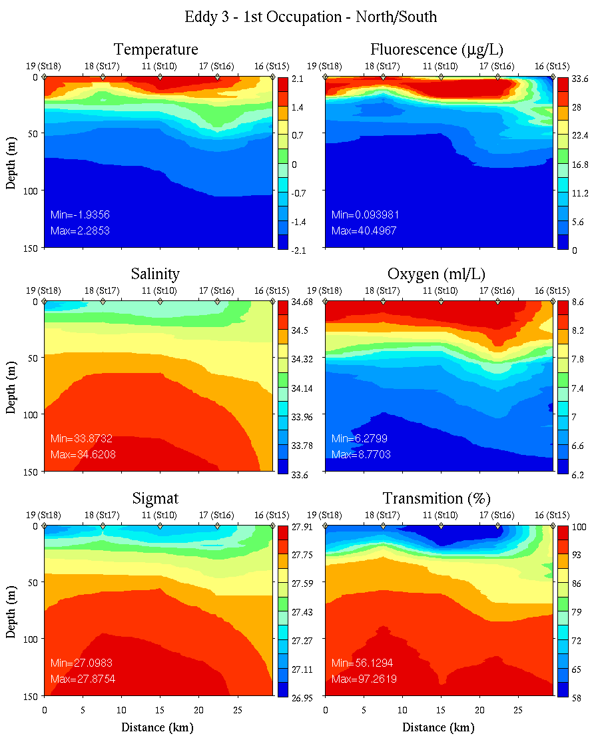
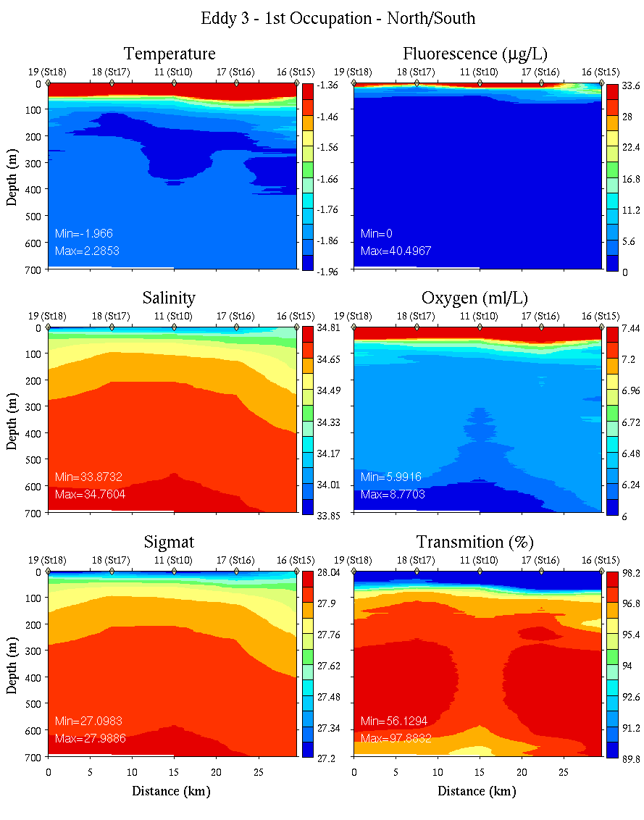
Eddy 3, First Occupation: North-South Transect
0-150m
0-700m

Slide 26
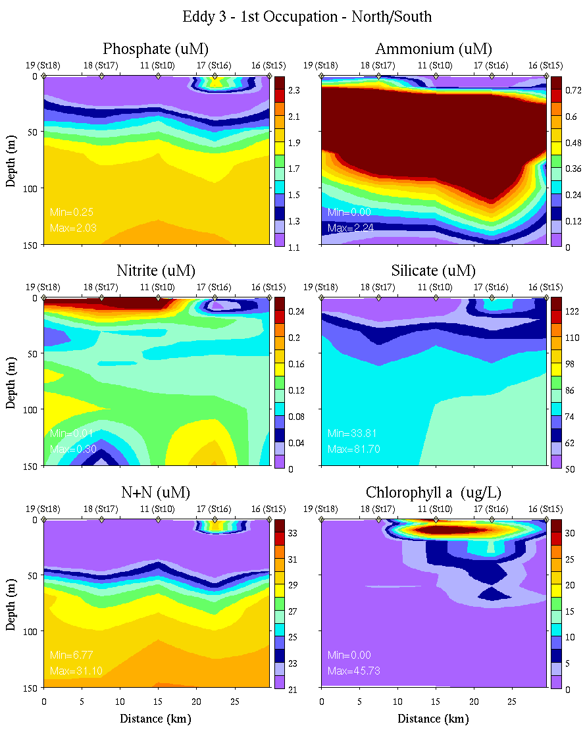
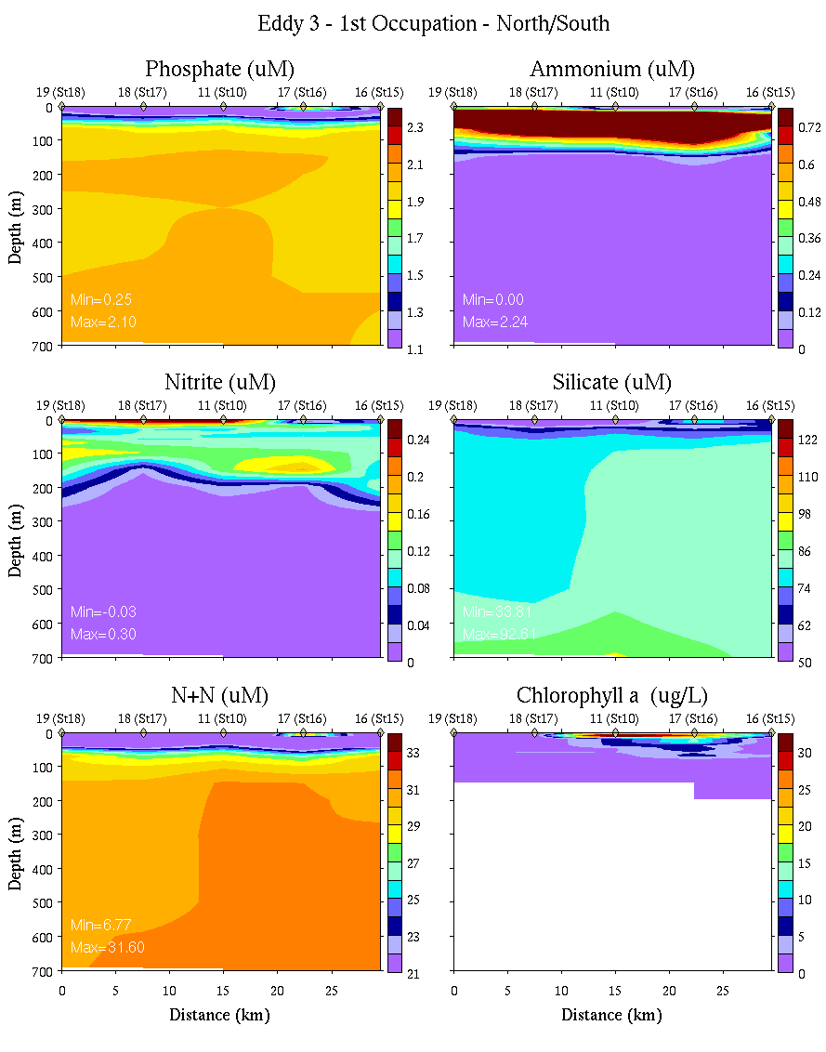
Eddy 3, First Occupation: North-South Transect
0-150m
0-700m

Slide 27
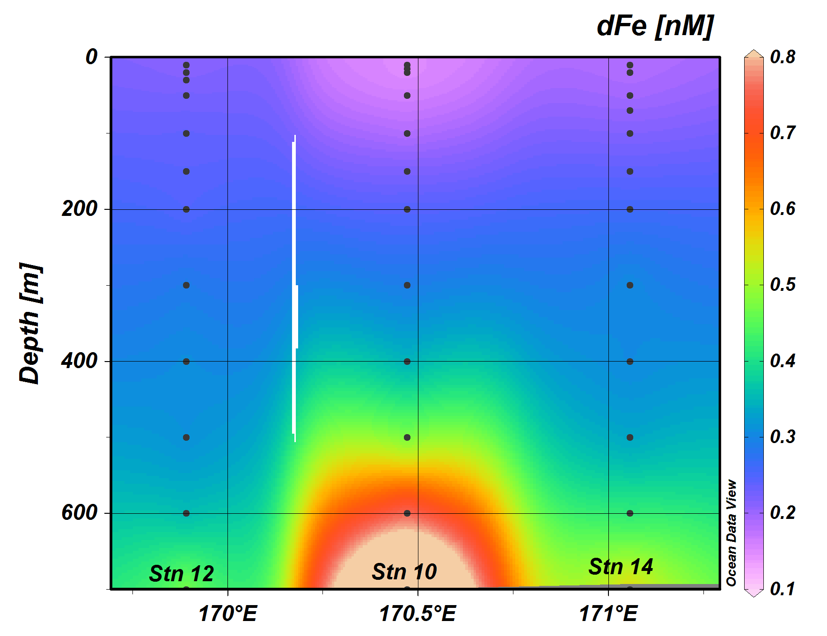
Eddy 3, First Occupation: East-West Transect
0-700m
Sedwick group Fe data

Slide 28
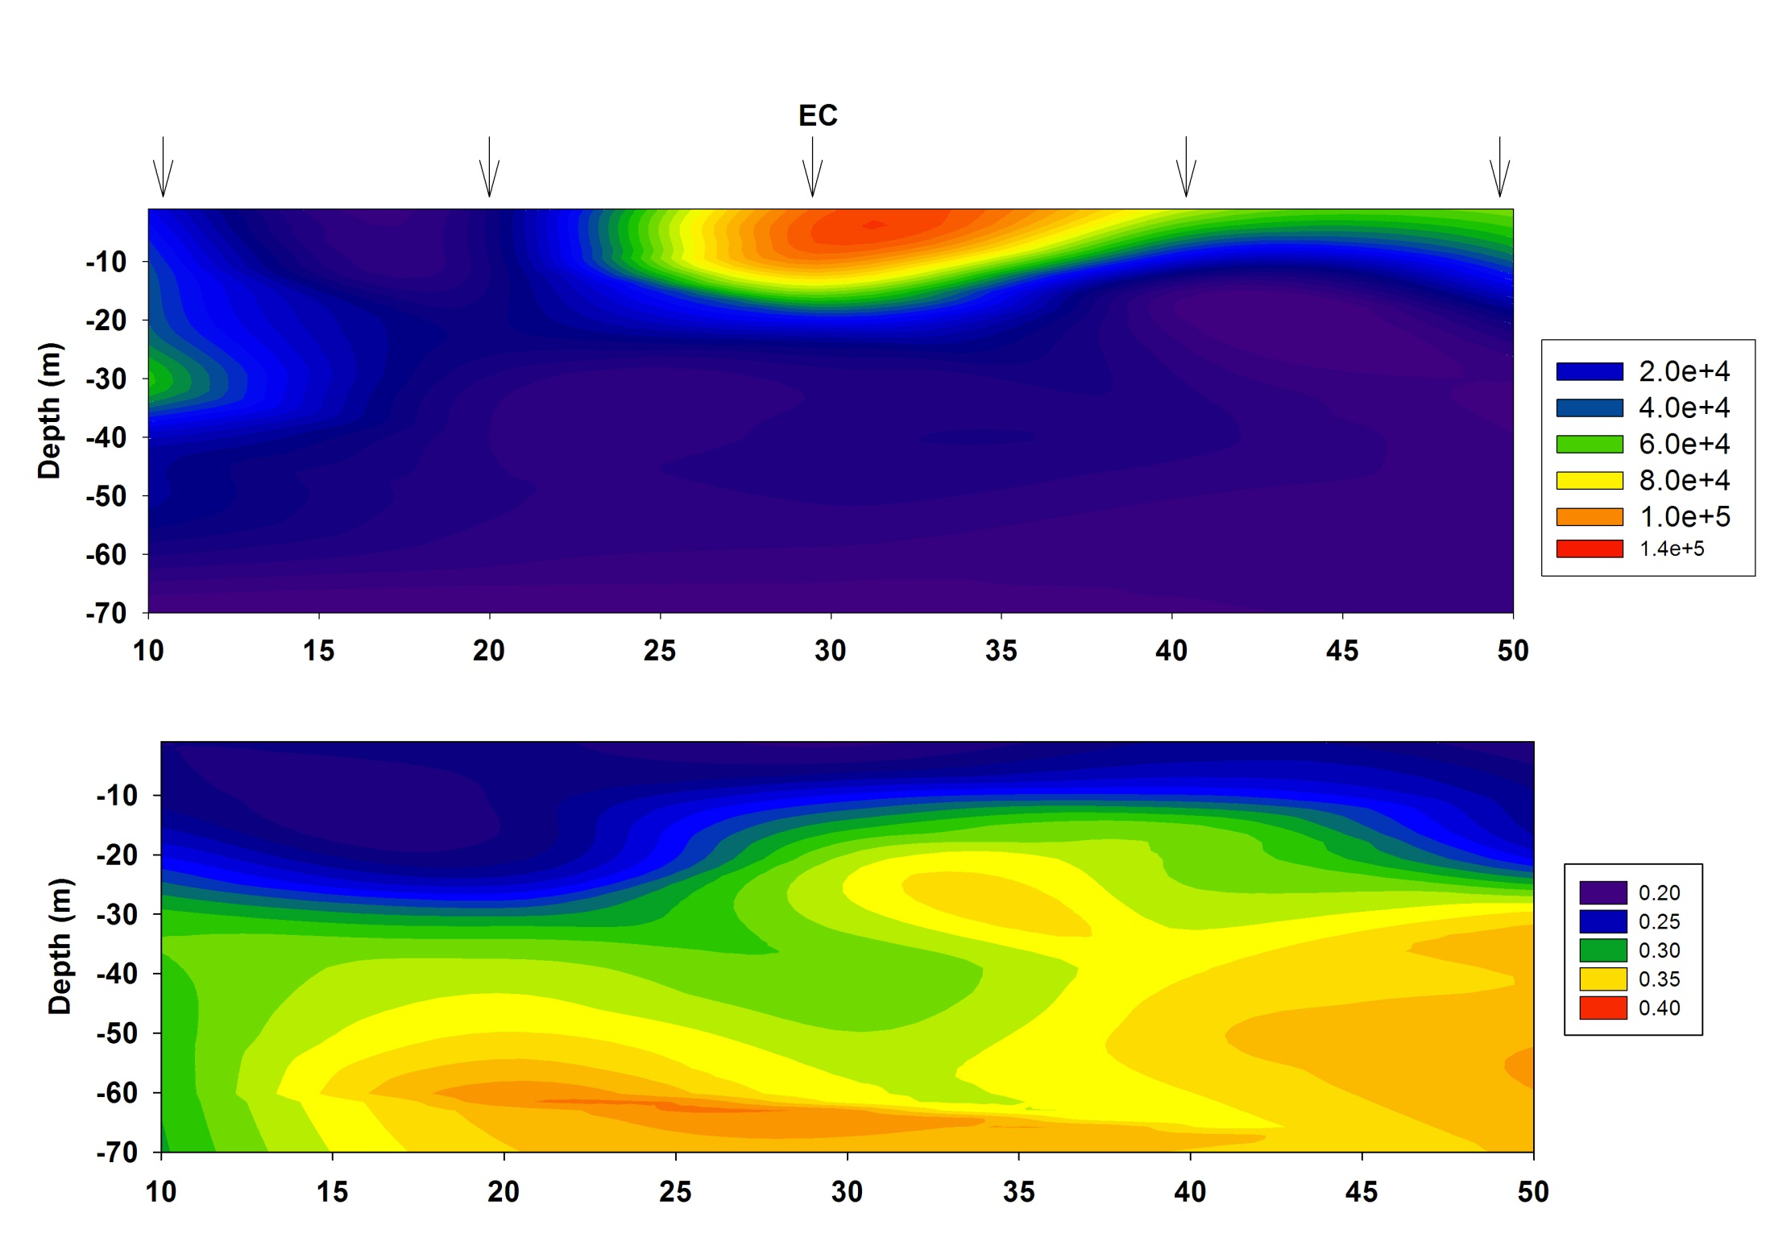
Fm
Fv/Fm
EDDY 3 – First Pass

Slide 29
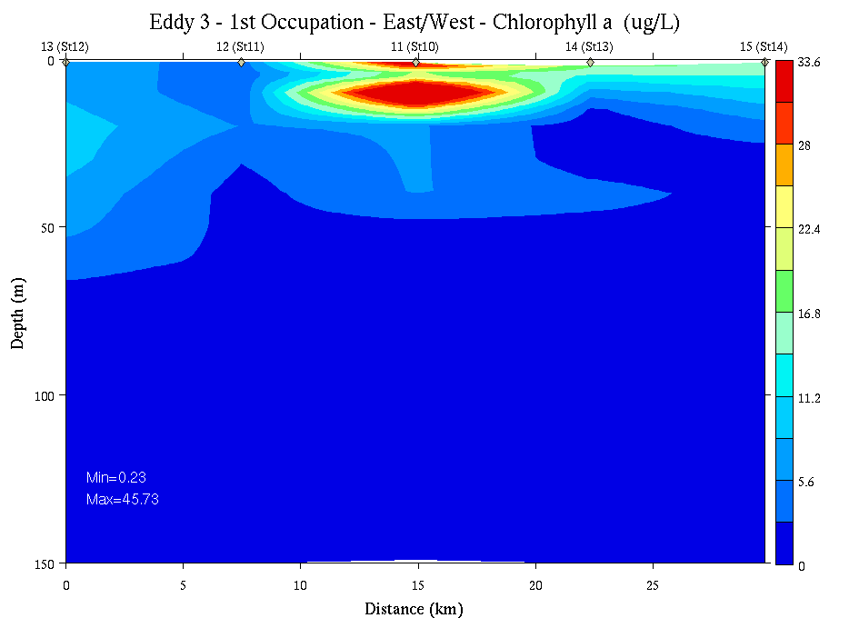
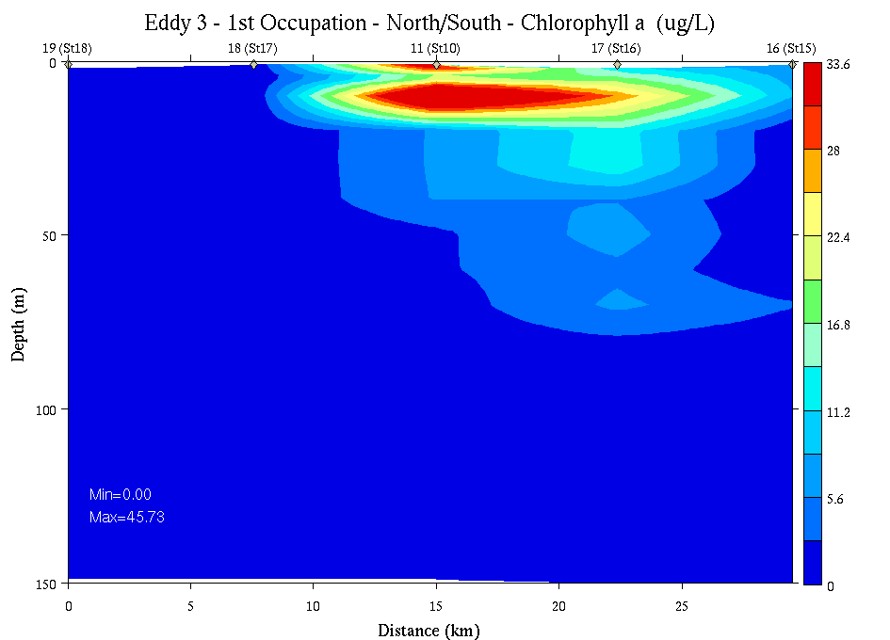
CTD Fluorometer vs. Extracted Pigments
Smith lab extracted Chl
CTD
Sfc
150m
East-
West
Sfc
150m
North-
South

Slide 30


MODIS 1/18/11
SST
Chlorophyll
Eddy 3
Eddy 3

Slide 31




VPR Survey of Eddy 3
Temperature
Salinity
Fluorescence
Optical Backscatter

Slide 32


Eddy 3, 2nd Occupation: East-West Transect
0-150m
0-700m

Slide 33


Eddy 3, 2nd Occupation: North-South Transect
0-150m
0-700m

Slide 34

Hai’s microscopy

Slide 35

SeaHorse Trajectory

Slide 36
Analysis of VPR observations
Focus on Eddy 3 survey
Temperature, Salinity and Fluorescence in top 100 m

Slide 37


Low Salinity near surface (20 m)
High Salinity at depth (100 m)
Density is mainly controlled by salinity at these temperatures.
Dense core eddy is a cyclone.
Circulation is clockwise.

Slide 38


High temperature on the western side of the eddy center.
Higher temperatures extend through 60 m but not much deeper.

Slide 39

Max Heat at
-76.74
170.25
Total heat content relative to in-situ freezing integrated 0 to 100 m.
Largest heat content is west of eddy center.

Slide 40



Section at 76.74 S
Higher Fluor west of high Temp which is west of eddy center.
Less stratification to west.

Slide 41



Section at 170.25
Warmer and fresher on west side.
Higher fluor to the west.

Slide 42


Eddy 3 Water mass distribution
VPR 4-5-6-7
Weiderwohl PhD thesis
All data
Climatology

Slide 43

Where did the warm water in Eddy 3 come from?
Satellite SST – Jan 13

Slide 44
Well, how did it get here?
Satellite SST – Jan 13
Eastward eddy flux of warm, fresh, (previously) high-iron meltwater?
Retreating sea ice leaves a wake of warm, fresh, (previously) high-iron meltwater?
Either way, these highly stratified conditions favor diatom blooms in the Ross Sea
Deep salinity anomaly in eddy 3
1
2

Slide 45

Eddy 2
Station 6
Inside Eddy 2

Slide 46



Eddy 2 VPR Survey
Outside Eddy
Inside
Eddy

Slide 47
Eddy 2 (VPR 3) Image Categories
Phaeocystis - Many
Phaeocystis - Individual
Marine Snow
Other
“Kidney Beans”
Blurry

Slide 48


Phaeocystis distribution
Covariance of individuals and aggregated colonies
Population center of mass deeper inside the eddy than at the periphery

Slide 49


Kidney beans and marine snow
Both abundant at depth inside the eddy

Slide 50


Slide 51

Next Up
1. Finish Ross Bank Survey
2. Deploy SeaHorse
3. CTD transect on Ross Bank
4. Ross Ice Shelf – in search of ISW
5. Return to Ross Bank
6. 2nd CTD occupation
7. Recover SeaHorse
8. Joides Trough

Slide 52

Ross Bank Survey

Slide 53

PRISM Cruise Track

