Slide 1
Science Meeting1/11/12

Slide 2
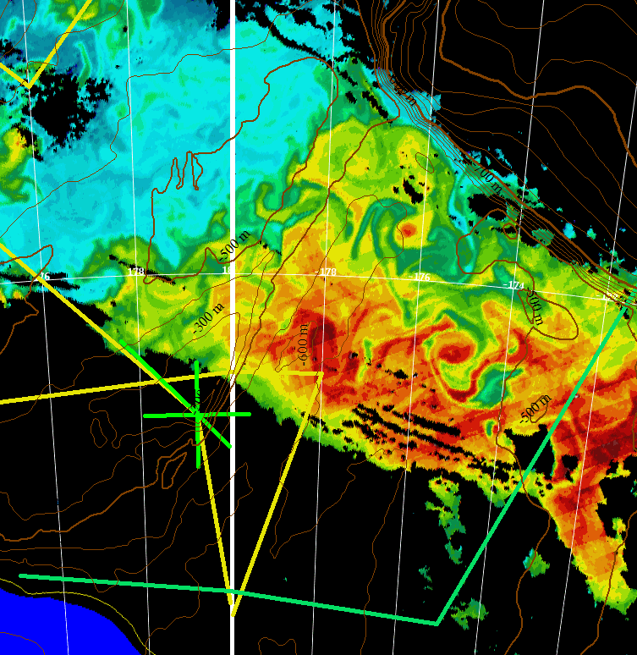
PRISM Sampling of Eddies 1 and 2
MODIS Jan 8
Station 4
Inside Geordie
H₁
Station 5
Outside Geordie
H₃
Station 6
Inside Eddy 2
H₂
H₂
H₃
H₄

Slide 3
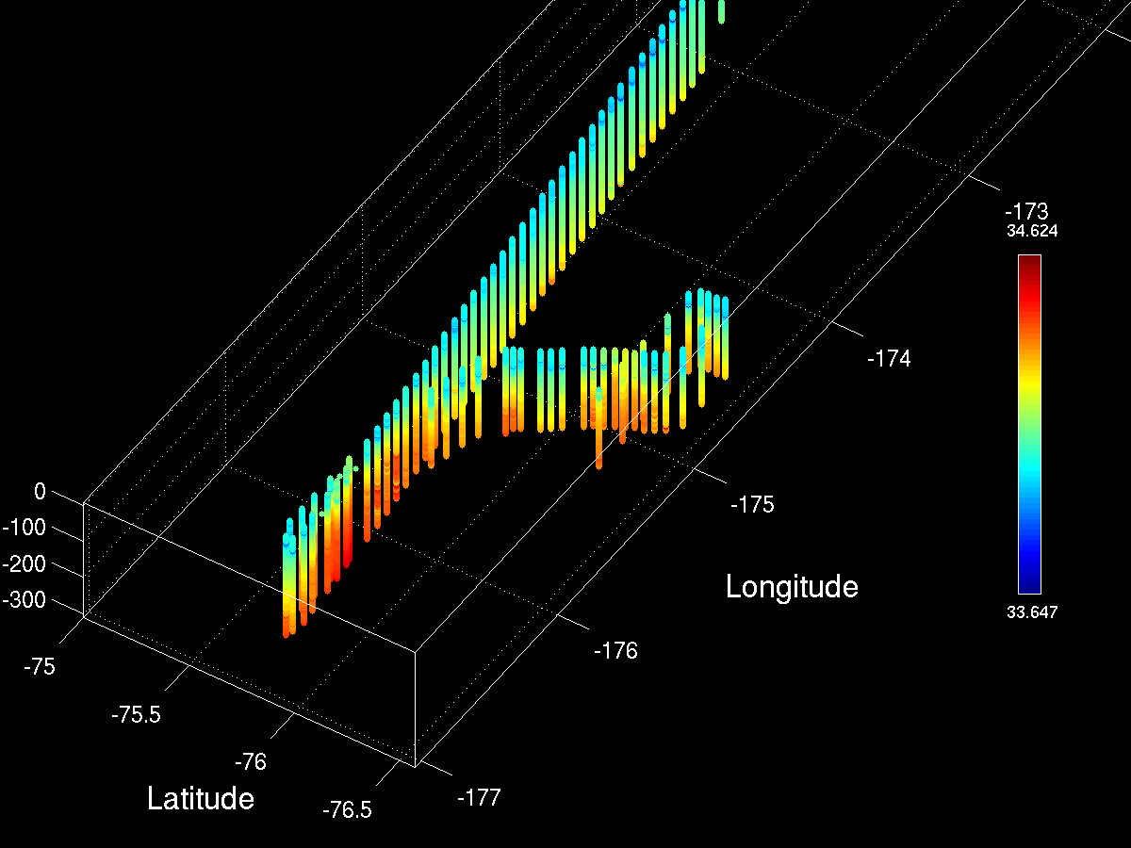
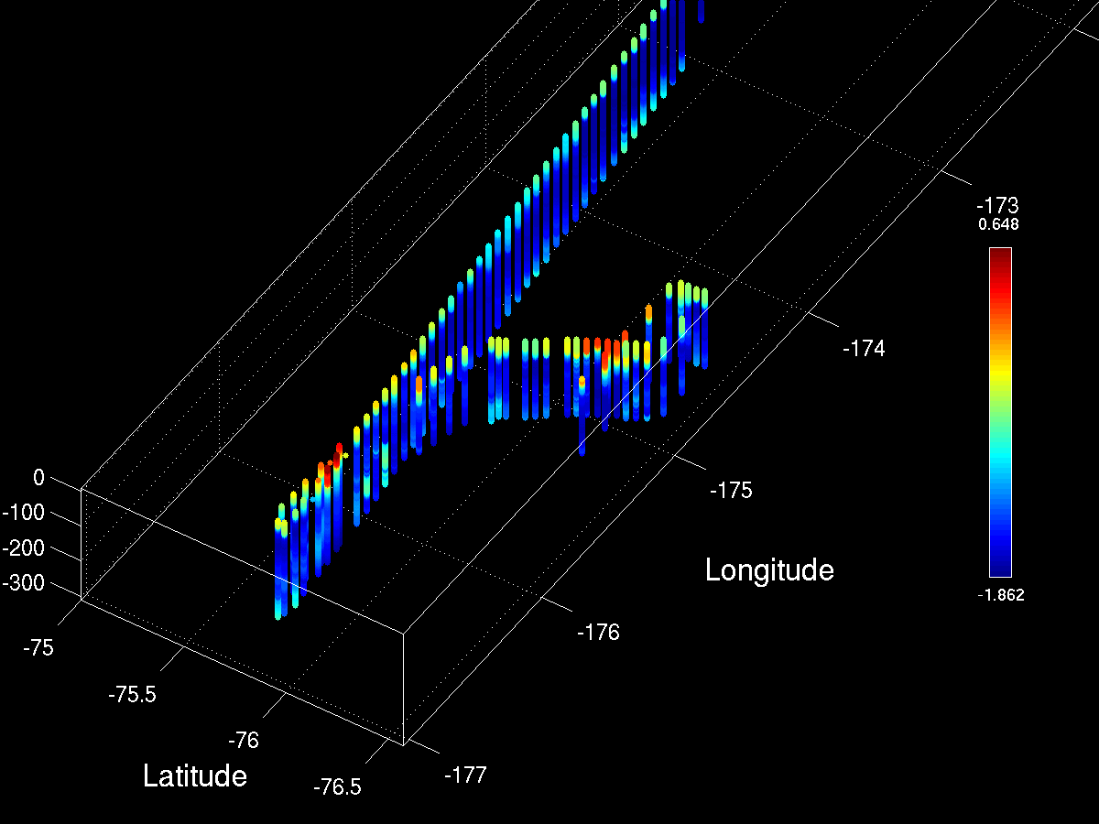
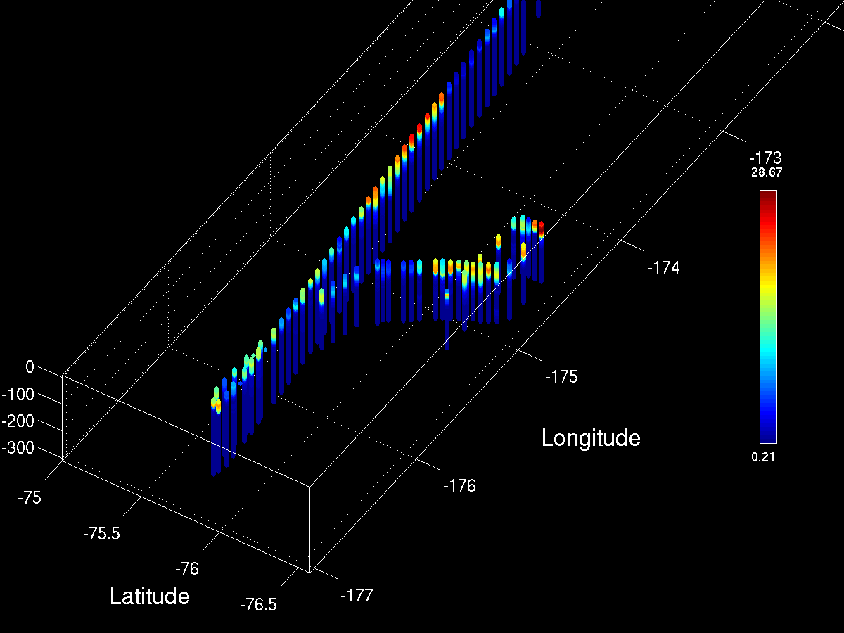
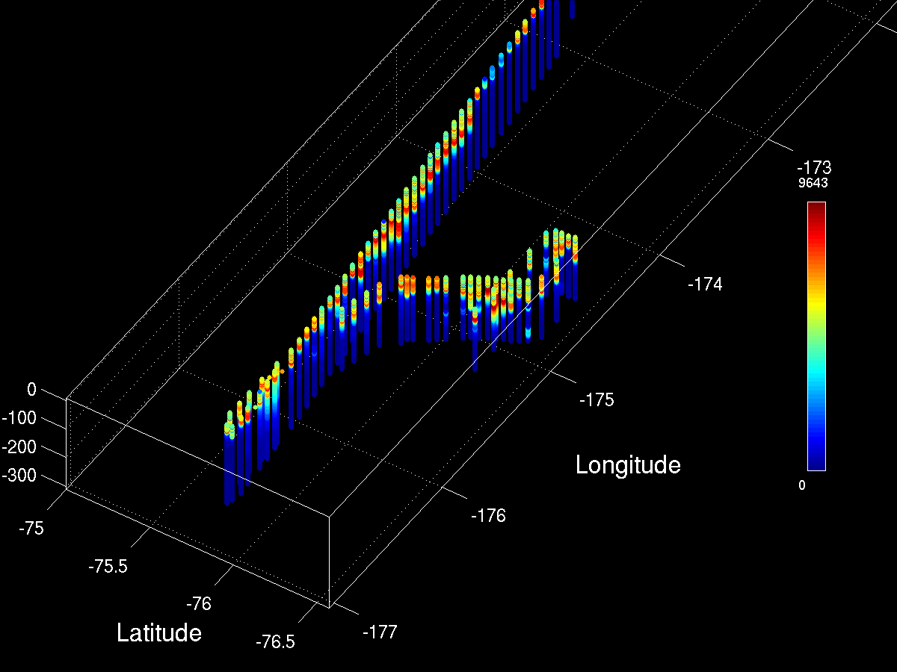
MVP Survey of Eddies 1 and 2: View from the SW
Salinity
Temperature
Eddy 1
Eddy 2
Fluorescence
LOPC

Slide 4
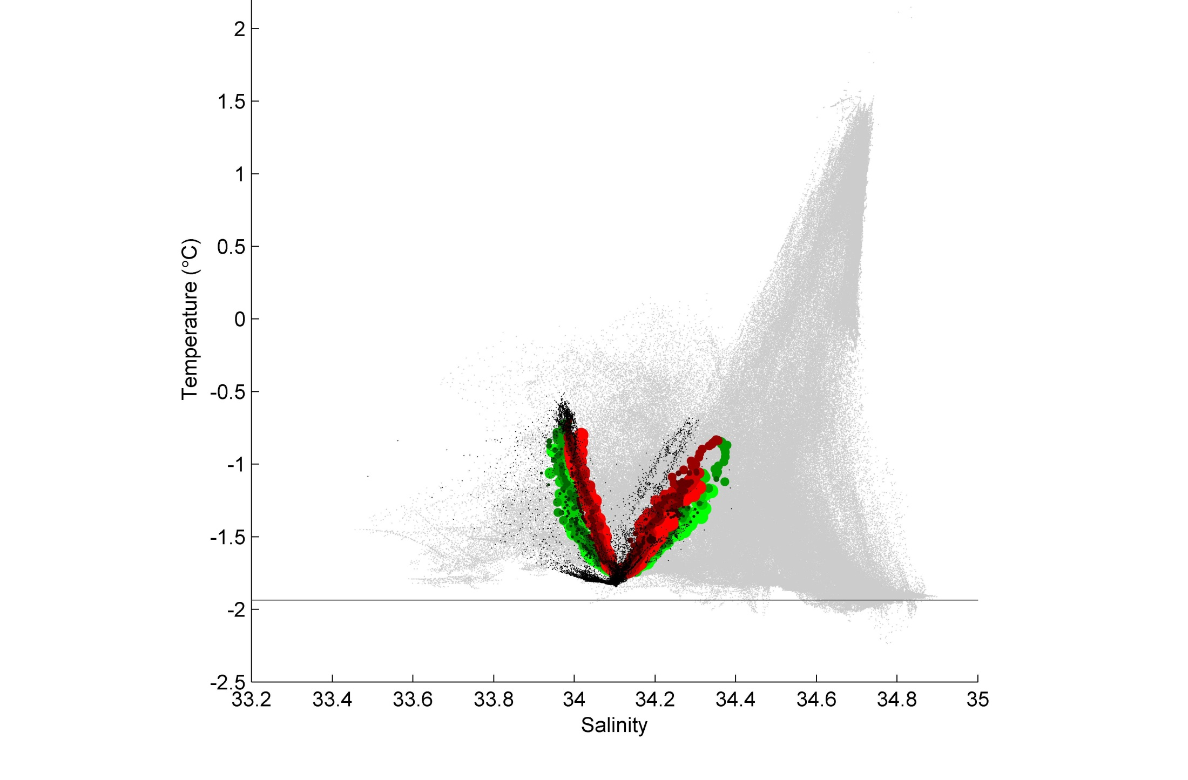
The MVP MCDW-o-meter
CDW
MCDW
AASW
LSSW, HSSW
ISW

Slide 5
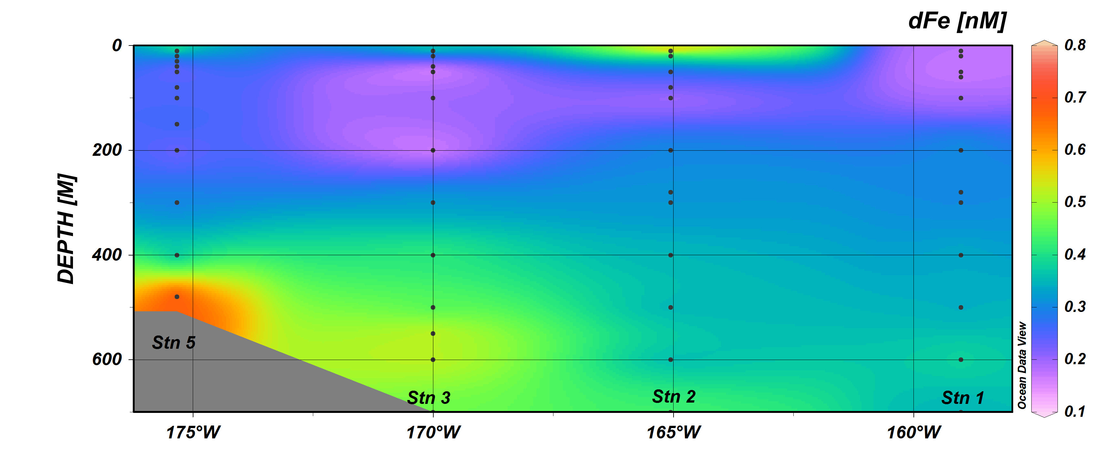
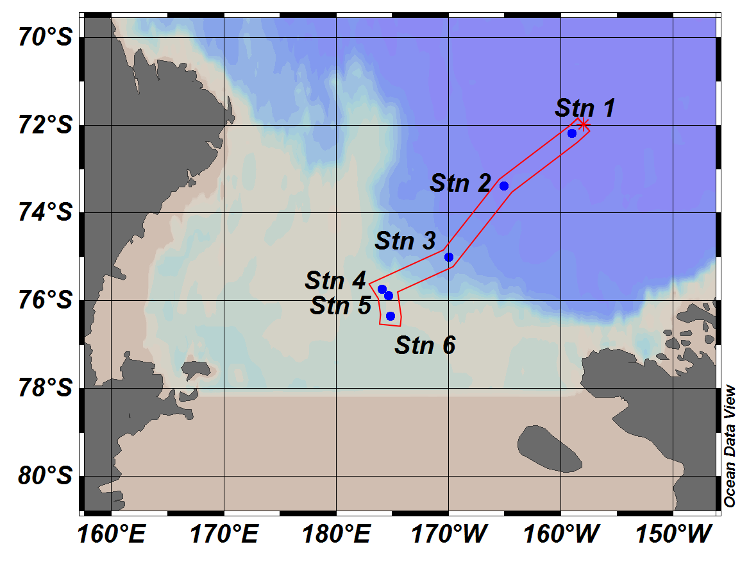
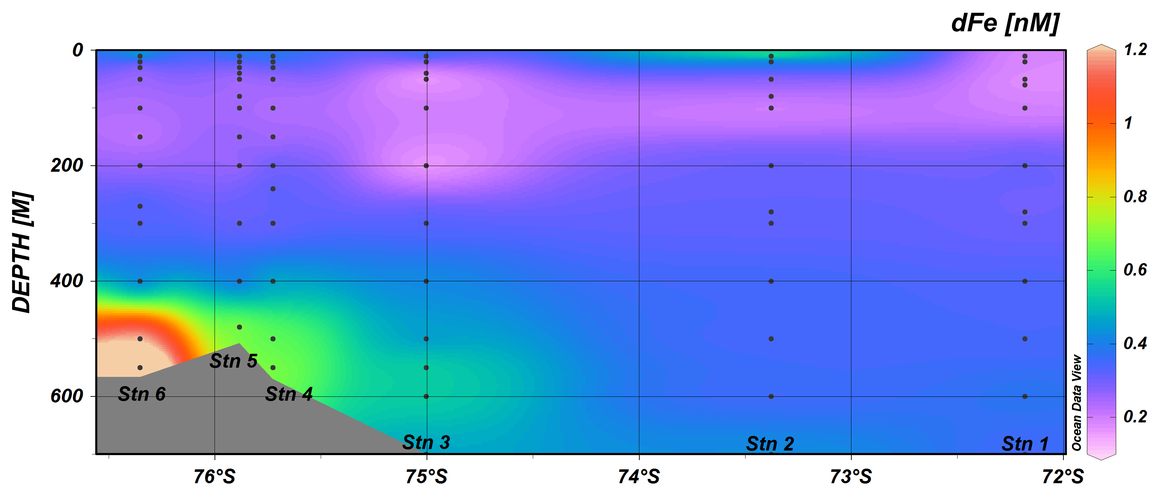
Sedwick Fe data

Slide 6
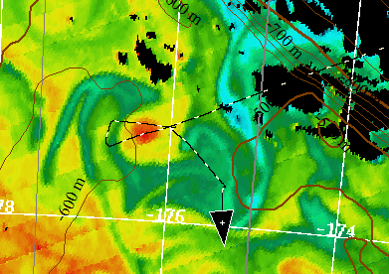
Eddy 1 “Geordie”
Station 4
“Inside Geordie”
Direction of
Geordie’s
propagation
Station 5
“Outside Geordie”

Slide 7
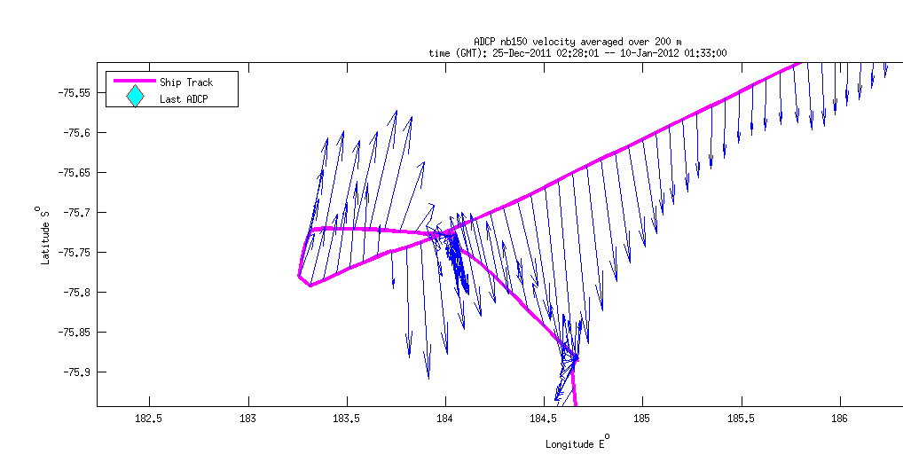
Geordie’s Velocity Field
Station 5
“Inside Geordie”
Station 6
“Outside Geordie”

Slide 8
Tom and Tommy

Slide 9
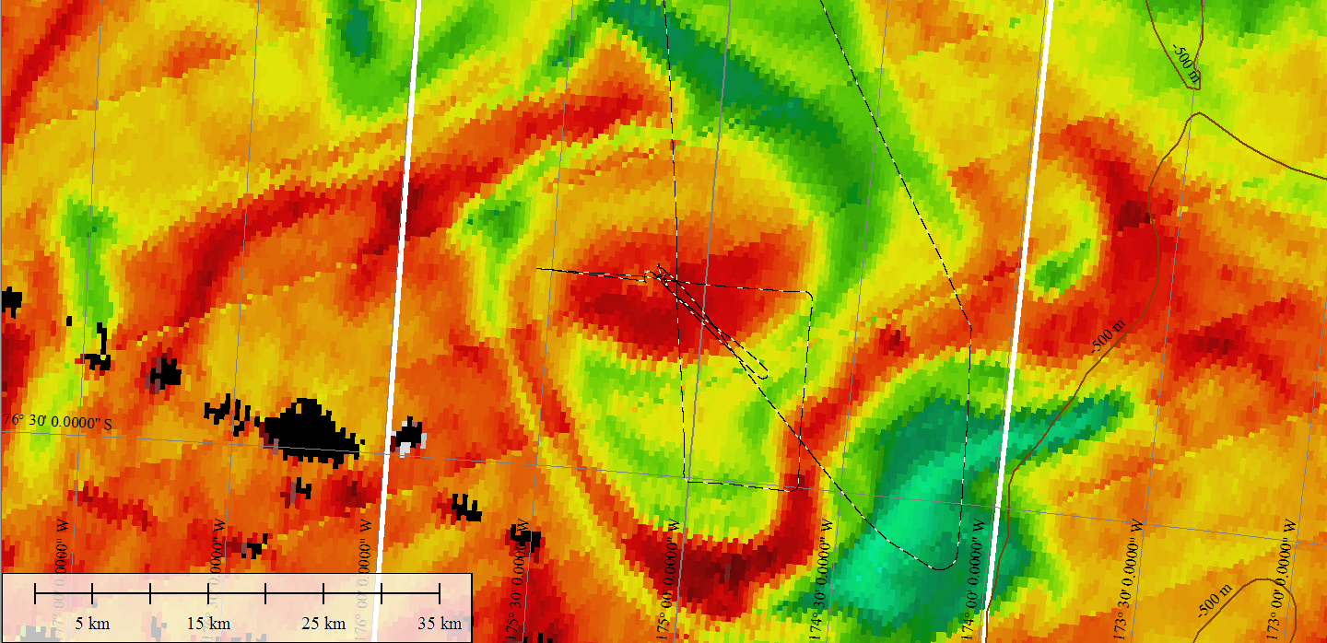
Eddy 2
Station 6
Inside Eddy 2

Slide 10
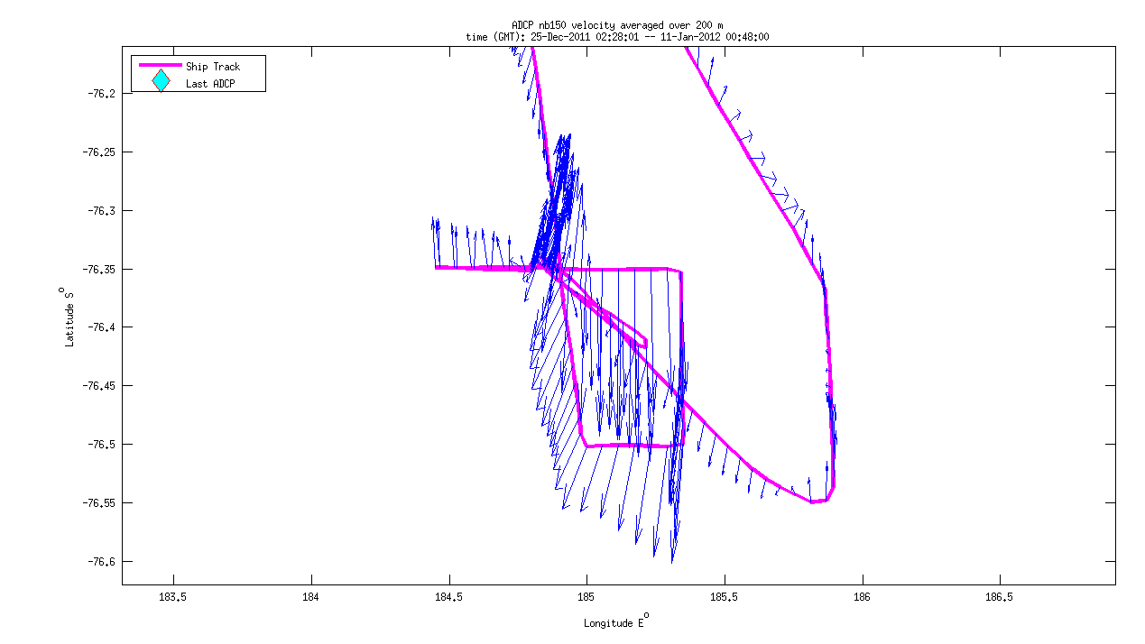
Eddy 2’s Velocity Field
VPR
Survey
Station 6
Inside Eddy 2

Slide 11
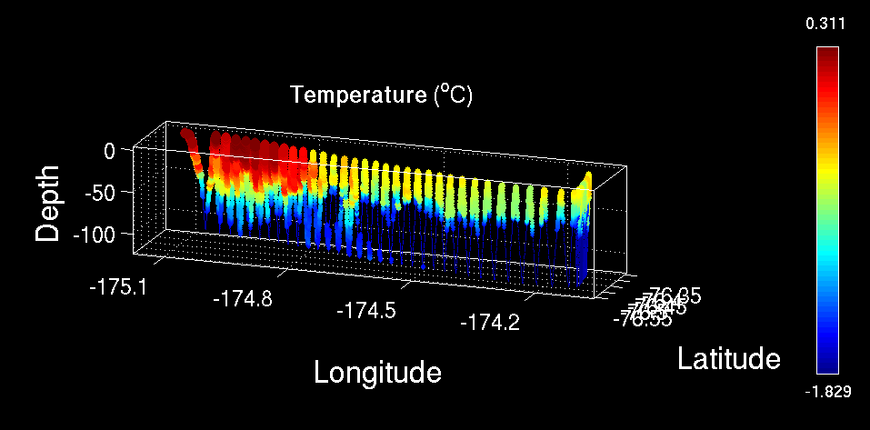
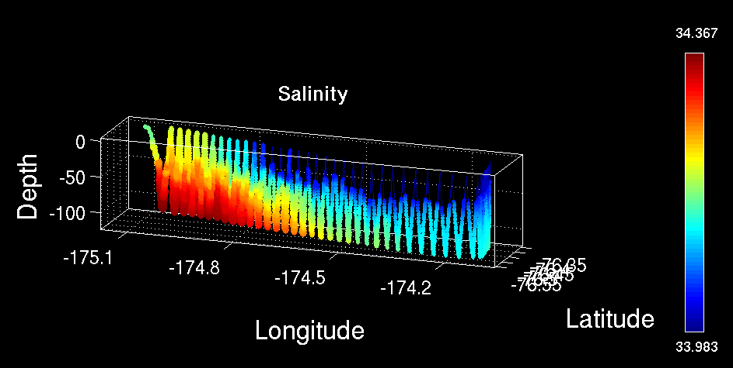
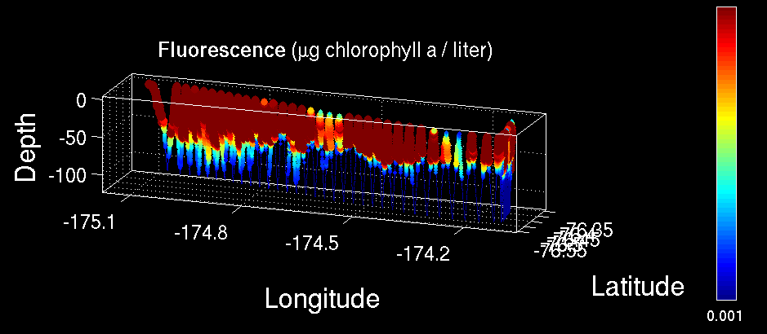
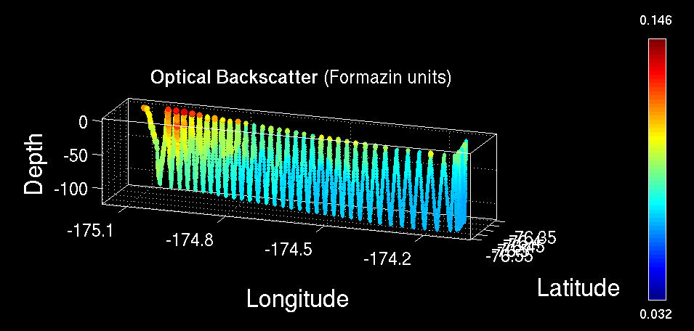
VPR Survey of Eddy 2
Temperature
Salinity
Fluorescence
Optical Backscatter

Slide 12
Sample VPR Images 1/10/12
Phaeocystis-
most abundant and very thick at surface
Collapsed Colonies?-
abundant at depth
Marine Snow-
abundant at depth
Other Stuff- rare

Slide 13
Science Planning 1/11/12
H₁: CDW
H₂: Sediment: banks/coastal
H₃: Sea ice
H₄: Glacial melt
H₅: ISW
H₆: Dry Valleys
H₇: Vents
Option 1
Ice Shelf
Ross Bank
Joides Trough
Western Ross
Opportunistic mesoscale studies
Option 2
Mesoscale process study of E-W Chl gradient
Ice Shelf
Ross Bank
Joides Trough
Western Ross
Opportunistic mesoscale studies

Slide 14
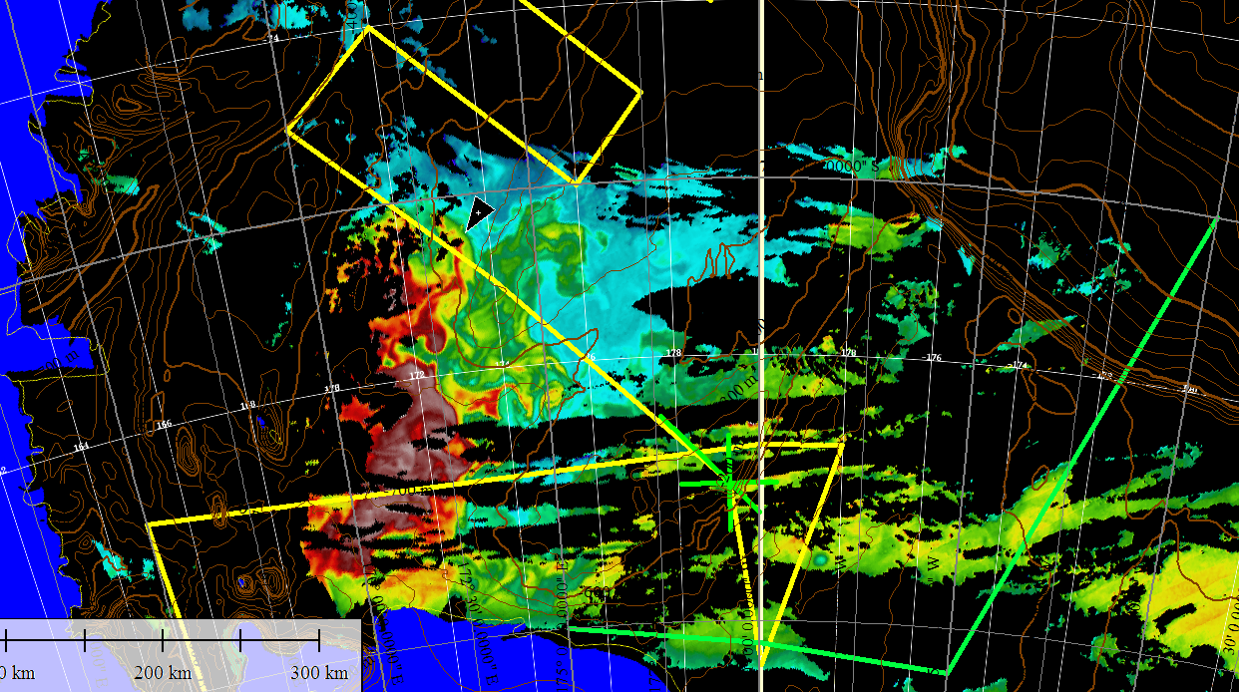
MODIS 1/11/12

Slide 15
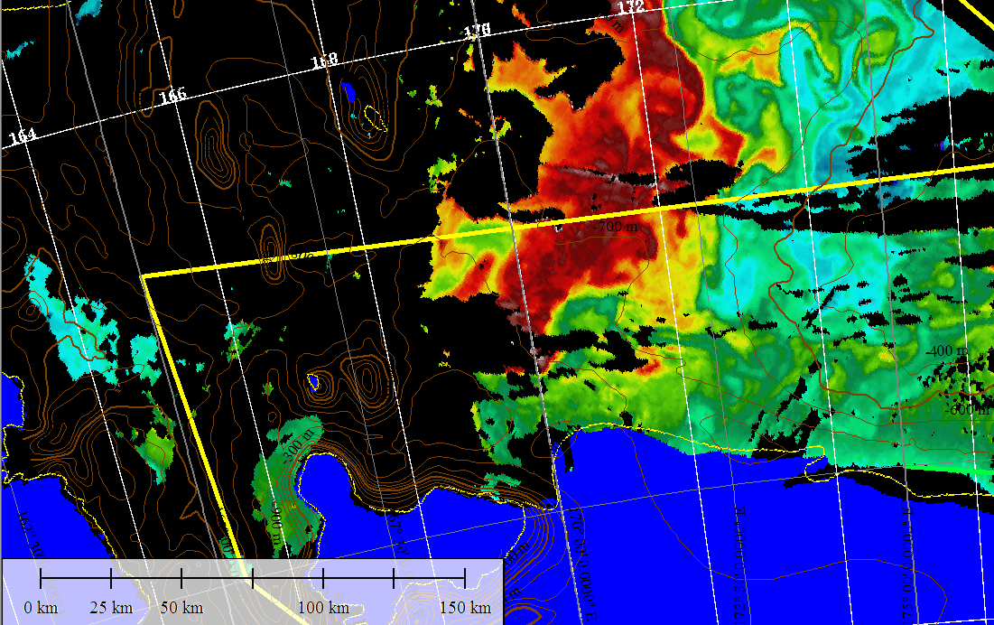
MODIS 1/11/12

Slide 16
MODIS 1/11/12
MVP/towfish survey to high biomass area
CTD/TMC Station
VPR Survey
Deploy SeaHorse
MVP/towfish survey to low biomass area
CTD/TMC Station (s)
MVP/SeaHorse survey to high biomass area
CTD/TMC Station (s)
VPR Survey vicinity of SeaHorse
Recover SeaHorse
Stations
Stations

