Slide 1
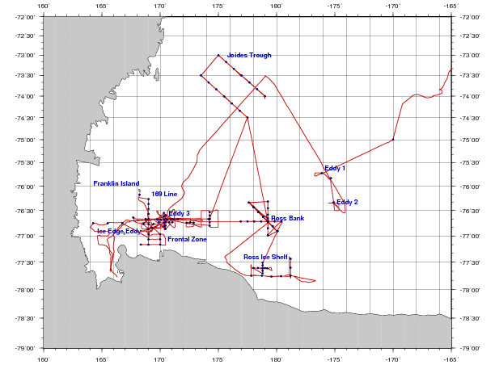
PRISM cruise track
H₁: CDW
H₂: Sediment: banks/coastal
H₃: Sea ice
H₄: Glacial melt
H₅: ISW
H₆: Dry Valleys
H₇: Vents
I. ACC Sea Ice
II. Eastern Ross Sea Eddies
III. Western Ross Sea
IV. Ross Bank
V. Ross Ice Shelf
VI. Joides Trough
VII. Western Ross Sea II

Slide 2
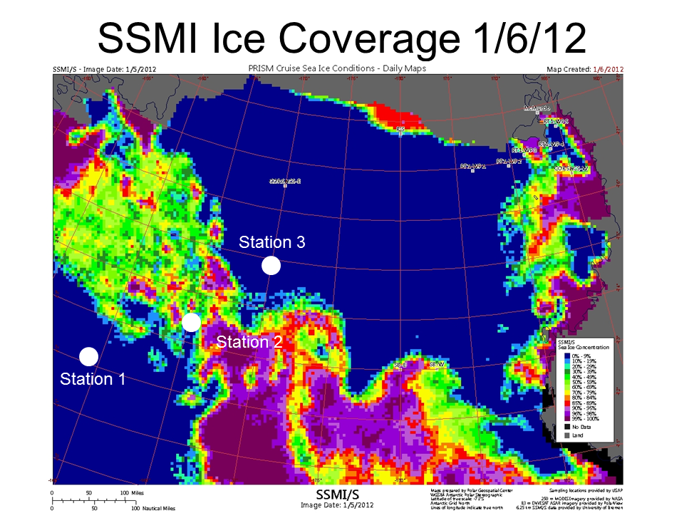
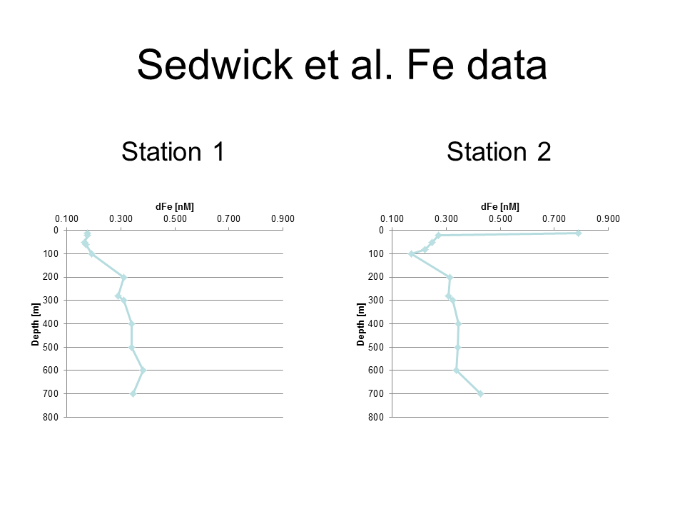
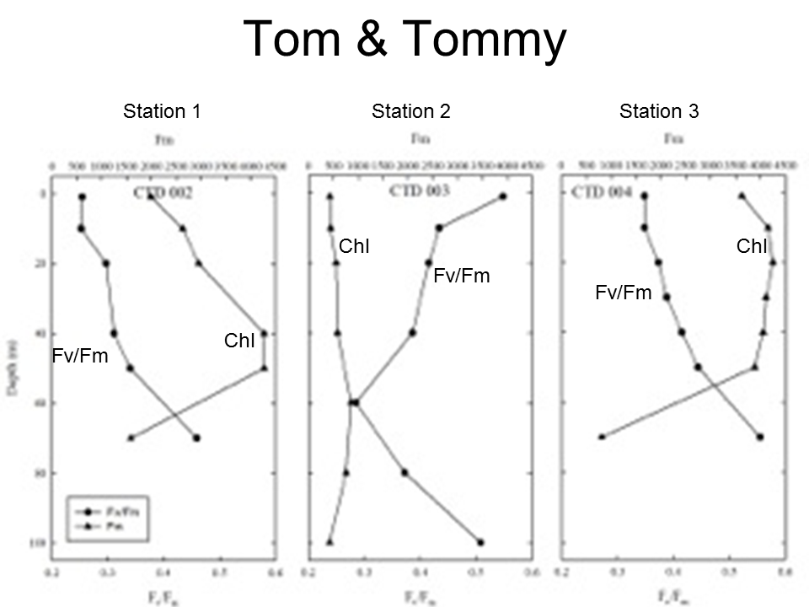
ACC Sea Ice
Station 3
Station 2
Open ocean sea ice a source of iron that improves physiological condition of phytoplankton
Iron measurements in CDW end-member consistent with previous studies.

Slide 3
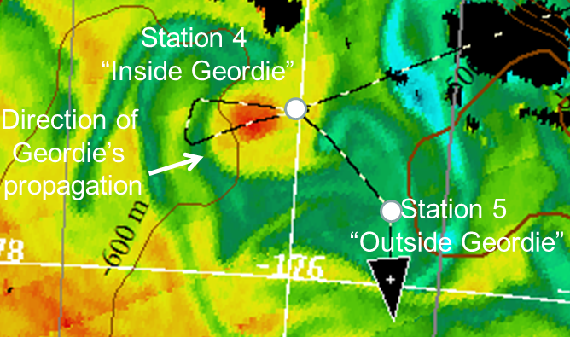
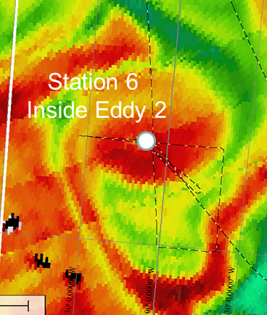
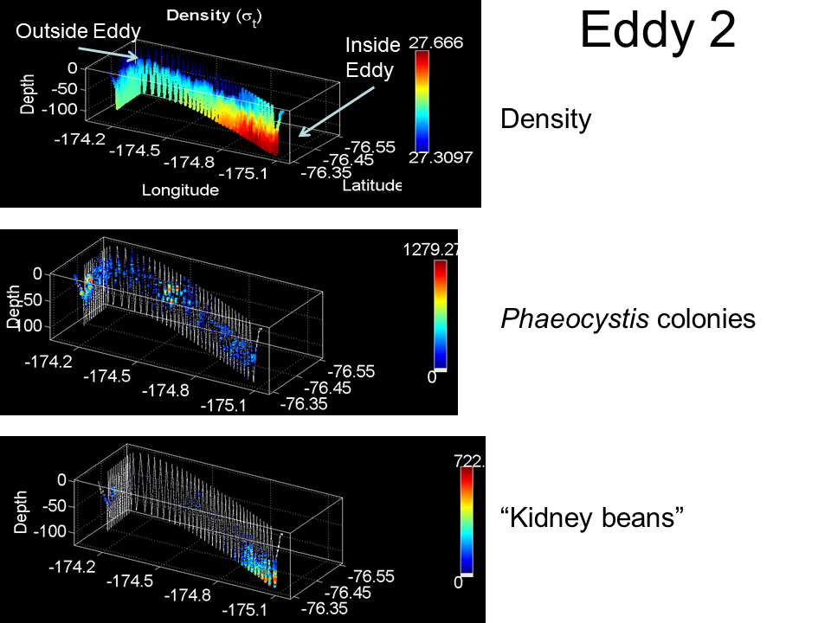
Eastern Ross Sea Eddies
Cyclonic eddies driven by doming of the halocline yield elevated Chl
Phaeocystis present as both individual colonies and aggregated colonies
Covariance in the distribution of individual and aggregated colonies, both deeper in the eddy interior than outside the eddy
High abundance of abandoned colonies and marine snow at depth at eddy center
Near-surface iron concentrations of 0.3-0.4 nM both inside and outside eddies

Slide 4
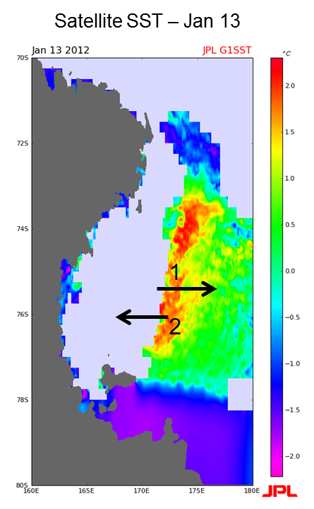
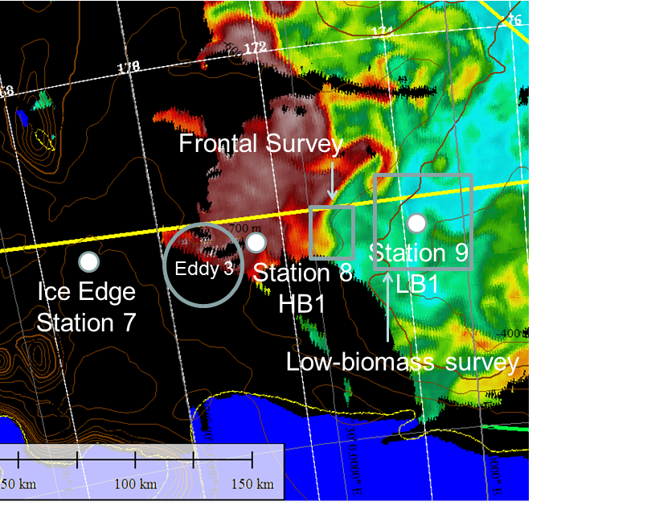
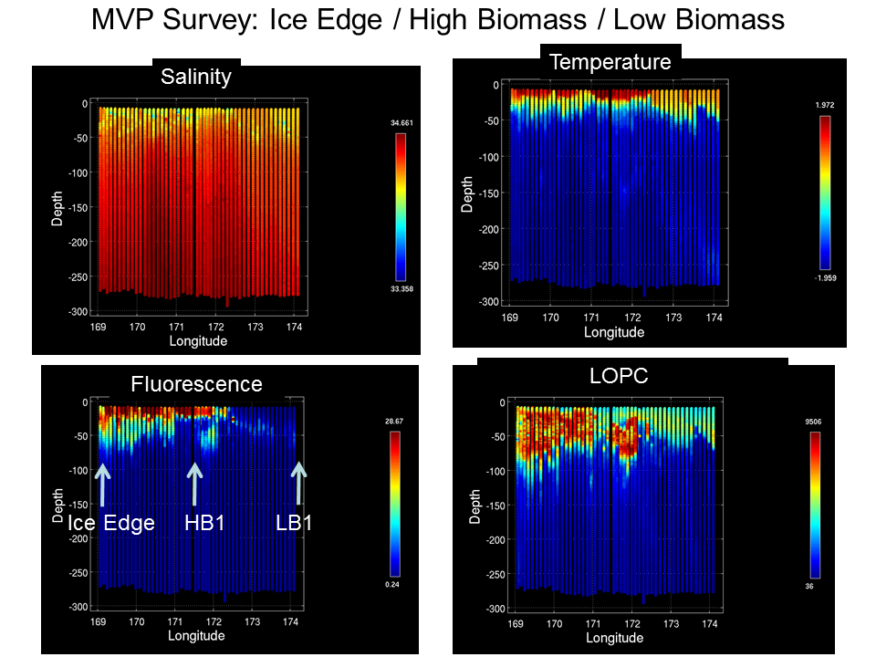
Western Ross Sea Process Study
Frontal boundary separates warm, fresh, higher iron (0.2 nM) surface waters to the west from cold, salty, lower iron (0.1 nM) surface waters to the east; pattern consistent with a wake of retreating sea ice
At depth, zonal trends are reversed: salinity decreases and iron increases to the east (HSSW production, bathymetry, respectively)
Warm, fresh, higher iron near-surface waters high in biomass: diatoms near the surface, Phaeocystis down deep; phytoplankton condition better than in low-biomass waters
Trends in macronutrient data consistent with a diatom bloom (silicate drawdown)

Slide 5
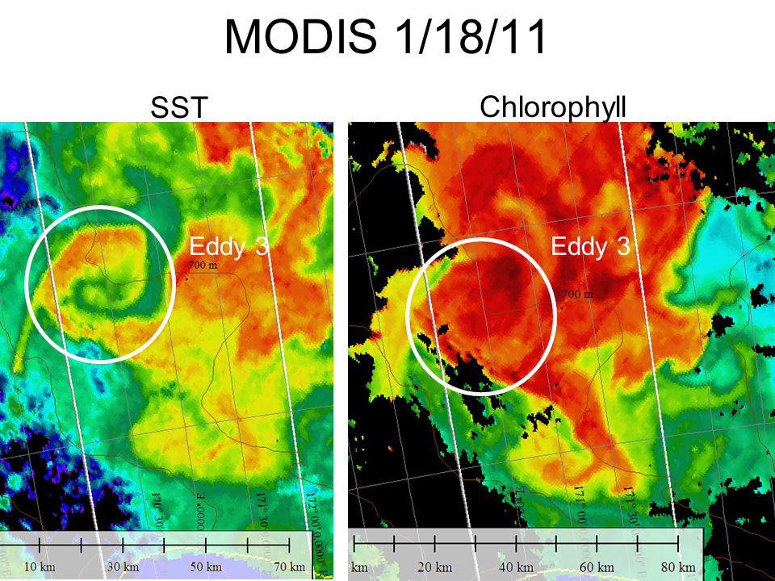
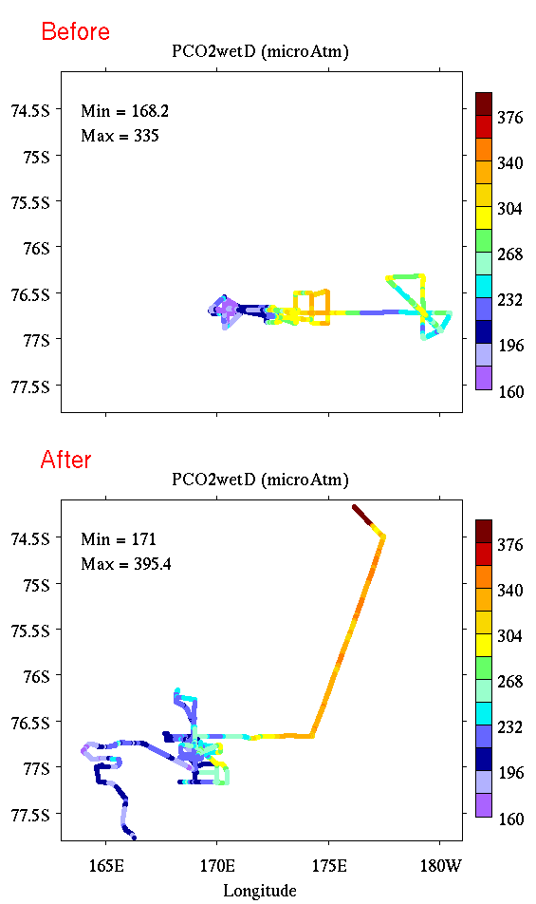
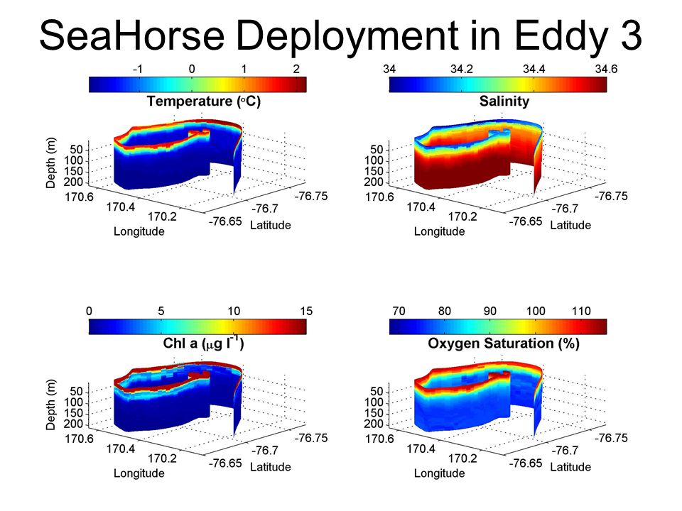
Western Ross Sea Process Study
Cyclonic eddy further elevates biomass in the high-biomass region; domed halocline and ferrocline consistent with increased iron supply, yet near-surface waters depleted in iron
Temporal increase (ca. 50%) in nitrite concentration 50-150m
Eddy heat content distinct from surrounding waters, indicating non-local origin; deep salinity suggests formation to the west
Eastward eddy flux of warm, fresh, (previously) high-iron meltwater?
Iron depletion and decrease in chlorophyll from 1st to 2nd occupation

Slide 6
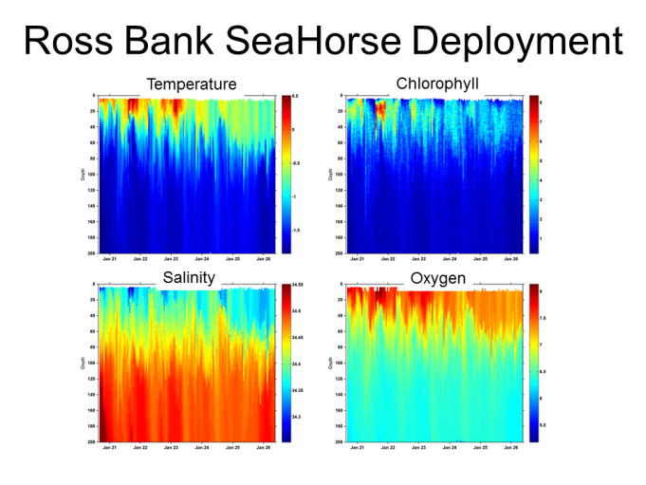
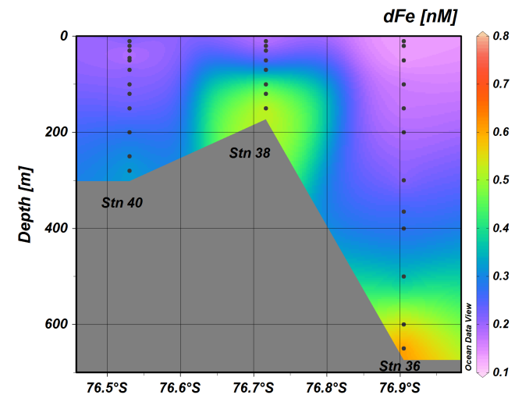
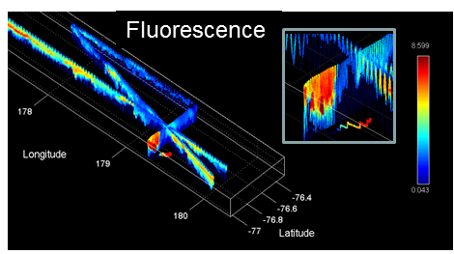
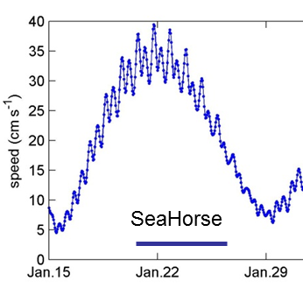
Ross Bank
Hydrographic characteristics
Crest colder, saltier, less stratified
Fluorescence enhanced on the more stratified periphery
ADCP velocity suggests counter-clockwise around-bank flow
Strong spring-neap cycle, tidal speeds ranging from 35 to 15 cm s⁻¹
Dissolved iron enhanced on the crest during spring tides, much less on neap tide
Rapid removal of iron from the aphotic zone on the crest suggests advective loss; hydrographic time-series also indicative of advection
Impact of iron supply from Ross Bank could be spread into the interior Ross Sea via advection
Iron also enhanced in benthic nepheloid layers on the flanks of Ross Bank

Slide 7
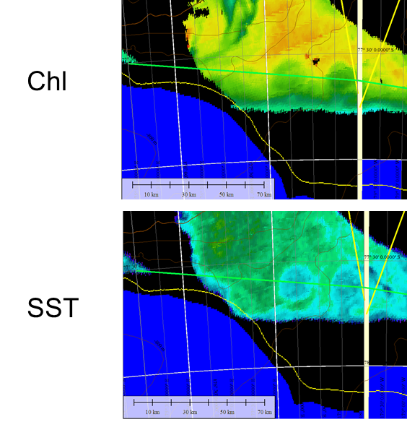
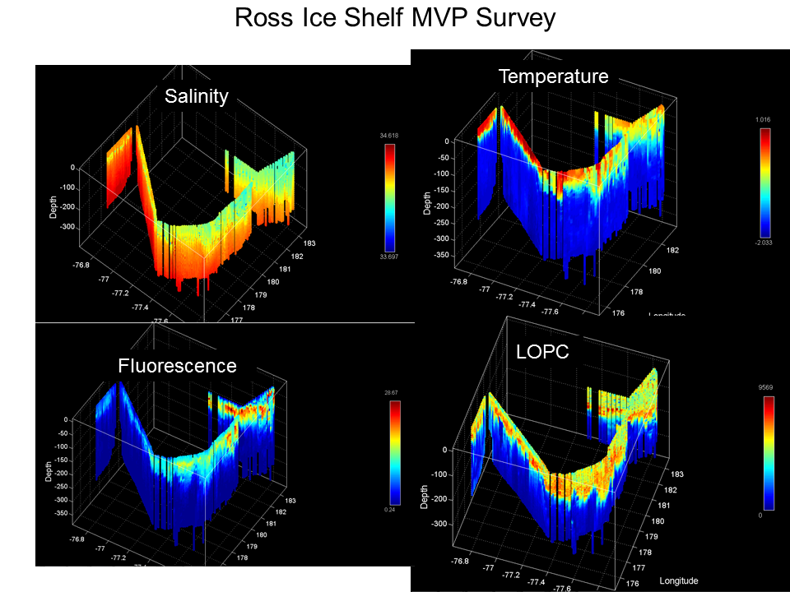
Ross Ice Shelf
First ever iron measurements in Ice Shelf Water; concentrations similar to the MCDW end-member at 0.3-0.5 nM
Near-surface waters adjacent to the RIS were cold, fresh, and relatively enhanced in iron (ca. 0.2 nM) apparently due to glacial meltwater
Upper-ocean anticyclonic eddies can transport (previously) iron-rich waters northward, producing substantial blooms of Phaeocystis

Slide 8
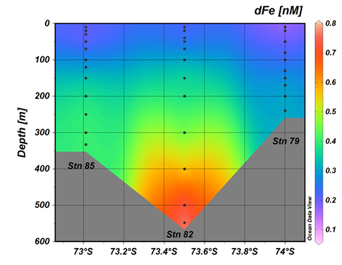
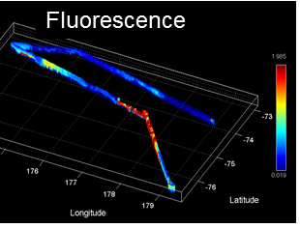
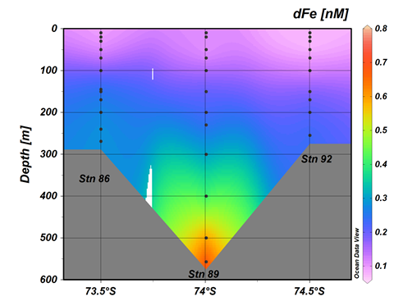
Joides Trough
MCDW present on both eastern and western flanks of Pennell Bank, as well as its crest
Most prominent expression of MCDW on the crest of Mawson Bank; also present on the eastern flank (western flank not sampled).
Except for an area of high Phaeocystis abundance on the southwestern transect across Pennell Bank, VPR observations suggest high abundance of small chain-forming diatoms and copepods, particularly in the northwest part of the survey
Surface dissolved Fe values higher (~0.2 nM) on the northern transect, perhaps reflecting the lesser time that these waters have been free of sea ice cover.
Benthic Fe sources from shelf depressions (rather than banks) may be at least as important in supplying Fe to surface waters as intrusions of MCDW.

Slide 9
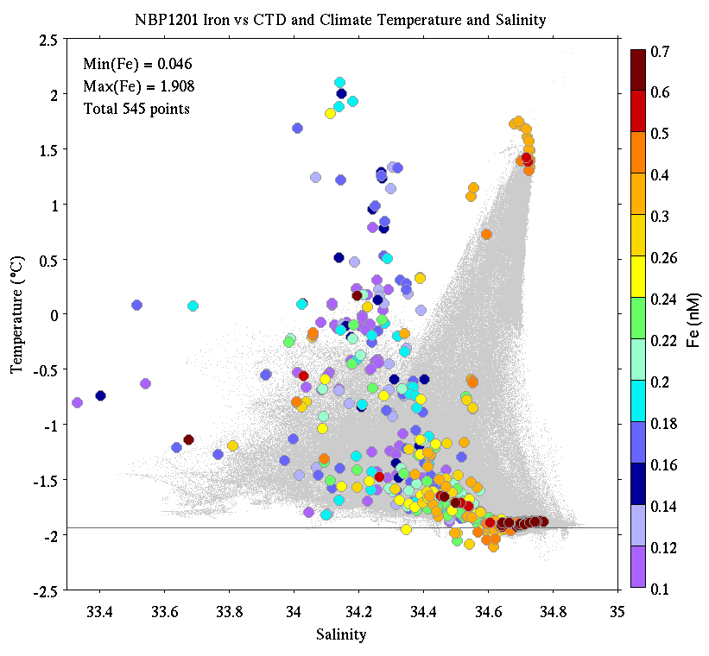
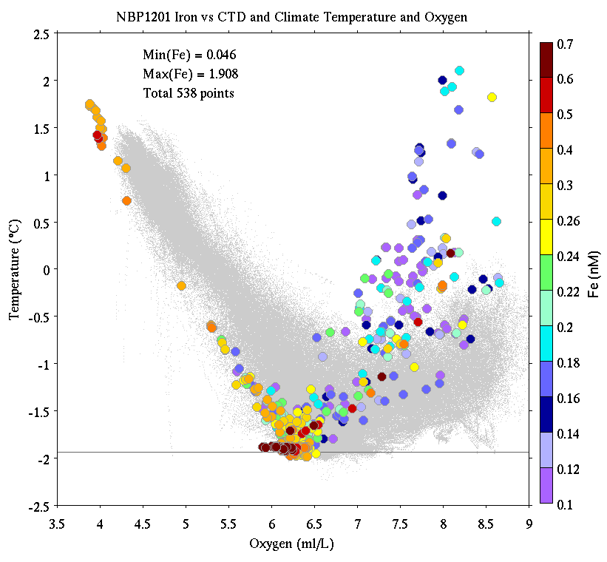
PRISM Iron Observations
CDW
Temperature
Temperature
MCDW
AASW
LSSW, HSSW
ISW
Salinity
Oxygen

Slide 10
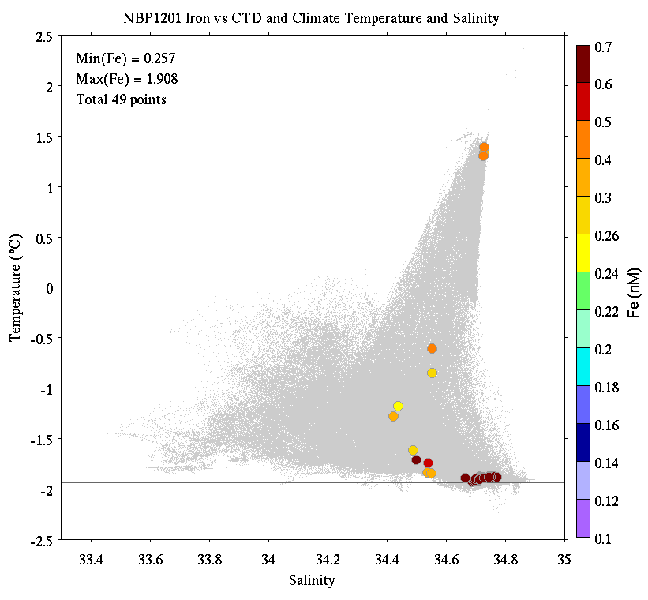
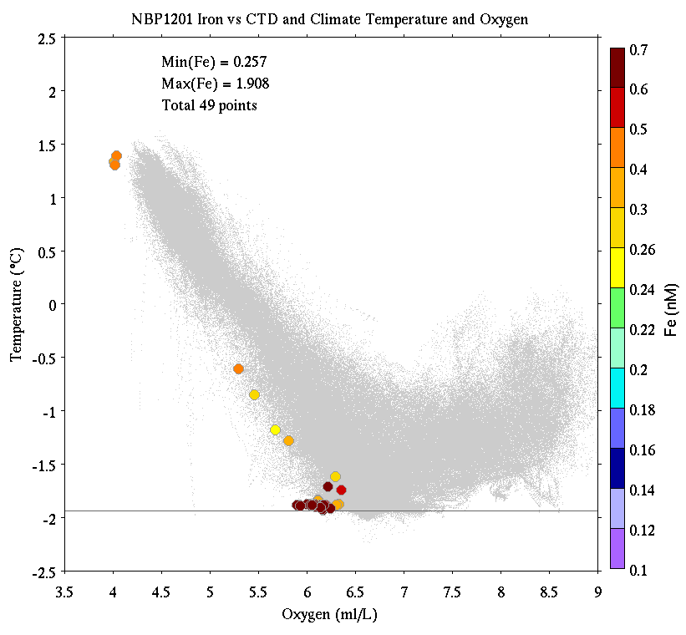
PRISM Iron Observations
Deepest Sample at Every Cast
CDW
Temperature
Temperature
MCDW
AASW
LSSW, HSSW
ISW
Salinity
Oxygen

Slide 11
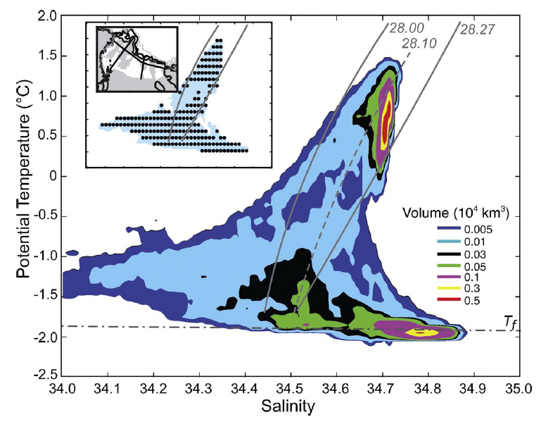
Orsi water mass volumes

Slide 12
Iron Sources
MCDW 0.3-0.5 nM offshore source; volume decreases shoreward
ISW 0.3-0.5 nM large volume on shelf
Benthic
Nepheloid
Layer 0.6-1.9 nM more available in shallow / less stratified areas
Ice melt variable most proximal source for phytoplankton
Vents - -

Slide 13
Evidence for iron supply from sea ice
Pre-bloom conditions consist of
High Fe
High Fv/Fm
Low Chl
Where did we find those conditions?
Offshore sea ice
Franklin Island
Joides Trough, northern transect
All areas in which ice was melting or recently cleared
[sea ice movie]

Slide 14
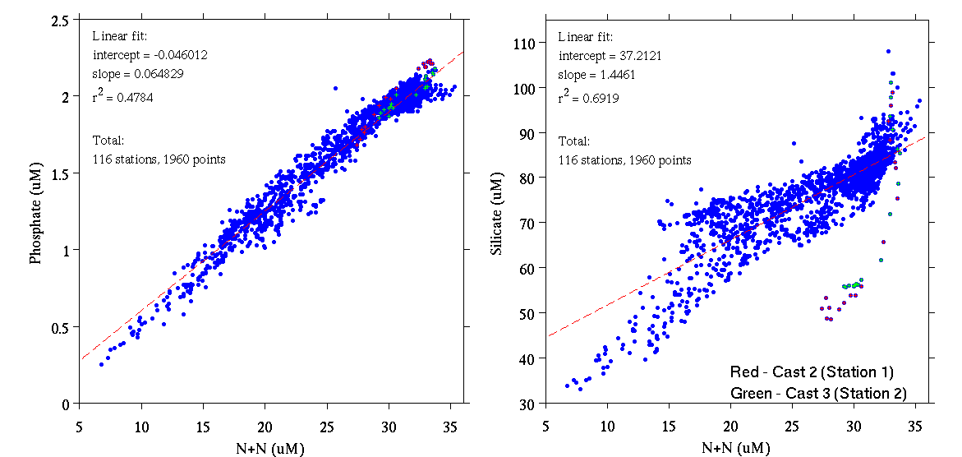
PRISM nutrient data
Phosphate
Silicate
Nitrate + Nitrite
Nitrate + Nitrite
Thank you, Lindsey!!!

Slide 15
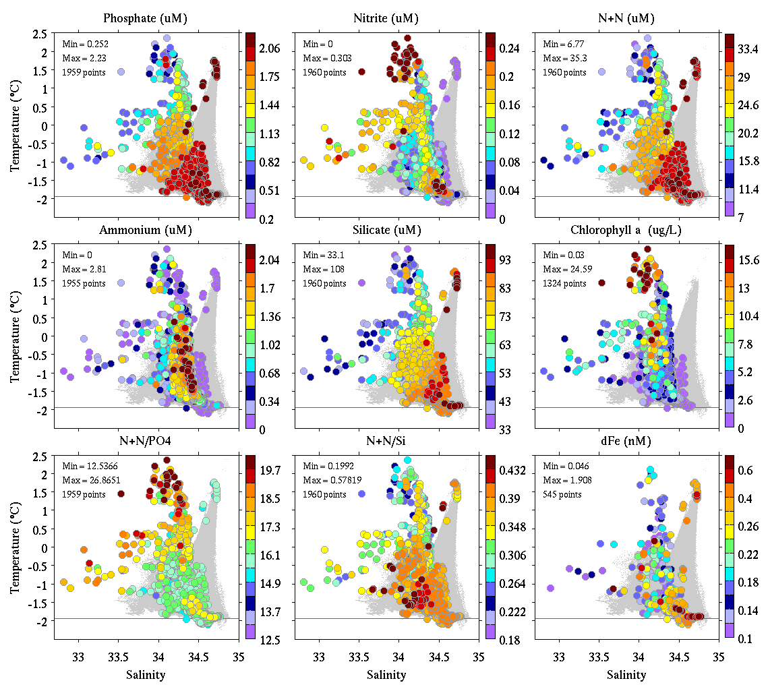
PRISM NutrientsChl, Fe
Phosphate Nitrite Nitrate+Nitrite
Ammonium Silicate Chlorophyll
N+N / P N+N/Si Fe
Thank you, Olga!!!

Slide 16
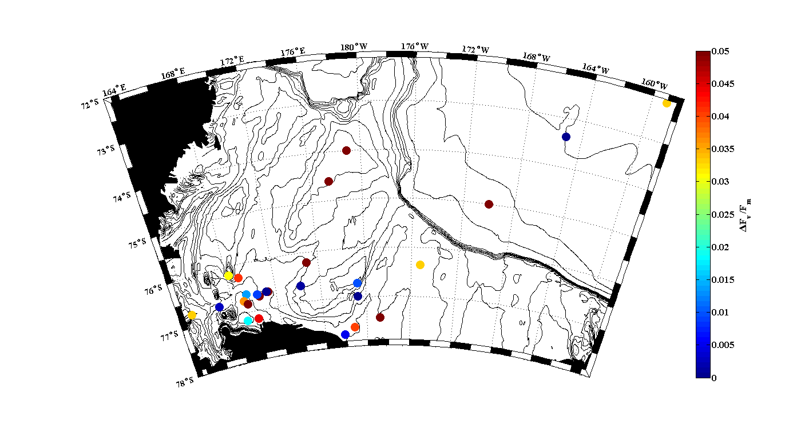
Delta Fv/Fm (48 hrs) All stations
Biggest response (52% increase in Fv/Fm at 48 hours was HMB region, 1st occupation - Also highest fluorescence (biomass)
Franklin Island – Highest in situ Fv/Fm – Fv/Fm went down in experimental controls but was maintained in Fe treatment.

Slide 17
Example 1: Ross Bank / Pennell Bank – Little signal of iron-addition effect at Ross Bank?

Slide 18
Example 2: Ice Shelf – Enhanced effect of iron addition further from Ice?

Slide 19
Example 3: Eddy comparison: Very strong iron-addition effect in Eddy 3 (High Biomass/Diatoms)

Slide 20
Dataset Summary
CTD – Bottle FRRF data (Fv/Fm is on cruise DVD)
Underway FRRF – Continuous
Short-Term and Long-Term Bioassays (Chl, Nutrients, FRRF, Community Structure and Samples for Protein Analysis)
CTD (Surface and Subsurface Chlorophyll Maximum) Samples for Protein Analysis
Combine these datasets with Fe, HPLC, Nutrients, Community Composition (Microscopy) and the physical environment.

Slide 21
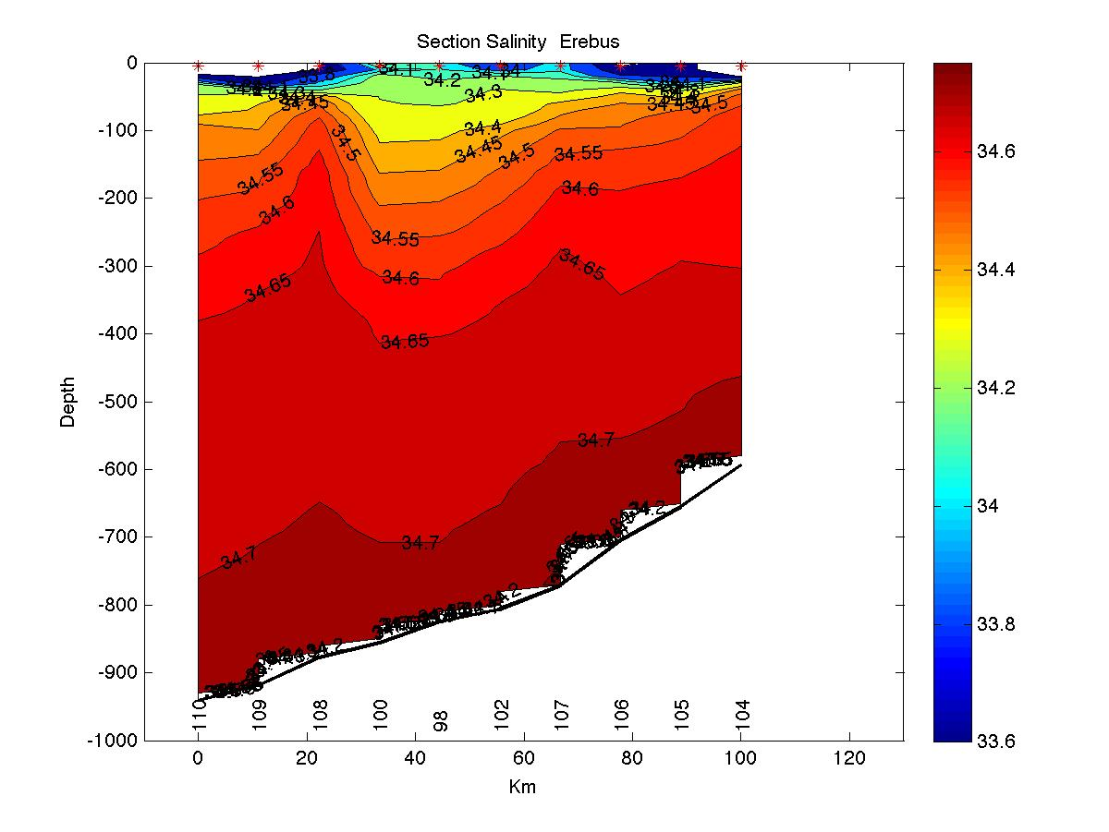
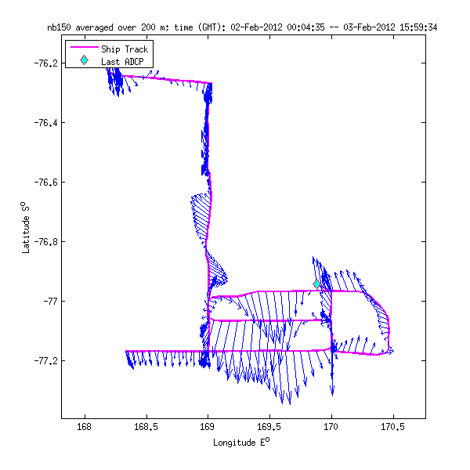
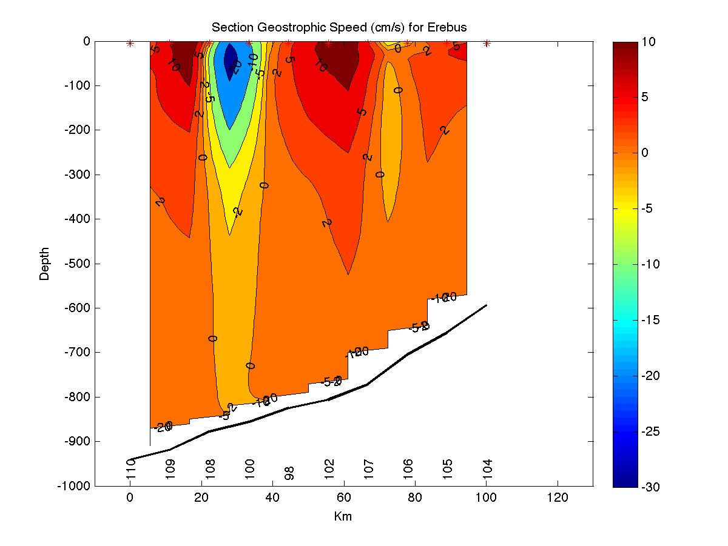
N-S Section at 169E
Salinity
Geostrophic velocity

