Slide 1
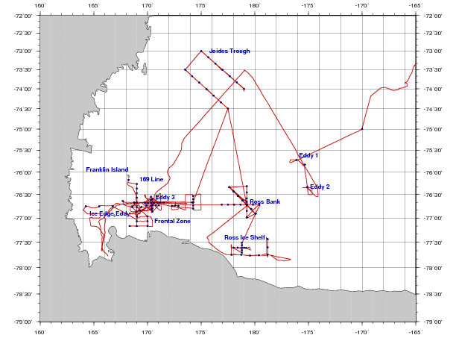
PRISM cruise track
I. ACC Sea Ice
II. Eastern Ross Sea Eddies
III. Western Ross Sea
IV. Ross Bank
V. Ross Ice Shelf
VI. Joides Trough
VII. Western Ross Sea II

Slide 2
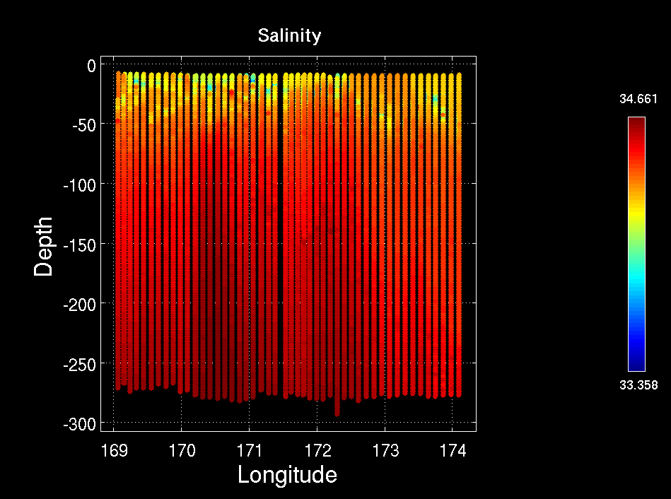
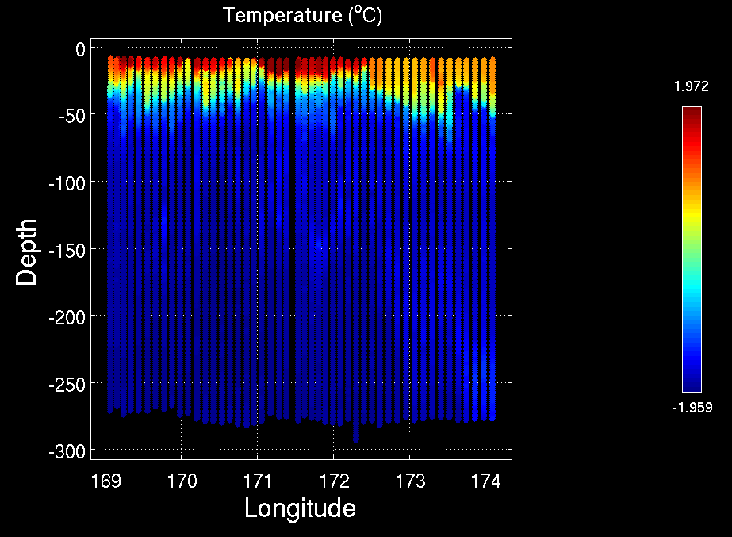
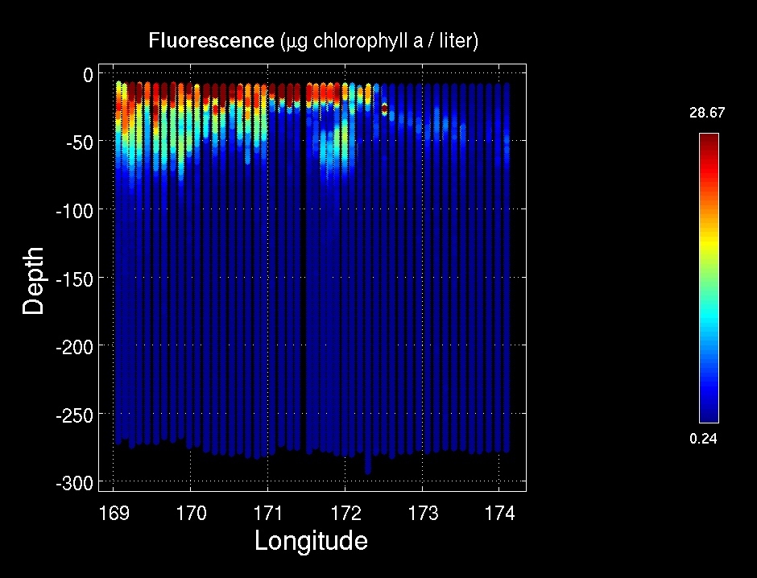
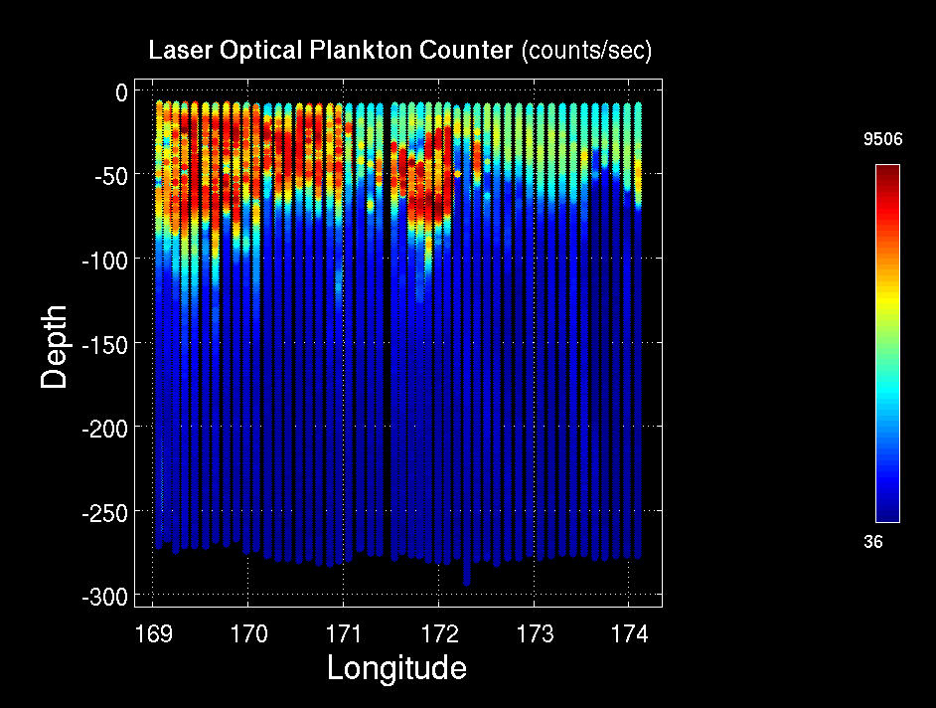
MVP Survey: Ice Edge / High Biomass / Low Biomass
Temperature
Salinity
Fluorescence
LOPC
Ice Edge HB1 LB1

Slide 3
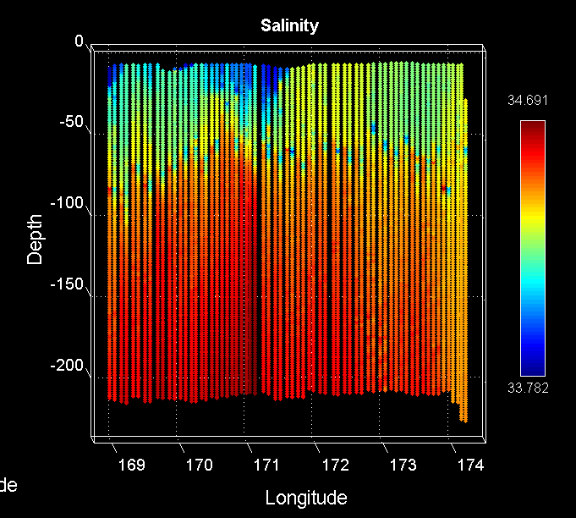
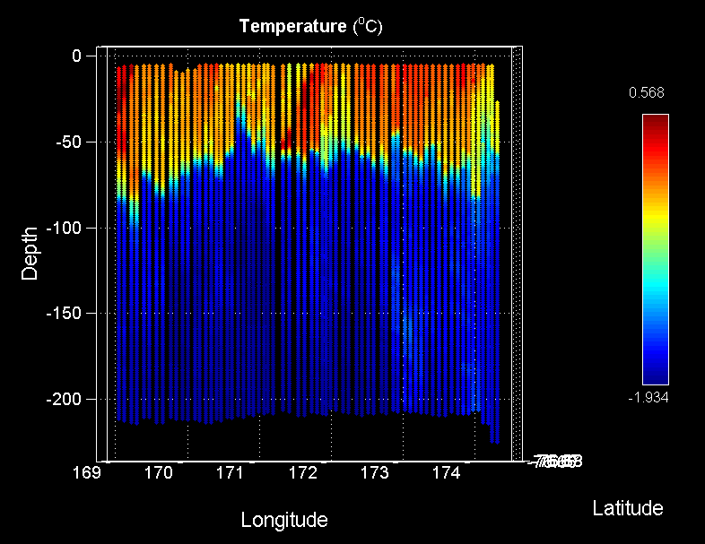
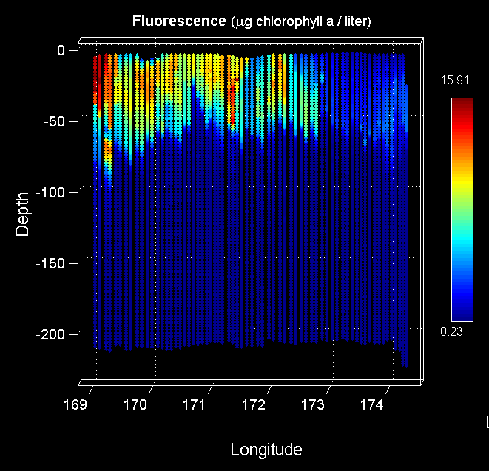
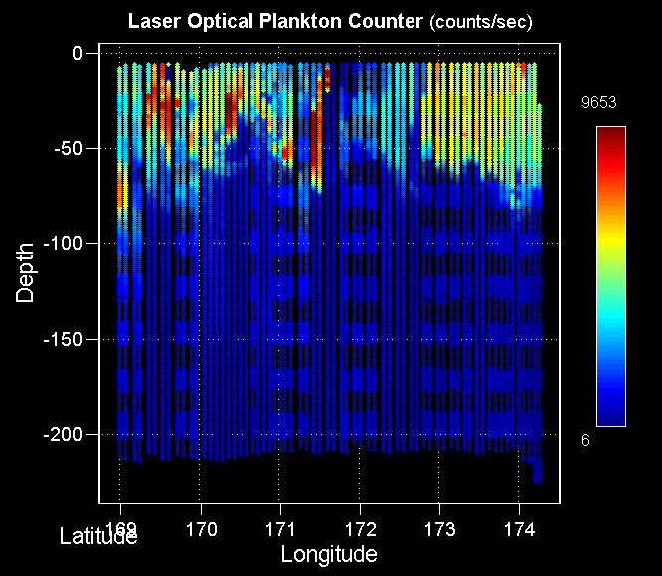
MVP Survey: Ice Edge / High Biomass / Low Biomass – 2nd
Salinity
Temperature
Fluorescence
LOPC
Ice Edge HB1 LB1

Slide 4
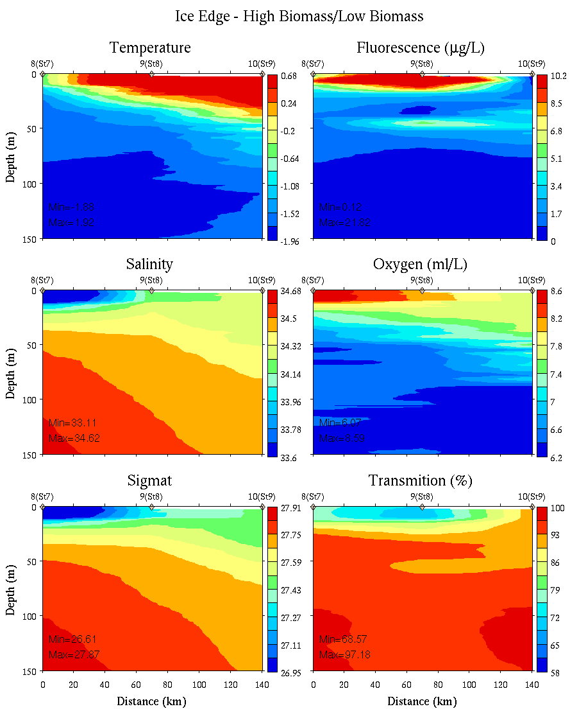
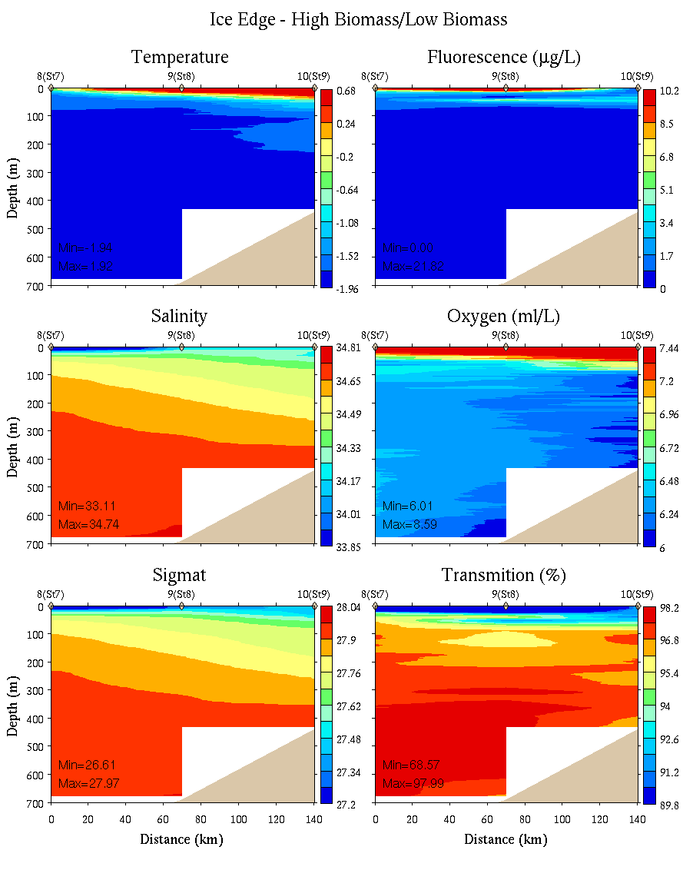
Ice Edge – High Biomass – Low Biomass
0-150m
0-700m

Slide 5
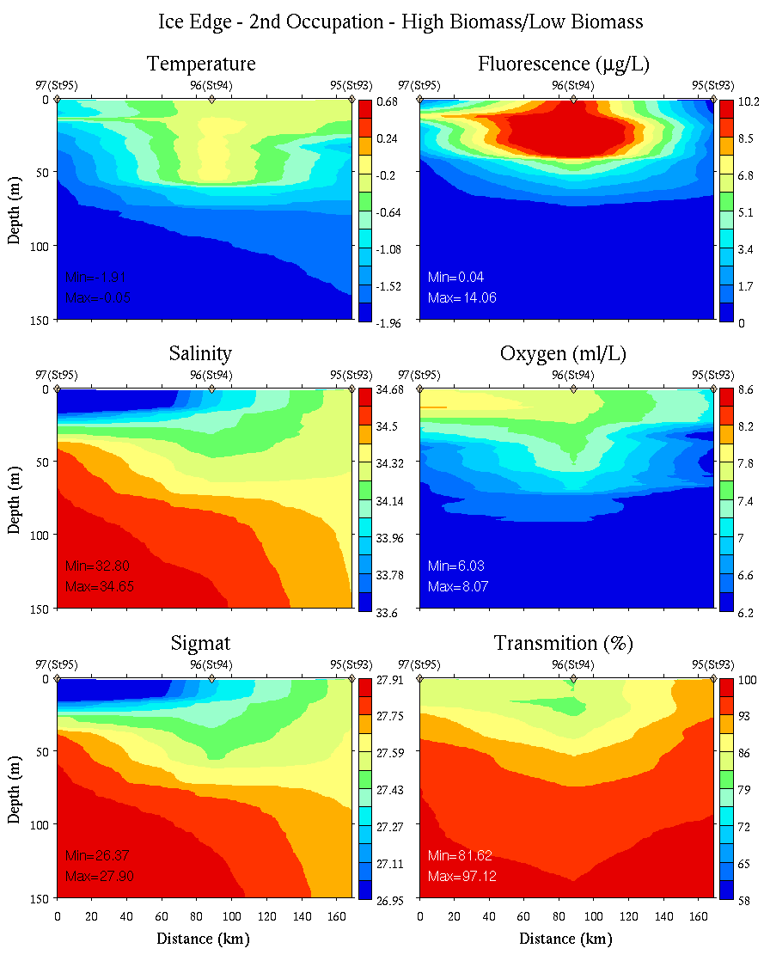
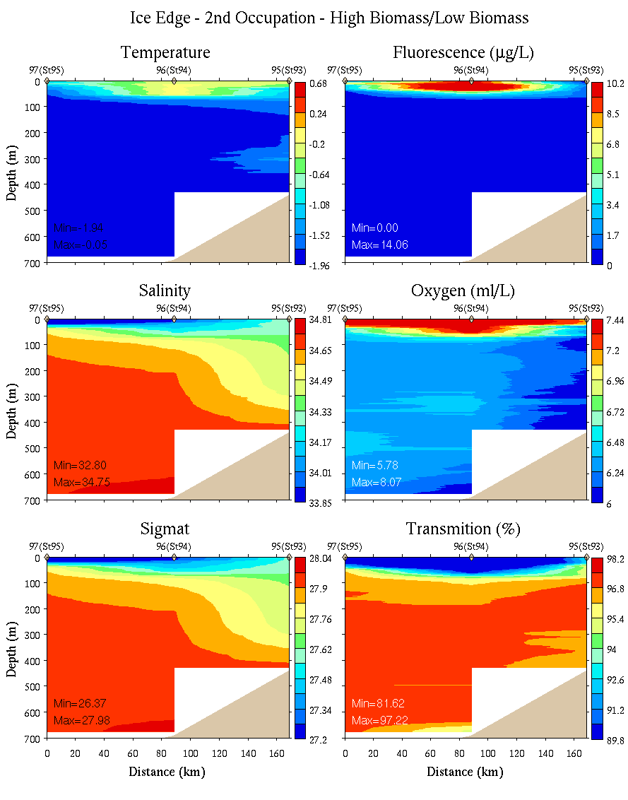
Ice Edge – High Biomass – Low Biomass: 2nd
0-150m
0-700m

Slide 6
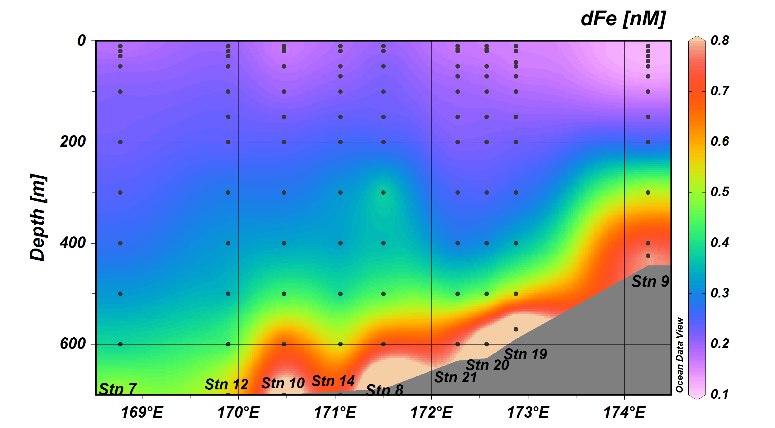
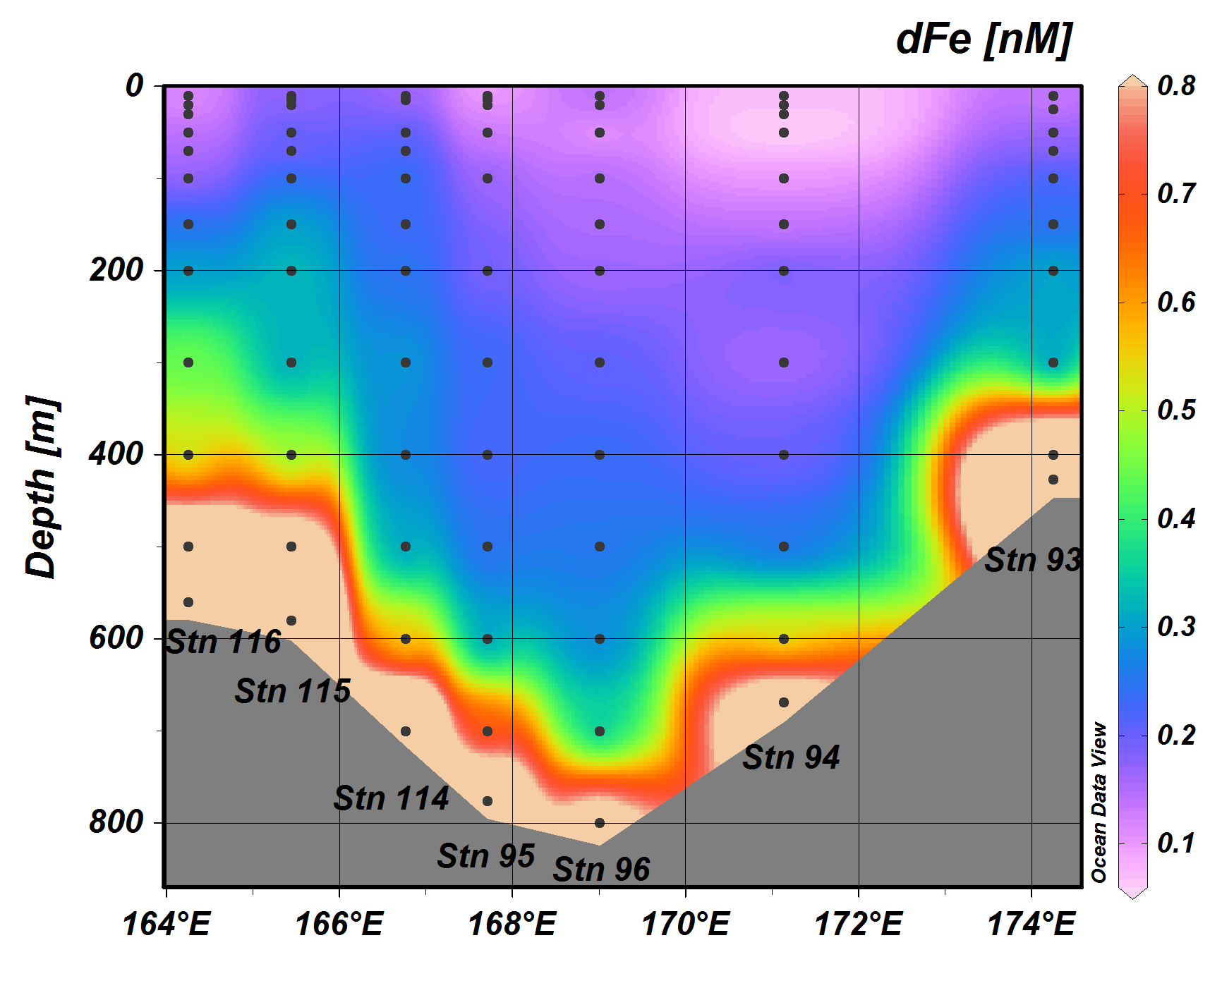
Sedwick group Fe data
Jan 11-20
Jan 30 – Feb 6

Slide 7
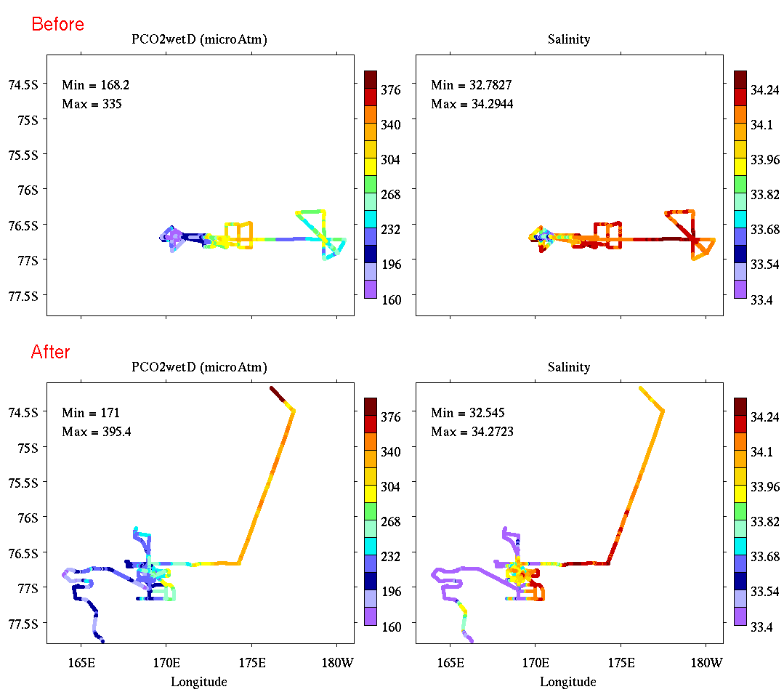
Underway pCO₂ and salinity
pCO₂
Salinity
Jan 15-20
pCO₂
Salinity
Jan 30 – Feb 6

Slide 8
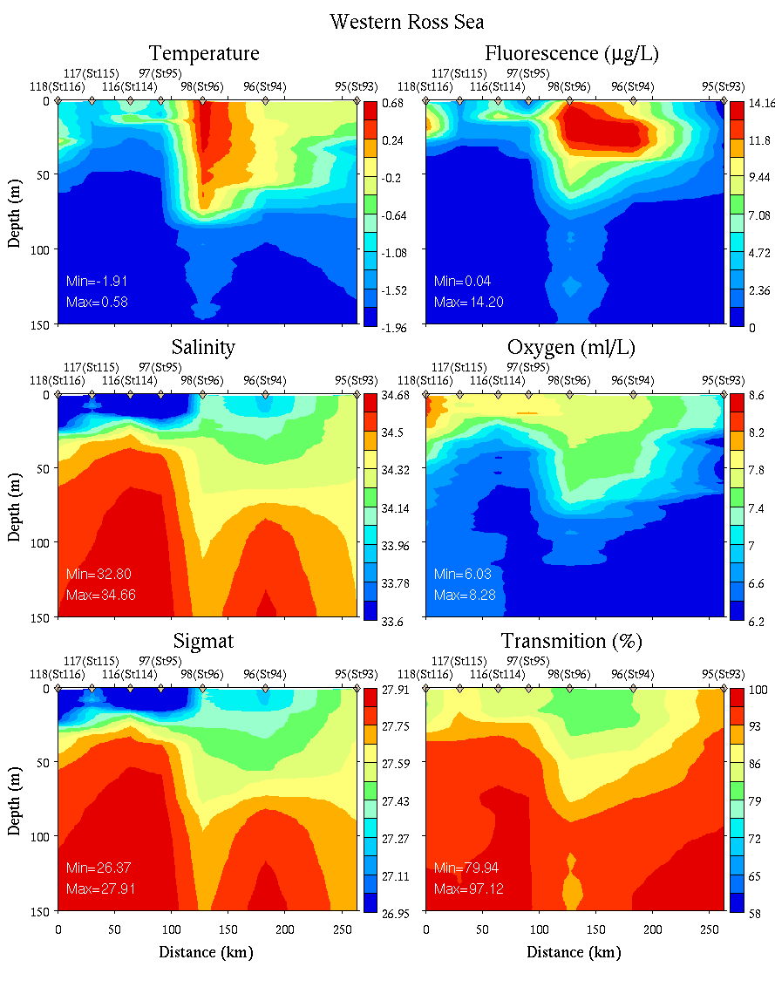
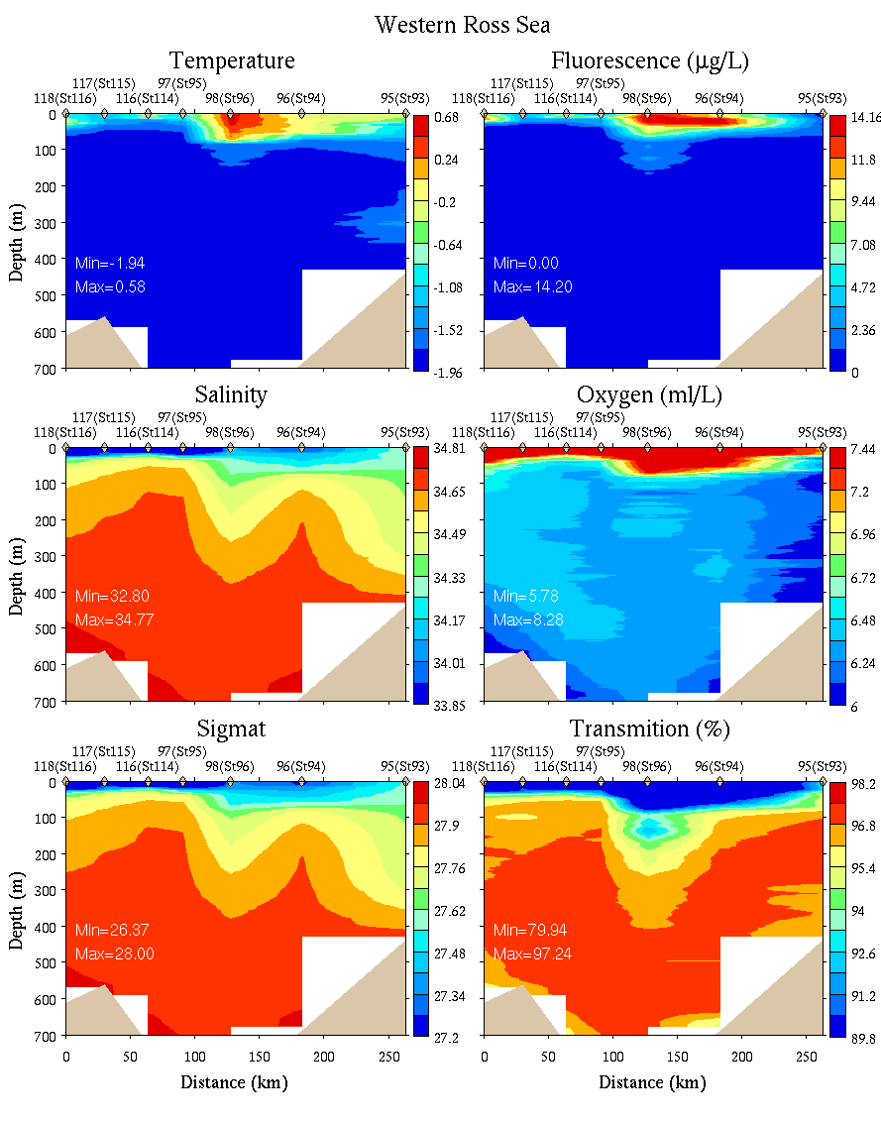
Western Ross Sea
0-150m
0-700m

Slide 9
Sedwick group Fe data
Jan 11-20
Jan 30 – Feb 6

Slide 10
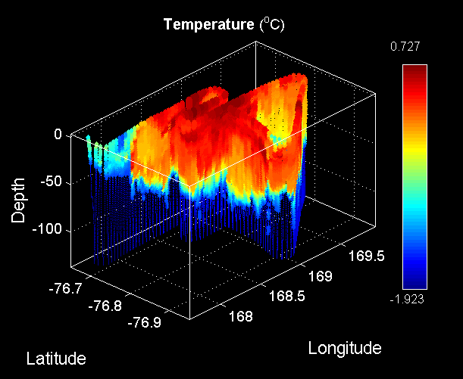
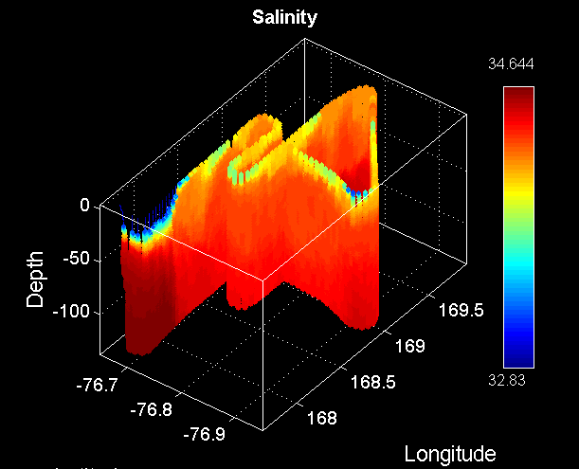
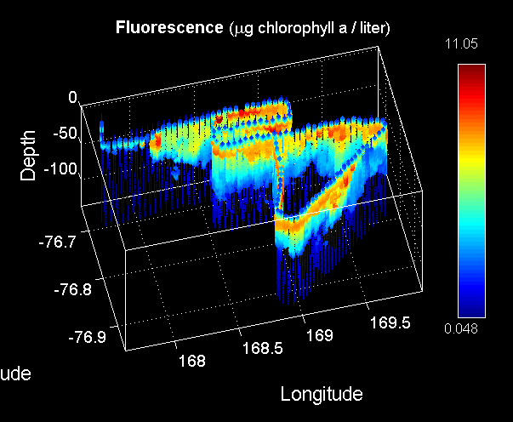
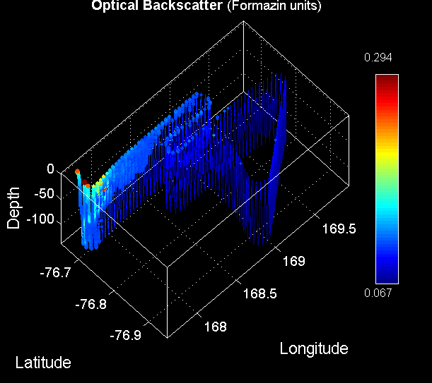
Ice Edge Eddy VPR Survey (VPR11)
Temperature
Salinity
Fluorescence
Backscatter

Slide 11
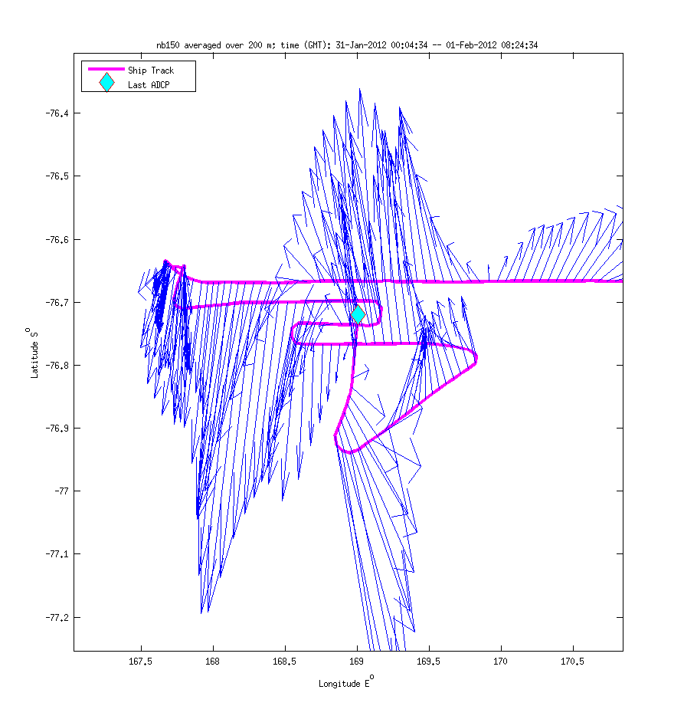
Ice Edge Eddy ADCP Survey
Anticyclone #2

Slide 12
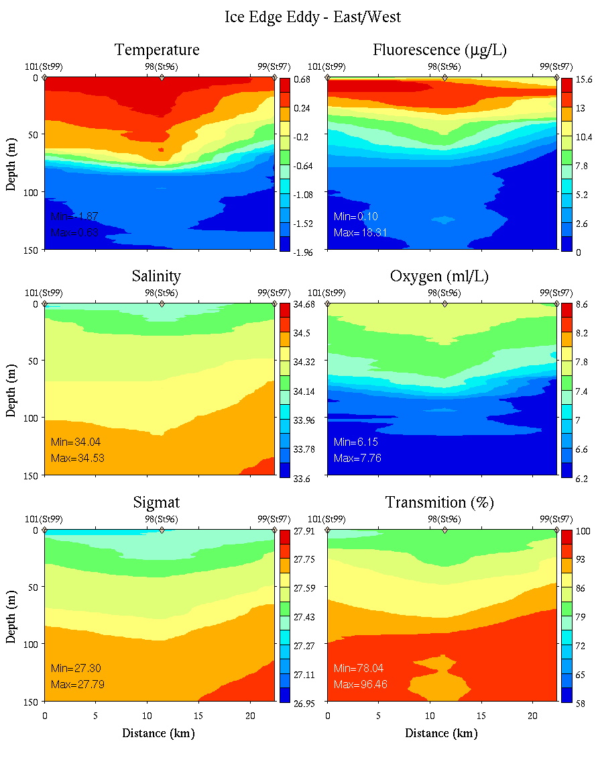
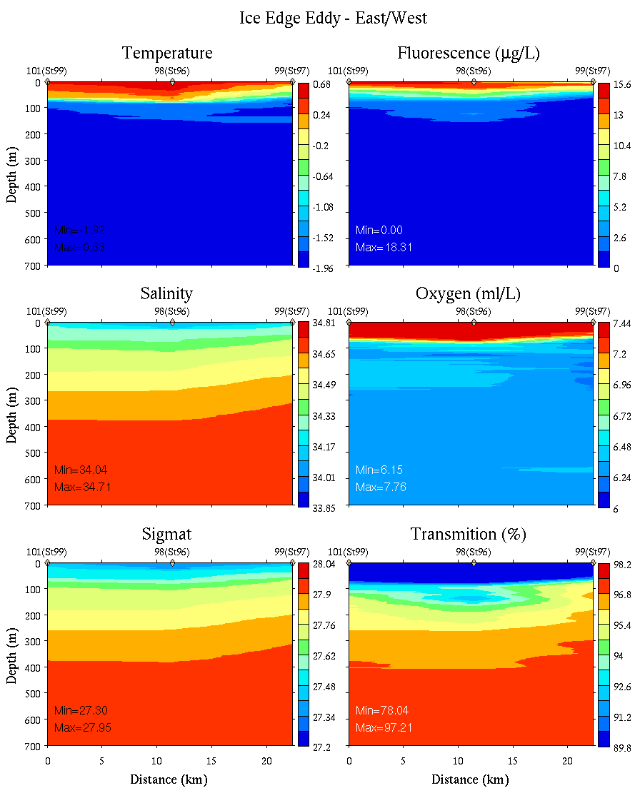
Ice Edge Eddy: East-West
0-150m
0-700m

Slide 13
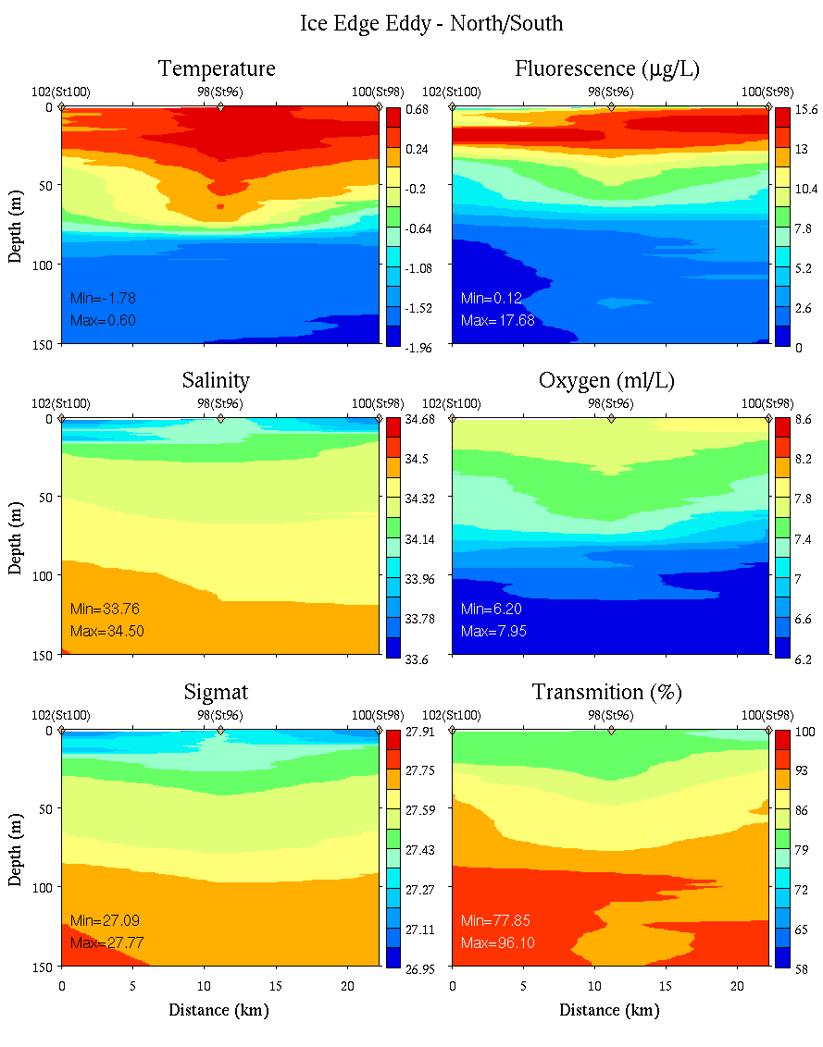
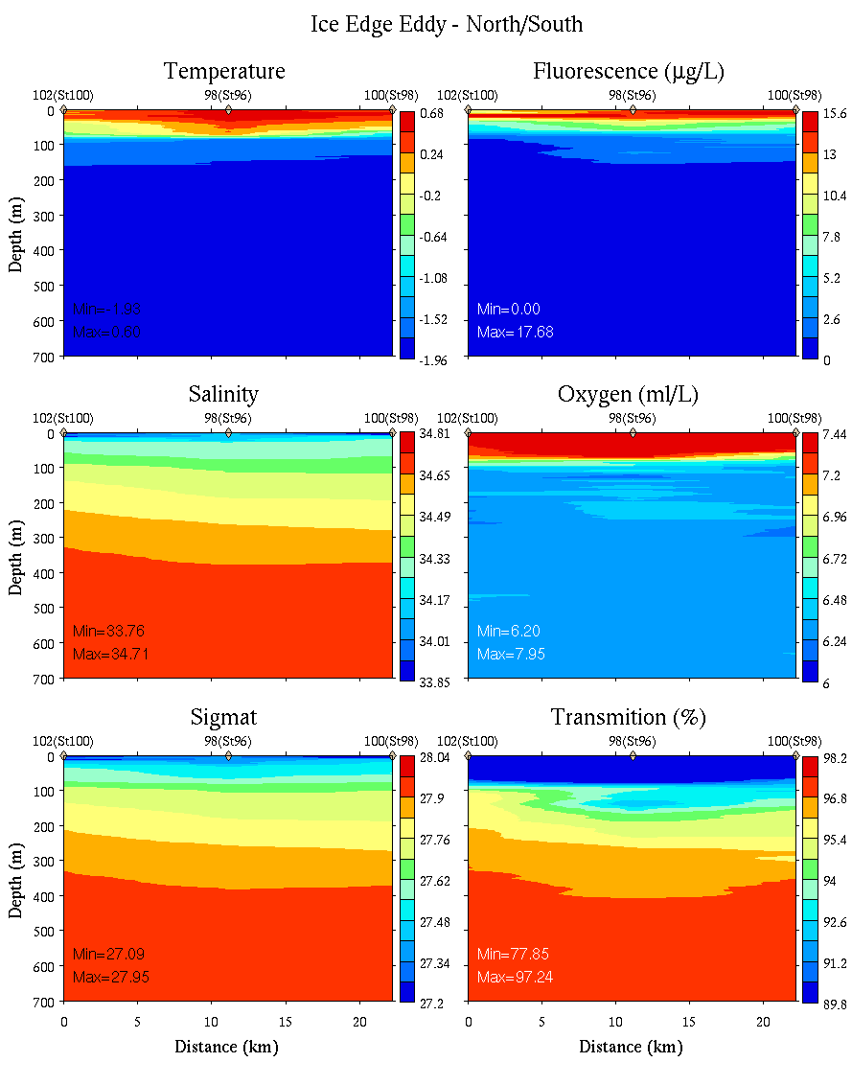
Ice Edge Eddy: North-South
0-150m
0-700m

Slide 14
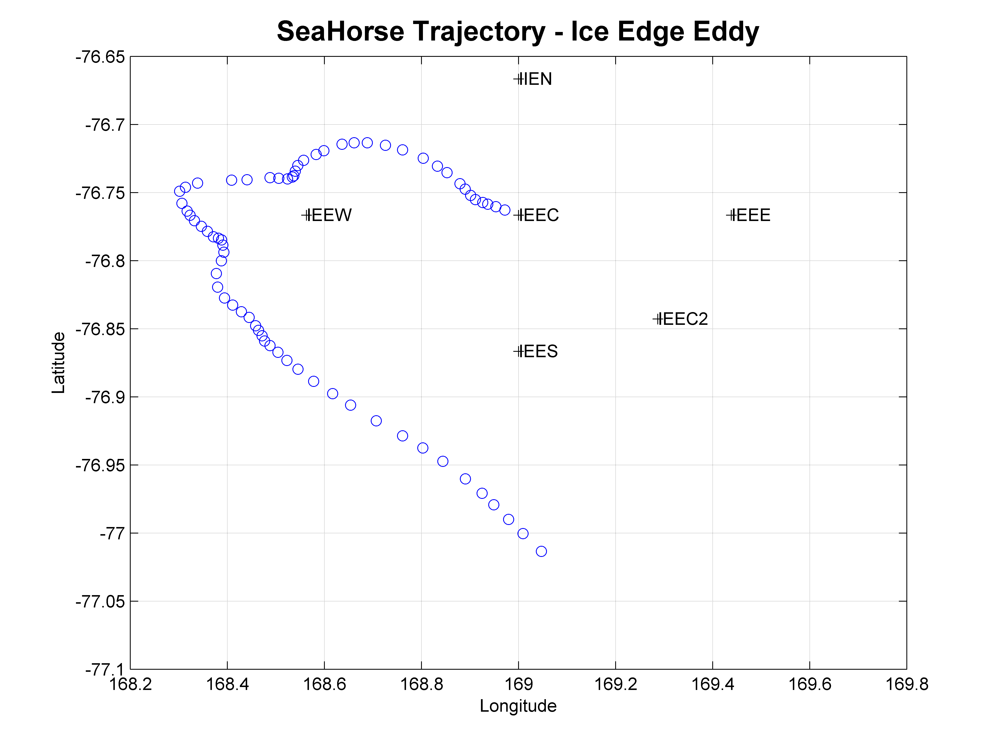
Ice Edge Eddy SeaHorse Deployment
Temperature
Chlorophyll
Salinity
Oxygen

Slide 15
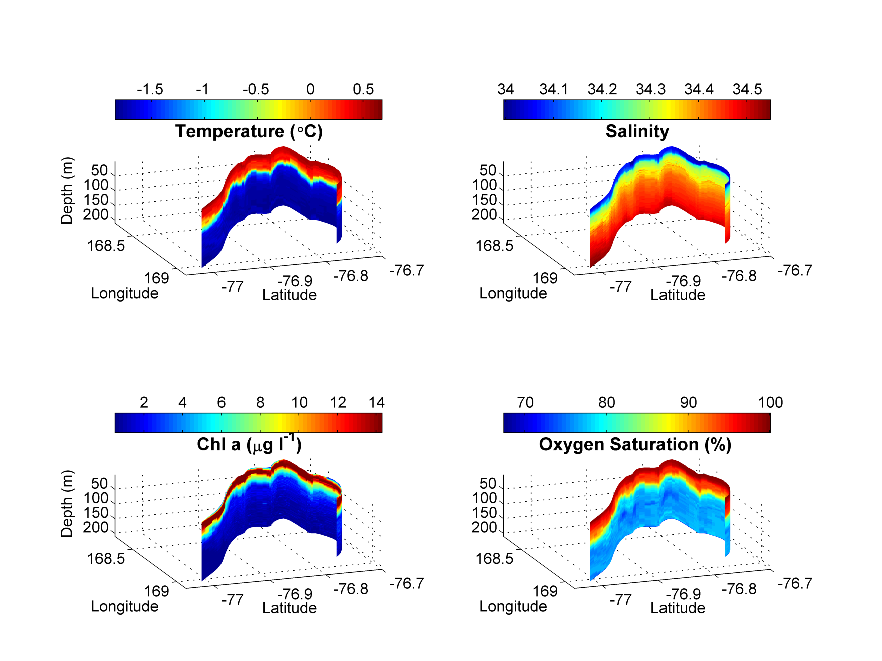
Ice Edge Eddy SeaHorse Deployment
Temperature
Chlorophyll
Salinity
Oxygen

Slide 16
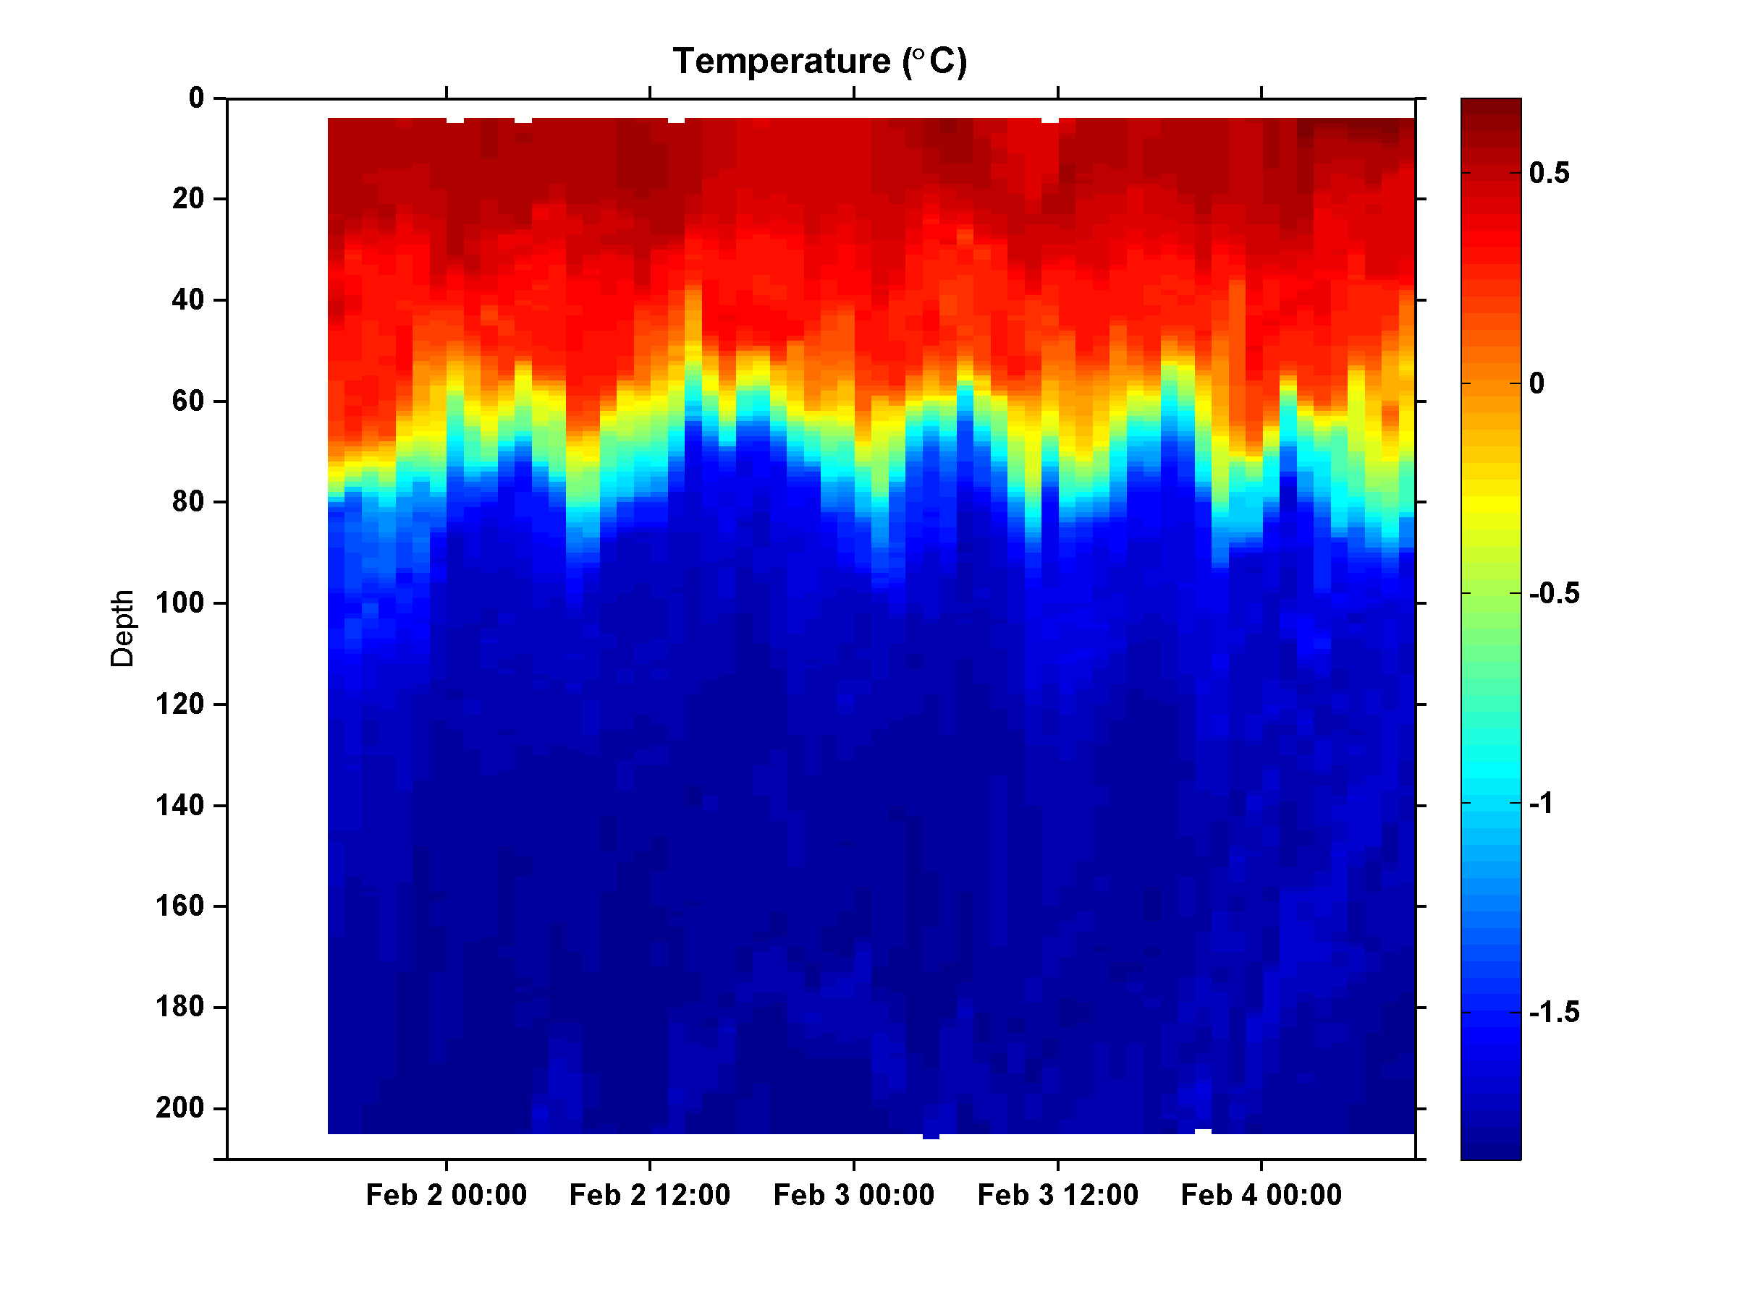
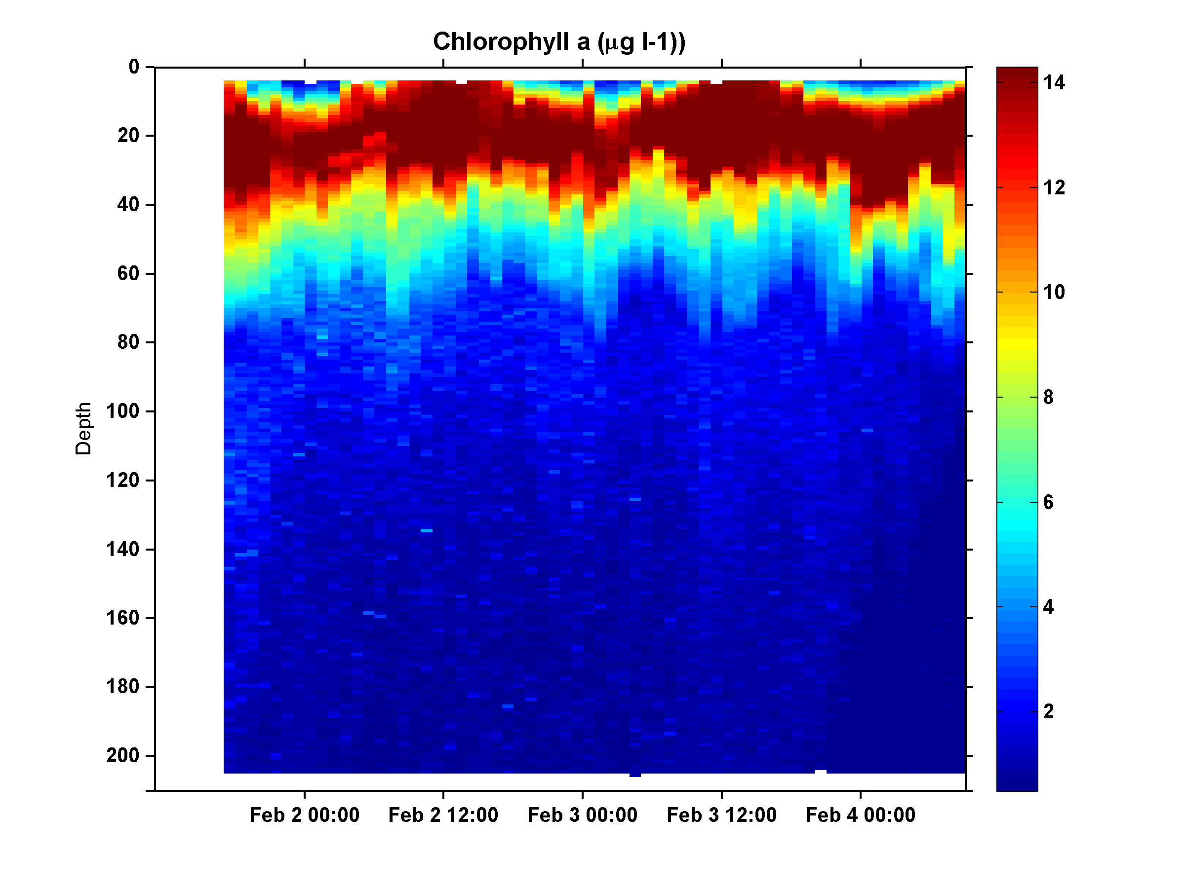
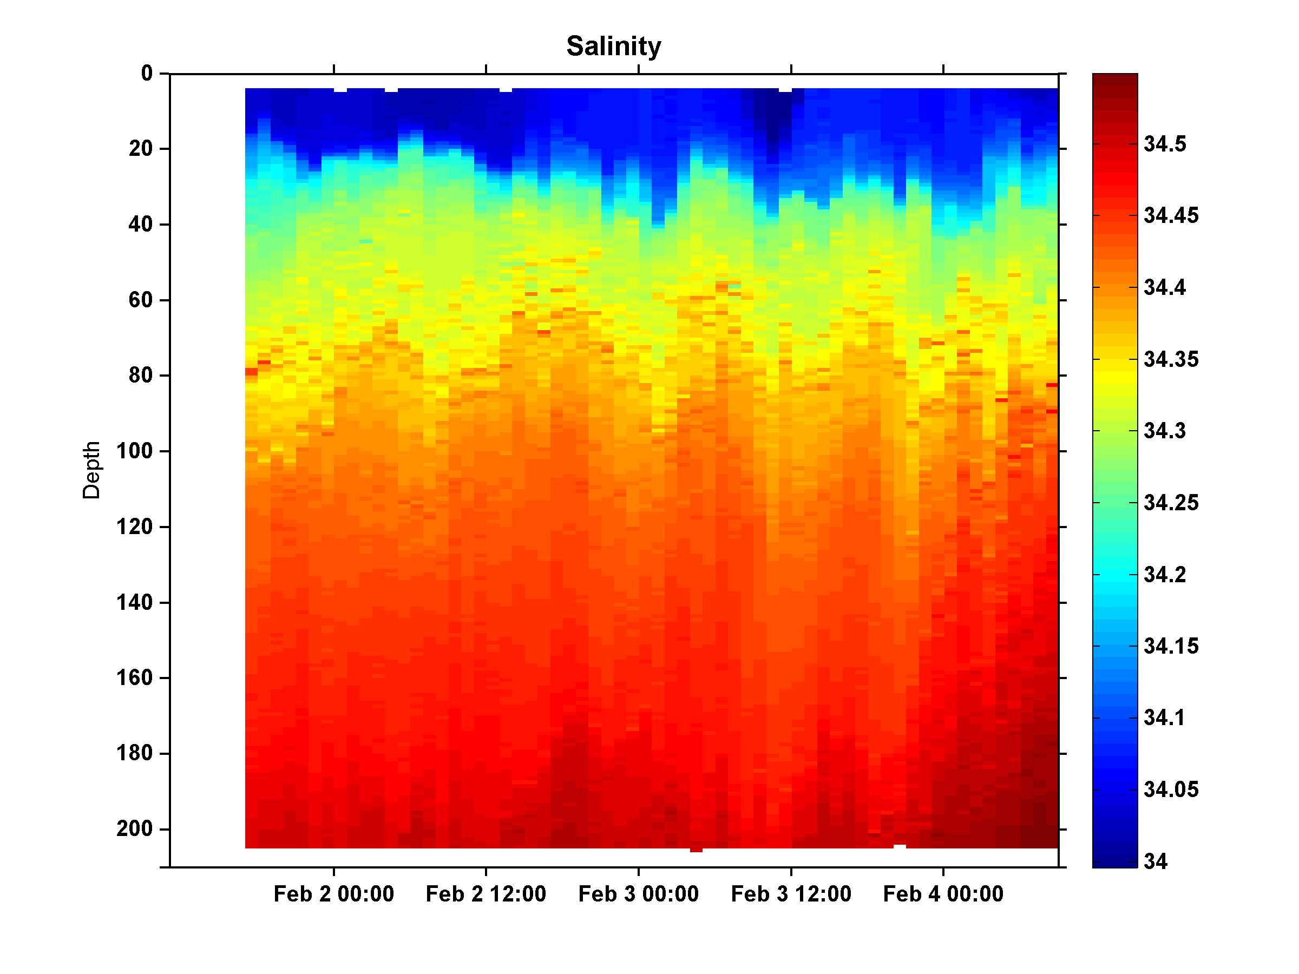
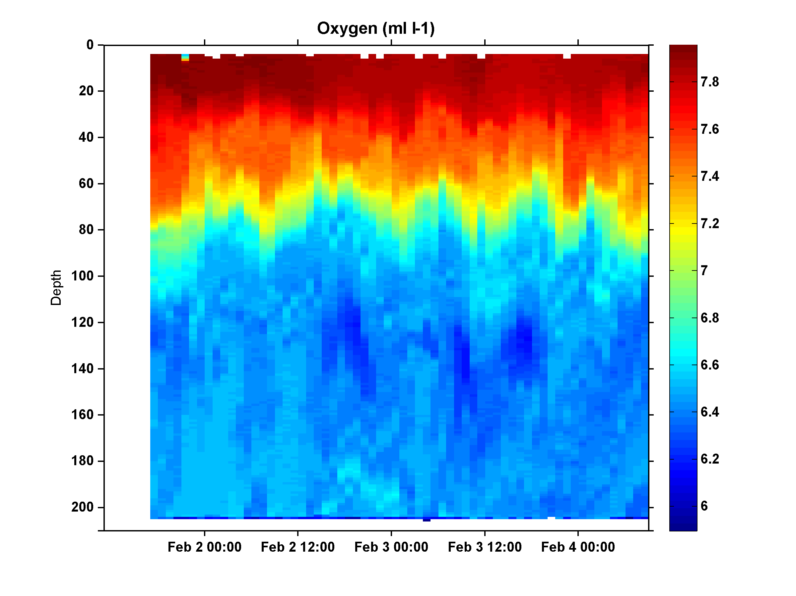
Ice Edge Eddy SeaHorse Deployment
Temperature
Chlorophyll
Salinity
Oxygen

Slide 17
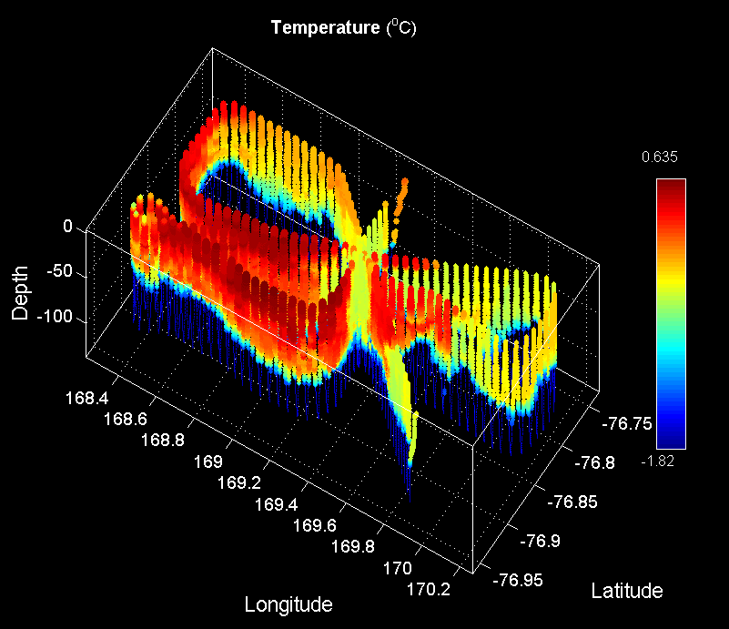
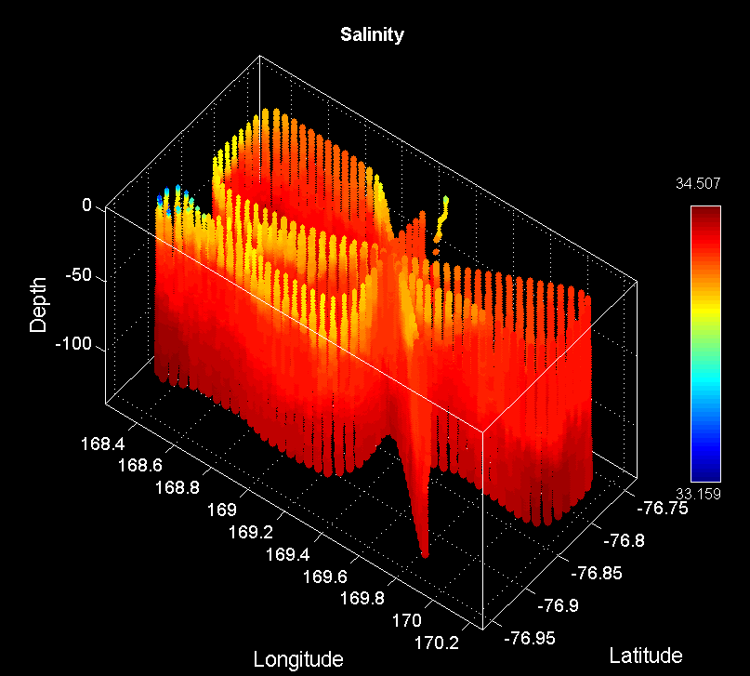
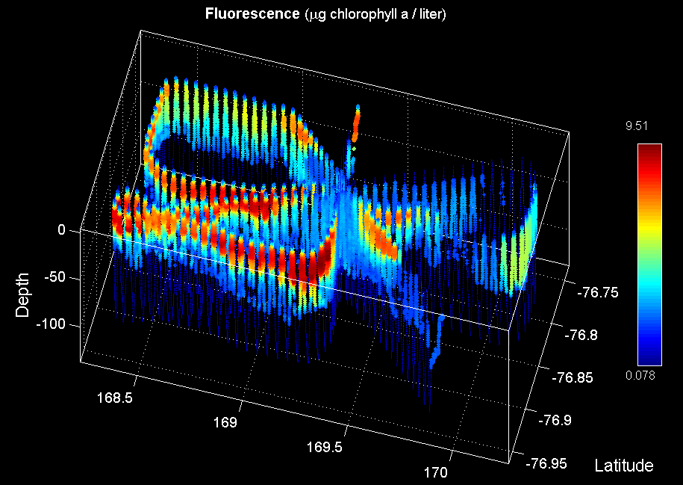
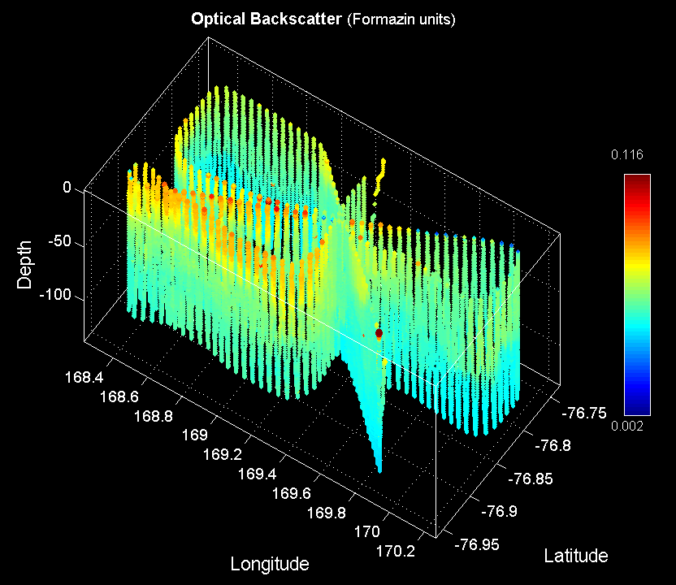
Ice Edge Eddy VPR Survey (VPR13)
Temperature
Salinity
Fluorescence
Backscatter
W,F,H
C,S,L

Slide 18
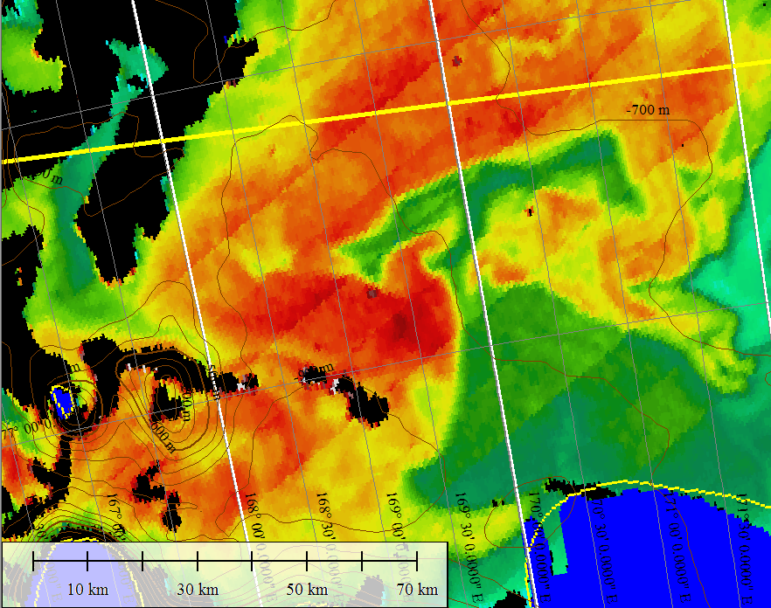
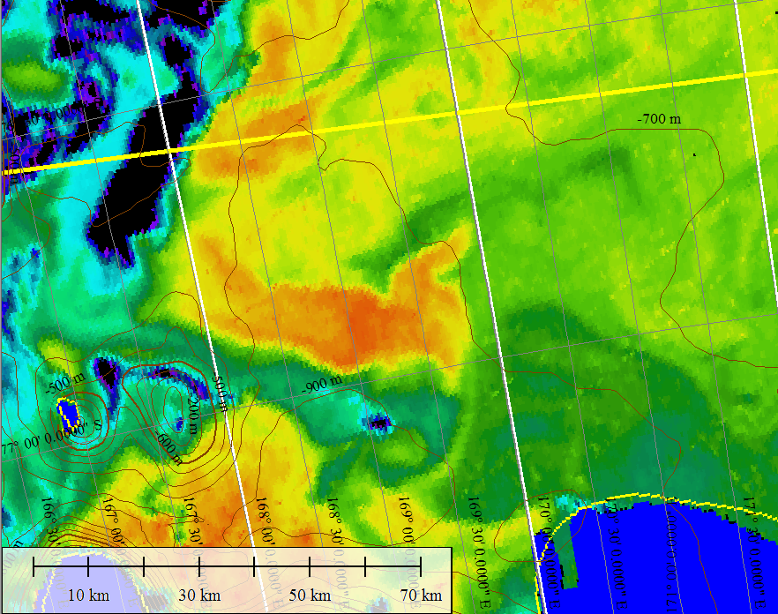
Ice Edge Eddy – Feb 4 MODIS
Chlorophyll
SST
Eddy center
Eddy center

Slide 19
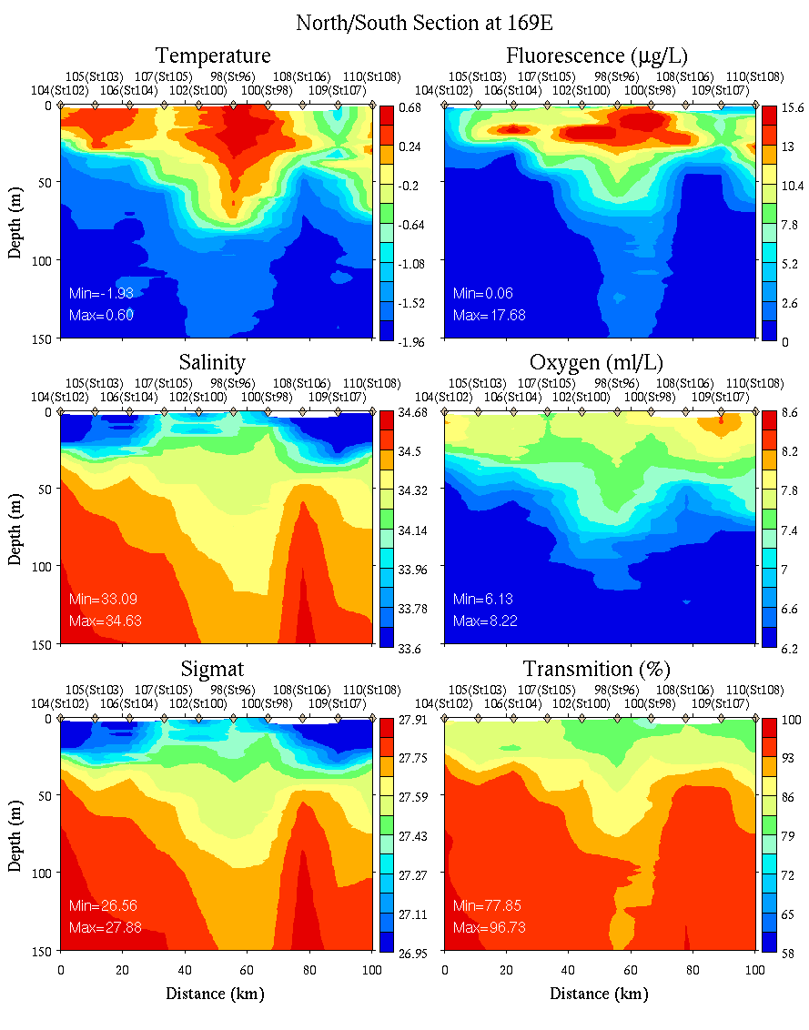
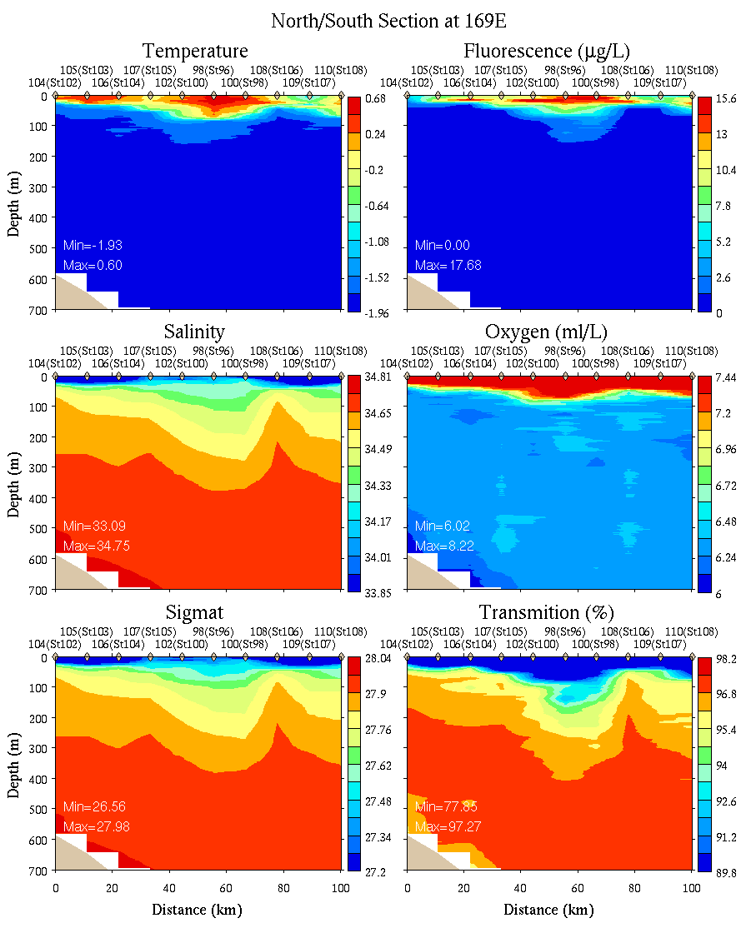
N-S Section at 169E
0-150m
0-700m

Slide 20
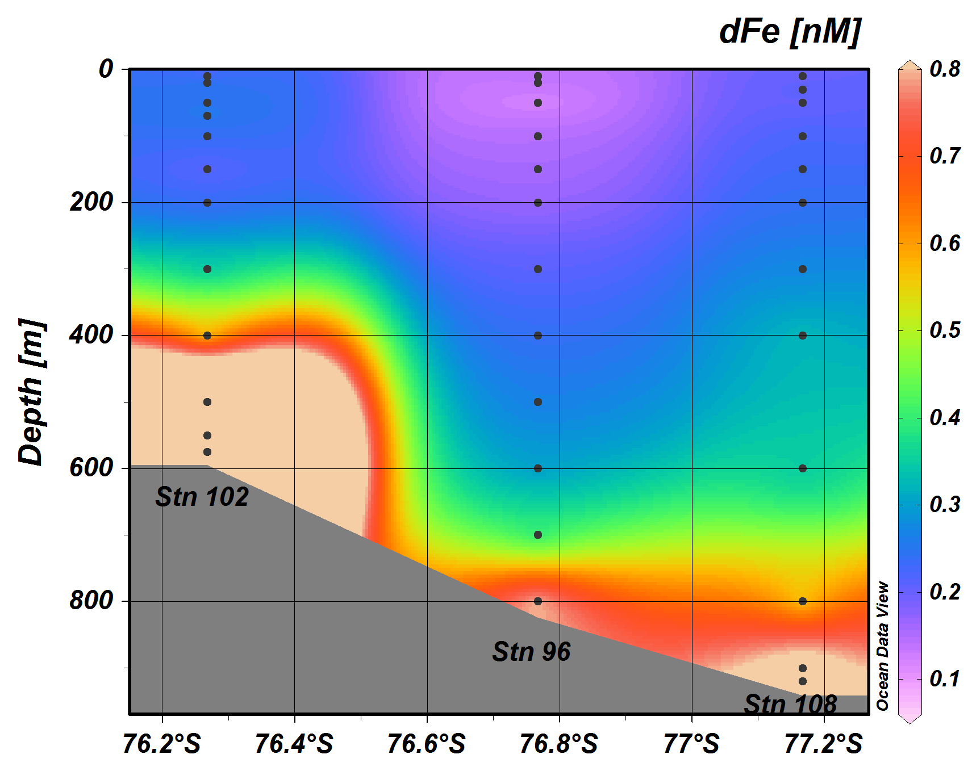
North-South Section at 169E
0-700m
Sedwick et al. Fe data

Slide 21
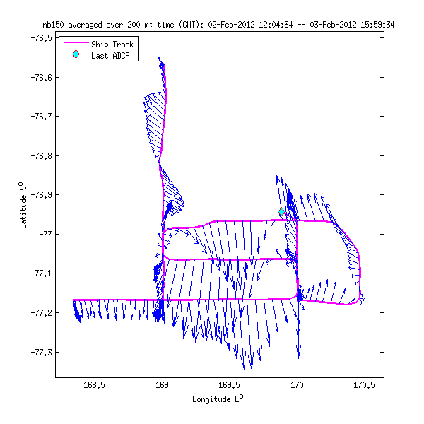
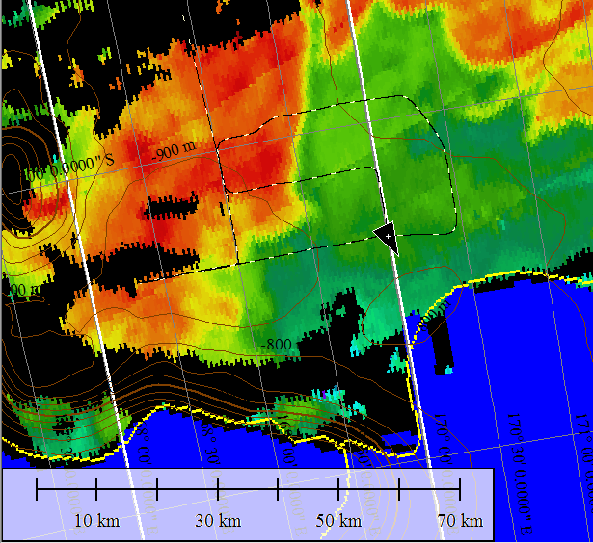
VPR Frontal Survey Feb 3
MODIS Feb 1
112
106
111
107
109
110
108

Slide 22
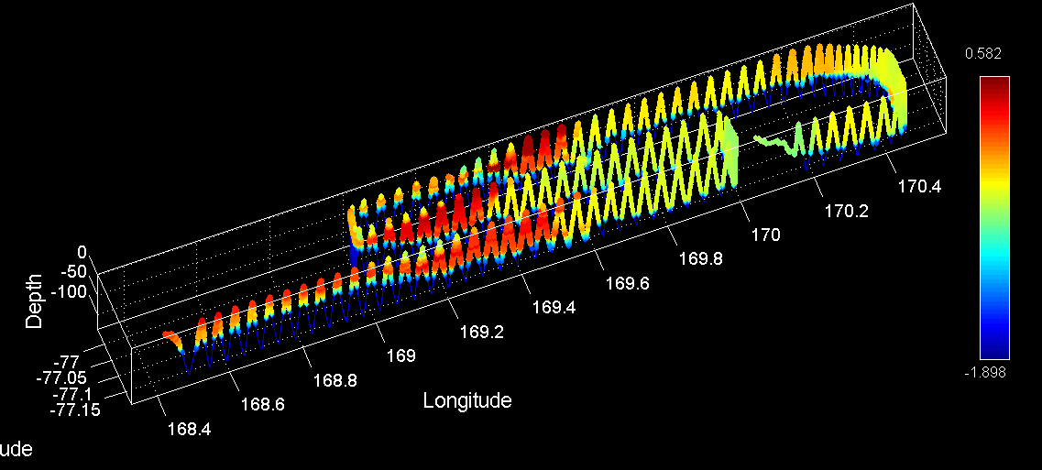
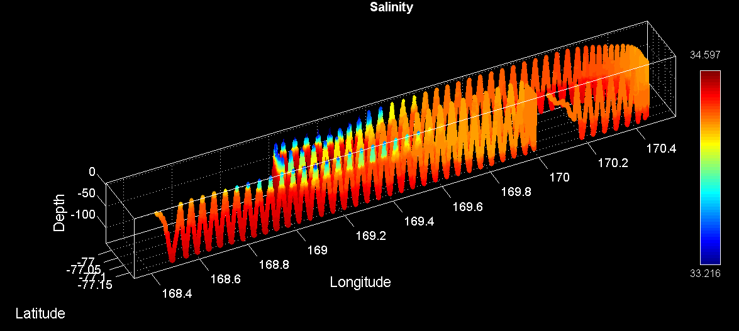
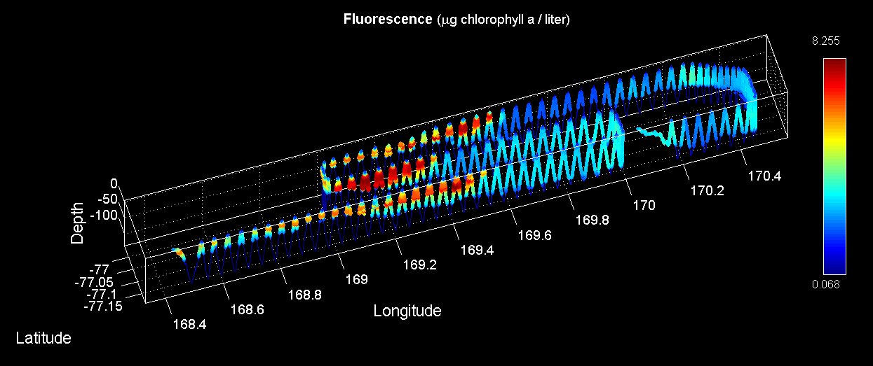
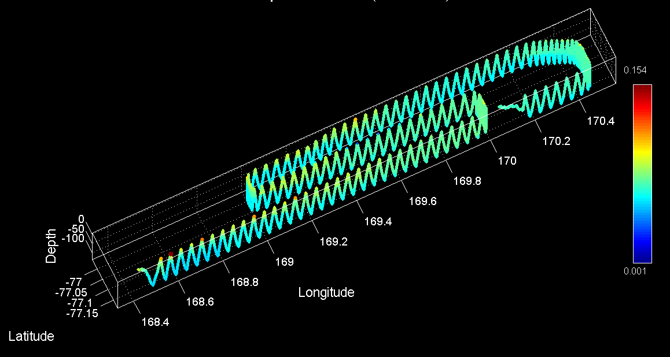
Frontal Area VPR Survey (VPR12)
Temperature
Salinity
Fluorescence
Backscatter

Slide 23
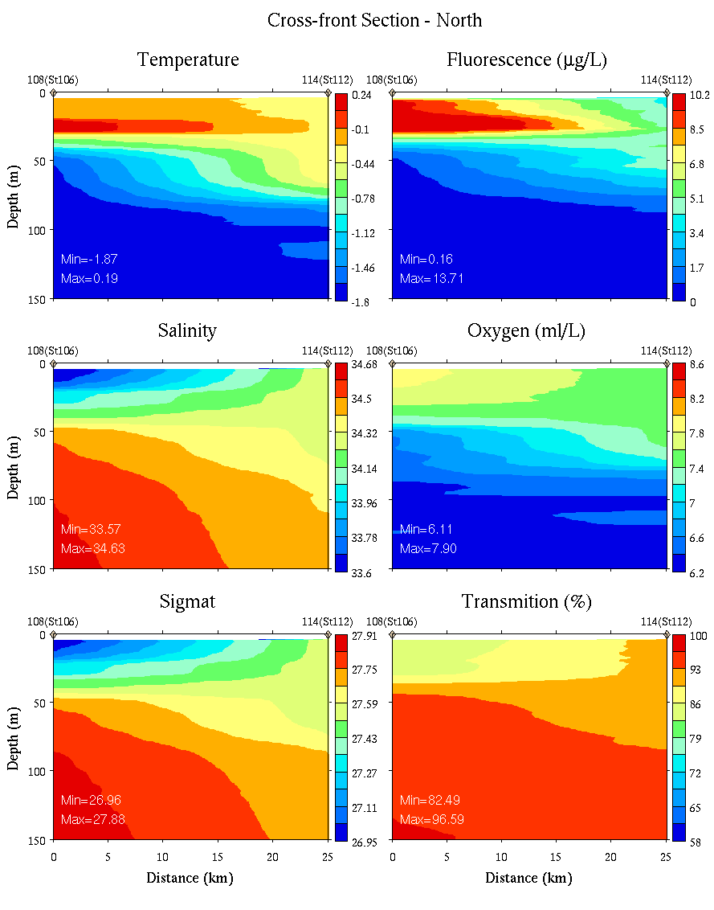
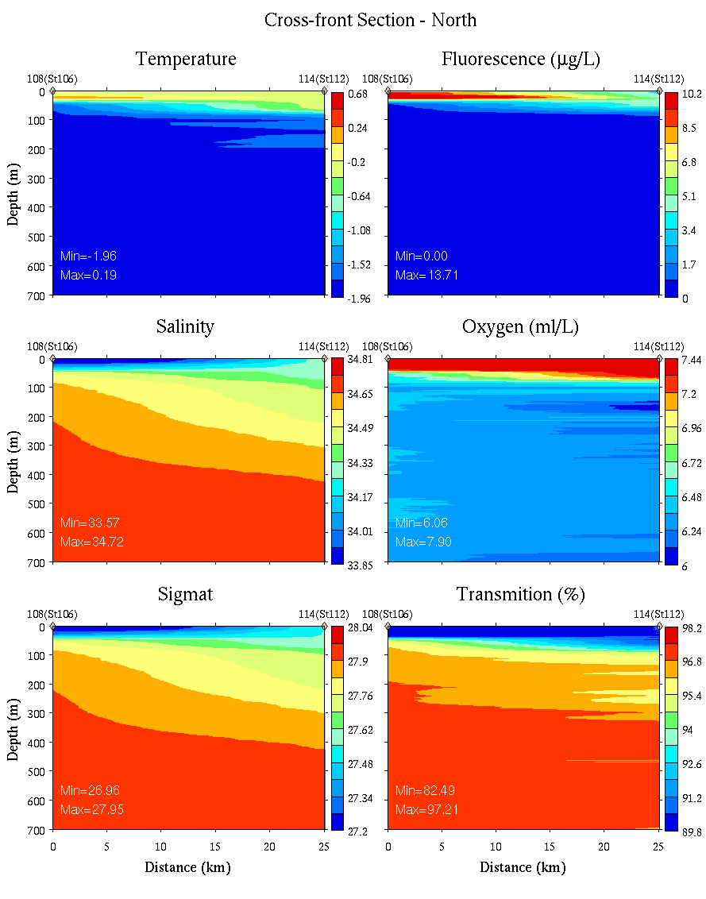
Front - North
0-150m
0-700m

Slide 24


Front - middle
0-150m
0-700m

Slide 25


Front - South
0-150m
0-700m

Slide 26


N-S Section at 170E
0-150m
0-700m

Slide 27

Western Ross Sea – McMurdo Sound
VPR Survey trackline overlayed on Feb 4 MODIS image

Slide 28




Western Ross Sea – McMurdo Sound
VPR Survey (VPR14-15)
Temperature
Salinity
Fluorescence
Backscatter

Slide 29

And now for the exciting conclusion of the mystery of the planktonic beans…

Slide 30



Eddy 2
Outside Eddy
Inside
Eddy
Density
Phaeocystis colonies
“Kidney beans”

Slide 31

Images from dissecting scope
16x, 1mm
16x
16x
40x
16x, 1mm

Slide 32

High (Hai) magnification image of bean from St. 96, 100/120m pooled sample

Slide 33
Gut content analysis (Hai)
Hoop net, station 113
Ice Edge Eddy Center
Krill – empty
Pteropod – empty
Amphipod – lots of diatoms

Slide 34
PRISM cruise track
I. ACC Sea Ice
II. Eastern Ross Sea Eddies
III. Western Ross Sea
IV. Ross Bank
V. Ross Ice Shelf
VI. Joides Trough
VII. Western Ross Sea II

Slide 35

Short Term Experiment Locations

Slide 36
Long-Term: Incubation Experiment 1 – Eddy 2

Slide 37
Long-Term: Incubation Experiment 2 – Ross Bank

Slide 38
Long-Term: Incubation Experiment 3 – Ross Ice Shelf

