Slide 1
Science Meeting 2/5/12

Slide 2
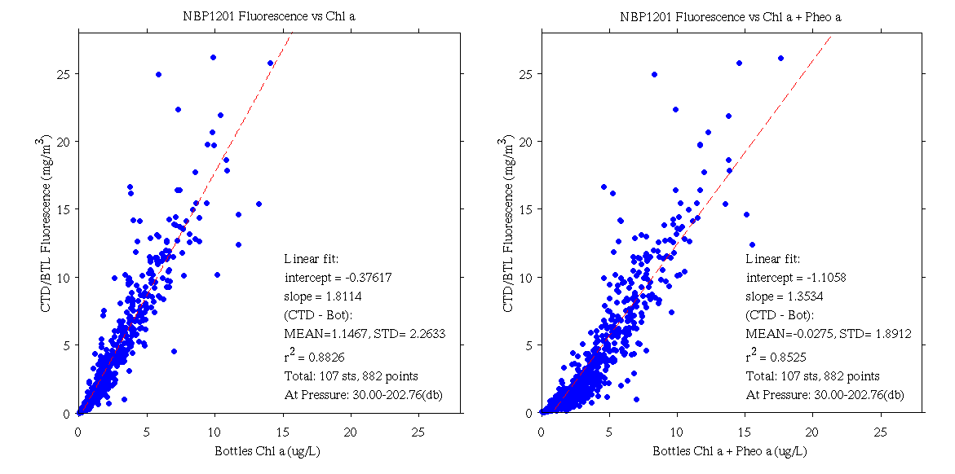
Extracted Chl versus CTD Fluorometer

Slide 3
Joides Trough

Slide 4
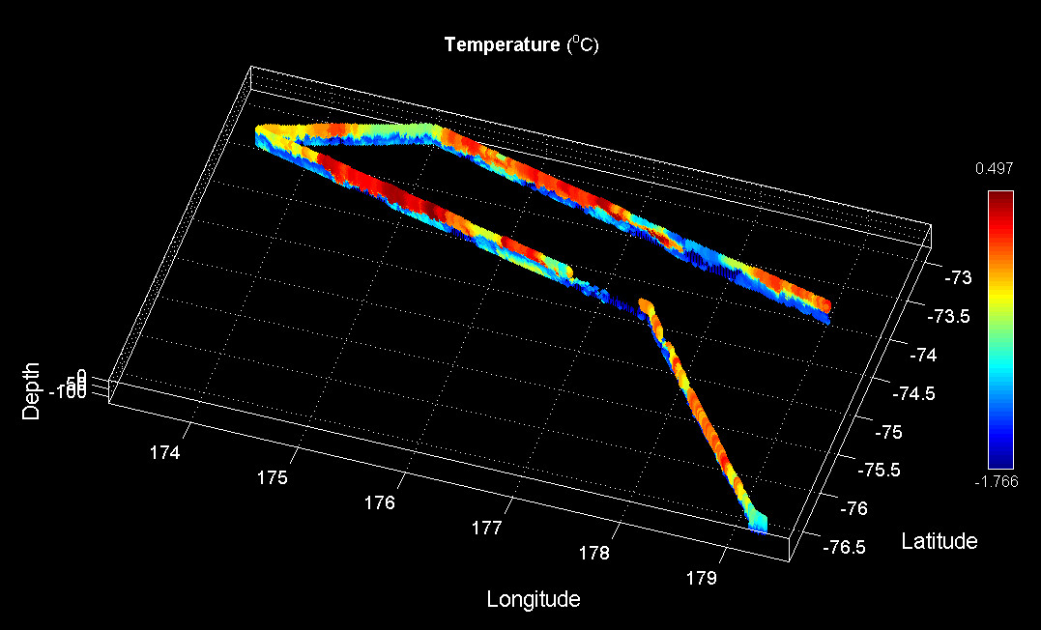
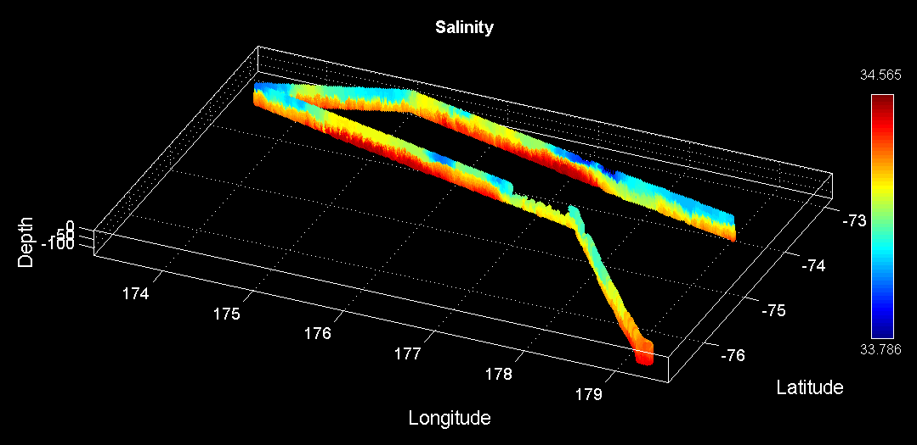
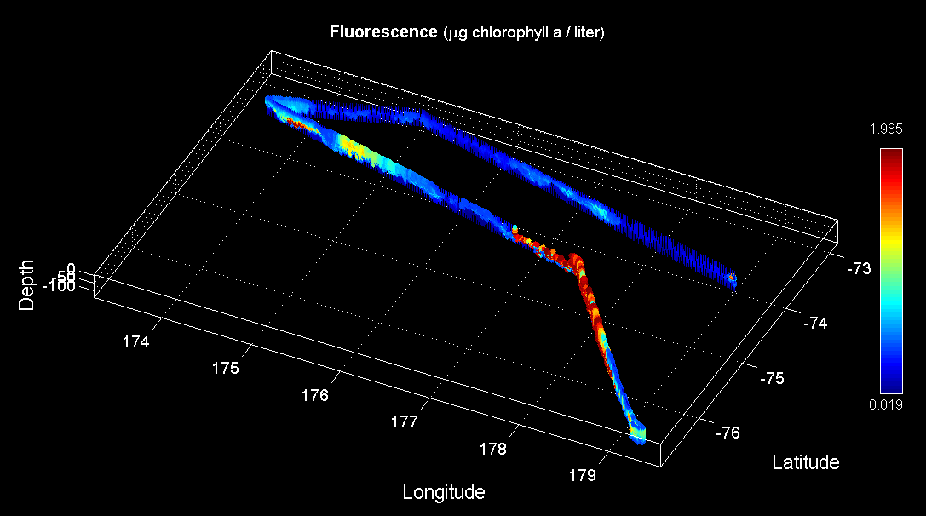
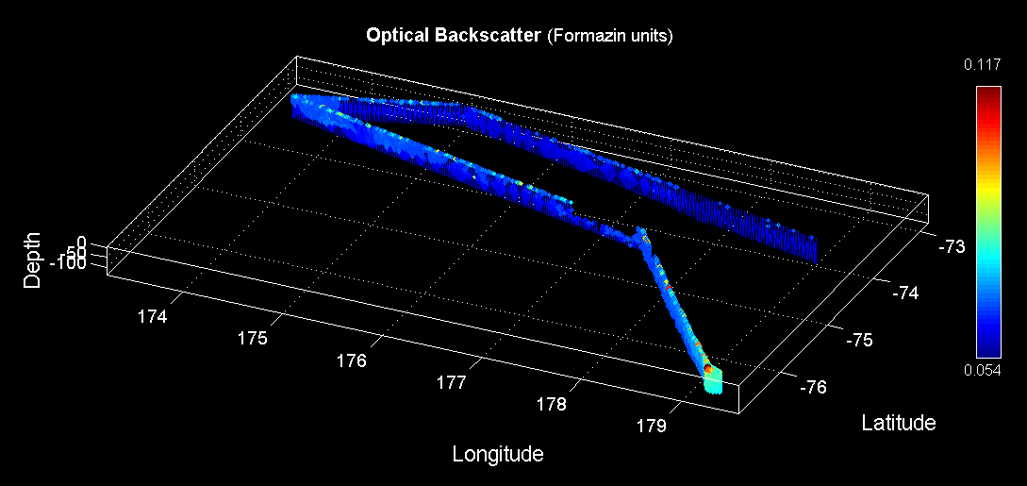
Ross Bank – Pennell Bank – Joides Trough – Mawson Bank VPR Survey (VPR10)
Temperature
Salinity
Fluorescence
Backscatter

Slide 5
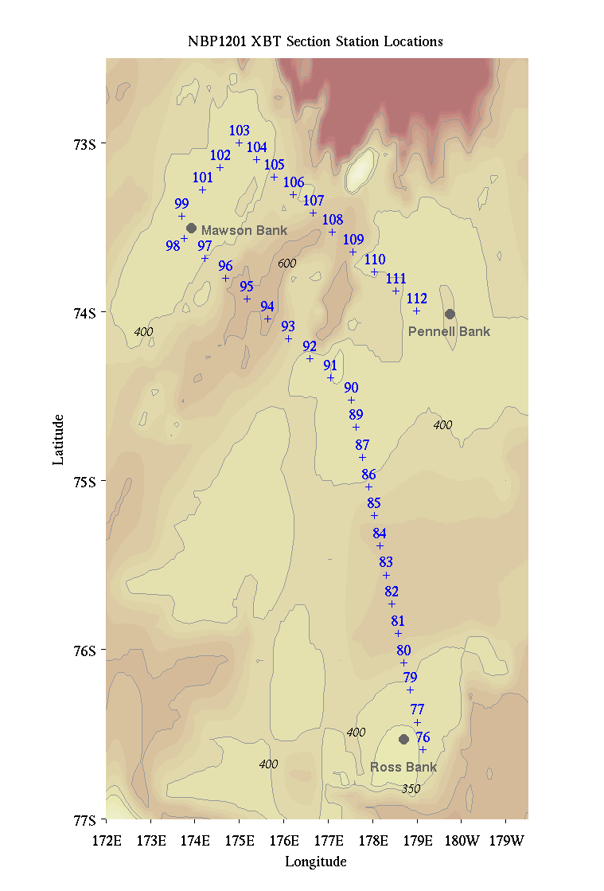
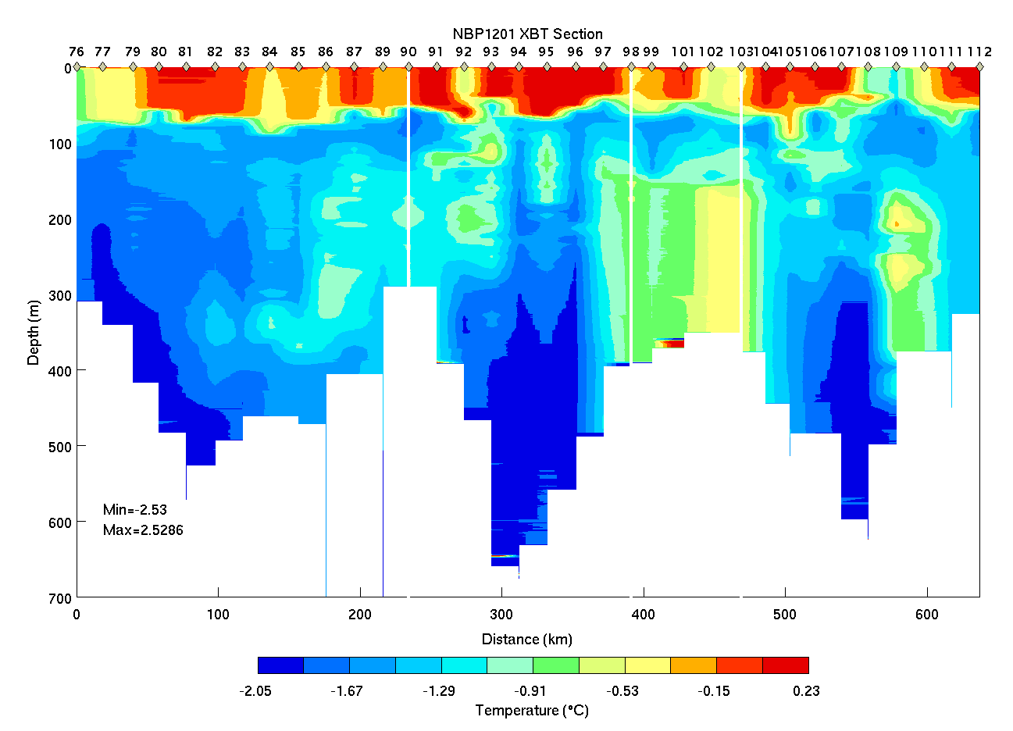
Ross Bank – Pennell Bank – Joides Trough – Mawson Bank XBT section
Ross Pennell Mawson Pennell

Slide 6
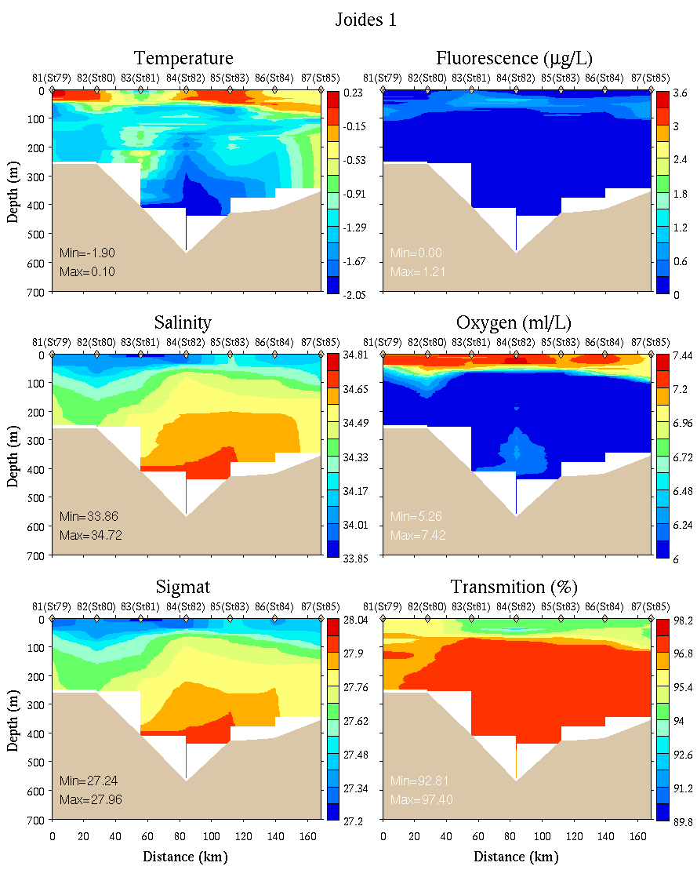
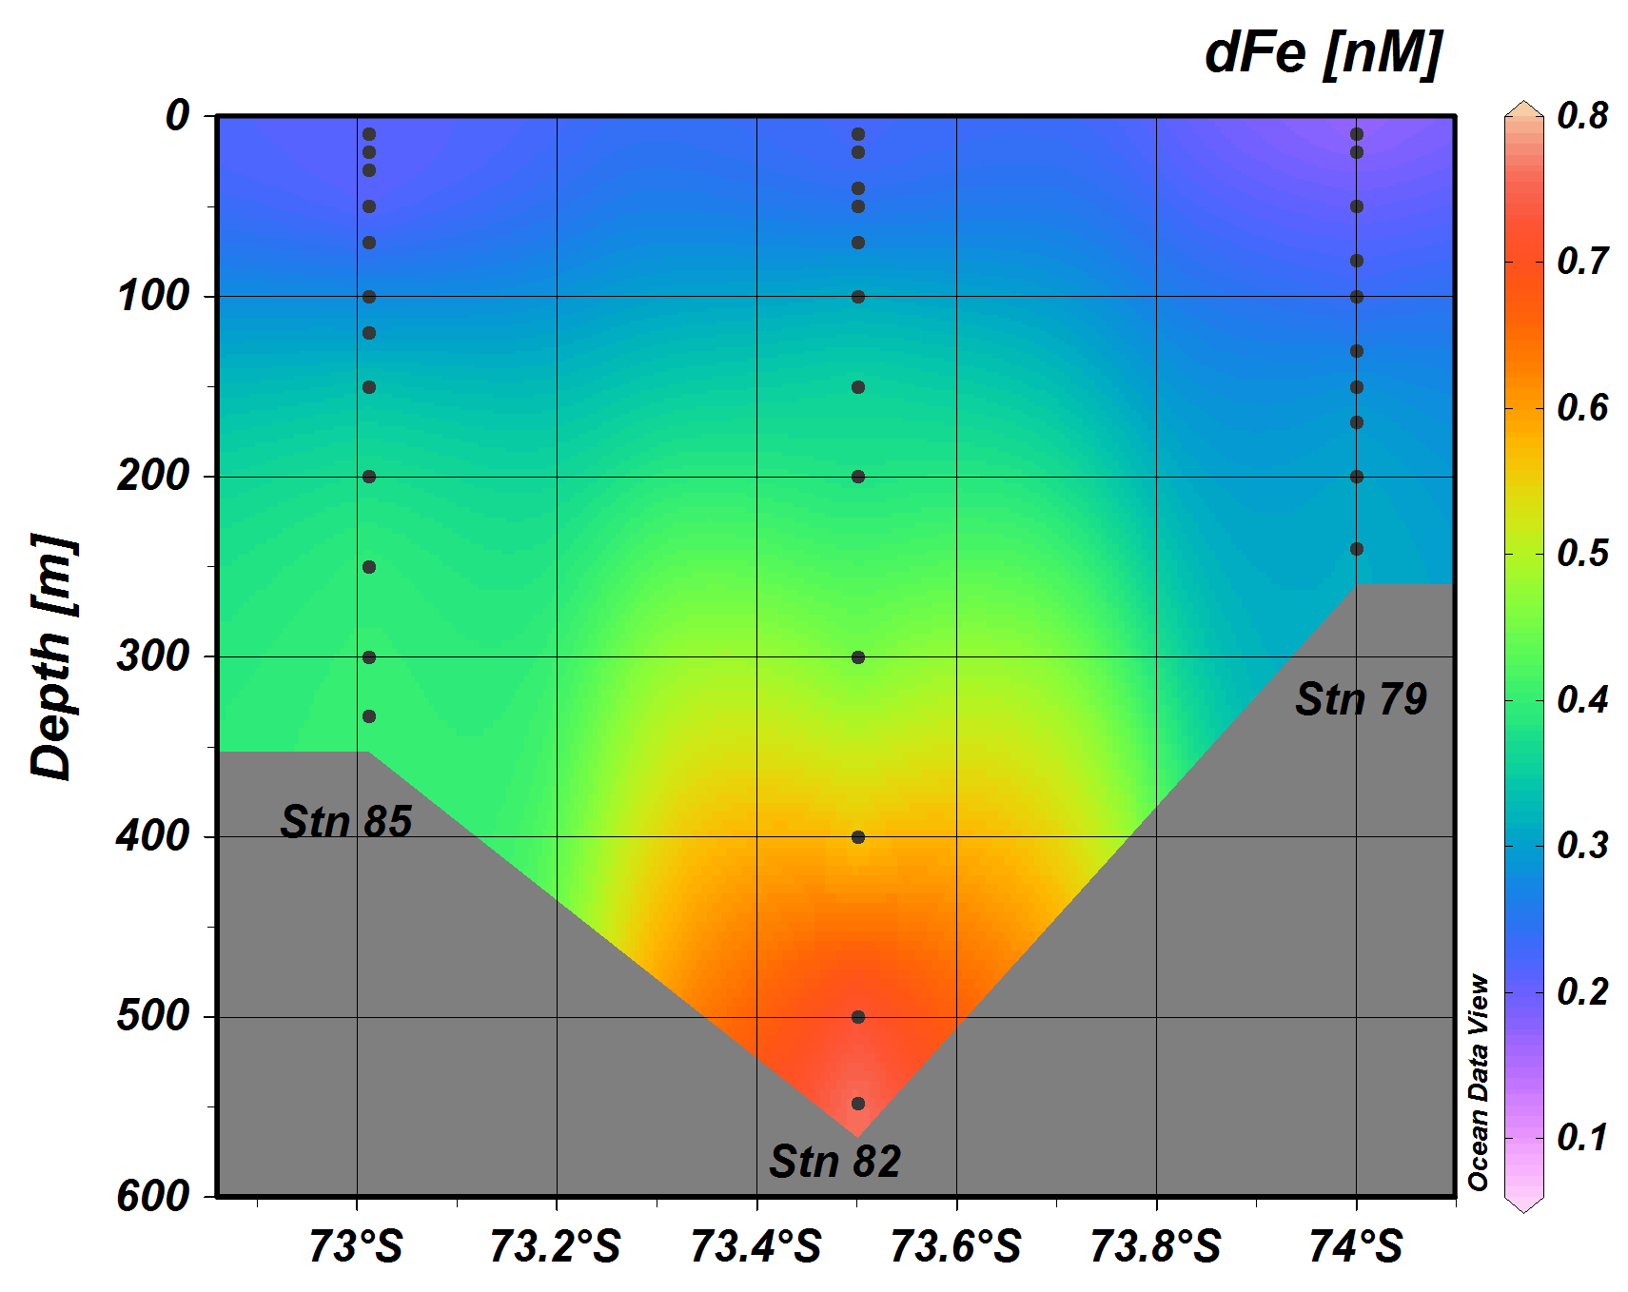
Joides Trough – Northeastern Section
0-700m
Sedwick et al. Fe data
Note axis reversal

Slide 7
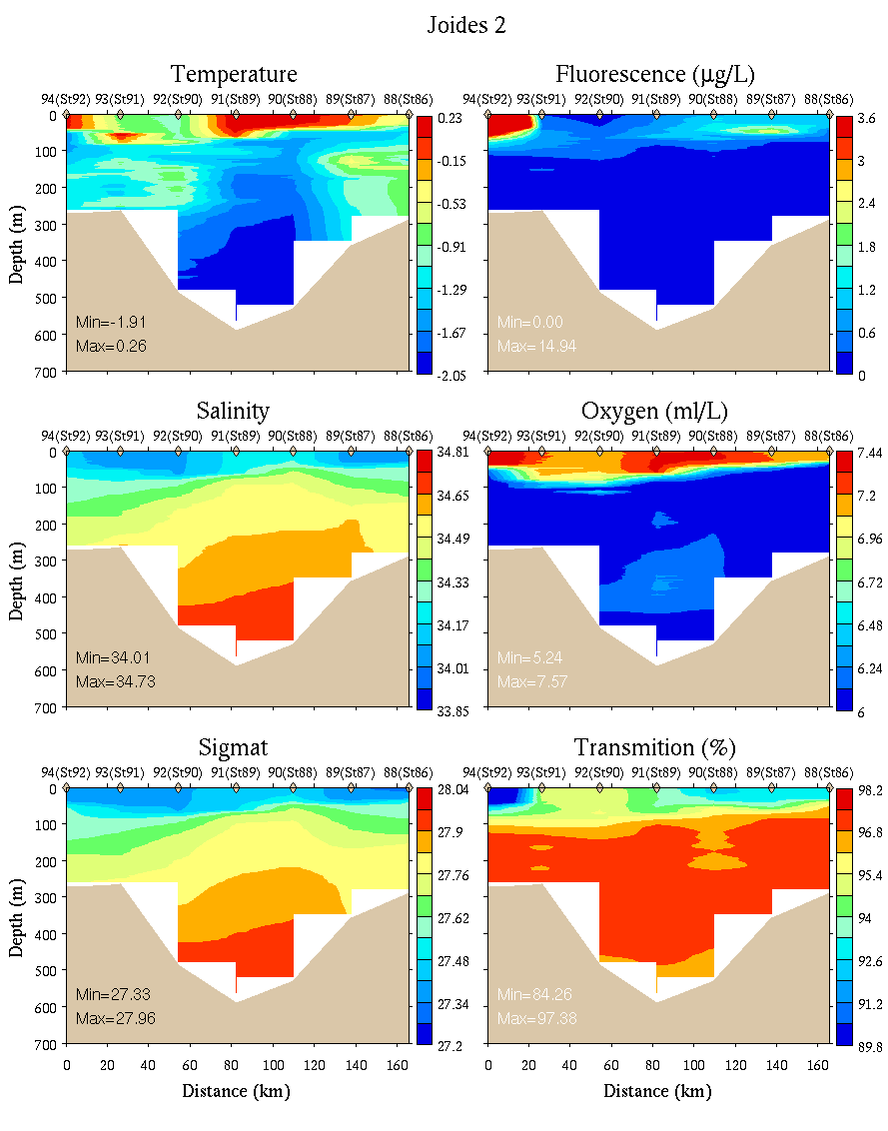
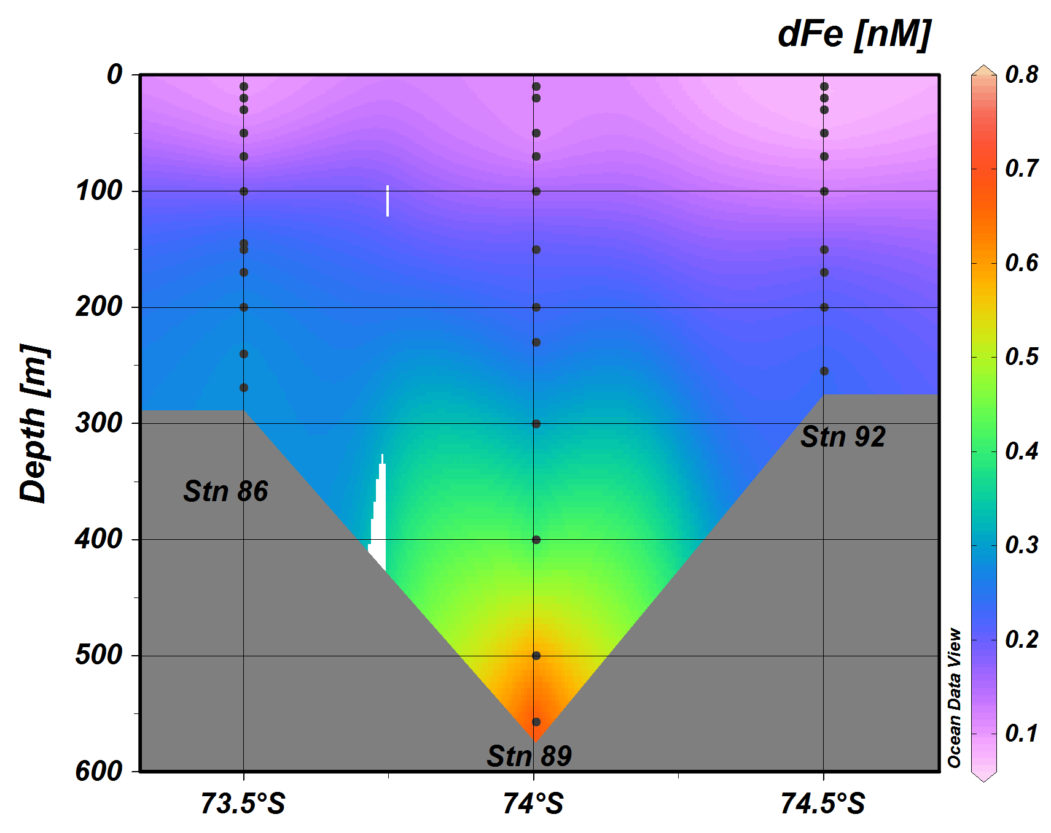
Joides Trough – Southwestern Section
0-700m
Sedwick et al. Fe data
Note axis reversal

Slide 8
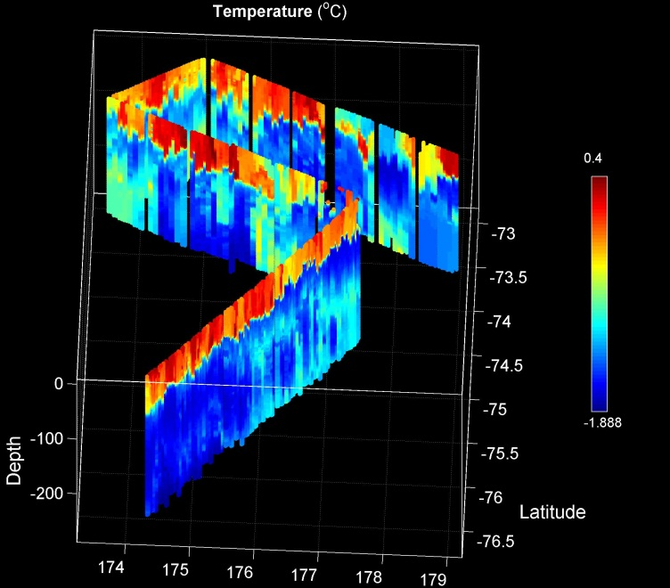
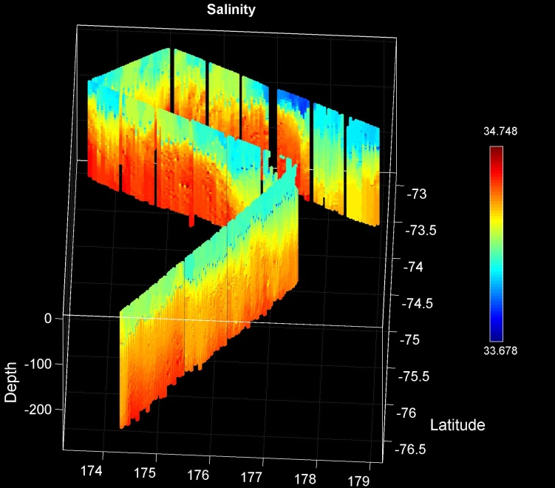
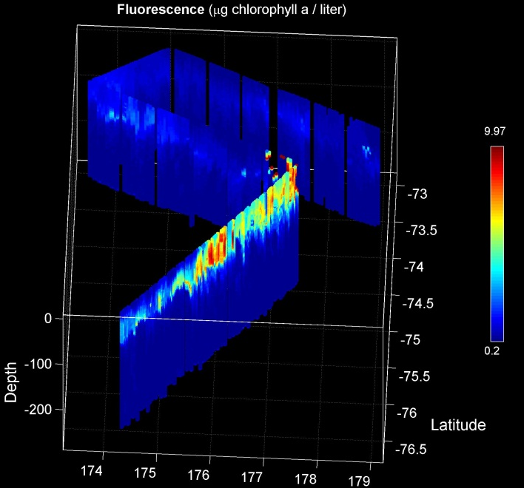
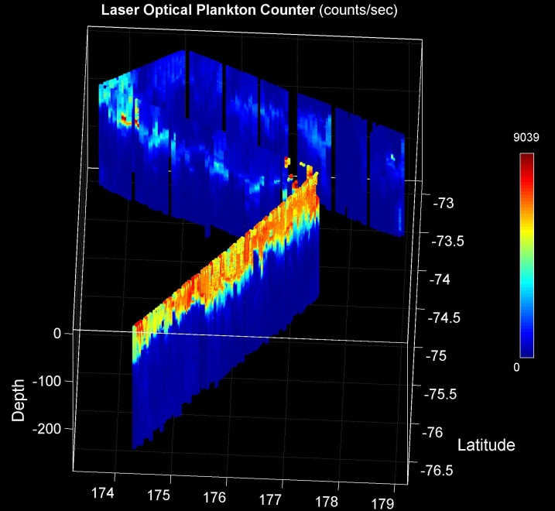
Joides Trough to Western Ross Sea MVP Survey
Temperature
Salinity
Fluorescence
LOPC

Slide 9
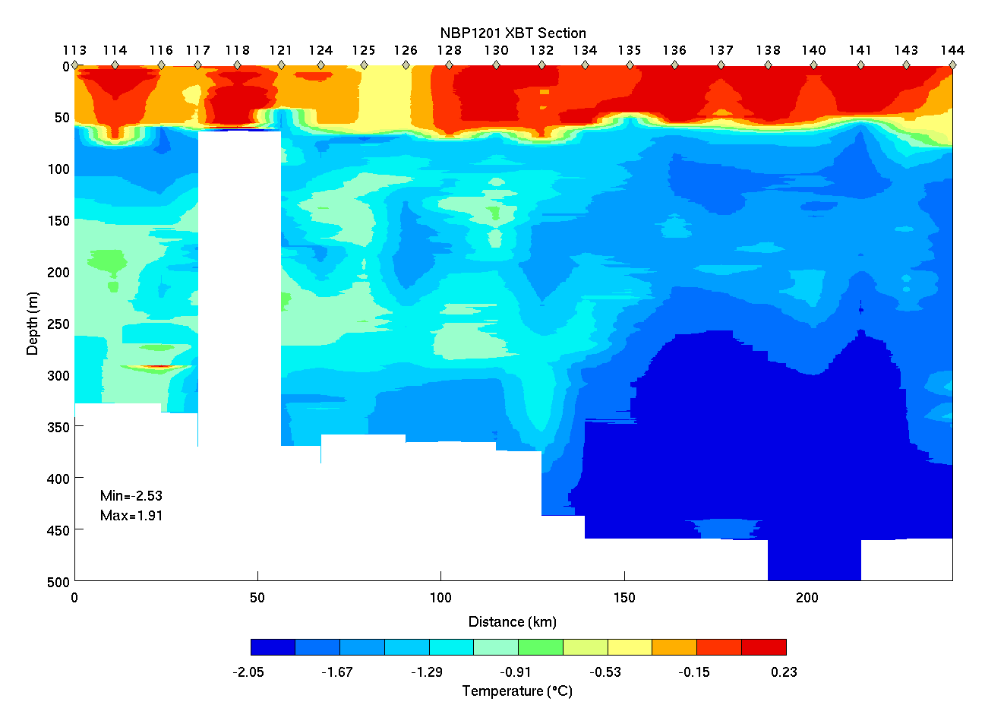
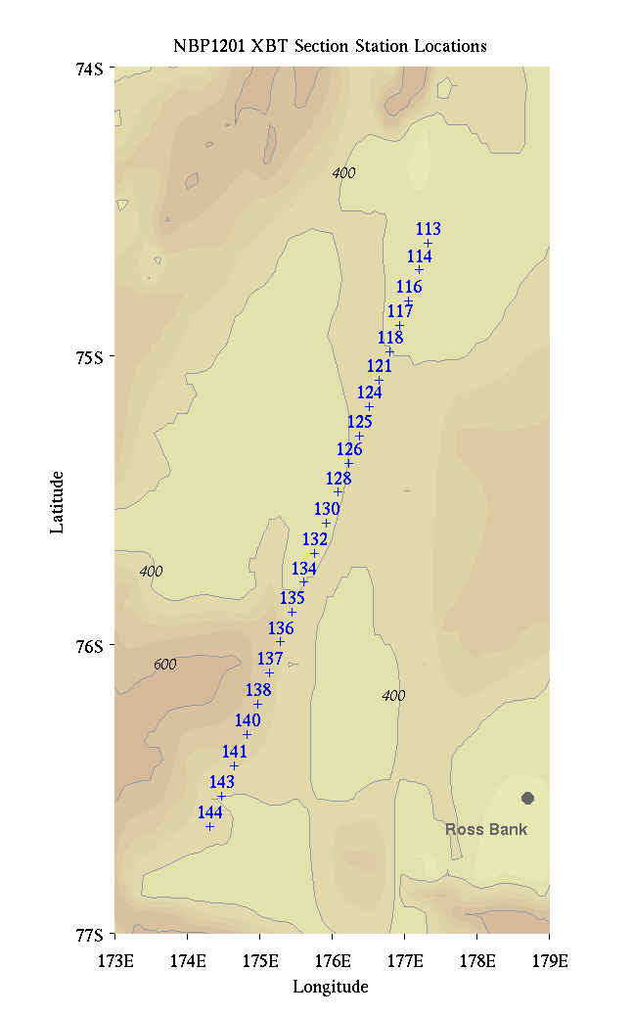
Pennell Bank – Western Ross Sea XBT section
Pennell WRS

Slide 10
Joides Trough
MCDW present on both eastern and western flanks of Pennell Bank, as well as its crest
Most prominent expression of MCDW on the crest of Mawson Bank; also present on the eastern flank (western flank not sampled).
Except for an area of high Phaeocystis abundance on the southwestern transect across Pennell Bank, VPR observations suggest high abundance of small chain-forming diatoms and copepods, particularly in the northwest part of the survey
Surface dissolved Fe values higher (~0.2 nM) on the northern transect, perhaps reflecting the lesser time that these waters have been free of sea ice cover.
Benthic Fe sources from shelf depressions (rather than banks) may be at least as important in supplying Fe to surface waters as intrusions of MCDW.

Slide 11
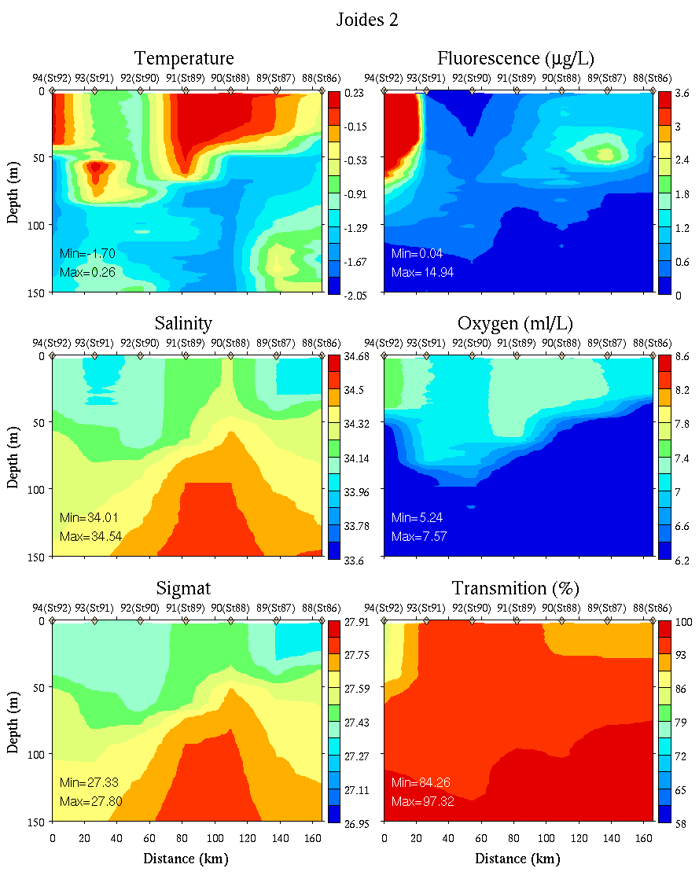
Joides Trough – Southwestern Section
0-150m
0-700m

Slide 12
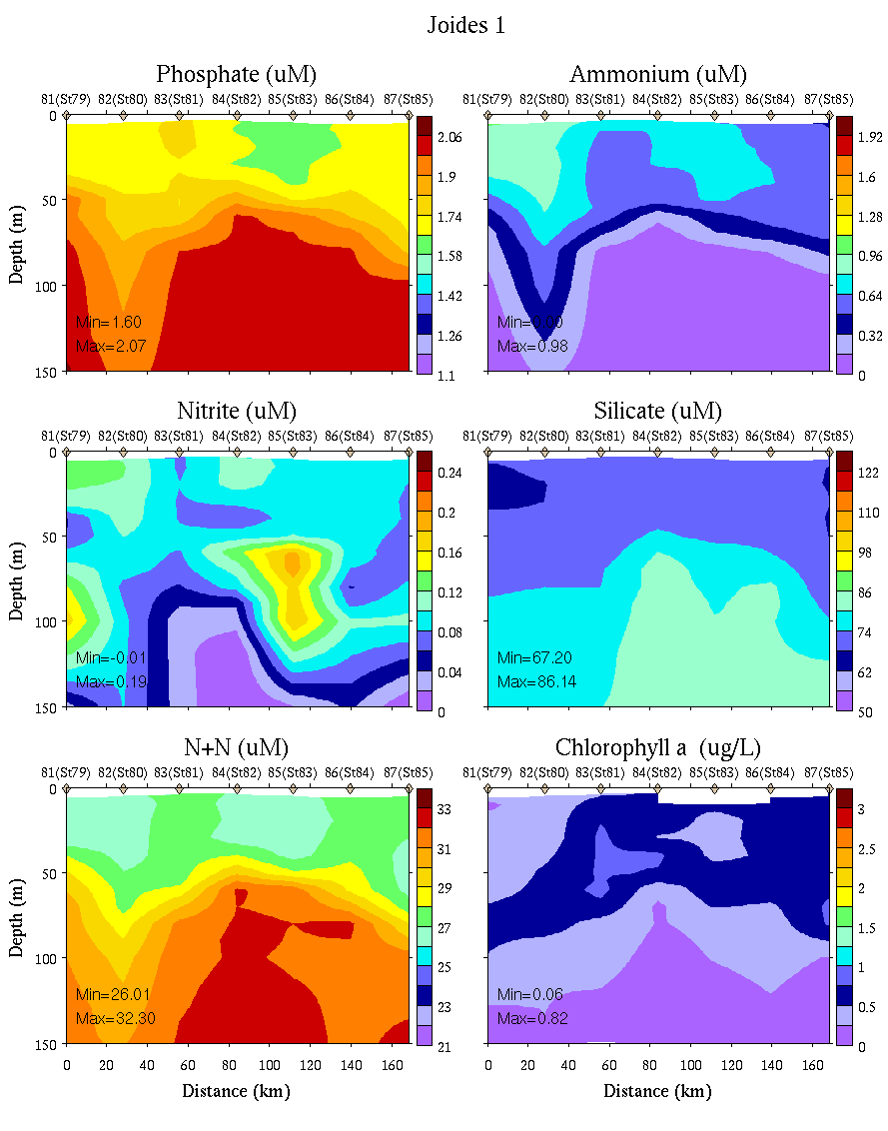
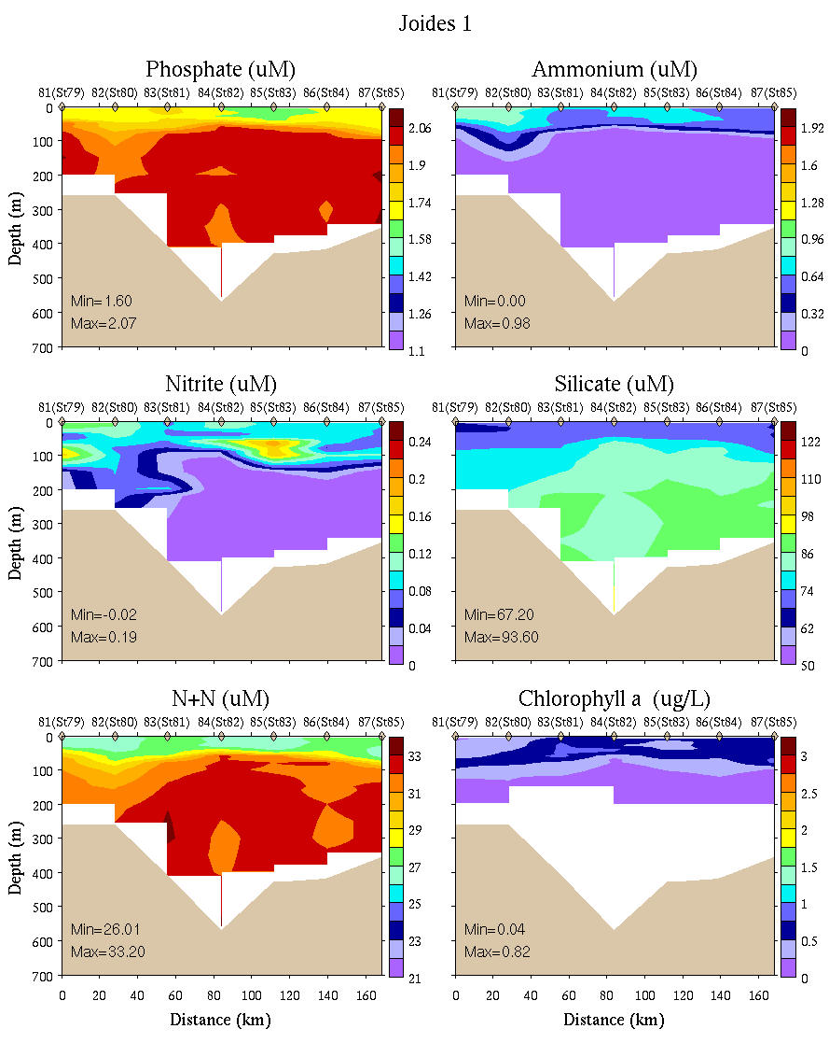
Joides Trough – Northeastern Section
0-150m
0-700m

Slide 13
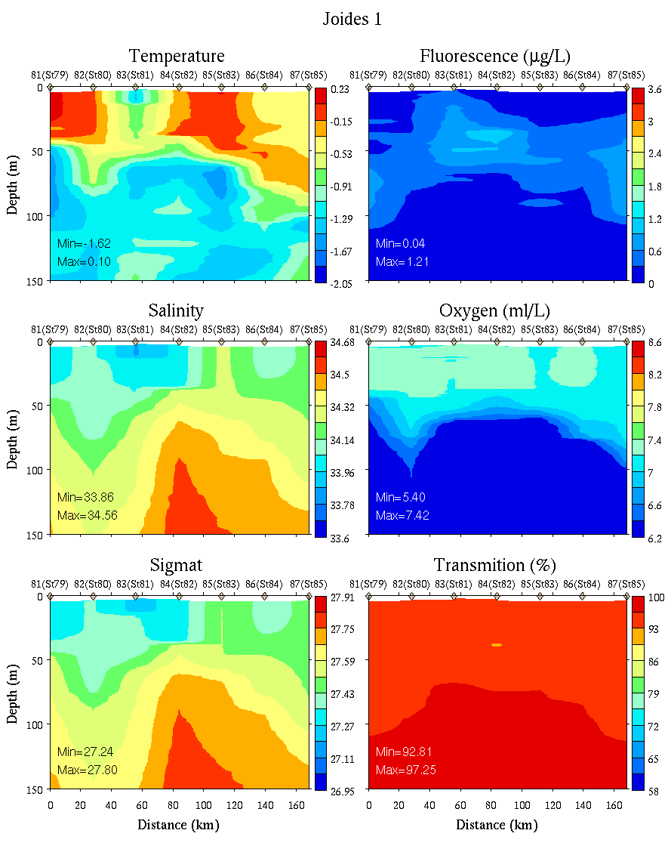
Joides Trough – Northeastern Section
0-150m
0-700m

